Slide 1
Use of the HIFROST Dilution Refrigerator for the T₂₀ Experiment
Matthew Roberts

Slide 2
Outline
Theory
Experiment
Our Dilution Refrigerator
The Problem
Conclusions and Next Steps

Slide 3
Theory
Deuteron
Tensor Analyzing Powers
Low Energy Region

Slide 4
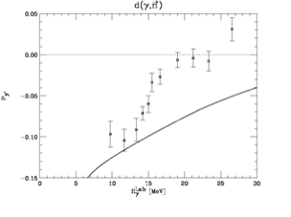
Theory
Discrepancy
Source: Nath et al.

Slide 5
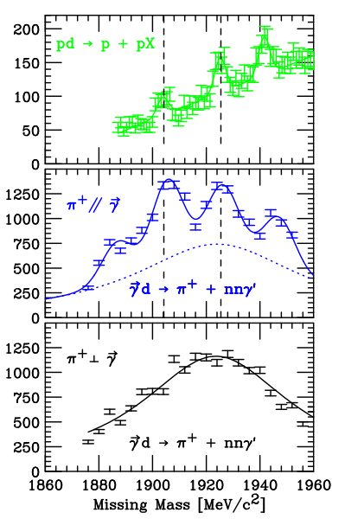
Theory
Discrepancy
pd→ppX
Source: Fil’kov et al. (Top)
S. Hoblit et al.
(middle and bottom)

Slide 6
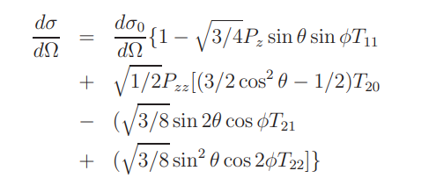
Theory
GDH
T₂₀
Source: Schmitt and Arenhovel

Slide 7
Outline
Theory
Experiment
Our Dilution Refrigerator
The Problem
Conclusions and Next Steps

Slide 8
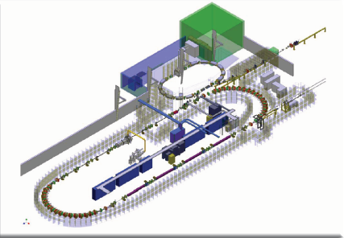
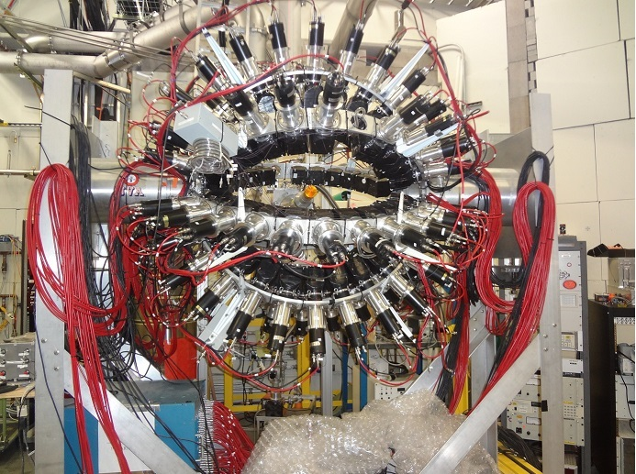
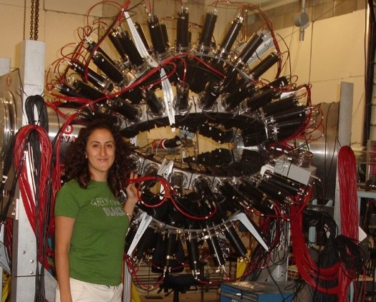
Experiment
Deuteron
Source: tunl.duke.edu

Slide 9
Experiment
Deuteron
Polarization

Slide 10
Outline
Theory
Experiment
Our Dilution Refrigerator
The Problem
Conclusions and Next Steps

Slide 11
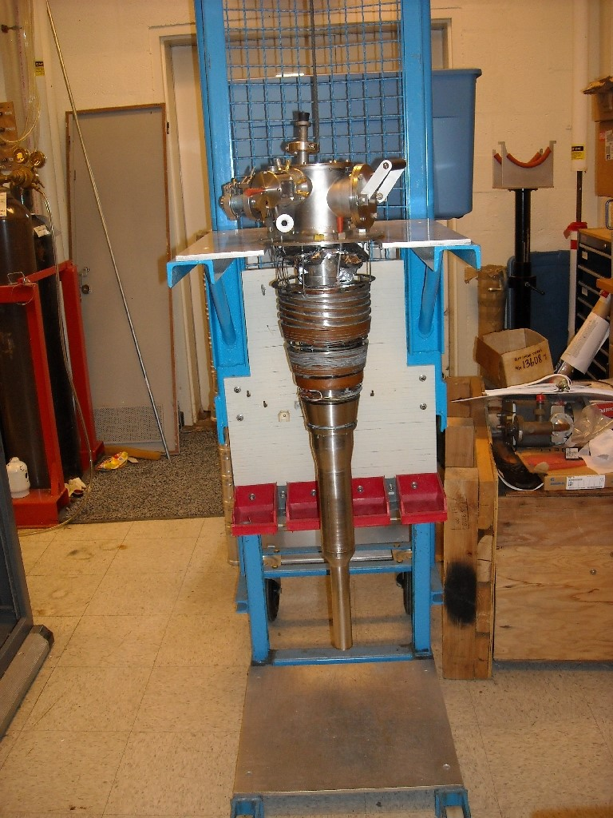
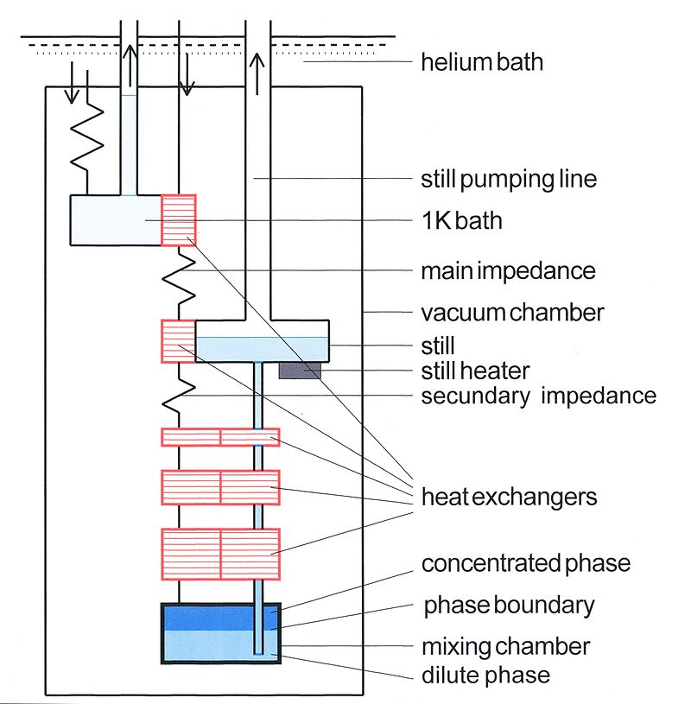
Our Dilution Refrigerator
By Adwaele - Created by Slidewrite, CC BY-SA 3.0, https://en.wikipedia.org/w/index.php?curid=35410063
HIFROST

Slide 12
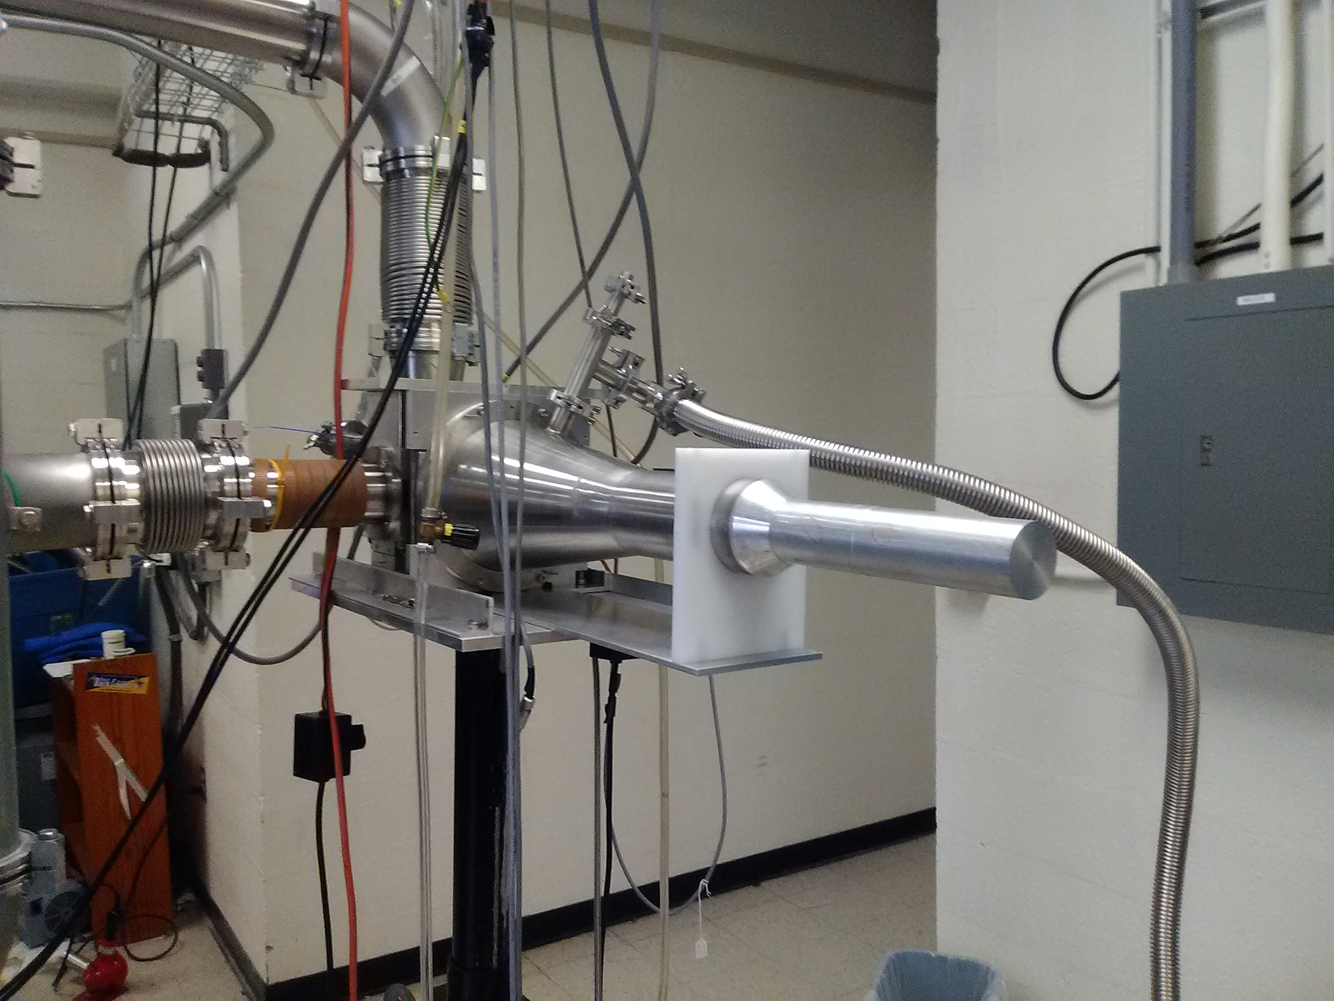
Our Dilution Refrigerator
Cooldowns

Slide 13
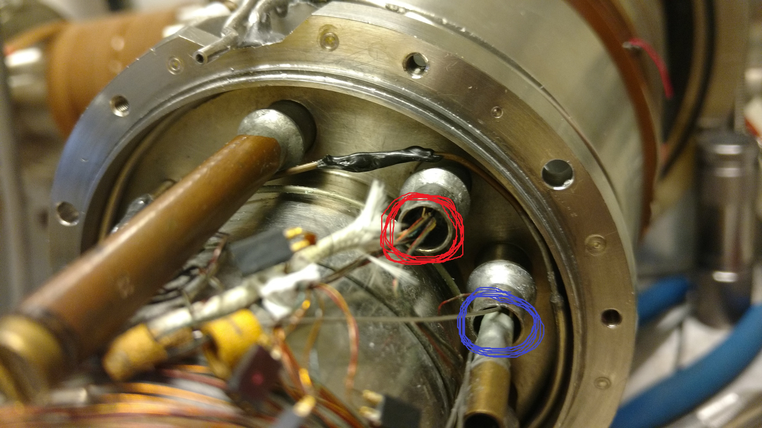
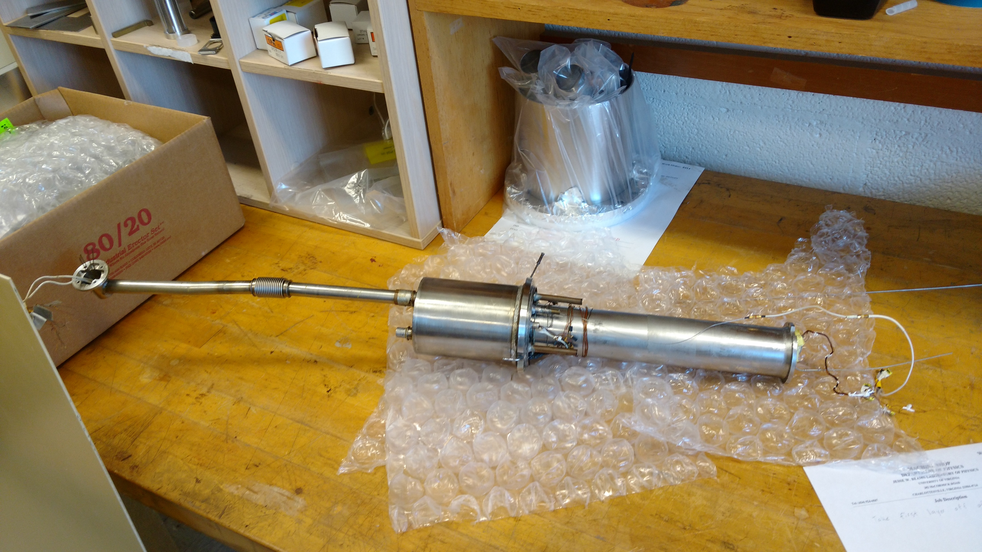
Our Dilution Refrigerator
Leaking still

Slide 14
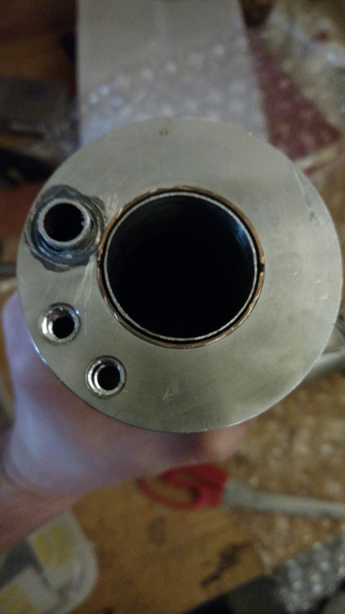
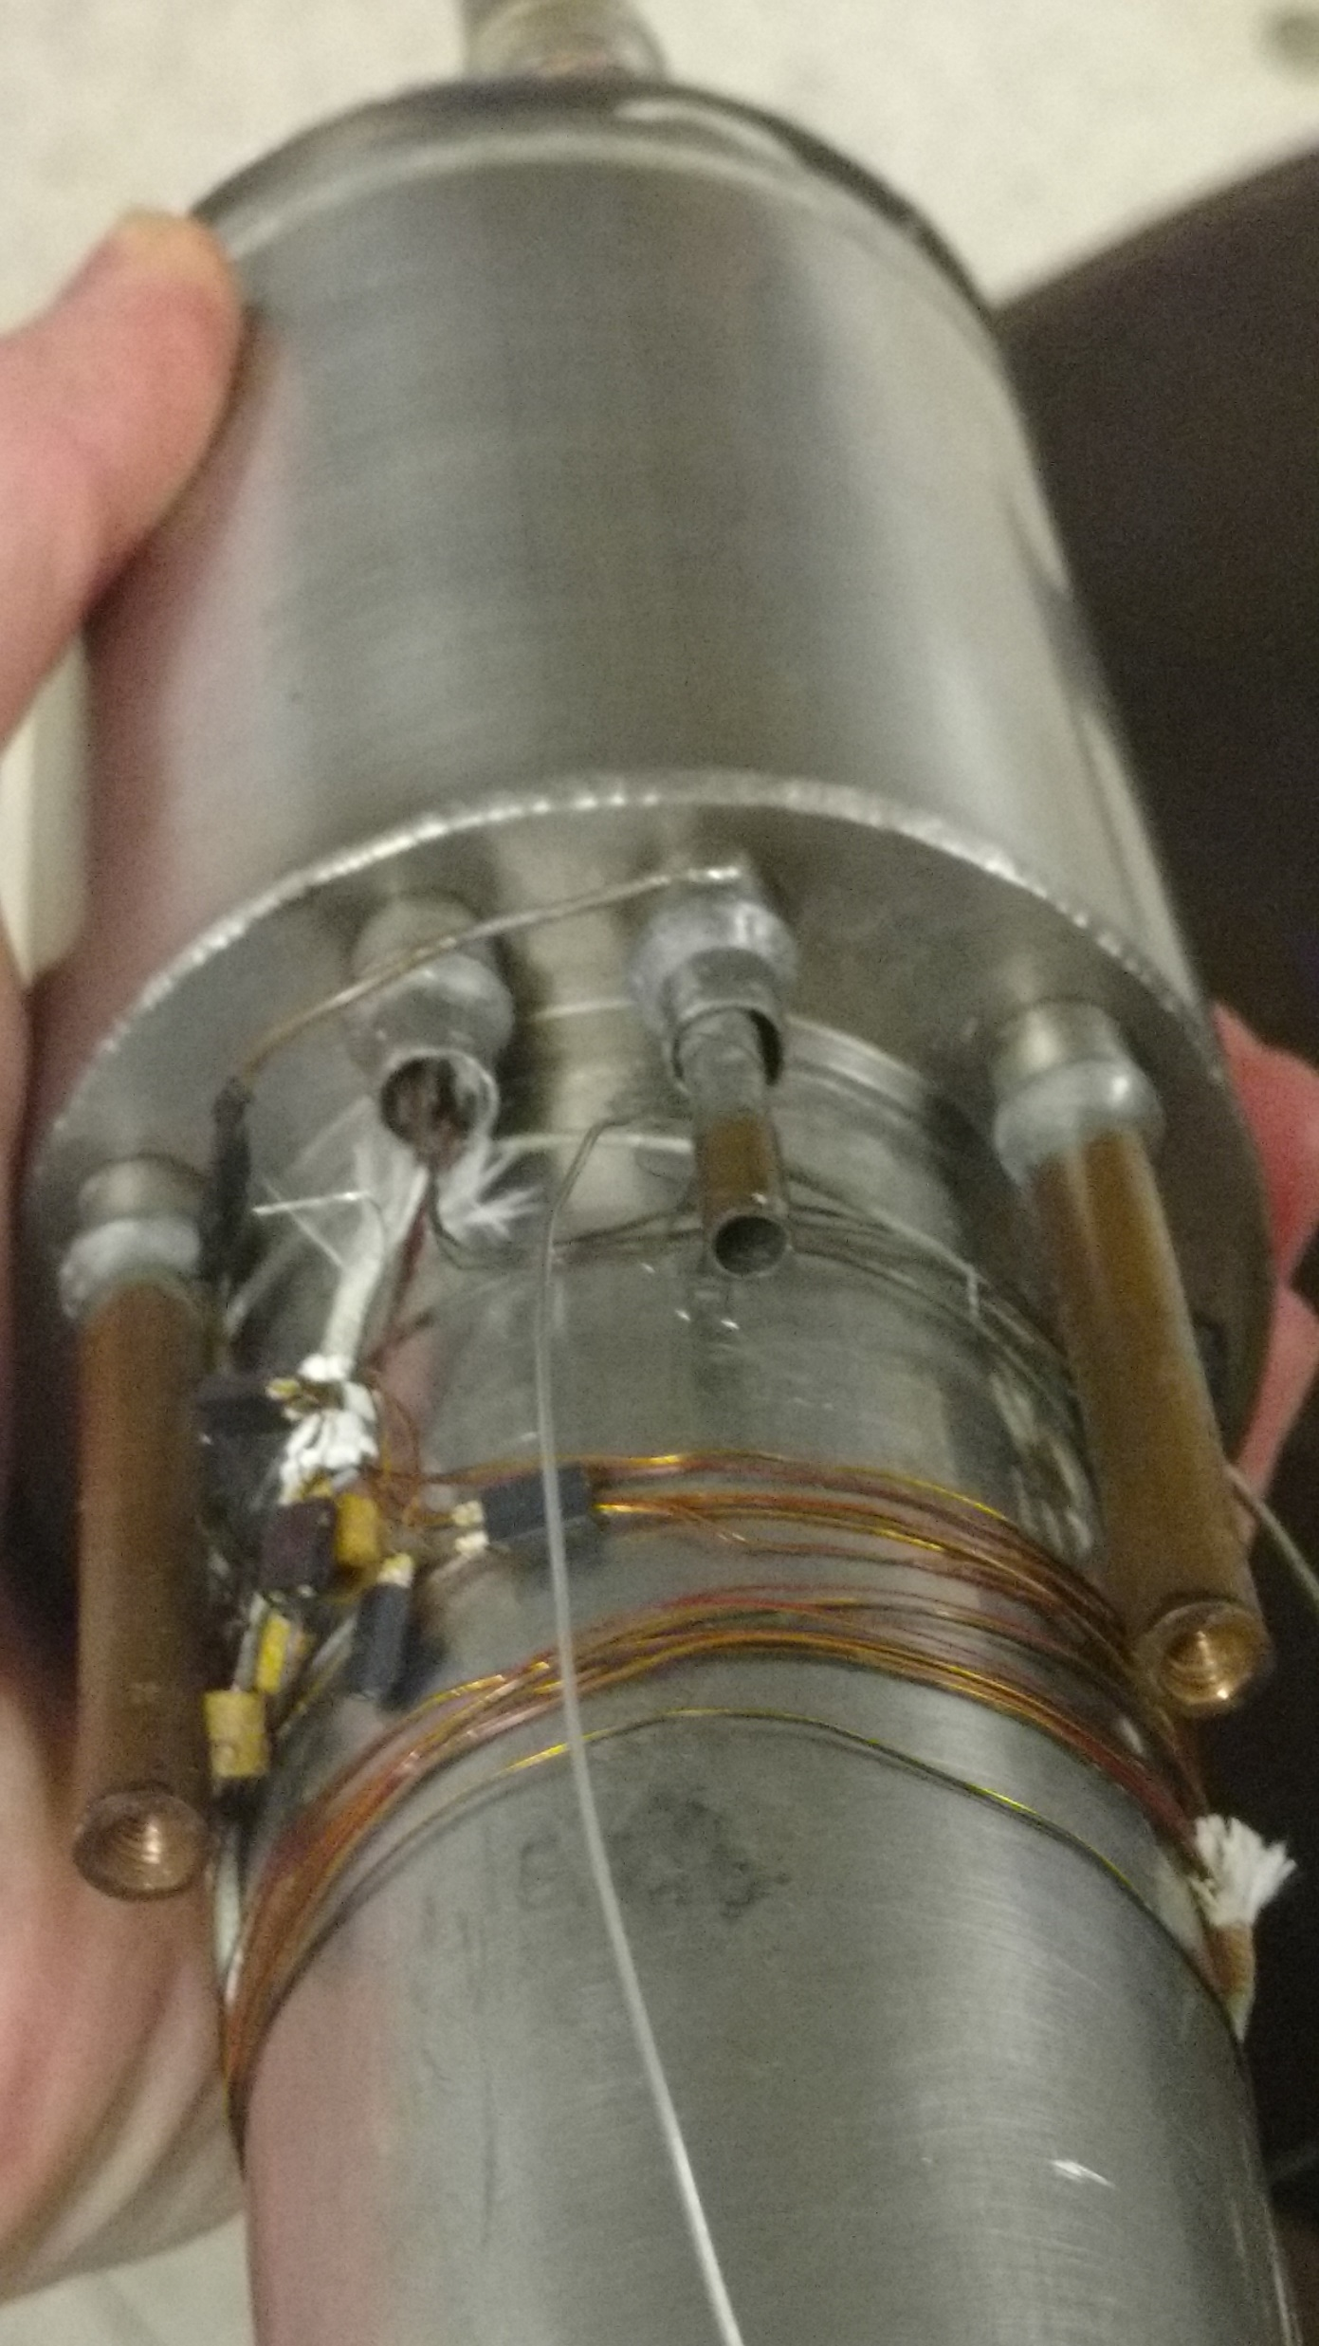
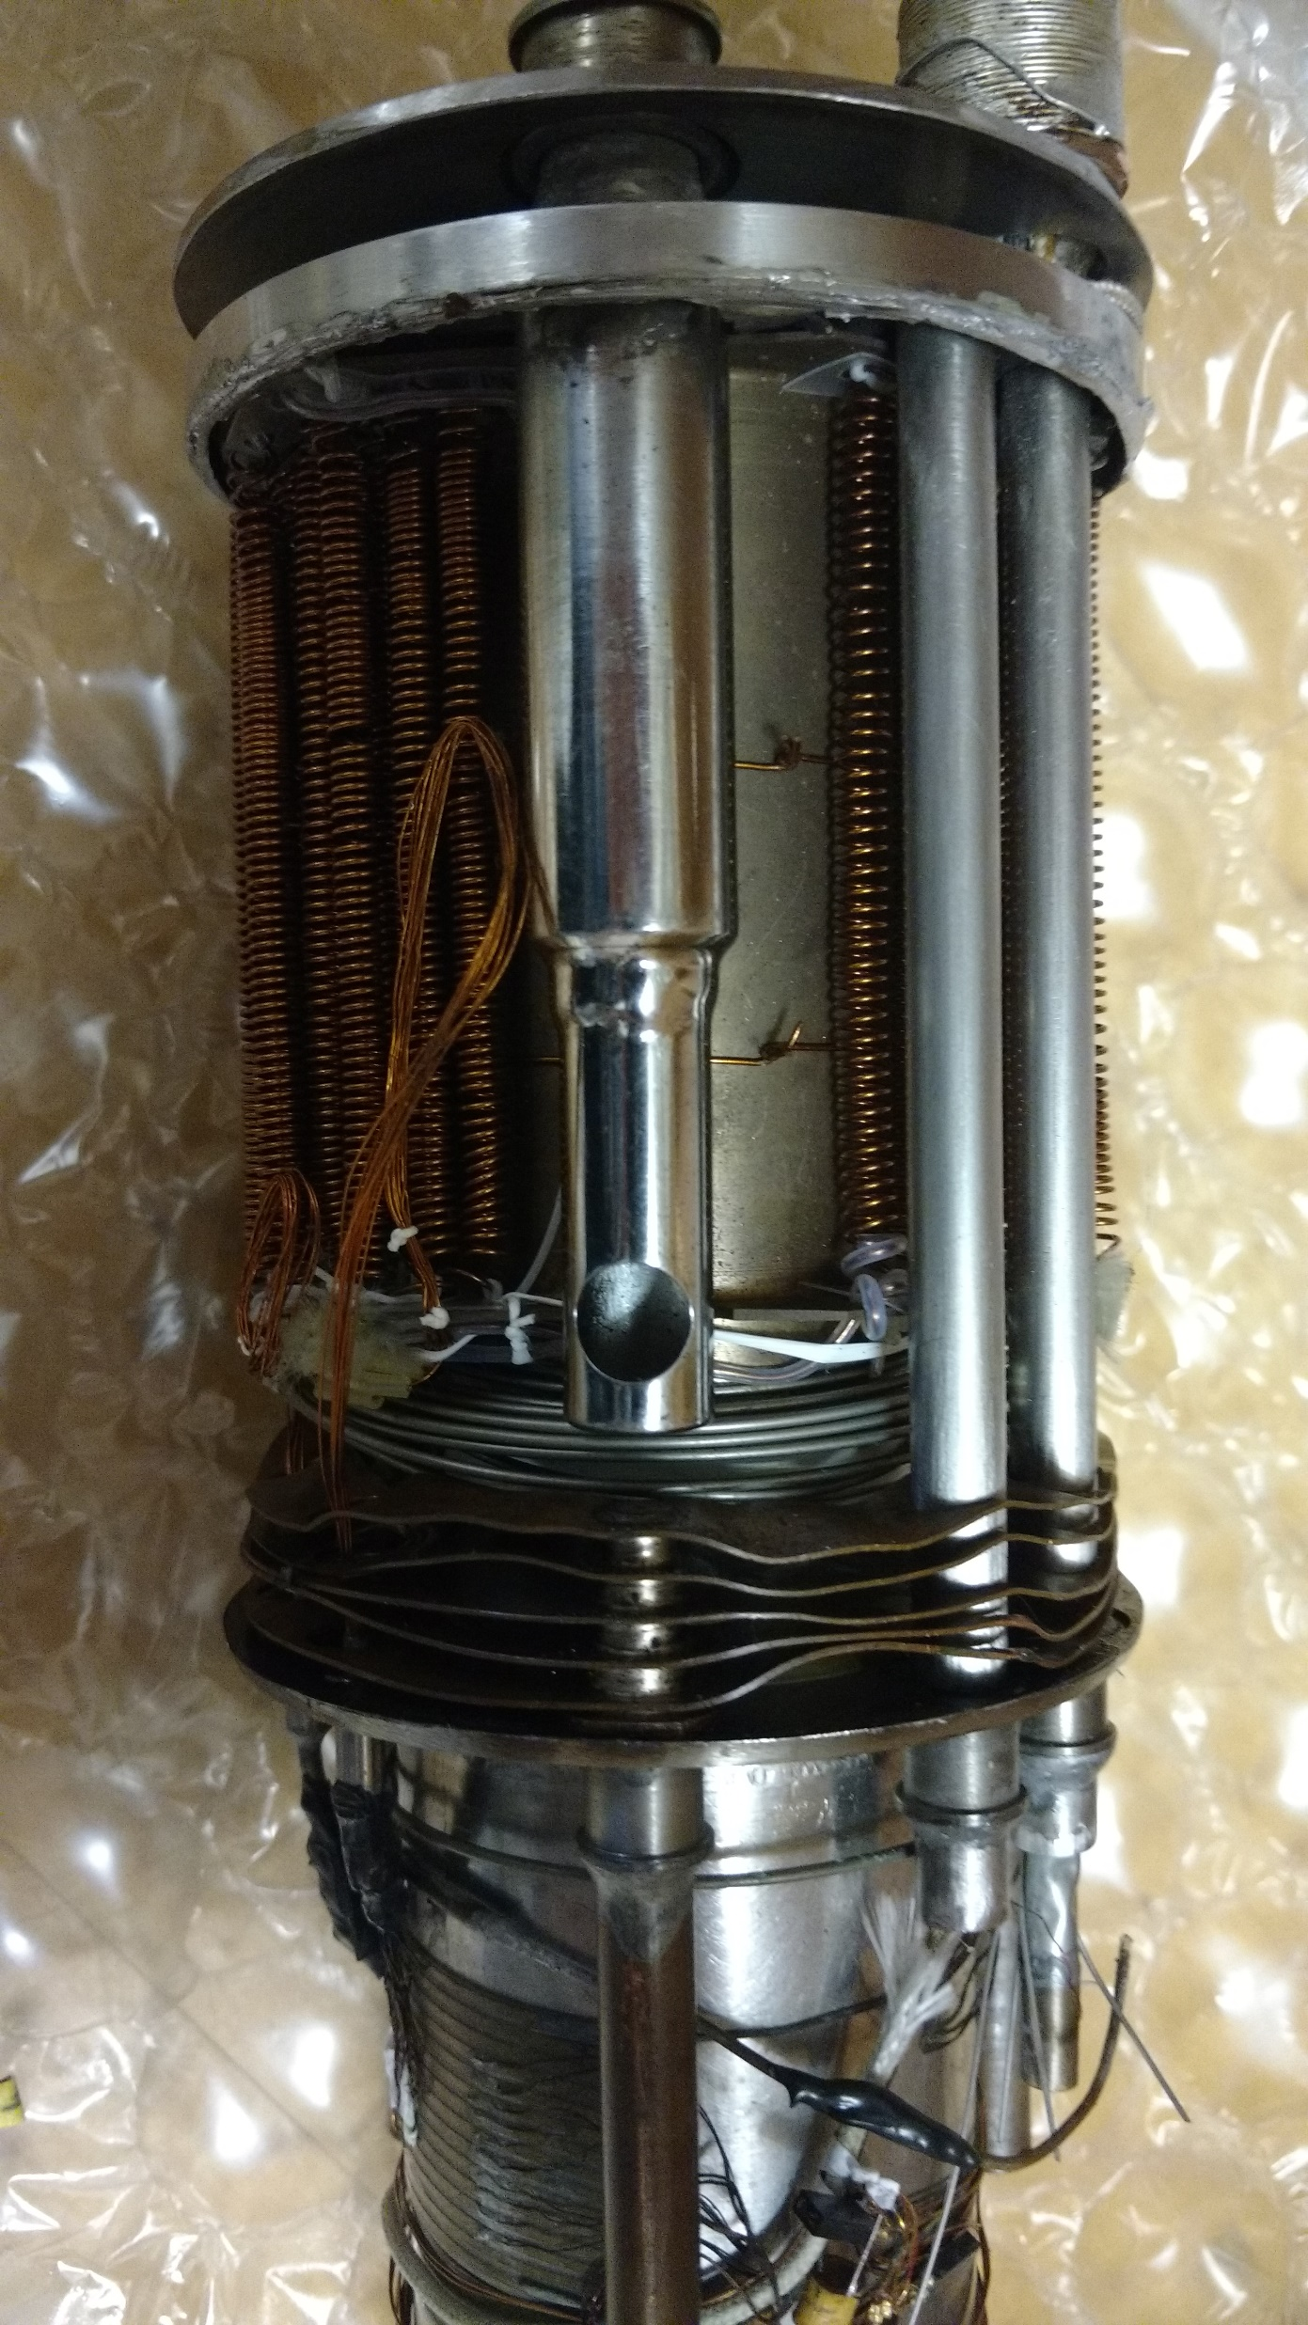
Our Dilution Refrigerator

Slide 15
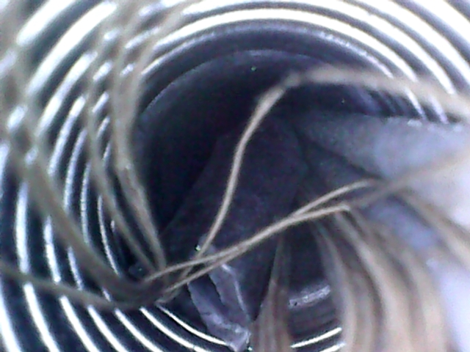
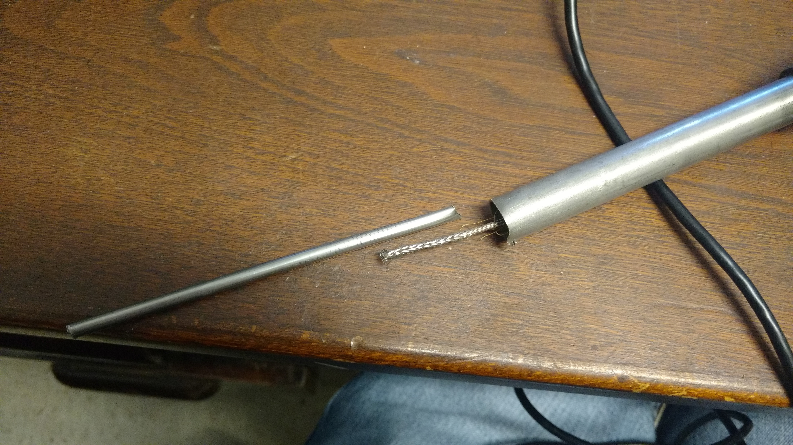
Our Dilution Refrigerator

Slide 16
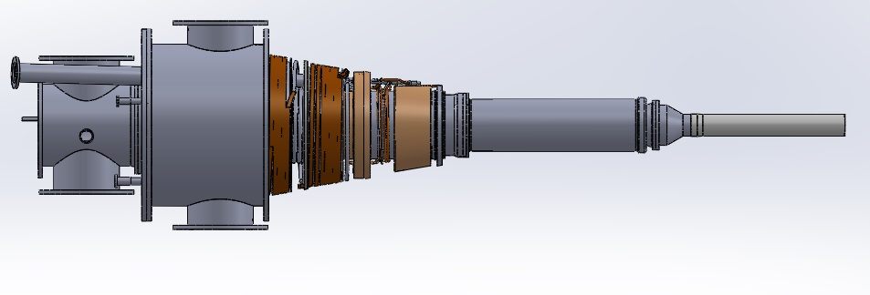
Our Dilution Refrigerator
Original
New

Slide 17
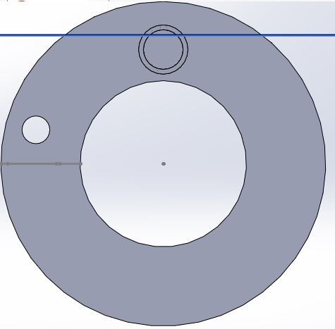
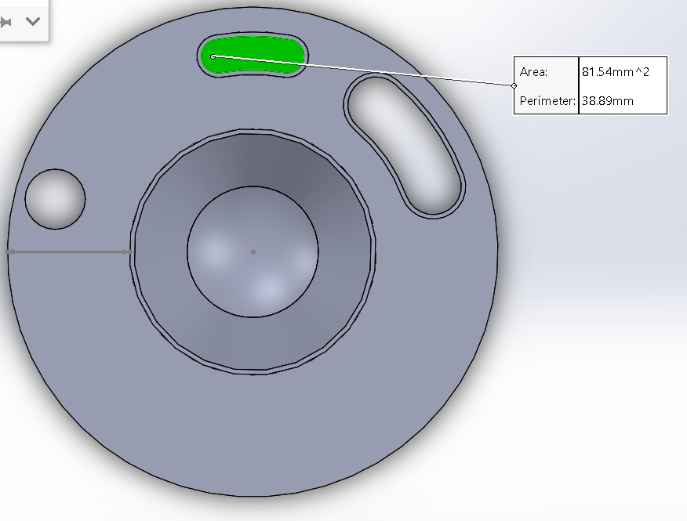
Our Dilution Refrigerator
Reduce pumpout OD

Slide 18
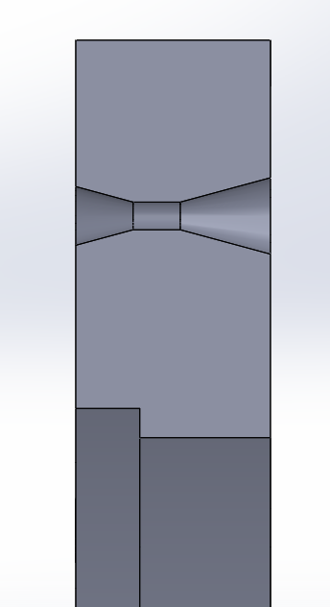
Our Dilution Refrigerator
Reduce pumpout OD
Add a bevelled inlet for He-3 line

Slide 19
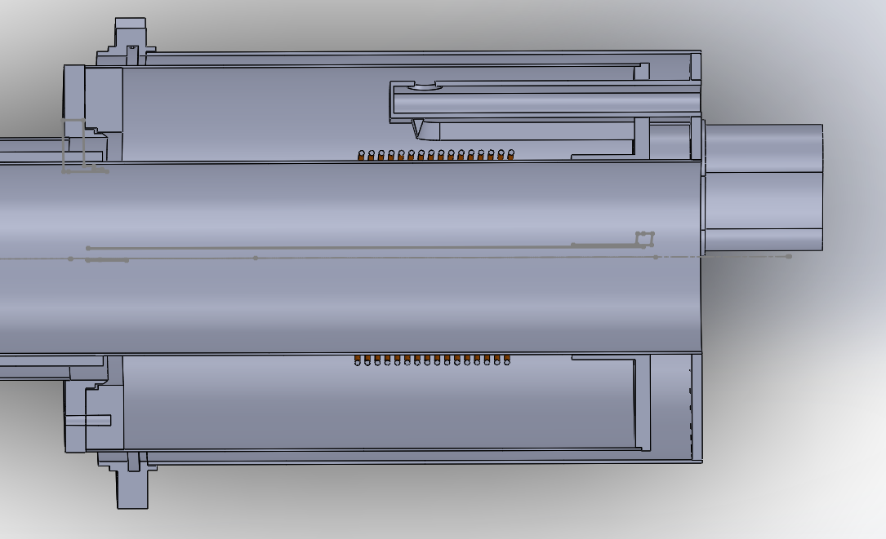
Our dilution refrigerator
Reduce pumpout OD
Add a bevelled inlet for He-3 line
Still access
Still Sensors

Slide 20
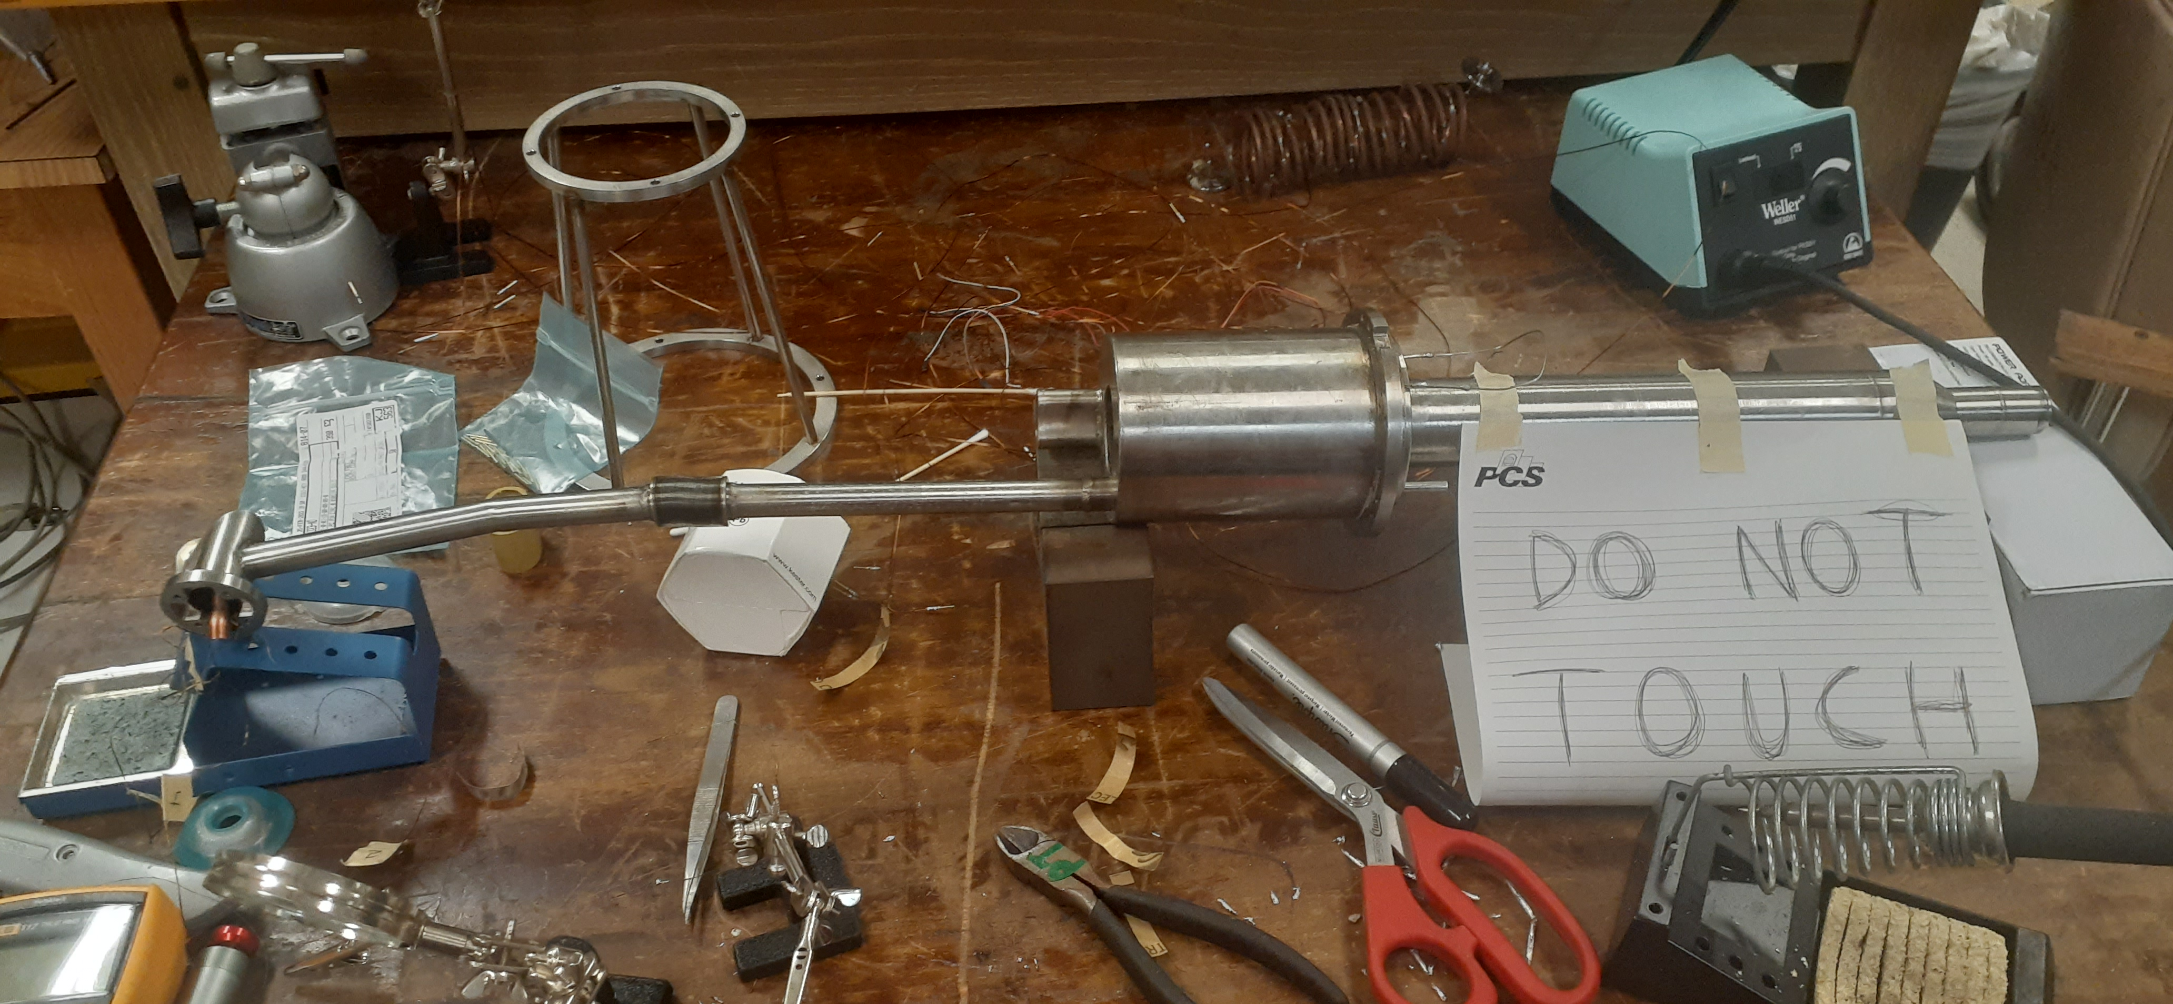
Our dilution refrigerator

Slide 21
Outline
Theory
Experiment
Our Dilution Refrigerator
The Problem
Conclusions and Next Steps

Slide 22
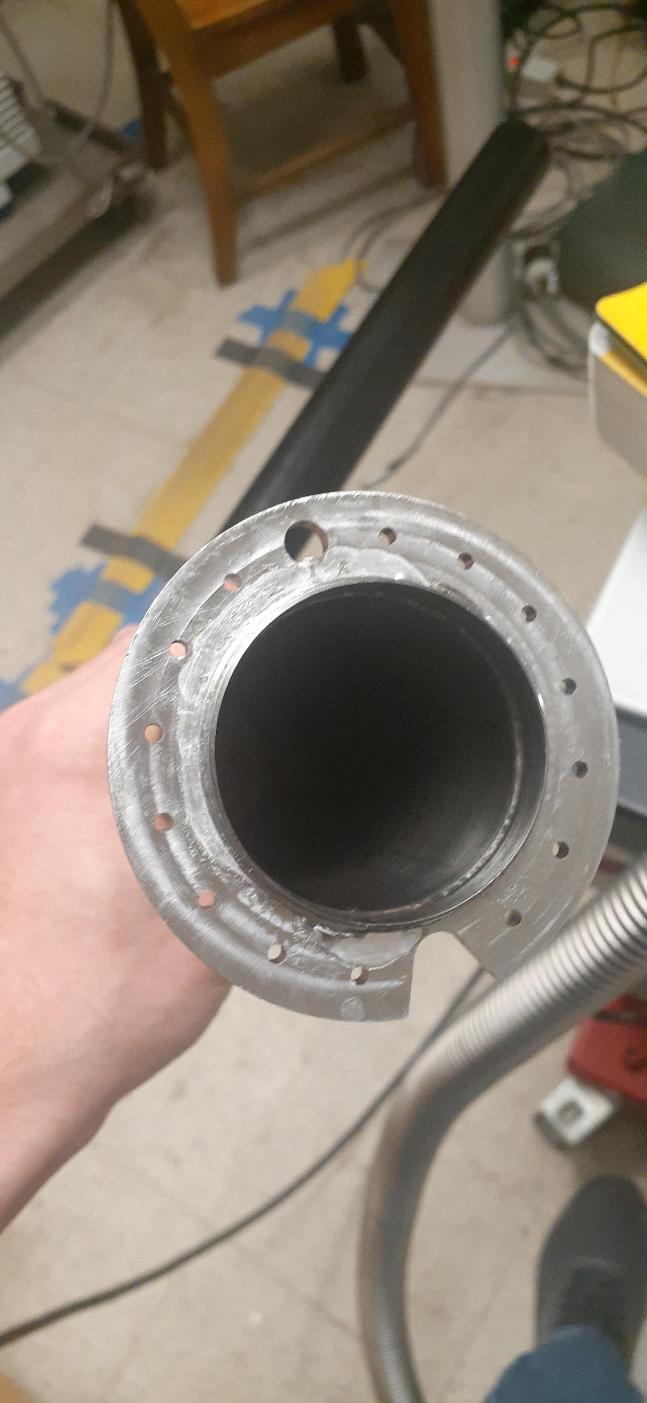
The problem
Leaks

Slide 23
The Problem
Leaks

Slide 24
The Problem
Leaks

Slide 25
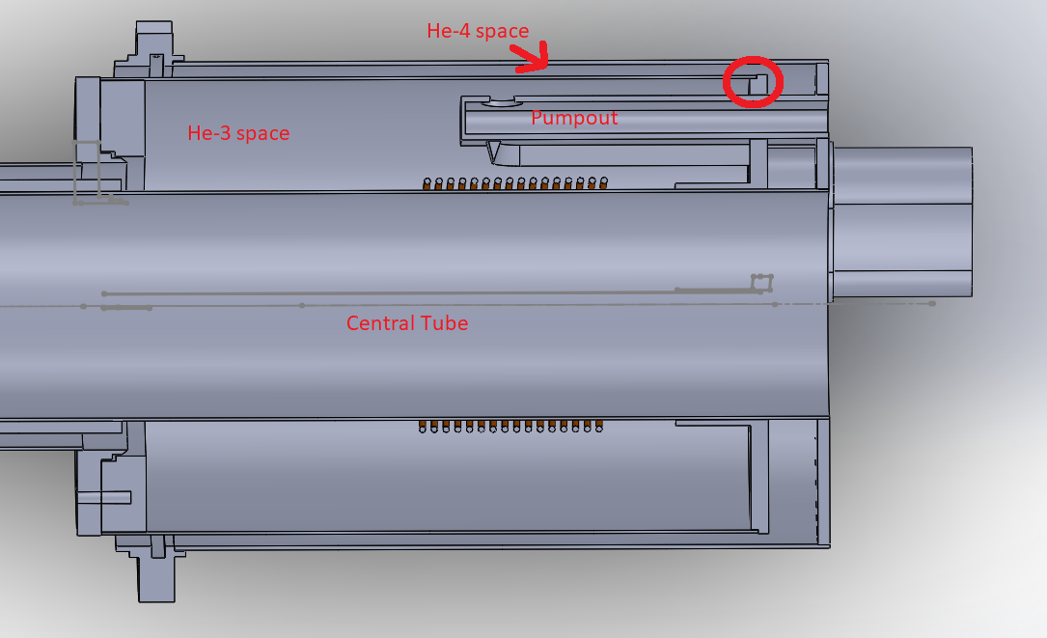
The Problem

Slide 26
Outline
Theory
Experiment
Our Dilution Refrigerator
The Problem
Conclusions and Next Steps

Slide 27
Conclusions and Next Steps
Work with Meyer to redesign the unit
Retest the ³He line and electronics
Testing NMR and microwave lines
Run a successful cooldown
Prepare for the GDH experiment
Prepare for the T₂₀ experiment

Slide 28
Acknowledgements
Don Crabb, Dustin Keller, Blaine Norum, and Donal Day for their knowledge and advice
Mark Hoegerl, Will Fariss, and Josh Ocheltree for their time and their patience
Chris Keith for his input
TUNL for their support and contributions

Slide 29
Sources
Keller, D., Norum, B., & Seo, P. (2016, February 16). Measurement of the Tensor Analyzing Power in Deuteron Photo-disintegration between Eγ = 4 MeV and 20 MeV.
T.O.Niinikoski,F.Udo,Nucl.Instr.andMeth.134(1976)219.
S. Hoblit, et al., LEGS-Spin Collaboration, Phys. Rev. Lett. 102 (2009)
https://en.wikipedia.org/wiki/Dilution_refrigerator
tunl.duke.edu
K.-M. Schmitt and H. Arenhovel, Few-Body Syst. 7, 95 (1989).
H. Arenhovel, W. Leidemann, and E. Tomusiak, Few-Body Syst. 28 (2000) 147.
“Search for supernarrow dibaryons in pd interactions,” L.V. Fil'kov et al., Phys. Rev. C61, 044004 (2000).
“Differential polarization of photoneutrons from deuterium,” R. Nath, F.W.K. Firk, and H.L. Schultz, Nucl. Phys. A194, 49 (1972).

