Slide 1
n-n’ Oscillations using nEDM Measurements
Prajwal T. MohanMurthy
MIT
$$379 s @ 90 \% C.L.$$

Slide 2
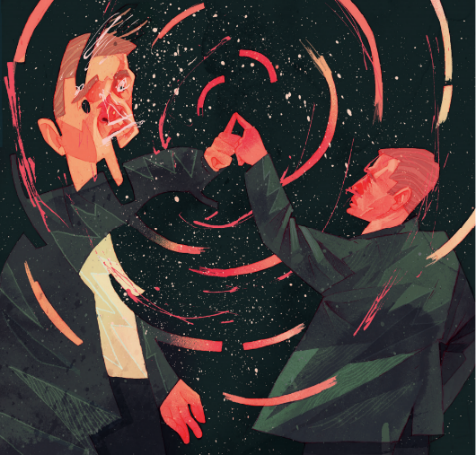
Overview
Motivation
Apparatus/Data
Summary
1
2
3
4
5
Prior Experiments
New Analysis
for NBC News
Art from: New Scientist 242, 34 (2019)

Slide 3
Mirror Realm in Sci-Fi
§1
Art from: ST Fandom, Capt. Jello

Slide 4
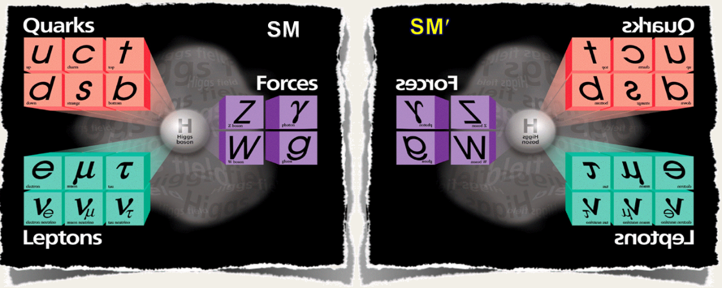
Mirror Realm
§1
Parity Violation (PV) in β–decay:
Lee & Yang’s
PRL 104, 254 (1956)
Introduce Mirror realm hidden from standard model particles →
No global PV in weak interactions
SM , SM’ Standard Model Particles
,
Mirror Realm Particles
$$ℒ_{total}=ℒ+ℒ^{′}+ℒ_{Mixing}$$
$ℒ_{Mixing}$, Neutral particle mixing (SM ↔ SM’): n ↔ n’, γ ↔ γ’, ν ↔ ν’
For Mirror Matter Review: L. B. Okun, Phys. Usp. 50 380-389 (2006)

Slide 5
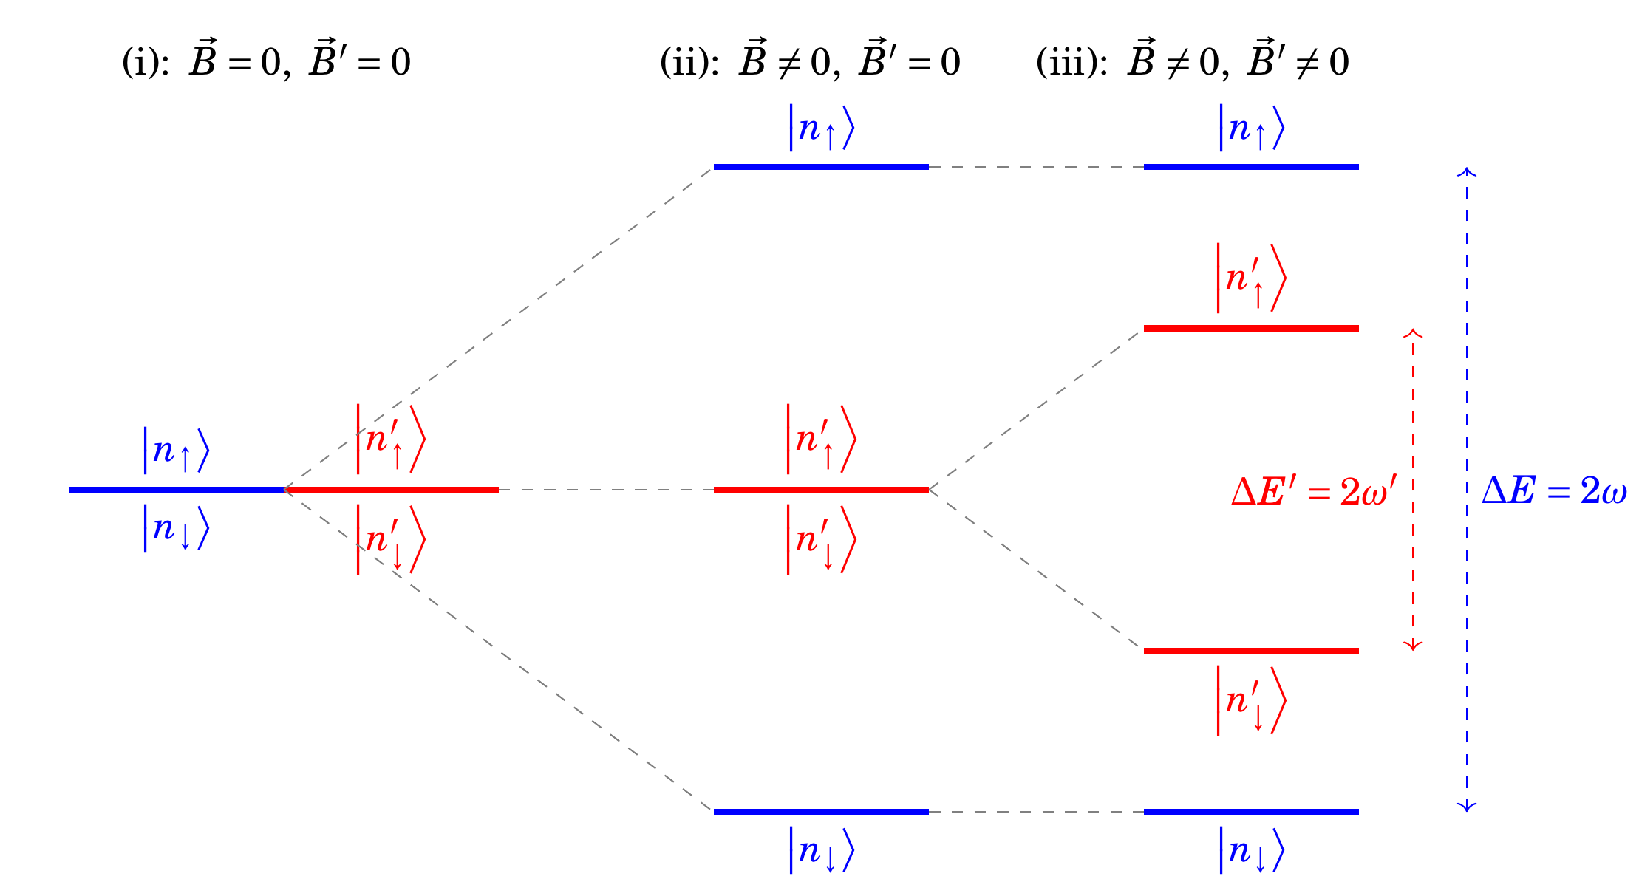
Theory of nn’ Oscillations
§1
$$\text{Typical}\text{ 2−}\text{level} \text{system} \text{for}\text{ (}\text{ii}\text{): }P_{n→n^{′}}\left(t\right)=\frac{1}{ω^{2}τ_{nn^{′}}^{2}+1}\sin^{2}\left[t\sqrt{ω^{2}+1/τ_{nn^{′}}^{2}}\right]\text{, }ω^{(′)}\text{=45 }\text{Hz}/μ\text{T}∙B^{(′)}$$
Z. Berezhiani, Euro. Phys. J. C 64, 421 (2009).

Slide 6
General Techniques
§1
UCN Storage Experiment
Store UCNs, apply 0 and >0 magnetic fields, check if some neutrons vanished (into mirror realm)?

Slide 7
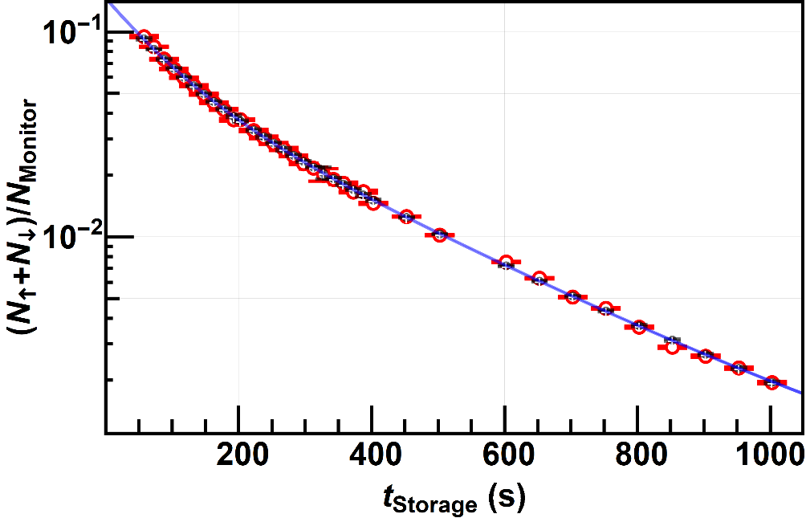
$$\text{Searches} \text{assuming} \text{B}\text{’}=\text{0}$$
§1
When, $B^{′}=0$: Most older experiments…
Ratio
$$E_{B}\left(t_{s}\right)=\frac{n_{0}\left(t_{s}\right)}{n_{B}\left(t_{s}\right)}−1$$
$=m_{s}Δ_{0}$
$$=\frac{t_{s}}{\left\langle t_{f}\right\rangle }\frac{\left\langle t_{f}^{2}\right\rangle }{τ_{nn^{′}}^{2}}$$
$m_{s} =$ $t_{s}/\left\langle t_{f}\right\rangle$
$$η=B/B^{′}$$
$\vec{B}$: magnetic field seen by SM particles, $\vec{B′}$: … (SM’) particles,
$β$: angle between $\vec{B}$ & $\vec{B′}$, $η$: ratio between $\vec{B}$ & $\vec{B′}$
$m_{s}$: number of times neutrons bounced off the walls
Z. Bereziani, Euro. Phys. J. C 64: 421-431 (2009)

Slide 8
$$\text{Searches} \text{assuming} \text{B}\text{’}≠\text{0}$$
§1
Relax the condition, $B^{′}≠0$: There are 2 channels of analysis
Ratio
Asymmetry
$$E_{B}\left(t_{s}\right)=\frac{n_{0}\left(t_{s}\right)}{n_{B}\left(t_{s}\right)}−1$$
$=m_{s}Δ_{B}$
$$=\frac{t_{s}}{\left\langle t_{f}\right\rangle }\frac{η^{2}(3−η^{2})}{{2ω}^{′2}τ_{nn^{′}}^{2}{(1−η^{2})}^{2}}$$
$${ A}_{B} \left(t_{s}\right)=\frac{n_{B}\left(t_{s}\right)−n_{−B}\left(t_{s}\right)}{n_{B}\left(t_{s}\right)+n_{−B}\left(t_{s}\right)}$$ $={−m}_{s}D_{B}Cos(β)$
$=−\frac{t_{s}}{\left\langle t_{f}\right\rangle }\frac{η^{3}Cosβ}{ω^{2}τ_{nn^{′}}^{2}{(1−η^{2})}^{2}}$
$m_{s} =$ $t_{s}/\left\langle t_{f}\right\rangle$
$$η=B/B^{′}$$
$\vec{B}$: magnetic field seen by SM particles, $\vec{B′}$: … (SM’) particles,
$β$: angle between $\vec{B}$ & $\vec{B′}$, $η$: ratio between $\vec{B}$ & $\vec{B′}$
$m_{s}$: number of times neutrons bounced off the walls
Z. Bereziani, Euro. Phys. J. C 64: 421-431 (2009)

Slide 9
General Techniques
§1
UCN Storage Experiment
Store UCNs, apply 0 and >0 magnetic fields, check if some neutrons vanished (into mirror realm)?
Regeneration Experiment
(“Particle Through a Wall” kind of experiment):
Shoot cold neutrons through a magnetic field onto a wall, check if neutrons can be detected on the other side of the wall under magnetic field?
Usually uses “Ratio-Channel” of analysis

Slide 10
General Techniques
§1
UCN Storage Experiment
Store UCNs, apply 0 and >0 magnetic fields, check if some neutrons vanished (into mirror realm)?
Regeneration Experiment
(“Particle Through a Wall” kind of experiment):
Shoot cold neutrons through a magnetic field onto a wall, check if neutrons can be detected on the other side of the wall under magnetic field?
Frequency Shift Experiment
Use nEDM data
Measure shifts in precession frequency when
magnetic field direction is flipped

Slide 11
Frequency Shift nn’
§1
Completely new systematics from Most older experiments…
Frequency Shift
$$\frac{δω}{ω}=\frac{R_{UD}^{↑}−R_{UD}^{↓}}{R_{0}^{}}$$
$$=\frac{\cos{β}}{τ_{nn^{′}}^{2}}\frac{1}{2ω′2η(η^{2}− 1)}$$
$R$= $f_{n}^{}/f_{Hg}^{}$
$$η=B/B^{′}$$
$\vec{B}$: magnetic field seen by SM particles, $\vec{B′}$: … (SM’) particles,
$β$: angle between $\vec{B}$ & $\vec{B′}$, $η$: ratio between $\vec{B}$ & $\vec{B′}$
P. Mohanmurthy et al., Symmetry 14, 487 (2022)

Slide 12
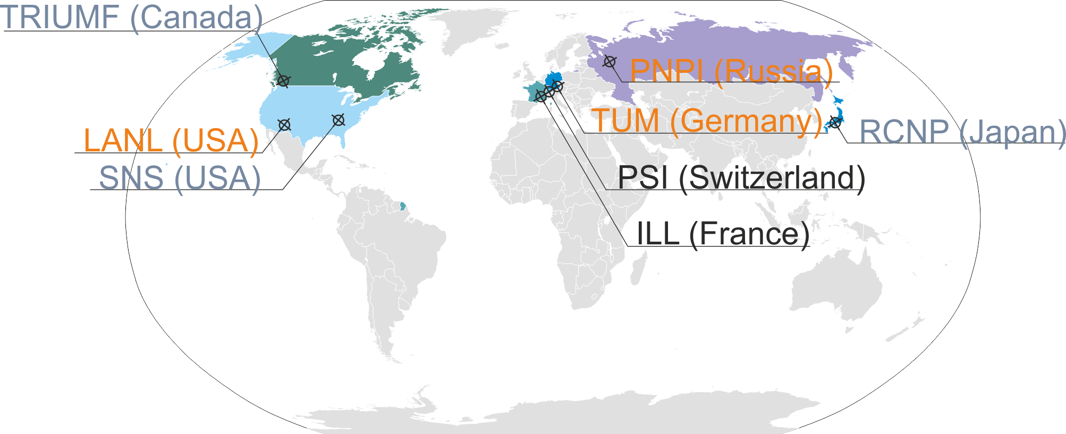
Worldwide efforts
§3
§2
Prior Efforts
ESS
⌖
This*: C. Abel et. al., Phys. Lett. B. 812, 135993 (2021): τ_{nn’}>12s, B’≠0 , τ_{nn’}>388s (90 % C.L.), B’=0 [@PSI]
N. Ayres et. al., Letter of Intent to PSI BVR 51 (2021) [@PSI]
H. Almazán et al., Phys. Rev. Lett. 128, 061801 (2022). τ_{nn’}>2ms, B’≠0 [@ILL]
C. Stasser, Euro. Phys. J. C 81, 17 (2021). τ_{nn’}>0.3ms, B’≠0 [@BR2]
G. Ban et al., Phys. Rev. Lett. 99, 161603 (2007): τ_{nn’}>103s, B’=0 [@ILL]
A. P. Serebrov et al. Phys. Lett. B 663, 3, 181-185 (2008): τ_{nn’}>448s (90 % C.L.), B’=0 [@ILL]
I. Altarev et al., Phys. Rev. D 80, 032003 (2009): τ_{nn’}>12s, B’≠0 [@ILL]
G. Ban et al., arXiv:[2303.10507]. τ_{nn’}>1s, B’≠0 [@ILL]
L. Broussard et. al., Phys. Rev. Lett. 128, 212503 (2022). τ_{nn’}>63µs, B’≠0 [@SNS]
U. Schmidt, Proceedings of 2007 BLNV Workshop: τ_{nn’}>2.7s (90 % C.L.), B’=0 [@FRM-II]
UCN - Experiments
Regeneration Experiments

Slide 13
Prior Efforts
§2
Dominated by: Disappearance Experiments
Look for magnetic field dependence of number of neutrons stored for time: t_{s}
PDG
Ratio
$$B^{′}=0$$
$$E_{B} \left(t_{s}\right)=\frac{n_{0}\left(t_{s}\right)}{n_{B}\left(t_{s}\right)}−1$$
$=\frac{t_{s}}{\left\langle t_{f}\right\rangle }\frac{\left\langle t_{f}^{2}\right\rangle }{τ_{nn^{′}}^{2}}$
Z. Berezhiani, Euro. Phys. J. C 64, 421 (2009).

Slide 14
!!!SIGNALS!!!
§2
Further analysis by Berezhiani et al., of storage type experiments:
$Δ_{B}$: Ratio Channel ; $D_{B}$: Asymmetry Channel
PNPI@ILL
PSI et al.@ILL
Z. Berezhiani, F. Nesti, Euro. Phys. J. C 72, 1974 (2012)
Berezhiani et al.’s further analysis of data from
G. Ban et al., Phys. Rev. Lett. 99, 161603 (2007)
$$D_{B=20μT}Cos\left(β\right)=−\left(16.0±3.2\right)×{10}^{−8}$$
$$D_{B=6μT}Cos\left(β\right)=\left(6.2±2.0\right)×{10}^{−7}$$
“5σ”
“3σ”
Z. Berezhiani et al., Euro. Phys. J. C 78, 717 (2018)
$$D_{B=12μT}Cos\left(β\right)=\left(16.6±6.7\right)×{10}^{−8}$$
“2σ”

Slide 15
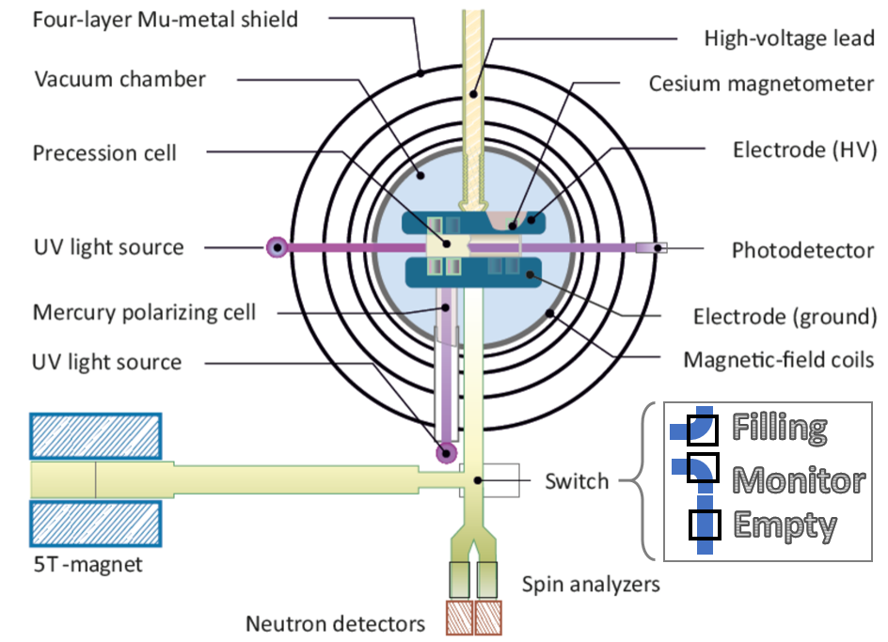
nEDM@PSI Apparatus
§3
Courtesy: C. Abel et al., PPNS 2018 (2019): arXiv [1811.04012]. C. Abel et al., Phys. Rev. Lett. 124, 081803 (2020).

Slide 16
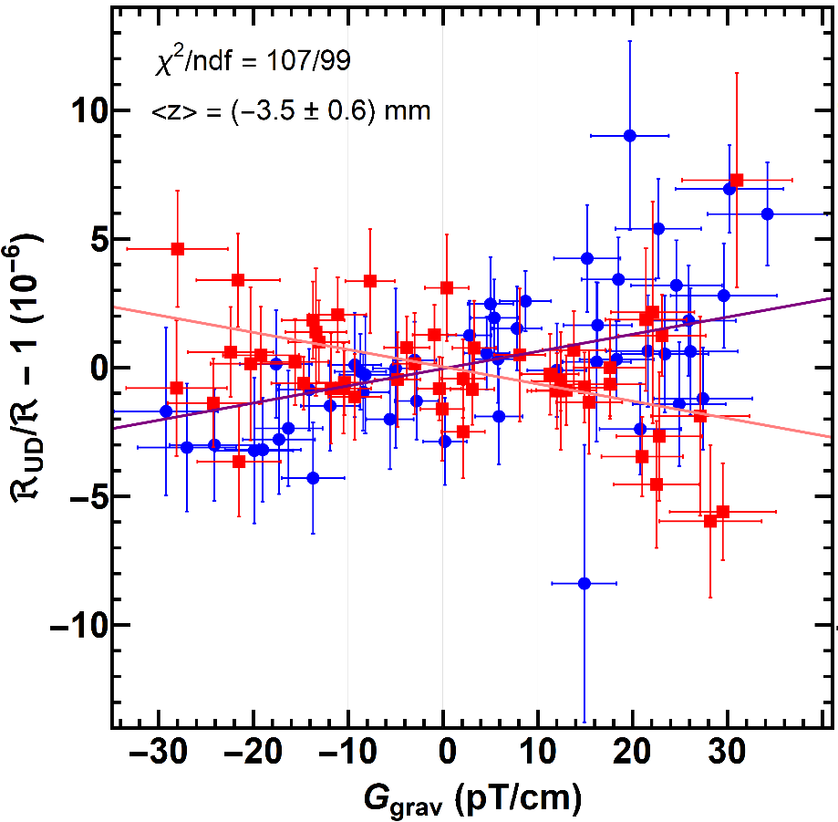
Frequency Shift nn’
§4
$$ℜ=\frac{f_{n}}{f_{Hg}}=\left|\frac{γ_{n}}{γ_{Hg}}\right|\left[1+δ_{nn′}+δ_{grav}+δ_{Earth}+{δ_{T}+δ}_{quad}+δ_{inc}+δ_{light}\right]$$
nn'
Due to B-field gradient
Earth’s rotation
Transverse B-fields
Quadratic E-field
Incoherent scattering Hg-n
Hg-light intensity
$$δ_{grav}=\frac{({dB}/{dz})\left\langle z\right\rangle }{B_{0}}$$
Can also read x-axis as dB/dz
P. Mohanmurthy et al., Symmetry 14, 487 (2022)

Slide 17
Frequency Shift nn’
§4
$$ℜ=\frac{f_{n}}{f_{Hg}}=\left|\frac{γ_{n}}{γ_{Hg}}\right|\left[1+δ_{EDM}+δ_{grav}+δ_{Earth}+{δ_{T}+δ}_{quad}+δ_{inc}+δ_{light}\right]$$
Real EDM
Due to B-field gradient
Earth’s rotation
Transverse B-fields
Quadratic E-field
Incoherent scattering Hg-n
Hg-light intensity
Frequency Shift
$$\frac{δω}{ω}=\frac{R_{UD}^{↑}−R_{UD}^{↓}}{R_{0}^{}}$$
$$=\frac{\cos{β}}{τ_{nn^{′}}^{2}}\frac{1}{2ω′2η(η^{2}− 1)}$$
$$\frac{δω}{ω}=(−7±{138}_{stat}±{27}_{sys})×{10}^{−8}$$
P. Mohanmurthy et al., Symmetry 14, 487 (2022)

Slide 18
Frequency Shift nn’
§4
$$ℜ=\frac{f_{n}}{f_{Hg}}=\left|\frac{γ_{n}}{γ_{Hg}}\right|\left[1+δ_{EDM}+δ_{grav}+δ_{Earth}+{δ_{T}+δ}_{quad}+δ_{inc}+δ_{light}\right]$$
Real EDM
Due to B-field gradient
Earth’s rotation
Transverse B-fields
Quadratic E-field
Incoherent scattering Hg-n
Hg-light intensity
Frequency Shift
$$\frac{δω}{ω}=\frac{R_{UD}^{↑}−R_{UD}^{↓}}{R_{0}^{}}$$
$$=\frac{\cos{β}}{τ_{nn^{′}}^{2}}\frac{1}{2ω′2η(η^{2}− 1)}$$
“$\cos{β}$”: compare with other asymmetry channel analysis
$$\frac{δω}{ω}=(−7±{138}_{stat}±{27}_{sys})×{10}^{−8}$$
P. Mohanmurthy et al., Symmetry 14, 487 (2022)

Slide 19
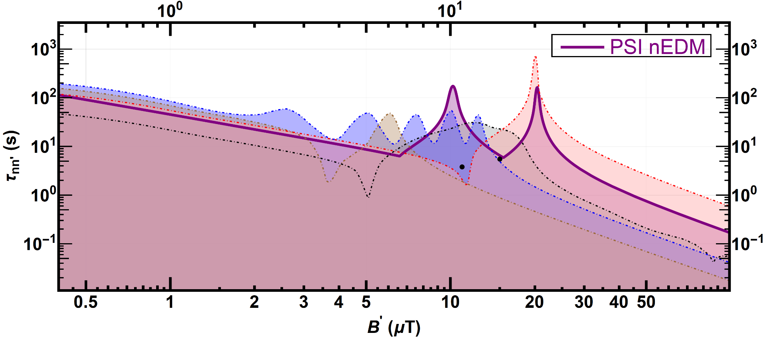
Constraints in Ratio Channel
§4
Combining the scaling function, $f_{E_{B}}\left(η\right)$, with constraints on ${τ_{nn^{′}}^{B^{′}≠0,E_{B}}}/{\sqrt{\left|f_{E_{B}}\left(η\right)\right|}}$ in appropriate range of B’
Dashed constraint for PSI nEDM neglects errors from uncertainty in energy spectra (like all the other constraints)
95% C.L. constraints
$τ_{nn^{′}}^{B^{′}≠0,E_{B}}=\sqrt{\underset{1/Δ_{B} }{\underbrace{\frac{t_{s}}{\left\langle t_{f}\right\rangle }\frac{1}{\left\langle E_{B}\right\rangle }}}\underset{f_{E_{B}}\left(η\right)}{\underbrace{\frac{η^{2}(3−η^{2})}{{2ω}^{′2}{(1−η^{2})}^{2}}}}}$
PRL 99, 161603 (2007)
PLB 663, 181 (2008)
PRD 80, 032003 (2009)
EPJ C 64, 421 (2009)
EPJ C 78, 717 (2018)
!!!>>> Assuming the angle β is fixed <<<!!!
C. Abel et al., Phys. Lett. B. 812, 135993 (2021).

Slide 20
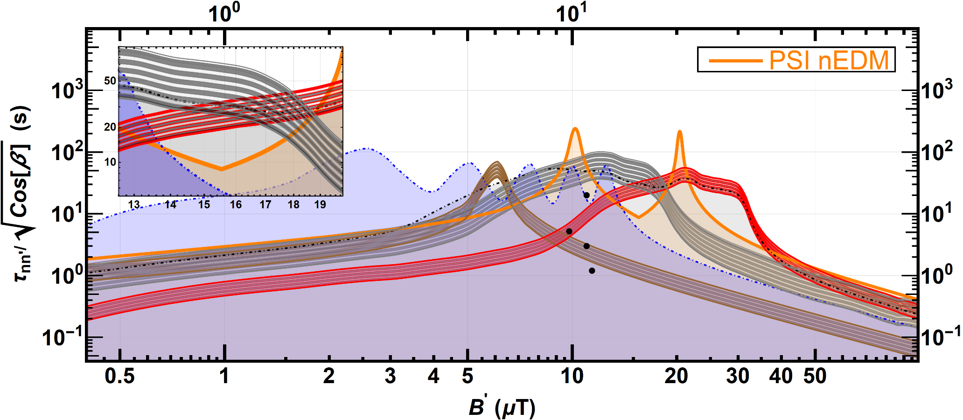
Constraints in Asymmetry Channel
§4
$$\frac{τ_{nn^{′}}^{B^{′}≠0,A_{B}}}{\sqrt{\cos{β}}}=\sqrt{\underset{1/D_{B} }{\underbrace{\frac{t_{s}}{\left\langle t_{f}\right\rangle }\frac{1}{\left\langle A_{B}\right\rangle }}}\underset{f_{A_{B}}\left(η\right)}{\underbrace{\frac{η^{3}}{ω^{2}{(1−η^{2})}^{2}}}}}$$
The signals shown here from further analysis of the data indicated in the papers shown in the legend by Berezhiani et al. in 2018
95% C.L./C.I.
PRD 80, 032003 (2009)
3σ: PRL 99, 161603 (2007)
2.5σ: EPJ C 78, 717 (2018)
5σ: EPJ C 78, 717 (2012)
PLB 812, 135993 (2021)
EPJ C 78, 717 (2012)
EPJ C 78, 717 (2018)
!!!>>> Assuming the angle β is fixed <<<!!!
C. Abel et al., Phys. Lett. B. 812, 135993 (2021).

Slide 21
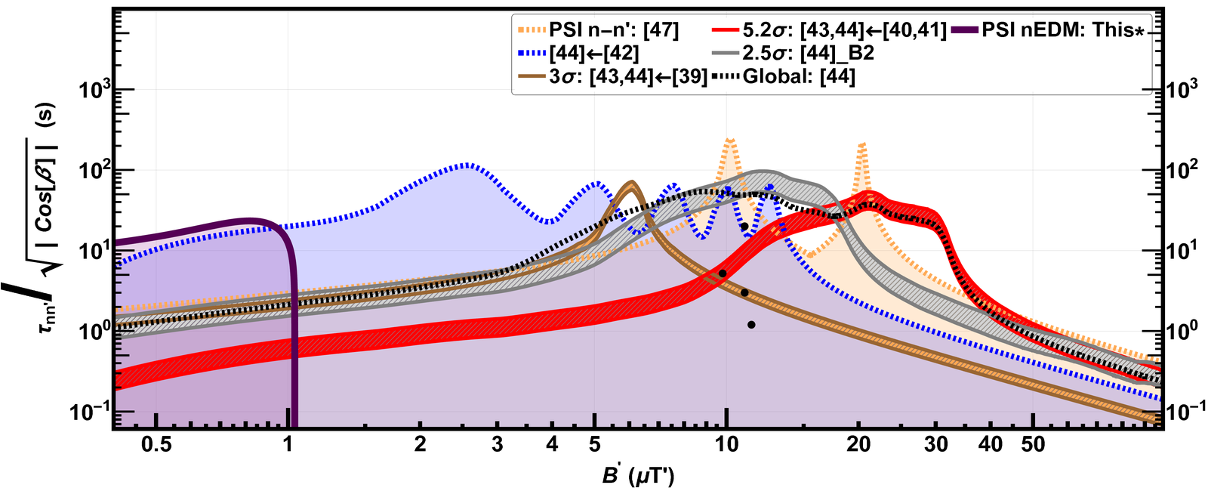
Constraints in Asymmetry Channel
§4
New constraint uses precession frequency of neutrons in {B, -B}
$$\frac{τ_{nn^{′}}^{B^{′}≠0,nEDM}}{\sqrt{\cos{β}}}=\sqrt{\frac{δω}{ω}\underset{f_{d}\left(η\right)}{∙\underbrace{\frac{1}{ω^{′2}{η(η^{2}−1)}^{}}}}}$$
95% C.L./C.I.
PRD 80, 032003 (2009)
3σ: PRL 99, 161603 (2007)
2.5σ: EPJ C 78, 717 (2018)
Symmetry 14, 487 (2022)
5σ: EPJ C 78, 717 (2012)
PLB 812, 135993 (2021)
EPJ C 78, 717 (2012)
EPJ C 78, 717 (2018)
!!!>>> Assuming the angle β is fixed <<<!!!
P. Mohanmurthy et al., Symmetry 14, 487 (2022)

Slide 22
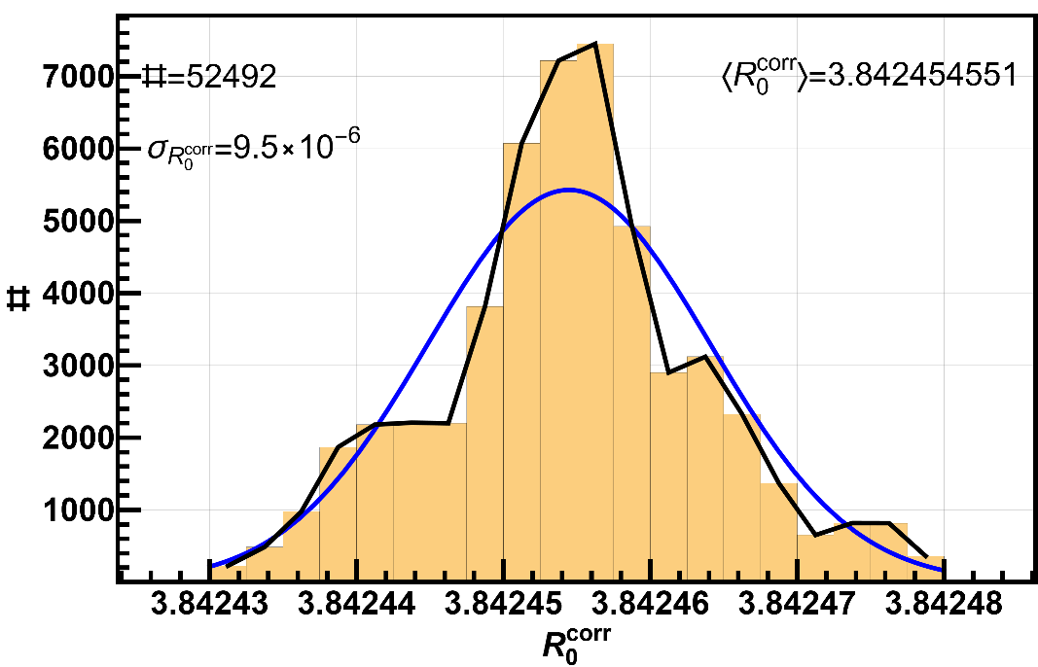
Frequency Shift nn’
§4
$$ℜ=\frac{f_{n}}{f_{Hg}}=\left|\frac{γ_{n}}{γ_{Hg}}\right|\left[1+δ_{EDM}+δ_{grav}+δ_{Earth}+{δ_{T}+δ}_{quad}+δ_{inc}+δ_{light}\right]$$
Real EDM
Due to B-field gradient
Earth’s rotation
Transverse B-fields
Quadratic E-field
Incoherent scattering Hg-n
Hg-light intensity
Frequency Shift
Possible to improve the measurement using careful systematics analysis
Previous measurement used:
$R_{0}^{}=3.8424574(30)$ [S. Afach et al. Phys. Lett. B 739, 128 (2014)]
Full width of the ($R_{UD}^{↑}−R_{UD}^{↓}$) value from crossing point analysis
$R_{UD}^{↑}=\text{3.84245454}\text{(65)}$ $R_{UD}^{↑}=\text{3.8424545}48 \left(64\right)$
$(R_{UD}^{↑}−R_{UD}^{↓}$)/ $R_{0}^{}=(1.5±2.3)×{10}^{−8}$
C. Abel et al., Lorentz Violation Search in nEDM,paperpile.com/shared/yKuYpn

Slide 23
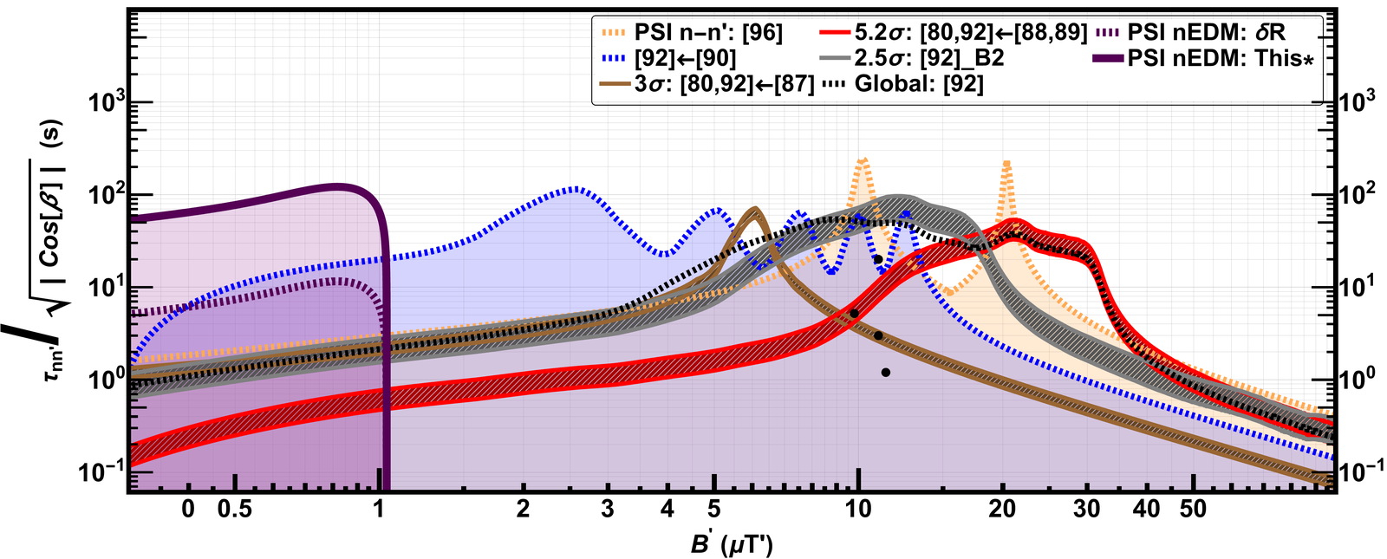
Constraints in Asymmetry Channel
§4
$$τ_{nn^{′}}^{d_{n}}/\sqrt{\cos{β}}>60 s ∀ B^{′} ∈ \left(0.39, 1.03\right) μT @ 95 \% C.L.$$
95% C.L./C.I.
PRD 80, 032003 (2009)
This*
3σ: PRL 99, 161603 (2007)
2.5σ: EPJ C 78, 717 (2018)
5σ: EPJ C 78, 717 (2012)
Symmetry 14, 487 (2022)
PLB 812, 135993 (2021)
EPJ C 78, 717 (2012)
EPJ C 78, 717 (2018)
!!!>>> Assuming the angle β is fixed <<<!!!
P. Mohanmurthy et al., Symmetry 14, 487 (2022)

Slide 24
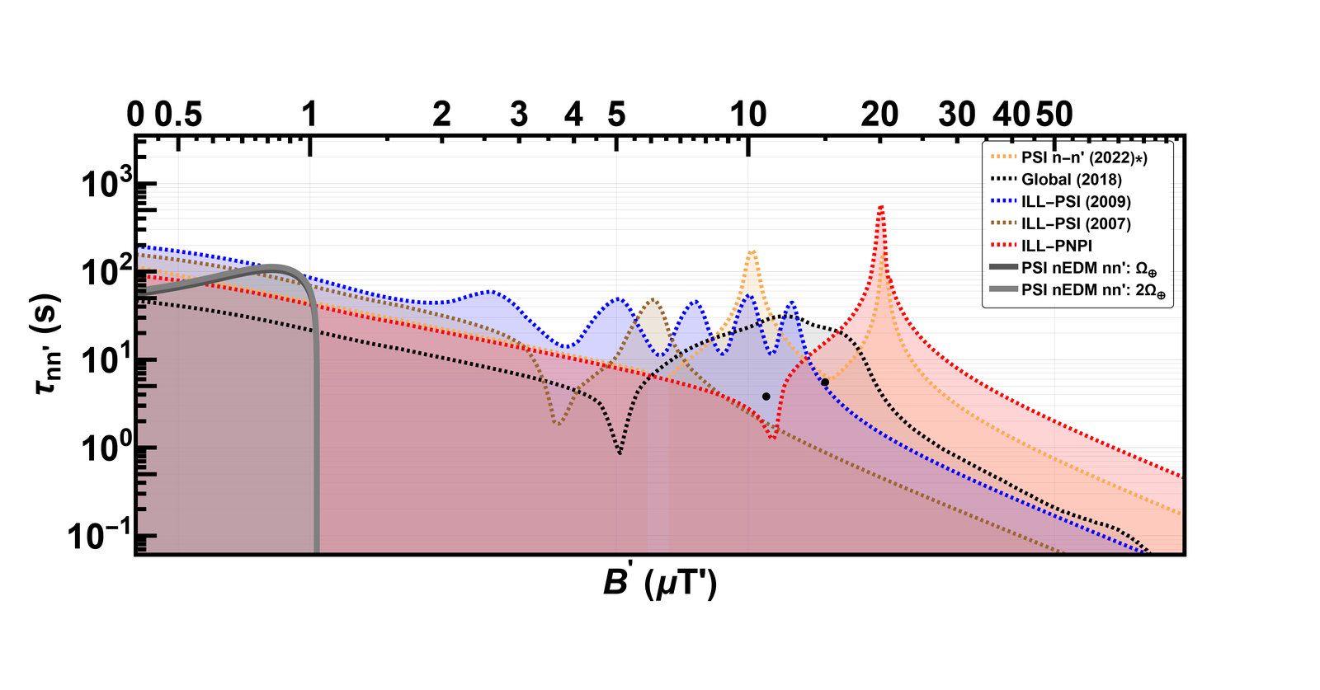
Constraints from Modulation
§4
$$τ_{nn^{′}}^{A_{B}^{Ω_{⨁} }}>51 s ∀ B^{′} ∈ \left(0.39, 1.03\right) μT @ 95 \% C.L.$$
$$τ_{nn^{′}}^{A_{B}^{{2Ω}_{⨁} }}>56 s ∀ B^{′} ∈ \left(0.39, 1.03\right) μT @ 95 \% C.L.$$
PRD 80, 032003 (2009)
PLB 812, 135993 (2021)
This*
3σ: PRL 99, 161603 (2007)
5σ: EPJ C 78, 717 (2012)
EPJ C 78, 717 (2012)
EPJ C 78, 717 (2018)
95% C.L./C.I.
Not seen in this domain: SNS, MURMUR, STEREO

Slide 25
Summary
§5
[A] C. Abel et al., Phys. Lett. B. 812, 135993 (2021)
[B] P. Mohanmurthy et al., Symmetry 14, 487 (2022)
$$τ_{nn^{′}}^{E_{B^{′}=0}^{}}>352 s @ 95 \% C.L.$$
Relevant Result Papers:
[1] G. Ban et al., Phys. Rev. Lett. 99 (2007) 161603.
[2] A. P. Serebrov et al., NIMA 611, 137–140 (2009);
Phys. Lett. B 663, 181 (2008).
[3] I. Altarev et al., Phys. Rev. D 80, 032003 (2009).
[4] Z. Berezhiani, EPJ C 64 (2009) 421.
[5] Z. Berezhiani and F. Nesti, EPJ C 72, 1974 (2012).
[6] Z. Berezhiani et al., EPJ C 78, 717 (2018).
$τ_{nn^{′}}^{E_{B}^{}}>6 s ∀ B^{′} ∈\left(0.38, 25.66\right) μT @ 95 \% C.L.$
$$τ_{nn^{′}}^{A_{B}^{}}/\sqrt{\cos{β}}>9 s ∀ B^{′} ∈\left(5.04, 25.39\right) μT @ 95 \% C.L.$$
$$τ_{nn^{′}}^{d_{n}}/\sqrt{\cos{β}}>60 s ∀ B^{′} ∈ \left(0.39, 1.03\right) μT @ 95 \% C.L.$$
$$τ_{nn^{′}}^{A_{B}^{\{Ω_{⨁},2Ω_{⨁}\}}}>\{51,56\} s ∀ B^{′} ∈\left(0.39, 1.03\right)μT @ 95 \% C.L.$$
✔
First projected sidereal modulation study
✔
First reported measurement using nEDM: frequency shift measurements
✔
Clear pathway to improving measurements using future nEDM efforts
!
Need further tests of these signals in the range of B’ ∈ (4, 37) μT

Slide 26
Backup

Slide 27
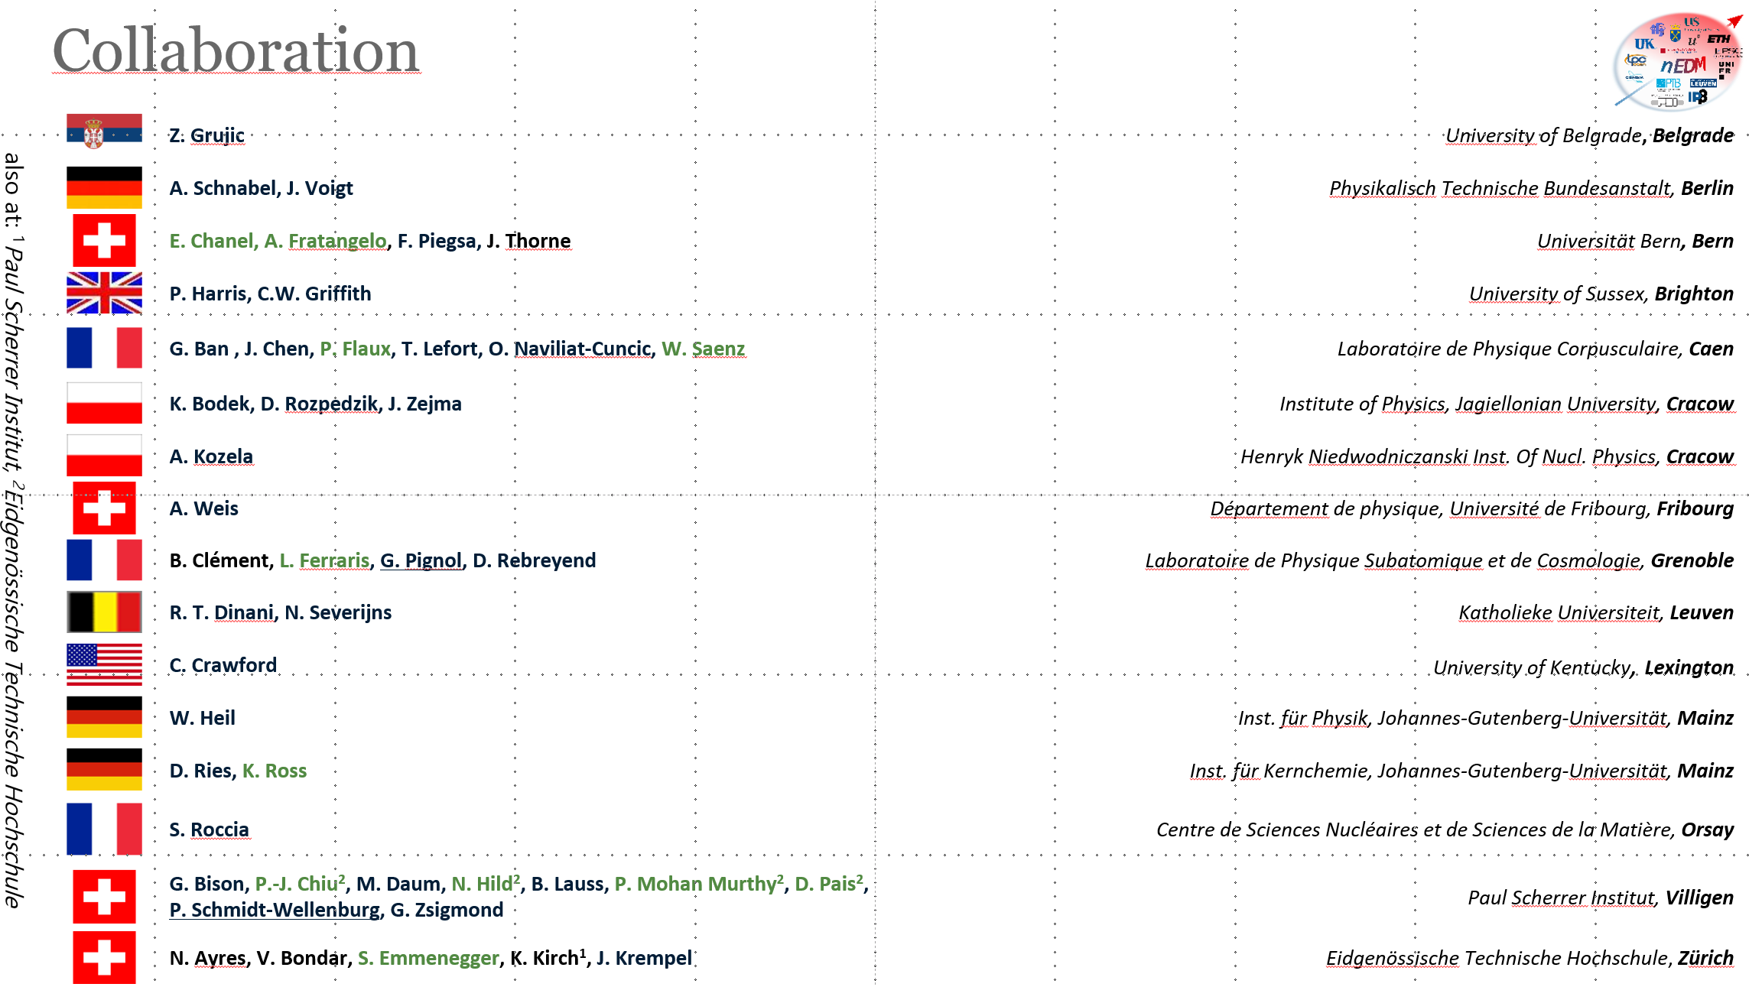
PSI nEDM Collaboration

Slide 28
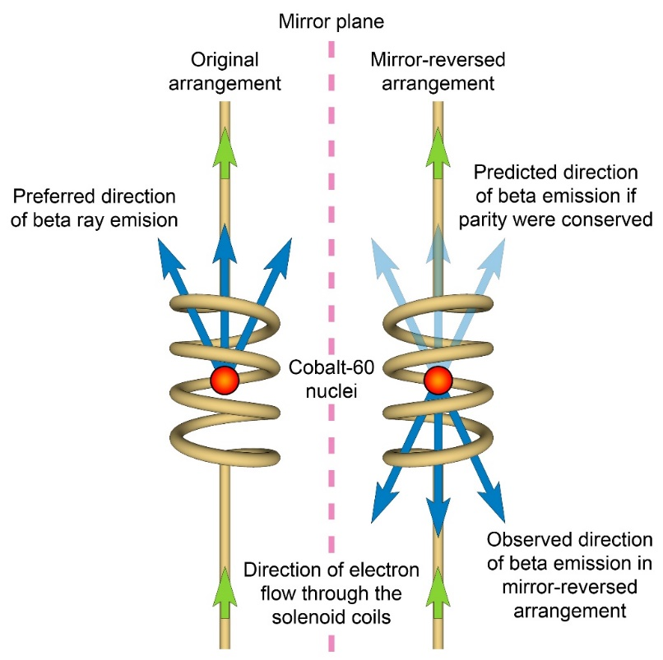
Mirror Realm
§1
Parity Violation (PV) in β–decay:
A consequence of which is neutrinos being mostly left handed.
Introduce Mirror realm hidden from standard model particles →
No global PV in weak interactions
$$ℒ_{total}=ℒ+ℒ^{′}+ℒ_{Mixing}$$
Don’t talk to each other
Except via the mixing of neutral particles
The idea is actually not a new idea!
Already noted in:
Lee & Yang’s PRL 104, 254 (1956):
Courtesy: M.Ramsey-Musolf
For Mirror Matter Review: L. B. Okun, Phys. Usp. 50 380-389 (2006)

Slide 29
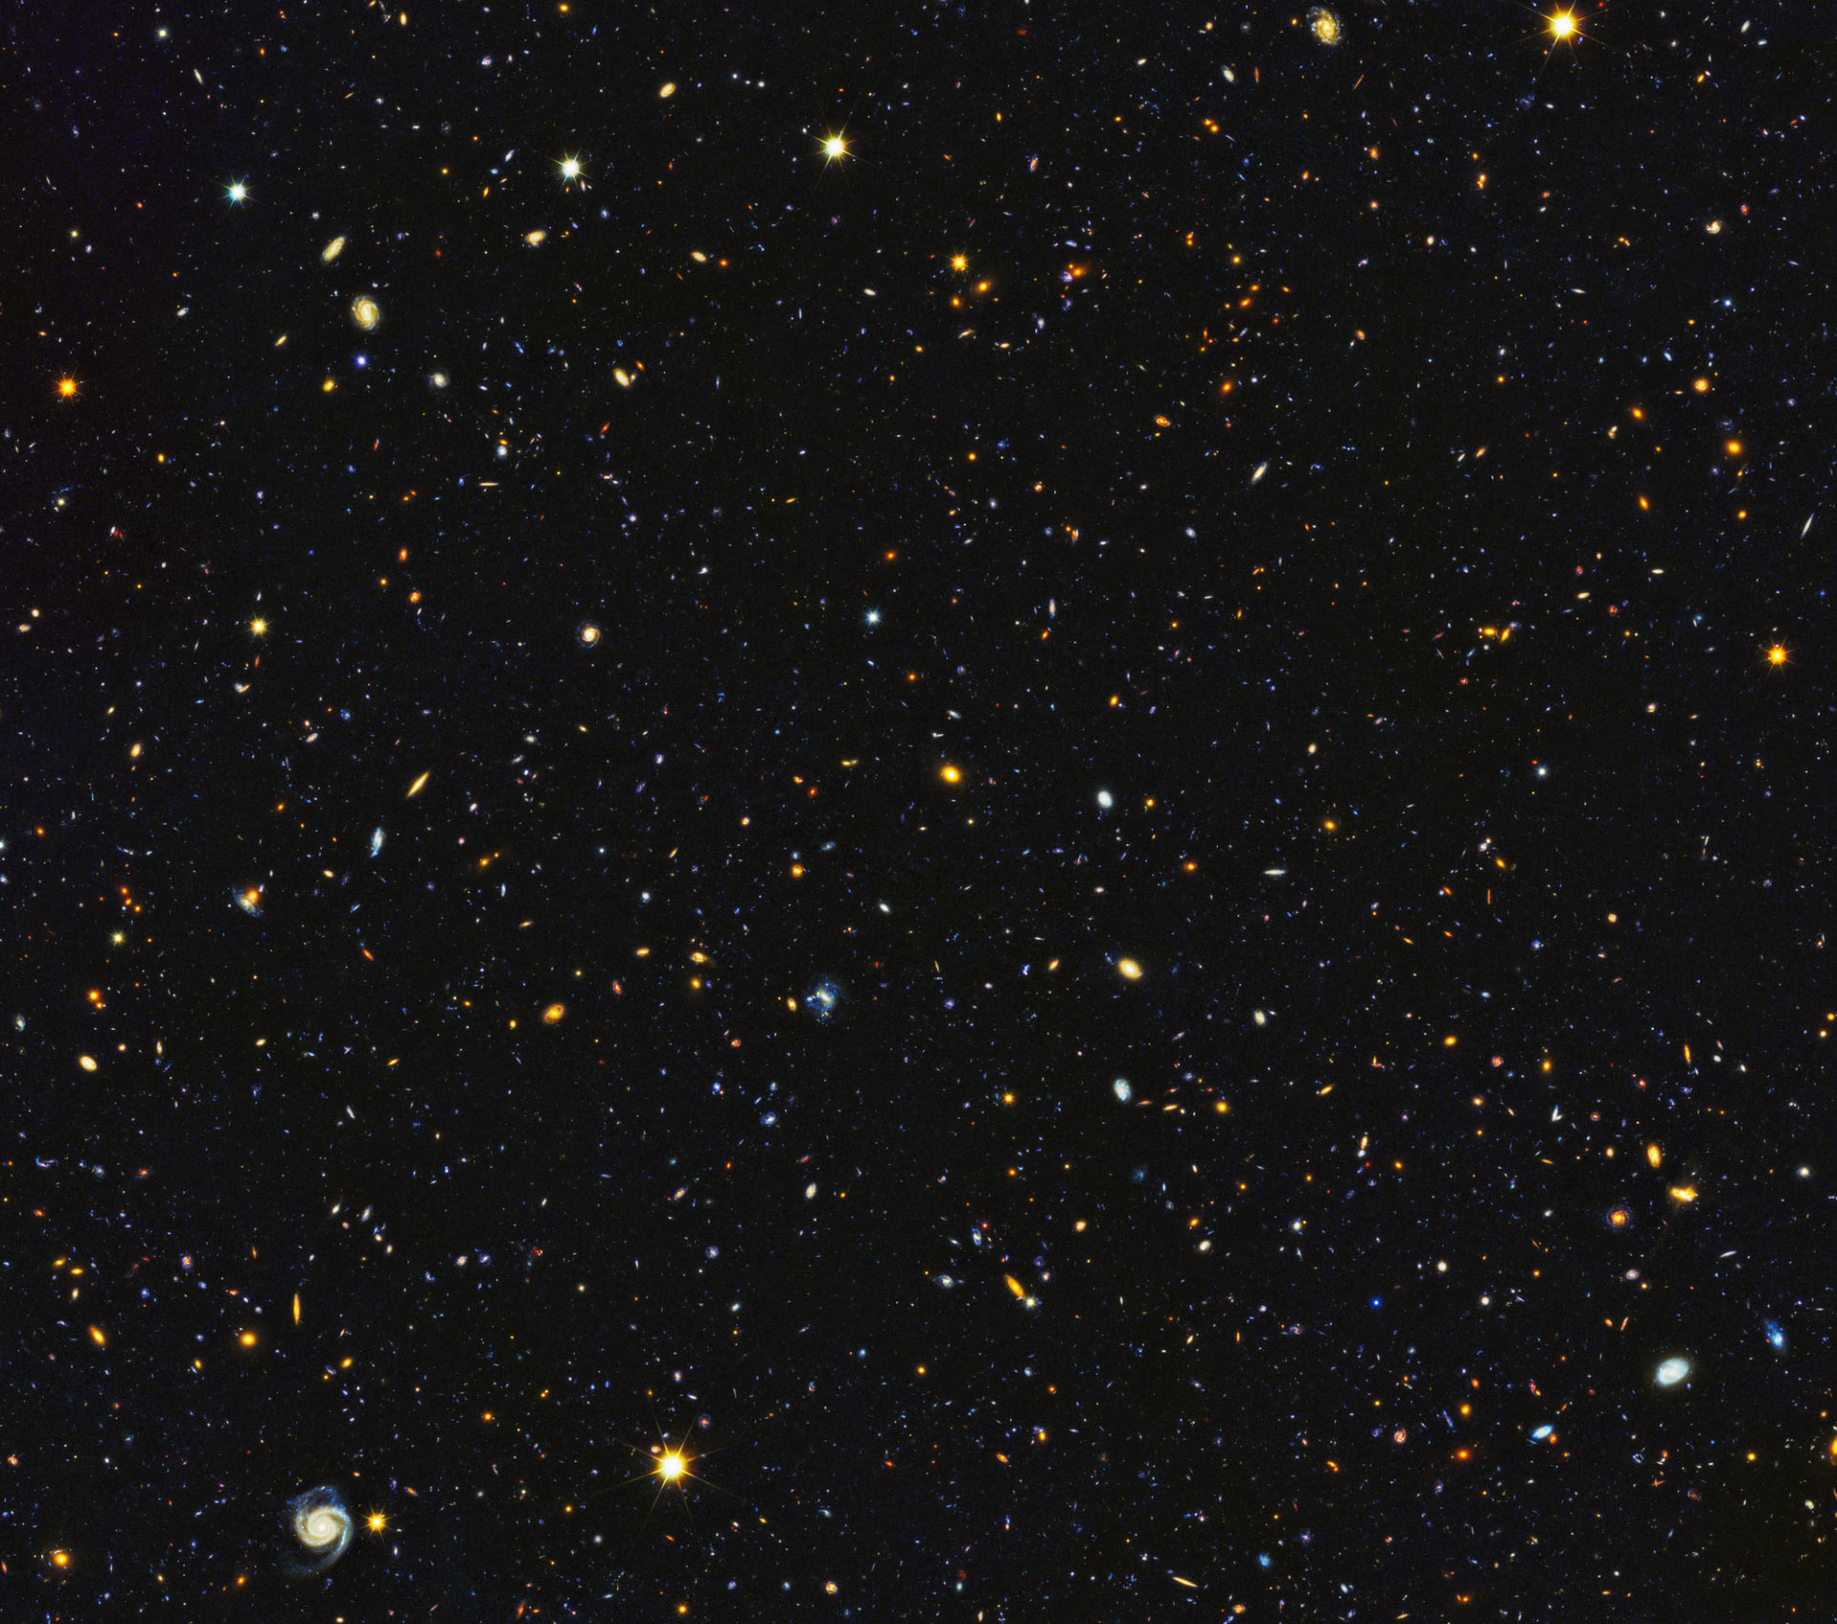
Baryon Asymmetry
§1
Naively, equal amounts of matter and antimatter; but, most of this is matter…
Asymmetry given by, $η_{B}={{(n}_{B}−η_{\overline{B}})}/{η_{γ}}=\left(6.135±0.027\right){10}^{−10}$ [Plank Collaboration, arXiv: 1807.06209]
SM ↔ SM’ Standard Model Particles
↔
Mirror Realm Particles
$$ℒ_{total}=ℒ+ℒ^{′}+ℒ_{Mixing}$$
$ℒ_{Mixing}$, Neutral particle mixing (SM ↔ SM’): n ↔ n’, γ ↔ γ’, ν ↔ ν’
n ↔ n’ violates baryon number: $\left|∆B\right|=1,\left|∆B^{′}\right|=1$
Courtesy: NASA; ESA; HUDF09 Team

Slide 30
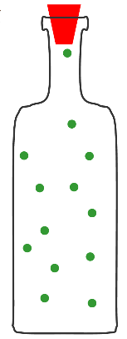
Existing Efforts
§1
UCN Storage
Experiments
G. Ban et al., Phys. Rev. Lett. 99, 161603 (2007): τ_{nn’}>103s (95 % C.L.), B’=0 [PSI-ILL]
A. P. Serebrov et al. Phys. Lett. B 663, 3, 181-185 (2008): τ_{nn’}>414s (90 % C.L.), B’=0 [PNPI-ILL]
I. Altarev et al., Phys. Rev. D 80, 032003 (2009): τ_{nn’}>12s (95 % C.L.), B’≠0 [PSI-ILL]
Regeneration
Experiments
U. Schmidt, Proceedings of 2007 BLNV Workshop: τ_{nn’}>2.7s (90 % C.L.), B’=0 [FRM-II]
L. Broussard et. al., Proceedings of 2017 DPF Meeting: τ_{nn’}>15s (90 % C.L.), B’≠0 [ORNL(HFIR)] {Phys. Rev. Lett. 128 212503}
B’=0
B’≠0
+ repeats with above apparatuses…

Slide 31
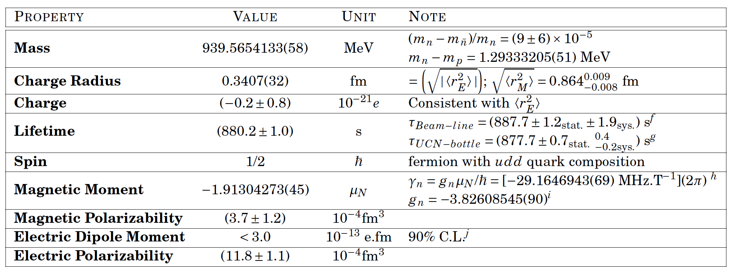
Properties of Neutron
§1
$$Decay$$
$$Capture$$
$$Oscillations$$
$$n↔n′$$
$$n→p+e^{−}+{\overline{ν}}_{e}$$
$${}_{}^{6}{Li}+n→{}_{}^{3}H+{}_{}^{4}{He}$$
$$n↔\overline{n}$$
Particle Data Group, Phys. Rev. D 98, 030001 (2018)

Slide 32
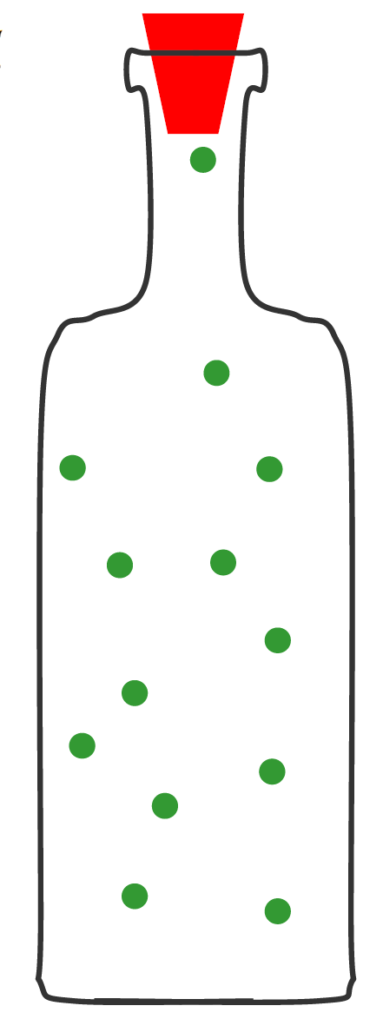
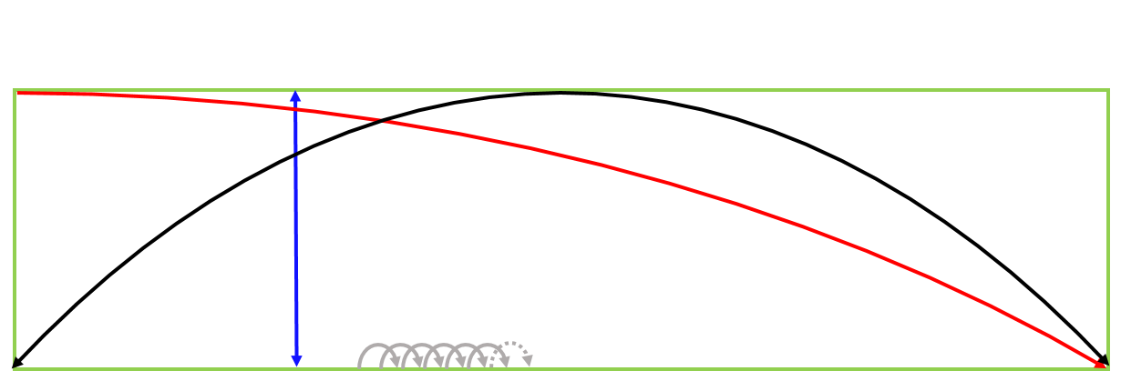
Ultracold Neutrons
§1
$ΔE_{g}$/$Δh$~1neV/cm
$$g=981 cm/s^{2}$$
UCN
“Storable Neutrons”
Neutrons with very low kinetic energy
Scattering & Absorption: UCNs bounce off materials, $V=V_{f}−𝕚W$, $V_{f}:$ Fermi potential, $W:$ absorption on materials.
Magnetic interaction: We saw this interaction in the previous slide.
Gravitational interaction: Neutrons see gravity, and their trajectories are affected non-negligibly by gravity (above).
Courtesy: UCN Group, TRIUMF

Slide 33
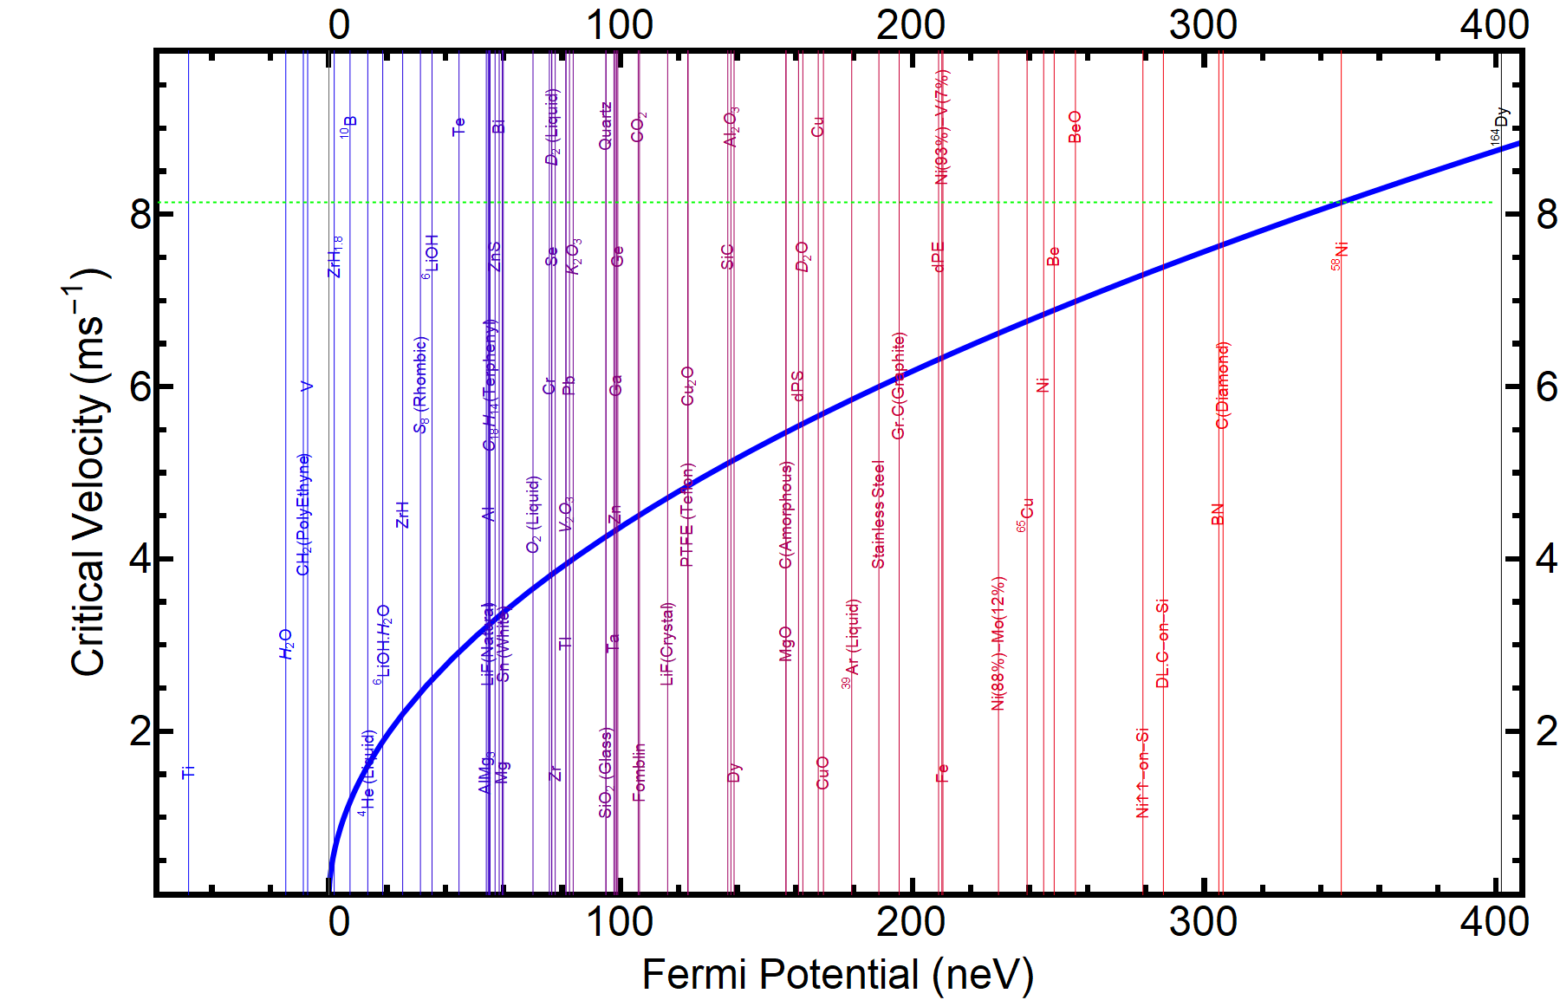
UCN Storage
§1
$${v<v}_{c}$$
$$V_{f}=V+𝕚W$$
$$|V|:$$
Neutrons lost with a probability, $∝μ(p,V_{f})$, at every bounce
$$η_{s}=W/V$$
Wall material dependent
Courtesy: UCN Group, TRIUMF

Slide 34
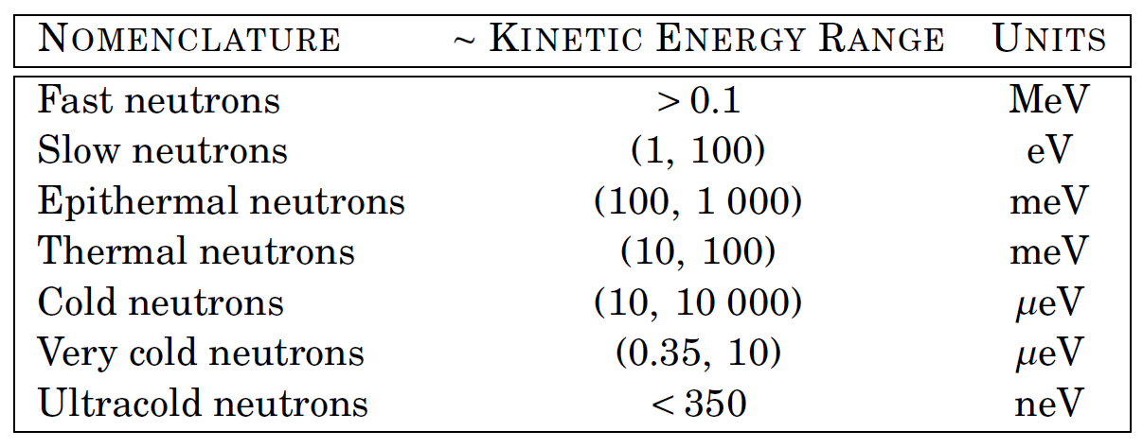
Ultracold Neutrons
§1
UCN
“Storable Neutrons”
Neutrons with very low kinetic energy
Courtesy: UCN Group, TRIUMF

Slide 35
Theory of n↔n’
§1.5
4. Then we look at the number of remaining neutrons after storage for time t_{s}, during which time neutrons are lost to decay, wall-scattering losses, …, and possibly to nn’ oscillation.
${1+E}_{B}=\frac{n_{0}\left(t_{s}\right)}{n_{B}\left(t_{s}\right)}=\frac{exp\{−\left({\sum_{i}{R}}^{(i)}+R_{B=0}^{nn′}+…\right)t_{s}\}}{exp\{−\left({\sum_{i}{R}}^{(i)}+R_{B≠0}^{nn′}+…\right)t_{s}\}}=$ $exp\{−\left(R_{B=0}^{nn′}{−R}_{B≠0}^{nn′}\right)t_{s}\}$
$$E_{B} \left(t_{s}\right)≈\frac{t_{s}}{\left\langle t_{f}^{2}\right\rangle }\frac{\left\langle t_{f}\right\rangle }{τ_{nn^{′}}^{2}}$$
Where $\left\langle t_{f}\right\rangle$ is the mean time between two consecutive wall collisions.

Slide 36
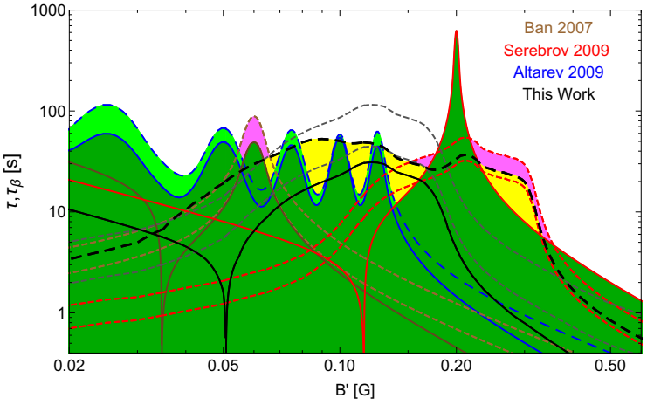
Prior Experiments
§1
Z. Berezhiani et al., EPJ C 78, 717 (2018).
“5σ” signal! : Need to check for reproducibility of these signals.

Slide 37
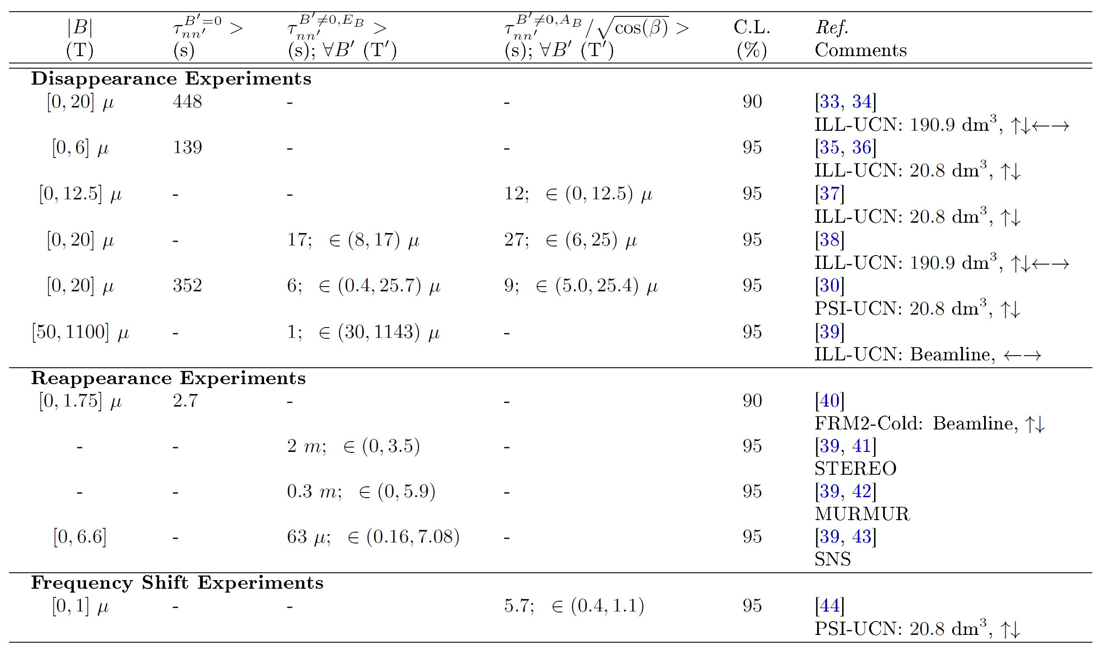
Prior Efforts
§2
Z. Berezhiani, Euro. Phys. J. C 64, 421 (2009).

Slide 38
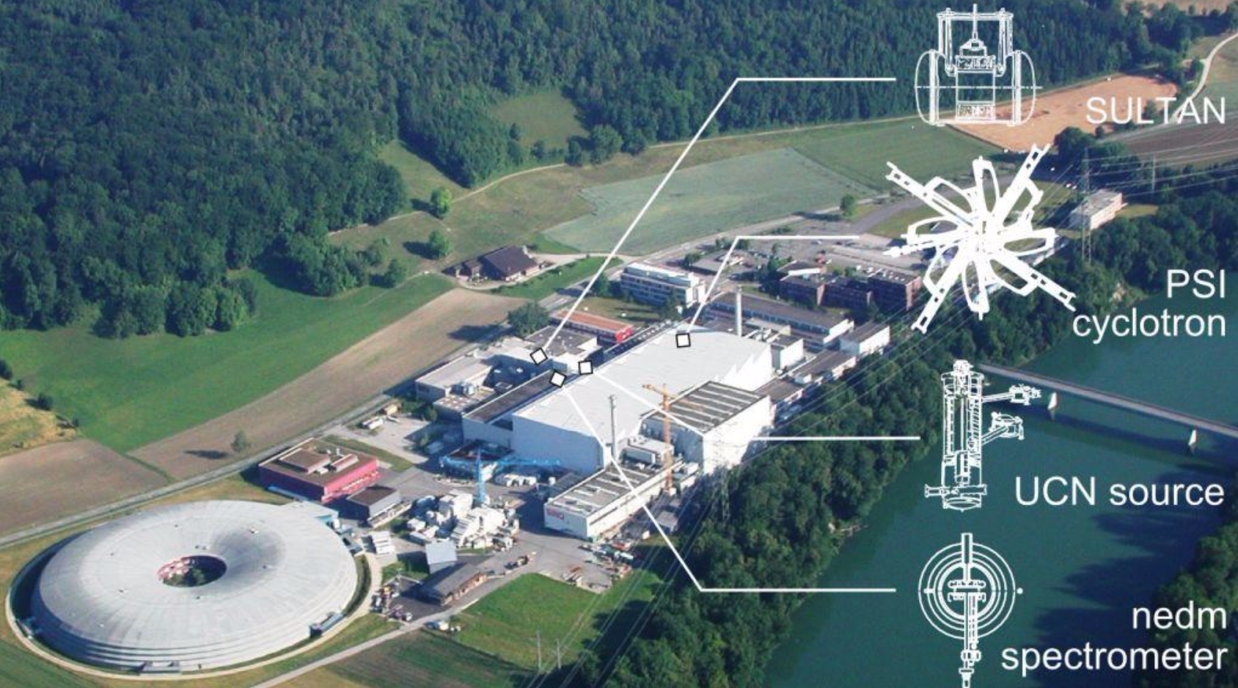
PSI
§2
Courtesy: PSI (2017)

Slide 39
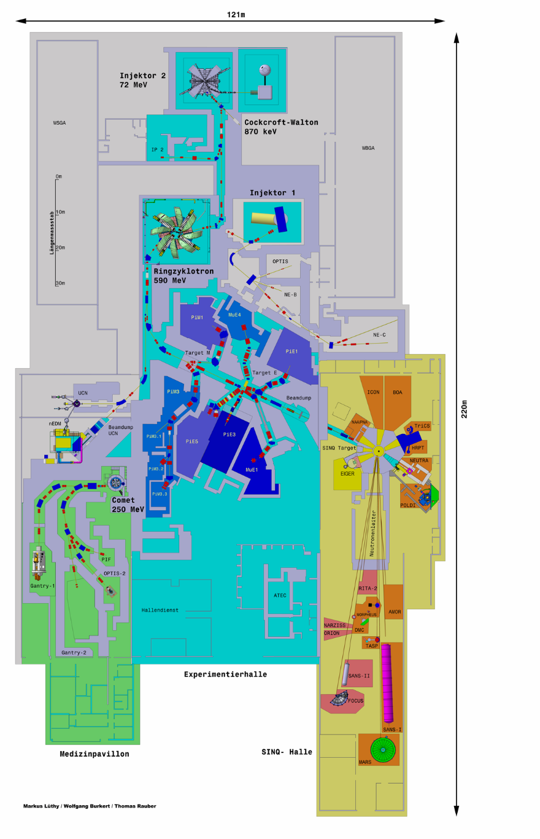
Spallation UCN Source
§2

Slide 40
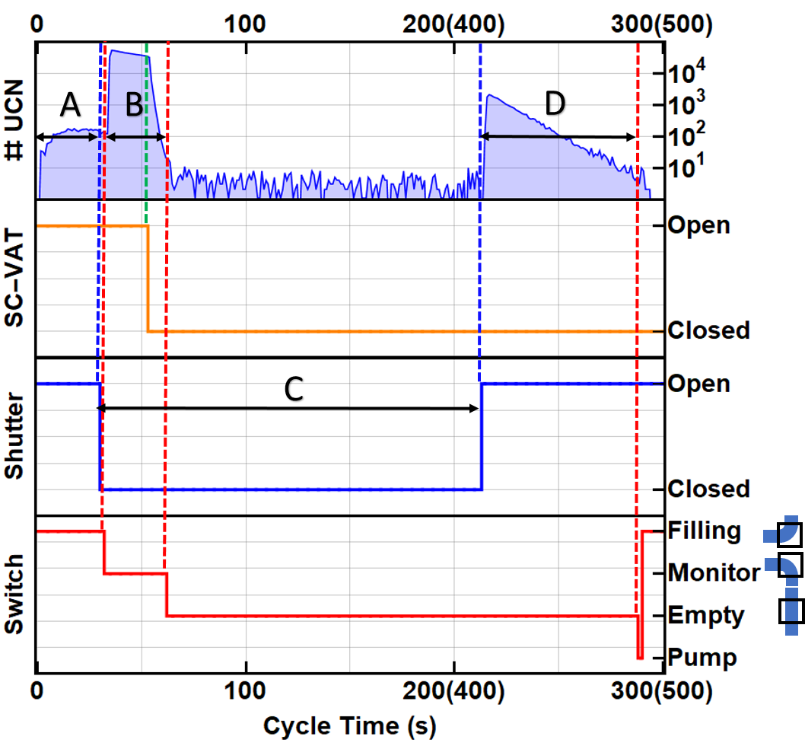
Data Collection Scheme
§3
Data collected in runs (right), each runs is made up of many cycles (left).
B - Pattern | t*_{s} (t_{t})/s | B_{max}/µT | # Cycles
0↑0↓0↓0↑0↓0↑0↑0↓0 | 180 (300) | 10 | 1616
0↑0↓0↓0↑0↓0↑0↑0↓0 | 380 (500) | 10 | 2908
0↑0↓0↓0↑0↓0↑0↑0↓0 | 180 (300) | 20 | 1296
0↑0↓0↓0↑0↓0↑0↑0↓0 | 380 (500) | 20 | 1992
Switch position:
Filling
Monitor
Emptying
Pump.
Cycle Time:
A: Filling phase
B: monitor phase
C: storage phase, and
D: emptying phase

Slide 41
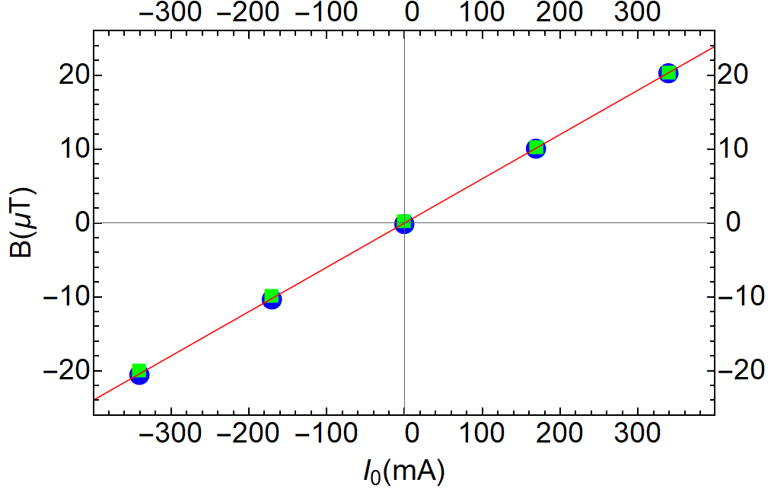
Magnetic Field Measurement
§3
We used Hg-199 & Cs-133 magnetometers to measure the magnetic field in-situ w.r.t applied coil current.
$${\left\langle \left|B_{max}\right|\right\rangle }^{\sim 10μT}=\left(10.20±0.02\right)μT$$
$${\left\langle \left|B_{max}\right|\right\rangle }^{\sim 20μT}=\left(20.39±0.04\right)μT$$
B(I₀)=f(|I₀|)/γ_{Hg}
where I₀ is the input current read by the ammeter

Slide 42
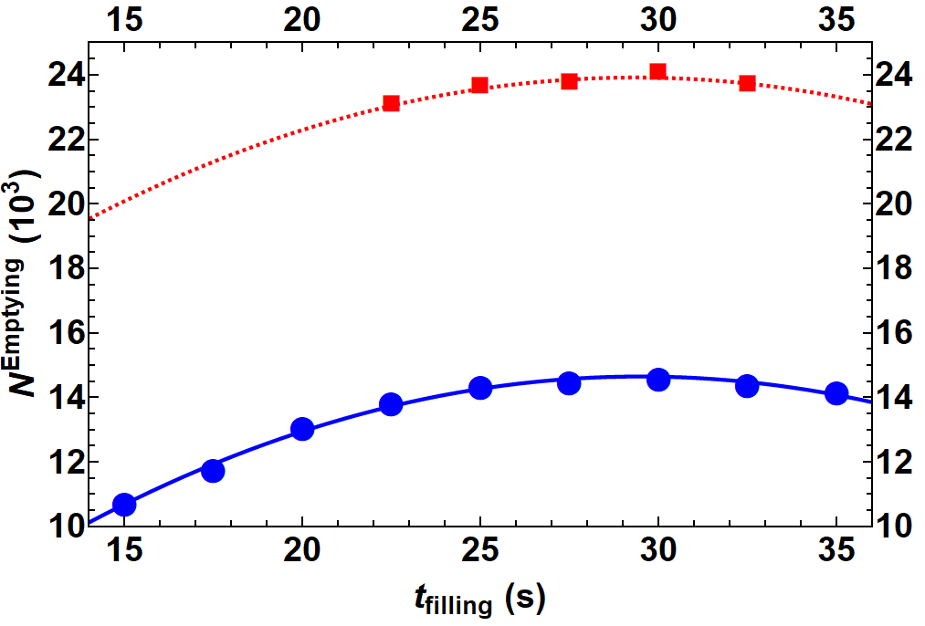
Filling and Monitor Time
§3
$$t_{filling}=29 s$$
We wanted to choose filling and monitor time such that the UCN statistics is highest.
There is an optimal filling time, as the UCN source output drops over time after each proton pulse.
We also verified that the UCNs in the beam guide are completely emptied while using monitor time as long as 20 s
$$t_{monitor}^{}=20 s$$

Slide 43
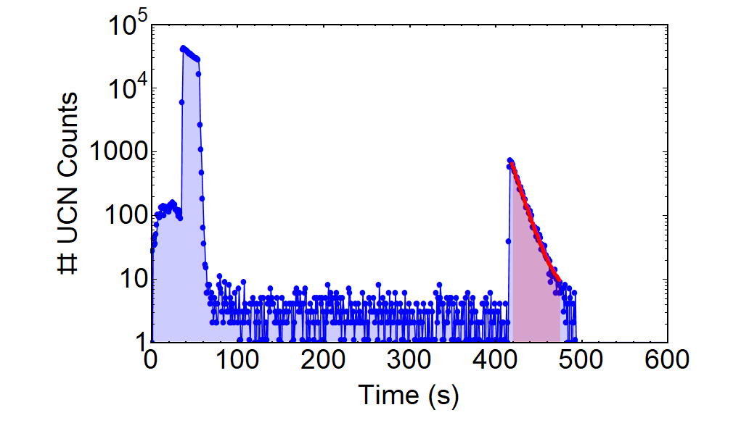
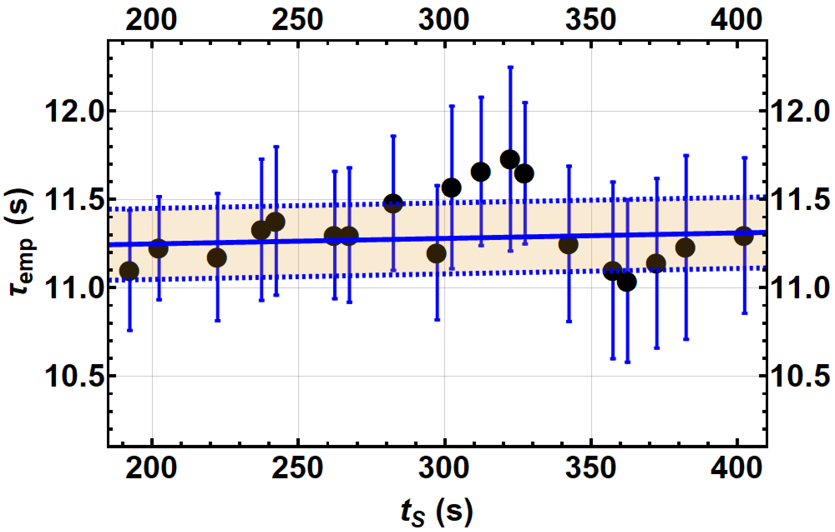
Effective Storage time
§3
Notice we made the distinction between $t_{s}^{∗}$ and $t_{s}.$
UCNs can also oscillate during filling ($τ_{emp}$) and emptying ($τ_{emp}$), we add ${2τ}_{emp}$ to the micro-timer storage time, $t_{s}^{∗}$.
$t_{s}=t_{s}^{∗}+2τ_{emp}$
$$t_{s}^{∗}=\left\{180, 380\right\}s$$
$$t_{s}=t_{s}^{∗}+{2τ}_{emp}$$
$$t_{s}^{}=\left\{202.6, 402.6\right\}(4)s$$

Slide 44
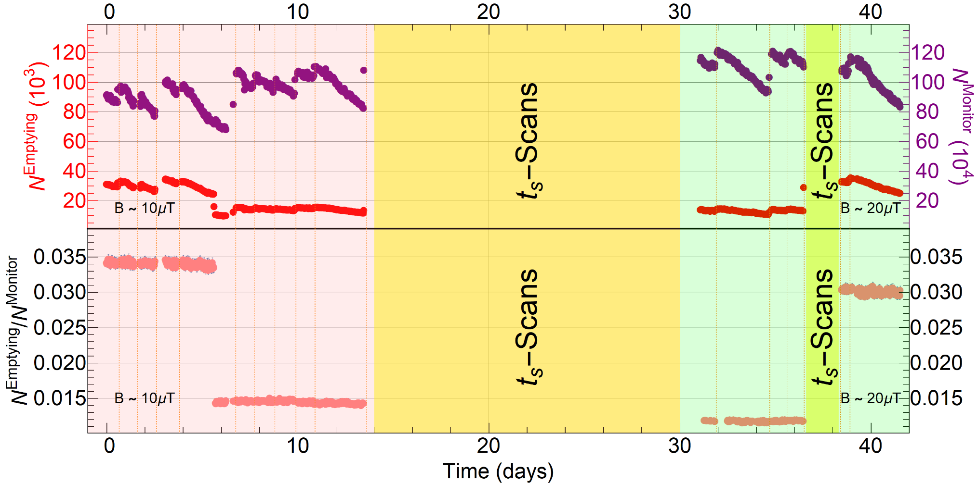
Normalizing Emptying Counts
§3
Monitor counts were found to be good normalizing counts. Using: $n=N^{Emptying}/N^{Monitor}$
$t_{s}^{∗}$=180 s
$t_{s}^{∗}$=380 s

Slide 45
Data Collection Scheme
§3
Data collected in runs (table), each runs is made up of many cycles (bottom).
B - Pattern | t*_{s} (t_{t})/s | B_{max}/µT | # Cycles
0↑0↓0↓0↑0↓0↑0↑0↓0 | 180 (300) | 10 | 1616
0↑0↓0↓0↑0↓0↑0↑0↓0 | 380 (500) | 10 | 2908
0↑0↓0↓0↑0↓0↑0↑0↓0 | 180 (300) | 20 | 1296
0↑0↓0↓0↑0↓0↑0↑0↓0 | 380 (500) | 20 | 1992
Cycle Time:
A: filling phase
B: monitor phase
C: storage phase, and
D: emptying phase

Slide 46
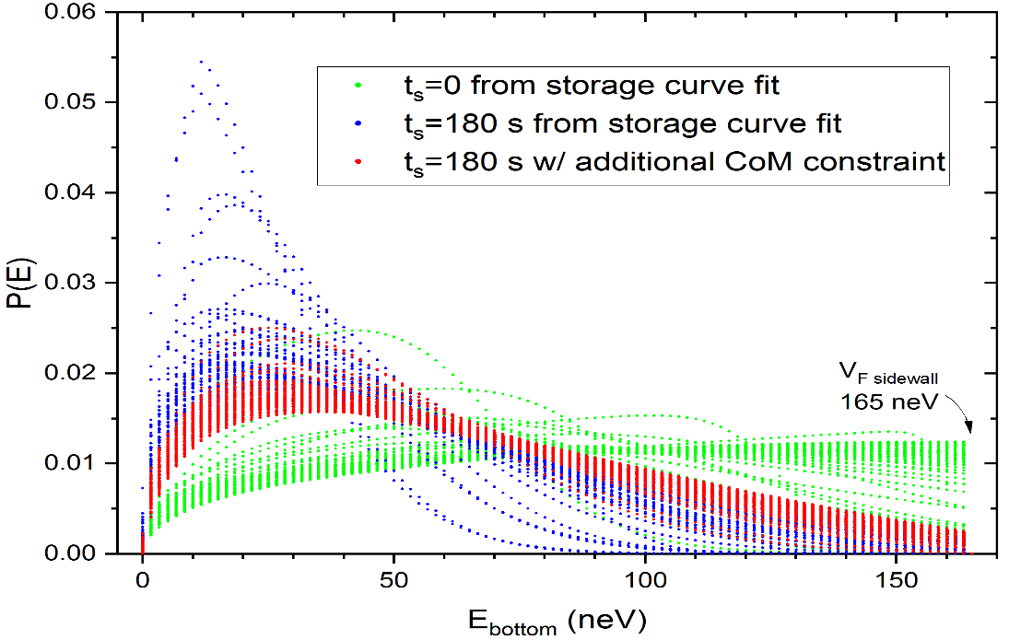
Energy spectra of UCNs
§3
We need to know the average number of times UCNs bounce off the walls, given by t_{s} /<t_{f}>,
<t_{f}> is the mean time between consecutive collisions.
This is dependent on the energy spectra of the UCNs
Simulate energy distribution and obtain <t_{f}> distributions
Obtain E_{B} or A_{B} UCN counting distributions
Combine data to generate constraints upon: $τ_{nn^{′}}^{}$
Combine data to generate constraints upon: 𝜏_(𝑛𝑛^′)^
We use the storage curve to extract energy distribution with a MC simulation
All of these spectras as valid.
The blue family of spectras come purely from storage curve
Adding the <z> constraint further constrains the family of spectras to red.

Slide 47
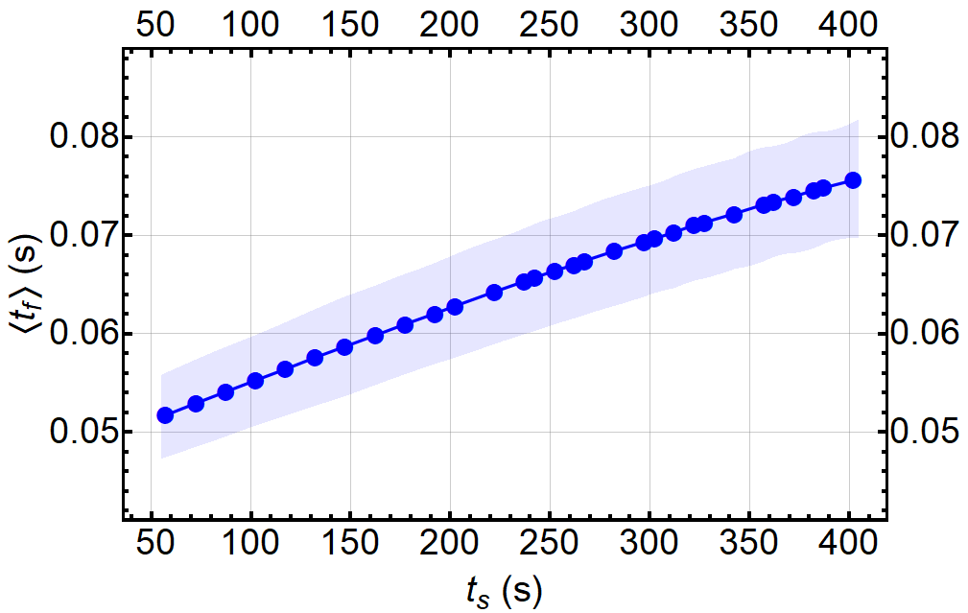
Mean Time of Flight
§3
<t_{f}> is dependent on the energy spectra of the UCNs.
Energy spectra from a fit of a loss model to the measured storage curve.
Simulate energy distribution and obtain <t_{f}> distributions
Obtain E_{B} or A_{B} UCN counting distributions
Combine data to generate constraints upon: $τ_{nn^{′}}^{}$
Combine data to generate constraints upon: 𝜏_(𝑛𝑛^′)^
$$E_{B} \left(t_{s}\right)=\frac{n_{0}\left(t_{s}\right)}{n_{B}\left(t_{s}\right)}−1$$
$=\frac{t_{s}}{\left\langle t_{f}\right\rangle }\frac{η^{2}(3−η^{2})}{{2ω}^{′2}τ_{nn^{′}}^{2}{(1−η^{2})}^{2}}$
Eg. the formula above uses averaged value of t_{f}: <t_{f}>
The plot here shows <t_{f}> and the error bar is the smearing introduced by the uncertainty in energy spectra of UCNs.
<t_{f}> changes with storage time.

Slide 48
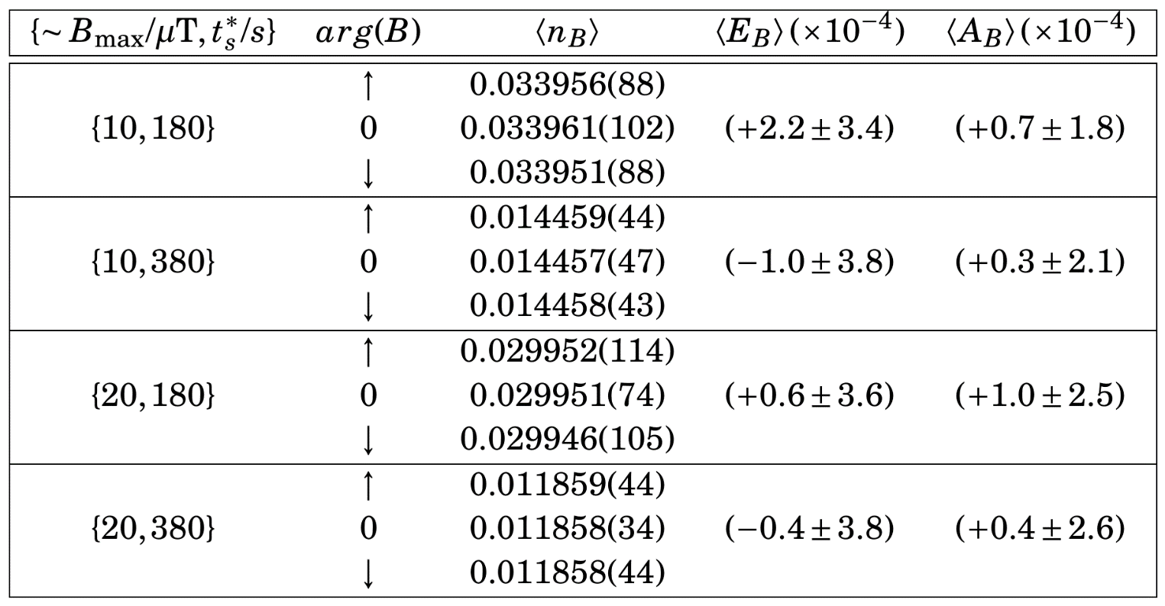
UCN Counting Statistics
§4
Simulate energy distribution and obtain <t_{f}> distributions
Obtain E_{B} or A_{B} UCN counting distributions
Combine data to generate constraints upon: $τ_{nn^{′}}^{}$
Combine data to generate constraints upon: 𝜏_(𝑛𝑛^′)^
$$\left\langle E_{B}\right\rangle =\frac{2\left\langle n_{0}\right\rangle }{\left\langle n_{↑}\right\rangle +\left\langle n_{↓}\right\rangle }−1$$
$$\left\langle A_{B}\right\rangle =\frac{\left\langle n_{↑}\right\rangle −\left\langle n_{↓}\right\rangle }{\left\langle n_{↑}\right\rangle +\left\langle n_{↓}\right\rangle }$$

Slide 49
UCN Counting Statistics
§4
Simulate energy distribution and obtain <t_{f}> distributions
Obtain E_{B} or A_{B} UCN counting distributions
Combine data to generate constraints upon: $τ_{nn^{′}}^{}$
Combine data to generate constraints upon: 𝜏_(𝑛𝑛^′)^
Each run has a characteristic {∼ B_{max}/μT, t∗_{s}/s } setting.
The normalized emptying counts are histogrammed for each run.
Eg. here the run corresponds to {∼ B_{max}, t∗_{s}} = {10 μT, 180 s}.
$$\left\langle E_{B}\right\rangle =\frac{2\left\langle n_{0}\right\rangle }{\left\langle n_{↑}\right\rangle +\left\langle n_{↓}\right\rangle }−1$$
$$\left\langle A_{B}\right\rangle =\frac{\left\langle n_{↑}\right\rangle −\left\langle n_{↓}\right\rangle }{\left\langle n_{↑}\right\rangle +\left\langle n_{↓}\right\rangle }$$

Slide 50
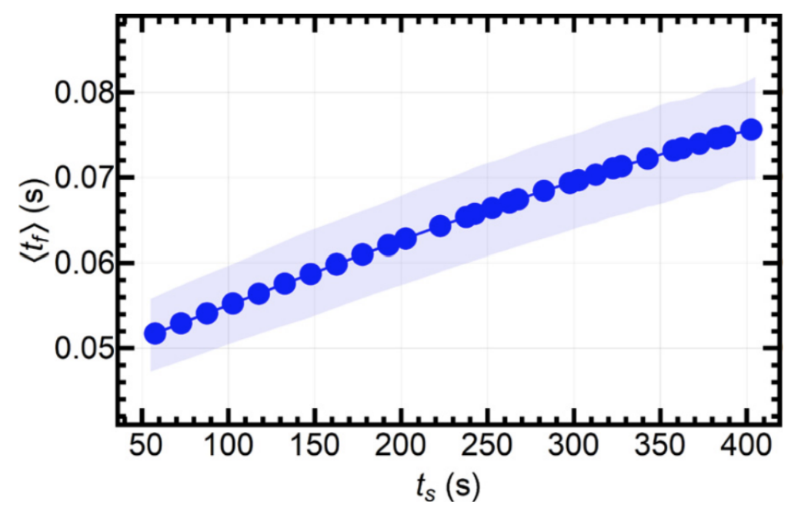
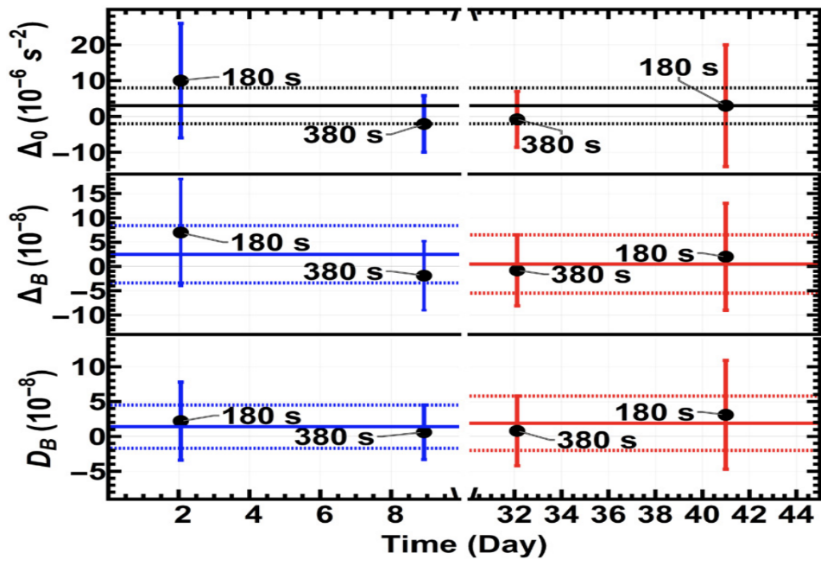
Combine Counting Data with <t_{f}>
§4
Simulate energy distribution and obtain <t_{f}> distributions
Obtain E_{B} or A_{B} UCN counting distributions
Combine data to generate constraints upon: $τ_{nn^{′}}^{}$
Combine data to generate constraints upon: 𝜏_(𝑛𝑛^′)^
C. Abel et al., Phys. Lett. B. 812, 135993 (2021).

Slide 51
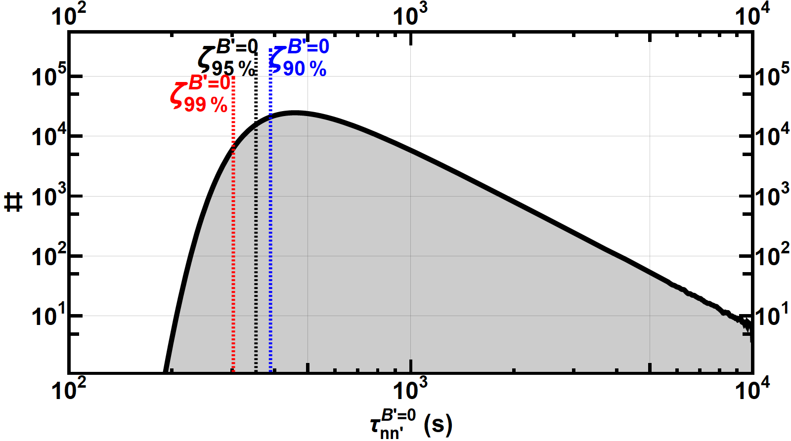
nn’ Oscillation Assuming B’=0
§4
Simulate energy distribution and obtain <t_{f}> distributions
Obtain E_{B} or A_{B} UCN counting distributions
Combine data to generate constraints upon: $τ_{nn^{′}}^{}$
Combine data to generate constraints upon: 𝜏_(𝑛𝑛^′)^
$$\left\langle Δ_{0}\right\rangle =(3.0±5.0)×{10}^{−6}s^{−2}$$
$$τ_{nn^{′}}^{(B^{′}=0)}>352 s (95\% C.L.)$$
$τ_{nn^{′}}^{}=\sqrt{\underset{−1/Δ_{0}}{\underbrace{\frac{t_{s}}{\left\langle t_{f}\right\rangle }\frac{\left\langle t_{f}^{2}\right\rangle }{(−\left\langle E_{B}\right\rangle )}}}}$
C. Abel et al., Phys. Lett. B. 812, 135993 (2021).

Slide 52
nn’ Oscillation Assuming B’≠0
§4
Simulate energy distribution and obtain <t_{f}> distributions
Obtain E_{B} or A_{B} UCN counting distributions
Combine data to generate constraints upon: $τ_{nn^{′}}^{}$
Combine data to generate constraints upon: 𝜏_(𝑛𝑛^′)^
$τ_{nn^{′}}^{B^{′}≠0,E_{B}}=\sqrt{\underset{1/Δ_{B} }{\underbrace{\frac{t_{s}}{\left\langle t_{f}\right\rangle }\frac{1}{\left\langle E_{B}\right\rangle }}}\underset{f_{E_{B}}\left(η\right)}{\underbrace{\frac{η^{2}(3−η^{2})}{{2ω}^{′2}{(1−η^{2})}^{2}}}}}$
Ratio
$$η=B/B^{′}$$
$$\frac{τ_{nn^{′}}^{B^{′}≠0,A_{B}}}{\sqrt{\cos{β}}}=\sqrt{\underset{1/D_{B} }{\underbrace{\frac{t_{s}}{\left\langle t_{f}\right\rangle }\frac{1}{\left\langle A_{B}\right\rangle }}}\underset{f_{A_{B}}\left(η\right)}{\underbrace{\frac{η^{3}}{ω^{2}{(1−η^{2})}^{2}}}}}$$
Asymmetry
!!!>>> Assuming the angle β is fixed <<<!!!
C. Abel et al., Phys. Lett. B. 812, 135993 (2021).

Slide 53
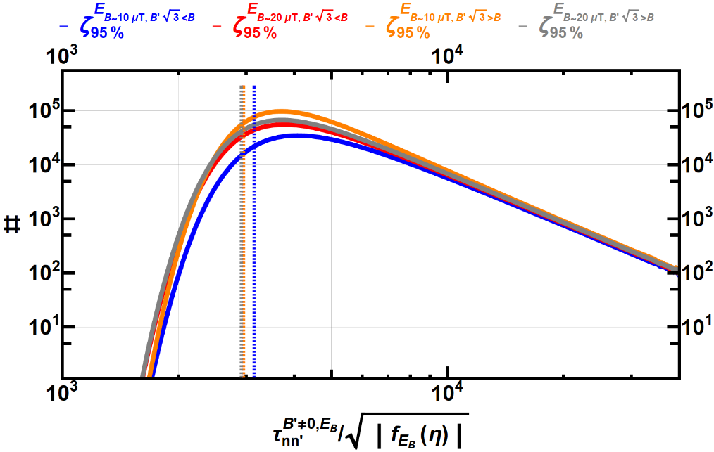
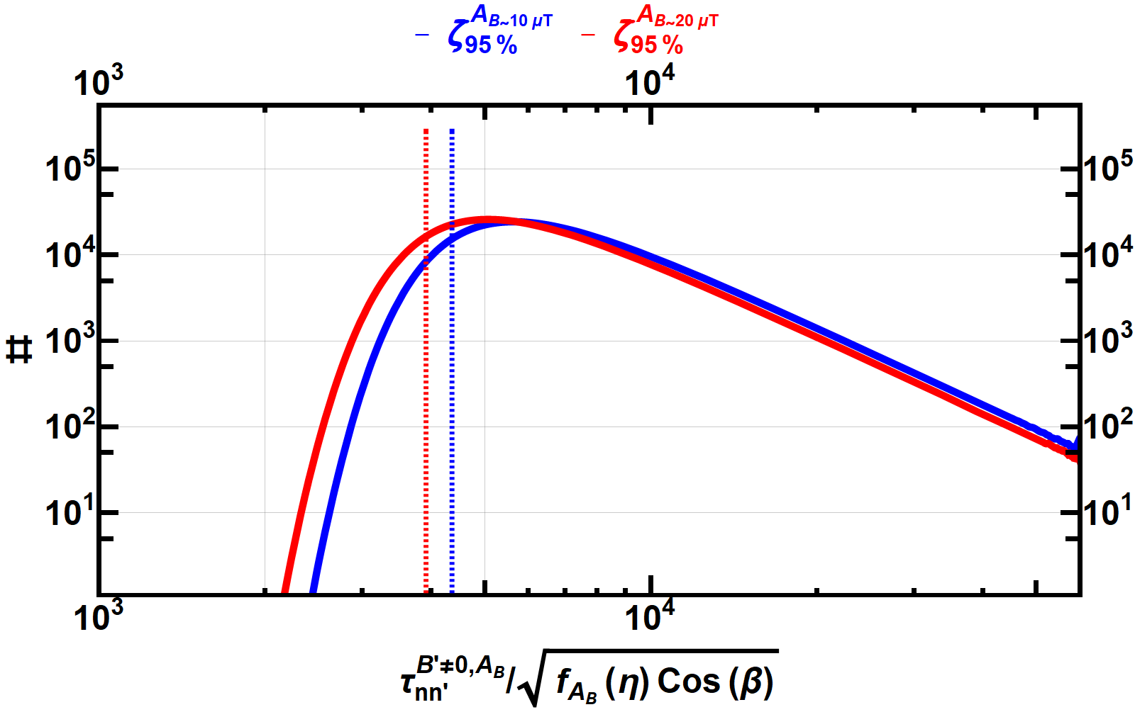
nn’ Oscillation Assuming B’≠0
§4
$f_{E_{B}}\left(η\right)$ changes sign at$B=B′\sqrt{3}$
$B>B′\sqrt{3}$: Use $\sqrt{−1/Δ_{B}}$
$B<B′\sqrt{3}$: Use $\sqrt{+1/Δ_{B}}$
$$\frac{τ_{nn^{′}}^{B^{′}≠0,E_{B}}}{\sqrt{\left|f_{E_{B}}\left(η\right)\right|}}>3145 \left(B\sim 10 μT,B>B′\sqrt{3}\right) \\ >2948 \left(B\sim 20 μT,B>B′\sqrt{3}\right) \\ >2954 \left(B\sim 10 μT,B<B′\sqrt{3}\right) \\ >2914 \left(B\sim 20 μT,B<B′\sqrt{3}\right)$$
$f_{A_{B}}\left(η\right)$ doesn not change sign
$$\frac{τ_{nn^{′}}^{B^{′}≠0,A_{B}}}{\sqrt{f_{A_{B}}\left(η\right)}}>4363 \left(B\sim 10 μT\right) \\ >3912 \left(B\sim 20 μT\right)$$
$τ_{nn^{′}}^{B^{′}≠0,E_{B}}=\sqrt{\underset{1/Δ_{B} }{\underbrace{\frac{t_{s}}{\left\langle t_{f}\right\rangle \left\langle E_{B}\right\rangle }}}\underset{f_{E_{B}}\left(η\right)}{\underbrace{\frac{η^{2}(3−η^{2})}{{2ω}^{′2}{(1−η^{2})}^{2}}}}}$
$$\frac{τ_{nn^{′}}^{B^{′}≠0,A_{B}}}{\sqrt{\cos{β}}}=\sqrt{\underset{1/D_{B} }{\underbrace{\frac{t_{s}}{\left\langle t_{f}\right\rangle \left\langle A_{B}\right\rangle }}}\underset{f_{A_{B}}\left(η\right)}{\underbrace{\frac{η^{3}}{ω^{2}{(1−η^{2})}^{2}}}}}$$
Ratio
Asymmetry
!!!>>> Assuming the angle β is fixed <<<!!!

Slide 54
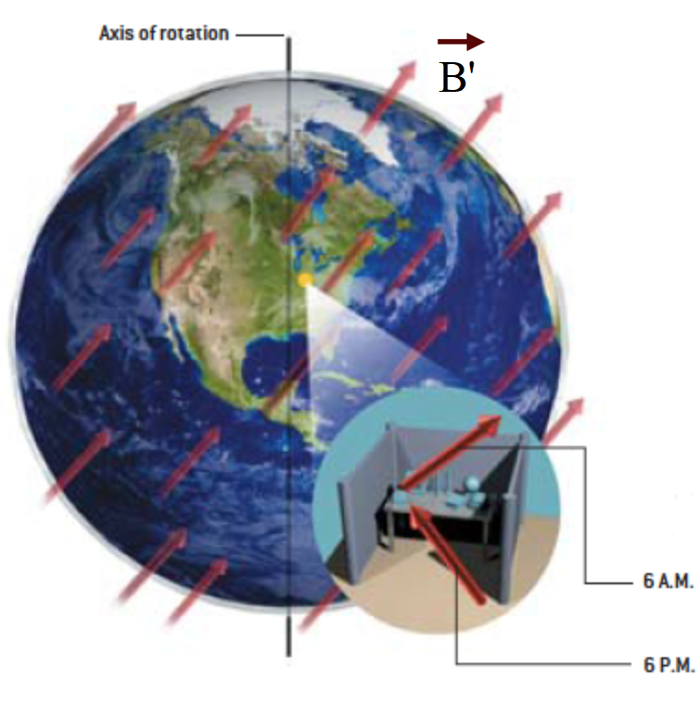
Modulations in Asymmetry Channel
§4
In the previous case, for A_{B}, we assume that the B’ field is fixed to the reference frame of the Earth and therefore the angle, $β$, is fixed in time. The exclusion plots are shown with $τ_{nn^{′}}^{}/\sqrt{Cosβ}$.
Here: B’ field is stationary in the cosmos and the angle, $β$, ranges from [0, 2 π] over a sidereal day. The exclusion plots are shown with $τ_{nn^{′}}^{}$ as the angle - $β$ could be extracted from the phase of the sidereal modulation.
@ ~6 AM
Axis of Earth’s Rotation
$$\vec{B′}$$
$$\vec{B}$$
$$β$$
@ ~6 PM
$$\vec{B}$$
Axis of Earth’s Rotation
$$\vec{B′}$$
$$\vec{B}$$
$$β+π$$
Courtesy: A. Kostelecky
Notes:
In the previous case, for A_{B}, we assume that the B’ field is fixed to the reference frame of the Earth and therefore the angle, $β$, is fixed in time. The exclusion plots are shown with $τ_{nn^{′}}^{}/\sqrt{Cosβ}$.
Here we analyze the situation where B’ field is stationary in the cosmos and the angle, $β$, ranges from [0, 2 π] over a sidereal day. The exclusion plots are shown with $τ_{nn^{′}}^{}$ as the angle - $β$ could be extracted from the phase of the sidereal modulation.
Similarly, such B’ fields may also cause annual modulation,

Slide 55
Modulations in Asymmetry Channel
§4
In the previous case, for A_{B}, we assume that the B’ field is fixed to the reference frame of the Earth and therefore the angle, $β$, is fixed in time. The exclusion plots are shown with $τ_{nn^{′}}^{}/\sqrt{Cosβ}$.
Such a B’ field could also cause annual modulation
~Mar 20, 6 AM
$$\vec{B′}$$
Axis of Earth’s Revolution
$$\vec{B′}$$
$$\vec{B}$$
$${60}^{o}$$
$$β$$
~Sep 23, 6 PM
$$\vec{B′}$$
$$\vec{B}$$
$$β+π$$

Slide 56
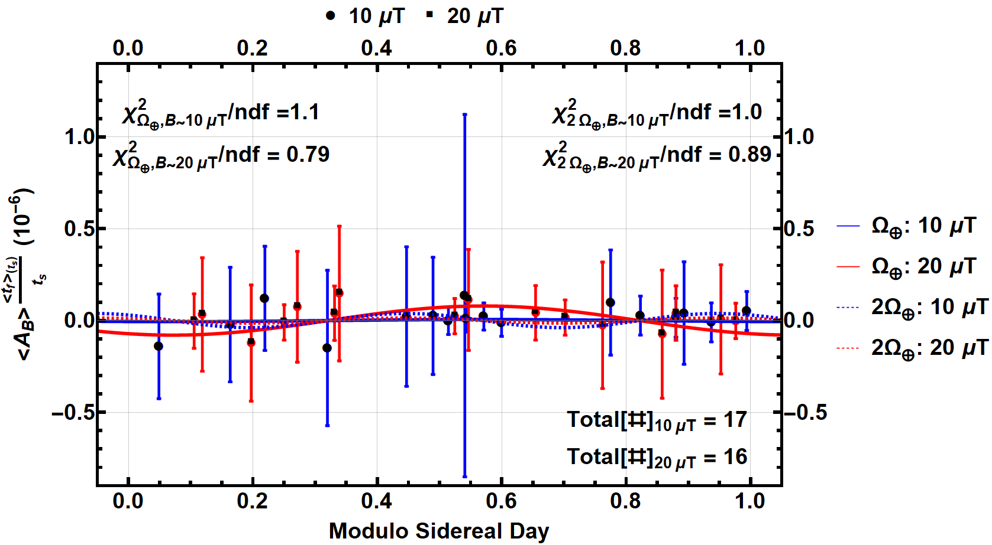
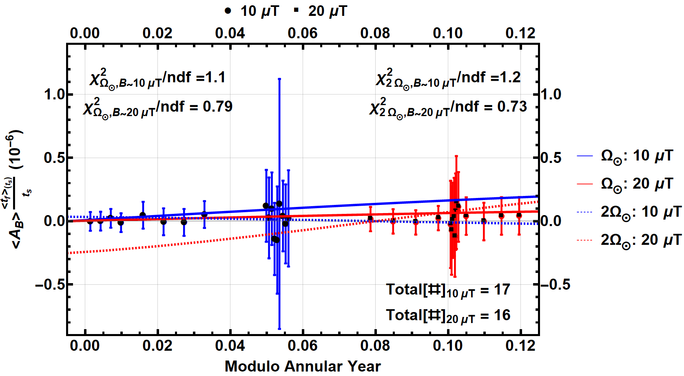
nn’ Oscillation from Modulations
§4
Sidereal
Such a B’ field would lead to modulation of $D_{B}$ parameter
$$D_{B}\left(t\right)=\underset{𝒟_{B} }{\underbrace{\left\langle A_{B}\right\rangle \frac{\left\langle t_{f}\right\rangle }{t_{s}}}}⋅\left|\cos\left[2πΩt+φ\right]\right|$$
Sidereal: $Ω_{⊕}=(1/86, 164) s^{−1}$
Annual
Annual: $Ω_{⨀}=(1/31, 558, 150) s^{−1}$
!!!>>> Assuming modulation of $D_{B}$ parameter <<<!!!

Slide 57
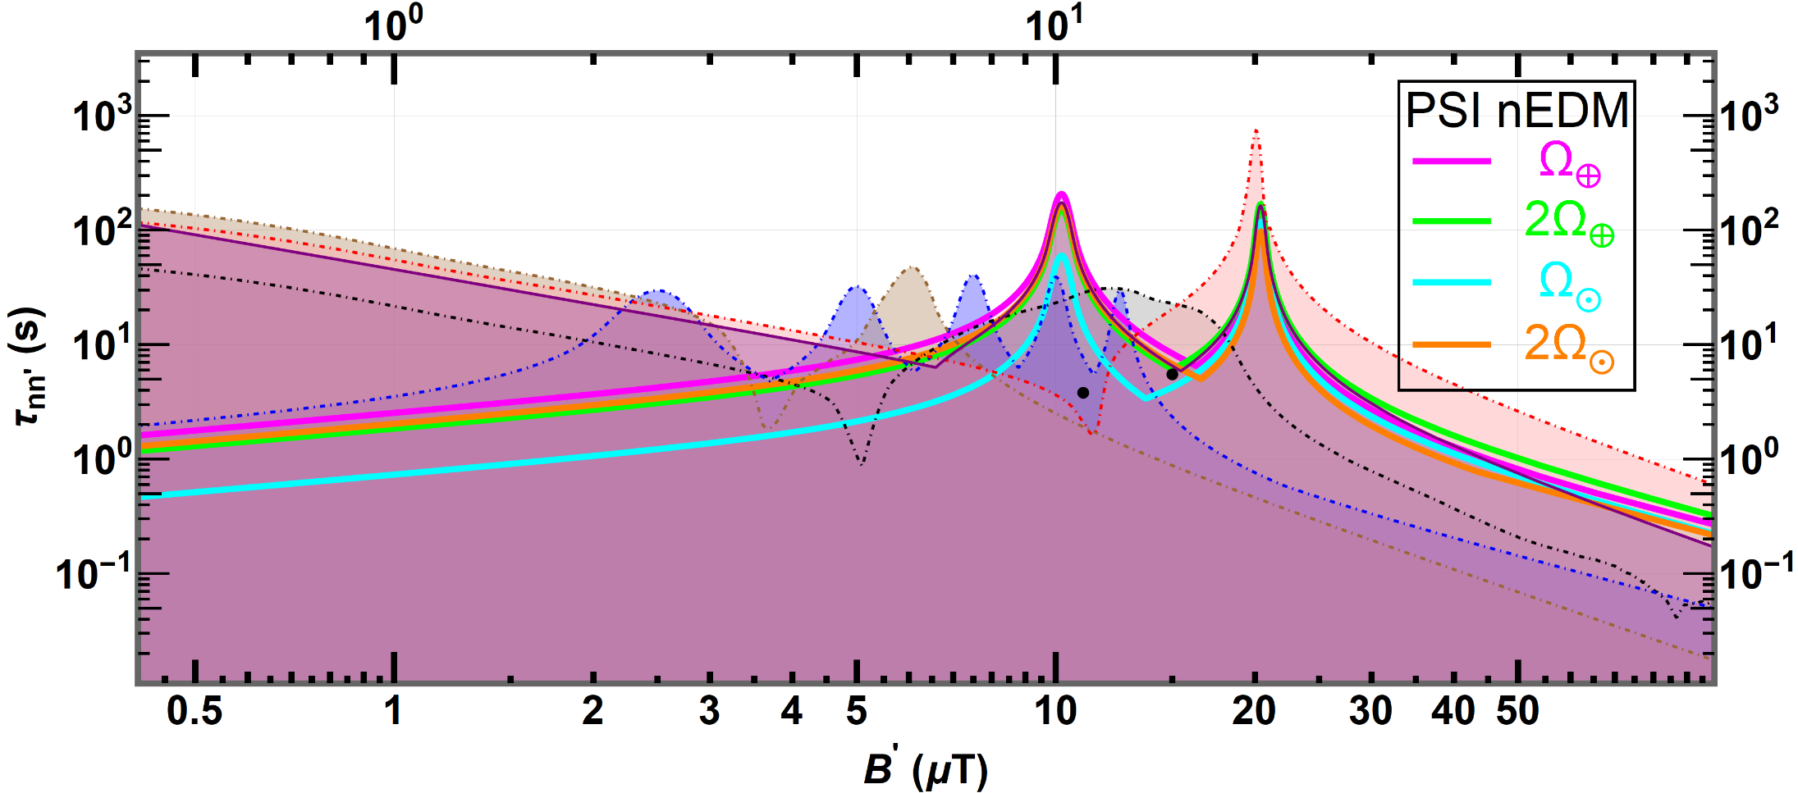
nn’ Oscillation from Modulations
§4
Plotting the constraint separately for B~{10,20}µT, and taking the envelope
95% C.L./C.I.
PLB 663, 181 (2008)
PRD 80, 032003 (2009)
PRL 99, 161603 (2007)
EPJ C 64, 421 (2009)
EPJ C 78, 717 (2018)
!!!>>> Assuming modulation of $D_{B}$ parameter <<<!!!

Slide 58
Constraints on fixed angle - $β$
§4
There have been measurements at ILL and PSI. If $β$ was a fixed value, then it would be different at PSI and at ILL. We can constrain $β$ using measurements from the 2 locations, under the assumption that the angle - $β$ is fixed to the reference frame of the Earth
ESS
⌖
Signals
Constraints
$$D_{B=20μT}Cos\left(β_{ILL}\right)=−\left(16.0±3.2\right)×{10}^{−8}$$
$$D_{B=10μT}Cos\left(β_{PSI}\right)=\left(1.4±3.1\right)×{10}^{−8}$$
$$D_{B=6μT}Cos\left(β_{ILL}\right)=\left(6.2±2.0\right)×{10}^{−7}$$
$$D_{B=20μT}Cos\left(β_{PSI}\right)=\left(1.9±3.9\right)×{10}^{−8}$$
$$D_{B=12μT}Cos\left(β_{ILL}\right)=\left(16.6±6.7\right)×{10}^{−8}$$

Slide 59
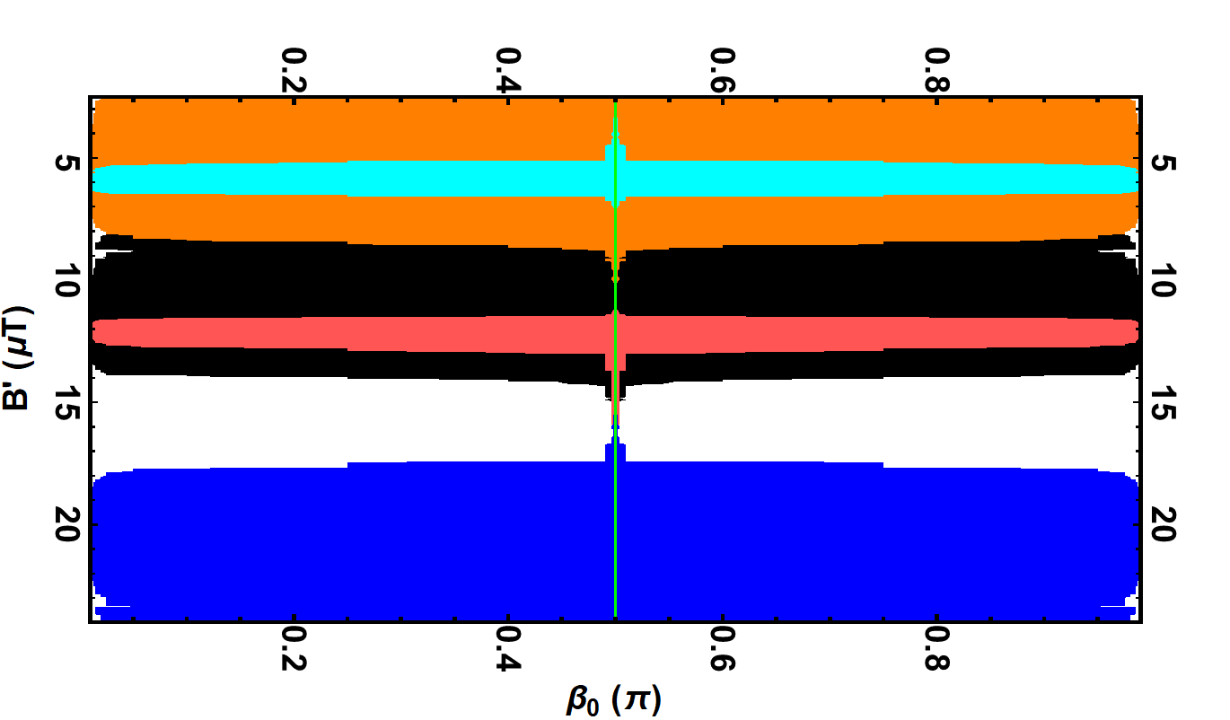
Constraints on fixed angle - $β$
§4
Allowed regions
$$\vec{B′}$$
$${\vec{B}}_{PSI}$$
$$D_{B=10μT}Cos\left(β_{PSI}\right)=\left(1.4±3.1\right)×{10}^{−8}$$
$$β_{PSI}$$
$$β_{ILL}$$
$$D_{B=20μT}Cos\left(β_{PSI}\right)=\left(1.9±3.9\right)×{10}^{−8}$$
$$2.889o$$
$${\vec{B}}_{ILL}$$
$$D_{B=6μT}Cos\left(β_{ILL}\right)=\left(6.2±2.0\right)×{10}^{−7}$$
$$D_{B=12μT}Cos\left(β_{ILL}\right)=\left(16.6±6.7\right)×{10}^{−8}$$
$$D_{B=20μT}Cos\left(β_{ILL}\right)=−\left(16.0±3.2\right)×{10}^{−8}$$
!!!>>> Assuming the angle β is fixed <<<!!!
Assuming all the vectors lie in the same plane

