Slide 1
MPGD-Based TRD
(proposal #2)
(PIs: Yulia Furletova and Julia Velkovska )
Yulia Furletova ( JLAB)
The EIC generic R&D meeting
(Nov 15-16, 2022)

Slide 2
Our team:
Temple University
Matt Posik
Bernd Surrow
Old Dominion University
Lee Belfore
University of Virginia
Nilanga K. Liyanage
Hương Nguyen
Jefferson Lab:
Fernando Barbosa
Cody Dickover
Yulia Furletova
Sergey Furletov
Kondo Gnanvo
Lubomir Pentchev
Chris Stanislav
Beni Zihlmann
Vanderbilt University
Senta V. Greene
Lauren Kasper
Sourav Tarafdar
Julia Velkovska
15-16 Nov, 2022
Yulia Furletova

Slide 3
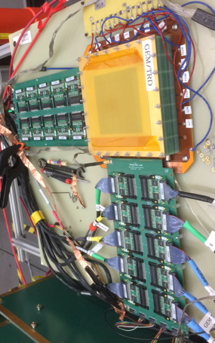
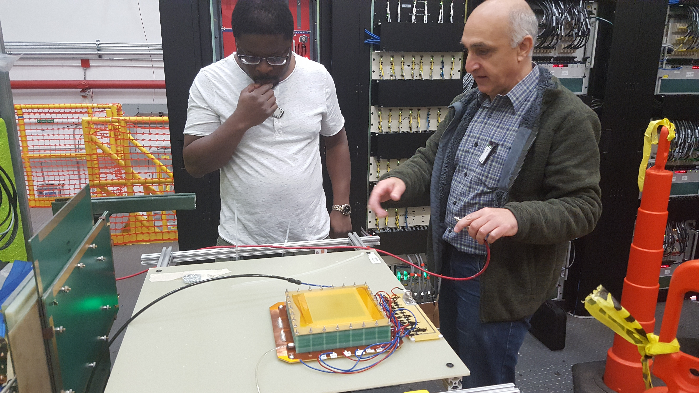
Please clarify what work was already partially addressed within eRD22, and what lines of R&D are new.
(eRD22)
The eRD22 proposal was submitted and approved in January 2018
A main goal was to demonstrate a proof of principle for an operation of GEM-based TRD. TRD provides e/$π$ rejection for particles with E>2GeV
We performed a standalone Geant4 simulation of the setup: optimization of TR-radiator thicknesses and gas volume - before the prototype assembly.
We developed a prototype, which was optimized for the TR applications.
We performed a studies with various Xe-based gas mixture, performed optimization of HV.
We made a specification for front-end electronics.
Due to covid , our testbeam at Fermilab ( e and hadron beam) was cancelled . We used JLAB setup ( e-only) beam to estimate e/pi rejection factor.
15-16 Nov, 2022
Yulia Furletova

Slide 4
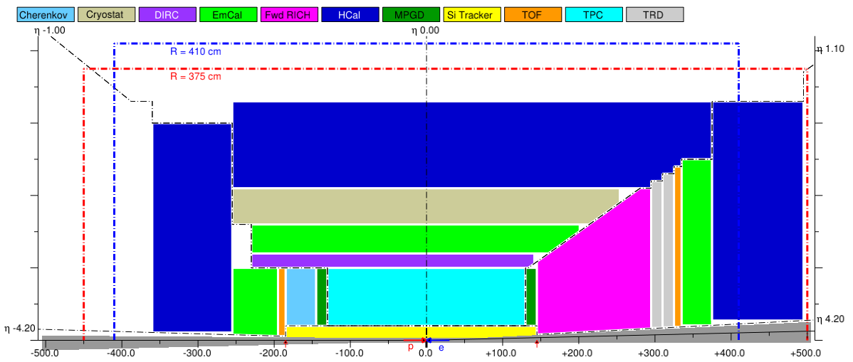
(Proposed program of work and deliverables)
Please clarify what work was already partially addressed within eRD22, and what lines of R&D are new.
Main goal is to continue to mature and optimize the MPGD-based Transition Radiation detector design to be ready for a large-scale detector production for the EIC detector upgrade (ePIC)
and/or as a complementary detector technology for the second detector at EIC.
- provide addition PID: e/$π$ separation (for E > 2 GeV)
- provide a track segment in front or behind the dRICH
15-16 Nov, 2022
Yulia Furletova

Slide 5
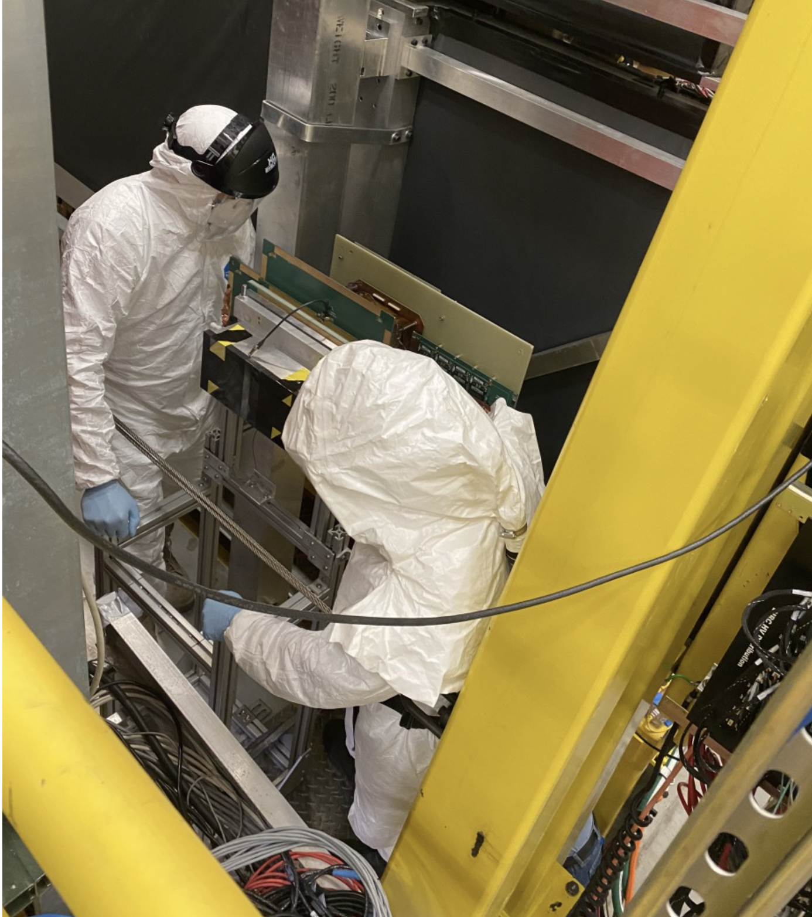
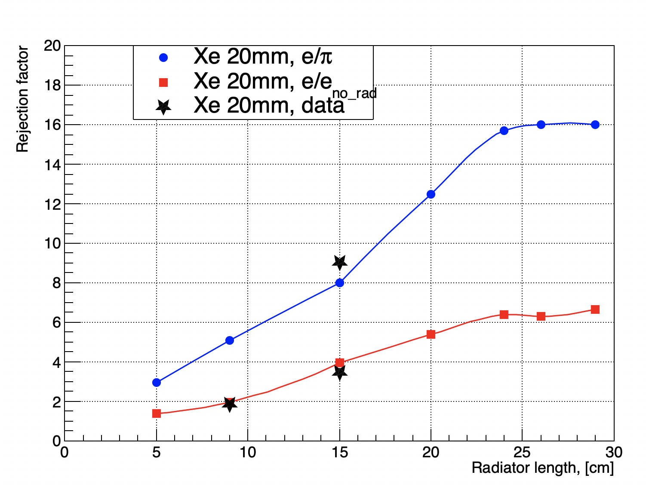
e/$π$ performance
Electron beam-only with and without radiator ( red line)
Data points are in a good agreement with MC predictions
Due to the lab and facilities closures due to COVID we were not able to perform a test at Fermilab.
For e/$π$ data point : compared data at the different locations: pair-spectrometer (e-beam only) vs Glue-X setup ( mainly hadrons) .
e/$π$
Need to validate this point at Fermilab with e and pion test beams.
we need to verify/confirm this data point at Fermilab
e/$e_{(norad)}$
Radiator Thickness [cm]
15-16 Nov, 2022
Yulia Furletova

Slide 6
Prototyping
We propose to perform a series of tests of different MPGD-based TRDs to study the characteristics of the signal collection, to optimize the material budget and other operation parameters (HV, etc)
Different readout configurations will be investigated aiming to minimize the detector noise level, to optimize the number of readout channels, and the detector spatial resolution.
For each design, measurements will be performed to charactarize the noise levels, gain uniformity, to perform HV and drift-time optimizations and establish baselines.
Micromegas prototype at Vanderbilt and μRWELL prototype at JLab
single amplification structure MPGD that will replace the stack of 3 GEM foils ( material budget)
The amplification structure itself is very similar to a GEM foil. TRD prototypes will be based on either bulk or microbulk technology, so just one structure.
MMG and $μ$RWELL do not require stretching and framing foils unlike GEMs ( benefit for large scale detectors)
10x10cm with capacitive-sharing strip/pads or zig-zag readouts to reduce channel counts while maintaining high spatial resolution capability.
15-16 Nov, 2022
Yulia Furletova

Slide 7
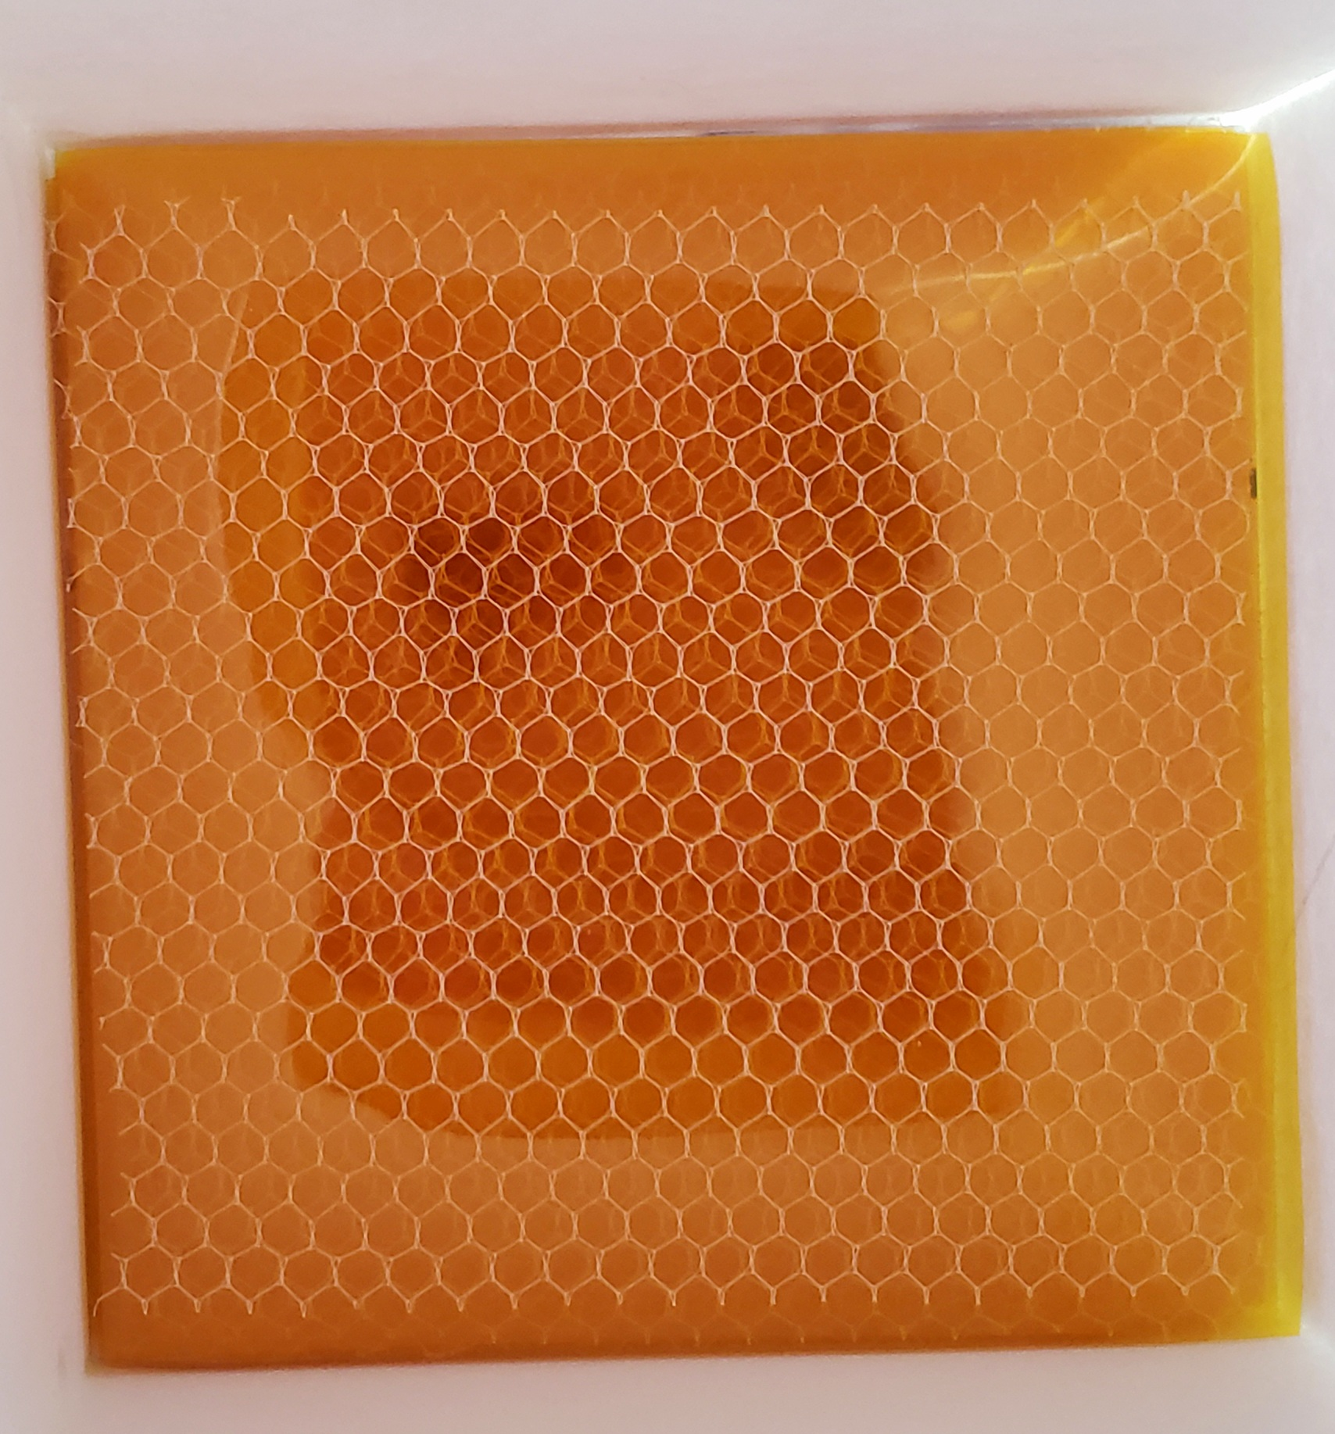
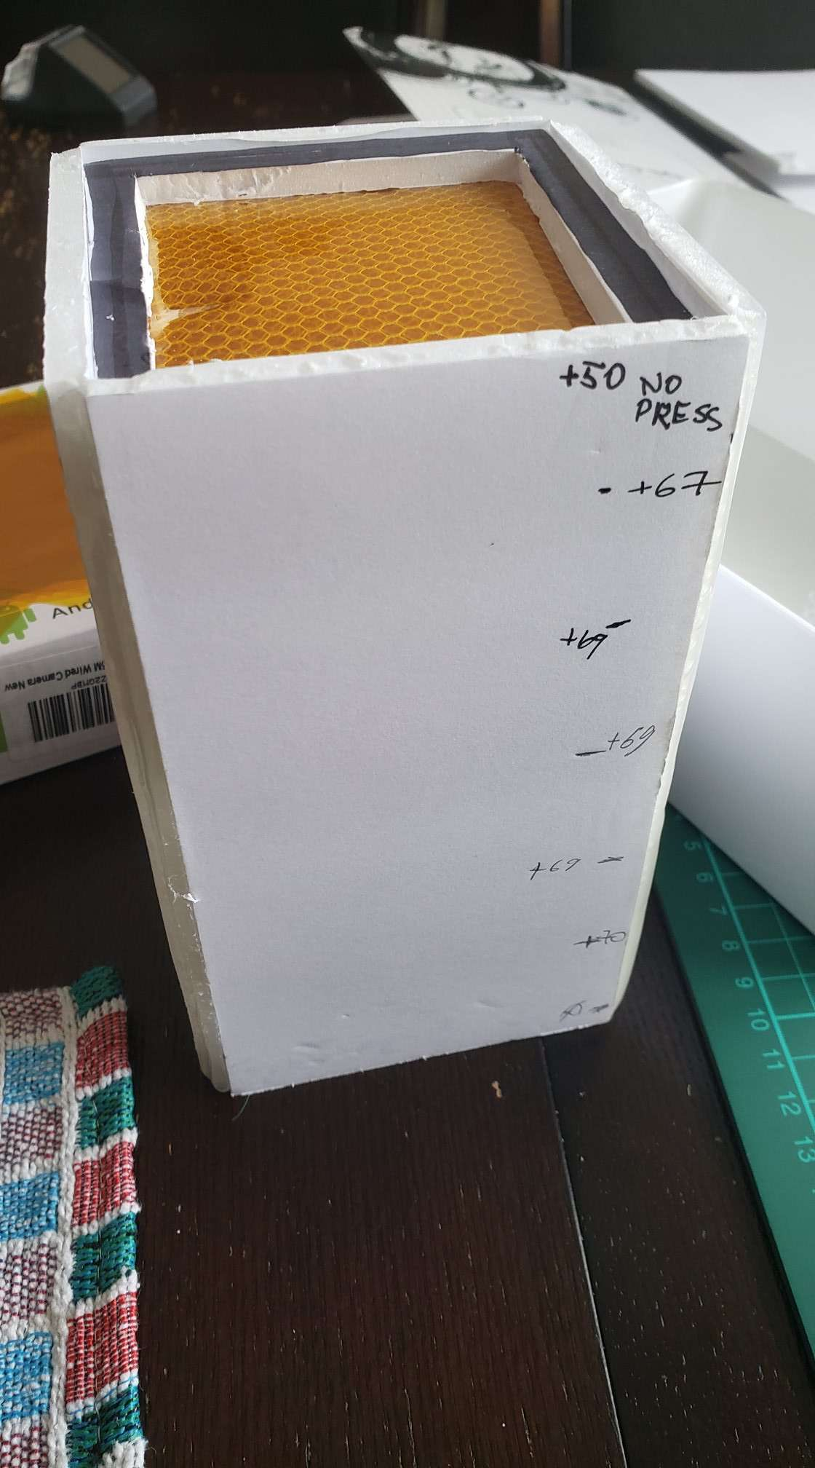
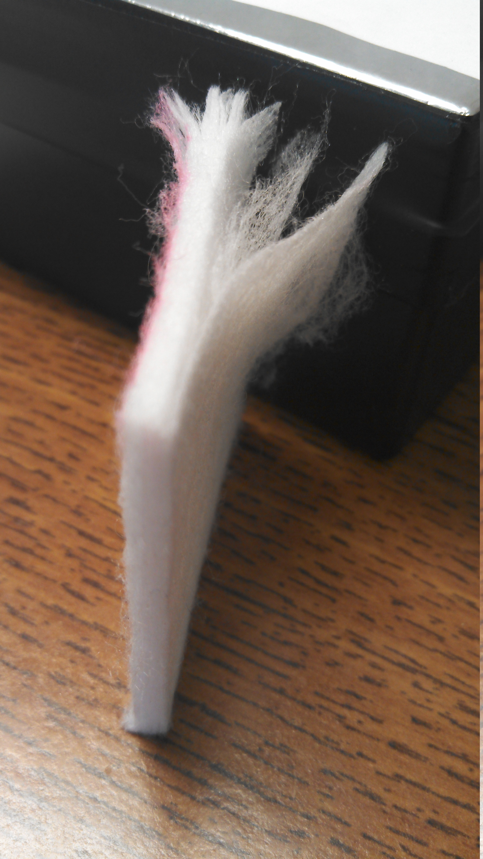
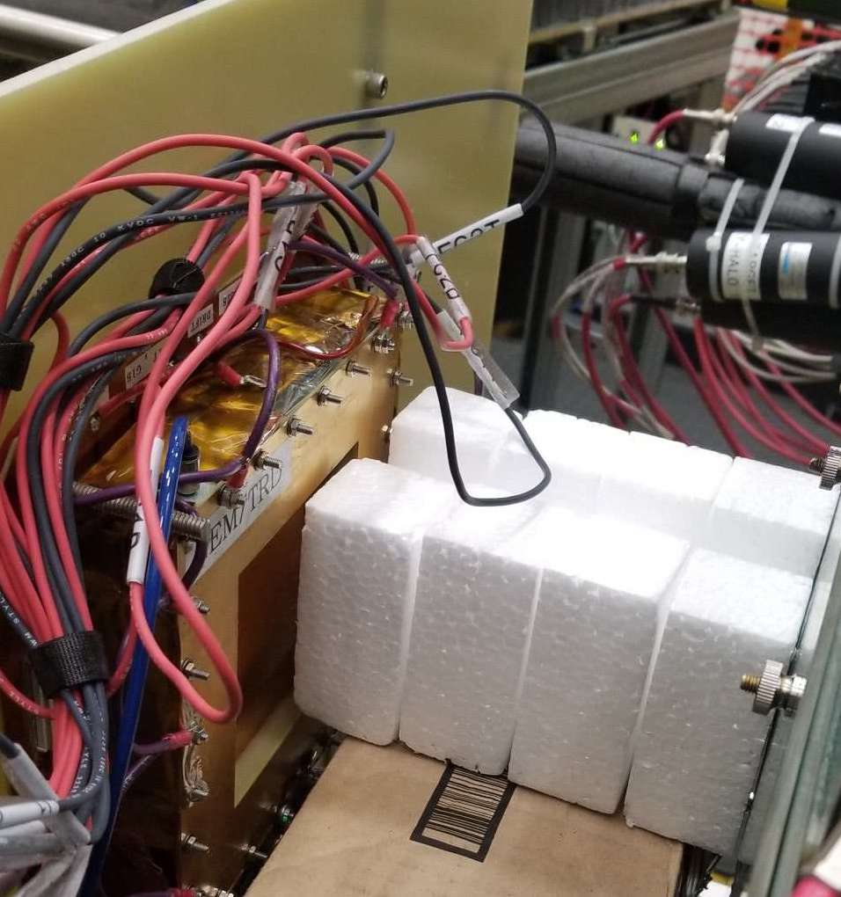
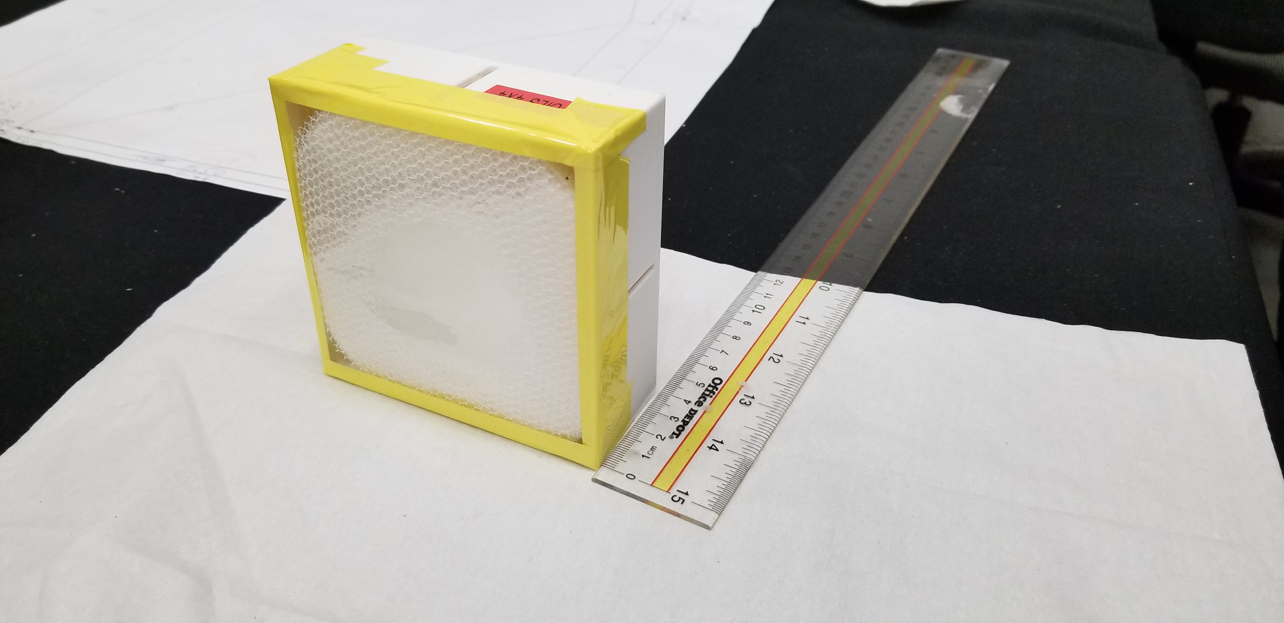
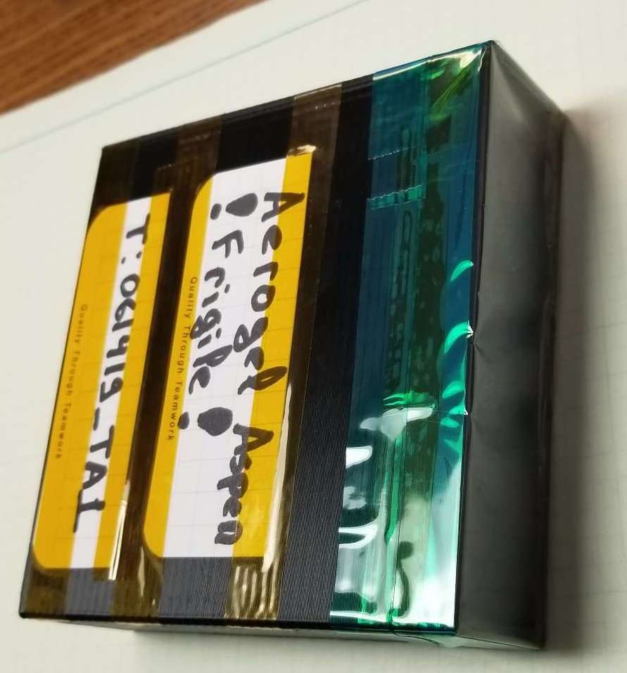
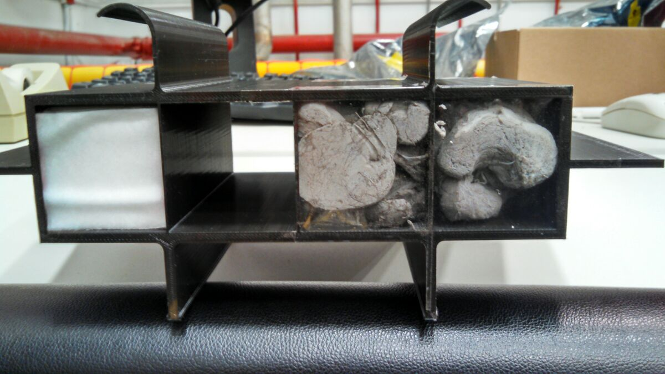
Different TR-radiators.
We continue to search and test different types of radiators
Goal: to find low material budget, but high TR-yield radiators
The TR-energy spectrum is very important (minimum of self-absorption)
Regular foils
25$μm$
Single module (X/X0) :
Radiator ( 10cm) ~ 1.5 % X₀ for fleece ( could go down with mylar foils )
Xenon gas (2.0 cm) ~ 0.1% X₀
MPGD with readout at active area ~ 0.5-1.5% X₀
Fleece
Foam
15-16 Nov, 2022
Yulia Furletova
Regular foils
9

Slide 8
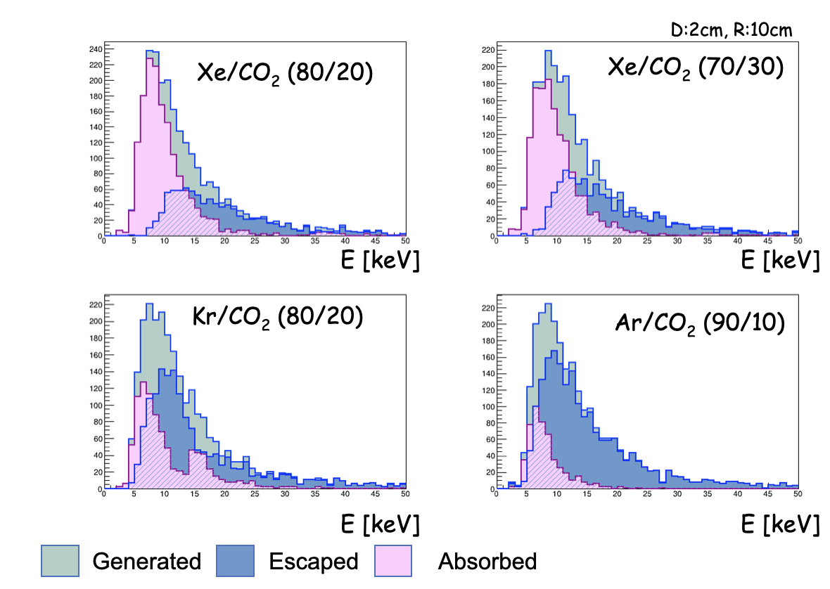
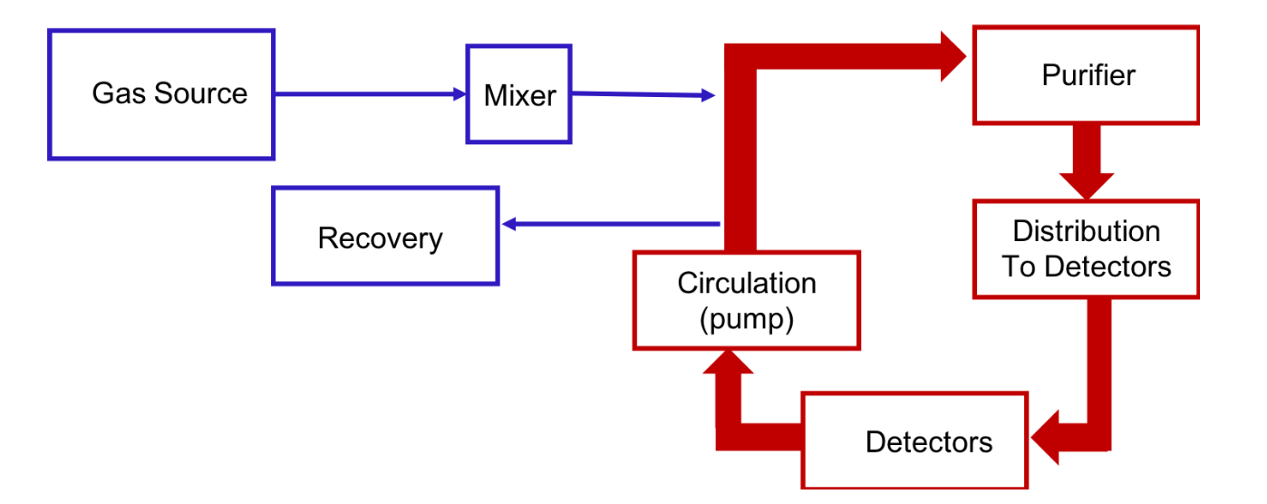
Gas system and gas mixture
In an effort to reduce the cost of gases needed to operate MPGD-based TRD we would like to perform a new series of tests with different Xe/Kr/CO2-based gas mixtures.
We plan to begin designing a small Xe gas cleaning and recirculation system to use with our MPGD-TRD prototypes.
For the implementation of these modules we plan to build off the knowledge and expertise of the ATLAS experiment at CERN, who also installed a Xe recirculation gas system for their TRT detector.
15-16 Nov, 2022
Yulia Furletova

Slide 9
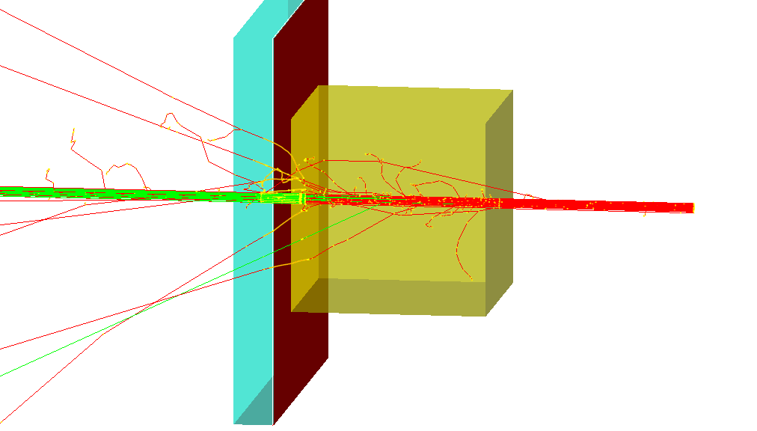
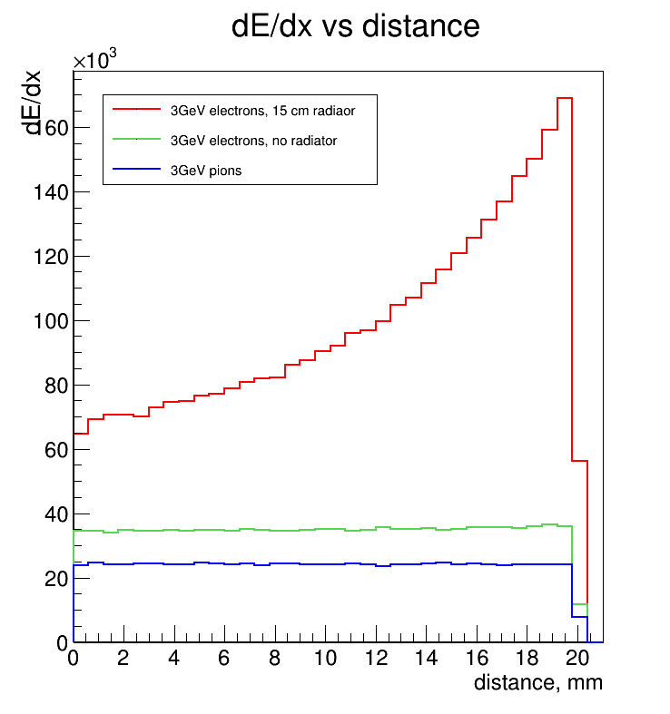
Simulation
A standalone simulation of GEMTRD was used to study and optimize the detector setup ( gas volume, radiator thickness, etc)
Planning to perform a Geant4 simulation with the integrated detector in the ePIC ( and/or Det-2) simulation software.
The simulation studies will focus on PID performance of MPGD-TRD in association with the Calorimeter in the hadron endcap.
also study the track angular resolution, the effect of having additional tracking information from the MPGD-TRD and how it may assist in the performance of dRICH (already underway)
MPGD-TRD (absorber and radiator) has been partially already implemented in both Fun4All and DD4Hep (studies are underway) .
Energy deposition (dE/dx + TR) vs drift distance
dE/dx of electrons + TR
dE/dx of electrons
dE/dx of Pions
15-16 Nov, 2022
Yulia Furletova

Slide 10
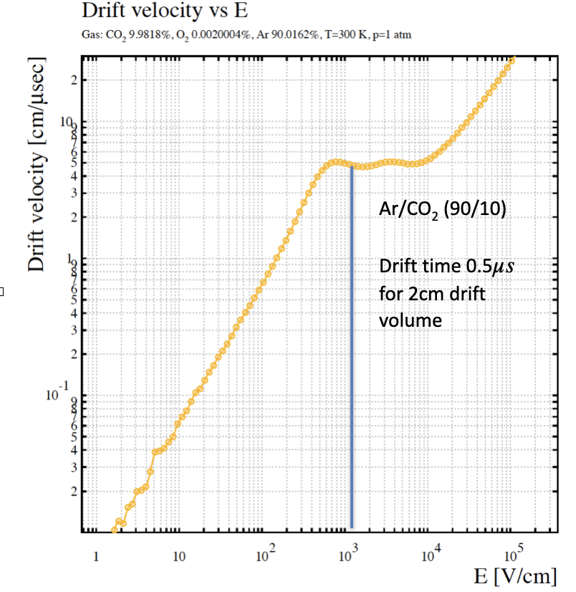
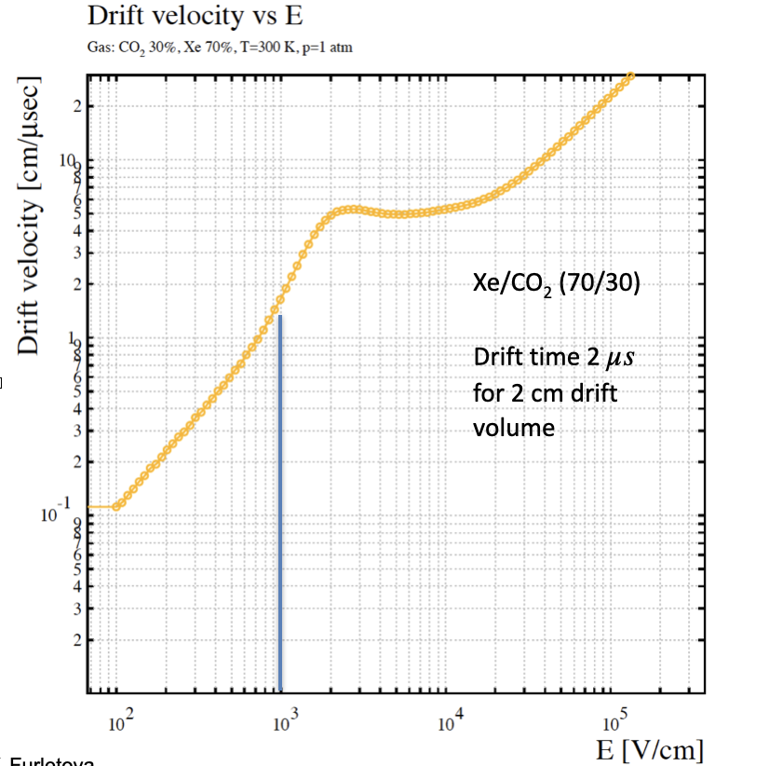
Simulation: Detector hardware
During the eRD22 studies we used GARFIELD and MAGBOLTZ simulation to optimize operation of the GEMTRD module with Ar and Xe mixtures ( drift-time, HV, etc )
For this proposal we would like to use standalone simulation packages like Magboltz, Heed and Finite Element Analysis software (ANSYS) to understand the properties of various proposed gas mixtures (Kr vs Xe) and also for designing the field cage.
While the gas properties will be stuided in Magbohtlz and Heed, the design and the need of a field cage will be studied in ANSYS. The study of the properties of the gas mixture will be helpful in optimizing the drift field.
15-16 Nov, 2022

Slide 11
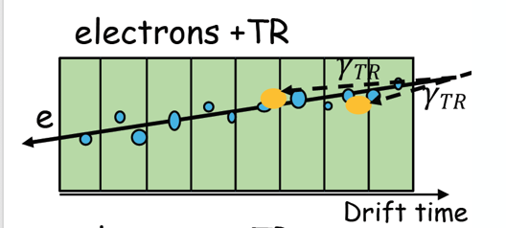
Simulation: Data analysis using various Machine Learning algorithms/tools
Nowdays many other new AI tools are available, such as Keras and Tensorflow for different types on neural networks: Graph Neural Network (GARNET) or Recurrent Neural Network (LSTM), etc. We will addopt the use of these AI tools for TRD applications.
during the eRD22 project ( GEMTRD) we used likelihood and artificial neural network (ANN) programs, such as JETNET or ROOT-based (Multi-layer Perceptron).
We compared cluster counting method and integrated charge within a bin (drift slice).
Cluster counting method ( Time, Amplitude, number of clusters )
15-16 Nov, 2022
Yulia Furletova

Slide 12
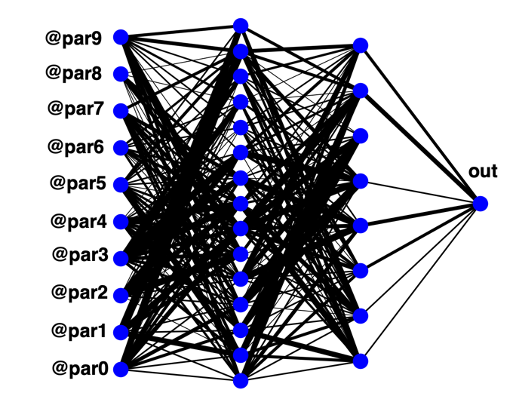
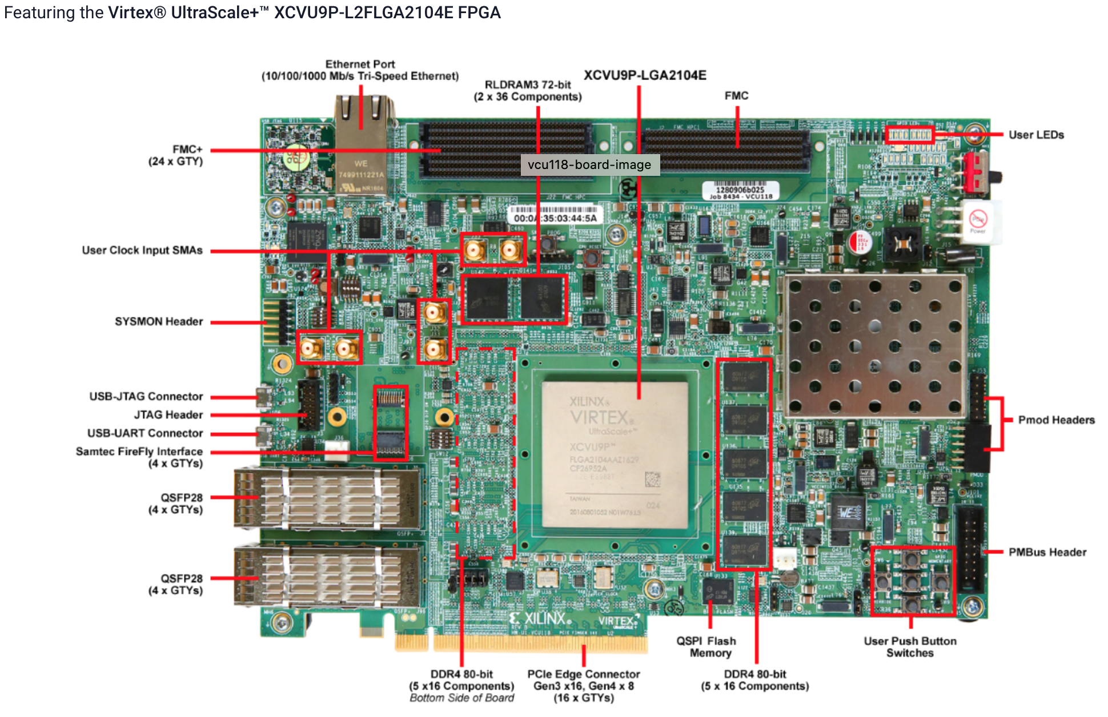
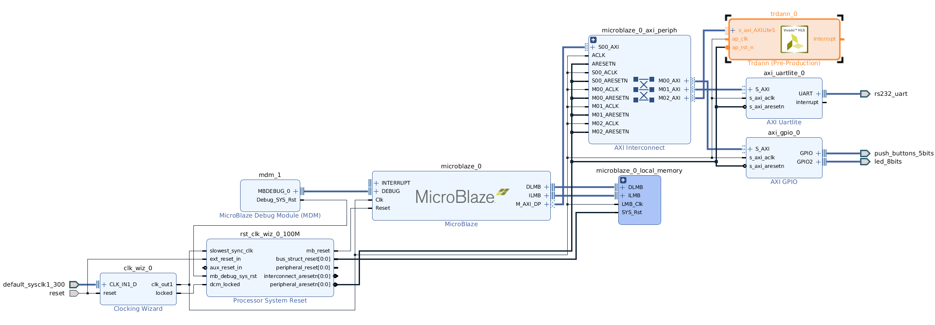
Machine Learning on FPGA
ML FPGA Core for TRD
Xilinx Virtex® UltraScale+™
For OFF-line data analysis we are using neural network library provided by root /TMVA package : MultiLayerPerceptron (MLP)
Moving towards ON-line data processing
TRD
ML Core
Initial latency estimation:
From 60 ns to 1.5 𝜇s.
In a collaboration with GlueX, PANDA and ODU
Setup is ready, need to test at the testbeam
synergy with proposal #15
AI4EIC, 7-10 Sept 2021
Yulia Furletova
15-16 Nov, 2022

Slide 13
2. Can you detail the prototype of the field cage that is planned?
See slide on page 10.
While the gas properties will be studied in Magbohtlz and Heed, the design and the need of a field cage will be studied in ANSYS. The study of the properties of the gas mixture will be helpful in optimizing the drift field.
Modeling and designing a filed cage to provide a uniform electric field in the drift region and for the optimization of HV for the use of different gas mixtures.
entrance window/ no gap optimization for TR-photons
15-16 Nov, 2022
Yulia Furletova

Slide 14
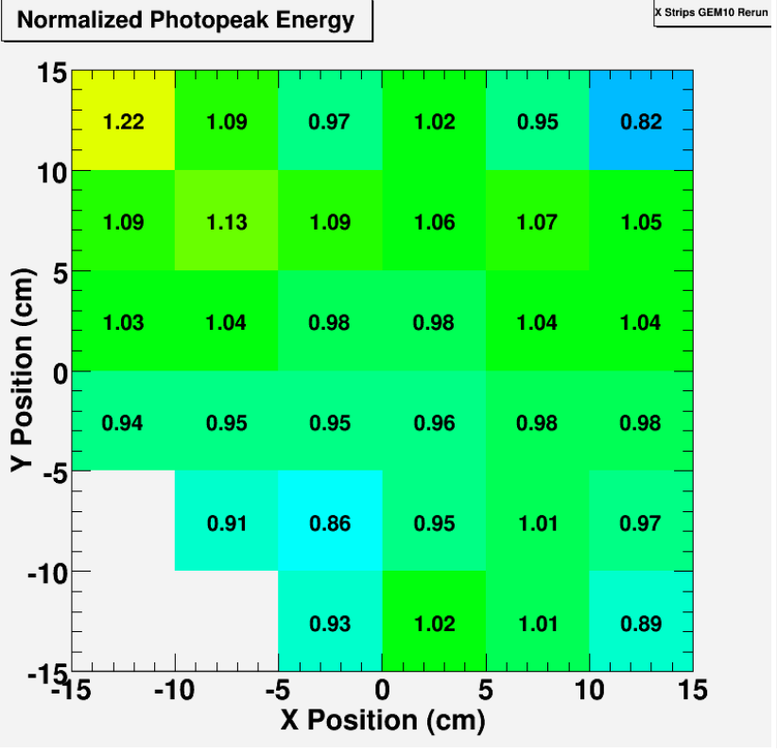
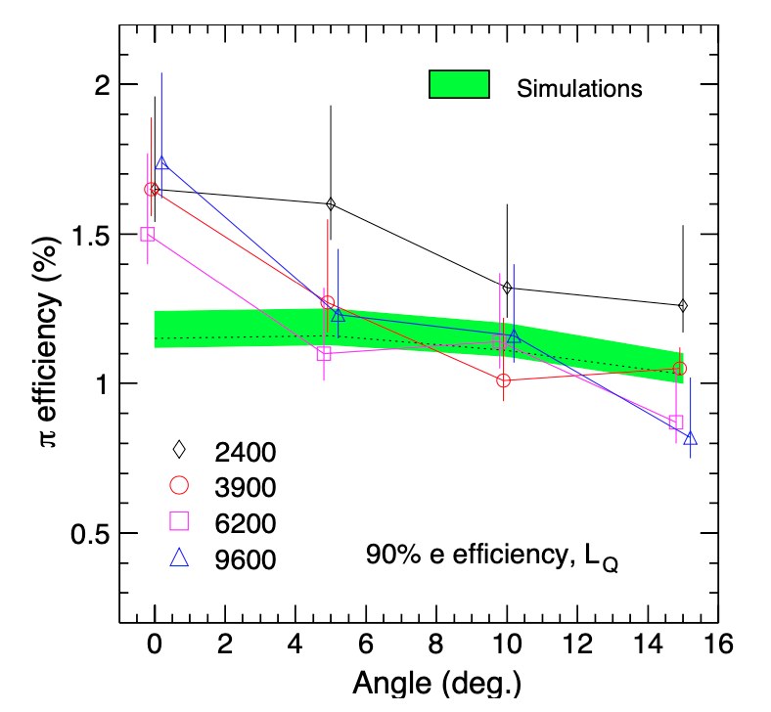
3. Why not buy the gain mapping device from a private company? (A lot of X-rays guns are available.)
Description of device
The proposed mapping device will act as scanner to have fine mapping of gain uniformity .
The X-ray gun to be mounted on the scanner has already been procured.
The scanner comprises the following
Bislide with span of 40” in X and Y
Step motors with controllers to control X and Y movement
Encoders along with digital readout .
Requirement of device
Fluctuation in MPGD gain can be caused by nonuniformity either in the amplification unit or in the readout board.
Precise mapping of gain is possible by controlled movement of X-ray device with collimation to map the gain in the form of small grid.
Example measurement of gain uniformity of a GEM foil with X-Y strip R/o
ALICE TRD has shown variation in pion rejection efficiency with change in gain of detector as shown below.
15-16 Nov, 2022
Yulia Furletova

Slide 15
4. There appears to be non-zero overlap in detector R&D prototypes with proposal #23: Development of Thin Gap MPGDs for EIC Trackers . (All received proposals can be found at https://www.jlab.org/research/eic_rd_prgm/receivedproposals .) If this is correct, and both proposals are funded, how would you exploit this potential synergy?
Synergy & overlap between proposal #2-MPGD-TRD and proposal #23-thin gap-MPGD
Technologies:
uRWELL, Micromegas, GEM
Development of Low channel count high-performance anode readout structures (zigzag / capacitive-sharing ..)
Same interest for exploring different gas mixtures (Xe. Kr mixtures …) ➔ cost saving
Application / detectors:
High- performance tracking for tg-MPGD proposal#23 vs. PID + tracking for MPGD-TRD proposal#2
Slightly different R&D effort ➔ Prototypes are different and not interchangeable
Different readout electronics.
Same expertise:
Demonstrated expertise and experience for all 3 MPGD technologies ➔ critical for both proposals
Improve chances of the successful outcome of the R&D effort ➔ share experience and knowledge
Share tg-MPGD / MPGD-TRD test beam time and resources:
Only one week slot available at Fermilab in 2023 for beam test ➔ Combined beam test
Will also save a lot in travel cost to Fermilab
Share gas during beam test ➔ Xe / Kr –based gas mixture are expensive and procurement is a concern

Slide 16
5. Travel costs are roughly ¼ of the budget request. Are all 6 people necessary for the tests at Fermilab?
Most of the travel cost is assigned to the test beams. We have 5 institutions participating in the proposal: 1-2 people per institution.
Only 1 week for beam test. Shifts: 2 people per shift on a 24h beam use => min 6 people.
During the testbeam operation we need experts on detector, electronics, DAQ
Testbeams provide a hands-on expertise for students.
We plan to minimize travel cost by combining beam test effort with the thin gap MPGD members ( proposal #23 ) and ML on FPGA members( proposal #15).
15-16 Nov, 2022
Yulia Furletova

Slide 17
Backup

Slide 18
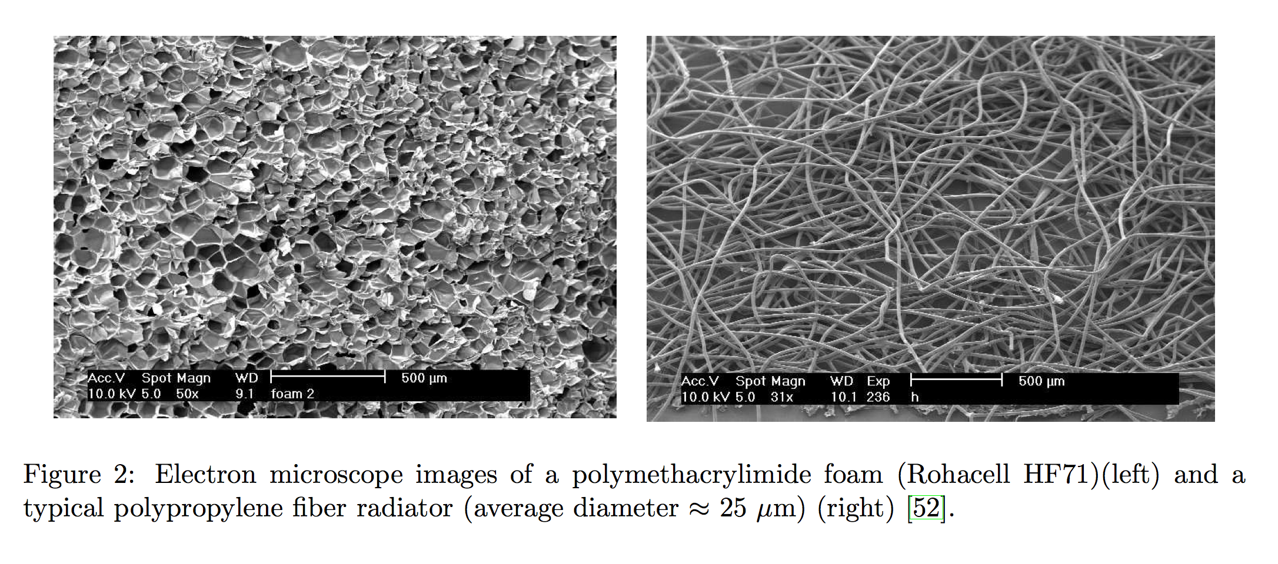
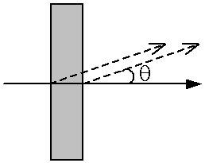
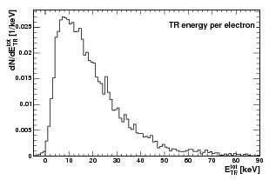
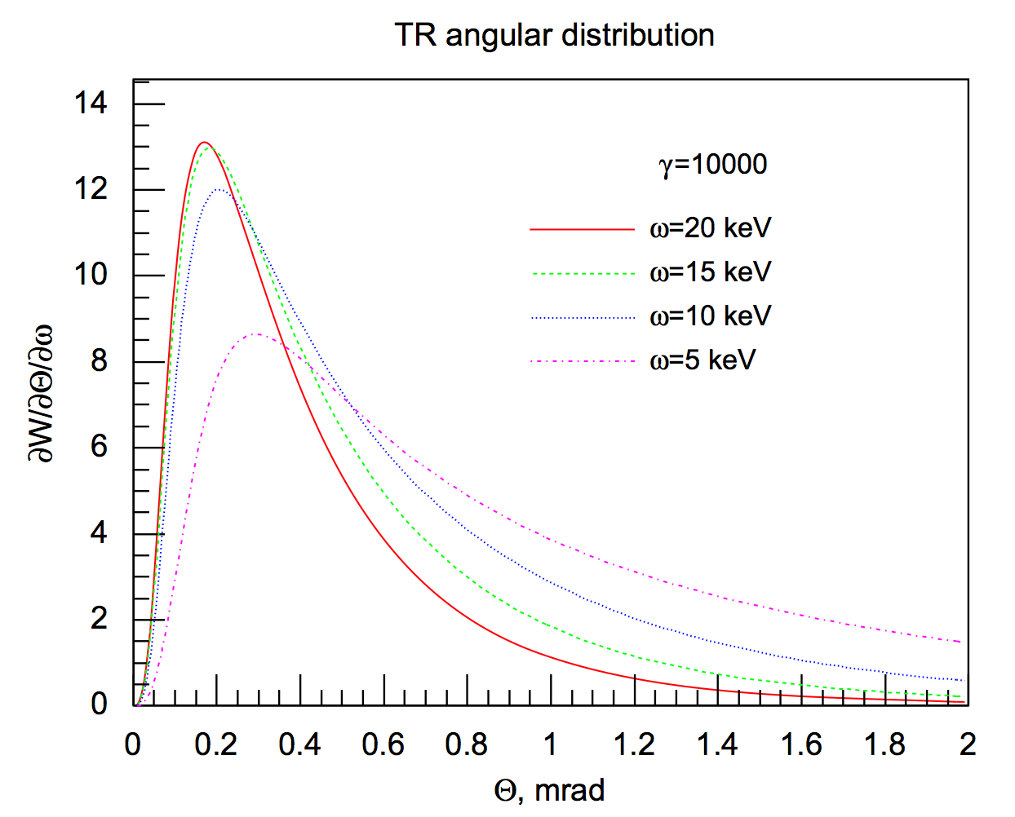
Transition Radiation
Transition radiation is produced by a charged particles when they cross the interface of two media of different dielectric constants
the probability to emit one TR photon per boundary is of order $α$~1/137. Therefore multilayer dielectric radiators are used to increase the transition radiation yield, typically few hundreds of mylar foils.
TR in X-ray region is extremely forward peaked within an angle of 1/γ
Energy of TR photons are in X-ray region ( 2 - 40 keV )
Total TR Energy ETR is proportional to the γ factor of the charged particle
Only e produce TR photons (E>1GeV)
Pions only start to produce TR at E > 100-150 GeV
AI4EIC, 7-10 Sept 2021
Yulia Furletova

Slide 19
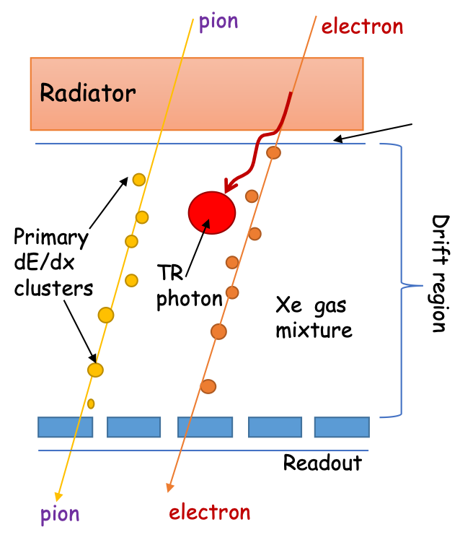
GEM as Transition Radiation detector and tracker for EIC ( eRD22)
High resolution tracker ( based on GEM)
Low material budget detector
And provides PID ( electron / pion separation)
How to convert GEM tracker to TRD:
Increase drift region up to 2-3 cm (for the same reason).
=> higher HV, and field uniformity
Change gas mixture from Argon to Xenon ( TRD uses a heavy gas for efficient absorption of X-rays )
=> higher HV ( Xe - slow gas)
Add a TR radiator in the front of each chamber ( radiator thickness ~5-15cm )
=> minimize material at entrance window
16 Oct 2020
Yulia Furletova

Slide 20
Energy deposition (dE/dx + TR) vs drift distance
dE/dx of electrons + TR
Implemented in g4e
e,$π$ ~3 GeV
Parameters:
Detector Gas Thickness (D) : 1 – 4 cm
Radiator Thickness (R): 3-10 cm
“Dead region”:
cathode material( Al, Cu, Cr)
gap (Xe filled) 400um
Gas mixture: Xe/CO₂ , Ar/CO_{2 …}
# layers:1,2,3 ...
dE/dx of electrons
dE/dx of Pions
24-26 March 2021
Yulia Furletova

Slide 21
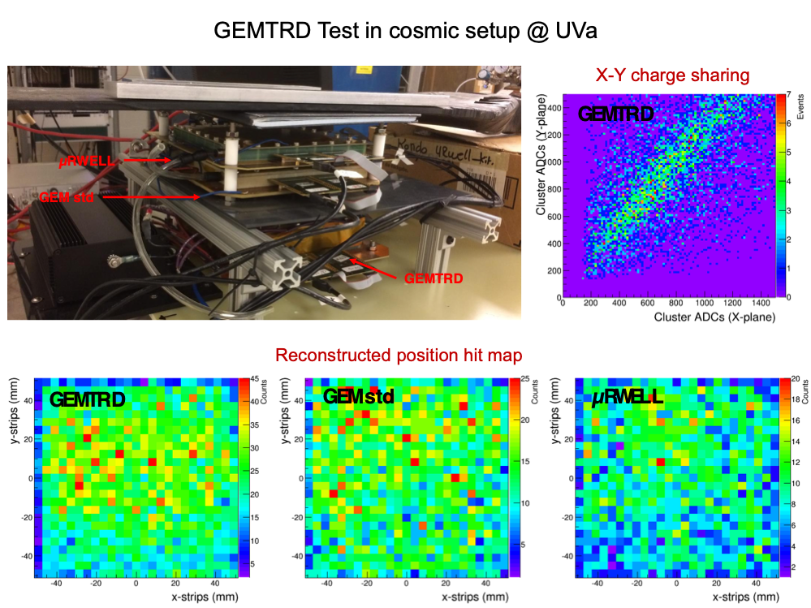
Prototypes
-10x10cm² prototypes assembled at Uva
-Assembly and X-ray/cosmic tests of each prototype
-Noise, pedestal tests
24-26 March 2021
Yulia Furletova
Notes:
Interior Page Design 2

Slide 22
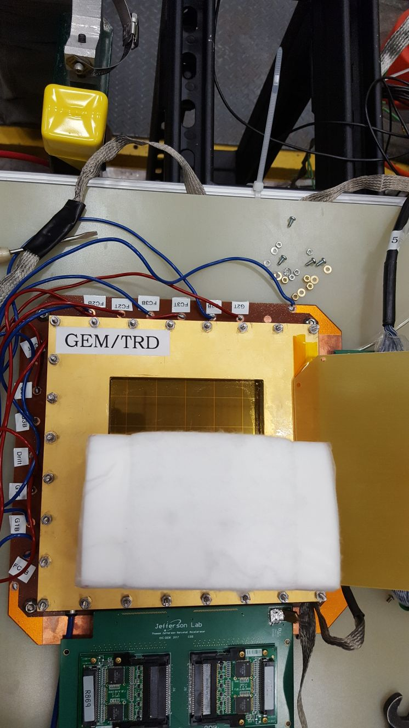
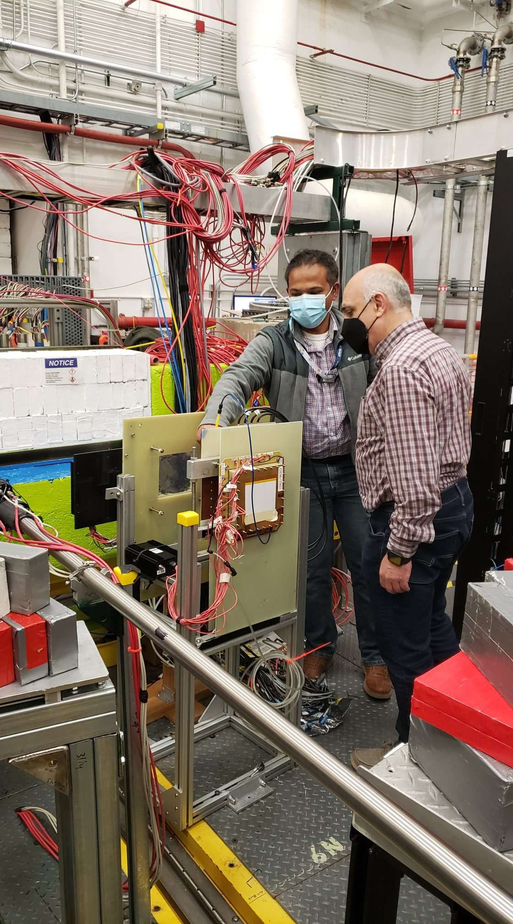
Beam test using Hall-D pair spectrometer
Pair spectrometer
Outside of the Glue-X acceptance
e+
HALL -D
Beamline
gamma
Electrons
3-6 GeV
$$γ$$
Radiator
WCTRD
Radiator
GEMTRD
$$γ$$
e-
3-6 GeV electrons in Hall-D from pair spectrometer
Flat beam: in-plane( y spread ~ 5mm) 10kHz rate
In parallel with other tracking detectors.
covered ½ of the sensitive area with radiator ( to compare with and without radiator)

Slide 23
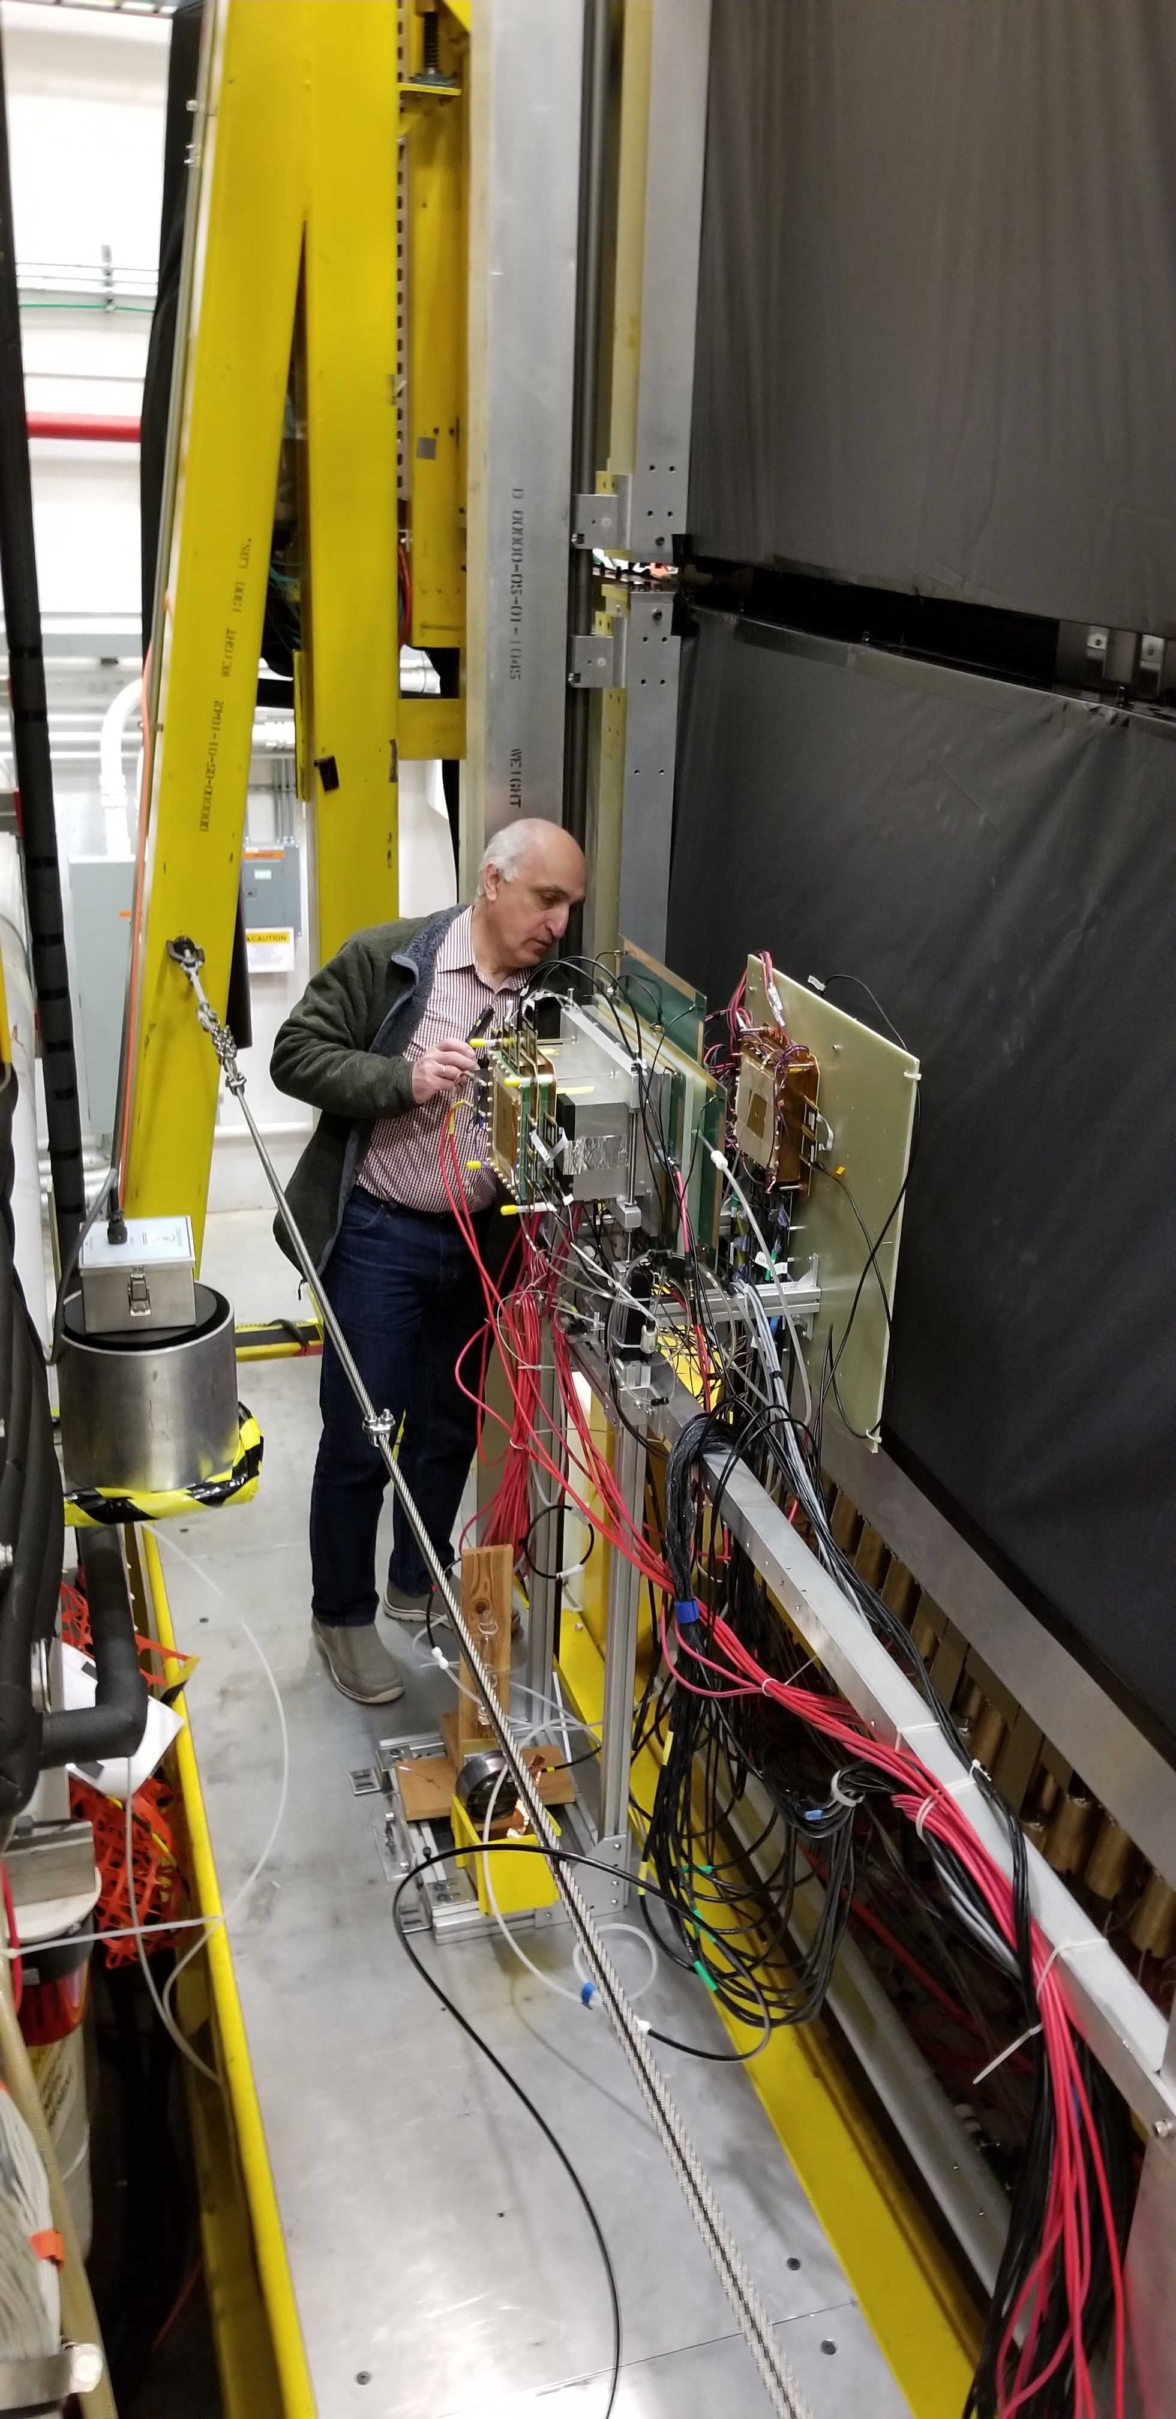
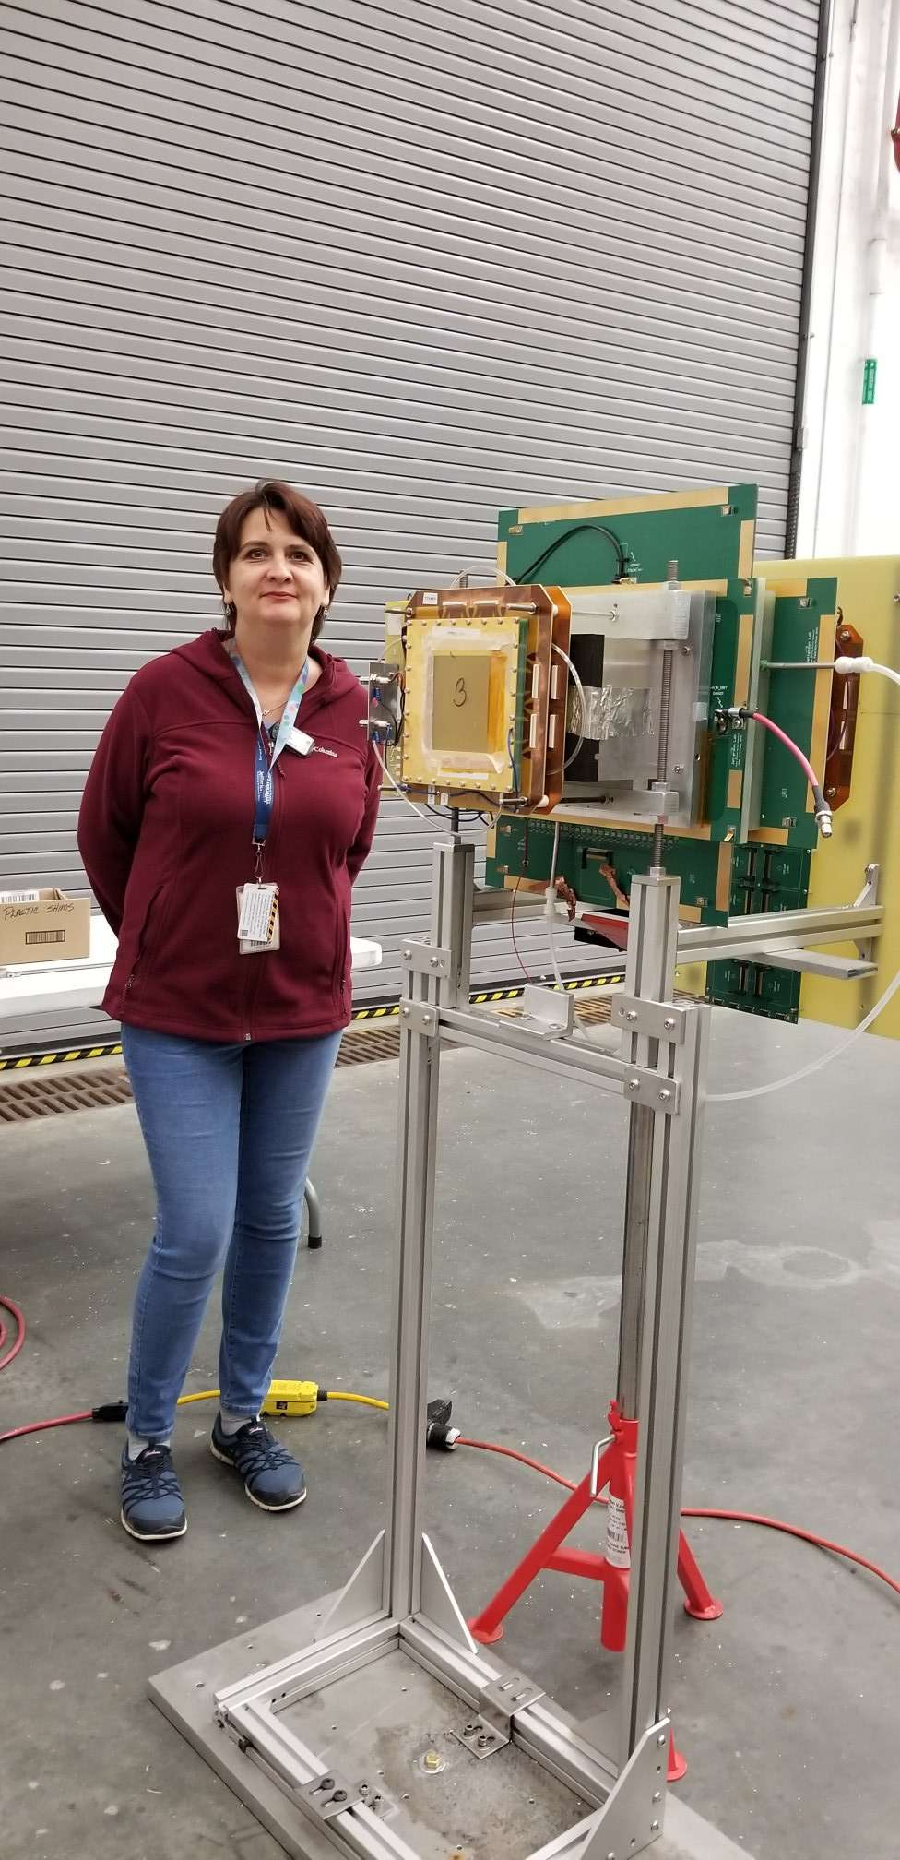
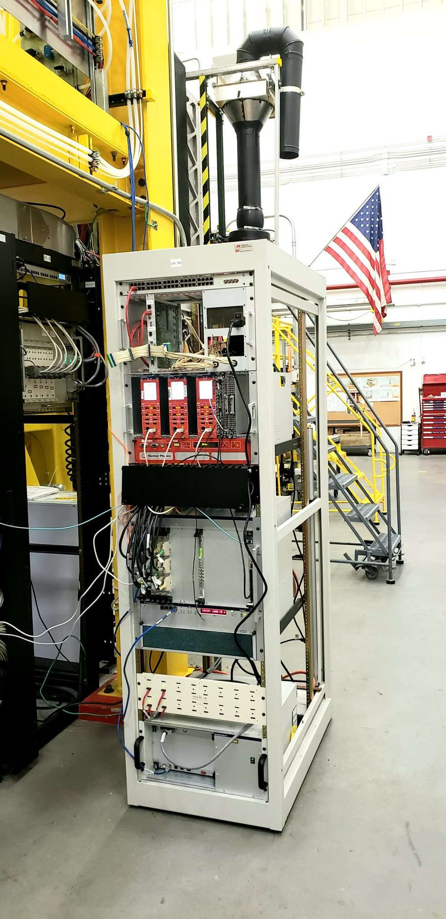
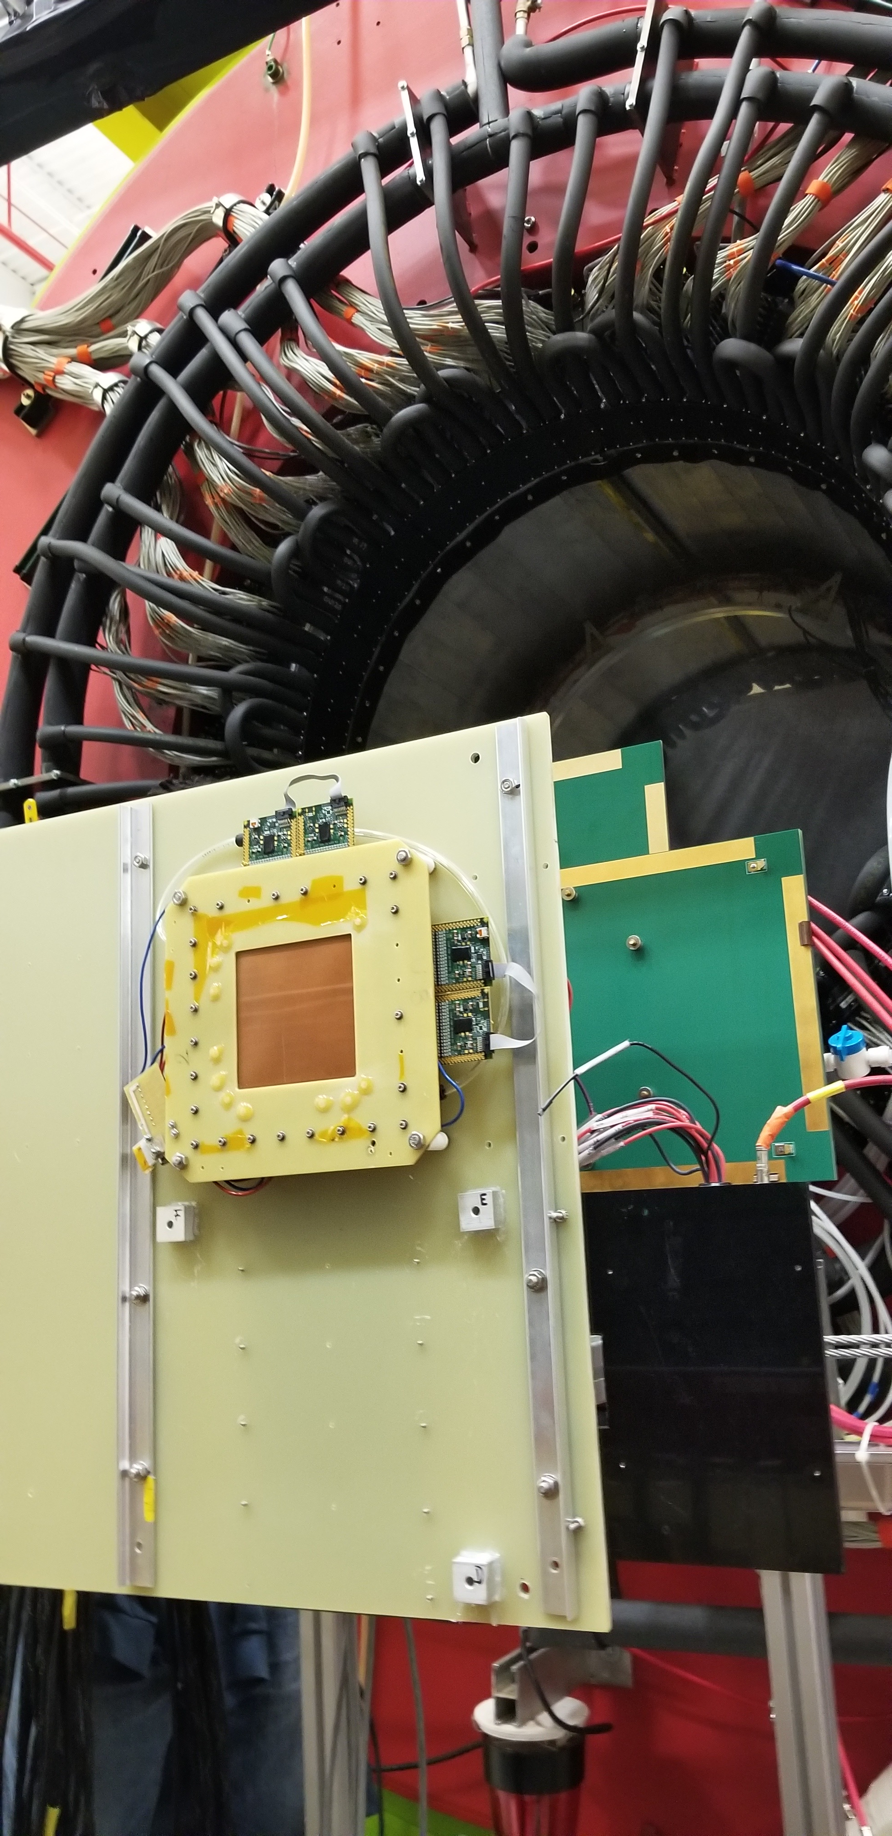
Integration into GlueX experiment
GEMTRD/TRD setup at GlueX (winter 2020)
24-26 March 2021
Yulia Furletova

Slide 24
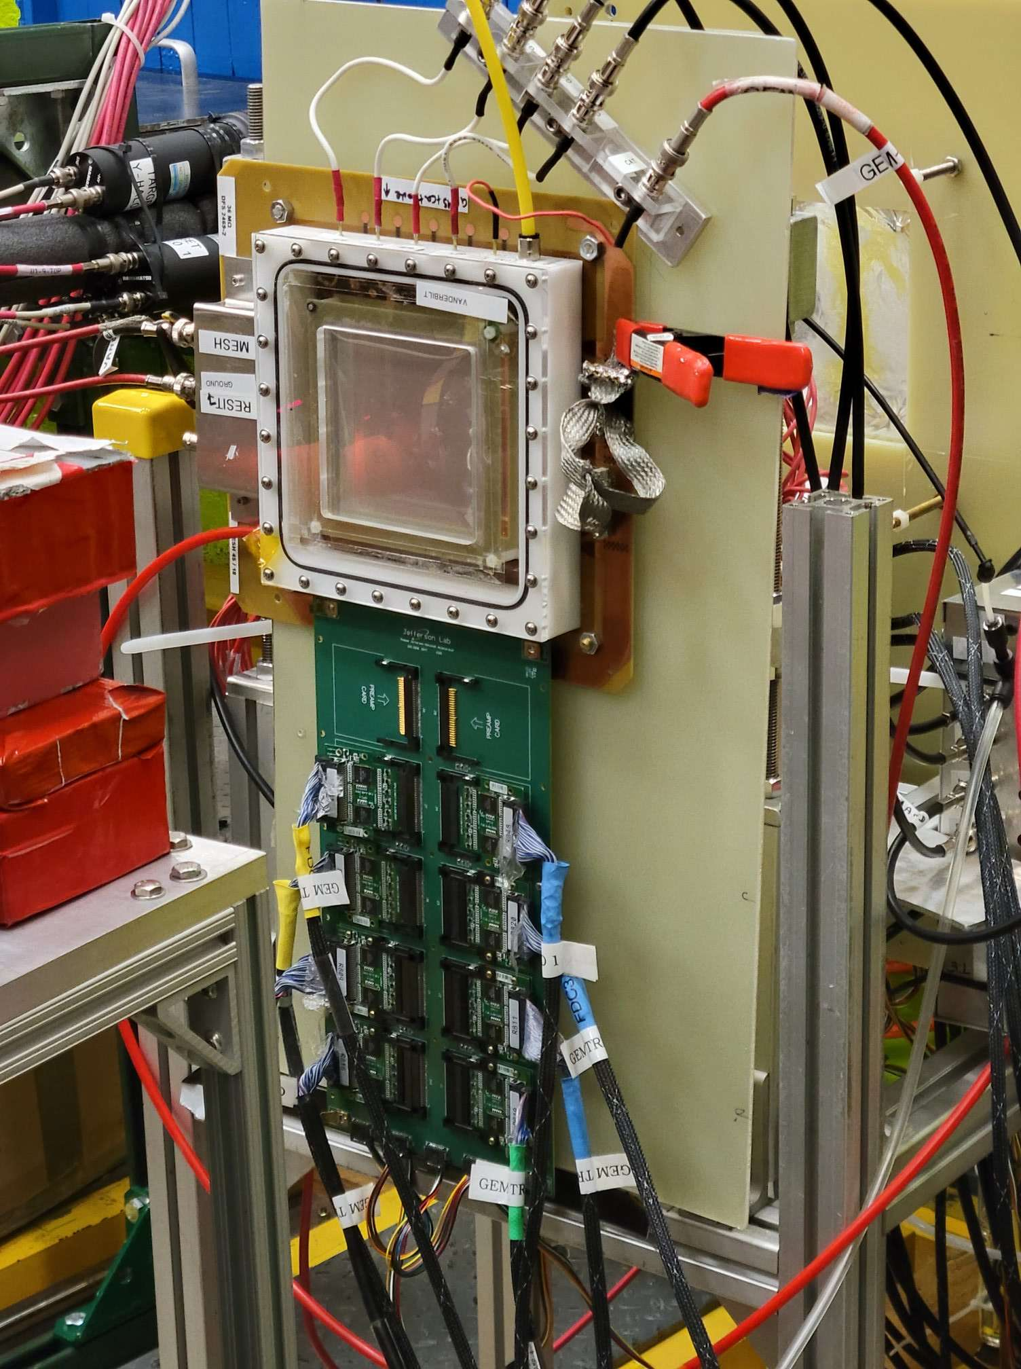
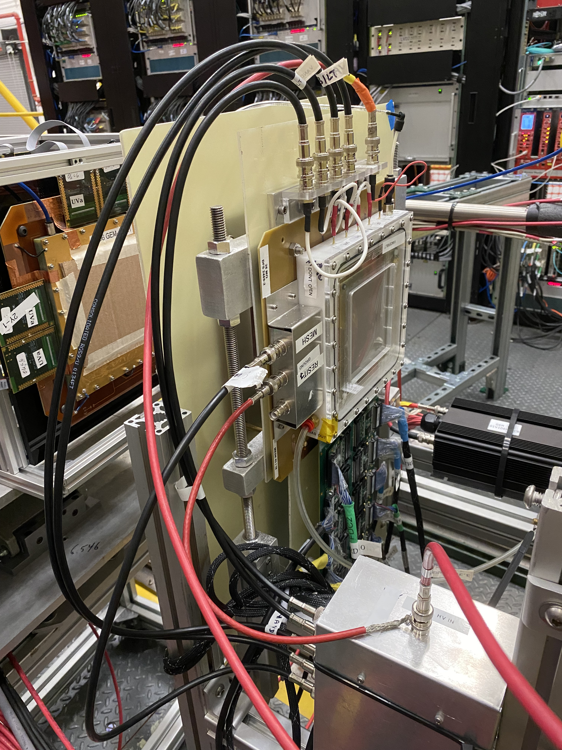
New prototype from Vanderbilt Uni @ JLAB test beam
Can you detail the prototype of the field cage that is planned?

Slide 25
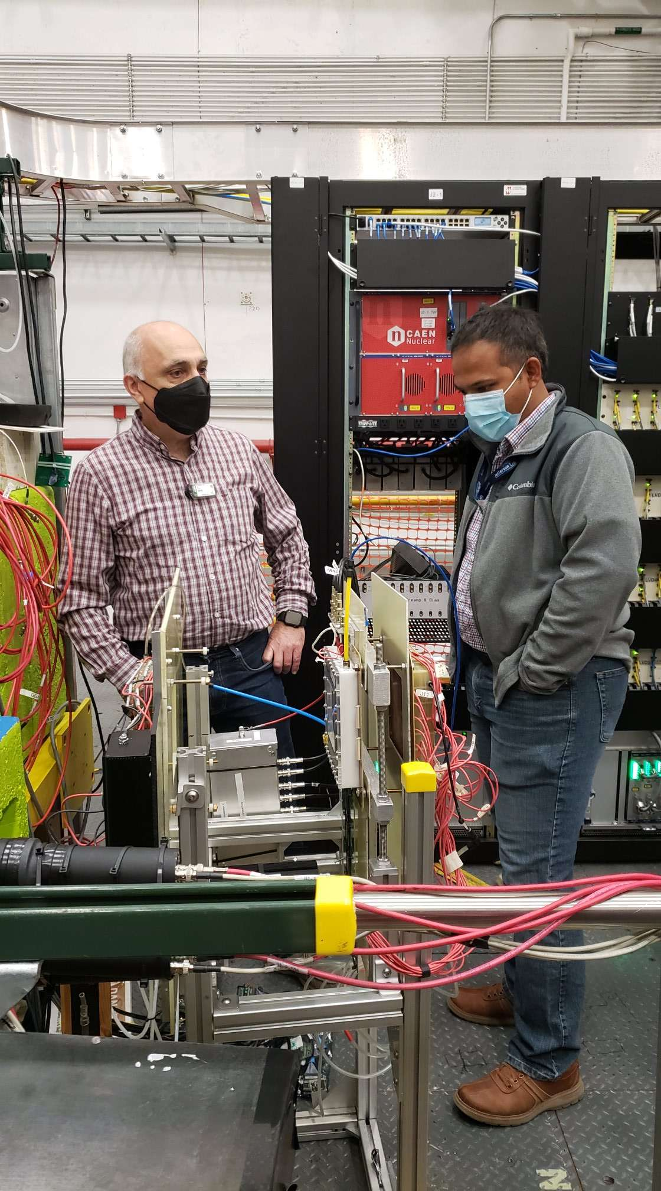
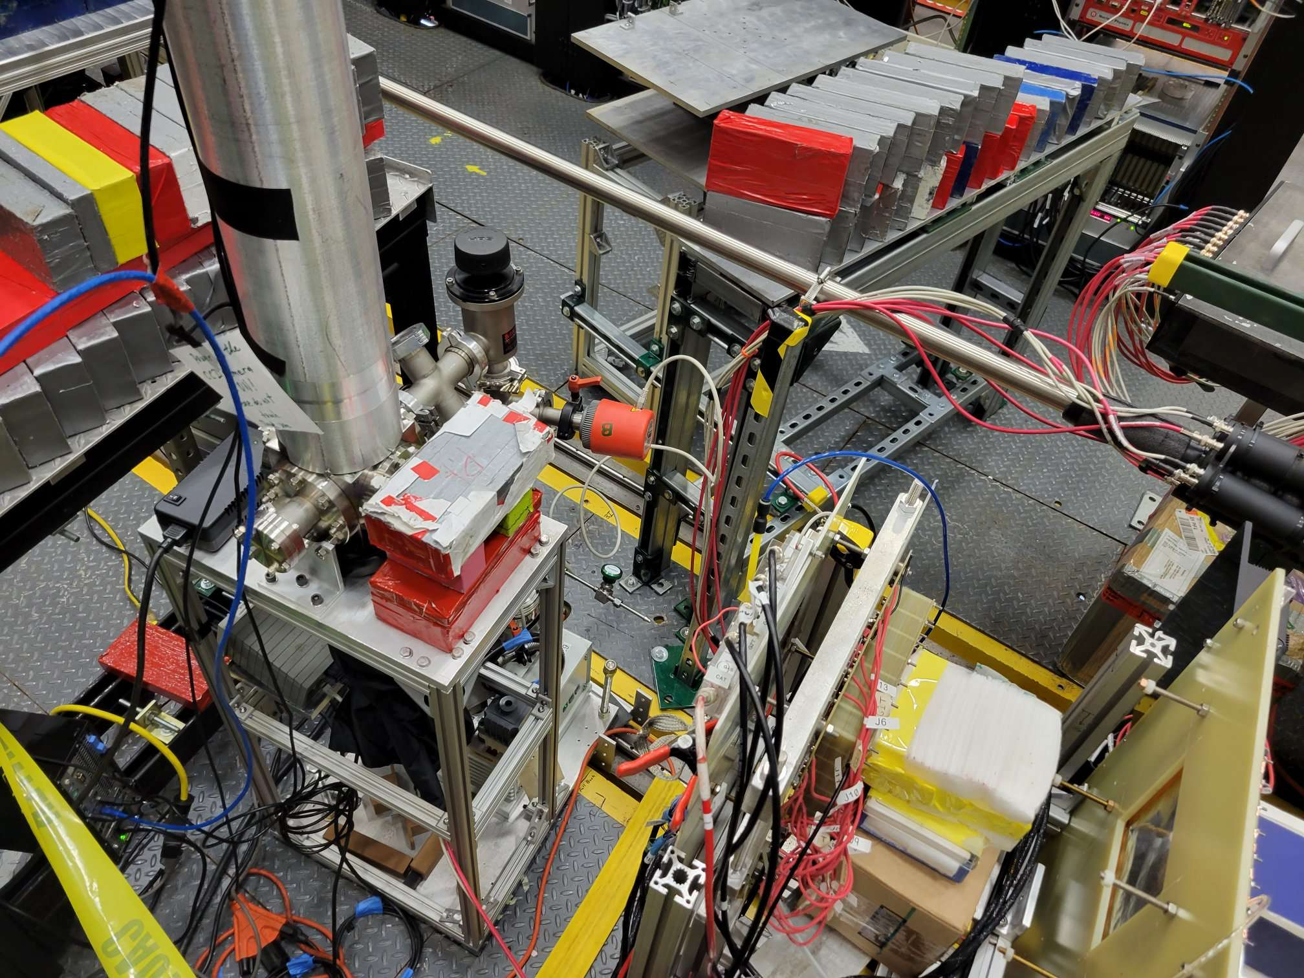
Setup

Slide 26
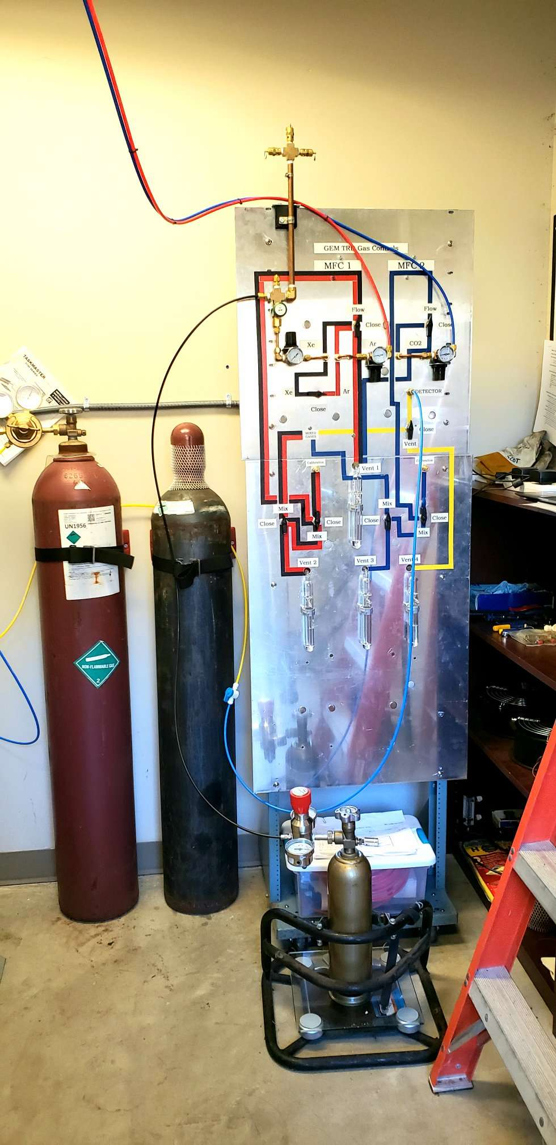
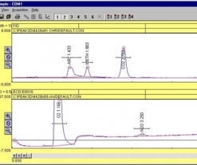
Gas system
Gas system ( assembled at Temple U.):
Without a re-circulation and a purification system (too early stage of R&D)
But with gas mixing system and Flow controller, C0₂ controller
We purchased gas analyzer to begin quantifying and monitoring contaminations and to measure the concentrations of the Xe and CO₂ gasses.
-> split a cost with Hall-D : our contribution $7k (40%) to extend up to Xe
Argon
CO₂
Xenon
Gas mixing setup:
Xenon/CO2: 80/20 percent.
Small Xe-gas bottle : $8k !
( need a good program planning!!!)
SRI 8610C

Slide 27
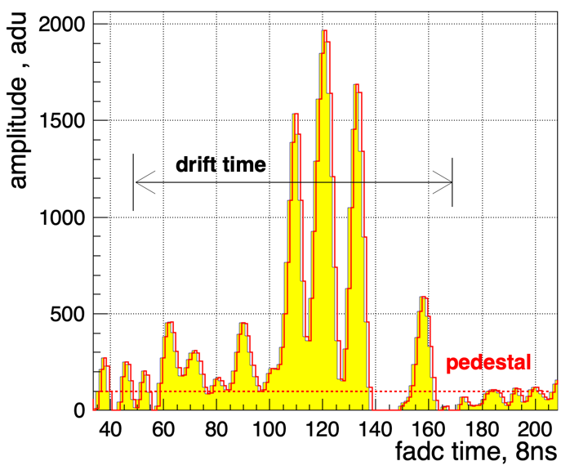
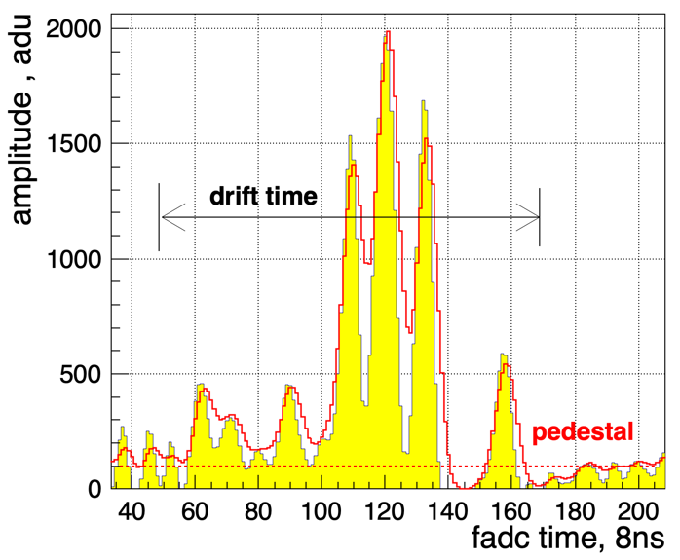
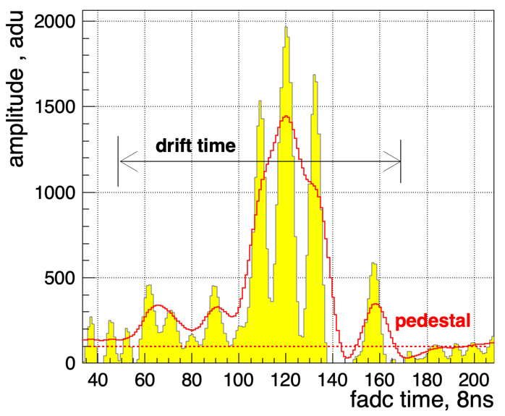
Readout
Current setup: preamplifiers (GAS2 ASIC chip) with shaping times of∼10-12ns.
The flash ADC has a sampling rate of 125 MHz and 12 bit resolution but provides only pipe-lined triggered readout ( price ~50$/channel)
Shaping time:
For TRD applications not only raising time is important, but also full width (tails, return to baseline )
In Xe – high density clusters ( ionization density)
80ns (Sampa) shaping time
~ 20ns shaping time
~ 40ns shaping time
Current setup
24-26 March 2021
Yulia Furletova

Slide 28
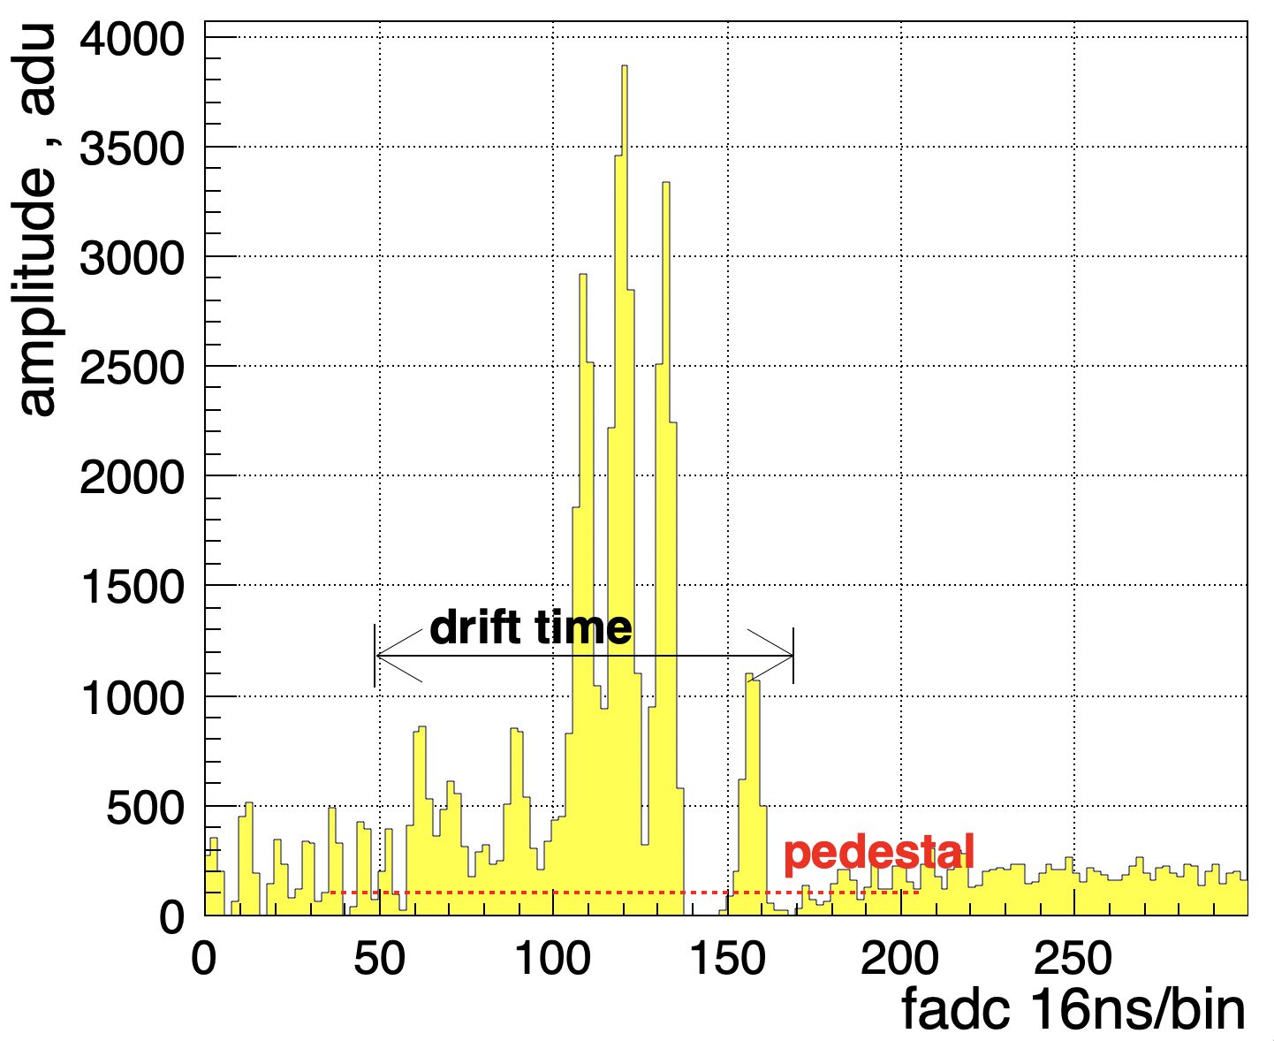
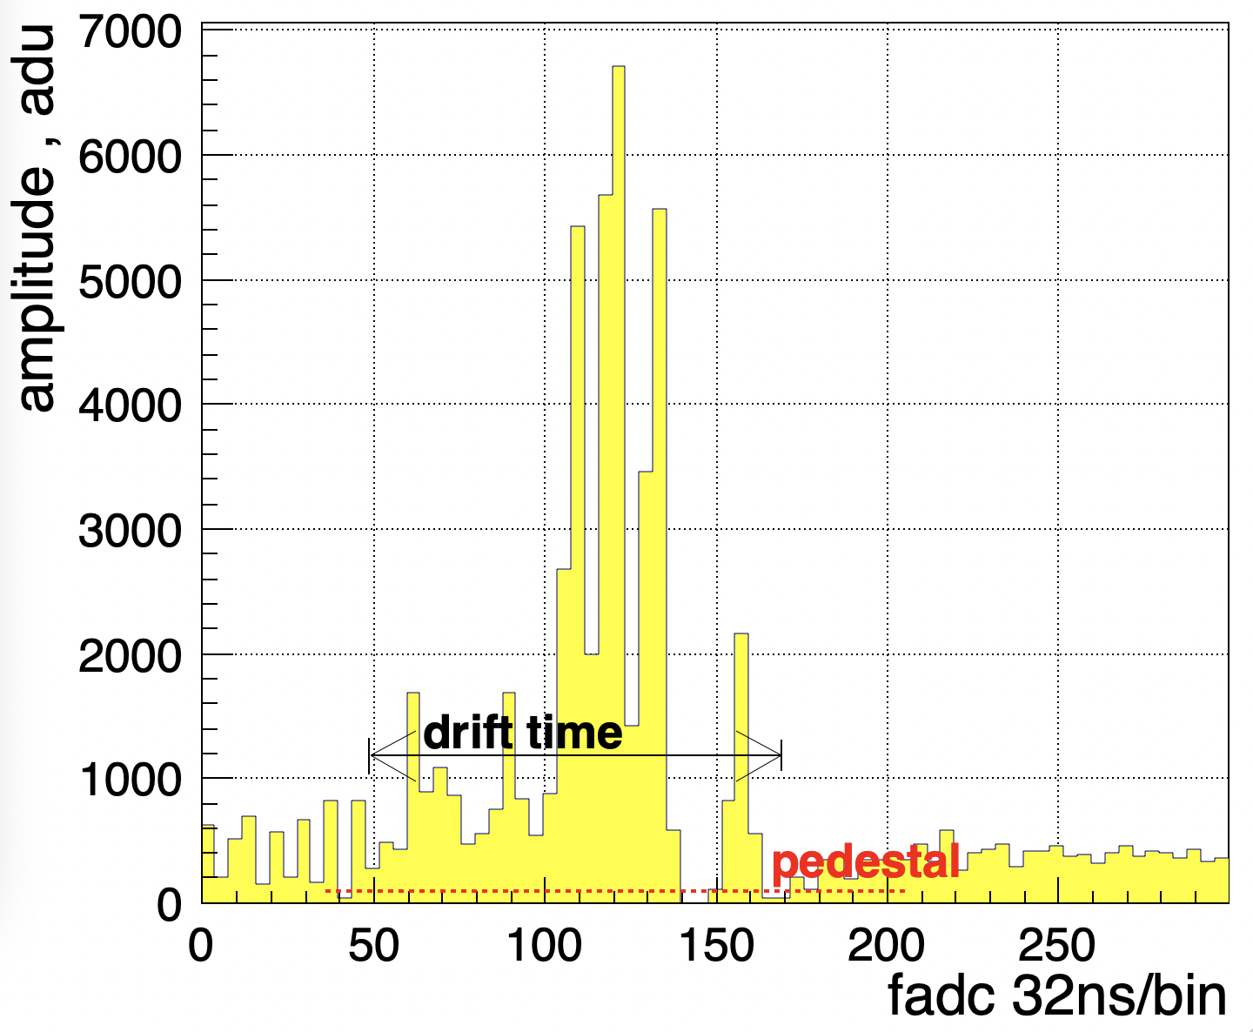
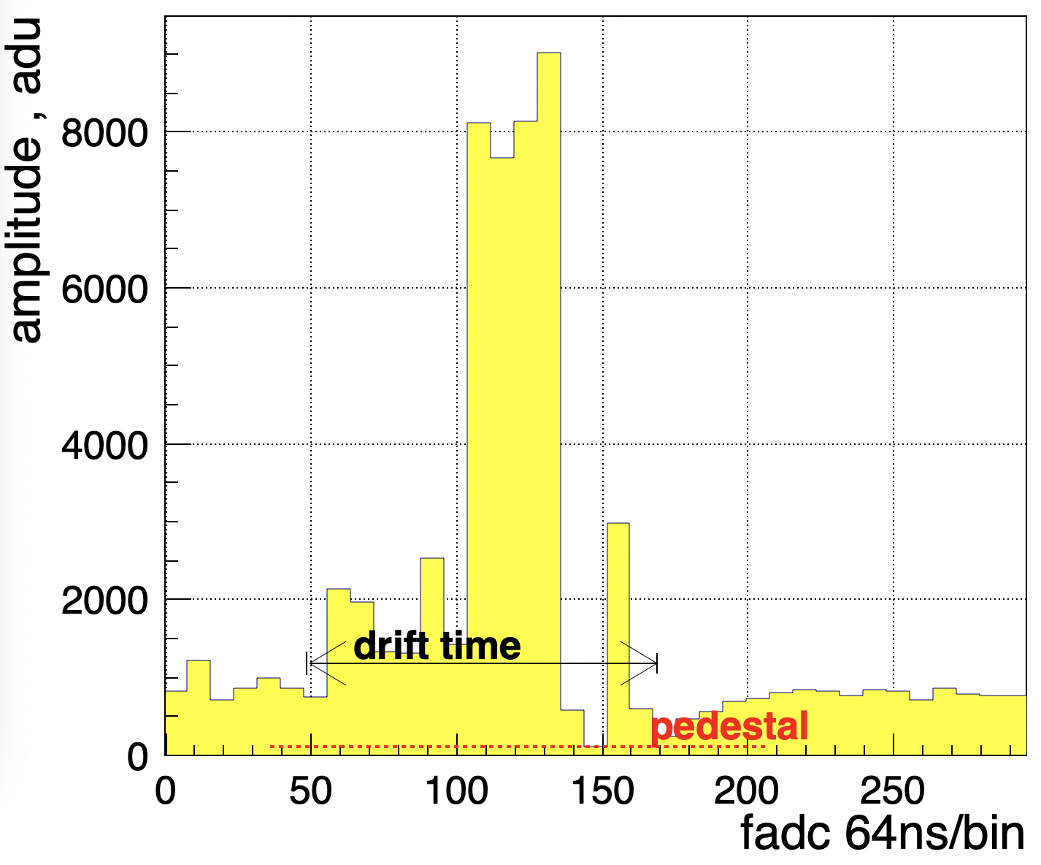
Readout
Current setup
125MHz
a preamplifier (GAS2 ASIC chip) with shaping times of∼10-12ns.
The flash ADC has a sampling rate of 125 MHz and 12 bit resolution but provides only pipe-lined triggered readout ( price ~50$/channel)
Sampling frequency:
62.5 MHz
31.25 MHz
15.6 MHz
24-26 March 2021
Yulia Furletova

Slide 29
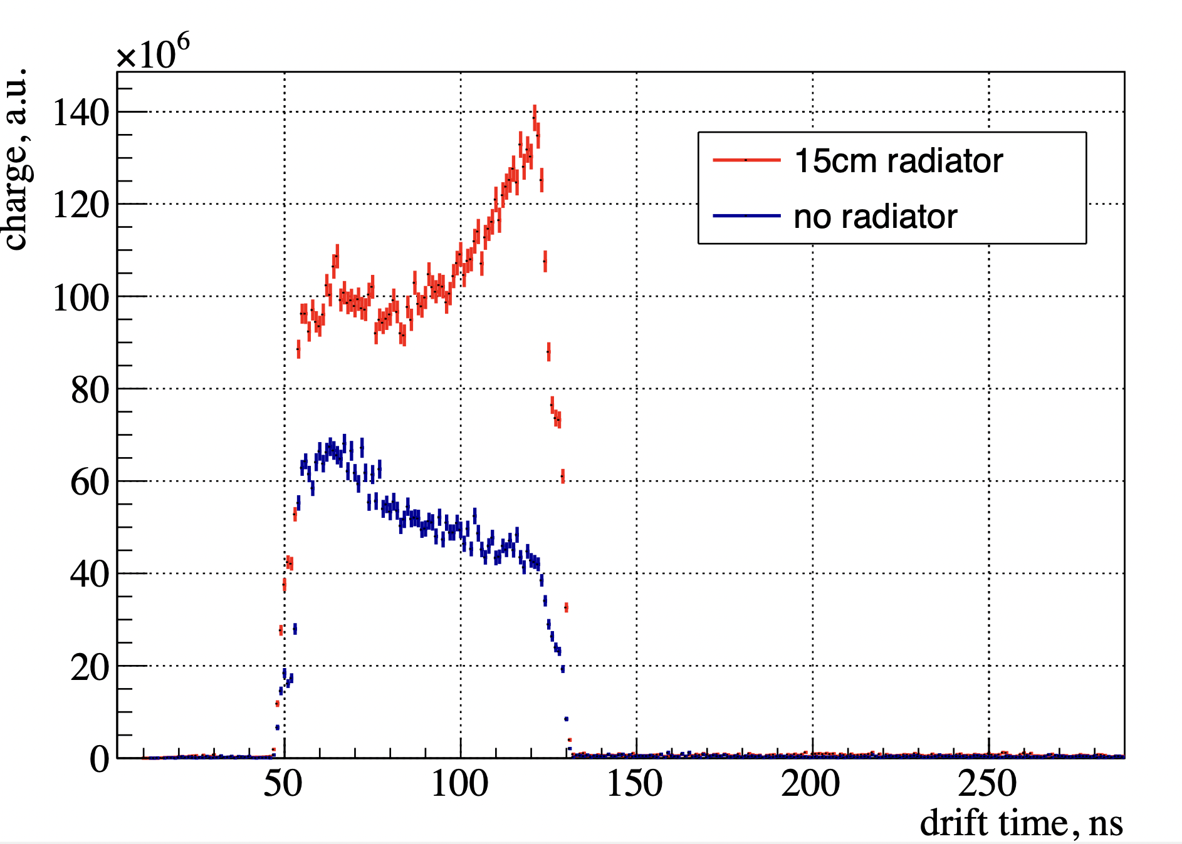
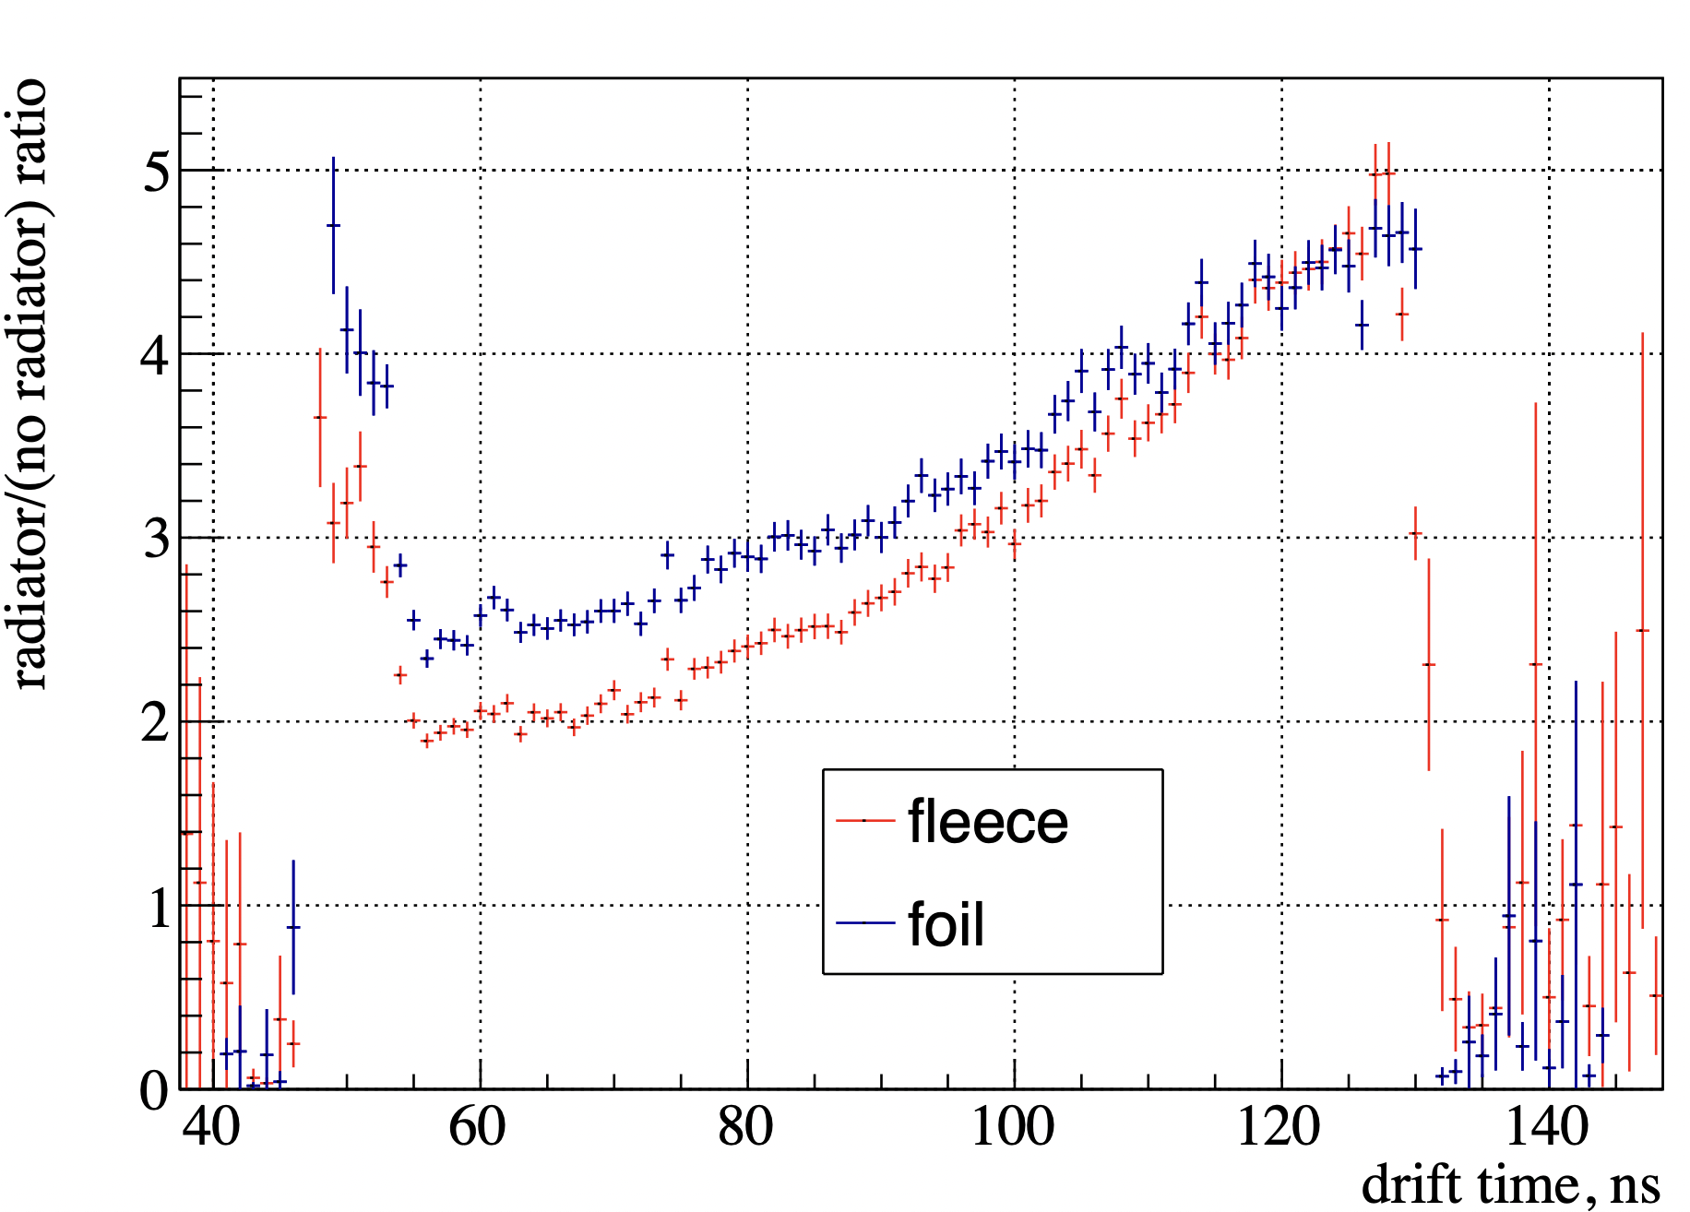
New Results ( very preliminary)
Radiator comparison
fleece,
ca 500 foils of different thickness 25$μm$ , 12 $μm$ (0.0005 inch )
foils : 12$μm$
25$μm$

Slide 30
Machine learning technique
Upto 20 variables were used as input for likelihood and artificial neural network (ANN) programs, such as JETNET or ROOT-based (Multi-layer Perceptron).
We compared cluster counting method and integrated charge within a bin (drift slice).
Cluster counting method ( Time, Amplitude, number of clusters )
10
10
Yulia Furletova
10

Slide 31
Budget

