Slide 1





Tracking and PID with a GridPIX Detector
NOTE: Our group is presently engaged in discussions with the LCTPC collaboration regarding cooperative efforts.
Klaus Dehmelt^{1,2}, ∗∗P. Garg^{1,2}, ∗Thomas Hemmick^{1,2}, Jochen Kaminski³, Peter Kluit⁴, Nikolai Smirnov⁵
¹Department of Physics and Astronomy, Stony Brook University, USA
²Center for Frontiers in Nuclear Science at Stony Brook University, USA
³Institute of Physics, University of Bonn, Germany
⁴Nikhef, The Netherlands
⁵Department of Physics, Yale University, USA

Slide 2
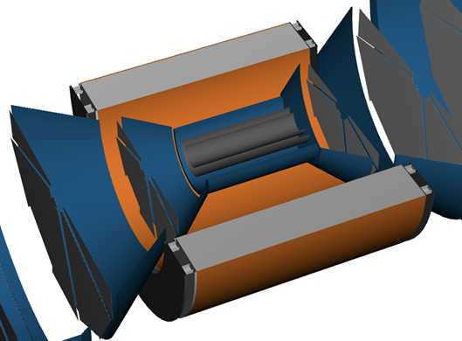
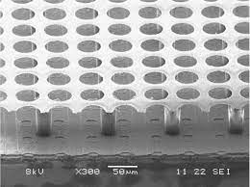
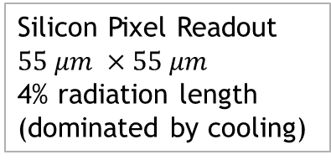
Brief Introduction
Originally as “upgrade path” for ATHENA.
Not discussed in current EPIC baseline.
Ideally suited for Detector 2.
Provides:
  PID (pi-K-p) from 100 MeV/c to 800 MeV/c
  ROBUST tracking (enormous number of hits per track)
  Virtually immune to synchrotron background.
Field Cage
1% radiation length, entrance and exit
Silicon Pixel Readout
$$55 μm ×55 μm$$
4% radiation length
(dominated by cooling)
Gas Volume
Readout
High Voltage (-10kV)
Low radiation Length
ATHENA’s Vision
T2K gas (low diffusion)

Slide 3
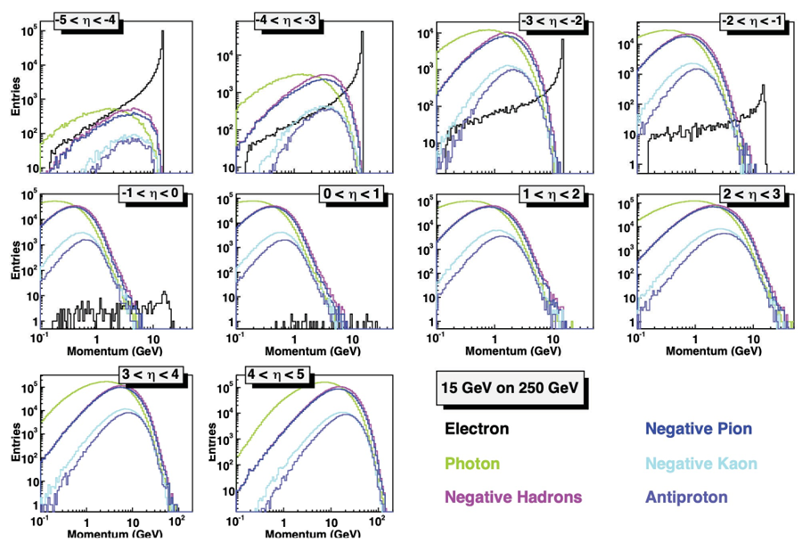
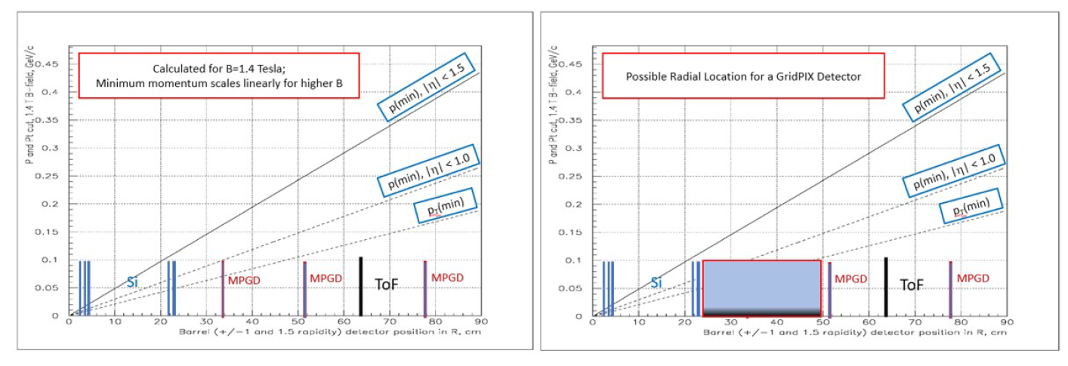
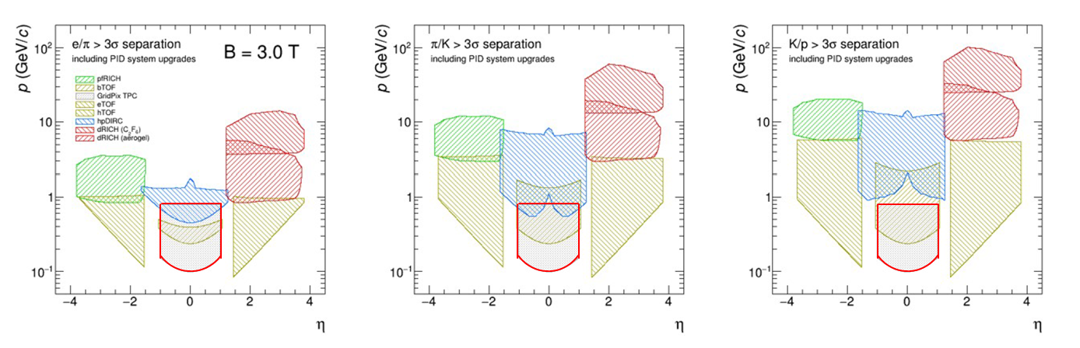
Physics Motivation
Many envision a Detector 2 with 3T or higher field.
Near η=0, soft particles dominate
TOF-PID has competition between p_{min} and resolving power
At the lowest momenta particle identification by dE/dx is advantageous.
Promising technology for EIC detector 2
dE/dx in ATHENA upgrade promised lowest PID reach

Slide 4
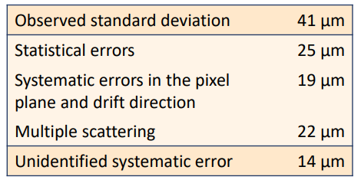
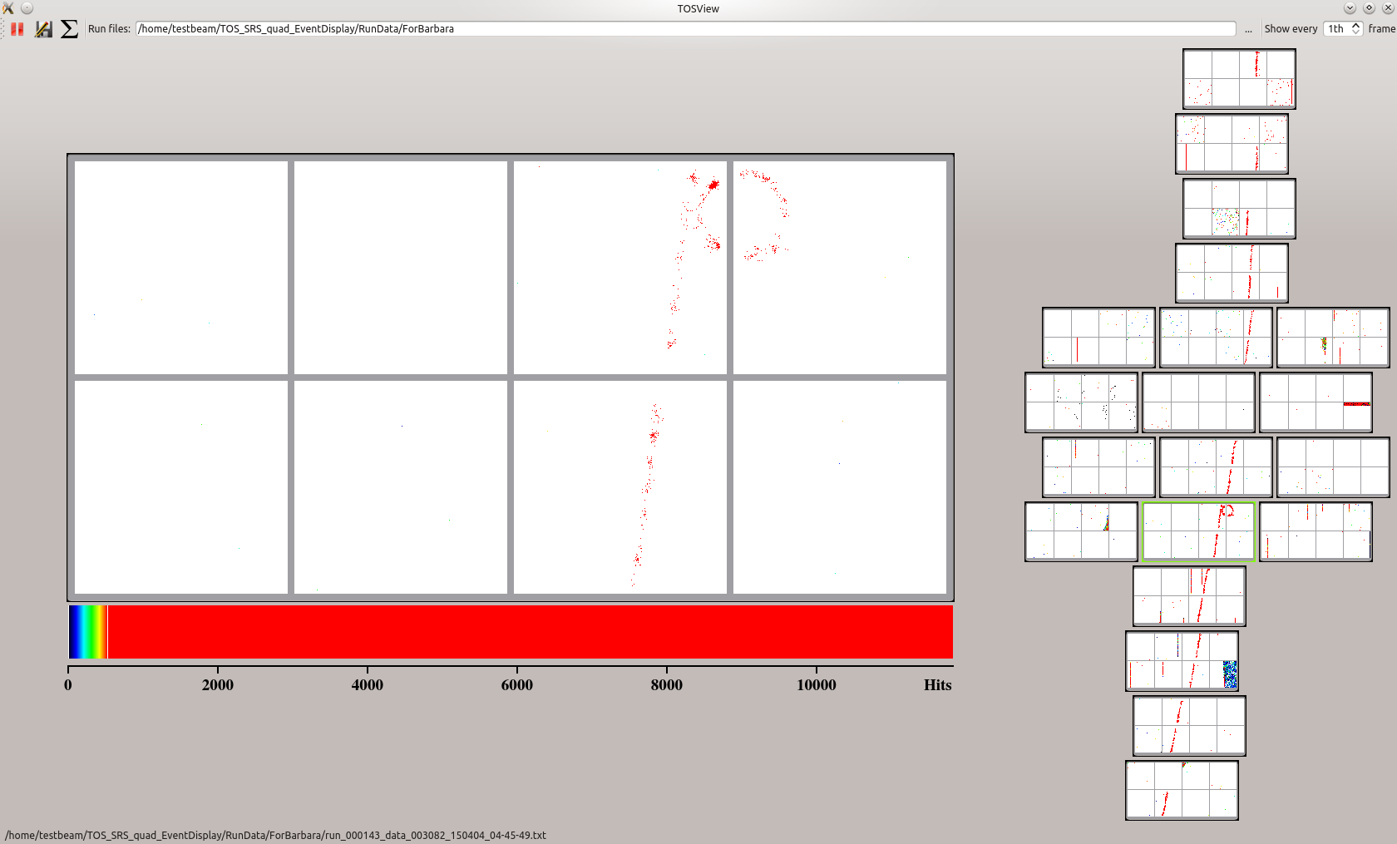
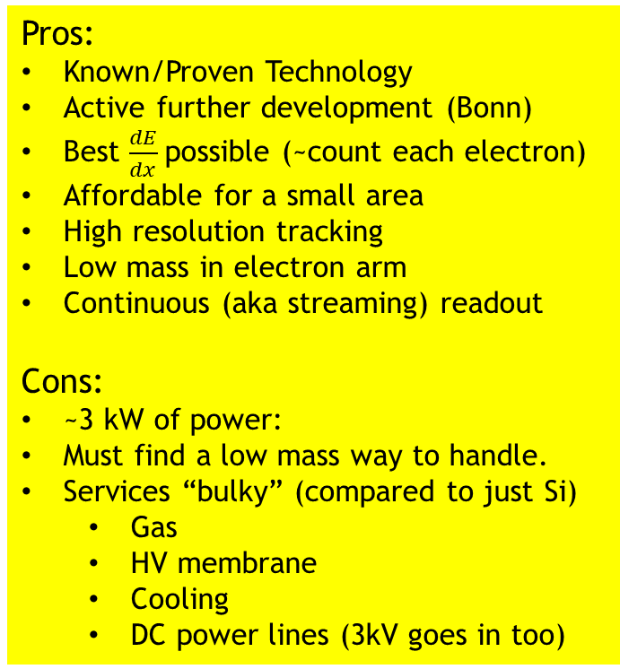
GridPIX Overview
3D e-by-e tracking
Pros:
Known/Proven Technology
Active further development (Bonn)
Best $\frac{dE}{dx}$possible (~count each electron)
Affordable for a small area
High resolution tracking
Low mass in electron arm
Continuous (aka streaming) readout
Cons:
~3 kW of power:
Must find a low mass way to handle.
Services “bulky” (compared to just Si)
  Gas
  HV membrane
  Cooling
  DC power lines (3kV goes in too)
Ultimate dE/dx device.
  Avalanche grid in front of 55 x 55 μm² pixels.
  >90% efficiency for single electrons.
  Goals:
    Enough diffusion to get every electron into a different hole.
    Count electrons one-by-one.
  Three generations of development and continuing.
Small area is not particularly expensive.
  1800 chips (order/produce/test 3600) = $716k
  Careful: 1.2-5.4 kW of power (occupancy dependent).

Slide 5
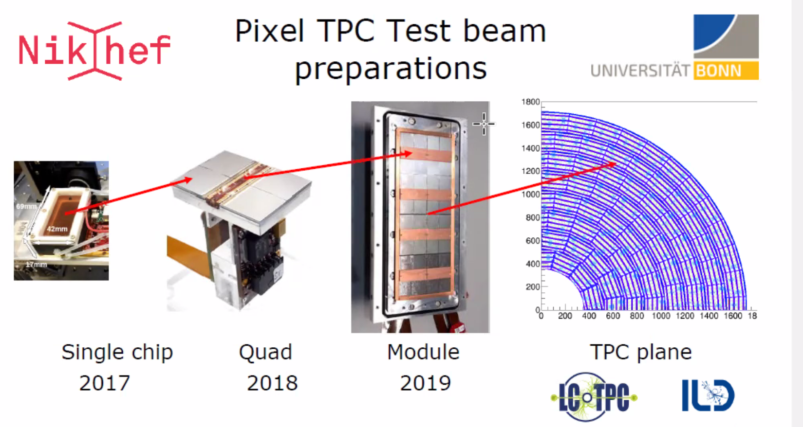

Slide 6
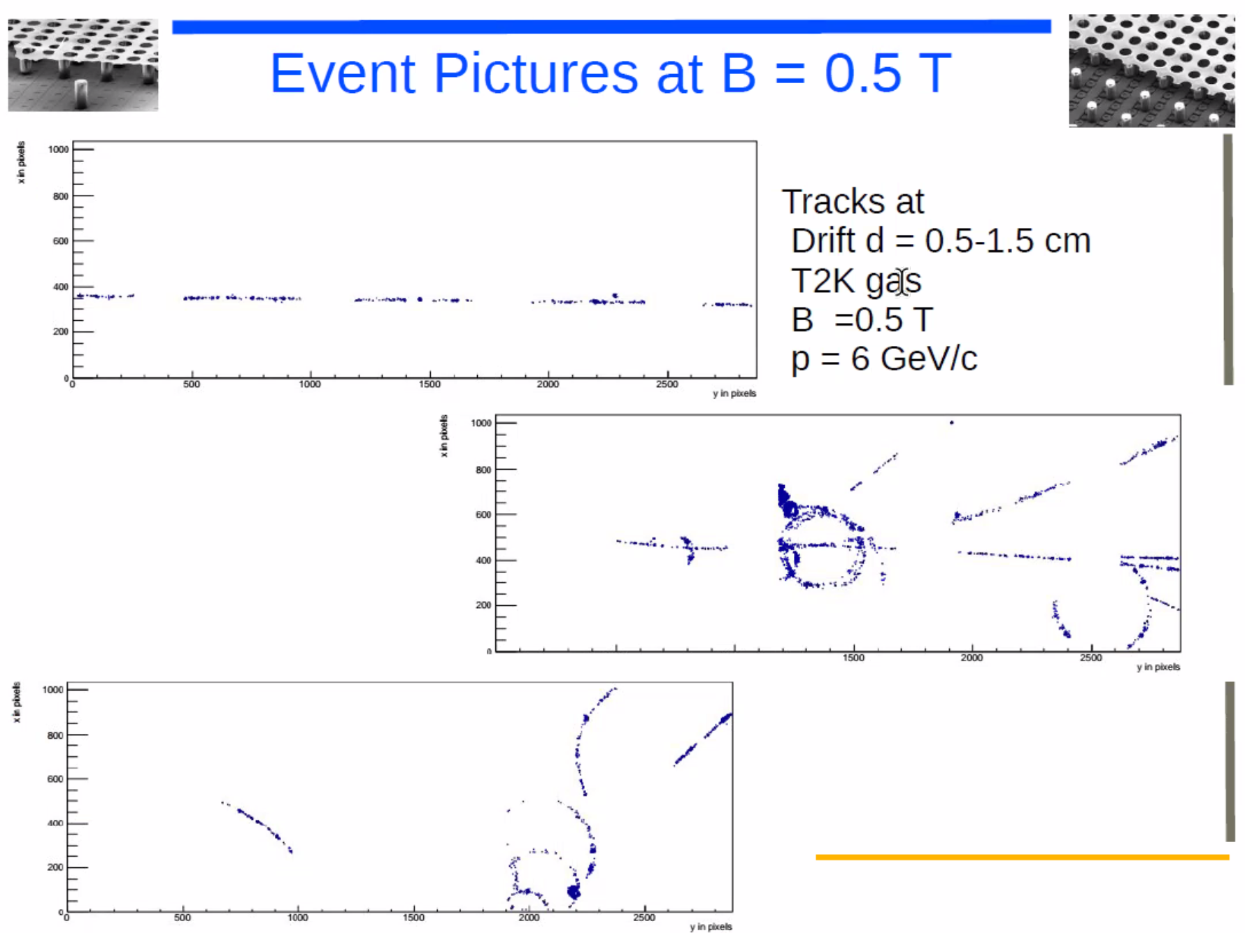
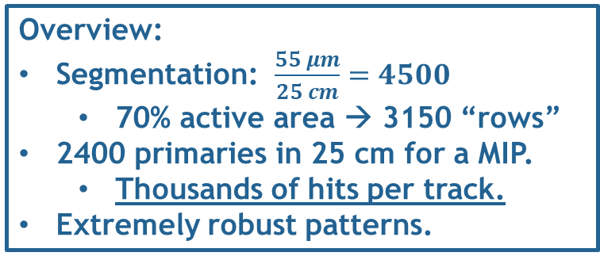
June 2021
Overview:
Segmentation: $\frac{55 μm}{25 cm}=4500$
  70% active area → 3150 “rows”
2400 primaries in 25 cm for a MIP.
  Thousands of hits per track.
Extremely robust patterns.

Slide 7
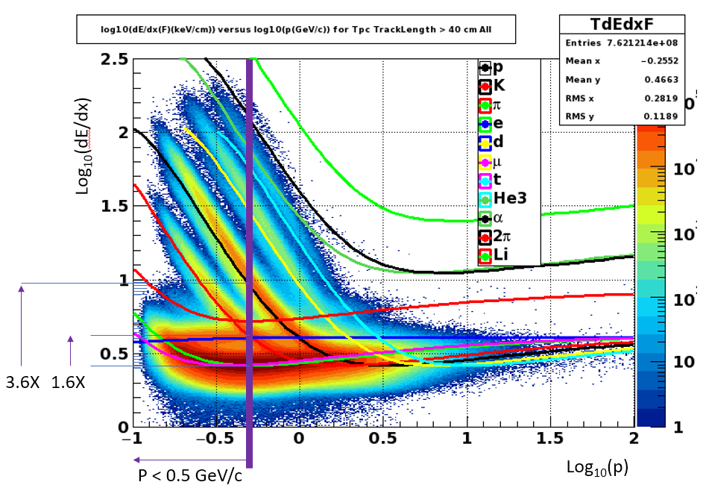
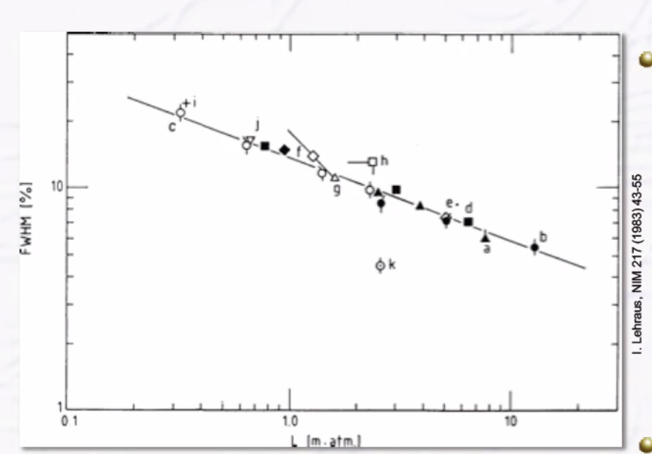
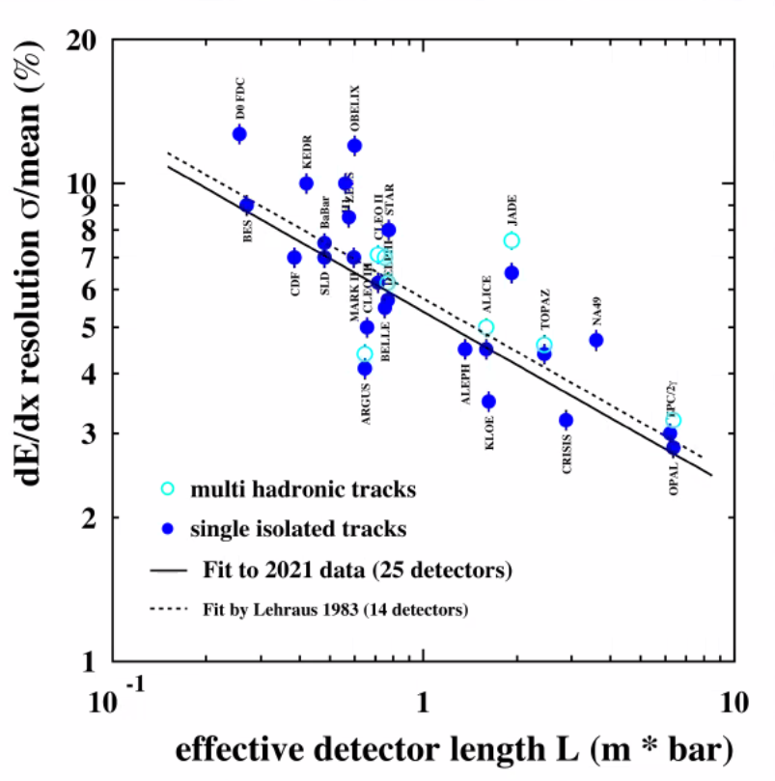
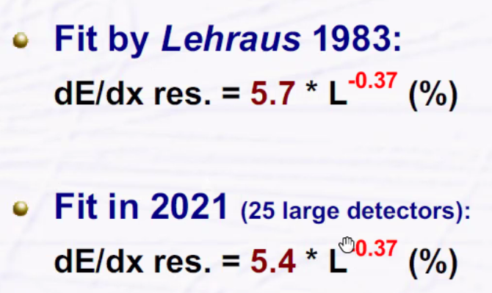
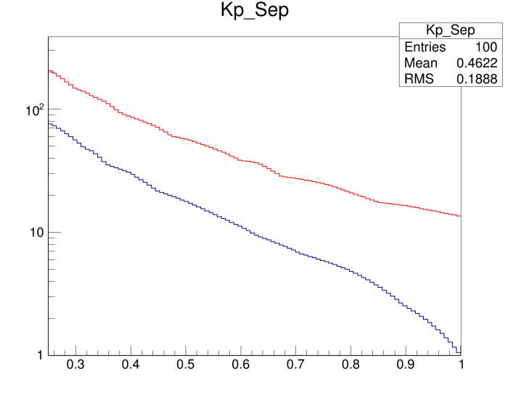
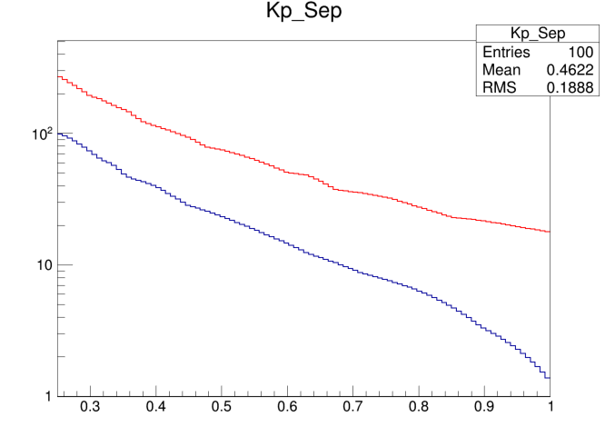
Anticipated dE/dx Performance
easy
hard
#σ
Lehraus Plot
Using 5.4 as a standard TPC
  5.4*(0.25)^{-0.37} = 9.0
Measured for GridPIX (truncated Mean)
  4.1% at 1 meter
  4.1*(0.25)^{-0.37} = 6.85
Roughly 20 sigma at 0.5 GeV/c
Useful range overlaps with DIRC
#σ
9.0%
6.85%
K-p
K-p
π-K
π-K
Momentum
Momentum

Slide 8
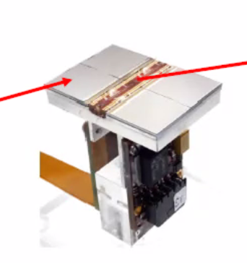
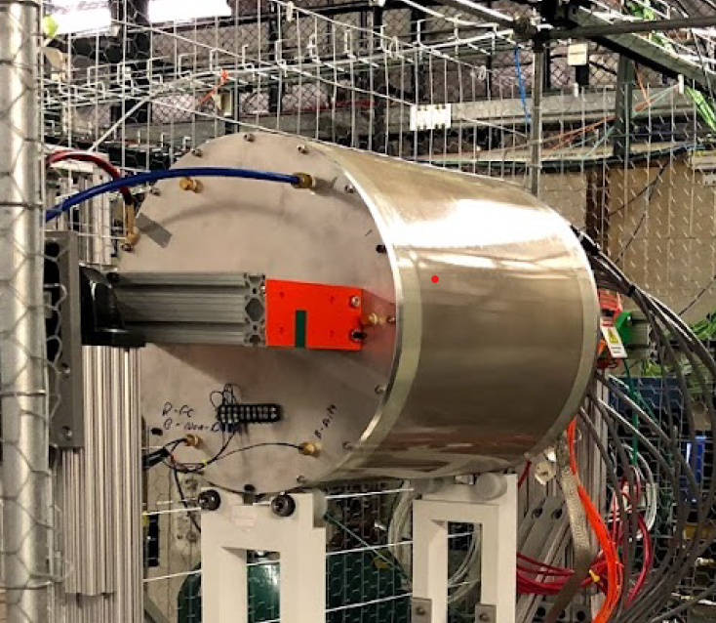
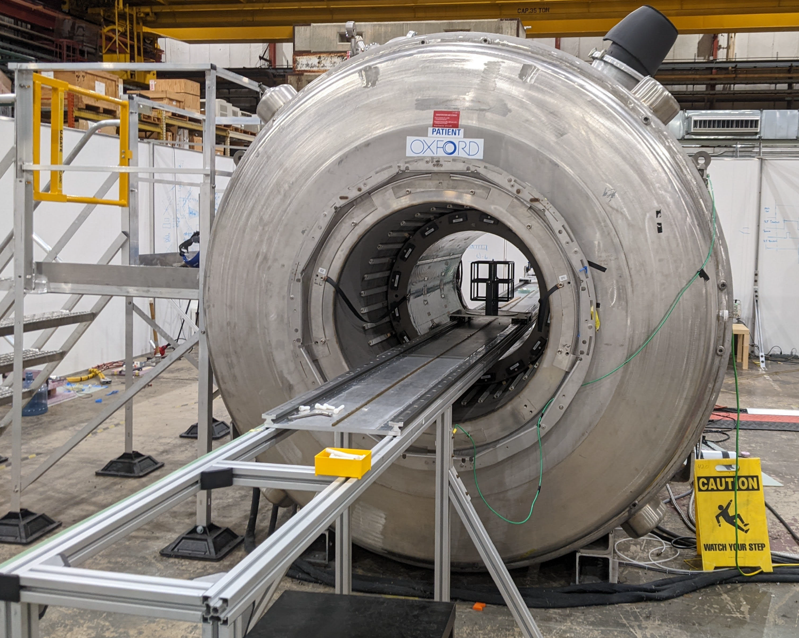
Initial R&D Plan
Thermal Management Studies
  At home
  No Apparatus
  Free in the first year
+
=
Ready for first tests at min. cost
sPHENIX TPC Prototype Field Cage
Nikhef Quad
Fermilab Test Beam
  Mixed beam at low energies
  Identified by beam line Cherenkov
Cosmic Rays at Argonne
  0-4 Tesla Field available.
  Limits diffusion, maintains “clusters”
Argonne Magnet Facility

Slide 9
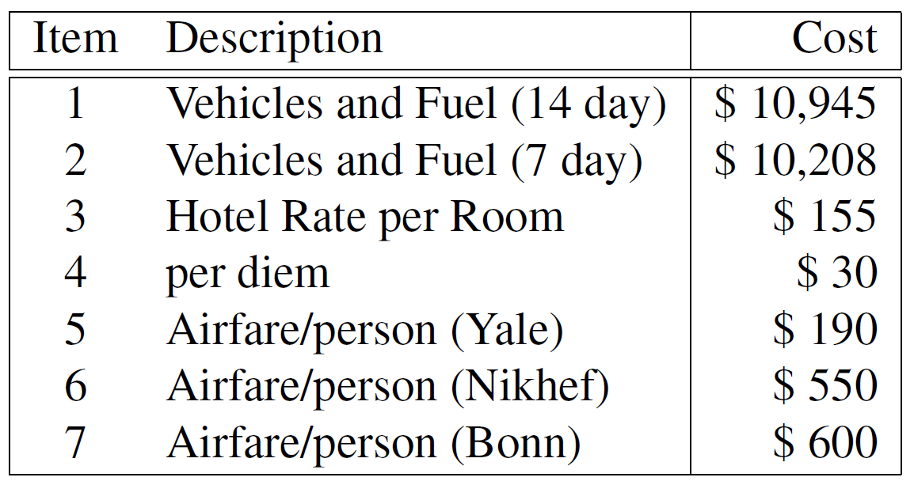
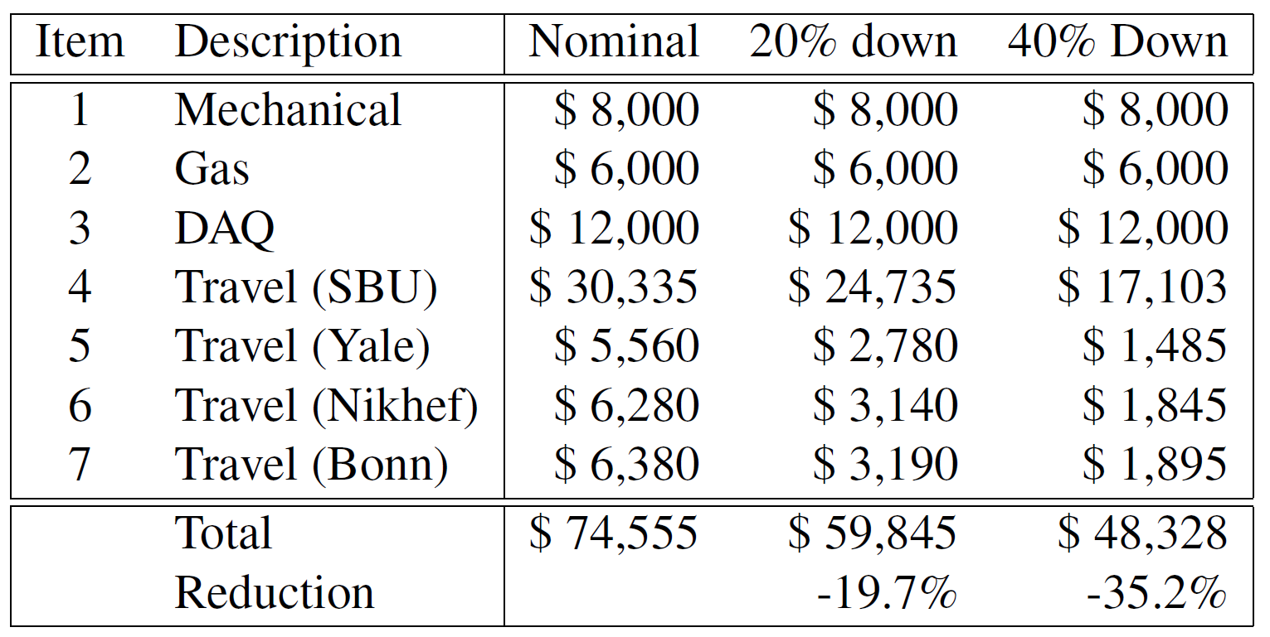
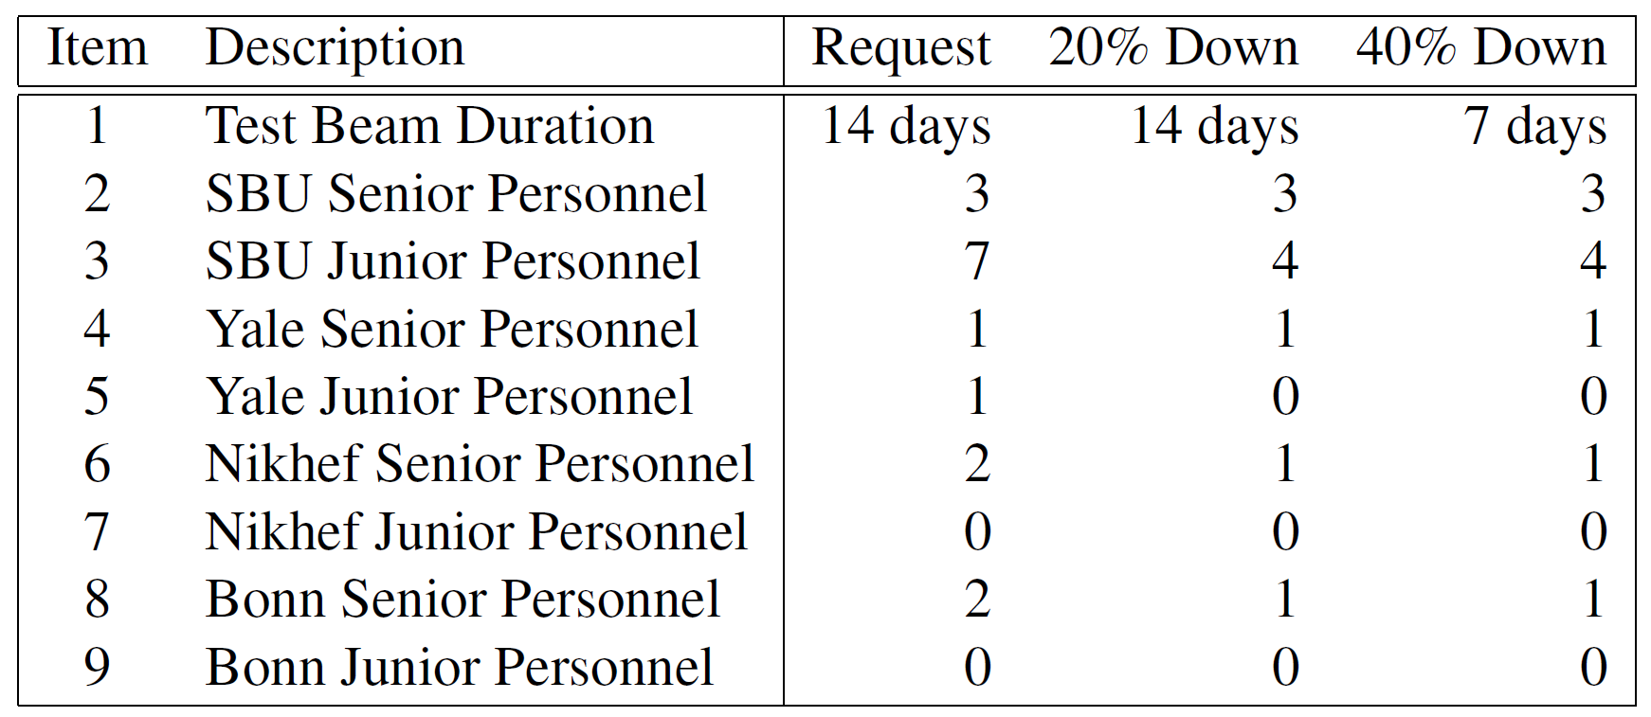
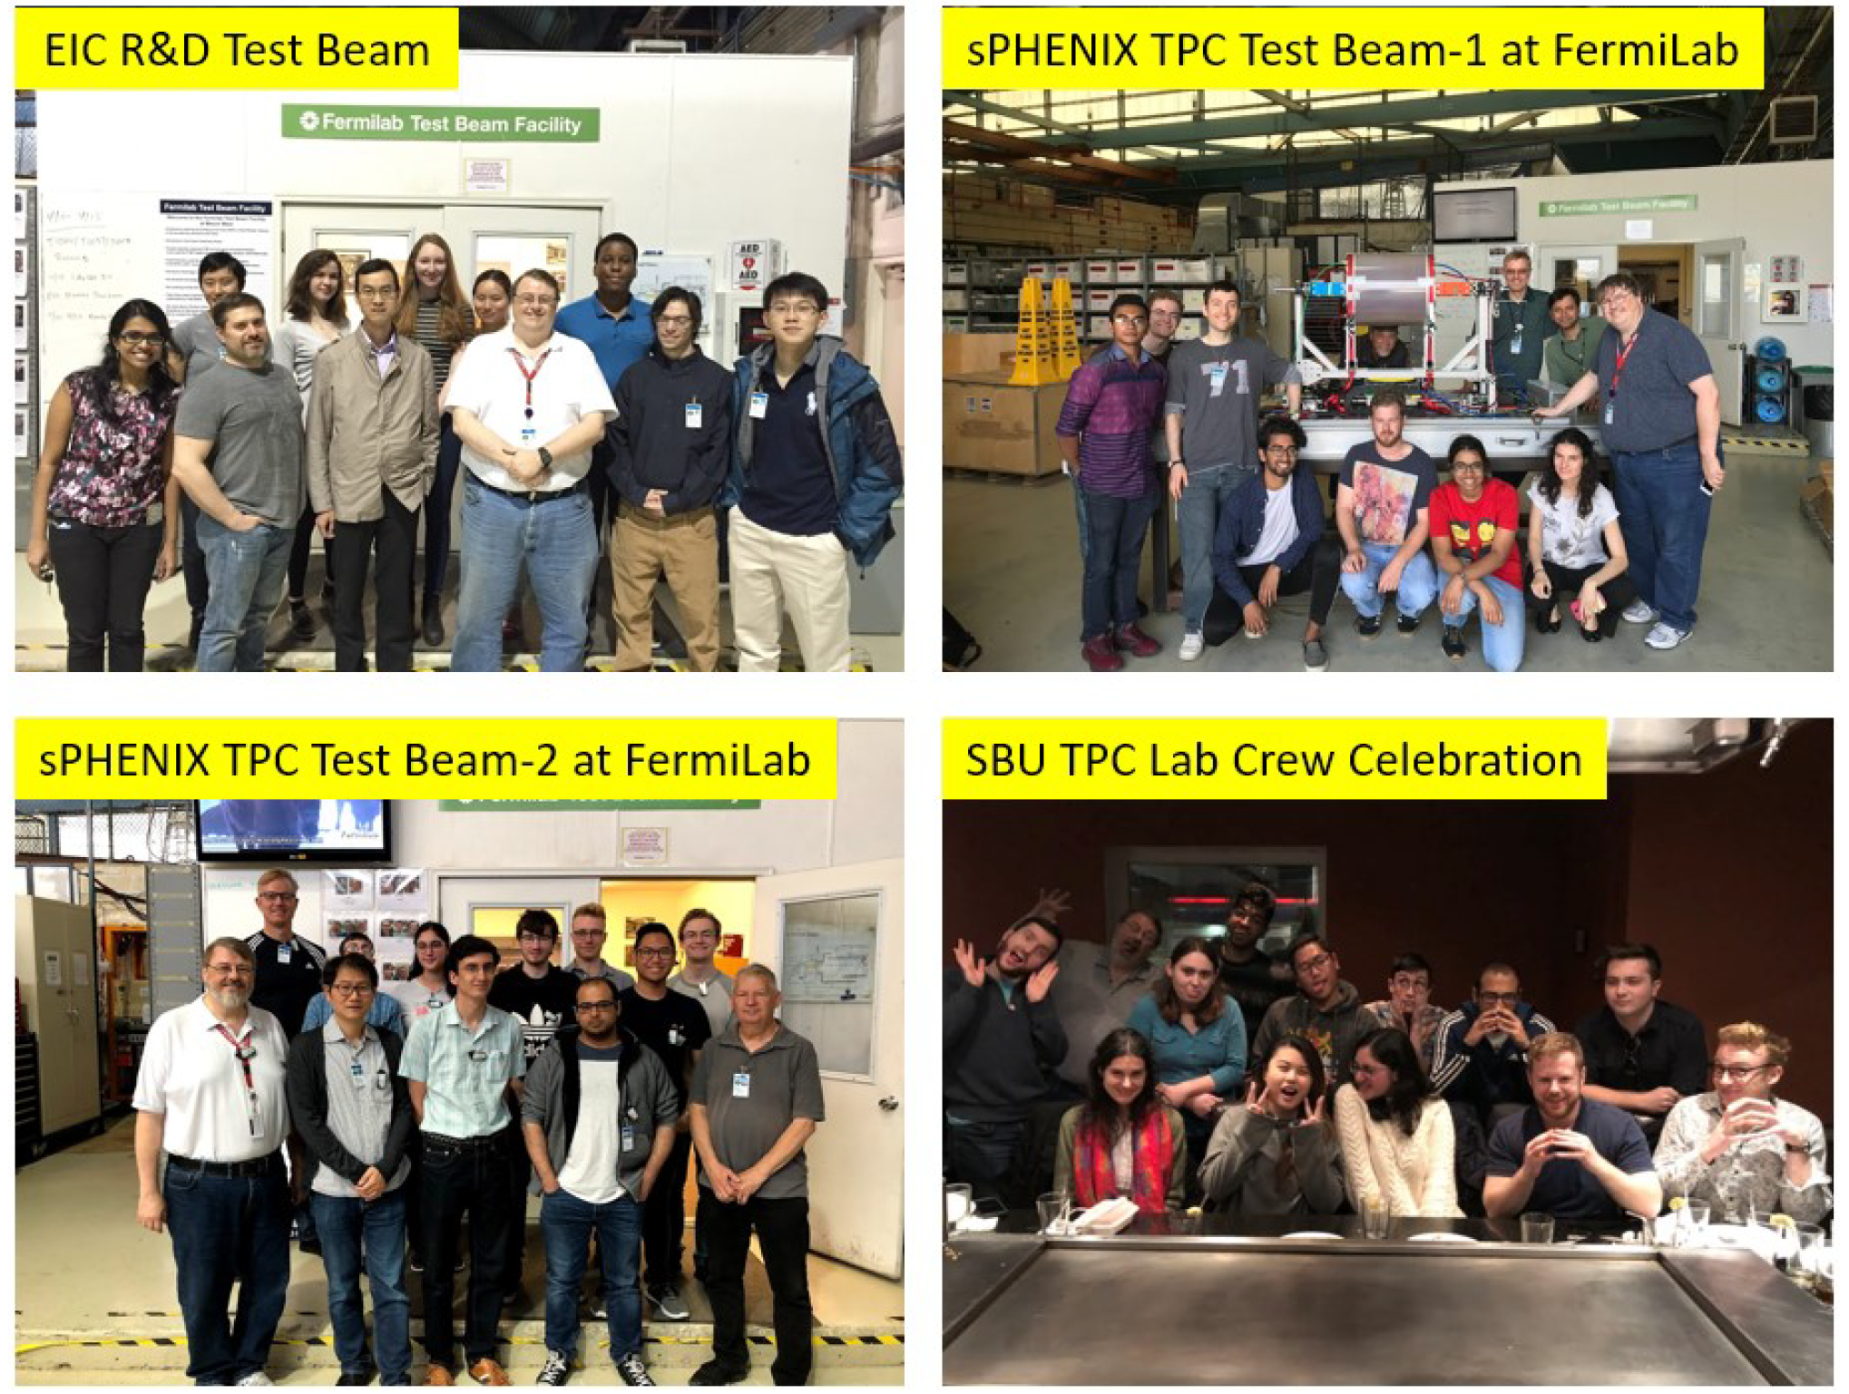
Budget Summary
Cost
Basis
We can only do the Fermilab in the first year.
The budget leverages existing apparatus
Two methods of realize reduced scenario:
  Limit the number of personnel
  Shorten the run
Large numbers of students are realistic
We have a long tradition of respecting DEI

Slide 10
Homework-1
GridPIX post-processing to prevent discharges is not addressed. This is a critical item for the long-term use. Can you discuss any overhead and risks this might entail in an EIC detector?
  In the post processing a SixNy is deposited on the TPX3 chip. This protection layer prevents the detector from sparking and protects the chip.
  This protective layer works well and for single chip detector, the quad detector and the 8 quad module.
  All detectors were successfully tested in three test beam campaigns. No problems with discharges occurred.
  The only problem that occurred in the test beam campaign of the 8-quad module was that we had to disconnect the HV of the grid of one chip due to a short. For a large system the distribution of the HV should be changed to allow for remote disconnection of the HV of the grid.

Slide 11
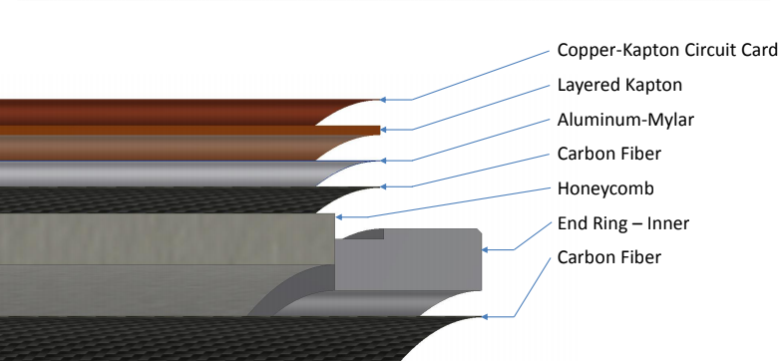
Homework-2
sPHENIX:
45 kV & 18 layers kapton.
Please detail the radiation length for the sPHENIX TPC (reportedly 1.5%), then do the same for the conceptual design for an EIC detector using the proposed technology (where 1% is said to be achievable).
EIC:
10 kV & 5 layers kapton.
The sPHENIX TPC wall thickness is dominated by an insulating kapton layer.
The EIC detector will operate at lower voltage and require less insulation.

Slide 12
Homework-3
What R&D will be needed after the FNAL beam test?
  Theme: Demonstrations this far with GridPix are not yet “deployable” in an experiment.
    Water cooling is only a proof of principle; CO₂ cooling should be implemented
      lower radiation budget, higher performance, more uniform temperature (important for parallel plate avalanche)
    Extending drift length over which cluster-counting PID can be effective
      Alternate gas choices (e.g. He + CF₄ + iC₄H₁₀, etc…)
      Goal: Extend cluster counting to 1 meter of drift.
      Deal with cluster merging in post processing of data.
      NOTE: Second EIC detector may use 3 Tesla field, thereby minimizing cluster merging.
    Readout Plane Technology (the next generation beyond the quad):
      The chips should more directly contact a cold plate without making separate quads.
      The (expensive) flex solution to bring the readout to the back should be redesigned.
      The multiplexer (that combines the data streams of 16 chips) should be redesigned/optimized for full sector readout.
      On-board tracklet formation
        effective rejection for background synchrotron radiation at electron machine at highest luminosity.

Slide 13
Summary
A mini-TPC with GridPIX readout seems an ideal technology for Detector 2 at EIC
  Especially useful at future luminosity,
  Robust pattern recognition against synchrotron background.
  Data reduction/background suppression to tracklets possible in hardware.
Excellent PID performance at the lowest momenta.
Startup costs minimal due to existing equipment.
Future years emphasis on developing a “deployable” configuration.

Slide 14
Backups

Slide 15
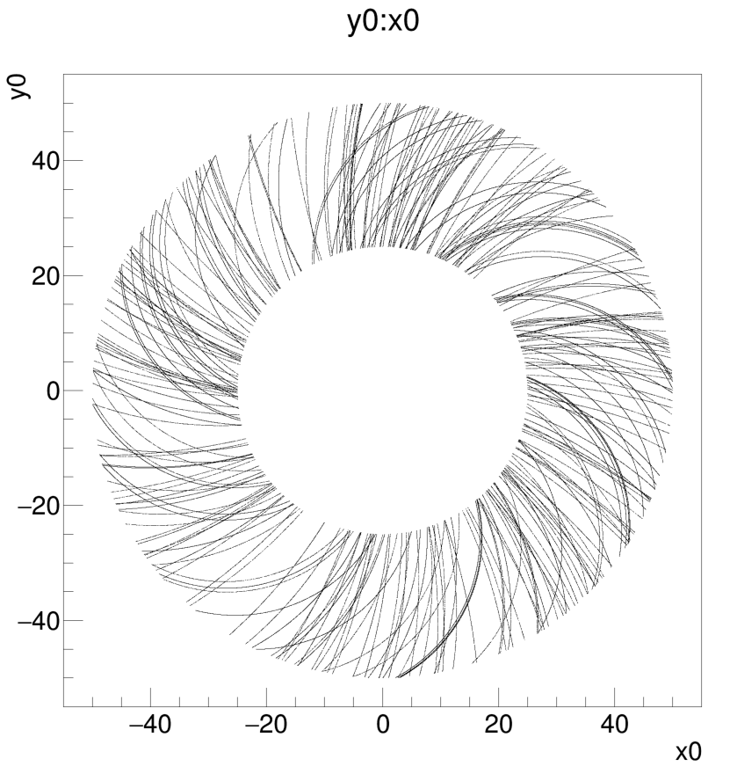
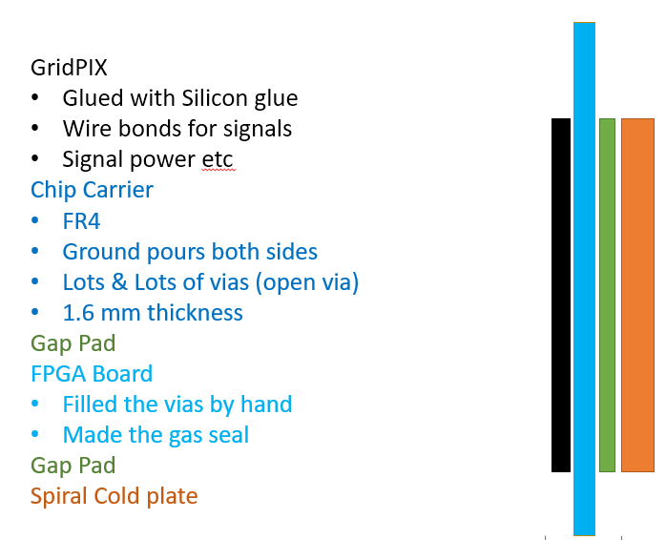
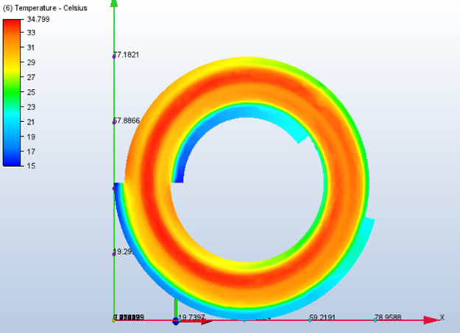
Garfield & Cooling
Temperature Profiles: 3 kW
4% Radiation Length
Coolant above the dew point
A Garfield simulation hints at the efficacy of the tracking.
Pattern recognition will be particularly robust against
A crude estimate of the radiation thickness at the hadron end yields reasonable results.
Future R&D can significantly improve the thickness with more modern techniques.

