Slide 1
Silicon Tracking and Vertexing Consortium: Functional Verification Model of EIC Tracking and Vertexing Detectors R&D
G.W. Deptuch
11/15/2022

Slide 2
Object-oriented analysis and design (OOAD) methodology
This is a proposal that brings together the worlds of physics, scientific instrument development and engineering.
The scope is investigation of building a multi-modal modeling environment that will integrate the physical space, signal processing, generation of data flows and data transmission, as well as on conducting functional verification of the EIC MAPS detectors based on Universal Verification Methodology (UVM) in SystemVerilog.
Universal Verification Methodology is defined in terms of developing system through architecting test-benches and test cases and comes with a library of classes that helps in building efficiently constrained random test-benches in a convenient way as part of the paradigm of the SystemVerilog framework.
The modeling of the entire detector, which may have several versions, will allow for its specific, virtual operation, giving the possibility of testing in conjunction with continuous stimulation from EIC event generators. It should also be seen as R&D towards risk reduction and optimization of the detector structure.

Slide 3
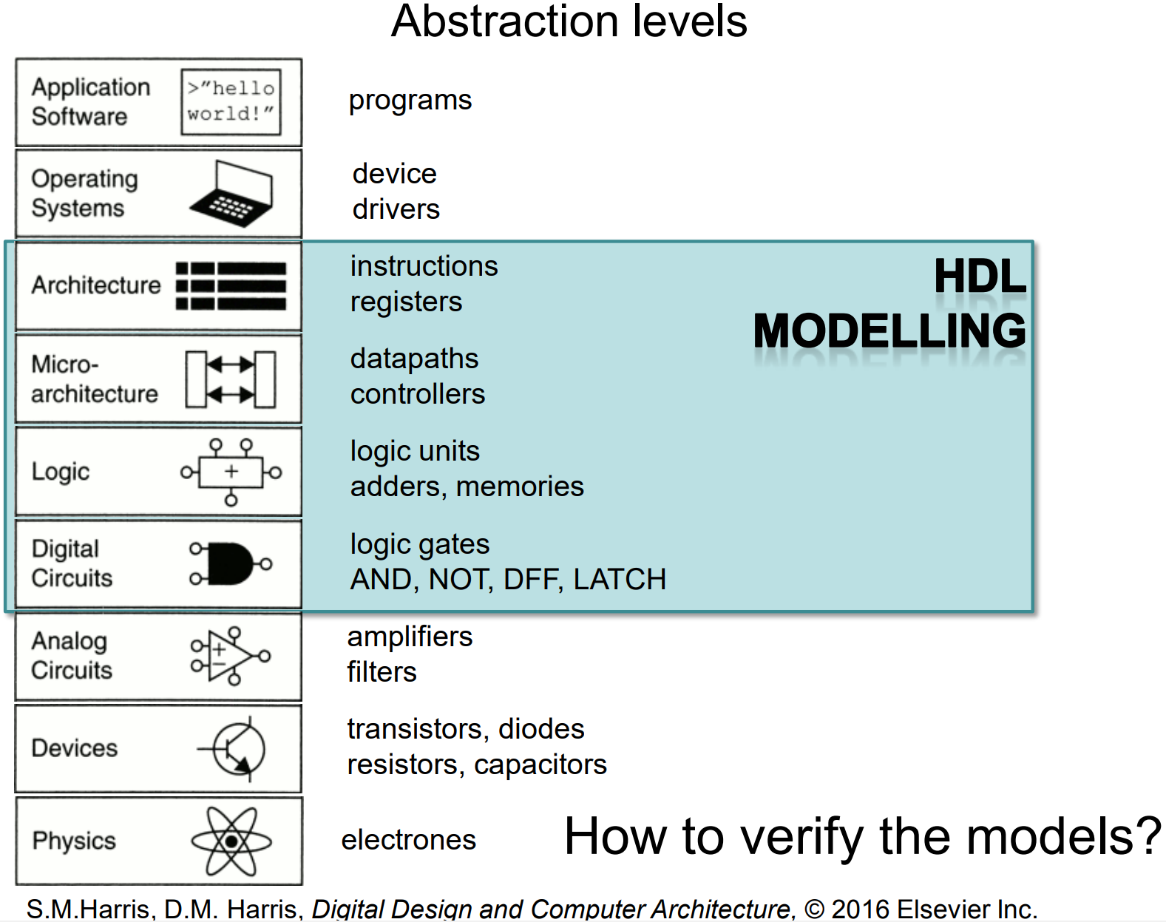
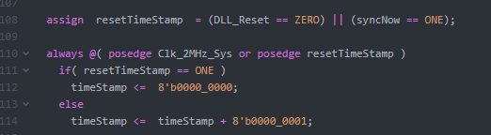
High-level of abstraction modeling
Scope of work)
HDL
MODELLING

Slide 4
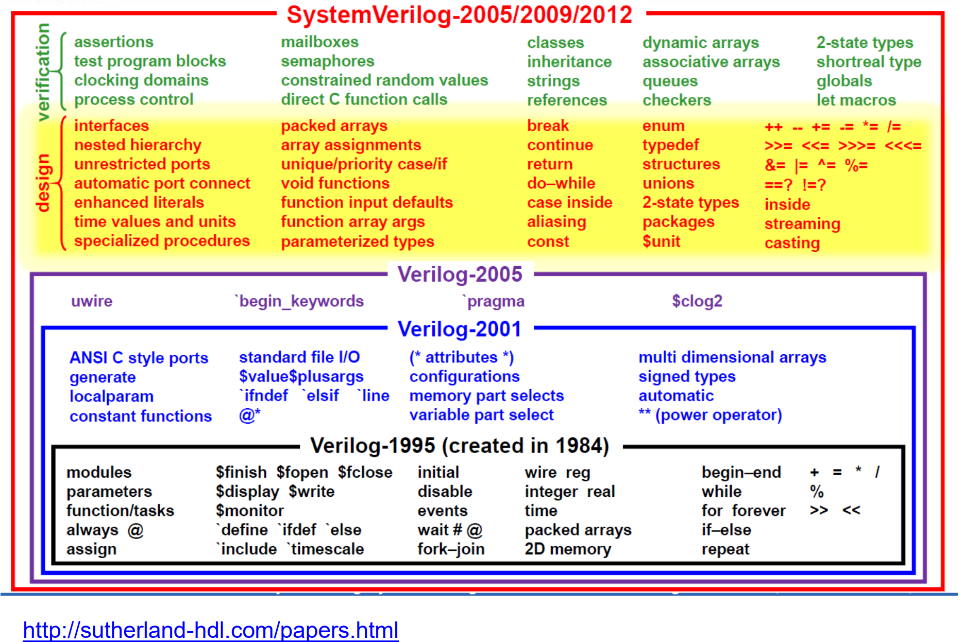
Tools for simulation and verification
System modeling and verification
(object-oriented programming for systems)
Integrated Circuit design (functional programming for elements)

Slide 5
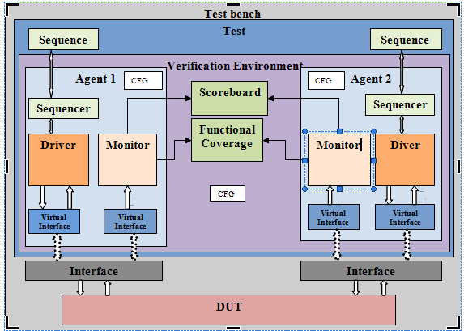
Tools for simulation and verification
General view of UVM test-bench architecture

Slide 6
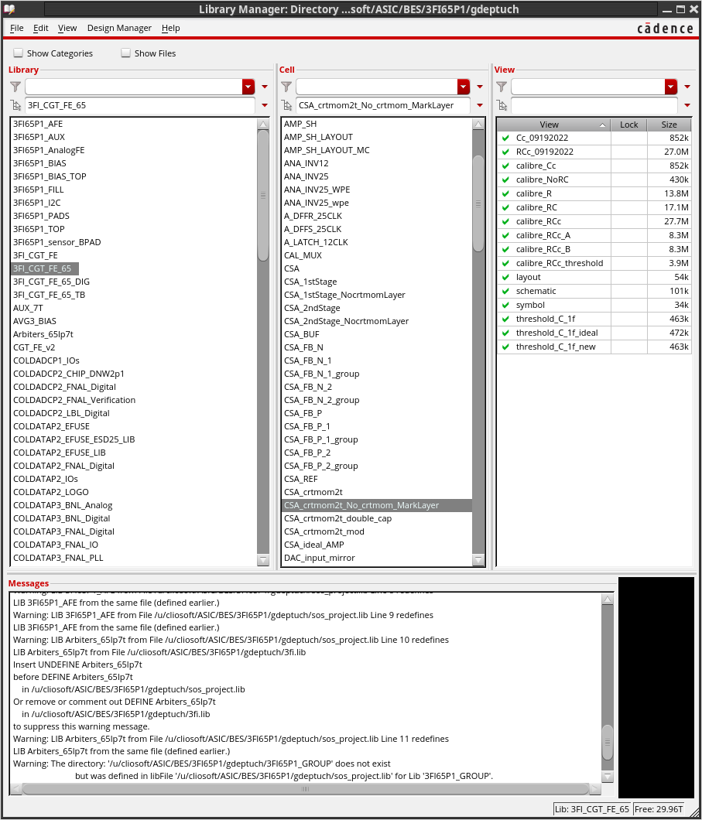
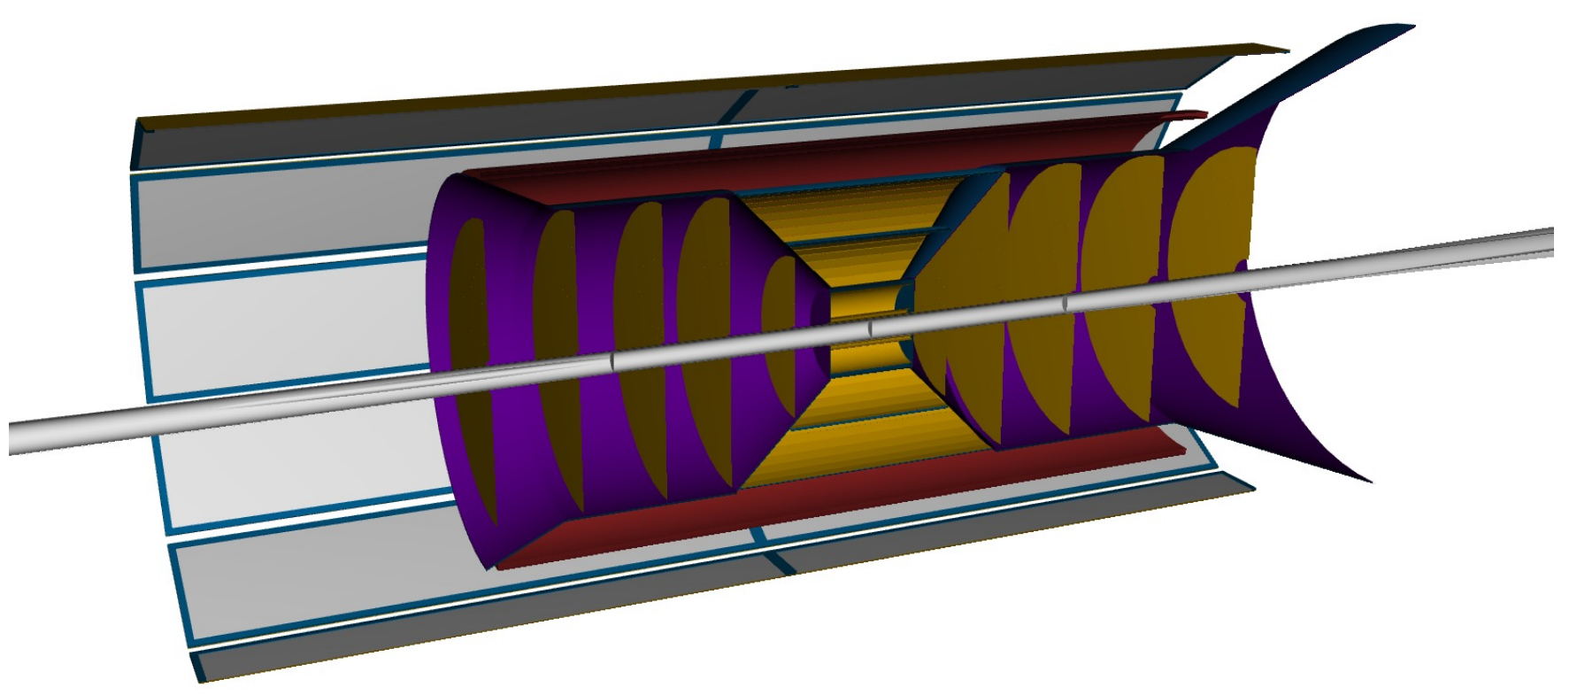
From database to detector
Fabricated Silicon
MAPS sensors are special devices that are designed as Application Specific Integrated Circuits that first exist in CAD/EDA database (with views schematic, functional, layout, SystemVerilog, symbol, etc.) with multiple of files providing information about timing, variability of process parameters that are used for fracturing of the masks and for fabrication of the actual circuits on silicon wafers.
CAD/EDA

Slide 7
Developing virtual detector
Performing “verification” consists of several stages:
DESIGN - ASIC designers develop blocks that are represented in various ways:
  Transistor schematics and physical mask layout (full custom, tedious to simulate at larger scale).
  Register Transfer Level code and synthesized netlists using standard cells and their timing models implemented later to physical mask layout with automated tools (digital, faster functional simulations).
  Higher-Level of Abstraction representation, behavioral coide with a combination of Verilog-A, AMS, SystemVerilog or other languages (covering larger functional parts with description, allowing simulation of subsystems with ASICs, commercial chips, FPGA, )
  System Level description using standards such as UVM (heterogenous integration of stimulus including physics event generators, hierarchical representation of chips and their internal architecture/functionalities, combined subsystems elements, and even data acquisition)
Building System Hierarchy – defining interfaces, interface monitors,
Building TestBenches, Coverage, Sequences and Scoreboard.
  Run simulations verifying results at different spots that are monitored and checked with respect to expected.
  Obtain dataflow and activities to perform other type of verification, such as electromagnetic and IR drop analyses

Slide 8
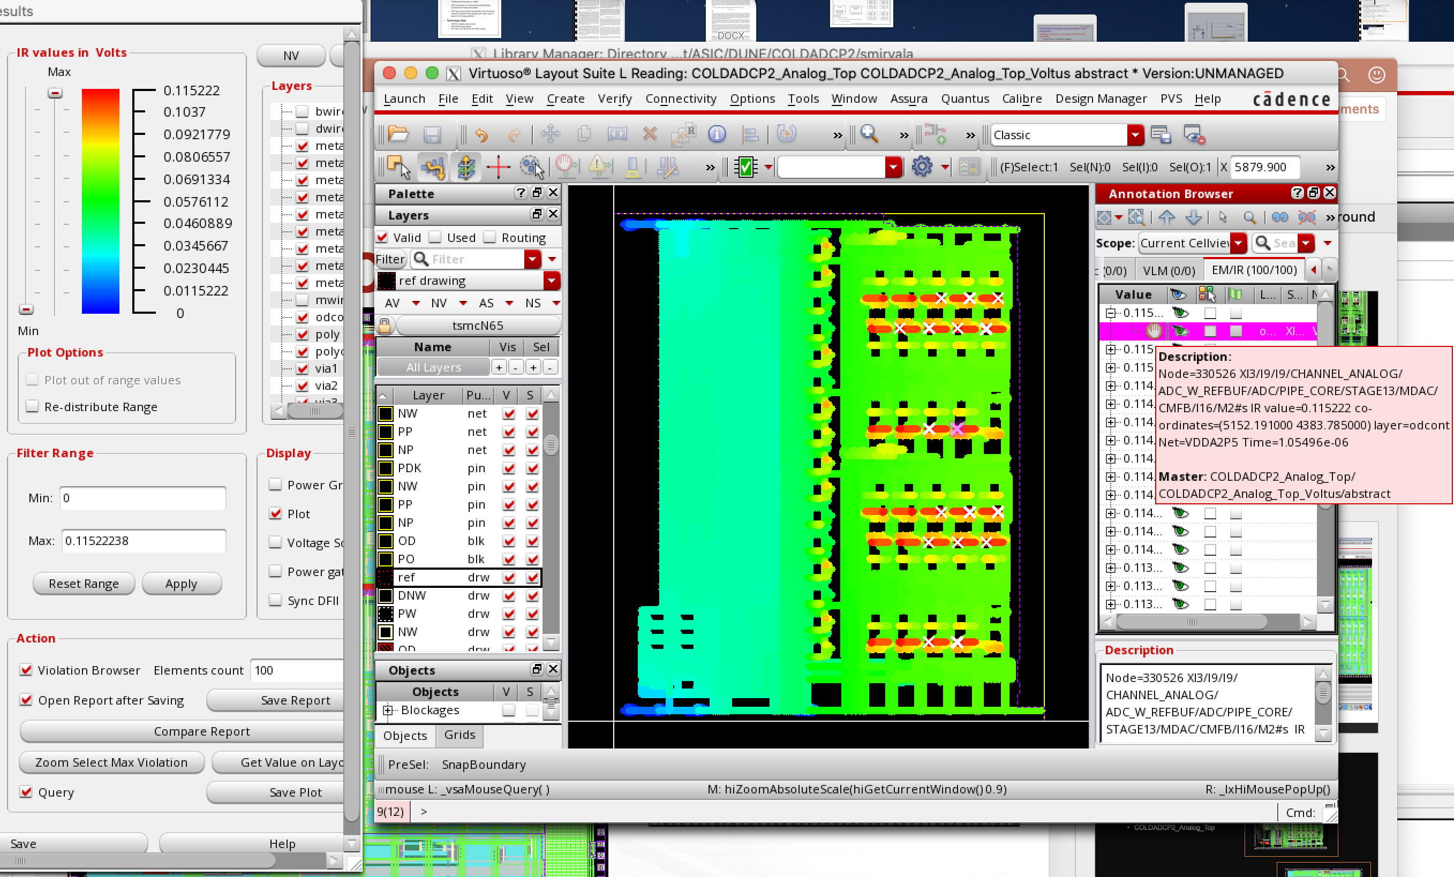
IR drops analysis coupled to ASIC activities
Example of ColdADC (DUNE) EMIR simulation showing IR drops (peak) for activities resulting from on chip operation.
interoperability of tools
big concern in Large Area Sensors are static, and, more importantly, dynamic IR (voltage drops due to the resistive nature of power supply lines conveying supply currents) power supply voltage drops that are dangerous for the high-fidelity operation of the front-end circuitry in the finely segmented pixels
Voltus fi

Slide 9
Goals and methods
R&D project aiming at how to develop a model of the full scale EIC tracking and vertexing detector complex to allow as complete as possible understanding of the operation of the detector layers and carrying out the necessary optimization.
It builds on top of the ALICE ITS3 (MAPS), seeking facilitated transfer of the ITS3 databases for the EIC purpose what the EIC Silicon Consortium is required to do.
Because the scale and depth of the hierarchy of the sensors excludes any SPICE modeling, we propose following the standard of verification methodology in an agreed framework of the Universal Verification Methodology (UVM) being part of the SystemVerilog language.
We consider realization of this proposal as an efficient way of transferring ITS3 design databases with preserved hierarchy and documented functionalities and allowing transforming of the databases for the EIC needs and addition of the elements developed for the EIX within the EIC SC groups
FY23 request
Requested 3 months of combined efforts of ASIC design researcher and physicist to perform ground setting analyzes of developing the model/verification flow and co-simulation

Slide 10
UVM is infinitely popular in industrial applications. In the field of nuclear electronics, or in general in the development of detector systems in particle or nuclear physics experiments, the UVM has been used successfully in the development of single integrated circuits,
References
RD53 Collaboration towards next generation Pixel Read-Out Chip for HL-LHC:
General
  S. Marconi, E. Conti, P. Placidi, J. Christiansen and T. Hemperek, “The RD53 Collaboration’s SystemVerilog-UVM Simulation Framework and its General Applicability to Design of Advanced Pixel Readout Chips” , 2014 JINST 9 P10005.
Data Throughput
  E. Conti, S. Marconi, T. Hemperek, J. Christiansen and P. Placidi, “Performance evaluation of digital pixel readout chip architecture operating at very high rate through a reusable UVM simulation framework”, 2016 IEEE NSS/MIC/RTSD, Strasbourg, France, November 2016.
Power analysis
  S. Marconi, S. Orfanelli, M. Karagounis, T. Hemperek, J. Christiansen and P. Placidi, “Advanced power analysis methodology targeted to the optimization of a digital pixel readout chip design and its critical serial powering system”, 2017 JINST 12 C02017.
Coupling to physics data generator
  E. Conti, S. Marconi, J. Christiansen, P. Placidi and T. Hemperek, “Simulation of digital pixel readout chip architectures with the RD53 SystemVerilog-UVM verification environment using Monte Carlo physics data”, 2016 JINST 11 C01069.
The introduction of the UVM formalism coupled with the physical level for modeling and verifying the entire detector, which is postulated, is a new approach and the scale of application in the experiment such as the EIC detector requires knowledge of ASIC design, detector system integration and the physics.

Slide 11
Questions
How does the full tracker design integrate with upstream ITS3 chip design and foundry?
It should be noted that some modeling work is carried out by the developers of ITS3, but it is limited to the area of a single sensor and do not cover the holistic aspect of the detector as and object.
It is also useful for EIC- SC groups to effectively assimilate the ITS3 sensor database.
The development grows upon the ground design work, while allowing for virtual operation of the detector from providing physical data to data flow to the data acquisition system.
Please sketch out the proposed design flow and how the existing tools are supplemented.
It is hoped that it will integrate engineering and physics and teams – new culture of detector development.
There is no ready-to-use tool, or even a pre-existing environment, allowing for a hierarchical description in the form of a model combining the physical characteristics of the detector object, its description at the functional level that would come down to the level of behavioral description of electronics or representation in the form of a physical model of the sensor itself – we would like to set foundations for this approach
There are tools in the form of hardware description languages (SystemVerilog and UVM is Ooprogramming environment oriented on hardware development) that we want to analyze to see if building a full model is possible and have it available for Det1, Det2...

