Slide 1
Unpolarized Kaon electroproduction on Hydrogen and Deuterium target
Vallarino Simone
INFN Ferrara & University of Ferrara
December 13, 2022

Slide 2
Semi-Inclusive Deep Inelastic Scattering (SIDIS)
Powerful tool to study the inner structure of nucleon, accessing to Transverse Momentum dependent Distribution functions (TMDs)
The polarization in leptoproduction provides new dimensions for testing QCD
Spin Asymmetries, in particular the large Single Spin Asymmetries (SSAs), can be related to TMDs
Complementary measures with π and K can provide information about the Collins fragmentation mechanism
These measures can be done with the CLAS12 detector, combining the high luminosity and the phase space extended after the 12 GeV upgrade
To identify the high-momentum K a new Cherenkov detector for PID has been realized and installed in two sectors of CLAS12
The proposal has been accepted and became the experiment E12-09-008 that is being performed by Run Group A (for Hydrogen) and B (for Deuterium)

Slide 3
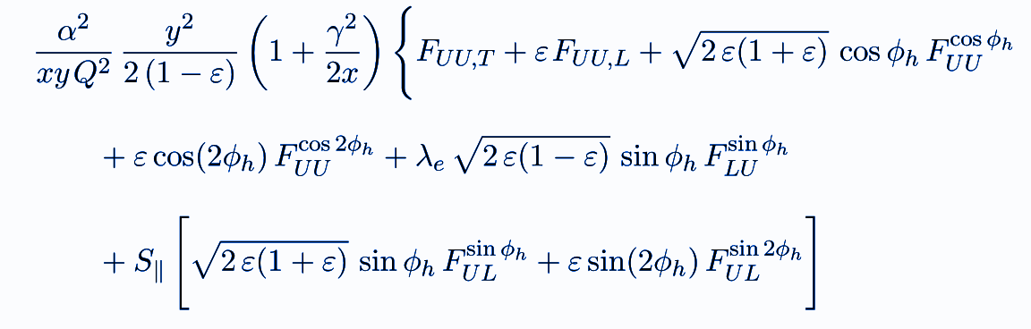
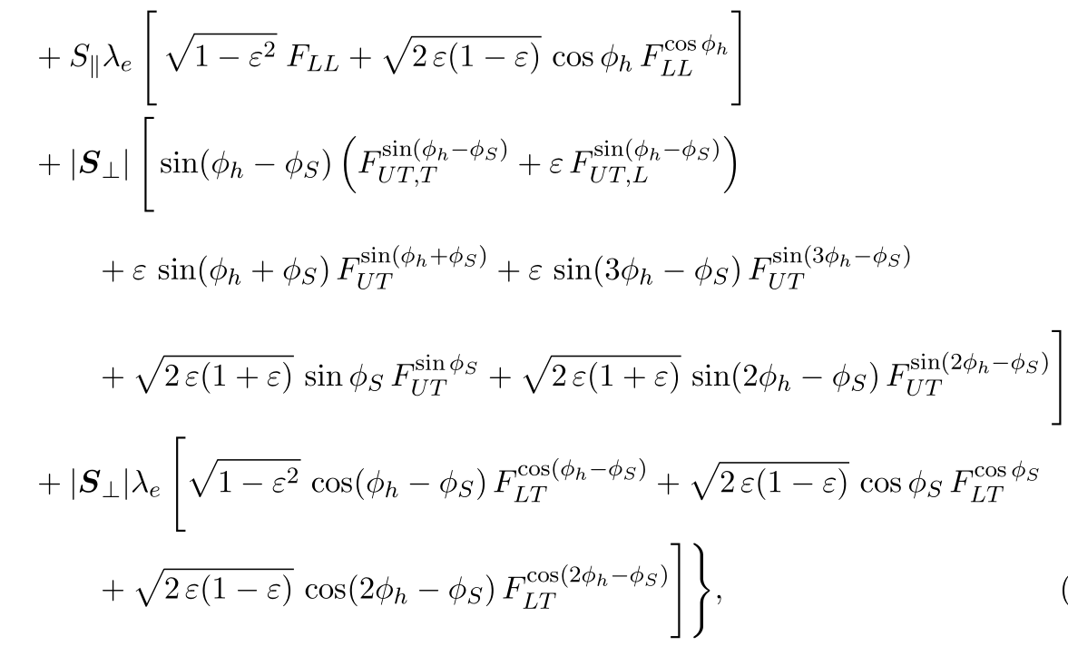
SIDIS cross section
The aim of the experiment is to study the Boer-Mulders distribution functions, the Collins function and the Cahn effect, by measuring three terms of the cross section with unpolarized and longitudinally polarized beams, and with unpolarized H and D targets.
Where h₁⟂ is the Boer-Mulders function, H₁⟂ is the Collins function. The Cahn effect is related to the collinearity of quark process i.e. intrinsic transverse momentum.

Slide 4
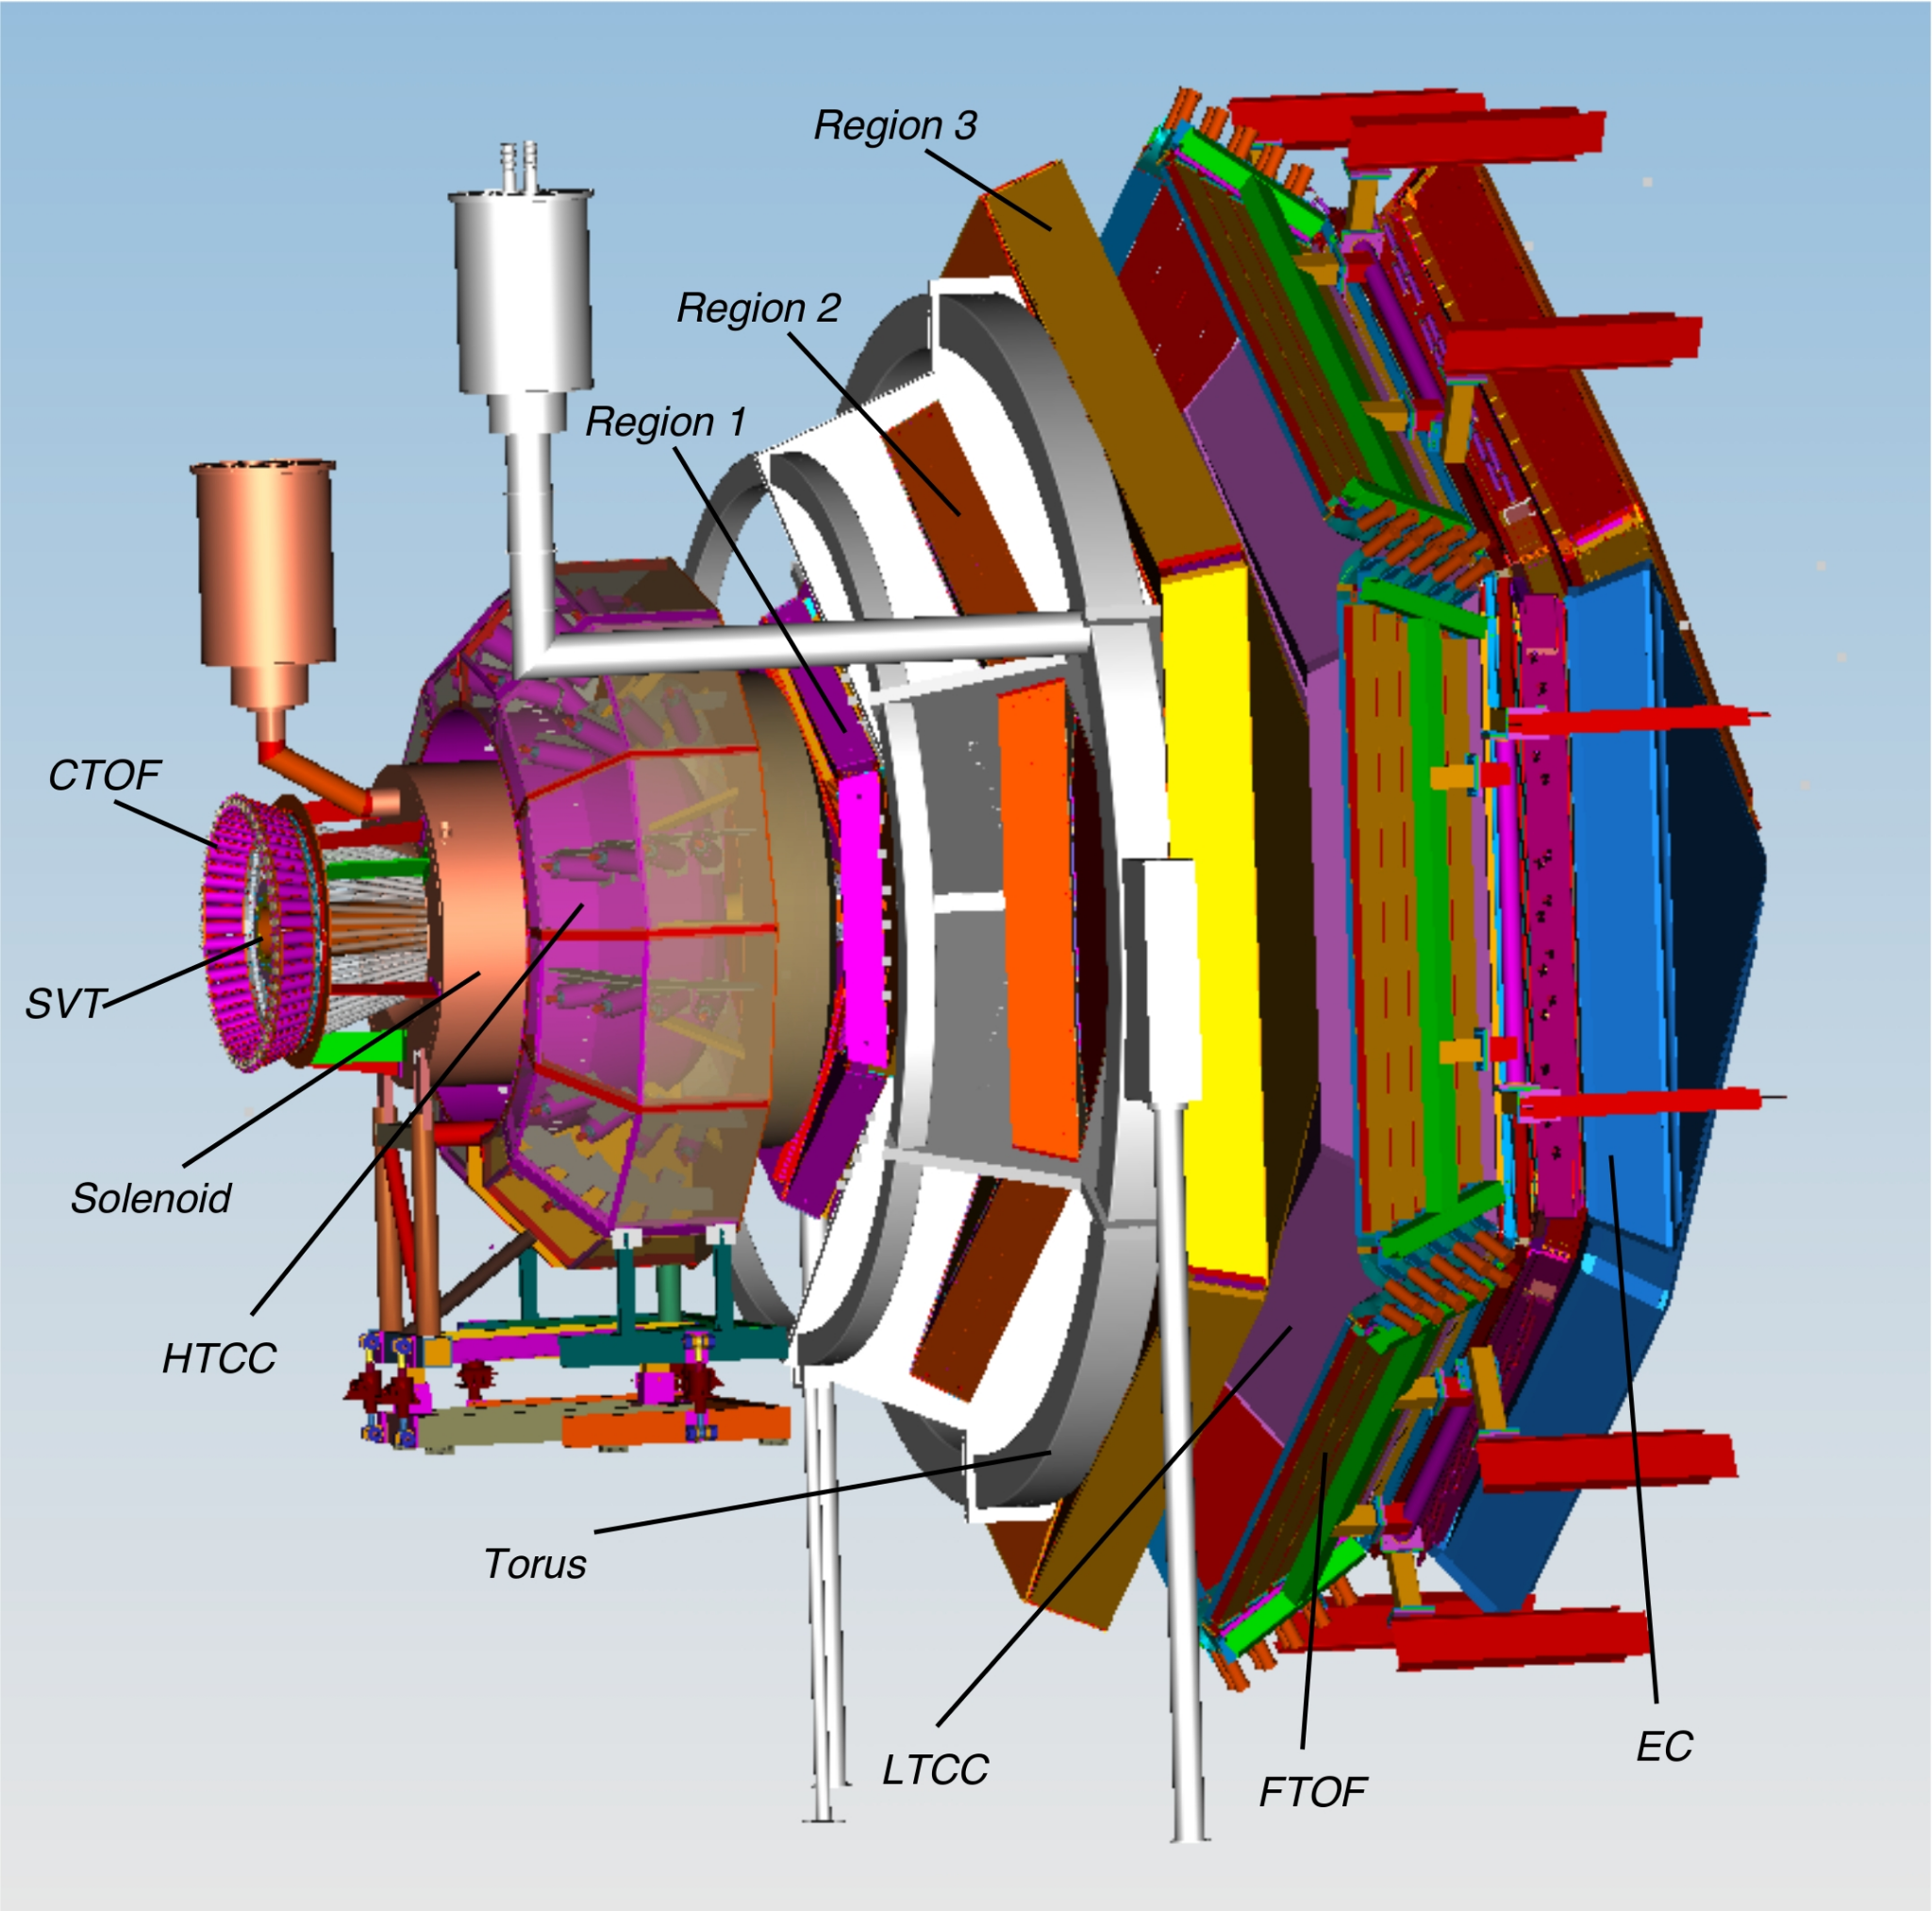
CLAS12 configuration
Unpolarized targets of hydrogen or deuterium
11 GeV beam
Toroidal magnetic field 2T (forward) and solenoid 5T (recoil).
Standard production system, data acquisition and online monitoring
The HTCC, LTCC and TOF system provides a good separation:
π/K up to 3 GeV/c
K/p in 2.5-5 GeV/c momentum range
In the 3-8 GeV/c it is not possible to well separate π/K/p then an extension in PID momentum range is needed
Two modules of Ring Imaging Cherenkov has been installed in sector 1 and 4 of the CLAS12 detector (completed in June 22)

Slide 5
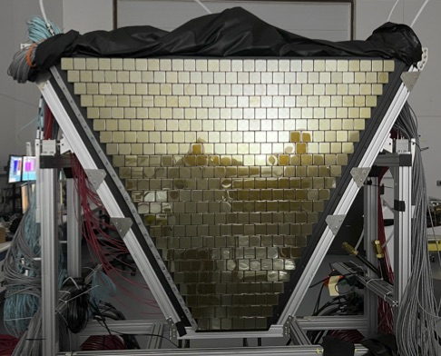
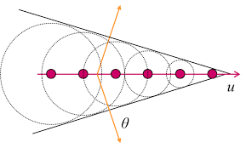
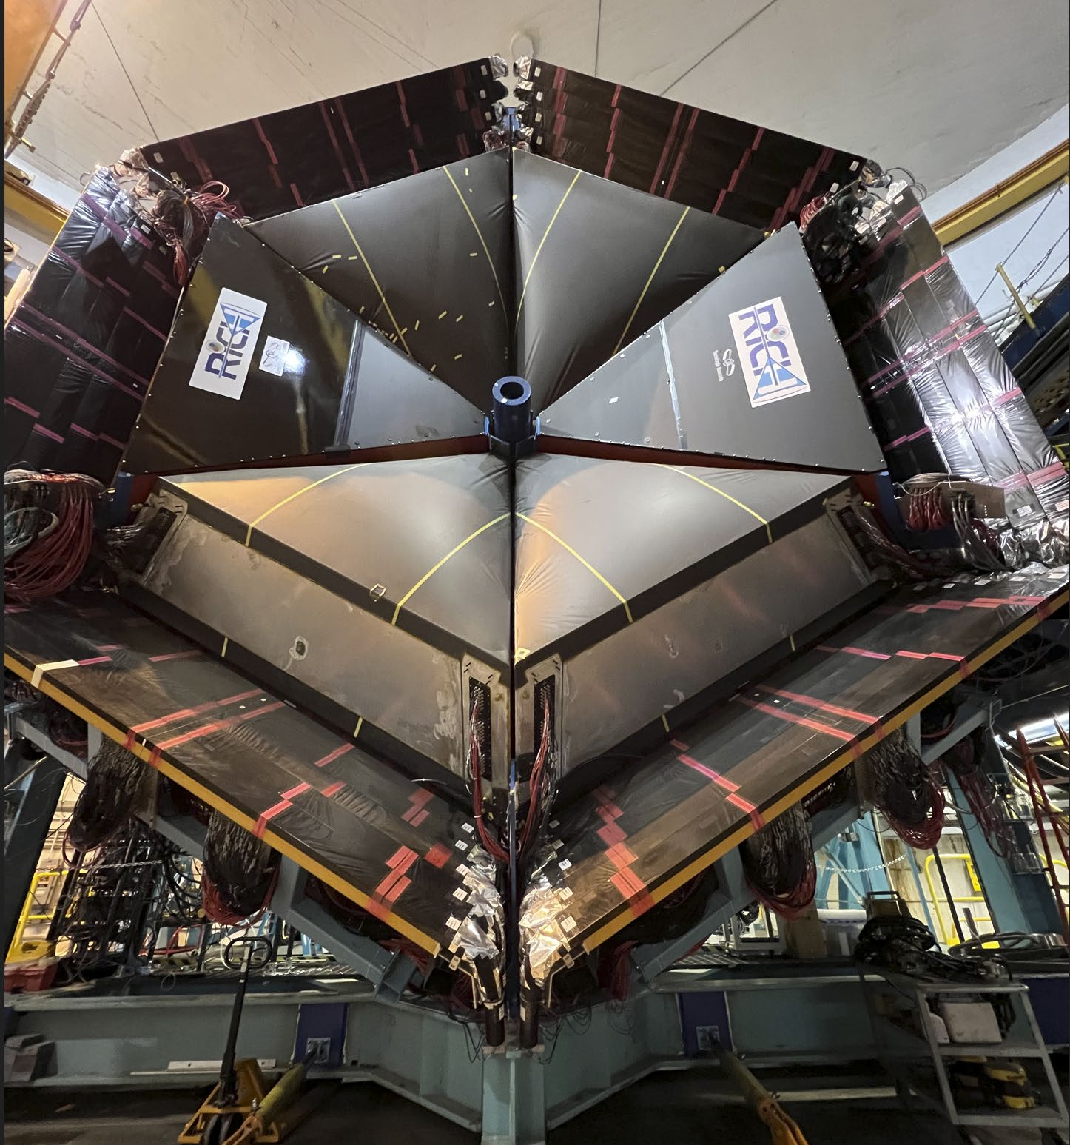
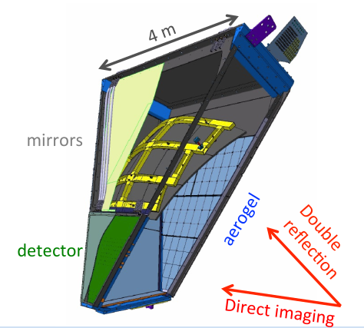
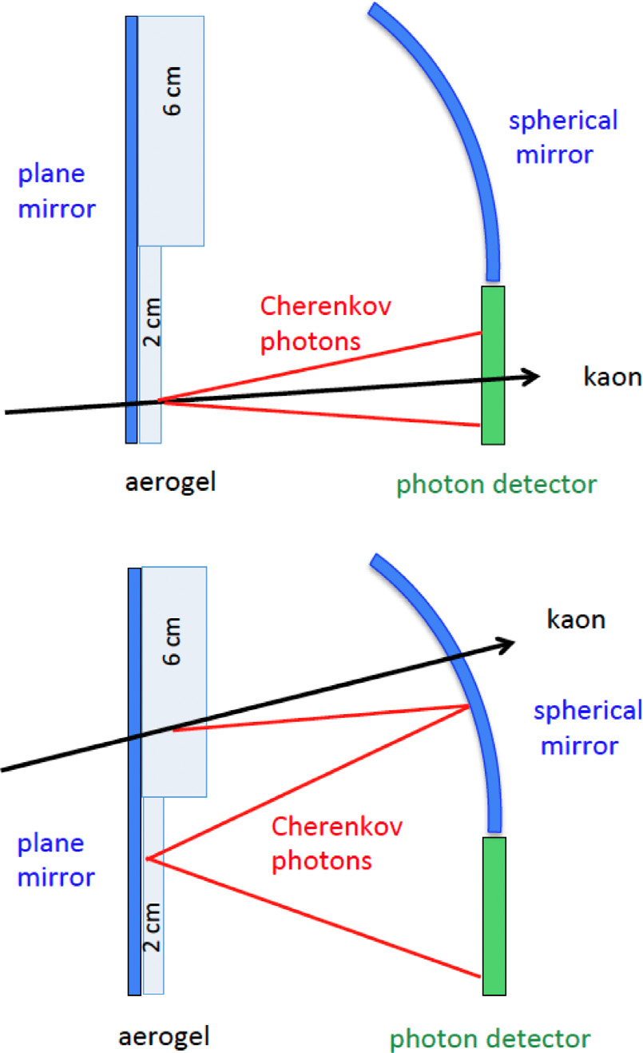
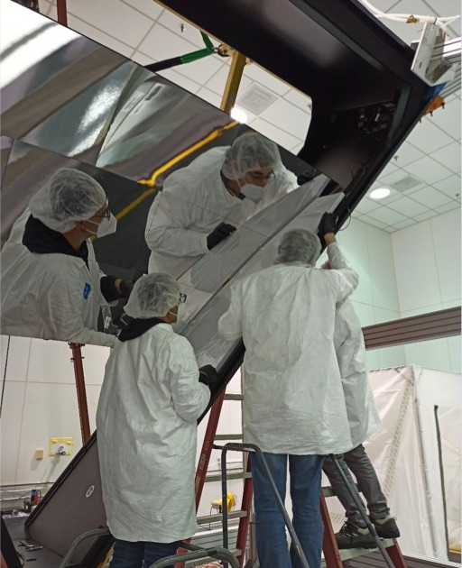
The CLAS12 Ring Imaging Cherenkov

Slide 6
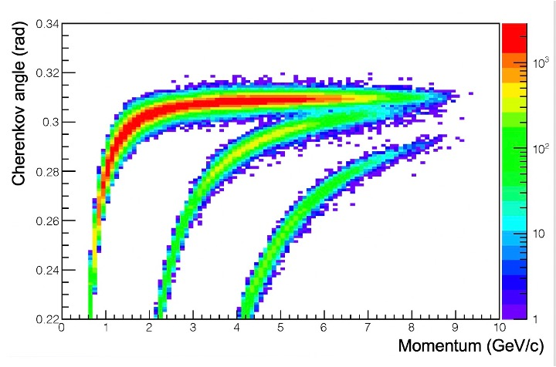
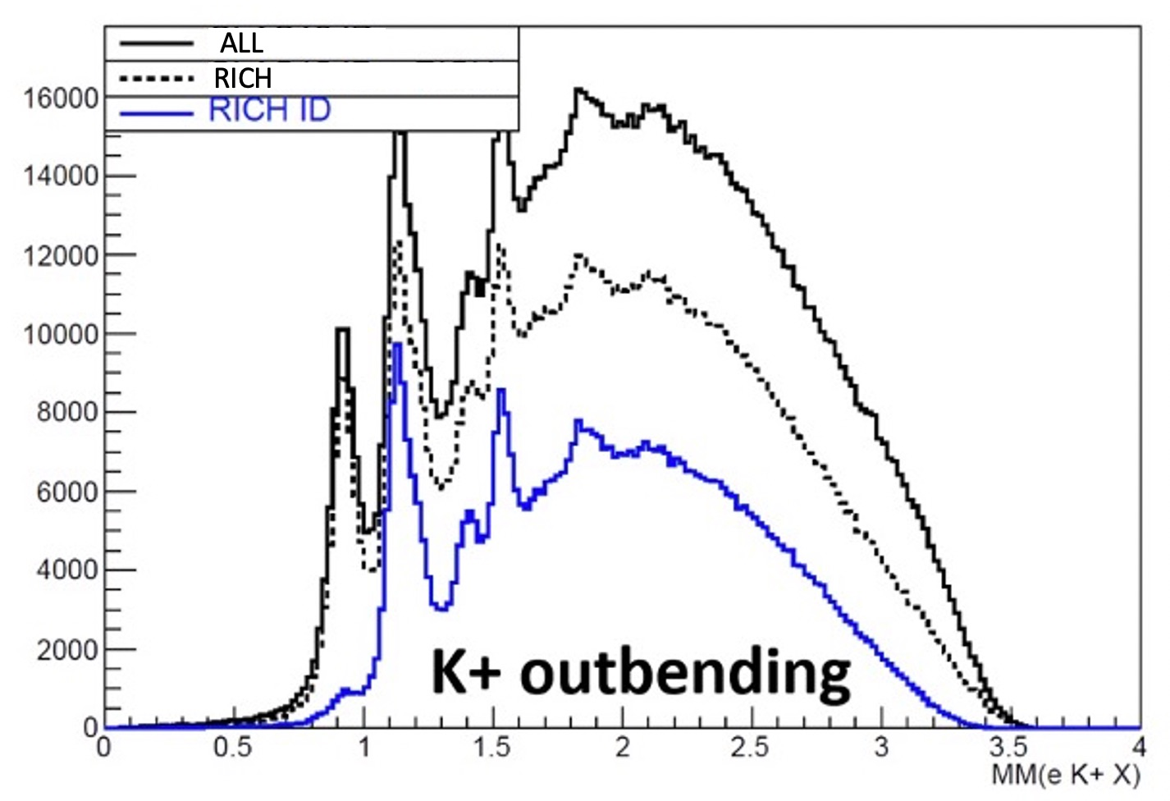
RICH preliminary performance
More details in M. Contalbrigo talk tomorrow
ep→e’πn
Left: hadron separation provided by RICH
Right: check with semi-inclusive channel
ep → e’H⁺X
ep→e’K⁺Λ

Slide 7
Data analysis
Selection of ep→e’KX events, improved by the RICH
Definition of x_{B}, Q², z_{k}, P_{T} binning
Extraction of the cross section and the single spin asymmetry
Extract A^{cos𝜙}_{UU}, A^{cos2𝜙}_{UU} and A^{sin𝜙} _{LU} from fit parameters
Fit with:

Slide 8
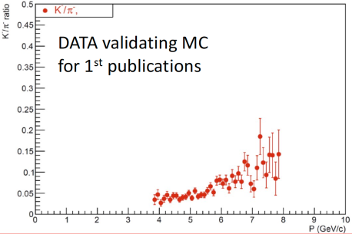
Expected statistical and systematic errors
The expected systematic errors have been evaluated using a fast Monte Carlo simulation of inclusive and semi-inclusive DIS with CLAS12 acceptance folded in.
This SSA measurement is rather insensitive to uncertainties in acceptance and charge normalization
Other sources include the longitudinal to transverse photo absorption cross section ratio and the beam polarization (for the sin𝜙 term)
A source of systematic error is the possible contamination of single K sample with K from decays of exclusive K* meson
The statistics for K is one order of magnitude less than π, as well as evaluated with MC and confirmed by the first data.
To reduce the statistic errors the request is 54 beam days plus 2 commissioning days.

Slide 9
Expected results
This experiment will simultaneously collect SIDIS data with π and K using H and D targets.
The extraction of cos𝜙, cos2𝜙 and sin𝜙 moments will provide information on Boer-Mulders function, the Collins function and the Cahn effect.
The measurements for charged K with two targets, combined with π measurement, will allow the extraction of Collins analyzing power ratios, providing information about the polarized FFs and flavor sensitivity of PDFs.
The measurements of azimuthal asymmetries will provide coinstains on the TMDs and will allow more precise test of factorization and the investigation of the Q² dependence, enabling to study the leading-twist and higher-twist nature of the corresponding observables.
The measurement of the P_{T} dependence of Boer-Mulders asymmetry will allow to check of high P_{T} predictions and study transition from non-perturbative to perturbative regime.
Combining analysis of CLAS12 data and HERMES measurement in high Q² domain will provide information on the Boer-Mulders funcion, that allows to study correlations between transverse spin and transverse momenta of quarks.

Slide 10
My role in this analysis
Since november 2020 I am working with the CLAS12 RICH group, in particular I was involved in the second module assembling, installation and commissioning.
I just started to study SIDIS and the SSA
I will start to analyze the CLAS12 data looking for the Single Spin Asymmetry
and extracting the A^{sin𝜙} _{LU} term.
The analysis will be performed on Run Group B data, which acquired ~43B triggers between 2019 and 2020. Also run group A data will be used to compare results from the two different targets.
If possible I will go deep in this analysis and trying to extract the A^{cos𝜙}_{UU}, A^{cos2𝜙}_{UU} terms.
At the end of 2023 I will conclude my PhD with a thesis on RICH and its use on physics analysis like this one.

Slide 11
Thank you for your kindly attention

Slide 12
References
[CLAS12 PAC 34 proposal] Studies of the Boer-Mulders Asymmetry in Kaon Electroproduction with Hydrogen and Deuterium Targets
[Bacchetta et Al] Semi-inclusive deep inelastic scattering at small
transverse momentum

