Slide 1
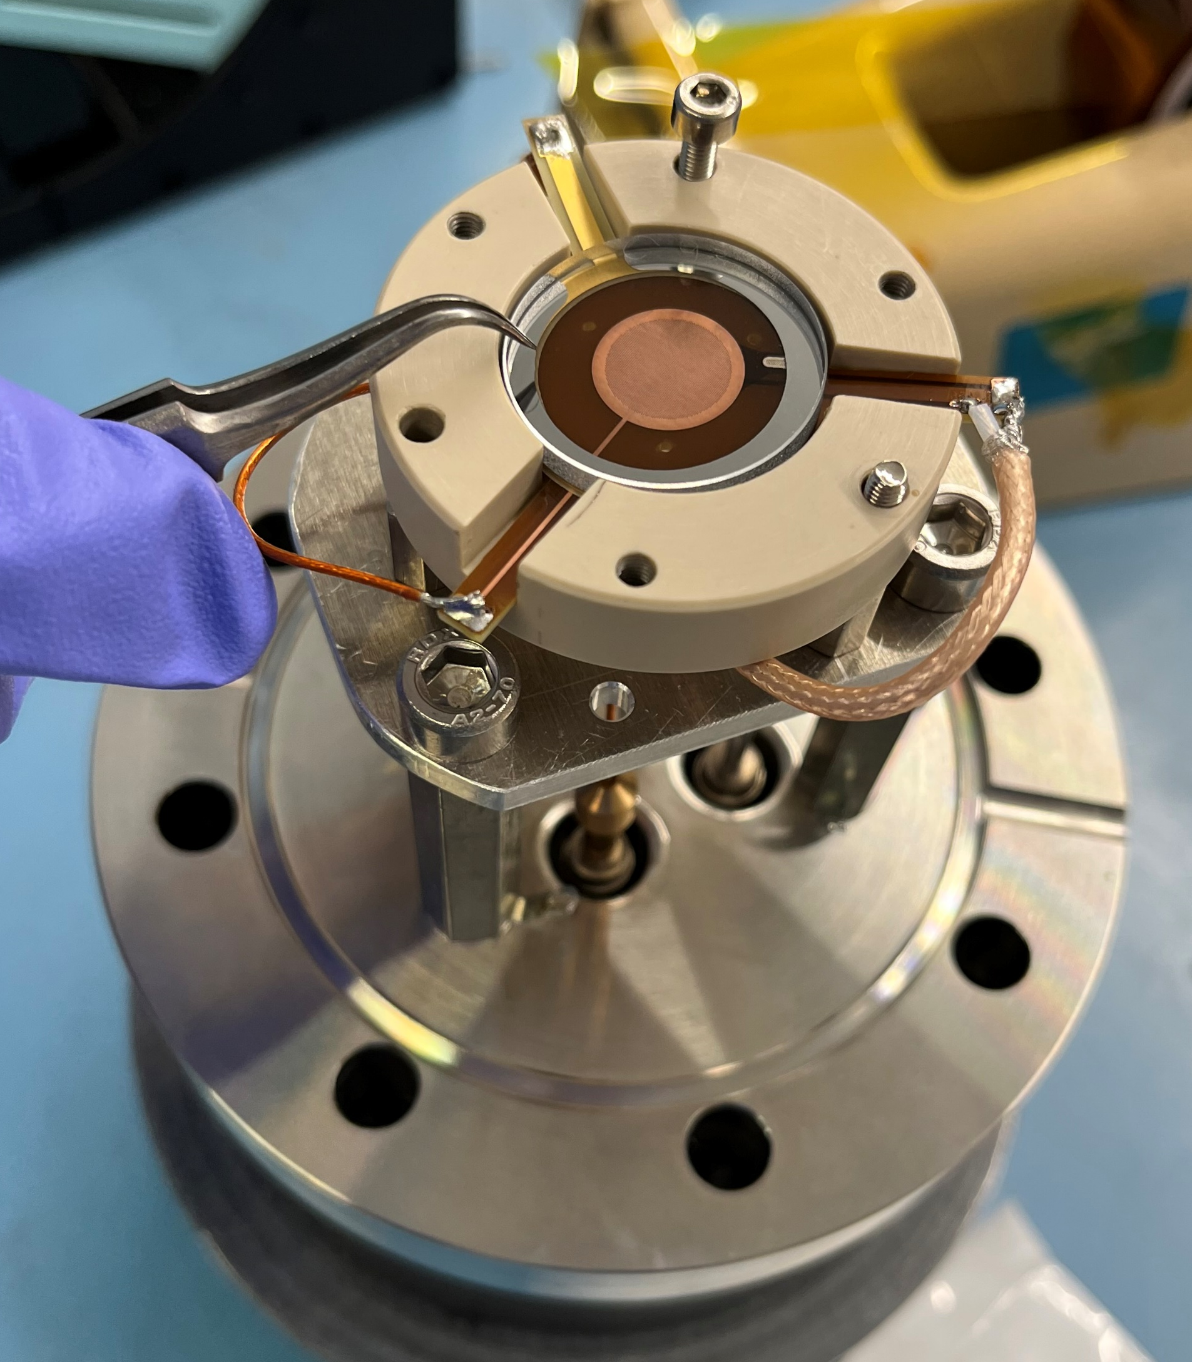
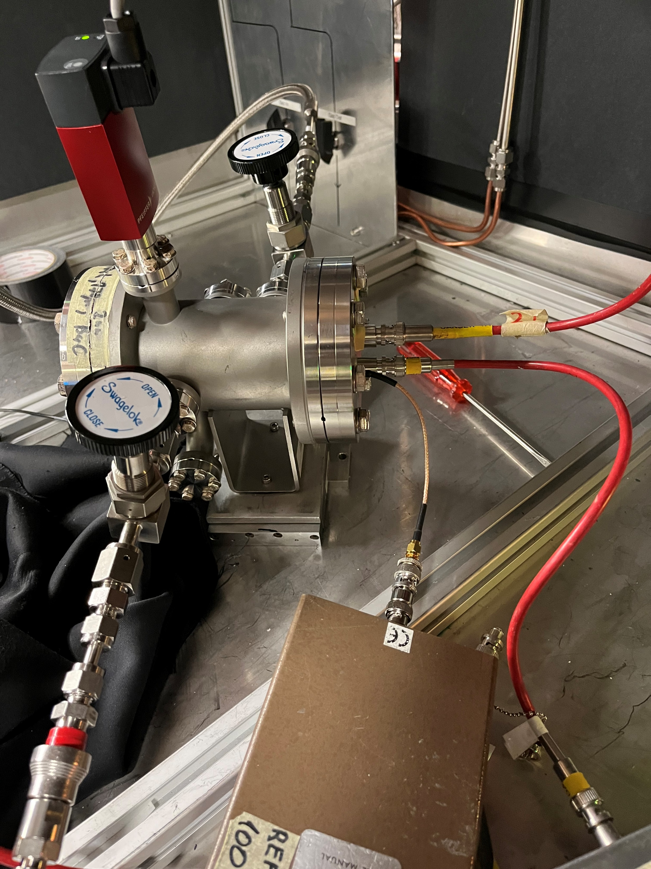
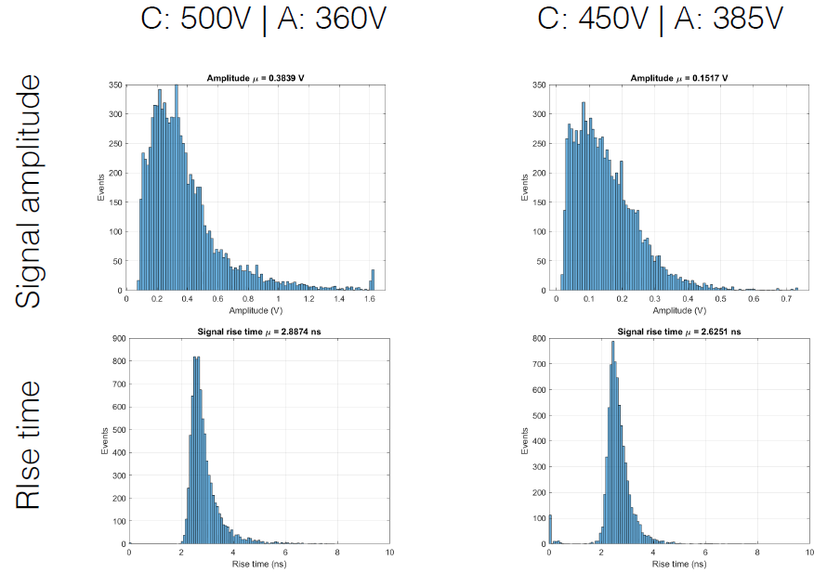
LD2309 - µrPICOSEC: Quarterly report (Q1) Progress and Issues
LD203 - µrPICOSEC R&D Group:
Group Indico page: https://indico.jlab.org/category/28/ - Weekly meeting every Monday at 1pm
Group Wiki page: https://wiki.jlab.org/urwell_picosec/index.php/Urwell-picosec
Member of CERN MM-PICOSEC collaboration
Design and prototyping effort:
Development of single-pad µrPICOSEC prototype and tested in the GDD lab at CERN, Dec. 2022. ✓
Analysis with promising results - ongoing
Design of µRWELL PCBs with optimized geometry ✓ procurement of the parts - ongoing
Multi-channel readout electronics and DAQ
Test of the single channel fast timing electronic based on programmable differential amplifier (PDA) – Wenze Xi, ongoing.
Design of the pre-prototype board to test multi-channel fast timing electronics - Jack McKisson, ongoing
Hiring a postdoctoral research associate
Position has been created and advertised. ✓
https://jefferson-lab.us.hire.com/p/a3328681ebdf46ef89d43c61e6ae4703-ldrd-urpicosec-postdoctoral-fellow
Very few candidates so far have applied ✗
Hope for a few more applications ➔ will wait until end January to start candidate selection.
Single-pad urPICOSEC in test @ CERN, Dec 2022
Single-channel prototype
Preliminary results – gain vs. signal arrival time
Some preliminary results
Dec 2022

