Slide 1
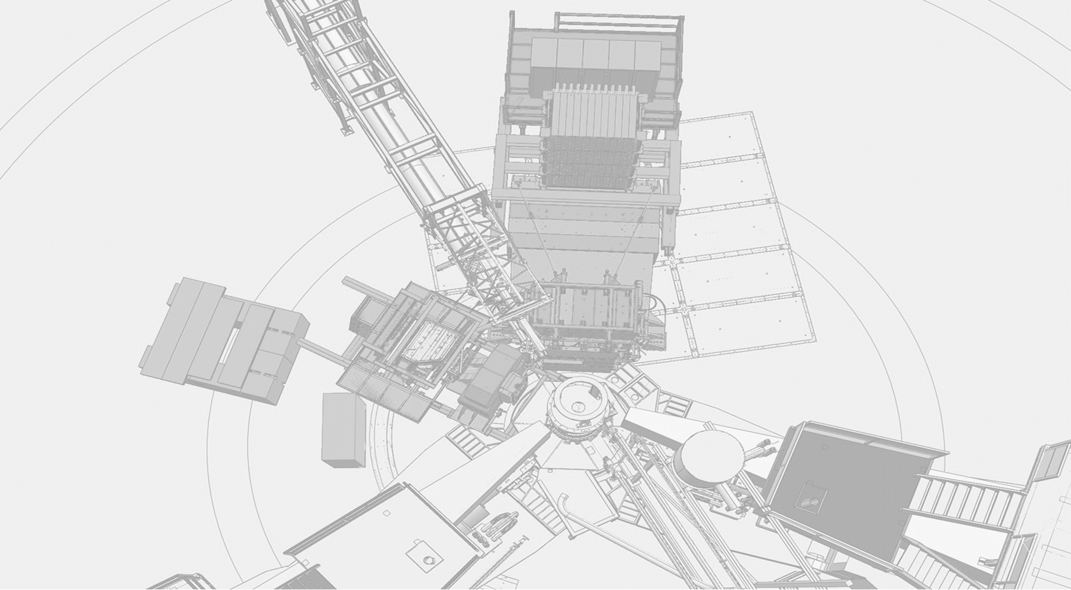
GEp-5 (E12-07-109)
Large Acceptance Proton Form Factor Ratio Measurements up to 12 GeV² using Recoil Polarization
E.Cisbani, M.Jones, N.Liyanage, L.Pentchev, A.Puckett, B.Wojtsekhowski
Don Jones
for the GEp collaboration
Hall A Collaboration Meeting, Jan. 27, 2023
Notes:
The experiment will continue the main stream of JLab physics with hadron form factors.

Slide 2
GEp experiment
GEp continues in the stream of the impactful JLab program of hadron form factors (FF) measurements
Selected by PAC 41(2014) as a high impact experiment
Re-approved by PAC 47 (2019)
GEp Spokespersons: E.Cisbani, M.Jones, N.Liyanage, L.Pentchev, A.Puckett, B.Wojtsekhowski

Slide 3
Schedule
Next SAD starts March 21 during which crane repair and installation of GEn-RP & Pion KLL happens
  Target changed from polarized He3 back to LH2 cryotarget.
  GEp electron calorimeter (ECal) + coordinate detector (CDET) assembly begins in the Hall.
GEn-RP and Pion KLL run in September followed by a second SAD Sept 26,2023 to July 19, 2024 for GEp installation
  BigBite decommissioned and removed.
  Installation of ECal+CDet on electron arm and proton polarimeter on hadron arm (SBS)

Slide 4
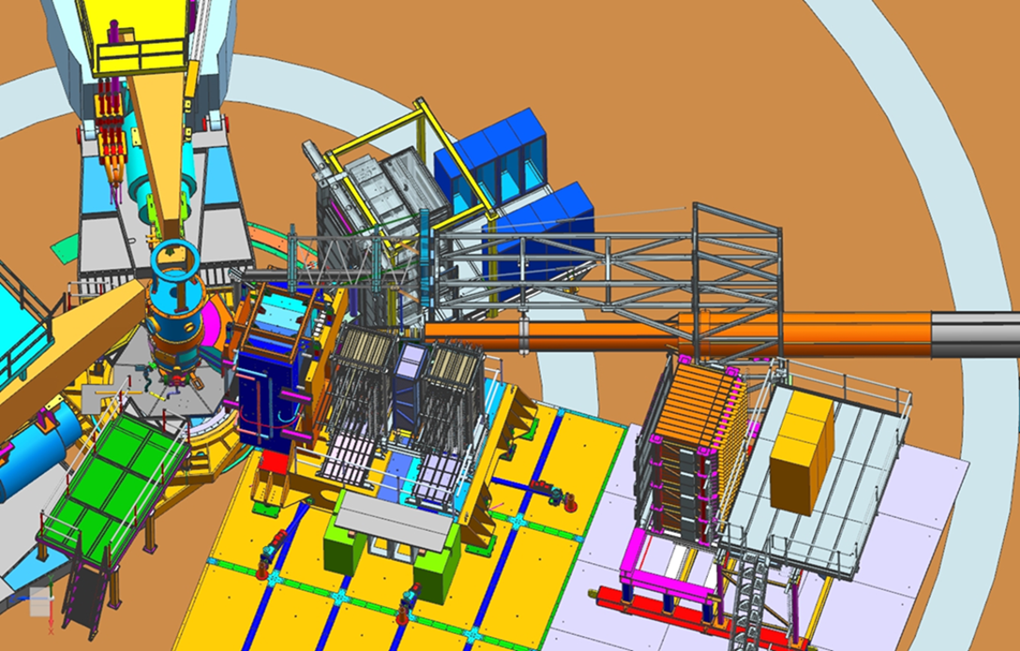
Electron-nucleon elastic scattering
30cm LH2 target
Electron arm
CDet + ECal
SBS dipole
beam
Hadron arm
Proton
polarimeter
HCal

Slide 5
Electron-nucleon elastic scattering
Nucleon current, one₋photon approximation, ⍺_{em} = 1/137,
Rosenbluth formulation 1950
Dirac FF
helicity conserving
Pauli FF
helicity non-conserving)
Sachs FFs GE and GM: linear combinations of F1 and F2
Notes:
Classical formula of the hadron current and FFs

Slide 6
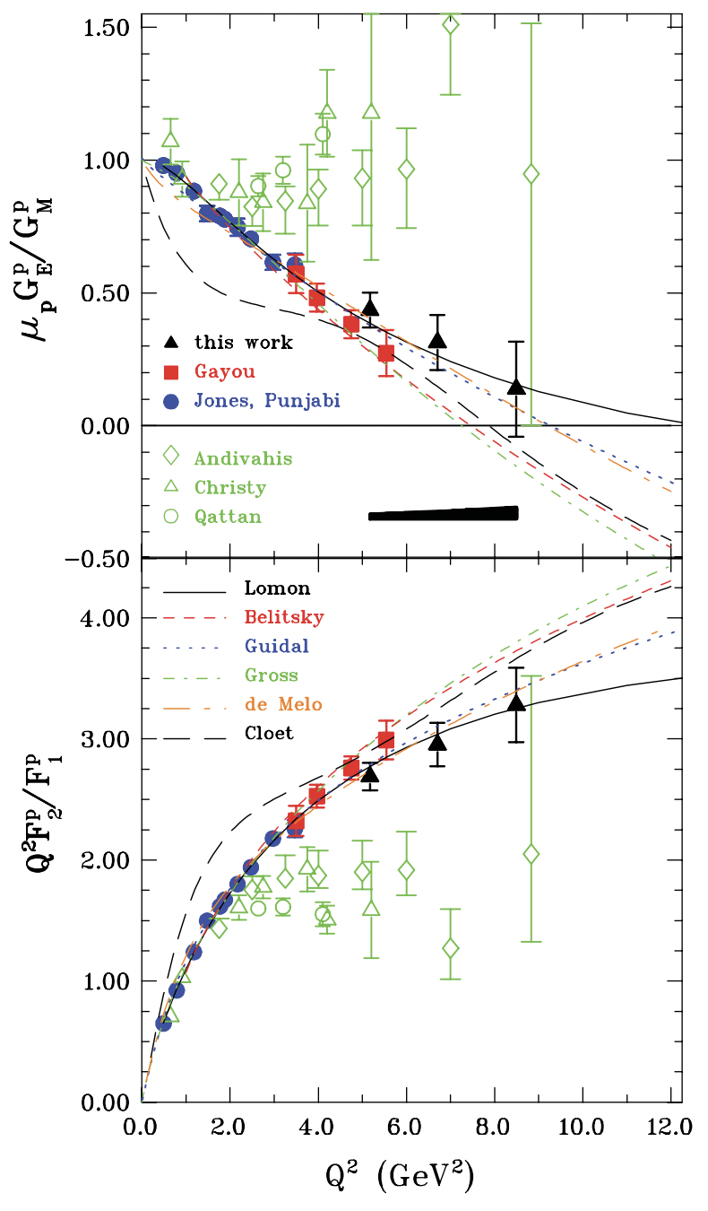
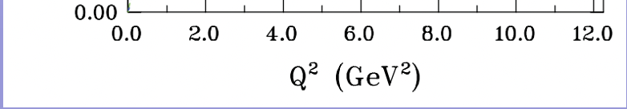
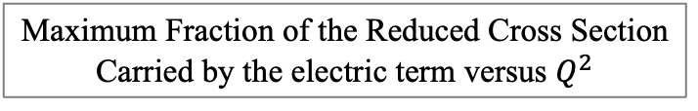
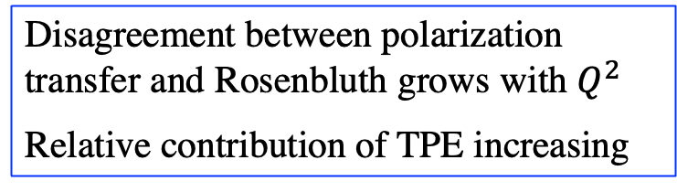
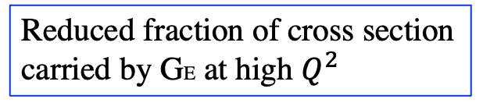
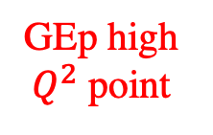
Issues with Rosenbluth Separations
PRL 104, 242301 (2010)
Maximum Fraction of the Reduced Cross Section
Carried by the electric term versus $Q^{2}$
arxiv.org/abs/2212.11107
GEp high
$Q^{2}$ point
Disagreement between polarization transfer and Rosenbluth grows with $Q^{2}$
Relative contribution of TPE increasing
Reduced fraction of cross section carried by GE at high $Q^{2}$

Slide 7
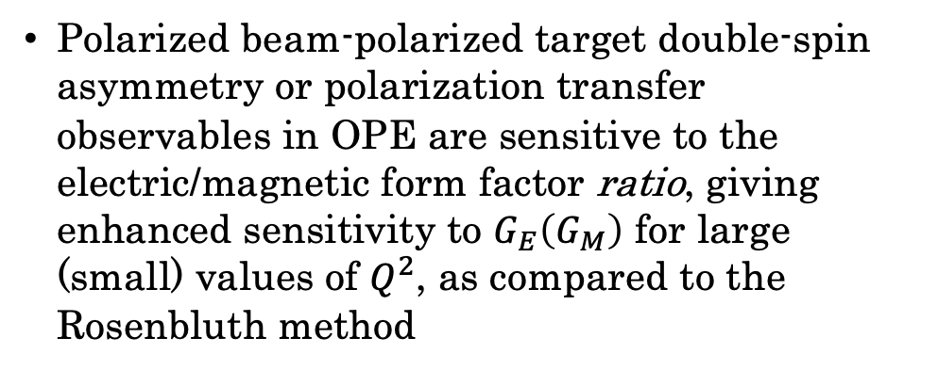
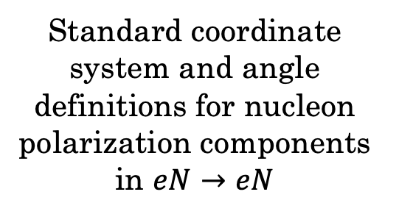
Polarization Observables in Elastic $eN→eN$ Scattering
Interesting factoid:
Theory was developed by Akhiezer and Rekalo(1968) and Dombey(1969) before polarized beams developed
Standard coordinate system and angle definitions for nucleon polarization components in $eN→eN$
Polarized beam-polarized target double-spin asymmetry or polarization transfer observables in OPE are sensitive to the electric/magnetic form factor ratio, giving enhanced sensitivity to $G_{E}\left(G_{M}\right)$ for large (small) values of $Q^{2}$, as compared to the Rosenbluth method

Slide 8
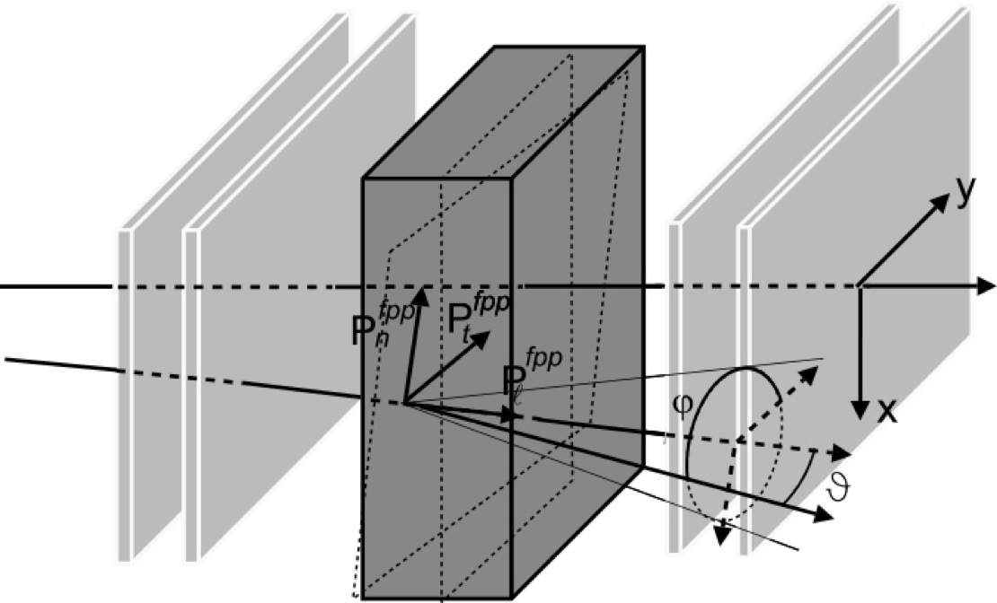
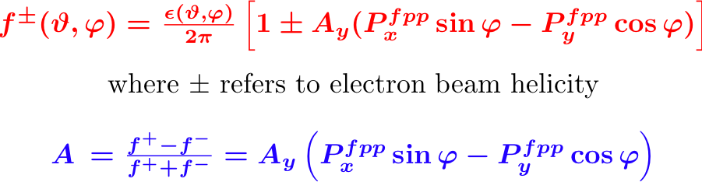
Method: Focal Plane Polarimeter
A_{Y} analyzing power vs.
inverse proton momentum
Track in
Track out
p will be ~ 7 GeV/c
fringe field correction
Notes:
The key element is a Focal Plane Polarimeter and the analyzing power of secondary scattering. Needs a well understood A_{Y}.

Slide 9
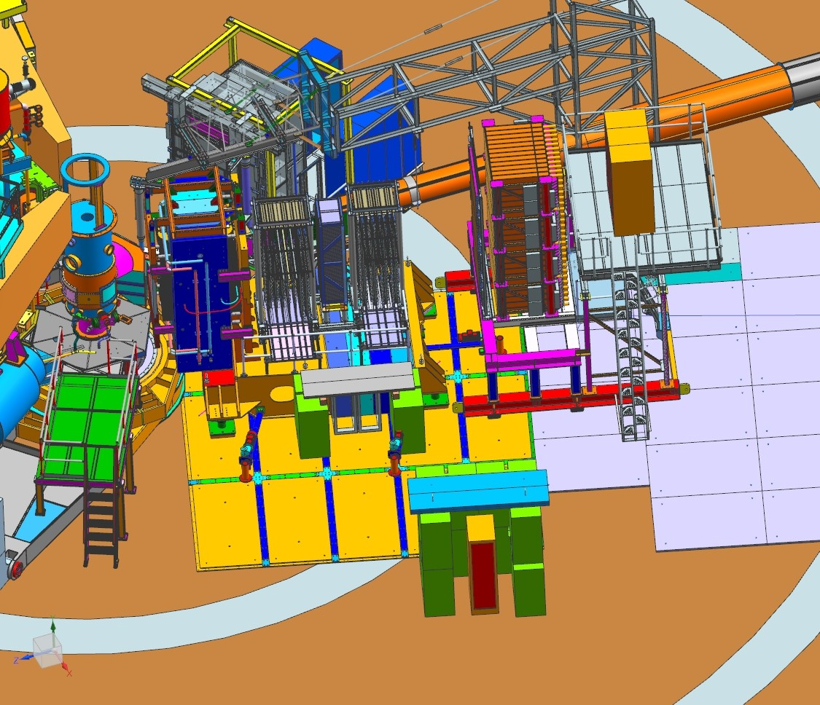
Experiment: Layout and Parameters
Beam: 75uA, 85% polarization
Target: 30 cm liquid H₂
Electron arm at 30º, covers Q² range from 10 to 14 GeV²
Proton arm at angle 17º,
Ω = 35 msr
Spin precession angle is ~ 90º
(it is optimum)
Event rate is 10 times higher
than with standard spectrometer
45 PAC days of production time under these conditions gives a resulting accuracy
Notes:
The same layout as 12 years ago, no competitors.
45 days approved in January 2010 by PAC35.

Slide 10
The proton GEp form factor
2, 11, 32 PAC days
Notes:
The latest experiment data on GEp-III were in PRL 2010 and
the final results were published in PRC 2017.
Our goal is an accurate measurement up to 12.5 GeV²

Slide 11
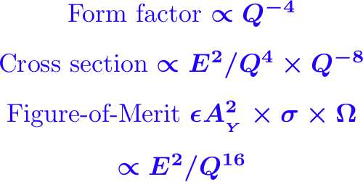
Challenges in this experiment
Need large statistics, max luminosity and solid angle
Max luminosity -> large background
Large solid angle -> small bend -> huge background
A solution is a modern tracking detector based on
Gas Electron Multiplier (Fabio Sauli, 1997)
Notes:
Q² increases from 8.5 to 12.5 GeV² but higher beam energy 11 vs. 6 GeV => a factor of 7 of the FOM loss, but the SBS larger solid angle helps.

Slide 12
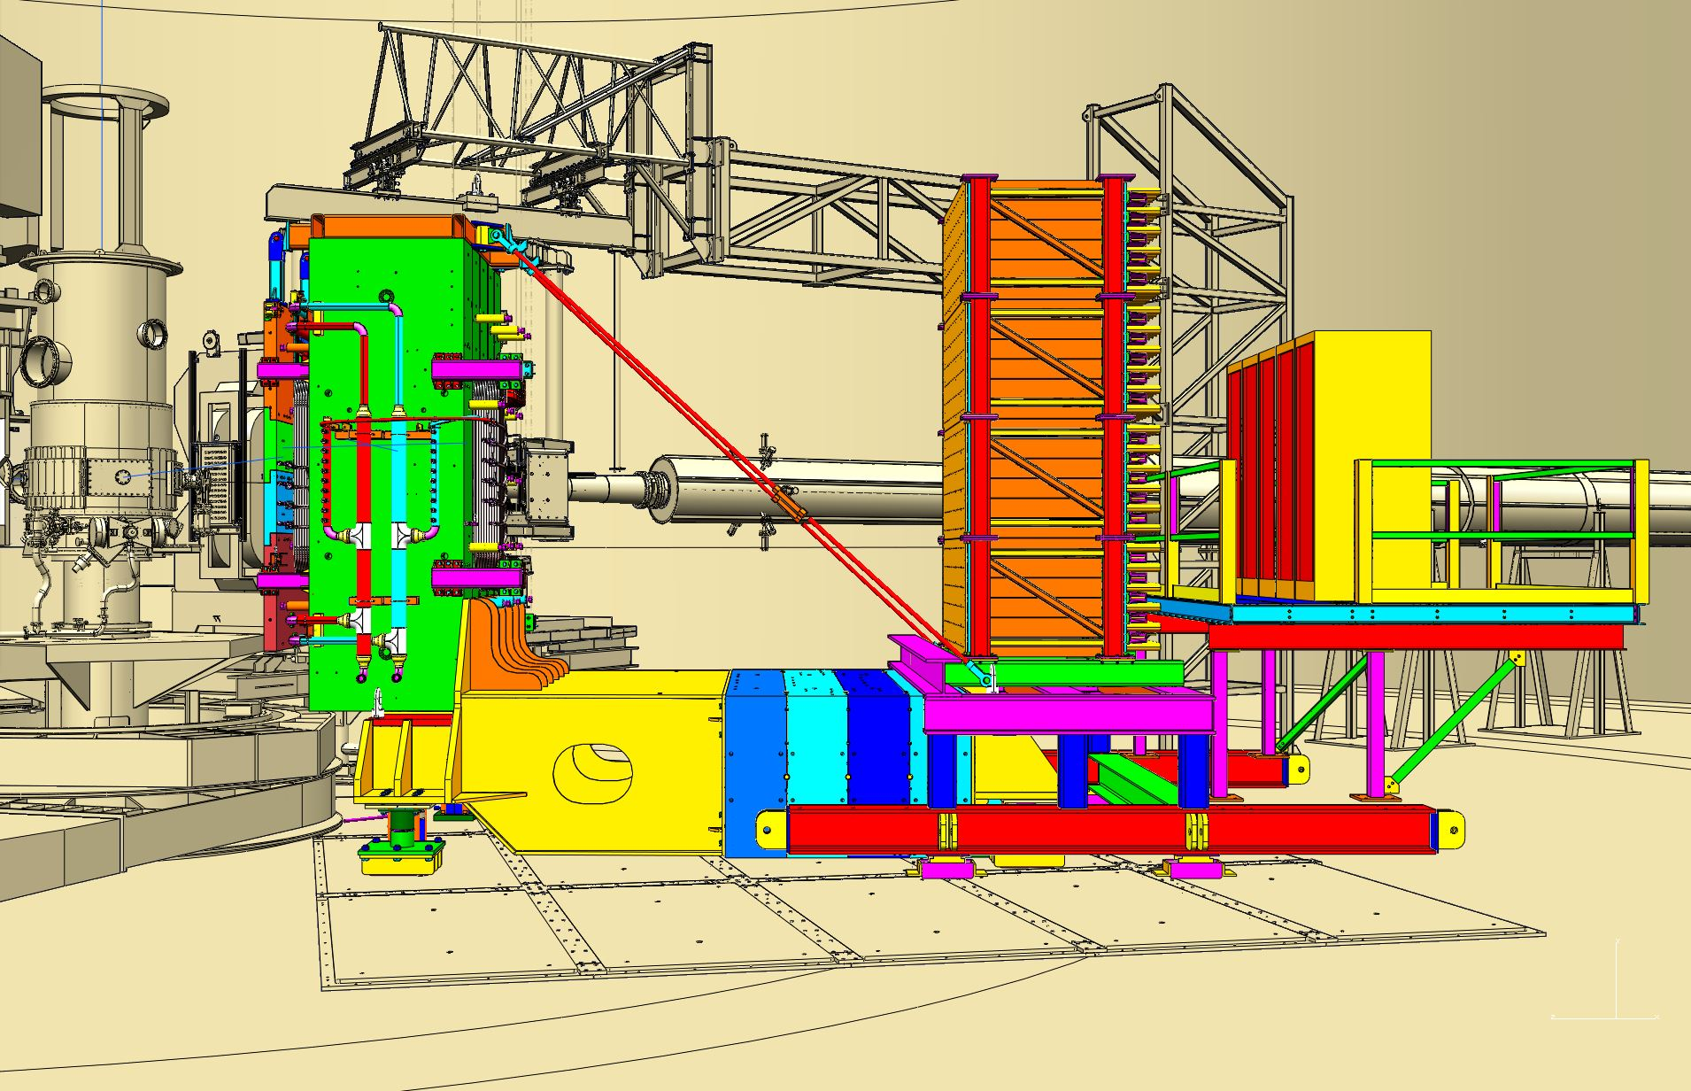
Proton arm calorimeter in the model
Notes:
The hadron calorimeter. Novel feature is sub ns time resolution.

Slide 13
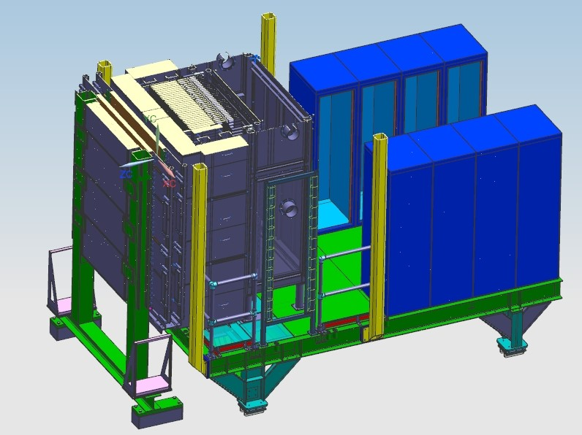
Electron arm calorimeter in the model
Front end electronics
ECal
Oven wall
CDet
Notes:
Electron arm is based on old technology with innovative addition of continuous thermal annealing. Fully tested. Construction is 2/3 completed.

Slide 14
Electron arm calorimeter in the model
56
1692 active lead-glass modules
Elevated temperature of the glass (225-185 C)
provides continuous annealing of radiation damage
Notes:
Electron arm is based on old technology with innovative addition of continuous thermal annealing. Fully tested. Construction is 2/3 completed.

Slide 15
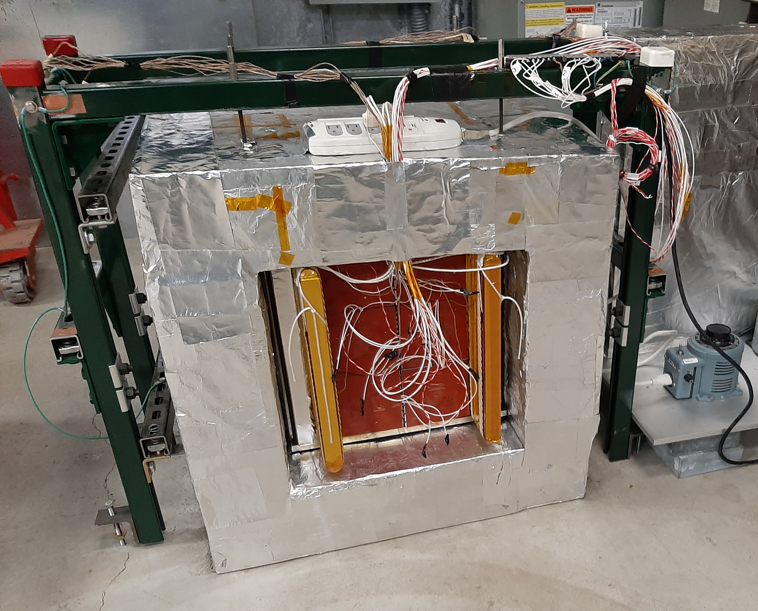
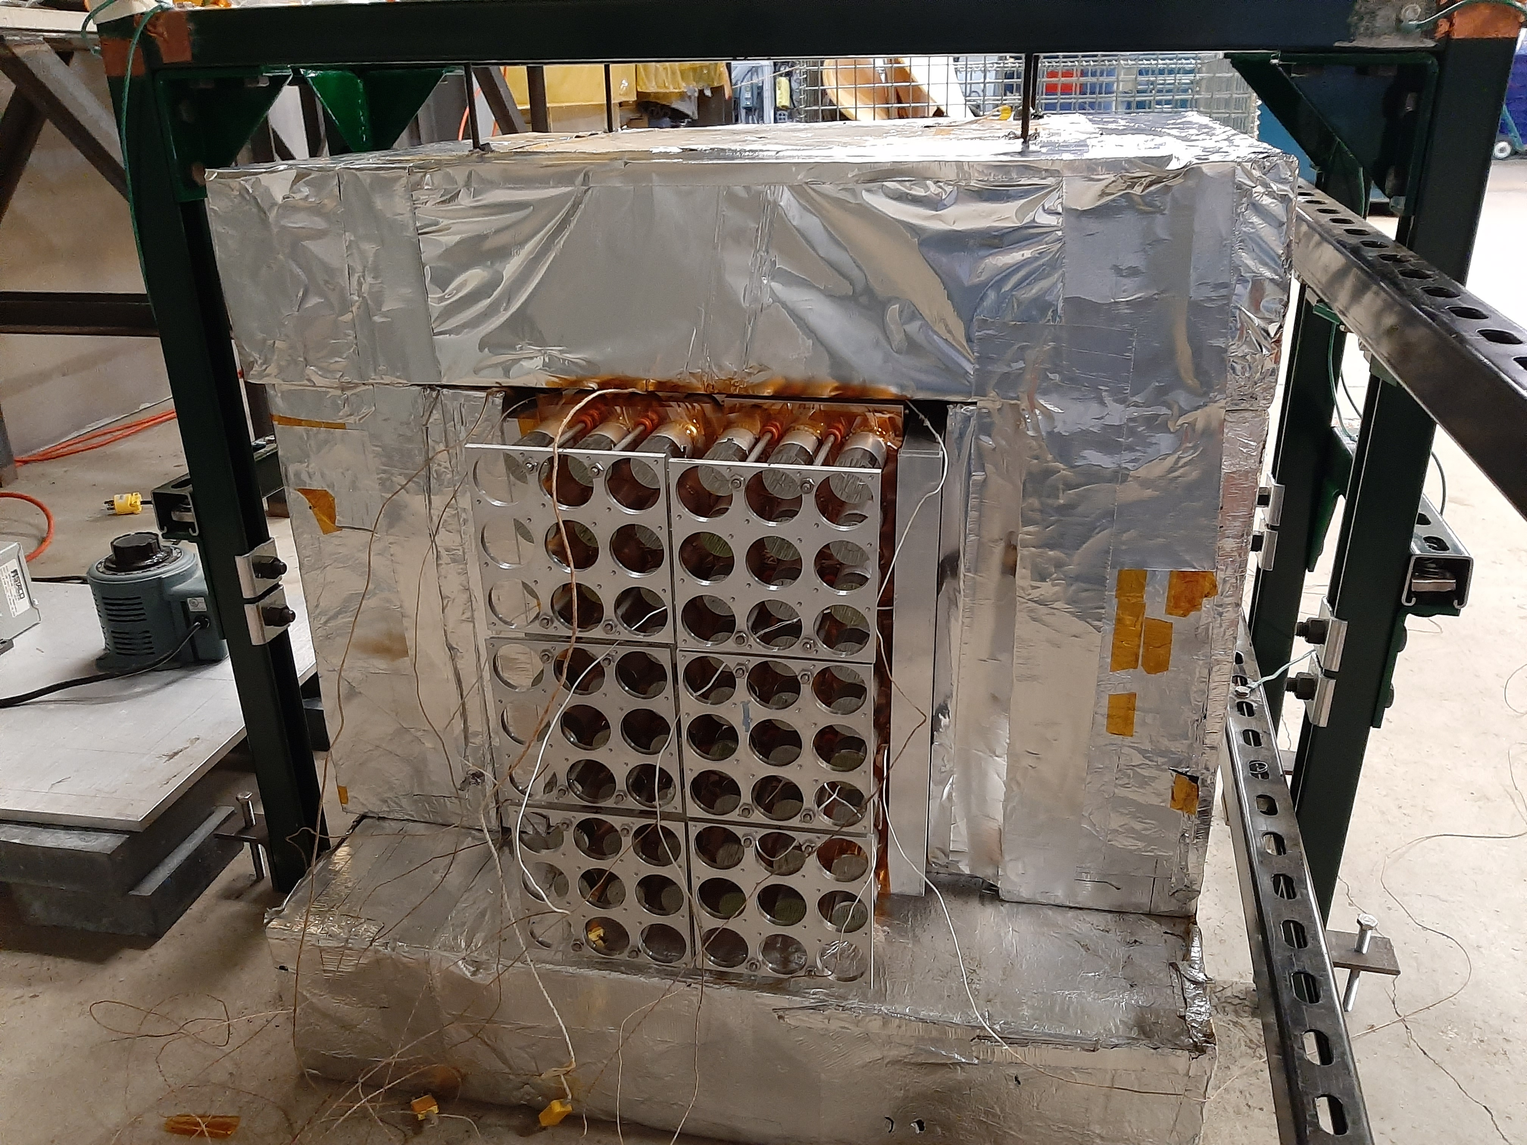
Ongoing heating test: 2nd iteration of heater design
Notes:
Electron arm is based on old technology with innovative addition of continuous thermal annealing. Fully tested. Construction is 2/3 completed.

Slide 16
Conclusion
After 15 years of development the GEp/SBS experiment is on track to be ready for installation in Oct. 2023.
Exciting potential. Who knows what we will measure at high Q-squared?
Students, postdocs: lot’s of work still to do and plenty of places to fit in. Exciting opportunity to get your hands on instrumentation and data next year!
Notes:
Thank you for your time and attention.

Slide 17
Backup slides

Slide 18
The nucleon electromagnetic form factors
GMp
GMn
SBS
GEp
GEn
Notes:
These data represent the final set before the 12-GeV era
plus new information from the 2016 Hall A GMp experiment.

Slide 19
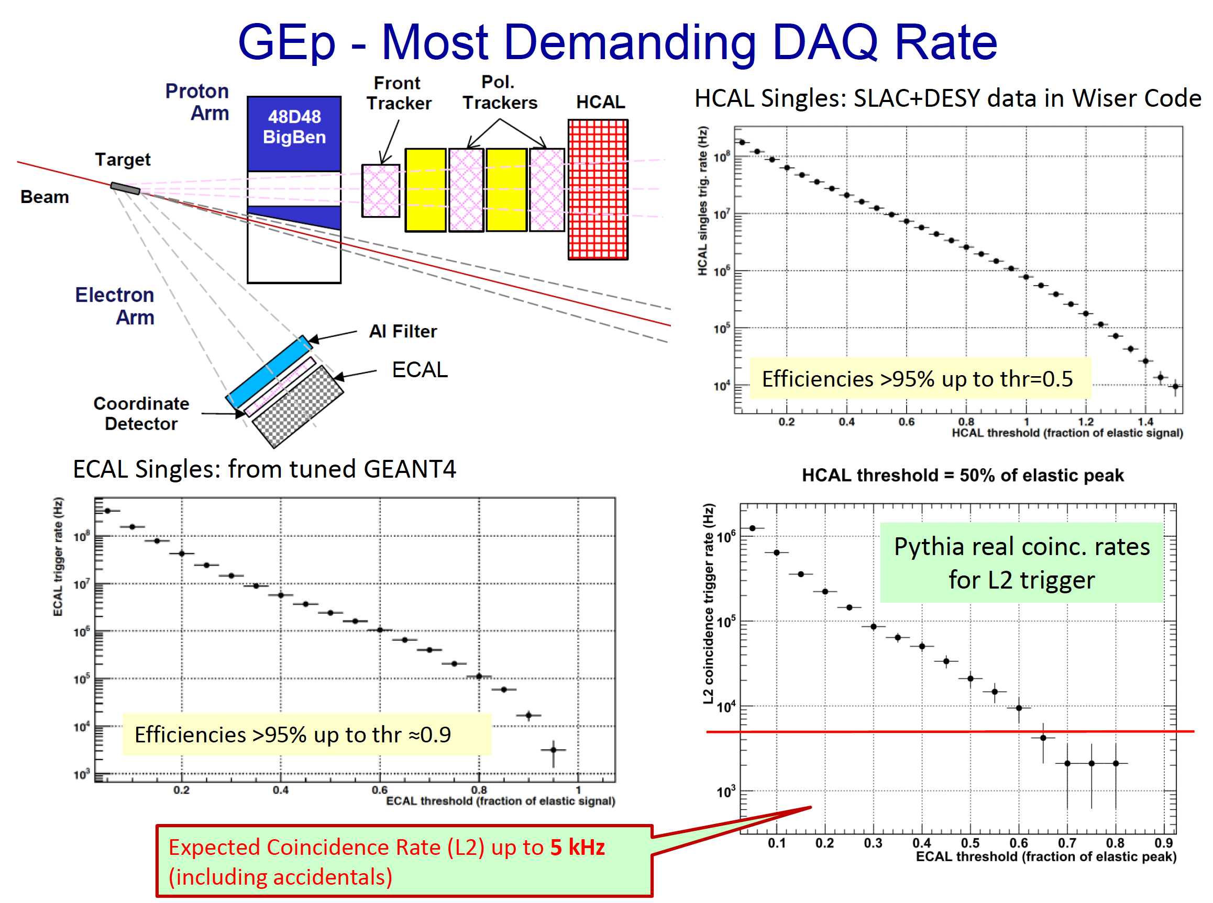

Slide 20
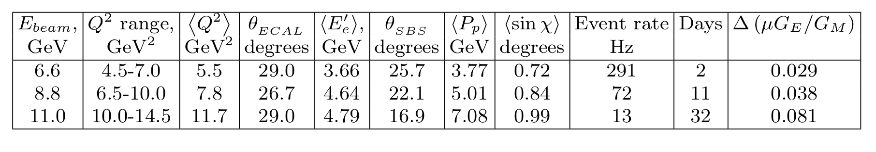
GEp/SBS Q² acceptance, projected accuracy, and beam time request
Total 45 days
Notes:
We updated the data points. As PAC35 recommended, we limited the Q² range by 12.5 GeV² and the total beam time is 45 days. About 20M events per data point.

Slide 21
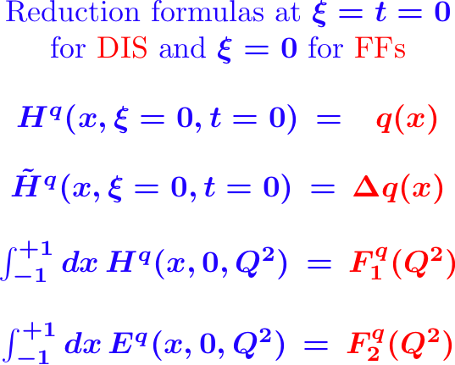
The nucleon structure in terms of GPDs

Slide 22
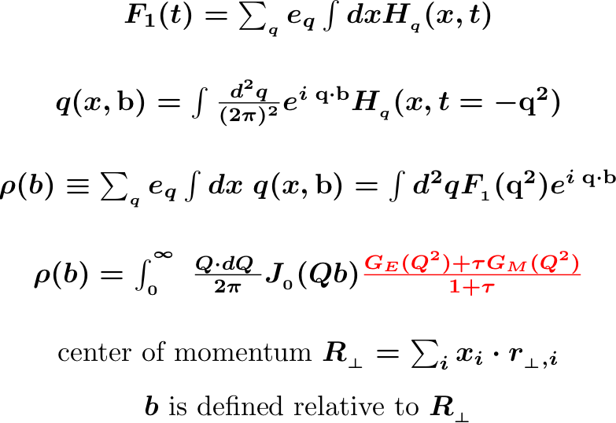
The nucleon structure in terms of GPDs
Muller, Ji, Radyushkin
M.Burkardt
P.Kroll: u/d segregation
G.Miller
Transverse center of the
quarks longitudinal
momentum fractions
Scientific case

Slide 23

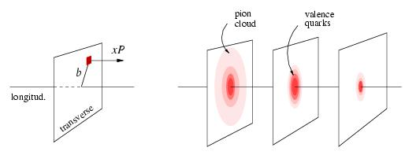
Mapping transverse distribution(s)
two-photon contributions at high Q²
x < 0.1
x ~ 0.3
x ~ 0.8
Scientific case
Notes:
Connections via the GPDs phenomenology. TPE contributions are small. The x=1 point data are from FFs.

Slide 24
Q² dependence of F2/F1
Flavor separated contributions:
The log scaling for the proton
Form Factor ratio at few GeV²
is likely “accidental”.
The lines for individual flavor
are straight!
Scientific case
Notes:
Flavor composition is important way to study FFs

Slide 25
Proton arm in the model
Notes:
Very briefly on equipment status: Magnet and beam line.

Slide 26
Proton arm: Calorimeter counter structure

