Slide 1
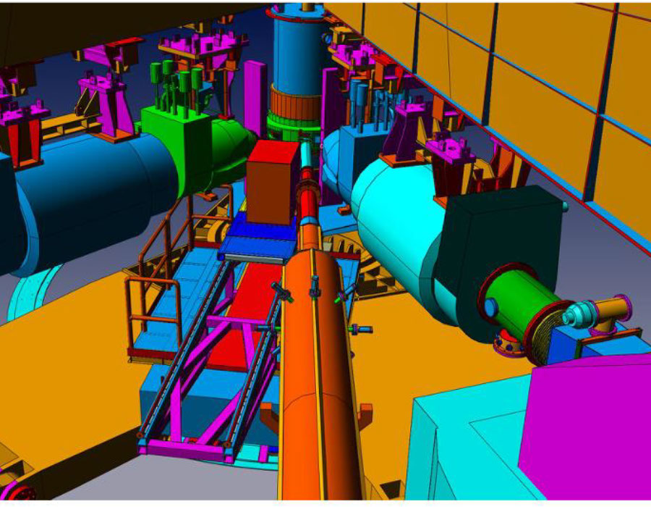
Deeply Virtual Compton and 𝜋⁰ Electroproduction
Charles Hyde
For the E12-06-114, Collaboration
F. Georges et al., Phys.Rev.Lett. 128 (2022) #25, 252002
M. Dlamini et al., Phys.Rev.Lett. 127 (2021) #15, 152301

Slide 2
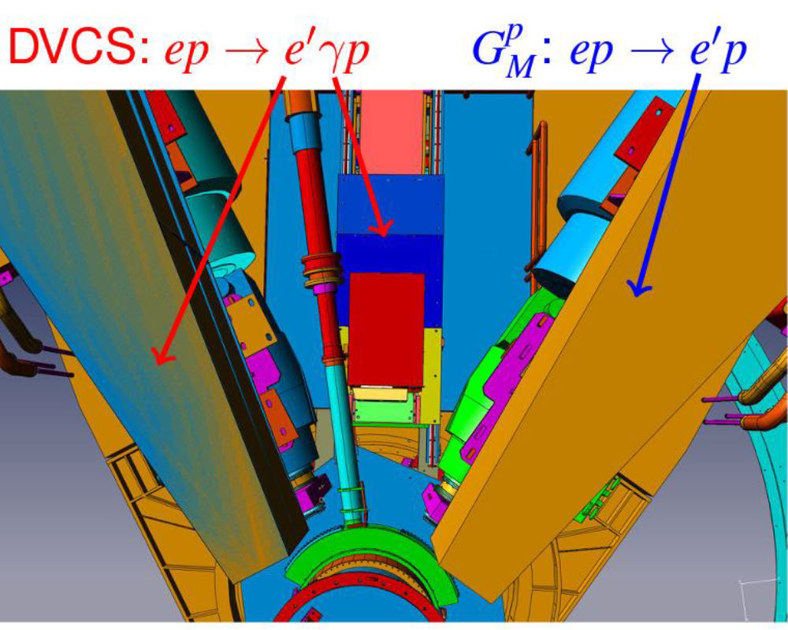
Hall A DVCS Experiment at 11 GeV: 2014-2016
H(e,e’𝛾)p & H(e,e’𝜋⁰)p
Cryogenic H₂ target
Electron in HRS-L Spectrometer
  Replace Q1 in middle of experiment
PbF₂ calorimeter for gamma-rays
  Cherenkov only, fast signals for
  pileup rejection.
  1 GHz Digitizer
Exclusivity by missing mass
  H(e,e’𝛾)X
  H(e,e’𝛾𝛾)X

Slide 3
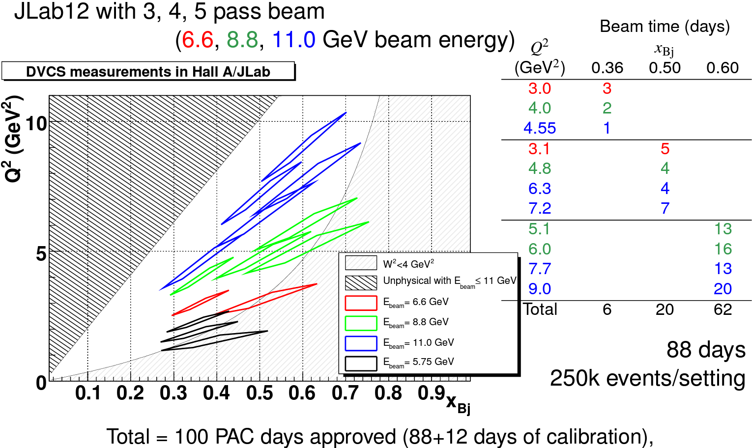
Kinematics and Beamtime (proposed)
26

Slide 4
JLab Hall A DVCS, Actual Physics Run: 2014-2016
E12-06-114, 50 “PAC days”

Slide 5
“Scaling” Predictions of
Deep Virtual Exclusive Scattering
The general 𝛾*p→𝛾p amplitude has 12 complex helicity amplitudes
At leading-twist there are just to just 4 complex helicity conserving amplitudes
QCD factorization implies Q²-dependence follows combination of DGLAP & ERBL evolution in ln(Q²)
DVCS should be dominated by “d𝜎_{T}”
Deep 𝜋⁰ should be dominated by “d𝜎_{L}”

Slide 6
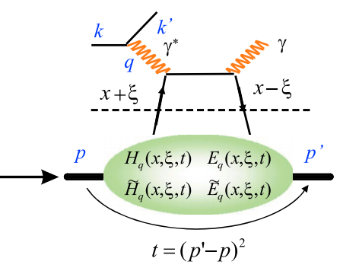
Longitudinal & Transverse
Momentum Coordinates
DIS defines a unique light-cone direction from
q^{μ} & P^{μ}
DVCS coordinate system is ambiguous up to order t/Q²
Light-cone from
  q^{μ} & P^{μ} DIS
  (q+q’)^{μ} & (P+P’)^{μ} Symmetrized
  q^{μ} & q’^{μ} V. Braun et al.

Slide 7
Deep Exclusive 𝜋⁰ Production
Co-linear factorization proven for 𝜎_{L}
(chiral-even GPDs)
Modified factorization approach
(model-dependent) for 𝜎_{T}
(chiral-odd/transversity GPDs)

Slide 8
Deep Virtual 𝜋⁰ Results
Previous 6 GeV data
  Hall A Rosenbluth-separation clearly identified d𝜎_{T} >> d𝜎_{L}
    D(e,e’𝜋⁰ )np: Mazouz et al Phys.Rev.Lett. 118 (2017) 22, 222002
    H(e,e’𝜋⁰ )p: Defurne et al., Phys.Rev.Lett. 117 (2016) 26, 262001
  Similar conclusions from CLAS data, including both 𝜋⁰, 𝜂 (but without Rosenbluth separations)
Dominance of Transversity GPDs⊗[Twist-3 pion DA]
  Amplitude induced by strong Chiral Symmetry Breaking
  Ahmad, Goldstein, Liuti, Phys.Rev.D 79 (2009) 054014
  Goloskokov, Kroll, Eur.Phys.J.A 47 (2011)

Slide 9
12 GeV Hall A H(e,e’𝜋⁰)p: cross sections
M. Dlamini et al., PRL 127 (2021) 152301
Evidence for 𝜎_{T} dominance
➔
Transversity GPDs

Slide 10
Exclusive 𝜋⁰ Electroproduction: Q²-Dependence
QCD asymptotic limits
  d𝜎_{L}/dt ∝ Q^{–6}
  d𝜎_{T}/dt ∝ Q^{–8}
Data: d𝜎_{U} = d𝜎_{T}+𝜀d𝜎_{L} ≈ (Q²)^{–3}
Goloskokov Kroll model
  d𝜎_{U} = d𝜎_{T}+𝜀d𝜎_{L} ≈ Q^{–7}
  GK underestimating Long. Amplitude?
NPS experiment coming this summer to Hall C
  First 12 GeV 𝜋⁰ Rosenbluth separations!

Slide 11
Example E12-06-114 DVCS Cross Sections
x_{B}=0.36, Q²=3.7GeV², t=–0.33GeV²; x_{B}=0.48, Q²=5.4 GeV², t=–0.33 GeV²; x_{B}=0.6, Q²=8.4 GeV², t=–0.91 GeV²

Slide 12
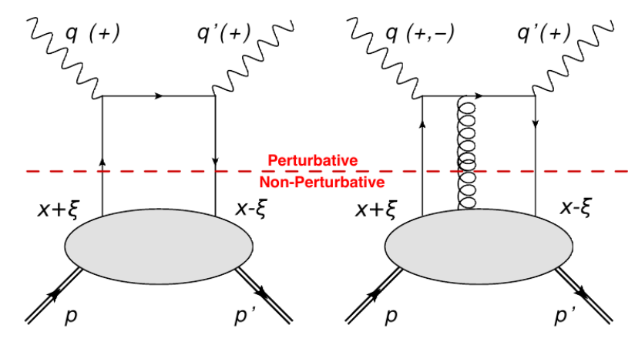

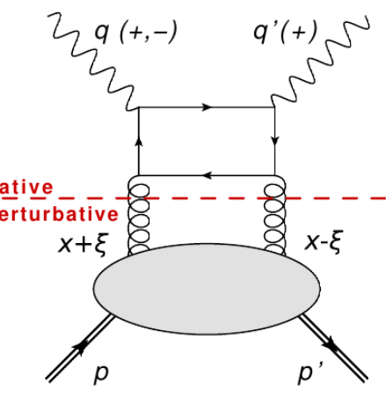

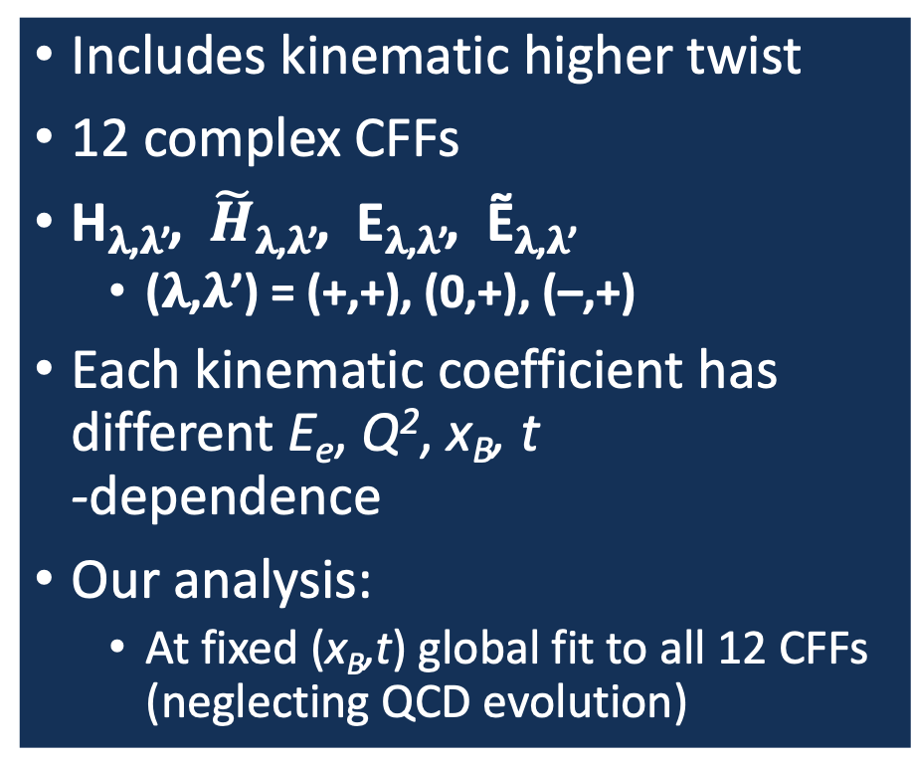
Braun, et al formalism
Includes kinematic higher twist
12 complex CFFs
H_{𝛌,𝛌’}, $\tilde{H}$_{𝛌,𝛌’}, E_{𝛌,𝛌’}, Ẽ_{𝛌,𝛌’}
  (𝛌,𝛌’) = (+,+), (0,+), (–,+)
Each kinematic coefficient has different E_{e}, Q², x_{B}, t
-dependence
Our analysis:
  At fixed (x_{B},t) global fit to all 12 CFFs (neglecting QCD evolution)
Helicity-flip (1 unit) CFFs
Same Q²-dependence
as higher-twist
Helicity-flip (2 units) CFFs
Same Q²-dependence
as NLO

Slide 13
CFF Extraction
x_{B}-dependence of t-averaged results for Re & Im parts of all four helicity-conserving Compton Form Factors
Helicity flip amplitudes included in fit, statistically consistent with zero, but necessary for realistic uncertainties.
Im[E₊₊] and Im[Ẽ₊₊] arbitrarily 0 in Kumericki Mueller KM15 model

Slide 14
Conclusion and Outlook
Realistic DVCS formalism essential for precision extraction of CFFs.
2023: Neutral Particle Spectrometer (NPS) DVCS run New PbWO₄ calorimeter: improved M_{X}² resolution
  Sweep magnet to maintain low background in calorimeter
  Higher momentum range of Hall C HMS and smaller angles for PbWO₄ allows access to full range of 12 GeV kinematics
Multiple (2 or 3) incident beam energies at fixed (Q², x_{B}): E12-13-010
  L/T separation of Deep Neutral Pion Production
  Improved precision on extraction of Re/Im parts of CFF.
Neutron DVCS/𝜋⁰ E12-22-006, approved by PAC-50, included in 2023-2024 run !
  u/d-flavor separations

Slide 15
Thank you,
and more slides

Slide 16
NPS DVCS/𝜋⁰

