Slide 1
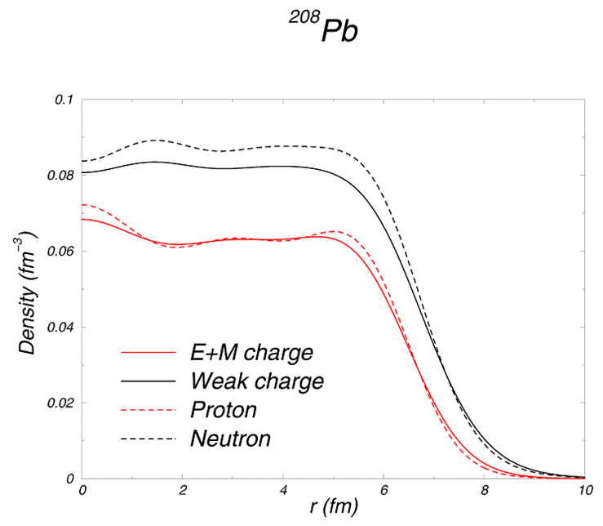

CREX and PREX
Robert Michaels
Jefferson Lab
⁴⁸Ca
²⁰⁸Pb
PRL 129, 042501 (2022)
PRL 126, 172502 (2021)
http://hallaweb.jlab.org/parity/prex
Hall A Collab Mtg, Jan 26, 2023
2
+
Electroweak Asymmetry in
Elastic Electron-Nucleus Scattering
C. J. Horowitz
Neutron Skin
1/15

Slide 2

The weak interaction changes with mirror imaging which allows to isolate it.
Positive spin
Incident electron
spin
momentum
Target
Mirror Image
A nucleus in target
Negative spin
Robert Michaels, Hall A Mtg, Jan 2023
p2

Slide 3
The weak interaction changes with mirror imaging which allows to isolate it.
Positive spin
Incident electron
spin
momentum
Target
Mirror Image
A nucleus in target
Negative spin
Method: Flip spin of electrons and look for difference in scattering rate.
p3

Slide 4
Using Parity Violation
Electron - Nucleus Potential
electromagnetic
axial
forward angle
is small, best observed by parity violation
neutron weak charge >> proton weak charge
Proton form factor
Neutron form factor
Parity Violating Asymmetry
Robert Michaels, Hall A Mtg, Jan 2023
p4

Slide 5
Weak Interaction: Sees the Neutrons
 | proton | neutron
Electric charge | 1 | 0
Weak charge | 0.08 | 1
Measured Asymmetry
Correct for Coulomb
Distortions
APPLICATIONS
Weak Density at one Q²
T.W. Donnelly, J. Dubach, and Ingo Sick, Nuc. Phys. A 503 (1989) 589.
Nuclear Theory (Symmetry Energy )
Small Corrections for
C.J. Horowitz, S.J. Pollock, P.A. Souder, R. Michaels, Phys. Rev. C63, 025501 (2001)
n
s
G
G
MEC
E
E
surface thickness
Atomic Parity Violation
Heavy
Skin
Neutron
Stars
R_{N} - R_{P}
Ions
p5

Slide 6
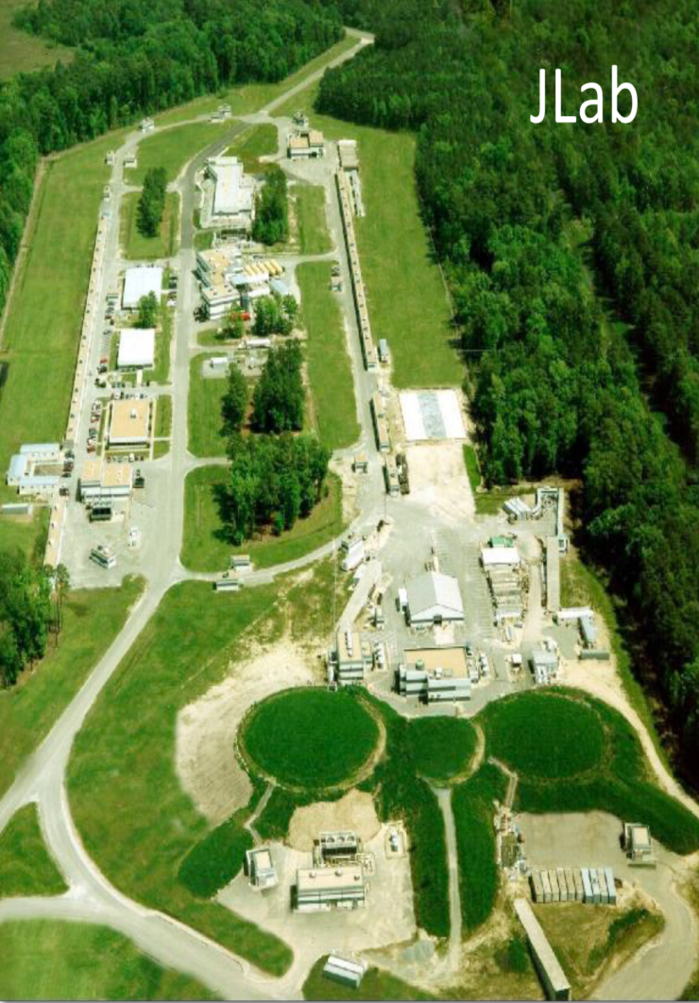
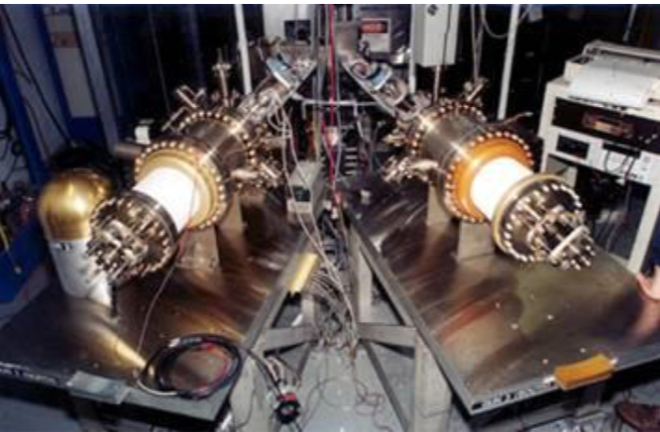
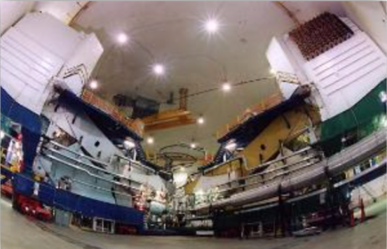
Experimental Overview
Polarized
Electron
Source
Hall A
High Resolution Spectrometers
Inj
A
Parity violation experiments at Jefferson Lab use a high-intensity polarized electron beam, with very low beam jitter, and high-resolution spectrometers to isolate elastic scattering.
Robert Michaels, Hall A Mtg, Jan 2023
p6
DNP
October 12, 2021
Notes:
Let’s move on to talk about the experiment itself. This took place at Jefferson Lab, CEBAF, the only operating facility in the world where this kind of experiment could be performed.

Slide 7
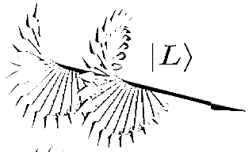
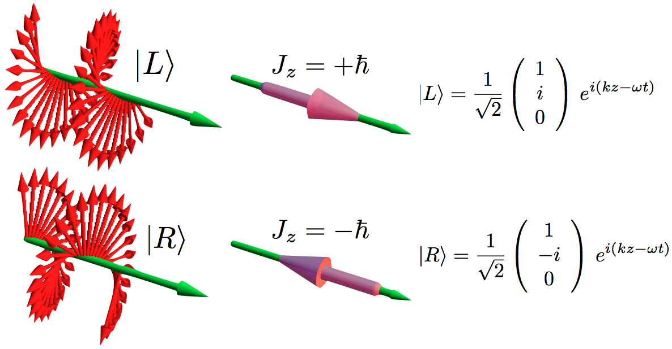

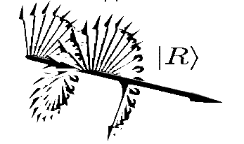




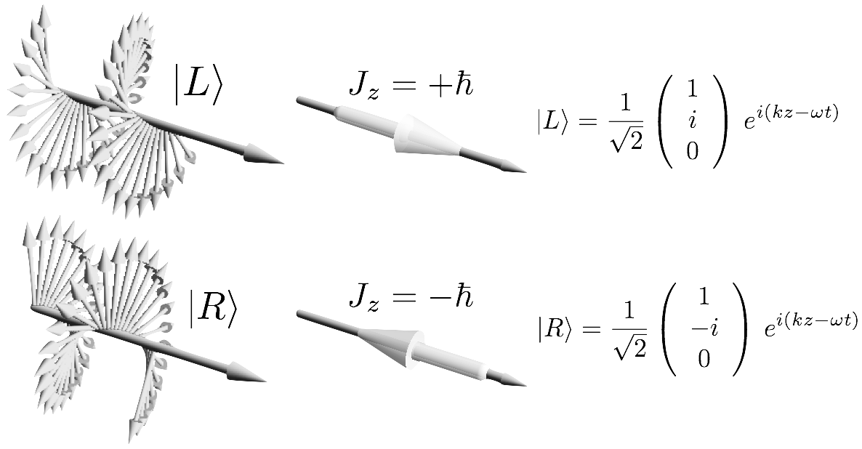
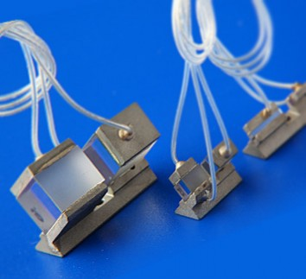
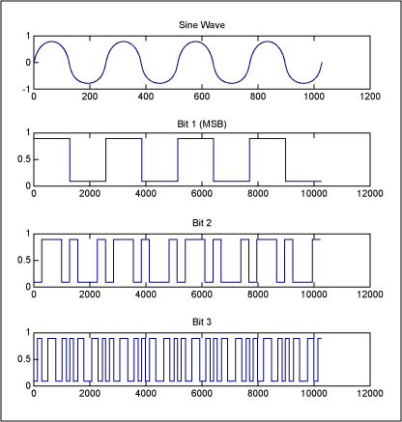
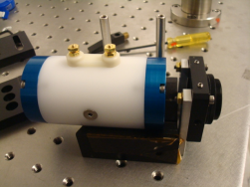
Producing Polarized Electrons
Reversal combinations
Helicity: HV +/-, IHWP out/in
Laser Beam
Electron Beam
Circularly polarized light
e- : Right handed
GaAs
crytsal
p
Spin
e- : Left handed
Laser beam
e- beam
Randomized
Helicity Signal
“Wien” – another slow reversal
Pockels Cell
fast
Experimental Hall
+/- HV
slow
accelerator
Robert Michaels, Hall A Mtg, Jan 2023
p7
Notes:
……For statistical convergence, L/R helicity is flipped back and fourth quickly. For suppression of systematics, both fast and slow reversals are used. The fast and slow reversals as follows: There are 8 total reversal combos: PC flips, HWP insertions, Double wein flips. PC flips are fast at 120Hz or 240Hz for PREXII, slow means infrequent. HWP reverses the laser pol once or twice/day, Double wein flipper reverses the ebeam pol. once per few weeks. The double wein consists of crossed E & B fields in the low energy injector that allow us to use precession of the spin of the electron beam to flip the electron beam polarization relative to the helicity state of the laser altogether.

Slide 8
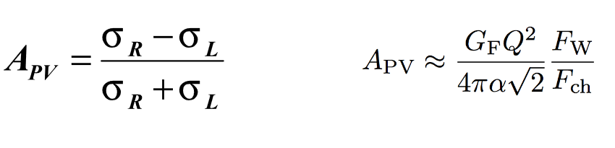
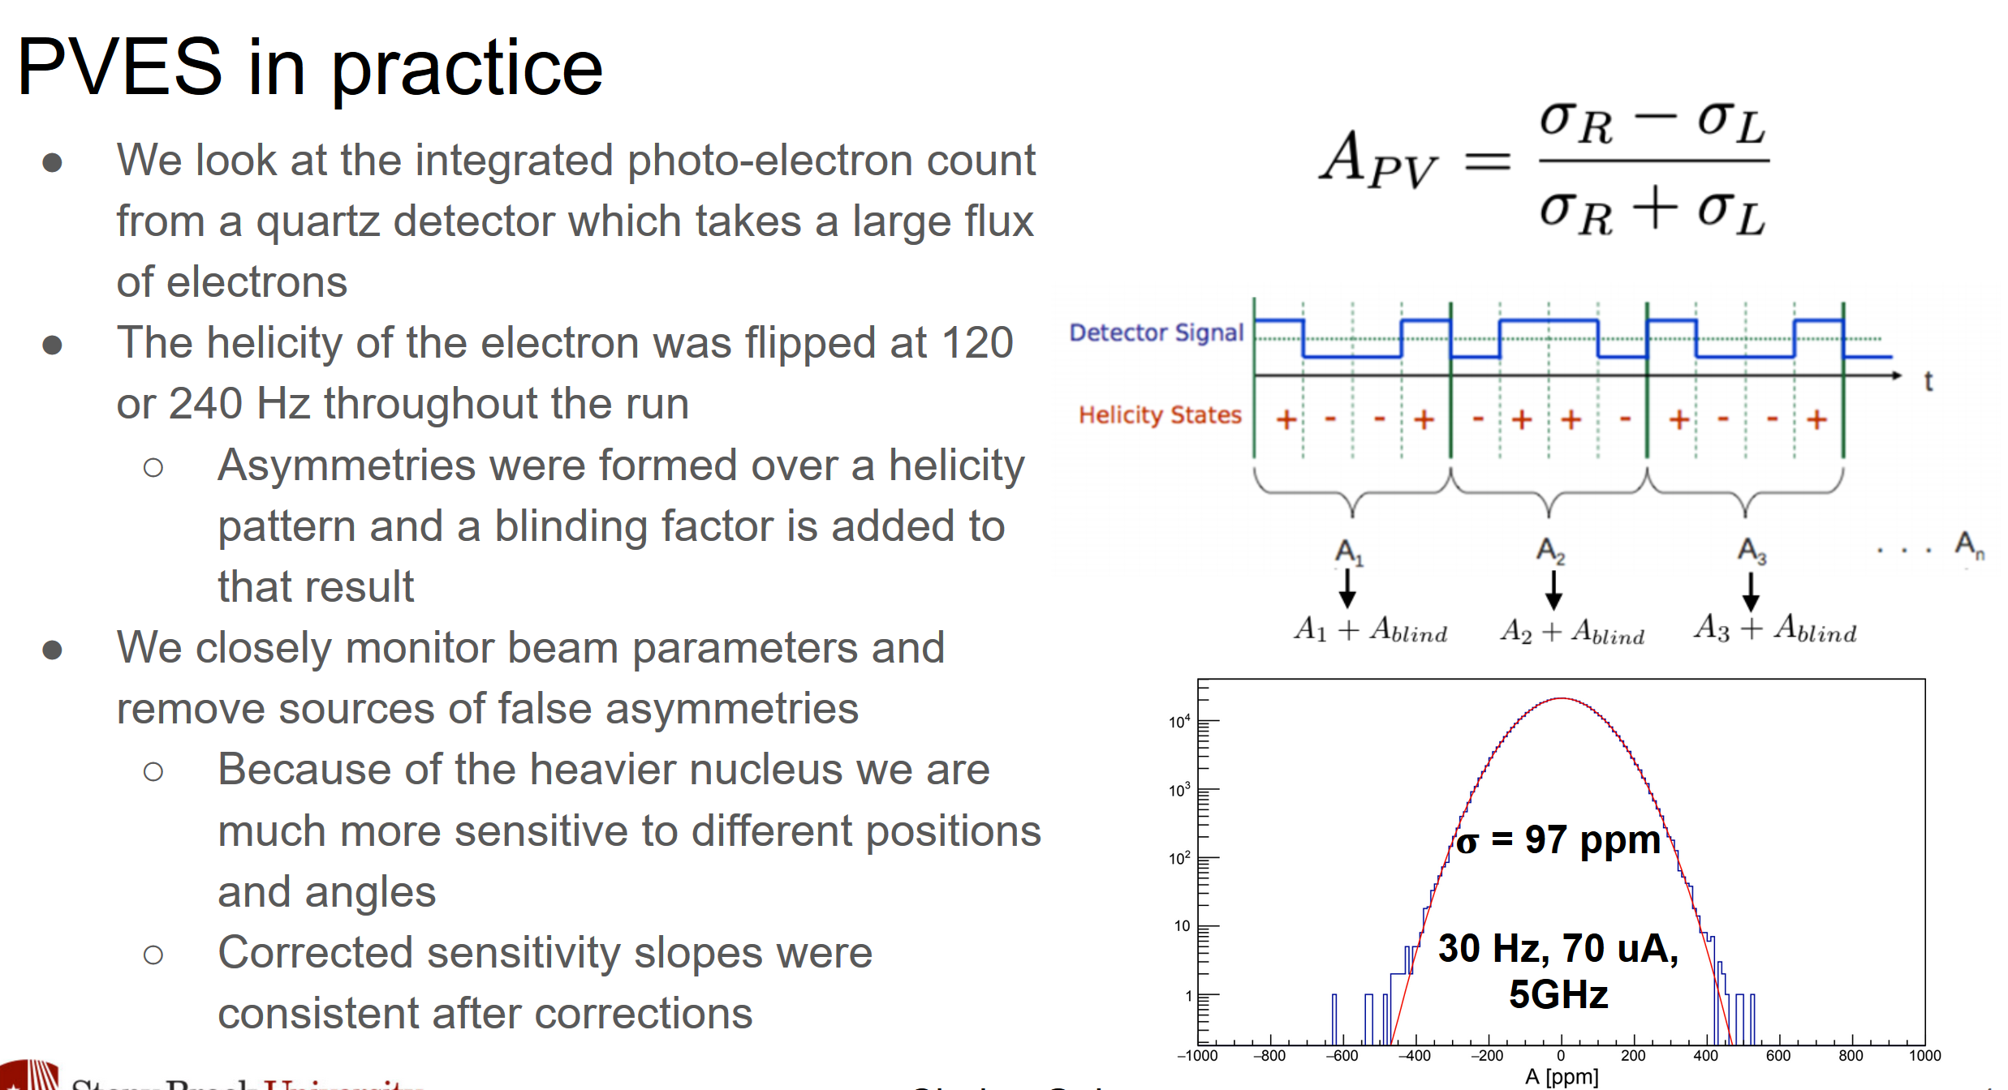



Measuring a Small Asymmetry
Goal: measure beam-helicity-correlated elastic scattering asymmetry to high precision
𝜎 =775ppm
30Hz, 150uA
56MHz 2 HRS
Integrating, not counting -- total number of detected electrons was ~2.4x10²¹, ~383 C
Online analysis showed we were dominated by counting statistics fairly early in the experiment
Number of flips ~ 300 million, quartets ~ 80 million
Technique built for big rates and small asymmetries (PREX 4GHz, 0.55ppm)
CREX less challenging in terms of rate (CREX 50MHz, 1% of PREX rate, larger asymmetry)
A[ppm]
Robert Michaels, Hall A Mtg, Jan 2023
p8
DNP
October 12, 2021
8
Notes:
(side by side prex/crex: this sort of technique optimized for rates up to PREX 4GHz, technical challenge reduced by this, 50MHz rate only needed for CREX 100X greater width 1% of rate, larger asymmetry really made this less challenging in terms of rate, 785ppm width, used the technique, built for big rates and small asym, but used it for relatively easy low rate meas.)To measure a small asymmetry like this, what you’ll do is measure the scattering rate for right handed and left handed electrons. But there’s no way you can count individual electrons. We measured over the course of the experiment about 6-peta-electrons or 9milliCoulombs of accumulated charge in our detectors. So that is a large # to count. You wouldn’t count that in a finite amount of time (the length of time you can keep a grad student around, you’d have very old graduate students and a very costly experiment if you tried to do this in counting mode). So, we integrate. We set the beam polarization, take data for a while doing an analog integration of everything that comes into the detector. And then we flip the polarization and do the same thing again. And analog integration is sensitive to baseline shifts and all sorts of sources of noise. But on the other hand you don’t care about measuring a xsec, you only care about a fractional difference. So if you do this rapidly enough, those sources of noise are steady over the course of that measurement and you can get a fractional difference measured rather precisely.
When we do this, we actually measure in octets of polarization: 8 windows where the polarization is held in a particular pattern to fit inside a 30Hz cycle, designed to cancel out dominant and problematic 60Hz noise from our measurement. We make 4 comparisons from the 8 windows and average them to generate 1 data point for 1 “event”. With a 70uA beam we saw about a 4GHz rate and measuring a width of about 97ppm. So this is our distribution in those individual measurements. It’s mean in this picture is indistinguishable from zero. But there’s a lot of events in there. Poisson statistics 1/rootN times 97ppm is the precision of our experiment. And the number of octet events was about 40million. So we collected data until it’s essentially like there were 40million points in this histogram…but we’ll get to data analysis that later.

Slide 9
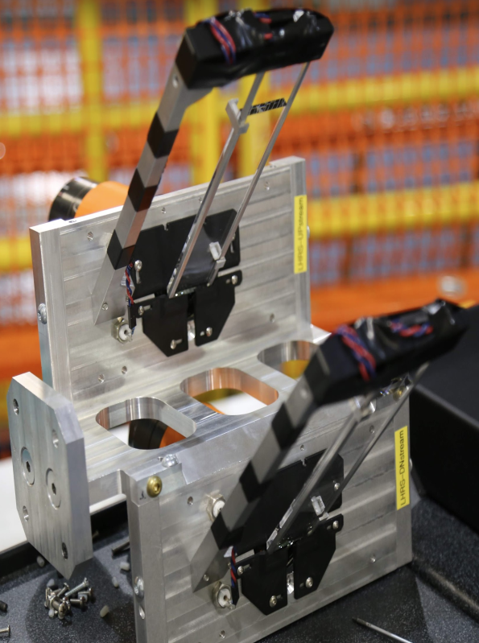
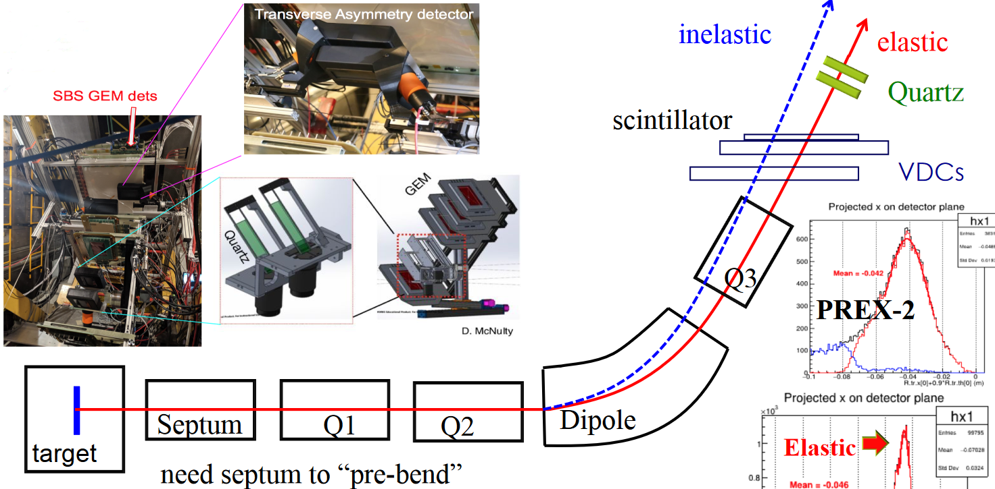
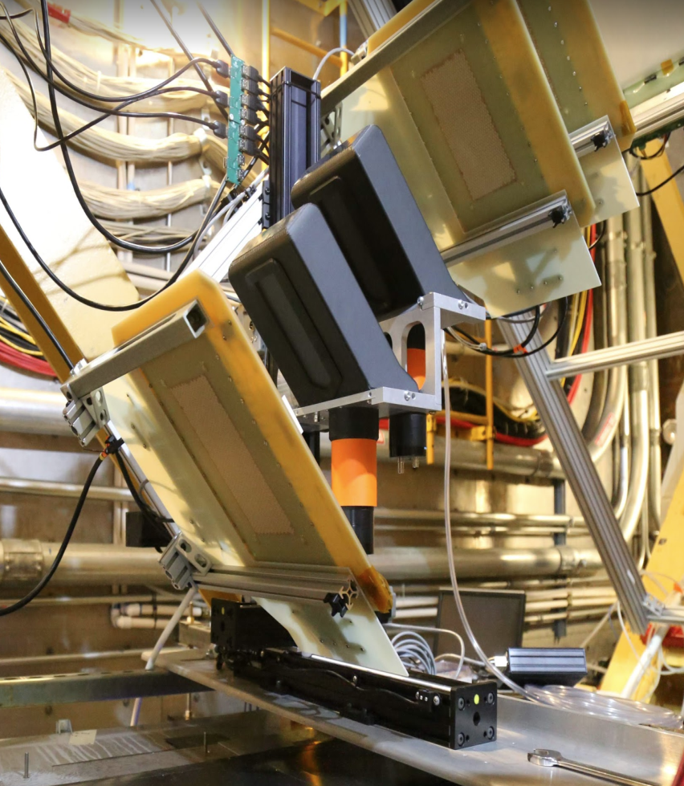
Detectors at the HRS Focus
“HRS” = high resolution spectrometers
Quartz
Quartz detectors are placed in the detector hut. They were used for both PREX and CREX.
Integrating detectors (zero deadtime DAQ)
Thick and thin quartz bars (different systematics)
Inside hut
Inside hut
Robert Michaels, Hall A Mtg, Jan 2023
p9
DNP
October 12, 2021
9
Notes:
(Now I’ll take you into where the action is inside the hut 5 stories tall)

Slide 10
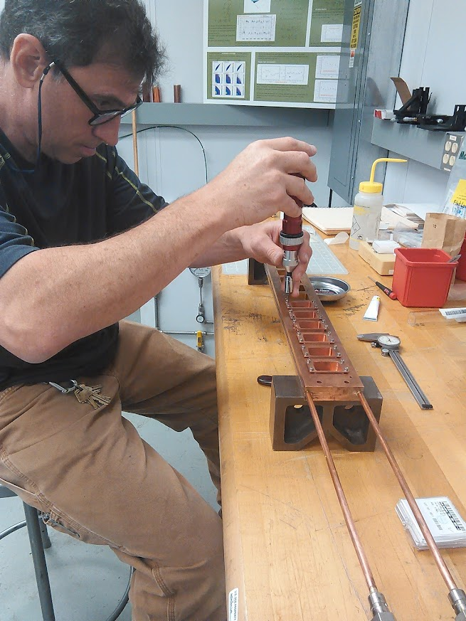
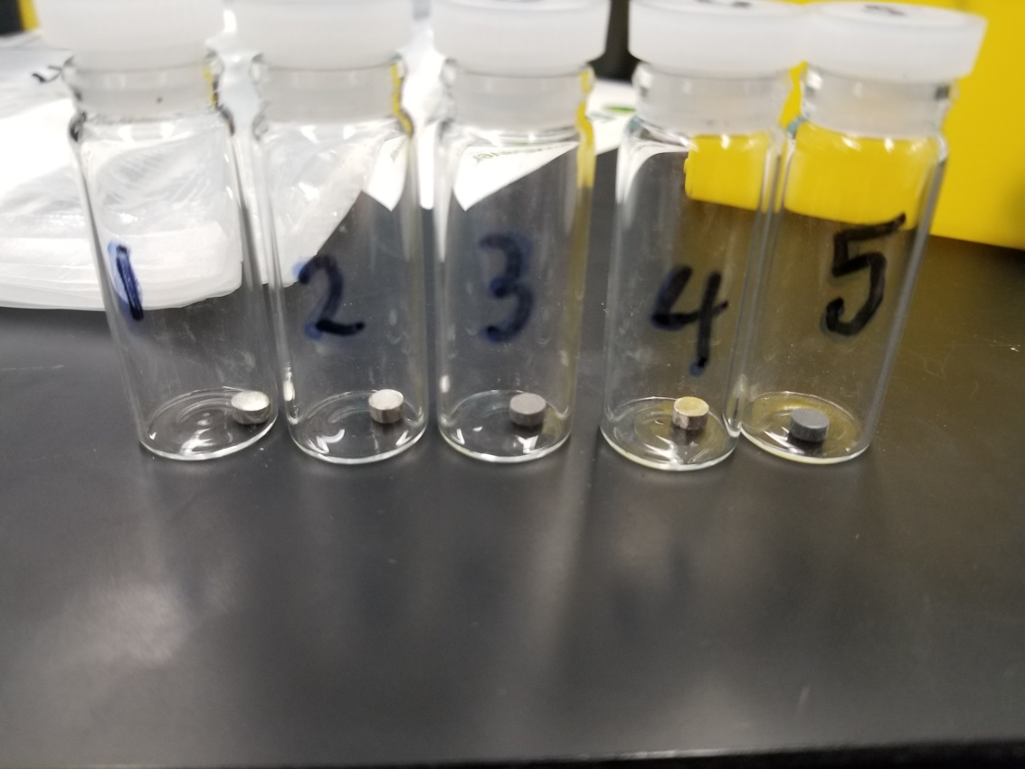
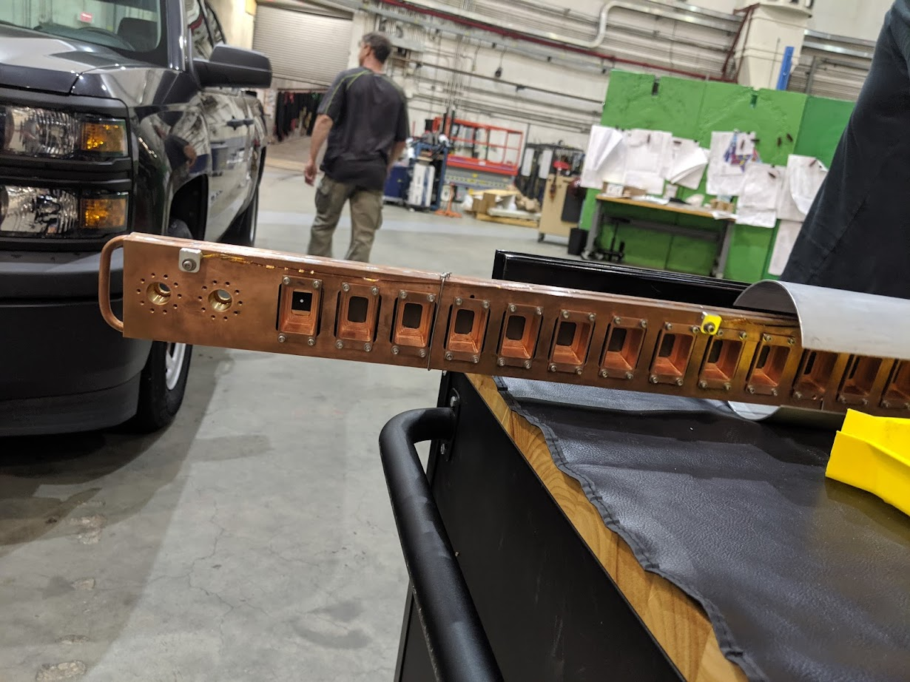
Targets : Isotopically pure ⁴⁸Ca and ²⁰⁸Pb
Started with Ended with
Single puck
5mm thick
96% ⁴⁸Ca
3.84% ⁴⁰Ca
1puck+2 foils sandwiched
~5.7mm thick total
~91.7% ⁴⁸Ca
~7.96% ⁴⁰Ca
0.511 mm
1.118 mm
4.094 mm
Dave Meekins
~12.7 mm
⁴⁸Ca
Cold target ladder (²⁰⁸Pb and ⁴⁸Ca)
Robert Michaels, Hall A Mtg, Jan 2023
p10

Slide 11
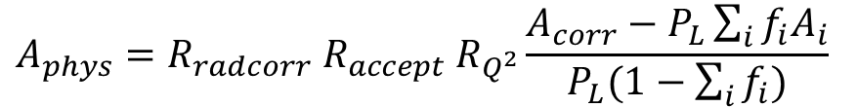
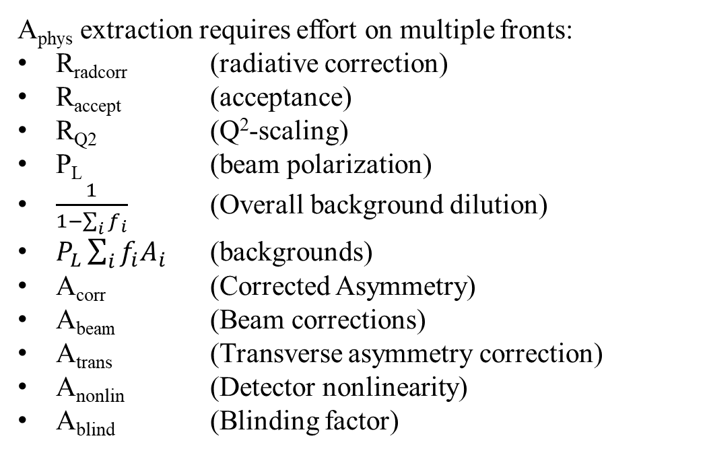
Extracting the Asymmetry
$$A_{phys}=R_{radcorr} R_{accept} R_{Q^{2}}\frac{A_{corr}−P_{L}\sum_{i}{f_{i}A_{i}}}{P_{L}(1−\sum_{i}{f_{i})}}$$
$$A_{corr}=A_{det}−A_{beam}−A_{trans}−A_{nonlin}−A_{blind}$$
A_{phys} extraction requires effort on multiple fronts:
R_{radcorr} (radiative correction)
R_{accept} (acceptance)
R_{Q2} (Q²-scaling)
P_{L} (beam polarization)
$\frac{1}{1−\sum_{i}{f_{i}}}$ (Overall background dilution)
$P_{L}\sum_{i}{f_{i}A_{i}}$ (backgrounds)
A_{corr} (Corrected Asymmetry)
A_{beam} (Beam corrections)
A_{trans} (Transverse asymmetry correction)
A_{nonlin} (Detector nonlinearity)
A_{blind} (Blinding factor)
Robert Michaels, Hall A Mtg, Jan 2023
p11
Caryn Palatchi
DNP
October 12, 2021
11

Slide 12
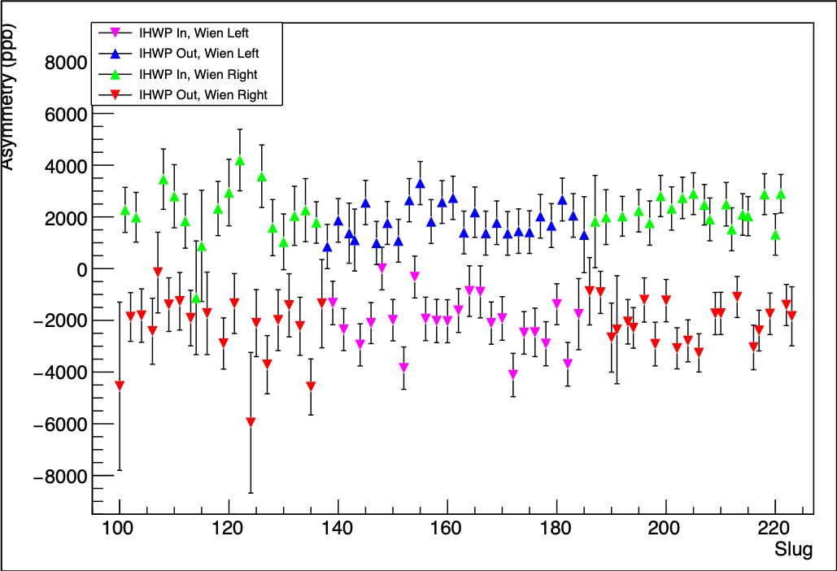
⁴⁸Ca Asymmetry Measurements
Asymmetry (ppb)
Slug # (~8 hour period)
p12

Slide 13
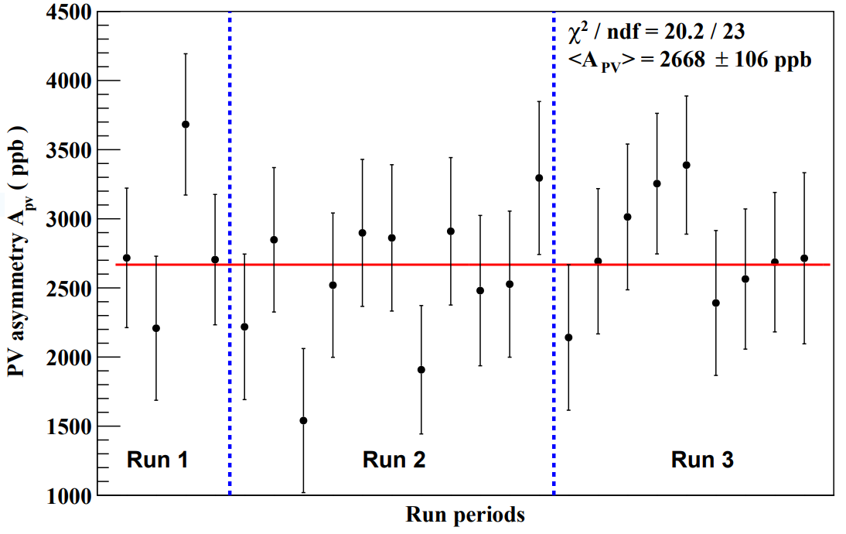
⁴⁸Ca Asymmetry Measurements
(~40 hour periods)
Three run periods demarcate injector spin orientation reversals.
Robert Michaels, Hall A Mtg, Jan 2023
p13

Slide 14
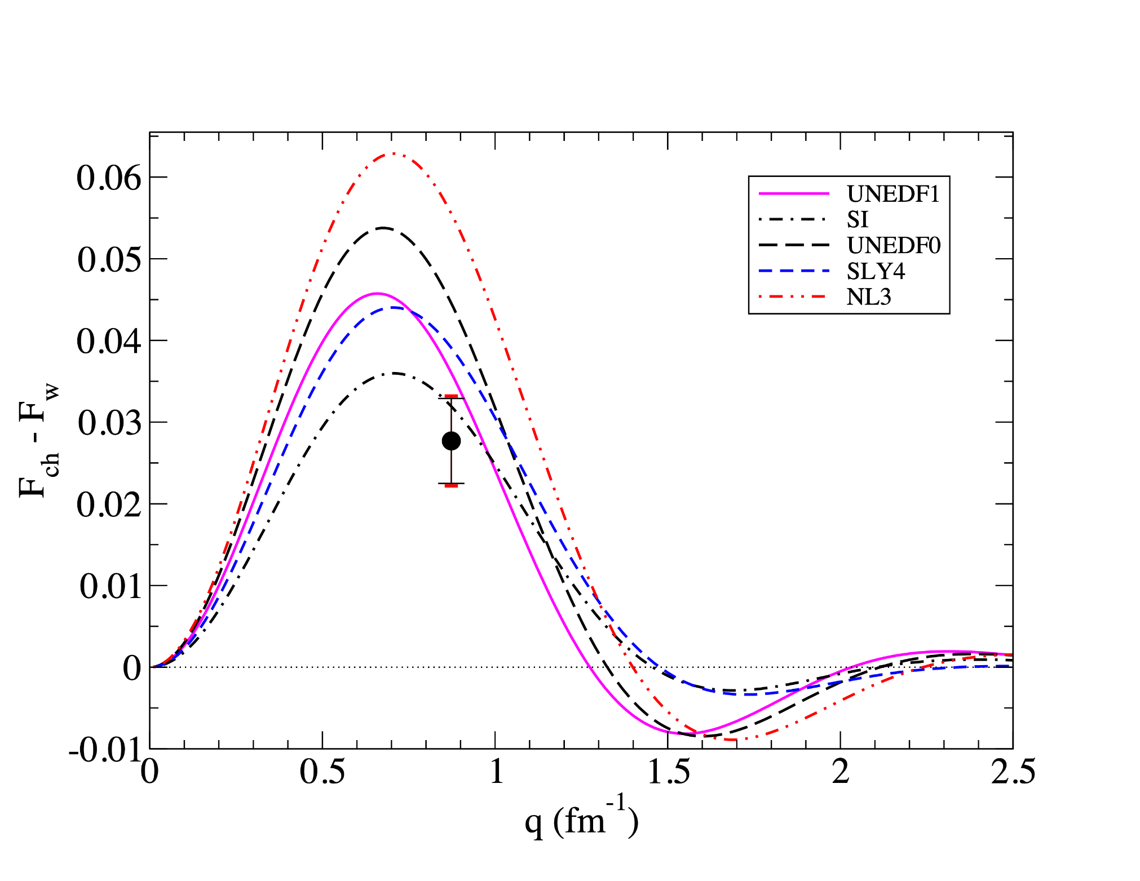
Difference between charge and weak form factor for ⁴⁸Ca
Density functional
models
CREX
data
Robert Michaels, Hall A Mtg, Jan 2023
p14

Slide 15
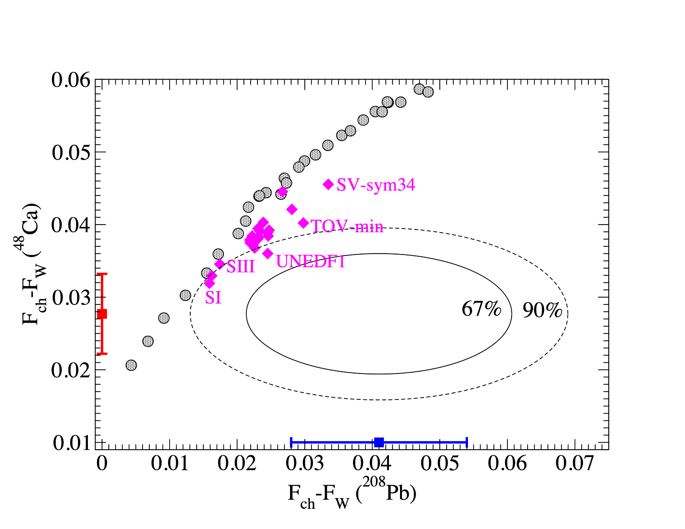
Weak Form Factor -- Model Independent
Comparing PREX (²⁰⁸Pb) and CREX (⁴⁸Ca) to Theory
CREX
data
PREX data
Robert Michaels, Hall A Mtg, Jan 2023
p15

Slide 16
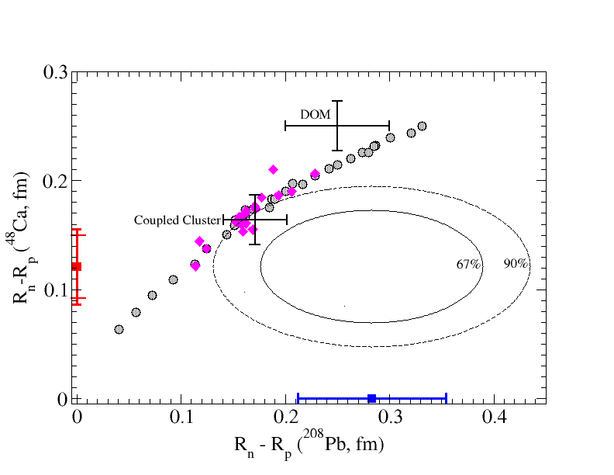
Neutron Skins -- Has a small model dependence
Neutron Skins vs Theory
CREX
data
PREX data
p16

Slide 17
PREX/CREX Related Publications
Recent or Planned
Authored by the PREX collaboration or by subsets of it.
-- CREX PRL 129, 042501 (2022)
-- PREX-2 PRL 126, 172502 (2021)
-- SSA PRL 128 14, (2022)
-- Moller polarimeter D.E. King et al, NIM.A 1045 (2023) 167506.
-- Compton polarimeter (planned)
-- Polarized source and beam P.A. Adderley et al, NIM.A 1046 (2023) 167710.
-- Phys Rev C archival paper (draft)
-- Target NIM (draft)
-- Quartz detector and PMT non-linearity NIM (planned)
-- New analysis methods (planned)
-- Theory (inelastics, extracting skins)
p17

Slide 18
Conclusions
New and precise measurement of the PVES Asymmetry from ⁴⁸Ca
Model-independent extraction of the weak form factor at q = 0.8733 fm⁻¹
Weak Skin and Neutron Skin extracted (w/ small model dependence).
⁴⁸Ca : thin skin
²⁰⁸Pb : thick skin
Consistent with a number of DFT models and with microscopic coupled- cluster model
compared to models
http://hallaweb.jlab.org/parity/prex
Robert Michaels, Hall A Mtg, Jan 2023

Slide 19
Backup Material

Slide 20
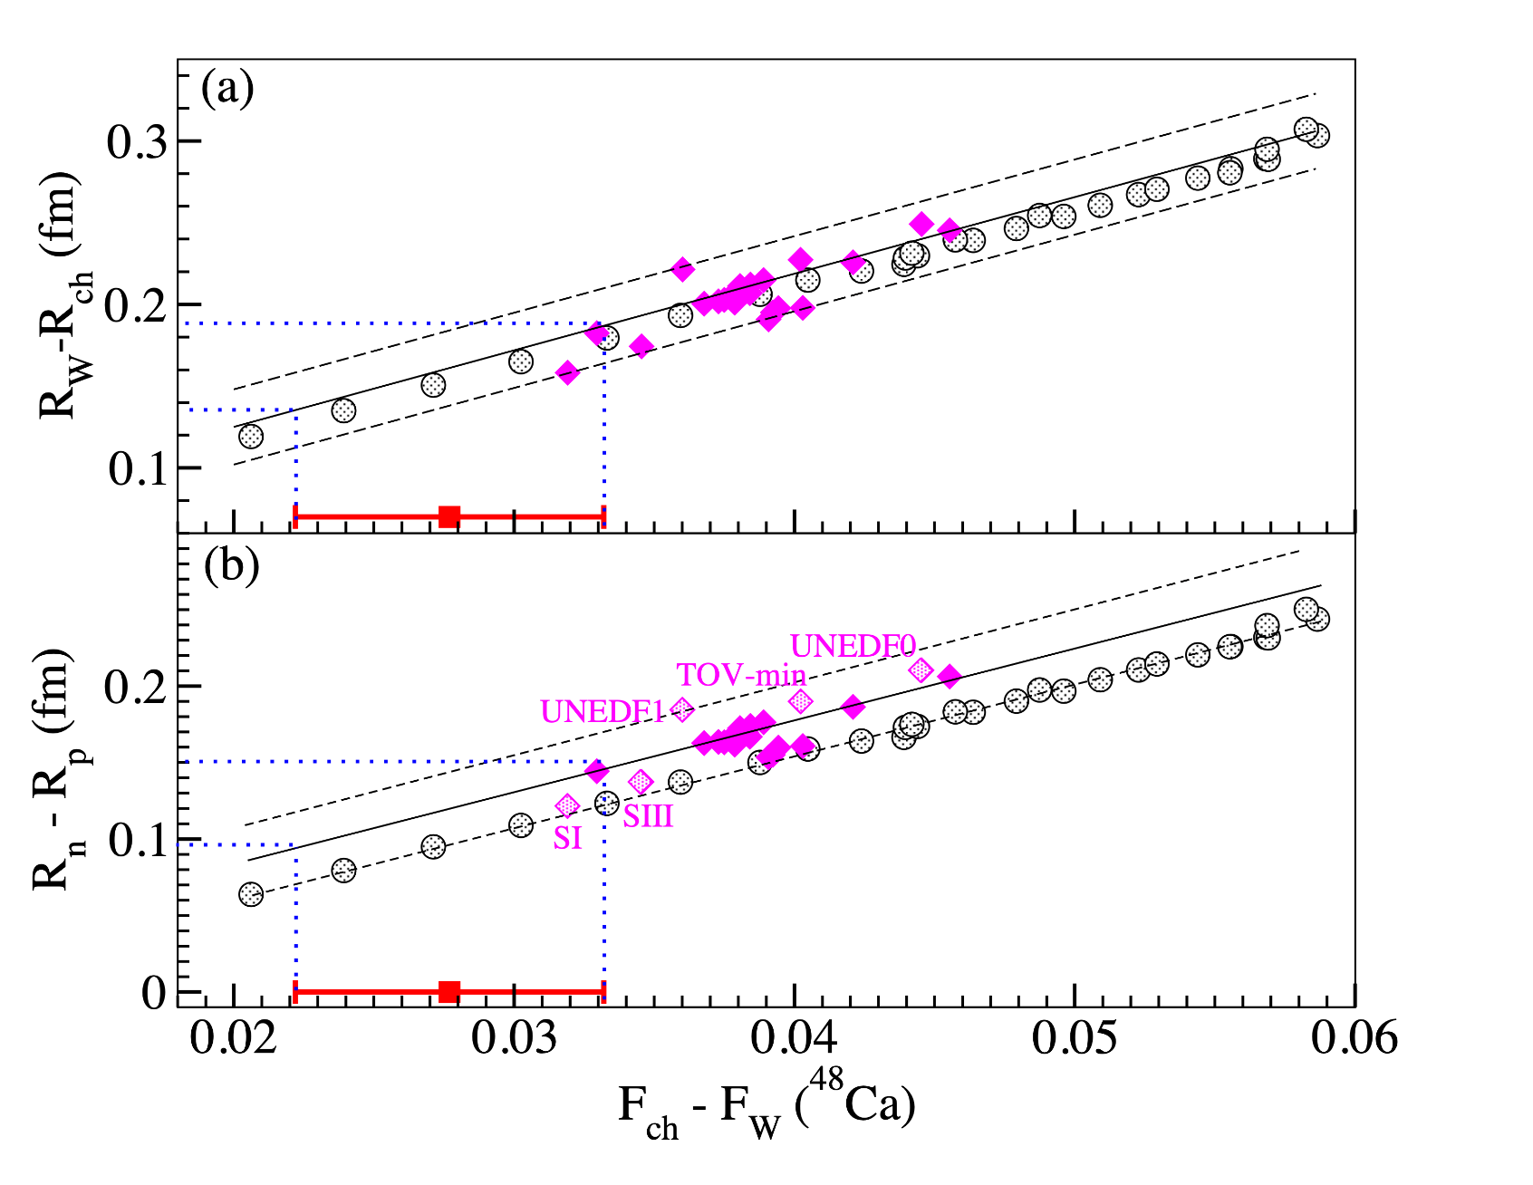
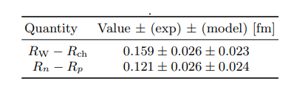
⁴⁸Ca Weak minus charge rms radius vs charge minus weak form factor (top), and neutron minus proton radius (bottom)
Weak skin
Neutron skin
CREX data
p19

Slide 21
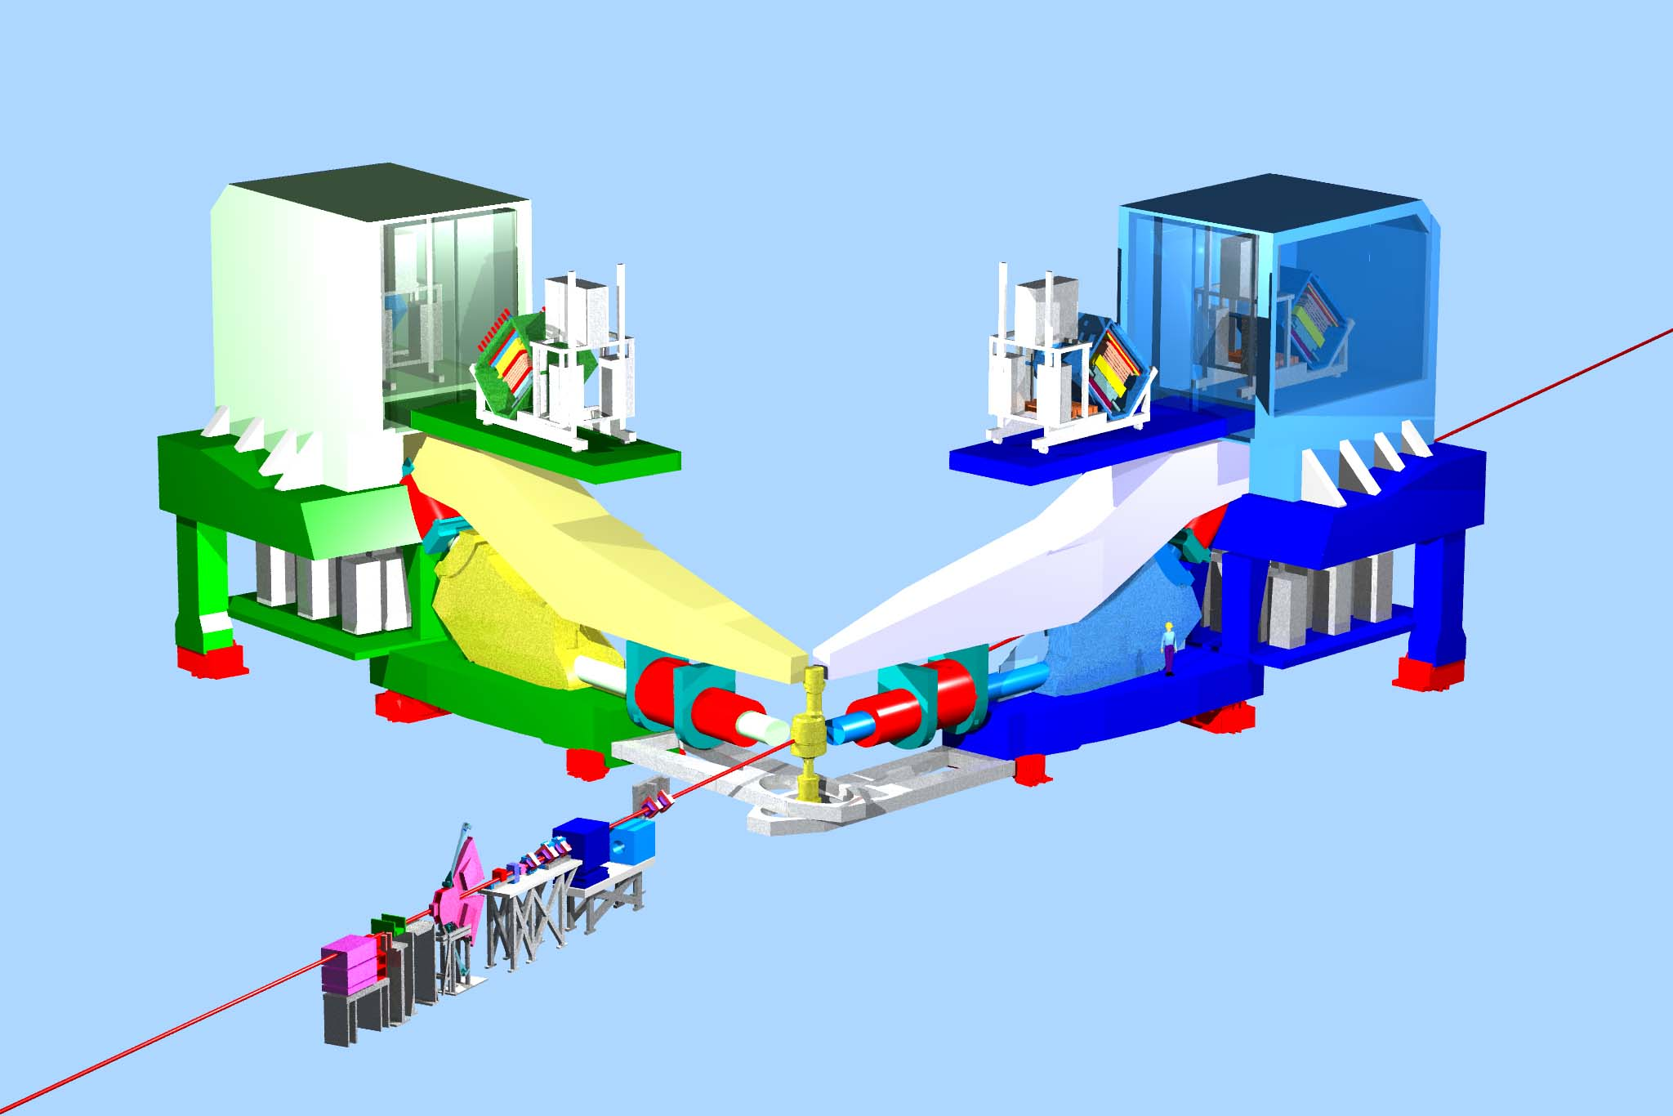
High Resolution Spectrometers
Spectrometer Concept: Resolve Elastic
1st excited state
Pb 2.6 MeV
Ca 3.84 MeV
Elastic
detector
Inelastic
Left-Right symmetry to control transverse polarization systematic
Quad
target
Dipole
Q Q
p9

Slide 22
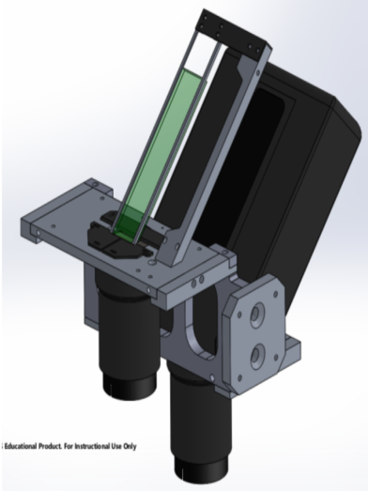
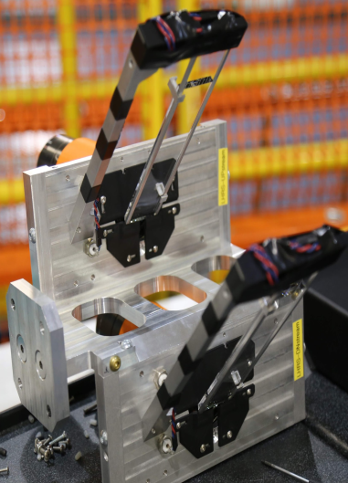
Integrating Detectors
Counting Detectors
The challenge: all electrons need to count the same - high photon statistics but low shower fluctuations
Fused silica Cerenkov radiator, 5mm thick, 3.5x16 cm² area, mated to a single PMT
~56 MHz signal rate in a 3x3 cm² area at the end of the detector
Non-linearity of detector response was tested on the bench and with beam during the experiment
The HRS Vertical Drift Chambers (VDCs) below the quartz detectors
GEMs that we installed upstream and downstream of our quartz detectors
Used to align the elastic peak on the quartz and to measure accepted kinematics
Used at very low beam currents (<1uA) “counting experimental mode”
p13
DNP
October 12, 2021
22
Notes:
Integrating det: In focal plane we place these integrating detectors. We focus the elastic stripe . It’s an unusual optics configuration for the spectrometer as well. We tune the optics so that we’re not separating out the elastic peak and trying to disperse the beam to measure it really well, instead we want to focus the elastic peak in a really small spot. So we focus that down onto a small piece of quartz, about 3.5cm across and a bit longer cause it’s carrying it’s own light back to the phototube. Each piece of quartz it mated to a single phototube. This fused silica Cerenkov radiator is about 5mm thick. Electrons go through, the photons radiate, those photons are collected. Now, a thin piece of quartz doesn’t give you a lot of photons and you have to have good resolution in this. All the photons need to count the same and to the extent that they don’t, that there’s noise in your measurement and that ultimately becomes statistical noise and degrades the statistical power of your result. So, you need to have the photon count as high as possible. There’s a very careful design with a lot of beam testing done which revealed that for this energy of electrons, you need to have this thin quartz because you can optimize it to get a lot of photons out but you really have to avoid developing showers which produce a long tail and screw up the uniformity of the measurement. The most crucial thing about this is actually nonlinearity. If you have a non-linear response in the phototube that’s a direct hit on your systematic uncertainty and that was extremely well characterized at Idaho State. We knew exactly how to run these to get a linear response.
Counting det:We also do have counting detectors up there. You have the standard HRS detectors, these vertical drift chambers, which lye just below the quartz detectors. But those are rate limited and if you are measuring at 4GHz you can only turn the beam down so low, so we needed to have a way to run at higher rates. For that we used GEMs, which were there in case we needed to measure at a higher beam current and unable to take trustworthy data with the Drift Chamber response. We used the drift chamber results to align the elastic peak on the quartz, to align our spectrometer, and ultimately to measure the acceptance of what we were detecting in our quartz. Mostly this stuff was used at very low currents, at 30nA.

Slide 23

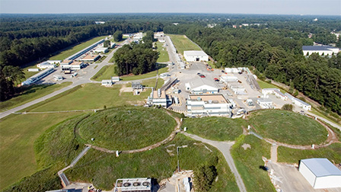
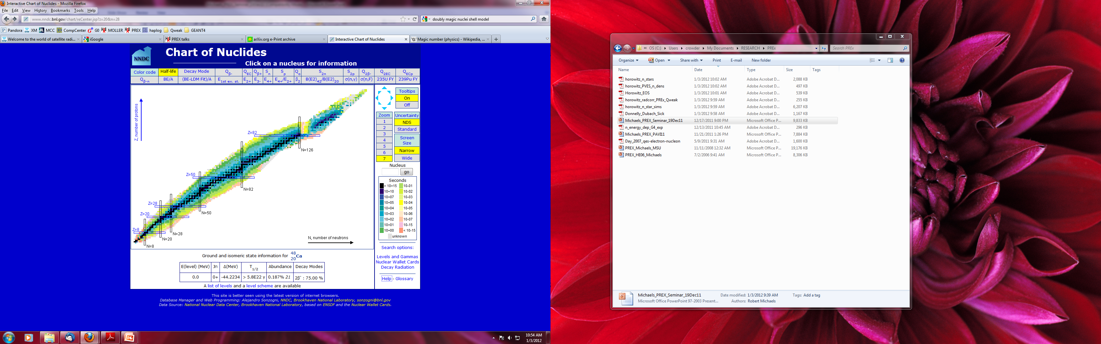

Neutron form factor
Hall A
Choice of Nuclear Targets
First excited state far from elastic
Neutron excess
Doubly-magic
Stable
High Resolution ( 10⁻⁴ ) Spectrometers
²⁰⁸Pb
⁴⁸Ca
Hall A
p5

Slide 24
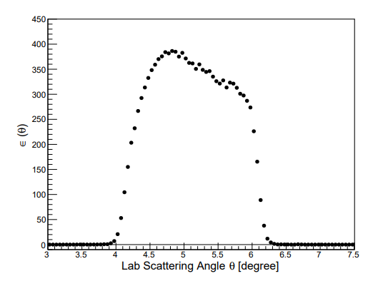
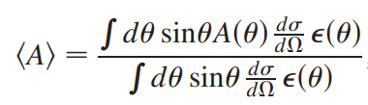
Acceptance Function
Robert Michaels, SSNET 22
p25

Slide 25
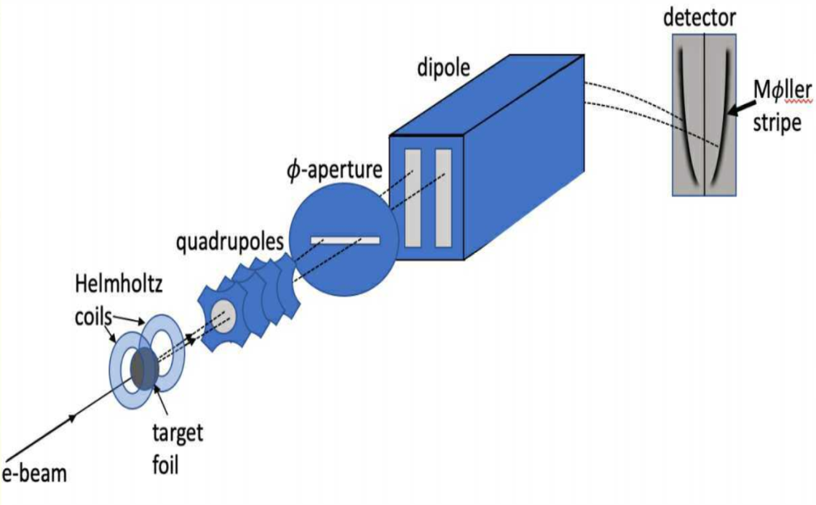
Beam Polarimetry
Compton Polarimetry
Moller Polarimetry
Acknowledgments: S. Malace, E. King, D. Jones, P. Souder
Acknowledgments: A.J. Zec, J. C. Cornejo, M. Dalton, C. Gal, D. Gaskell, C. Palatchi, K. Paschke, A. Premithilake, B. Quinn
Low-current, invasive measurement
3-4T field provides saturated magnetization perpendicular to the foil
Spectrometer redesigned for 11 GeV
CREX reoptimized the spectrometer tune (and detector configuration), to provide high precision and sensitivity to systematic effects
Polarimeter runs were taken approximately every week
Continuous, non-invasive measurement
Utilized integrating technique with photon detector
Evaluated systematic uncertainty
Polarimeter runs taken continuously alongside main detector data
Robert Michaels, SSNET 22
p26
Caryn Palatchi
DNP
October 12, 2021
Notes:
When the beam gets to the Hall, we measure it’s polarization. For CREX this was done with two types of polarimeters: a Compton polarimeter and a Moller polarimeter. Moller: is a low current measurement, you have to turn the beam current way down. It’s invasive because it uses an iron foil. We have this saturated magnetization in the iron foil, in a high field magnet 3-4 Tesla. There’s a spectrometer, 4 quadrapole magnets, and a dipole magnet that will separate out the two symmetric elastic scattered Moller electrons. You can have a coincidence measurement L to R, so in that sense it’s a very low background measurement, and can be done relatively cleanly. There are some dangerous systematics hiding under that. You have to be very clear about what kinematics you’re accepting, and in particular there’s this troublesome problem of scattering off of atomic bound electrons, which confuses there acceptance slightly. You have to be very careful with how you setup the magnetic tune of the spectrometer. And that had to be redesigned
But we did that, some terrific work being done on that by the Moller group.

Slide 26
Compton and Moller polarimeter results
1st period Spring 2020
Right (In/Out)
2nd period Spring 2020
Left (In/Out)
3rd periodSummer 2020
Right (In/Out)
Beam Polarization (%)
Spans
~ +-1.3% relative error
Acknowledgments: A.J. Zec, J. C. Cornejo, M. Dalton, C. Gal, D. Gaskell, C. Palatchi, K. Paschke, A. Premithilake, B. Quinn
Average Compton polarization:
87.10 ± (0.52% dP/P)
Average Moller polarization:
87.06 ± (0.85% dP/P)
CREX Polarimetry Result:
P_{e}=87.09 +/- (0.44% dP/P)
Robert Michaels, SSNET 22
This precision is a world record.
p27
DNP
October 12, 2021
26
Notes:
Average polarization re-weighted by production data. Compton data fit piecewise to various significant events during run. Moller data compared to fits. Compton reporting one overall average rather than point-to-point correction. Consistent

Slide 27
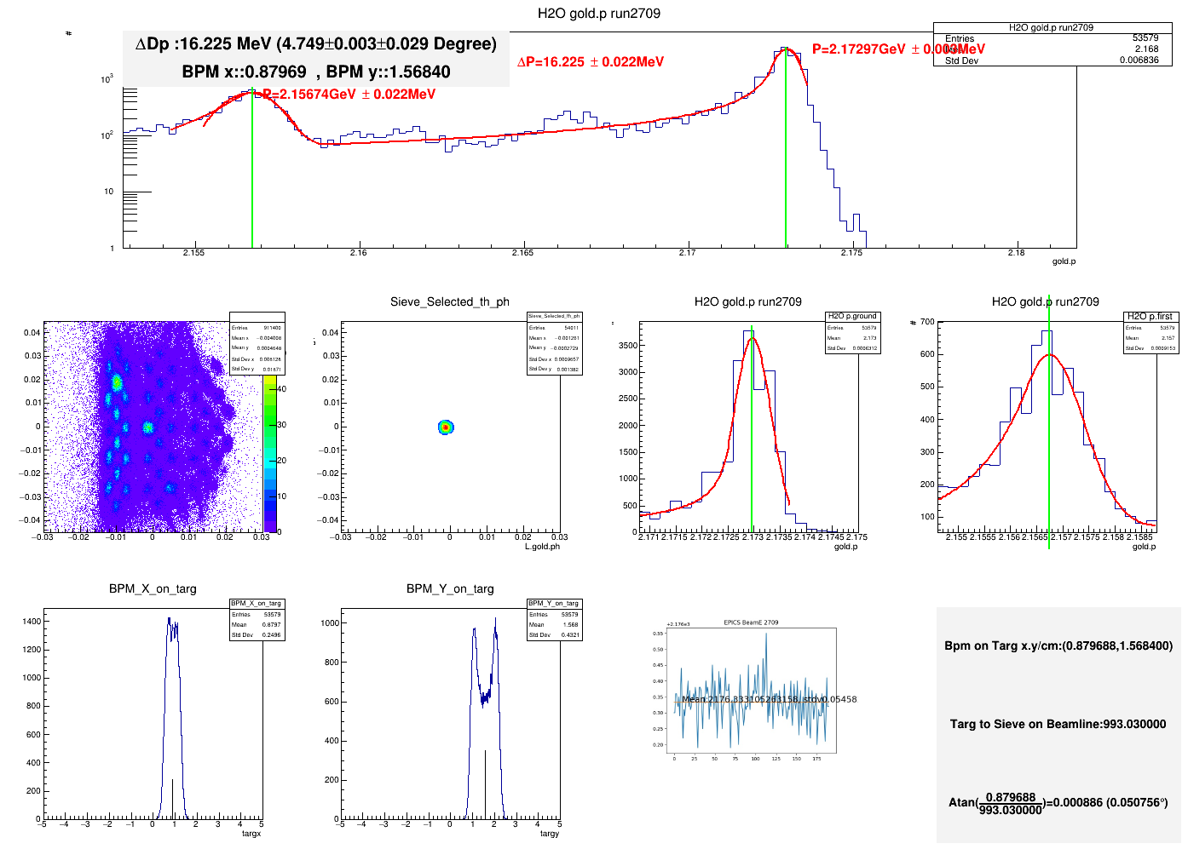
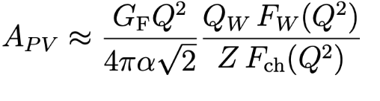
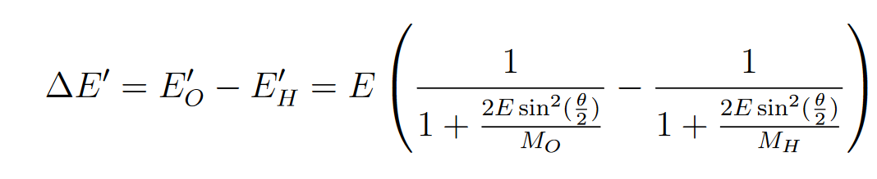
Scattering angle calibration with water cell
Nuclear recoil method
¹H and ¹⁶O in one target (same E-loss) provides measurement of angle θ
Energy spectrum from water target
Elastic H peak
Elastic O peak
**Analysis by Siyu Jian
and Nilanga Liyanage
2.155 2.16 2.165 2.17 2.175 2.18
Momentum [GeV]
Determined central angle with pointing with precision of
δθ = 0.02⁰ (0.45%)
recoil momentum difference ⟶ scattering angle
Robert Michaels, SSNET 22
p28
DNP
October 12, 2021

Slide 28
Beam Corrections
Beam jitter noise several times greater than counting statistics
Analysis removes noise and evaluates residual helicity correlations (systematics).
𝜎 =765ppm
𝜎=1650ppm
A_{raw} = A_{det} - A_{Q} + α Δ_{E}+ Σβ_{i} Δx_{i}
The α for energy is another β for a monitor.
Potential for systematic error if average beam asymmetries are not well corrected
Multiple techniques used to calibrate correction factors (βi )
Robert Michaels, SSNET 22
p29
Caryn Palatchi
DNP
October 12, 2021

Slide 29
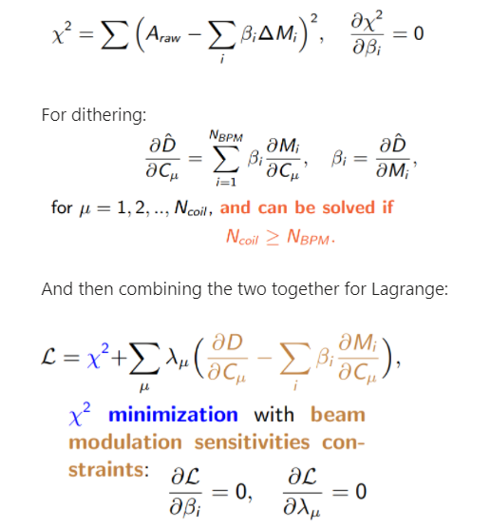
The Math of Beam Corrections -- 3 Methods
A_{raw} = A_{det} - A_{Q} + α Δ_{E}+ Σβ_{i} Δx_{i}
Regression
The α for energy is another β for a monitor.
Dithering
Credit: Paul Souder, Tao Ye, Kent Paschke, Cameron Clarke, Ye Tian, Victoria Owen
Lagrange -- a combination of the above two
Robert Michaels, SSNET 22
p30

Slide 30
Beam corrected (but still blinded) Asymmetries
Half Wave Plate: IN/OUT Wien(Spin Manipulator): Left/Right
Sign-uncorrected, Each point: 8h time-scale
Sign-corrected, Each point: ~1week time-scale
Blinded
Blinded
Asymmetry (ppb)
Asymmetry (ppb)
1 Spring
Right (In/Out)
2 Spring
Left (In/Out)
3 Summer
Right (In/Out)
1 Spring
Right (In/Out)
2 Spring
Left (In/Out)
3 Summer
Right (In/Out)
Slug
R , In
R, Out
L, In
L, Out
R, In
R, Out
Entire data set! 6 colors on left correspond to 6 points on the right (zoomed in y-scale)
Measuring continuously flipping sign by 2 methods (IHWP, Wien)
The corrected asymmetry removed effects from beam asymmetries and noise
p31
DNP
October 12, 2021
30
Notes:
Slow down. Meaureing continuously flipping sign by 2 methods. Entire data set!
.
12BPM Lagrange corrected main detector asymmetry mean vs. slow controls. 1and5areIHWPIn,2and6areIHWPOut,andallareWienRight. 3and4are IHWP In and Out respectively, both Wien Left.

Slide 31
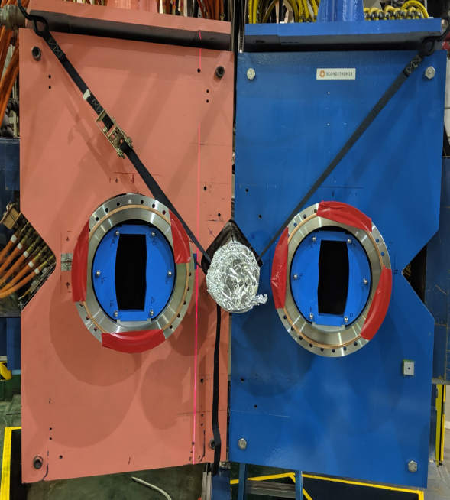
High Resolution Spectrometers -- HRS
Spectrometer separates elastic peak, directs it onto integrating detector (quartz).
Integrate detector in each of the spectrometer pair independently
Q1 (L)
Q1 (R)
⁴⁸Ca Spectrum
^{Excited States}
~12.5^{ο} Spectrometers
Q1 (L)
Q1 (R)
Septum
~5^{ο} scattering
2.5m
target
Robert Michaels, SSNET 22
p32
DNP
October 12, 2021
31
Notes:
The measurement was made using the HRS (high resolution spectrometers). These have two quadrupole magnets a dipole and a 3rd quad.The dipole analyzes the momentum of the accepted particles very strongly. You end up being able to separate the elastic scattered electrons very well from the inelastic scattering. So it’s a 14m dispersion, so this 2.6MeV or so separation to the inelastic is well separated in the scattering plane from where we put our detector. In this way, we can just put our detector there and just do an analog integration of our detector, and readout only the elastics with only a very small contamination that’s not difficult to quantify at the necessary level. These spectrometers are big, though. They don’t get very close together for a very forward angle experiment. We need to measure around 5deg scattering so we introduced a septum magnet in front of the first quadrupole of each HRS. This is a tight squeeze, it was tough to fit in. After the beam goes through the septum, entering the HRS at a 12.5 deg opening angle , and you can see that aperture we need its about the size of your hand, that’s our acceptance about 2.5m downstream of the target.

Slide 32
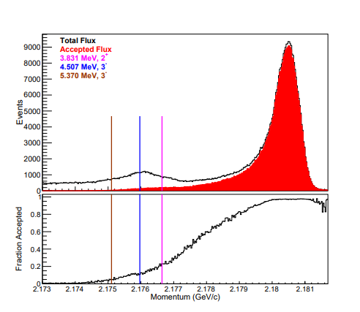
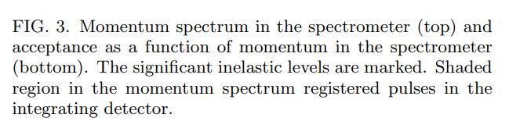
Robert Michaels, SSNET 22
p33

