Slide 1
Technical solutions for CEBAF upgrade, towards
- Positrons experimental capability
- 22 GeV energy upgrade program
Presented to the
JLab Staff Scientist Meeting on NSAC LRP
Andrei A. Seryi
Associate Director for Accelerator Operations and R&D
Newport News, Virginia
August 19, 2022

Slide 2
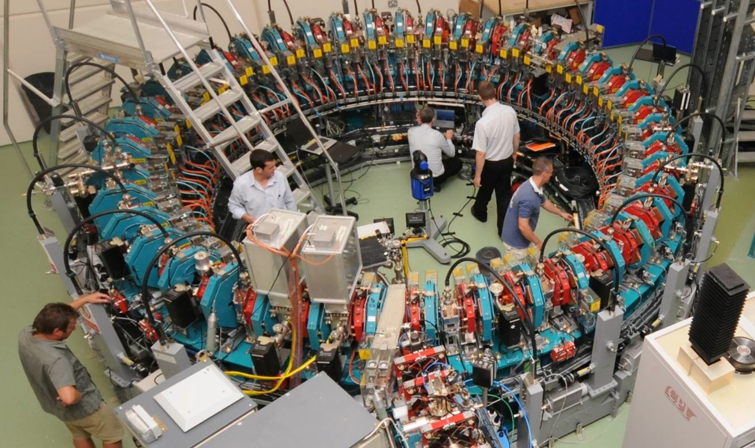
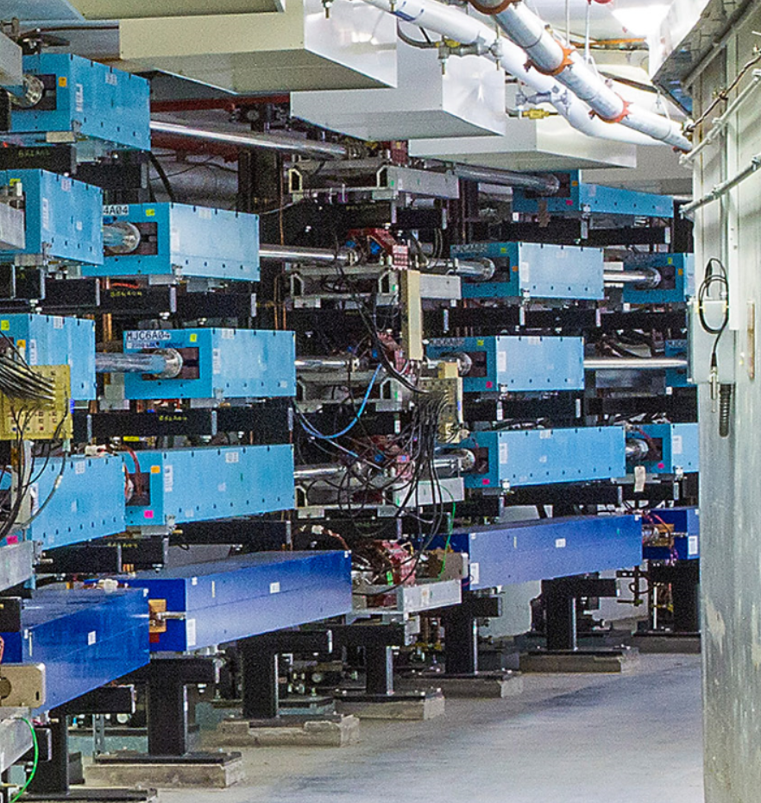
Energy upgrade foundation
EMMA (Electron Model for Multiple Applications) –demonstrated that orbits can be compacted to within 10 mm in radius over an electron momentum range of 12–18 MeV/c
Acceleration in the linear non-scaling fixed-field alternating-gradient accelerator EMMA, S. Machida, et al.,
Nature Physics volume 8, pages 243–247 (2012)
CEBAF – separate arc for each different energy

Slide 3
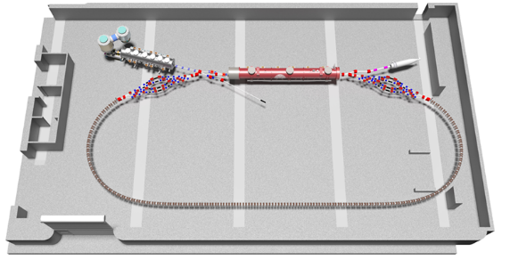
Energy upgrade foundation
CBETA (Cornell-Brookhaven energy recovery linac Test Accelerator) – the fixed-field alternating-gradient optical system used for the return loop successfully transported electron bunches of 42, 78, 114, and 150 MeV in a common vacuum chamber
CBETA: First Multipass Superconducting Linear Accelerator with Energy Recovery, A. Bartnik, et al., Phys.Rev.Lett. 125 (2020) 4, 044803
CEBAF – separate arc for each different energy
EMMA & CBETA FFA approach: we can increase number of passes through CEBAF linac without the need to increase the number of arcs

Slide 4
The FFA@CEBAF Collaboration
†
Alex Bogacz is leading the energy upgrade design efforts
Positrons @CEBAF Collaboration
Alex Bogacz, JLab
Alicia Hofler, JLab
Amy Sy, JLab
Andriy Ushakov, IJCLab-Orsay
Carlos Hernandez-Garcia, JLab
Cristhian Valerio, Univ. of Sinoloa
Dennis Turner, JLab
  Eric Voutier, IJCLab-Orsay
  Fanglei Lin, ORNL
  Jay Benesch, JLab
  Karl Smolenski, Xelera
  Larry Cardman, JLab
  Reza Kazimi, JLab
  Ryan Bodenstein
  Ryan Richards, Univ. of Virginia
  Sami Habet, IJCLab-Orsay
  Stephen Brooks, BNL
  Joe Grames, JLab
  Val Kolstrum, Xelera
  Yuhong Zhang, JLab
  Yves Roblin, JLab
Joe and Eric continue to fan and feed and push things along

Slide 5
Accelerator expertise and CEBAF upgrade foundations
CEBAF upgrade will significantly benefit from JLAB world-leading expertise in many areas:
  Recirculating accelerators
  Energy Recovery Linacs (ERL)
  Superconducting RF (SRF)
  Polarized electron sources, etc.
CEBAF upgrade is benefitting from experience of collaborating teams, BNL, Cornell, ORNL, IJCLab-Orsay:
  Fixed Field Alternative gradient optics (FFA)
  Permanent magnets FFA
  CBETA operations experience
  ILC positron production design, etc.

Slide 6
CEBAF upgrade, assumptions → design focus
Polarized positrons capability
  Near term, about five years from now, 12 GeV, multi-hall
Energy upgrade experimental program
  22-24 GeV, a decade from now, multi-hall
    Can have an intermediate stage of 17 GeV
    No positrons required in 22 GeV era
Modern and advanced design approach
  Non-scaling FFA demonstrated at EMMA (Daresbury, UK) and CBETA (Cornell)
  Fixed field suitable for permanent magnets – energy efficiency
  Collaborative efforts with BNL, ORNL and Cornell experts
Maximizing the overall affordability
  Uncoupled stages, build up on the previous stage, make each stage affordable
  Maximally re-use resources (space, buildings, hardware) already available

Slide 7
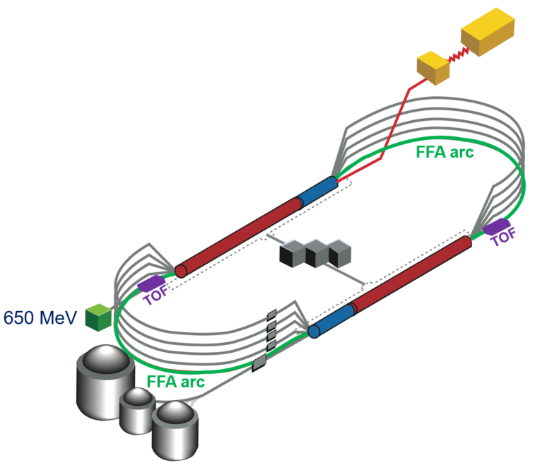
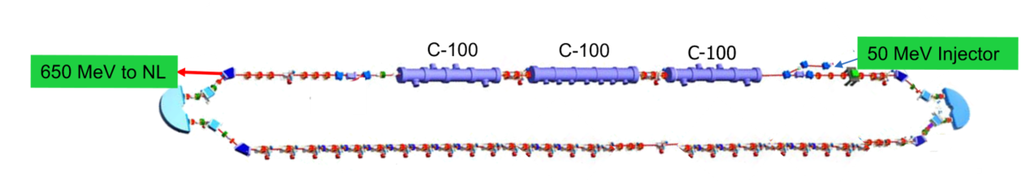
Energy upgrade to 22 GeV, big picture
Hardware needed:
  Replace an arc per side with new FFA permanent magnet arc
    (One or two pair of arcs considered)
    (Options for 22 GeV or 24 GeV)
  Add ~650MeV injector (e.g. one-pass-recirculation-based compact injector)
    This mean a shielded vault of ~70x10m

Slide 8
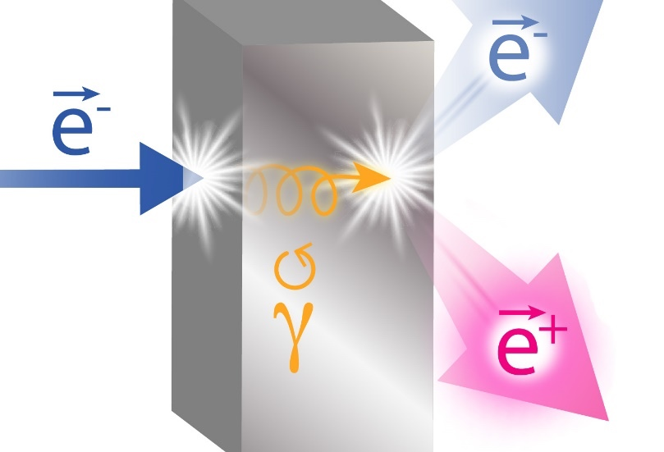
Polarized e+, big picture
Hardware needed:
  High current polarized e- source
  A cryomodule to accelerate e-
  An e+ target-source and collection system
  A cryomodule to accelerate e+
e+ @ 123
e+ source/collection
e-
e+
e-
e-
10
90-110
90-110
Cryomodule ~C100
Polarized positrons generation
Cryomodule ~C100
Space requirements for e+ source are similar to what is needed for ~600 MeV injector for 22 GeV program
Most of hardware from e+ stage can be re-used in the 22 GeV program – synergy with energy upgrade
Scheme courtesy Joe Grames. See also JLAB UO’22 talk by Matt Poelker

Slide 9
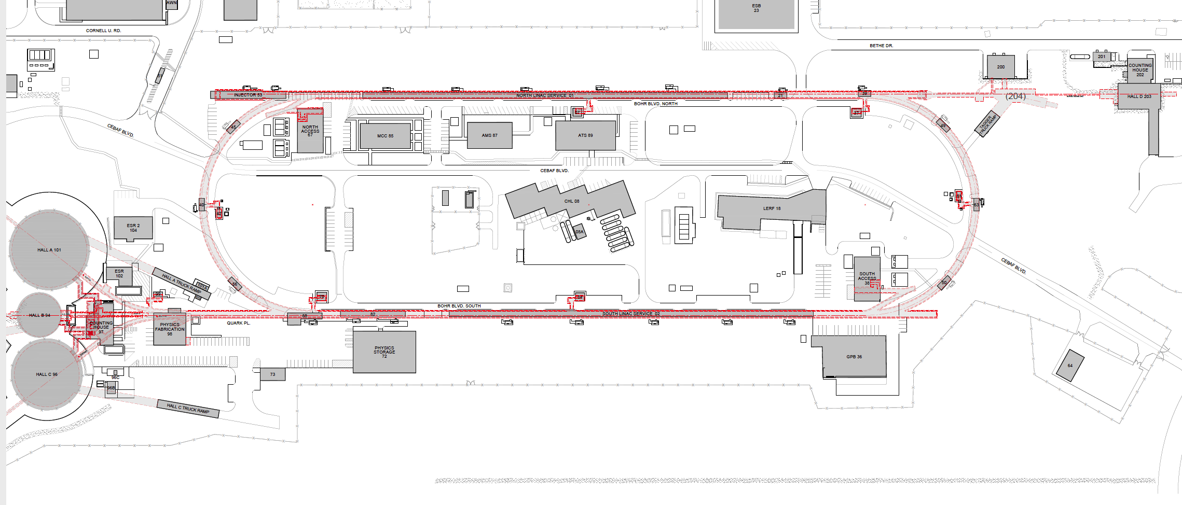
Several options were considered, e.g. … :
New underground vault
…however, the most cost-effective is the one which re-uses an existing shielded facility

Slide 10
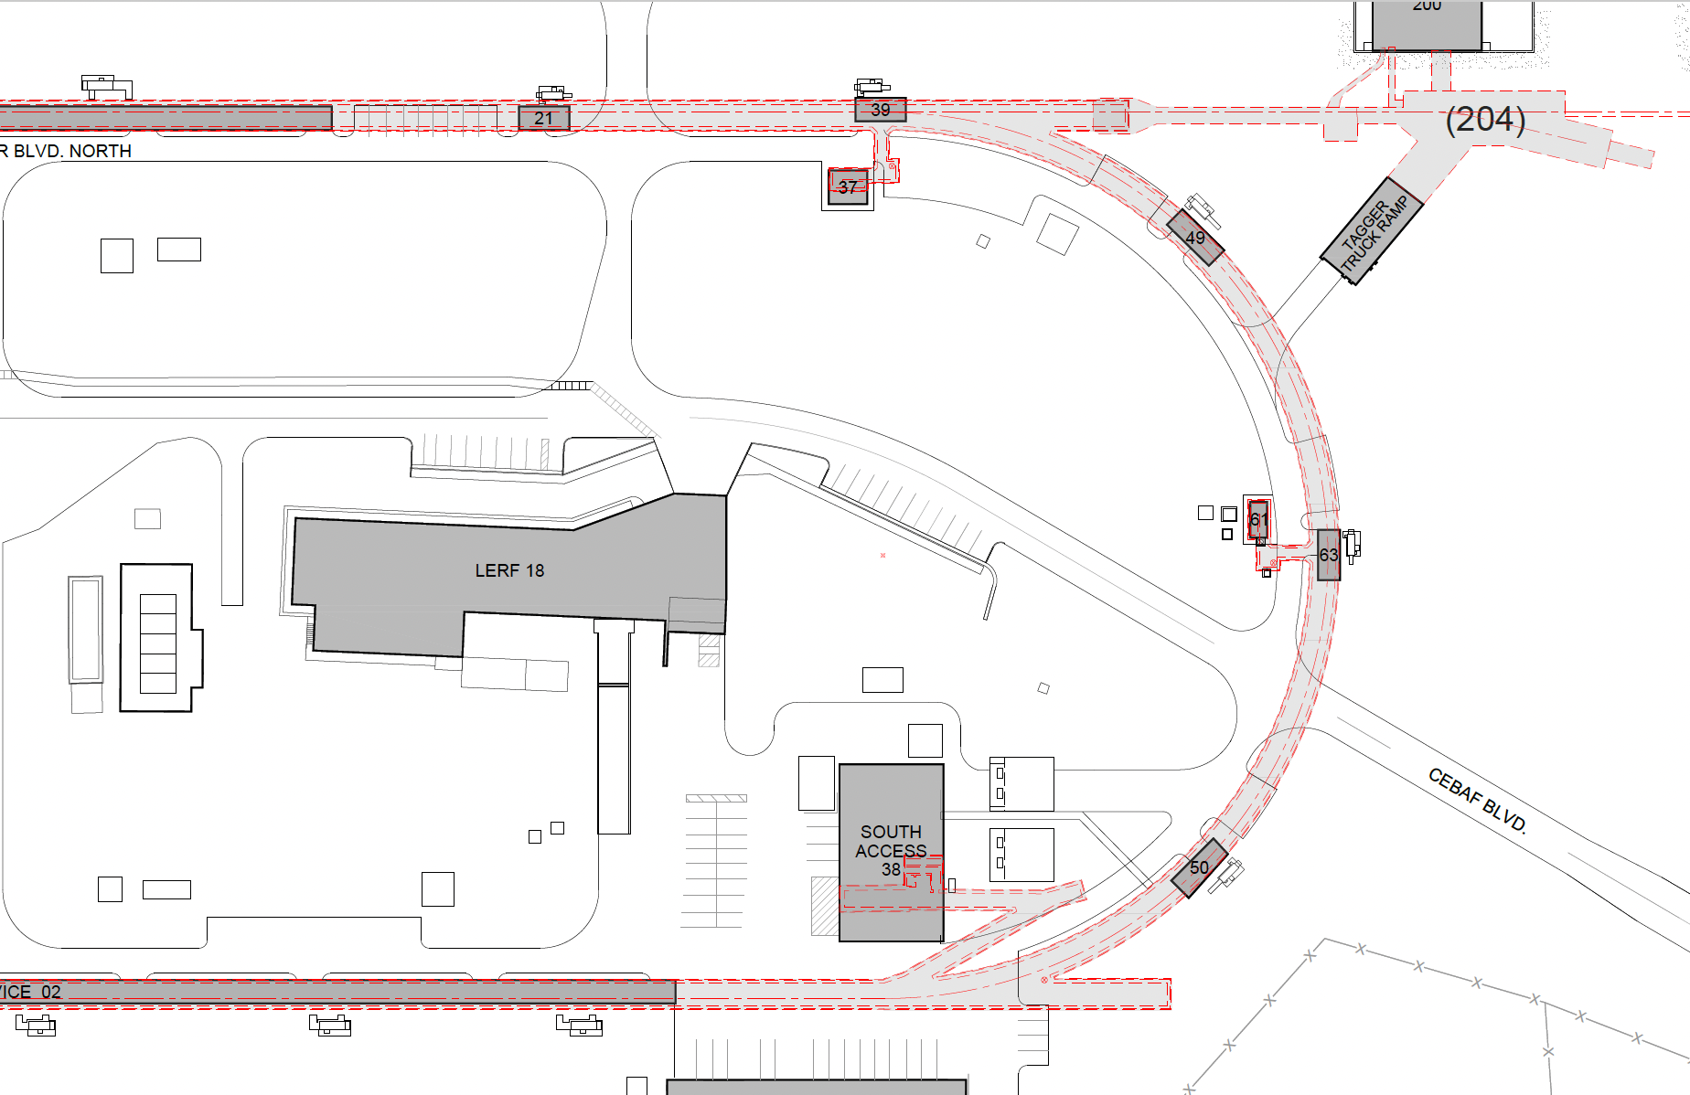
Option 2c: new cut-and-cover tunnel between LERF and E Arcs
LERF is used for e+ development, while tunnel is constructed. Once connected – start e+ program. Then reconfigure LERF as 650 MeV injector and start 22 GeV program
New tunnel,
with slope from LERF to tunnel level
A new beamline from East arc, along the ceiling of South Linac, and along the West arc, can bring ~120 MeV positrons, or 650 MeV electrons, into the standard injection point at the beginning of the North Linac
2c
2b
Options 2a and 2b assumed connecting the new tunnel to one of the existing stabs. They both have some disadvantages and they were put aside in the process of design optimization with our conventional construction experts
2a

Slide 11
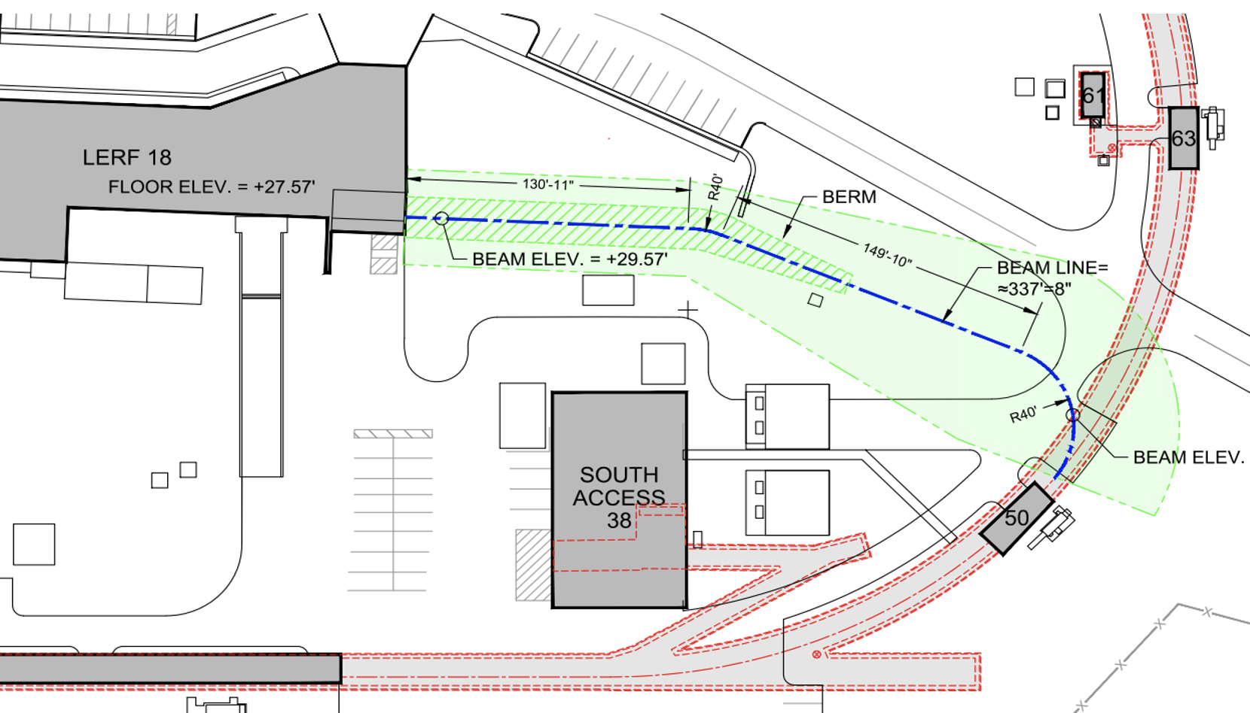
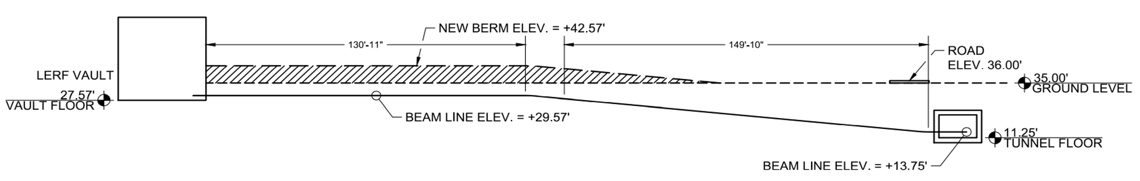
Tunnel to East Arc
Conventional Facilities construction experts assessment and design optimization
  Options 2a and 2b assessed
  Option 2c suggested and evaluated
  Feasibility confirmed
Rough cost estimates for hardware are in the process
Drawings courtesy Joel Dolbeck

Slide 12
Accelerator Physics Details of CEBAF Energy Upgrade
Feasibility study for FFA* racetracks in the existing CEBAF tunnel to reach the top energy of about 22-24 GeV
*FFA (Fixed Field Alternating-Gradient)
Materials courtesy of Alex Bogacz, Accelerator Physics Group, CASA

Slide 13
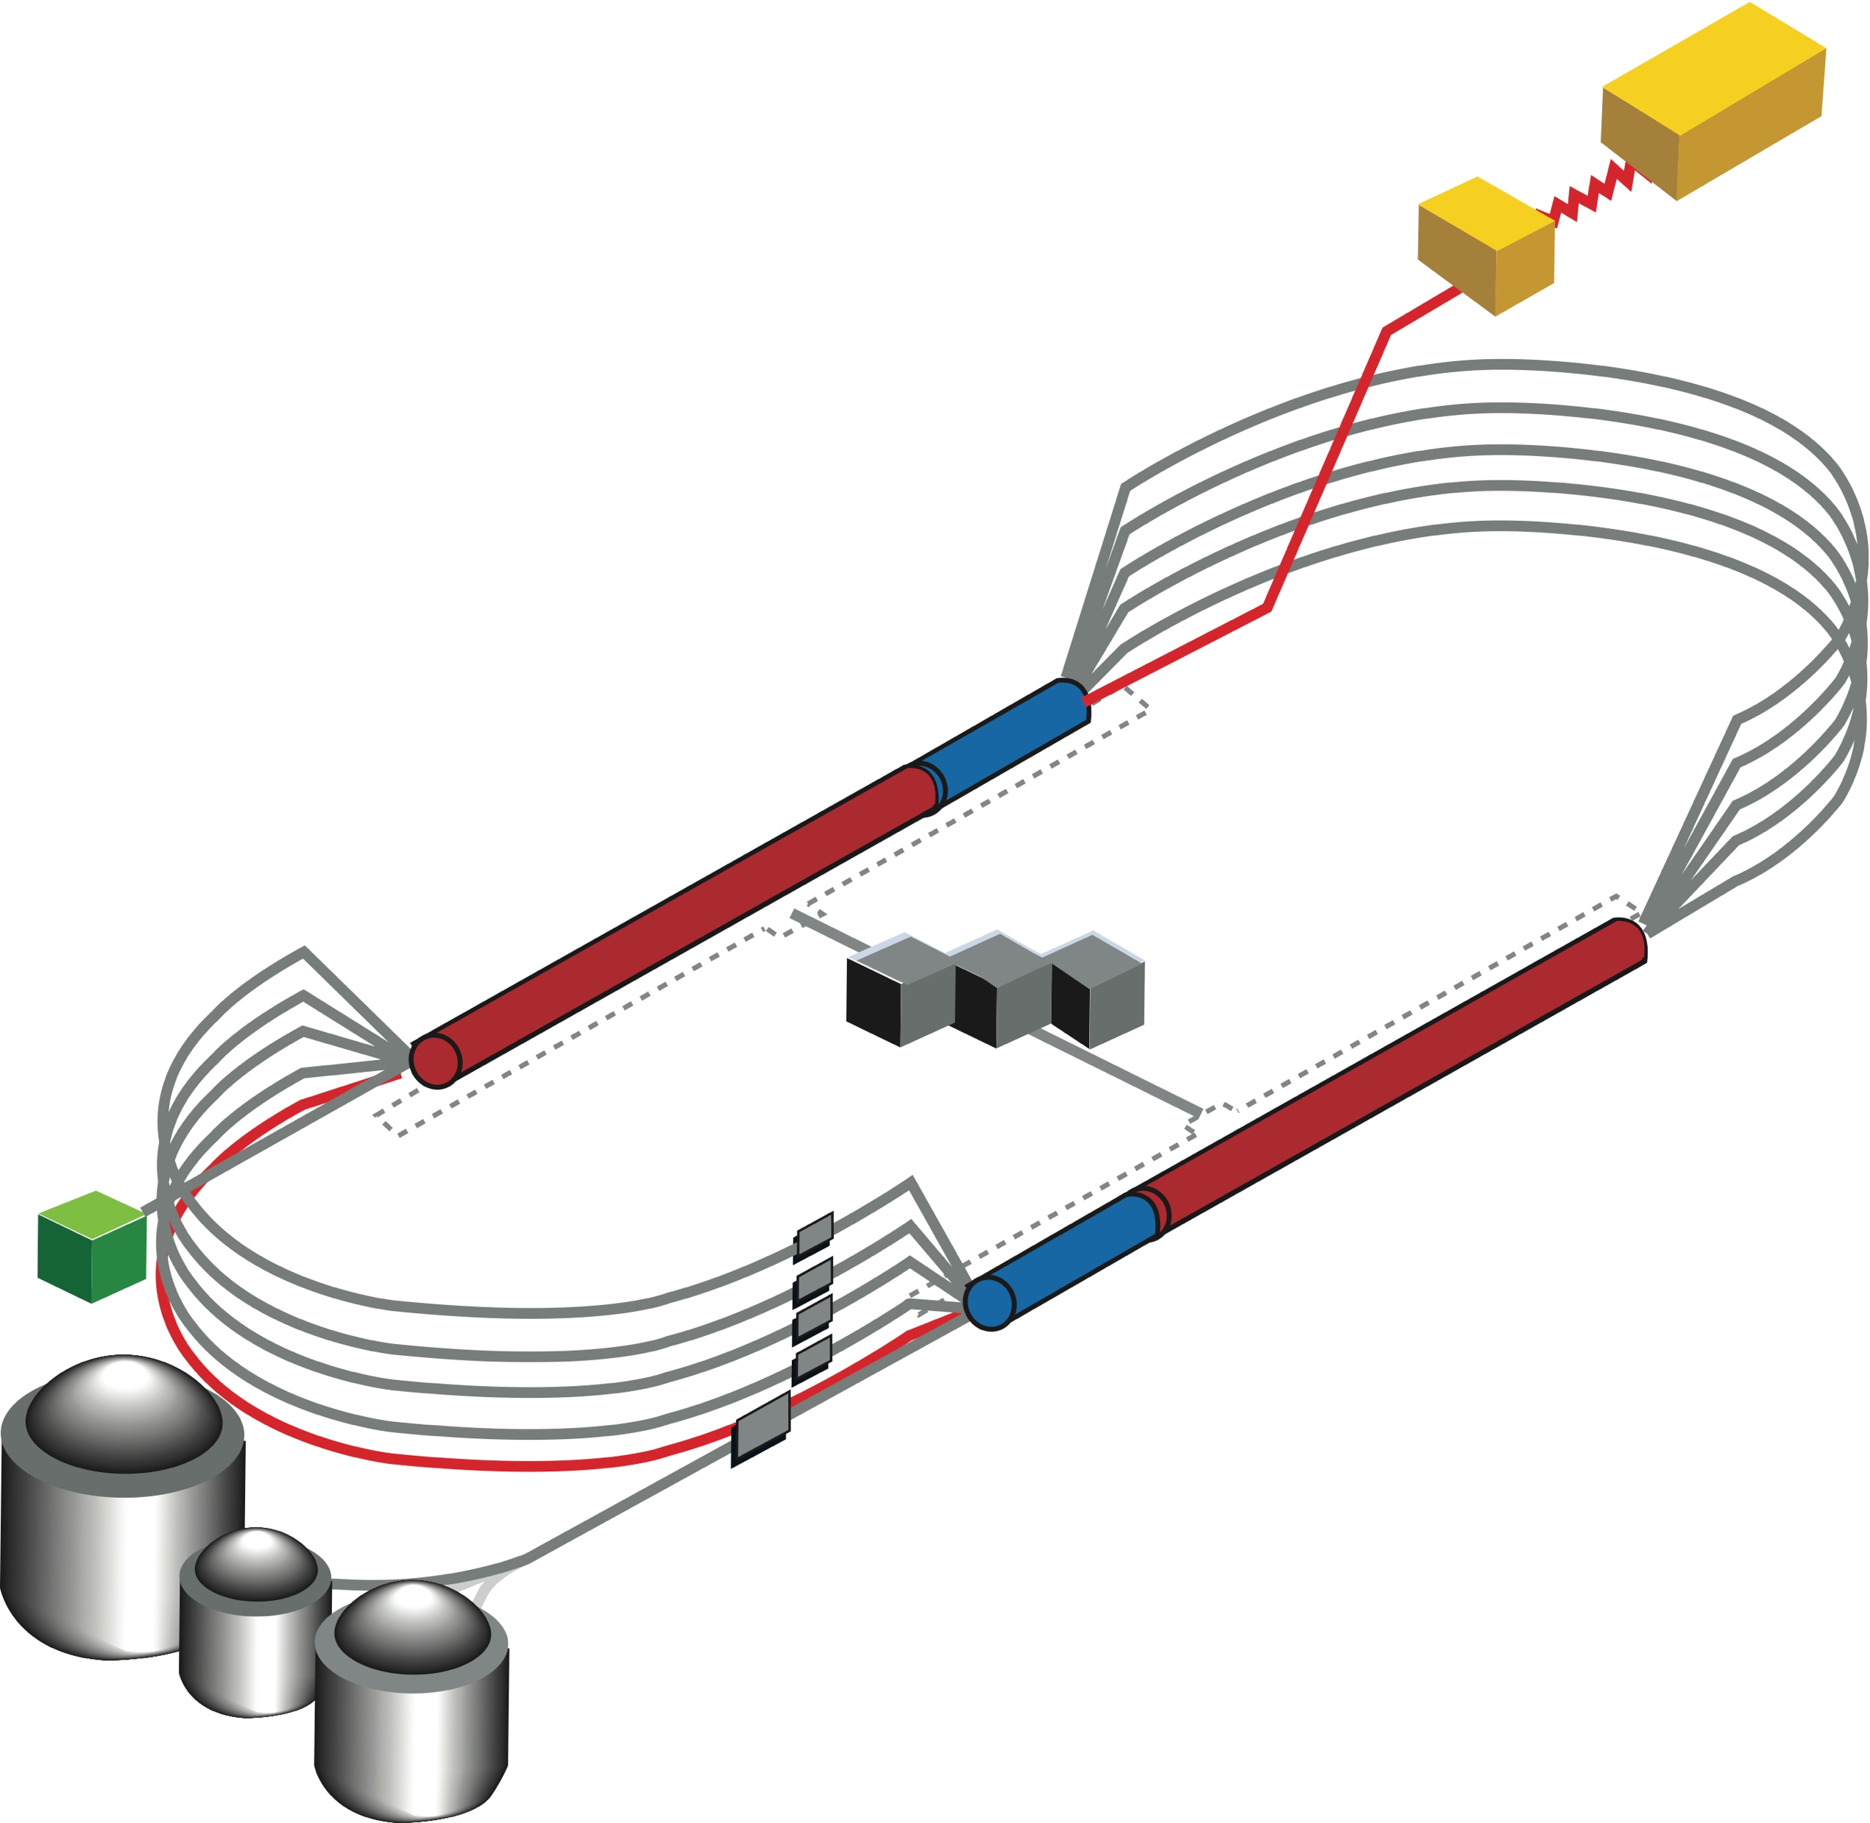

CEBAF FFA Upgrade – ‘Option 1 under Study’
  Starting with 12 GeV CEBAF as a baseline
  NO new SRF (1.1 GeV per linac)
  New 650 MeV recirculating injector
  Remove the highest recirculation pass (Arc 9 & A) and replace them with two FFA arcs including time-of-flight chicanes
  Recirculate 4 + 6 times to get to about 22 GeV
TOF
TOF
650 MeV
Novel permanent magnet technology used for power and cost savings
Pass Arithmetic: 5 -1 + 6 = 10

Slide 14
CEBAF FFA Upgrade – ‘Option 2 under Study’
  Starting with 12 GeV CEBAF as a baseline
  NO new SRF (1.1 GeV per linac)
  New 650 MeV recirculating injector
  Remove the highest recirculation pass (Arc 9 & A) and replace them with two FFA arcs including time-of-flight chicanes
  Recirculate 4 + 4 times to get to about 18 GeV
TOF
TOF
  Install a second pair of FFA arcs ‘on the floor’ below Arc 9 & A
  Recirculate 3 times to get to about 24 GeV
TOF
650 MeV
TOF
Novel permanent magnet technology used for power and cost savings
Pass Arithmetic: 5 -1 + 4 + 3 = 11

Slide 15
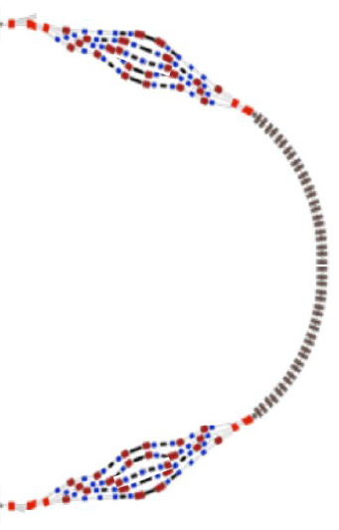
FFA CEBAF with -like Arcs

Slide 16
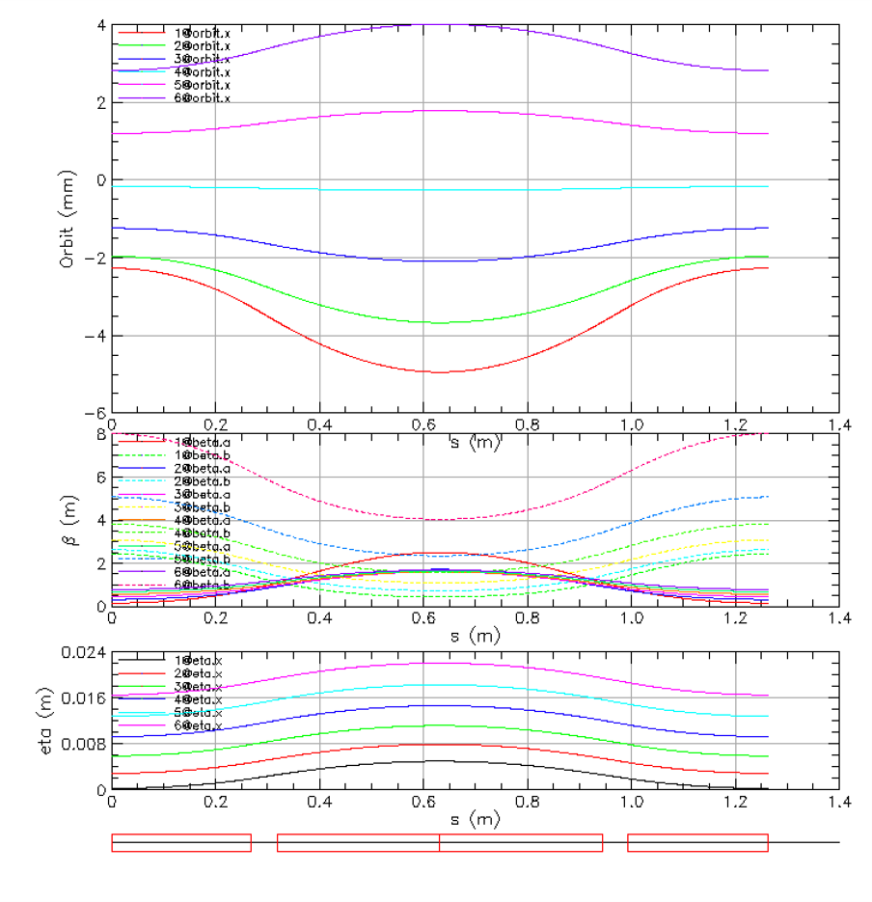
Compact FFA FODO Cell – How Does it Work?
Large momentum acceptance FFA cell, configured with combined function magnets capable of transporting multiple energy beams through the same string of permanent magnets (six beams with energies spanning a factor of two)
magnets: from 38cm² to 78cm²
BD
BF
BD
1 T
50 T/m
1 T
50 T/m
Closely spaced orbits for all six beams (~ 1 cm)
Extremally low dispersion (a few mm) in a combined function lattice
Self similar beta functions for different energy beams
BD
BF
BD

Slide 17
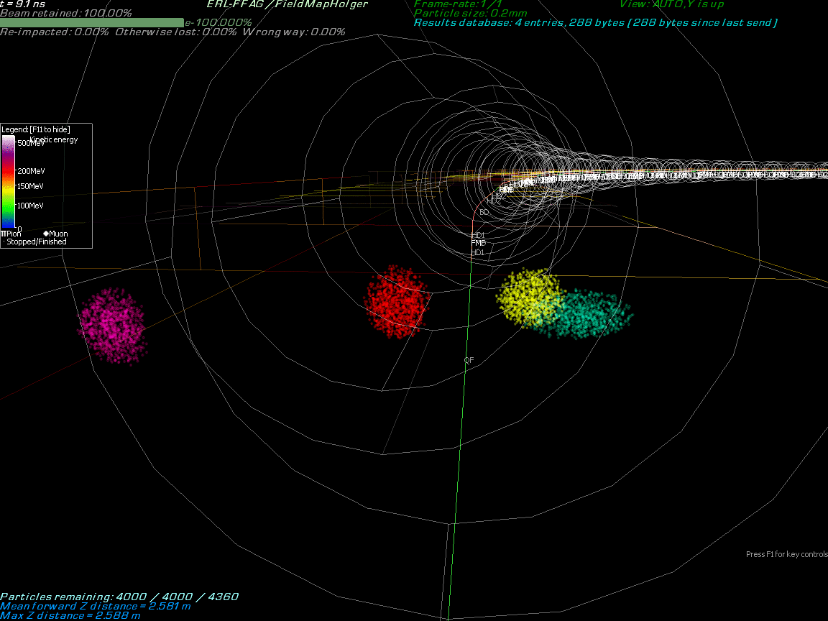
Multi-Bunch Dynamics in FFA Arc
Stephen Brooks
BNL

Slide 18
Injector Upgrade − 650 MeV Recirculating Injector
With the present 123 MeV injector, the difference in the first and final pass energies in the North Linac is too large (1:175) to effectively control the beam.
Option 2c: new cut-and-cover tunnel between LERF and E Arcs
LERF is used for e+ development, while tunnel is constructed. Once connected – start e+ program. Then reconfigure LERF as 650 MeV injector and start 22 GeV program
650 MeV recirculating injector (3-pass) based on LERF will allow a manageable difference in energies (1:33)
A new beamline from East arc, along the ceiling of South Linac, and along the West arc, can bring ~120 MeV positrons, or 650 MeV electrons, into the standard injection point at the beginning of the North Linac

Slide 19
Recirculating Injector Based on LERF (3-pass)
10 MeV + 3 × 3 × 71 MeV = 650 MeV
10 MeV
436 MeV
C-75
C-75
C-75

Slide 20
Recirculating Injector Based on LERF (3-pass)
10 MeV + 3 × 3 × 71 MeV = 650 MeV
650 MeV
C-75
C-75
C-75
New arc
New arc

Slide 21
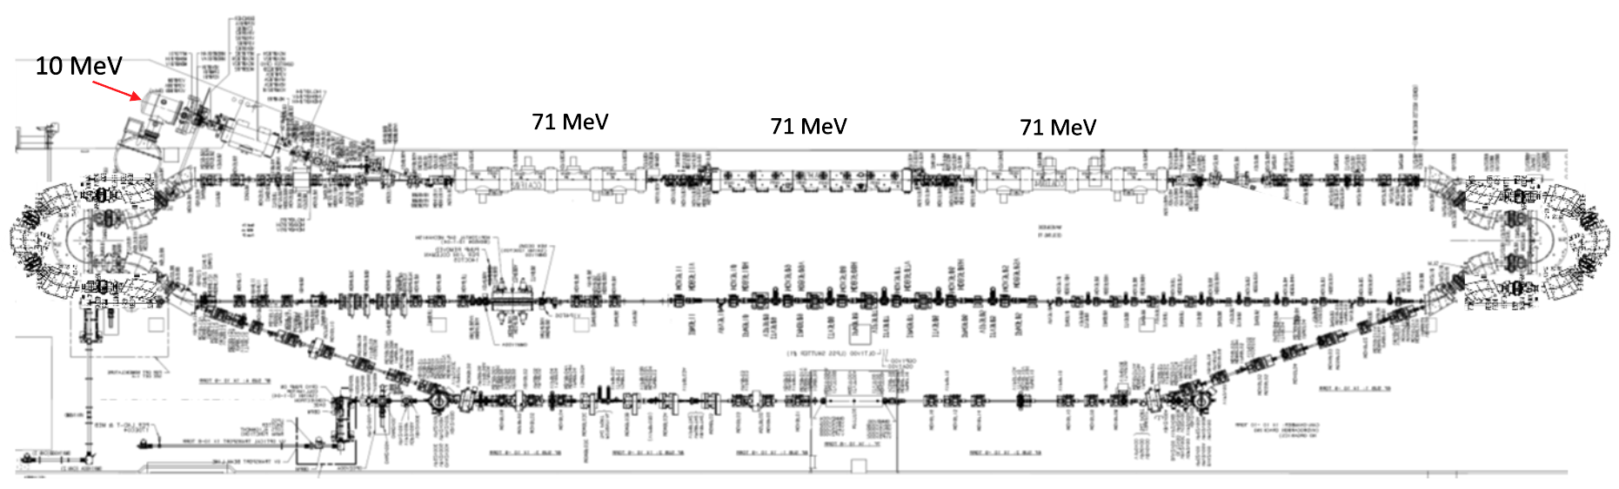
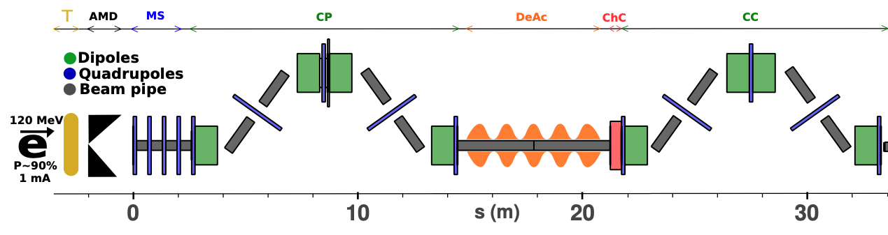
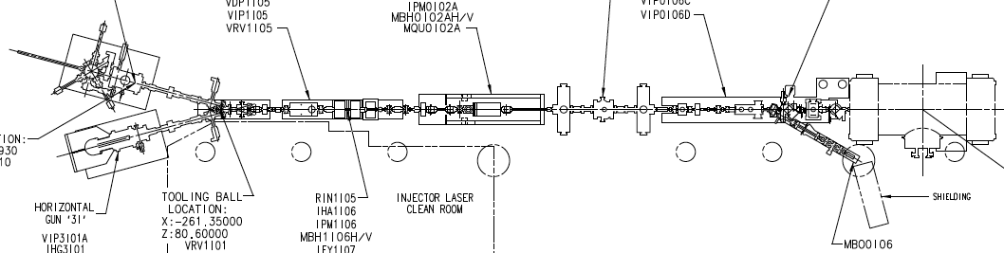
123 MeV e+ injector for 12 GeV positrons
#1A – FEL style compact e- injector 10 MeV
#6 – SRF accelerate e+ to 123 MeV
#2 - SRF accelerate >100 MeV
#5 – Injector e+ to linac
#3 – Extract e- to target
#4 - Produce e+ accelerate to 50-70 MeV
#1B – CEBAF style polarized e- injector 10 MeV
#7 – Transport e+ at 123 MeV to exit LERF
The e+ and E+ configs in LERF are compatible, and most of hardware re-used

Slide 22
Energy Loss, Emittance Dilution (4-pass CEBAF)
  Doubling the energy, while staying within current CEBAF footprint, makes the synchrotron radiation effects of paramount importance.
  Quantum nature of a ‘recoil’ effect on electrons due to photon emission makes significant impact on both the transverse and longitudinal beam dynamics, leading to cumulative emittance growth (transverse and longitudinal).
Energy loss
Emittance dilution
Natural energy spread

Slide 23
Energy loss, Emittance Dilution (Option 1: 6-pass FFAs)
Synchrotron radiation mitigation in FFAs
  High fill factor (88% space filled with bends) increases significantly the bend radius, ρ.
  By virtue of extremally small dispersion and betas, the horizontal emittance dispersion, <H>, is highly suppressed (factor of 50 lower then in a conventional CEBAF arc lattice).
6 passes

Slide 24
Energy loss, Emittance Dilution (Option 2: 7-pass FFAs)
4 passes
Synchrotron radiation mitigation in FFAs
  High fill factor (88% space filled with bends) increases significantly the bend radius, ρ.
  By virtue of extremally small dispersion and betas, the horizontal emittance dispersion, <H>, is highly suppressed (factor of 50 lower then in a conventional CEBAF arc lattice).
3 passes

Slide 25
Accelerator Design Summary
Present Baseline (1.1 GeV per linac):
  650 MeV Recirculating Injector (additional three C-75 cryomodules)
  Recirculate 4 passes with the current CEBAF plus:
    Option 1: Additional 6 passes via a single FFA: 10.4 – 22.8 GeV
    Option 2: Additional 7 (4 + 3) passes via two FFAs: 10.4 – 17.9 GeV and 19 – 24.6 GeV
Adiabatic FFA arcs configured with compact FODO cells
  Beta and dispersion matching to the linacs through cell-by-cell variation (length, bend)
  Open mid-plane permanent magnet design: B-field ≤ 1 T, Gradient ≤ 47 T/m
Synchrotron Radiation impact on beam quality (Option 1):
  Net transverse emittance dilution (normalized): 60 mm mrad
  Net natural energy spread: 2×10⁻³
  Net synchrotron radiated energy: 1 GeV
Engineering analysis and cost estimations – are in progress
  Will be ready in time for LRP submission
at 22 GeV, β = 20 m → σ = 150 microns

Slide 26
Summary on the path towards 22-24 GeV CEBAF era
Modern design, energy efficient, cost-effective approach
Strong collaborative design team – BNL, ORNL, Cornell, JLAB
  Enthusiasm and inspiration
Staged approach allow gradual realization:
Start e+ capability in about five years
  Design to be synergic with the energy upgrade, to maximize overall affordability
In about a decade, implement FFA 22-24 GeV upgrade (one or two stages)
Positrons upgrade:
Source in LERF
New tunnel to East arc
Beamline E-Arc to NL
Energy upgrade to 18GeV
Pair of FFA arcs
Injector in LERF
Beamlines to halls upgrade
Energy upgrade to 24GeV
Second pair of FFA arcs

Slide 27
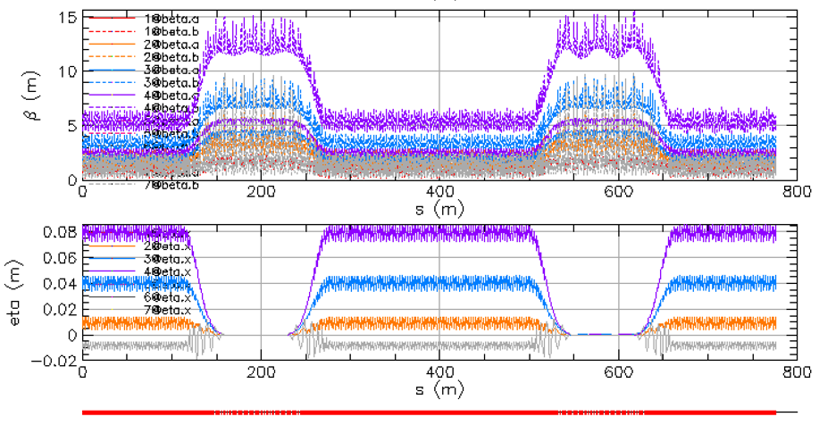
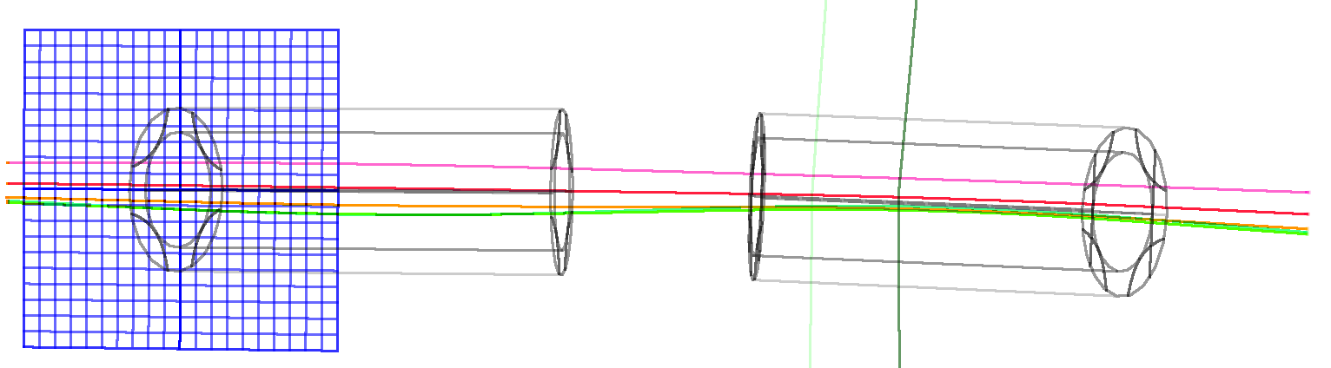
Thanks for your attention!

