Slide 1
Scientific Case for CEBAF Energy Upgrade
Presented to the
JLab Staff Scientist Meeting on NSAC LRP
Jianwei Qiu
Associate Director for Theoretical and Computational Physics
Newport News, Virginia
August 26, 2022

Slide 2
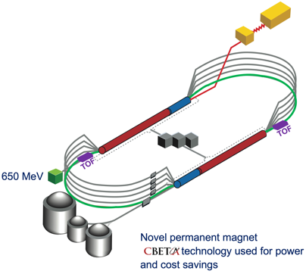
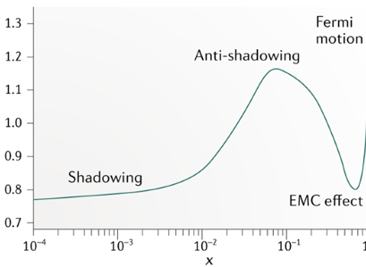
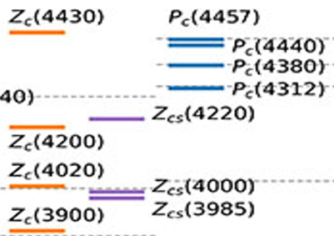
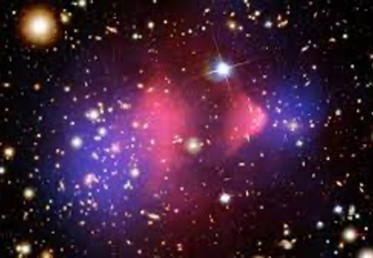
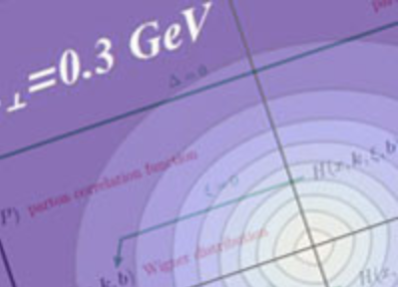
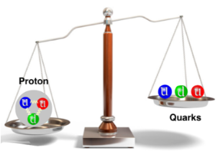
High Energy Workshop Series 2022
Organized jointly by the Lab and JLab Users Organization
CEBAF FFA Upgrade – ‘Big Picture’
Science at Mid x: Anti-shadowing and the Role of the Sea
Recirculate 11 times to get to about 22 GeV
July 22 & 23
See talk by Andrei Seryi
Hadron Spectroscopy with a CEBAF Energy Upgrade
Physics Beyond the Standard Model
June 16 & 17
August 1
The Next Generation of 3D Imaging
J/Psi and Beyond
August 16 & 17
July 7 & 8
https://www.jlab.org/conference/hews22

Slide 3
The Goal of the Workshop Series
To probe the science that would be opened up by a higher energy electron beam (~20-24 GeV) at Jefferson Lab
To identify key measurements that are not possible to access at 12 GeV
initially utilize largely existing or already-planned Hall equipment
leverage the unique capabilities of luminosity and precision possible at JLab in the EIC era
Identify the flagship measurements that can be done only with 20+ GeV and its science impact (uniqueness)
Identify the flagship measurements with 20+ GeV that can extend and improve the 11 GeV measurements, helping the physics interpretation through multidimensional bins in extended kinematics (enrichment)
Identify the measurements with 20+ GeV that can set the bridge between JLab12 and EIC (complementarity)

Slide 4
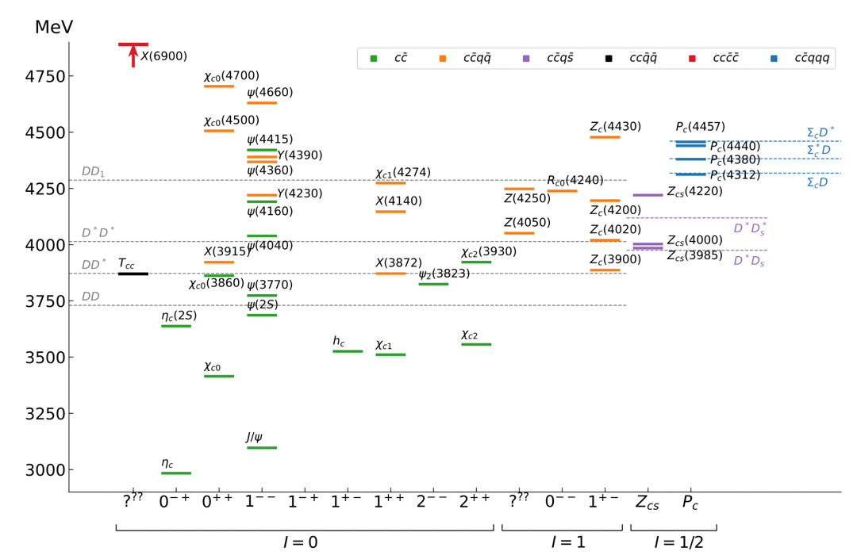
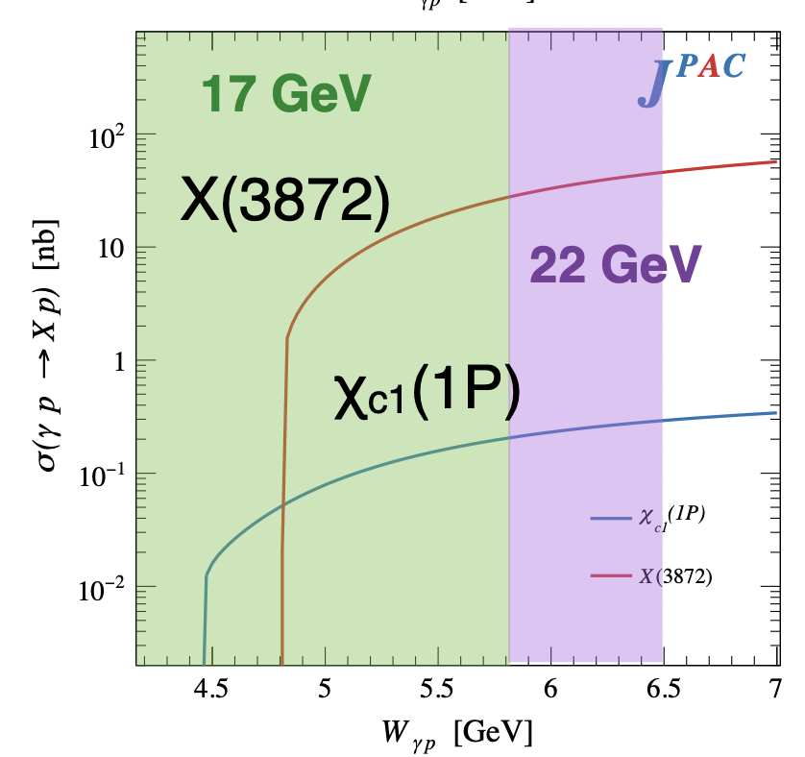
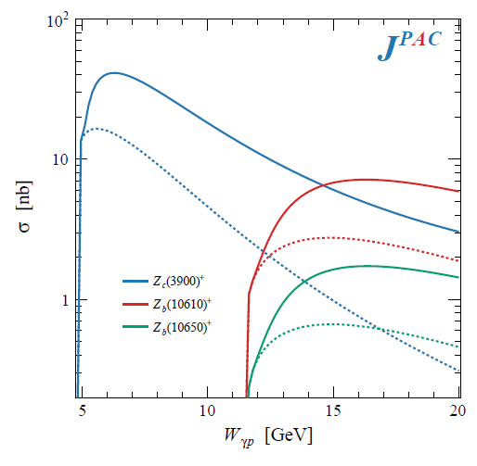
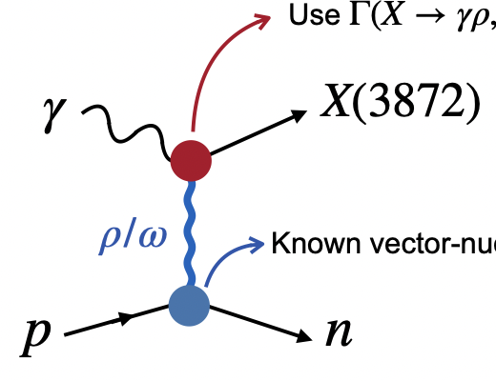

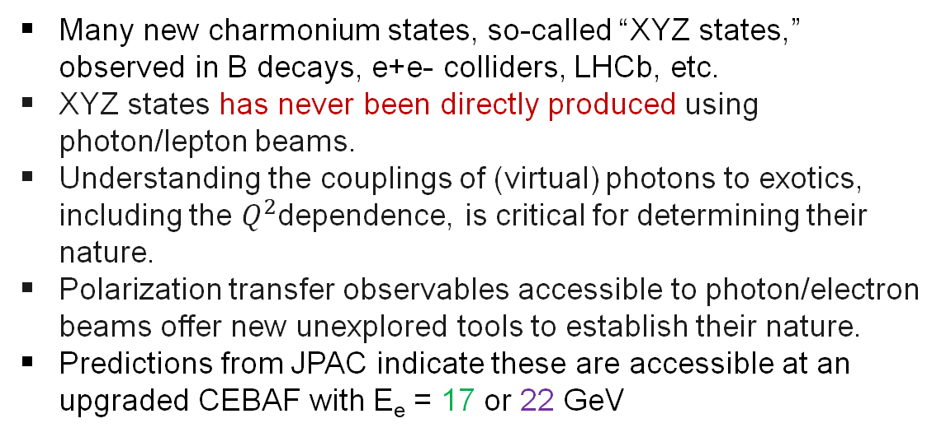
Hadron Spectroscopy with a CEBAF Energy Upgrade
Many new charmonium states, so-called “XYZ states,” observed in B decays, e+e- colliders, LHCb, etc.
XYZ states has never been directly produced using photon/lepton beams.
Understanding the couplings of (virtual) photons to exotics, including the $Q^{2}$dependence, is critical for determining their nature.
Polarization transfer observables accessible to photon/electron beams offer new unexplored tools to establish their nature.
Predictions from JPAC indicate these are accessible at an upgraded CEBAF with E_{e} = 17 or 22 GeV
Semi-inclusive photo-production of the Z states

Slide 5
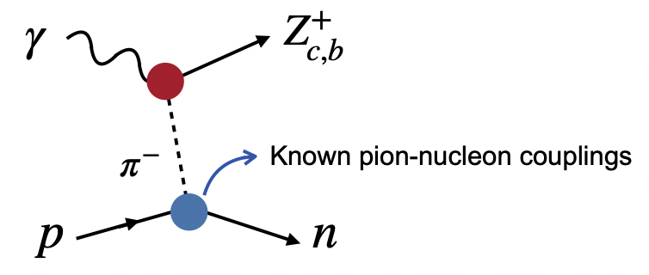
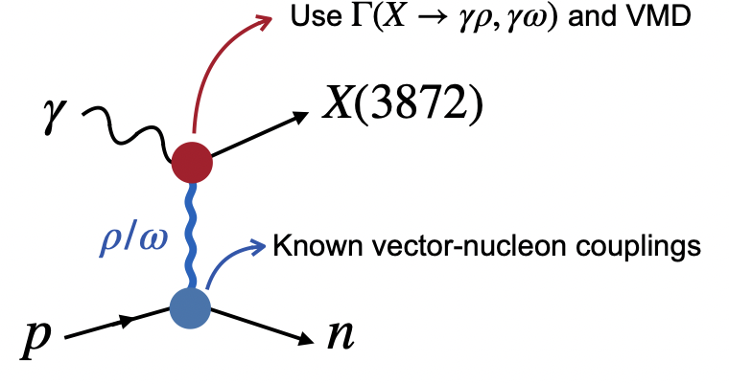
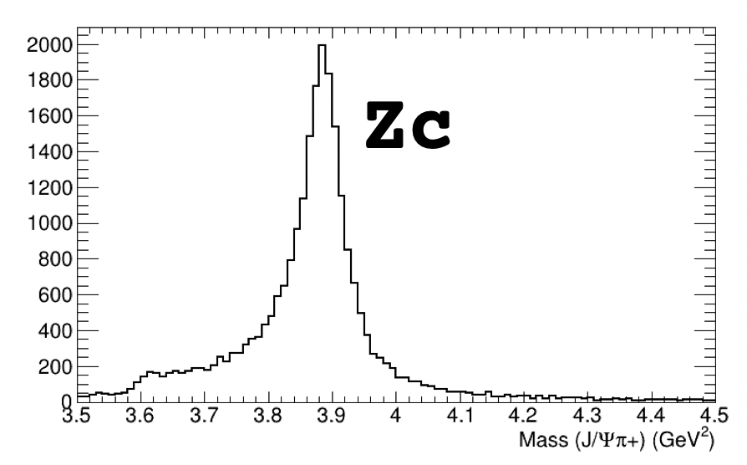
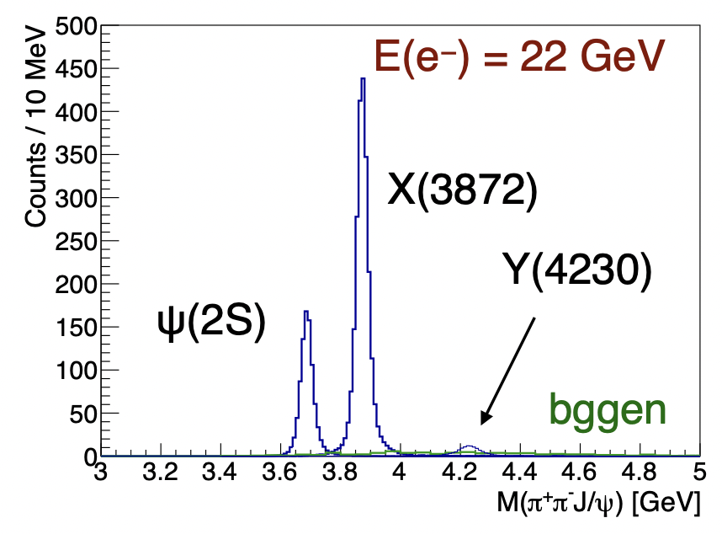

Hadron Spectroscopy with a CEBAF Energy Upgrade
Initial simulations from GlueX and CLAS12 demonstrate the capabilities of the existing detectors to measure these reactions
Upgraded CEBAF energy ideally situated for near-threshold photo production of X and Z
Electroproduction of N* resonances with increased Q² range will explore emergence of hadron mass

Slide 6
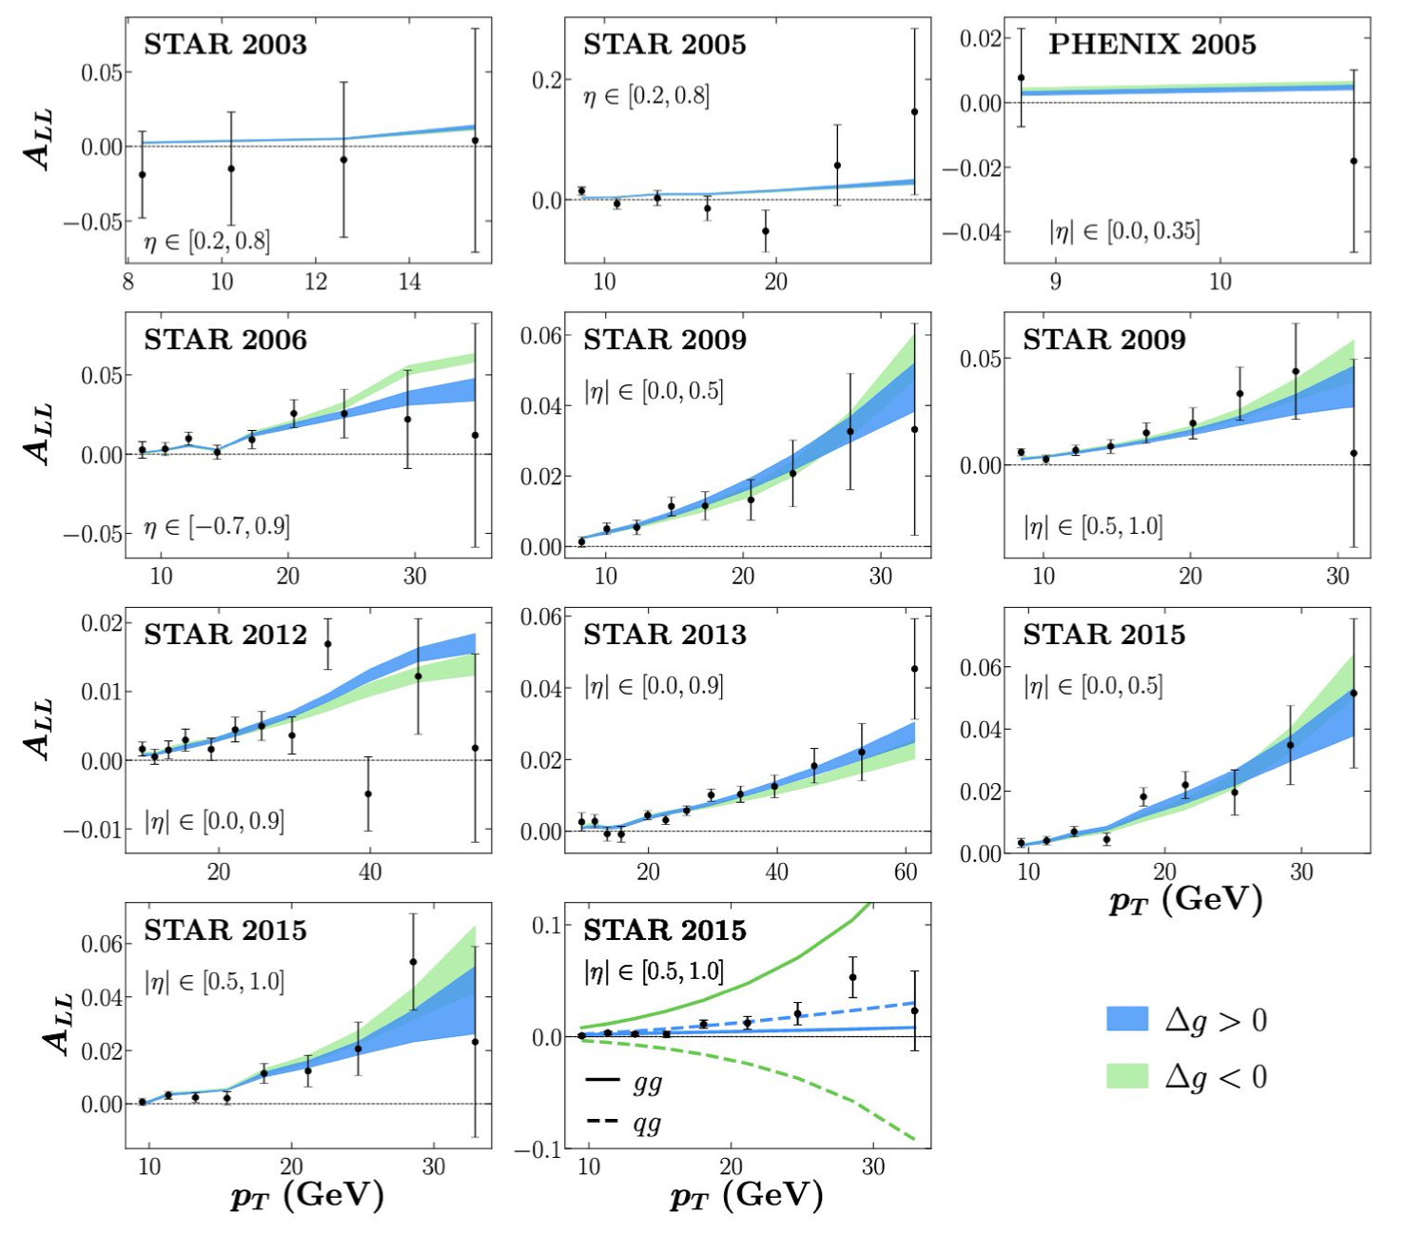
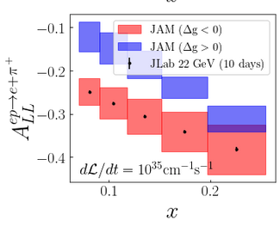
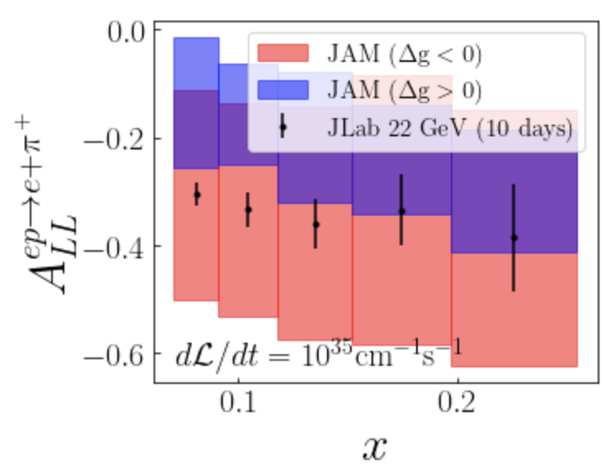
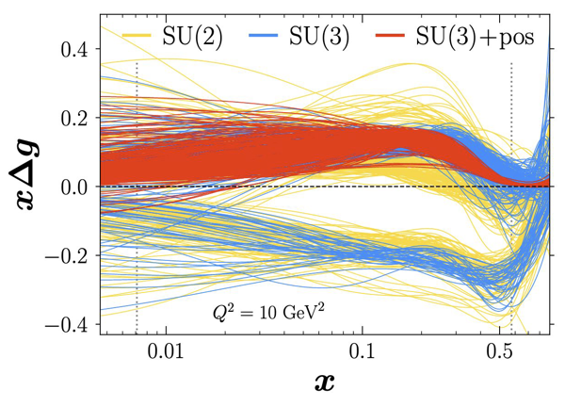
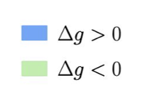
The Sign of Gluon Polarization: Δg
Existing measurements from hadronic collisions cannot distinguish the “sign” of gluon polarization!
New measurements: Polarized single hadron production vs P_{T}
– No 2nd scale Q² !
Z=0.2
Z=0.5
arXiv:2201.02075v2
N. Sato

Slide 7
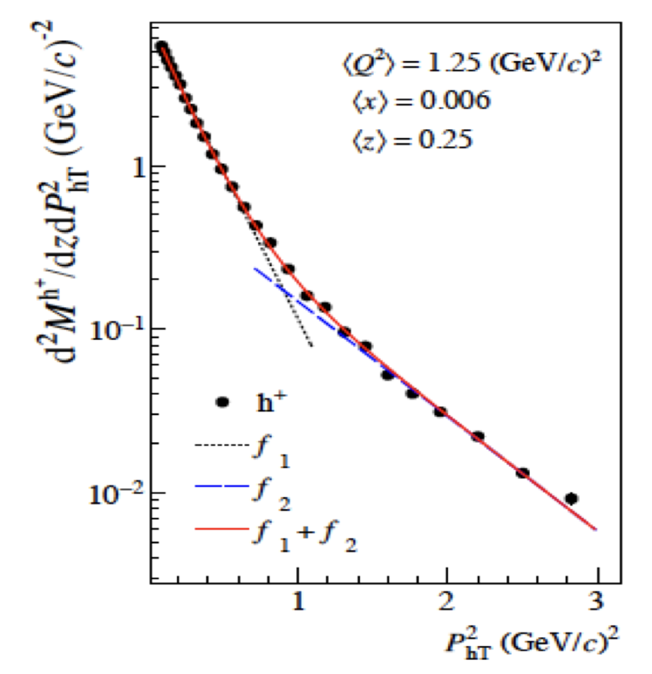
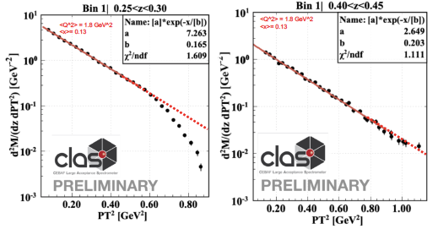
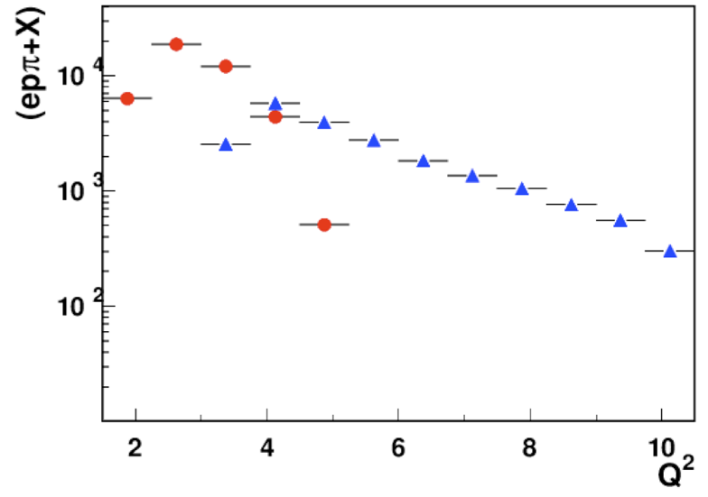
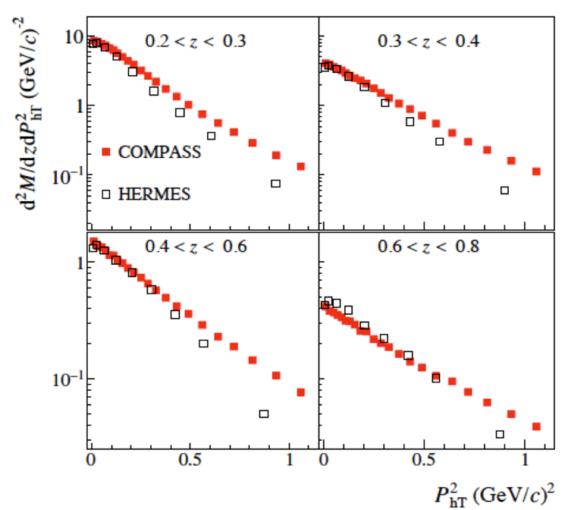
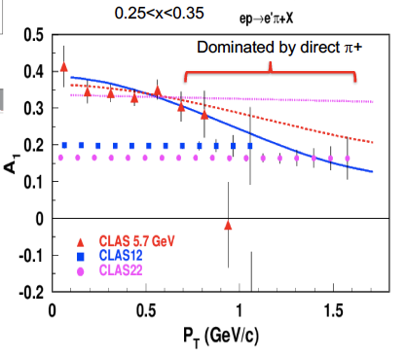
Enhancement of the Q² and P_{T} range - SIDIS
For some kinematic regions, at low z, the high P_{T} distribution appear suppressed: there is no enough energy in the system to produce hadron with high P_{T} (phase space effect).
What is the origin of the
“high” P_{T} (0.8-1.8) tail?
Perturbative/non perturbative contributions?
JLab12: not enough energy to produce large P_{T}
HERMES: not enough luminosity to access large P_{T}
Larger P_{T} range and high luminosity is the key for a better insight into the problem
TMDs are universal, so what is the origin of the differences observed ?
H. Avakian

Slide 8
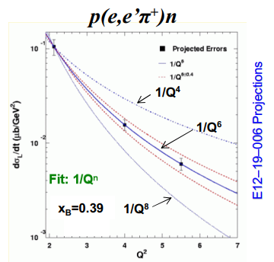
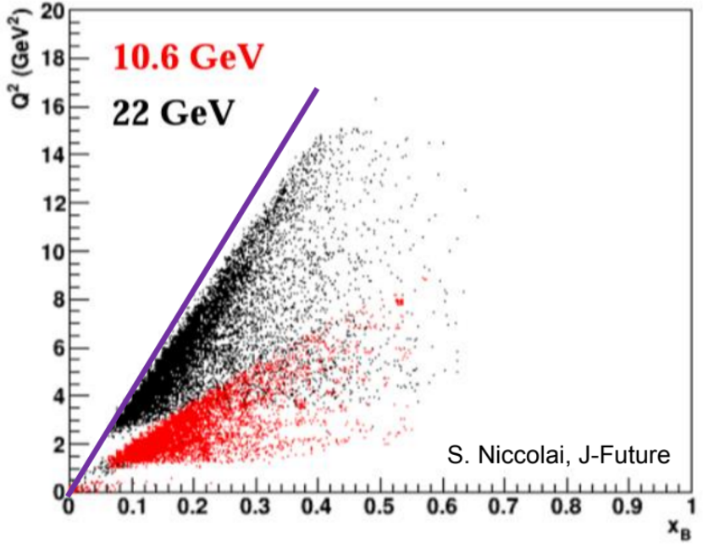
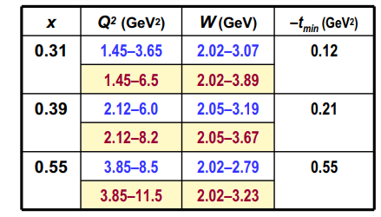
The Next Generation of 3D Imaging – Exclusive Processes
Higher Q² reach will significantly enhance the 3D imaging exclusive program:
The higher reach allows one to more cleanly extract pure twist-2 CFFs with suppressed higher twist (3) contributions
Evolution effects in GPDs may be studied more fully at the higher Q² as well
DEMP Q–n Hard–Soft Factorization Tests
Q–n scaling test range nearly doubles with 18 GeV beam and HMS+SHMS

Slide 9
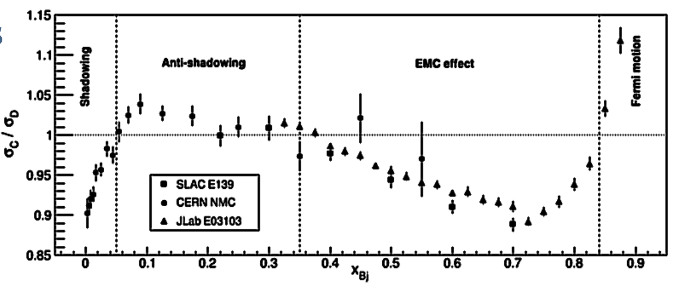
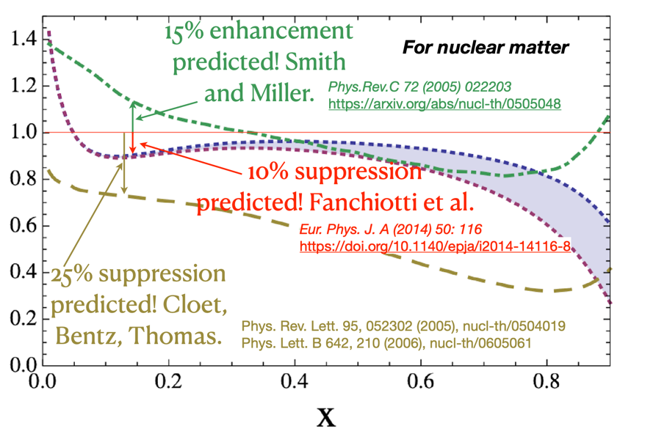
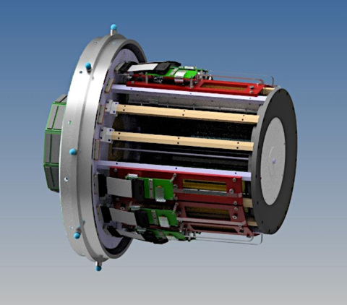
Anti-Shadowing – solving a multi-decade mystery
Anti-Shadowing region (0.1 < x < 0.3) is fascinating!
Near-equally dominated by valence quarks, sea-quarks, and gluons - anti-quark and gluon PDFs, together with their spin and flavor dependence, are of great interest in the anti-shadowing region
The transition between shadowing and the EMC regimes – a testing ground for different descriptions
Where are the nuclear pions remains a major question - is there still a puzzle with nuclear anti-quarks?
Perhaps caused by flavor-dependent Reggeon exchange or a coherent effect from another mechanism – hundreds of theoretical papers and predictions
Anti-Shadowing is the least studied nuclear structure function effect experimentally - flavor and spin dependence essentially uncharted in this regime, no tagged measurements
JLab at ~22 GeV is an anti-shadowing regime machine !
E-A (x, Q²) range accessible for the first time in decades
High precision required: perfect for JLab beam, spectrometers, ability to change targets quickly,…
Tensor polarized deuterium, mirror nuclei, polarized/unpolarized mapping across A, N, Z, nuclear tagging – ALL POSSIBLE at JLab

Slide 10
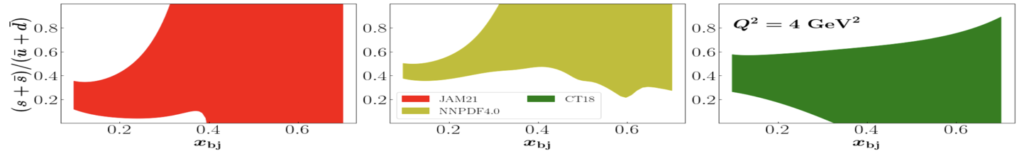
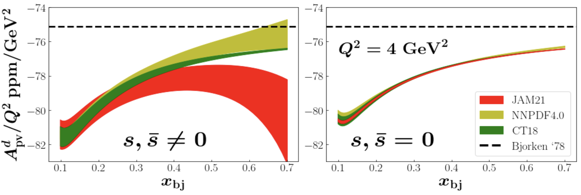
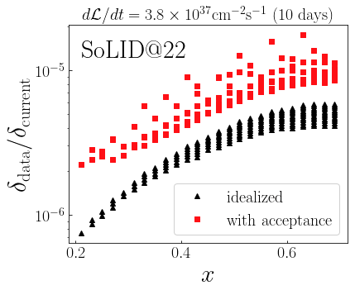
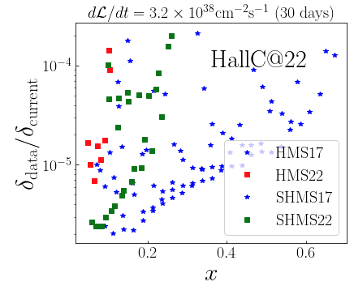
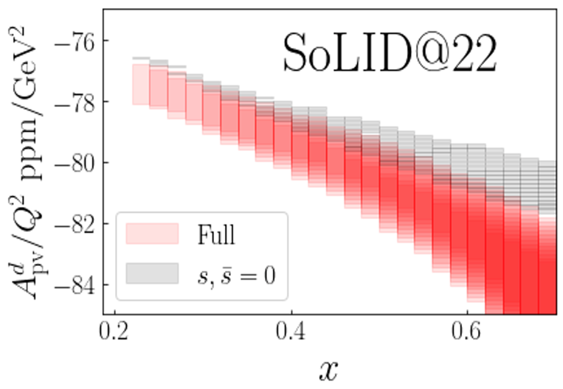
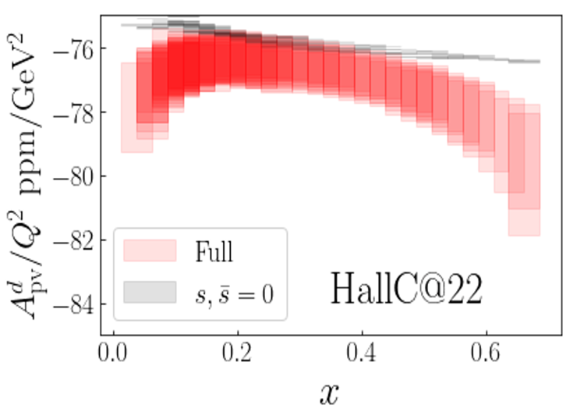
PVDIS – Impact on Strong Quark Puzzle
Current uncertainty in strangeness:
Precision extraction of sin²θ_{W}
Impact on A_{PV} of PVDIS:

Slide 11
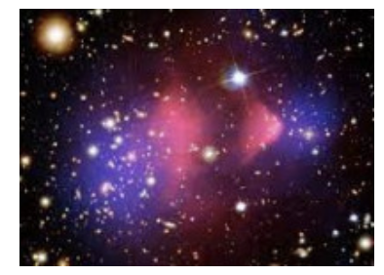
Physics Beyond the Standard Model
Possibilities for testing the Standard Model and searching for new physics beyond the Standard Model enabled by 20-24 GeV electron beams at CEBAF will be discussed. There will be opportunities for presentations and discussions where new ideas can be brought forward.
BSM Workshop in a nutshell
Conveners: M.Battaglieri, R.McKeown, X.Zheng
One full day of oral presentations and discussion, https://indico.jlab.org/event/540/overview
Hybrid format, ~40 registered attendees
Topic | Presenter | Highlight/Comment
SoLID PVDIS on deuteron | A. Emmert | Prelim. Study  reduced uncertainty in sin²θ_{W}
BSM in PVDIS experiments | S. Mantry | e  μ study underway
Primakov effect experiments | L. Gan | γ + e  π +e, new gauge boson searches
BDX experiment | M. Spreafico | Prelim. Study  expanded reach
BSM with secondary beams | M. Bondi | Competitive with current hadron facilities
Vector currents in e-A scattering | A. Ashkenazi | Few GeV beam energy relevant to ν program
Panel discussion
S. Su, G. Krnjaic, P. Schuster
Prelim. studies need further effort to determine feasibility and sensitivity
Primakov experiments appear most promising for justifying higher energy beam at CEBAF

Slide 12
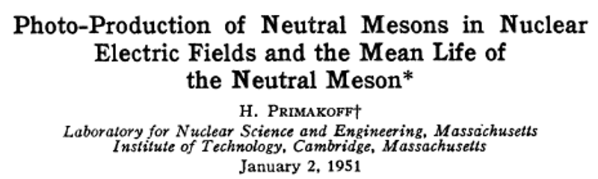
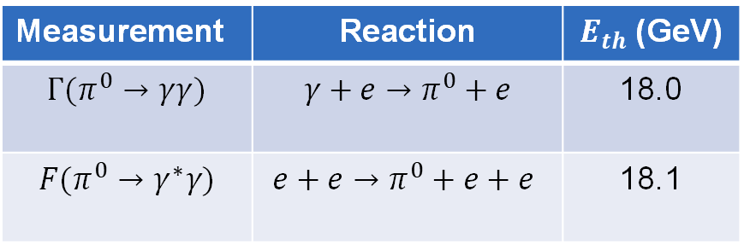
Primakoff Production Experiments
$π^{0}$ Primakoff production off an electron target will eliminate all nuclear backgrounds
By L. Gan
Measurement | Reaction | $E_{th}$ (GeV)
$$Γ(π^{0}→γγ)$$ | $${γ+e→π}^{0}+e$$ | 18.0
$$F(π^{0}→γ^{∗}γ)$$ | $${e+e→π}^{0}+e+e$$ | 18.1
Primakoff production of light scalar or pseudoscalar boson
Favorable experimental condition:
A high energy beam
A high Z nuclear target
Very forward angles to reduce QCD background

Slide 13
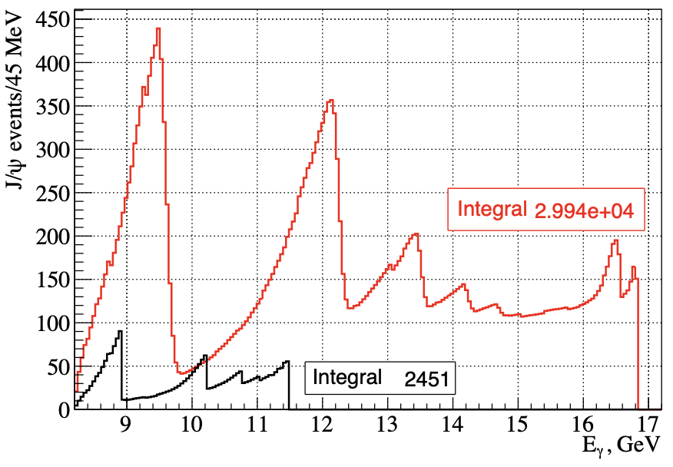
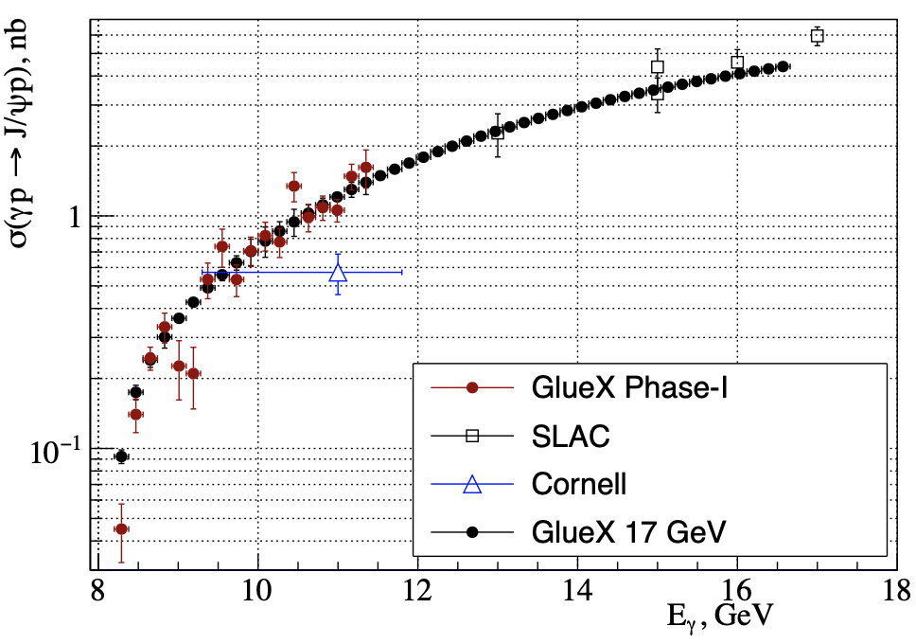
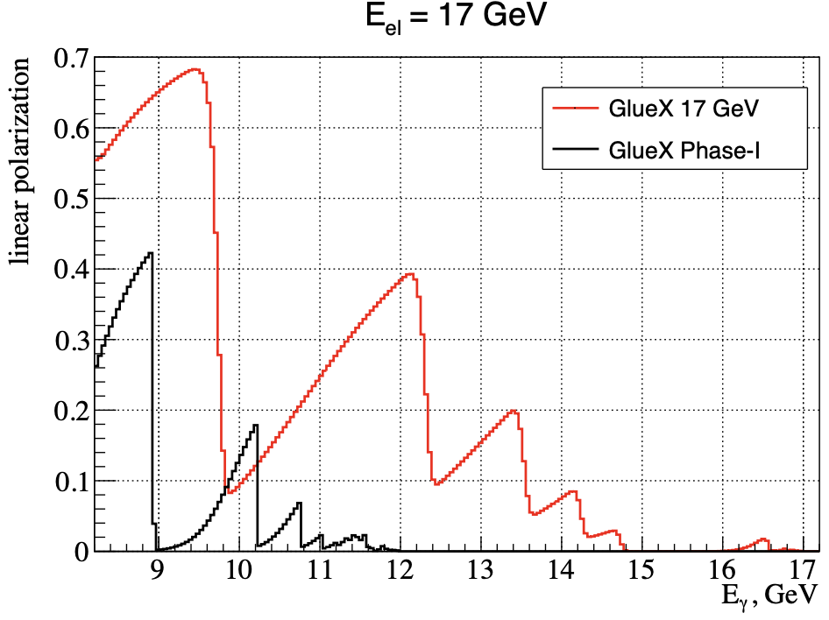
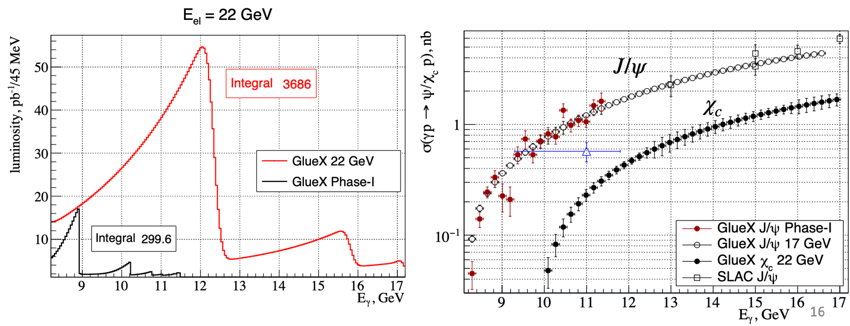
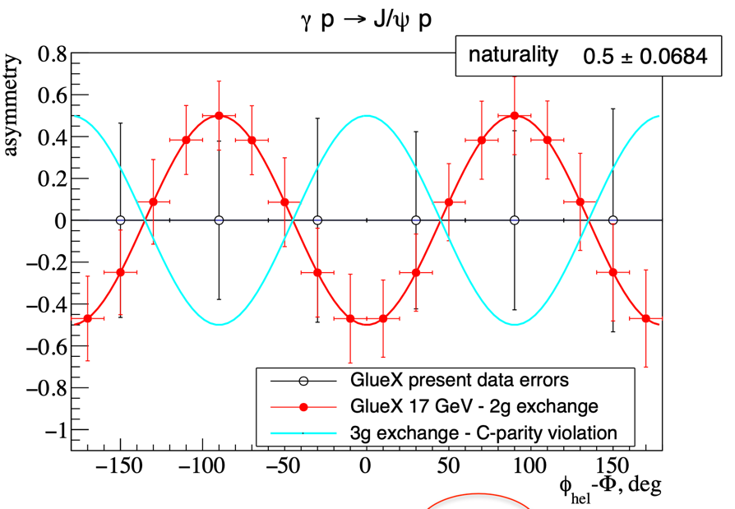
Photo-Production of J/ψ with a Polarized beam
HE: High photon flux and polarization at Hall D:
HE @ 22 GeV:

Slide 14
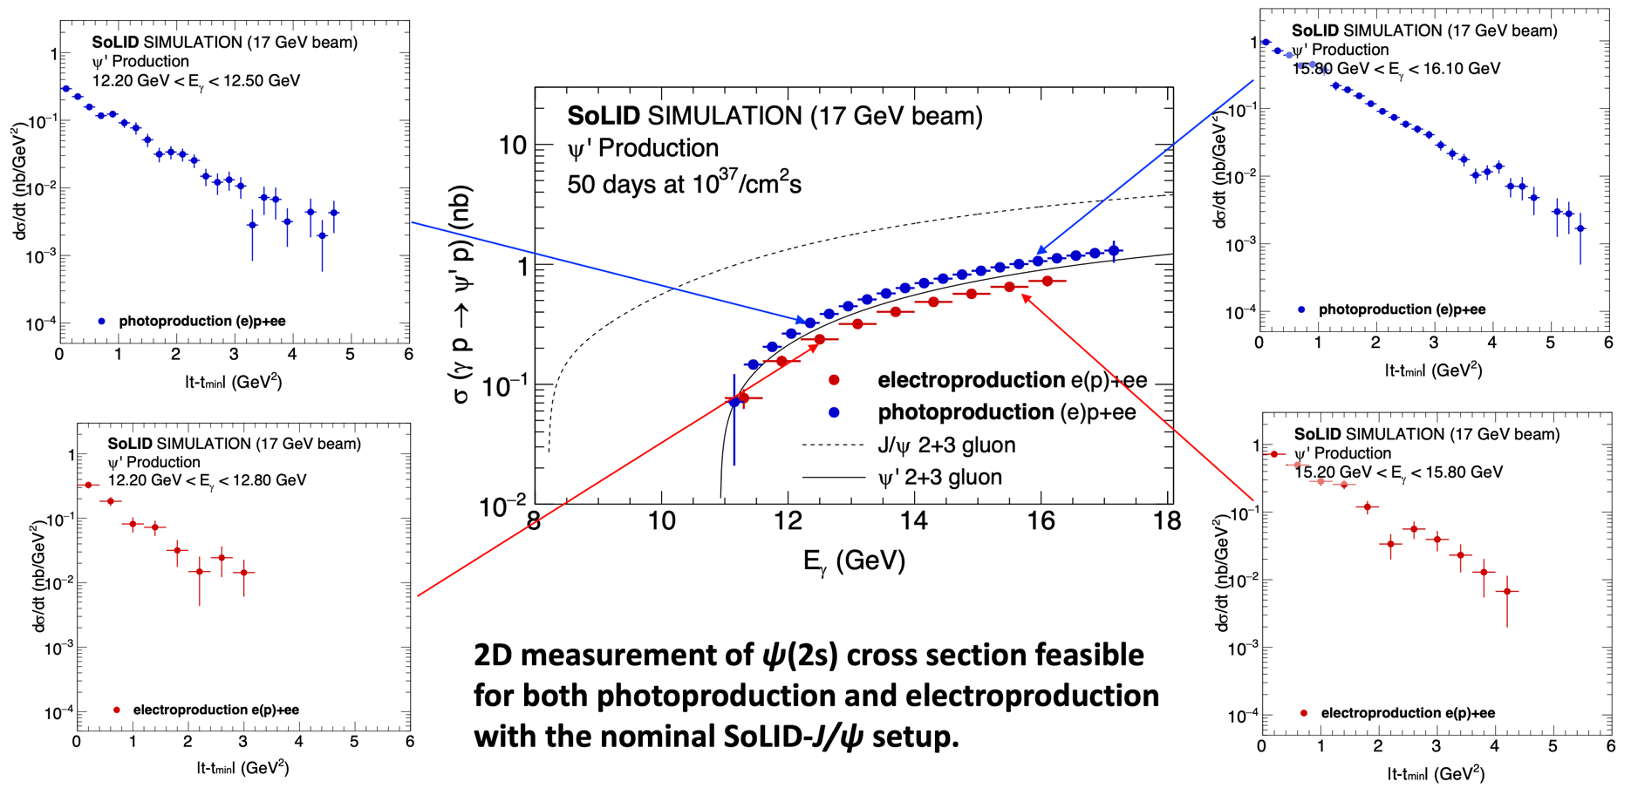
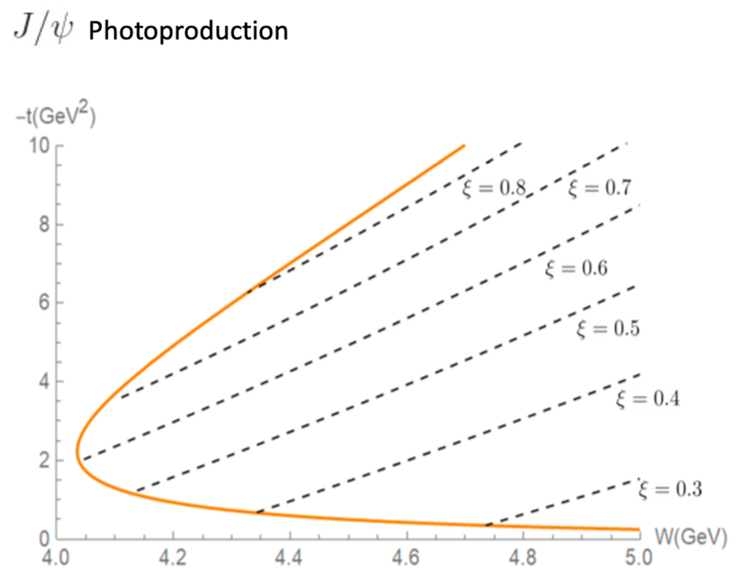


J/ψ – Away from the Threshold
HE: Precision charmonium production beyond the threshold:
Trace anomaly
Gravitational form factors
Proton mass radius
Proton radius of quark,
or gluon density,
…
Better separation of hadron property from production J/ψ:
Large ξ and small -t
Photon, lepton, pion, …
Need the phase space
– the energy upgrade!

Slide 15
Summary
CEBAF 20+ GeV upgrade is technically feasible
There is a strong science for such an upgrade:
Many new charmonium states, so-called “XYZ states,” could be directly observed/tested at JLab
– Fundamental question on how hadrons are emerged?
Uniquely determine the sign of gluon polarization
– Critically important for understanding the “proton spin”
Explore the anti-shadowing phenomenon
– a chance to solve the multi-decade mystery
Allow 𝝅⁰ Primakoff production off an electron target
– help eliminate nuclear background
Precision charmonium production near threshold in lepton-hadron collisions
– as a precision probe of fundamental hadron properties and its tomography
More simulations and hard work are needed
Thank you!

