Slide 1
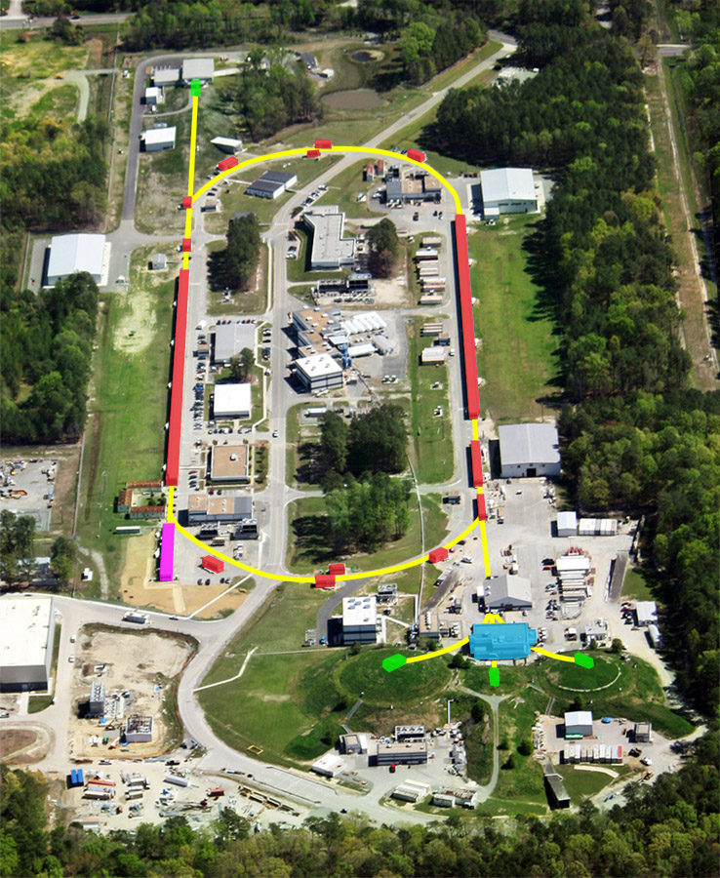
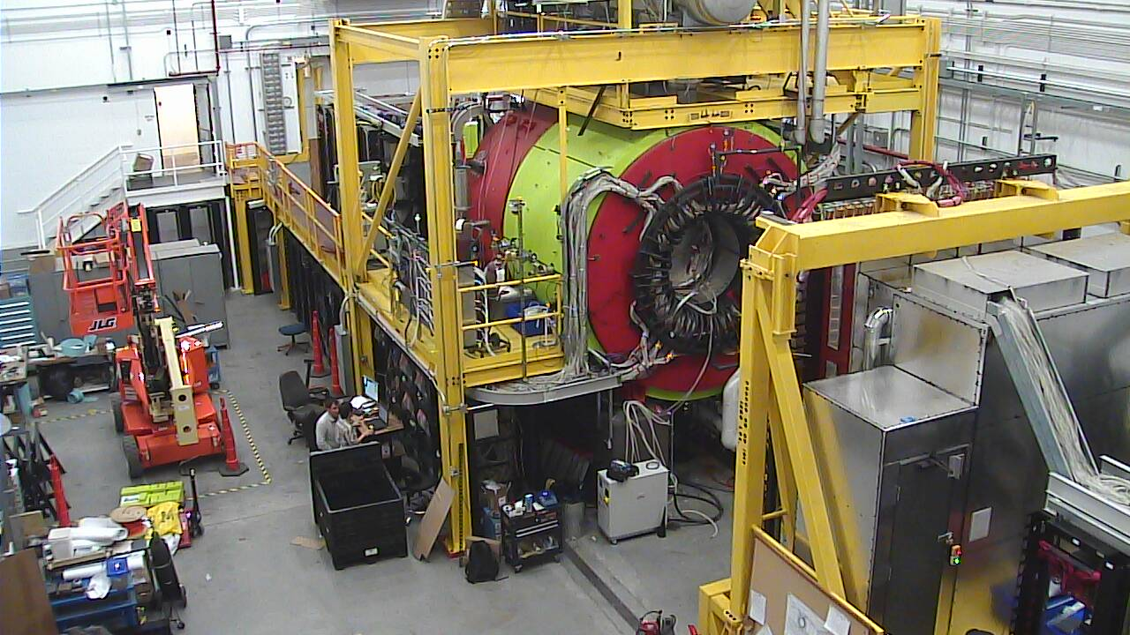
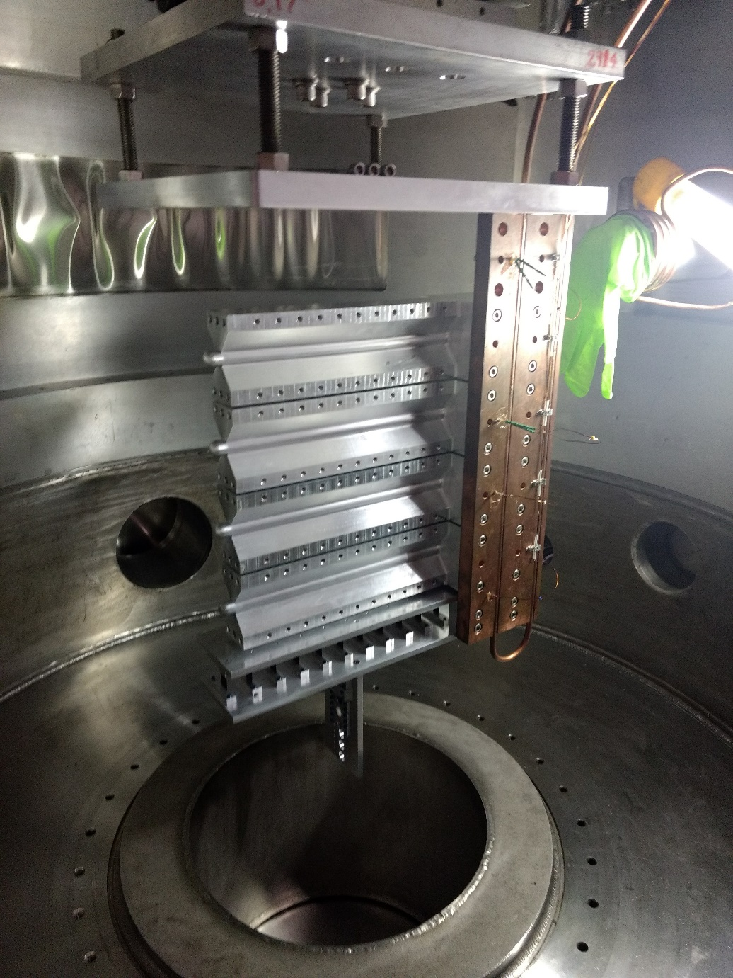
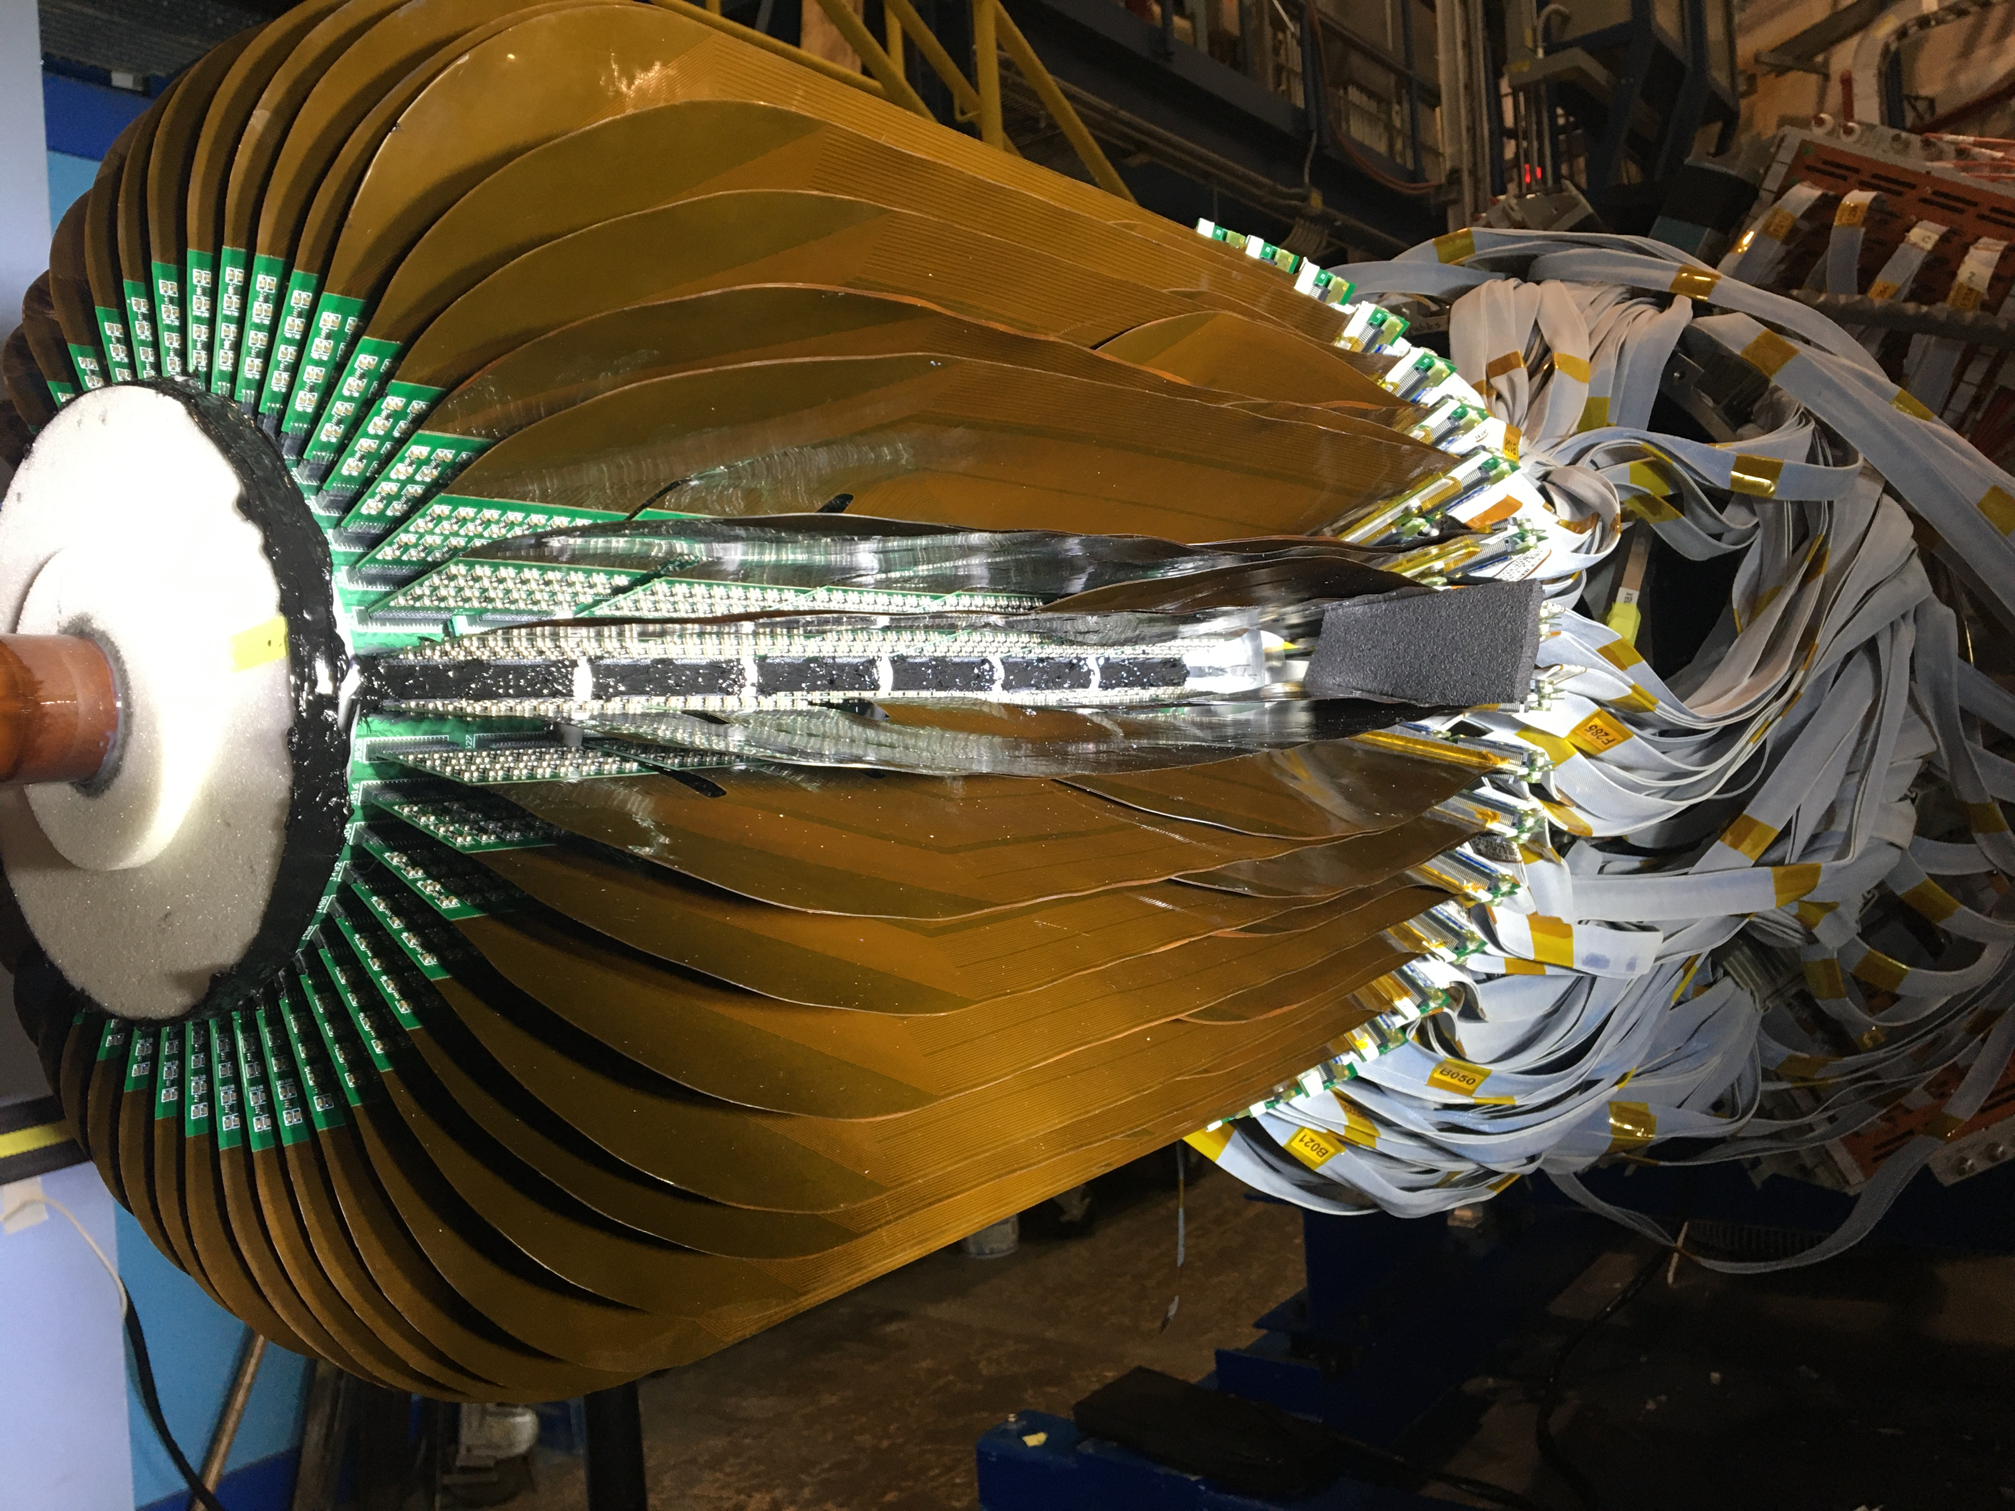
Scope and Science of the 12 GeV Program
Thia Keppel
August 26, 2022

Slide 2
Nuclear Physics at JLab – Fundamental Questions
c
Nuclear Science to:
Understand the fundamental structure of visible matter (quarks, gluons,..)
Understand how hadrons (mesons, nucleons,..) and nuclei are formed

Slide 3
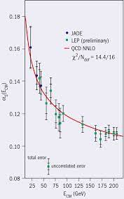
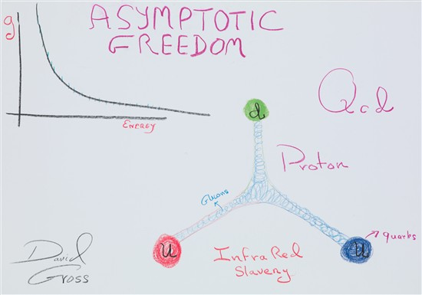
Nucleons
What we know
Partons in a nucleon are asymptotically free at small distances, infinitely bound at large

Slide 4
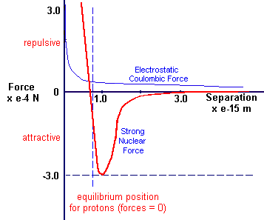
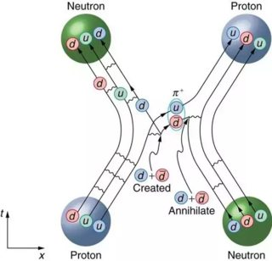
Nucleons
Nuclei
What we know
Partons in a nucleon are asymptotically free at small distances, infinitely bound at large
Nucleons in a nucleus experience strong repulsion at small distances, are in equilibrium at ~the nucleon radius, and then experience an attractive nuclear force

Slide 5
don’t
Nucleons
Nuclei
What we know
Partons in a nucleon are asymptotically free at small distances, infinitely bound at large
Nucleons in a nucleus experience strong repulsion at small distances, are in equilibrium at ~the nucleon radius, and then experience an attractive nuclear force
We seek to explain all of these dynamics with Quantum ChromoDynamics!
…and what about spin, nucleon structure, nuclear medium modifications, other hadrons (mesons), mass generation, exotics,..??

Slide 6
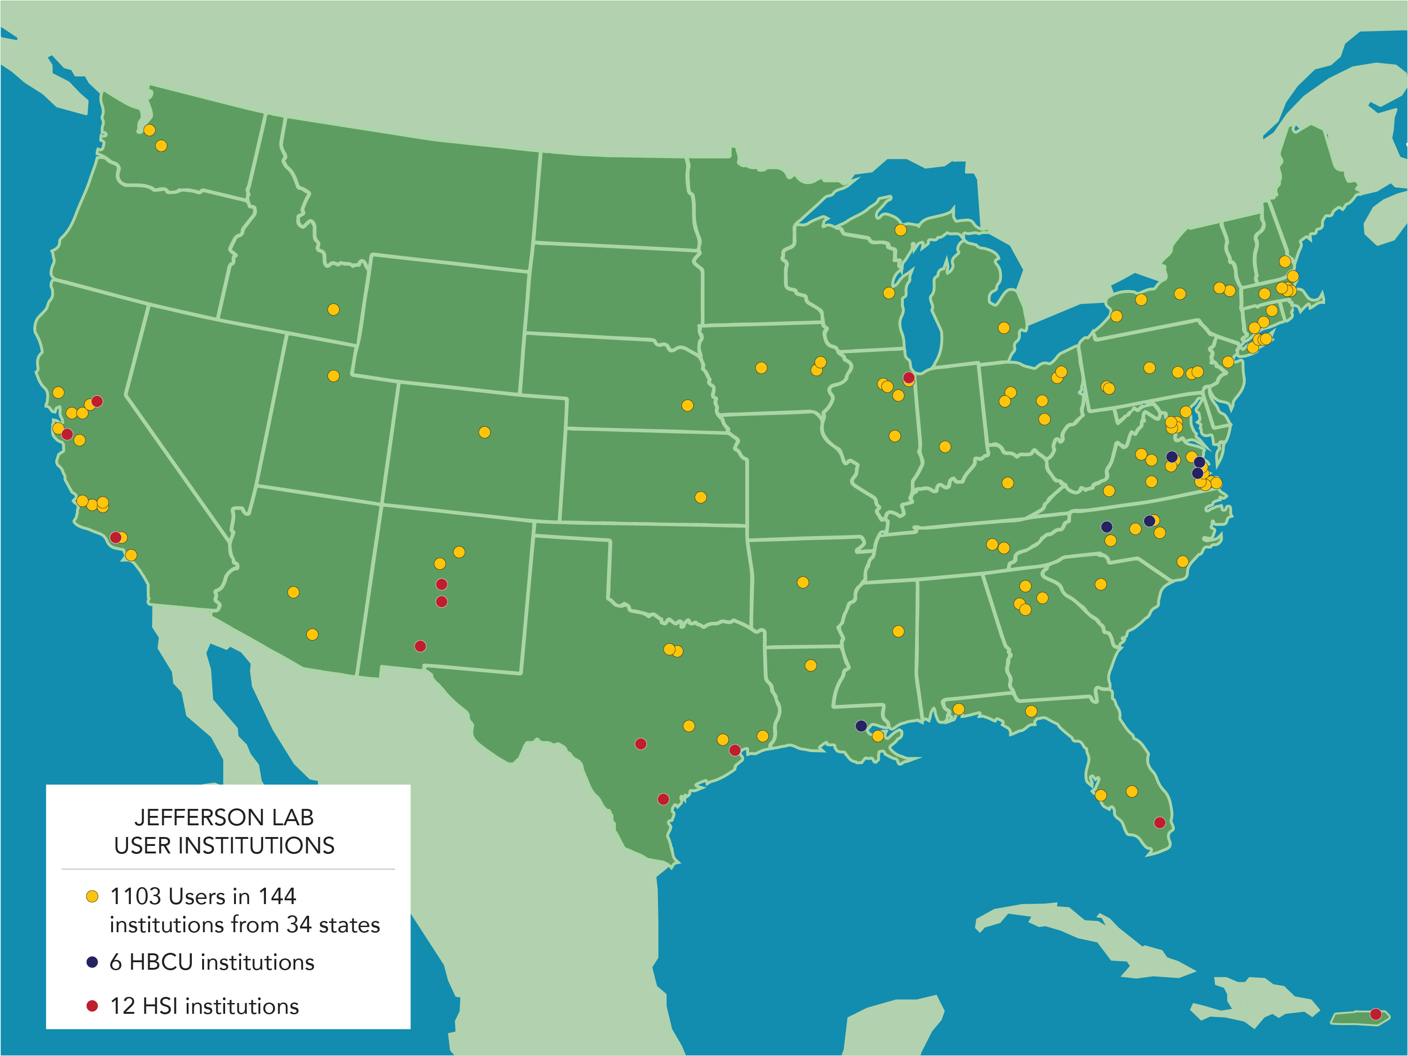
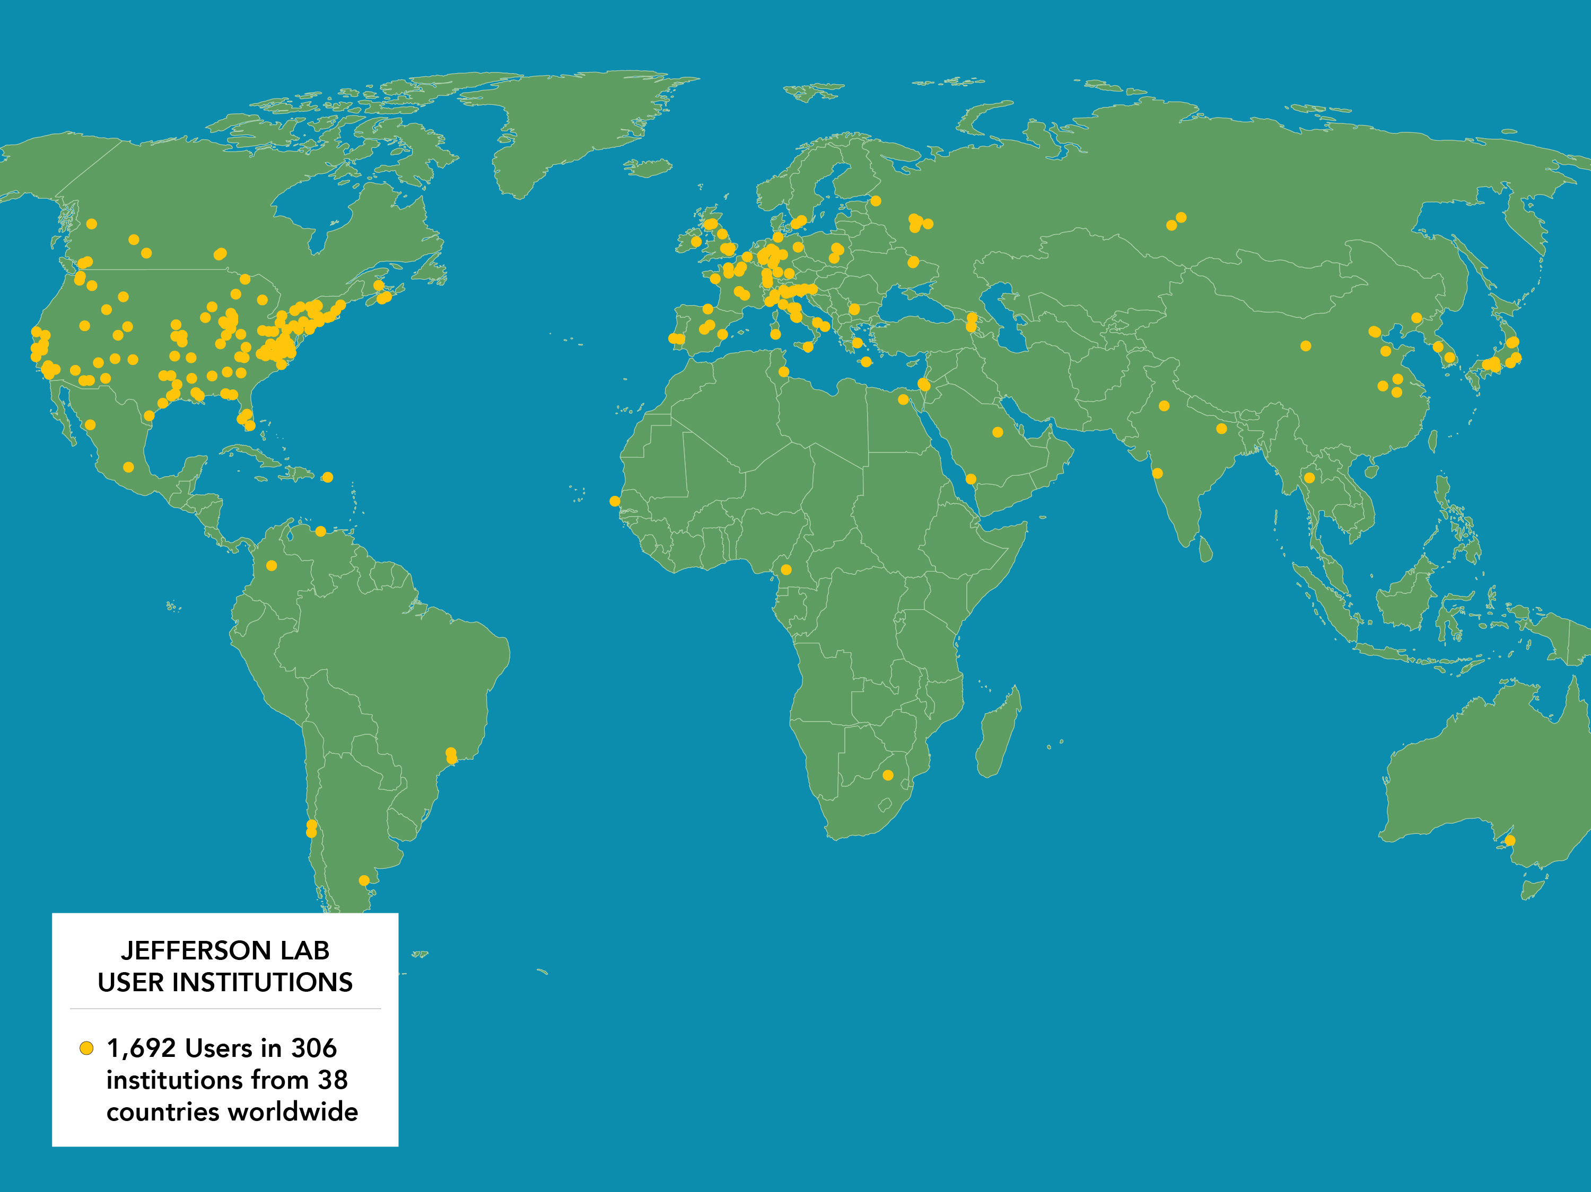
Jefferson Lab – because there’s quite a lot we don’t know!
Mission: gain a deeper understanding of the structure of matter through advances in fundamental research in nuclear physics 2,217 scientific papers and journal articles Largest Nuclear Physics user community in the world (~1700 users)…and growing. Scientific users from 39 countries, 278 institutes (124 institutions in 34 states) CEBAF’s approved program extends into 2030s Requires completion of MOLLER and SoLID CEBAF will remain the prime facility for fixed target electron scattering at high luminosity There are emerging scientific opportunities with a higher energy CEBAF (see J. Qiu’s talk)
CEBAF is a unique and powerful facility that will remain in high demand, even in the EIC era

Slide 7
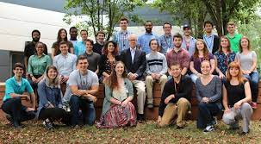
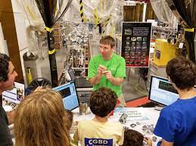


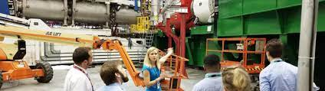
A premiere training ground for nuclear science
731 PhDs granted to-date (over 175 more in progress) ~1/3 of US PhDs in nuclear physics 27 Joint faculty with 13 universities K-12 programs serve more than 12,000 students and 950 teachers annually (non-COVID) THE facility to prepare the community for the science of the EIC

Slide 8
PAC Approved Experiments (status February 7, 2022)
Topic | Hall A | Hall B | Hall C | Hall D | Total
Hadron spectra as probes of QCD | 0 | 2 | 1 | 4 | 7
Transverse structure of the hadrons | 7 | 4 | 3 | 1 | 15
Longitudinal structure of the hadrons | 1 | 3 | 7 | 1 | 12
3D structure of the hadrons | 6.5 | 9 | 6.5 | 0 | 22
Hadrons and cold nuclear matter | 10 | 6 | 8 | 1 | 25
Low-energy tests of the Standard Model and Fundamental Symmetries | 3 | 1 | 0 | 1 | 5
Total | 27.5 | 25 | 25.5 | 8 | 86
Total Experiments Completed | 11.0 | 10.5 | 8 | 2.7 | 32.2
Experiments Removed by Jeopardy | 0.8 |  | 0.7 |  | 1.5
Total Experiments Remaining | 15.7 | 14.5 | 16.8 | 5.3 | 52.3
Does not include SoLID
PAC50 approved 5 new experiments in July 2022

Slide 9
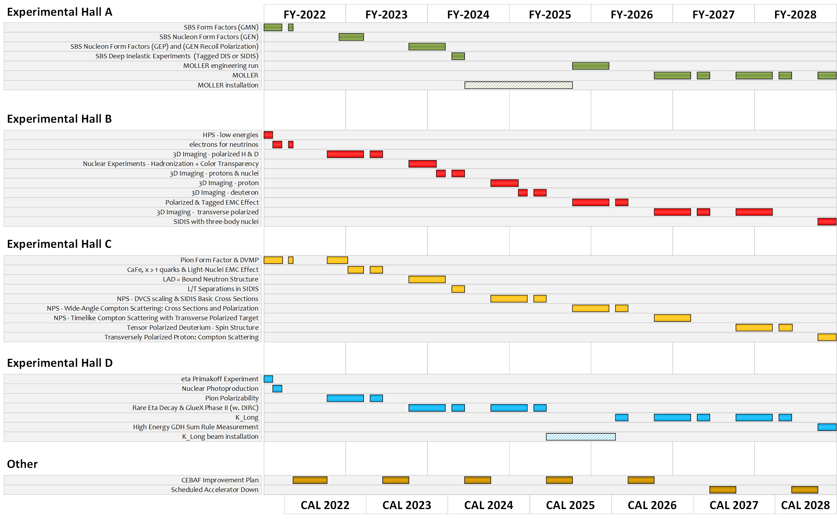
Extended experimental schedule
199 completed experiments to-date (22 full; 22 partial in 12 GeV era)
57.3 experiments remaining
~8 years at ~30 weeks/year
…not including SoLID
…not including new proposals

Slide 10
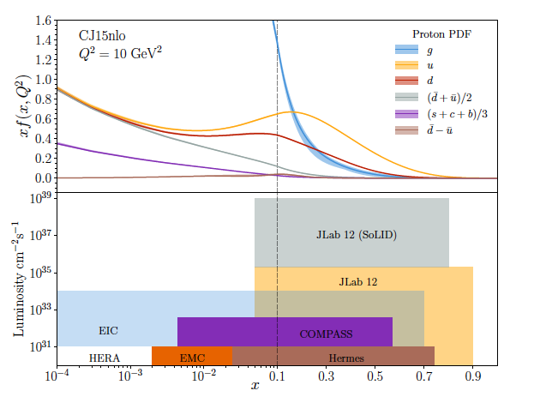
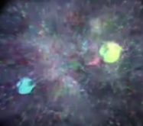
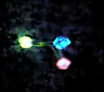
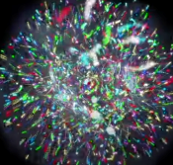
Scientific Program at the Luminosity Frontier
Probability Distribution
High luminosity, precision beam and instrumentation, control of systematic uncertainties - critical to high precision measurements
Probability Distribution
2020s-2030s
Luminosity (cm⁻²s⁻¹)
2030s-2040s
2010s-2020s
Physics with CEBAF at 12 GeV and Future Opportunities
(Nov 30, 2021)
e-Print: 2112.00060 [nucl-ex]
2000s-2010s
1980s-1990s
Fraction of nucleon momentum

Slide 11
Recent Results - examples

Slide 12
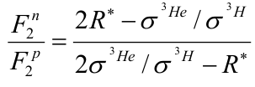
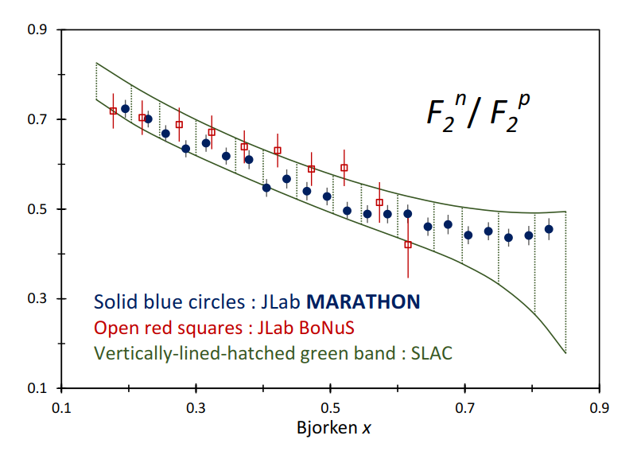
F₂^{n}/F₂^{p} – keen discriminator of fundamental models
MARATHON results published March 31, 2022 in Phys. Rev. Lett. 128, 132003
Measured ³He and ³H cross sections in DIS kinematics using the LHRS and RHRS (last RHRS experiment!)
Extracted ratio of neutron to proton structure functions
Assume R* is small (some theoretical uncertainty here)
F₂^{n}/F₂^{p} predicted by models
Model | F₂^{n}/F₂^{p}
SU(6) | 2/3
NJL | 0.43
DSE-1 | 0.49
CQM | 0.25
pQCD | 3/7
SLAC deuteron data represented by green band since extraction sensitive to the NN potential used in the deuteron wave function
Table from C. D. Roberts, R. J. Holt, S. M. Schmidt
Physics Letters B, 727, 2013,p249-254

Slide 13
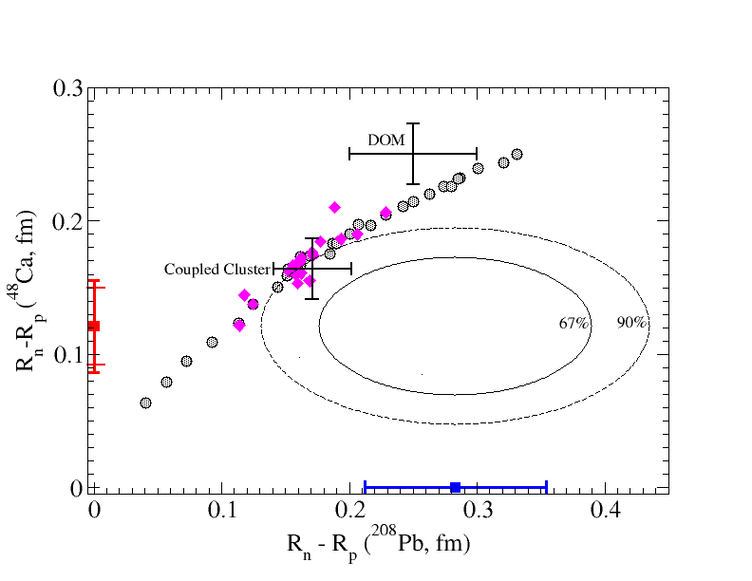
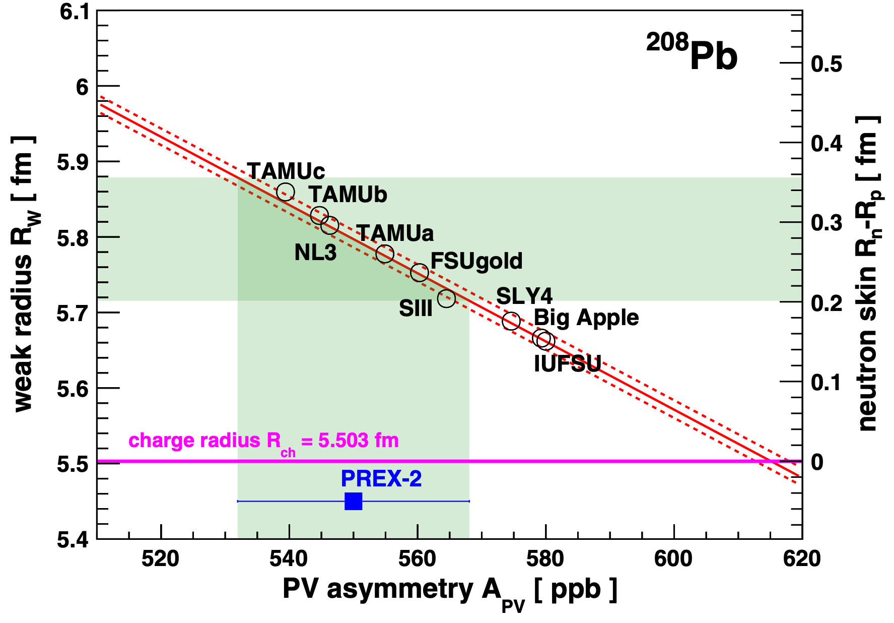
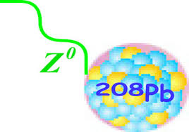
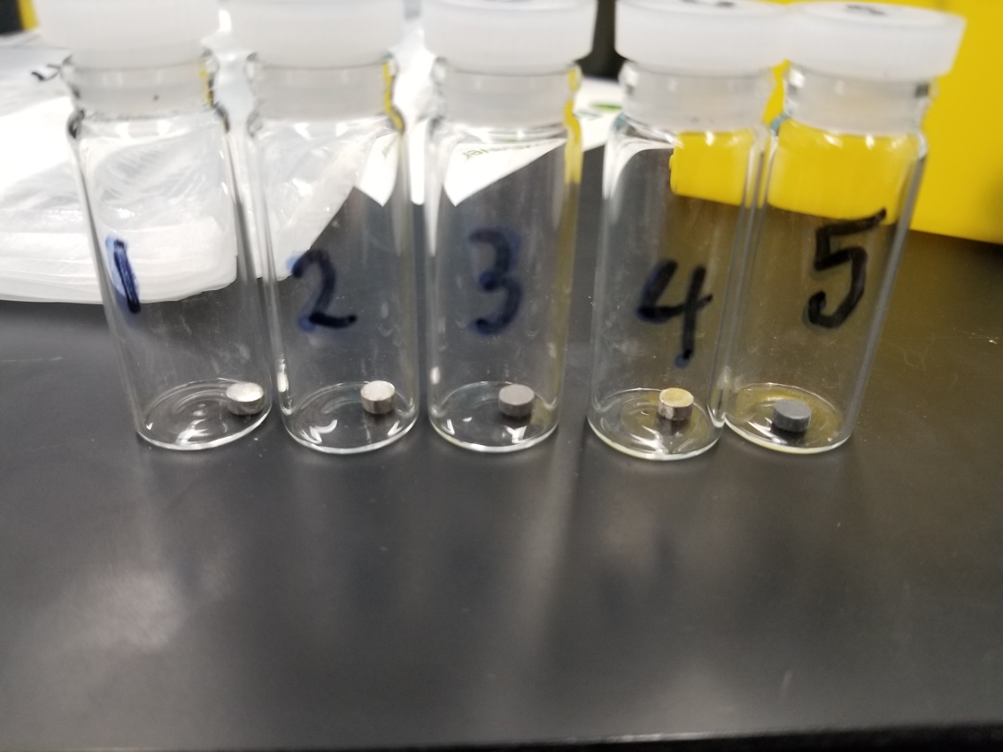
PREX and CREX are in tension with theory
Hall A
PREX-II Phys. Rev. Lett. 126, 172502 (2021)
CREX: arXiv:2205.11593, approved for publication in PRL
How thick is the neutron skin?
⁴⁸Ca
CREX
data
PREX data
⁴⁸Ca : thin skin
²⁰⁸Pb : thick skin
Electroweak asymmetry in elastic electron-nucleus scattering : Extract R_{n}
Implications for the EOS of neutron matter – thus for understanding neutron star skins
A_{PV} (ppm)

Slide 14

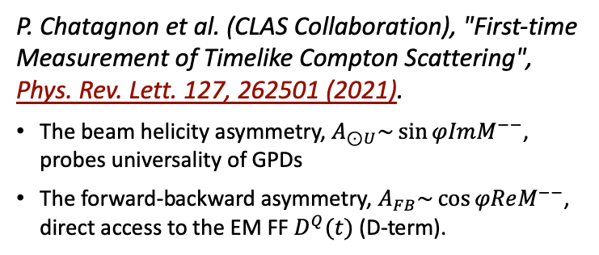
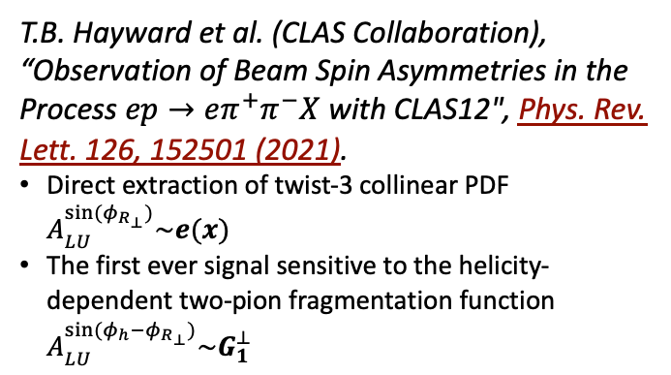


CLAS12 provides first-ever measurements
Hall B
T.B. Hayward et al. (CLAS Collaboration), “Observation of Beam Spin Asymmetries in the Process $ep→eπ^{+}π^{−}X$ with CLAS12", Phys. Rev. Lett. 126, 152501 (2021).
Direct extraction of twist-3 collinear PDF $A_{LU}^{\sin{(φ_{R_{⊥}})}}\sim e(x)$
The first ever signal sensitive to the helicity-dependent two-pion fragmentation function ${A_{LU}^{\sin{(φ_{h}−φ_{R_{⊥}})}}\sim G}_{1}^{⊥}$
P. Chatagnon et al. (CLAS Collaboration), "First-time Measurement of Timelike Compton Scattering", Phys. Rev. Lett. 127, 262501 (2021).
The beam helicity asymmetry, $A_{⊙U}\sim \sin{φImM^{−−}}$, probes universality of GPDs
The forward-backward asymmetry, $A_{FB}\sim \cos{φReM^{−−}}$, direct access to the EM FF $D^{Q}(t)$ (D-term).
$$\sim Imℋ$$
$$\sim Reℋ$$

Slide 15

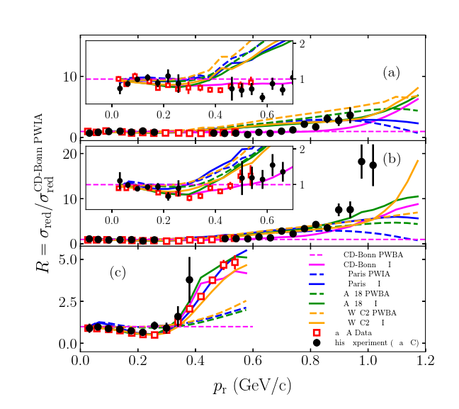
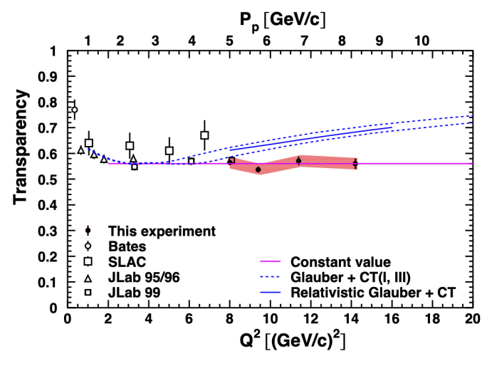
New nuclear data challenge theory
First Phys. Rev. Letters with data using new SHMS in 12 GeV Era
PRL 126 ”Ruling out color transparency in quasi-elastic 12C(e,ep) up to Q² of 14.2 (GeV/c)2”
PRL 125 “Probing the Deuteron at Very Large Internal Momenta”
CD-BONN theory (magenta) explains data for p_{r} < 600
Prediction with Color Transparency
CD-BONN theory cannot explain data for p_{r} > 0.6
Need to complete experiment to explore if trend continues to p_{r} > 1.1
Data has flat dependence
No Color Transparency !

Slide 16
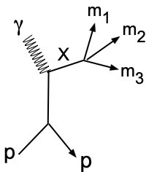
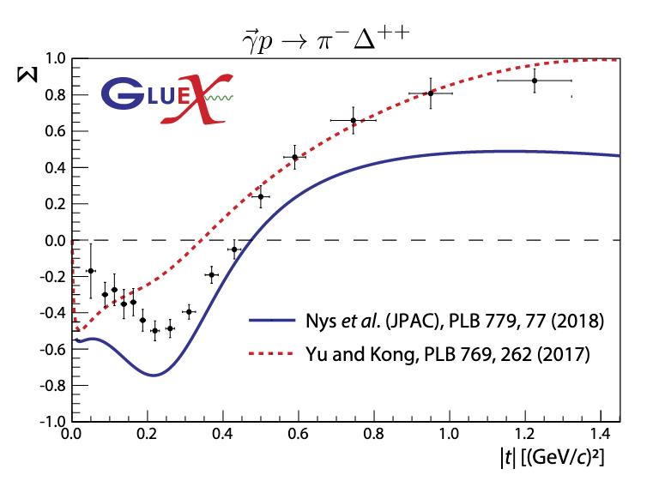
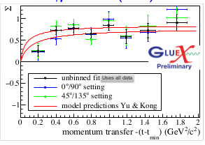
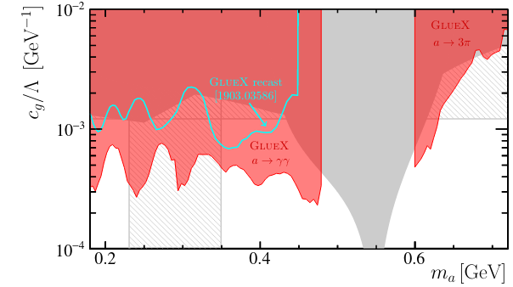
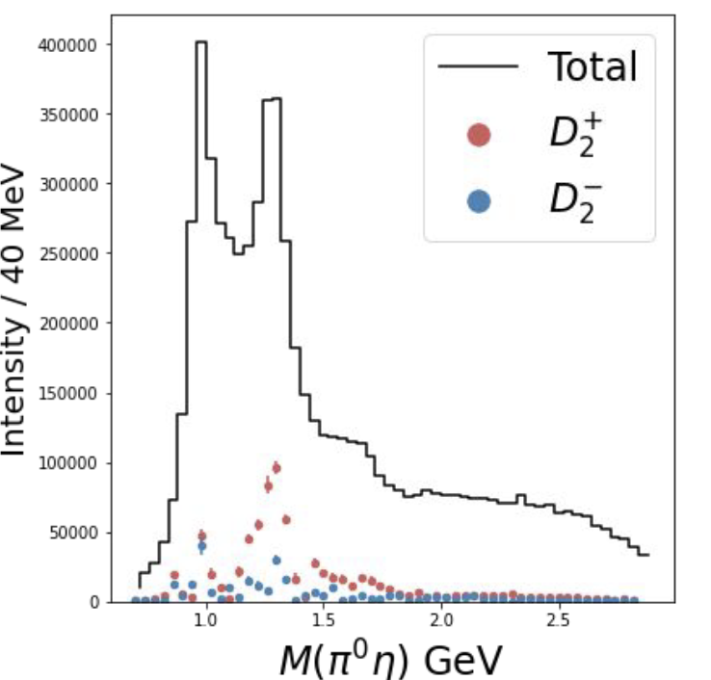
Hall D
Searching for hidden states in photoproduction
GlueX: Meson Spectroscopy
Understand production mechanisms: Natural J^{P}=0⁺, 1⁻, 2⁺, …and unnatural J^{P}=0⁻, 1⁺, 2⁻ exchanges: measure the beam asymmetry Σ using linearly polarized beam 6 PRC papers
Spin Density Matrix Element (SDME) measurements
PRC 103, L02201 (2021) asymmetry
PRC 105, 035201 (2022) SDME, asymm.
2109.13439 (2021) search for axion
Axion search
unnatural
natural
γp→K⁺Λ(1520⁾
γp→pπ⁻π⁺π⁺
γp→pγγ
γp→π⁻Δ⁺⁺
GlueX limit (in red)
a₂(1320)
Status of search for hybrid mesons
Reviewed in 2021
Prerequisites: SDME, cross sections, PWA of known resonances – in progress
PWA identifies the well known a₂(1320): D waves for +/- naturality
ηπ⁰

Slide 17
Upcoming Program - examples

Slide 18

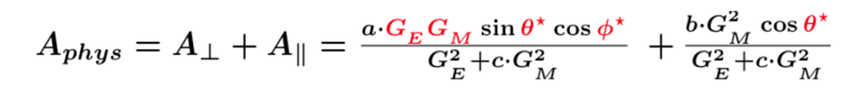
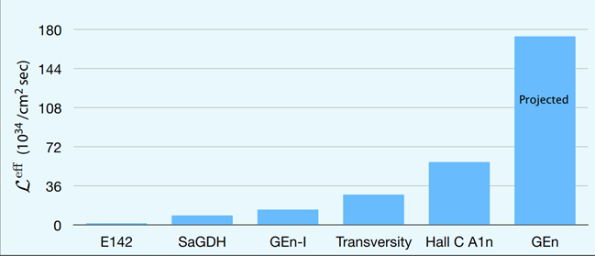
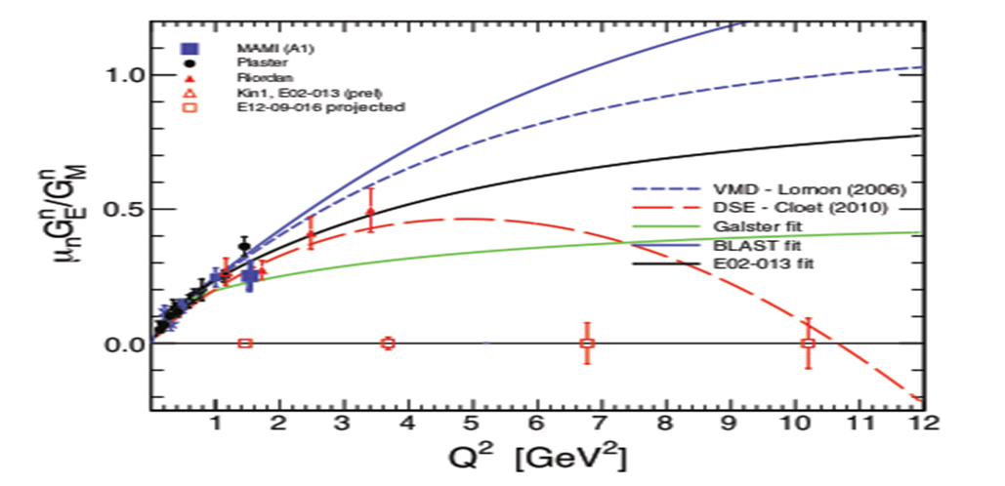
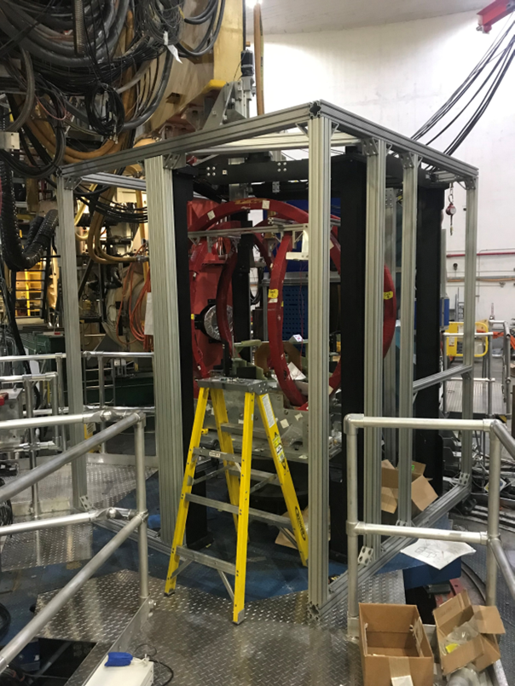
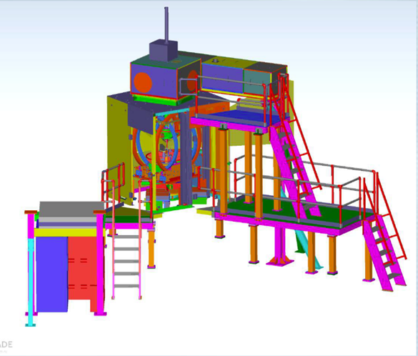
SBS measures form factors at unprecendented Q²
Hall A
Neutron Electromagnetic Form Factor G_{E}^{n}
Polarized 3He target – highest L to date!
  60cm long (40cm in Hall C)
  55-60% polarization
  60μA (30μA in Hall C)
Use the same BigBite and SBS+HCAL setup as GM_{n} to measure quasi-free scattering on polarized ³He
Trend of Luminosity

Slide 19
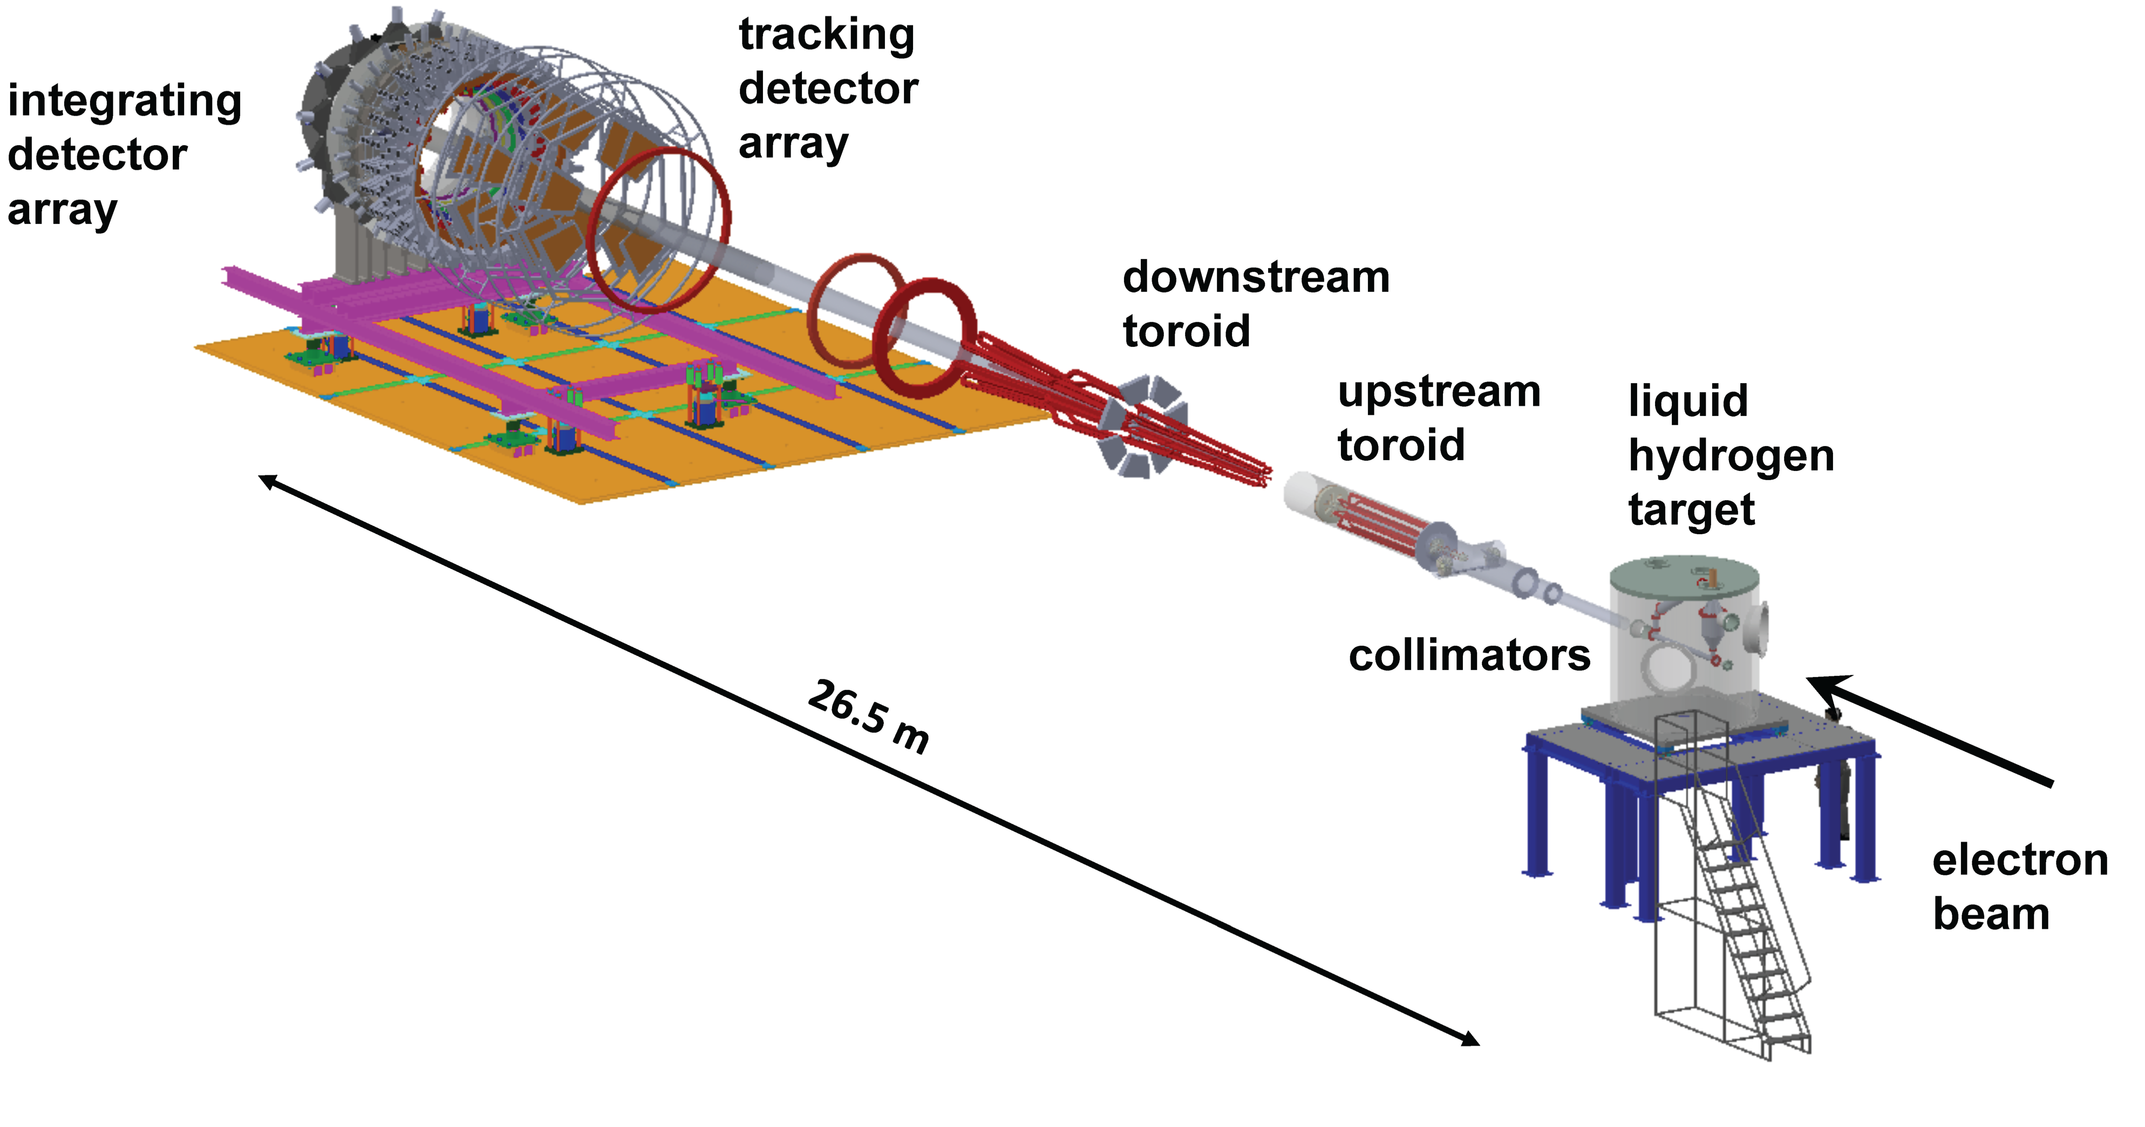
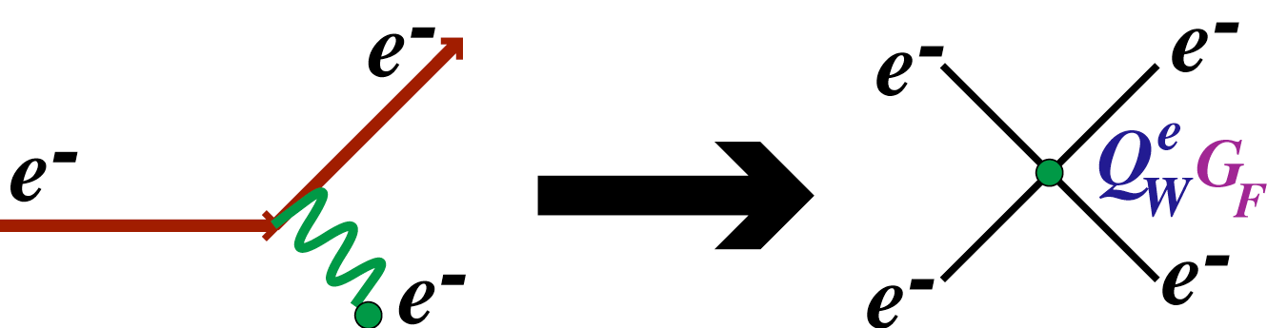
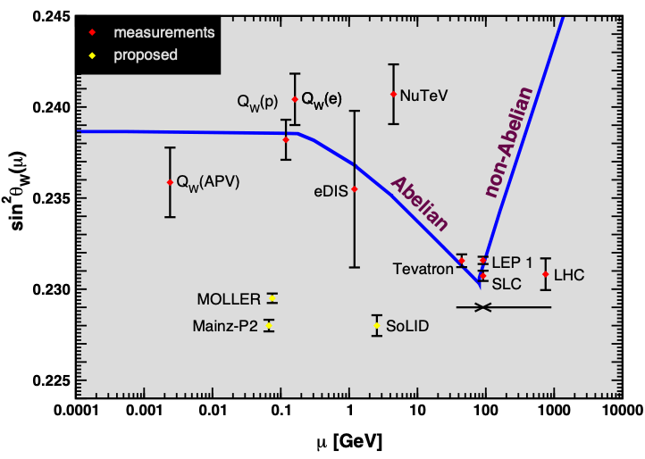


MOLLER – World leading measurement of A_{PV}
Parity-Violating Asymmetry in Fixed Target Polarized Electron-Electron Scattering
Special opportunity with the 12 GeV upgrade
11 GeV, 65 μA
90% beam polarization
APV ~ 32 ppb
δ(APV) ~ 0.8 ppb
δ(Q^{e}W) = ± 2.1 % (stat.) ± 1.1 % (syst.)
δ(sin²θW) = ± 0.00023 (stat.) ± 0.00012 (syst.)
Only e-e measurement: SLAC E158
~ 0.1%
Search for new flavor diagonal neutral currents
Look for tiny but measurable deviations from precisely calculable prediction for SM processes
Unique (purely leptonic) new physics reach
JLab Measurements
A_{new}
MOLLER: improve QW(e) by a factor of 5
MOLLER Reach
Discovery space comparable to a 500 GeV lepton collider
19

Slide 20


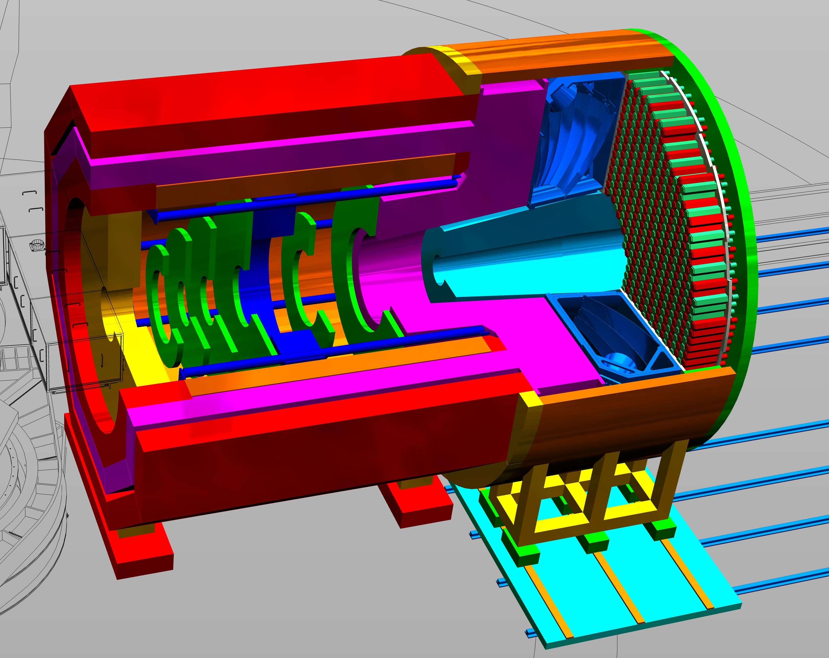
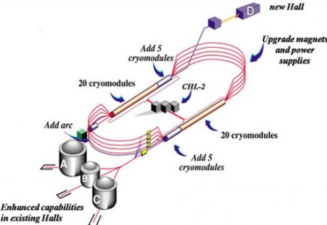
SoLID@JLab: at the QCD Intensity Frontier
Hall A
SoLID will maximize the science return of the 12-GeV CEBAF upgrade by combining...
High Luminosity
10³⁷⁻³⁹ /cm²/s
[ >100x CLAS12 ][ >1000x EIC ]
Large Acceptance
Full azimuthal 𝜙 coverage
PAC50 Re-affirmed priority of science program
5 jeopardy experiments re-approved
One experiment raised from A- to A
Two new experiments approved
Research at SoLID will have the unique capability to explore the QCD landscape while complementing the research of other key facilities
Precision lepto-quark couplings at unique mass and sensitivity scales
3D momentum imaging of a relativistic strongly interacting confined system (nucleon spin)
Superior sensitivity to the differential electro- and photo-production cross section of J/𝜓 near threshold (proton mass)
Synergistic with the pillars of EIC science (proton spin and mass) through
high-luminosity valence quark tomography and precision J/𝜓 production near threshold
Notes:
20

Slide 21
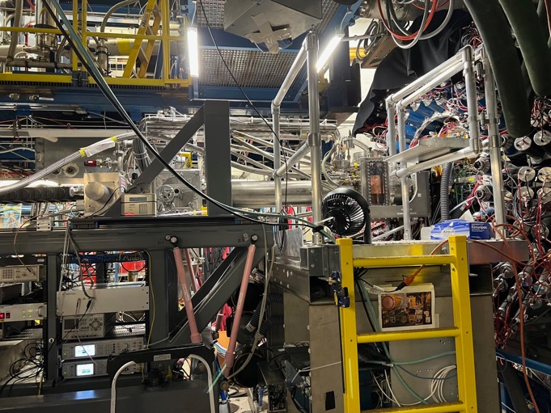
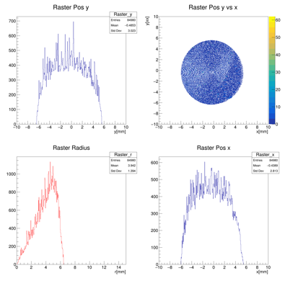
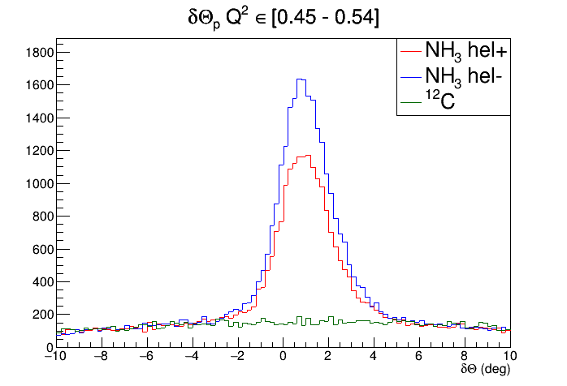
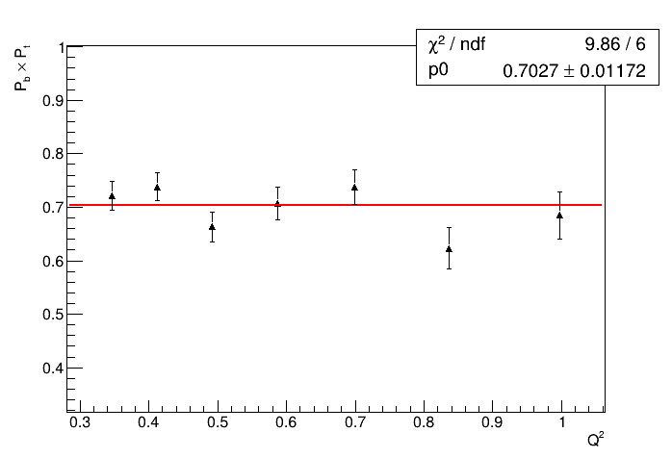
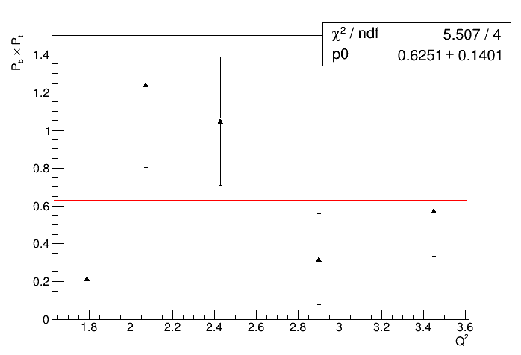







Comprehensive program of nucleon spin and 3D structure – and more!
CLAS12 (~140000 channels).
Few new systems, RICH-II, raster, and polarized target
Off to a good start!
Two sectors of RICH-II
~1 Hz full cycle
Longitudinally polarized NH3 and ND3 target system in the hall
First time target has been polarized in the CLAS12 solenoid field.
$$E_{b}=2.2 GeV$$
$${NH}_{3}$$
$$E_{b}=10.55 GeV$$
Measured high polarization for NH₃ from the elastic scattering data:
$${NH}_{3}$$
PRELIMINARY
$$ep→e^{′}p^{′}$$
$$P_{t}≈P_{b}≈0.85$$
$$P_{t}≈0.8$$
Run Group C: Spin structure of the nucleon, neutron DVCS, SIDIS kaon production,…

Slide 22
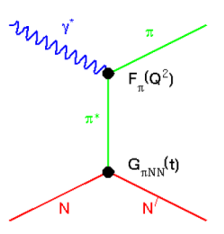
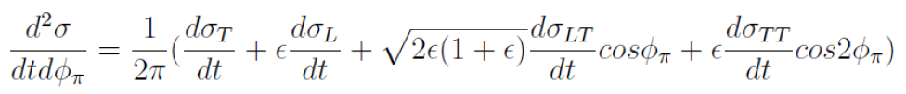


Pion electroproduction signals transition to pQCD
Study of the L–T Separated Pion Electroproduction Cross Section at 11 GeV and Measurement of the Charged Pion Form Factor to High Q²
Low epsilon data taken from Sept 2021 to Feb 2022
High epsilon data is currently being taken.
Indirectly measure F_{π} using the pion cloud in p(e,e’π⁺)n
Need to isolate the σ_{L} at low t
Measure F_{π} to Q² = 8.5
Extend highly cited 6 GeV era measurement
Online results:
Clean identification of p(e,e’π⁺)n final state

Slide 23






Continue path towards exotic searches: $a_{2}(1320)$
Hall D
Prioritize channels for searches including exotic $π_{1}(1600)$ decays to $ηπ$ and $η^{′}π$ – review committee on $ηπ$ results:
“The D waves show impressive signals for the $a_{2}$ meson. This indicates that there is a well-functioning analysis capable of extracting meaningful signals... The Committee endorses the collaboration’s goal of presenting results on cross sections and mechanisms for $a_{2}(1320)$ photoproduction in one year’s time”
Relevance to exotic search:
  Validates theoretical amplitudes and analysis techniques with a known resonance
  Forms a benchmark “standard candle” needed to analyze 𝜂′𝜋, which is more sensitive to exotics than 𝜂𝜋
Status:
  Preliminary results for $a_{2}^{0}$ shown at JLUO Meeting
  Technical challenges with $a_{2}^{−}$ remain
  Advanced preliminary results expected by Fall 2022
γ
$$a_{2}^{0}$$
t
p
p
$γp→a_{2}p$ with $a_{2}→ηπ$

Slide 24

Roughly a decade of 12 GeV experiments
  Apologies to those I didn’t mention!
Potential energy upgrade
Positrons at 12 GeV
More new detectors
Theory
Accelerator
…and the EIC is coming!
Eur. Phys. J. A 58 (2022) 3, 45

Slide 25


One last note – technical synergies
Example: medical applications of detector technology
Medical Imaging
Example: advanced computing
EIC-related generic detector R&D program
Established nascent BioMedical Technology Center
Hosted joint workshop with NIH NCI and NIBIB, follow-on in Spring 2023
Streaming Readout
AI/ML
Distributed Computing
Heterogeneous Computing

Slide 26
LRP Preparation…
Looking towards a well-crafted resolution that expresses the sentiment of the science staff and user community, perhaps:
The JLab community, in preparation for the DNP QCD Town Meeting and the NSAC Long Range Plan exercise, embraces with the highest priority the scientific capitalization of investments made at CEBAF, the nation’s premier QCD facility. We strongly support optimal running of the 12 GeV program, including the construction and deployment of the SOLID detector.
Thank you!

