Slide 1
Strategy for the NSAC Long Range Plan
Presented to the
JLab scientific community
David J. Dean
Deputy Director for Science
Newport News, Virginia
August 26, 2022

Slide 2
Background on the NSAC process
First Long Range Plan came in 1979 (see https://science.osti.gov/np/nsac for the list)
Fairly consistent cadence: every 5-7 years
They focus on the science, but do indicate budgetary constraints
What do these plans have in common?
  Their input is community driven (hence, the involvement of DNP in administering Town Meetings)
  They should articulate the scientific case for the priorities laid out in the plan
  They come with budgetary constraints
  They indicate to DOE/NSF ‘what to do’, but not ‘how to do it’
  There is a closed “Working Group” consisting of scientists and DOE/NSF that actually writes the plan and sets the priorities.
OUR PARTICIPATION MATTERS…if you aren’t in the room, you are not going to be heard; it is that simple.
QCD Town Meeting at MIT, 23-25 September 2022 https://indico.mit.edu/event/538/

Slide 3
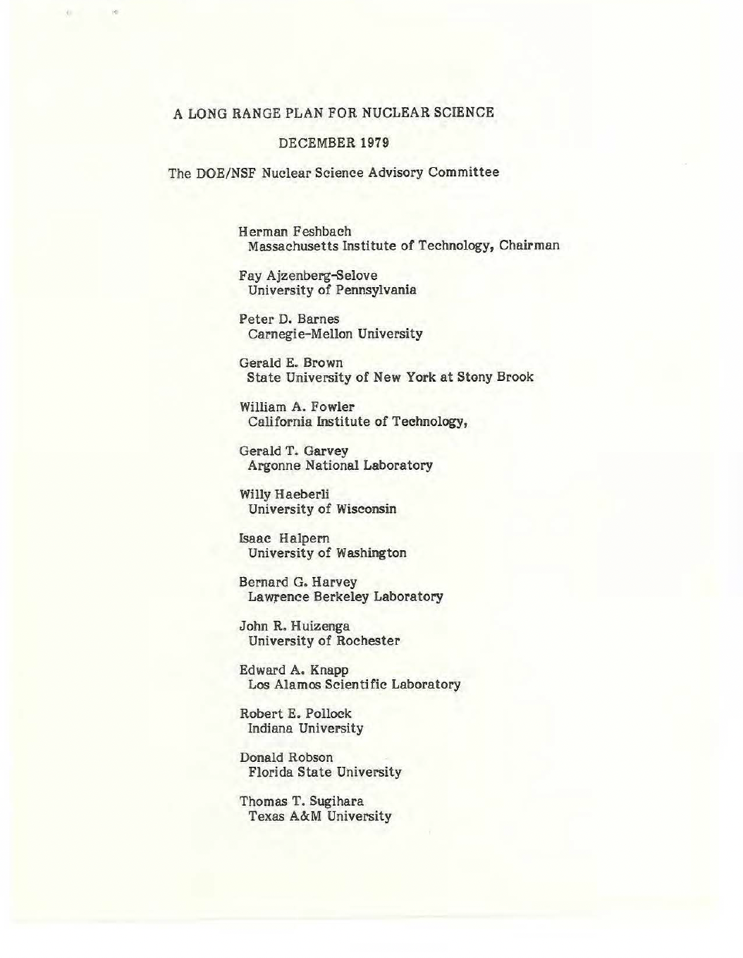

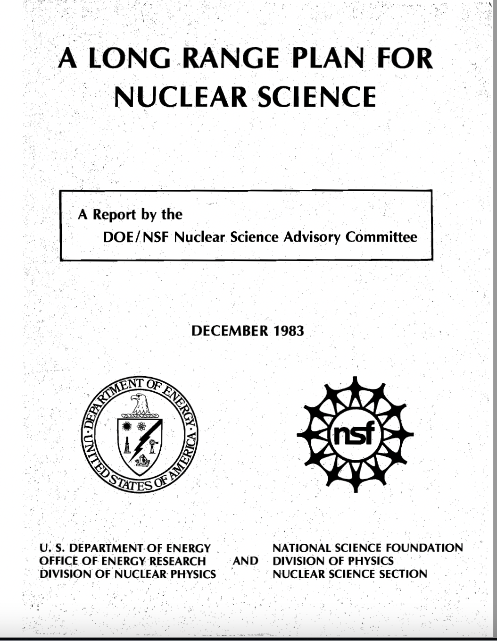


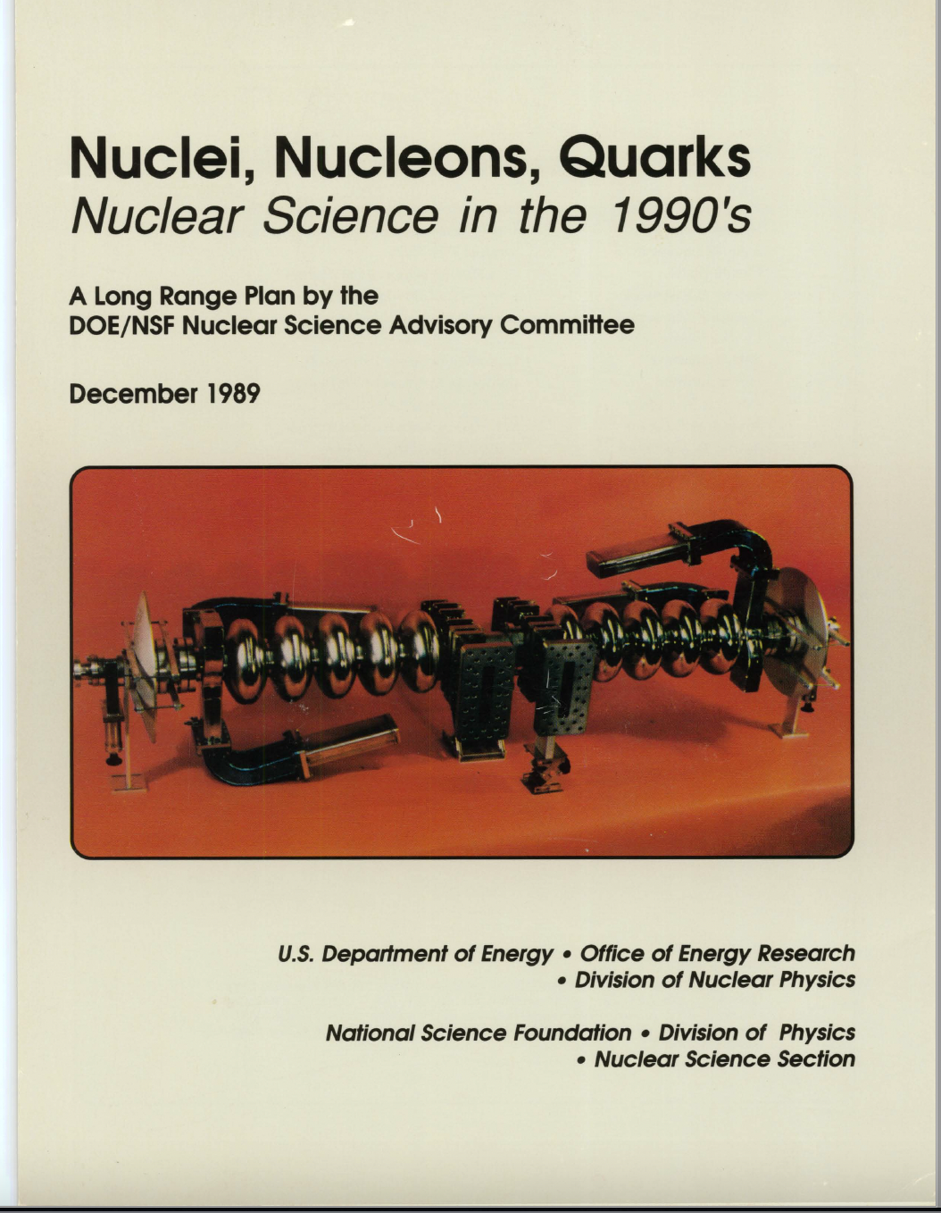

Long Range Planning is a 40+ year tradition
1979
2015
1983
2007
2002
1989
1996
3

Slide 4
Long range plans impact the future
1983
The 4-GeV electron accelerator of the national electron accelerator laboratory recently recommended by NSAC, will be an ideal instrument for exploring this crucial area and it is eagerly awaited by the nuclear physics community.
1989
The highest priority in U.S. nuclear science at this time is the timely completion of the Continuous Electron Beam Accelerator Facility (CEBAF) and the beginning of its important research program.
1996
1. The highest priority for U.S. nuclear science is vigorous pursuit of the scientific opportunities provided by the nation’s recent investments in forefront instrumentation and facilities.
  The recommendation applies equally to the very large facilities CEBAF and RHIC (once it begins operation) and to the lower-energy facilities at universities and national laboratories…
2002 (4th recommendation)
We strongly recommend the upgrade of CEBAF at Jefferson Laboratory to 12 GeV as soon as possible.
2007 (1st recommendation)
We recommend completion of the 12 GeV CEBAF Upgrade at Jefferson Lab. The Upgrade will enable new insights into the structure of the nucleon, the transition between the hadronic and quark/gluon descriptions of nuclei, and the nature of confinement.
2015 (1st recommendation)
The progress achieved under the guidance of the 2007 Long Range Plan has reinforced U.S. world leadership in nuclear science. The highest priority in this 2015 Plan is to capitalize on the investments made.
  With the imminent completion of the CEBAF 12-GeV Upgrade, its forefront program of using electrons to unfold the quark and gluon structure of hadrons and nuclei and to probe the Standard Model must be realized.

Slide 5
Bottom line up front
Institutional approach to the LRP
Support full operation of CEBAF 12 GeV program throughout the “term” of the next LRP.
  This includes making good on SoLID
  And this is an absolute requirement in order to have a community ready to deliver science from EIC
Support EIC Construction (including the first detector)
Seek community support for an energy upgrade to CEBAF that produces great science
  Capture the $75M from EIC@JLab for an energy upgrade

Slide 6
Caveats
We control
  Our science case
  Our rapport
We do not control (but we can influence)
  Congress (lab employees need to be careful in this respect)
  SC-1 (Dr. Berhe), SC-2 (Steve Binkley), SC-3 (Harriet Kung)
  S-1 (in some instances)
  OMB/OSTP – Note: OMB is mostly careers; OSTP is mostly political appointees
FRIB is operational; 0nubb expts marching toward CD-1; EIC is at CD-1; IRA puts a lot of funding into the system to fix some near-term issues
NSF, while important, is small in this space
Contemporary inflation rates were not included in the FY23 PBR; if not corrected by congressional action (although this is the likely congressional appropriations outcome), we will see a significant erosion of science funding in FY23.

Slide 7
Federal budget and LRP timelines
 | October | November | December | January | February | March | April | May | June | July | August | September
FY | Start execution (usually CR from FY-1)
FY+1 |  | OMB Pass back | Agency Response |  | PBR (first Monday) | Congressional budget hearings | Cong. Budget resolution (15 April); 302a’s set |  |  | Approps Committee markups |  | Approps become law
FY+2 |  |  | Internal budget discussions |  | LMBB and related activities | NP retreat |  | DOE | Budget | Formulation |  | Dept sends budget to OMB
FY+3 |  |  |  |  |  |  |  |  |  |  | OSTP S&T priorities letter for FY+2
July 13, 2022 DOE/NSF charge; Town Halls and meetings through January, 2023 or so. Resolution committee, July 2023 (or earlier); publication, December 2023
Could have effect on FY24 budget (via congressional action)
Will have effect on FY25 budget formulation
November, 2024 → Presidential election (expect long CR for FY25)

Slide 8
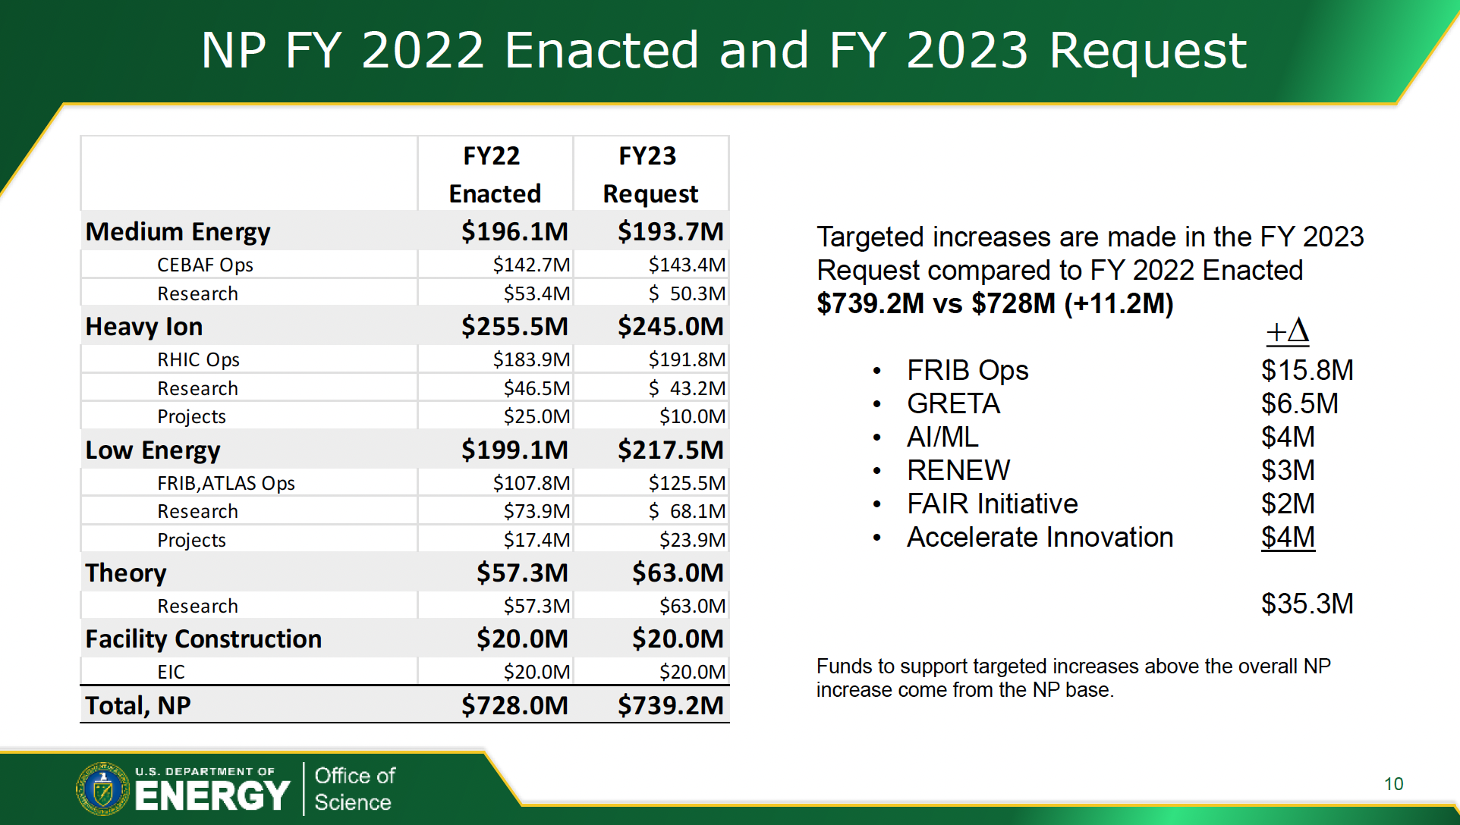
Funding realities and LRP constraints
Tim Hallman April NSAC talk
Hallman, NSAC April 28, 2022 talk

Slide 9
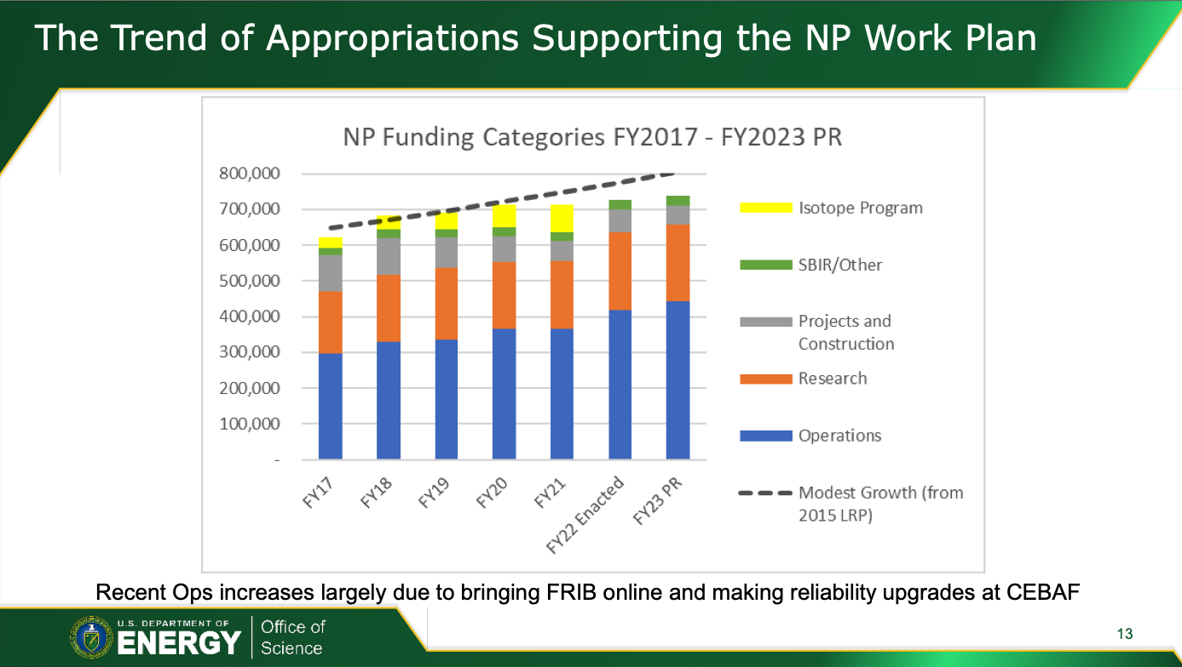
From Hallman April 2022 NSAC talk

Slide 10
Balance of funding within NP (FY23 PBR)
 | Operations | Research | Projects | Construction | Total
HI | 191.8 | 43.2 | 10.0 |  | 245
ME | 143.4 | 50.3 |  |  | 193.7
LE | 125.5 | 68.1 | 23.9 |  | 217.5
Theory |  | 63.0 |  |  | 63.0
EIC |  |  |  | 20.0 | 20.0
Totals | 460.7 | 224.6 | 33.9 | 20.0 | 739.2
RHIC running ends in FY25. The community already made an implicit decision to walk away from hot QCD.
Inevitably (at these budget numbers), the alternatives are:
Redirect a facility and add budget (requires $150M/year new funds starting in FY24)
Redirect two facilities (presumably HE and ME operations combined)
Abandon EIC plans and reinvest in RHIC and CEBAF
  But RHIC has done most of its science mission
Abandon EIC, upgrade FRIB to RIA and continue CEBAF
Abandon EIC, upgrade CEBAF, redirect to major neutrino push (ton scale and beyond)

Slide 11
FY 2023 budget will set the stage – there is a long way to go
”The budget is a year-long process.” Requires some flexibility in thinking
NP budget | FY 2022 enacted | FY 2023 PBR | FY 2023 House | FY 2023 Senate
Total | 728.0 | 739.2 | 780.0 | 755.2
EIC | 20.0 | 20.0 | 35.0 | 50.0
Research | 708 | 719.2 | 745.0 | 805.2
FY23 House mark may alleviate some of the significant inflationary pressures (7% increase over FY22); however it should not be taken as real growth.
FY23 House mark for SC is $8B ($201M above PBR; $525M above FY22); represents 7% increase overall. Senate Mark: $8.1B
Note: CPI was 8.5% for the 12 months ending in July. (https://www.bls.gov/cpi/)

Slide 12
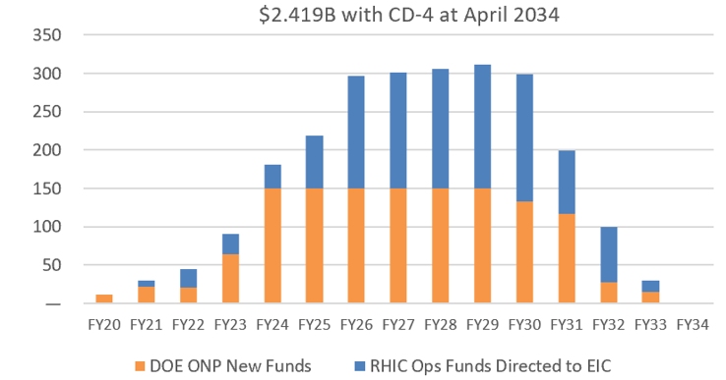
What does the EIC need
This is an interesting question
  At the 2015 LRP meeting, the pre-CD0 estimated cost was $1.0-1.5B in FY15 dollars
    Translates to $1.13 – $1.7B in 2021 costs.
  Today, the estimate is $1.7B - $2.8B with a mid point estimate of $2.419B. (profile 3)
  Caps new funds at $150M/year
  $2.419B does not include the high 2022 inflation rates (escalation for this estimate was 3.5% for labor and 2.3% for materials).
  Inflation currently carried as $50M risk in the project
  The high rate of inflation in FY22 and FY23 could easily add $100-200M to the project requirements.
The current EIC profile:
UPDATE: Inflation Reduction Act (IRA): +$217M one time
$110M to EIC in FY22
Moller fully funded
HRS@FRIB, GRETA, 0nubb also receive funding

Slide 13
NP budget history
Using an inflation rate for FY22 --> FY23 of 8.4%
Inflation Reduction Act: $217M to NP in FY22 to be spent by FY27
Moller (to complete)
HRS@FRIB (to complete)
GRETA@FRIB (to complete)
EIC (to get to CD-2)
0nubb (to get to CD-1)

Slide 14
Alternatives impacts analysis
Impacts
Redirect a facility and add budget (requires $150M/year new funds starting in FY24)
  Continue ramp in FY23 budget; a ramp over several years would enable the project, but delay CD-4
  CEBAF continues optimally; JLAB would obtain half of the new funds ($75M/year) for EIC
  Strategy would be to capture those $75M/year into CEBAF upgrade later
Redirect two facilities (presumably HE and ME operations combined)
  This is a non starter for JLab
Abandon EIC plans and reinvest in RHIC and CEBAF
  Would require RHIC to develop a new science case
Abandon EIC, upgrade FRIB to RIA and continue CEBAF with upgrades
  This is a non-starter for BNL and neutrinos
Abandon EIC, upgrade CEBAF, redirect to major neutrino push (ton scale and beyond)
  Would not have BNL support

Slide 15
What would a 22 GeV upgrade need
Captures EIC funds at JLab and directs toward upgrade as EIC ramps down.
  Upgrade project would tie to EIC…this may not be an optimal scenario. JLab@12 may require some experimental updates by the early 2030s.
Could be a path toward a unified front with BNL
22 GeV upgrade peak shown here is ‘notional’ not optimal or technically driven (the science would be better served by an earlier upgrade, particularly if EIC is delayed)

Slide 16
Rack and stack
Medium scale instrumentation packages: $150-250M
FRIB upgrade (to 400 MeV plus multi user): $200-500M
Neutrinoless double beta decay experiment: $250-500M
EIC (CD-1 cost range) $1.7B – $2.8B (inflation an issue)
There is a little bit of free energy in the current budget due to IRA
Inflation is moving costs up, and they are not coming back down.
Attracting and retaining people into nuclear physics may be an issue…

Slide 17
Politics vs physics (David’s thoughts)
Everyone will have different physics tastes
EIC
  BNL health depends on a viable RHIC to EIC strategy
  EIC second detector is a distraction
  JLab health and survival depends on a viable CEBAF and EIC strategy
  JLab could easily be asked to give up operations to fund EIC. It would be an error to do so.
Fundamental Symmetries and neutrinos
  It will be difficult to maintain a world-leading effort in neutrinos whereas neutron physics and “Moller” size efforts are doable
  International partnerships could help the neutrino discussion (but so far this has not really helped)
Low Energy (NS/NA)
  FRIB must be healthy (it is brand new) and it has upgrade needs to reach its full potential. This will put pressure on ATLAS@ANL
Theory
  Theory – computation/AI/ML…

Slide 18

Discussion

