Slide 1
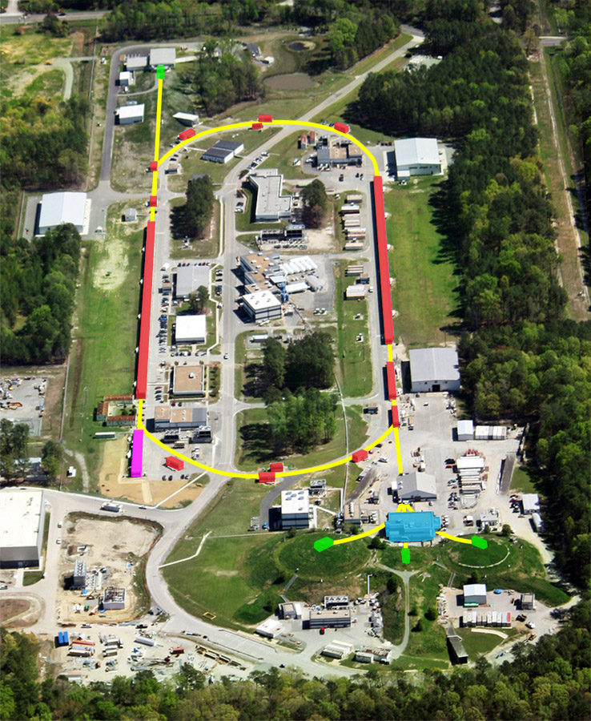
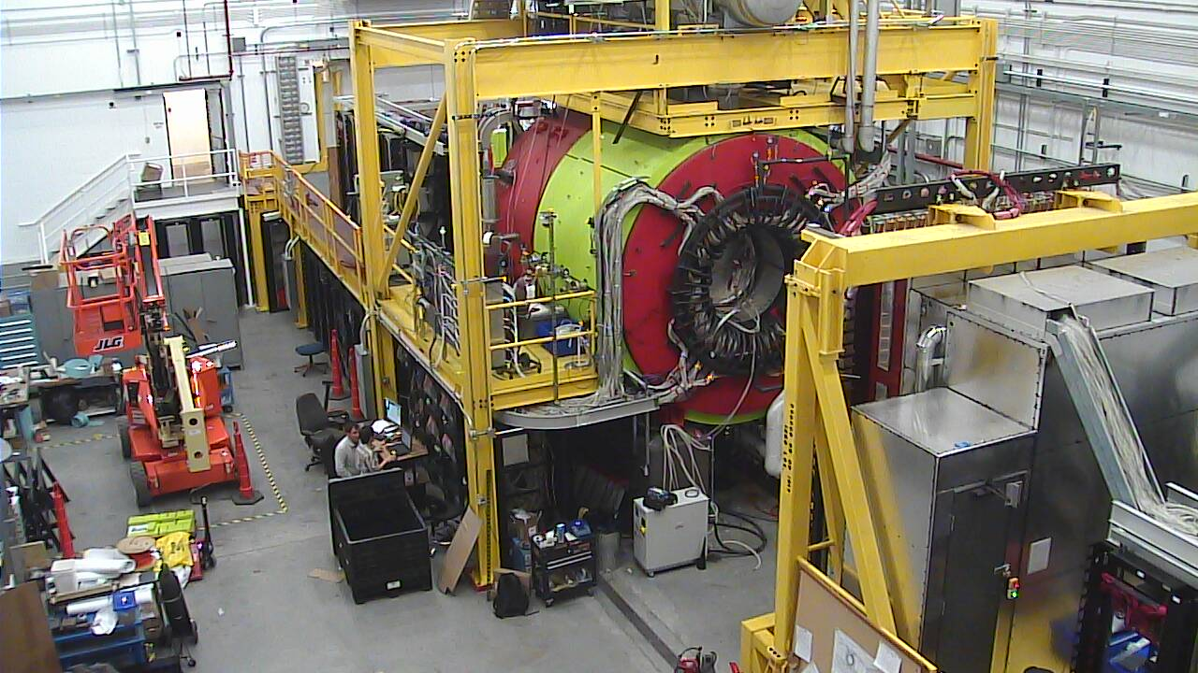
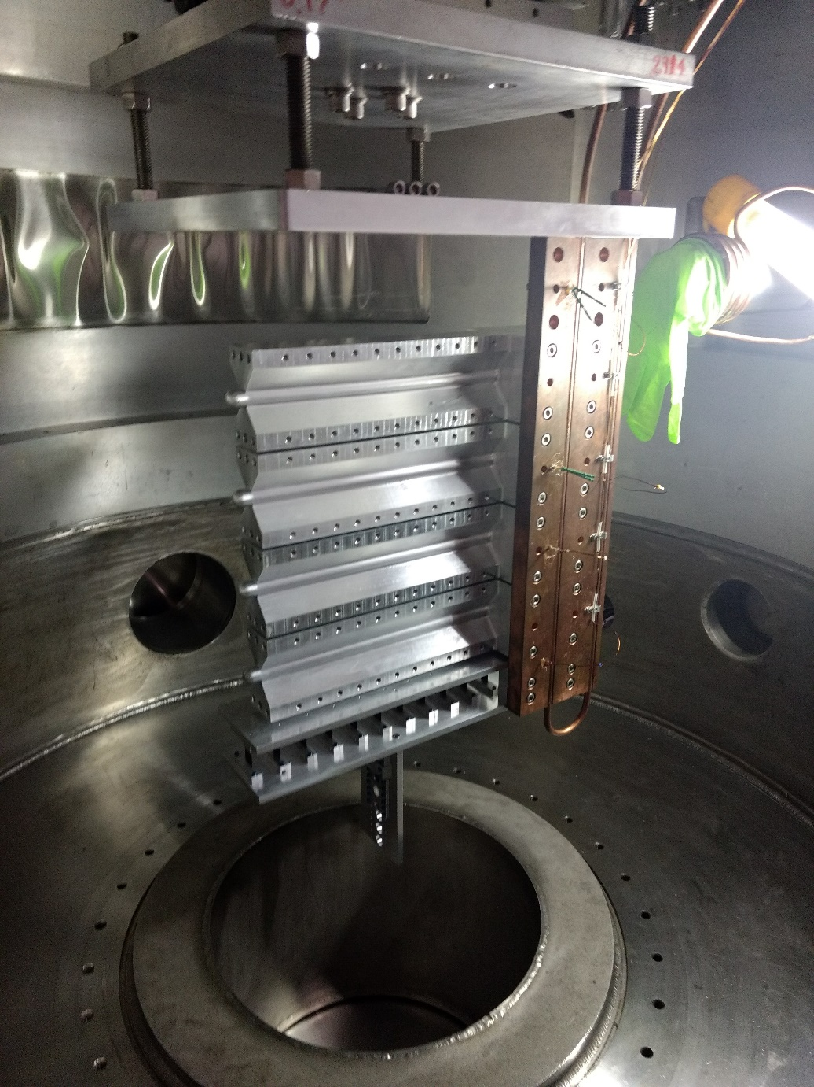
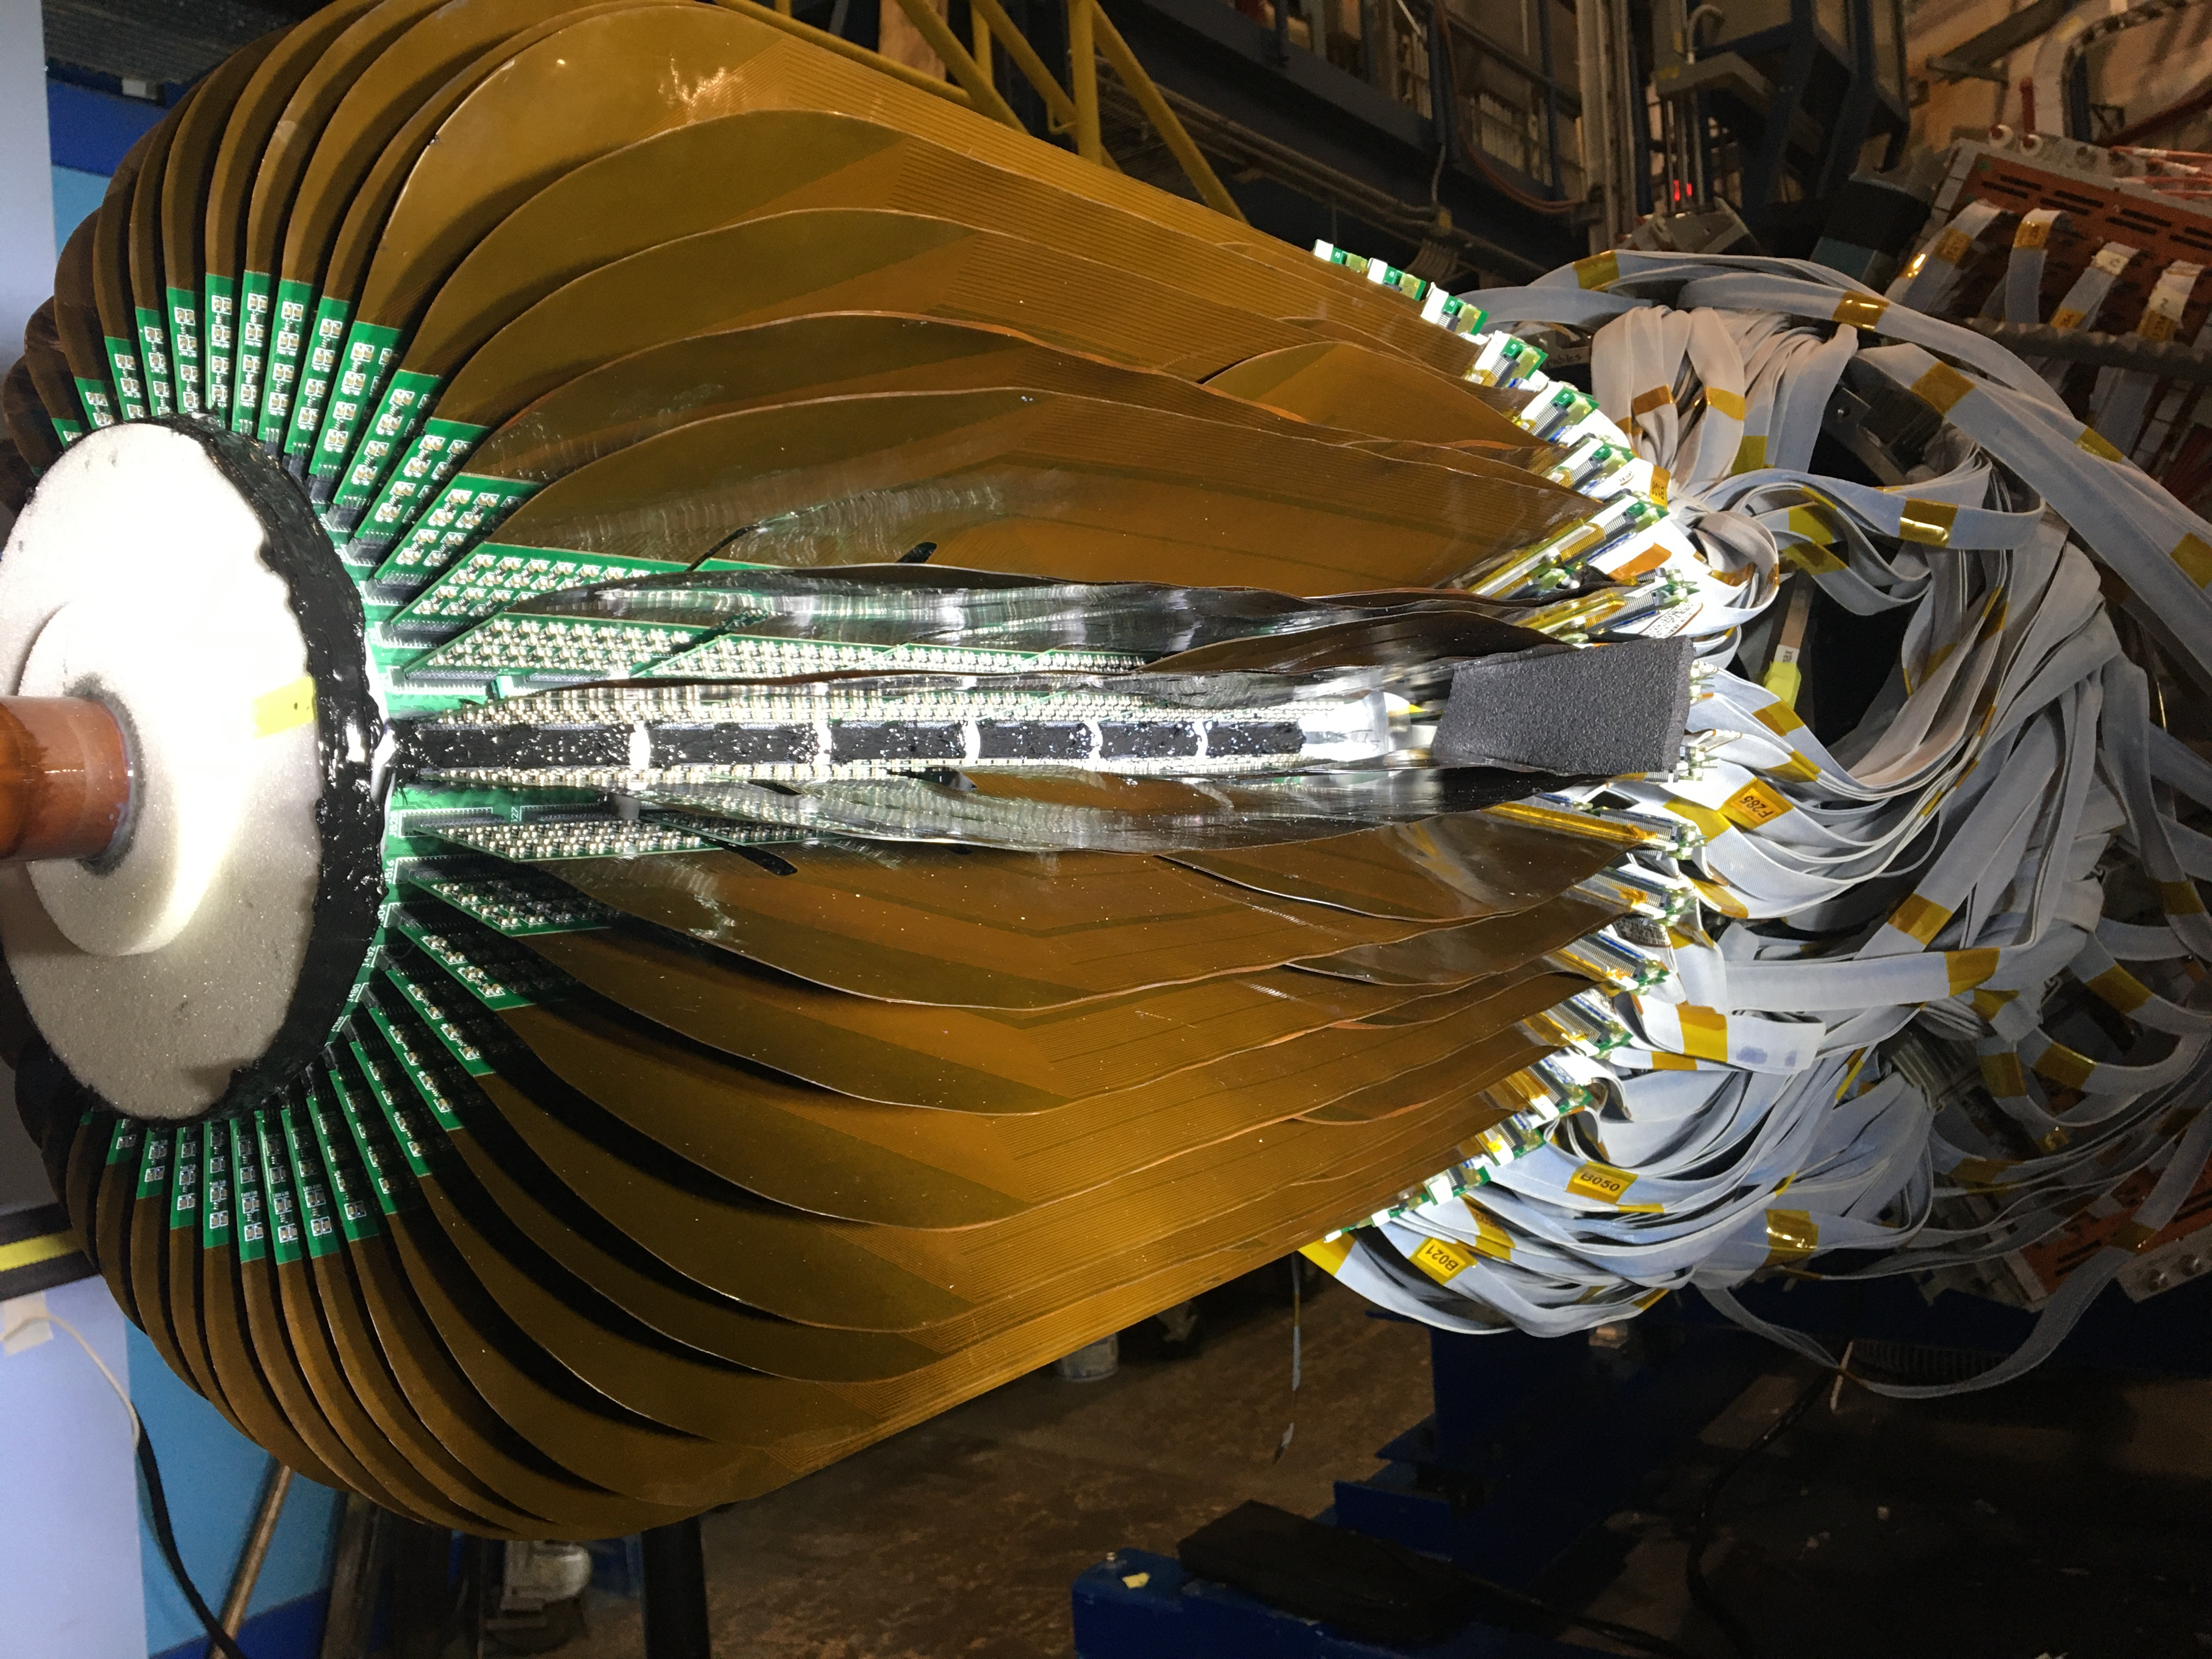
12 GeV Program
Thia Keppel
September 8, 2022

Slide 2
Requested Topics
Accomplishments from last LRP (2015) until now
Highlights and duration of the currently approved program
Trend on the number of new approved PAC days in recent years
Before we start….

Slide 3
Reminders about LRP, Process and Results
Results…
LRP 2007:
  4 Recommendations, in the following order
    Complete 12 GeV upgrade
    Construct FRIB
    Neutrinos, construct DUSEL
    RHICII luminosity upgrade
    - mentions EIC, unnumbered
  4 Initiatives
    Theory
    Accelerator R&D
    GRETA (FRIB detector)
    University research
  Many other things mentioned later in text
LRP 2015:
  4 Recommendations, in the following order
    Operate existing facilities, JLab12 mentioned first
    Deploy Ton-scale neutrinoless double beta decay experiment
    EIC Construction
    Investment in small and mid scale projects
  2 Initiatives + Workforce Development
    Theory
    Accelerator and Detector R&D
  Many other things mentioned later in text
    Significant scientific achievements
    Science to come (d/u, TMDs, EMC effect, MOLLER, SOLID,…)
      Sidebars and figures

Slide 4
Reminders about LRP, Process and Results
Results… hoped for in 2023 LRP!! (JLab Priorities)
12 GeV operations remains the first priority Recommendation for nuclear science
  Should be combined as “operate existing facilities” with FRIB
  Should explicitly include SoLID
EIC project is another priority Recommendation
  As approved – i.e. not with the second detector (which would be fine as an Initiative)
20+ GeV upgrade is a (hopefully first) major Initiative
Advanced computing for nuclear physics is another major Initiative
JLab experiments prominent in science text (a few pictures, plots,…)
  Positrons go here
Support theory, education, innovation

Slide 5
Reminders about LRP, Process and Results
Process…
Topical Town Meetings (3-5):
  QCD
  Nuclear Structure
  Fundamental Symmetries
  Education and Outreach, Innovation
Resolution/Writing/Working Group
  Receive priorities and input from the above
  This is where decisions are made
  This is where budget is discussed

Slide 6
Requested Topics
Accomplishments from last LRP (2015) until now
Highlights and duration of the currently approved program
Trend on the number of new approved PAC days in recent years

Slide 7
Trend on the number of new approved PAC days in recent years
PAC history since start of 12 GeV approvals
Days approved by PAC
Many more days proposed!
More experiments (run groups increasing)
Creative community - new ideas still coming up
t

Slide 8
Requested Topics
Accomplishments from last LRP (2015) until now
Highlights and duration of the currently approved program
Trend on the number of new approved PAC days in recent years

Slide 9
PAC Approved Experiments (status February 7, 2022)
Topic | Hall A | Hall B | Hall C | Hall D | Total
Hadron spectra as probes of QCD | 0 | 2 | 1 | 4 | 7
Transverse structure of the hadrons | 7 | 4 | 3 | 1 | 15
Longitudinal structure of the hadrons | 1 | 3 | 7 | 1 | 12
3D structure of the hadrons | 6.5 | 9 | 6.5 | 0 | 22
Hadrons and cold nuclear matter | 10 | 6 | 8 | 1 | 25
Low-energy tests of the Standard Model and Fundamental Symmetries | 3 | 1 | 0 | 1 | 5
Total | 27.5 | 25 | 25.5 | 8 | 86
Total Experiments Completed | 11.0 | 10.5 | 8 | 2.7 | 32.2
Experiments Removed by Jeopardy | 0.8 |  | 0.7 |  | 1.5
Total Experiments Remaining | 15.7 | 14.5 | 16.8 | 5.3 | 52.3
Does not include SoLID
PAC50 approved 5 new experiments in July 2022
57.3

Slide 10
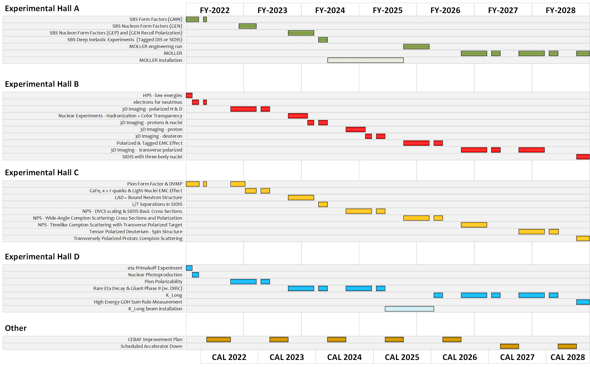
Extended experimental schedule
199 completed experiments to-date (22 full; 22 partial in 12 GeV era)
57.3 experiments remaining
~8 years at ~30 weeks/year
…not including SoLID
…not including new proposals

Slide 11
Requested Topics
Accomplishments from last LRP (2015) until now
Highlights and duration of the currently approved program
Trend on the number of new approved PAC days in recent years

Slide 12
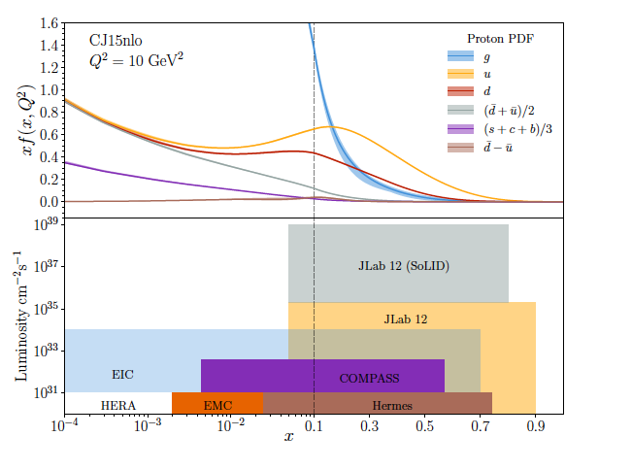
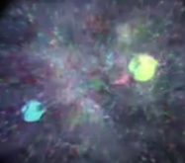
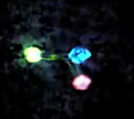
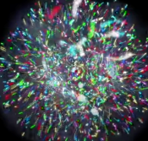
Scientific Program at the Luminosity Frontier
Probability Distribution
High luminosity, precision beam and instrumentation, control of systematic uncertainties - critical to high precision measurements
Probability Distribution
2020s-2030s
Luminosity (cm⁻²s⁻¹)
2030s-2040s
2010s-2020s
Physics with CEBAF at 12 GeV and Future Opportunities
(Nov 30, 2021)
e-Print: 2112.00060 [nucl-ex]
2000s-2010s
1980s-1990s
Fraction of nucleon momentum

Slide 13
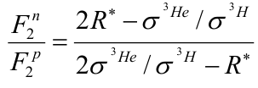
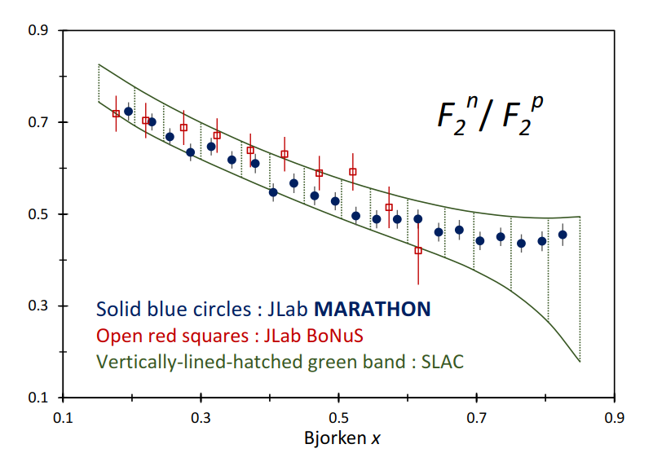
F₂^{n}/F₂^{p} – keen discriminator of fundamental models
MARATHON results published March 31, 2022 in Phys. Rev. Lett. 128, 132003
Measured ³He and ³H cross sections in DIS kinematics using the LHRS and RHRS (last RHRS experiment!)
Extracted ratio of neutron to proton structure functions
Assume R* is small (some theoretical uncertainty here)
F₂^{n}/F₂^{p} predicted by models
Model | F₂^{n}/F₂^{p}
SU(6) | 2/3
NJL | 0.43
DSE-1 | 0.49
CQM | 0.25
pQCD | 3/7
SLAC deuteron data represented by green band since extraction sensitive to the NN potential used in the deuteron wave function
Table from C. D. Roberts, R. J. Holt, S. M. Schmidt
Physics Letters B, 727, 2013,p249-254

Slide 14
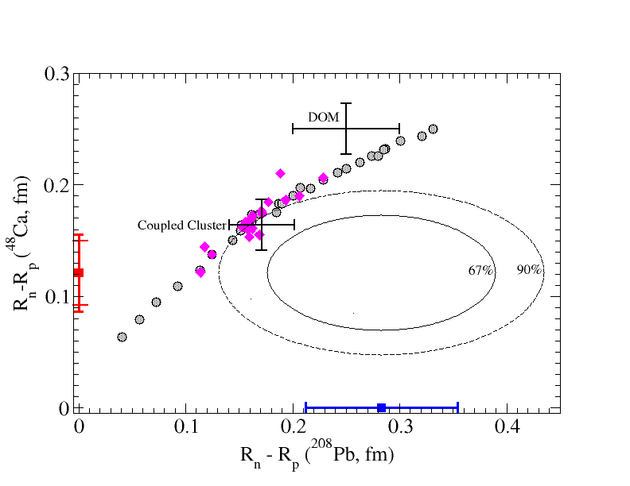
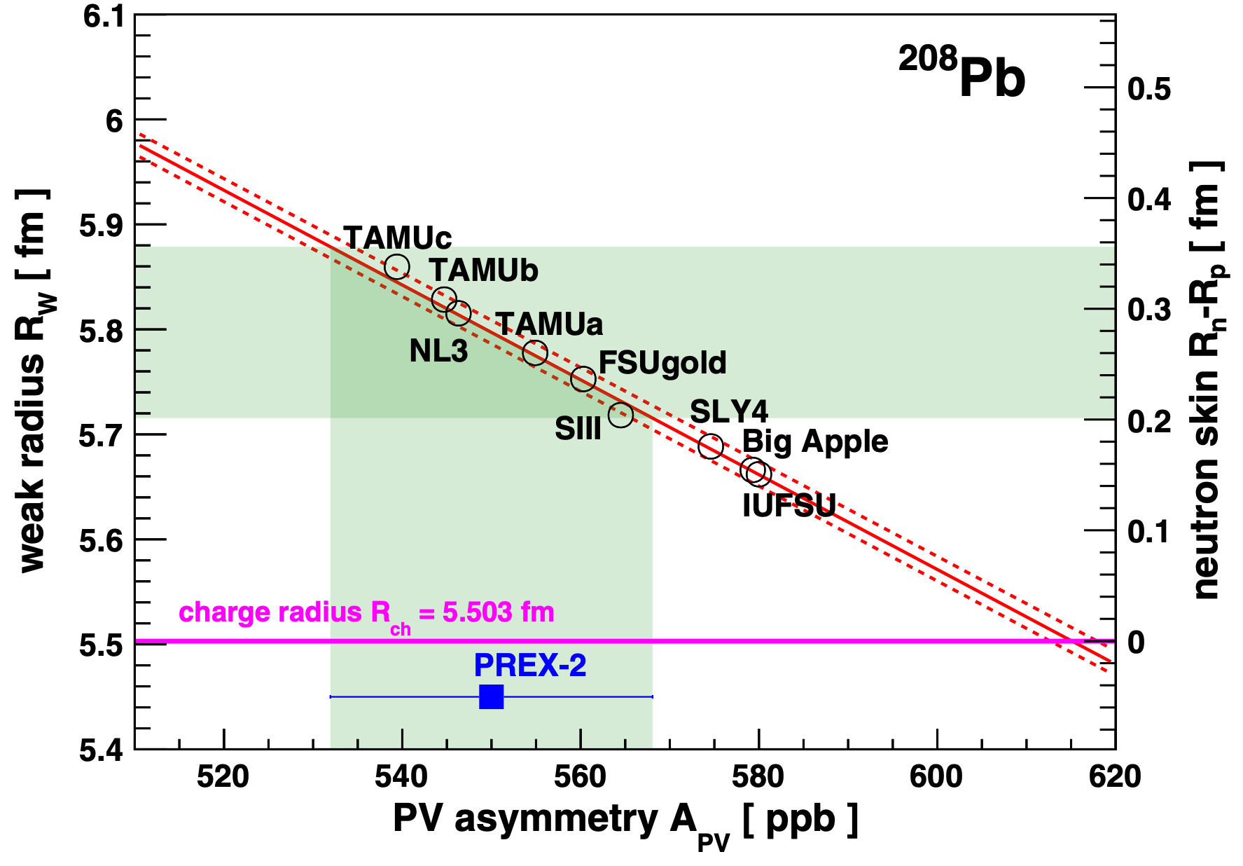
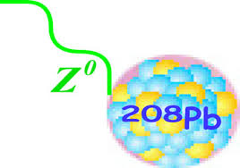
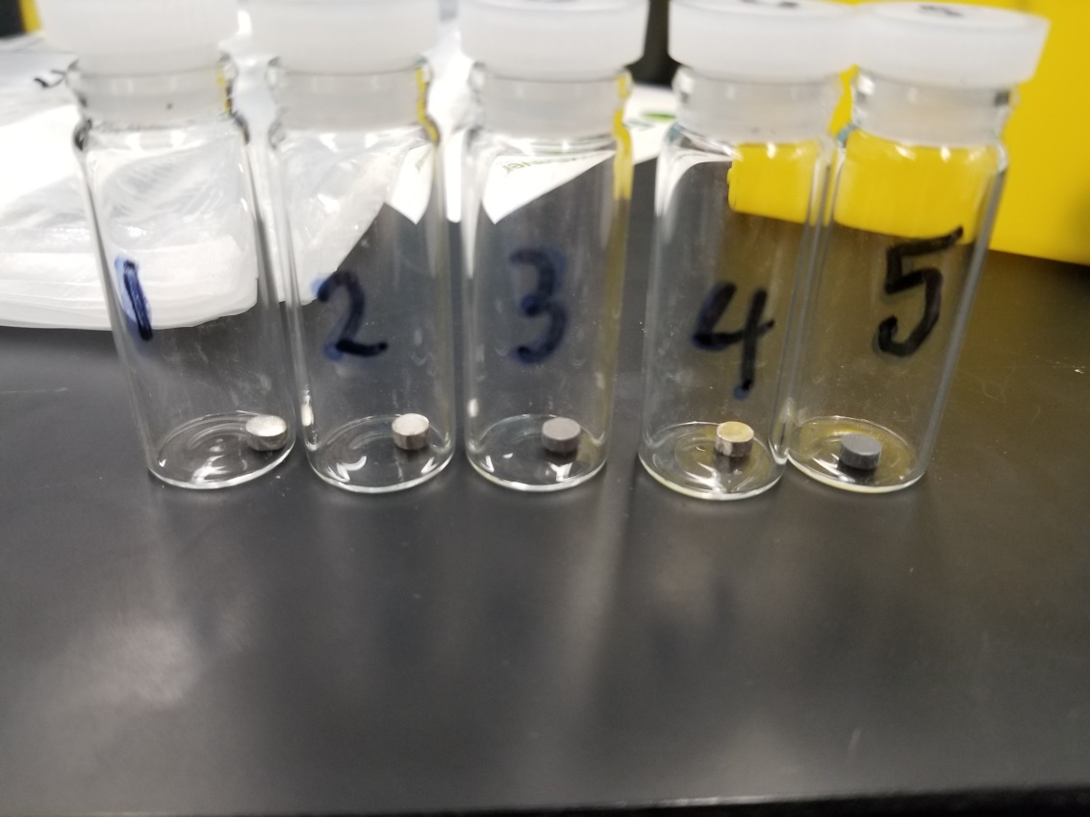
PREX and CREX are in tension with theory
PREX-II Phys. Rev. Lett. 126, 172502 (2021)
CREX: arXiv:2205.11593, approved for publication in PRL
How thick is the neutron skin?
⁴⁸Ca
CREX
data
PREX data
⁴⁸Ca : thin skin
²⁰⁸Pb : thick skin
Electroweak asymmetry in elastic electron-nucleus scattering : Extract R_{n}
Implications for the EOS of neutron matter – thus for understanding neutron star skins
A_{PV} (ppm)

Slide 15
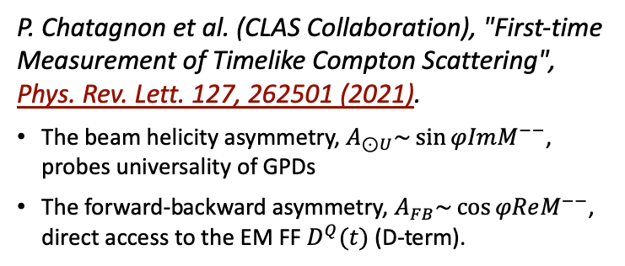
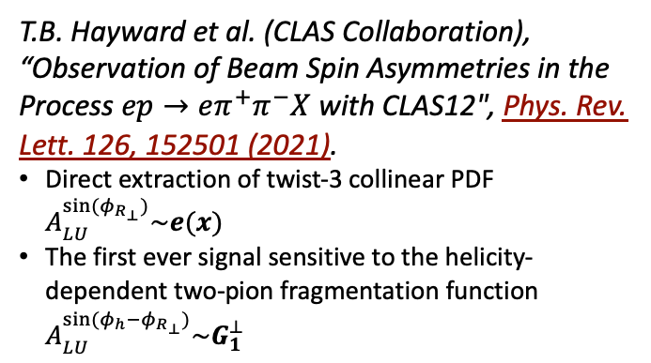


CLAS12 provides first-ever measurements
T.B. Hayward et al. (CLAS Collaboration), “Observation of Beam Spin Asymmetries in the Process $ep→eπ^{+}π^{−}X$ with CLAS12", Phys. Rev. Lett. 126, 152501 (2021).
Direct extraction of twist-3 collinear PDF $A_{LU}^{\sin{(φ_{R_{⊥}})}}\sim e(x)$
The first ever signal sensitive to the helicity-dependent two-pion fragmentation function ${A_{LU}^{\sin{(φ_{h}−φ_{R_{⊥}})}}\sim G}_{1}^{⊥}$
P. Chatagnon et al. (CLAS Collaboration), "First-time Measurement of Timelike Compton Scattering", Phys. Rev. Lett. 127, 262501 (2021).
The beam helicity asymmetry, $A_{⊙U}\sim \sin{φImM^{−−}}$, probes universality of GPDs
The forward-backward asymmetry, $A_{FB}\sim \cos{φReM^{−−}}$, direct access to the EM FF $D^{Q}(t)$ (D-term).
$$\sim Imℋ$$
$$\sim Reℋ$$

Slide 16
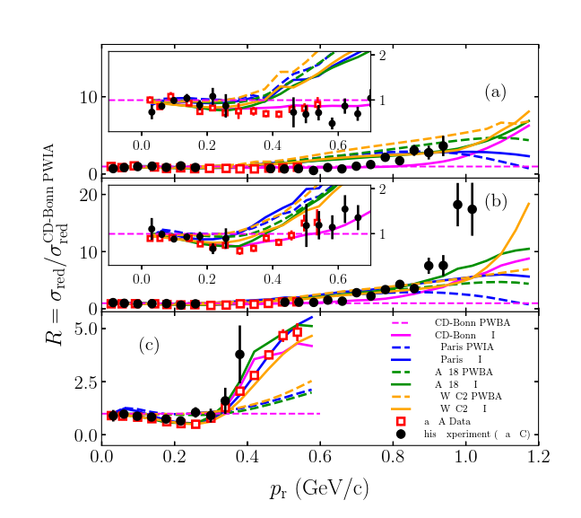
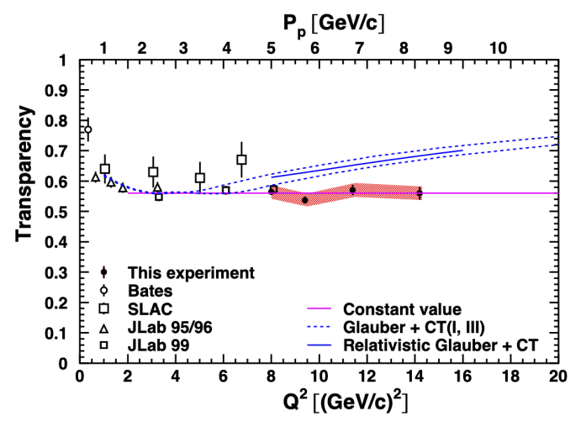
New nuclear data challenge theory
First Phys. Rev. Letters with data using new Hall C SHMS in 12 GeV Era
PRL 126 ”Ruling out color transparency in quasi-elastic 12C(e,ep) up to Q² of 14.2 (GeV/c)2”
PRL 125 “Probing the Deuteron at Very Large Internal Momenta”
CD-BONN theory (magenta) explains data for p_{r} < 600
Prediction with Color Transparency
CD-BONN theory cannot explain data for p_{r} > 0.6
Need to complete experiment to explore if trend continues to p_{r} > 1.1
Data has flat dependence
No Color Transparency !

Slide 17
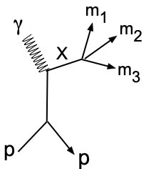
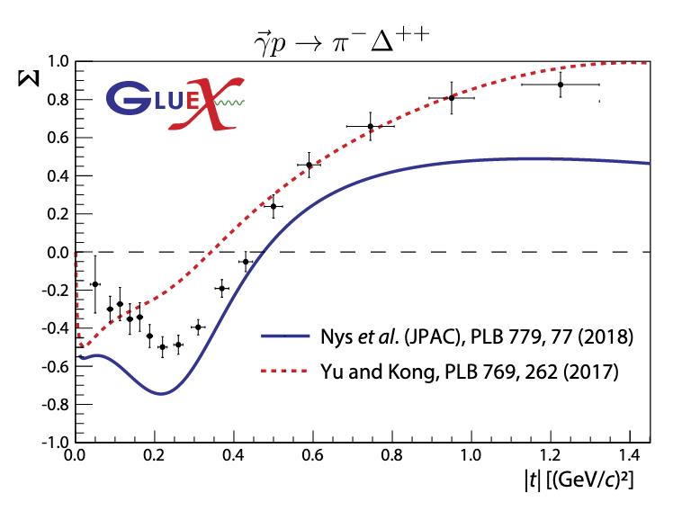
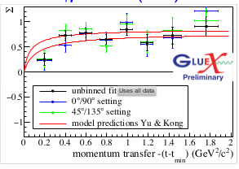
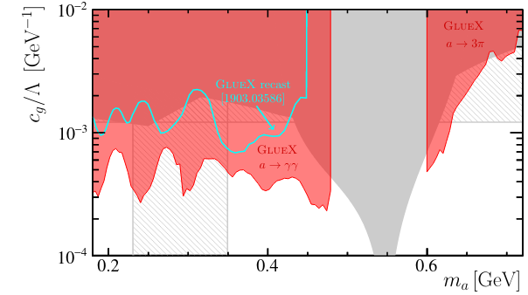
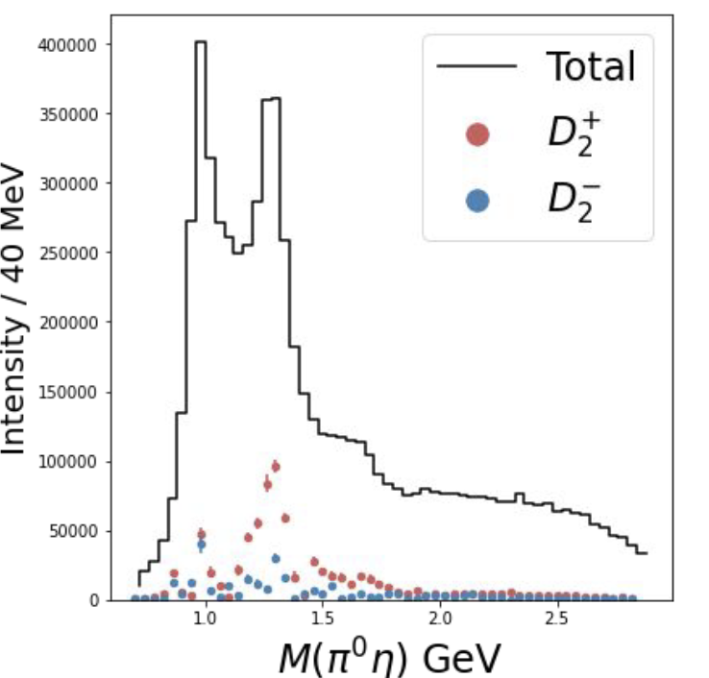
Searching for hidden states in photoproduction
GlueX: Meson Spectroscopy
Understand production mechanisms: Natural J^{P}=0⁺, 1⁻, 2⁺, …and unnatural J^{P}=0⁻, 1⁺, 2⁻ exchanges: measure the beam asymmetry Σ using linearly polarized beam 6 PRC papers
Spin Density Matrix Element (SDME) measurements
PRC 103, L02201 (2021) asymmetry
PRC 105, 035201 (2022) SDME, asymm.
2109.13439 (2021) search for axion
Axion search
unnatural
natural
γp→K⁺Λ(1520⁾
γp→pπ⁻π⁺π⁺
γp→pγγ
γp→π⁻Δ⁺⁺
GlueX limit (in red)
a₂(1320)
Status of search for hybrid mesons
Reviewed in 2021
Prerequisites: SDME, cross sections, PWA of known resonances – in progress
PWA identifies the well known a₂(1320): D waves for +/- naturality
ηπ⁰

Slide 18
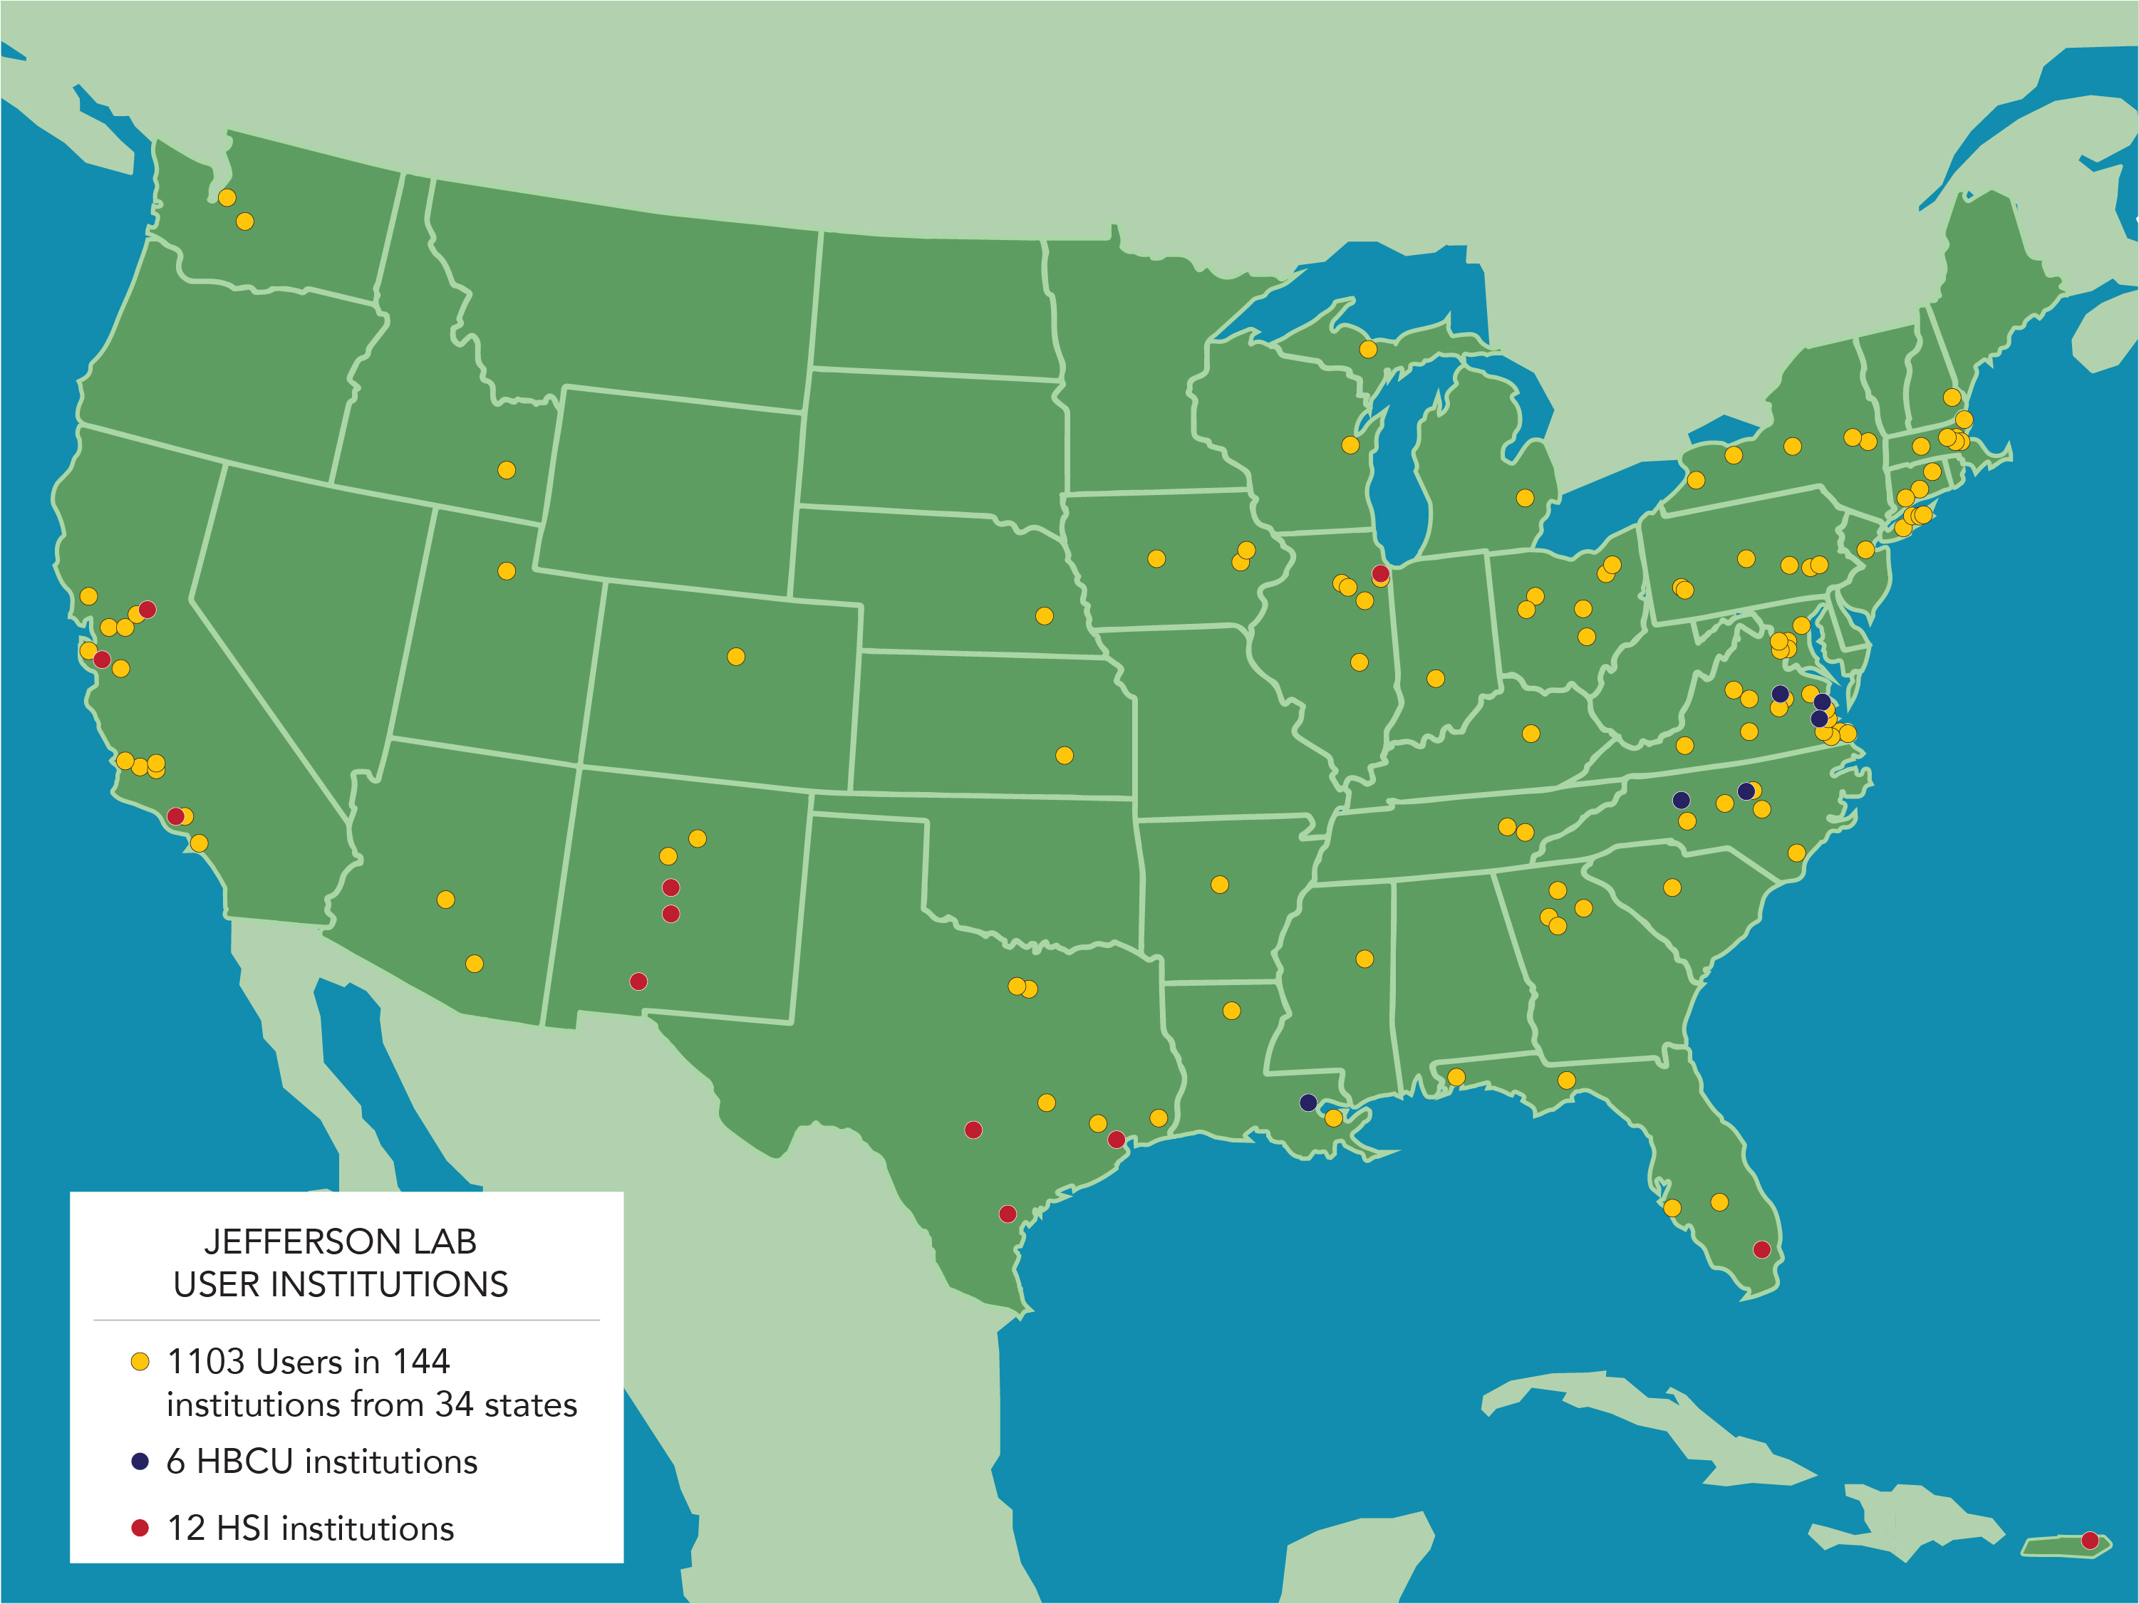
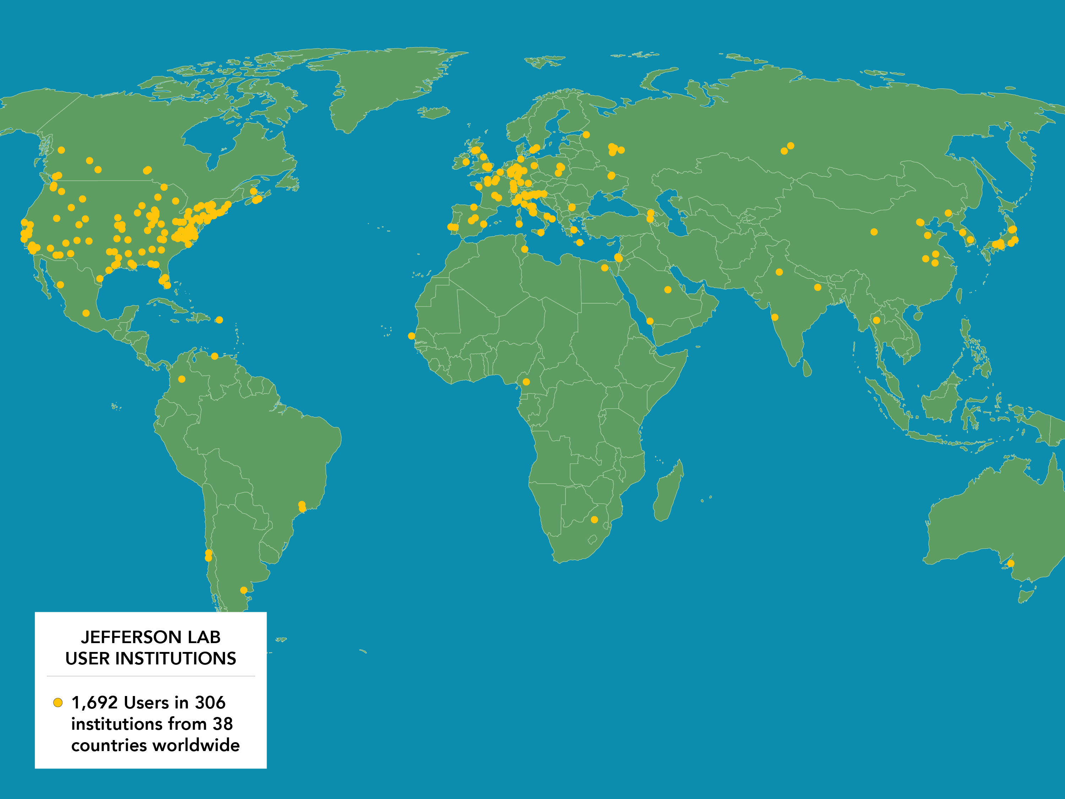
(Pre) Summary
As the high priority for nuclear science, has significantly advanced the understanding of the structure of matter – and brought forth new questions 2,217 scientific papers and journal articles Large and growing Nuclear Physics user community (~1700 users) Scientific users from 39 countries, 278 institutes (124 institutions in 34 states) CEBAF’s approved program extends into 2030s Requires completion of MOLLER and SoLID CEBAF will remain a critical facility for fixed target electron scattering at high luminosity There are emerging scientific opportunities with a higher energy CEBAF
CEBAF is a unique and powerful facility that will remain in high demand, even in the EIC era

Slide 19
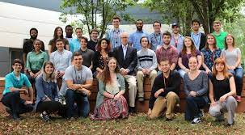
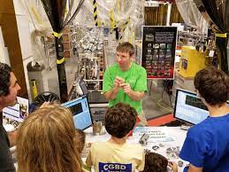


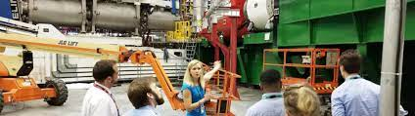
A premiere training ground for nuclear science
731 PhDs granted to-date (over 175 more in progress) ~1/3 of US PhDs in nuclear physics 27 Joint faculty with 13 universities K-12 programs serve more than 12,000 students and 950 teachers annually (non-COVID) THE facility to prepare the community for the science of the EIC

Slide 20
LRP Preparation…
Looking towards a well-crafted resolution that expresses the sentiment of the Jefferson Lab community, perhaps:
The JLab community, in preparation for the DNP QCD Town Meeting and the NSAC Long Range Plan exercise, embraces with the highest priority the scientific capitalization of investments made at CEBAF, the nation’s premier QCD facility. We strongly support optimal running of the 12 GeV program, including the construction and deployment of the SOLID detector.

Slide 21


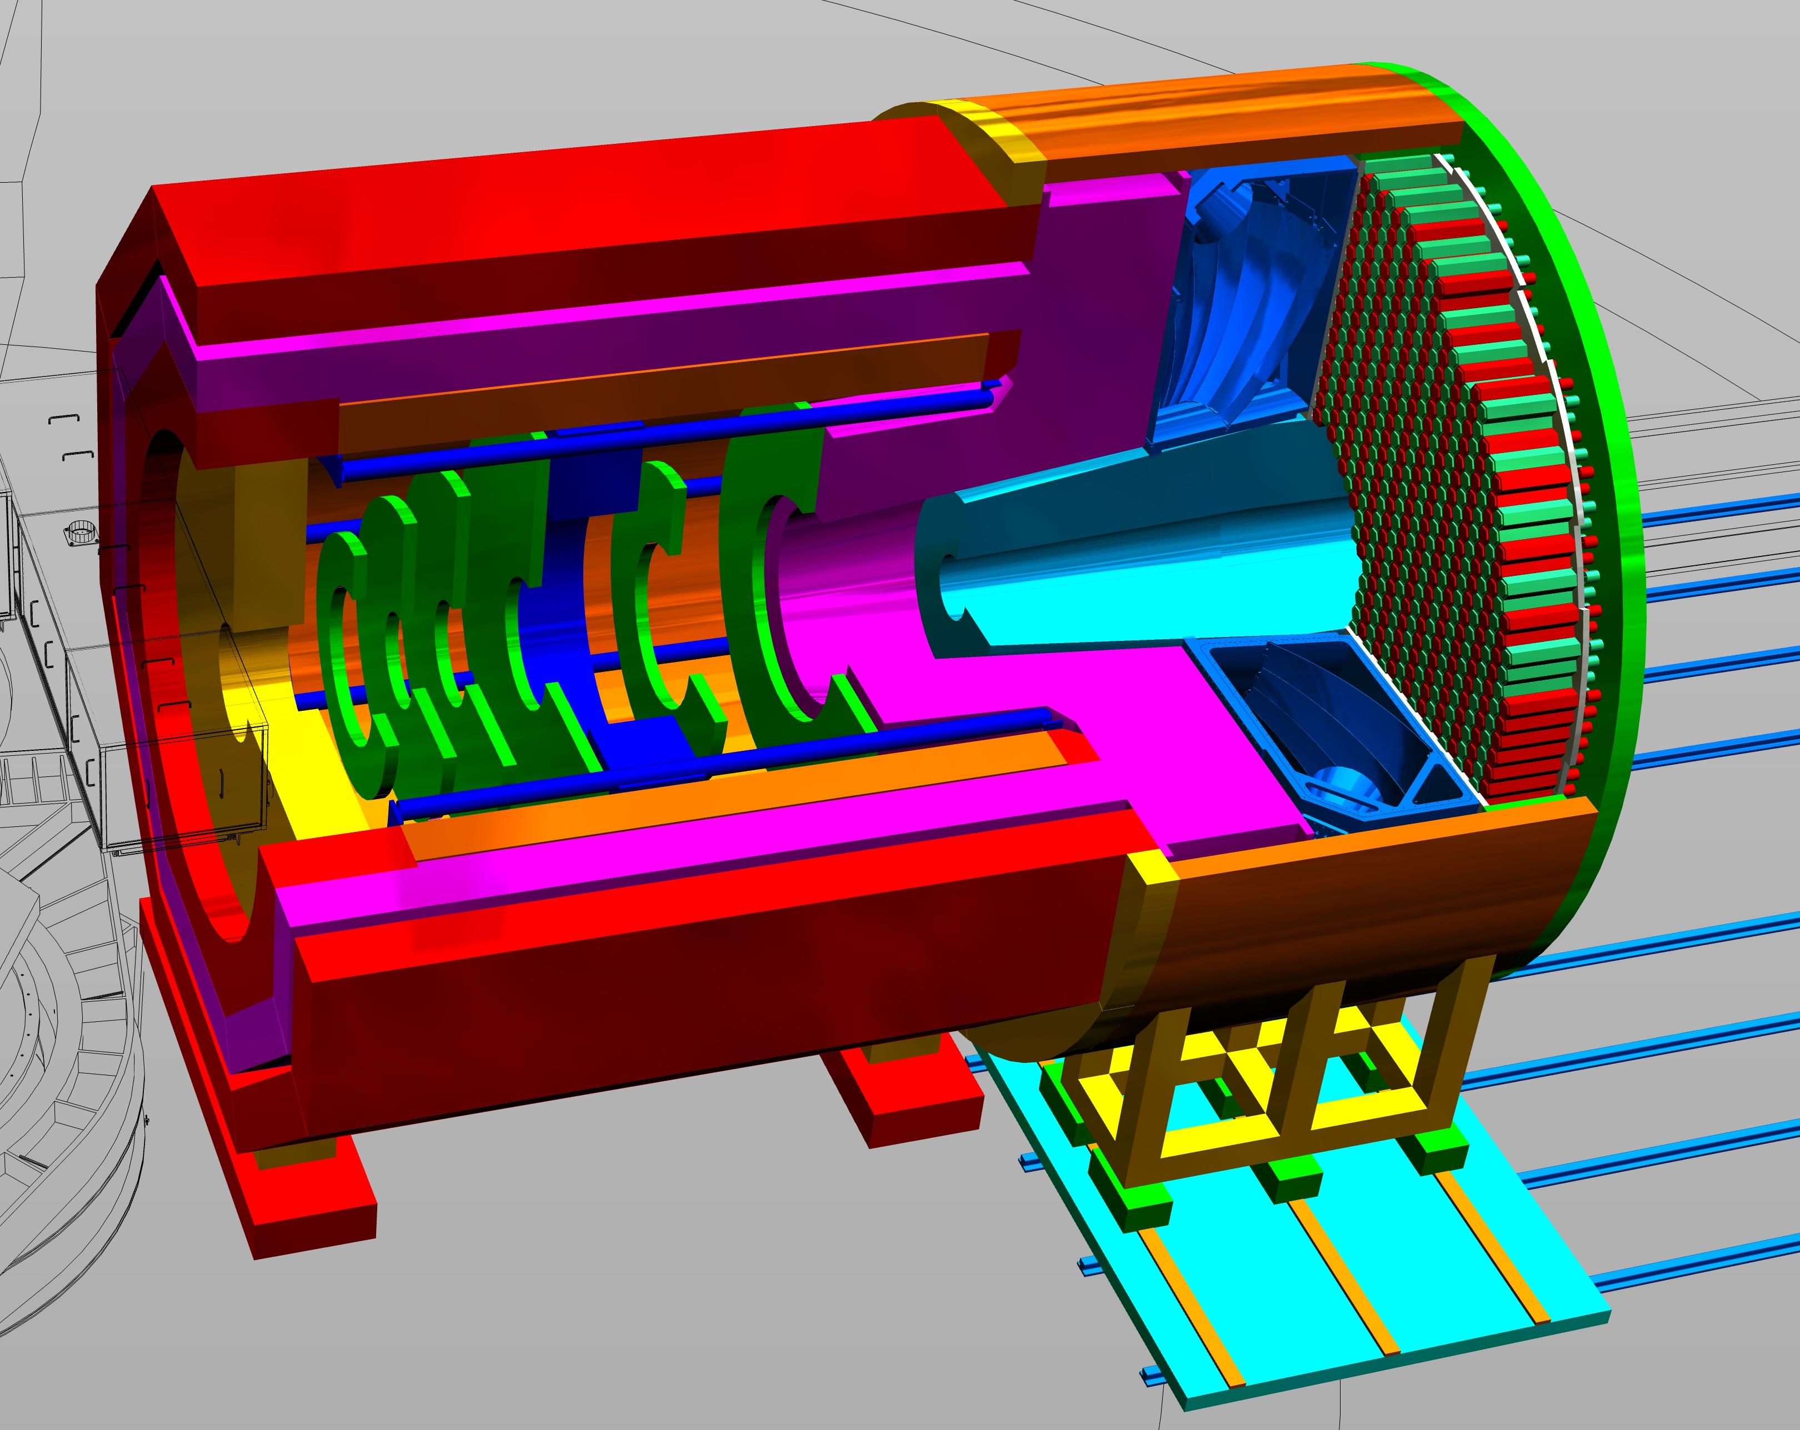
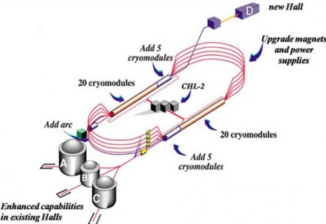
SoLID@JLab: at the QCD Intensity Frontier
SoLID will maximize the science return of the 12-GeV CEBAF upgrade by combining...
High Luminosity
10³⁷⁻³⁹ /cm²/s
[ >100x CLAS12 ][ >1000x EIC ]
Large Acceptance
Full azimuthal 𝜙 coverage
PAC50 Re-affirmed priority of science program
5 jeopardy experiments re-approved
One experiment raised from A- to A
Two new experiments approved
Research at SoLID will have the unique capability to explore the QCD landscape while complementing the research of other key facilities
Precision lepto-quark couplings at unique mass and sensitivity scales
3D momentum imaging of a relativistic strongly interacting confined system (nucleon spin)
Superior sensitivity to the differential electro- and photo-production cross section of J/𝜓 near threshold (proton mass)
Synergistic with the pillars of EIC science (proton spin and mass) through
high-luminosity valence quark tomography and precision J/𝜓 production near threshold
Notes:
21

Slide 22
Thank you!

