Slide 1
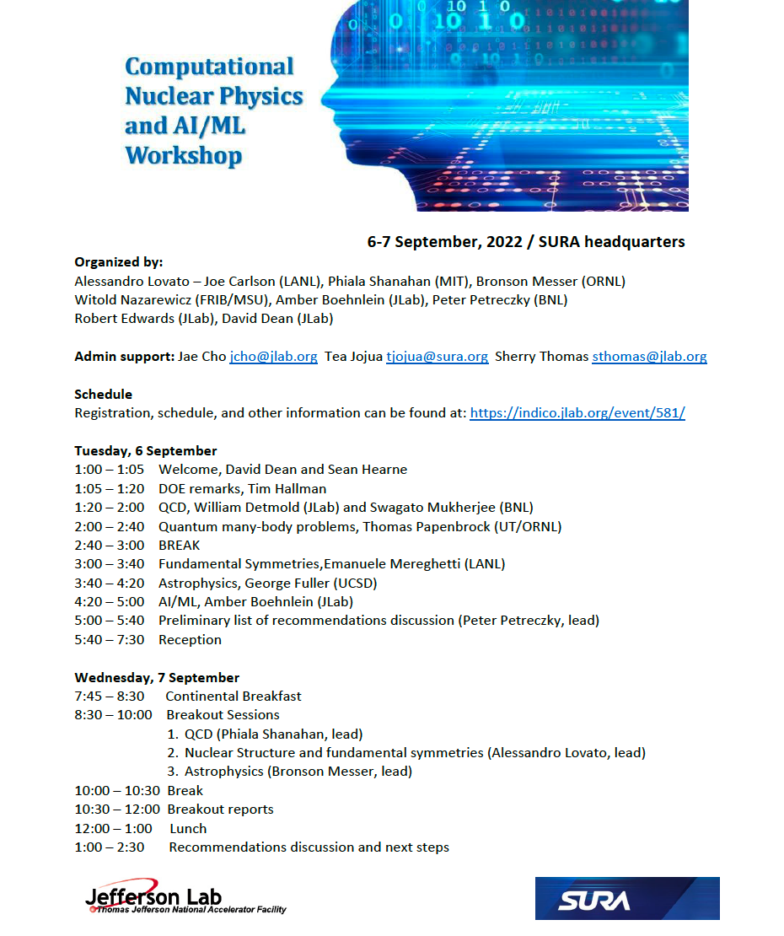
Computational Nuclear Physics and AI/ML Workshop
Organized by:
Alessandro Lovato (ANL)
Joe Carlson (LANL)
Phiala Shanahan (MIT)
Bronson Messer (ORNL)
Witold Nazarewicz (FRIB/MSU)
Amber Boehnlein (JLab)
Peter Petreczky (BNL)
Robert Edwards (JLab)
David Dean (JLab)
6-7 September 2022 at SURA in Washington, DC
60 registered participants (40 in person, 20 on line), including DOE representation
https://indico.jlab.org/event/581/
All talks archived
Short white paper being prepared for the LRP
Notes:
Sensing,

Slide 2
Workshop Resolution
High-performance computing is essential to advance nuclear physics on the experimental and theory frontiers. Increased investments in computational nuclear physics will facilitate discoveries and capitalize on previous progress. Thus, we recommend a targeted program to ensure the utilization of ever-evolving HPC hardware via software and algorithmic development, which includes taking advantage of novel capabilities offered by AI/ML.
The key elements of this program are to:
Strengthen and expand programs and partnerships to support immediate needs in HPC and AI/ML, and also to target development of emerging technologies, such as quantum computing, and other opportunities.
Take full advantage of exciting possibilities offered by new hardware and software and AI/ML within the nuclear physics community through educational and training activities.
Establish programs to support cutting-edge developments of a multi-disciplinary workforce and cross-disciplinary collaborations in high-performance computing and AI/ML.
Expand access to computational hardware through dedicated and high-performance computing resources.

