Slide 1
Nuclear astrophysics in the coming decade
…and the NSAC Long-Range Plan

Slide 2
Some major directions
Nucleosynthesis^
  site(s) and evolution of the r-process ++
  impact of nuclear physics on other explosive phenomena (e.g. X-ray bursts, Type Ia SNe) and their observables
Nature of nuclear matter
Neutrino flavor physics*
ALL of these aims and more depend on high-fidelity, multi-D simulation capabilities, including AI/ML (in many different guises!) and the possibility of using quantum computing. None of these needs are decreasing with time.
^ perhaps very amenable to ML approaches
* a prime target for the incremental introduction of quantum computing

Slide 3
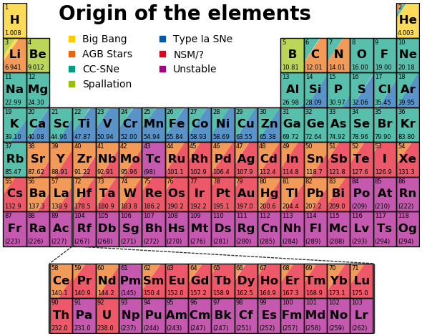
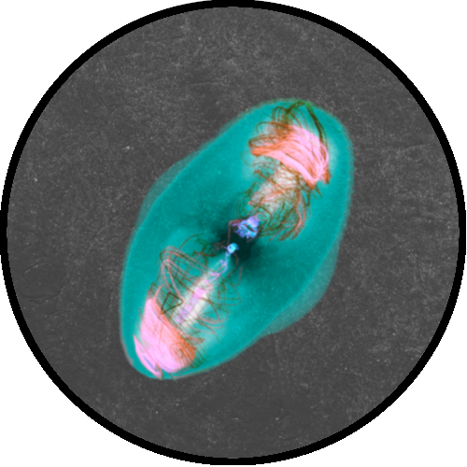
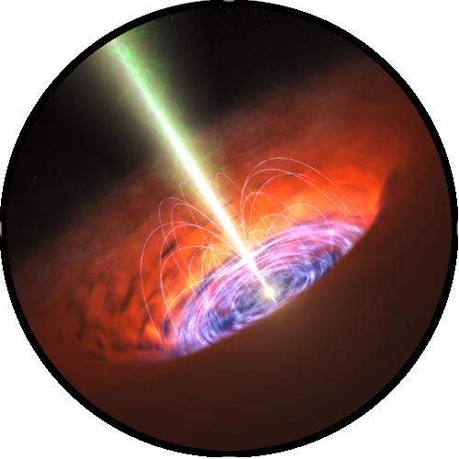
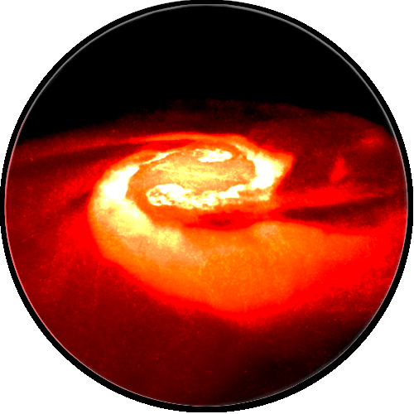
The where and how of the r-process
Magnetorotational
supernovae
Collapsars
Neutron star
mergers
M. Reichert, M. Obergaulinger, M. Á. Aloy, M. Gabler, A. Arcones
NPA-X (Tuesday, 6 Sept. 2022)

Slide 4
Compact Object Neutrino & Nuclear Physics
GW170817
- some r-process nuclei
Event rate,
amount of ejecta right,
troubles with neutrinos
Event rate?
Ejecta mass
per event?
Single Core Collapse to Hot Neutron Star
Modest Initial Neutron Excess –
evolving toward . . . ??
Merging Cold Neutron Stars
Very Neutron-rich initially
– heating and evolving toward
lower n-richness in ejecta ? ?

Slide 5
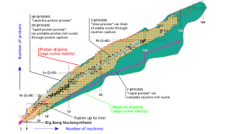
Nucleosynthesis
A possible organizing notion for nucleosynthesis: The exploration of a complicated, multidimensional surface subject to varying constraints.
This is a pretty typical ML problem in a lot of ways.
Interdependence on so many other nuclear physics calculations – masses, neutron separation, etc.
Fig: Rodrıguez (2014) 10.1088/1742-6596/503/1/012038

Slide 6
Accessing all of the QCD phase diagram
PNS and just outside
(both CCSNe and NSM)
Understanding this dynamic environment
Requires multi-D and high-fidelity physics
Requires maximum stable masses and timescales only truly obtainable through full GR, rad-hydro

Slide 7
quasi-mean field neutrino and antineutrino evolution
in time, momentum, flavor, and spin
Coupling evolution of
these equations via quantum computer with hydrodynamics, EOS, etc. evolved on a classical computer presents an opportunity for incremental adoption
advection
coherent
evolution
collisions

Slide 8
Recommendation:
To facilitate discoveries in nuclear physics and capitalize on previous progress, increased investments in computational nuclear physics should be made by DOE and NSF, through a targeted program.
Much of the success of nuclear astrophysics in obtaining consistent and large computing allocations is predicated on our ability to effectively exploit the machines for impactful science. Substantial investments have been made in several uniquely capable codes over the past decade or so. For many of these efforts, major sources of support (often ASCR) are ending, without the possibility of renewal.

Slide 9
(some) computational tools of compact object nuclear astrophysics
Backed by multiple
INCITE awards
ECP
SciDAC
ASCR facility ES
SciDAC
ECP
ECP

Slide 10
The key elements of this program are to:
Strengthen and expand programs and partnerships dedicated to computational nuclear physics to support: (i) the utilization of ever-evolving hardware; (ii) the exploitation of novel tools offered by AI/ML; and (iii) targeted development of emerging technologies such as quantum computing, neuromorphic hardware, and other opportunities.
We need to advocate for support for ongoing work to exploit the next generation of machines in the absence of direct ASCR and other support.
Partnerships with BOTH ASCR Research (via, e.g., SciDAC) and ASCR Facilities (like has been the case with ECP and ES programs) divisions are useful. The ties to facilities are especially strong in nuclear astrophysics and other subfields of nuclear physics.

Slide 11
2) Expand and manage the access to computational hardware resources (computing and disk storage) and high-performance computing allocations.
Leadership computing allocations are essential to nuclear astrophysics, but so are smaller resources to accomplish attendant tasks.
Storage-–and its effective use to enable ML training, for example—is becoming a substantial bottleneck. E.g., a recent Type Ia simulation at OLCF produced 0.5 PB of data in the form of ~40GB files.

Slide 12
3) Take full advantage of exciting possibilities offered by HPC and AI/ML within the nuclear physics community through educational and training activities.
4) Establish programs to support cutting-edge developments of a multi-disciplinary expertise in high-performance computing and AI/ML.
In each of these areas, nuclear astrophysics problems have been proven to be attractive for students and other colleagues. Without support, the excellent opportunities afforded by this interest will be lost.

