Slide 1
Status of HRS Detectors
Barak Schmookler

Slide 2
Overview
Standard detector stack
Upgrades*:
VDC: Replaced the old discriminator cards
One straw chamber from FPP is installed in each arm
Gas Cherenkov: New windows, new PMTs, S0 on front
*Partially Completed

Slide 4
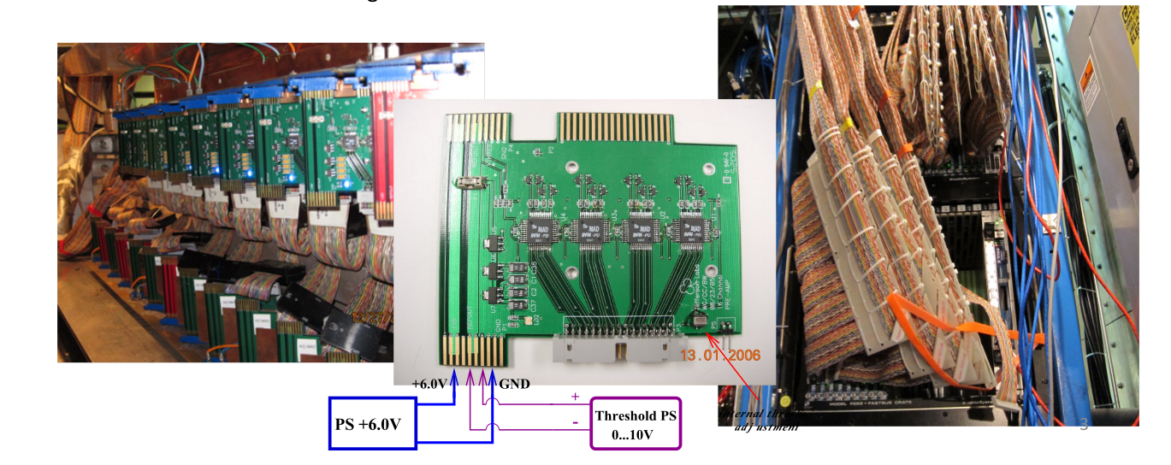
VDC
Replaced discriminator cards with new MAD cards
HRS-L: gas, DAQ restored & tested
HRS-R: in progress
Install new threshold PS module for cards (Dec 2013): currently set to 3V for cosmic data runs

Slide 5
FPP
Straw chambers installed in each arm
Gas operational in L-HRS; need clean gas line in R-HRS
All cables installed; HV distribution active
Low voltage supply for read-out modules operational (Nov 2013)
Signals checkout: in progress

Slide 6
Gas Cherenkov/S0
Gas Cherenkov /S0 installed in both arms
Added extension to L-HRS Gas Cherenkov
New windows added; mirror alignment completed
PMTs should be installed in Jan-Feb 2014

Slide 7
Gas Cherenkov/S0

Slide 8
Gas Cherenkov: New Windows & Mirror Alignment
Replaced 3 out of 4 windows
New frame is half thickness of old frame; new aluminum windows are thinner
We could not install new window in back of L-HRS GC, because of fixtures attached to two mirrors
Used old window with aluminum plate instead
Placed light source a certain distance from mirrors and adjusted image located at PMT position

Slide 9
Gas Cherenkov: New PMTs
Mirror Reflectivity tests done
Deterioration in reflectivity was observed for all mirrors tested
Reduction in relative efficiency for BURLE PMTs ~7%

Slide 10
Gas Cherenkov: New PMTs
Will use new PMTs (ET Enterprises, model: 9390KB)
Tested 4 different types of wavelength –shifting (WLS) paint to increase efficiency
Goal: At least 10 PE in the experiment

Slide 11
Gas Cherenkov: New PMTs

Slide 12
Gas Cherenkov: New PMTs
Tested four different WLS paint samples:
– EJ-289 #2 (commercially available)
– EJ-299-31A
– EJ-299-31C Evaluation samples specially developed by Eljen Technologies
– EJ-299-31E
Sample EJ-299-31E gave best improvement in number of photo-electrons
-------------------------------------------------------------------------------------------------
Setup # painted(y/n) # of PE % increase in gain
-------------------------------------------------------------------------------------------------
A no 10.8 -
B no 10.1 -
C no 6.13 -
-------------------------------------------------------------------------------------------------
A yes 14.3 32
B yes 13.8 37
C yes 8.63 41
-------------------------------------------------------------------------------------------------
Different Setups correspond to different locations of the silica disks
Results are reproducible with different PMTs and over time (~2 weeks)

Slide 13
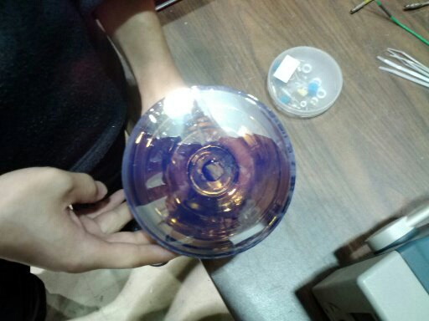
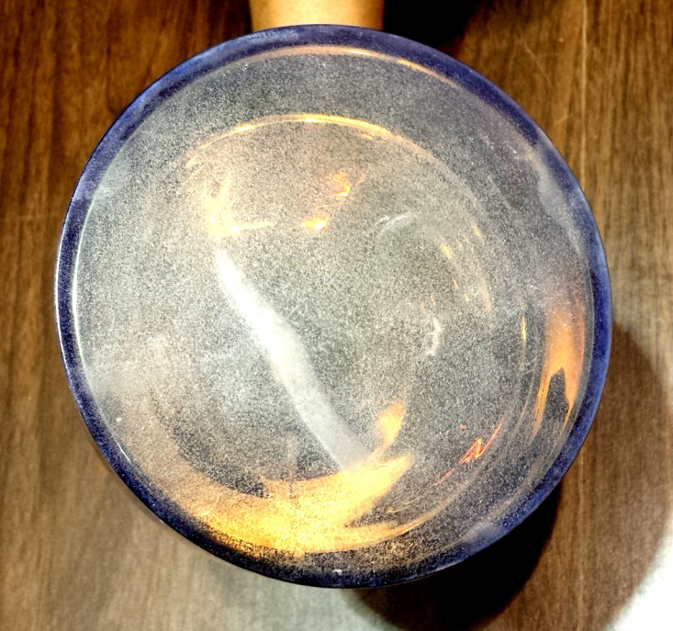
Gas Cherenkov: New PMTs
Tested four different WLS paint samples:
– EJ-289 #2 (commercially available)
– EJ-299-31A
– EJ-299-31C Evaluation samples specially developed by Eljen Technologies
– EJ-299-31E
Sample EJ-299-31E gave best improvement in number of photo-electrons
-------------------------------------------------------------------------------------------------
Setup # painted(y/n) # of PE % increase in gain
-------------------------------------------------------------------------------------------------
A no 10.8 -
B no 10.1 -
C no 6.13 -
-------------------------------------------------------------------------------------------------
A yes 14.3 32
B yes 13.8 37
C yes 8.63 41
-------------------------------------------------------------------------------------------------
Different Setups correspond to different locations of the silica disks
Results are reproducible with different PMTs and over time (~2 weeks)
Paint turns cloudy after 2-3 days but this does not affect QE

Slide 14
Data Acquisition
Took data in L-HRSwith cosmic particles over last week
Triggered on coincidence between S2M and old S0
After some work: VDC, S2M, and Calorimeter are functioning well. (Need to perform gain matching)
FPP map/database is complete; but need to determine which wire in bunch was hit

Slide 15
Summary
VDC upgrades are completed
Gas Cherenkov/S0 should be operational in Jan-Feb 2014
Work continues on FPP chambers

