Slide 1

A superconducting nanowire pulse counter integrated with an SNSPD
11/29/2022
Superconducting Electronics and Detectors Workshop– Jefferson Lab
Matteo Castellani*¹, Owen Medeiros¹, Reed Foster¹, Alessandro Buzzi¹, Marco Colangelo¹, Joshua C. Bienfang², Alessandro Restelli², Karl Berggren¹
¹Electrical Engineering and Computer Science, Massachusetts Institute of Technology, Cambridge, Massachusetts, United States; ²Joint Quantum Institute, National Institute of Standards and Technology and University of Maryland
Gaithersburg, Maryland, United States
Notes:
Add all the other logos

Slide 2

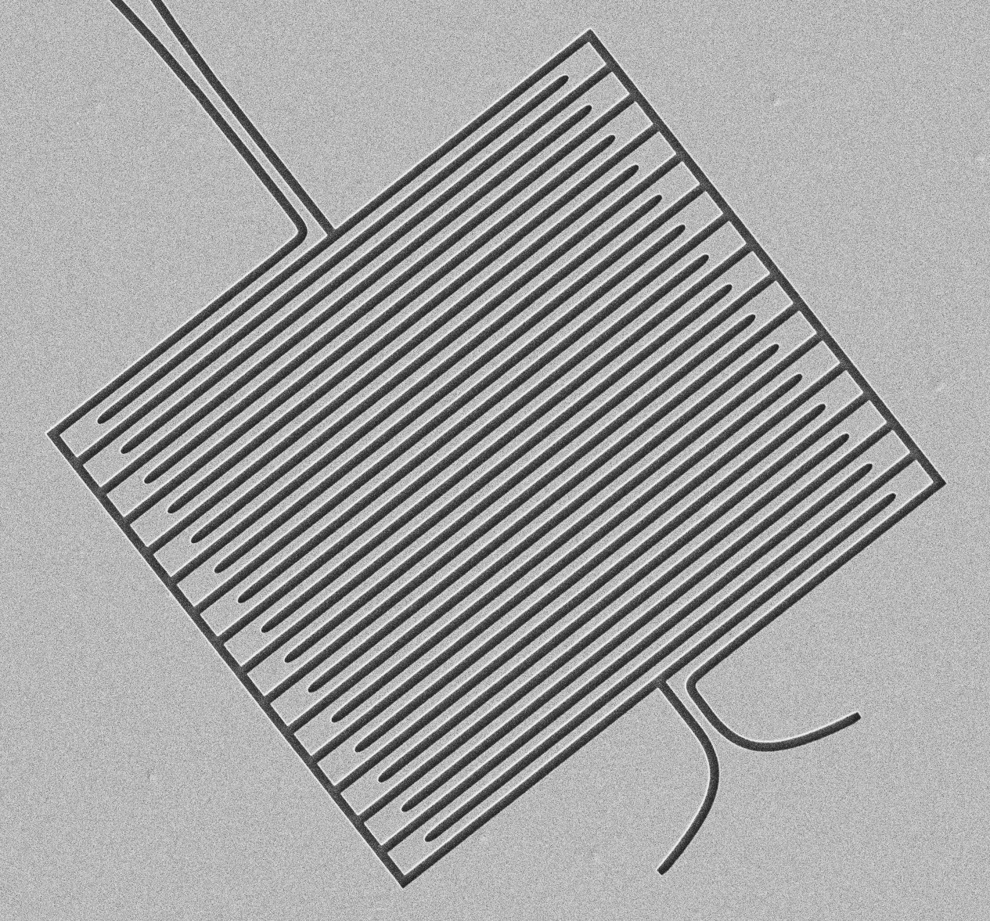
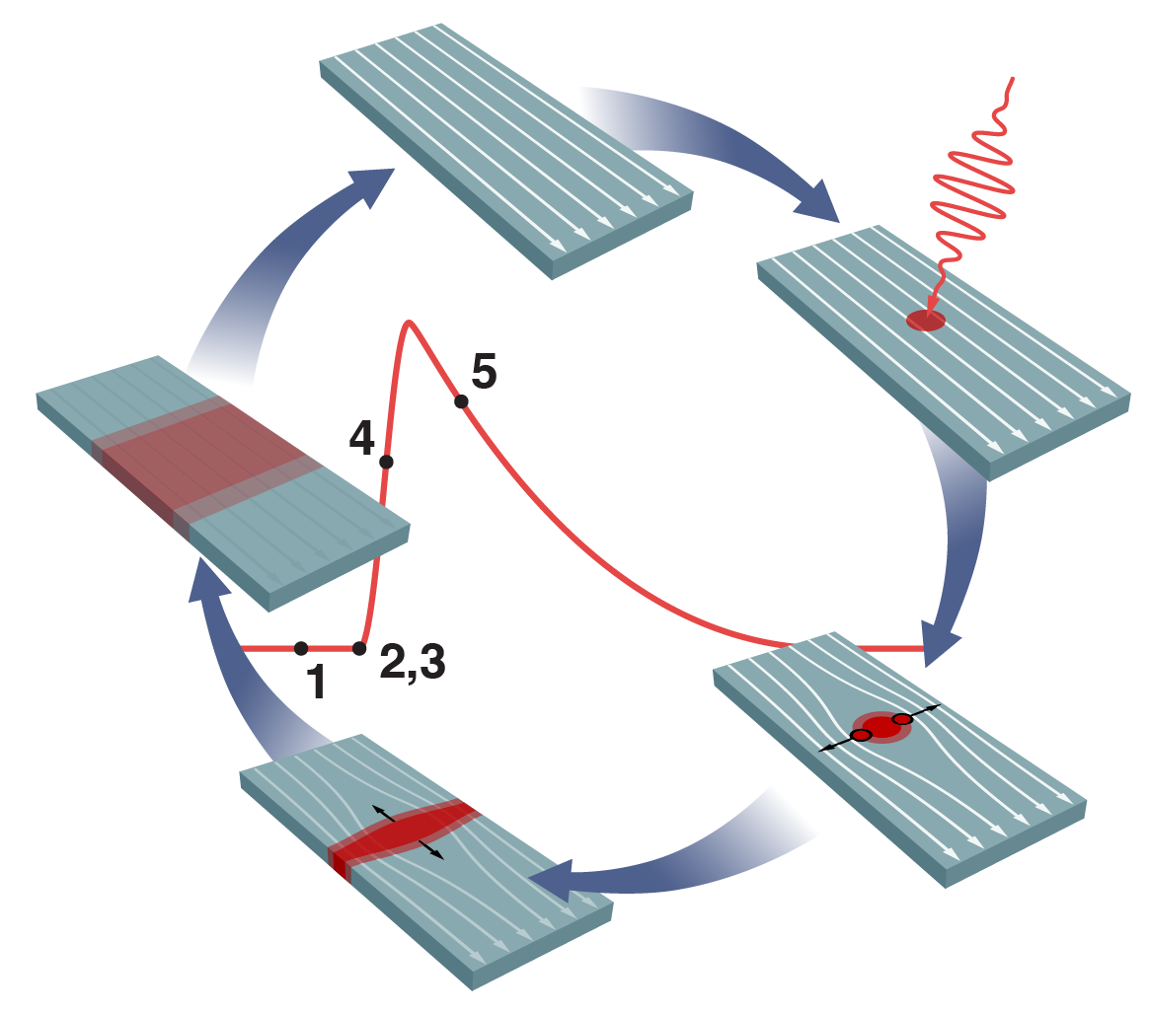
Superconducting Nanowire Single-Photon Detectors (SNSPDs)
2 μm
J. P. Allmaras, PhD Thesis CalTech (2020)
Wide wavelength sensitivity.
High efficiency.
Low dark count and jitter.
Applications: quantum information, life science, imaging.
Notes:
App: quantum infor, life science, low power optical comm, imaging,
Signal digitalized at room temp with scope or time-tagger

Slide 3
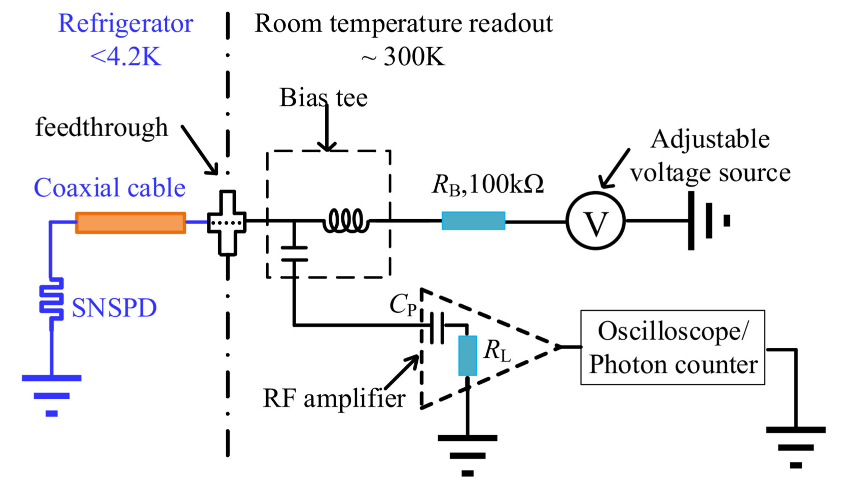
Superconducting Nanowire Single-Photon Detectors (SNSPDs)
Standard readout setup
2 μm
J. P. Allmaras, PhD Thesis CalTech (2020)
Wide wavelength sensitivity.
High efficiency.
Low dark count and jitter.
Applications: quantum information, life science, imaging.
D. Wang et al. Sensors 22(3)
Notes:
App: quantum infor, life science, low power optical comm, imaging,
Signal digitalized at room temp with scope or time-tagger

Slide 4
Superconducting Nanowire Single-Photon Detectors (SNSPDs)
Standard readout setup
2 μm
J. P. Allmaras, PhD Thesis CalTech (2020)
Wide wavelength sensitivity.
High efficiency.
Low dark count and jitter.
Applications: quantum information, life science, imaging.
D. Wang et al. Sensors 22(3)
New architecture necessary to read out arrays of SNSPDs
Notes:
App: quantum infor, life science, low power optical comm, imaging,
Signal digitalized at room temp with scope or time-tagger

Slide 5
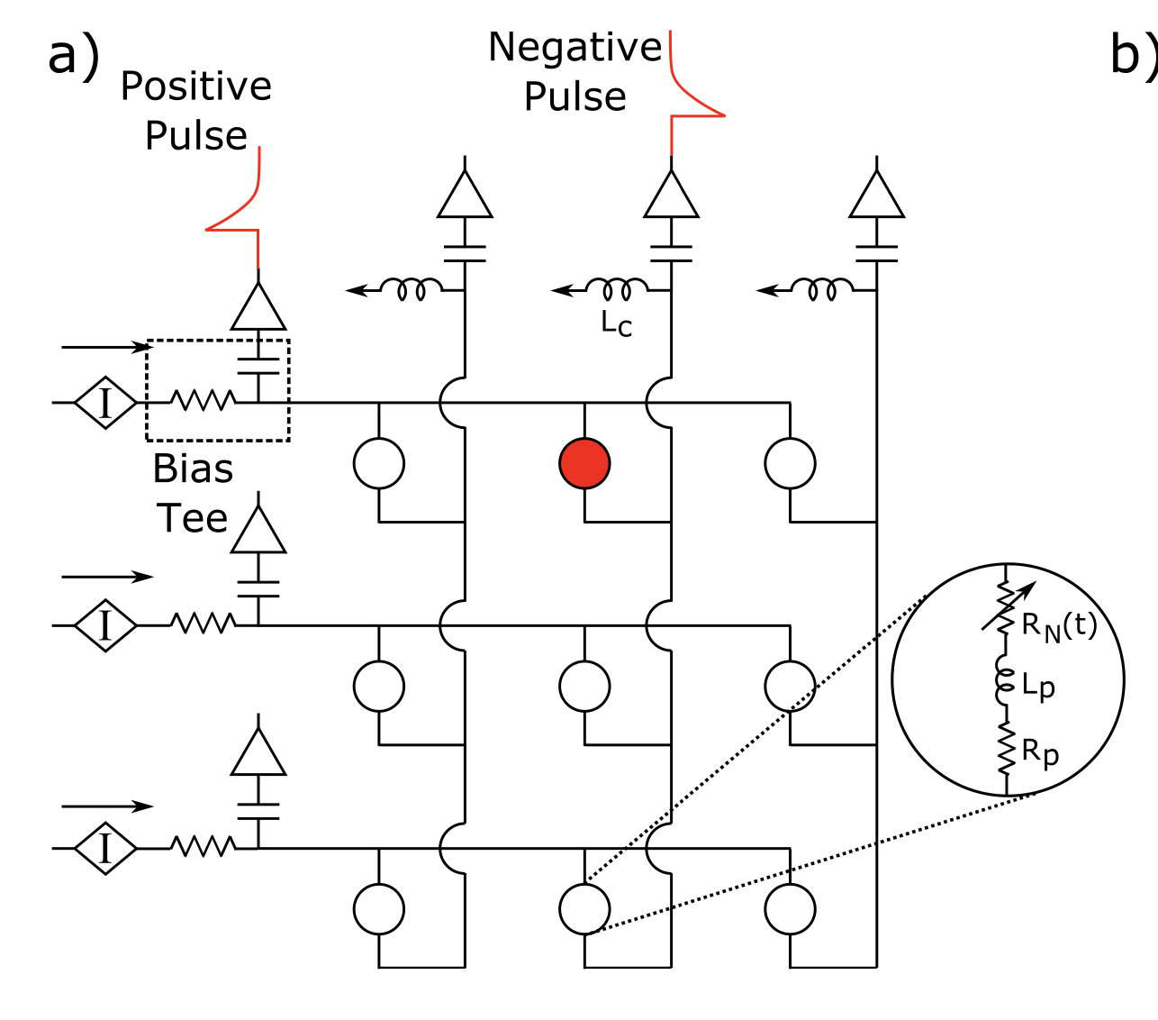
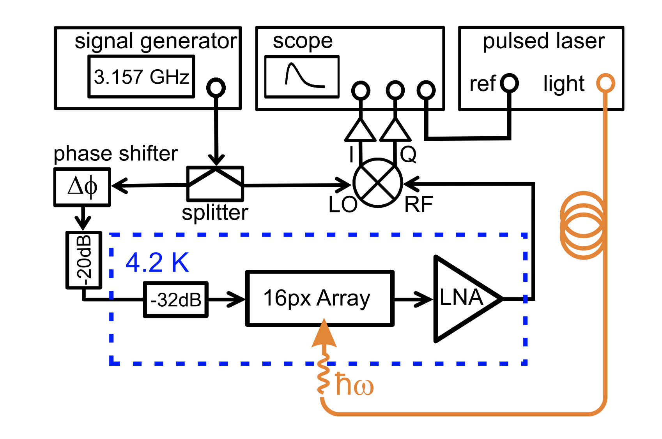
Readout of SNSPD arrays
Analog multiplexing
Row-column
readout
M. S. Allman et al. Appl. Phys. Lett. 106 (2015)
Frequency
multiplexing
S. Doerner et al. Appl. Phys. Lett. 111 (2017)
Notes:
Two kind of readout
On-chip digitalization (show image of a paper) Cost on chip complexity
Or analog multiplexing on cjip and then conventional electronic at room temp (show image of a paper)
Show row column readout 2sqrt(N) lines
Frequency multilexing
All this analog solutions limit some of the advantages of snspd (count rate, low jitter)

Slide 6
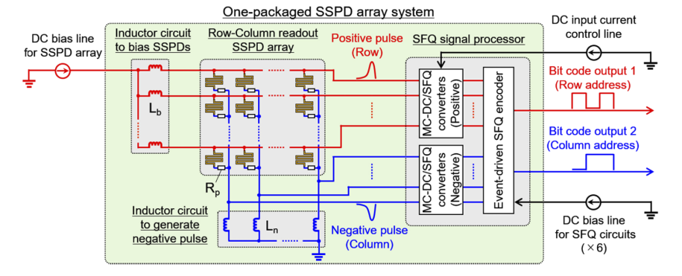
Readout of SNSPD arrays
Analog multiplexing
Digitized readout
Row-column
readout
M. S. Allman et al. Appl. Phys. Lett. 106 (2015)
M. Yabuno et al. Opt. Express 28 (2020)
The digitization is a key element for scaling up.
Multi-chip system.
JJs can not drive high loads.
Frequency
multiplexing
S. Doerner et al. Appl. Phys. Lett. 111 (2017)
Notes:
Two kind of readout
On-chip digitalization (show image of a paper) Cost on chip complexity
Or analog multiplexing on cjip and then conventional electronic at room temp (show image of a paper)
Show row column readout 2sqrt(N) lines
Frequency multilexing
All this analog solutions limit some of the advantages of snspd (count rate, low jitter)

Slide 7
Readout of SNSPD arrays
Analog multiplexing
Digitized readout
Row-column
readout
M. S. Allman et al. Appl. Phys. Lett. 106 (2015)
M. Yabuno et al. Opt. Express 28 (2020)
The digitization is a key element for scaling up.
Multi-chip system.
JJs can not drive high loads.
Frequency
multiplexing
S. Doerner et al. Appl. Phys. Lett. 111 (2017)
On-chip integration with electronics and higher signal levels can help scaling up
Notes:
Two kind of readout
On-chip digitalization (show image of a paper) Cost on chip complexity
Or analog multiplexing on cjip and then conventional electronic at room temp (show image of a paper)
Show row column readout 2sqrt(N) lines
Frequency multilexing
All this analog solutions limit some of the advantages of snspd (count rate, low jitter)

Slide 8
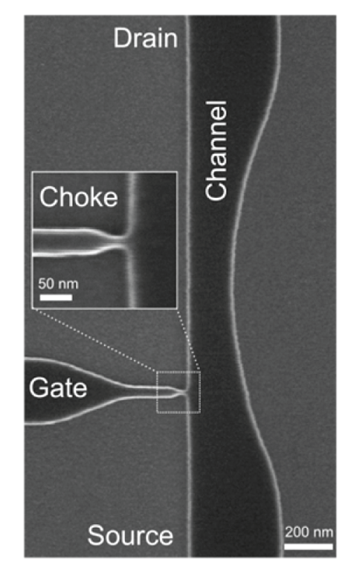
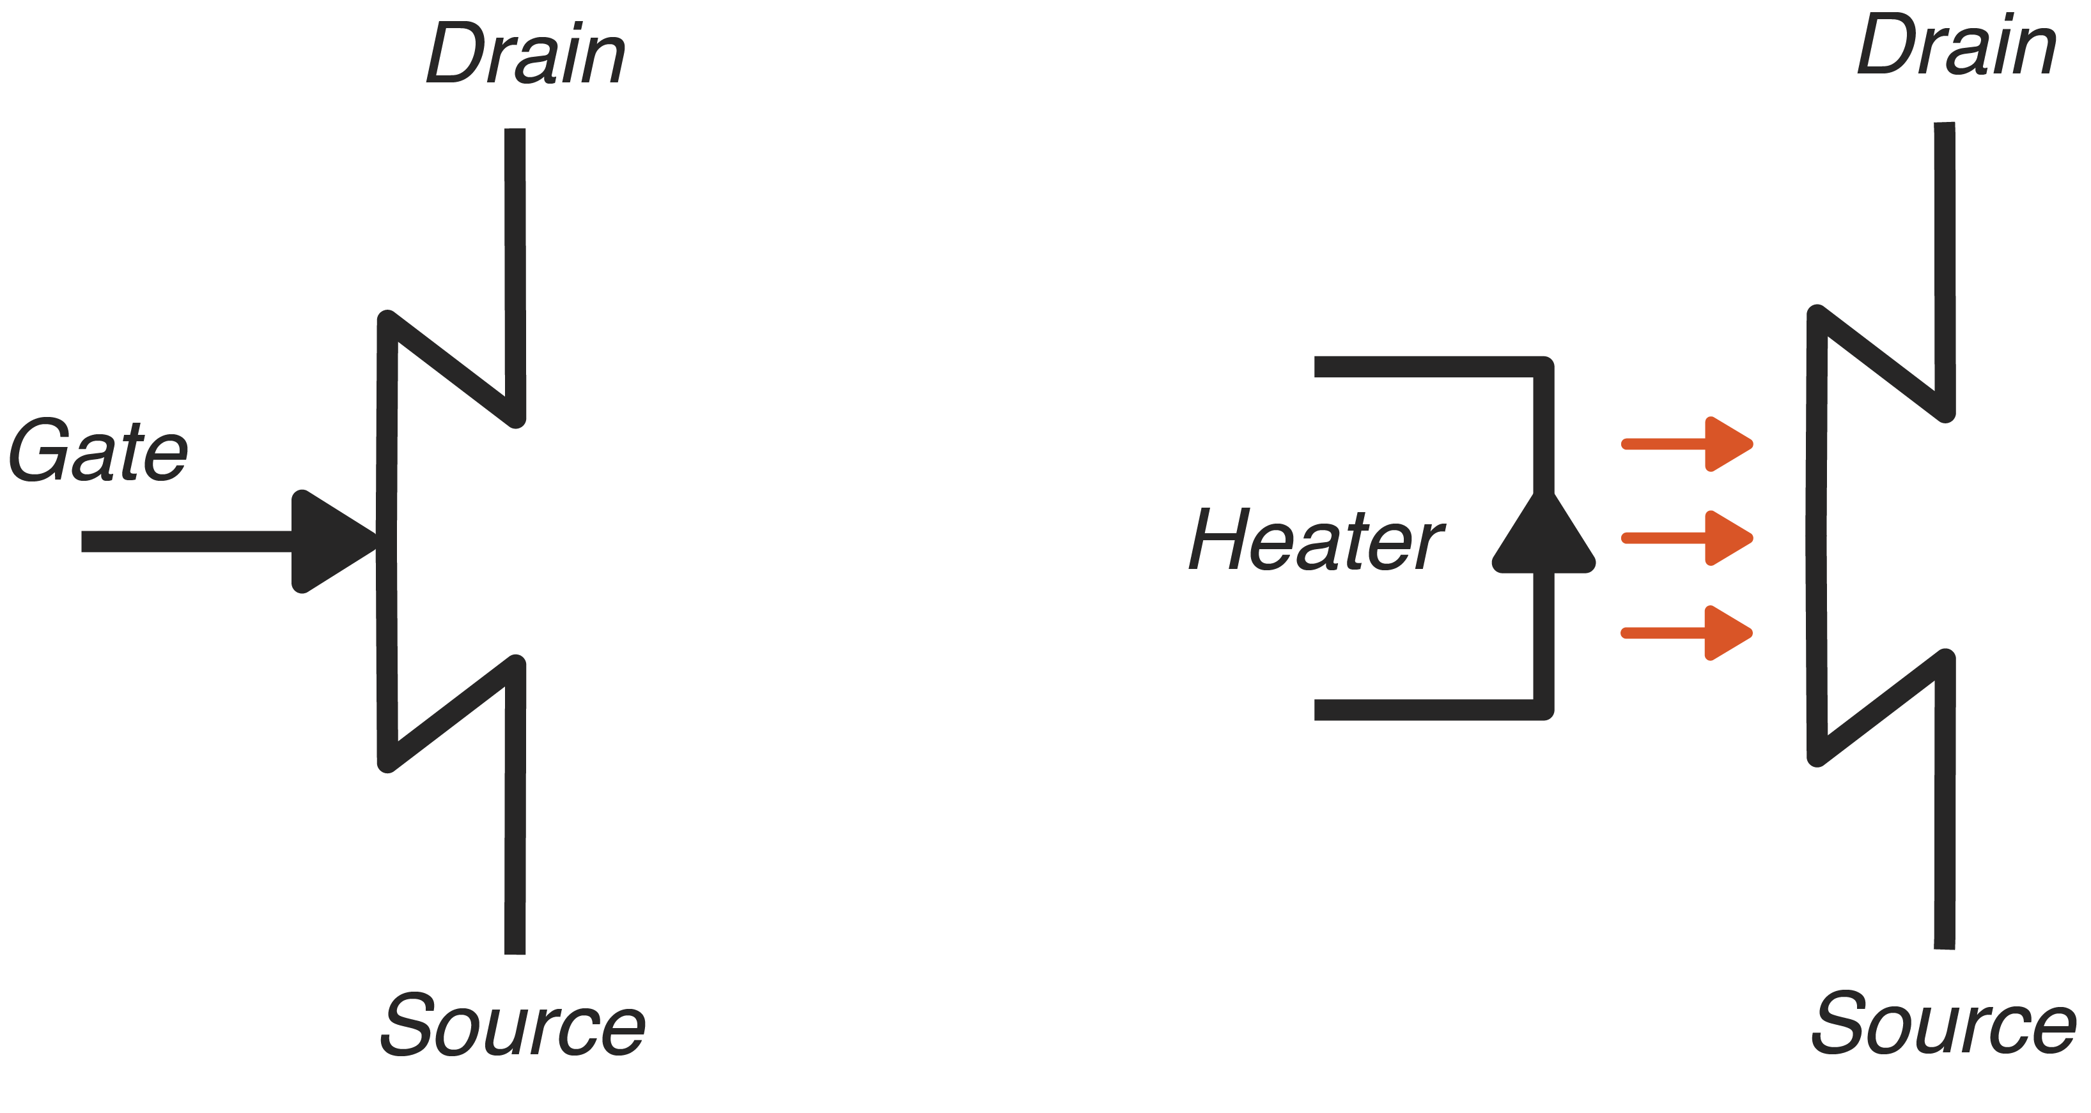
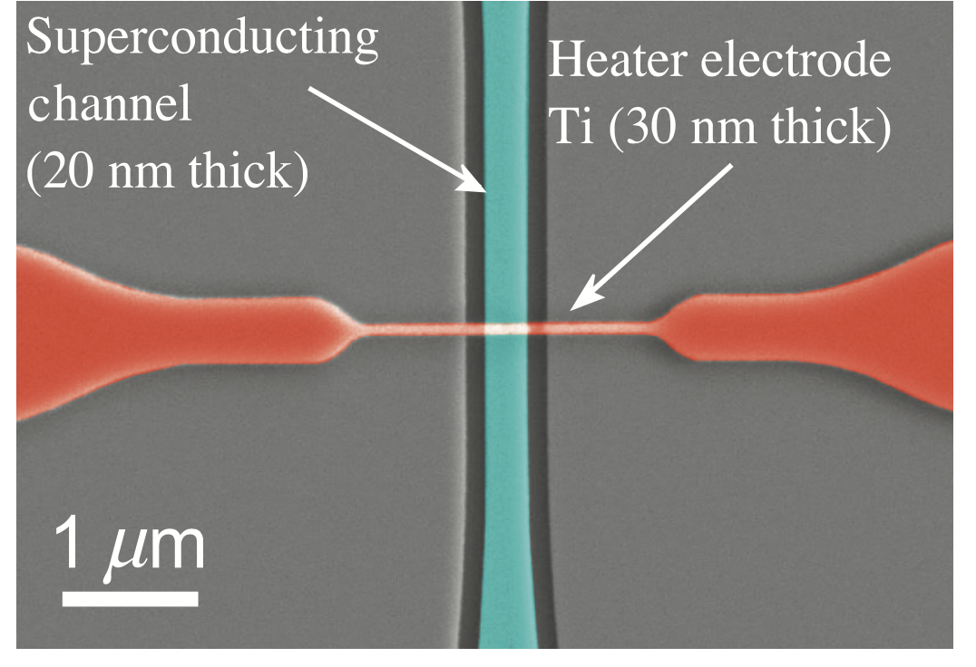
Superconducting nanowire electronics: Nanocryotrons
Nanocryotron (nTron)
Heater-Nanocryotron (hTron)
R. Baghdadi et al. Phys Rev. App. 14 (2020)
A.N. McCaughan et al. Nano Lett. 14 (2014)
Notes:
Von Neumann architectures are reaching a performance plateau.
The system power consumption (J/bit) has been growing linearly over the years.

Slide 9
Superconducting nanowire electronics: Nanocryotrons
Nanocryotron (nTron)
Heater-Nanocryotron (hTron)
R. Baghdadi et al. Phys Rev. App. 14 (2020)
A.N. McCaughan et al. Nano Lett. 14 (2014)
Simple structure
Magnetic field robustness
High load driving
Coupling with CMOS, JJs
Notes:
Von Neumann architectures are reaching a performance plateau.
The system power consumption (J/bit) has been growing linearly over the years.

Slide 10
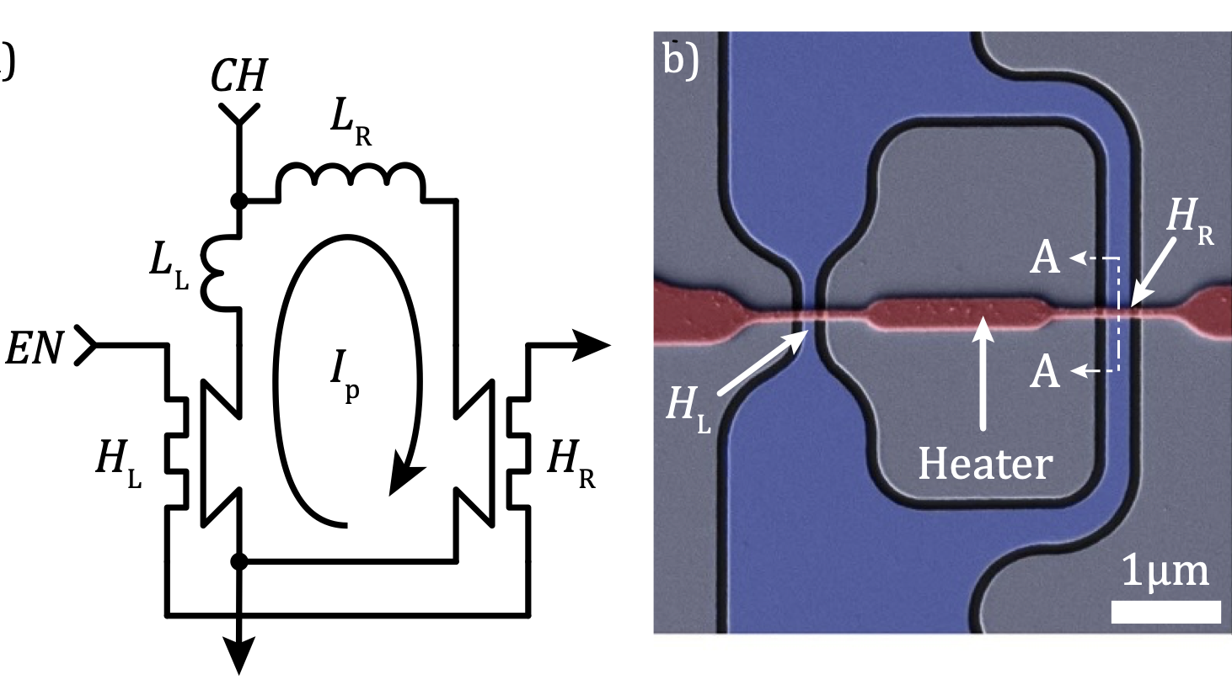
Superconducting nanowire electronics
Non-volatile memory
B. A. Butters et al. SST 34 2021
Notes:
Von Neumann architectures are reaching a performance plateau.
The system power consumption (J/bit) has been growing linearly over the years.

Slide 11
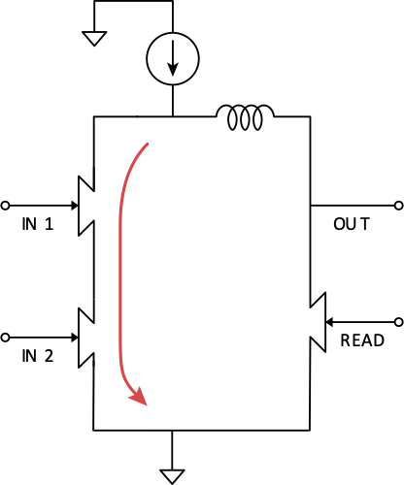
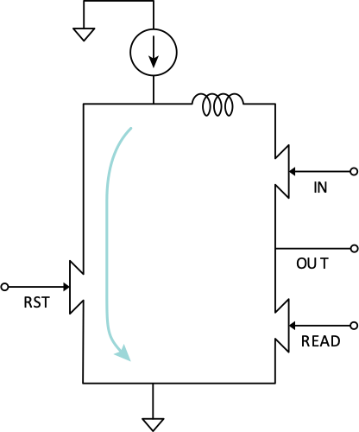
Superconducting nanowire electronics
Non-volatile memory
OR gate
NOT gate
B. A. Butters et al. SST 34 2021
A. Buzzi et al. WOLTE 22
Notes:
Von Neumann architectures are reaching a performance plateau.
The system power consumption (J/bit) has been growing linearly over the years.

Slide 12
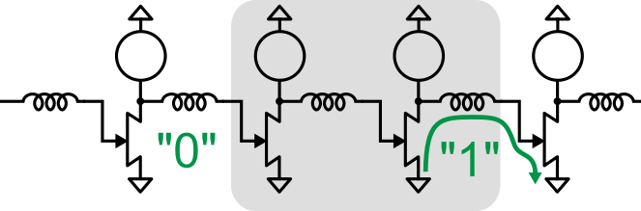
Superconducting nanowire electronics
Non-volatile memory
OR gate
NOT gate
B. A. Butters et al. SST 34 2021
A. Buzzi et al. WOLTE 22
Shift-register
R. A. Foster et al. WOLTE 22
Notes:
Von Neumann architectures are reaching a performance plateau.
The system power consumption (J/bit) has been growing linearly over the years.

Slide 13
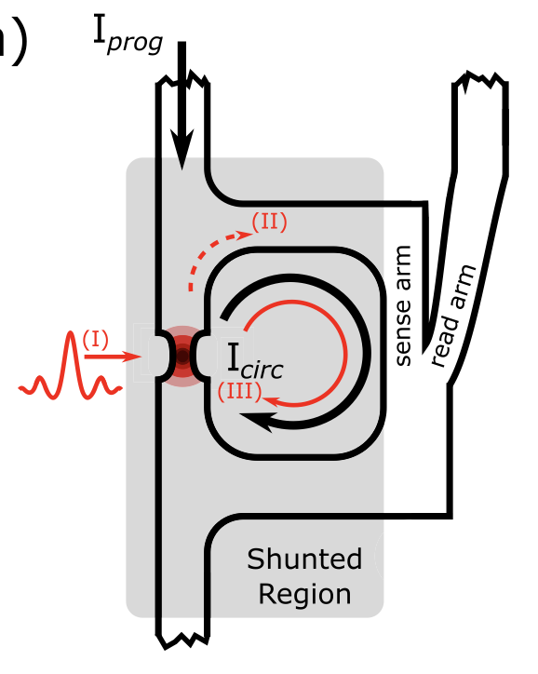
Superconducting nanowire electronics
Non-volatile memory
OR gate
NOT gate
B. A. Butters et al. SST 34 2021
A. Buzzi et al. WOLTE 22
Shift-register
Integrator
M. Onen et al. Nano Lett. 2020
R. A. Foster et al. WOLTE 22
Notes:
Von Neumann architectures are reaching a performance plateau.
The system power consumption (J/bit) has been growing linearly over the years.

Slide 14
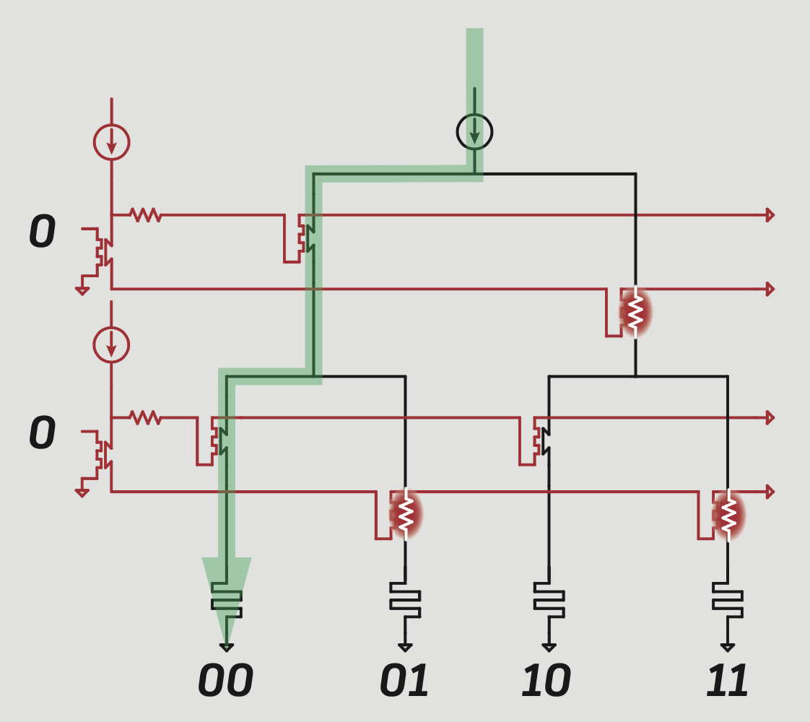
Superconducting nanowire electronics
Non-volatile memory
OR gate
NOT gate
Multiplexer
B. A. Butters et al. SST 34 2021
A. Buzzi et al. WOLTE 22
Shift-register
Integrator
M. Onen et al. Nano Lett. 2020
O. Medeiros et al. ASC 22
SNSPD: Physics, Measurement, Readout, Applications
R. A. Foster et al. WOLTE 22
Notes:
Von Neumann architectures are reaching a performance plateau.
The system power consumption (J/bit) has been growing linearly over the years.

Slide 15
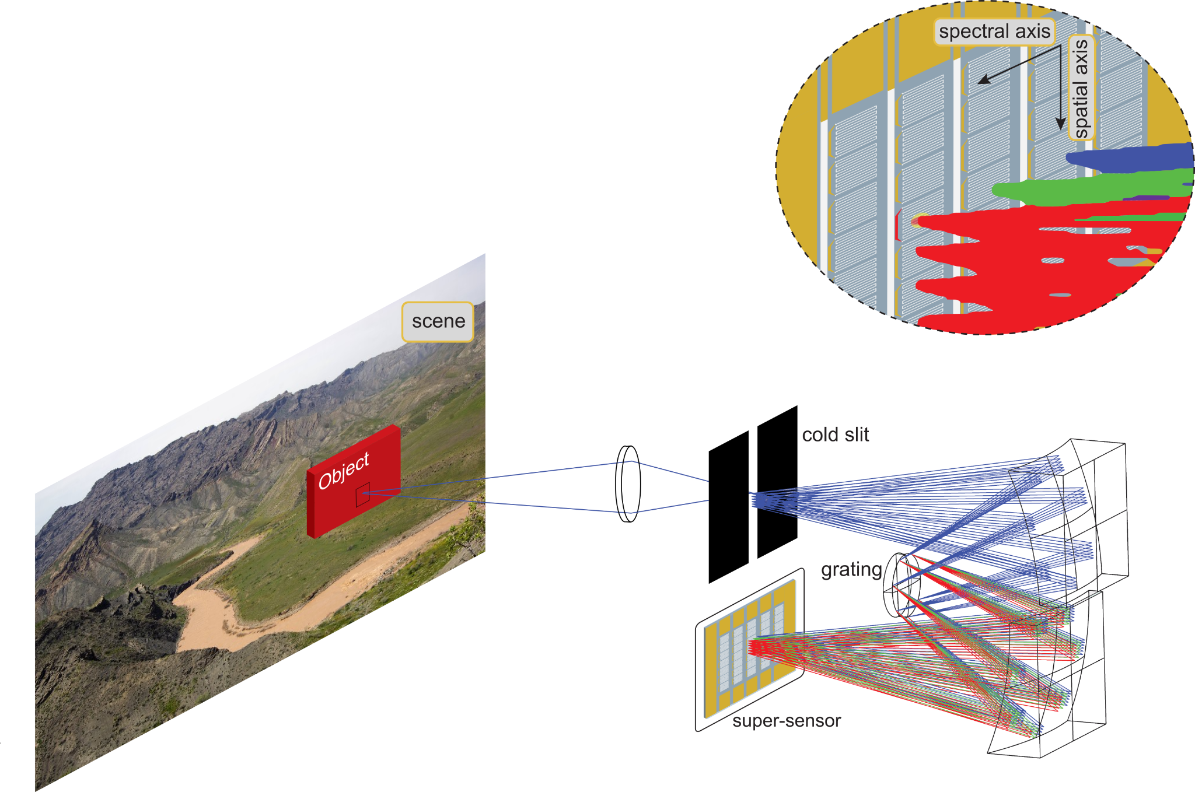
Megapixel SNSPD array for hyperspectral imaging
Negligible dark counts and readout noise to support high frame rates.
High efficiency in MWIR (4-8 um), LWIR (8-12 um), and/or VLWIR (12-15 um).
Count rates 10⁵ - 10⁷ cps per pixel (10¹² per array) without losing any photons.
The timing information is not relevant.
Slide from Invisible Headlight DARPA project (2022)
Notes:
Von Neumann architectures are reaching a performance plateau.
The system power consumption (J/bit) has been growing linearly over the years.

Slide 16
Megapixel SNSPD array for hyperspectral imaging
Negligible dark counts and readout noise to support high frame rates.
High efficiency in MWIR (4-8 um), LWIR (8-12 um), and/or VLWIR (12-15 um).
Count rates 10⁵ - 10⁷ cps per pixel (10¹² per array) without losing any photons.
The timing information is not relevant.
We need to count and store the exact number of photons in a certain time interval.
Slide from Invisible Headlight DARPA project (2022)
Notes:
Von Neumann architectures are reaching a performance plateau.
The system power consumption (J/bit) has been growing linearly over the years.

Slide 17
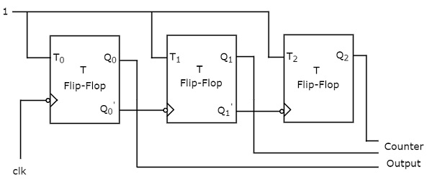
Superconducting nanowire pulse counter
Notes:
Von Neumann architectures are reaching a performance plateau.
The system power consumption (J/bit) has been growing linearly over the years.

Slide 18
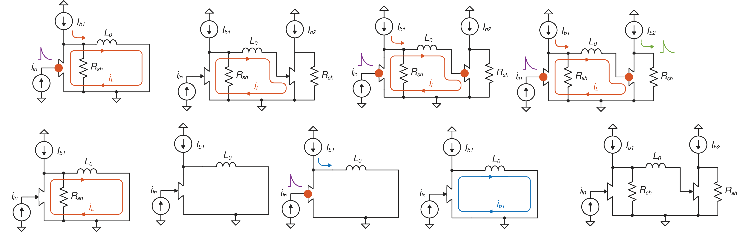
Superconducting nanowire pulse counter
Notes:
Von Neumann architectures are reaching a performance plateau.
The system power consumption (J/bit) has been growing linearly over the years.

Slide 19
Superconducting nanowire pulse counter
Notes:
Von Neumann architectures are reaching a performance plateau.
The system power consumption (J/bit) has been growing linearly over the years.

Slide 20
Superconducting nanowire pulse counter
Notes:
Von Neumann architectures are reaching a performance plateau.
The system power consumption (J/bit) has been growing linearly over the years.

Slide 21
Superconducting nanowire pulse counter
Notes:
Von Neumann architectures are reaching a performance plateau.
The system power consumption (J/bit) has been growing linearly over the years.

Slide 22
Superconducting nanowire pulse counter
Notes:
Von Neumann architectures are reaching a performance plateau.
The system power consumption (J/bit) has been growing linearly over the years.

Slide 23
Superconducting nanowire pulse counter
Notes:
Von Neumann architectures are reaching a performance plateau.
The system power consumption (J/bit) has been growing linearly over the years.

Slide 24
Superconducting nanowire pulse counter
Notes:
Von Neumann architectures are reaching a performance plateau.
The system power consumption (J/bit) has been growing linearly over the years.

Slide 25
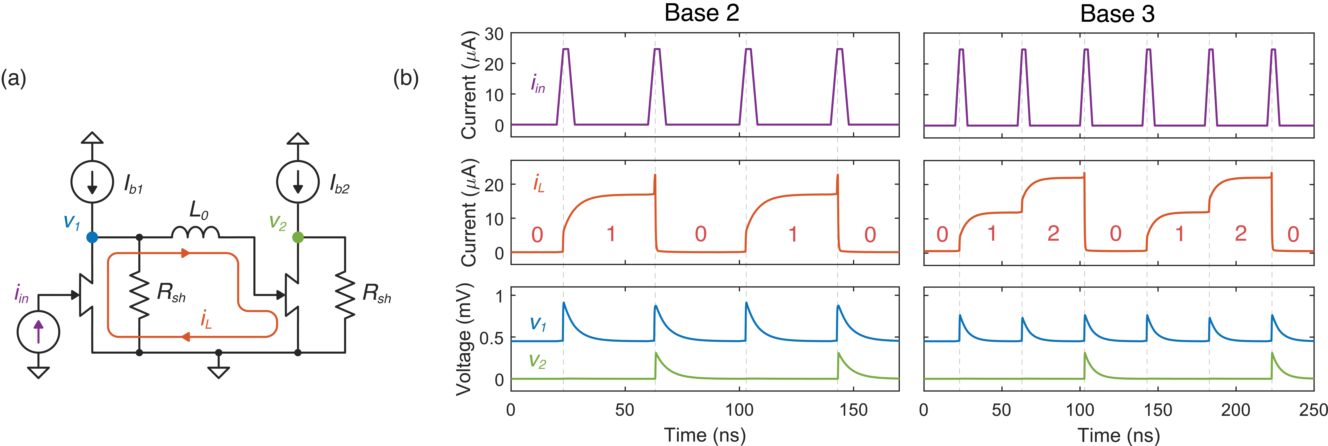
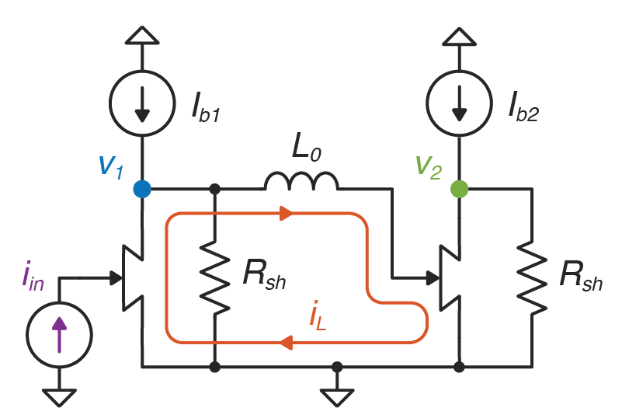
Superconducting nanowire pulse counter
Notes:
Von Neumann architectures are reaching a performance plateau.
The system power consumption (J/bit) has been growing linearly over the years.

Slide 26
Superconducting nanowire pulse counter
Simulations
Notes:
Von Neumann architectures are reaching a performance plateau.
The system power consumption (J/bit) has been growing linearly over the years.

Slide 27
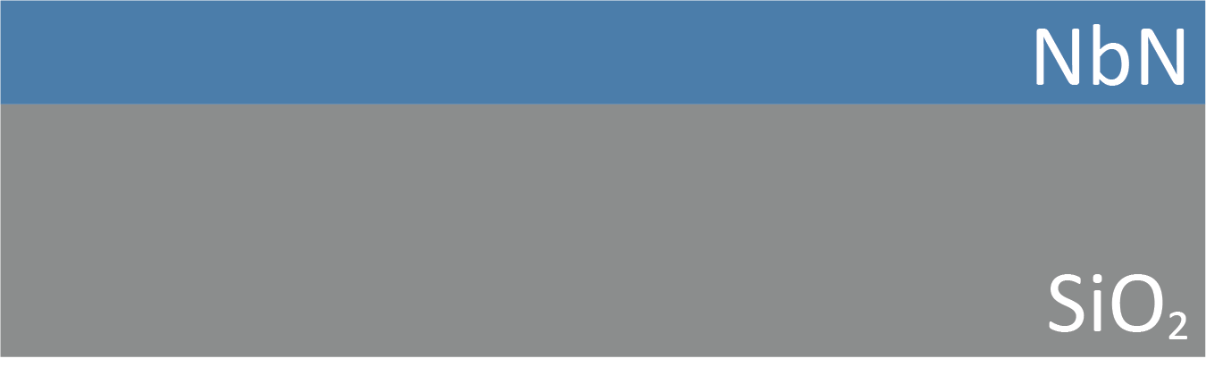

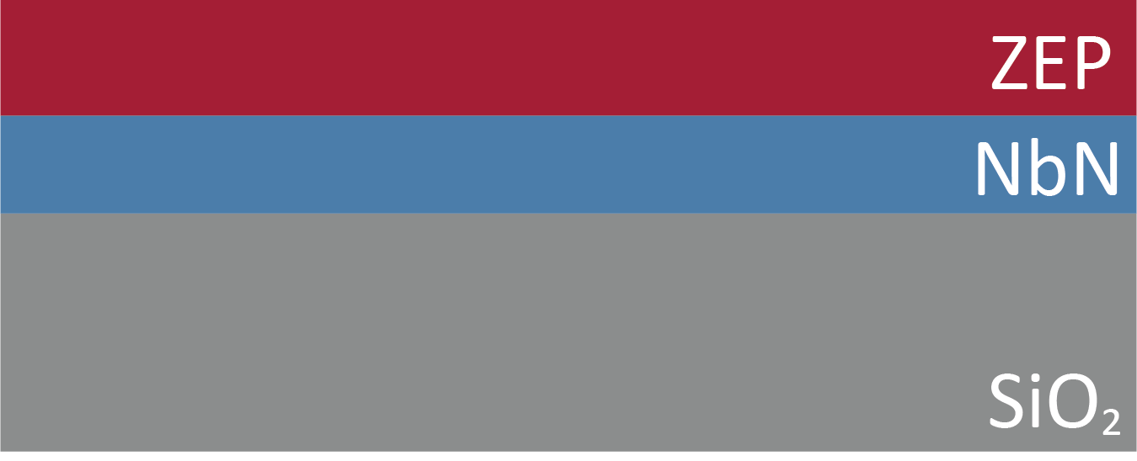
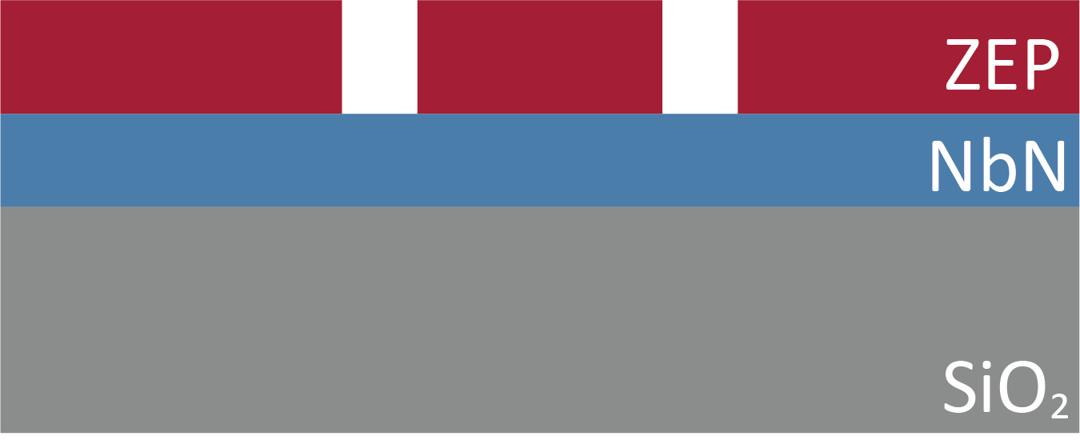
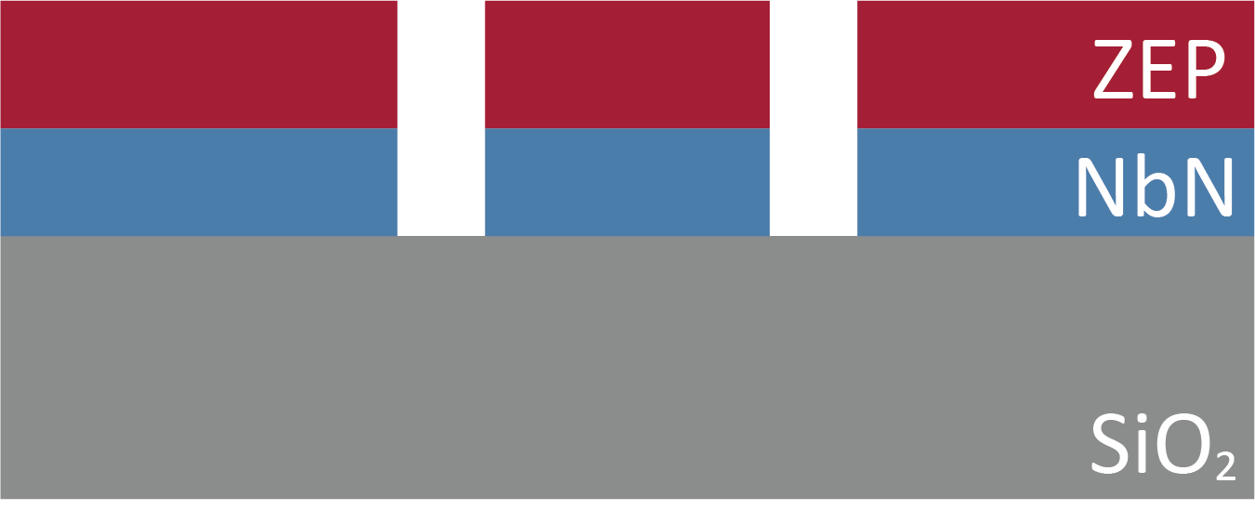
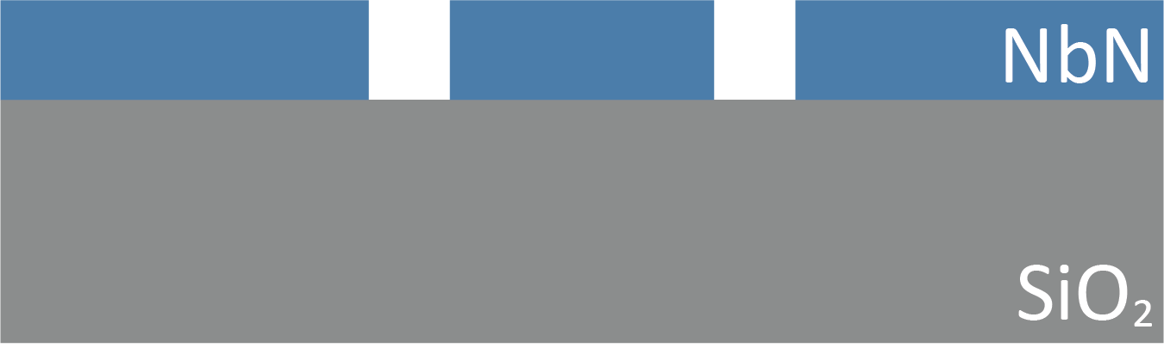
Fabrication
A
B
300 nm SiO₂ on Si
15 nm sputtered NbN
C
D
ZEP530 spin coating
E-beam exposure
+ development
E
F
CF₄ reactive ion etching
Resist removing
A. Buzzi et al. WOLTE 22
Notes:
Von Neumann architectures are reaching a performance plateau.
The system power consumption (J/bit) has been growing linearly over the years.

Slide 28
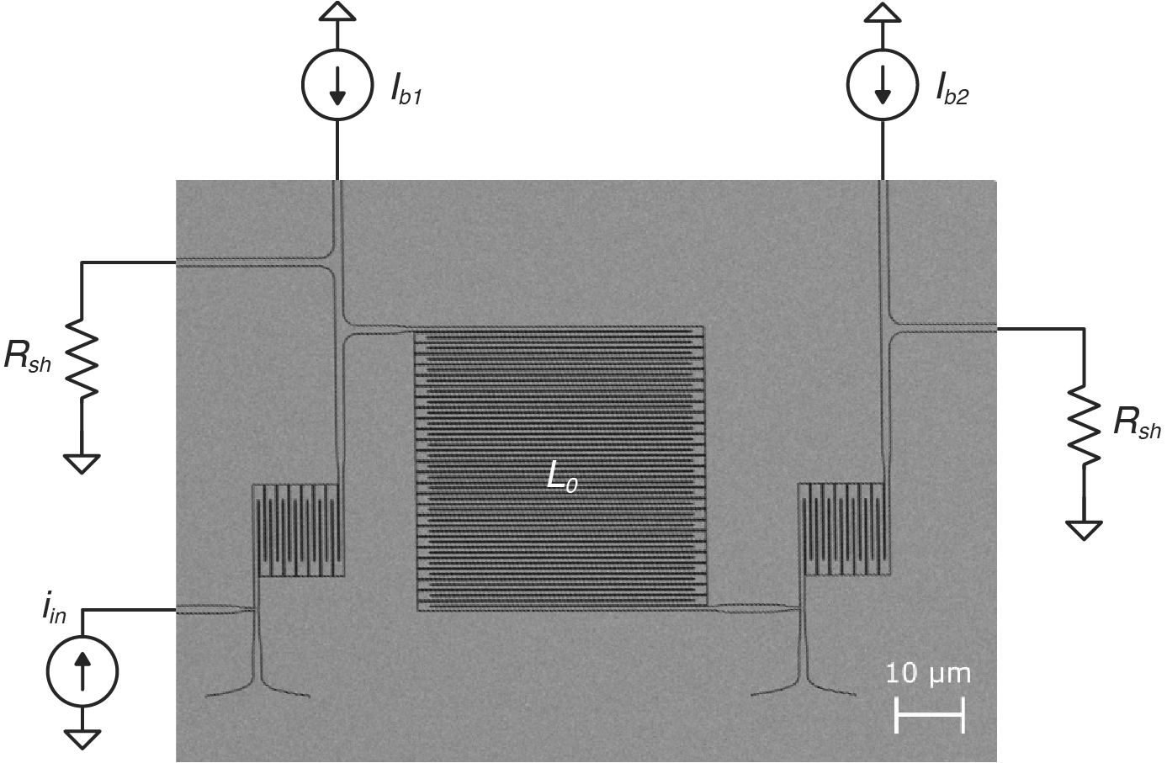
Fabrication
A
B
300 nm SiO₂ on Si
15 nm sputtered NbN
C
D
ZEP530 spin coating
E-beam exposure
+ development
E
F
CF₄ reactive ion etching
Resist removing
L₀ ≈ 150 nH
R_{sh} = 3 Ω
A. Buzzi et al. WOLTE 22
Notes:
Von Neumann architectures are reaching a performance plateau.
The system power consumption (J/bit) has been growing linearly over the years.

Slide 29
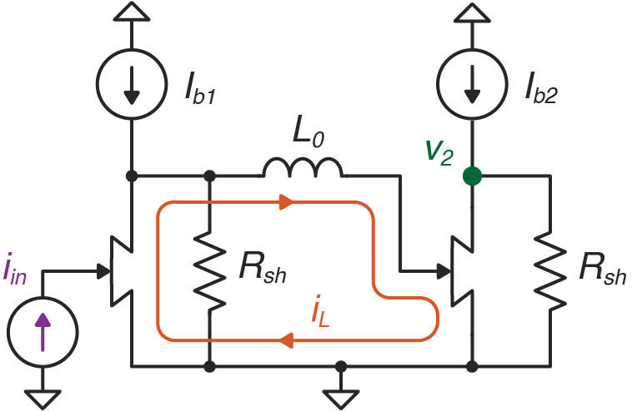
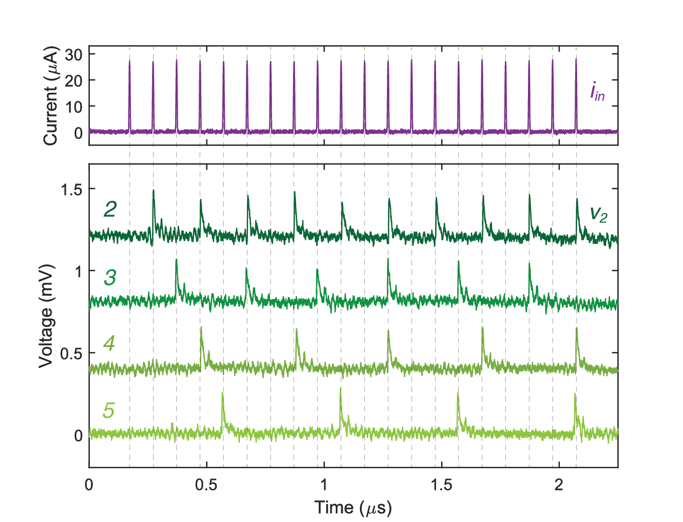
Single stage: measurements
Tested at 4.2 K in helium dewar
I_{b1}
Notes:
Von Neumann architectures are reaching a performance plateau.
The system power consumption (J/bit) has been growing linearly over the years.

Slide 30
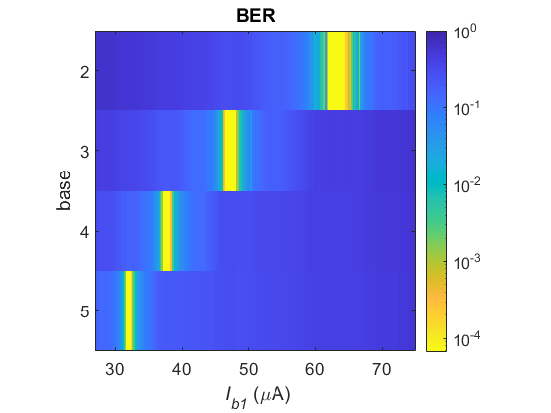
Single stage: measurements
Tested at 4.2 K in helium dewar
I_{b1}
correct
operation
<
Notes:
Von Neumann architectures are reaching a performance plateau.
The system power consumption (J/bit) has been growing linearly over the years.

Slide 31
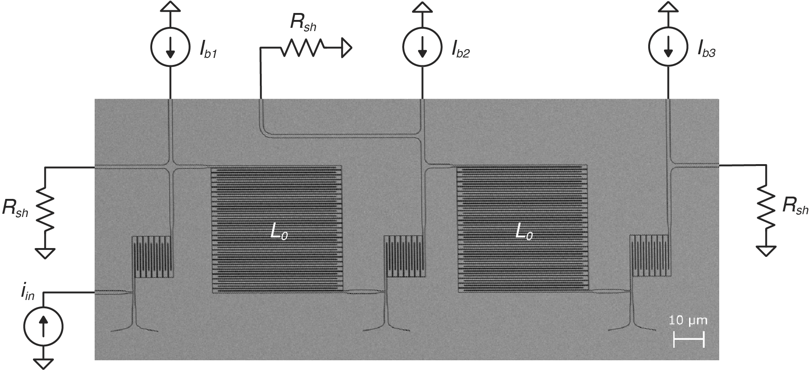
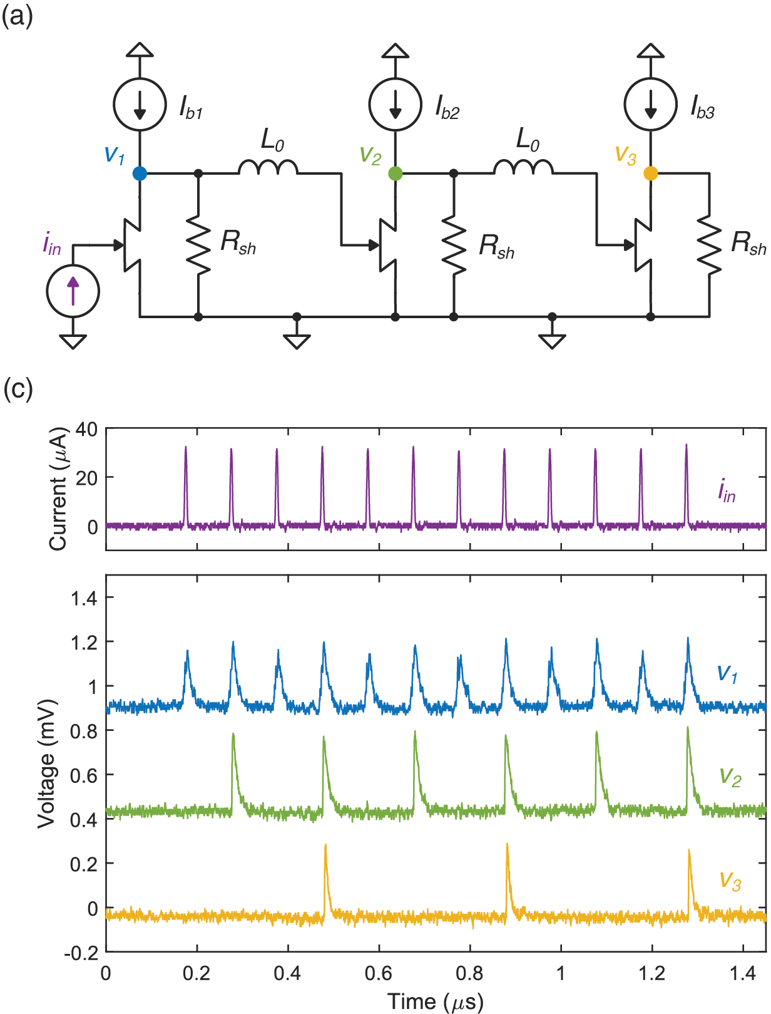
2-digit counter: fabrication
Notes:
Von Neumann architectures are reaching a performance plateau.
The system power consumption (J/bit) has been growing linearly over the years.

Slide 32
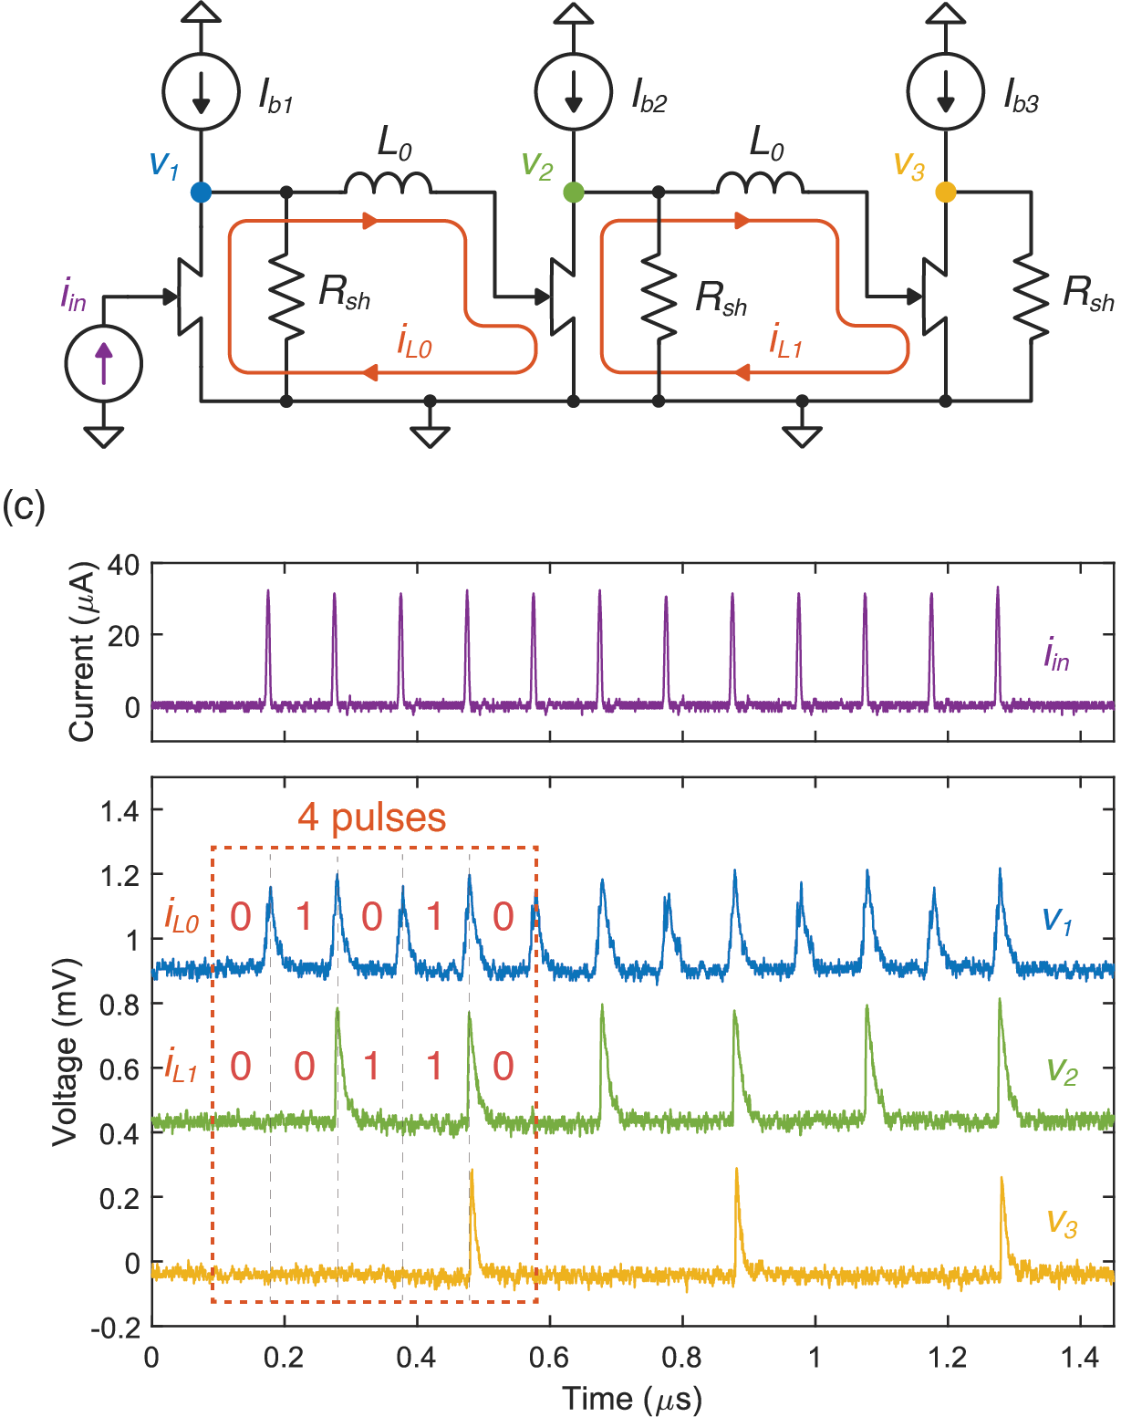
2-digit counter: measurements
Base 2
Notes:
Von Neumann architectures are reaching a performance plateau.
The system power consumption (J/bit) has been growing linearly over the years.

Slide 33
2-digit counter: measurements
Base 2
Notes:
Von Neumann architectures are reaching a performance plateau.
The system power consumption (J/bit) has been growing linearly over the years.

Slide 34
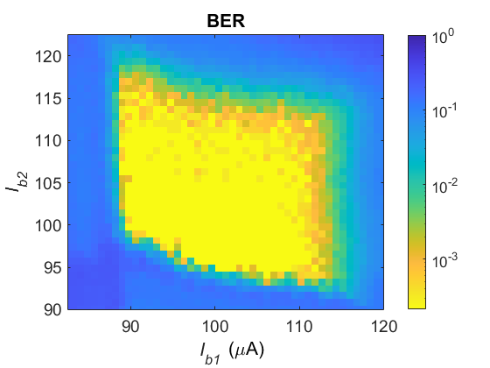
2-digit counter: measurements
Base 2
< 2x10⁻⁴
Notes:
Von Neumann architectures are reaching a performance plateau.
The system power consumption (J/bit) has been growing linearly over the years.

Slide 35
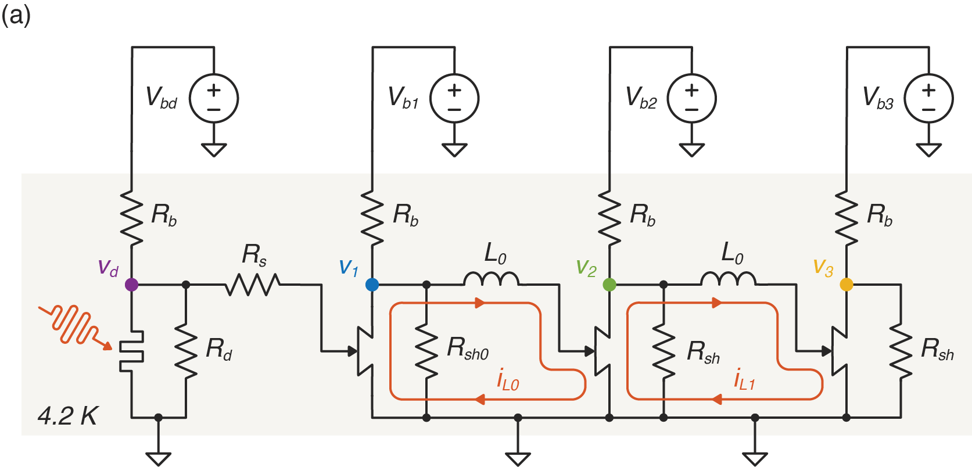
SNSPD + 2-digit counter
Tested at 1550 nm and 405 nm
Notes:
Von Neumann architectures are reaching a performance plateau.
The system power consumption (J/bit) has been growing linearly over the years.

Slide 36
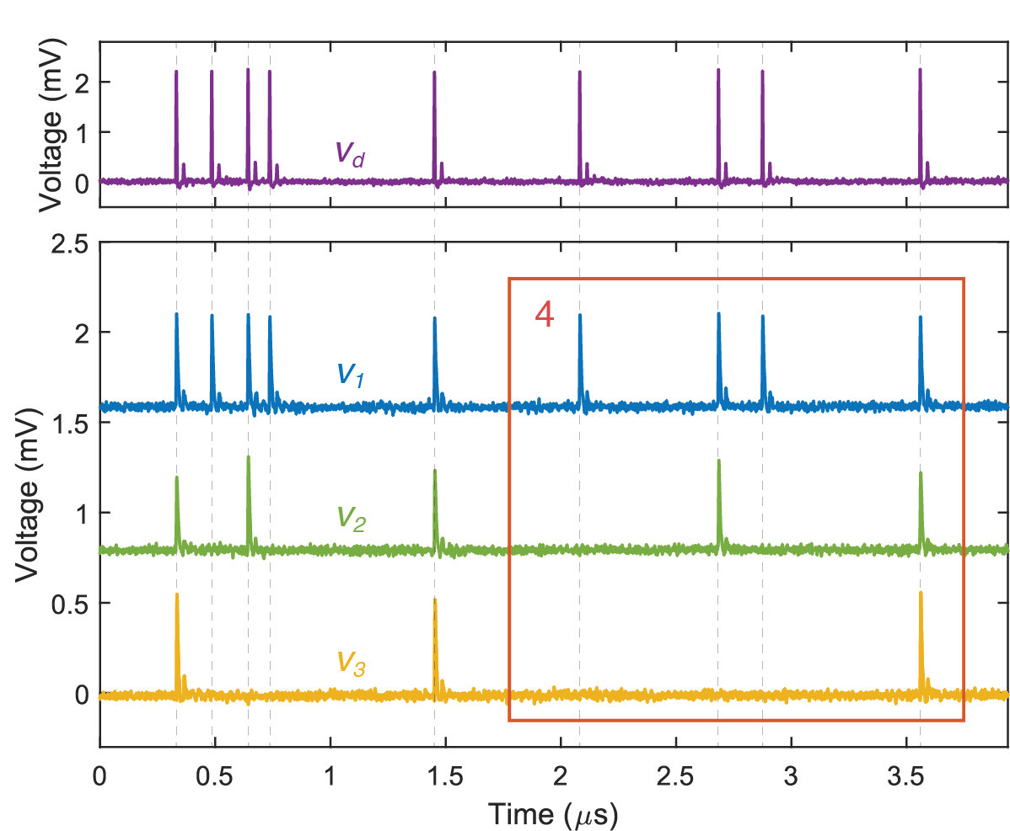
SNSPD + 2-digit counter
Base 2 at 405 nm
Tested at 1550 nm and 405 nm
Notes:
Von Neumann architectures are reaching a performance plateau.
The system power consumption (J/bit) has been growing linearly over the years.

Slide 37
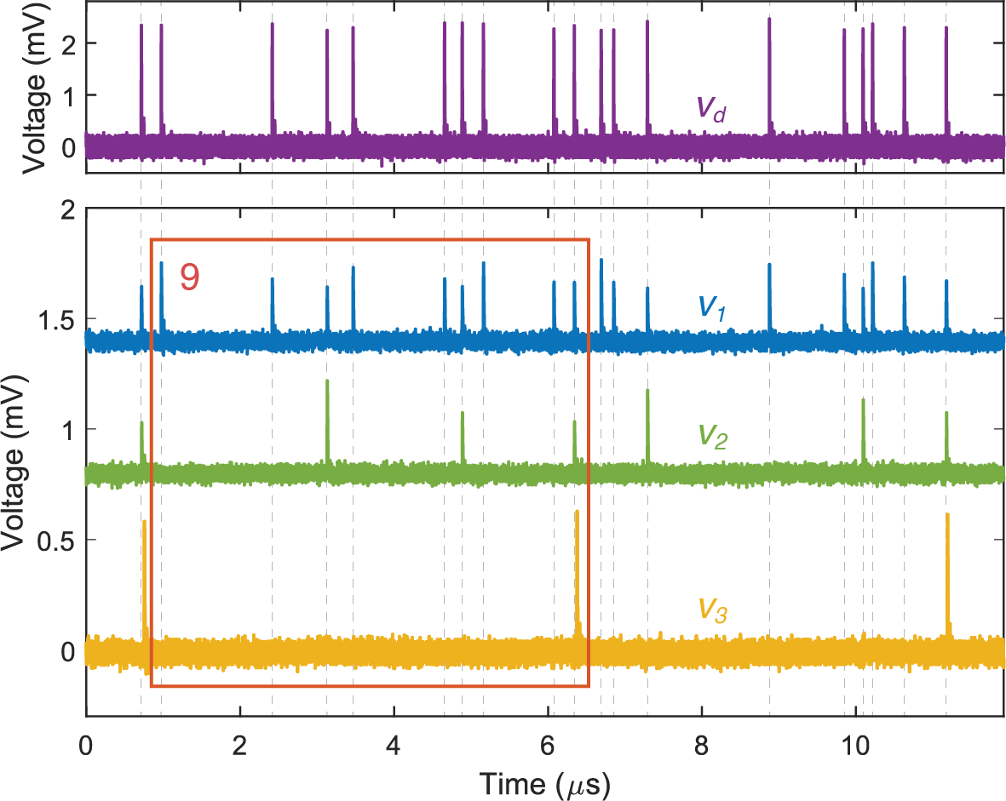
SNSPD + 2-digit counter
Base 3 at 405 nm
Tested at 1550 nm and 405 nm
Notes:
Von Neumann architectures are reaching a performance plateau.
The system power consumption (J/bit) has been growing linearly over the years.

Slide 38
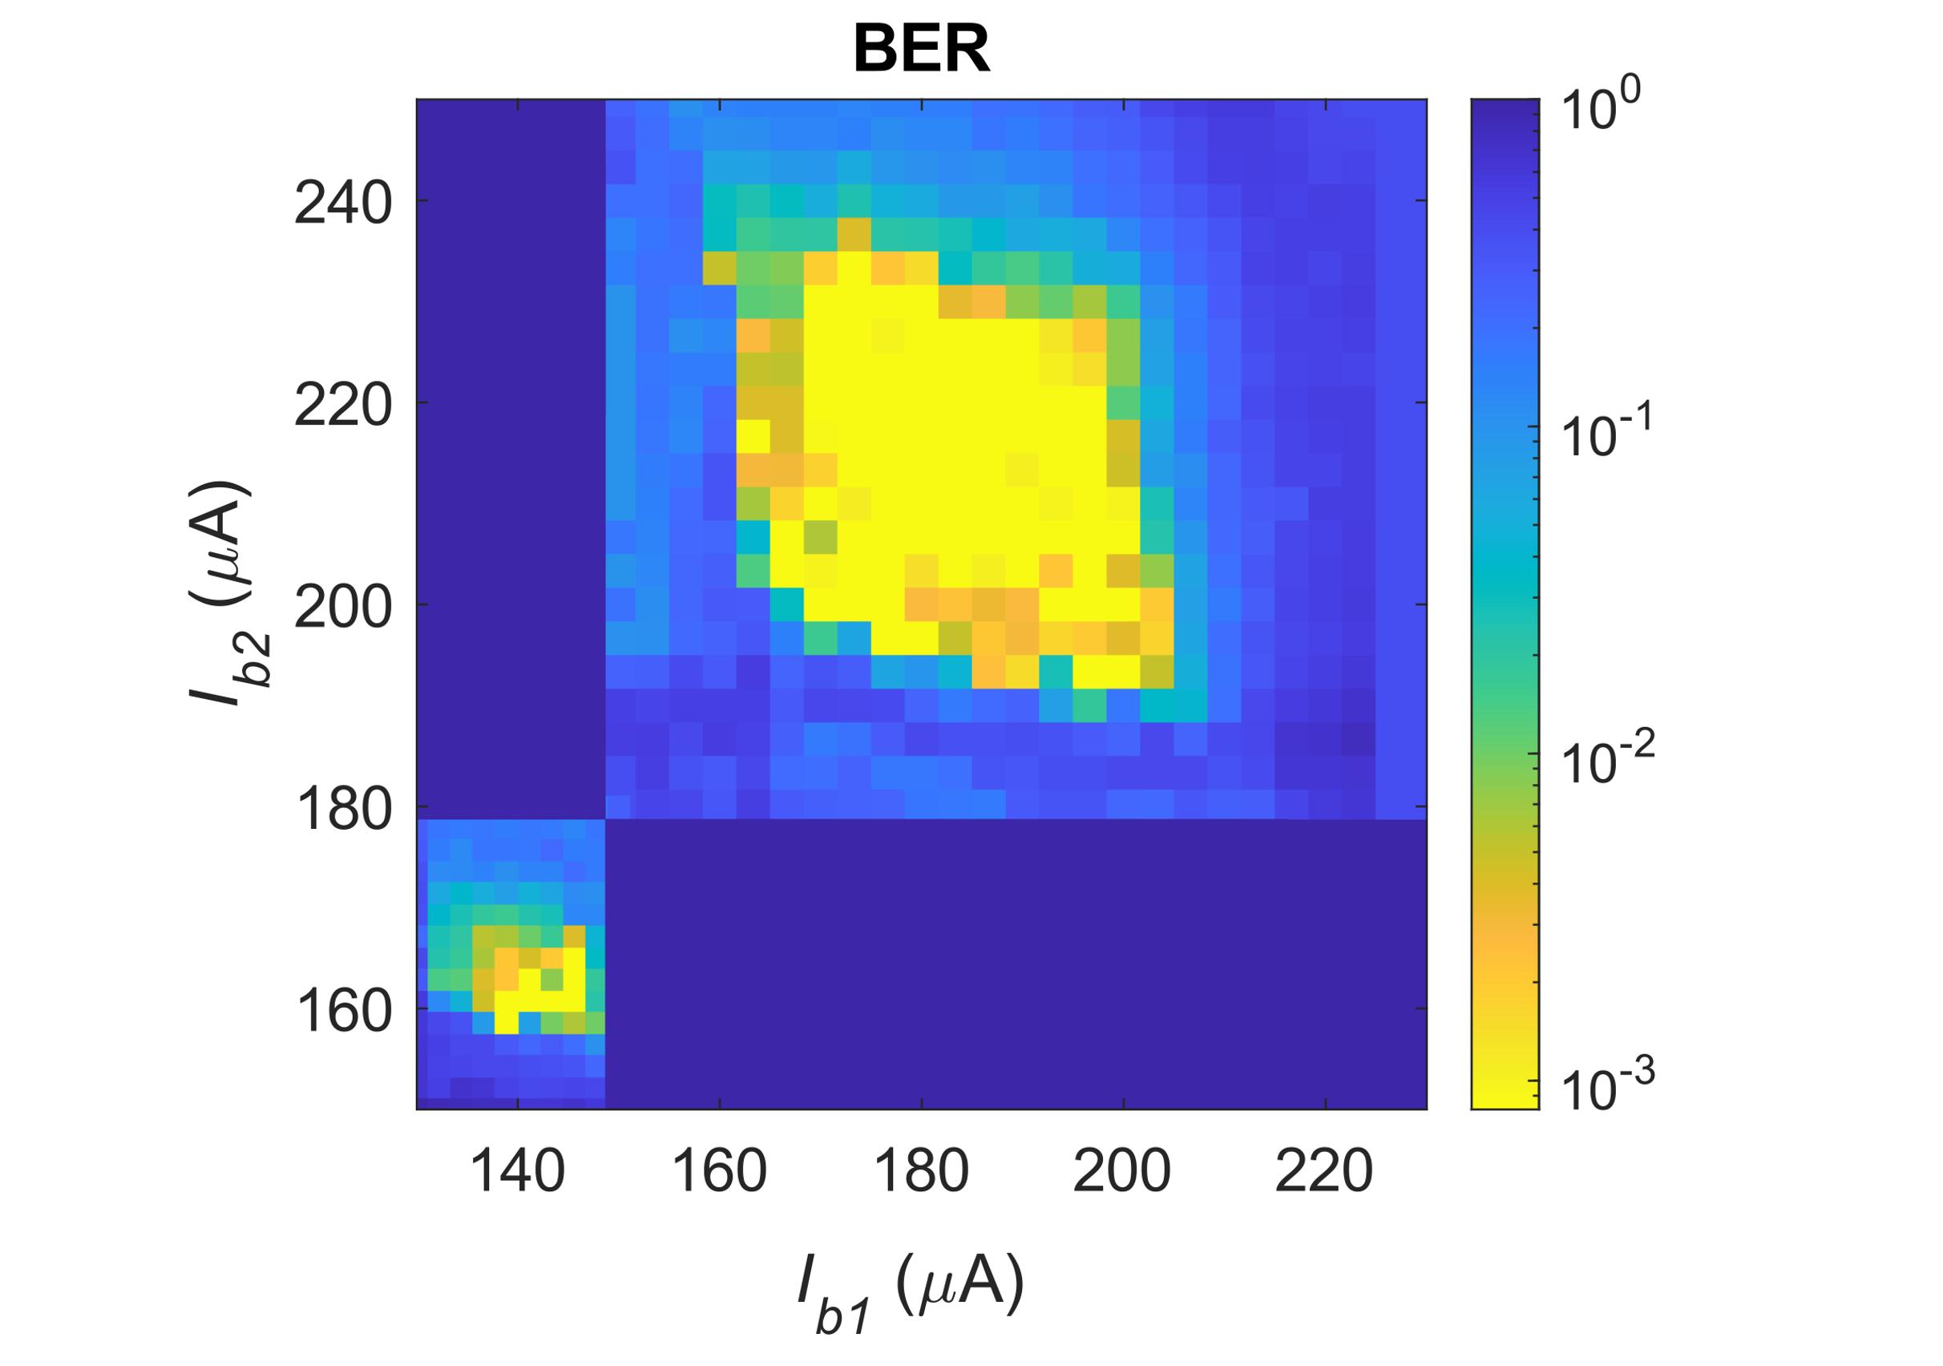
SNSPD + 2-digit counter
Tested at 1550 nm and 405 nm
<
Notes:
Von Neumann architectures are reaching a performance plateau.
The system power consumption (J/bit) has been growing linearly over the years.

Slide 39
SNSPD + 2-digit counter
Tested at 1550 nm and 405 nm
Base 3
Base 2
<
Notes:
Von Neumann architectures are reaching a performance plateau.
The system power consumption (J/bit) has been growing linearly over the years.

Slide 40
SNSPD + 2-digit counter
Tested at 1550 nm and 405 nm
Base 3
Base 2
<
We still need to demonstrate how to read out the state of the counter
Notes:
Von Neumann architectures are reaching a performance plateau.
The system power consumption (J/bit) has been growing linearly over the years.

Slide 41
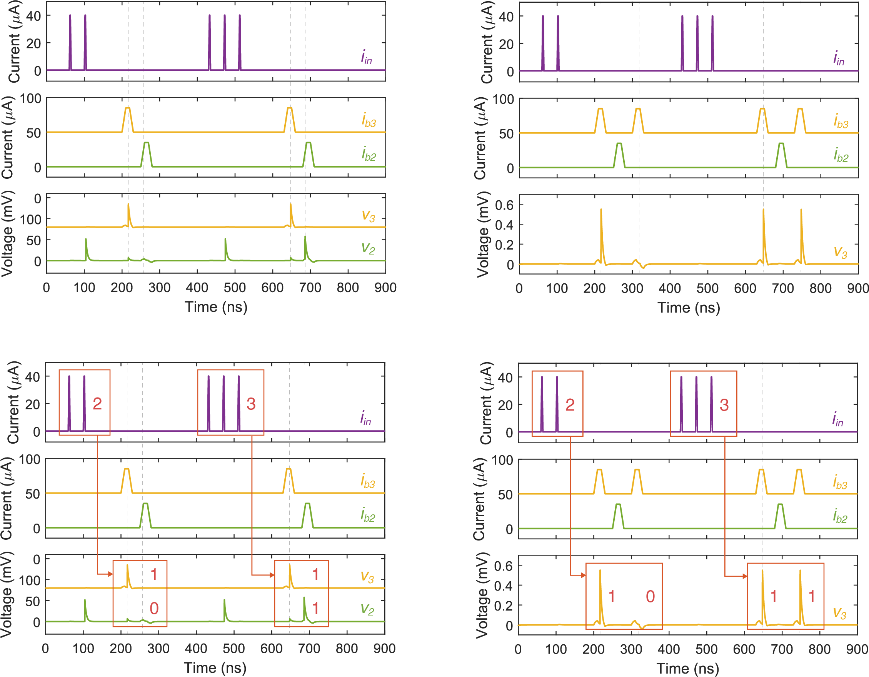
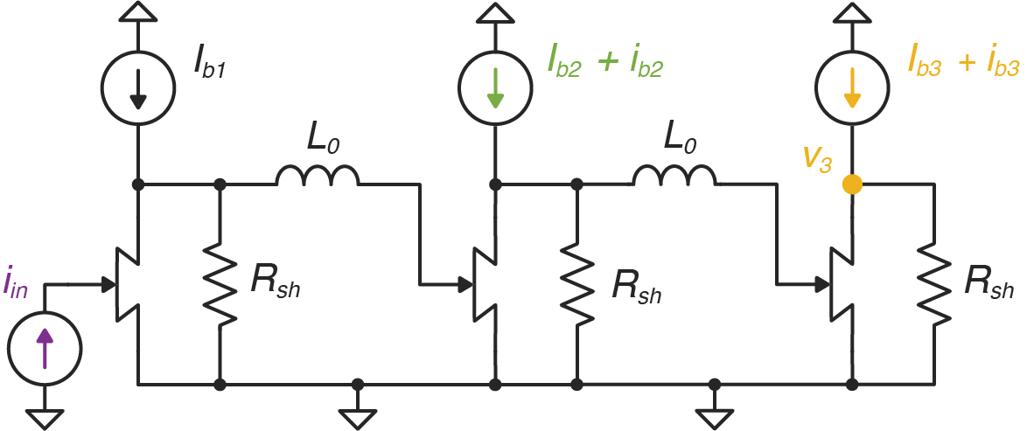
Read-out method: shift-register
Simulation
Notes:
Von Neumann architectures are reaching a performance plateau.
The system power consumption (J/bit) has been growing linearly over the years.

Slide 42
Read-out method: shift-register
Simulation
Notes:
Von Neumann architectures are reaching a performance plateau.
The system power consumption (J/bit) has been growing linearly over the years.

Slide 43
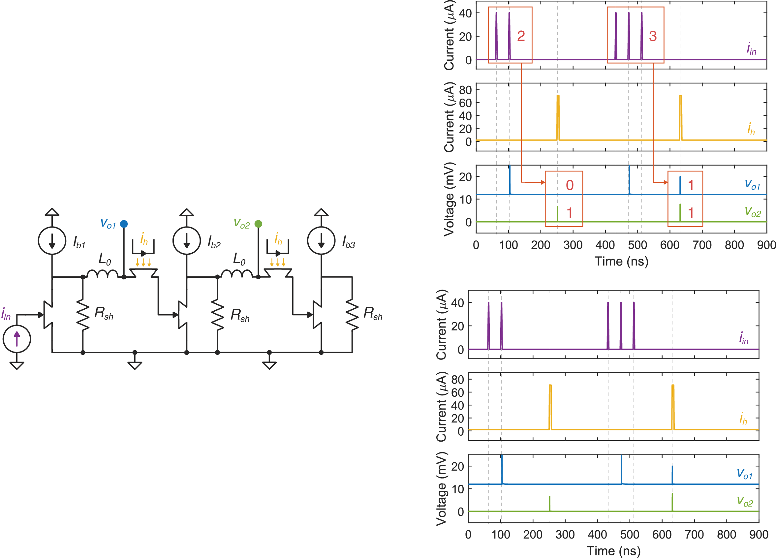
Read-out method: parallel
Simulation
Notes:
Von Neumann architectures are reaching a performance plateau.
The system power consumption (J/bit) has been growing linearly over the years.

Slide 44
Read-out method: parallel
Simulation
Notes:
Von Neumann architectures are reaching a performance plateau.
The system power consumption (J/bit) has been growing linearly over the years.

Slide 45
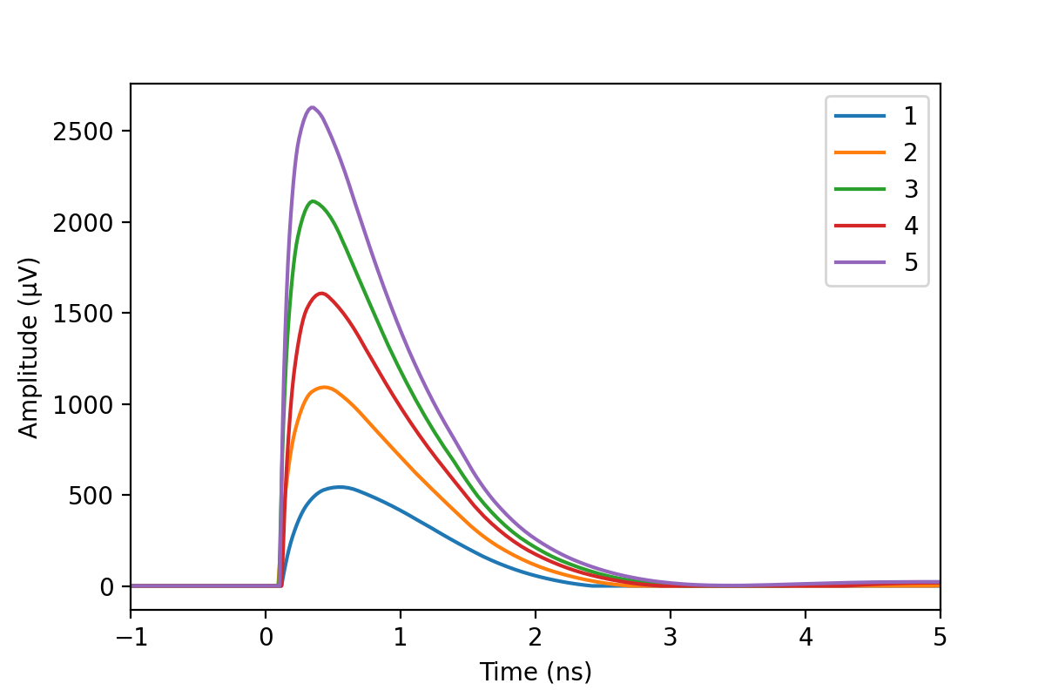
Megapixel SNSPD array
Output levels - parallel readout in base 6
Notes:
Von Neumann architectures are reaching a performance plateau.
The system power consumption (J/bit) has been growing linearly over the years.

Slide 46
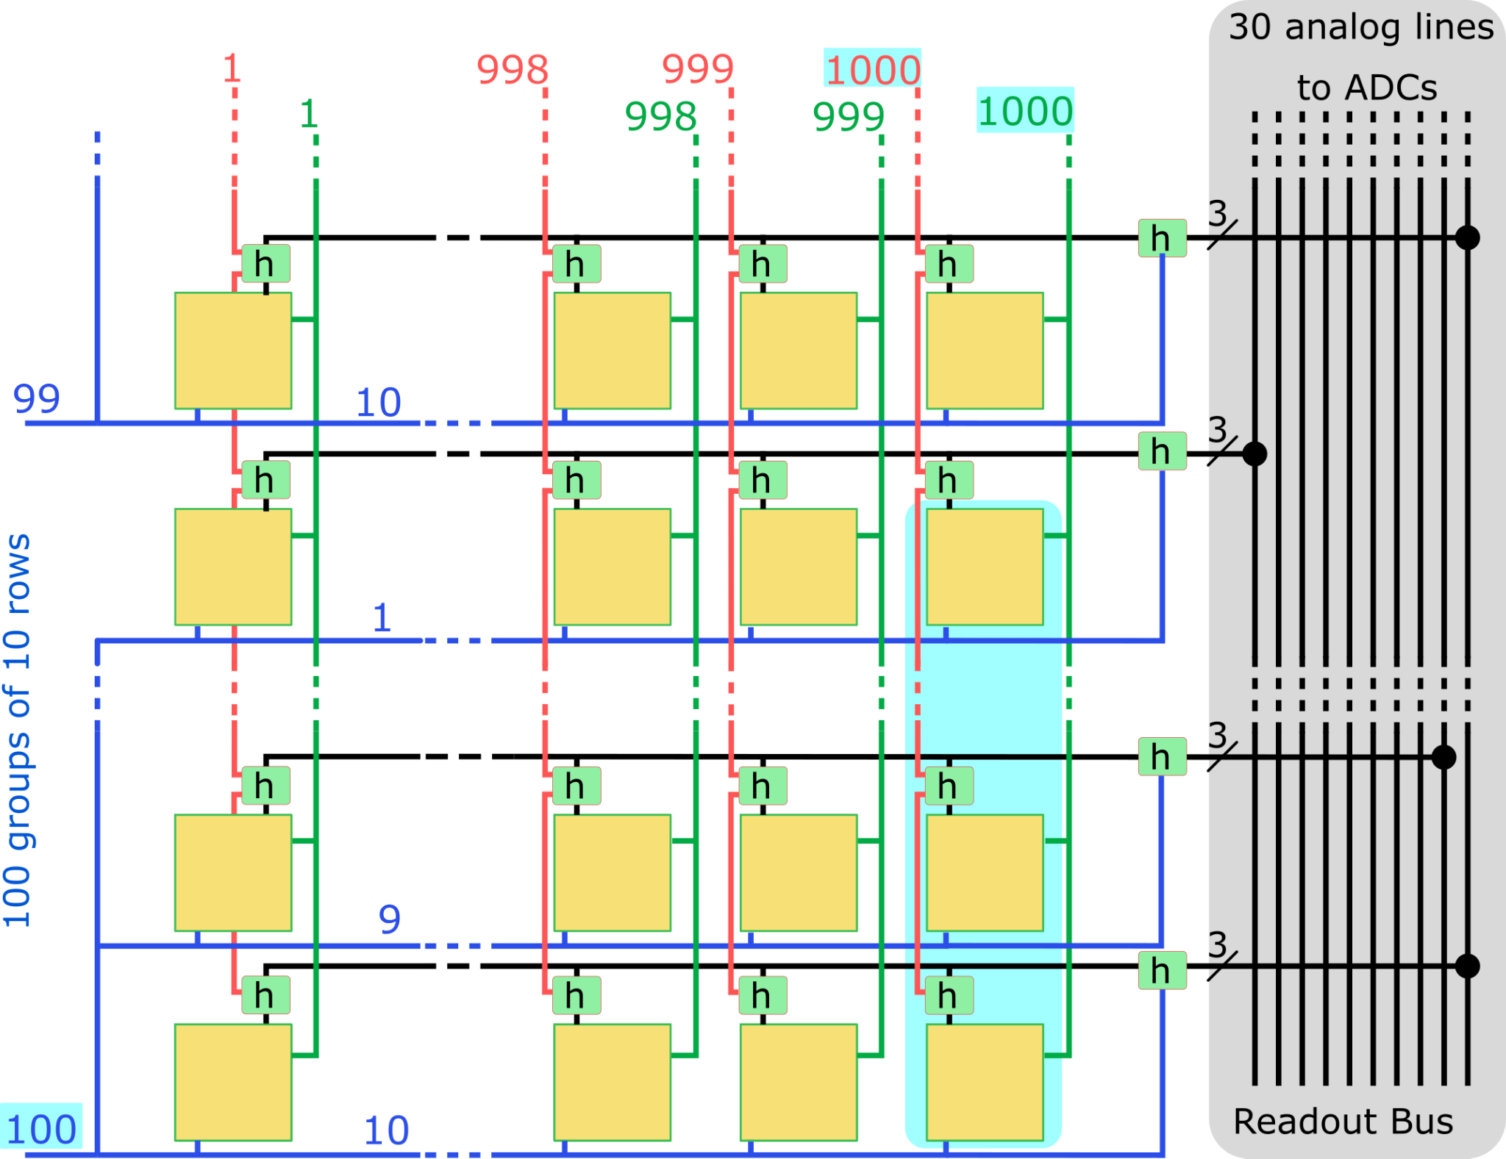
Megapixel SNSPD array
Output levels - parallel readout in base 6
With 3 digits in base 6 the maximum count is 215.
10¹² cps if the array is read out every 200 us.
The rows are read out 10 at a time.
30-line ADC to read out
Notes:
Von Neumann architectures are reaching a performance plateau.
The system power consumption (J/bit) has been growing linearly over the years.

Slide 47
Conclusions
We demonstrated a tunable pulse counter coupled to an SNSPD at 1150 nm and 405 nm.
We showed that both sensing and signal processing can be performed with the same technology on-chip.
The main application are SNSPD arrays, but it can be useful for quantum communications or cryogenic electronics generally.
Notes:
Von Neumann architectures are reaching a performance plateau.
The system power consumption (J/bit) has been growing linearly over the years.
Integration with snspd of multi loops
Scaling up dimensions
Power consumption = 0.5 fJ/spike
Power = 25 nW per nTron
Area = 50x50 um2
Integration with resistors
Advantage of snspd is high count rate, the design must be optimize to have the same

Slide 48


Conclusions
We demonstrated a tunable pulse counter coupled to an SNSPD at 1150 nm and 405 nm.
We showed that both sensing and signal processing can be performed with the same technology on-chip.
The main application are SNSPD arrays, but it can be useful for quantum communications or cryogenic electronics generally.
Operating temperature: 4.2 K
A
Cell footprint:
50x50 μm²
Energy consumption: 0.5 fJ/spike
Power: 25 nW/nTron
Maximum count rate: 5 x 10⁷ cps
Notes:
Von Neumann architectures are reaching a performance plateau.
The system power consumption (J/bit) has been growing linearly over the years.
Integration with snspd of multi loops
Scaling up dimensions
Power consumption = 0.5 fJ/spike
Power = 25 nW per nTron
Area = 50x50 um2
Integration with resistors
Advantage of snspd is high count rate, the design must be optimize to have the same

Slide 49
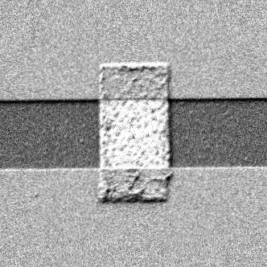
Conclusions
We demonstrated a tunable pulse counter coupled to an SNSPD at 1150 nm and 405 nm.
We showed that both sensing and signal processing can be performed with the same technology on-chip.
The main application are SNSPD arrays, but it can be useful for quantum communications or cryogenic electronics generally.
Multi-layer process and on-chip resistors
1 μm
Operating temperature: 4.2 K
Scaling down inductors
A
Cell footprint:
50x50 μm²
Energy consumption: 0.5 fJ/spike
Power: 25 nW/nTron
Maximum count rate: 5 x 10⁷ cps
Notes:
Von Neumann architectures are reaching a performance plateau.
The system power consumption (J/bit) has been growing linearly over the years.
Integration with snspd of multi loops
Scaling up dimensions
Power consumption = 0.5 fJ/spike
Power = 25 nW per nTron
Area = 50x50 um2
Integration with resistors
Advantage of snspd is high count rate, the design must be optimize to have the same

Slide 50









Acknowledgement
Notes:
Von Neumann architectures are reaching a performance plateau.
The system power consumption (J/bit) has been growing linearly over the years.

Slide 51
Thank you!
Notes:
Von Neumann architectures are reaching a performance plateau.
The system power consumption (J/bit) has been growing linearly over the years.

