Slide 1


Superconducting Tunnel Junction (STJ)
Radiation Detectors
Stephan Friedrich, LLNL
Part 1: What are STJs?
Part 2: The BeEST Sterile Neutrino Search
This work was performed under the auspices of the U.S. Department of Energy by Lawrence Livermore National Laboratory under Contract DE-AC52-07NA27344.
LLNL-PRES-811064

Slide 2
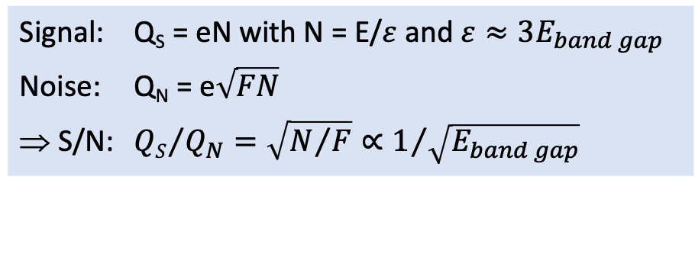
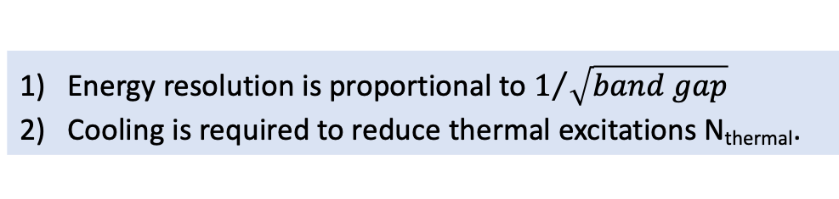


Refresher: Si and Ge Semiconductor Detectors
Conduction band (empty)
Photon
(Energy E)
Energy resolution is proportional to $1/{\sqrt{band gap}}$
Cooling is required to reduce thermal excitations N_{thermal}.
$$E_{band gap}≈1eV$$
Valence band (full)
$$V ≈1 keV$$
Signal: Q_{S} = eN with N = E/$ε$ and $ε≈3E_{band gap}$
Noise: Q_{N} = e$\sqrt{FN}$
⇒ S/N: ${QS}/{Q_{N}}=\sqrt{N/F}∝1/{\sqrt{E_{band gap}}}$

Slide 3
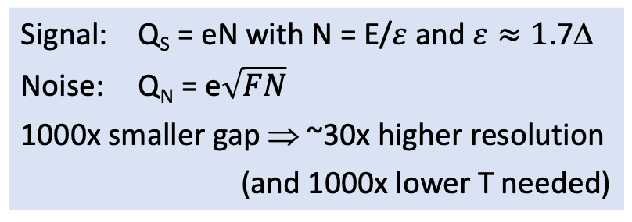


Semiconducting vs Superconducting Detectors
Conduction band (empty)
Photon
(Energy E)
Photon
(Energy E)
$$E_{band gap}≈1eV$$
Δ $≈1meV$
Valence band (full)
Valence band (full)
$$V ≈1 keV$$
$$V ≈100µeV$$
Signal: Q_{S} = eN with N = E/$ε$ and $ε≈3E_{band gap}$
Noise: Q_{N} = e$\sqrt{FN}$
⇒ S/N: ${QS}/{Q_{N}}=\sqrt{N/F}∝1/{\sqrt{E_{band gap}}}$
Signal: Q_{S} = eN with N = E/$ε$ and $ε≈1$.7Δ
Noise: Q_{N} = e$\sqrt{FN}$
1000x smaller gap ⇒ ~30x higher resolution
(and 1000x lower T needed)

Slide 4
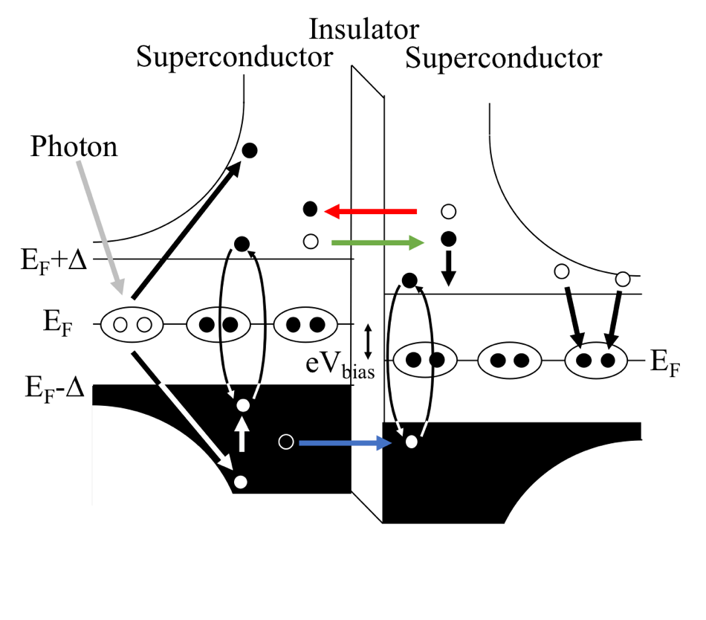
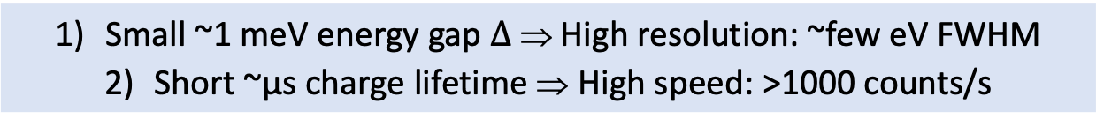
Superconducting Tunnel Junctions (STJs)
STJ Cross Section
STJ Band Diagram
X-ray Photon
Al
2
O
3
Ta Absorber
Al
Al
Ta
Nb
SiO
2
Si Substrate
100×100 μm²
Small ~1 meV energy gap $Δ$ ⇒ High resolution: ~few eV FWHM
Short ~µs charge lifetime ⇒ High speed: >1000 counts/s

Slide 5
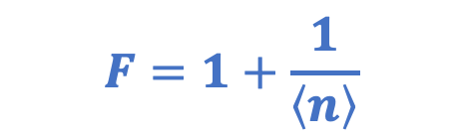

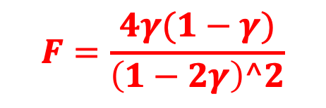
Statistical Noise in STJ Detectors
Charge Generation
Due to Backtunneling
Due to Reverse Tunneling
$$F=0.2$$
$$F=1+\frac{1}{\left\langle n\right\rangle }$$
$$F=\frac{4γ(1−γ)}{\left(1−2γ\right)^2}$$

Slide 6
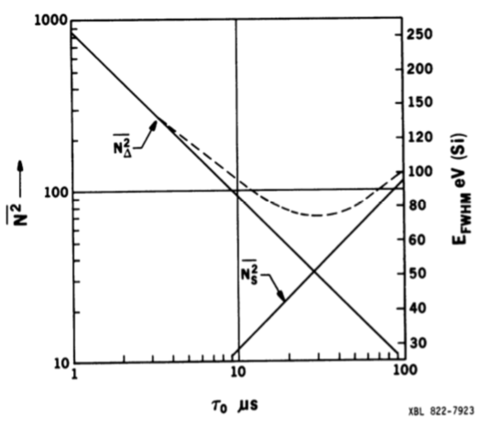
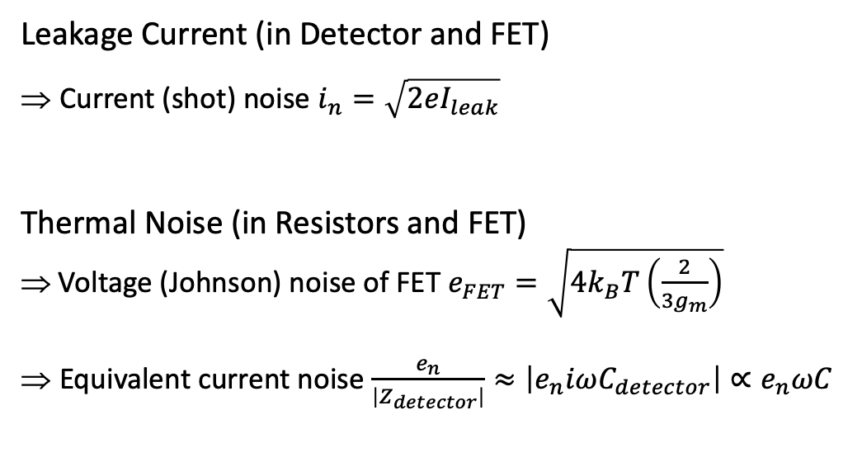
Refresher: Electronic Noise in Si and Ge Detectors
Current and Voltage Noise
Noise vs Frequency
Leakage Current (in Detector and FET)
Current (shot) noise $i_{n}=\sqrt{2eI_{leak}}$
Thermal Noise (in Resistors and FET)
⇒ Voltage (Johnson) noise of FET $e_{FET}=\sqrt{4k_{B}T\left(\frac{2}{3g_{m}}\right)}$
Equivalent current noise $\frac{e_{n}}{\left|Z_{detector}\right|}≈\left|e_{n}iωC_{detector}\right|∝e_{n}ωC$
pA/Hz
pA/√Hz
[Goulding 1982]
i_{n}
e_{n}
FET noise and Si / Ge detector capacitance set electronic noise.
Shaping time [µs]

Slide 7
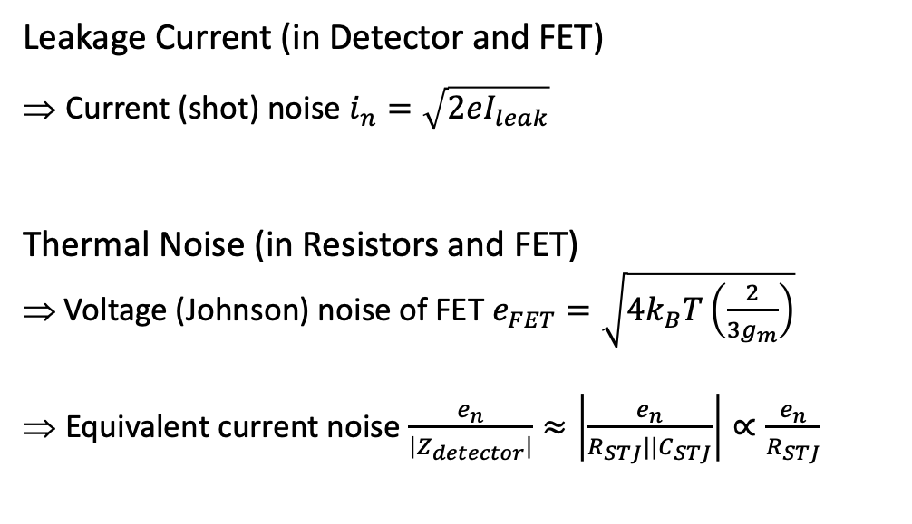
Electronic Noise in STJ Detectors
Current and Voltage Noise
Noise vs Frequency
Leakage Current (in Detector and FET)
Current (shot) noise $i_{n}=\sqrt{2eI_{leak}}$
Thermal Noise (in Resistors and FET)
⇒ Voltage (Johnson) noise of FET $e_{FET}=\sqrt{4k_{B}T\left(\frac{2}{3g_{m}}\right)}$
Equivalent current noise $\frac{e_{n}}{\left|Z_{detector}\right|}≈\left|\frac{e_{n}}{R_{STJ}||C_{STJ}}\right|∝\frac{e_{n}}{R_{STJ}}$
pA/Hz
pA/√Hz
[Goulding 1982]
STJs vs Ge:
• Slower signal
• Resistive detector
i_{n}
e_{n}
FET noise and STJ detector resistance set electronic noise.
Shaping time [µs]

Slide 8
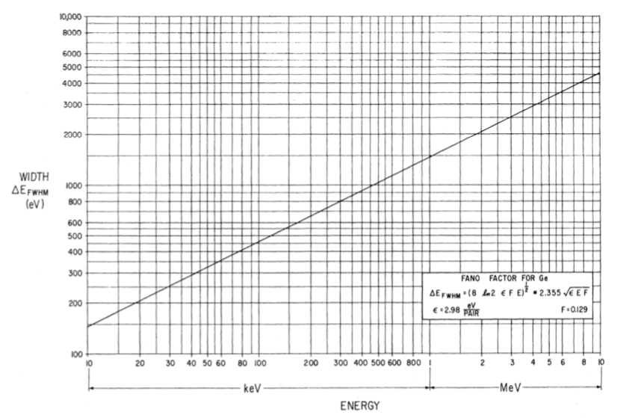
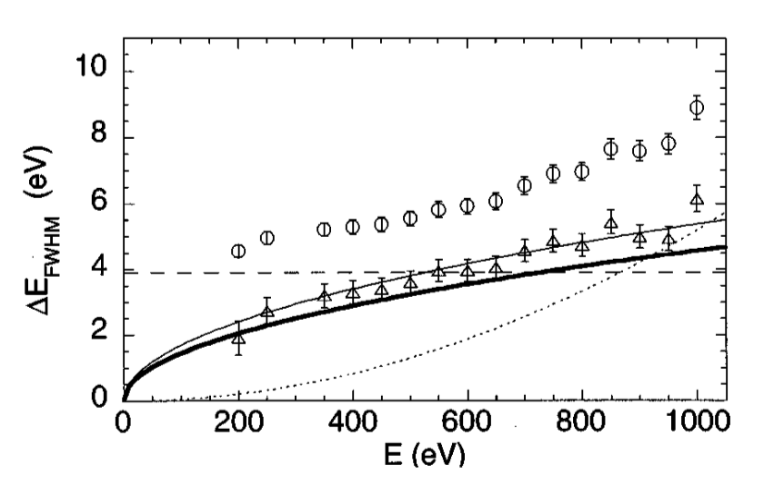
Measuring Statistical and Electronic Noise
Ge Detectors
STJ Detectors
Bilger, Phys. Rev. 163, 238 (1967)
le Grand et al., Appl. Phys. Lett. 73, 1295 (1998)
ε = 2.98eV
F = 0.129
Measured resolution
El. Noise
Statistical noise
• Statistical noise ∝ √E • Electronic noise is constant with E • Inhomogeneity causes broadening ∝ E

Slide 9

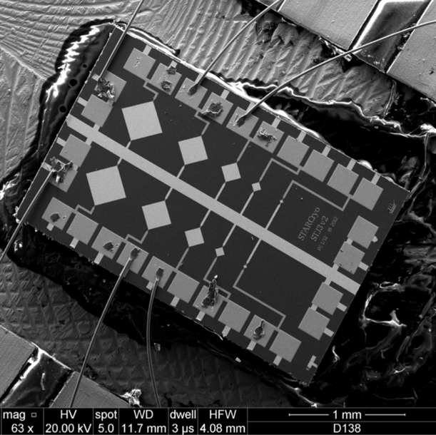
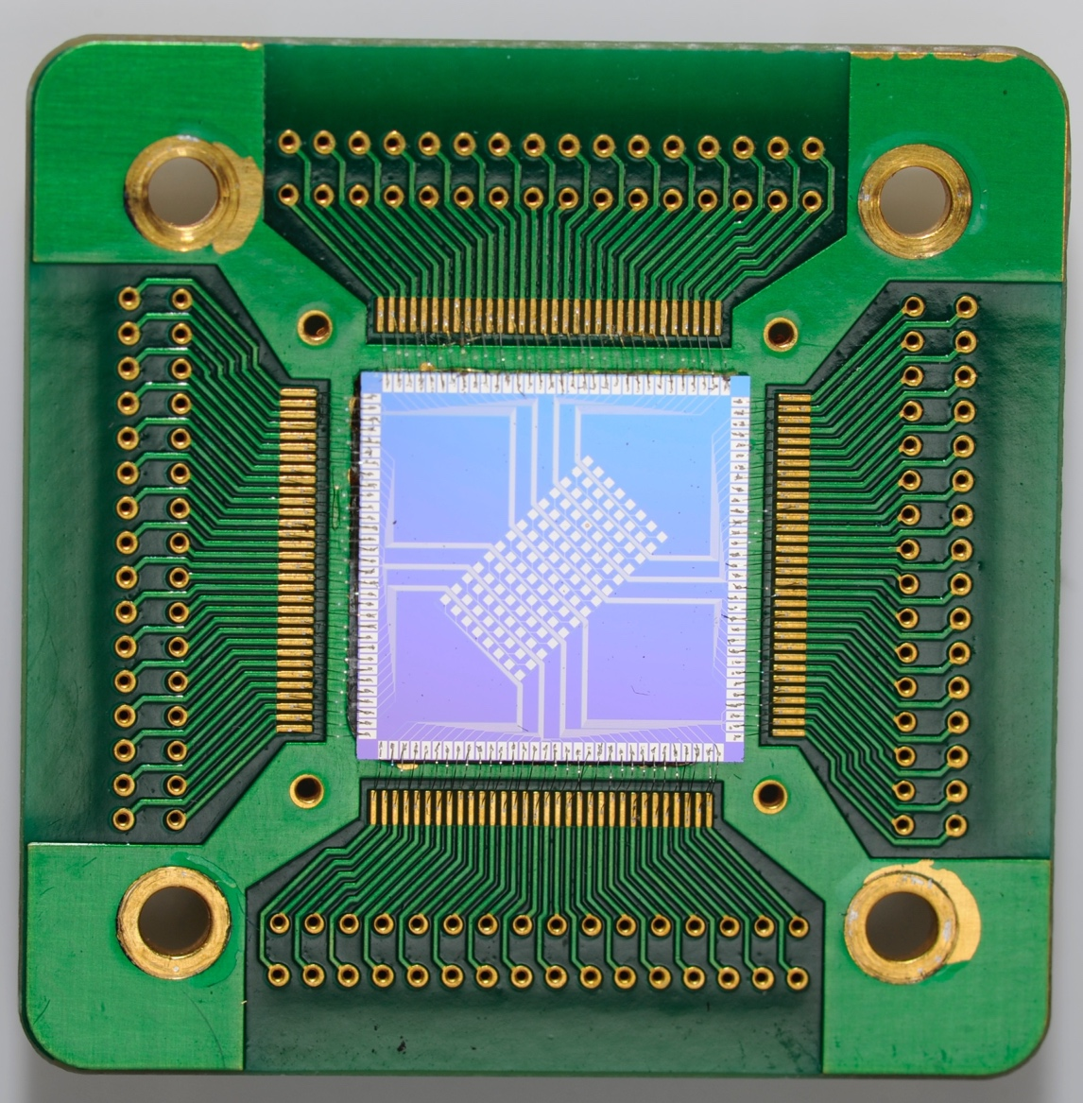
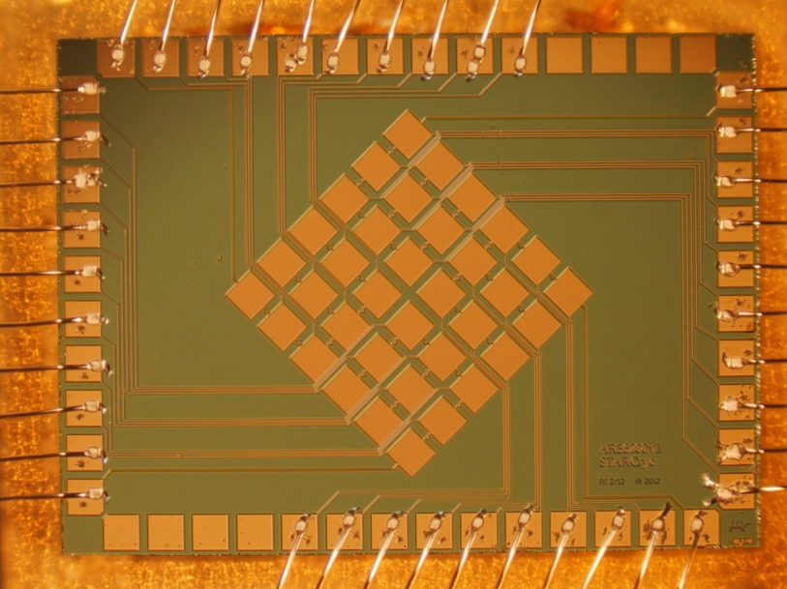
STJ Fabrication
Few Pixels
128 Pixels
36 Pixels
(25µm)² to (284µm)²
(208µm)² pixels
(208µm)² pixels
Our STJs are fabricated by photolithography at STAR Cryo in Santa Fe.

Slide 10
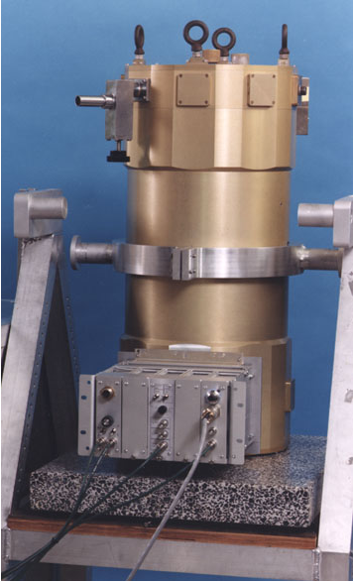
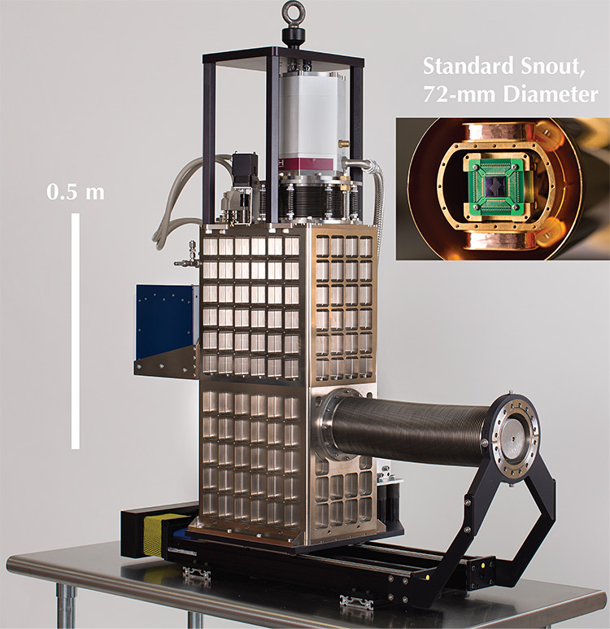

Automated STJ Cooling to 0.1K
1990s: 2010s:
Liquid N₂ and He pre-cooling Pulse-tube pre-cooling (“dry”)
Single-stage ADR Two-stage ADR
1) Close heat switch
2) Apply B (lower entropy S)
3) Open heat switch (decouple T)
4) Reduce B slowly (keeping
entropy constant ⇒ reduce T)
Adiabatic Demagnetization Refrigerators (ADRs) are compact, reliable, automated and commercially available.

Slide 11
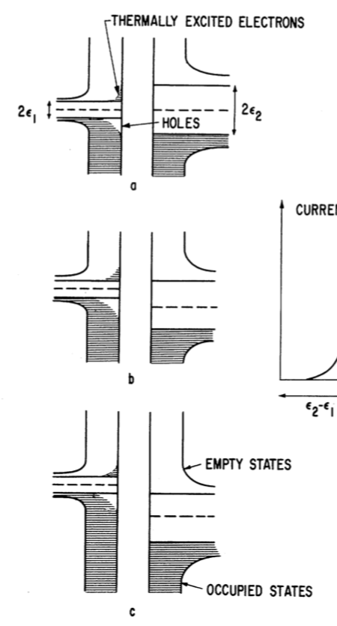
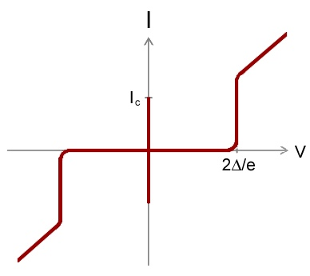
STJ Operation
Current-Voltage I(V) Curve (Textbook Version)
I(V) Curve (Real Life)
Fiske modes
Suppressed
Josephson
current
dc Josephson
current (1962)
Thermal
leakage
current
I. Giaever (1960)
Cool to ≤ 0.1T_{C} to suppress thermal current.
Apply B to suppress dc Josephson current.

Slide 12

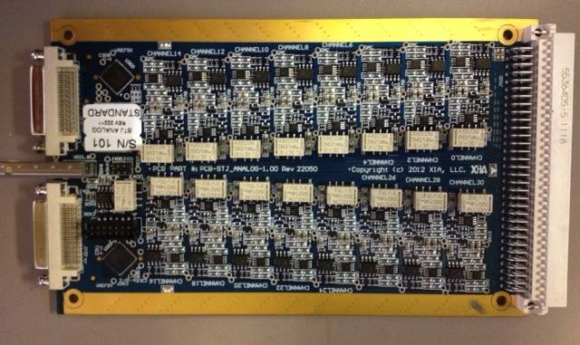
STJ Electronics
Readout Requirements
Computer-Controlled Preamplifier (XIA)
• Low noise (e_{n} ≤ 1 nV/√Hz)
• Stable biasing (to ±few µV)
• Voltage bias (dc load line <100 Ω)
• Low noise, stable biasing, dc voltage bias
• Computer-controlled
• 32 preamplifiers per board
Specialized STJ preamplifiers are commercially available, too.

Slide 13

STJ vs. Si Detectors
High resolution is important at low energies where lines are closely spaced.

Slide 14
STJ Performance: Resolution and Linearity
S. Friedrich et al., JLTP (2020)
Pulsed 355 nm (3.5eV) laser at 5,000 Hz
⇒ Comb of peaks at integer multiples of 3.5 eV
⇒ Energy resolution between ~1.5 and ~2.5 eV FWHM
⇒ Only quadratic non-linearity
⇒ Calibration accuracy of order ±1 meV in 1 hour

Slide 15
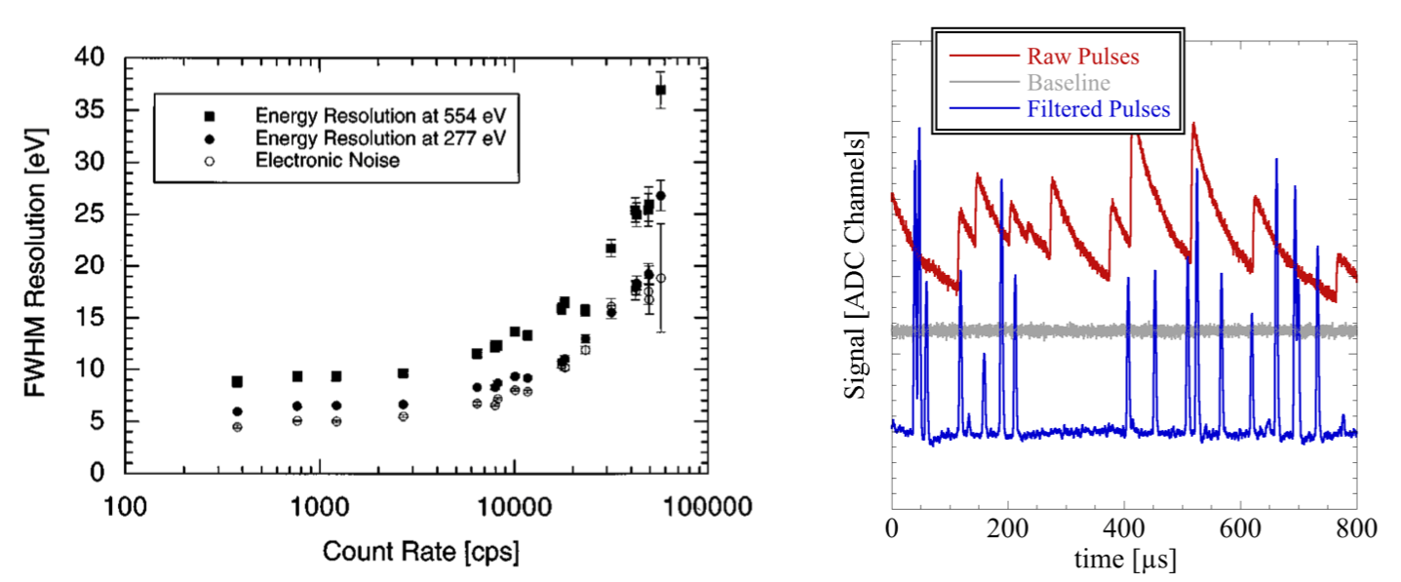
STJ Performance: Speed
Nb-STJs (τ_{decay} ≈ few µs)
Ta-STJs (τ_{decay} ≈ few 10 µs)
M. Frank et al, RSI (1998)
M. Carpenter et al., JLPT (2017)
STJ Signal:
• Single exponential
decay constant
DSP pulse processing:
• Trapezoidal filter
• Pile-up rejection
~20,000 counts/s
STJs detectors can be operated at rates well above 1000 counts/s per pixel.

Slide 16
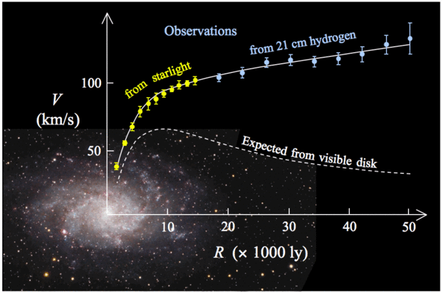
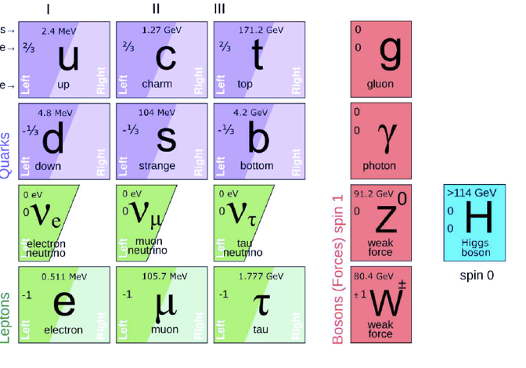
Part II: The BeEST Sterile Neutrino Search
What is Dark Matter?
Do Right-Handed (Sterile) Neutrinos Exist?
Fermions Bosons
Leptons Quarks
• What is 85% of the mass in the Universe?
• Why the matter-antimatter asymmetry?
• Why are all neutrinos left-handed?
• Why do neutrinos have mass?

Slide 17
How to Find Something that
Doesn’t emit light
Doesn’t absorb light
Doesn’t interact (except through its mass)?

Slide 18
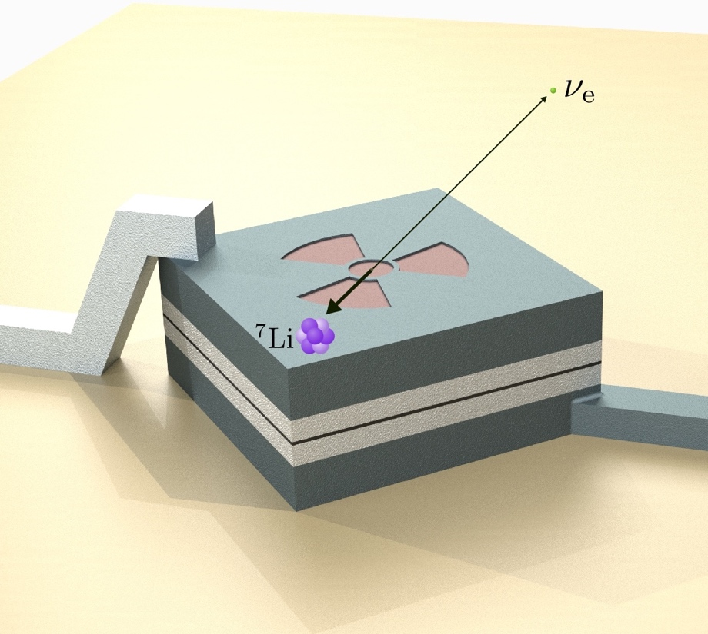
How to Find Something that
Doesn’t emit light
Doesn’t absorb light
Doesn’t interact (except through its mass)?
From the recoil it causes!
|p_{Li-7}| = |p_{ν}|
(Missing momentum experiment.)

Slide 19


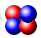
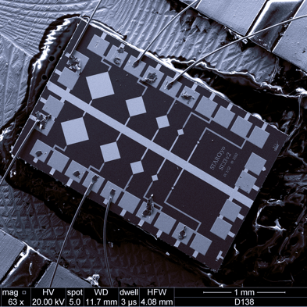
A Sterile Neutrino Search with STJ Detectors
Implant ⁷Be
at TRIUMF
Superconducting Detector
from LLNL
⁷Be
STJ
Si
Implant ⁷Be into STJ detectors.
τ_{1/2} = 53 days, Q = 861 keV

Slide 20
Beryllium-7 Electron Capture in STJ Detectors
Implant ⁷Be
at TRIUMF
Detect ⁷Be Decay
at LLNL
⁷Be
STJ
⁷ Li
Si
ν_{e-}
⁷Be + e- ⟶ ⁷Li + ν_{e-}
with ν_{e-}= 𝝨 |U_{ea}|²ν_{active}
Measure electron capture decay of ⁷Be to ⁷Li.
2-body decay ⇒ Monochromatic recoil (in principle)

Slide 21
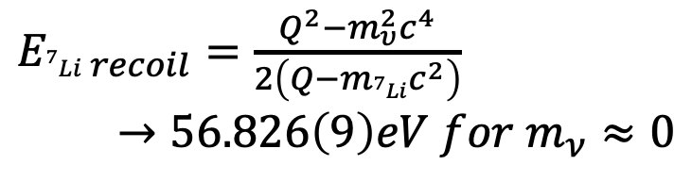
Be-7 Electron Capture in STJs: The BeEST Experiment
Implant ⁷Be
at TRIUMF
Detect ⁷Be Decay
at LLNL
⁷Be
STJ
⁷ Li
$E_{{}_{ }^{7}{Li} recoil}=\frac{Q^{2}−m_{υ}^{2}c^{4}}{2\left(Q−m_{{}_{ }^{7}{Li}}c^{2}\right)}$
$→56.826\left(9\right)eV for m_{ν}≈0$
Si
ν_{e-}
⁷Be + e- ⟶ ⁷Li + ν_{e-}
with ν_{e-}= 𝝨 |U_{ea}|²ν_{active} + |U_{es}|²ν_{sterile}
Heavy sterile neutrinos would change ⁷Li recoil energy.
Look for new peaks in recoil spectrum.

Slide 22
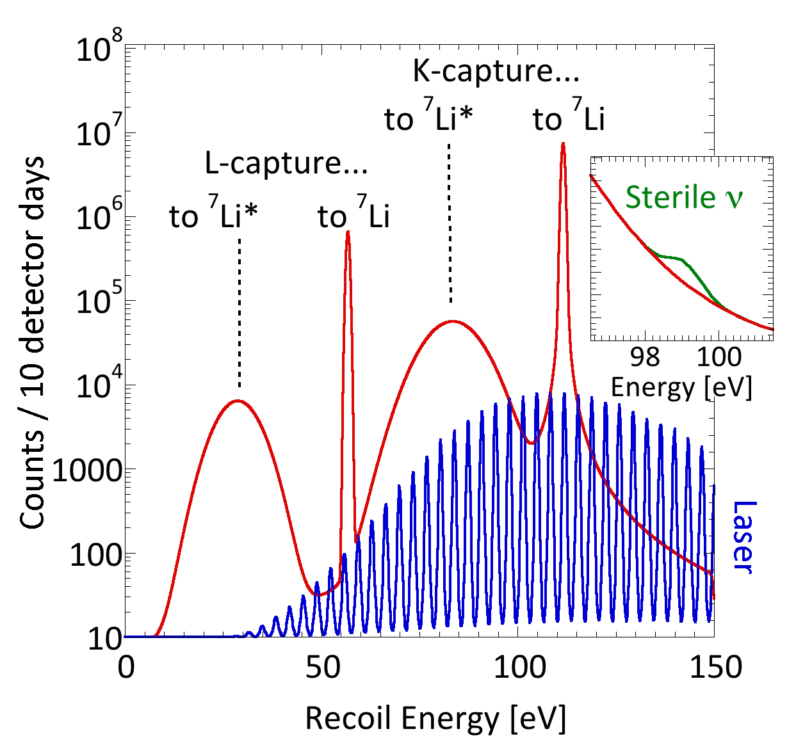
The BeEST Sterile Neutrino Search
Implant ⁷Be
at TRIUMF
Detect ⁷Be Decay
at LLNL
High-Resolution Recoil Simulation
⁷Be
STJ
⁷ Li
Pulsed Laser
(Calibration)
Si
ν_{e-}
⁷Be + e- ⟶ ⁷Li + ν_{e-}
with ν_{e-}= 𝝨 |U_{ea}|²ν_{active} + |U_{es}|²ν_{sterile}
Calibrate STJ with pulsed laser.
Four peaks due to K- and L- capture into ⁷Li ground and excited state

Slide 23
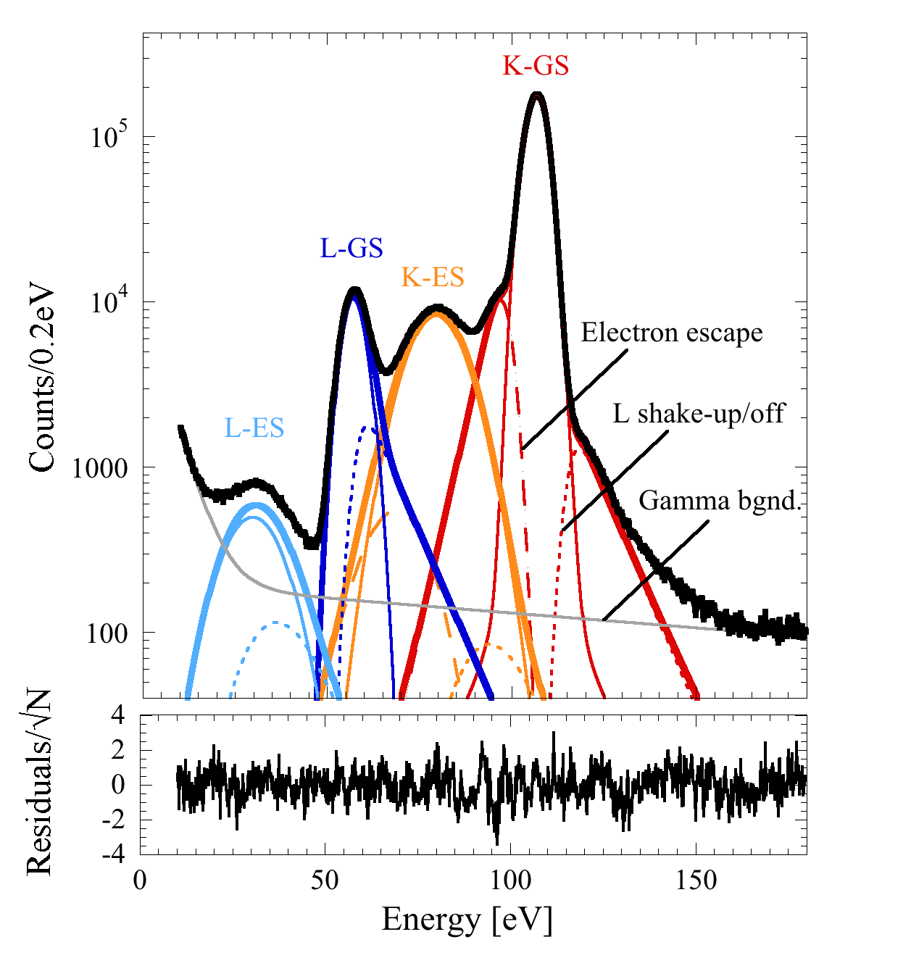
The BeEST Sterile Neutrino Search
Implant ⁷Be
at TRIUMF
Detect ⁷Be Decay
at LLNL
Data from 1 Ta-STJ Detector for 28 Days
⁷Be
• 4 primary peaks
– 2 x K-capture, 2x L-capture
– to ⁷Li ground state and to ⁷Li*
• 4 high-energy tails
– Shake-off effects
• 2 low-energy tails
– (Partial) Auger e- energy loss
• 1 broad background
– 478 keV γ‘s in substate
STJ
⁷ Li
Pulsed Laser
(Calibration)
Si
ν_{e-}
⁷Be + e- ⟶ ⁷Li + ν_{e-}
with ν_{e-}= 𝝨 |U_{ea}|²ν_{active} + |U_{es}|²ν_{sterile}
L/K Ratio = 0.070(7)
PRL 125, 032701 (2020)

Slide 24
The BeEST Sterile Neutrino Search
Data with Hypothetical Sterile v Signal
Exclusion Plot
Hypothetical
sterile neutrino signal
10x improvement with 1 pixel.
PRL 126, 021803 (2021)

Slide 25
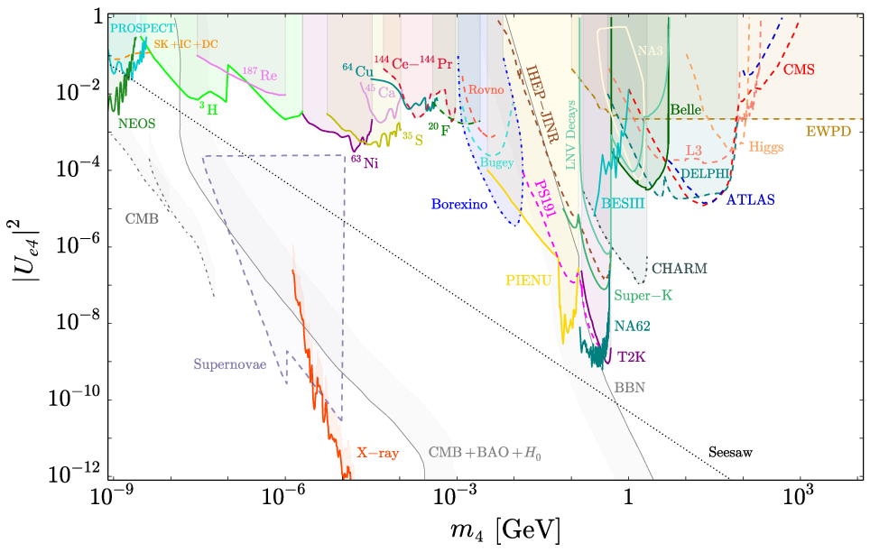
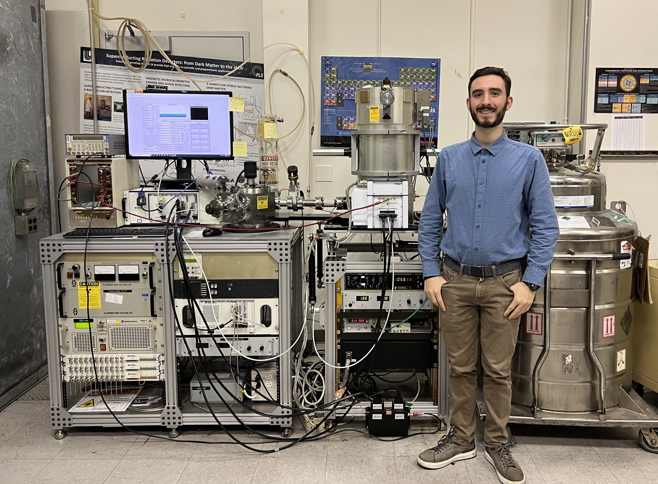
The BeEST in Context
Summary of Sterile Neutrino Searches (2021)
Tabletop BeEST Experiment
BeEST
2021
G$ experiments
From: Physics Reports 928, 1 (2021)
m₄ [GeV]

Slide 26

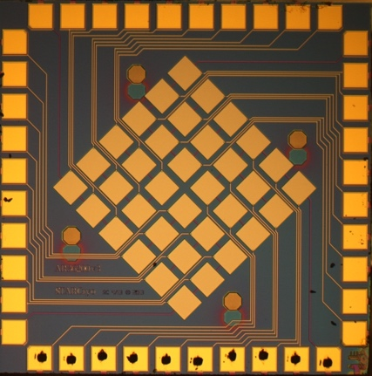
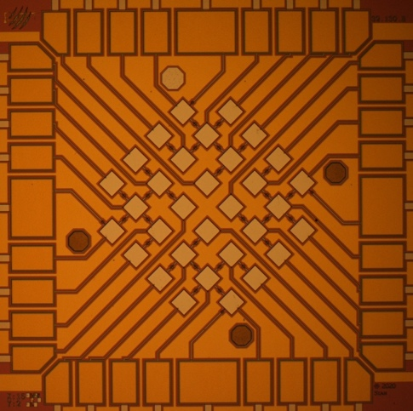
Current Work: New Materials and More Pixels
STJs from Different Materials
Currently Taking Data with Ta-STJ Array
Ta-STJ Detector
Nb-STJ Detector
Al-STJ Detector
Separate BSM physics from material effects.
Stay tuned!

Slide 27

Summary: STJs and the BeEST
Superconducting Tunnel Junctions
Beryllium-7 Electron Capture in STJs
• High energy resolution: ~1 – 5 eV
• High speed: >1000 counts/s per pixel
• No quenching
• High-sensitivity recoil measurement
• Exclusion to |U_{e4}|² to ~10⁻⁴ with 1 pixel
• Currently scaling to arrays

Slide 28







Thank You!
Stephan Friedrich
G.-B. Kim, I. Kim, A. Samanta, V. Lordi
Kyle Leach
S. Fretwell, C. Bray, A. Marino, C. Harris
Chris Ruiz
A. Lennarz, P. Machule, D. McKeen
BeEST Experiment
⁷Be Implantation
⇒ DFT Simulations
Cosmology
⇒ TEM Imaging
Weak Interaction Physics
Monte-Carlo Simulations
Robin Cantor
Ad Hall
Xavier Mougeot
⇒ STJ Fab
EC Decay Simulations
Bill Warburton
J. Harris
Jose-Paolo Santos
J. Machado, M. Guerra
Cynthia Volkert
H. Hadenfeldt, J. Arlt
⇒ STJ Electronics
Shake-up/off Simulations

