Slide 1
Tensor Target Developments
Elena Long
JLab Hall A/C Users Group Meeting
June 17th, 2022

Slide 2
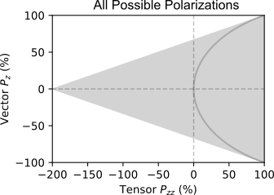
Tensor Polarization Basics
Spin-1
System
$$P_{zz}^{equil}=2−\sqrt{4−3P_{z}^{2}}$$
$=Gray Half−circle$
m = +1
m = 0
m = -1
( + )-2
Tensor $P_{zz}={(p}_{+}+p_{−})−2p_{0}$

Slide 3
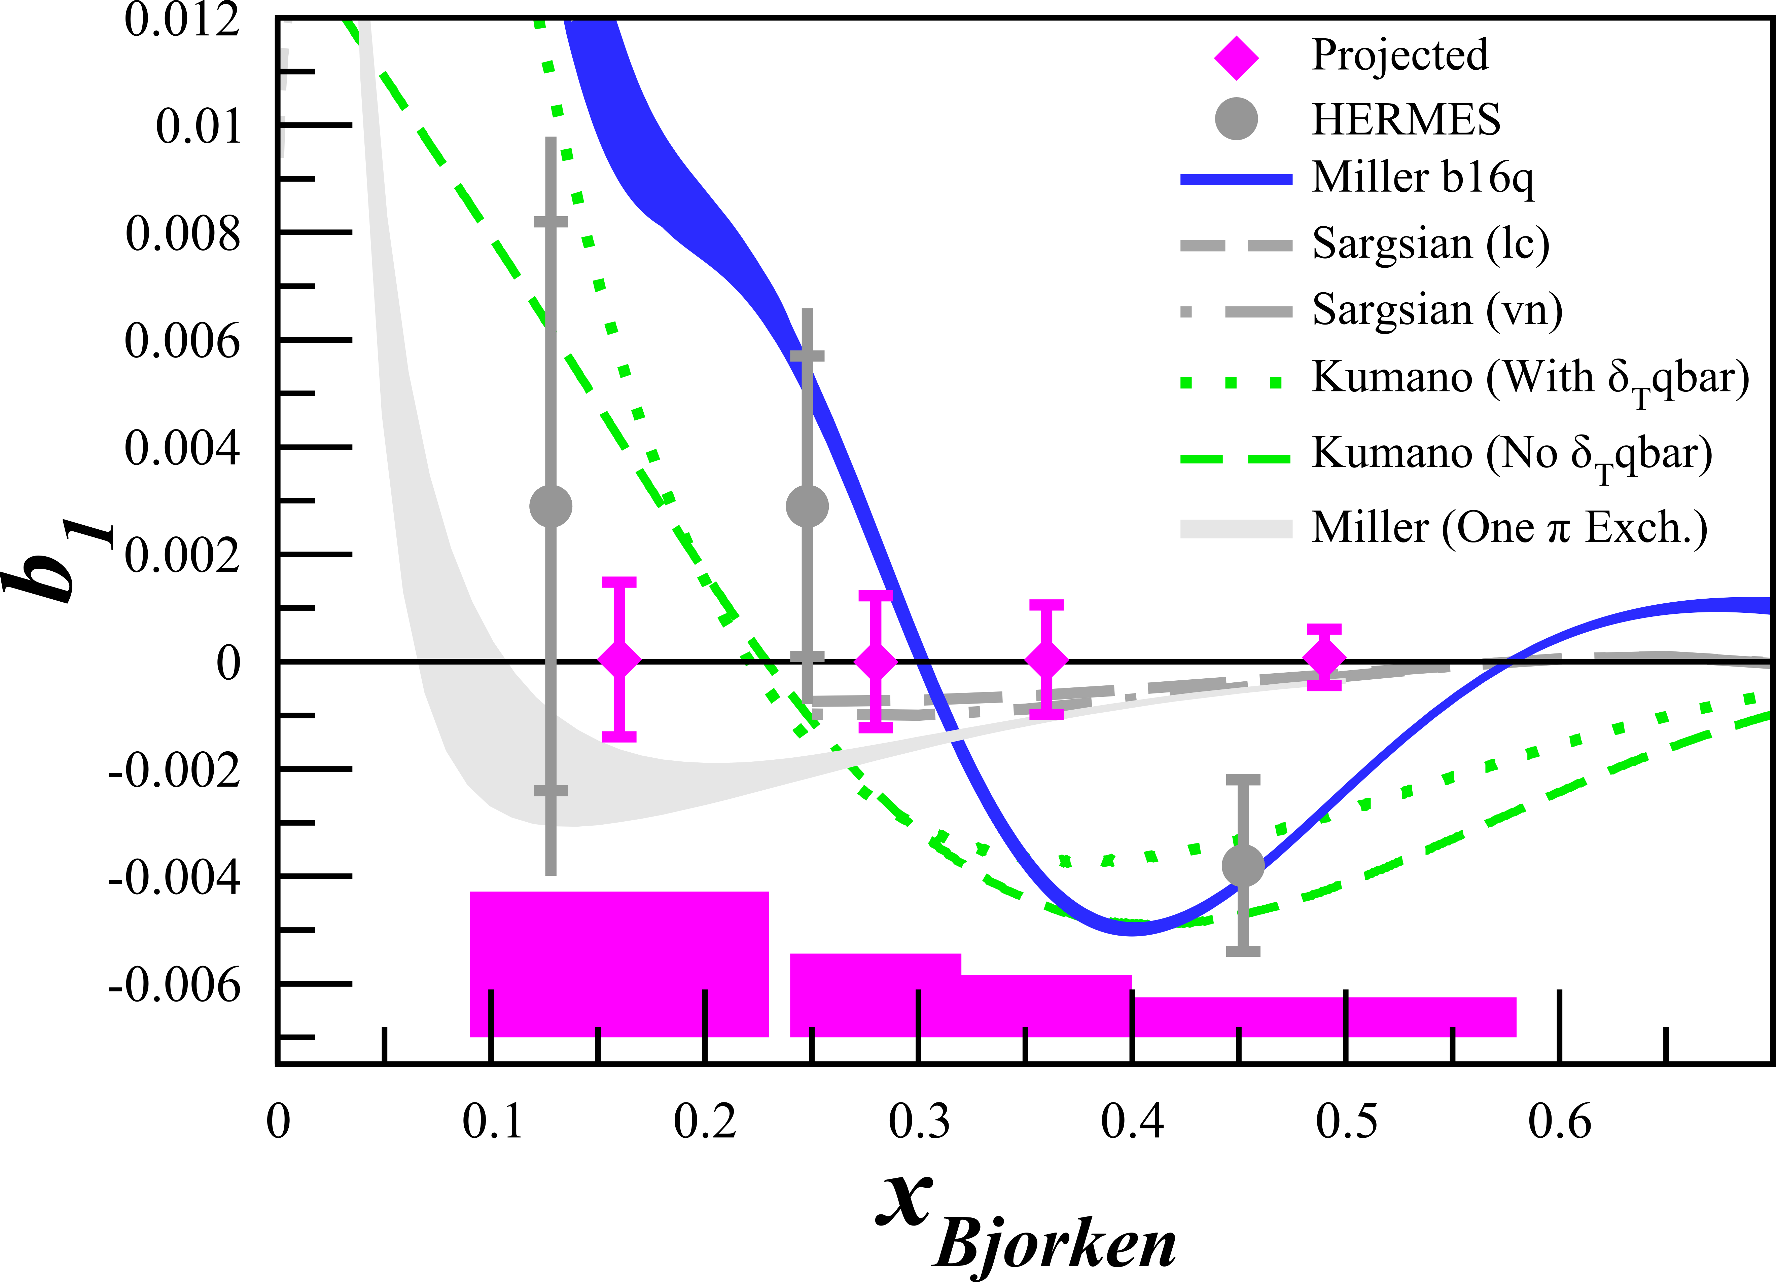
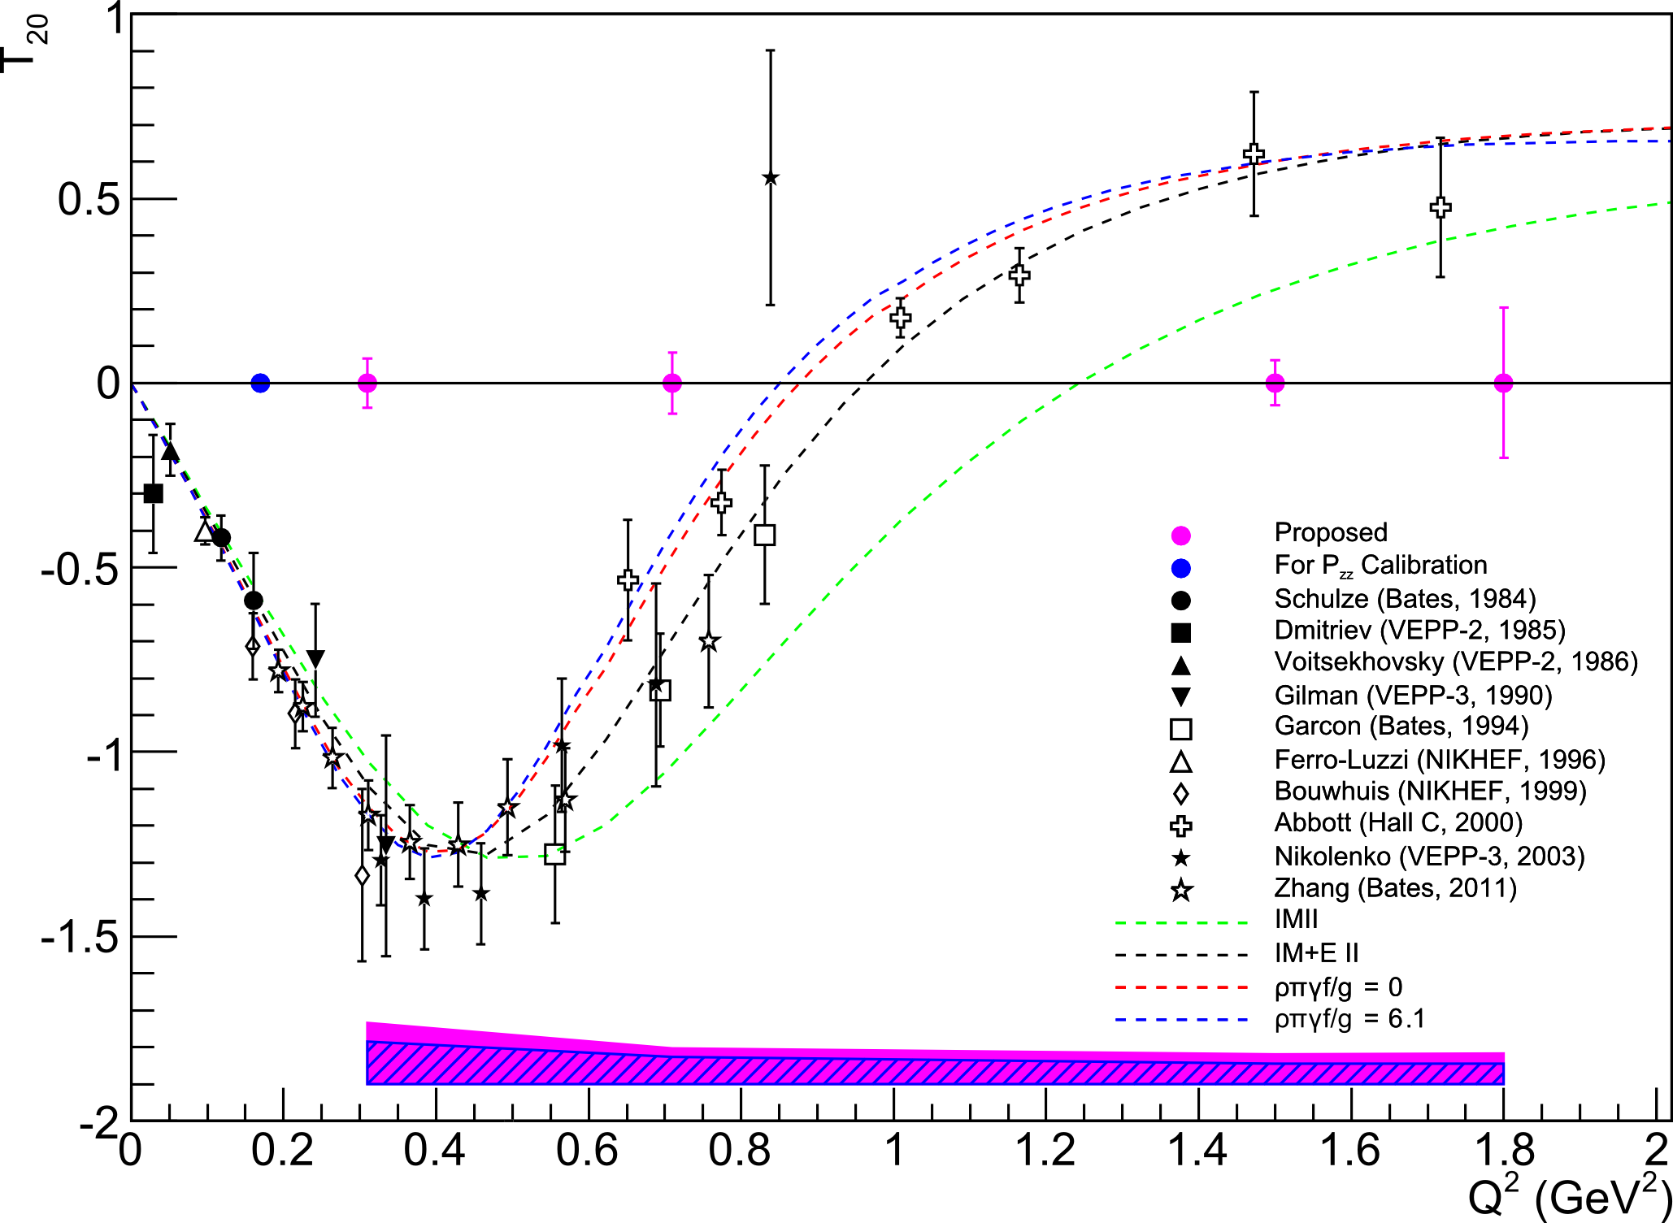
JLab Tensor Program
See K. Slifer’s talk at 1:48pm
C12-13-011: $b_{1}$
C12-15-005: $A_{zz}$
C12-15-005 Spokespeople:
E. Long, K. Slifer, P. Solvignon (UNH)
D. Keller, D. Day (UVA)
D. Higinbotham (JLab)
C12-15-005: $T_{20}$
C12-13-011 Spokespeople:
K. Slifer, E. Long, P. Solvignon (UNH)
D. Keller, O. Rondon (UVA)
J.-P. Chen (JLab)
N. Kalantarians (Hampton U.)
Condition: Achieve & reliably measure $P_{zz}≳30\%$

Slide 4
DNP Target Basics - Proton
Fill $m_{p}=+\frac{1}{2}$
Fill $m_{p}=−\frac{1}{2}$
Energy splitting of electrons is much bigger than for protons
At 5T and 1K, >99% of electrons are in their ground state
To change energy states, a system absorbs or emits photons of specific energies ($E=hν$)
In the right conditions, proton and electron levels can be coupled
We can measure the proton transition frequencies with NMR to measure the polarization
If bombarded with microwaves of the right frequency, we can excite the lower energy level states into higher energy level states
Electrons are much lighter than protons, so they relax to their ground state much more quickly
Each electron can excite multiple protons
$$e$$
$$p$$
$$e$$
$$p$$
$$e$$
$$p$$
$$e$$
$$ν_{p}$$
Energy
$$ν_{e}−ν_{p}$$
$$ν_{e}+ν_{p}$$
$$e$$
$$e$$
$$ν_{e}$$
$$ν_{p}$$

Slide 5
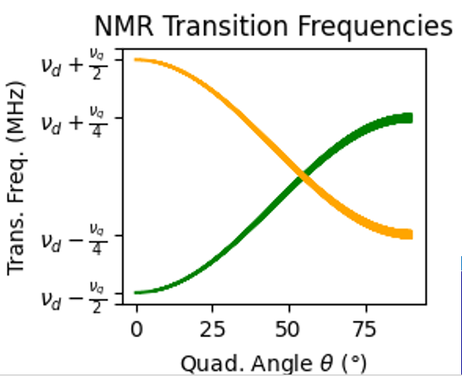
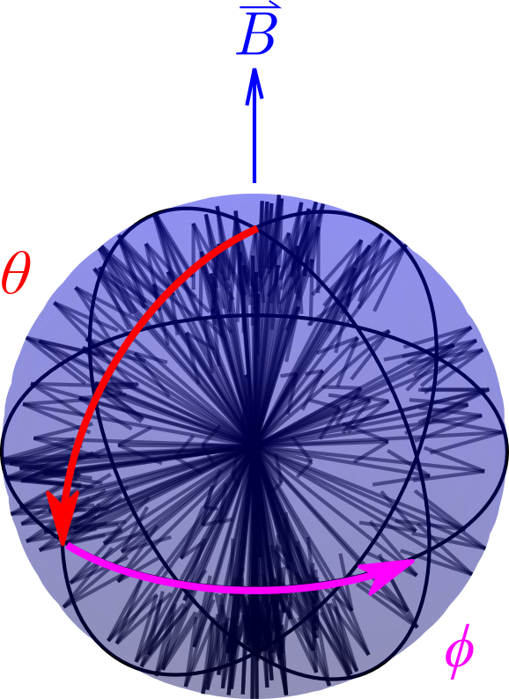
DNP Target Basics - Deuteron
We can do the same thing but with the deuteron
Instead of $m_{p}=±1/2$, the deuteron has 3 spin states: $m_{D}=−1, 0, 1$
And we need to shift the energy levels further in order to determine how many are in the $m_{D}=0$
We need that information to determine tensor polarization
This happens in ND₃ due to a quadrupole electric field from electronic molecular structure
This gets complex quickly, and is dependent on the angle $θ$ between the electric quadrupole field and external magnetic field
( + )-2
Tensor $P_{zz}={(p}_{+}+p_{−})−2p_{0}$

Slide 6
Measuring Polarization
For vector polarization,
$P_{z}=cc∙A_{NMR}=cc∙\left(I_{+}+I_{−}\right)$
For tensor polarization,
$P_{zz}=cc∙\left(I_{+}−I_{−}\right)$
Reducing $I_{−}$
Increases +$P_{zz}$
Line shape fits used to extract $I_{+}$ and $I_{−}$ area difference
D. Keller, et al., NIM A 981, 164504 (2020)
D. Keller, Eur. Phys. J. A 53, 155 (2017)

Slide 7
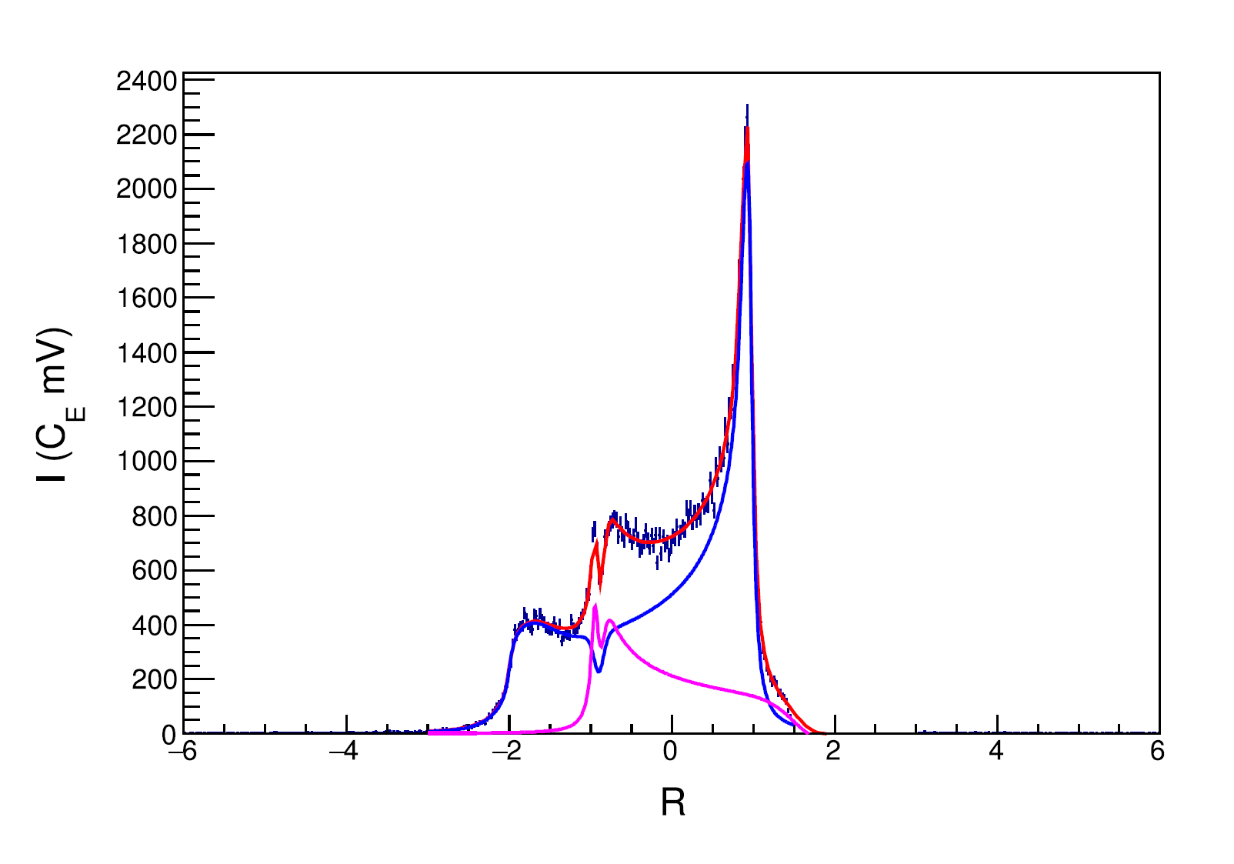
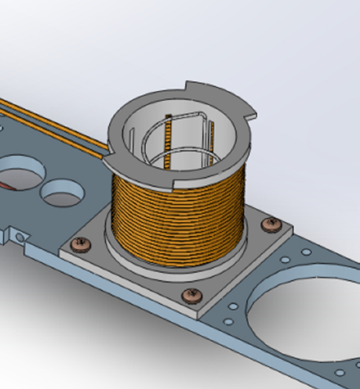
Semi-Selective RF Saturation (ssRF)
^{[1]} D. Keller, et al., NIM A 981, 164504 (2020)
^{[2]} D. Keller, Eur. Phys. J. A 53, 155 (2017)
^{[3]} A. Abragam, Principles of Nuclear Magnetism (1961)
Technique developed by D. Keller & UVA Polarized Target Lab^{[1,2]}
Additional RF coils drive spin-flips within NMR frequencies to minimize $I_{−}$ while having a minimal or enlargement factor on $I_{+}$
Frequencies are ‘mirrored’, but quadrupole angle $θ$ is not, so spin manipulation at one $θ$ shows up at two frequencies
Area reduction of $I_{−}(θ)$ causes a ½ area increase of $I_{+}(θ)$
To measure $P_{zz}$, a line shape derived from Abragam was used that allows for manipulated spin states with different polarizations at different frequencies (and thus different values of $θ$) ^{[2,3]}
UVA achieved $P_{zz}=28.8\%$ using ssRF^{[1]} on peak and shoulder of $I_{−}$
UVA $P_{zz}$ measurement agrees with independent UNH extraction within experimental uncertainty
$$P_{zz}=28.8\%±5.7\% {(rel)}^{[1]}$$
$$+\frac{1}{2}I(θ)$$
$$−I(θ)$$

Slide 8
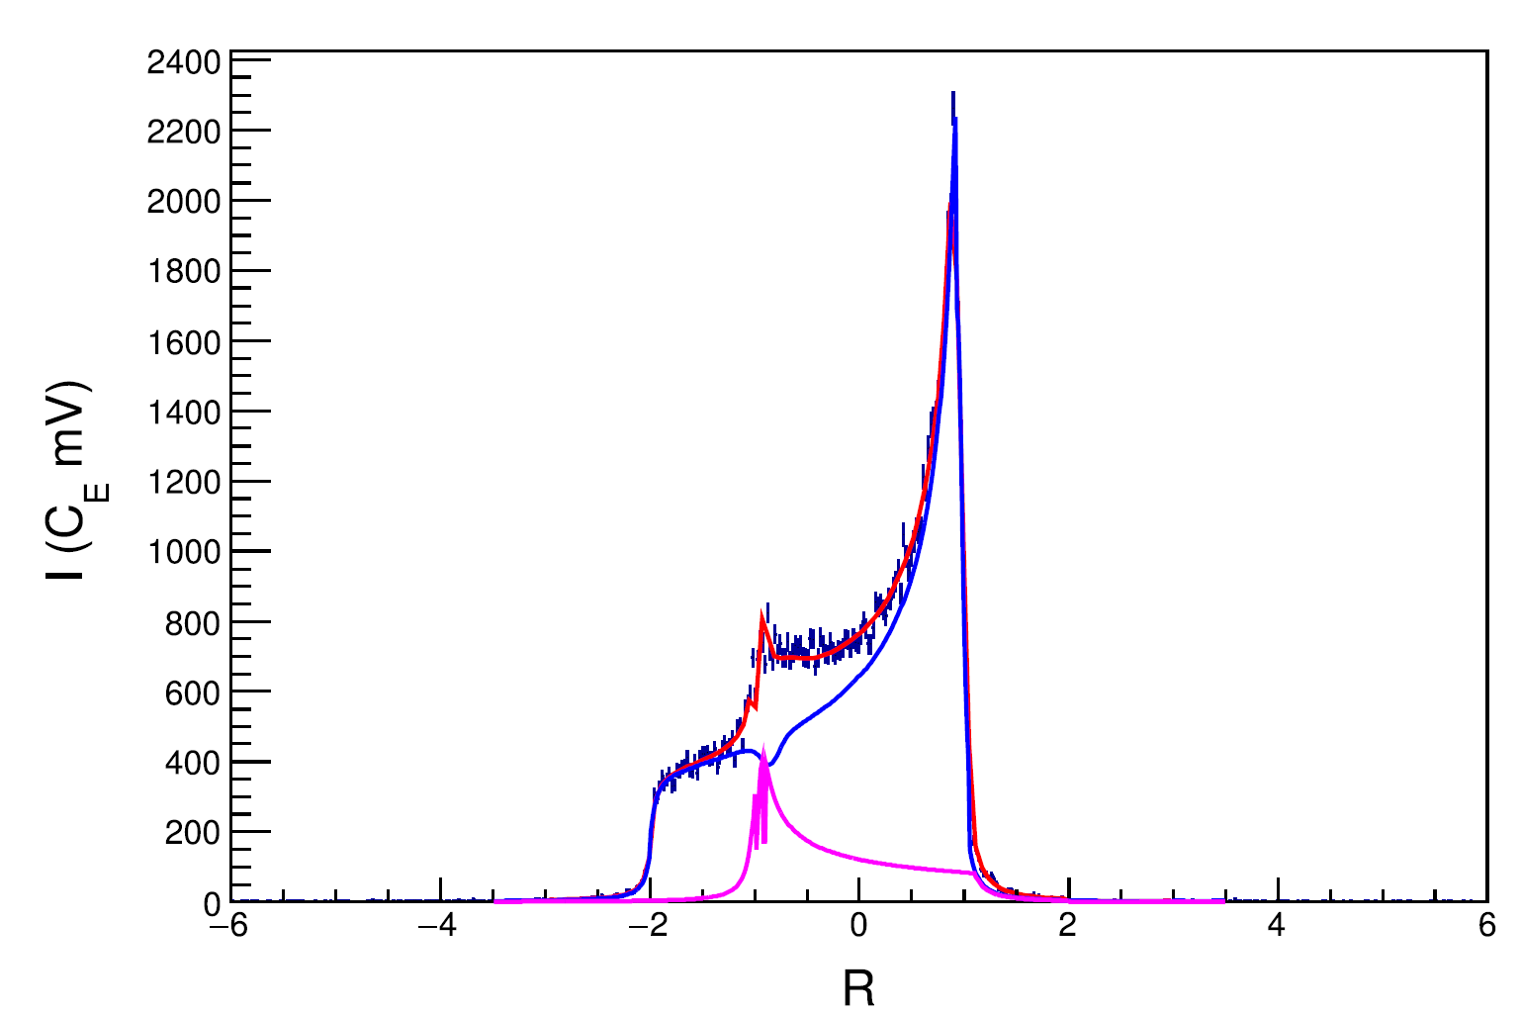
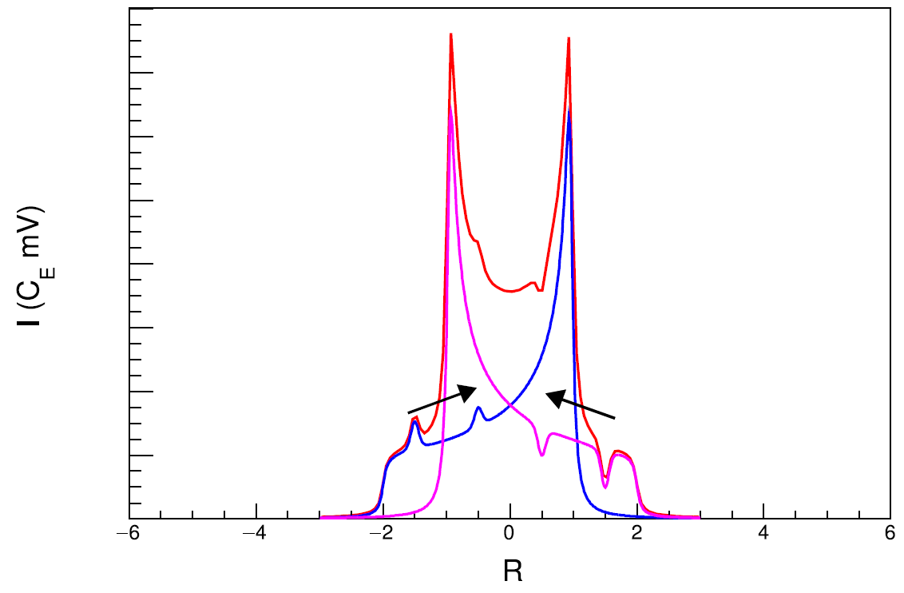
ssRF + Rotation
^{[1]} D. Keller, et al., NIM A 981, 164504 (2020)
^{[2]} D. Keller, Eur. Phys. J. A 53, 155 (2017)
Technique developed by D. Keller & UVA Polarized Target Lab^{[1,2]}
Rotating target material changes which nuclei are at which $θ$, and thus which NMR frequency
Rotating during ssRF can better transport spin manipulation, further increasing tensor polarization
Ideal rotation would be about $θ_{MAS}=54.7°$
UVA achieved $P_{zz}>36\%$ using double ssRF + rotation^{[1]}
$$P_{zz}=36.3\%±9.3\% {(rel)}^{[1]}$$
ssRF
Rot.
ssRF
$A_{zz} \& b_{1}$ Condition: Achieve & reliably measure $P_{zz}≳30\%$
Rot.

Slide 9
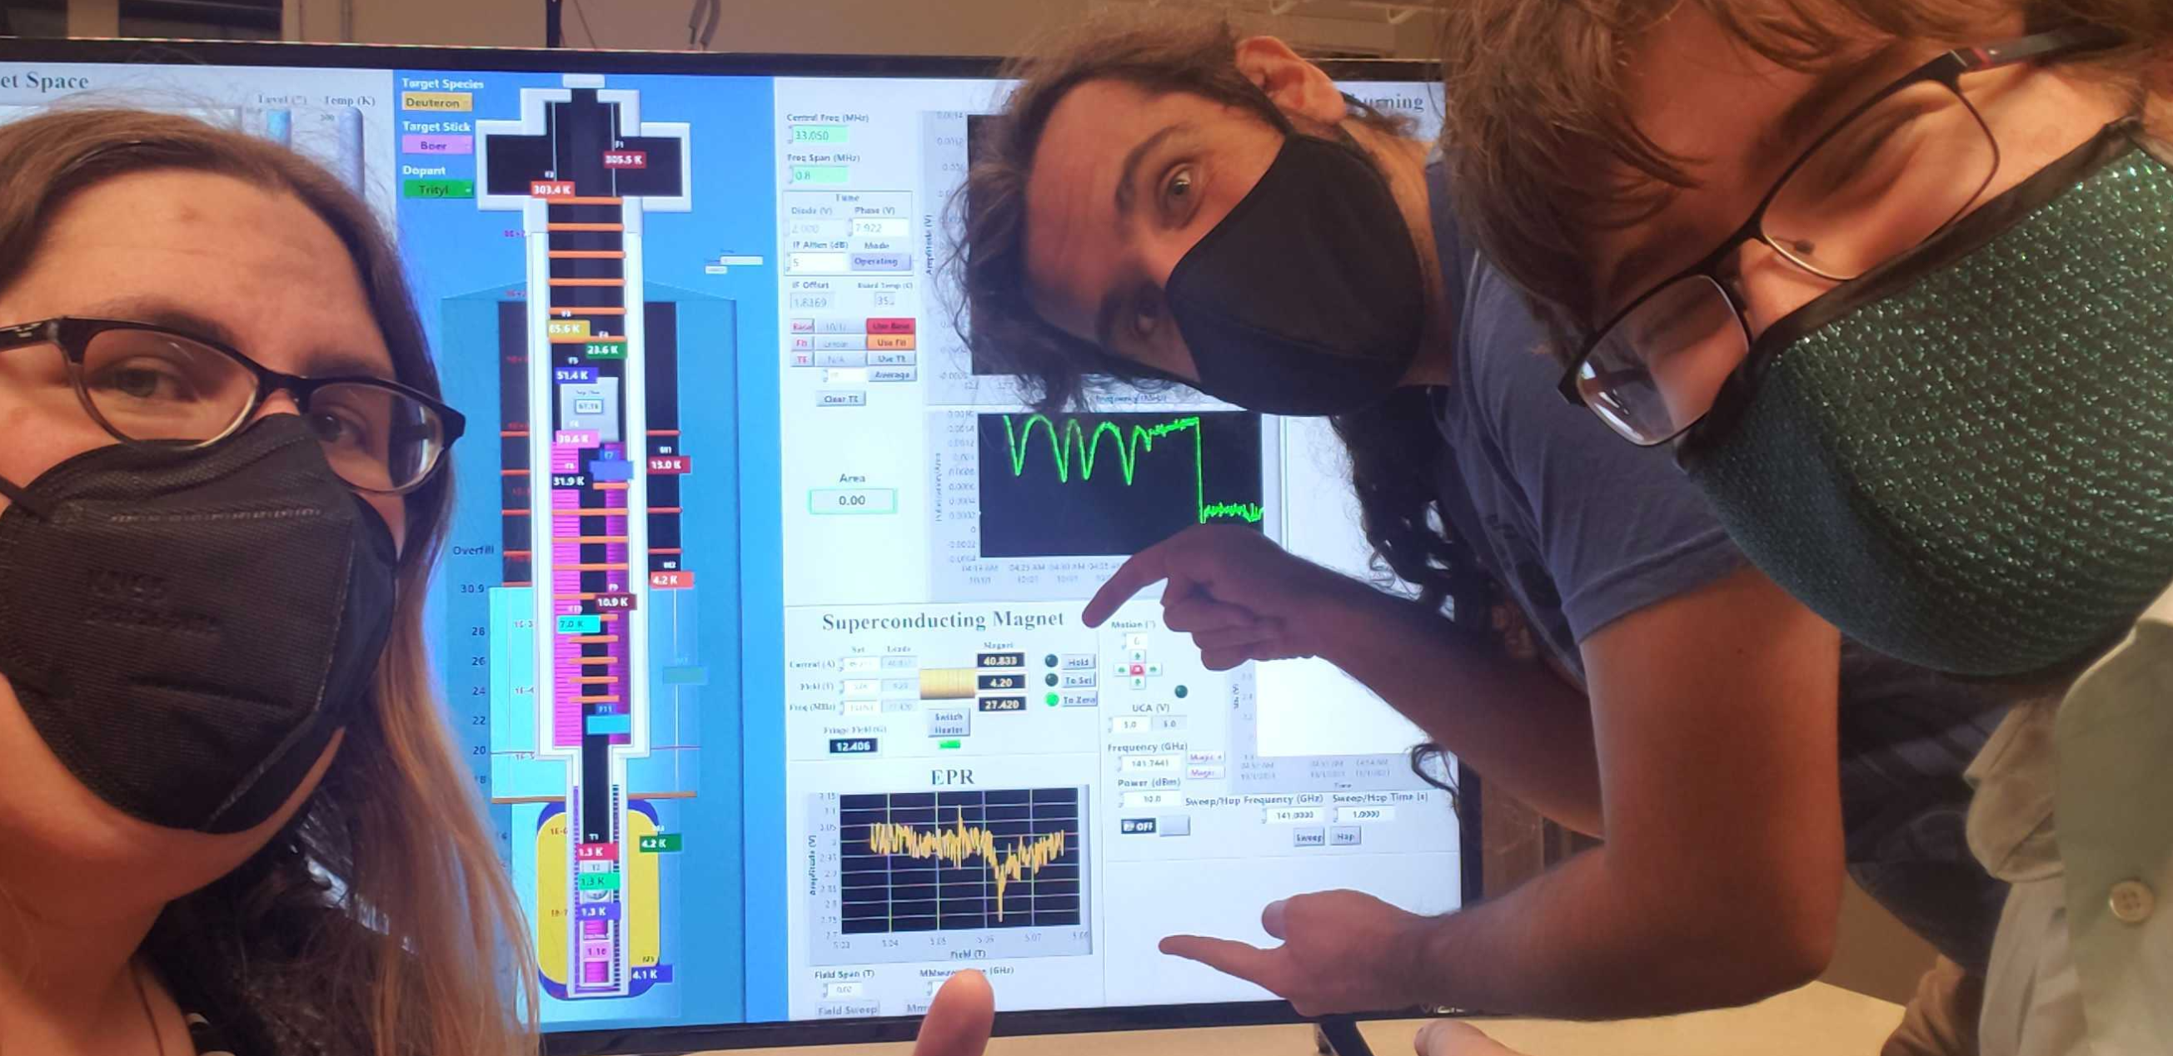
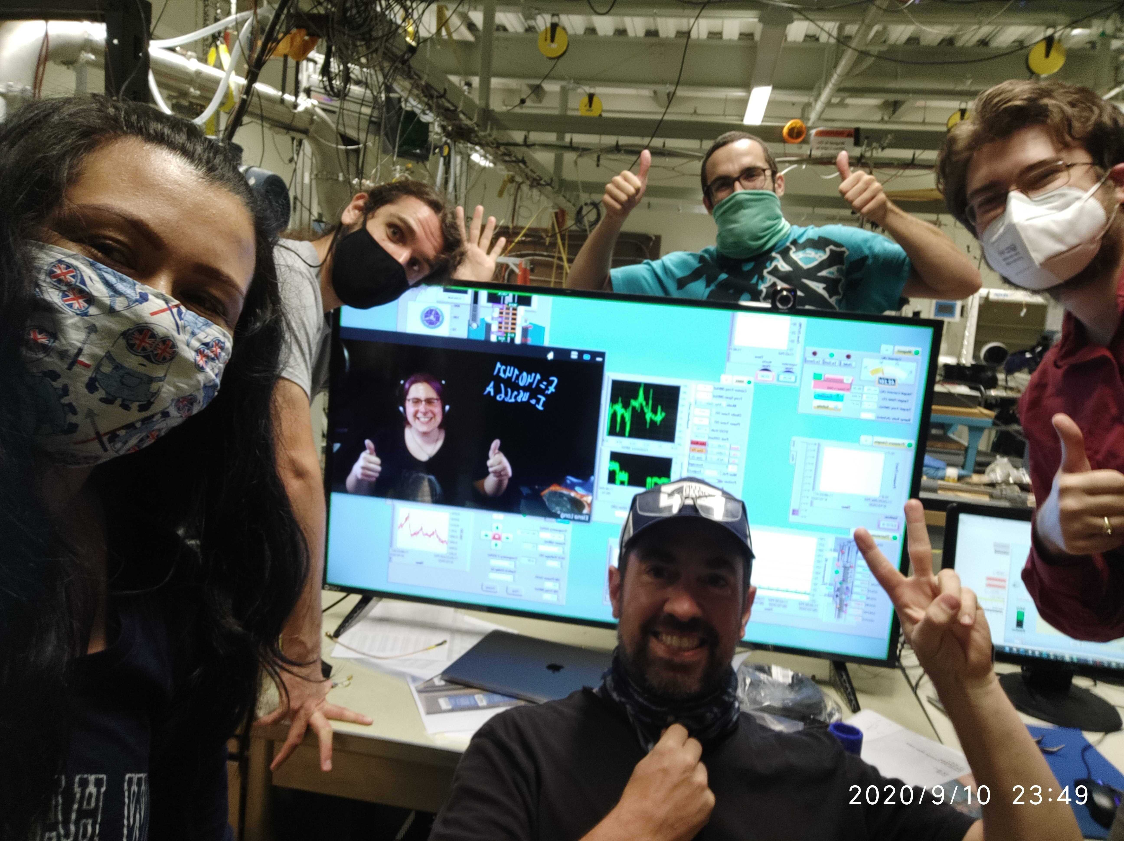
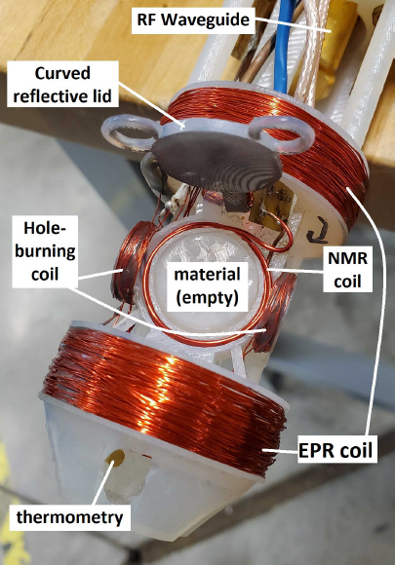
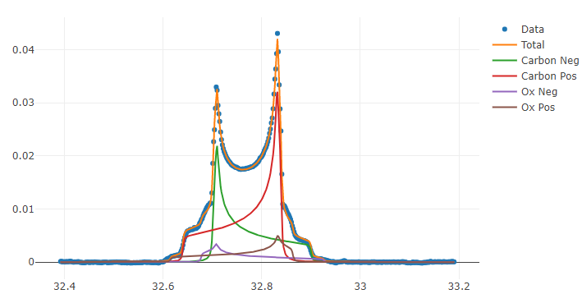
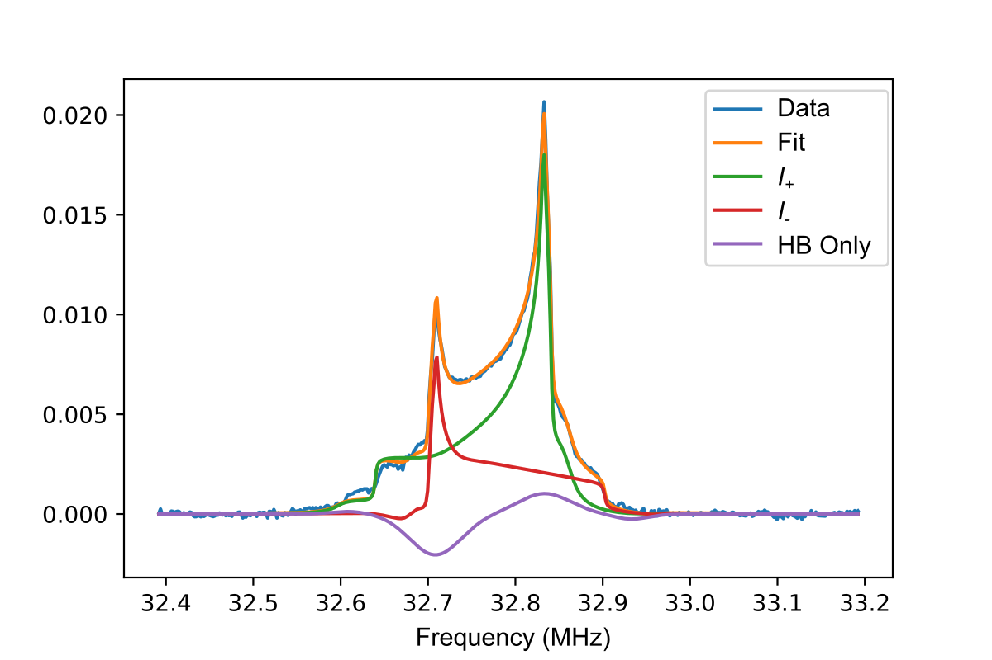
UNH Polarized Target Lab
We’re up and running with proton polarization & deuteron polarization
+ recent $P_{zz}$ enhancement via RF manipulation
System optimization in progress
First UNH EPR Measurement 10/1/21
Vector Enhancement
Preliminary
Tensor Enhancement
Very Preliminary
First UNH deuteron DNP Measurement 9/10/20
Courtesy M. McClellan
Courtesy M. McClellan
Courtesy E. Mustafa

Slide 10
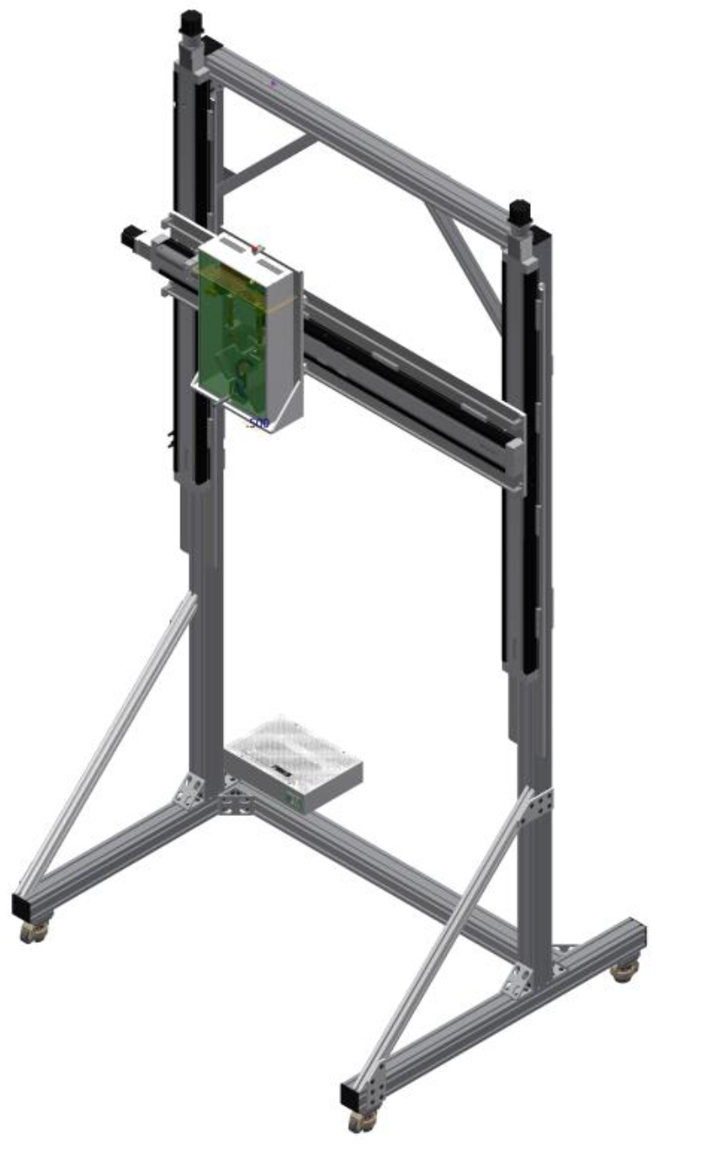
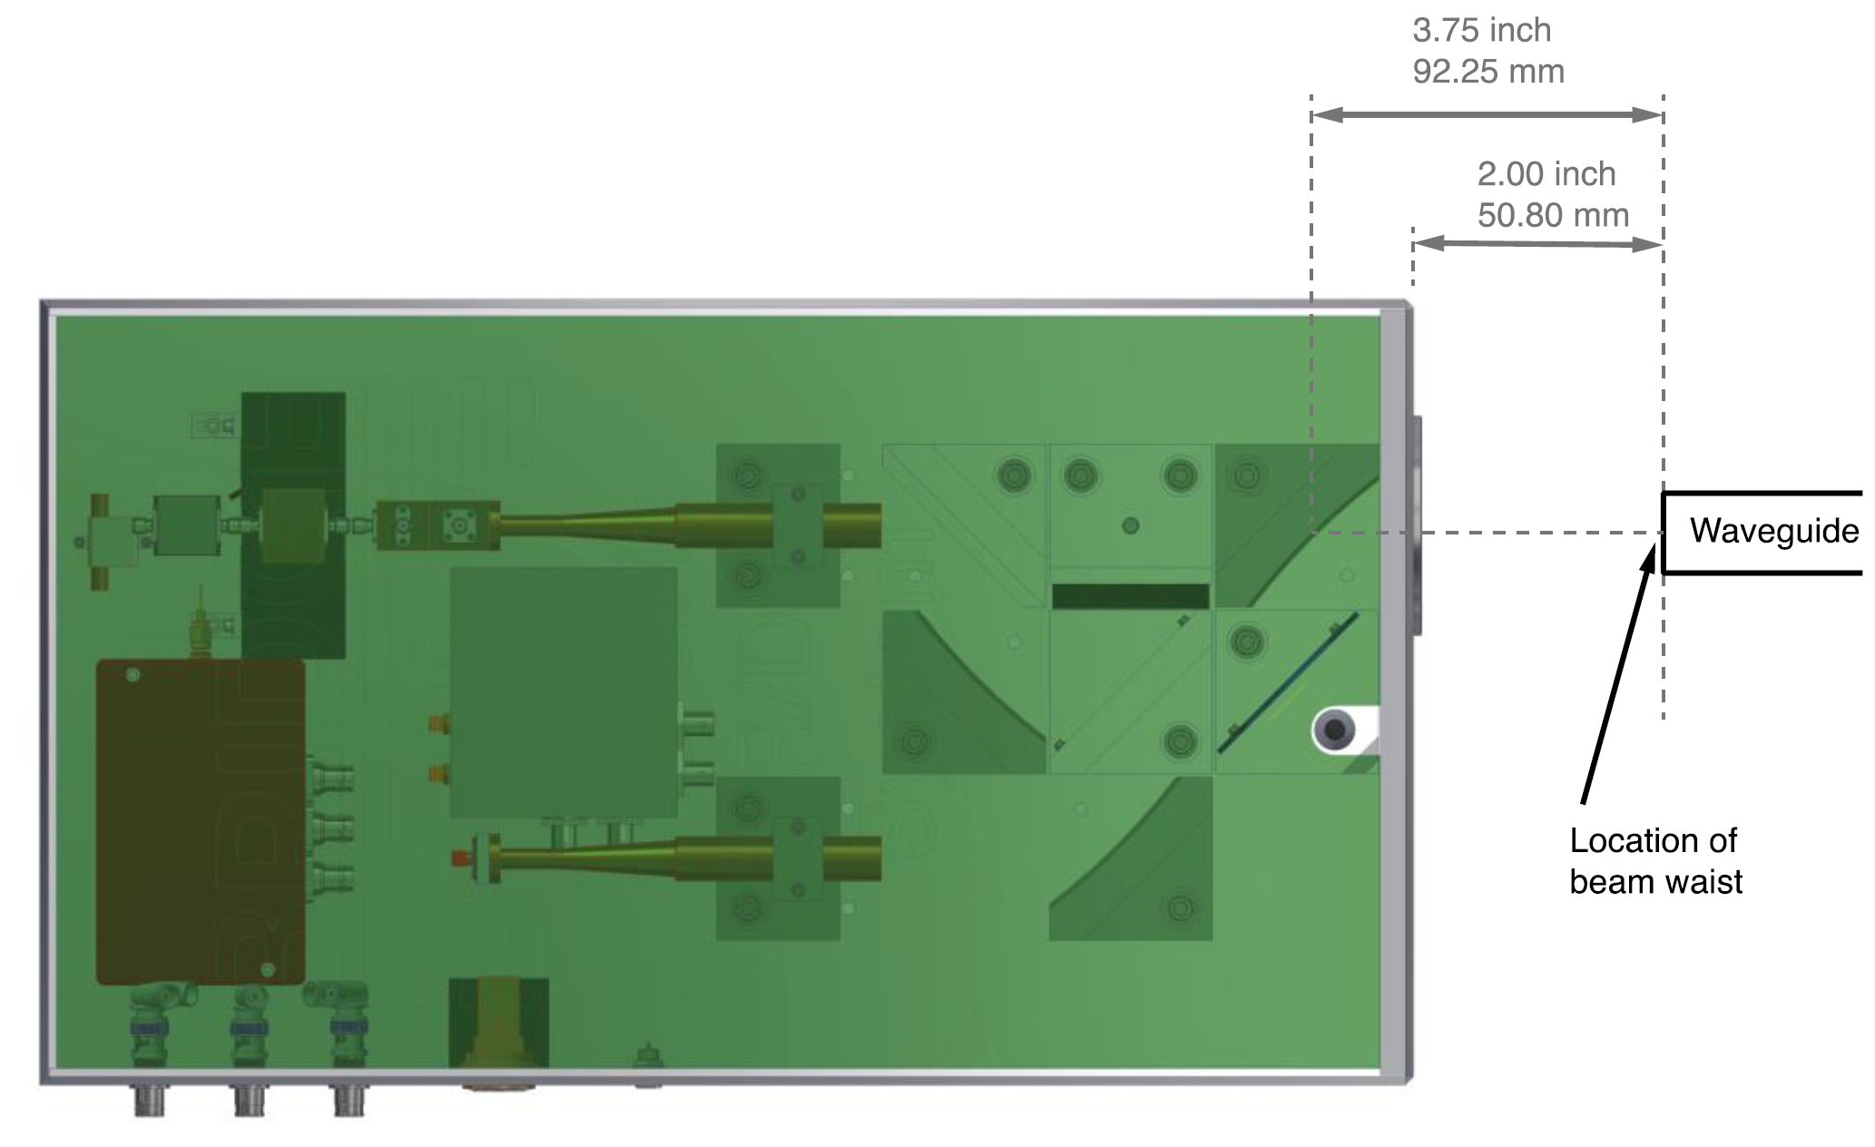
Solid-State mm-Wave System
12x Frequency Multiplier & Amplifier Chain
12 GHz Signal Generator
EPR Detector

Slide 11
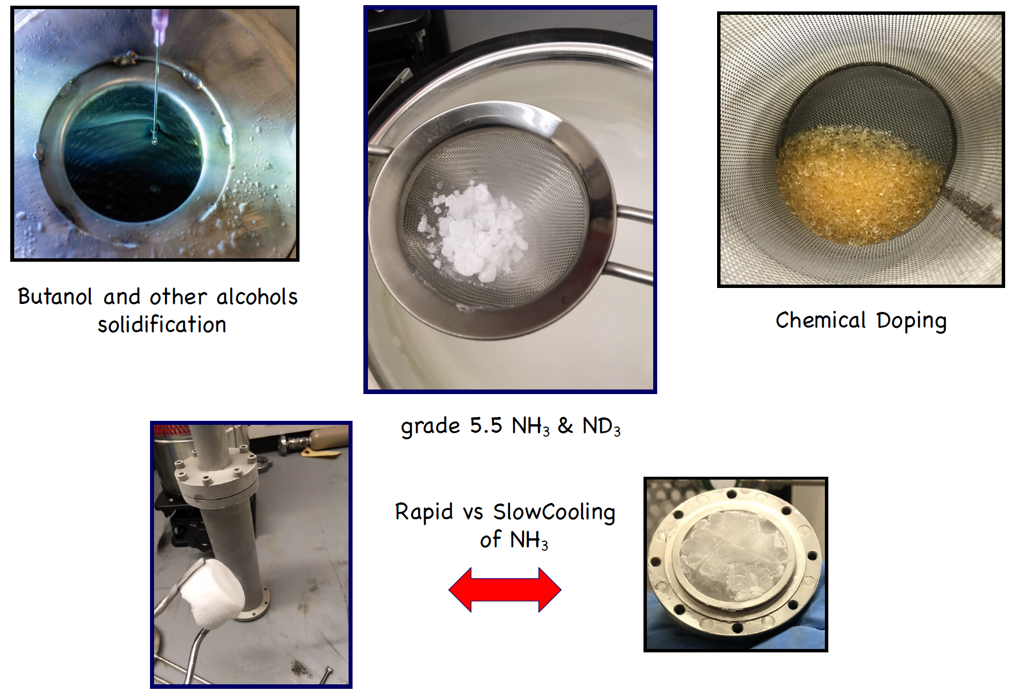
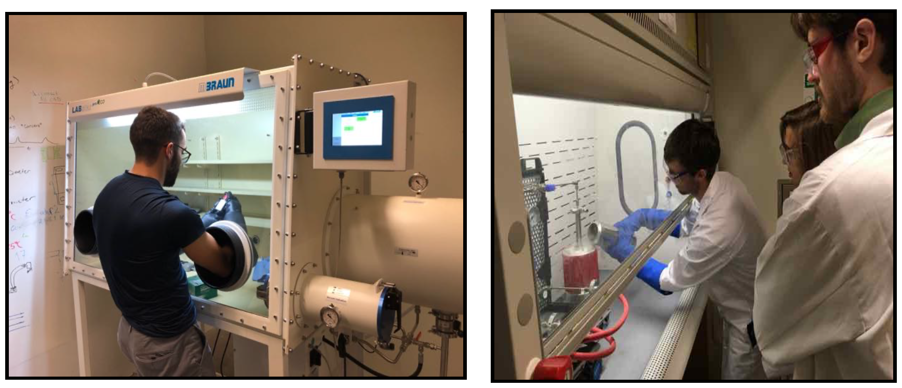
Material Production @ UNH
D.M. Aliaga, et al, NIM A 972, 164061 (2020)
Dedicated fume hood for handling Ammonia and other caustic/toxic materials
Vacuum Glove Box allows for over/under-pressuring
Primarily chemical doping of ammonia and alcohols for now
But potential to do much more
We’ve produced about 200 grams of NH₃ plus a few grams of ND₃
Courtesy K. Slifer

Slide 12
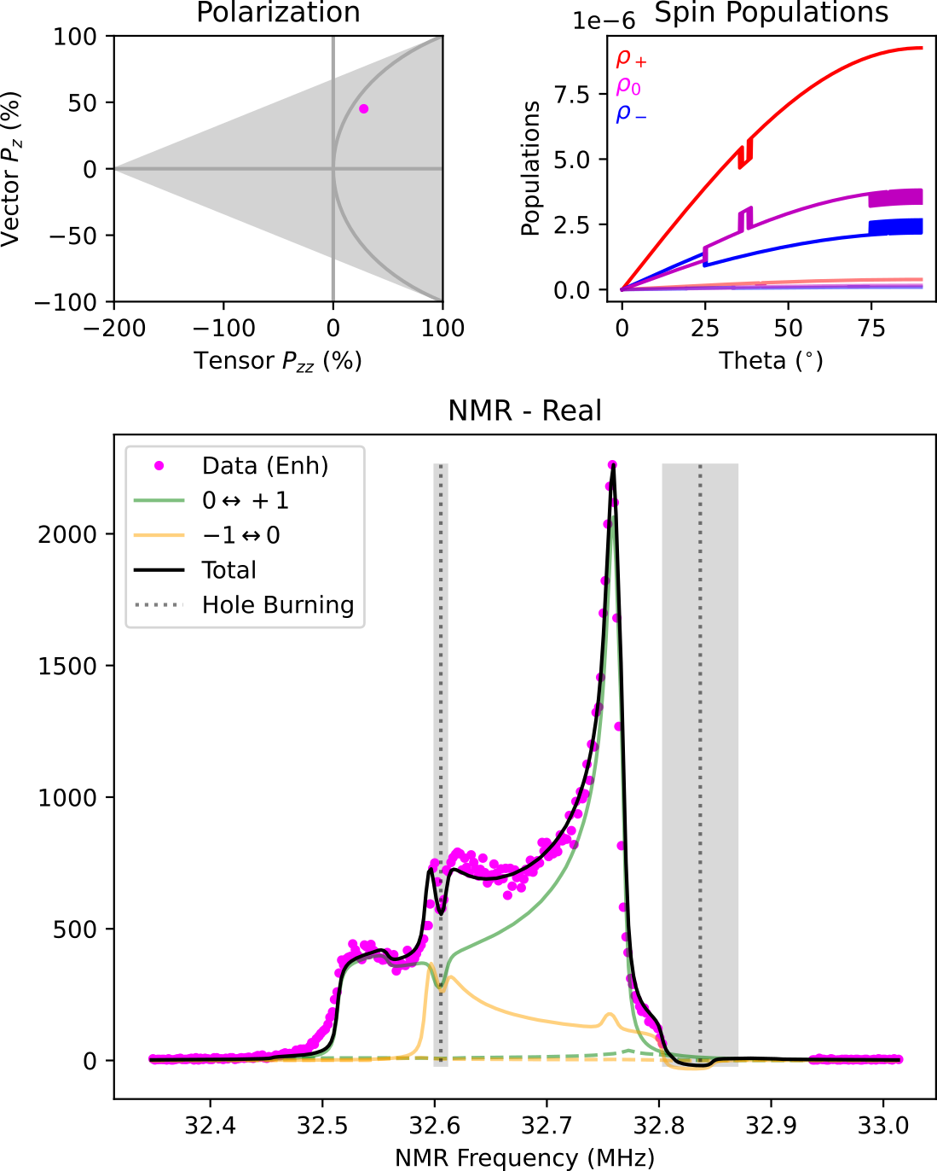
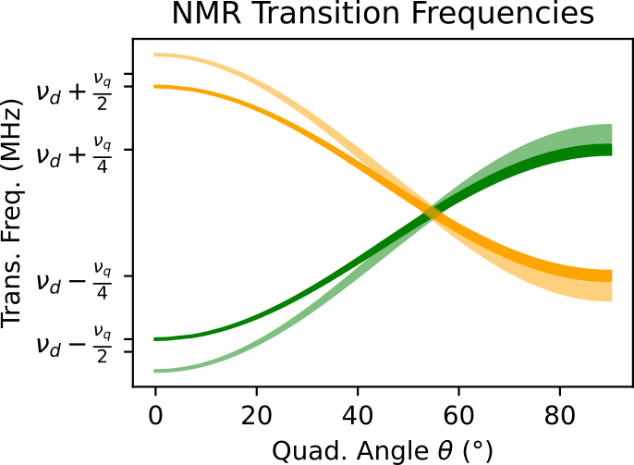
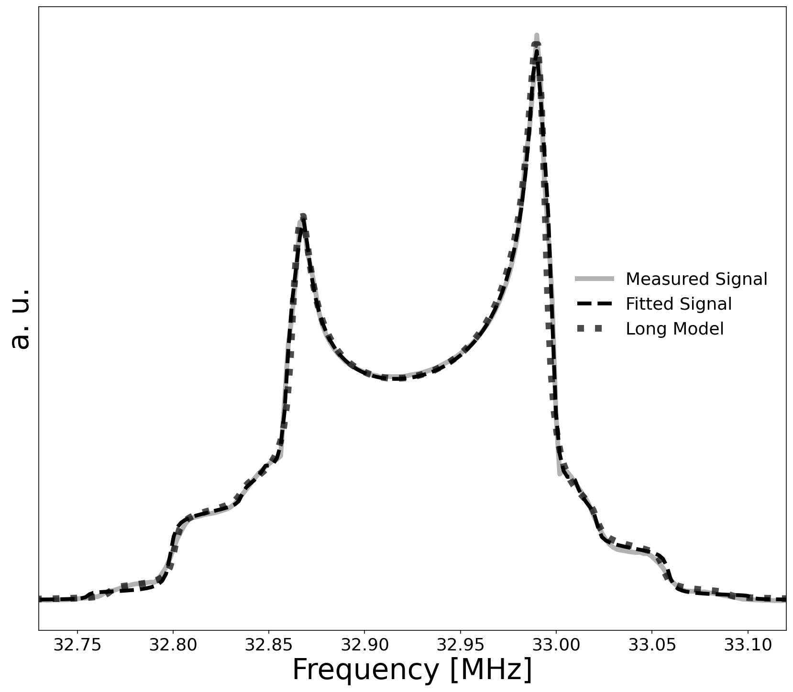
UNH NMR Simulation
M.H. Cohen, F. Reif, Solid State Phys. 5, 321 (1957)
UNH simulation based on modified Cohen & Reif
Calculates transition frequencies from energy levels
$E_{m}/h=−mν_{D}+\frac{1}{2}ν_{q}f_{0}^{H}\left(m^{2}−\frac{I(I+1)}{3}\right)$
$f_{0}^{H}=\frac{3}{2}\cos^{2}{θ}−\frac{1}{2}−\frac{1}{2}η\sin^{2}{θ}\cos{(2φ)}$
$I=1$ and $m=−1, 0, +1$
Assumes random powder pattern for $θ$ & counts spin flips across NMR frequency bins
Calculates ~125,000 spin flips into ~300 NMR bins
Spin flips determined by $P_{z}$ and $P_{zz}$, which can be independent in $θ \& φ$ bins to account for simple RF manipulation
Broadens each frequency bin into all others via real & imaginary Lorentzian
Allows phase angle extraction
Higher order spin diffusion not yet fully implemented
Simulation already agrees with UVA direct $P_{zz}$ measurement within experimental uncertainties, and we expect this agreement to further improve once spin diffusion is fully implemented
Extremely
Preliminary
Preliminary
Courtesy M. McClellan

Slide 13
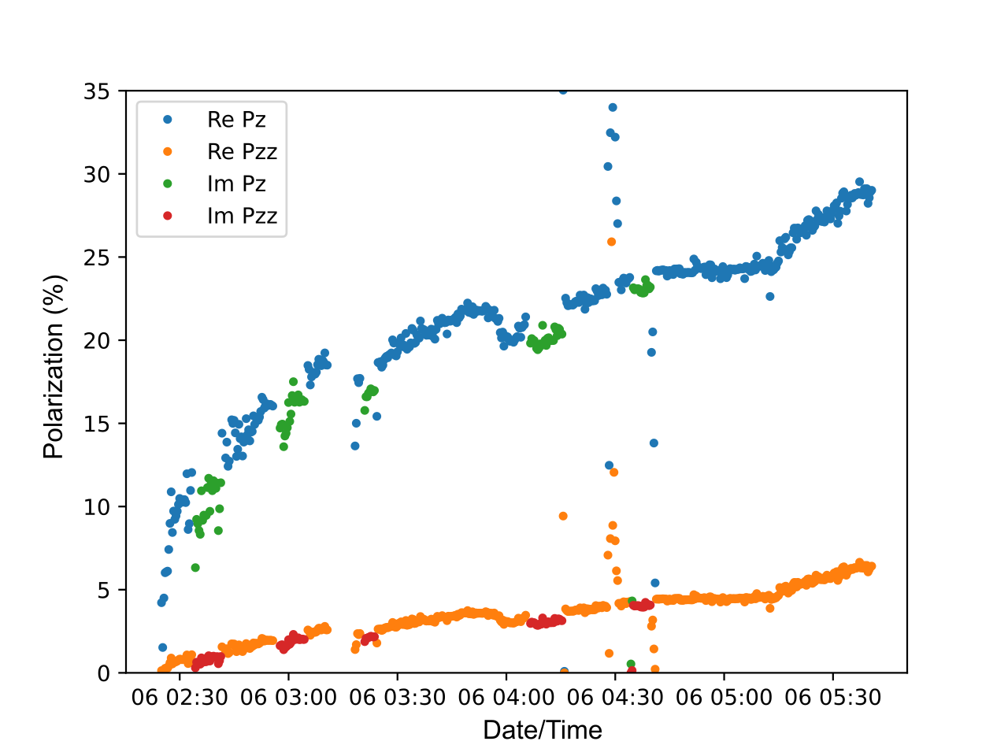
Real & Imaginary NMR Signals
Recently took first data swapping between real and imaginary NMR signals
Imaginary NMR was not ideally tuned, with an off-tuned phase angle of approximately $−20°$
Preliminary polarization extraction with both signal types is encouraging
Used Dulya fits for real & modified Dulya fits for imaginary
Much optimizing to be done!
Extremely
Preliminary
C. Dulya, NIM A 398, 109 (1997)
Courtesy M. McClellan & E. Mustafa

Slide 14
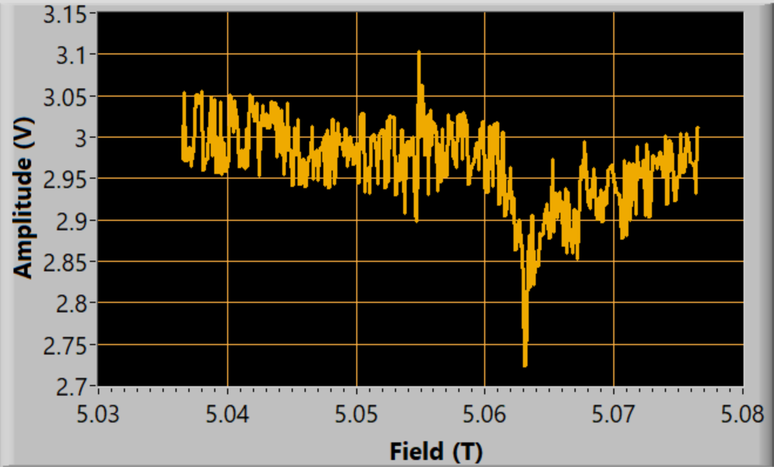
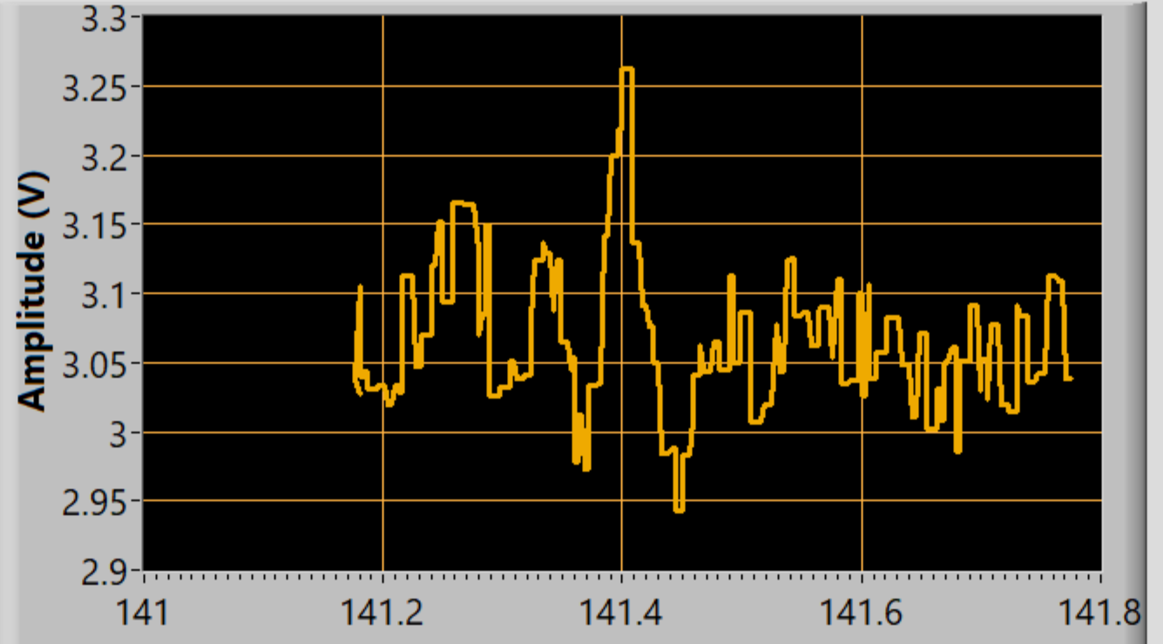
Material Characterization
Microwave sweeping allows measurements of polarization changes vs. frequency that are used to optimize polarizing frequencies
‘Effective’ EPR spectra
Direct 5T/1K EPR measurement system currently being commissioned
TEMPO p-Araldite
dP_{z}/dt
TEMPO d-Butanol
Mag. Field-Swept EPR
mmWave Frequency-Swept EPR
Extremely
Preliminary
Extremely
Preliminary
Trityl d-Propanediol
mmWave Freq./Mag. Field (GHz/T)

Slide 15
Summary
$P_{zz}>30\%$ has been achieved and reliably measured
Achieved by UVA target lab
Meeting of $A_{zz} \& b_{1}$ conditionals to be reviewed in coming weeks
UNH polarized target lab is operational and productive
D. Keller, et al., NIM A 981, 164504 (2020)
UVA
$$P_{zz}=36.3\%±9.3\%(rel)$$
UNH

Slide 16
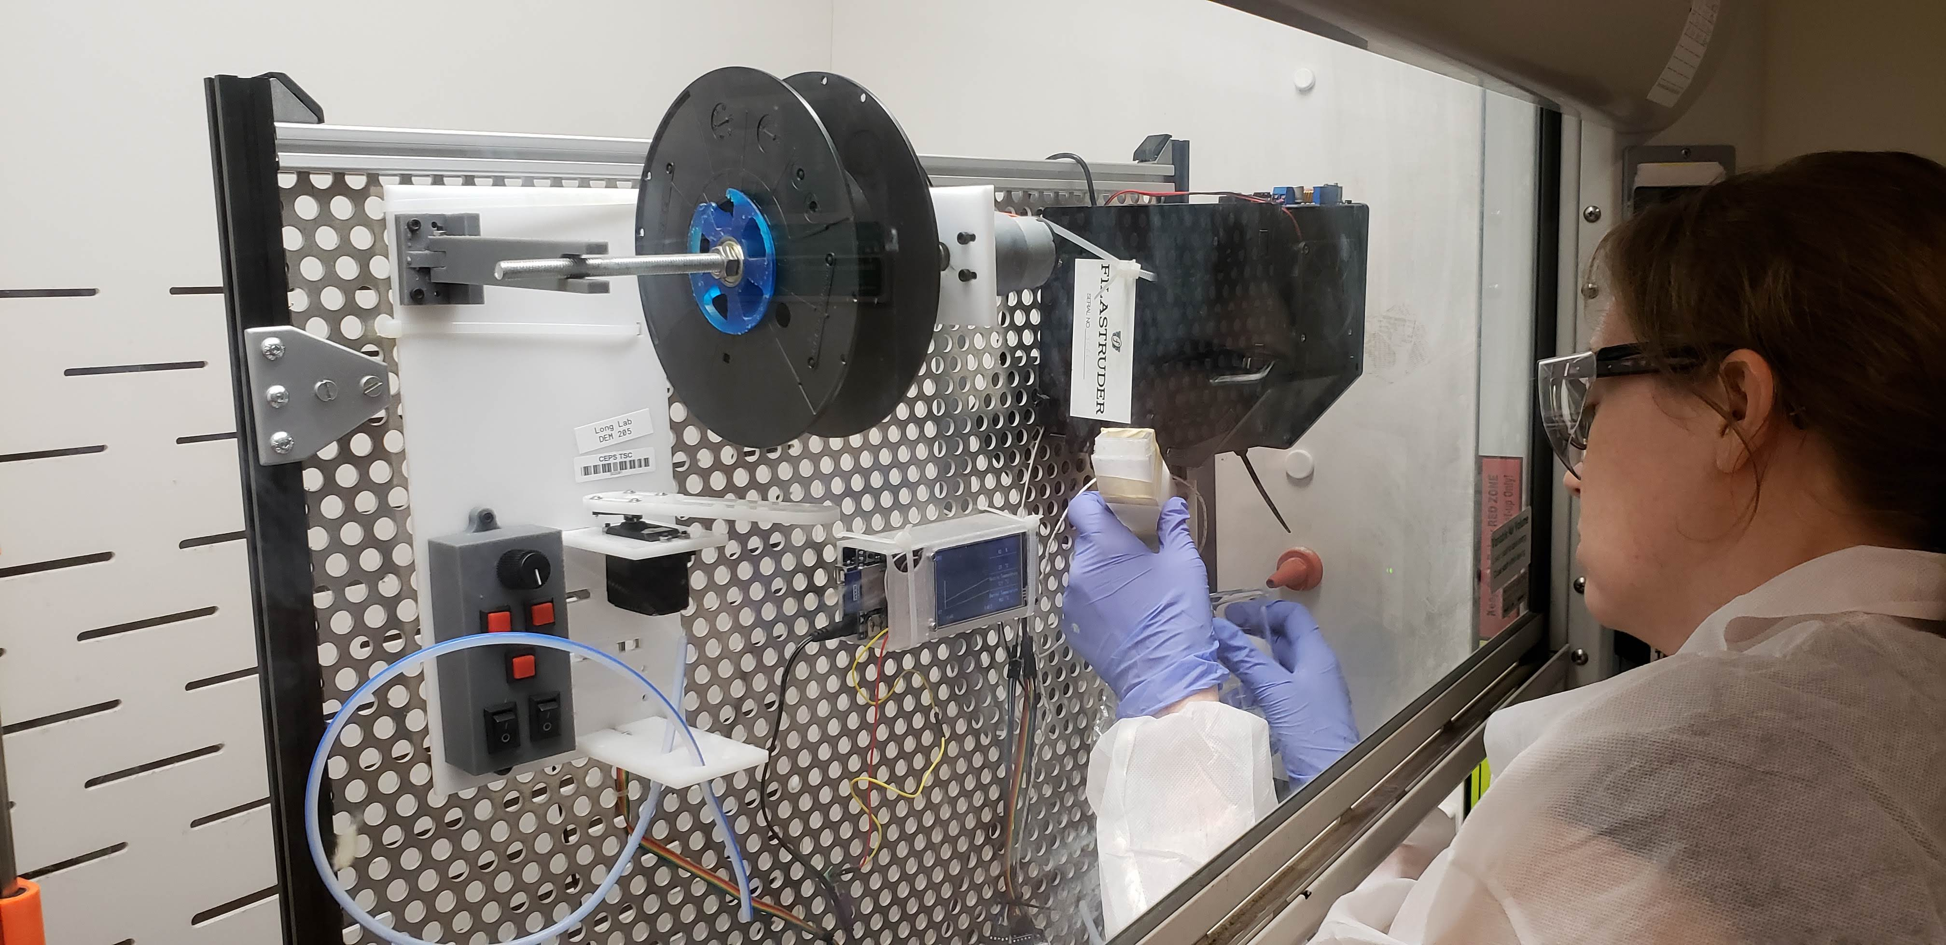
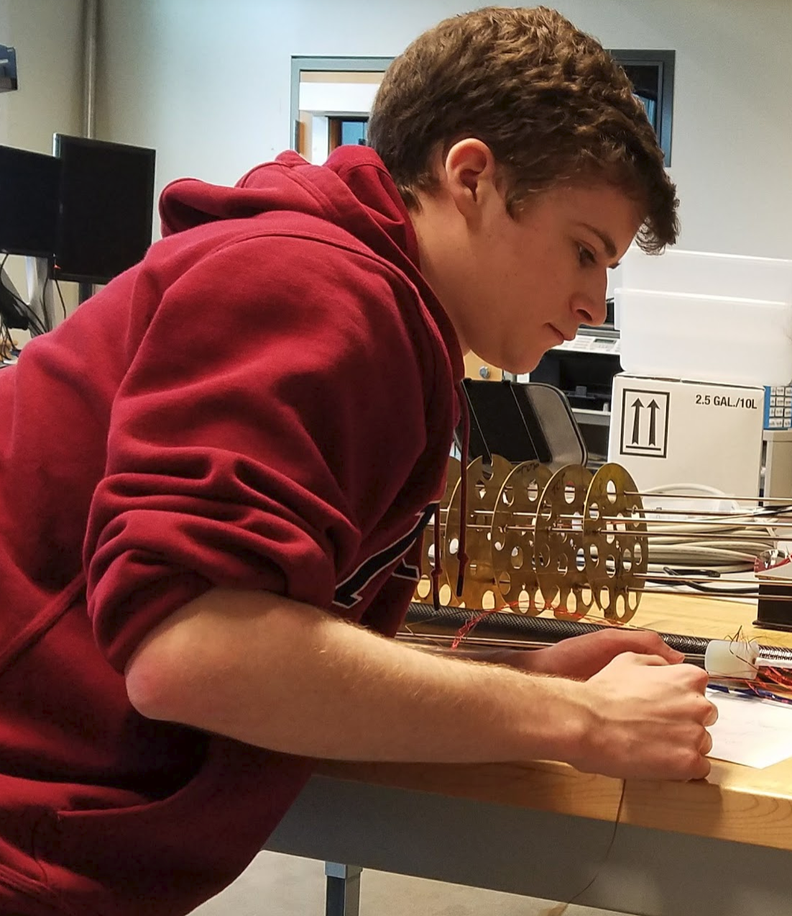
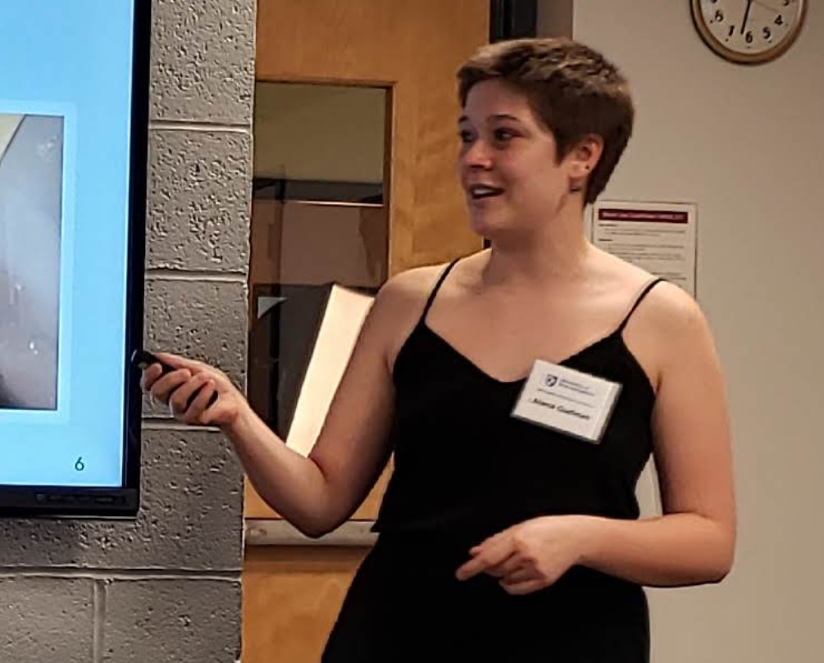
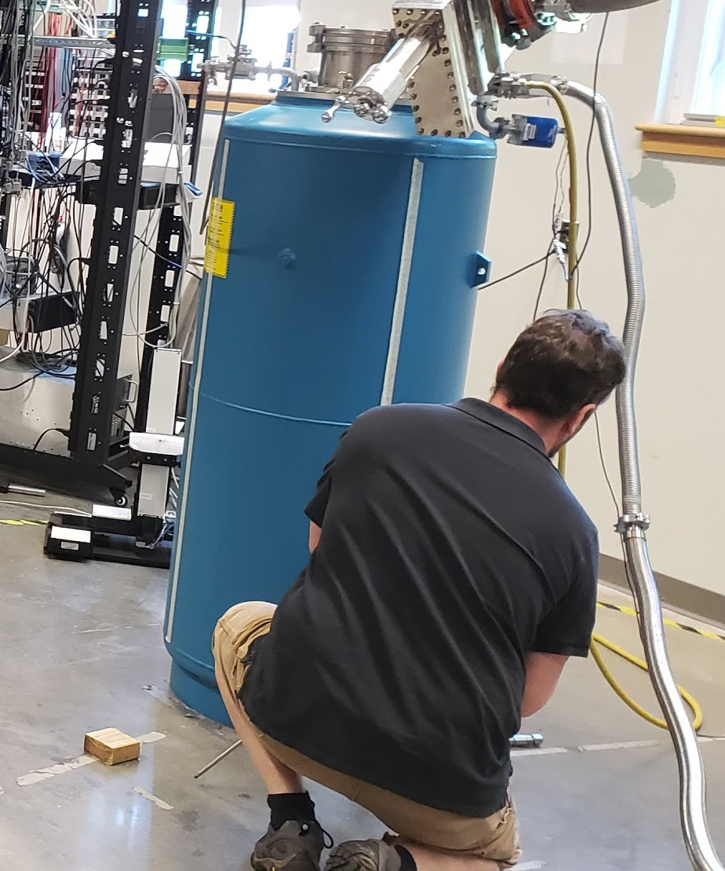
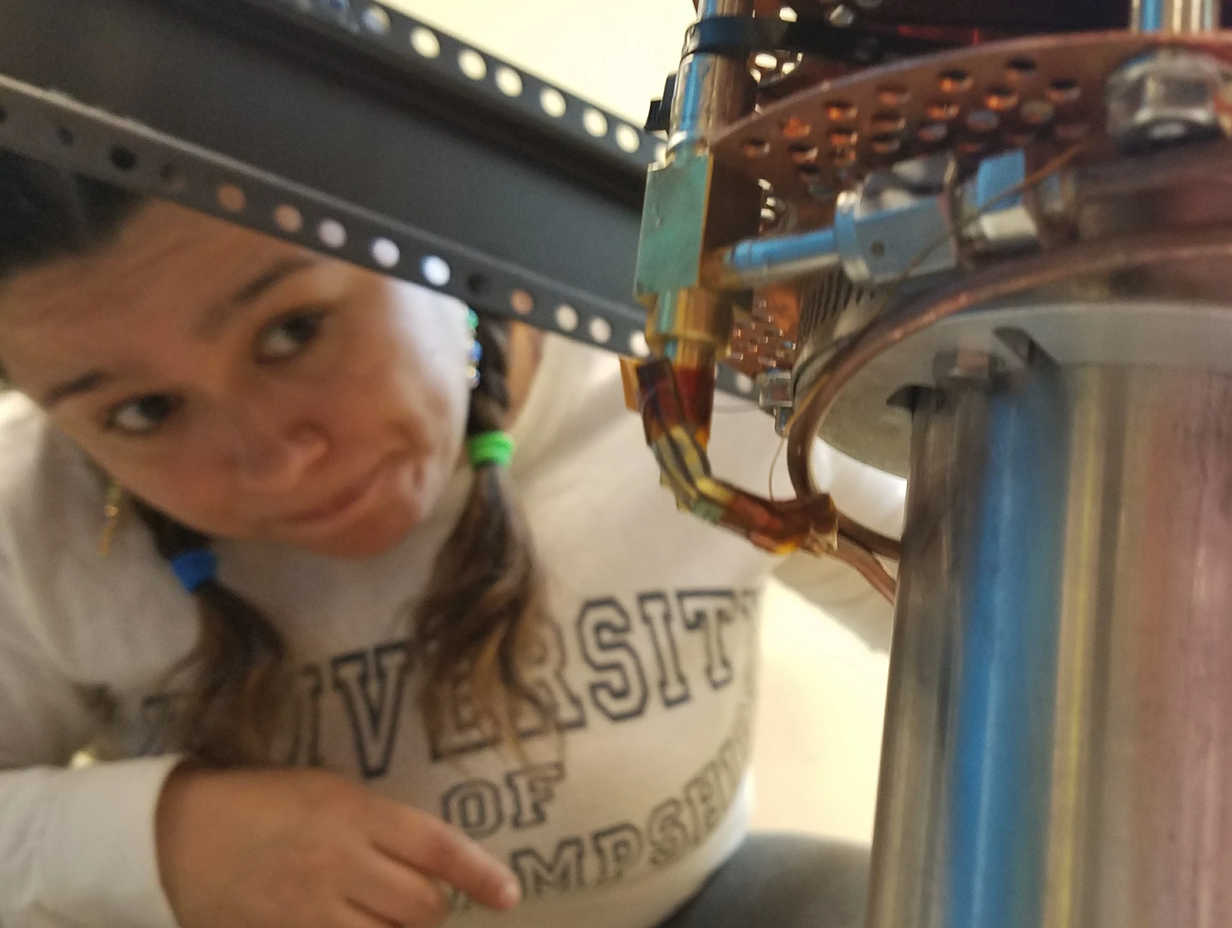
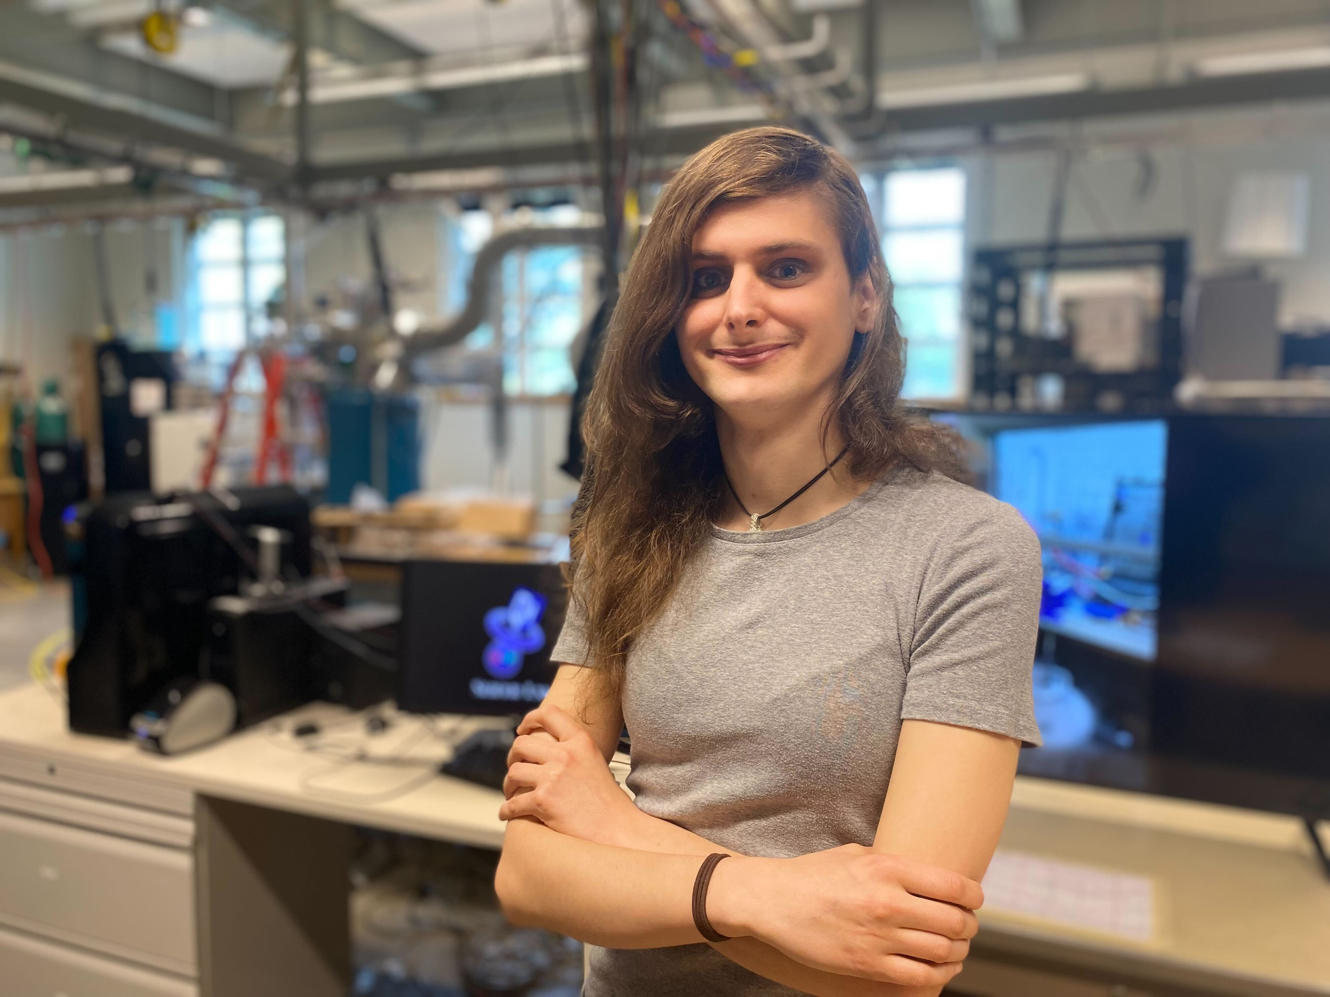
Thank you!
K. McGuire UG (prev)
J. Yost UG (prev)
A. Gudinas UG (prev)
M. McClellan PhD Student
L. Kurbany
PhD Student
E. Mustafa PhD Student
R. Williams UG (prev)
D. Ruth PhD Student
K. Slifer
D. Ruth PhD Student
M. McClellan PhD Student
A. Zec
Post Doc
L. Kurbany
PhD Student
A. Zec
Post Doc
N. Santiesteban Post Doc
E. Long
N. Santiesteban Post Doc
Z. Wolters PhD Student

