Slide 1
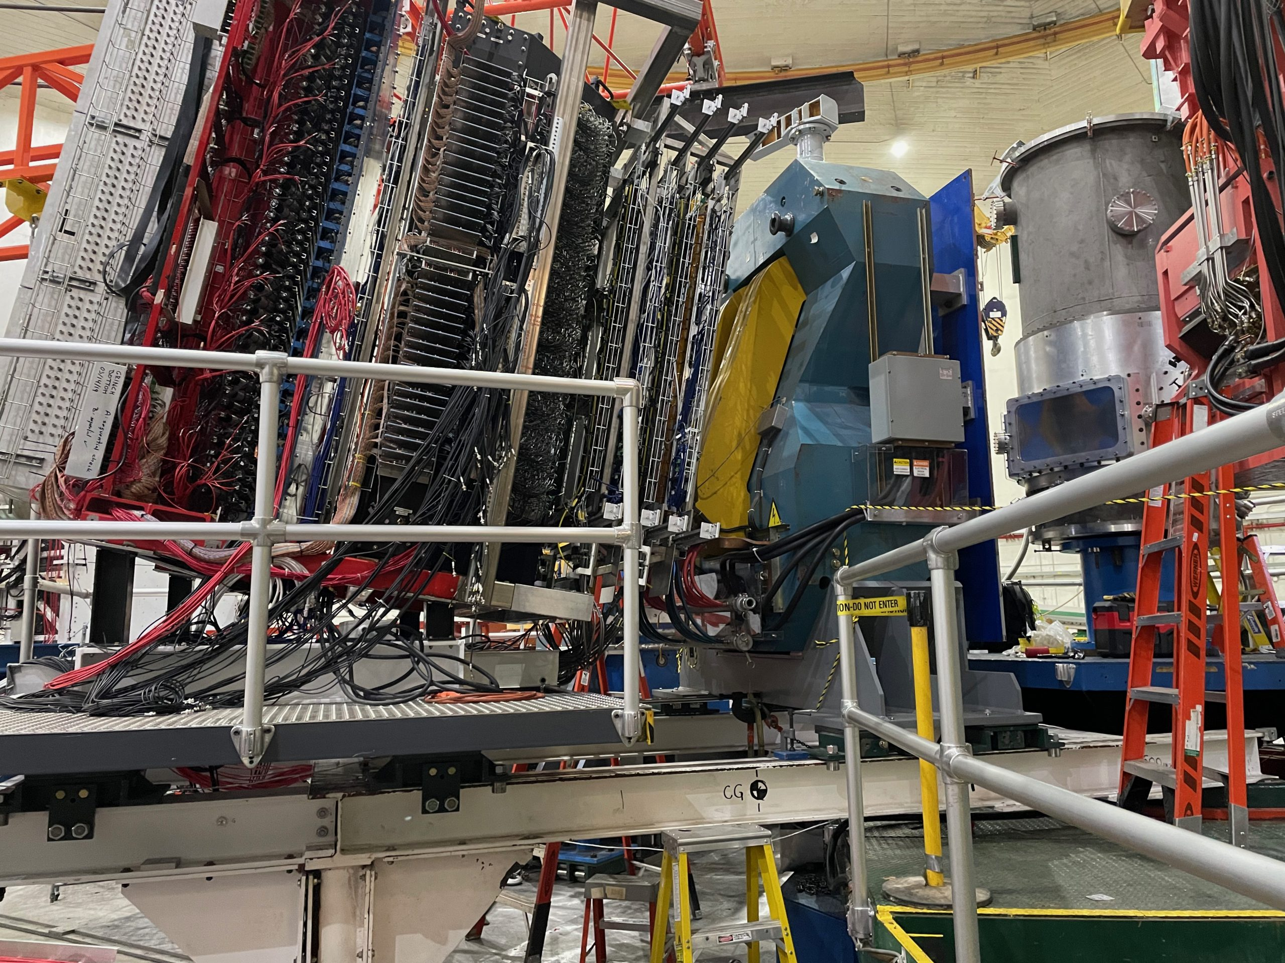
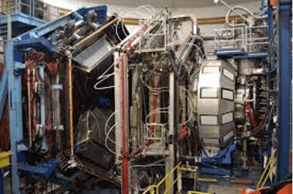
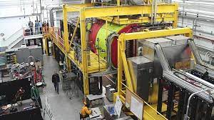
12 GeV Program Overview
Thia Keppel
Program Advisory Committee 50
July 2022

Slide 2
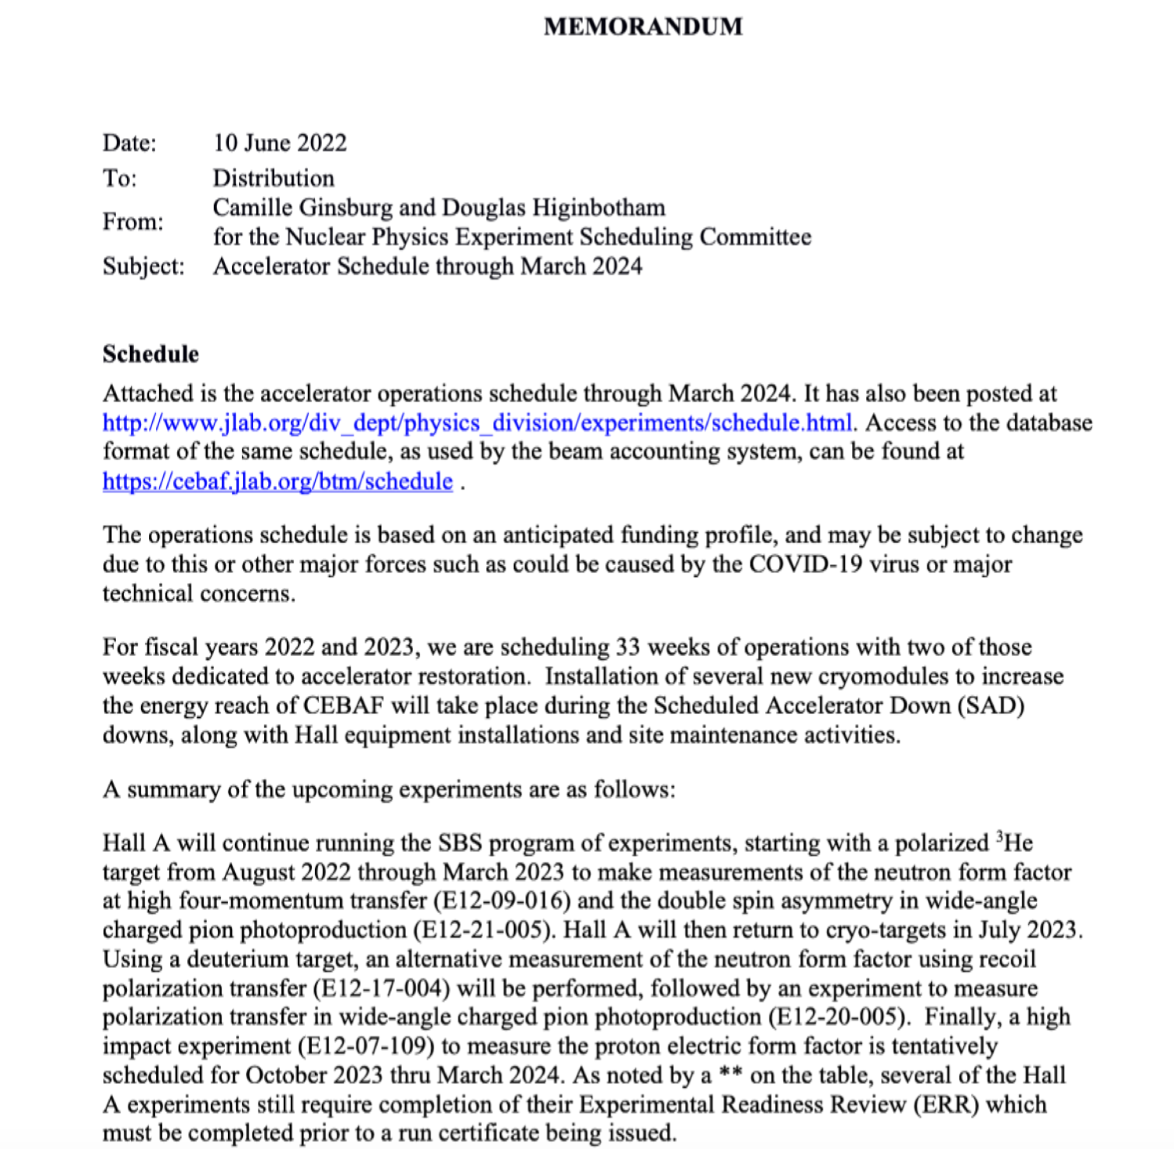
The Hall Leaders covered where we are and where we’re going…
Available at https://www.jlab.org/sites/default/files/user-liaison/files/Scheduling-Memo-20220610.pdf
New NPES Schedule posted to March 2024
Assumes 33 weeks of physics running annually

Slide 3
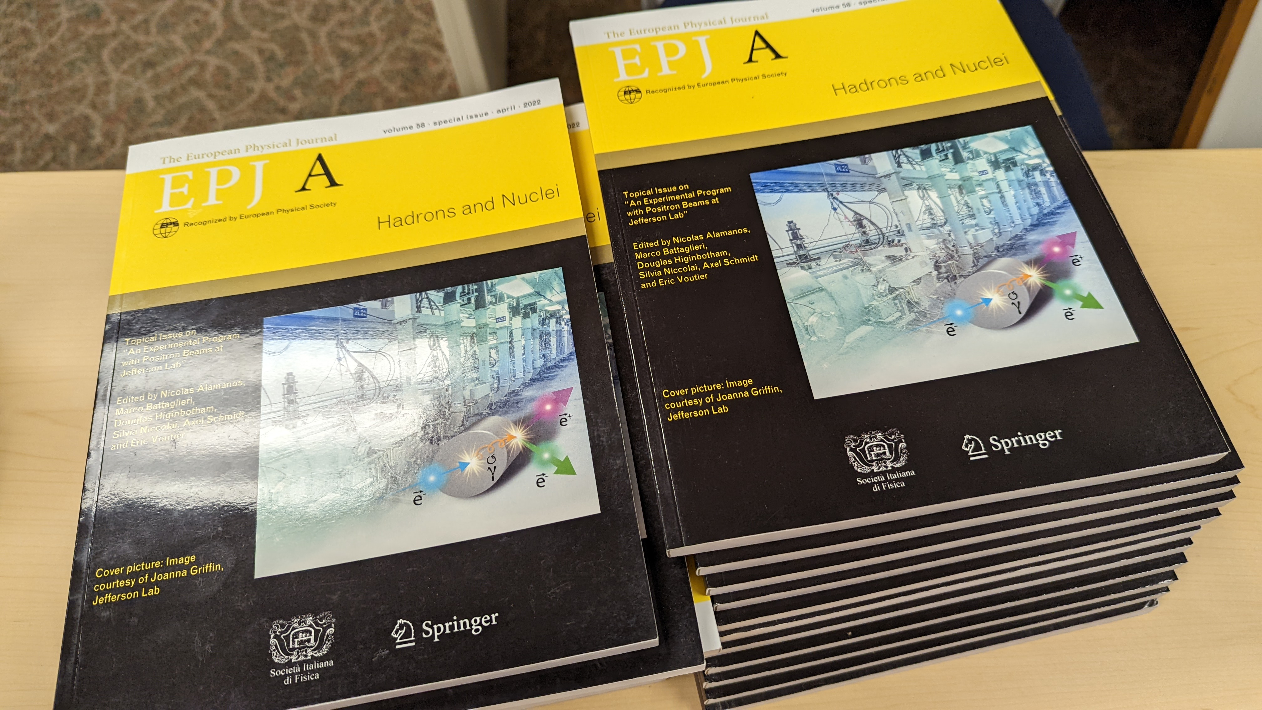
The non-Hall-specific future….
Positrons at 12 GeV
Accelerator, engineering looking at what will be required
Physics Case:
Eur. Phys. J. A 58 (2022) 3, 45

Slide 4
…and higher energies
Interested in your thoughts…

Slide 5
Questions?

