Slide 1
Hall C Status
Mark Jones, Acting Hall A/C Group Leader
PAC meeting
July 2022
Results for experiments that are near publication.
Experiments scheduled for current June 2022 to March 2023 run period
Future plans for July 2023 to March 2024

Slide 2
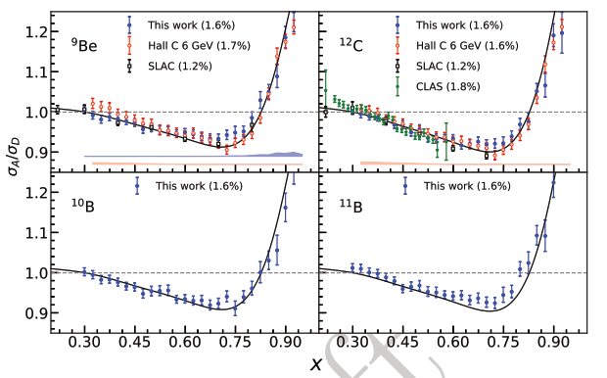
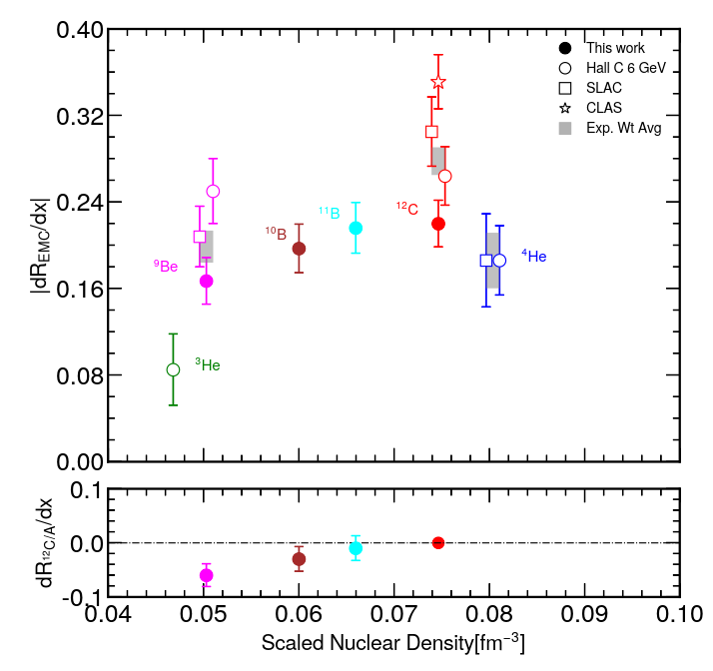
EMC effect in ¹⁰B and ¹¹B
Previous experiments on 9Be found that the EMC slope for 9Be was similar to 4He.
9Be has α-cluster component to nuclear structure, local density effect?
Correlation between EMC effect and SRC.
Two theories: Local density or highly virtual nucleons in correlated pair.
Part of E12-10-008 on 9Be, 10B, 11B, 12C was completed as one of the SHMS commissioning experiments.
An additional test of local density effect, since 10B and 11B are nuclei with α-cluster component.
Submitting publication for PRL this week.
Completion of E12-10-008 starts in Aug 2022
¹⁰B and ¹¹B similar slope to ⁹Be, ¹²C, ⁴He
Slope of line fitted to σ_{A}/σ_{D} between 0.3 < x < 0.7
Error bars on points are statistical and point-to-point systematic in quadrature
Percentage in parenthesis is the normalization error
Black line is A-dependent fit from SLAC E139

Slide 3
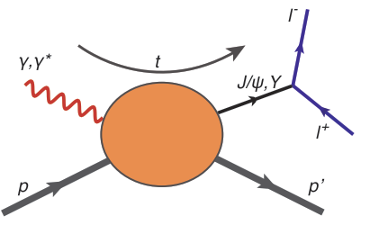
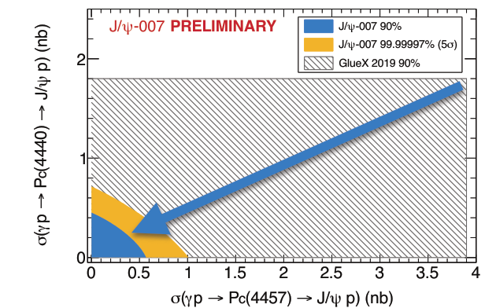
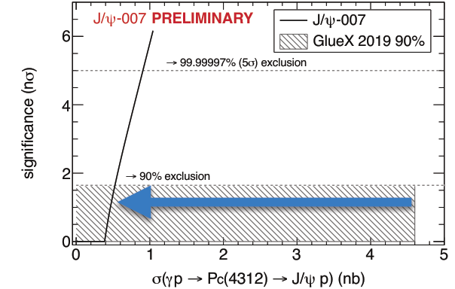
Photoproduction of J/ψ
At DNP 2021: Released of final results of the E12-16-007 “A Search for the LHCb Charmed “Pentaquark” using Photoproduction of J/ψ at Threshold in Hall C at Jefferson Lab”
CERN LHCb found 3 narrow hidden charm states: Pc(4312), Pc(4440) and Pc(4457)
Pentaquark states? Molecular states?
Photoproduction of J/ψ is excellent way to search for pentaquark
Hall D GlueX published results in 2019 ( grey box in figure)
Hall C (J/ψ-007) measured 5x more statistics
New results are inconsistent with reasonable assumptions for true 5-quark states.
Factor of 8 improvement
Factor of 8 improvement

Slide 4
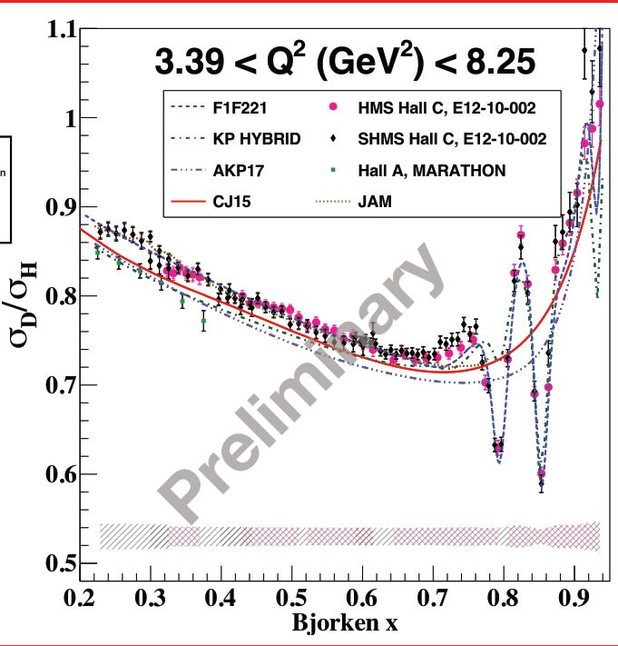
E12-10-002: Proton and Deuteron F₂
Inclusive ep and ed cross section.
Main physics goals
Constrain PDFs
Quark hadron duality
Non singlet moments
Resonance/DIS modeling
Good agreement in σ_{D}/σ_{H} between HMS and SHMS at 21 deg

Slide 5
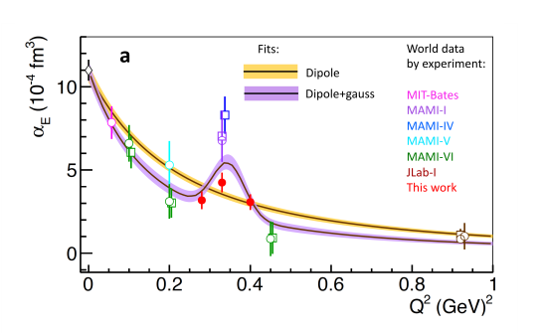
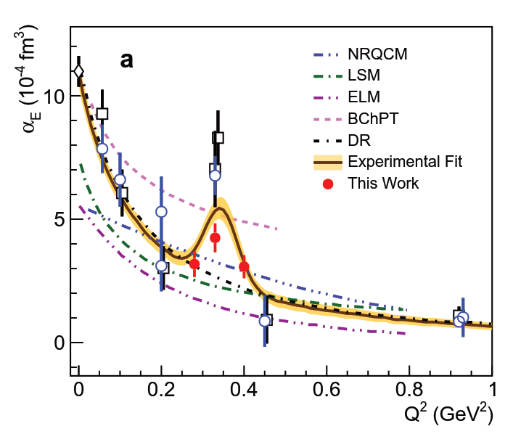
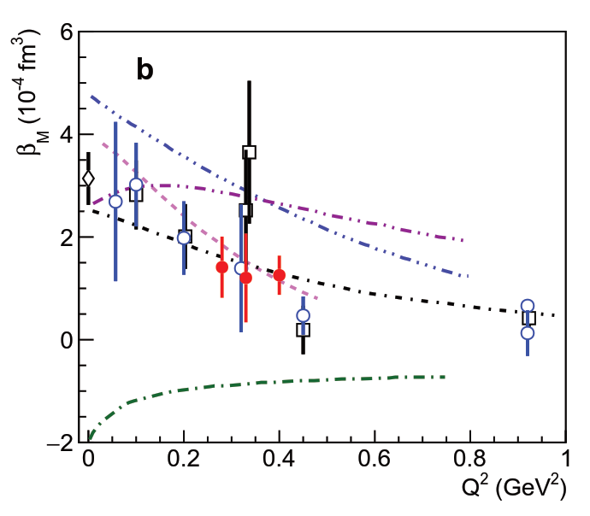
Virtual Compton Scattering (VCS) Experiment
Theory expects α_{E} to have a smooth Q² dipole dependence
Experiments MAMI-1 and MAMI-IV measured α_{E} at Q²= 0.3 which deviated from the dipole behavior seen in other experiments.
New JLab measurement of α_{E} has also has a deviation from the dipole behavior.
Smaller effect, but better statistical error.
Fit all world data with dipole+Gaussian has factor 2 better chi2/dof compared to dipole fit.
Comparisons to theory

Slide 6
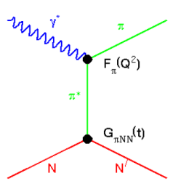
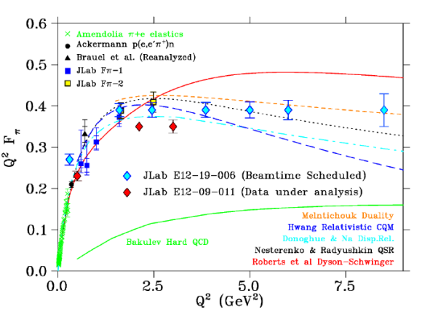
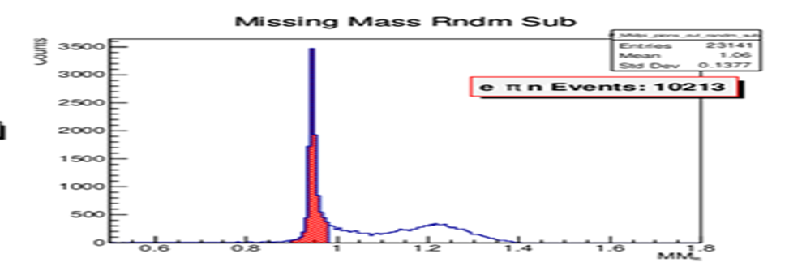
Experiments during June 2022 –March 2023 (Part 1a)
E12-19-006 : Study of the L–T Separated Pion Electroproduction Cross Section at 11 GeV and Measurement of the Charged Pion Form Factor to High Q²
Low epsilon data taken from Sept 2021 to Feb 2022
High epsilon data is currently being taken.
Indirectly measure F_{π} using the pion cloud in p(e,e’π⁺)n
Need to isolate the σ_{L} at low t
Measure F_{π} to Q² = 8.5
Online results:
Clean identification of p(e,e’π⁺)n final state

Slide 7
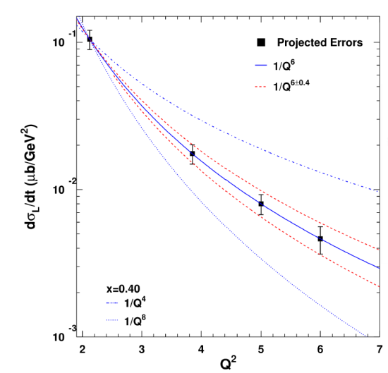
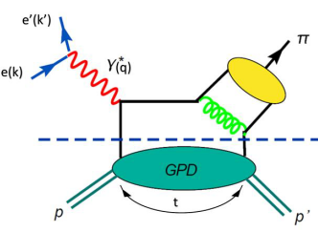
Experiments during June 2022 –March 2023 (Part 1b)
E12-19-006 : Study of the L–T Separated Pion Electroproduction Cross Section at 11 GeV and Measurement of the Charged Pion Form Factor to High Q²
Low epsilon data taken from Sept 2021 to Feb 2022
High epsilon data is currently being taken.
Scaling study at fixed x_{bj} = 0.31, 0.40 and 0.55
In Hard Scattering regime
σ_{L} scales at 1/Q⁶
σ_{Τ} scales at 1/Q⁸
Study hard/soft factorization for GPD extraction
Does σ_{L} or σ_{Τ} dominate?
Projected errors for x_{bj} = 0.40

Slide 8
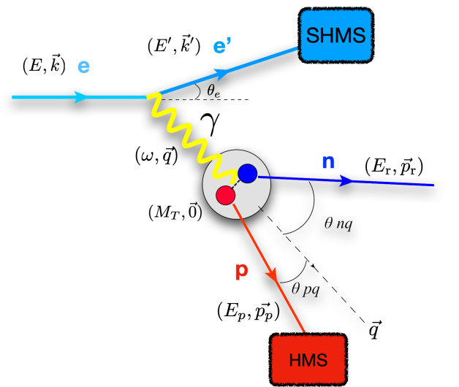
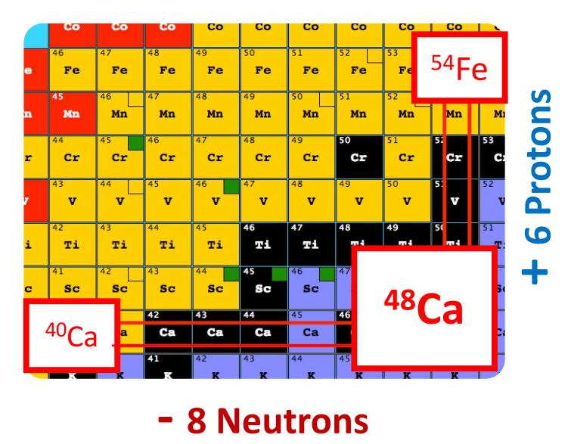
Experiments from June 2022 to March 2023 (Part 2)
E12-17-005 : The CaFe Experiment:Short-Range Pairing Mechanisms in Heavy Nuclei
Measure (e,e’p) on ⁴⁰Ca, ⁴⁸Ca, ⁵⁴Fe at Θ_{nq} < 40 deg which minimizes FSI.
Ratio of cross sections in the mean field region (k < k_{fermi}) to the SRC region (k > k_{fermi})
The measurements will allow separation of SRC pairing probabilities for protons and neutrons in order to determine how pairing depends on nuclear mass and proton-neutron asymmetry.
Complements (e,e’) studies of SRC in E12-06-105

Slide 9
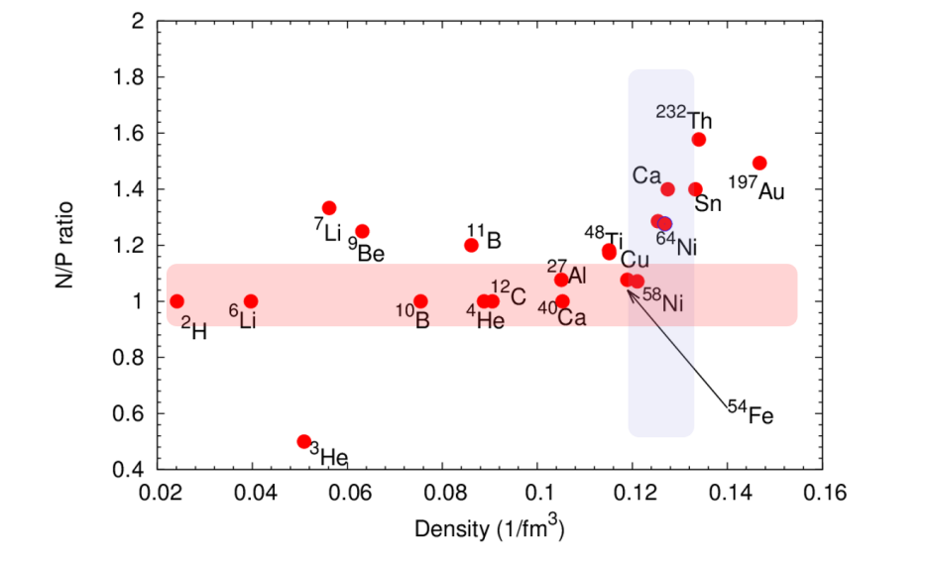
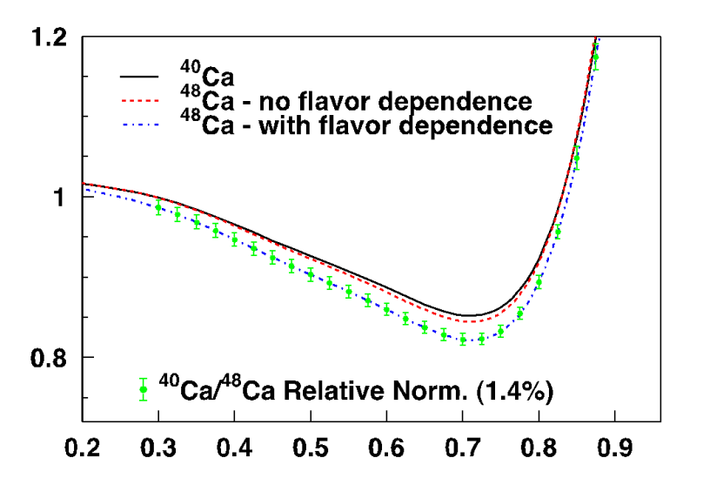
Experiments from June 2022 to March 2023 (Part 3)
E12-10-008 Detailed studies of the nuclear dependence of F₂ in light nuclei.
E12-06-105 Inclusive Scattering from Nuclei at x > 1 in the quasielastic and deeply inelastic regimes
Both experiments use:
Inclusive electron scattering
Variety of nuclei to study:
Density effects
N/P= # Neutron/# Proton dependence
Isospin dependence ( e.g. ⁴⁰Ca/⁴⁸Ca)
E12-10-008 studies EMC effect
Add 6Li and 7Li to light nuclei
Flavor dependence with 40Ca and 48 Ca
E12-06-105 studies 2N and 3N SRC
Precision measurement of 2N SRC
A-dependence in light nuclei
Variation with neutron excess
Connect EMC effect and SRC
First observations of 3N SRC
Nuclear PDFs at x > 1 and look for superfast quarks

Slide 10
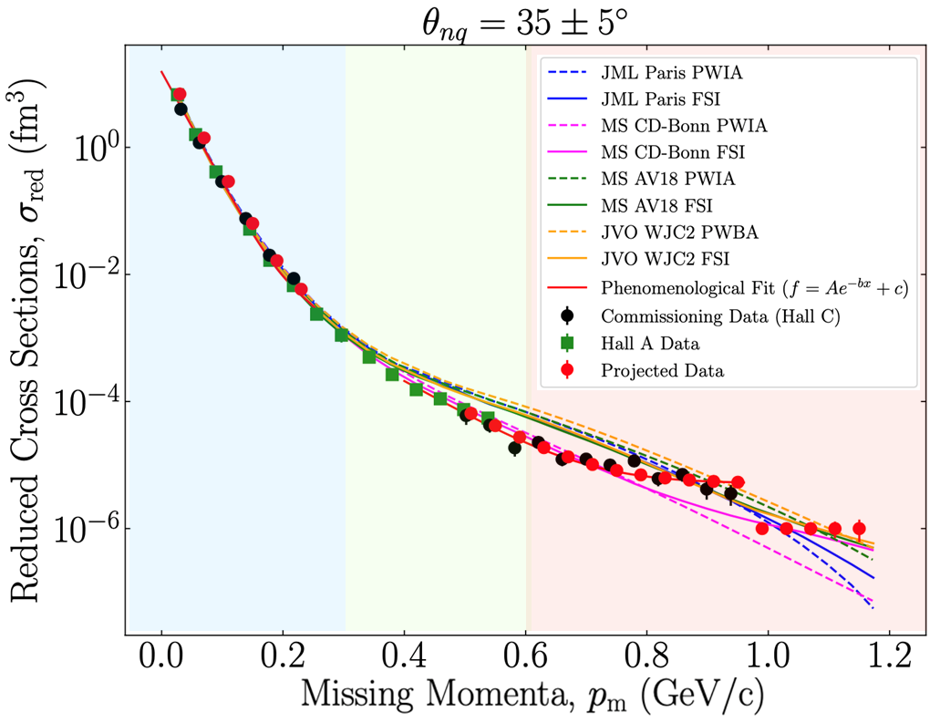
Experiments from Aug 2022 to March 2023 (Part 4)
E12-10-003 Deuteron Electro-Disintegration at Very High Missing Momentum
Ran 3 days of experiment as commissioning data. Published in PRL
At PAC Jeopardy, approved to complete the remaining 18 days.
Focus at Θ_{nq} = 35 where FSI are minimal.
1.5 < r < 2 fm
(long-range OPEP)
Above ~700 MeV/c, data shows a strikingly different behavior than predicted by any of the model
1.0 < r < 1.5 fm (intermediate, NN tensor interaction)
r < 1 fm (repulsive hard-core, NN scalar interaction)

Slide 11
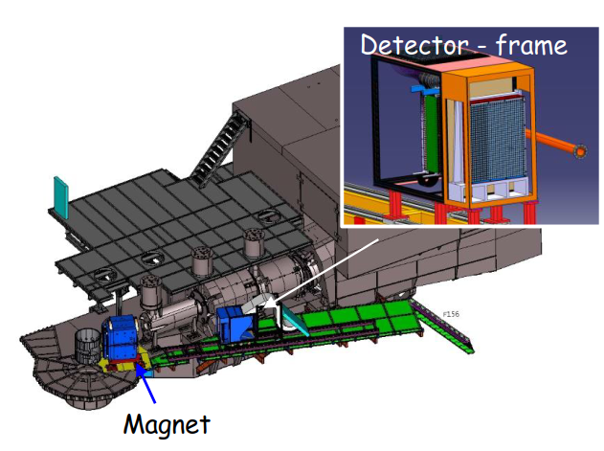
Plan to run the NPS experiments in July 2023 – Mar 2024
Install Neutral Particle Spectrometer (NPS) during March 2023 to July 2023 down
Magnet with calorimeter
1080 Lead-Tungstate blocks in Calorimeter to detect γ and π⁰
Remove the SHMS HB magnet
Experiments
E12-13-010 is two concurrent experiments
Exclusive Deeply Virtual Compton on proton
SIDIS p(e,e’,π⁰) cross section. Map the transverse momentum dependence.
53 PAC days.
E12-06-114 is completion of Hall A DVCS experiment
35 PAC days.
Note that new proposal for Neutron DVCS could change the schedule
Two experiments with photon beam running concurrently
E12-14-003 : Wide-angle Compton Scattering at 8 and 10 GeV Photon Energies (18 PAC days)
E12-14-005 :Wide Angle Exclusive Photoproduction of pi-zero Mesons

Slide 12
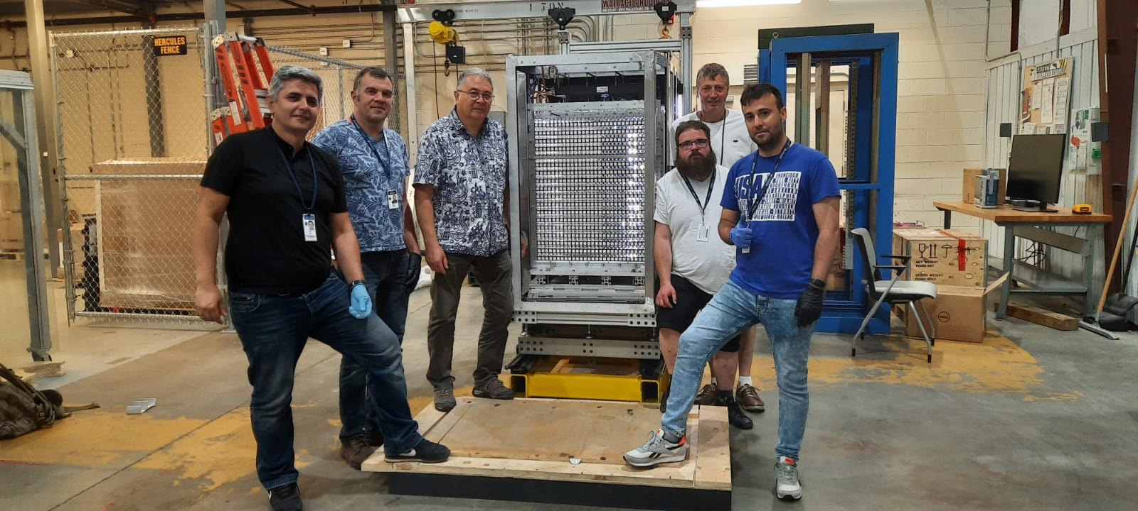
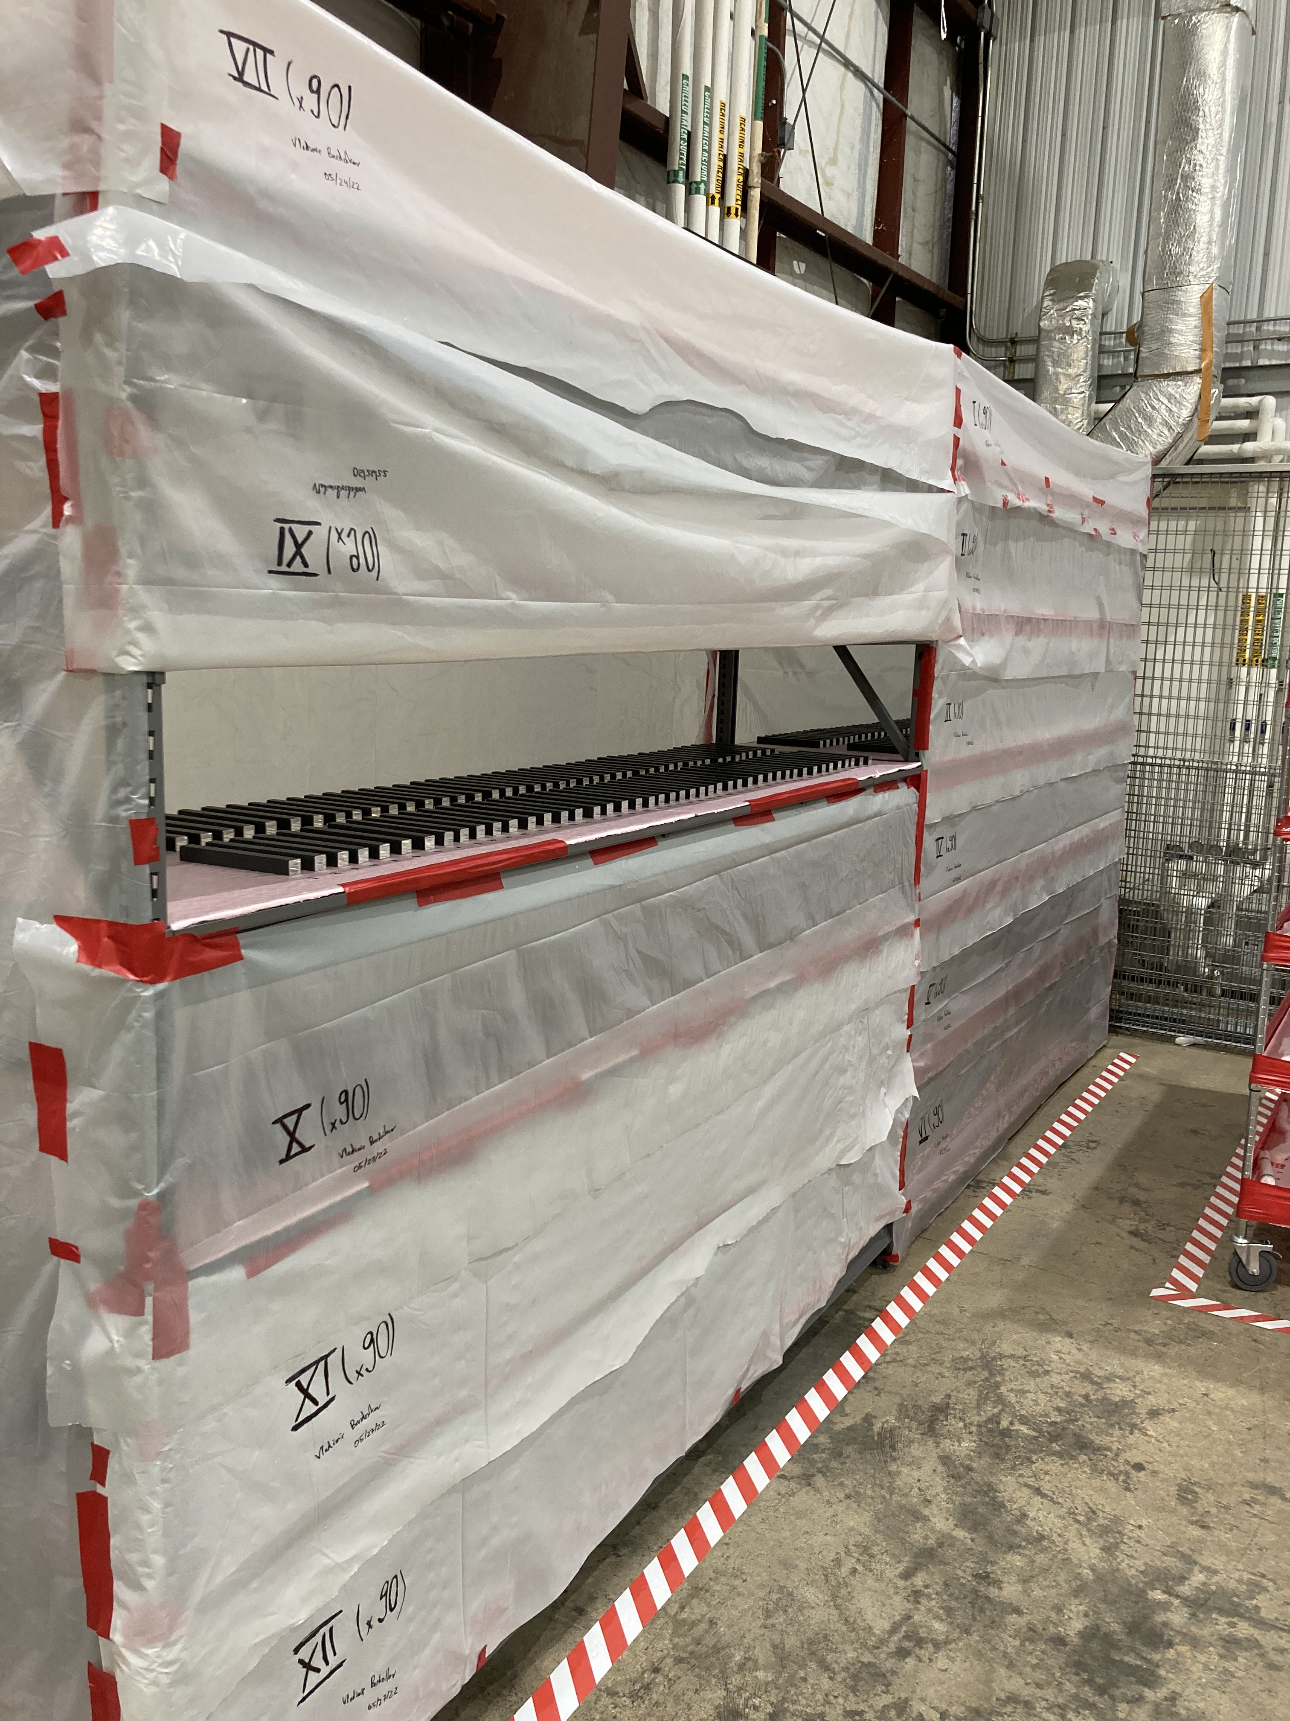
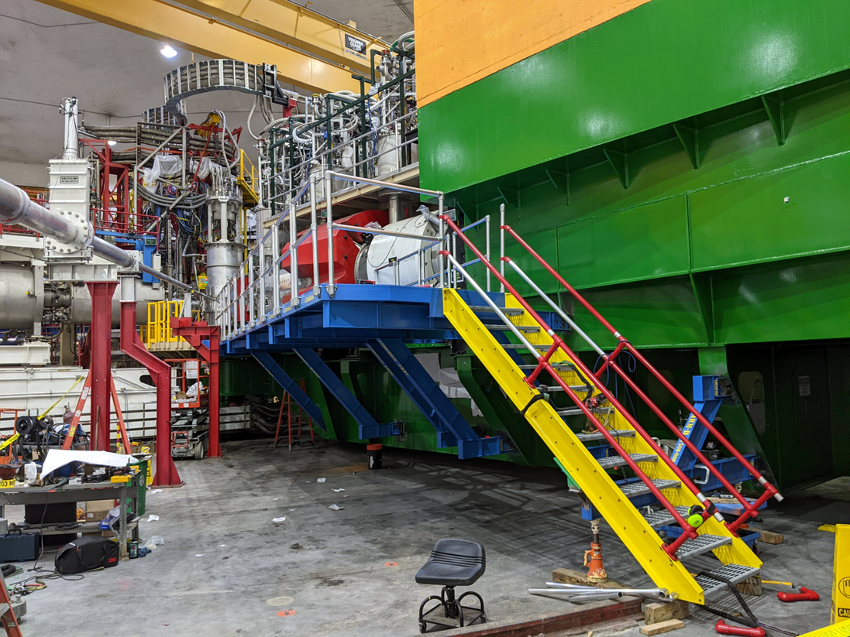
NPS preparation status
All 1080 blocks have been inspected and tested.
In month of May all blocks wrapped.
Stored in EEL108 for installation.
French CNRS-IN2P3 group built calorimeter frame which was shipped to USA.
From May 31st to June 16th, the French group is at Jlab to assemble the calorimeter.
Completed assembly!
Test installation of NPS platform and rails was done in Hall C during Feb-June 2022 down.
Has been disassembled and stored.

Slide 13
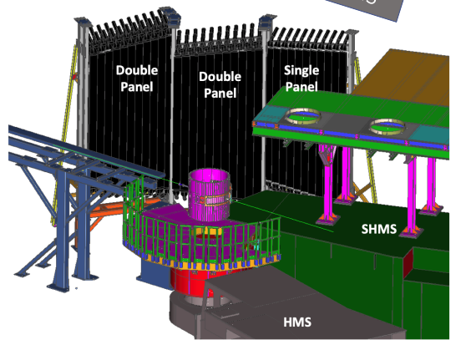
Hall C Near term future after March 2024
Options of experiments to install after March 2024
Standard SHMS/HMS
E12-06-104 R=σ_{L}/σ_{T} in SIDIS
E12-06-107 Complete CT experiment
E12-11-107 Spectator tagged DIS d(e,e’p_{s})
Install Large Angle Detector
HMS/SHMS detect electron
Longer term future
Standard SHMS/HMS experiments
Experiments using the Compact Photon Source
Capital project is ongoing
Hypernuclear physics
Experiments using the NPS

