Slide 1
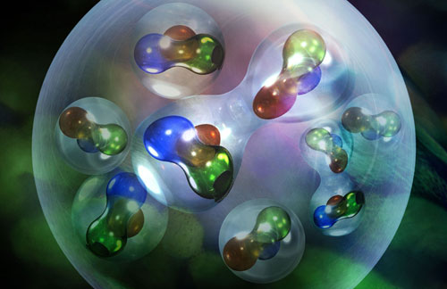
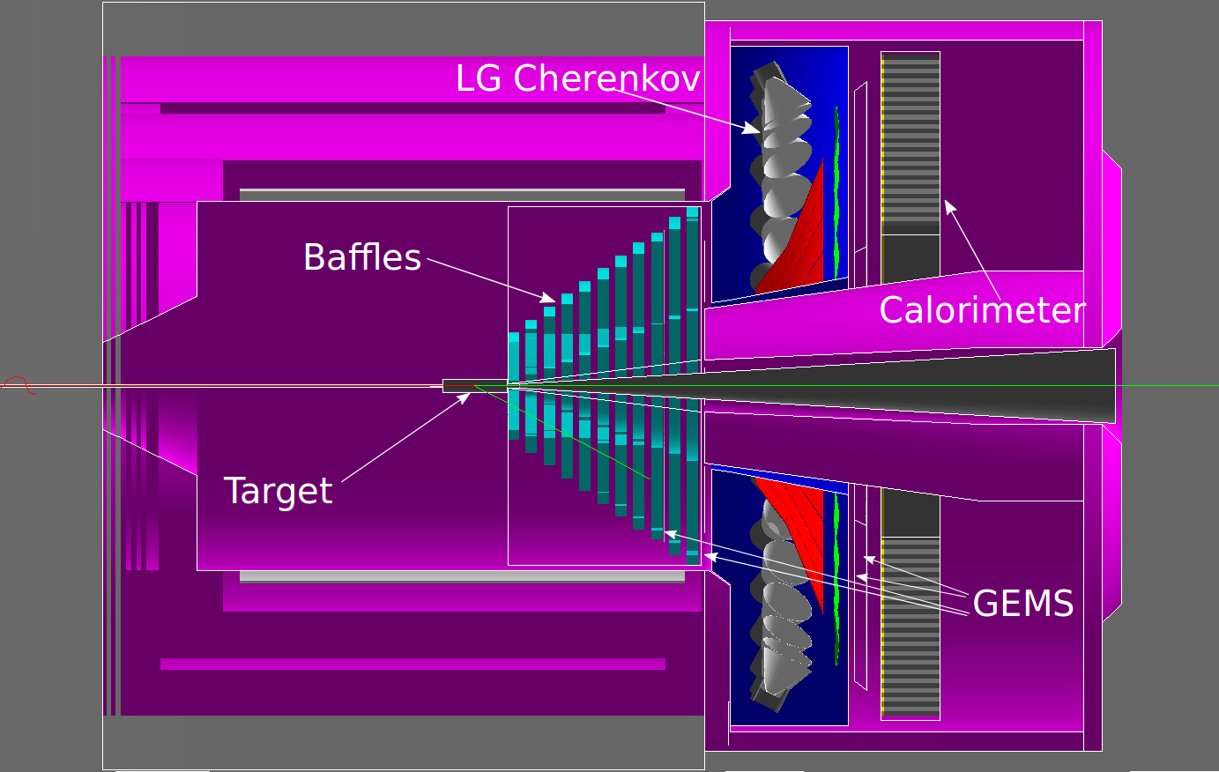
PVEMC: First measurement of the flavor dependence of nuclear pdf modification using PVDIS
J. Arrington, R. Beminiwattha, D. J. Gaskell, J. Mammei, P. E. Reimer - spokespeople
PAC50, Jefferson Lab, July 12, 2022

Slide 2
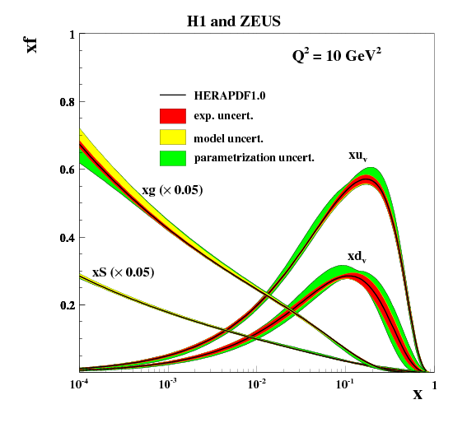
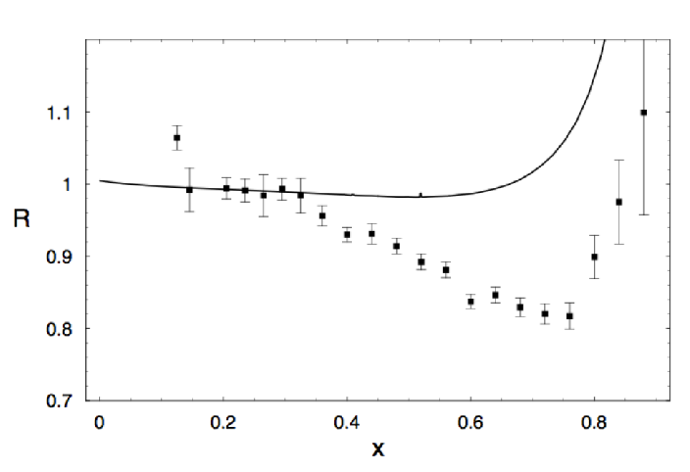
Quark distributions in nuclei: EMC effect
Deeply-inelastic scattering (DIS) measures structure function F₂(x)
  x = quark longitudinal momentum fraction
  F₂(x) related to parton momentum distributions (pdfs)
Ratio of F₂ per nucleon for heavy nucleus to deuteron sensitive to nuclear modification of the pdfs
F₂(x) ∼ Σ e_{i}² q_{i}(x) i=up, down, strange…
J. J. Aubert, et al., PLB 123, 275 (1983)
R = (F₂^{Fe}(x) / F₂^{D}(x))_{iso}

Slide 3
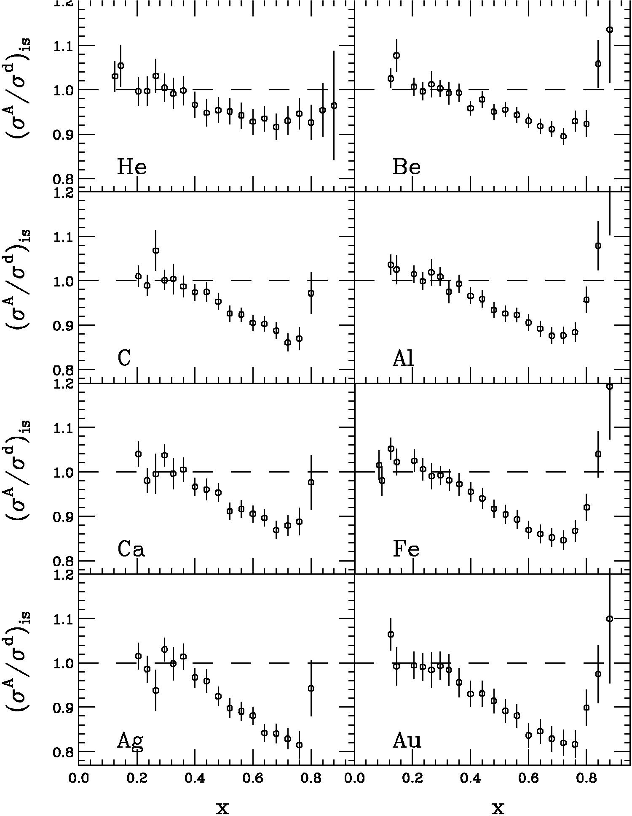
EMC effect: SLAC E139
J. Gomez, et al., PRD49, 4349 (1994)
SLAC E139
  Nuclei from A=4 to 197
  Universal x-dependence
  Size depends weakly on A
    Scales well with density or with A (~A^{1/3})

Slide 4
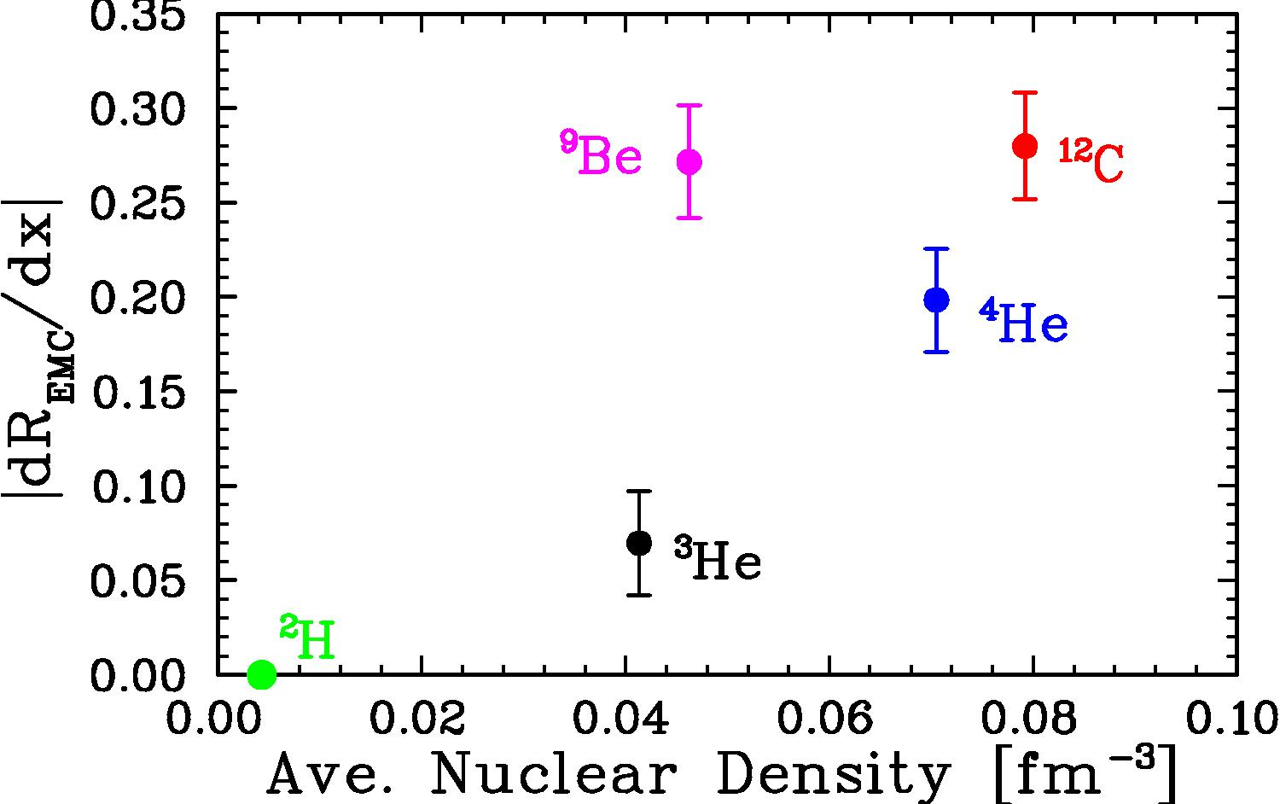
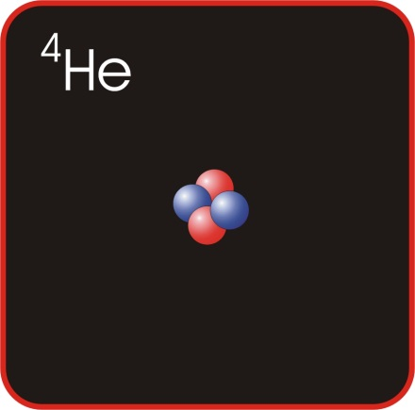
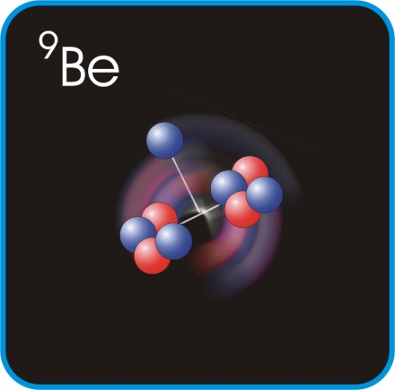
EMC effect: SLAC E139
J.Seely, et al., PRL103, 202301 (2009)
SLAC E139
  Nuclei from A=4 to 197
  Universal x-dependence
  Size depends weakly on A
    Scales well with density or with A (~A^{1/3})
JLab E03-103
  High-x ratios for ³He, ⁴He, ⁹Be, ¹²C, ⁶³Cu, ¹⁹⁷Au
  Universal x-dependence
  Size does NOT scale with density
    ⁹Be is low density, but has ‘large’ EMC effect
Still have competing explanations of the EMC effect. New observables important to making progress: spin dependence, tagged measurements, flavor dependence

Slide 5
Flavor-dependent EMC effect?
Always assumed that EMC effect is identical for proton and neutron; becoming extremely hard to believe, at least for non-isoscalar nuclei
  EMC-SRC correlation + n-p dominance of SRCs suggests enhanced EMC effect in minority nucleons
    In ³H, np-dominance suggests single proton generates same high-momentum component as two neutrons –> larger proton EMC effect if caused by high-momentum components
  Neutron rich nuclei like ⁴⁸Ca, ²⁰⁸Pb expected to have significant neutron skin; neutrons preferentially sit near the surface in lower density regions
    Larger proton EMC effect in ‘local-density’ picture
  Calculations show difference for u-, d-quark as result of scalar and vector mean-field potentials in asymmetric nuclear matter I. Cloet, et al., PRL 102, 252301 (2009)
All show enhanced EMC for minority nucleons; size of effect varies factor of ~3

Slide 6
Flavor-dependent EMC effect?
There is reason to expect flavor-dependent EMC effect
  EMC-SRC correlation
  Calculation
  Multiple predictions based on simple scaling models
It is critical that it be measured
  Totally new information to help elucidate origin of the EMC effect
  Input to high-energy e-A, ν-A, p-A, and A-A measurements (polarized e-³He)
  Confirm significance of the effect on NuTeV anomaly
As of today, no significant observation to support flavor dependence
(or to set strong upper limits on flavor dependence)

Slide 7
PVEMC: Flavor dependence
PVDIS on ⁴⁸Ca
Photon-Z interference / photon-squared
  Flavor-independent EMC effect → all pdfs rescaled same way, cancels in ratio
Flavor-dependent EMC gives enhanced impact from d-quarks in numerator (weak vs EM charge)
Suppressed
Expanding about u_{A}=d_{A} limit, neglecting sea quarks:
PVDIS sensitive to difference in up and down quark distributions in nuclei

Slide 8
PVEMC proposal - SoLID detector
Uses SOLID in PVDIS configuration
Identical spectrometer/detector configuration as PVDIS (baffles, etc.)
Only the target is different
PVEMC measurement requires target with N ≠ Z and large EMC effect
⁴⁸Ca satisfies both requirements with smaller radiation length than heavier targets (e.g., gold or lead)
Sufficient ⁴⁸Ca at JLab to provide 2.4 g/cm² thickness – modified target design; reprocessing of existing calcium will be required

Slide 9
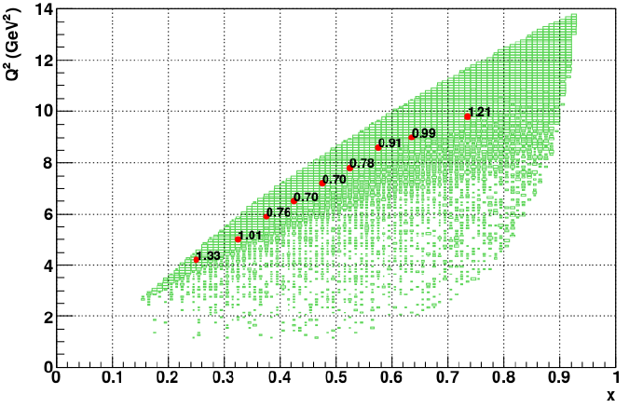
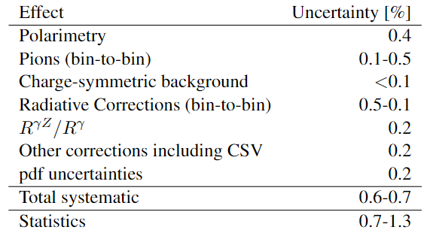
Kinematic coverage and projected precision
Kinematics and statistics (%) for 68 days data taking shown on right
Estimated systematics summarized below - includes experimental uncertainties AND model dependence associated with interpreting the data in terms of flavor dependence.
Estimated model-dependence, treated as experimental systematics in sensitivity studies
0.4% normalization uncertainty (polarimetry)
Note: double counted, as pt-to-pt AND norm. in sensitivity studies
Notes:
[add all: 0.64-0.73%; no polarimetery: 0.49-0.61%, no THY: 0.35-0.51%]
Still, min. stat++sys error goes from 0.95 to 0.85% ~10% reduction, probably closer to 5% overall [i.e. extra 5% sensitivity for all PVEMC]

Slide 10
Estimates of flavor dependence?
Cloët, Bentz, and Thomas, PRL 102, 252301 (2009)
CBT calculation – mean-field model; impact of QCD scalar, vector fields modifies up, down quark differently for N > Z nuclei
Simple assumptions about underlying cause:
  EMC scales with #/high-momentum nucleons, avg nucleon kinetic energy, amount of short-distance configurations
  All can be calculated for p, n separately → isospin dependence
“Extreme cases” – EMC is 100% up (or down) quarks
  Not very realistic, but sometimes used as reference for other measurements
pdf analyses
  Tension between electron and neutrino data suggested possible flavor dependence, of a size similar to the CBT model
  Recent updates comparing 3H/3He and 2H/1H DIS data also suggest possible flavor dependence C. Cocuzza, et al., PRL 127 (2021) 242001
    Large effect, large uncertainty, hard to translate to ⁴⁸Ca
JA, EPJ Web Conf. 113 (2016) 01011, arXiv: 1508.05042

Slide 11
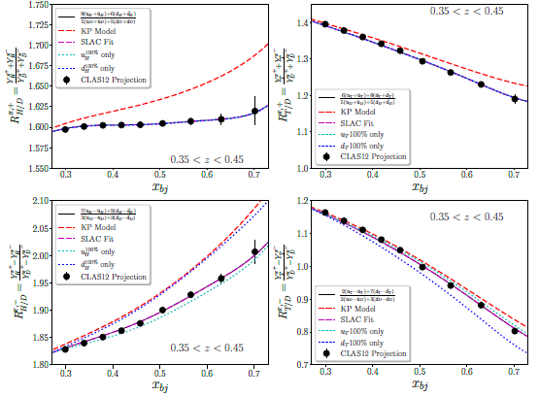
SIDIS measurements
SIDIS projections: various target ratios for sums (differences) of π+ (valence u) and π− (valence d); estimates from CLAS proposal (2021)
In general, only “KP” (red dash) and “d-quark only” (blue dotted) curves give effects above few percent
KP based on the Kulagin-Petti model, but isn’t the KP calculation. It reproduces the KP EMC effect for 3H & 3He, but applies this as a flavor-independent EMC effect for the SIDIS calculation.
From PR12-21-004

Slide 12
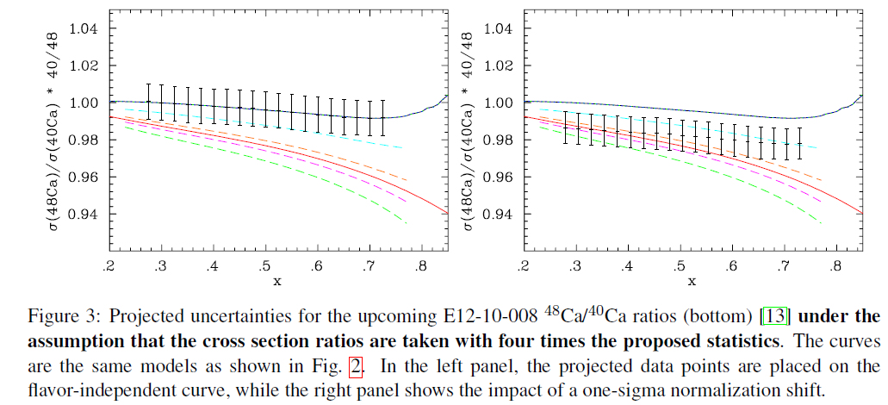
⁴⁸Ca/⁴⁰Ca comparison to models/projections
Error bars assume factor of four increase over proposed statistics (syst. limited)
Left: comparison to various models Right: Same, but with 1-sigma normalization shift
2.1σ deviation from CBT (red line) as proposed 1.7σ deviation from CBT
2.9σ deviation if quadruple proposed statistics 2.3σ deviation with quadrupled statistics
Neglecting normalization uncertainty → can reduce to single number: EMC “slope”
Notes:
1.4% norm. uncertainty

Slide 13
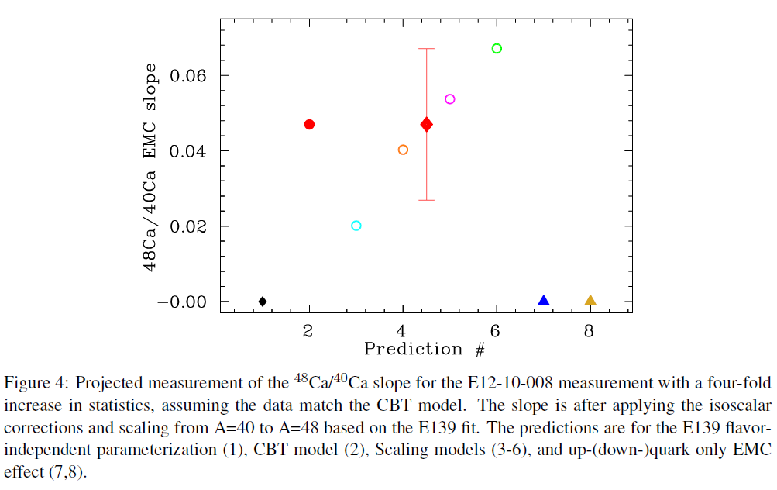
⁴⁸Ca/⁴⁰Ca comparison to models/projections
Error bars assume factor of four increase over proposed statistics (syst. limited)
% high-p
“overlap”
(<1 fm)
CBT
K.E.
density
Left: comparison to various models Right: Same, but with 1-sigma normalization shift
2.1σ deviation from CBT (red line) as proposed 1.7σ deviation from CBT
2.9σ deviation if quadruple proposed statistics 2.3σ deviation with quadrupled statistics
Neglecting normalization uncertaintyuncertainty → can reduce to single number: EMC “slope”
>3σ sensitivity ONLY for largest (green) curve if we assume 4x the proposed statistics
~2σ between largest and smallest non-zero models
Flavor independent
Down only
Up only

Slide 14
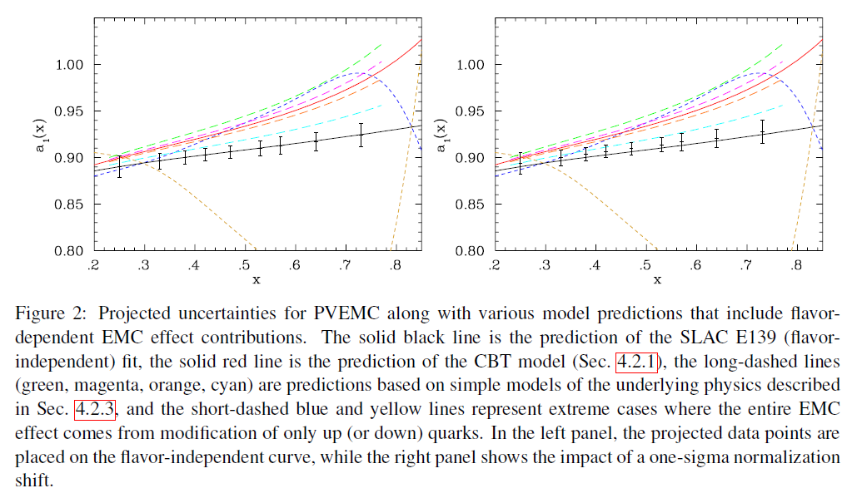
PVEMC comparison to models/projections
Left: comparison to various models Right: Same, but with 1-sigma normalization shift
7.9σ deviation from CBT (red line) 7.1σ deviation from CBT
Precision to differentiate models, set significant limit if results consistent with flavor-independent result
Even smallest prediction (cyan curve) is >3σ from flavor-independent prediction
Smallest effect (cyan) is ~8σ from largest (green), ~4.5σ from CBT
If the data are consistent with the flavor-independent prediction, they set significant limits

Slide 15
Uncertainties in the flavor-independent prediction
Approach: Make initial estimates of uncertainties in the calculation of a₁(x); focus on those that are more significant.
Initial estimates were 0.1-0.2% for the various corrections, but with a large uncertainty. Well below total ~1% level uncertainties, so small impact even if they are factor ~2 larger
Many in common with PVDIS-LD2. LD2 looking for 0.4-0.5% statistics (per x bin), 0.3% in total, vs our 0.7-1.3%
As work continues for the SoLID program; these will be examined further. More detailed calculations will be performed where indications are that these might be larger.
Hard to motivate theorists to put significant time into this in advance of having an approved experiment and formal SoLID project approval. Nonetheless, significant work going on.
Notes:
a) Less sensitive than SoLID-LD2, also allows comparison to LD2 for several syst.

Slide 16
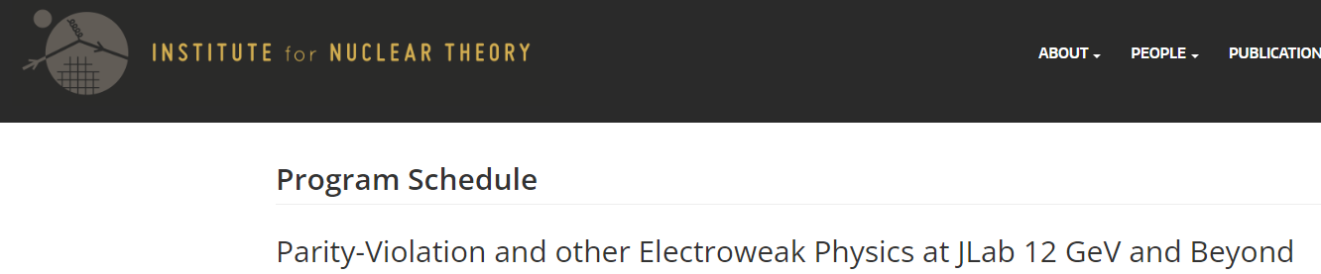
INT Workshop
Week-long virtual workshop dedicated to PVES and related topics at Jefferson Lab
25 talks, significant time for dedicated discussion
SoLID program was a major focus including several talks related to interpretation of the results
  6 talks on radiative corrections
  3 talks on pdf global fits, 2 more on new and upcoming measurements of d(x)/u(x)
  Other talks related to corrections to PVDIS, future data that will be relevant, etc…
General conclusions: The data is of significant impact to the community, there were no show-stoppers identified, and there is interest in doing additional work to address model dependence of the interpretation. Some work will probably wait until it is clear that the SoLID program will run (e.g. after it is an formal DOE project)

Slide 17
Beamtime Request
Request 83 days total for first measurement of flavor dependence of EMC effect via PVDIS from ⁴⁸Ca
→ Time included for spectrometer optics, charge symmetric background measurements, commissioning and polarimetry
Activity | Time (days) | E (GeV) | Current (μA)
⁴⁸Ca Production | 68 | 11 | 80
Optics | 2 | 4.4 | Up to 80
Positive polarity | 4 | 11 | 80
Møller Polarimetry | 4 | 11 | 2
Commissioning | 5 | 11 | Up to 80
Total | 83
*Would need 5 more days to maintain FoM if the target purity is 90%, as suggested by TAC report

Slide 18
Summary
Despite renewed activity in recent years, no consensus on origin of the EMC effect; new observables required to provide more insight
PVDIS offers a precise, interpretable measurement of possible flavor dependence of the EMC effect
  Important input to other measurements that need nuclear pdfs
PR12-22-002: Measurement of PVDIS from 48Ca using SOLID apparatus
  83 days total (68 days production)
  Will provide ~7σ test of CBT model, provide significant constraints on flavor dependence no matter what value is obtained
  Several aspects less challenging than approved PVDIS on LD2 experiment: lower rates, no target boiling, shorter target (better control of acceptance and collimation)

Slide 19
PVEMC -
Projections
Scaling models (p>300 MeV, kinetic energy, average density, overlap probability)
CBT Model
Up quark only
Flavor independent
Down quark only
Sensitivity translates to ~2% uncertainty in difference between up and down in ⁴⁸Ca
8σ sensitivity to CBT model (neglecting normalization); >6.5σ if you shift the data up by twice the scale uncertainty
>3σ sensitivity to the smallest prediction (cyan curve)
Smallest prediction (cyan) is ~8σ from largest (green), ~4.5σ from CBT

Slide 21
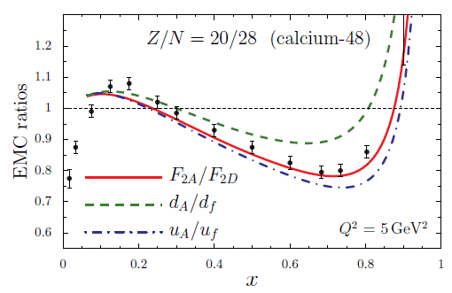
Estimates of flavor dependence?

Slide 22
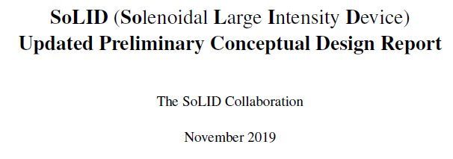
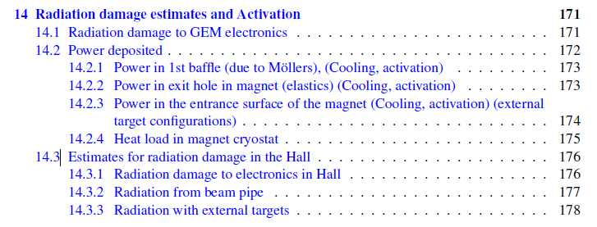
Radiation summary
Site boundary dose
  1.3 mrem – PVDIS (LD2)
  0.7 mrem – PVDIS (LH2)
  0.1 mrem – SoLID (other)
  2.5 mrem – PVEMC (48Ca)
  ~5 mrem total for current multi-year SoLID program
    Estimates typically 50+% higher than measured doses
    Doses based on PVDIS as approved
Uses same GEANT4 simulation as PREX, CREX, Moller, and SoLID (⁴⁸Ca results are also consistent with scaling from PVDIS doses)
SoLID working on improved shielding configurations to reduce site boundary and dose to electronics
Pre-CDR does not include PVEMC-specific estimates

Slide 23
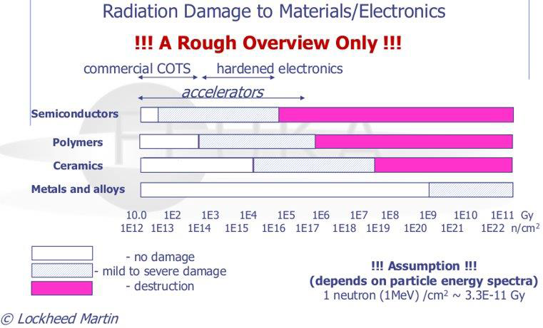
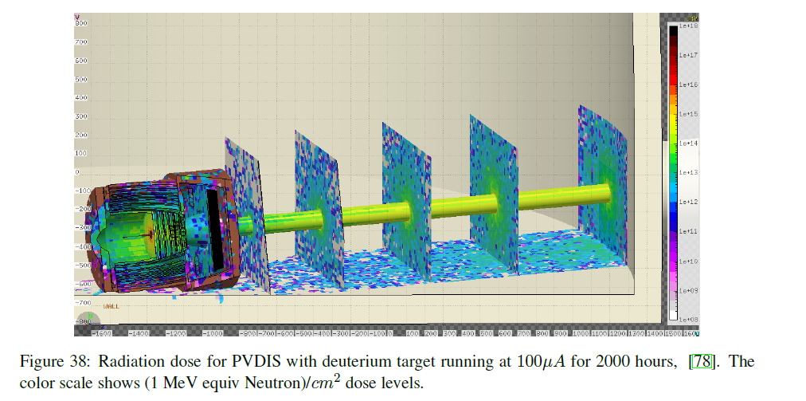
Radiation
Comparison to previous experiments
Electronics damage threshold exceeded only in area near downstream beamline (FLUKA simulations)
Electronics (except limited GEM readout electronics) can be placed away from high-radiation areas; all electronics will have local shielding

Slide 25
Model-dependent corrections and uncertainties
0.4% normalization uncertainty (polarimetry)
Note: double counted, as pt-to-pt AND norm. in sensitivity studies
Needs to be verified; still expect ~0.1% level
Estimated model-dependence, treated as experimental systematics in sensitivity studies
Details/breakdown:
R^{γ}: PRD, 77:114023 (2008) – correction up to 2%, 0.1% a1 uncertainty based on R1990 fit is [new data to be taken]
R^{γΖ}/R^{γ} : PRD84, 074008 (2011) estimated expected deviation for proton from target mass effects to be <4%, roughly half that for 2H and 48Ca, giving 0.1% a1 uncertainty. Assume additional 0.1% for other effects on R^{γΖ}
CSV: Constrained by SoLID-LD2 → 0.2% uncertainty
d(x)/u(x): CJ15 fit gives uncertainty of 0.006 on d/u, but global fits give somewhat inconsistent results. Efforts are underway to understand these differences; we assume d/u uncertainty of 0.01 will be reasonable at the time of publication; especially after new results from BoNUS12 and PVDIS-LH2 → 0.2% on a1. Sea-quark uncertainty is <0.1% except for lowest x (which has a 1.3% total uncertainty).

Slide 26
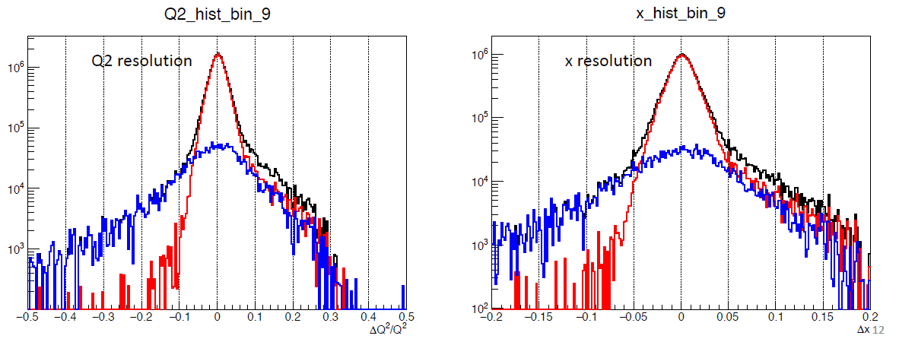
TRACKING
 | Single track efficiency [%] | Single track accuracy [%]
0% bg, single strips | 90.7 +/- 0.1 | 99.41 +/- 0.00
100% bg, single strips | 83.8 +/- 0.5 | 81.40 +/- 0.05
100% bg, seg. strips | 83.9 +/- 0.4 | 92.49 +/- 0.03
Current tracking algorithm: ~15% tracking inefficiency, 20% “imperfect” tracks (missing real hits or including background hits)
Both of these can be improved with additional development of the tracking; track accuracy can also be improved with segmented detectors
Anticipate 90% tracking efficiency with further development (5% loss of FoM – balances 5% overestimate due to double-counting polarization error)
Anticipate reduction of imperfect tracks, but even now it is mainly a resolution effect (non-gaussian tails)
  Deviation between flavor-dependent models and flavor-independent baseline has minimal x and Q² dependence
  PVDIS estimate is 0.2% corrections, but uncertainty will be smaller as we can simulate effect of smearing

Slide 27
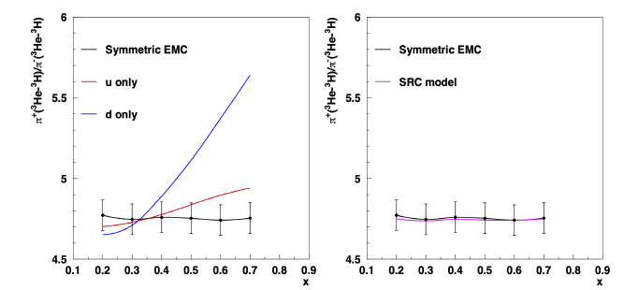
SIDIS
SIDIS projections: various target ratios for sums (differences) of π+ (valence u) and π− (valence d)
Symmetric EMC effect and “SRC” model (flavor dependence driven by SRC isospin structure) nearly indistinguishable - Large signal only when the EMC effect is d-quark only

Slide 28
SIDIS
Only “KP” and “d-quark only” models give effects above few percent. Other cases are at most 1-2% effects (systematics limited)
“KP” refers to the Kulagin-Petti calculation, but isn’t consistent with KP. It reproduces the KP EMC effect for 3H and 3He, but applies this as a flavor-independent EMC effect for the SIDIS calculation.
Drell-Yan: AMBER plans D-Y with π+ and π− beams, which is sensitive to flavor dependent EMC effect. Data limited to x < 0.34 – very complimentary, but not covering conventional “EMC effect” region

Slide 29
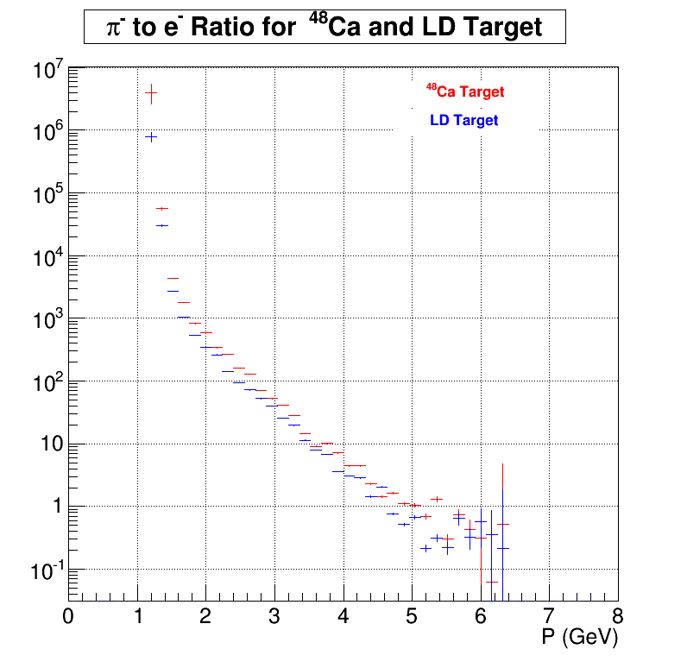
Backgrounds
Estimated charge symmetric background
→ Model scaled to agree w/Hall C e+/e- ratios
~1% for all but lowest x bin
Dominated by direct production from target: independent of solenoid polarity
Production in baffles is NOT polarity independent (but is generated by high-E scattered electron, i.e. expect production to be well below target production (New simulations in progress)
If target produces 0.9% and baffles produce 0.1%, then doubling the baffle production with modified polarity means 0.1% error in dilution factor: 0.1% error
Pion fraction no worse than 4%.
Rejection: Cherenkov (1000-400:1), calorimeter (100:1)
Uncertainty assumed pion has no asymmetry (will use measured asymmetry, assumed to be smaller but same sign)

Slide 30
Theory report
The proposed experiment aims at measuring the parity violating left-right beam asymmetry on a 48Ca target with the SoLID detector. The measurement will be performed in the deep-inelastic regime at 4 GeV2 < W2 < 12 GeV2 in the valence 0.2 < x < 0.8 region, and will study the flavor dependence of nuclear PDF modifications. This should provide important information on the long-standing questions regarding the possibly different nuclear modifications of up vs. down quarks in bound nucleons compared to free nucleons.
What distinguishes this experiment from similar ones previously approved or proposed is a greater sensitivity to flavor-dependent nuclear PDF modifications and reduced systematic experimental uncertainty. Achieving the aimed precision of the data would allow one to discriminate the largest predicted flavor-dependent nuclear modification (in the Cloet, Bentz, and Thomas model) from pure neutron excess effects at the 6σ level from a direct analysis of the slope of the data vs. x. Models with milder modifications could be then analyzed, for example, by including experimental data in global fits of nuclear PDFs.
Reducing the systematics is central to achieving the desired results. Systematic effects that can affect the interpretation of the data include power corrections (from target mass or higher-twist quark-gluon correlation effects in the target) that, unlike the logarithmic QCD evolution, do not cancel in the asymmetry ratio, and the d vs. u flavor separation in analyses of free nucleon PDFs. The former are expected to be at the ∼ 0.2% level and can be constrained by comparing with the PVDIS measurements on LD2 (E12-10-007). The latter is difficult to quantify at present, since extraction of the d/u ratio at large x still suffer from theoretical uncertainties. With the availability of data from the SoLID and BONuS12 experiments, to complement the recently published MARATHON results, the uncertainties on d/u are likely to be reduced; however, the current uncertainties assigned to this ratio in this proposal may be underestimated. In particular, extractions from the CJ and AKP groups differ at large x by more than the reported statistical PDF uncertainties, due to different treatments of higher twist terms and their interplay with off-shell deformations of the nucleon PDFs. Depending on the kinematics, this systematic difference may be larger than estimated in the proposal, inflating the PDF uncertainties by up to ∼ 60%. Furthermore, compared to the previous proposal, the comparison of the size of nuclear corrections for a1 to the statistical precision of the proposed predictions is not present. A similar figure for the systematic effects from d/u extractions would be informative. By the time the experiment, if approved, would be performed, the mentioned systematic differences in d/u extractions will likely be reconciled, and data from BONuS12 will further reduce the PDF uncertainties. However, at this stage a more comprehensive assessment of these uncertainties would be welcome.
Finally, some of the formulas in Appendix A appear to be inconsistent. While APV in Eq. (17) includes corrections from the R (= σL/σT ) ratio, in Eqs. (21) and (22) R is implicitly set to zero in writing F2 = 2xF1. The authors should verify whether the correct formulas were used in obtaining the numerical estimates presented in this proposal.
Overall, we expect this could be an important experiment utilizing the unique capabilities of CEBAF at 11 GeV, that should provide complementary data for the determination of the flavor dependence of the EMC effect and give further insight into its underlying mechanism – which still eludes the community 40 years after its discovery.

Slide 31
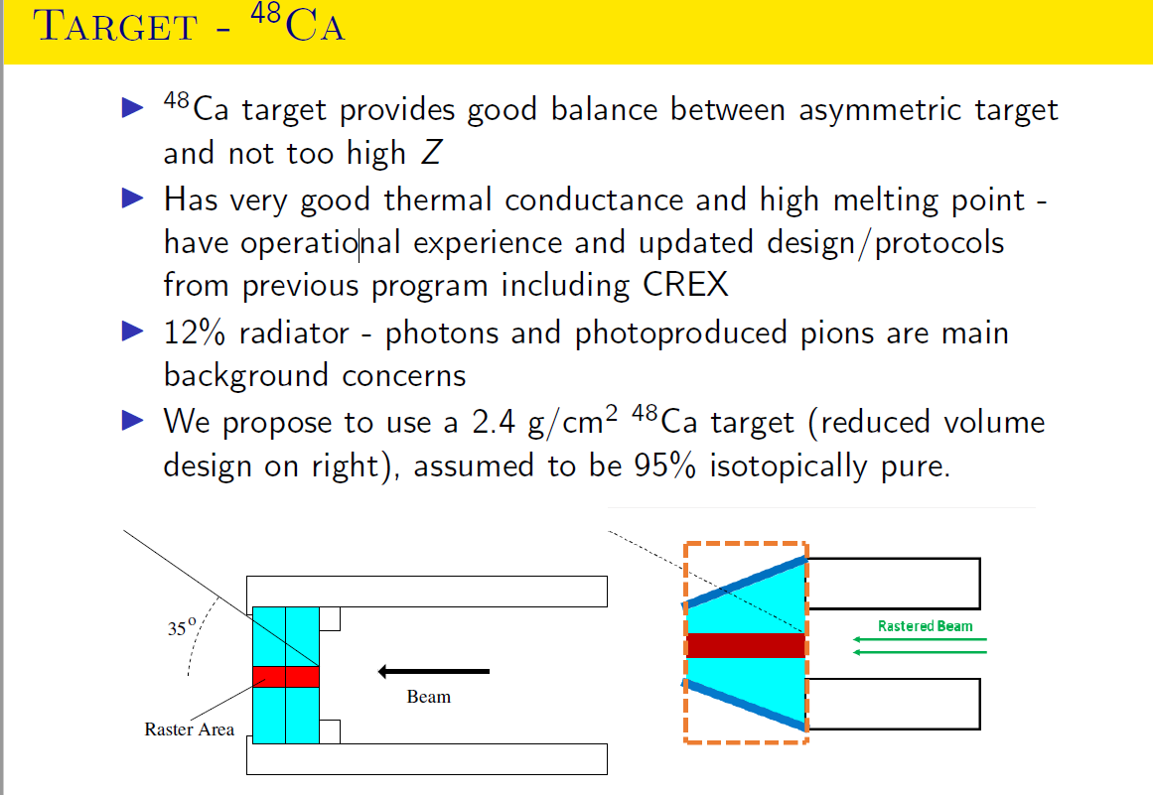
93%
If 90% pure, need five additional days to maintain same figure of merit

Slide 32
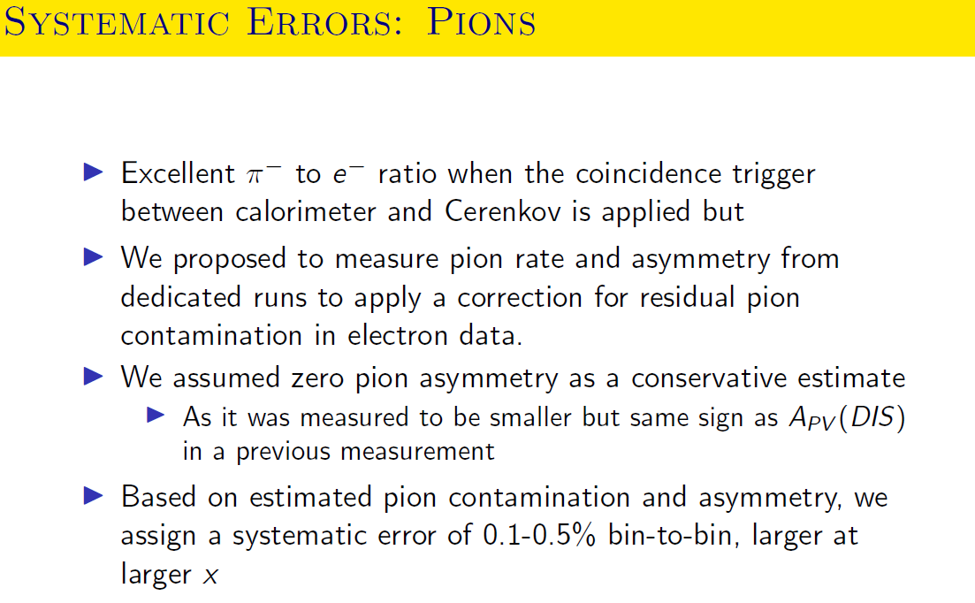

Slide 33
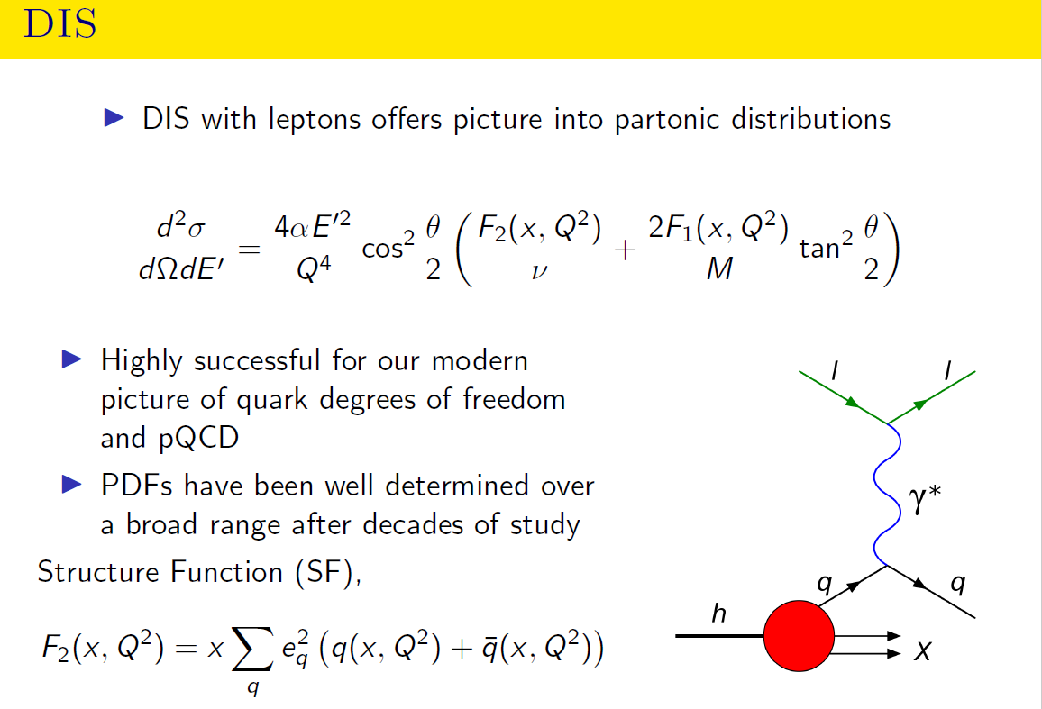

Slide 34
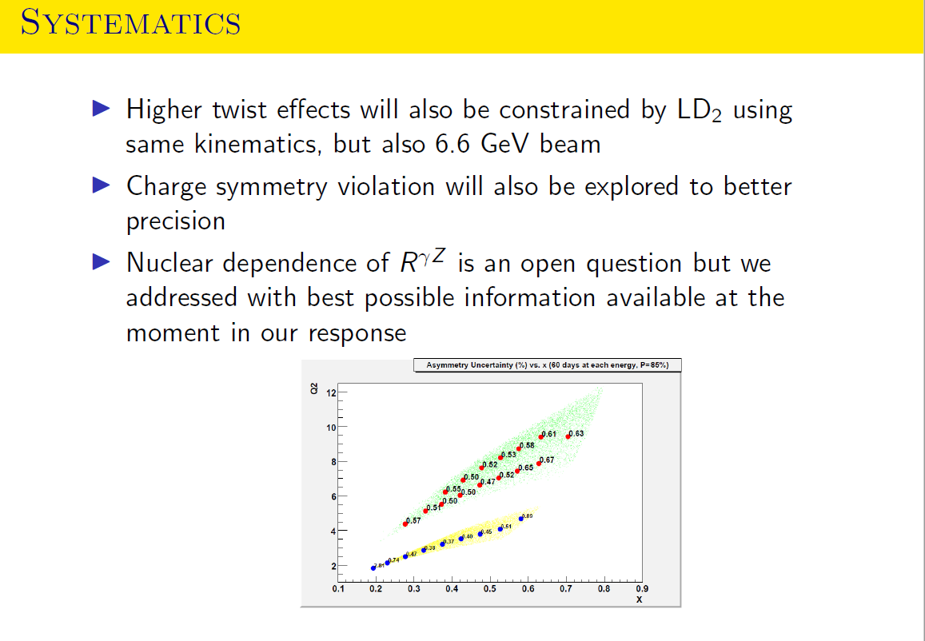

Slide 35
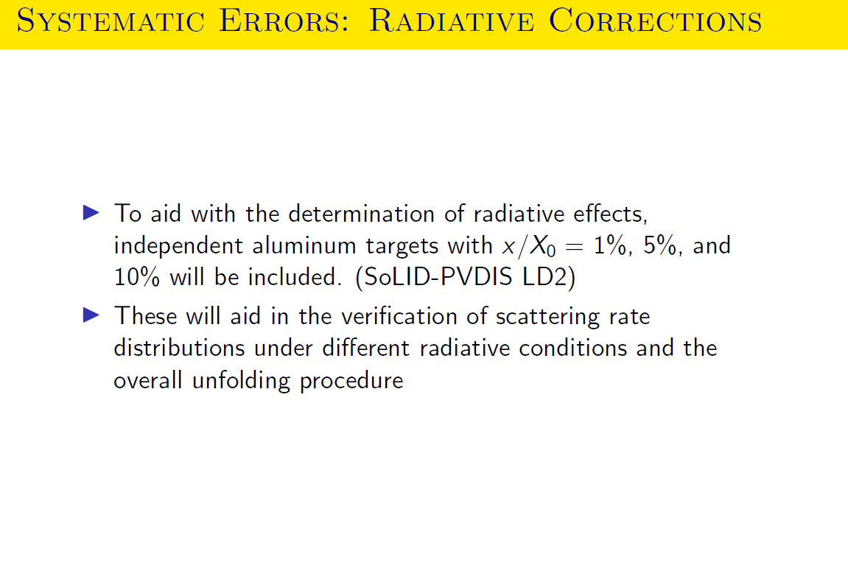

Slide 36
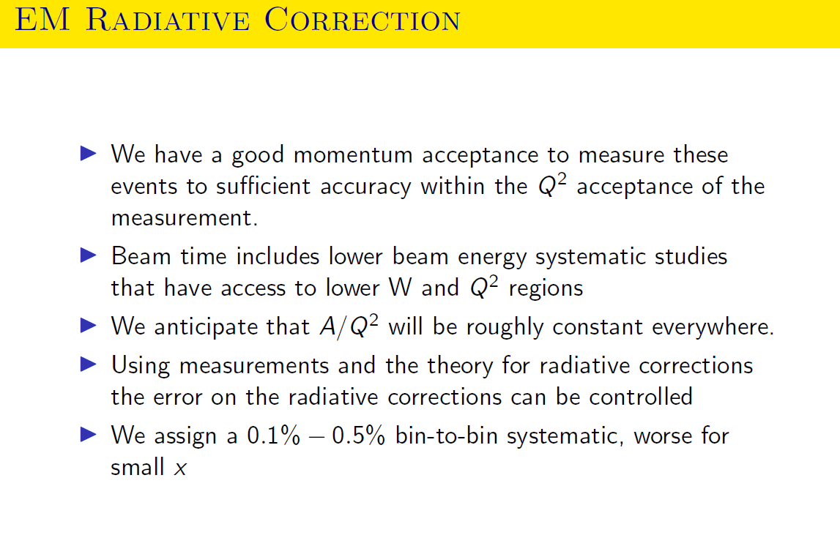

Slide 37
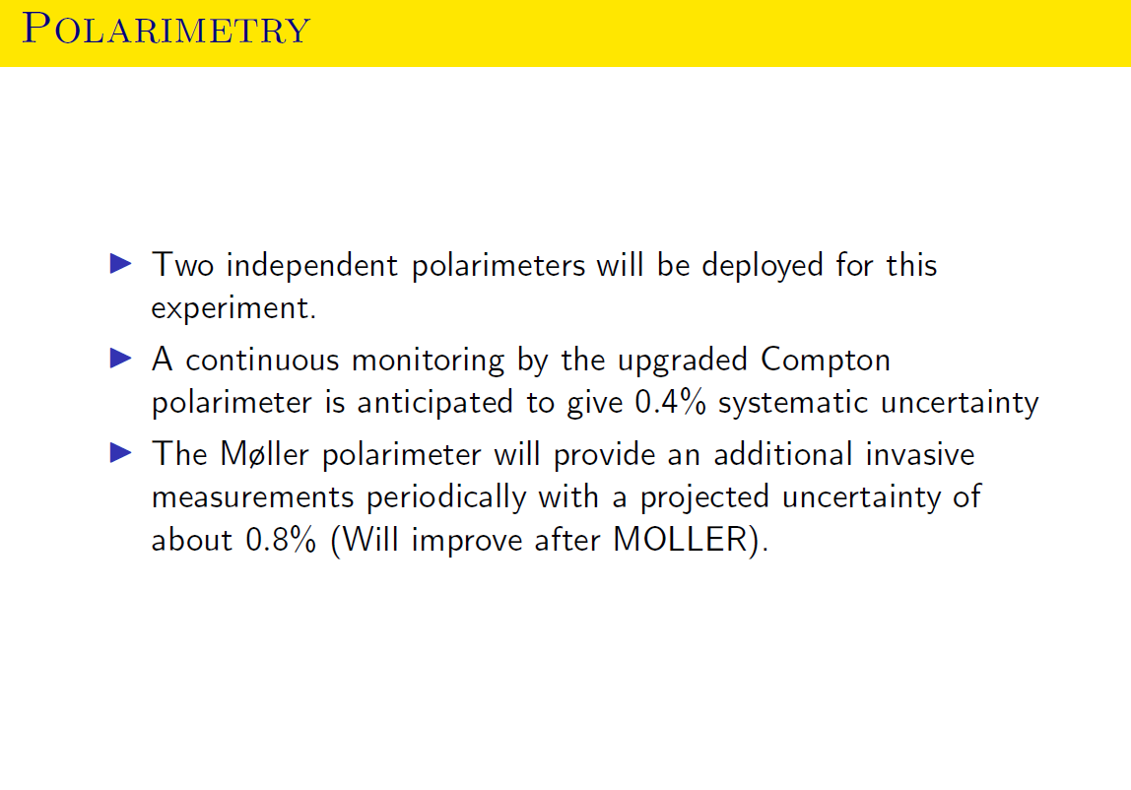

Slide 39
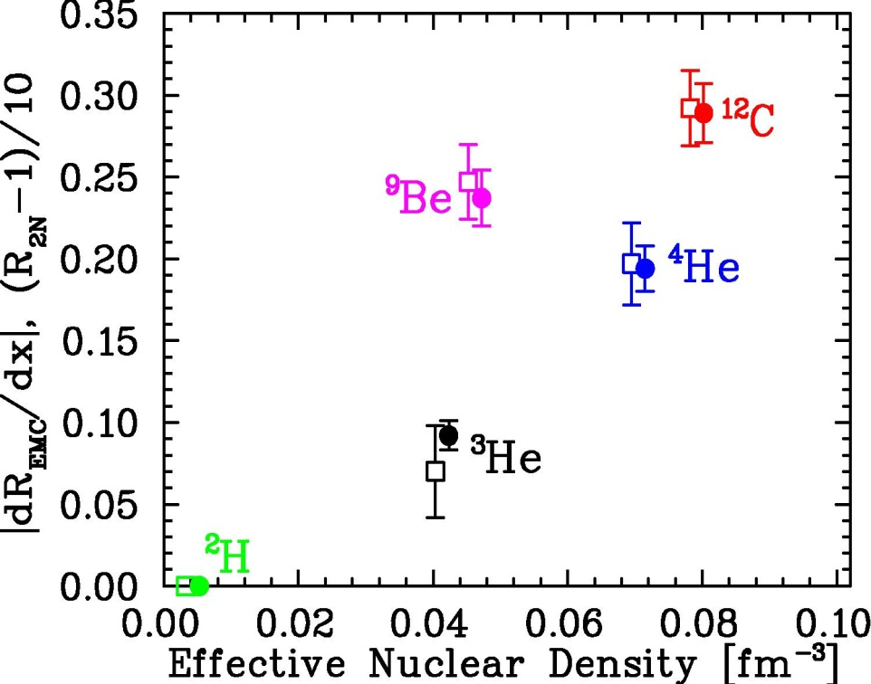
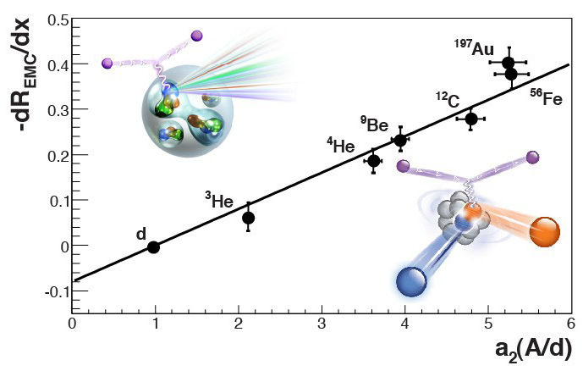
EMC–SRC correlation
SRCs are mainly np pairs (>90% for heavy nuclei)
Does SRC isospin dependence lead to flavor dependence of the EMC effect?
J. Seely, et al., PRL103, 202301 (2009)
Potential between two nucleons
N. Fomin, et al., PRL 108, 092052 (2012)
L. Weinstein, et al., PRL 106, 052301 (2011)
JA, et al., PRC 86, 065204 (2012)

Slide 40
Brief digression: short-range structures
Data on light nuclei suggest importance of ‘local density’
  Shows connection to detailed nuclear structure, clustering effects
  Intriguing observation, but microscopic explanation not yet clear
Can we study these high-density structures directly?
  Short-range correlation (SRC) measurements are meant to probe such high-density configurations
    Aim is to study contribution of high density configurations
    The experiments measure high momentum nucleons
Potential between two nucleons

Slide 41
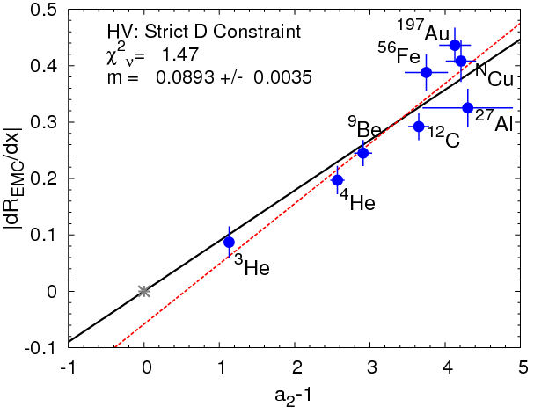
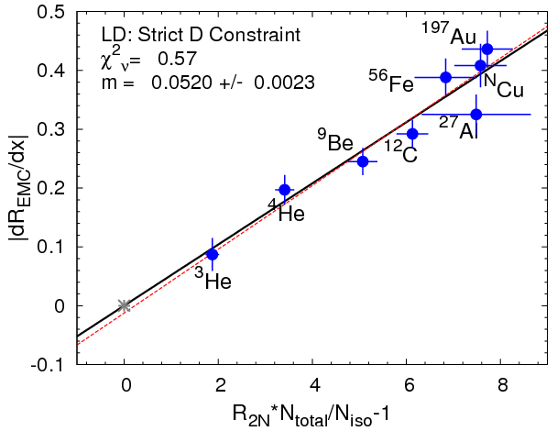
Two Hypotheses for EMC-SRC correlation
JA, et al., PRC 86 (2012) 065204
High-Virtuality (HV):
EMC ~ #/high-p nucleons
“HV”: short-distance → SRCs, but large momenta in SRCs → EMC
EMC ~ # of high-p nucleons ~ a₂
a₂ ~ (σ_{A}/A)/(σ_{D}/2) in SRC region
Isospin dependence, due to np dominance
Local Density (LD):
EMC ~ short-distance pairs
“LD”: short-distance → SRCs and EMC effect
a₂ measures high-p contribution of np pairs. a₂ has to be corrected for smearing from SRC CM motion and scaled from np to NN pairs.
Short-distance pairs assumed to be isospin-independent in this analysis
Hypothesis | Fit type | χ²_{ν} | EMC(D)
High Virtuality | 2-param No constraints | 1.26 | -0.058±0.036
High Virtuality | 1-param | 1.47 | --
Local Density | 2-param No constraints | (0.64) 0.84 | -0.012±0.033
Local Density | 1-param | (0.57) 0.74 | --
“Local Density” (flavor-independent) model gives better correlation, better extrapolation to (known) deuteron values
Difference only at the 2σ level
Notes:
Keep it brief

Slide 42
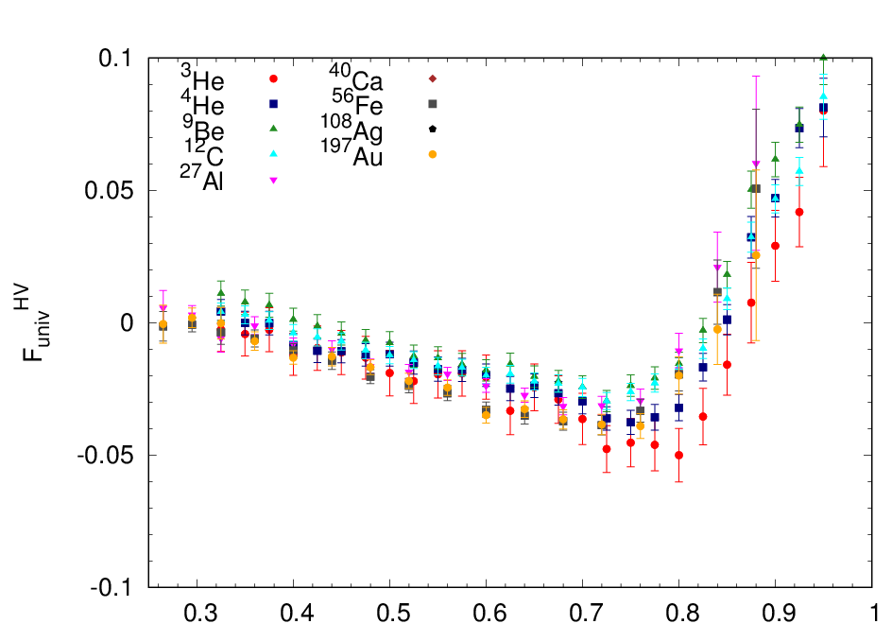
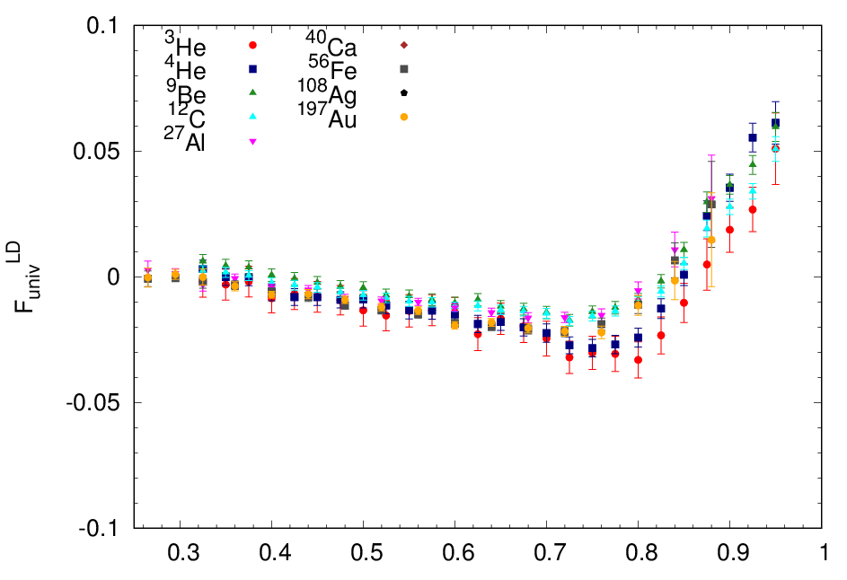
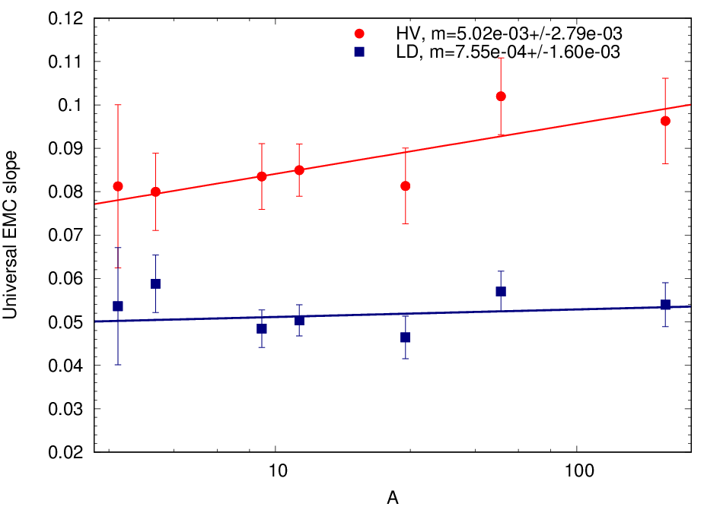
Similar analysis, looking at “universal EMC effect” extracted under similar assumptions:
B. Schmookler, et al., Nature 566 (2019) 345
JA, N. Fomin, PRL 123 (2019) 042501
HV picture (left): EMC effect from np-SRC, yields specific flavor dependence
LD picture (right): Driven by short-distance pairs, assumed to be flavor independent
JA, N. Fomin, PRL 123 (2019) 042501
HV: Slope = (5.0+/-2.8)x10⁻³
LD: Slope = (0.8+/-1.6)x10⁻³
Both give reasonable description; slightly better for LD
Very different deuteron EMC effect for HV and LD
This approach is nearly identical to the previous analysis (looking at the quality of EMC-SRC correlation)
Notes:
Keep it brief

Slide 43
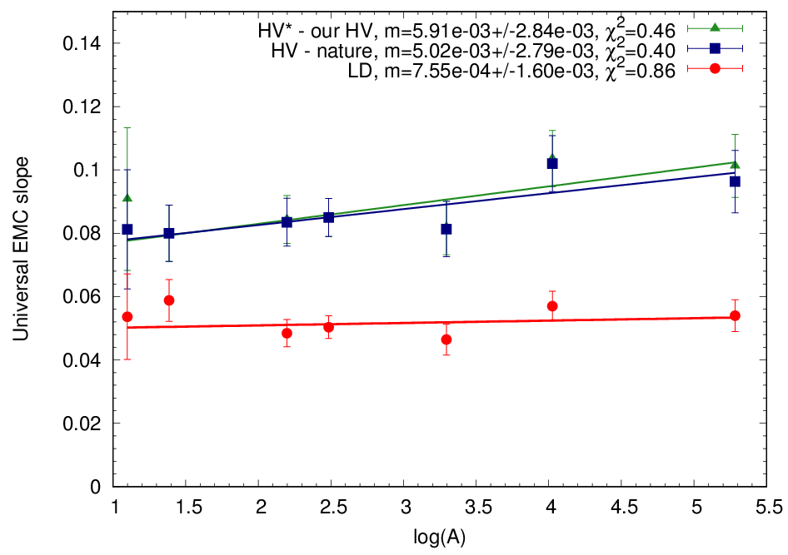
How flavor-sensitive are the non-isoscalar nuclei?
HV: 100% np dominance
Flavor-dependent
LD: For comparison with HV, chosen to be flavor-independent
Naïve EMC-SRC correlation:
slope = EMC slope / a₂
Flavor-independent
Sensitivity of a single nucleus to flavor dependence is small; need large N/Z range, systematic study

Slide 44
Estimates from Quantum Monte Carlo
Provides ab initio calculations of several important quantities up to A=12
  Momentum distributions: Fraction of high-momentum nucleons
  Momentum distributions: Average kinetic energy of nucleons
  Density distributions: Average density of nucleus
  Two-body densities: Average ‘overlap’ (local density) of nn, pn, pp pairs
Predict A-dependence of unpolarized EMC effect [JLab E12-10-008]
  Cross section weighted average of proton and neutrons
Can calculate each of these for protons and neutron separately
  Isospin/flavor dependence as function of fractional neutron excess: (N-Z)/A

Slide 45
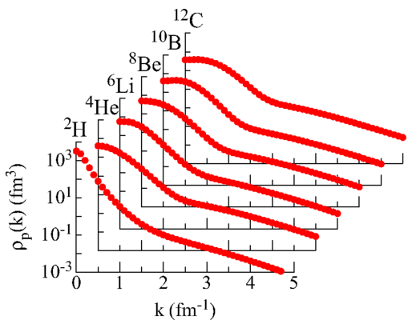
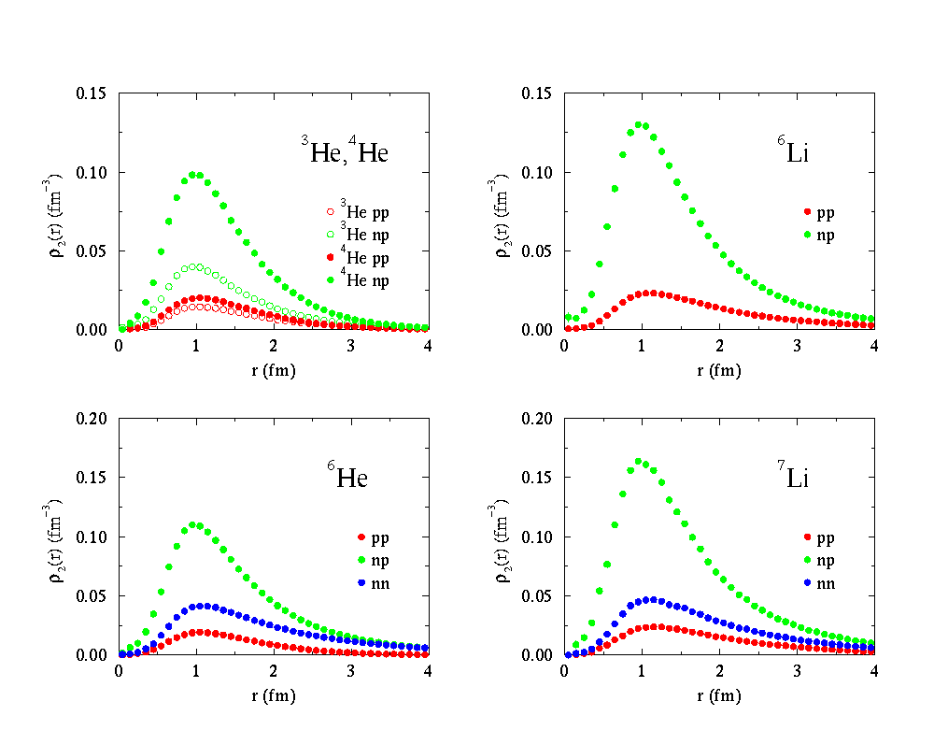
Estimates from Quantum Monte Carlo
Provides ab initio calculations of several important quantities up to A=12
  Momentum distributions: Fraction of high-momentum nucleons
  Momentum distributions: Average kinetic energy of nucleons
  Density distributions: Average density of nucleus
  Two-body densities: Average ‘overlap’ (local density) of nn, pn, pp pairs
R. Wiringa, R. Schiavilla, S. Pieper, and
J. Carlson, Phys. Rev. C89 (2014) 024305

Slide 46
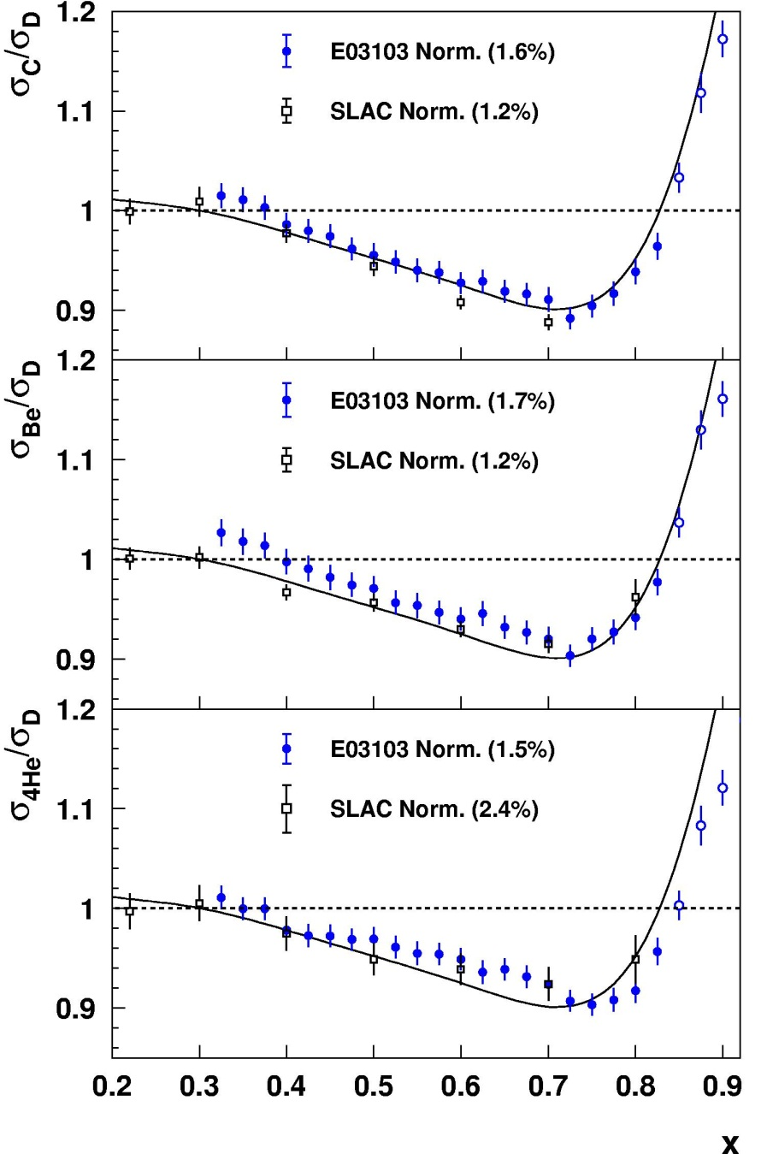
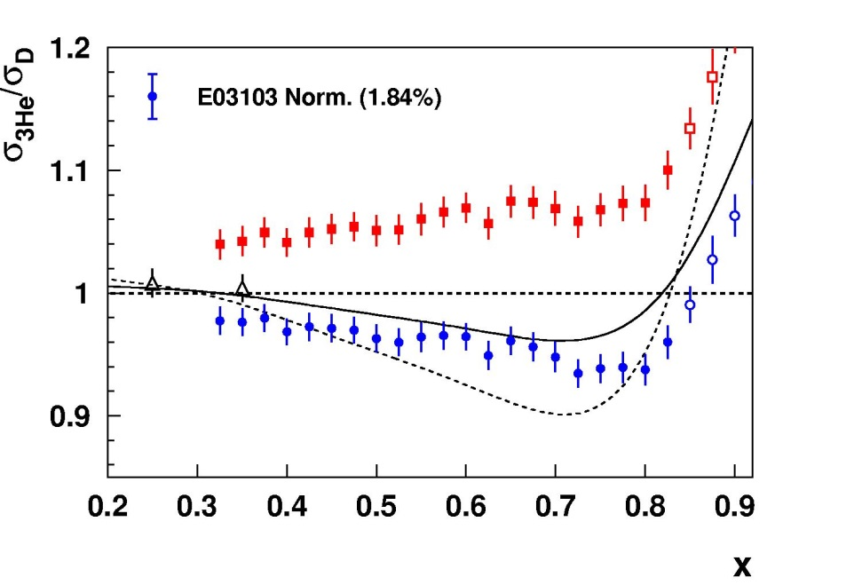
EMC effect in light nuclei
JLab E03-103: JA, D. Gaskell - spokespersons
¹²C
Measured EMC effect for ³He, ⁴He, ⁹Be, ¹²C, ⁶³Cu, ¹⁹⁷Au,
Consistent shape for all nuclei (Curve is SLAC fit for ¹²C)
Quantify EMC effect using the slope in the linear region (0.35<x<0.7)
⁹Be
⁴He
EMC effect grows with density except for ⁹Be – low
average density but significant alpha clustering
K. Arai, et al., PRC54, 132 (1996)
J.Seely, et al., PRL103, 202301 (2009)

Slide 47
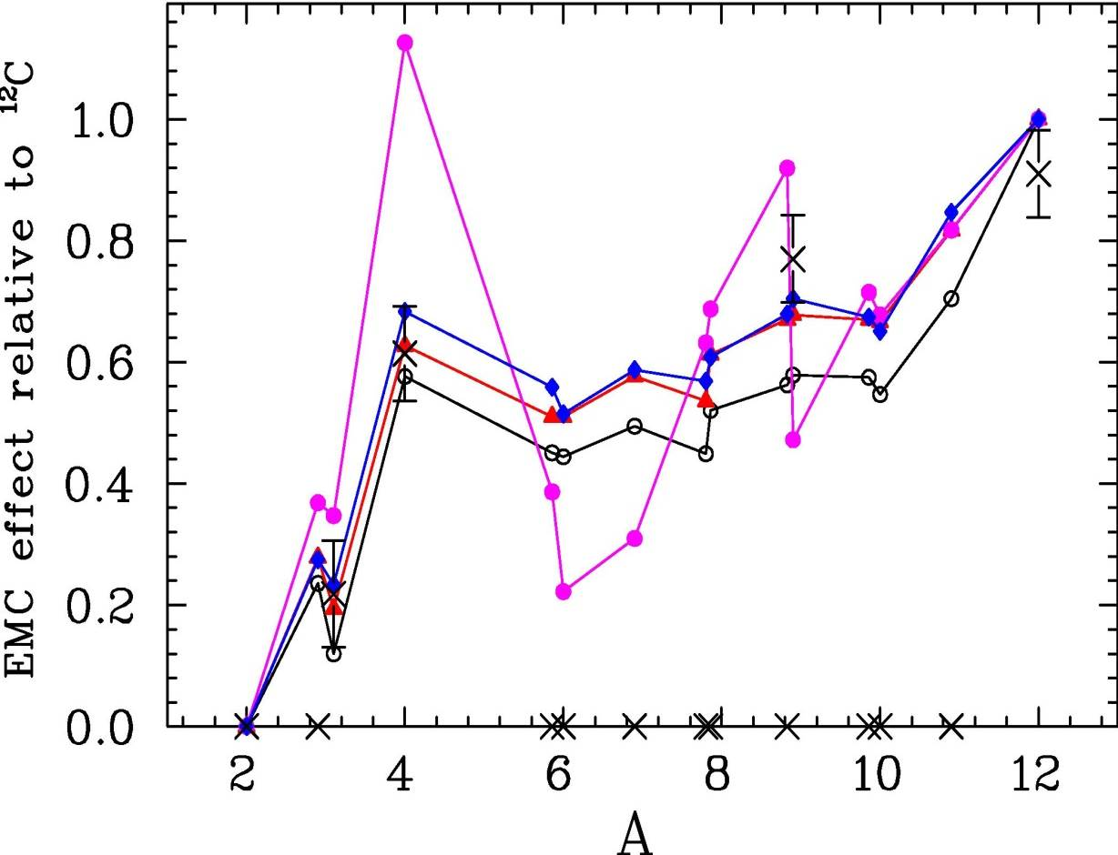
A-dependence of unpolarized EMC effect
4 simple models of EMC scaling:
Fraction of n(k) above 300 MeV
Average Kinetic Energy
Average Density
Nucleon Overlap (r₁₂ < 1 fm)
Fixed normalizations for ²H for ¹²C
Preliminary
³H
³He
A-dependence of light nuclei already excludes average density
High-momentum tail has small, systematic difference for most nuclei

Slide 48
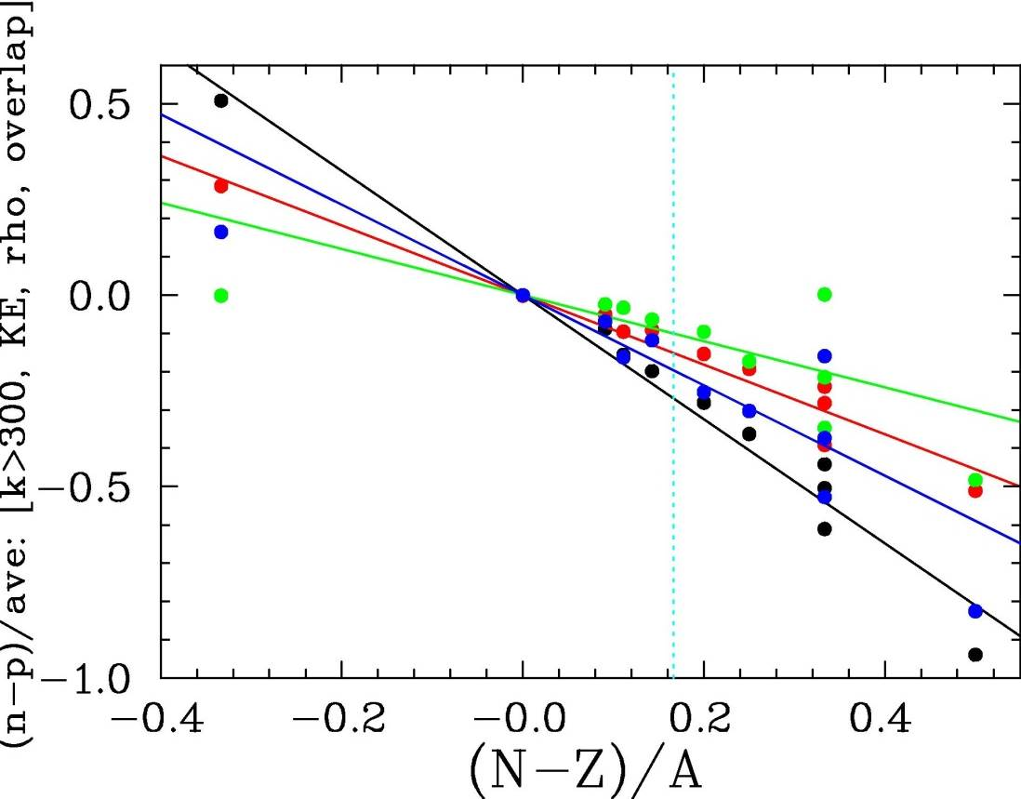
Isospin dependence vs fractional neutron excess
4 simple models of EMC scaling:
Fraction of n(k) above 300 MeV
Average Kinetic Energy
Average Density
Nucleon Overlap (r₁₂ < 1 fm)
EMC effect isospin asymmetry: (neutron-proton)/average
Cloet estimates: scaled from NM
⁴⁸Ca
⁹Be
Cloet, et al.
Preliminary
Can be probed directly in parity-violating electron scattering
⁴⁸Ca measurements proposed at JLab
Light nuclei (e.g. ⁹Be) may also have good sensitivity; help disentangle effects

Slide 49
Systematic Uncertainties
Effect | Uncertainty (%)
Beam polarimetry | 0.4
R^{γZ}/R^{γ} | 0.2
Pions (bin-to-bin) | 0.1-0.5
Charge-symmetric background | <0.1
Radiative corrections (bin-to-bin) | 0.5-0.1
Other corrections (including CSV) | 0.2
PDF uncertainties | 0.2
Total Systematic | 0.6-0.7
Same as PVDIS on LD2
PRD 84:074008, 2011
Constrained by measurements at opposite field
Constrained by MARATHON, PVDIS, BONUS12
Statistical uncertainty = 0.7-1.3%
Total systematic uncertainty expected to be comparable or smaller than statistical uncertainty

Slide 50
Short-distance behavior and the EMC effect
EMC effect driven by average density of the nucleus
[J. Gomez, et al., PRD 94, 4348 (1994), Frankfurt and Strikman, Phys. Rept. 160 (1988) 235]
2. EMC effect is driven by Local Density (LD) – overlap of nucleons
[J. Seely et al., PRL 103, 202301, 2009]
  SRCs generated by interactions in short-distance (high-density) np pairs
  EMC effect driven by high-density nucleon configurations (pairs, clusters)
3. EMC effect driven by High Virtuality (HV) of the nucleons [L. Weinstein et al, PRL 106, 052301,2011]
  SRC measurements directly probe high-momentum nucleons
  EMC effect driven by off-shell effects in high-momentum nucleons
Comparison of HV/LD explanations of EMC-SRC correlation:
JA, A. Daniel, D. Day, N. Fomin, D. Gaskell, P. Solvignon, PRC 86 (2012) 065204
Notes:
EXAMINE EMC-SRC CORRELATION UNDER THESE DIFFERENT ASSUMPTIONS
CORRELATION VS CAUSATION!!!!

Slide 51
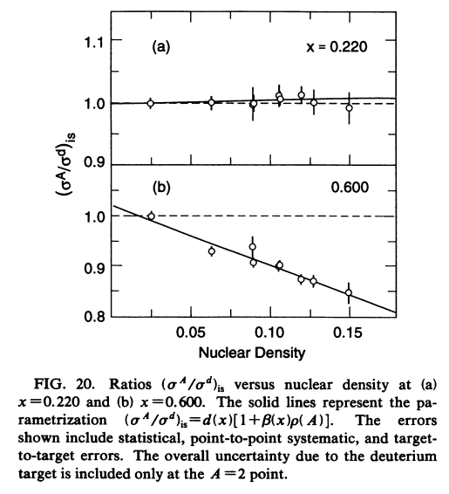
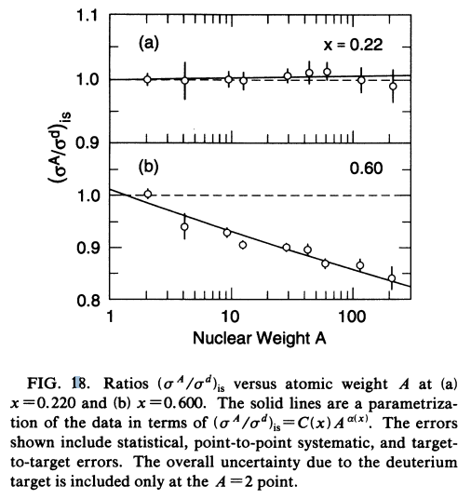
EMC effect: SLAC E139
J. Gomez, et al., PRD49, 4349 (1994)
SLAC E139
  Most precise large-x data
  Nuclei from A=4 to 197
  Universal x-dependence
  Size depends weakly on A
    Scales well with density or with A (~A^{1/3})
    Scales with density

Slide 52
Nuclear structure ←→ Quark effects?
Data on light nuclei suggest importance of ‘local density’
  Shows connection to detailed nuclear structure, clustering effects
  Intriguing observation, but microscopic explanation not yet clear
Can we study these high-density structures directly?
  Short-range correlation (SRC) measurements are meant to probe such high-density configurations
    Aim is to study contribution of high density configurations
    The experiments measure high momentum nucleons
Potential between two nucleons

