Slide 1
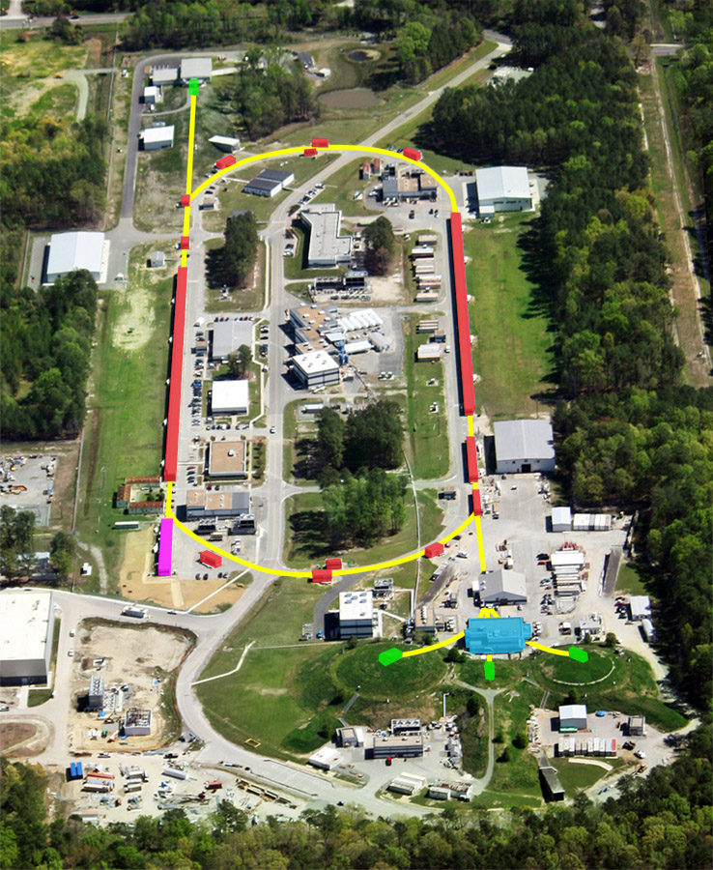
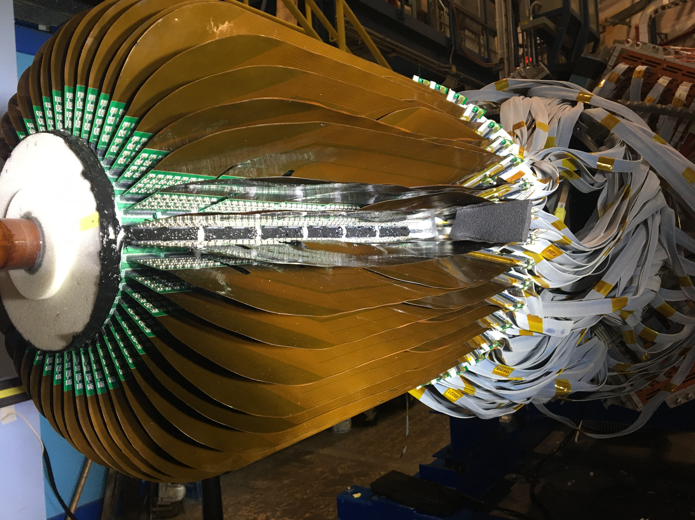
Nuclear Science at Jefferson Lab
Thia Keppel
Hampton University Graduate Studies (HUGS) at JLab
June 2022

Slide 2
Nuclear Physics – Fundamental Questions
c
Nuclear Physics Seeks to:
Understand the fundamental structure of visible matter (quarks, gluons,..)
Understand how hadrons (mesons, nucleons,..) and nuclei are formed

Slide 3
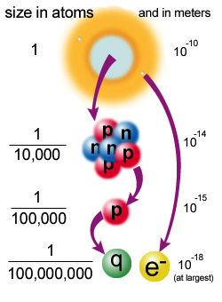
How to probe the nucleons / quarks?
Electron scattering experiments employ the high momentum point-like electrons, + electromagnetic interactions, which are well understood, to probe nuclear structure (which isn’t).
High energy electrons are a great tool for the job!
short distance -> large momentum

Slide 4
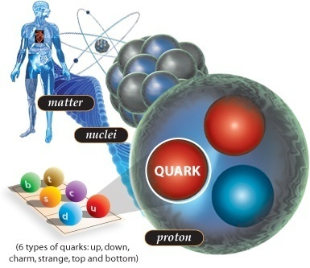
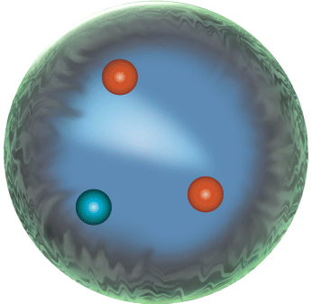
Highly relativistic motion…
Protons and neutrons swirl in a heavy atomic nucleus with speeds of up to some ¾ c. More commonly, their speed is some ¼ the speed of light. They are “strong-forced” to reside in a small space.
Quarks (and gluons) are “confined” to the even smaller space inside protons and neutrons. Because of this, they swirl around with the speed of light.

Slide 5
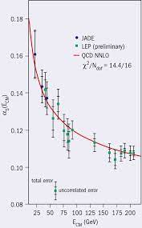
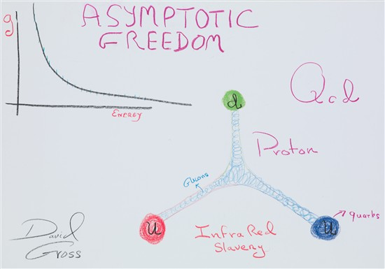
What we know
Nucleons
Nuclei

Slide 6
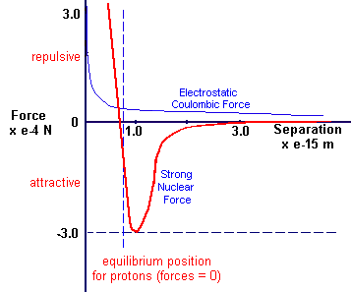
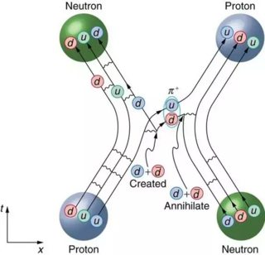
What we know
Nucleons
Nuclei

Slide 7
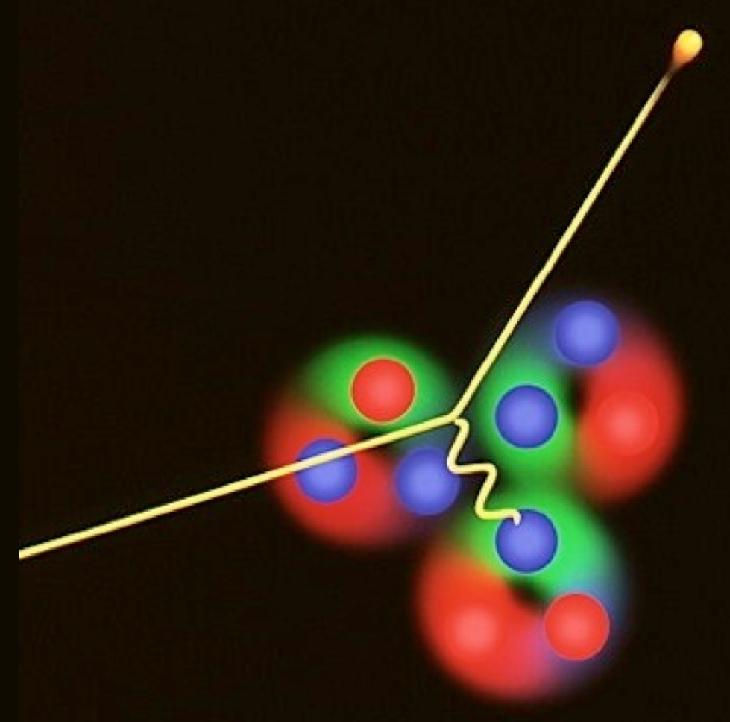
Lepton Scattering: a Powerful Tool
The best evidence we have for what the nucleon looks like comes from electron scattering experiments
→
e’ = (E’, k’)
SUCCESS
CHALLENGES
Clean probe of hadron structure
Electron (lepton) vertex well-known from QED
One can vary the wave-length of the probe to view deeper inside the hadron
The interaction is weak
→ small cross sections
Small cross sections also in large x “valence” regime
Would also like coincidence measurements with struck/created hadrons
γ*
→
Hadrons
e = (E, k)
→
p = (M, 0)

Slide 8
Jefferson Lab – because there’s still lots we don’t know!
DOE Office of Science Laboratory with a single program focused on Nuclear Physics. In operation since 1995 Created to build and operate the Continuous Electron Beam Accelerator Facility (CEBAF), world-unique user facility for Nuclear Physics. Mission is to gain a deeper understanding of the structure of matter: Through advances in fundamental research in nuclear physics Through advances in accelerator and nuclear science and technology Largest Nuclear Physics user community in the world…and growing.
Jefferson Lab by the numbers: ~700 employees, 27 Joint faculty 169 acre site ~1,700 Active Users ~700 PhDs granted to-date (200 more in progress) K-12 programs serve more than 12,000 students and 950 teachers annually (non-COVID) Scientific users from 39 countries, 278 institutes (124 institutions in 34 states)

Slide 9
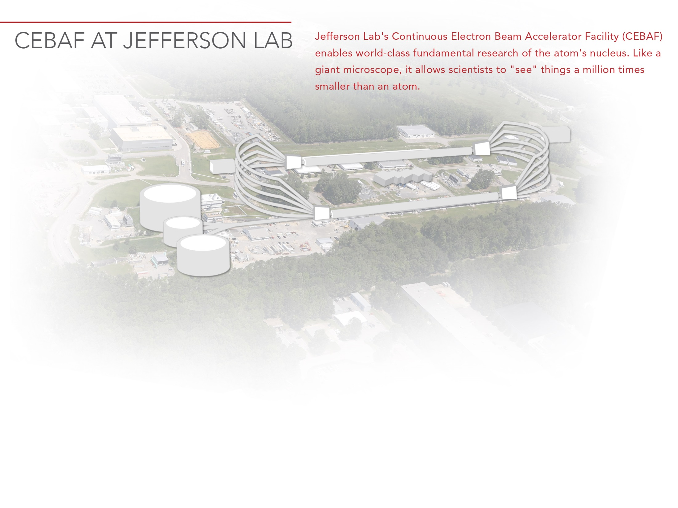
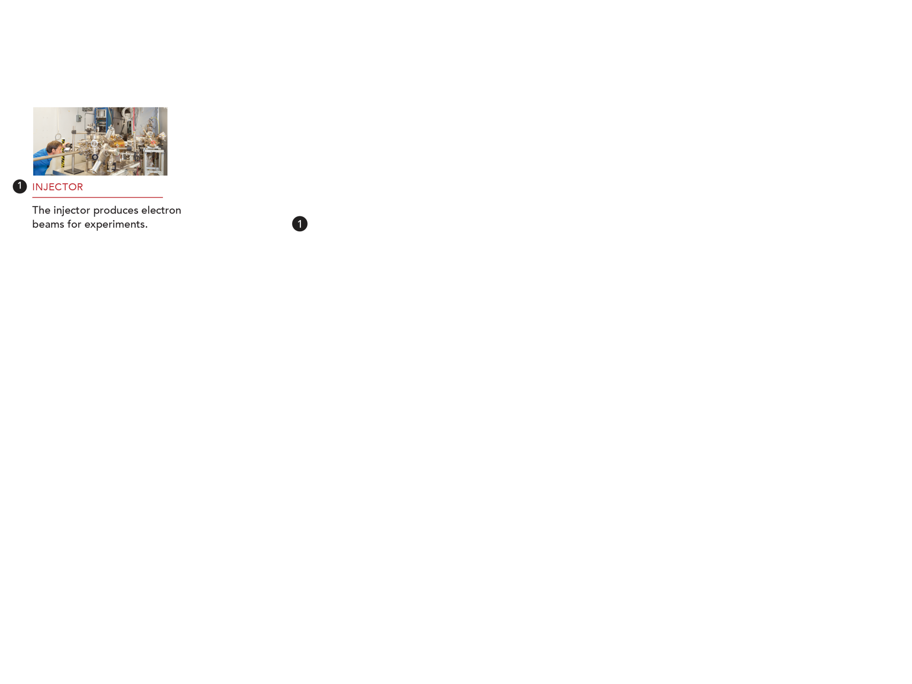
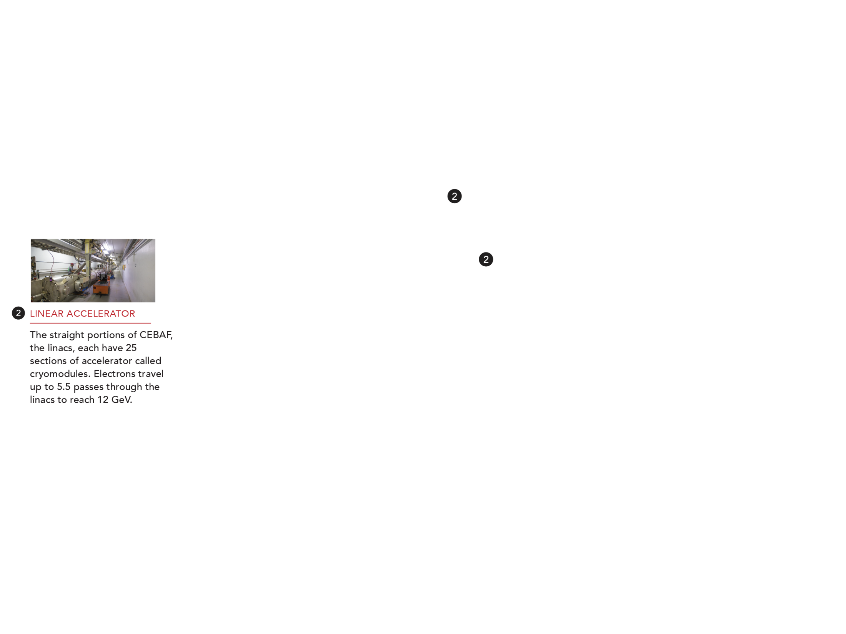

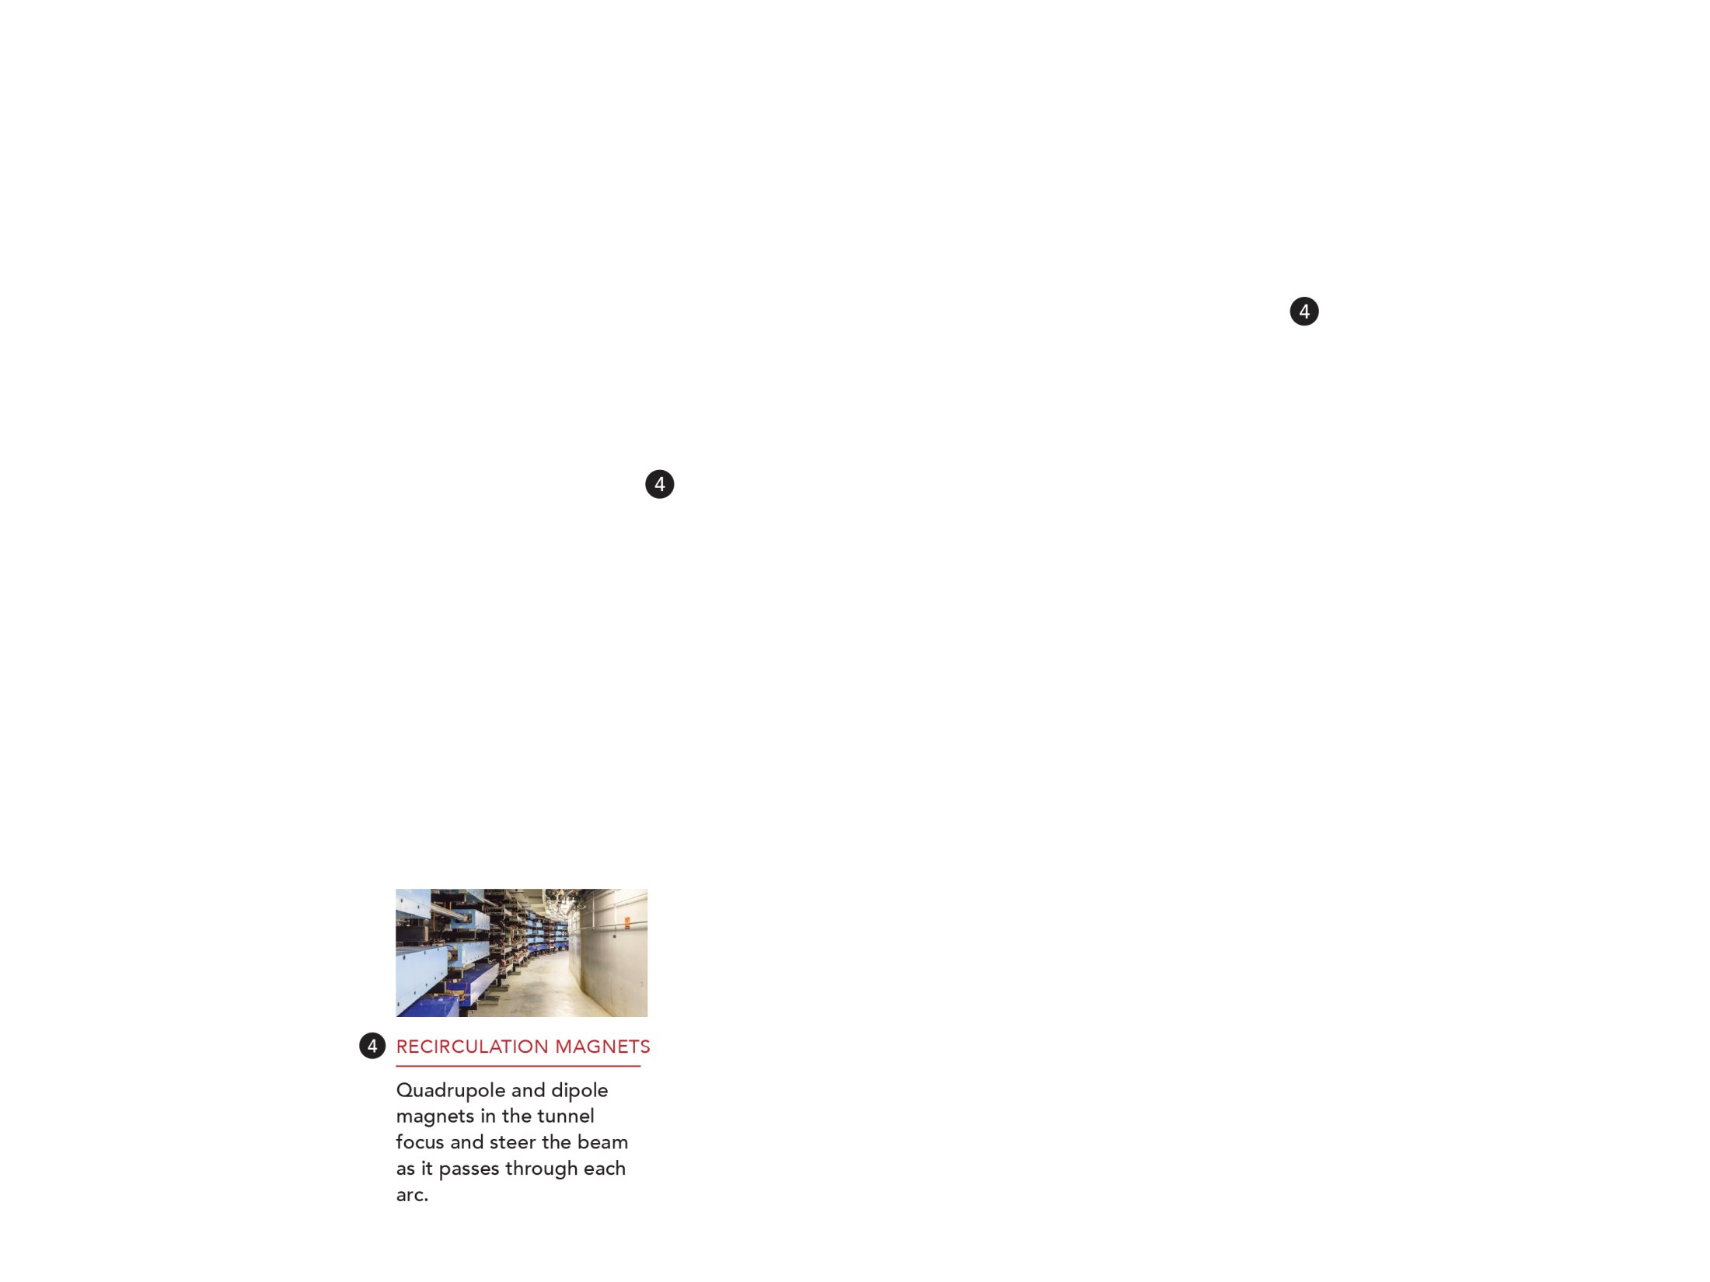
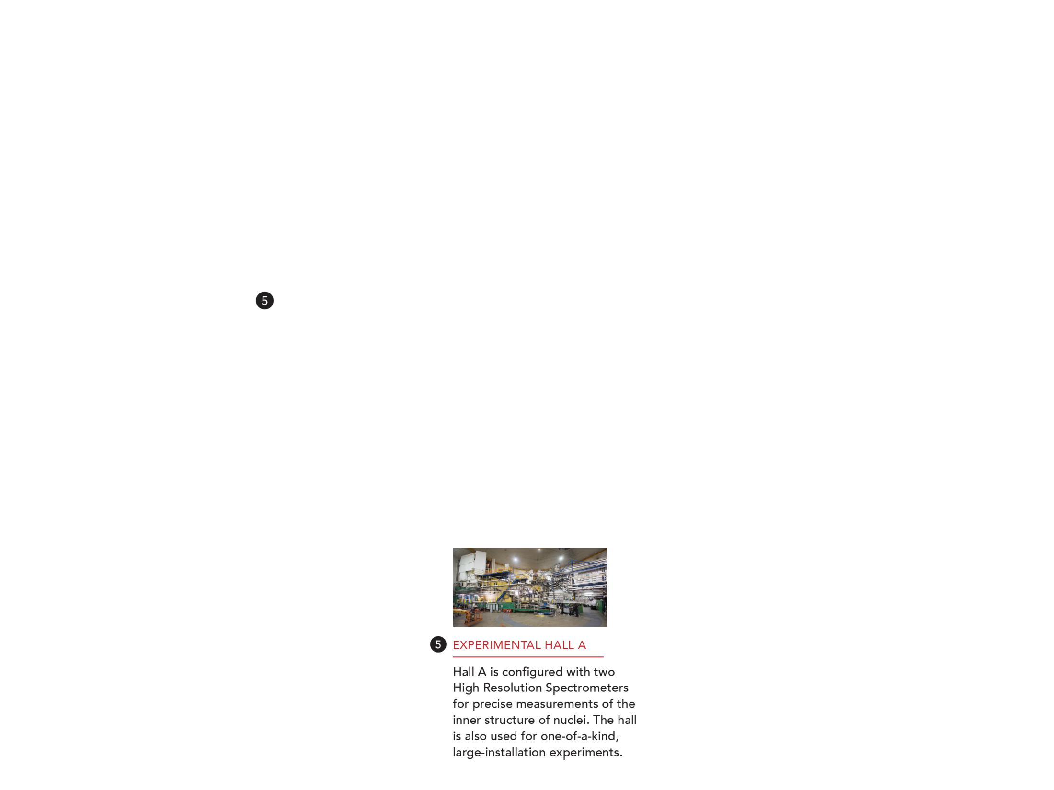
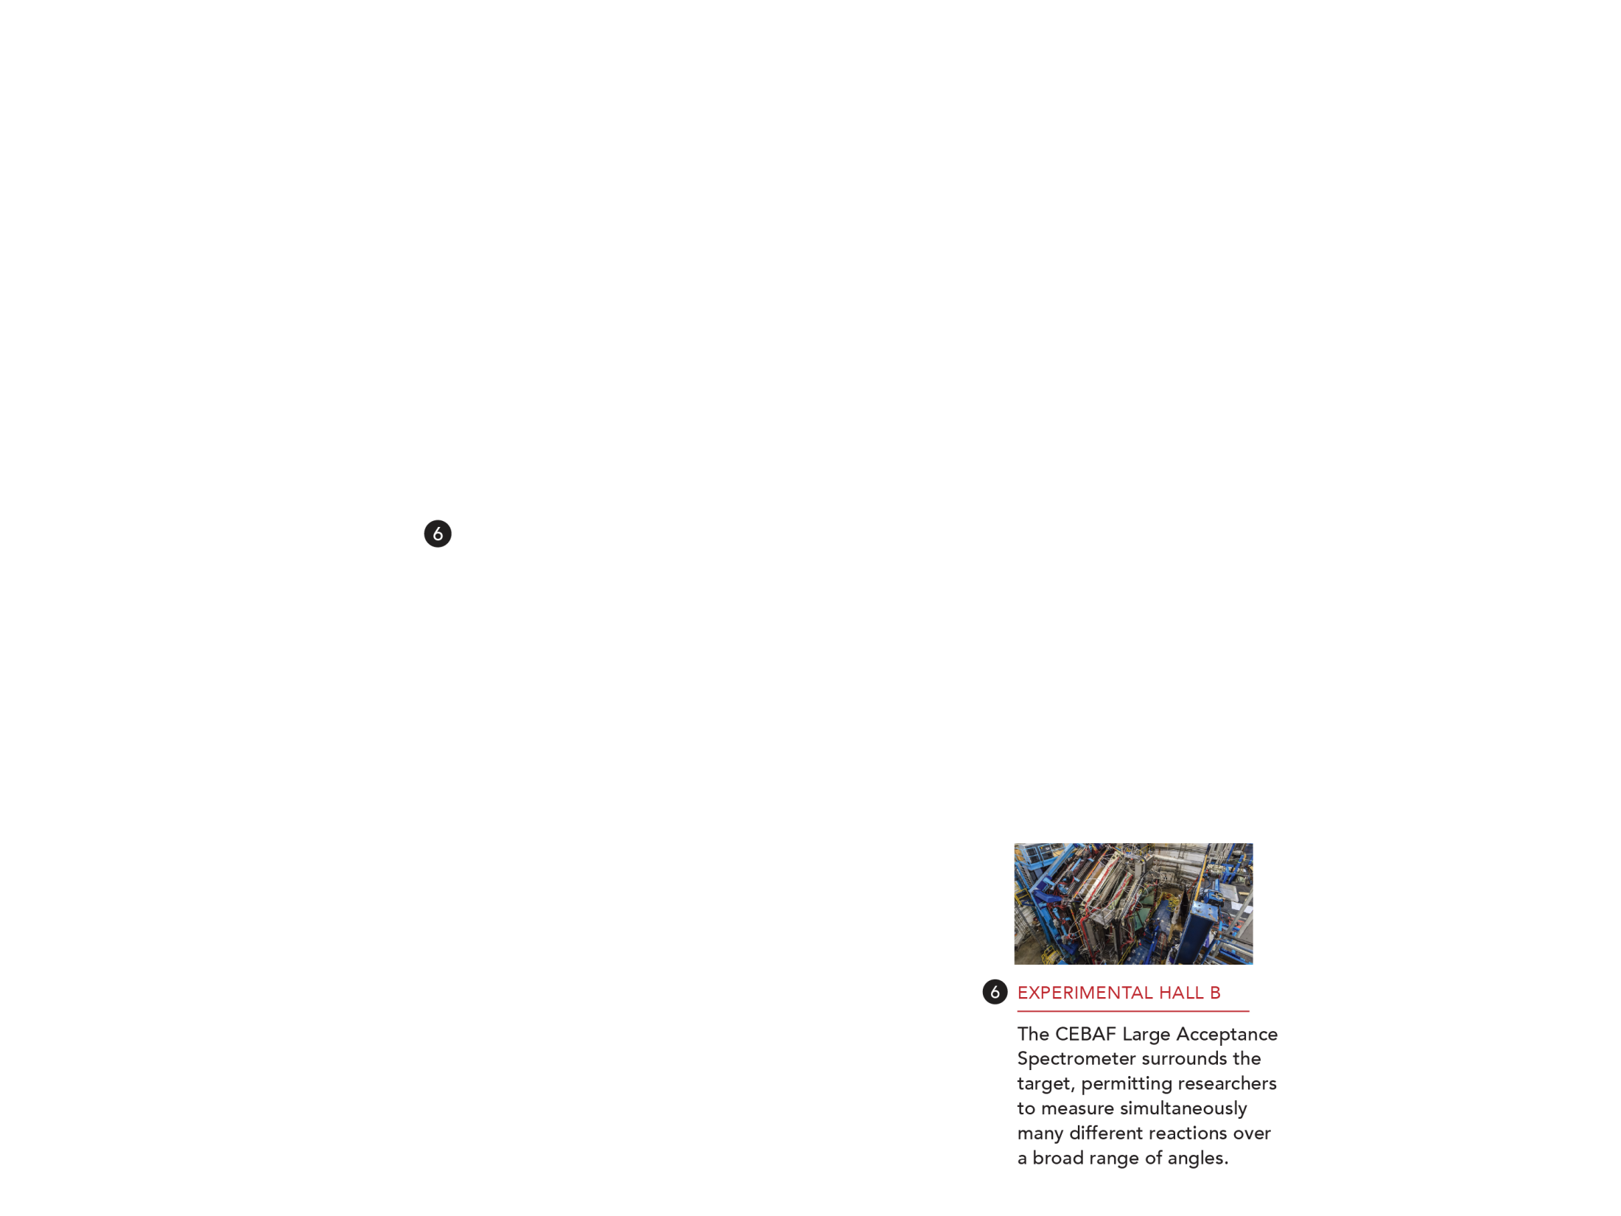

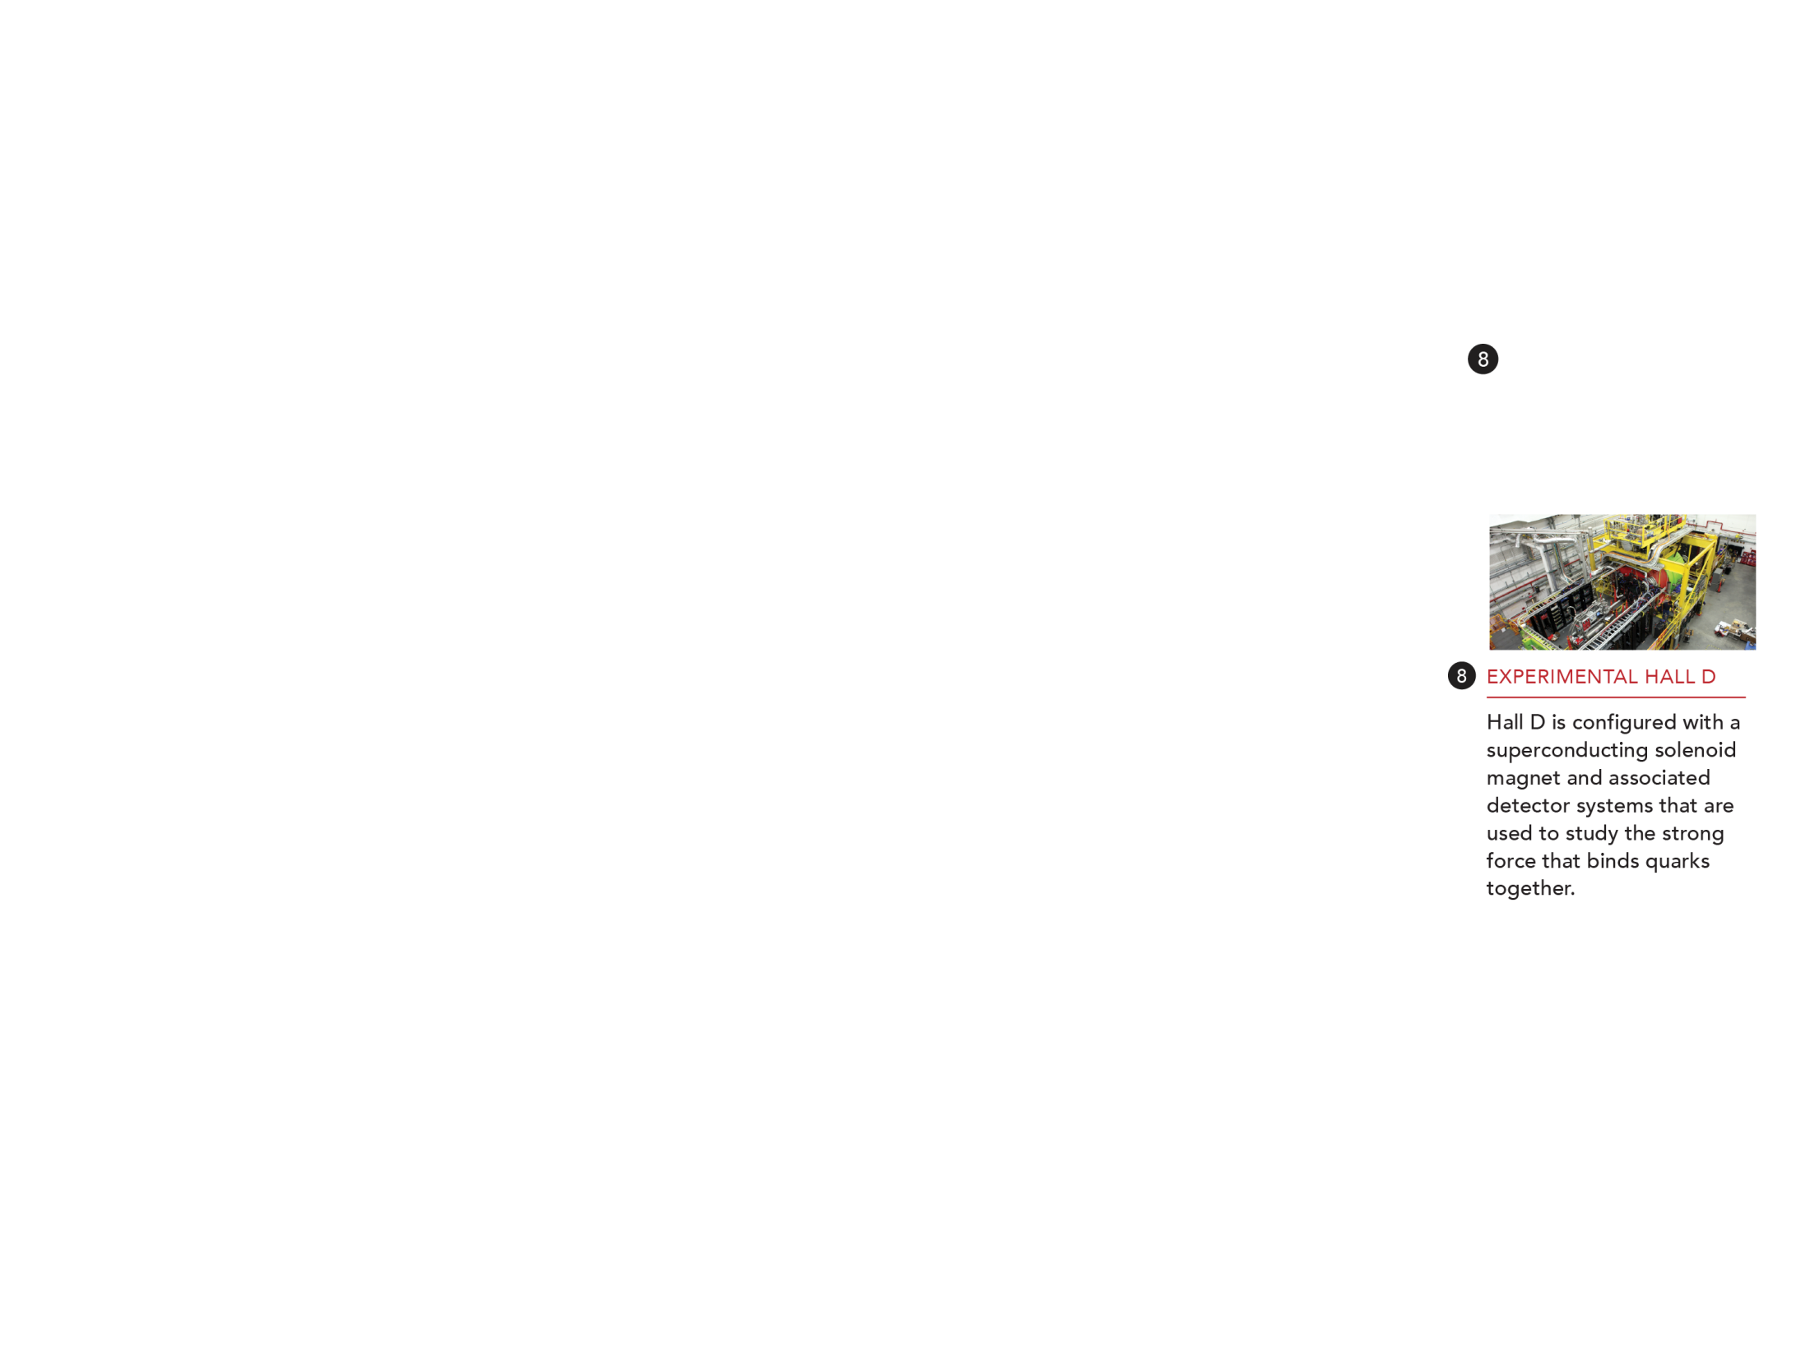
Diagram representational of below ground structure

Slide 10
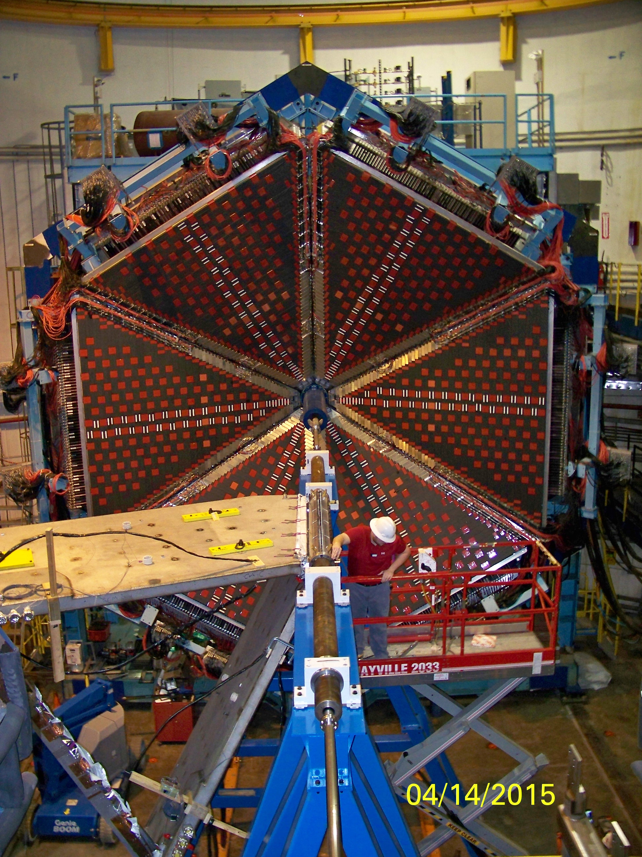
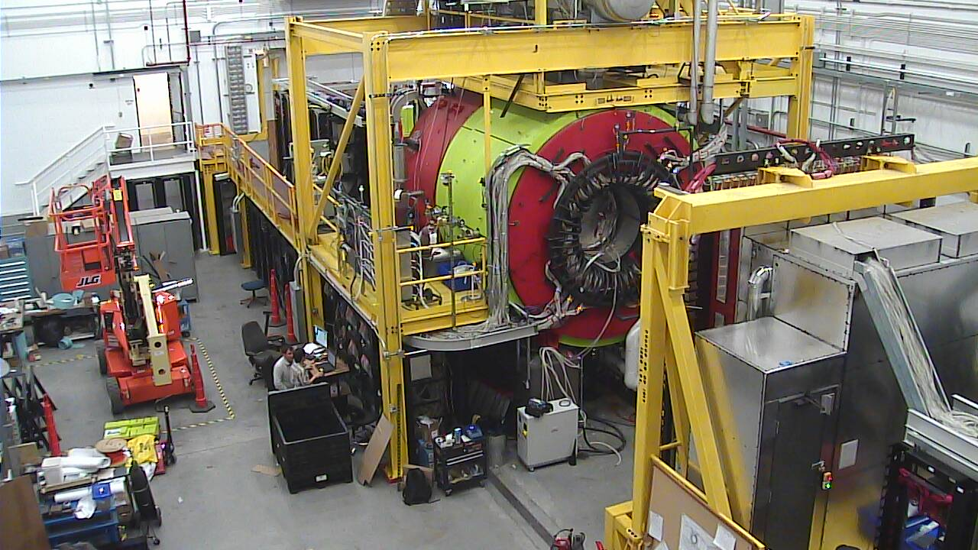
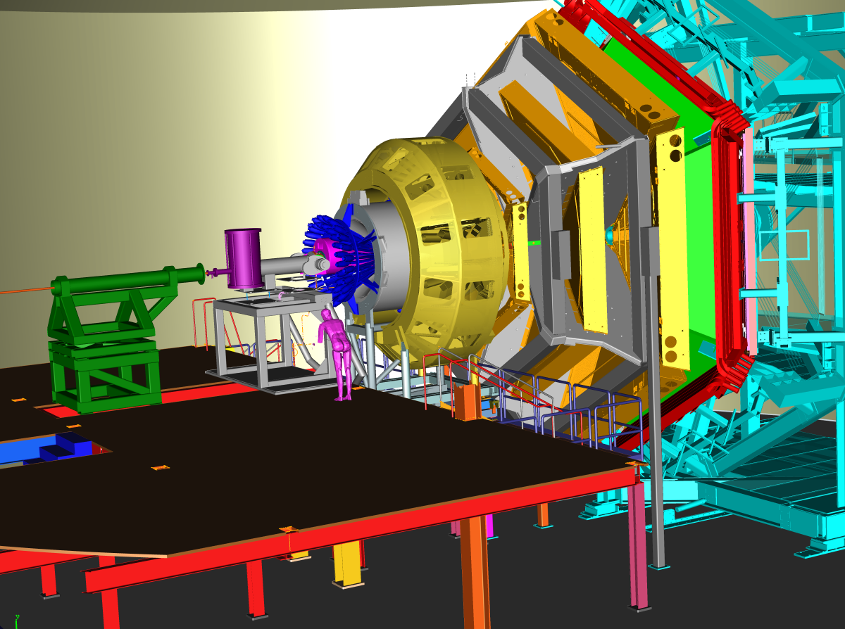
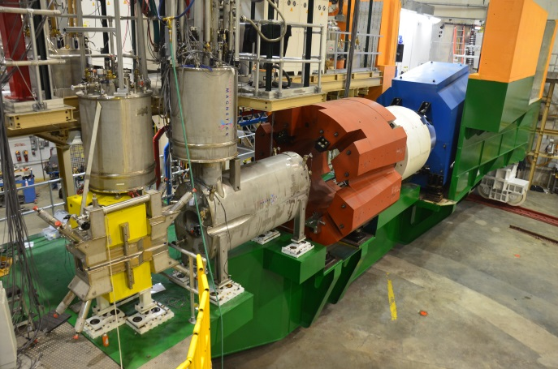
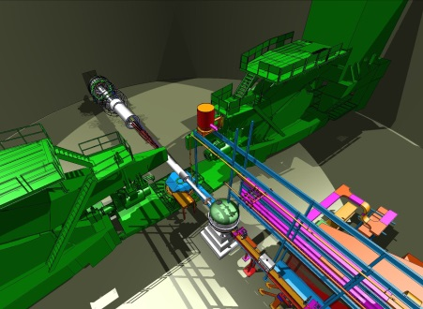
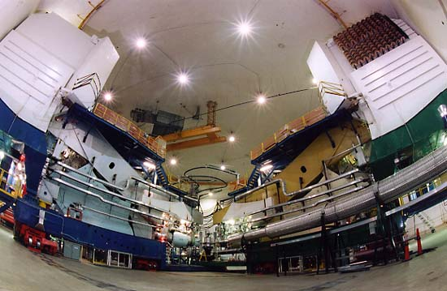
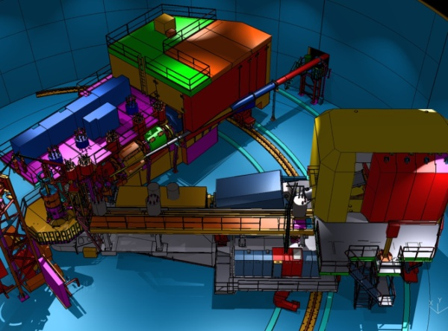
Detectors in 4 Halls = Numerous Scientific Capabilities!
Hall B – understanding nucleon structure via 3D imaging
Hall D – exploring origin of confinement by studying exotic mesons
Hall C – precision determination of quark properties in nucleons/nuclei
Hall A – charge distributions, future new experiments
Notes:
10
Note BSM not included in project

Slide 11
Particle Detection: an analogy
Look at water wake… height of waves, width of waves, how long, direction, how fast dissipating.....
Provides information about the ship that created them!

Slide 12
Let’s look at some currently/recently running experiments….

Slide 13
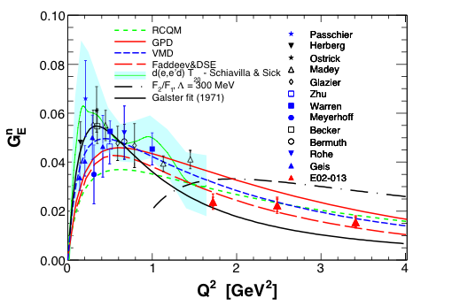
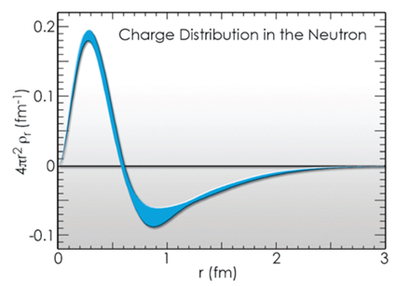
Basic Experiment Example: Neutron “Form Factor” (charge distribution)….. Why not zero?
Neutron has no charge, but it does have a charge distribution: n = p + π⁻, n = ddu. Use polarization and ³H(e,e’n) to access. “Guarantee” that electron hits a neutron AND electron transfers its polarization to this neutron.
n = p + π⁻

Slide 14
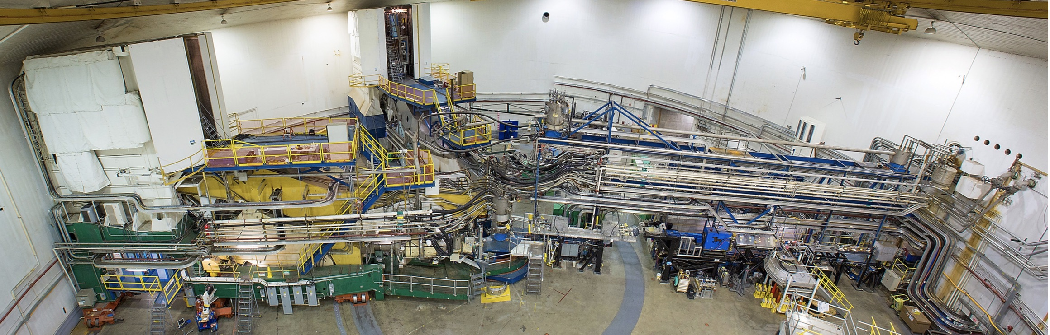
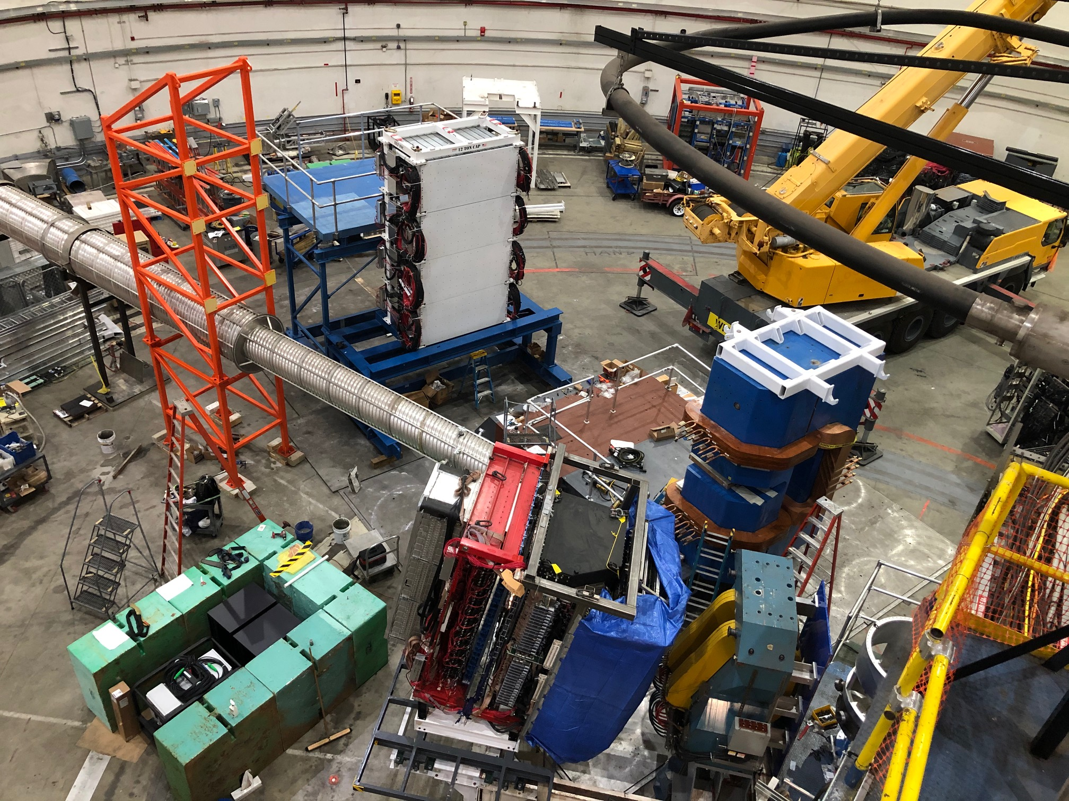
JLab Hall A Super BigBite Spectrometer Program
Prior to last year
Remove and Install SBS
Substantial new equipment installation
Dedicated to precision measurements of nucleon form factors to highest Q²
Started taking data < two weeks ago!

Slide 15
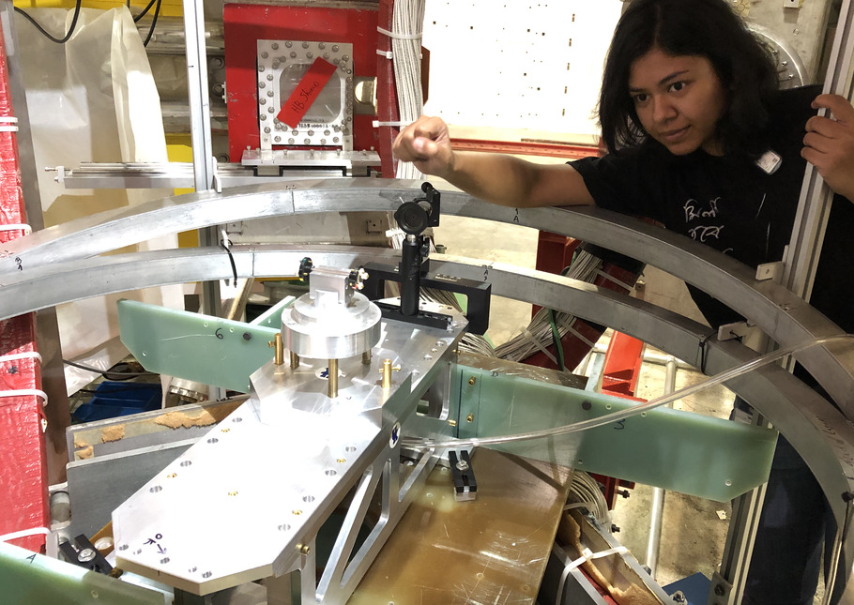
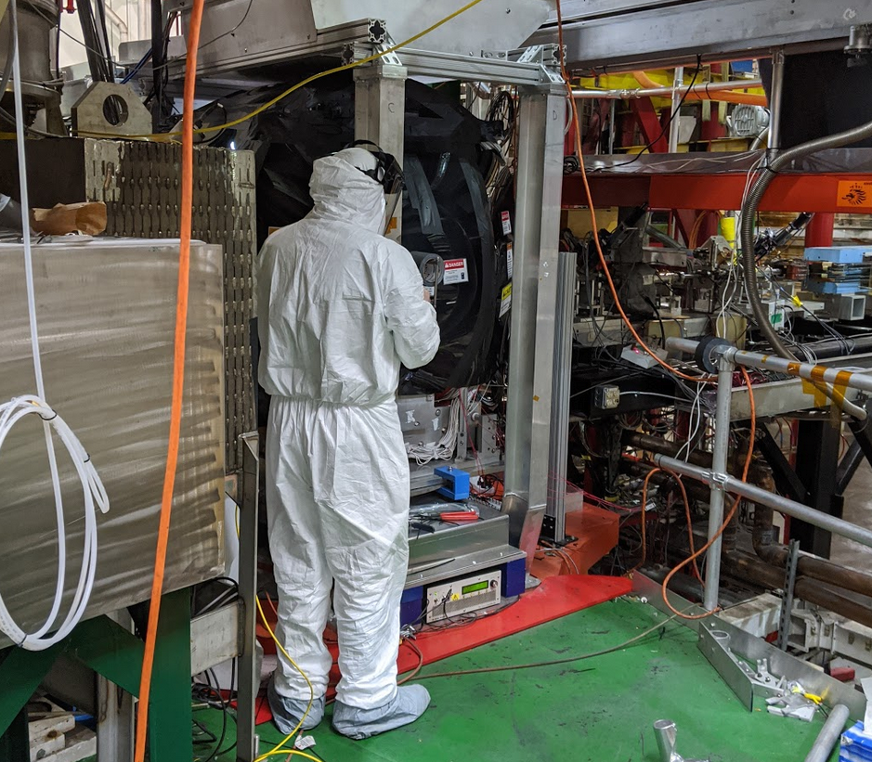
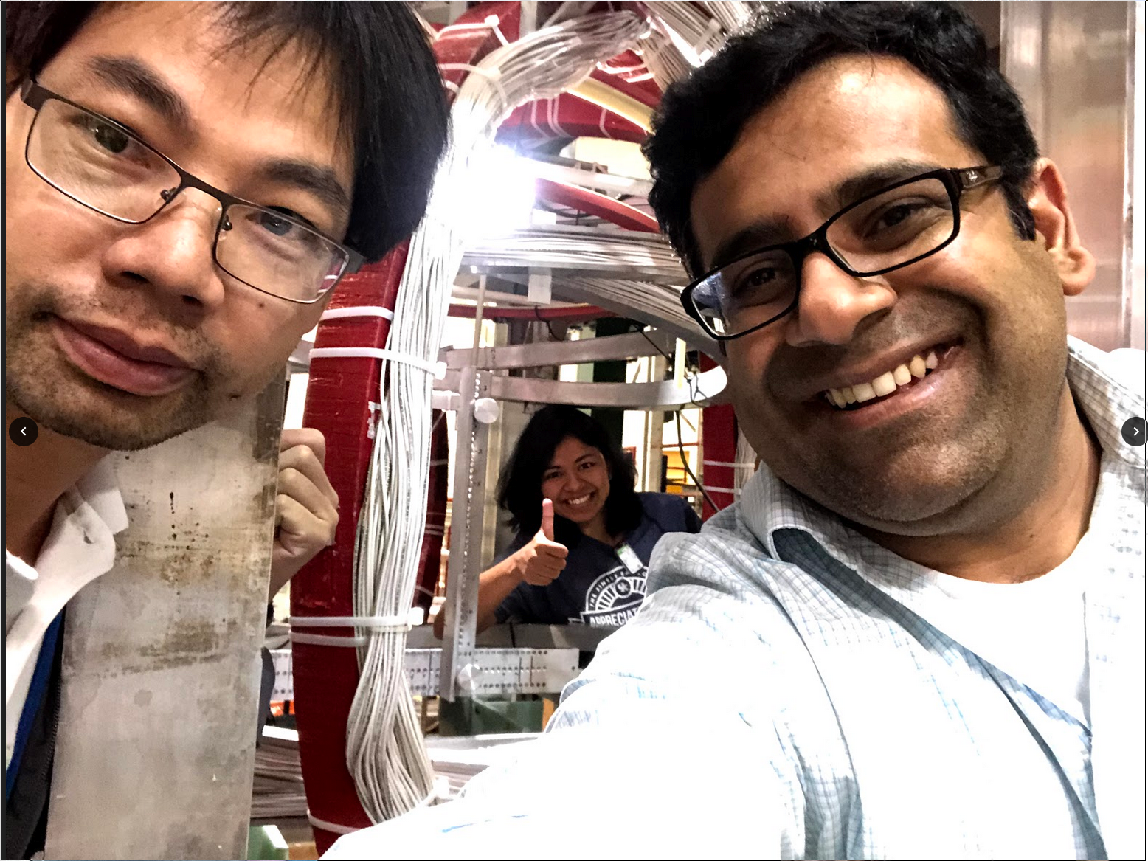
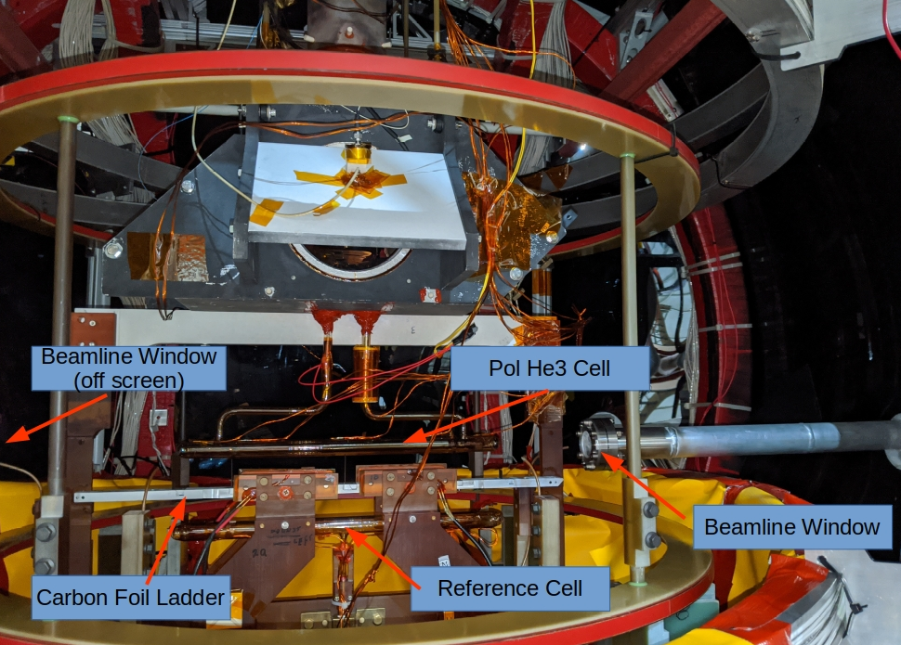
Polarized ³He Target in JLab Hall C
Data collected in 2020 for
three experiments:
  E12-06-110 (A1n)
  E12-06-121 (d2n, g2n)
  E12-06-121A

Slide 16
SBS Physics: Extending Q² Range of Nucleon Form Factors
G^{M}_{p}
G^{M}_{n}
G^{E}_{p}
G^{E}_{n}
high
impact
Imaging of the nucleon charge and magnetization densities in impact-parameter space in the infinite momentum frame
Combined data allows flavor separation for large range of Q²
Map transition to perturbative regime—running of dressed quark mass function

Slide 17

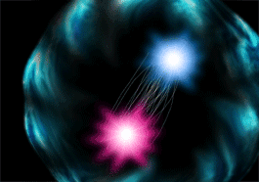
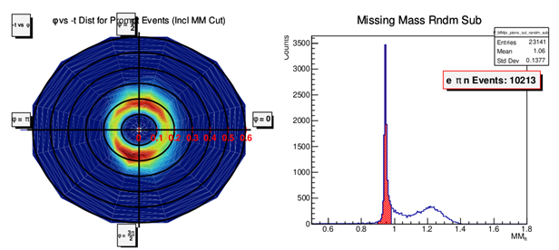
Hall C Charged Pion Form Factor Experiment
E12-19-006 : Study of the L–T Separated Pion Electroproduction Cross Section at 11 GeV and Measurement of the Charged Pion Form Factor to High Q²
Why measure the pion factor?
The pion is attractive as a QCD laboratory:
Simple, 2 quark system
Electromagnetic form factor can be calculated exactly at very large momentum transfer (small distances).
Pion’s structure is determined by two valence quarks, and the quark-gluon sea.
Indirectly measure pion form factor using the “pion cloud” of the proton via p(e,e’π⁺)n
Online results:
Clean identification of p(e,e’π⁺)n final state

Slide 18
Pion and Kaon Form Factors (JLab Hall C)
Jefferson Lab will provide tantalizing data for the pion (kaon) form factor up to Q² ~ 10 (5) GeV², and measurements of the pion (kaon) structure functions at large-x (> 0.5) through the Sullivan process.
18

Slide 19

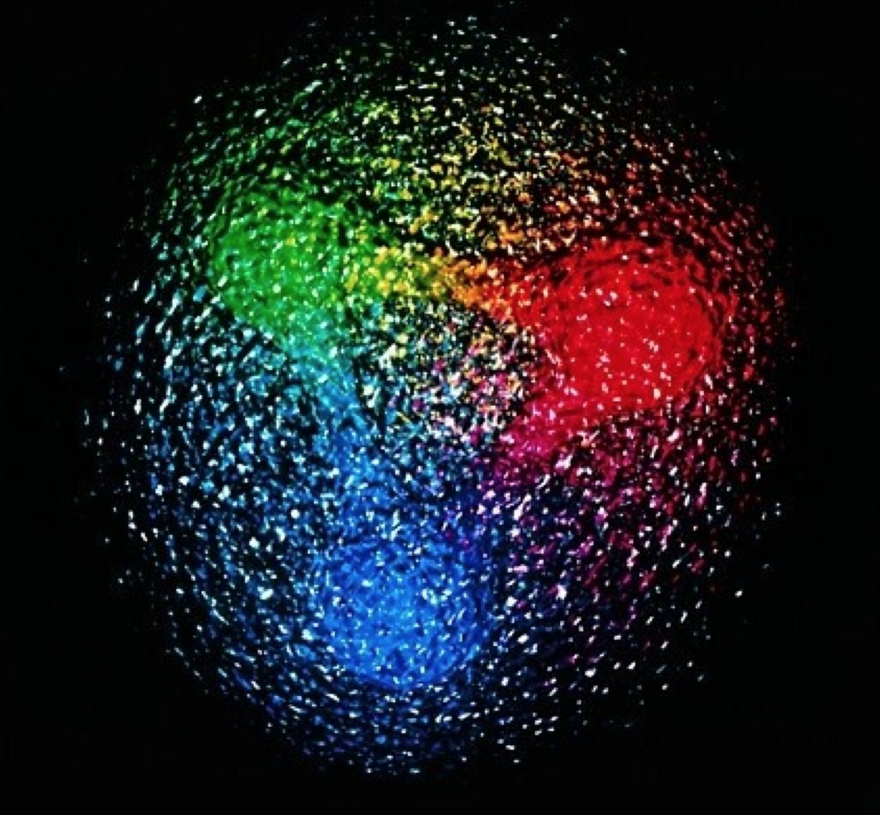
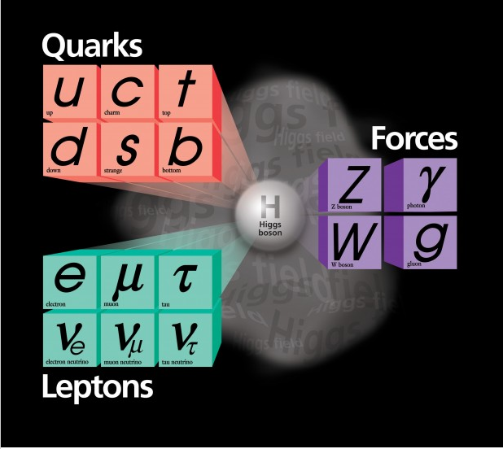
The Standard Model and QCD
Elementary Particles
Nucleon
Proton Mass ⋙ M(up) + M(up) + M(down) ~ 10 MeV
Proton Spin : Only 25% of the proton spin is carried by the quarks
The proton mass is close to ~1 GeV!!

Slide 20

Epilogue
Nature has two sources of mass
  Higgs mass-generating mechanism = understood
  Phenomenon of Emergent Hadron Mass (EHM) = much to learn
EHM (possibly/probably?) lies within the Standard Model,
i.e., in strong QCD
Basic predictions:
  Gluons acquire mass ⇒ running coupling saturates on infrared domain, restoring approximate conformal behaviour
  Enigmatically, the unusually light Nambu-Goldstone bosons provide the clearest windows onto the Emergence of Mass in Nature
With modern & on-the-horizon facilities having the capacity to deliver practical pion & kaon “targets”, science can finally move beyond proton, to explore & explain an entirely different form of hadron matter = the mesons without which observable Universe could not exist

Slide 21
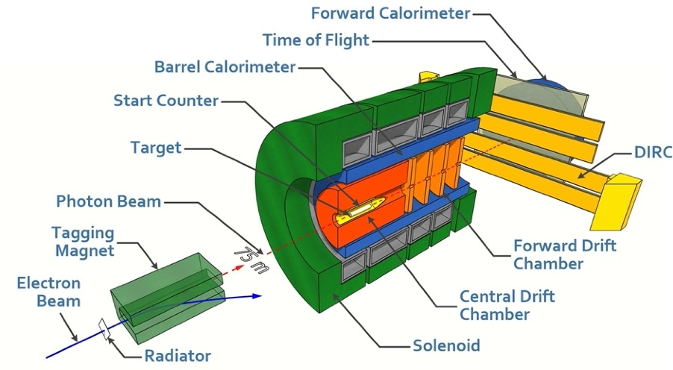
Hall D
Let’s look at the recent life of a Hall….
Experiments and Runs up to FY23
Tagged photon Bremsstahlung beam, linearly polarized at ≈9 GeV
A hermetic spectrometer based on a solenoid magnet
Inclusive trigger: a very large statistics of photoproduction
Publications since 2017:
  1 in PRL 2019 (112 citations), 5 in PRC, 2 submitted to PRC
  7 in NIMA (on instrumentation)
JLab code | Experiment | PAC appr. days | Runs: calendar days of running in FYs |  |  |  |  |  | % data taken
 |  |  | ≤18 | 19 | 20 | 21 | 22 | 23
E12-06-102 | GlueX-I: Light meson Spectroscopy, search for hybrids | 120 | 245 |  |  |  |  |  | 100%
E12-12-002 | GlueX-II: Study of Final States with Strangeness (with DIRC) | 220 |  | 13 | 156 |  |  | 128 | 33%
A | JEF: Rare decays of η (with FCAL upgrade) | (100) |  |  |  |  |  | instal | 0%
E12-10-011 | PrimeX-η: η→γγ Width using the Primakoff process (γγ→..) | 79 |  | 53 |  | 15 | 35 58 | 17 | 53%
E12-19-003 | SRC/CT: Short-Range Correlations in photon beam | 15 |  |  |  |  | 43 |  | 100%
E12-13-008 | CPP/NPP: π Polarizability using the Primakoff process (γγ→.) | 25 |  |  |  |  | 50 |  | 0%
Red - scheduled

Slide 22
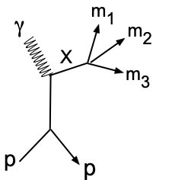
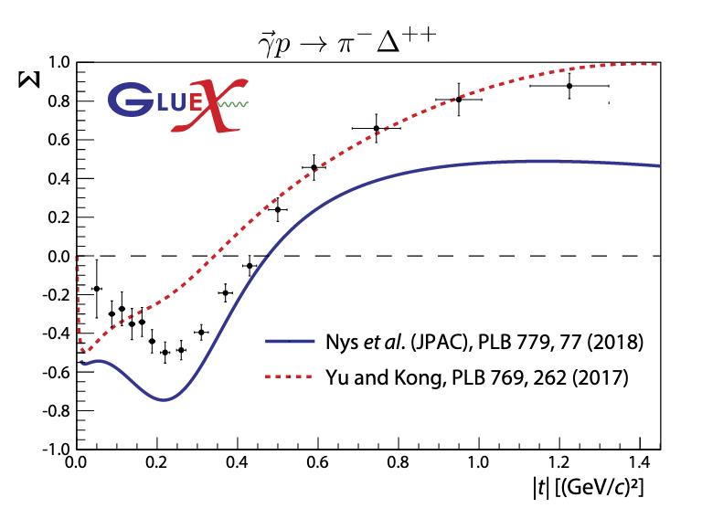
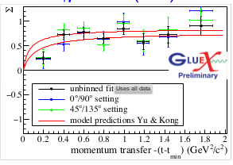
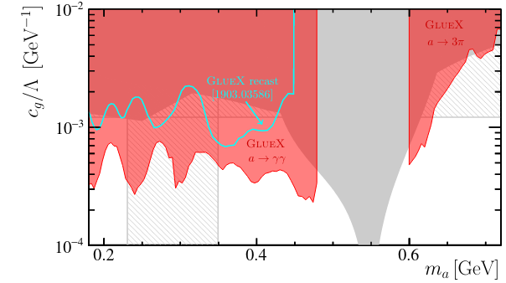
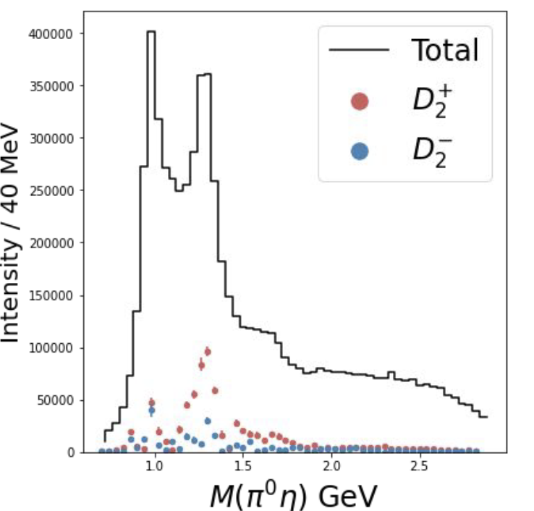
Hall D
FY21-22: Physics results and progress in data analysis
Meson Production
Meson Spectroscopy: Data Analysis Path
Understand production mechanisms: Natural J^{P}=0⁺, 1⁻, 2⁺, …and unnatural J^{P}=0⁻, 1⁺, 2⁻ exchanges: measure the beam asymmetry Σ using linearly polarized beam 6 PRC papers
SDME measurements, 1 paper submitted to PRC, 1 paper is under internal review
PRC 103, L02201 (2021) asymmetry
2107.12314 (2021) asymmetry
2109.13439 (2021) search for axion
Axion search
unnatural
natural
γp→K⁺Λ(1520⁾
γp→pπ⁻π⁺π⁺
γp→pγγ
γp→π⁻Δ⁺⁺
GlueX limit (in red)
a₂(1320)
Status of search for hybrid mesons
Prerequisites: SDME, cross sections, PWA of known resonances – in progress many final states are studied
PWA identifies the well known a₂(1320): D waves for +/- naturality
ηπ⁰

Slide 23
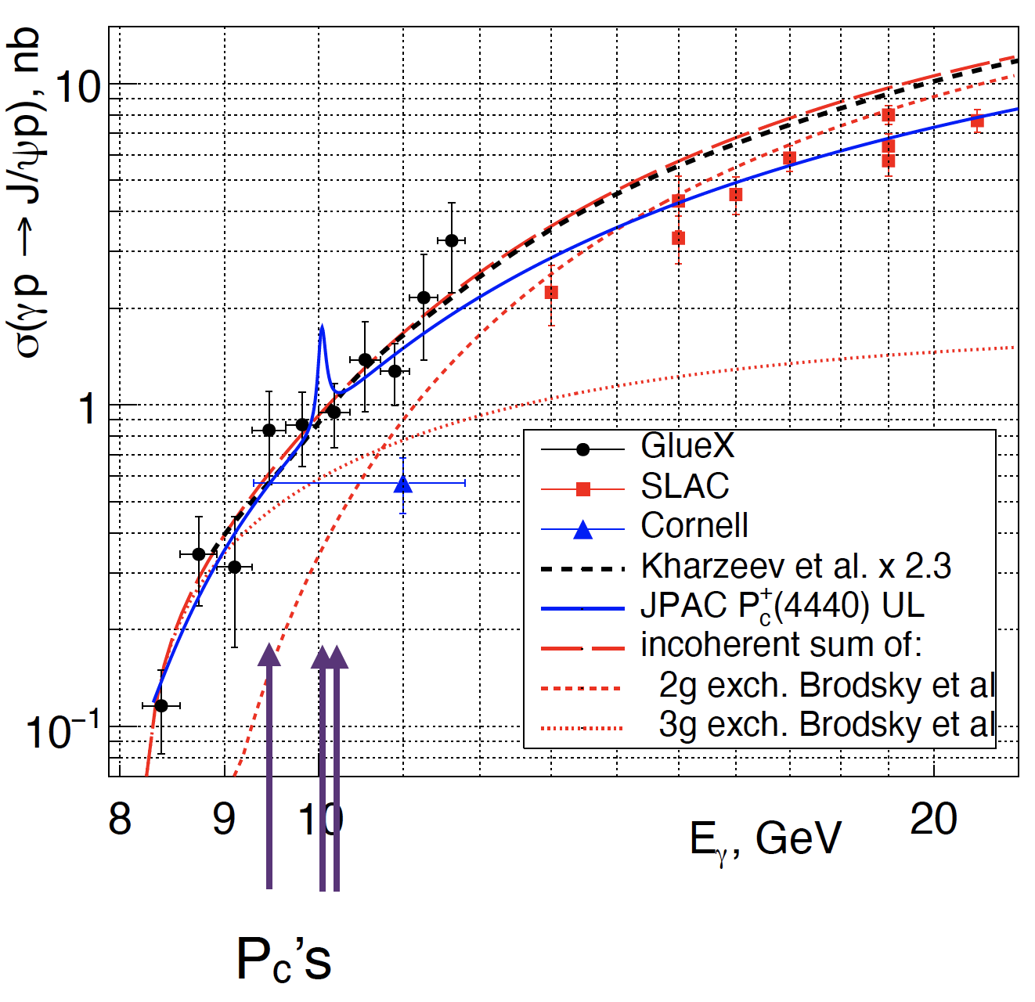
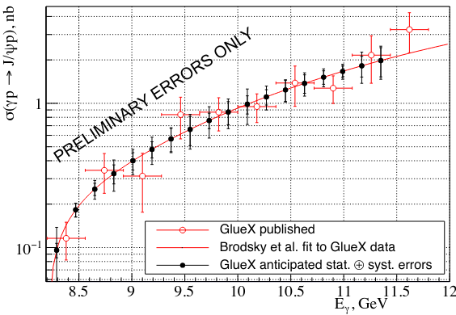
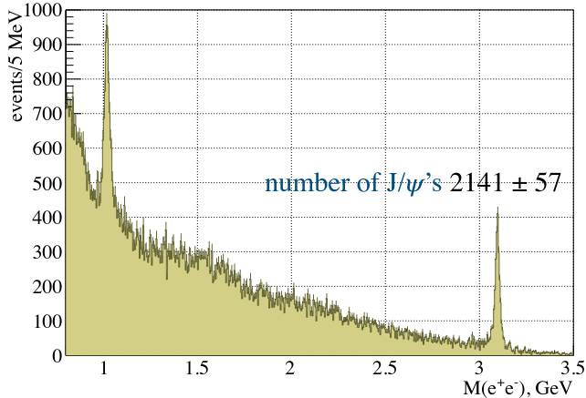
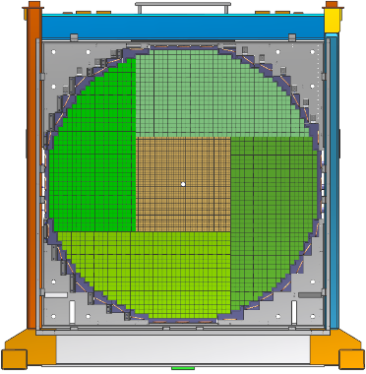
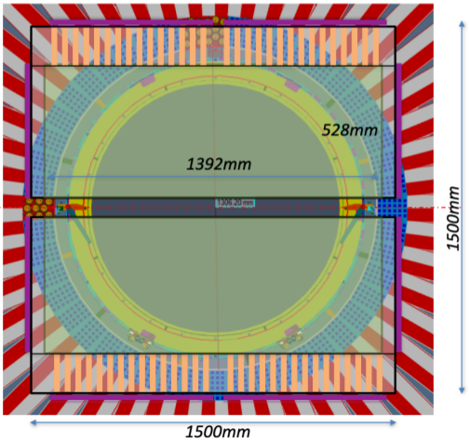
Hall D
FY21-22: Physics results and progress in data analysis
γp → p J/ψ Cross section at threshold
GlueX paper PRL 123, 2019 (112 citations)
Plenty of interest to the subject:
Production mechanism probes QCD objects (gravitational form factors, mass radius of the proton etc), many theoretical papers and discussions
Constraints on the LHCb pentaquark properties
New results with ×4 statistics (full GlueX-I data) – under GlueX internal review
GlueX PRL 123, 072001 (2019)
Accuracy of new results, in preparation
New results: e⁺e⁻ mass spectrum
γp → p J/ψ Outlook for GlueX
GlueX-II: statistics ×4 of GlueX-I
Reduction of dominant systematic uncertainty caused by e/π PID
  FCAL2 – better resolution
  TRD for electron PID (considered)
  Ready for JEF data taking (last 100 PAC days of GlueX-II) FY24-25
FCAL2
TRD

Slide 24
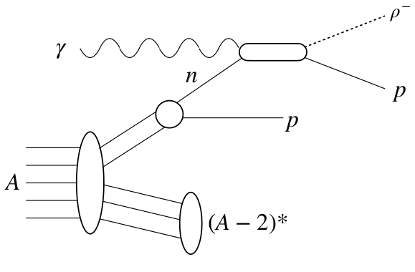
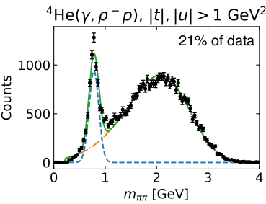
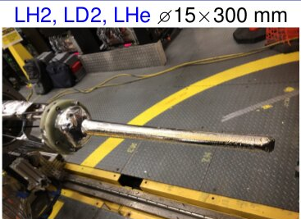




Hall D
  Short range correlations
  Color transparency
  In real photon beam
Runs in FY22: SRC/CT E12-19-003
Reconstruct recoil nucleons in reactions A(γ, p π⁻ p) , A(γ, ρ⁰ p p) . . .
Determine fraction of np, pp SRC pairs
Nuclear targets: LD, LHe, C
SRCs have never been tested using a photon beam
Challenge: nuclear target → no kinematic fit
43 calendar days, 100% data taking complete
Preliminary data analysis:
  Final states well identified
  Kinematic range in t is sufficient for SRC
  SRC: spectator proton detected γn(p)→ρ⁻p (p)
Carbon foils
2-track vertex
Z-position
SRC
→

Slide 25






Hall D
Detector testing
FY22-23: CPP/NPP E12-12-008 new;
PRIMEX-η, GlueX-II - continue
Pair Spectrometer γ→e⁺e⁻ provides electrons 3-6 GeV, dE/E≈1%
Used to test parasitically detector prototypes for Jlab and EIC: GEM, TRD, mRICH, ECAL
Active program for FY22 and later
CPP/NPP (Pion Polarizability) – requires installation of a muon detector, a new solid target, moving the tagger counter, and a trigger upgrade
Installation in progress:
MWPC
Steel absorber
Support
μ-detector

Slide 26


Hall C FY21 Highlights
Deinstalled the polarized helium target
Installed standard cryo target and small angle beam line
Installed new power supplies for 3 HMS quads
Work in Hall C
Scientific Highlights
First PRLs with data using new SHMS in 12 GeV Era
PRL 126 “Ruling out color transparency in quasi-elastic 12C(e,ep) up to Q² of 14.2 (GeV/c)2”
PRL 125 “Probing the Deuteron at Very Large Internal Momenta”
Only 3 days of beam. PAC approved remaining 18 days
CD-BONN theory (magenta) explains data for p_{r} < 600
Prediction with Color Transparency
CD-BONN theory cannot explain data for p_{r} > 0.6
Need to complete experiment to explore if trend continues to p_{r} > 1.1
Data has flat dependence
No Color Transparency !

Slide 27

Hall C FY22 experiments
Ran in Oct 2021 to Feb 2022
E12-19-006 : Study of the L–T Separated Pion Electroproduction Cross Section at 11 GeV and Measurement of the Charged Pion Form Factor to High Q² (Continuation of experiment from FY21, low epsilon kinematics)
Plan to run starting June 2022
E12-17-005 : The CaFe Experiment: Short-Range Pairing Mechanisms in Heavy Nuclei
E12-10-008 Detailed studies of the nuclear dependence of F₂ in light nuclei.
E12-06-105 Inclusive Scattering from Nuclei at x > 1 in the quasielastic and deeply inelastic regimes
Use the nucleus a laboratory to study the nucleon
Inclusive electron scattering
Variety of nuclei to study:
    Density effects
    N/P= # Neutron/# Proton dependence
    Isospin dependence ( e.g. ⁴⁰Ca/⁴⁸Ca)
Study 2N and 3N short range correlations (SRC)
Study the F₂ nuclear dependence

Slide 28


Hall C FY23 plans
Plan to run Oct 2022 to March 2023
E12-19-006 : Study of the L–T Separated Pion Electroproduction Cross Section at 11 GeV and Measurement of the Charged Pion Form Factor to High Q² (Continuation of experiment with high epsilon kinematics)
E12-10-003 Deuteron Electro-Disintegration at Very High Missing Momentum (complete the experiment)
Detect proton
Options of experiments to install after March 2023
Standard SHMS/HMS
  E12-06-104 R=σ_{L}/σ_{T} in SIDIS
  E12-11-107 Spectator tagged DIS d(e,e’p_{s})
  Install Large Angle Detector
  HMS/SHMS detect electron
2. HMS with Neutral Particle Spectrometer (NPS)
  NPS
      Magnet with calorimeter
      Calorimeter to detect γ and π⁰
      Remove the SHMS HB magnet
  E12-13-010 is two experiments
      Exclusive Deeply Virtual Compton
      σ_{L} and σ_{T} measured in exclusive π⁰ production

Slide 29




Hall-B Physics Highlights from FY21
T.B. Hayward et al. (CLAS Collaboration), “Observation of Beam Spin Asymmetries in the Process $ep→eπ^{+}π^{−}X$ with CLAS12", Phys. Rev. Lett. 126, 152501 (2021).
Direct extraction of twist-3 collinear PDF $e\left(x\right)$, $A_{LU}^{\sin{(φ_{R_{⊥}})}}\sim e(x)$ – provides information about the interaction between gluons and quarks.
The first ever signal sensitive to the helicity-dependent two-pion fragmentation function $G_{1}^{⊥} ,$ ${A_{LU}^{\sin{(φ_{h}−φ_{R_{⊥}})}}\sim G}_{1}^{⊥}$
P. Chatagnon et al. (CLAS Collaboration), "First-time Measurement of Timelike Compton Scattering", Phys. Rev. Lett. 127, 262501 (2021).
First ever measurement of the TCS process
The beam helicity asymmetry, $A_{⊙U}\sim \sin{φ}$, accesses the imaginary part of the Compton amplitude, the same way as in DVCS and probes universality of GPDs
The forward-backward asymmetry, $A_{FB}\sim \cos{φ}$, projects out the real part of the Compton amplitude – direct access to the EM FF $D^{Q}(t)$ (D-term) that relates to mechanical properties of the nucleon (quark pressure distribution inside the nucleon).
TCS – time-reversal symmetric process to DVCS: incoming photon is real, and the outgoing photon has large time-like virtuality.
TCS
Bethe-Heitler (BH)
+
$$\sim Imℋ$$
Incoming photon polarization
$$\sim Reℋ$$

Slide 30





Hall-B Experiment in FY21 - HPS
Experiment searches for dark matter force carrier, a heavy or dark photon, $A^{′}$, over a wide range of couplings, $ε2>{10}^{−10}$, masses, $20 MeV<m_{A^{′}}<220 MeV$.
HPS uses a compact spectrometer in downstream alcove of Hall-B to detect $e^{+}e^{−}$ pairs from $A^{′}$ decay radiated in electron scattering off tungsten target.
Experiment is 40% complete and with available data will be able to expect to explore a new, uncharted territory of mass and coupling using a displaced vertex search method.
Kinetic mixing between Dark Sector photon, $A^{′}$, and the Standard Model 𝛄
DS
SM
Compact, forward spectrometer consist of SVT, a hodoscope and a calorimeter.
SVT and the hodoscope are inside the vacuum chamber in the magnet bore.
The edge of the firs layer of the tracker is only 500 μm from the beam plane, providing detection of electrons at $\sim 15$ mrad angles.
Parameter space in mass and coupling for $A^{′}$ search
HPS
Two search strategies
Beam’s Eye View of the SVT inside the vacuum chamber
Si Layer I is only 5 cm from W target and has only 1 mm gap between top and bottom modules for ~10¹²/sec electrons go through

Slide 31

Hall-B Experiments in FY22
RG-M – two experiments
RG-C – seven experiments
Electrons for neutrinos (E12-17-006): test vector-current part of neutrino event generators using $A\left(e,e^{′}\right)X$ reactions. Event generators are key to reconstruct neutrino oscillation parameters.
Target single and beam/target double spin asymmetries in proton and neutron DVCS
Measure spin- and transverse momentum-dependent PDFs (SIDIS
Inclusive structure functions $\left(A_{1},g_{1}\right)$ of the proton and deuteron
Flavor tagging $\left(π^{±},K^{±}\right)$ to extract $Δq$ in the valence and moderate-x sea regions
Will use longitudinally polarized NH₃ and ND₃ targets and a 11 GeV polarized beam. Target is undergoing final tests, will be moved to the hall in mid April.
Run is scheduled to start in June for 122 beam days
In neutrino scattering experiments, reconstruction of the incoming neutrino energy relies on models for neutrino interactions.
Short range correlations (E12-20-002): Study SRCs using the reactions $A\left(e,e^{′}pN\right)X$ and $A\left(e,e^{′}pNN\right)X$ to understand the SRC formation, connection to EMC effect, and NN interactions and nuclear wave function.
NMR coils
Ammonia target cell
Hall-B longitudinally polarized target assembly on EEL
RG-M successfully completed $\sim 80\%$ of the program. Acquired data at the beam energies 2 GeV, 4 GeV and 6 GeV with various targets ranging from deuterium to tin (Sn).
Superconducting shim coil

Slide 32


Hall A FY21 Highlights
PREX
PRL 126, 172502 (2021)
BigBite and
Super BigBite (SBS) Installation
²⁰⁸Pb
Electroweak Asymmetry in
Elastic Electron-Nucleus Scattering Extract
R_{n}-R_{p} [fm]

Slide 33


Hall A FY22 Highlights
CREX
CREX - accepted to PRL!
Extracting the weak form factor F_{w}
⁴⁸Ca
Asymmetries – raw (red), corrected for beam (blue)
Curves are model with different skin thickness R_{w}- R_{ch}
$$A_{PV} = \frac{σ_{R} − σ_{L}}{σ_{R} + σ_{L}}$$
Prelim.
Published “Deep Exclusive Electroproduction of π⁰ at High Q²”, Phys. Rev. Lett. 127
Extract structure functions from cross sections measured from Q² = 3.1 to 8.4 GeV²
The data are well described by calculations based on transversity Generalized Parton Distributions (GPDs) coupled to a helicity ﬂip Distribution Amplitude (DA) of the pion
Suggest the amplitude for transversely polarized virtual photons continues to dominate

Slide 34









JLab: A Laboratory for Medium Energy Nuclear Science
Z⁰
Nuclear Structure
Fundamental
Forces & Symmetries
Structure of Hadrons
Jefferson Lab is a state-of-the-art user facility for nuclear physics research and beyond.
Medical Imaging
Nuclear Astrophysics
Accelerator S&T
Cryogenics
Theory & Computation

Slide 35







Particle Detector Spin-Offs Advance Patient Care
Nuclear physics detector technology developed to explore the structure of matter at Jefferson Lab leads to new and advanced tools for better patient care.
Tools for nuclear physics research photomultiplier tubes, silicon photo multipliers, scintillator and detector electronics.
Tools for better patient care
Hand held gamma camera to guide surgeons
Silicon photo multipliers provide precise imaging at low voltages
Now also wireless, to give flexible motion without tethering
Working on on-board display
Compact gamma camera for breast cancer detection
Led to several Jefferson Lab patents and a start-up company
9
Notes:
35

Slide 36
Roughly a decade of 12 GeV experiments
Perhaps a positron beam or energy upgrade
More new detectors
…and the EIC is coming!

Slide 37

Thank You!
…and apologies to all the exciting experiments and efforts I didn’t have time to touch on
Jefferson Lab Hall C

