Slide 1

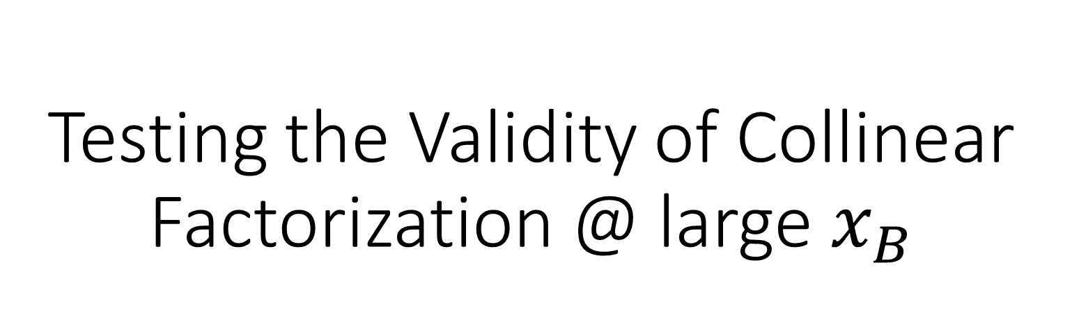
Testing the Validity of Collinear Factorization @ large $x_{B}$
Andy Krause
In collaboration with: Dr. Alberto Accardi, Juan Guerrero
Hampton University

Slide 2
Table of Contents
QCD
Simulating the Theory
Analysis
Conclusion

Slide 3
I) QCD
QCD
  Quark Distribution Function
  Kinematics
  Collinear Factorized parton Distribution Functions
Simulating the Theory
Analysis
Conclusion

Slide 4
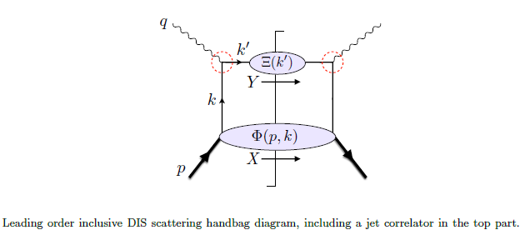
I.)QCD
Factorize the DIS component of the model hadronic tensor in terms of a quark distribution function and a perturbatively calculable photon-quark term
  Juan V. Guerrero and Alberto Accardi.

Slide 5
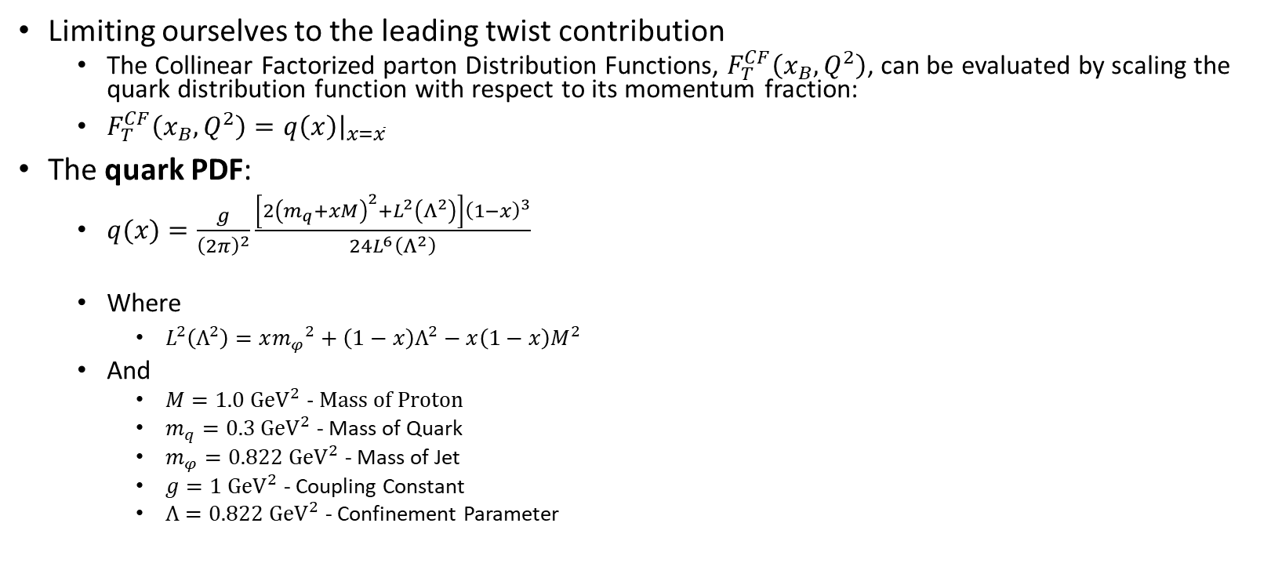
I.ii) Quark Distribution Function
Limiting ourselves to the leading twist contribution
  The Collinear Factorized parton Distribution Functions, $F_{T}^{CF}\left(x_{B},Q^{2}\right)$, can be evaluated by scaling the quark distribution function with respect to its momentum fraction:
  $F_{T}^{CF}\left(x_{B},Q^{2}\right)={\left.q\left(x\right)\right|}_{x=\overline{x}}$
The quark PDF:
  $q(x)=\frac{g}{{\left(2π\right)}^{2}}\frac{\left[2{\left(m_{q}+xM\right)}^{2}+L^{2}\left(Λ^{2}\right)\right]{\left(1−x\right)}^{3}}{24L^{6}\left(Λ^{2}\right)}$
  Where
    $L^{2}\left(Λ^{2}\right)=x{m_{φ}}^{2}+\left(1−x\right)Λ^{2}−x\left(1−x\right)M^{2}$
  And
    $M=1.0 {GeV}^{2}$ - Mass of Proton
    $m_{q}=0.3 {GeV}^{2}$ - Mass of Quark
    $m_{φ}=0.822 {GeV}^{2}$ - Mass of Jet
    $g=1 {GeV}^{2}$ - Coupling Constant
    $Λ=0.822 {GeV}^{2}$ - Confinement Parameter

Slide 6
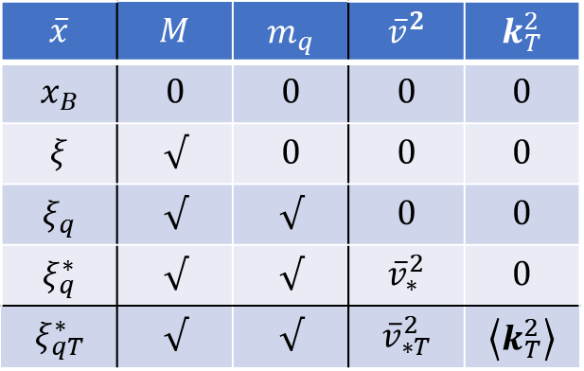
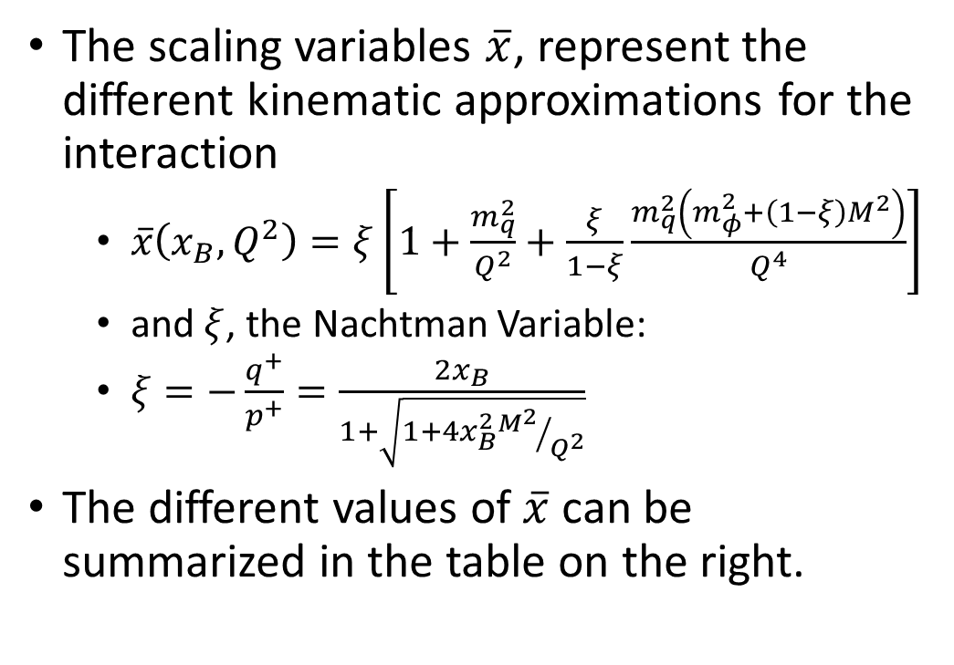
I.i) Kinematics
The scaling variables $\overline{x}$, represent the different kinematic approximations for the interaction
  $\overline{x}\left(x_{B},Q^{2}\right)=ξ\left[1+\frac{m_{q}^{2}}{Q^{2}}+\frac{ξ}{1−ξ}\frac{m_{q}^{2}\left(m_{φ}^{2}+\left(1−ξ\right)M^{2}\right)}{Q^{4}}\right]$
  and $ξ$, the Nachtman Variable:
  $ξ=−\frac{q^{+}}{p^{+}}=\frac{2x_{B}}{1+\sqrt{1+4x_{B}^{2}{M^{2}}/{Q^{2}}}}$
The different values of $\overline{x}$ can be summarized in the table on the right.
$$\overline{x}$$ | $$M$$ | $$m_{q}$$ | $${\overline{v}}^{2}$$ | $$k_{T}^{2}$$
$$x_{B}$$ | $$0$$ | $$0$$ | $$0$$ | $$0$$
$$ξ$$ | $$√$$ | $$0$$ | $$0$$ | $$0$$
$$ξ_{q}$$ | $$√$$ | $$√$$ | $$0$$ | $$0$$
$$ξ_{q}^{∗}$$ | $$√$$ | $$√$$ | $${\overline{v}}_{∗}^{2}$$ | $$0$$
$$ξ_{qT}^{∗}$$ | $$√$$ | $$√$$ | $${\overline{v}}_{∗T}^{2}$$ | $$\left\langle k_{T}^{2}\right\rangle$$

Slide 7
II. Simulating the Theory
QCD
Simulating the Theory
  Data Generation
    Binning
  Fitting to the Data
    Bernstein Polynomials
    Fitting the Observables
    Fitting Higher Twist Correction Terms
  Average Fit
  Fit of Average Data
Analysis
Conclusion

Slide 8
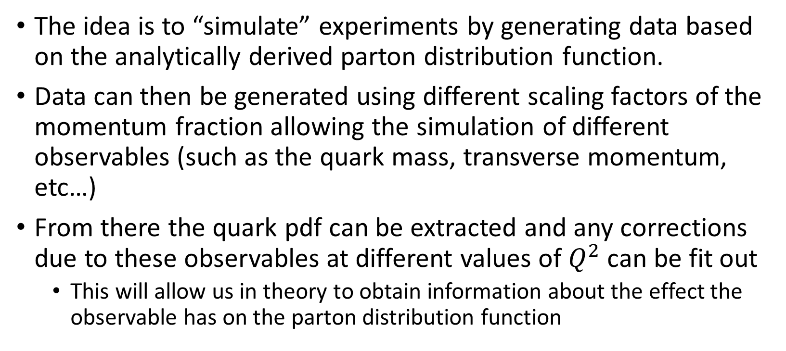
II. Simulating the Theory
The idea is to “simulate” experiments by generating data based on the analytically derived parton distribution function.
Data can then be generated using different scaling factors of the momentum fraction allowing the simulation of different observables (such as the quark mass, transverse momentum, etc…)
From there the quark pdf can be extracted and any corrections due to these observables at different values of $Q^{2}$ can be fit out
  This will allow us in theory to obtain information about the effect the observable has on the parton distribution function

Slide 9
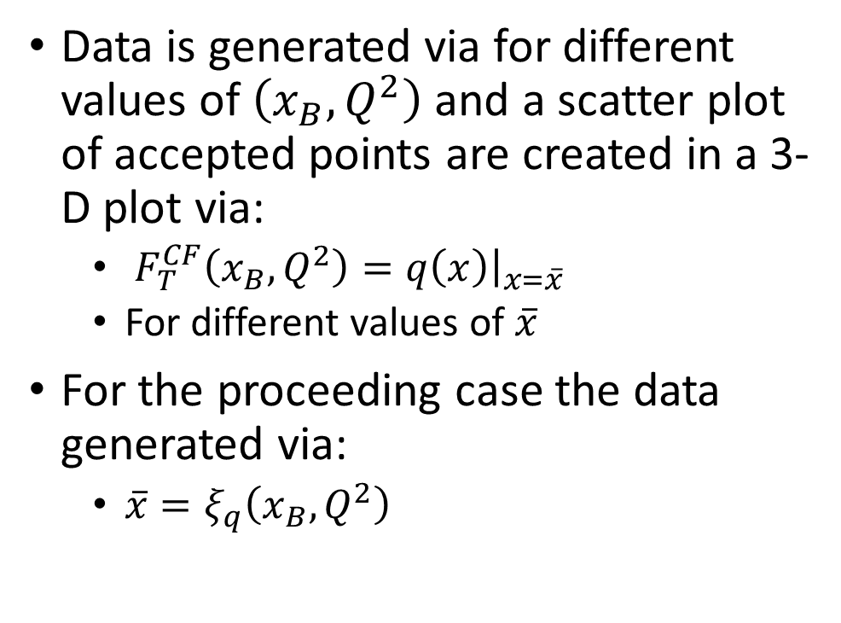
II.i) Data Generation
Data is generated via for different values of $\left(x_{B},Q^{2}\right)$ and a scatter plot of accepted points are created in a 3-D plot via:
  $F_{T}^{CF}\left(x_{B},Q^{2}\right)={\left.q\left(x\right)\right|}_{x=\overline{x}}$
  For different values of $\overline{x}$
For the proceeding case the data generated via:
  $\overline{x}=ξ_{q}\left(x_{B},Q^{2}\right)$

Slide 10
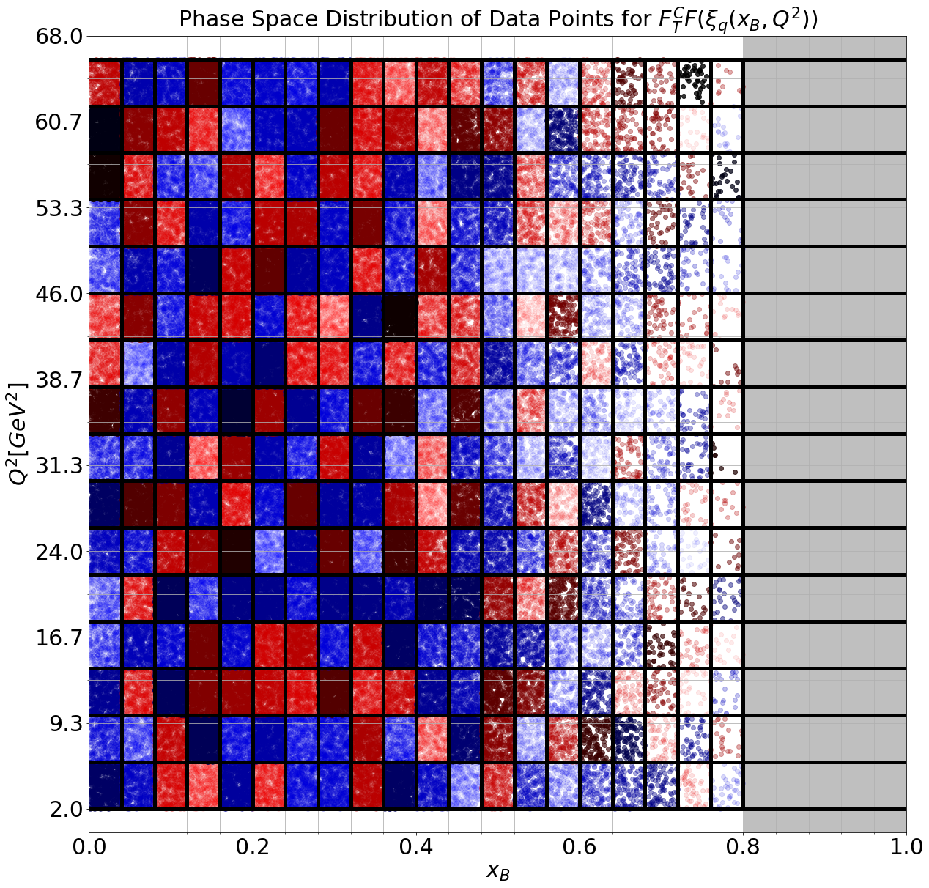
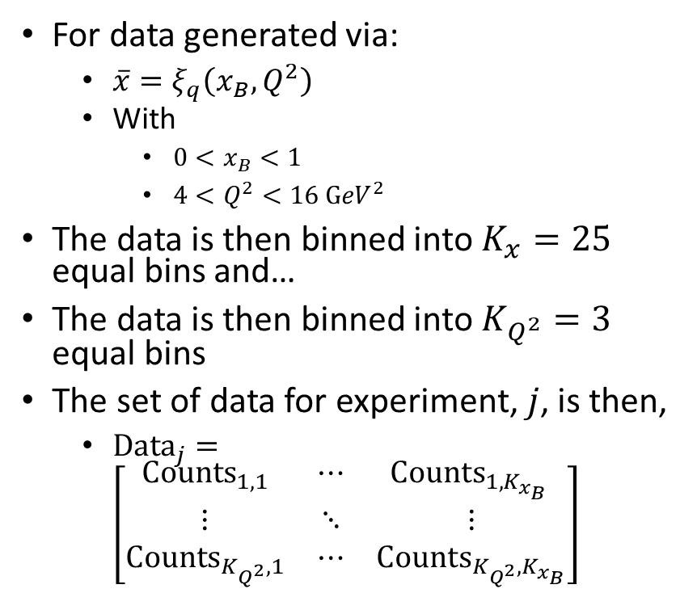
II.i.a) Binning
For data generated via:
  $\overline{x}=ξ_{q}\left(x_{B},Q^{2}\right)$
  With
    $0<x_{B}<1$
    $4<Q^{2}<16 {GeV}^{2}$
The data is then binned into $K_{x}=25$ equal bins and…
The data is then binned into $K_{Q^{2}}=3$ equal bins
The set of data for experiment, $j$, is then,
  ${Data}_{j}=\left[\begin{matrix}{Counts}_{1,1} & ⋯ & {Counts}_{1,K_{x_{B}} } \\ ⋮ & ⋱ & ⋮ \\ {Counts}_{K_{Q^{2}},1} & ⋯ & {Counts}_{K_{Q^{2}},K_{x_{B}}}\end{matrix}\right]$

Slide 11
II.ii) Fitting to the Data
Fits are generated using the method of least squares
  A Bernstein Polynomial is chosen to fit the data
Generate fits for the chosen “observable”
  Fit using the same scaling value to generate the data
  This ensures that the Bernstein Polynomial can fit the quark PDF
Generate fits with extracted correction terms
  This will allow us to extract information about our chosen observable

Slide 12
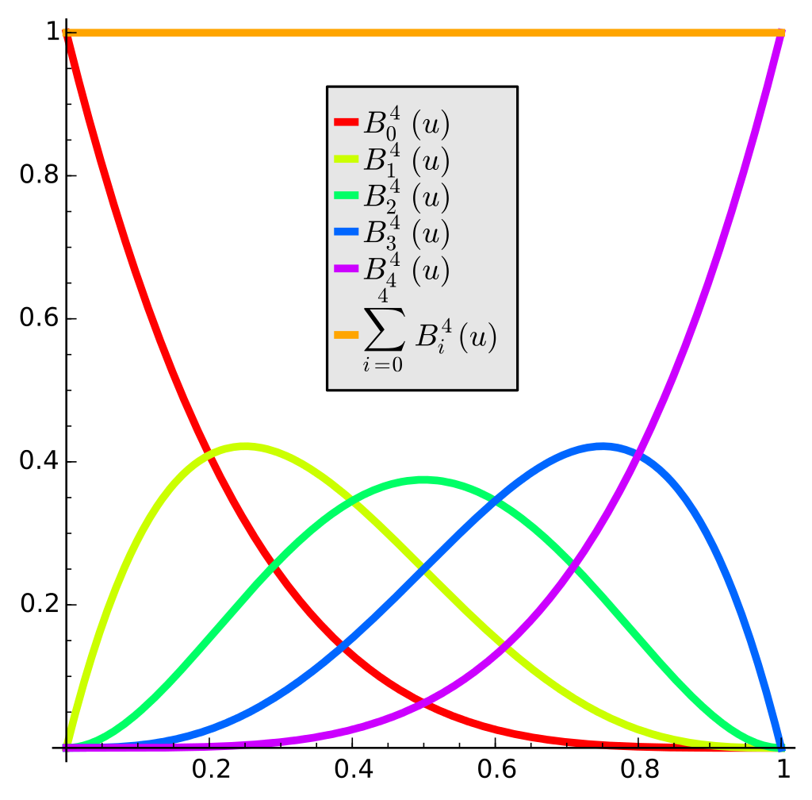
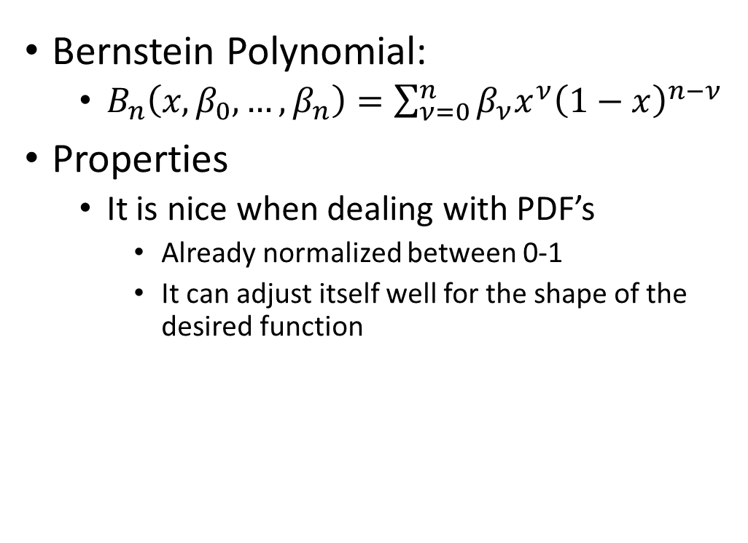
II.ii.a) Bernstein Polynomials
Bernstein Polynomial:
  $B_{n}\left(x,β_{0},…,β_{n}\right)=\sum_{ν=0}^{n}{β_{ν}x^{ν}{\left(1−x\right)}^{n−ν}}$
Properties
  It is nice when dealing with PDF’s
    Already normalized between 0-1
    It can adjust itself well for the shape of the desired function

Slide 13
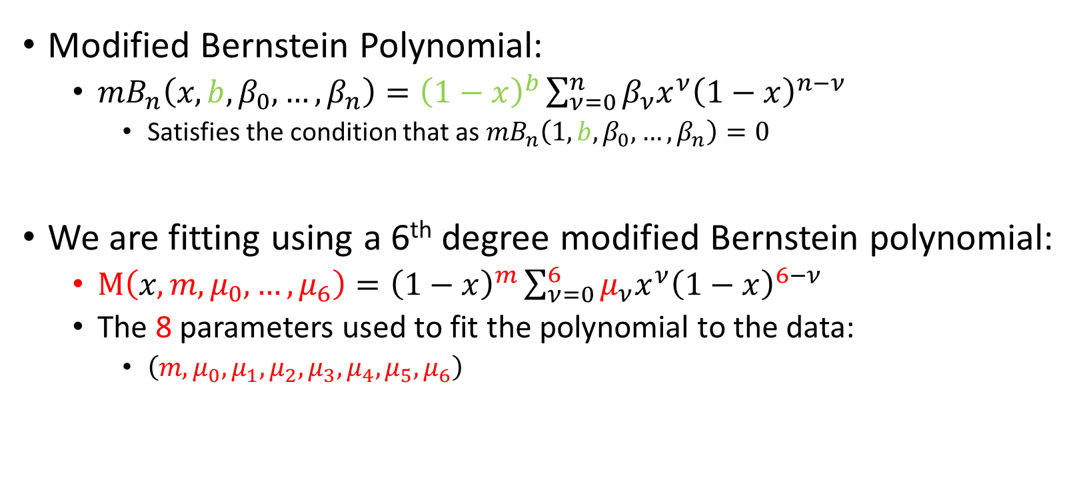
II.ii.b) Fitting The Observables
Modified Bernstein Polynomial:
  $mB_{n}\left(x,b,β_{0},…,β_{n}\right)={\left(1−x\right)}^{b}\sum_{ν=0}^{n}{β_{ν}x^{ν}{\left(1−x\right)}^{n−ν}}$
    Satisfies the condition that as ${mB}_{n}\left(1,b,β_{0},…,β_{n}\right)=0$
We are fitting using a 6th degree modified Bernstein polynomial:
  $Μ\left(x,m,μ_{0},…,μ_{6}\right)={\left(1−x\right)}^{m}\sum_{ν=0}^{6}{μ_{ν}x^{ν}{\left(1−x\right)}^{6−ν}}$
  The 8 parameters used to fit the polynomial to the data:
    $\left(m,μ_{0},μ_{1},μ_{2},μ_{3},μ_{4},μ_{5},μ_{6}\right)$

Slide 14
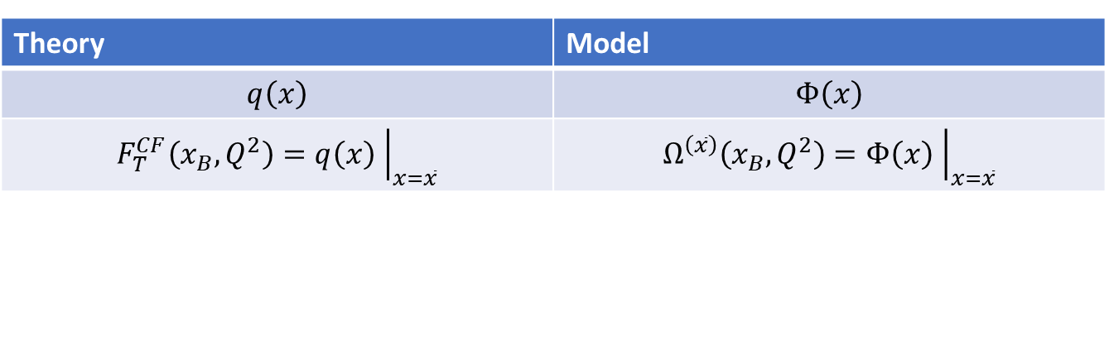

II.ii.b) Fitting The Observables
The mBP is then fit to each experimental data for a desired scaling factor, $\overline{x}$
  $Ω^{\left(\overline{x}\right)}\left(x_{B},Q^{2}\right)={\left.Φ\left(x\right)\right|}_{x=\overline{x}}$
Where the extracted parton distribution function is simply:
  $Φ\left(x\right)=Μ\left(x,m,β_{0},…,β_{6}\right)$
Theory | Model
$$q\left(x\right)$$ | $$Φ\left(x\right)$$
$${F_{T}^{CF}\left(x_{B},Q^{2}\right)=\left.q\left(x\right) \right|}_{x=\overline{x}}$$ | $$Ω^{\left(\overline{x}\right)}\left(x_{B},Q^{2}\right)={\left.Φ\left(x\right) \right|}_{x=\overline{x}}$$

Slide 15

II.ii.c) Fitting The Correction Terms
Correction Terms will be fit using a 3rd degree Bernstein Polynomial
  $Η\left(x,η_{0},…,η_{3}\right)=\sum_{ν=0}^{3}{η_{ν}x^{ν}{\left(1−x\right)}^{3−ν}}$
  The 4 parameters used to fit the correction terms are to the data:
    $\left(η_{0},η_{1},η_{2},η_{3} \right)$

Slide 16
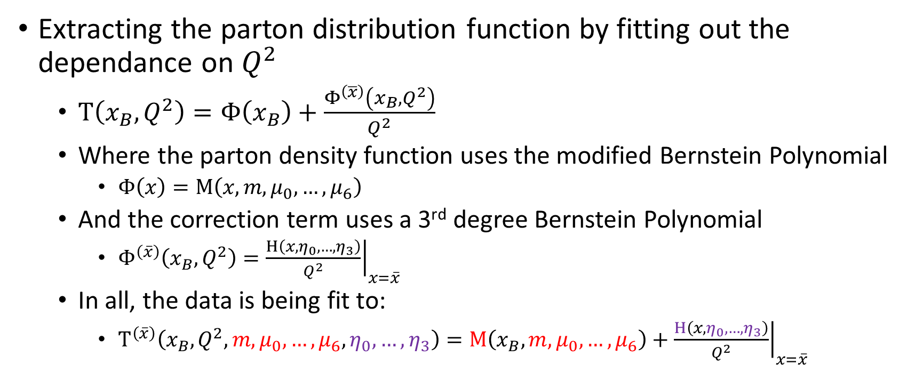
II.ii.c) Fitting The Correction Terms
Extracting the parton distribution function by fitting out the dependance on $Q^{2}$
  $Τ\left(x_{B},Q^{2}\right)=Φ\left(x_{B}\right)+\frac{Φ^{\left(\overline{x}\right)}\left(x_{B},Q^{2}\right)}{Q^{2}}$
  Where the parton density function uses the modified Bernstein Polynomial
    $Φ\left(x\right)=Μ\left(x,m,μ_{0},…,μ_{6}\right)$
  And the correction term uses a 3rd degree Bernstein Polynomial
    $Φ^{\left(\overline{x}\right)}\left(x_{B},Q^{2}\right)={\left.\frac{Η\left(x,η_{0},…,η_{3}\right)}{Q^{2}}\right|}_{x=\overline{x}}$
  In all, the data is being fit to:
    $Τ^{\left(\overline{x}\right)}\left(x_{B},Q^{2},m,μ_{0},…,μ_{6},η_{0},…,η_{3}\right)=Μ\left(x_{B},m,μ_{0},…,μ_{6}\right)+{\left.\frac{Η\left(x,η_{0},…,η_{3}\right)}{Q^{2}}\right|}_{x=\overline{x}}$

Slide 17
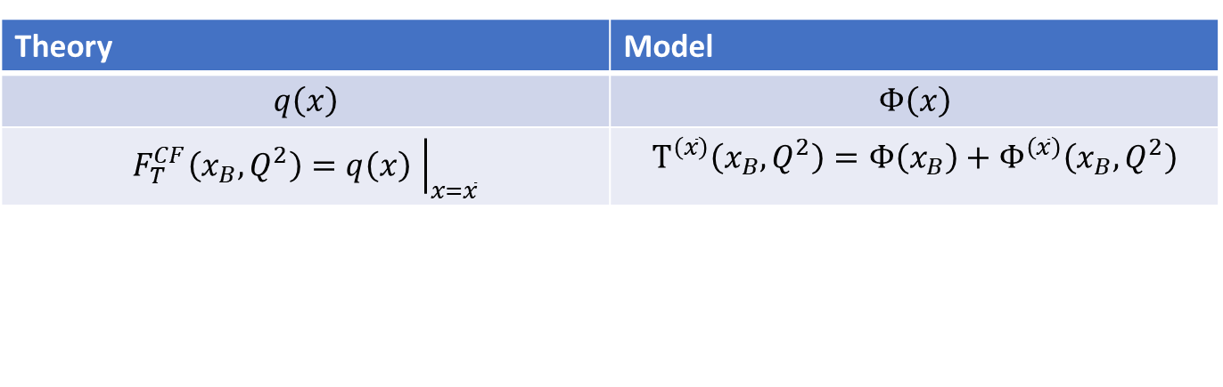
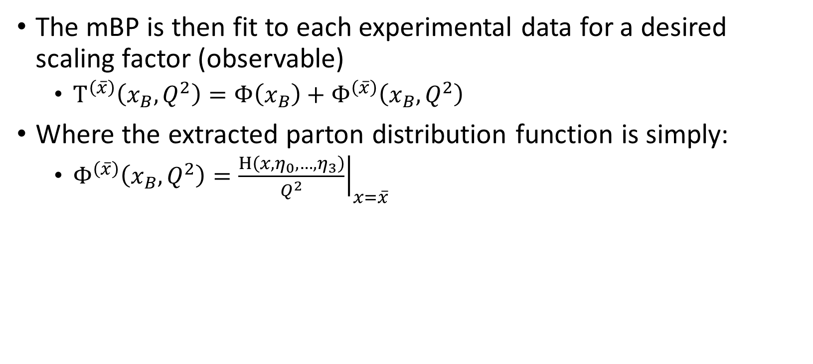
II.ii.c) Fitting The Correction Terms
The mBP is then fit to each experimental data for a desired scaling factor (observable)
  $Τ^{\left(\overline{x}\right)}\left(x_{B},Q^{2}\right)=Φ\left(x_{B}\right)+Φ^{\left(\overline{x}\right)}\left(x_{B},Q^{2}\right)$
Where the extracted parton distribution function is simply:
  $Φ^{\left(\overline{x}\right)}\left(x_{B},Q^{2}\right)={\left.\frac{Η\left(x,η_{0},…,η_{3}\right)}{Q^{2}}\right|}_{x=\overline{x}}$
Theory | Model
$$q\left(x\right)$$ | $$Φ\left(x\right)$$
$${F_{T}^{CF}\left(x_{B},Q^{2}\right)=\left.q\left(x\right) \right|}_{x=\overline{x}}$$ | $$Τ^{\left(\overline{x}\right)}\left(x_{B},Q^{2}\right)=Φ\left(x_{B}\right)+Φ^{\left(\overline{x}\right)}\left(x_{B},Q^{2}\right)$$

Slide 18
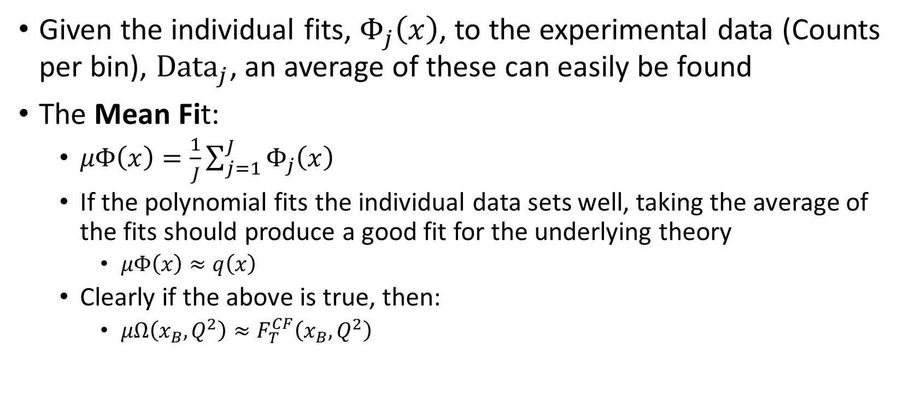
II.ii.c) The Mean Fit
Given the individual fits, $Φ_{j}\left(x\right)$, to the experimental data (Counts per bin), ${Data}_{j}$, an average of these can easily be found
The Mean Fit:
  $μΦ\left(x\right)=\frac{1}{J}\sum_{j=1}^{J}{Φ_{j}\left(x\right)}$
  If the polynomial fits the individual data sets well, taking the average of the fits should produce a good fit for the underlying theory
    $μΦ\left(x\right)≈q\left(x\right)$
  Clearly if the above is true, then:
    $μΩ\left(x_{B},Q^{2}\right)≈F_{T}^{CF}\left(x_{B},Q^{2}\right)$
Notes:
** all we are doing is rescaling x. If the functions are nearly the same, simply rescaling x will leave functions invariant

Slide 19
III. Analysis
QCD
Simulating the Theory
Analysis
  Statistical Analysis
  Analyzing the Observables
  Analyzing the Higher Twist Correction Terms
Conclusion
Appendix

Slide 20
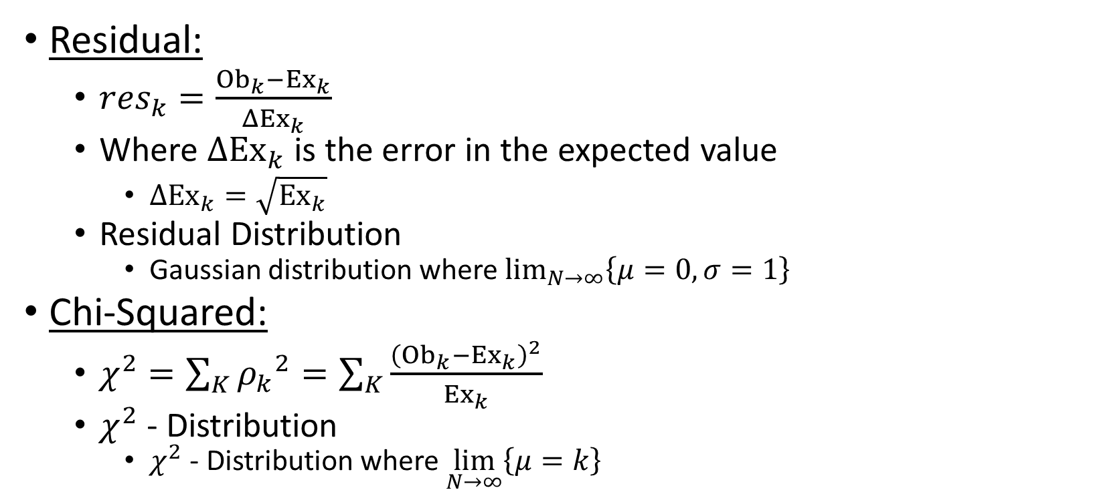
III.i) Statistical Analysis
Residual:
  ${res}_{k}=\frac{{Ob}_{k}−{Ex}_{k}}{{ΔEx}_{k}}$
  Where ${ΔEx}_{k}$ is the error in the expected value
    ${ΔEx}_{k}=\sqrt{{Ex}_{k}}$
  Residual Distribution
    Gaussian distribution where $\lim_{N→∞}\left\{μ=0,σ=1\right\}$
Chi-Squared:
  $χ^{2}=\sum_{K}{{ρ_{k}}^{2}}=\sum_{K}{\frac{{\left({Ob}_{k}−{Ex}_{k}\right)}^{2}}{{Ex}_{k}}}$
  $χ^{2}$ - Distribution
    $χ^{2}$ - Distribution where $\lim_{N→∞}\left\{μ=k\right\}$

Slide 21
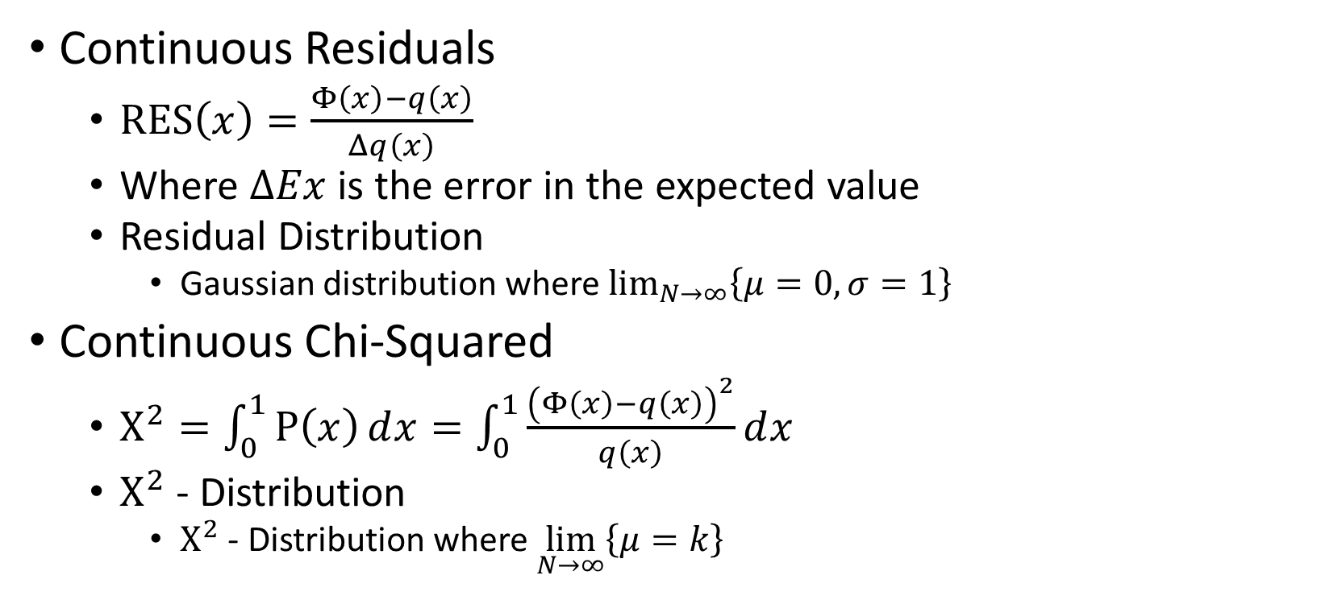
III.i) Statistical Analysis
Continuous Residuals
  $RES\left(x\right)=\frac{Φ\left(x\right)−q\left(x\right)}{Δq\left(x\right)}$
  Where $ΔEx$ is the error in the expected value
  Residual Distribution
    Gaussian distribution where $\lim_{N→∞}\left\{μ=0,σ=1\right\}$
Continuous Chi-Squared
  $Χ^{2}=\int_{0}^{1}{Ρ\left(x\right)ⅆx}=\int_{0}^{1}{\frac{{\left(Φ\left(x\right)−q\left(x\right)\right)}^{2}}{q\left(x\right)}ⅆx}$
  $Χ^{2}$ - Distribution
    $Χ^{2}$ - Distribution where $\lim_{N→∞}\left\{μ=k\right\}$

Slide 22
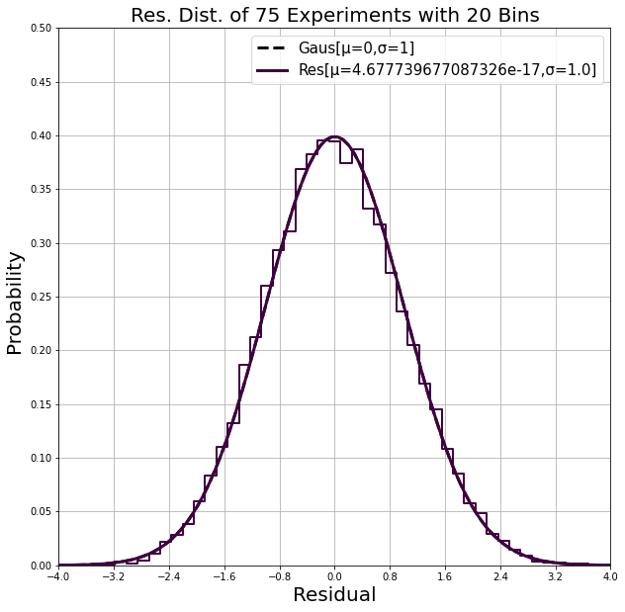
III.ii) Analyzing the Observables
Residual distribution of the counts with the average count
  The data generation is working as it should!
Notes:
**Cross Checking the generated data with the theory used to generate it is a good way to make sure the algorithm is working correctly

Slide 23
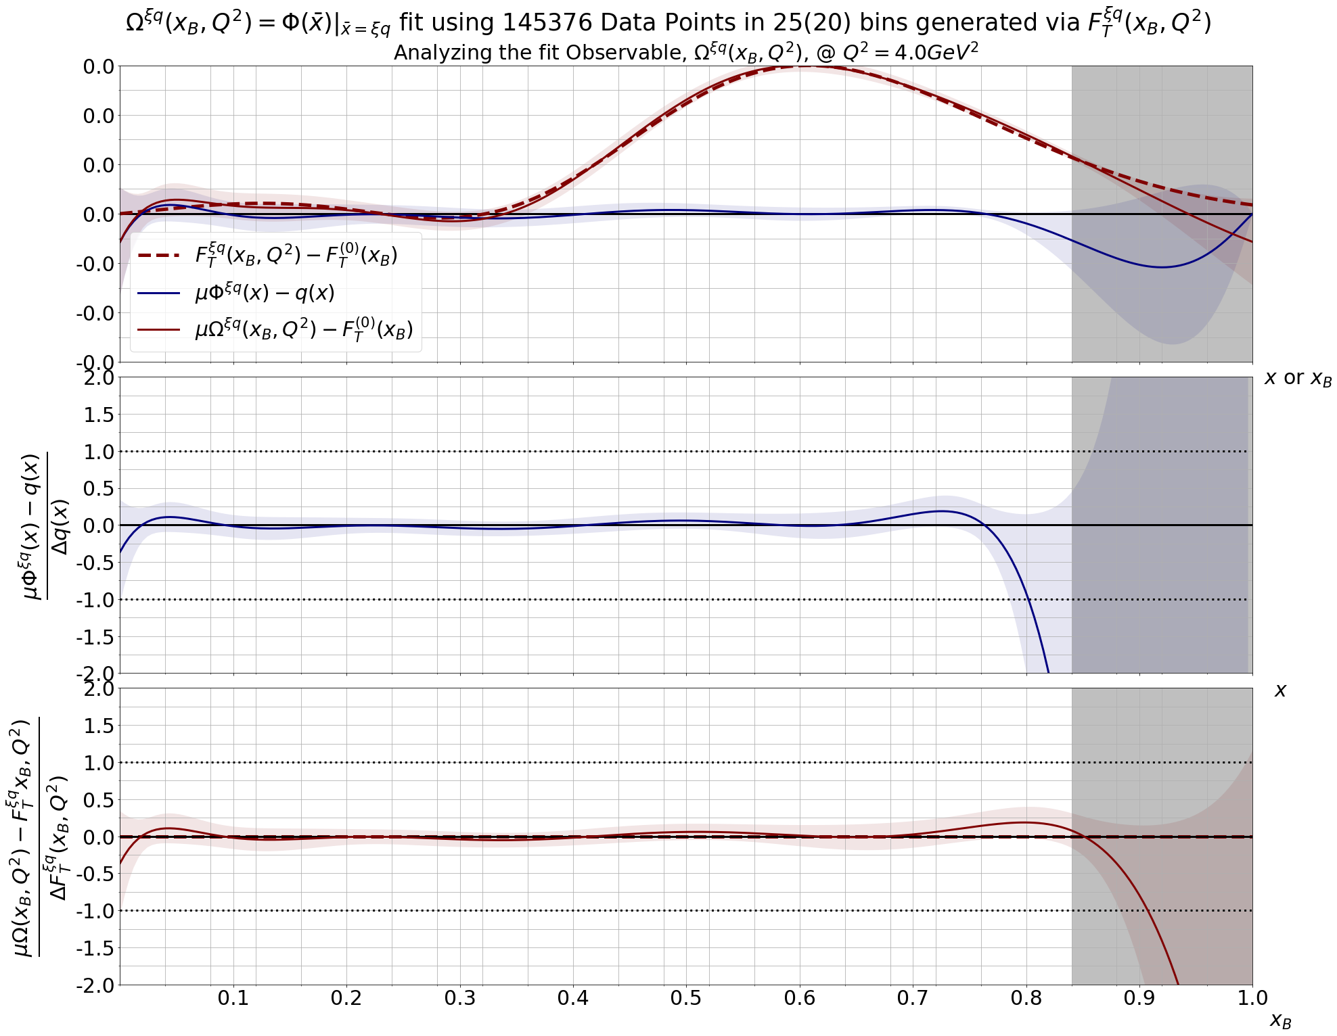
III.ii) Analyzing the Observables
Looking first at our fit observables compared to the theory
  ~150000 data points per experiment
  75 experiments
Notes:
**Cross Checking the generated data with the theory used to generate it is a good way to make sure the algorithm is working correctly

Slide 24
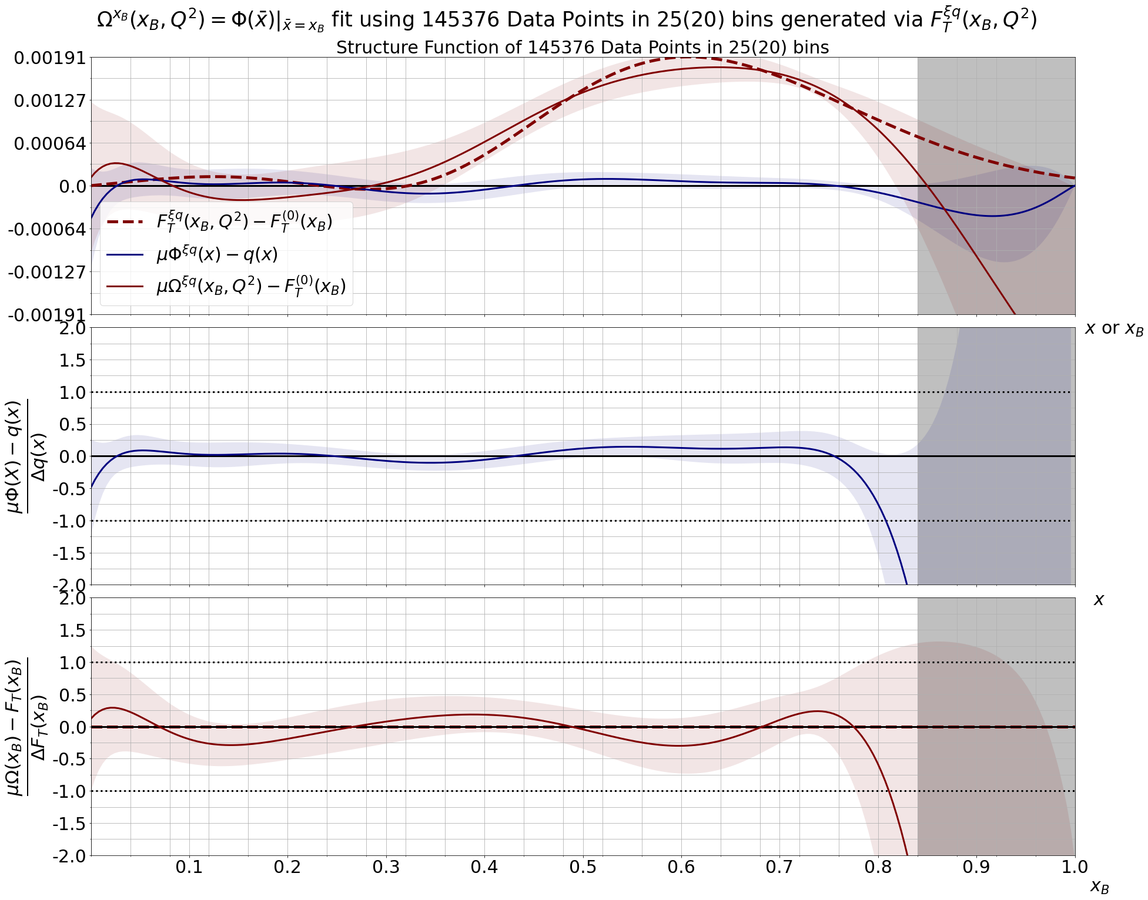
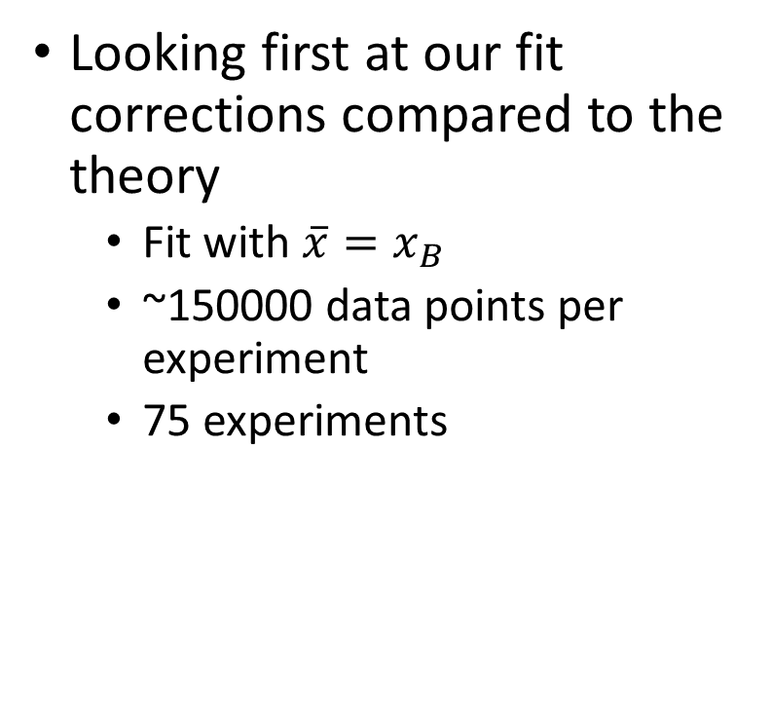
III.ii) Analyzing the Higher Twist Corrections
Looking first at our fit corrections compared to the theory
  Fit with $\overline{x}=x_{B}$
  ~150000 data points per experiment
  75 experiments
Notes:
**Cross Checking the generated data with the theory used to generate it is a good way to make sure the algorithm is working correctly

Slide 25
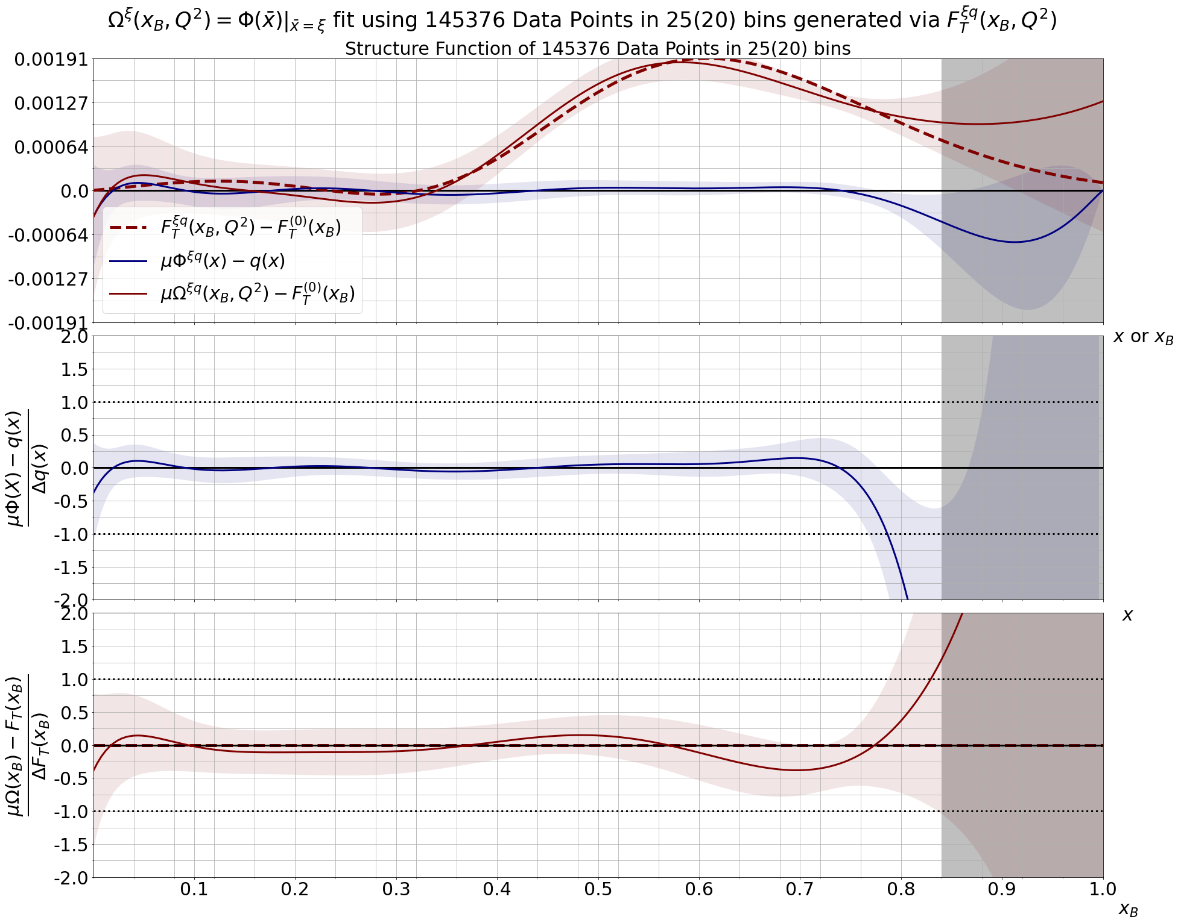
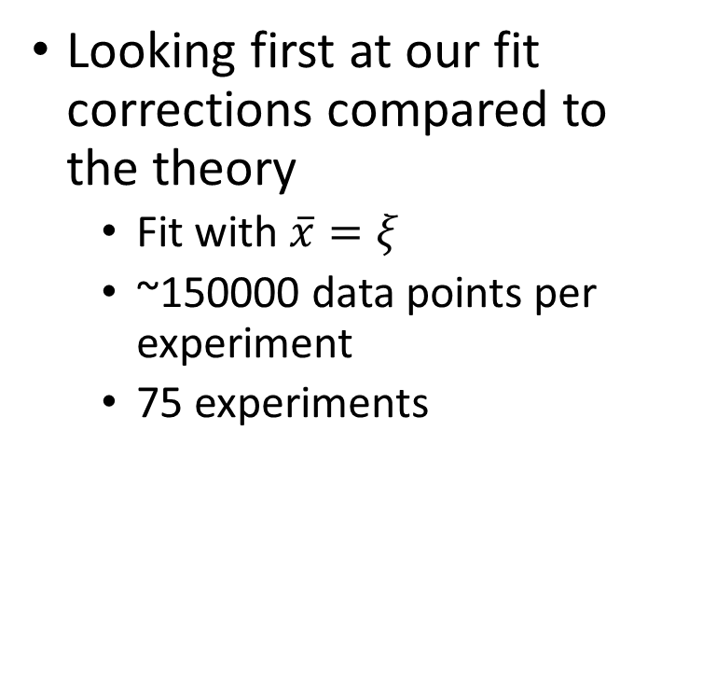
III.ii) Analyzing the Higher Twist Corrections
Looking first at our fit corrections compared to the theory
  Fit with $\overline{x}=ξ$
  ~150000 data points per experiment
  75 experiments
Notes:
**Cross Checking the generated data with the theory used to generate it is a good way to make sure the algorithm is working correctly

Slide 26
IV. Conclusion
QCD
Simulating the Theory
Analysis
Conclusion
  Current Standing
  Future Work

Slide 27
IV. i) Current Standing
Cross-checking the data with the underlying theory we can make sure the algorithm is working
  It is!
  The chosen polynomial can fit the desired observables
We can extract quark distribution function from the higher twist correction term
  This will allow us to extract information about the observable

Slide 28
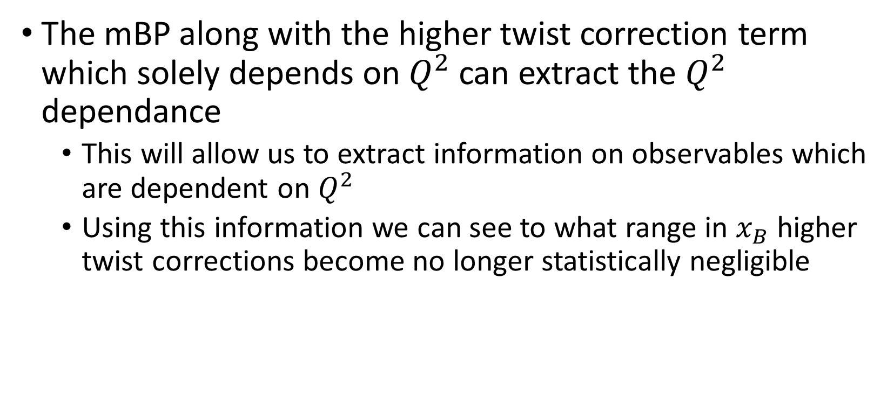
IV. ii) Future Work
The mBP along with the higher twist correction term which solely depends on $Q^{2}$ can extract the $Q^{2}$ dependance
  This will allow us to extract information on observables which are dependent on $Q^{2}$
  Using this information we can see to what range in $x_{B}$ higher twist corrections become no longer statistically negligible

Slide 29
Thank you/Questions

Slide 30
References
Juan V. Guerrero and Alberto Accardi. “Collinear Factorization at sub-asymptotic kinematics and validation in a diquark spectator model”. In: (Oct. 2020). arXiv: 2010.07339 [hep-ph]
A. Accardi et al. “Parton Propagation and Fragmentation in QCD Matter”. In: Riv. Nuovo Cim.32.9-10 (2009), pp. 439–554. DOI: 10.1393/ncr/i2009-10048-0. arXiv: 0907.3534
[nucl-th]

