Slide 1
Development of Future Forward Calorimeter for CLAS12
6/16/22 Alec Peck

Slide 2
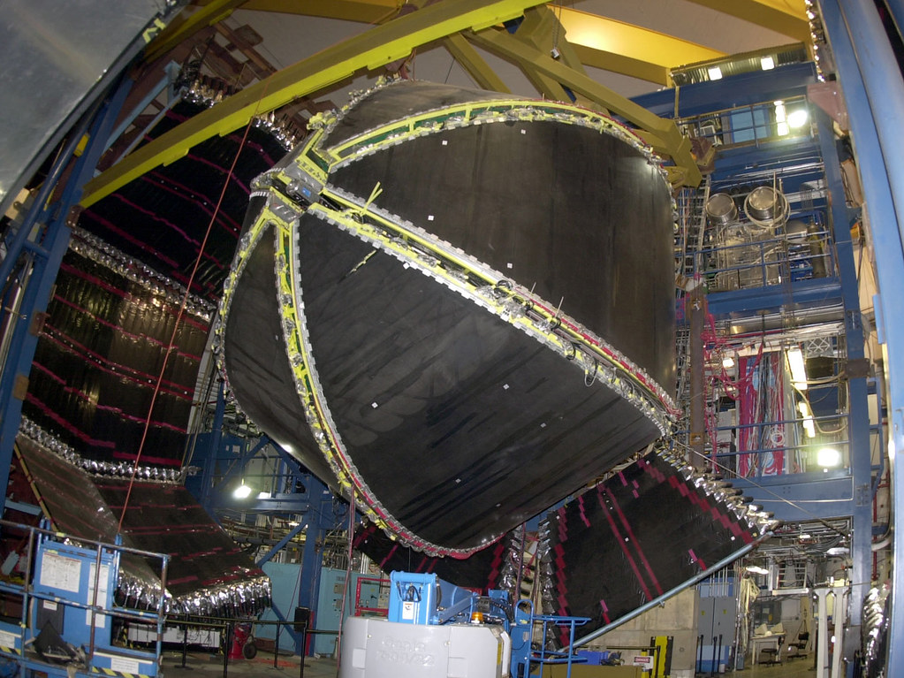
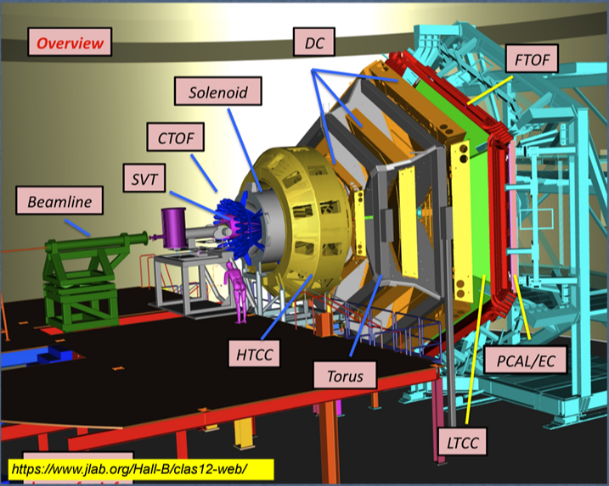
Hall B & the CLAS
Purpose: 3D tomography, form factors, TDPs, GPDs
Pre-shower, Electromagnetic, and forward tagger Calorimeters
Central barrel: neutron detector

Slide 3
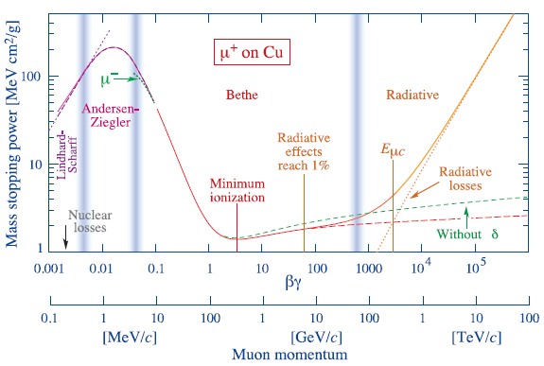
Minimum Ionizing Particle (MIP) Calorimetry
Energy loss in matter: Bethe-Bloch formula, radiative corrections
Large kinematic range of minimal Ionization

Slide 4
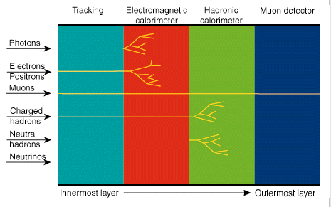
Minimum Ionizing Particle (MIP) Calorimetry
Energy loss in matter: Bethe-Bloch formula, radiative corrections
Large kinematic range of minimum Ionization
Muons, other neutral hadrons

Slide 5
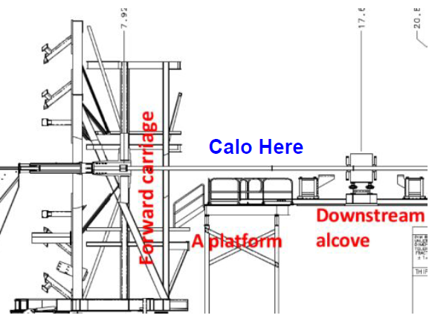
MIP Calorimeter at the CLAS
Far forward $(θ<11°)$ region
Energy deposition and spatial tracking
Neutrons, K_{L}, and Muon detection
Currently at prototype stage
Applications for Hall B and GlueX

Slide 6
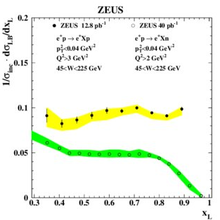
Neutron Detection
High-x neutron emission
SRC pair detection
Hadronization model dependence
Leading Neutron production, neutron spin asymmetries, isospin asymmetries

Slide 7
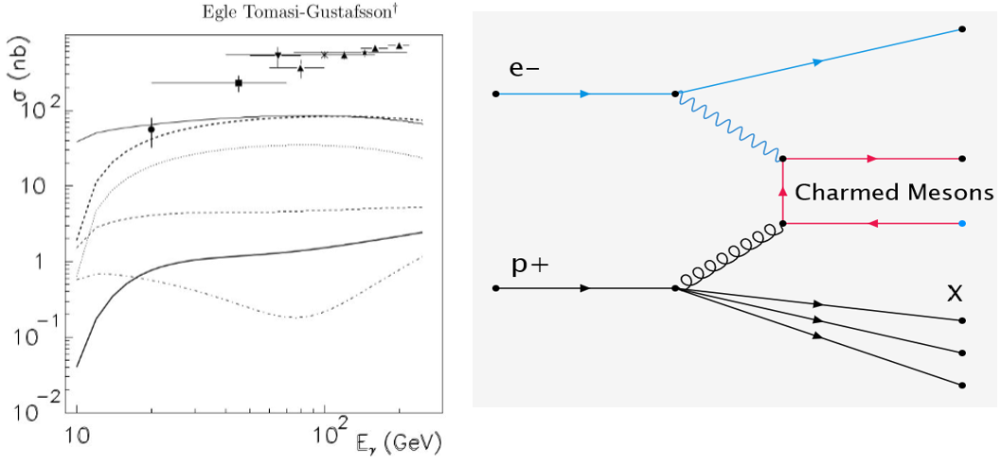
Muon Detection
Muon tagging in open charm production
Sensitive to GPDs
Cross sections poorly constrained at low energy
Relatively high decay to muons
$γ+p→Λ_{c}^{+}+{\overline{D}}^{0}$ (solid line)
$γ+p→Σ_{c}^{++}+D^{−}$ (dashed line)
$γ+p→Σ_{c}^{+}+{\overline{D}}^{0}$ (dotted line)
$γ+p→Σ_{c}^{+}+D^{−}$(thick solid line)
$γ+p→Σ_{c}^{0}+{\overline{D}}^{0}$ (thick dashed line)
Decay BR

Slide 8
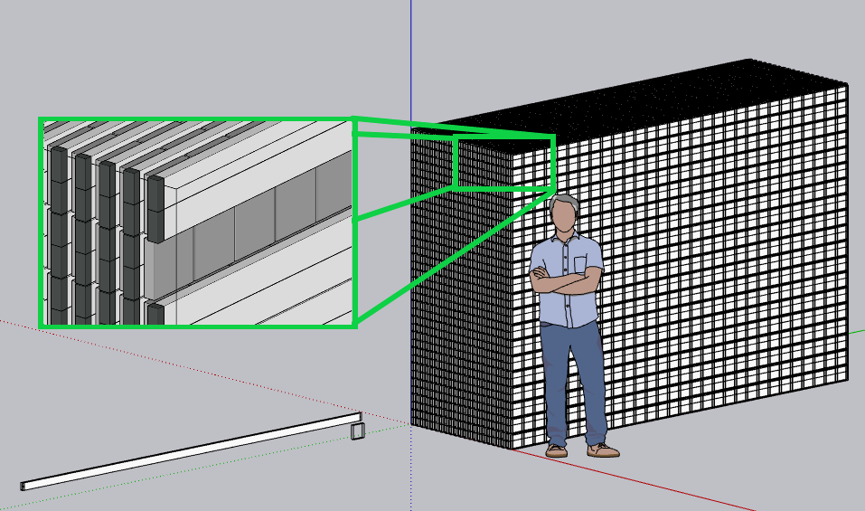
MIP Calorimeter Design
Array of scintillating material
Fast, high gain readout electronics
Signal amplitude, timing correlate to energy deposition and location
Based on previous designs used for muon tomography, muon telescopes

Slide 9
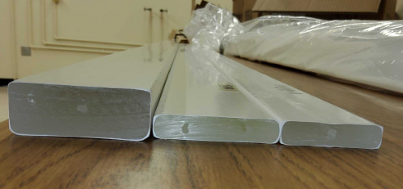
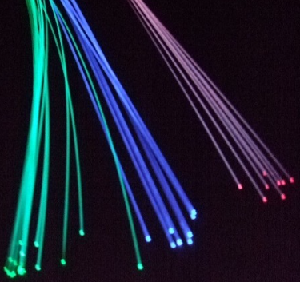
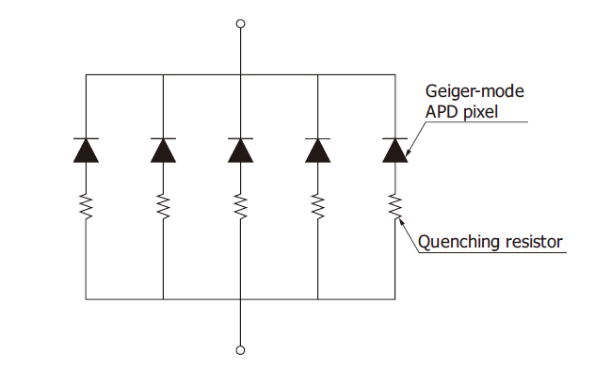
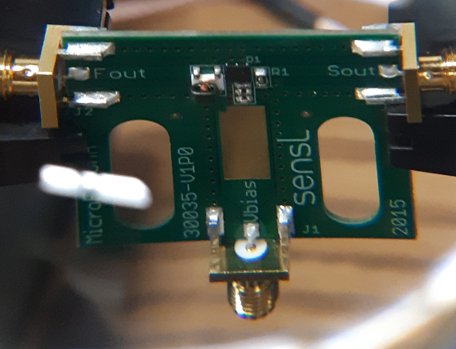
MIP Calorimeter Design
Diphenyloxazole (PPO) doped plastic scintillator
Wavelength shifting fiber
Silicon Photomultiplier (SiPM), “multi-pixel photon counter”

Slide 10
Implementation at the CLAS
Placement behind EM cal.
Relatively inexpensive, ~$0.5M
Plastic: ~$10/bar
Electronics: ~$100/channel
Operationally simple: readout alternative to PMTs
LOI within next year

Slide 11
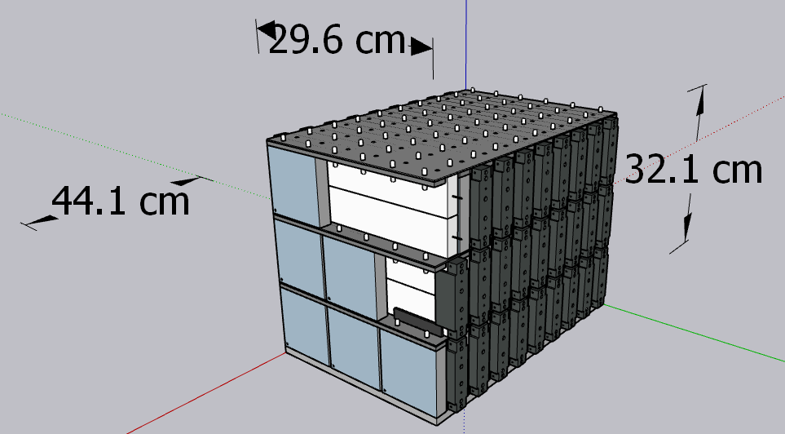
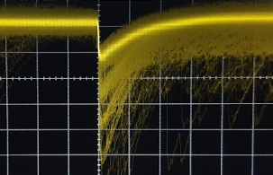
Benchtop Prototype
Test unit comprised of single, scintillating bar and small scintillating tiles for triggering
MIP passes through bar
Bar scintillates in UV
Photons captured, wavelength shifted in fiber
Photons activate discrete pixels in SiPM
MIP

Slide 12
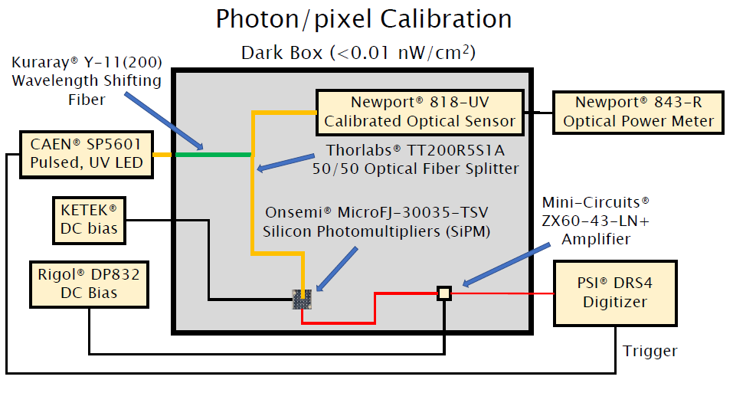
Benchtop Prototype
LED simulates UV signal from MIP
Calibrated photodiode determines photon flux

Slide 13
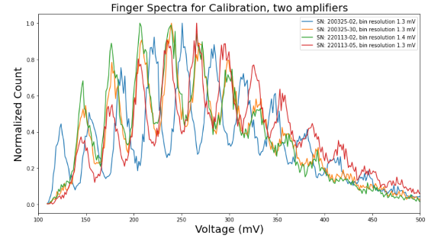
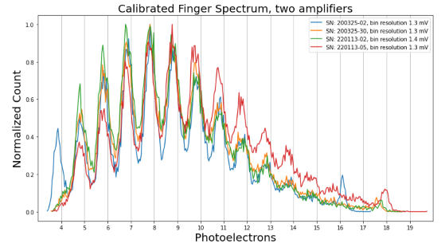
Benchtop Prototype
SiPM pulse amplitudes produce “Finger spectrum”
After calibration, ADC voltage converts to photon flux

Slide 14
GEant4 Monte Carlo (GEMC) simulations
Simulate expected performance; energy resolution, spatial resolution
Good responsivity to incident muons
Known radiation source can be used to calibrate simulated SiPM response

Slide 15
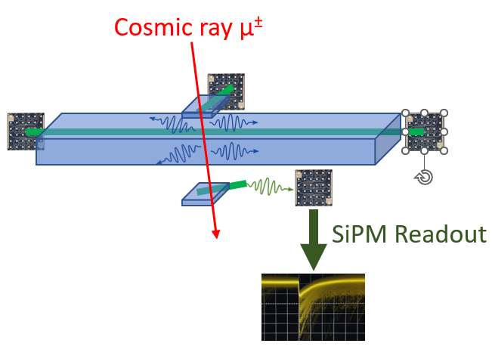
Cosmic Ray Test
We can test cosmic ray muons for free!
Trigger by coincident detection at small tile above and below
Signal collected from both ends of the bar

Slide 16
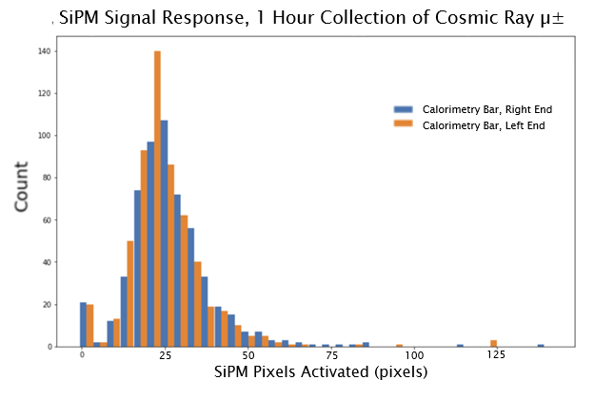
Cosmic Ray Test
Pulse amplitude spectrum is a Landau distribution – what we expect for cosmic rays!
~87% trigger efficiency
Good correlation between ends of the bar

Slide 17
Next Steps
MIP
Characterize responsivity of scintillating bars
Complete GEMC simulations of SiPM response
Scale benchtop model (and electronics) to full size
Propose!

Slide 18
References
M. Battaglieri, “Present and future of JLab CLAS12 physics program” (2020)
A. Buniatyan, “Leading Hadron Production at HERA” , EPJ Web of Conferences (2013)
M. Arratia “About a forward “KLM” calorimeter for CLAS12”, (2022)
PDG Reviews “33. Passage of Particles Through Matter” (2018)
Image Sources
Jefferson Lab, https://www.jlab.org/physics/hall-b/clas12
Kuraray, http://kuraraypsf.jp/
Thank you to the Department of Energy for funding this research!

Slide 19
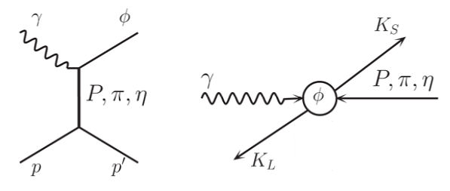
K_{L} Detection
Neutral kaon decay channels in vector mesons
K_{L} decay length typically 10-100m
Investigate CP violation

Slide 20
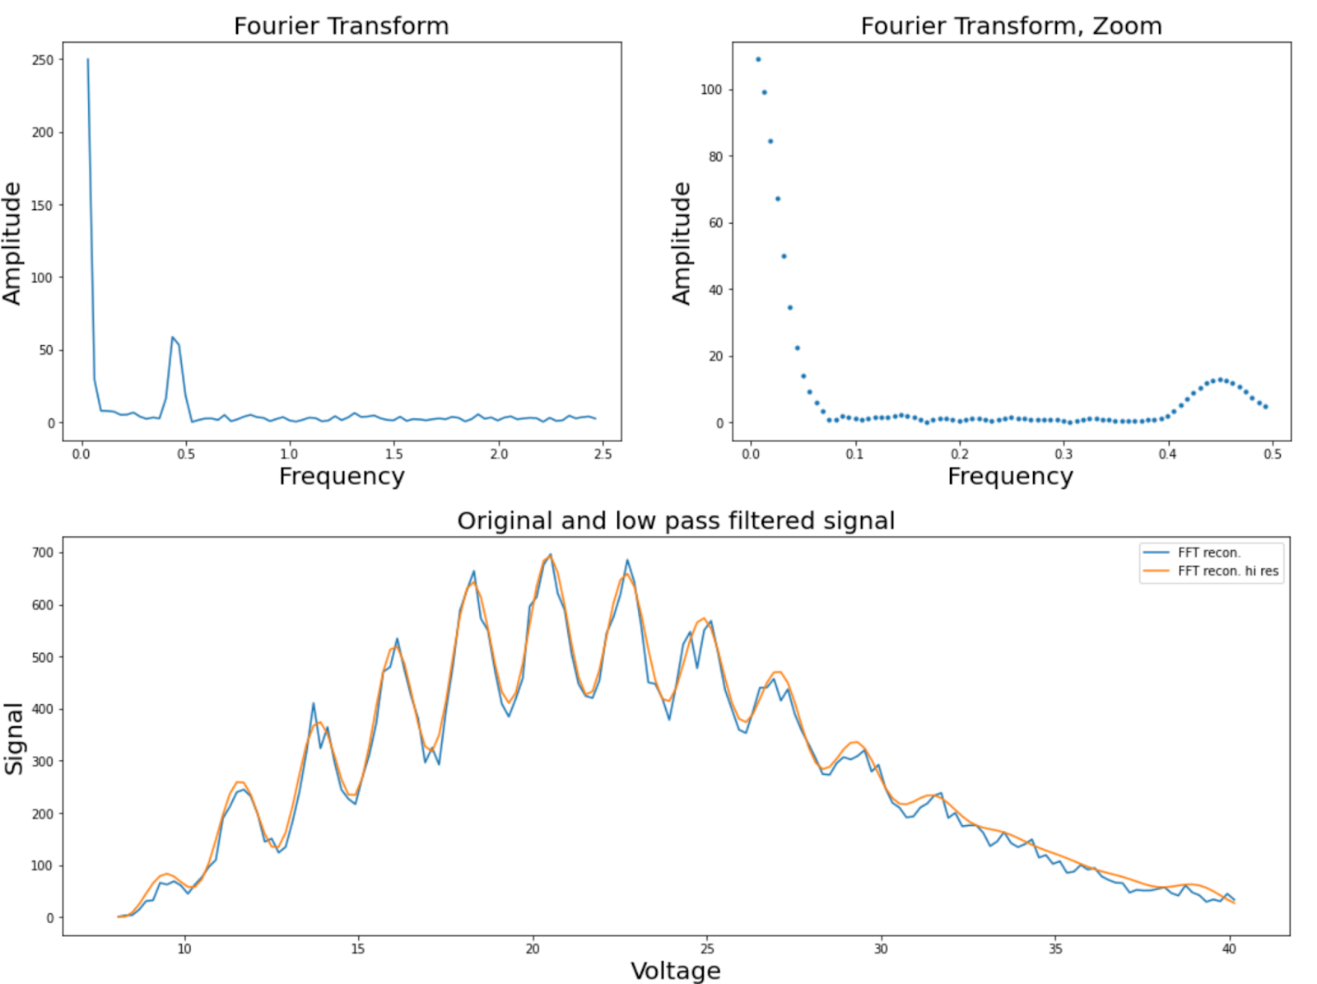
SiPM Signal Calibration
Pixel count determined from low-intensity “finger spectrum”
Gaussian noise floor and ~sinusoidal fingers separated by Fourier Transform
100 ns

Slide 21
SiPM Signal Calibration
Incident photon count determined from Newport calibrated photodiode
Constant splitter ratio
Calibrated diode measures average power from LED
SiPM pixel count “measures” photons/pulse
Calibrated Photodiode
DUT: SiPM
Fiber Optical Splitter
LED: UV light source

Slide 22
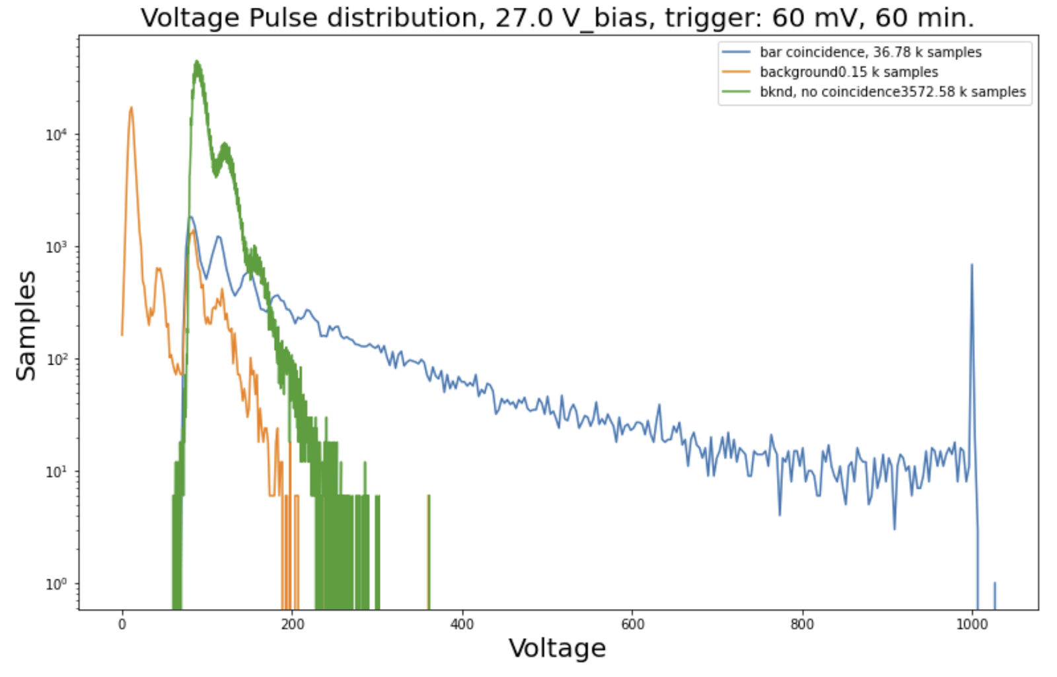
Calorimeter Trigger
Smaller tiles of scintillating plastic above and below bar trigger data collection
Trigger occurs if both SiPM are above the 3.3 pixel threshold
Requiring coincidence between tiles removes background noise
With scintillator material added, high energy coincident spectrum appears – not Landau

