Slide 1
CEBAF 20+ GeV Energy Upgrade
Feasibility study for FFA* racetracks in the existing CEBAF tunnel to reach the top energy of about 22-24 GeV
Alex Bogacz
*FFA (Fixed Field Alternating-Gradient)

Slide 2
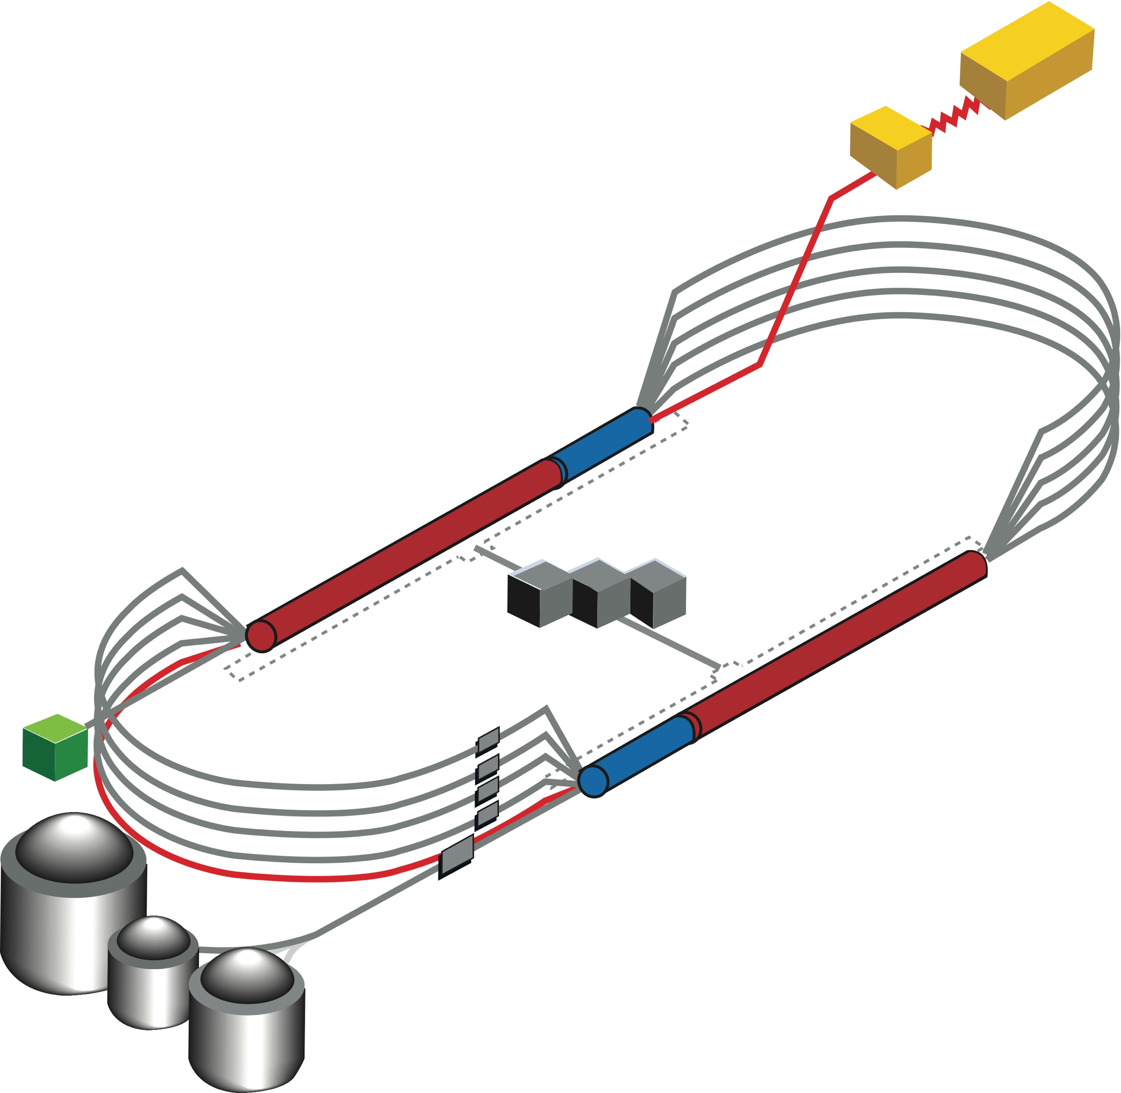

CEBAF FFA Upgrade – ‘Currently under Study’
  Starting with 12 GeV CEBAF as a baseline
  NO new SRF (1.1 GeV per linac)
  New 650 MeV recirculating injector
  Remove the highest recirculation pass (Arc 9 & A) and replace them with two FFA arcs including time-of-flight chicanes
  Recirculate 4 + 4 times to get to about 18 GeV
TOF
TOF
  Install a second pair of FFA arcs ‘on the floor’ below Arc 9 & A
  Recirculate 3 times to get to about 24 GeV
TOF
650 MeV
TOF
Novel permanent magnet technology used for power and cost savings
Pass Arithmetic: 5 -1 + 4 + 3 = 11

Slide 3
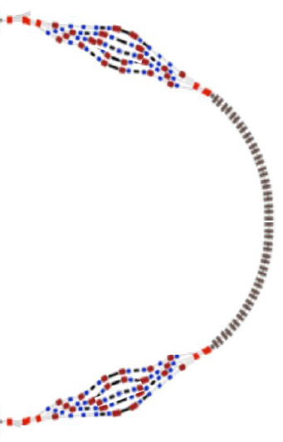
FFA CEBAF with -like Arcs

Slide 4
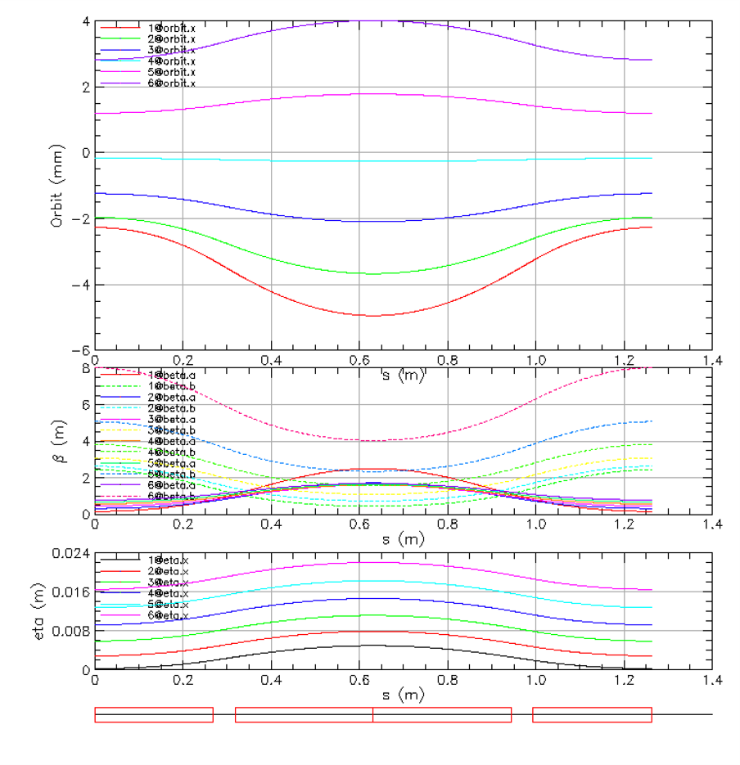
Compact FFA FODO Cell – How Does it Work?
Large momentum acceptance FFA cell, configured with combined function magnets capable of transporting multiple energy beams through the same string of permanent magnets (beams with energies spanning a factor of two)
BD
BF
BD
1 T
50 T/m
1 T
50 T/m
magnets: from 38cm² to 78cm²
BD
BF
BD

Slide 5
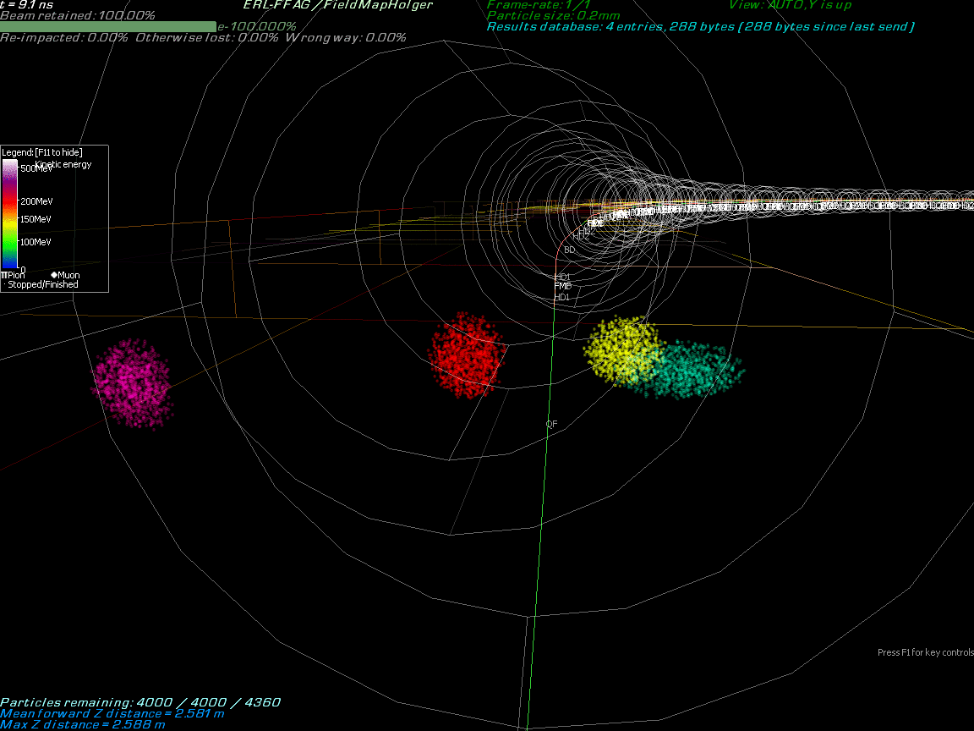
Multi-Bunch Dynamics in FFA Arc
Stephen Brooks
BNL

Slide 6
Multi-Bunch Dynamics in FFA Arc
Stephen Brooks
BNL

Slide 7
Energy Loss, Emittance Dilution (4-pass CEBAF)

Slide 8
Energy loss, Emittance Dilution (7-pass FFAs)

Slide 9
Summary
Present Baseline (1.1 GeV per linac):
  650 MeV Recirculating Injector (additional three C-90 cryomodules)
  Recirculate 4 passes with the current CEBAF
  Option 1: Additional 7 (4 + 3) passes via two FFAs: 10.4 – 17.9 GeV and 19 – 24.6 GeV
  Option 2: Additional 6 passes via a single FFAs: 10.4 – 22.8 GeV
Adiabatic FFA arcs configured with compact FODO cells
  Beta and dispersion matching to the linacs through cell-by-cell variation (length, bend)
  Open mid-plane permanent magnet design: B-field ≤ 1 T, Gradient ≤ 47 T/m
Synchrotron Radiation impact on beam quality
  Net transverse emittance dilution (normalized): 60 mm mrad
  Net natural energy spread: 2×10⁻³
  Net synchrotron radiated energy: 1 GeV
Physics topics that can only be explored with energy well above 12 GeV (Hall C)
  Interpretation of EIC exclusive and semi-inclusive programs, e.g. conventional Rosenbluth LT separations
  Double Deep Virtual Compton Scattering, Deeply Virtual Meson Production (scaling region)
  Parity Violation to constrain strange quarks, Tagged Deep Inelastic Scattering
at 23 GeV, β = 20 m → σ = 150 microns

Slide 10
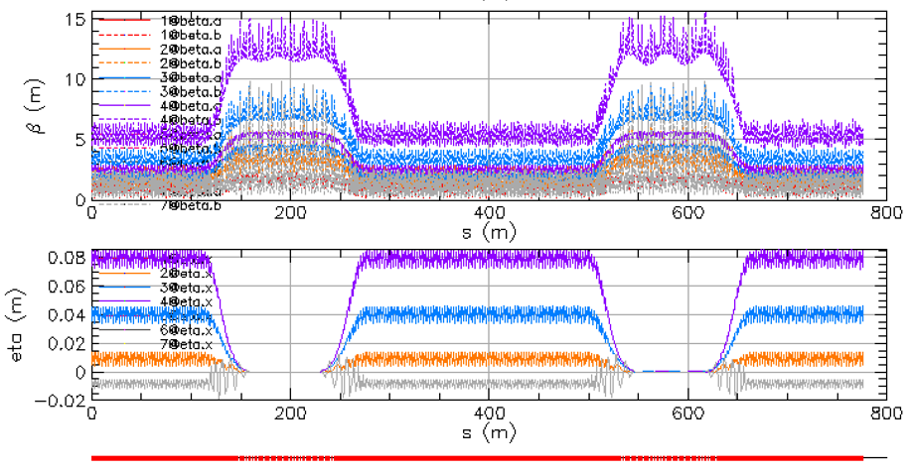
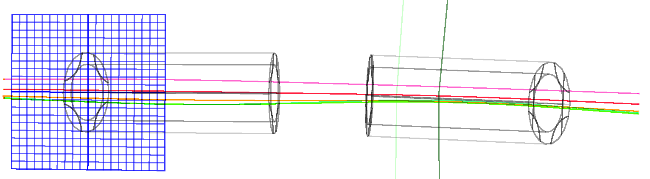




Thanks for your attention!

Slide 11

The FFA@CEBAF Collaboration
†

Slide 12
Backup Slides

Slide 13
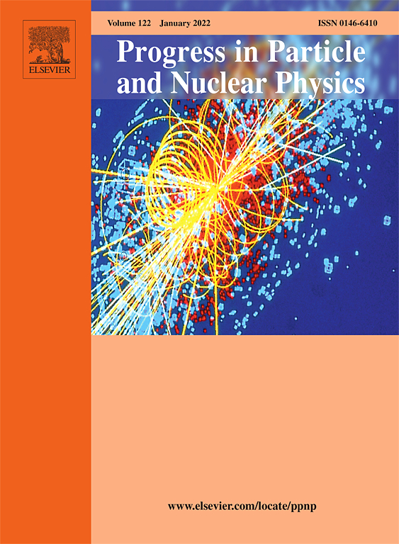
Outlook
‘White Paper’ on Future of CEBAF

Slide 14
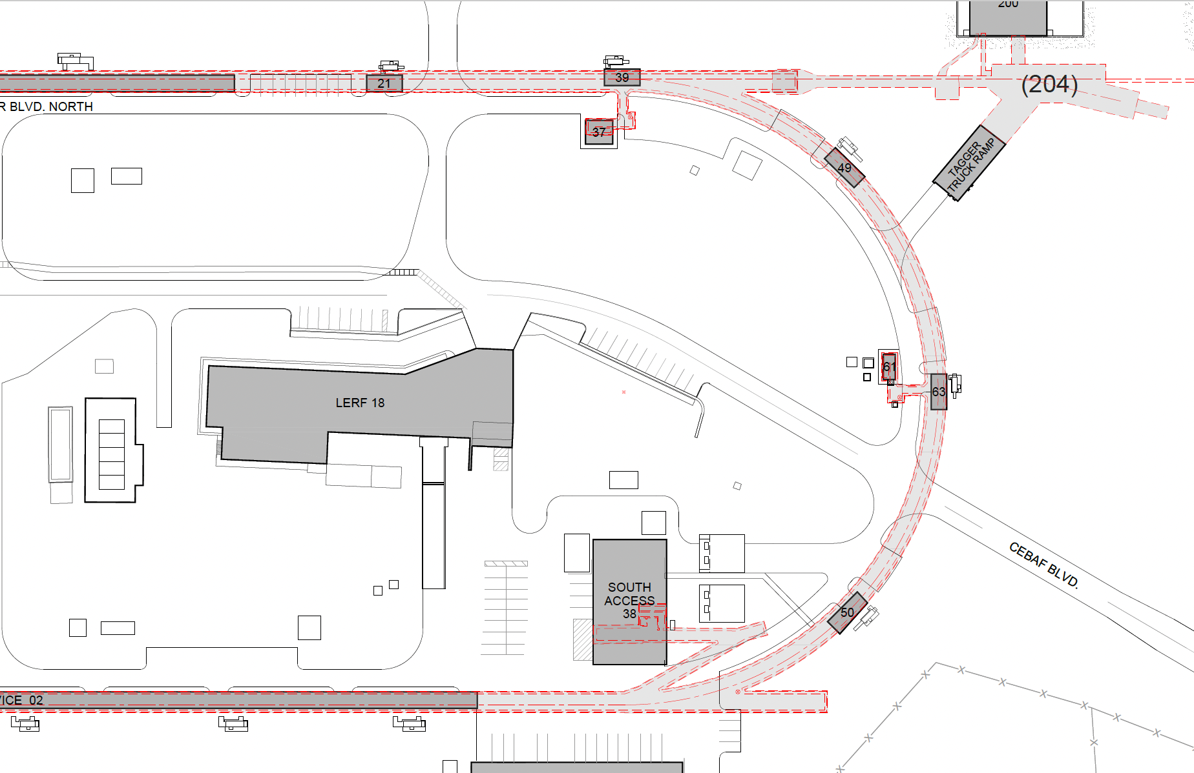
Option 2c: new cut-and-cover tunnel between LERF and E Arcs
LERF is used for e+ development, while tunnel is constructed. Once connected – start e+ program. Then reconfigure LERF as 650 MeV injector and start 22 GeV program
Note: the nominal CEBAF beam as 100.000m. The LERF beam is at 105.000m
Shorter tunnel, but challenges:
Interference with CM installation (may be solved by placing beamline at ceiling height).
Radiation sky-shine from transport beamline (may be solved with shaft shielding cover)
LERF vault
New tunnel,
slope from LERF 105m down to 100m
Joe Grames
JLAB

