Slide 1
Advanced Characterization of SRF Samples
Sebastian Keckert
21 September 2022
Thin Films Workshop, JLab

Slide 2
How can we characterize samples?
DC
RF
e.g. QPR
H_{vp}
T_{c}
Local
Magnetometry
R_{S}
H_{c2}
H_{c1}
RRR
λ
VSM,
PPMS
µSR
R_{S} requires RF testing
RF characterization is essential

Slide 3
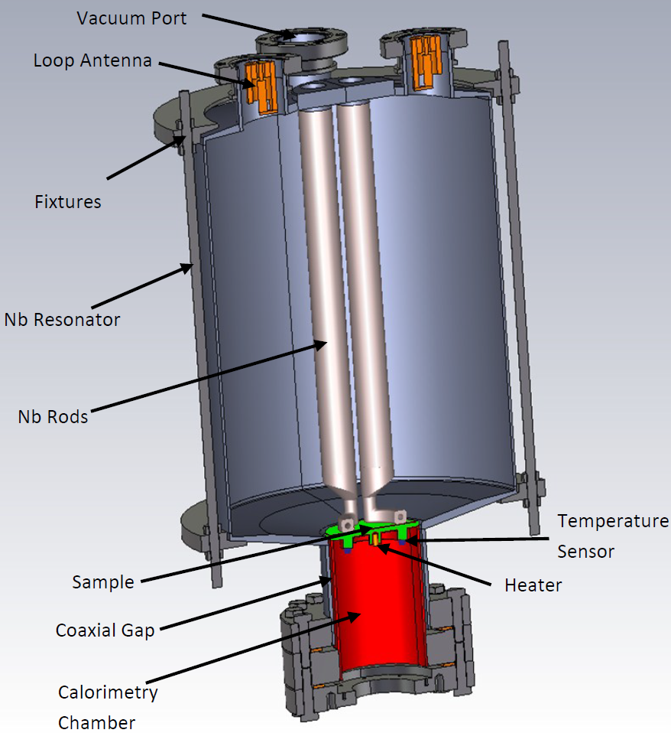

The Quadrupole Resonator (QPR)
Dedicated sample test cavity
sample: Ø = 75mm, H ≈ 100mm
  details: see →
Quadrupole modes near 415, 850, 1290 MHz
Operated in vertical bath cryostat
  LHe at constant temperature (1.8 K typ.)
Coaxial structure
  Thermal decoupling of sample and resonator
  Calorimetric measurement of R_{S}
➔ T_{Sample} = 1.8 … > 20 K
[Rev. Sci. Instrum. 92 064710, 2021]

Slide 4
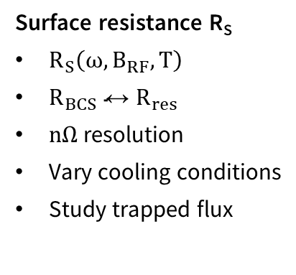
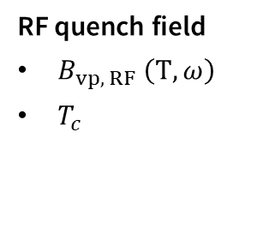
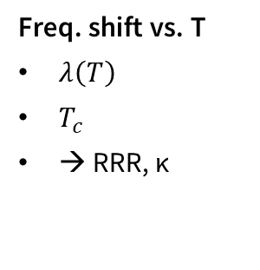
QPR: Characterizing SRF Samples
3 frequencies: 415, 850, 1290 MHz
T_{Sample} = 1.8 … > 20 K
B_{max} ≈ 120 mT
  R_{S} measurements are typically limited by RF heating
Wide parameter range in T, B_{RF} and ω
Surface resistance R_{S}
$R_{S}\left(ω,B_{RF},T\right)$
$R_{BCS}↔R_{res}$
$nΩ$ resolution
Vary cooling conditions
Study trapped flux
Freq. shift vs. T
$λ\left(T\right)$
$T_{c}$
→ RRR, κ
RF quench field
$B_{vp, RF} \left(T,ω\right)$
$T_{c}$

Slide 5
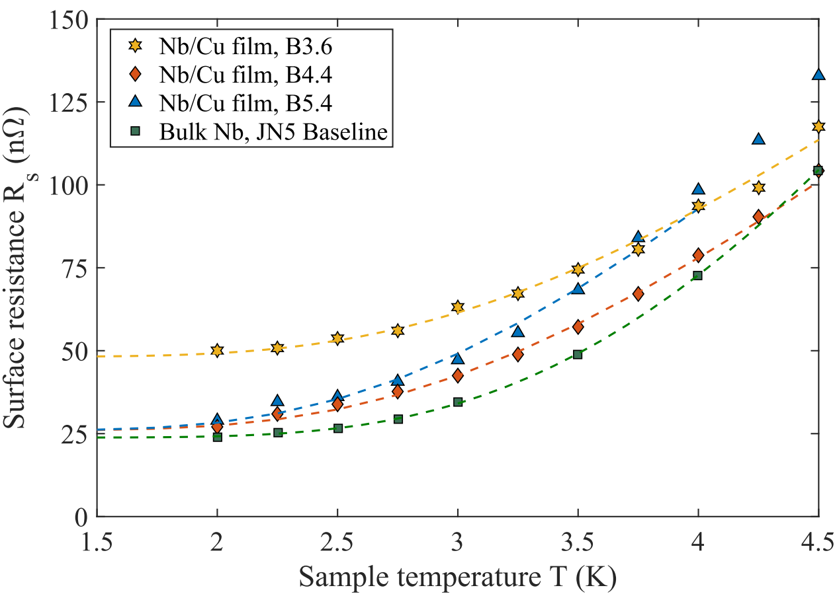
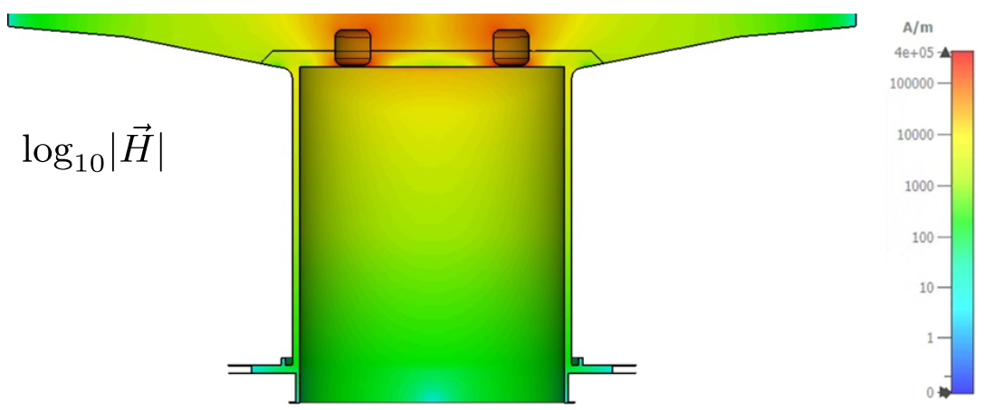

Systematic bias: Parasitic losses
Observation: Surface resistance higher than expected, especially at 1.3 GHz
→ accuracy issue
Calorimetric measurement
→ any heating of the sample → R_{S}
Parasitic losses?!
→ coaxial line provides only limited damping
$δ=\frac{\iint_{sample}{{\left|H\right|}^{2}}}{\iint_{coax}{{\left|H\right|}^{2}}}$ max. $≈10^{6}$ at 415 MHz
Exemplary data sets for R vs T for different Nb/Cu coating and a bulk Nb sample

Slide 6
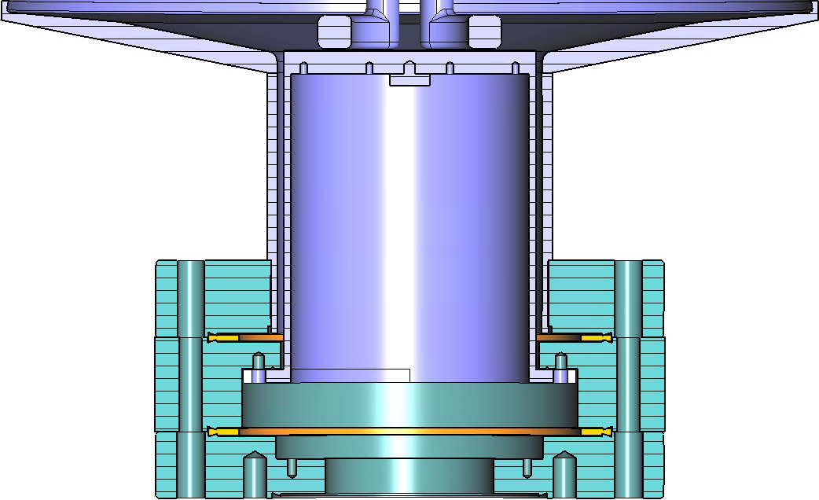
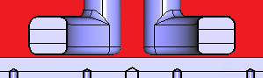
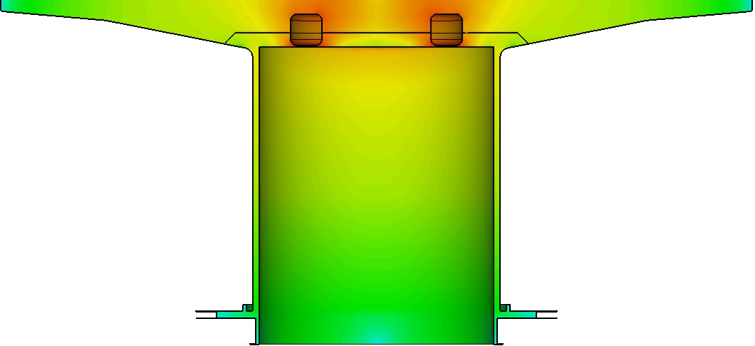
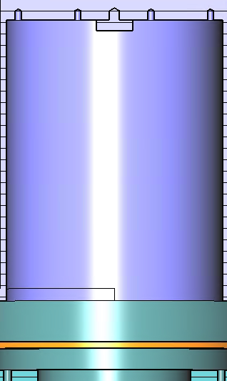
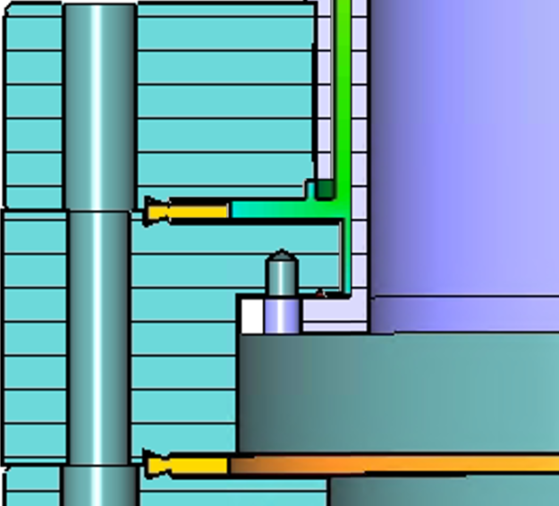

The cause
QPR cavity
Sample surface
$$\log\left|\vec{H}\right|$$
Calorimetric measurement of the RF surface resistance
  Integral of all losses on the sample assembly
  (weighted with the thermal distribution)
Sample assembly with
insulation vacuum
Stainless steel
Cu gaskets
DN 100 CF
LHe, 1.8 K
Indium wire gasket

Slide 7

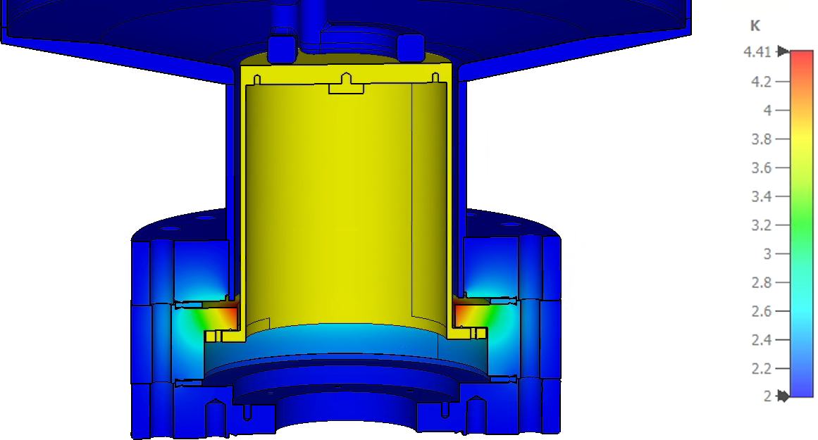
Understanding parasitic losses
RF simulations are not enough
→ we need the full picture
→ non-linear temperature dependence
Results:
RF field | Q1 | Q2 | Q3
5 mT | 12.6 nΩ | 26.0 nΩ | 63.1 nΩ
10 mT | 12.6 nΩ | 26.0 nΩ | 63.0 nΩ
20 mT | 12.6 nΩ | 25.9 nΩ | 62.1 nΩ
50 mT | 12.4 nΩ | 25.9 nΩ | 67.3 nΩ
100 mT | 13.4 nΩ | 29.5 nΩ | 73.6 nΩ
[Simulations: W. Ackermann, TU Darmstadt]

Slide 8
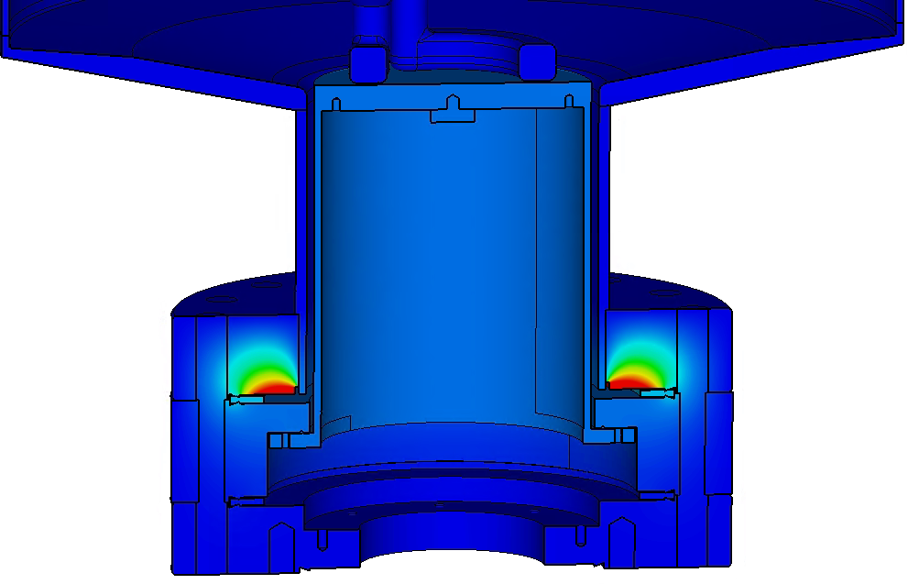


The solution
➔ We have to „switch off“ losses on the sample adapter flange
T_{max} = 4.4 K
T_{max} = 2.5 K
$$R_{res}≈13 nΩ$$
$$R_{res}≈0.3 nΩ$$
Same RF field, different color scale!
(Eigenmode solver, 1 J stored energy)

Slide 9
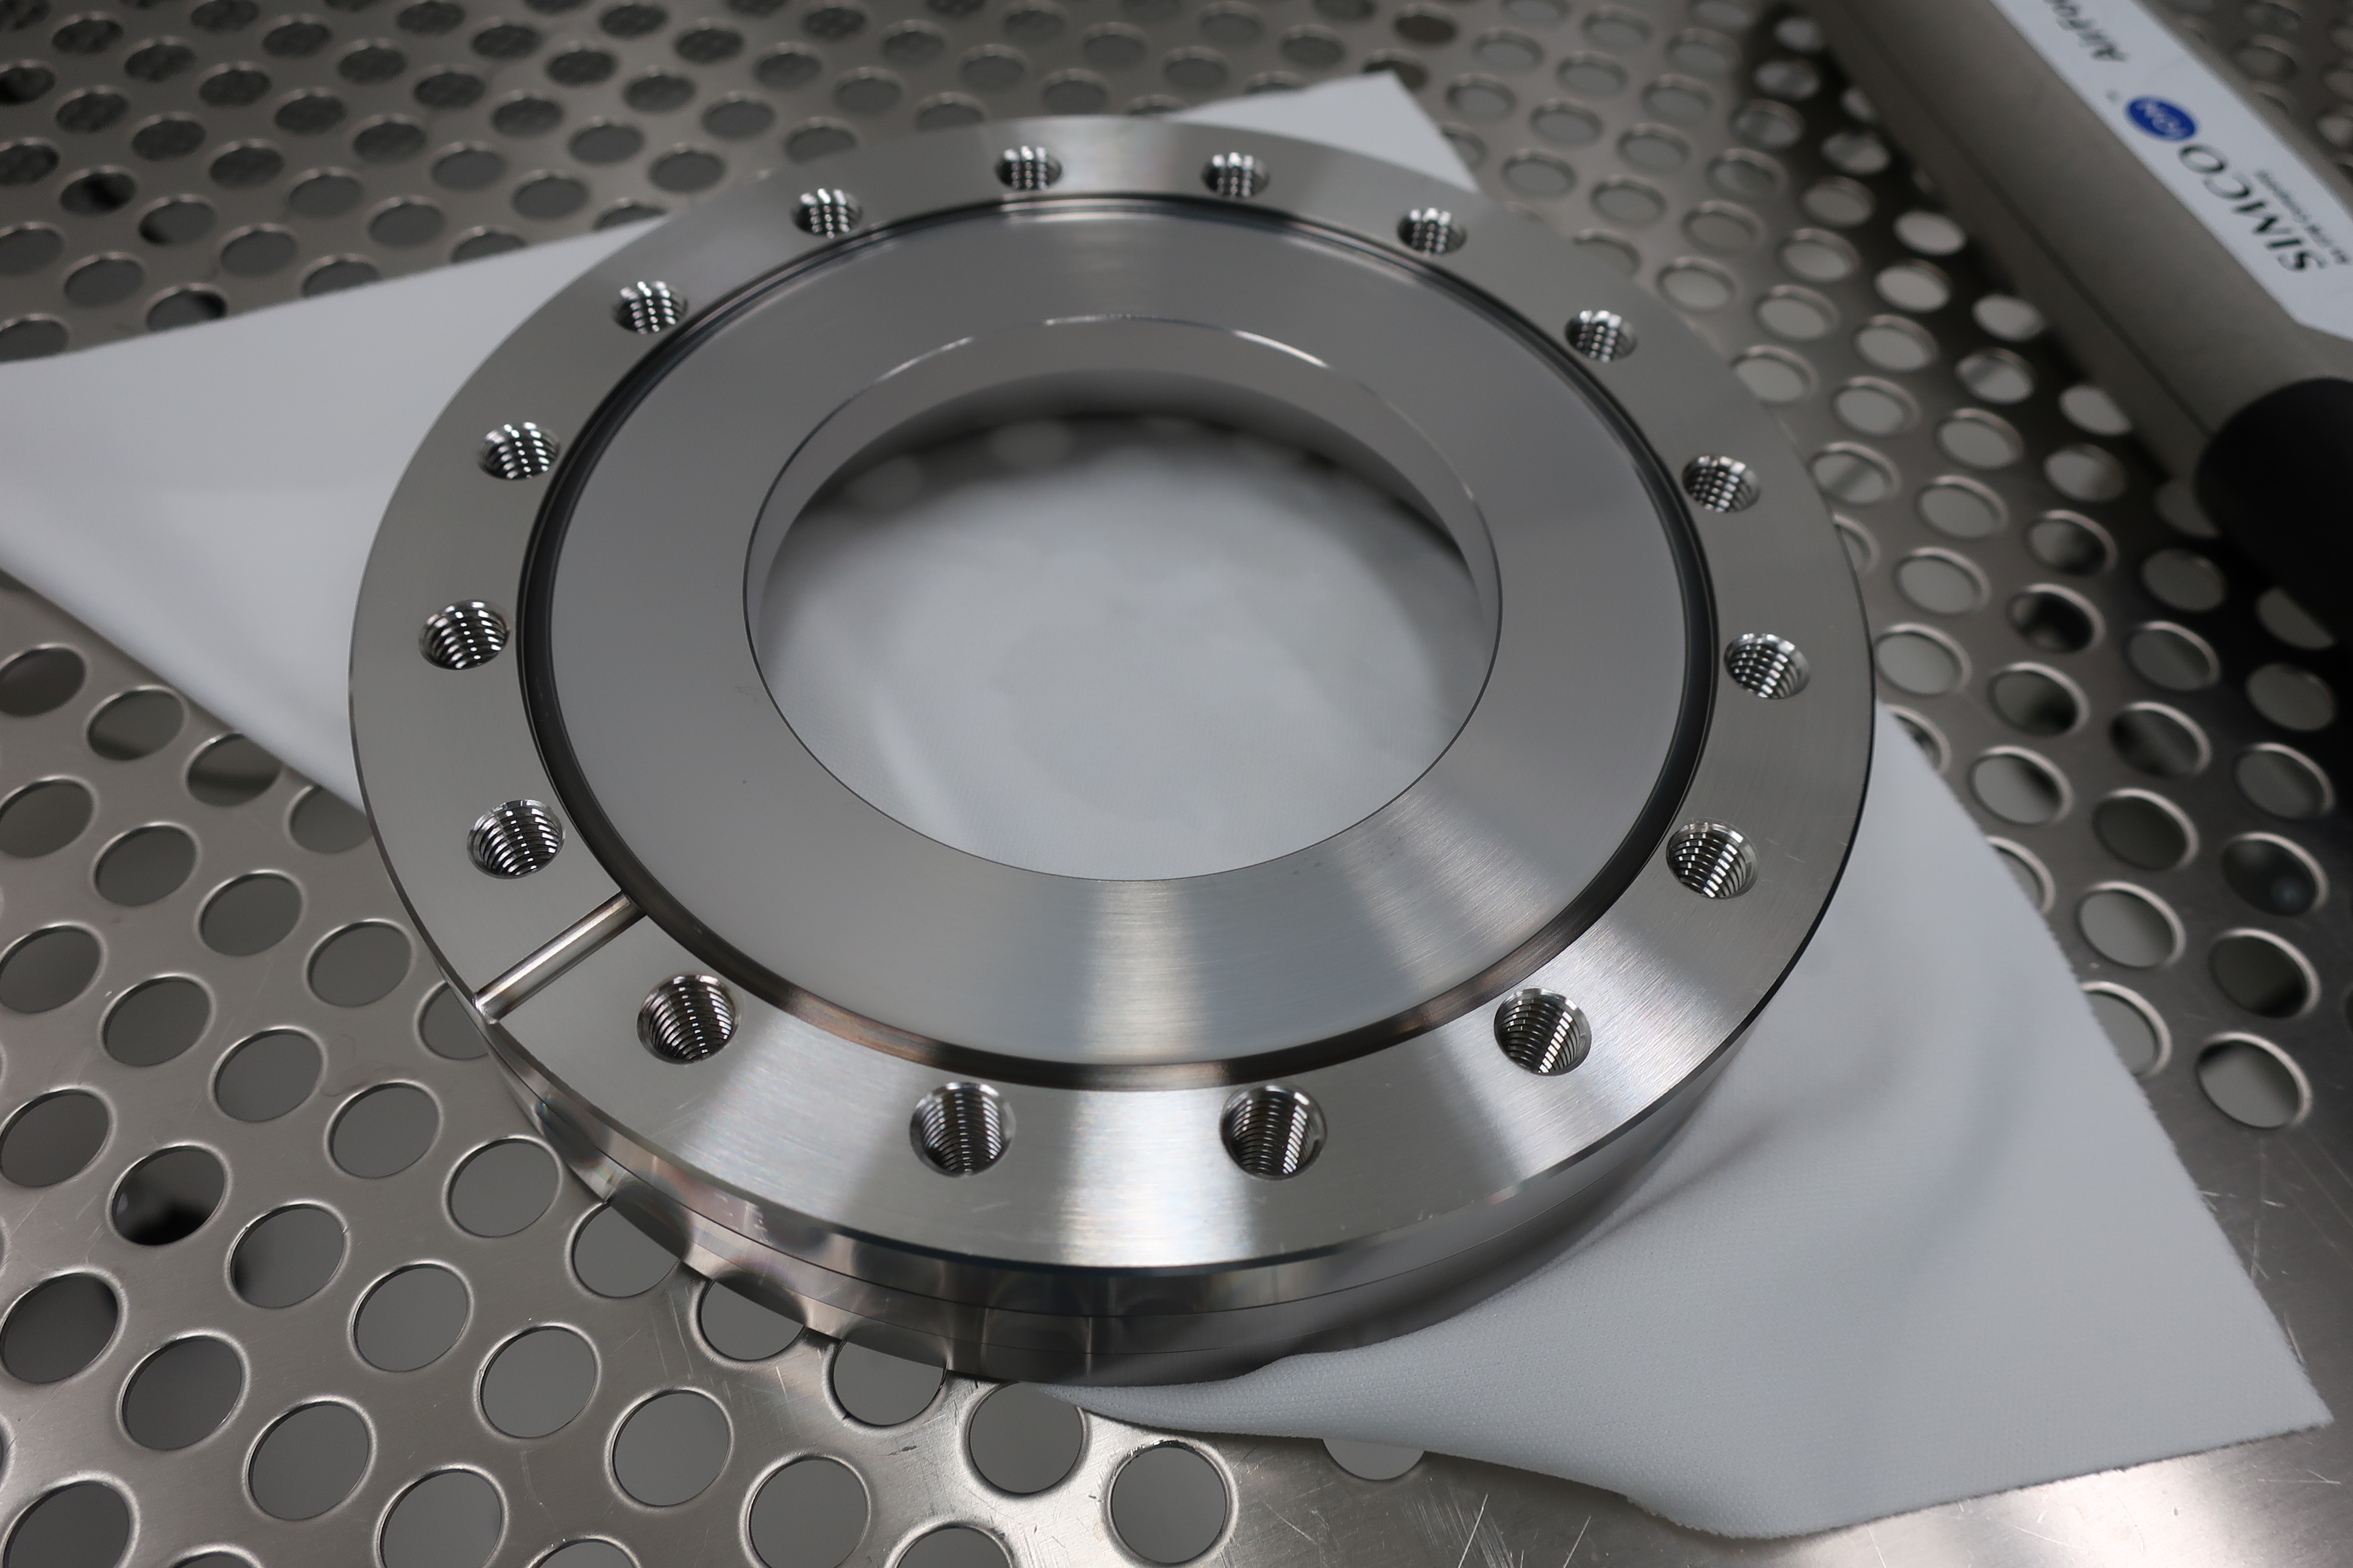

The solution
Thin film coating: Nb on stainless steel
at University of Siegen
HiPIMS coating of surfaces
that are exposed to RF fields
4 … 12 µm → full screening
CF knife edge covered during coating

Slide 10
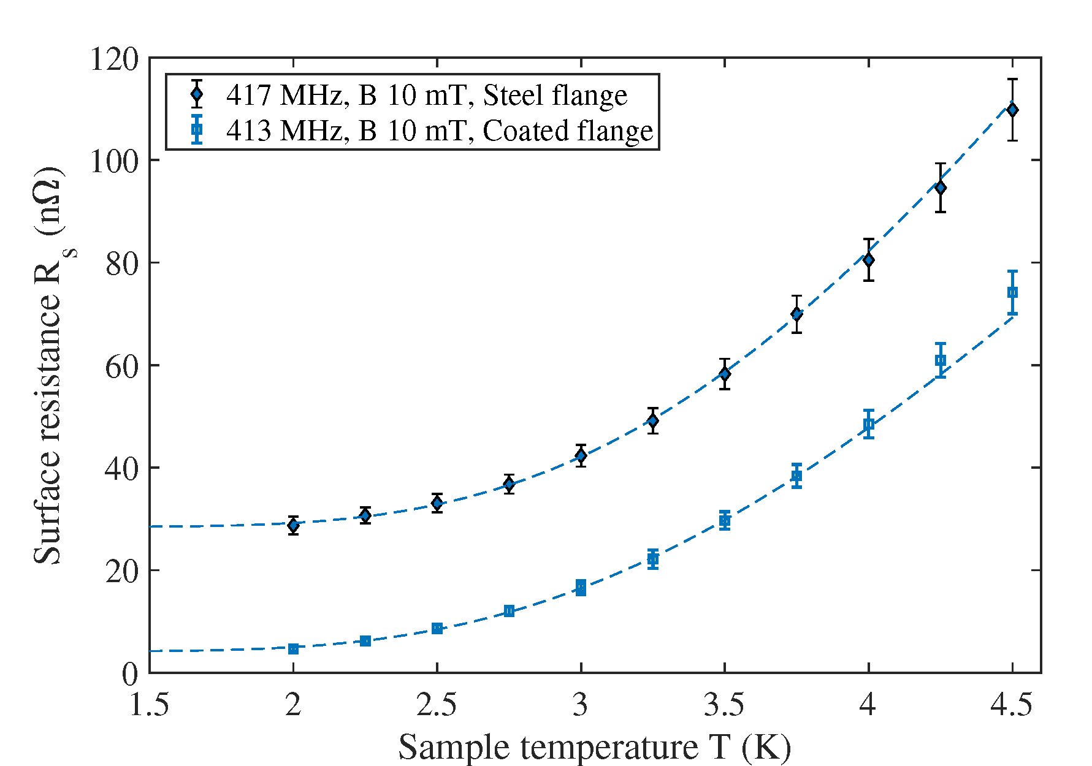
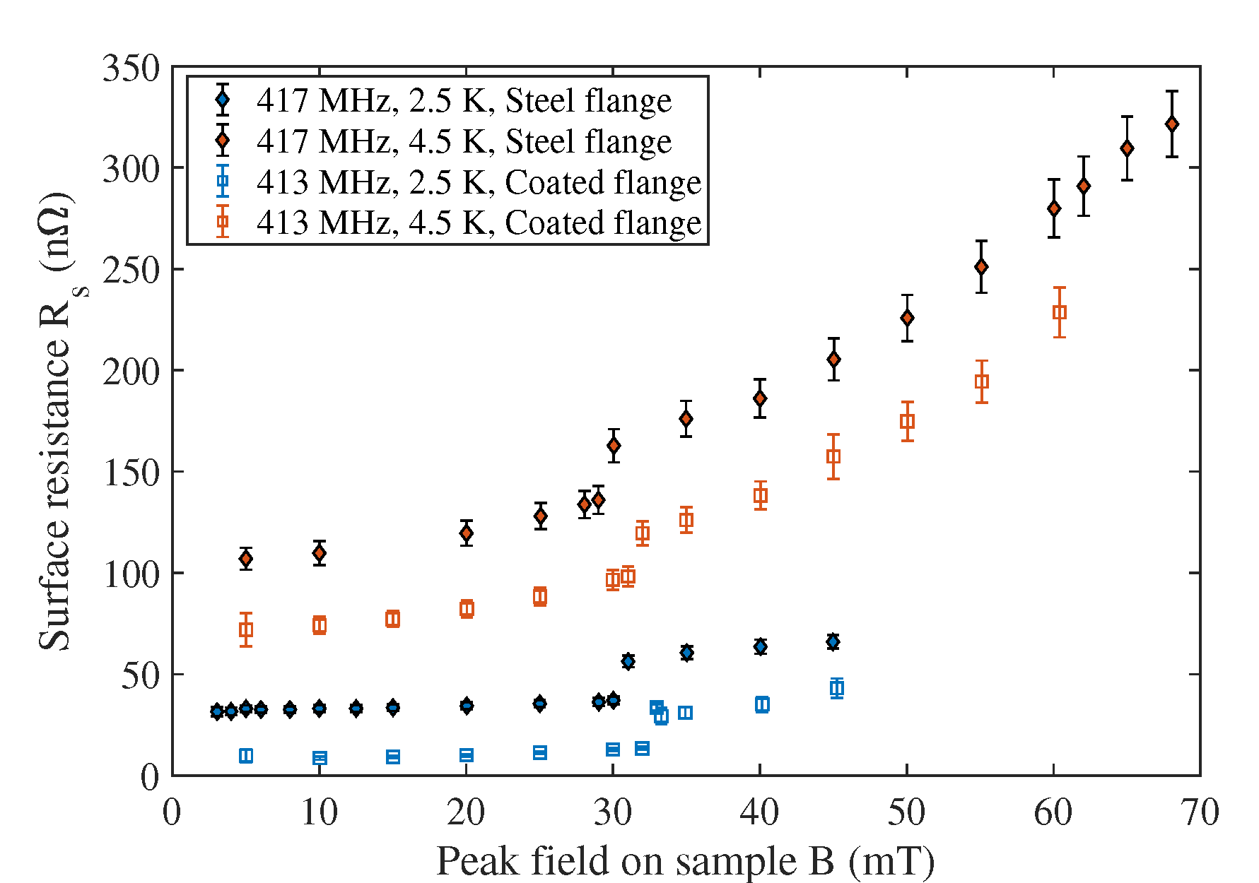
The impact
Measured ΔR = 24 nΩ
ΔR is independent of RF field and temperature → bias of R_{res} only

Slide 11
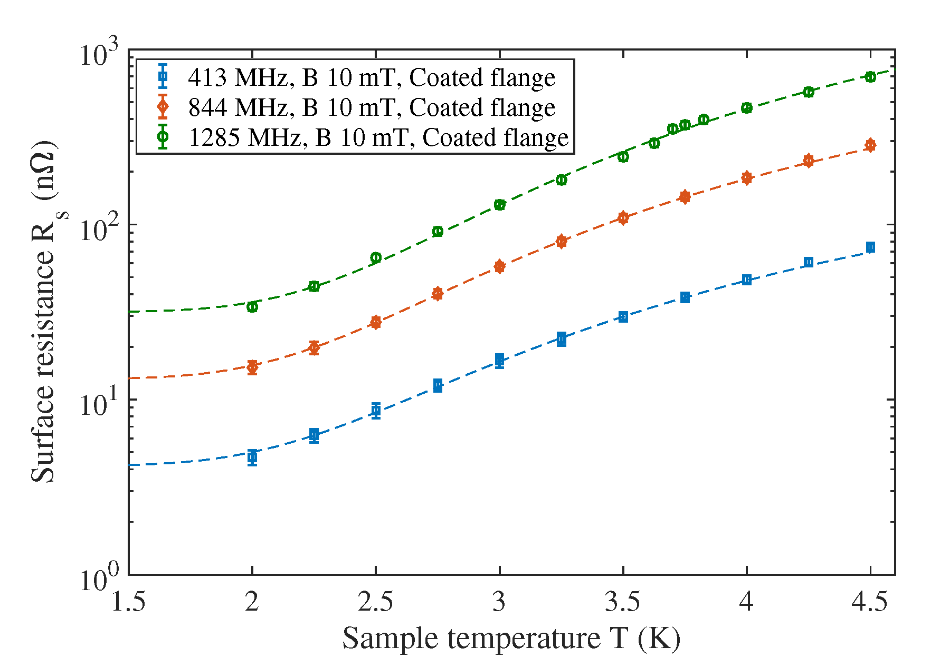
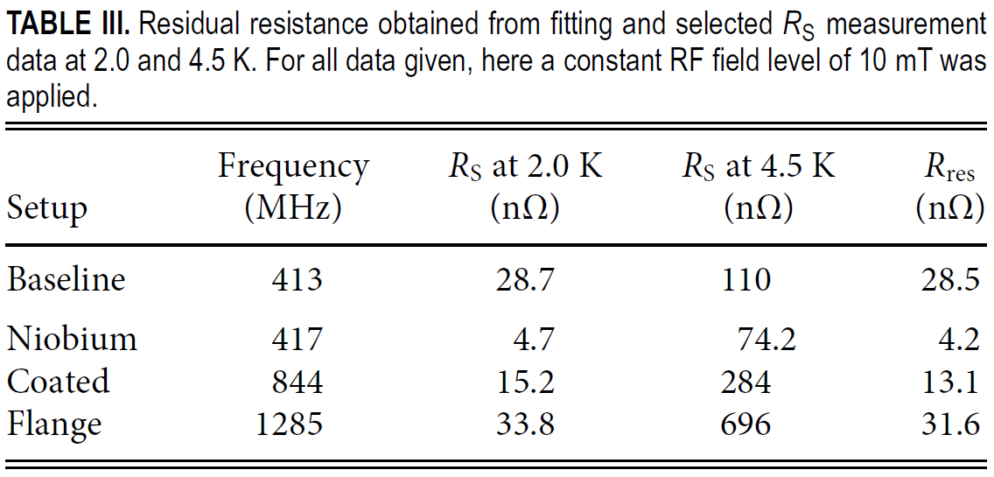
The impact
First „usable“ R_{res} at the third QPR mode (1.29 GHz)
[AIP Advances 11 125326, 2021]

Slide 12
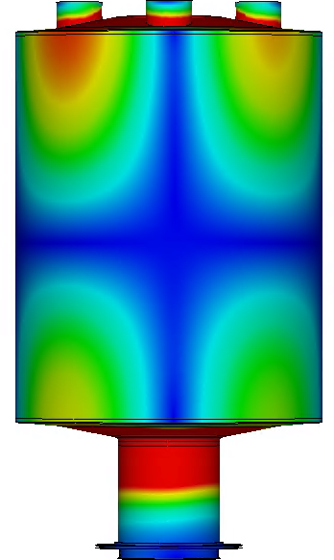
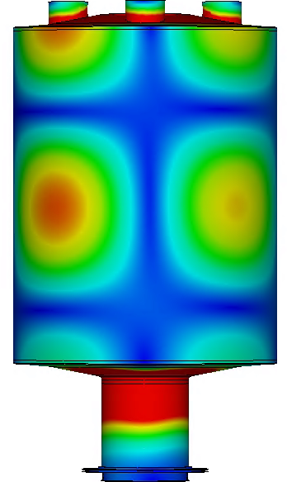
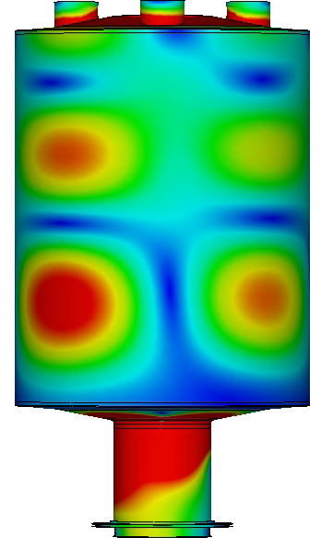
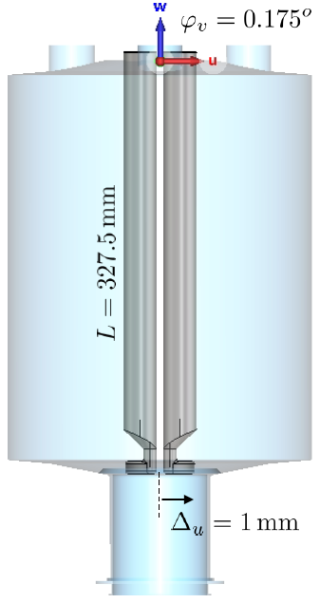



QPR: Next studies
Study the impact of geometry errors
(broken symmetry, manufacturing tolerances)
Example: tilt one pair of rods by 0.175°
→ displacement 1 mm
Q1
$$\left|\vec{H}\right|$$
Q2
$$\left|\vec{H}\right|$$
Q3
$$\left|\vec{H}\right|$$
CST eigenmode solver (color plot with linear scaling!)
Asymmetric quadrupole mode
→ increased fields in the coaxial structure
Drastic impact for Q3
[Courtesy: W. Ackermann, TEMF, TU Darmstadt]

Slide 13
SRF sample testing: Next step
QPR
RaSTA
H_{sh}
T_{c}
Local
Magnetometry
R_{S}
RRR
H_{c1}
H_{c2}
λ
µSR
VSM
PPMS
Upgrade R_{S} test capabilities

Slide 14
All-in-two devices
Quadrupole Resonator
High quality measurements (resolution, accuracy, precision)
R_{S}(T, B_{RF}, f) and R_{res}
RF quench field
Penetration depth, RRR
Long turn-around: 1 week preparation and 1+ week testing
Radiation protection (bunker, interlock)
Cleanroom environment
Complex cryo plant, shared test stand
RaSTA – Rapid Superconducting Test Apparatus
Several samples per week
R_{S}(T) and R_{res}
No radiation protection
No cleanroom
Low RF field only
Single, higher frequency only
Less resolution and accuracy
Shared test stand, LHe still required
Pre-selection of QPR samples
Enable iterative approach

Slide 15
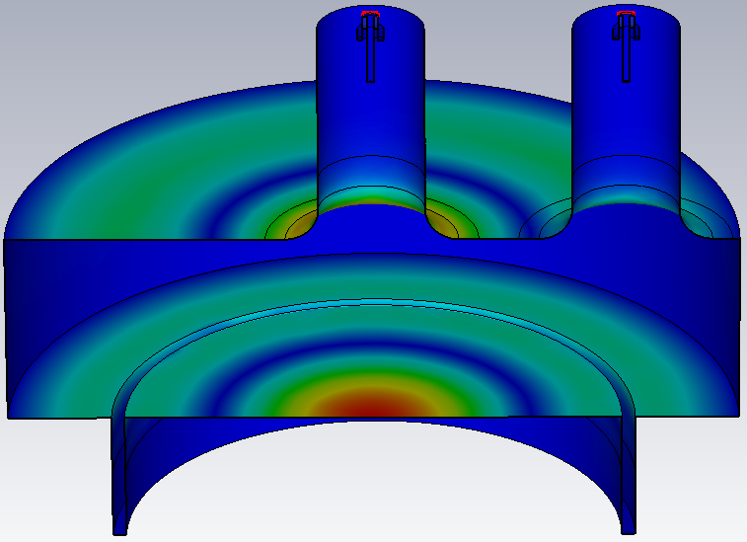
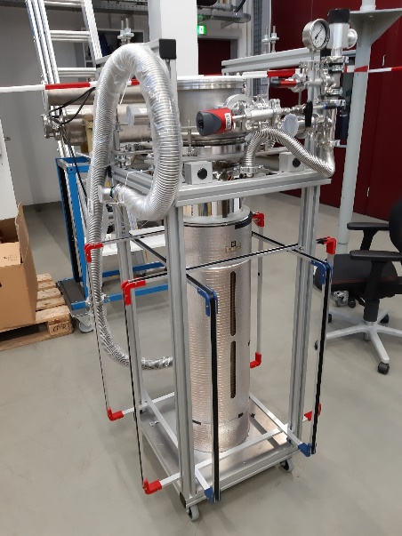
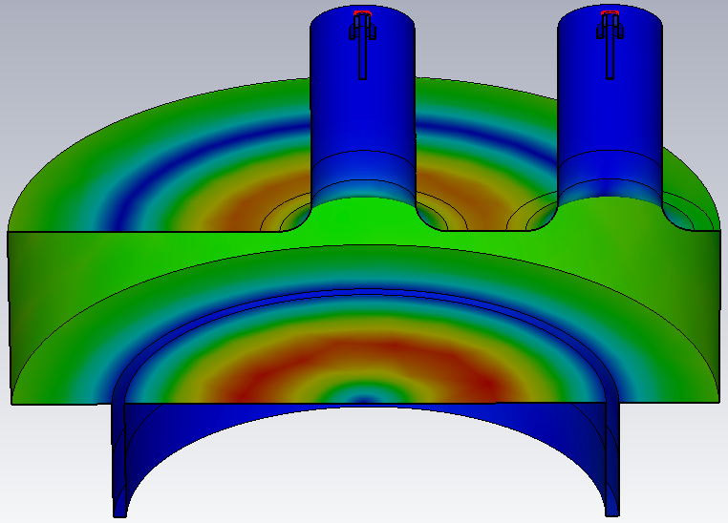
RaSTA: „faster“ testing
E
Requirements
  Use QPR samples
  Calorimetric measurement
  → Thermal decoupling
Pillbox-like design
TM₀₂₀ mode, f ≈ 4.8 GHz
Possibility to operate without radiation safety
→ Limit: 5 kV
  B_{sample} = 10 mT
  P_{sample} = 0.5 W
  P_{total} = 2 W
German patent 10 2021 123 261
H

Slide 16
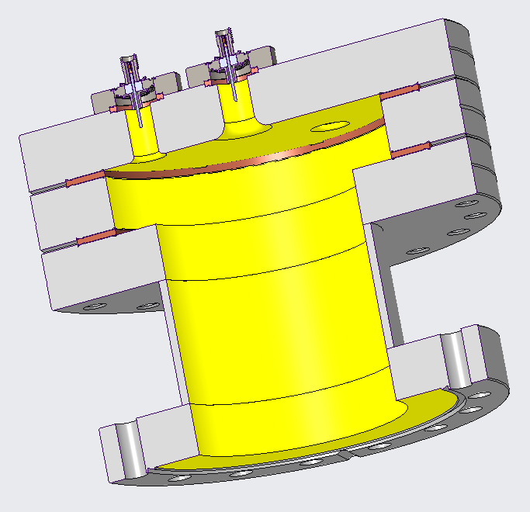
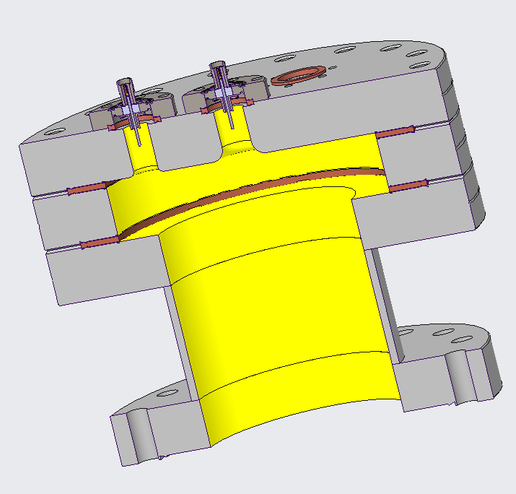
171 mm
160 mm
Yellow: Nb coating on stainless steel

Slide 17
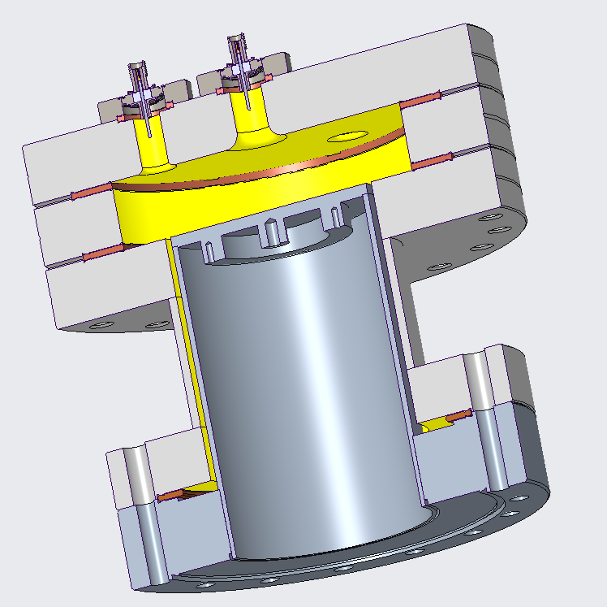
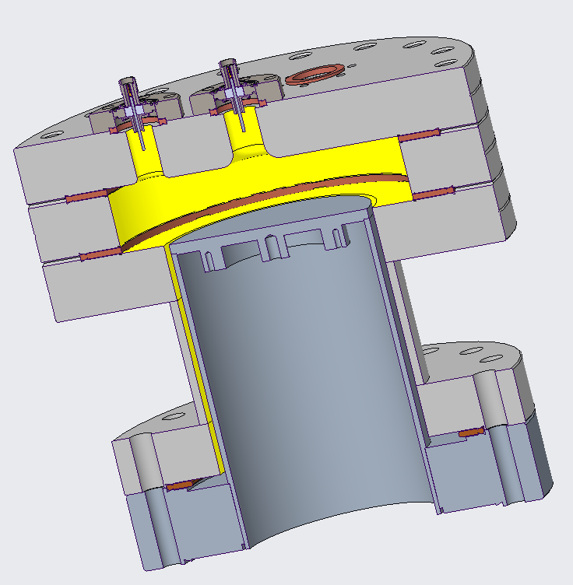
171 mm
220 mm

Slide 18
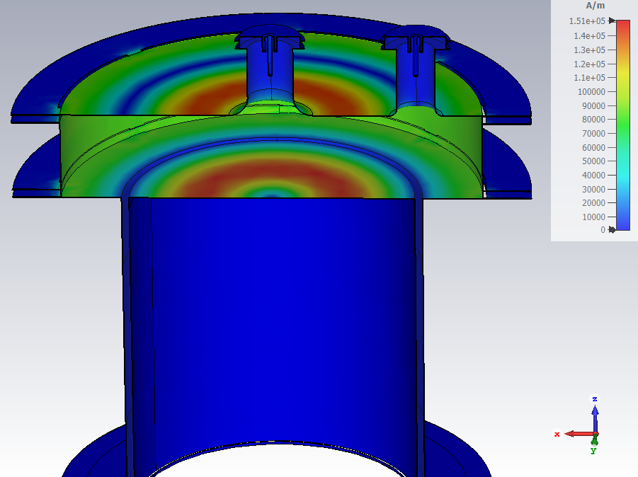
RaSTA: Challenges, questions, …
First prototype with copper gaskets
  → check RF heating
Power requirements
  Calorimetric measurement resolution
  RF field on sample
  Max. voltage and radiation safety
Multipacting?
Parasitic losses?
  Alignment and tolerances are critical
  Niobium coating required
Thin samples?
  Long-felt want for QPR
  Needs new sample holder, gasket, …

Slide 19
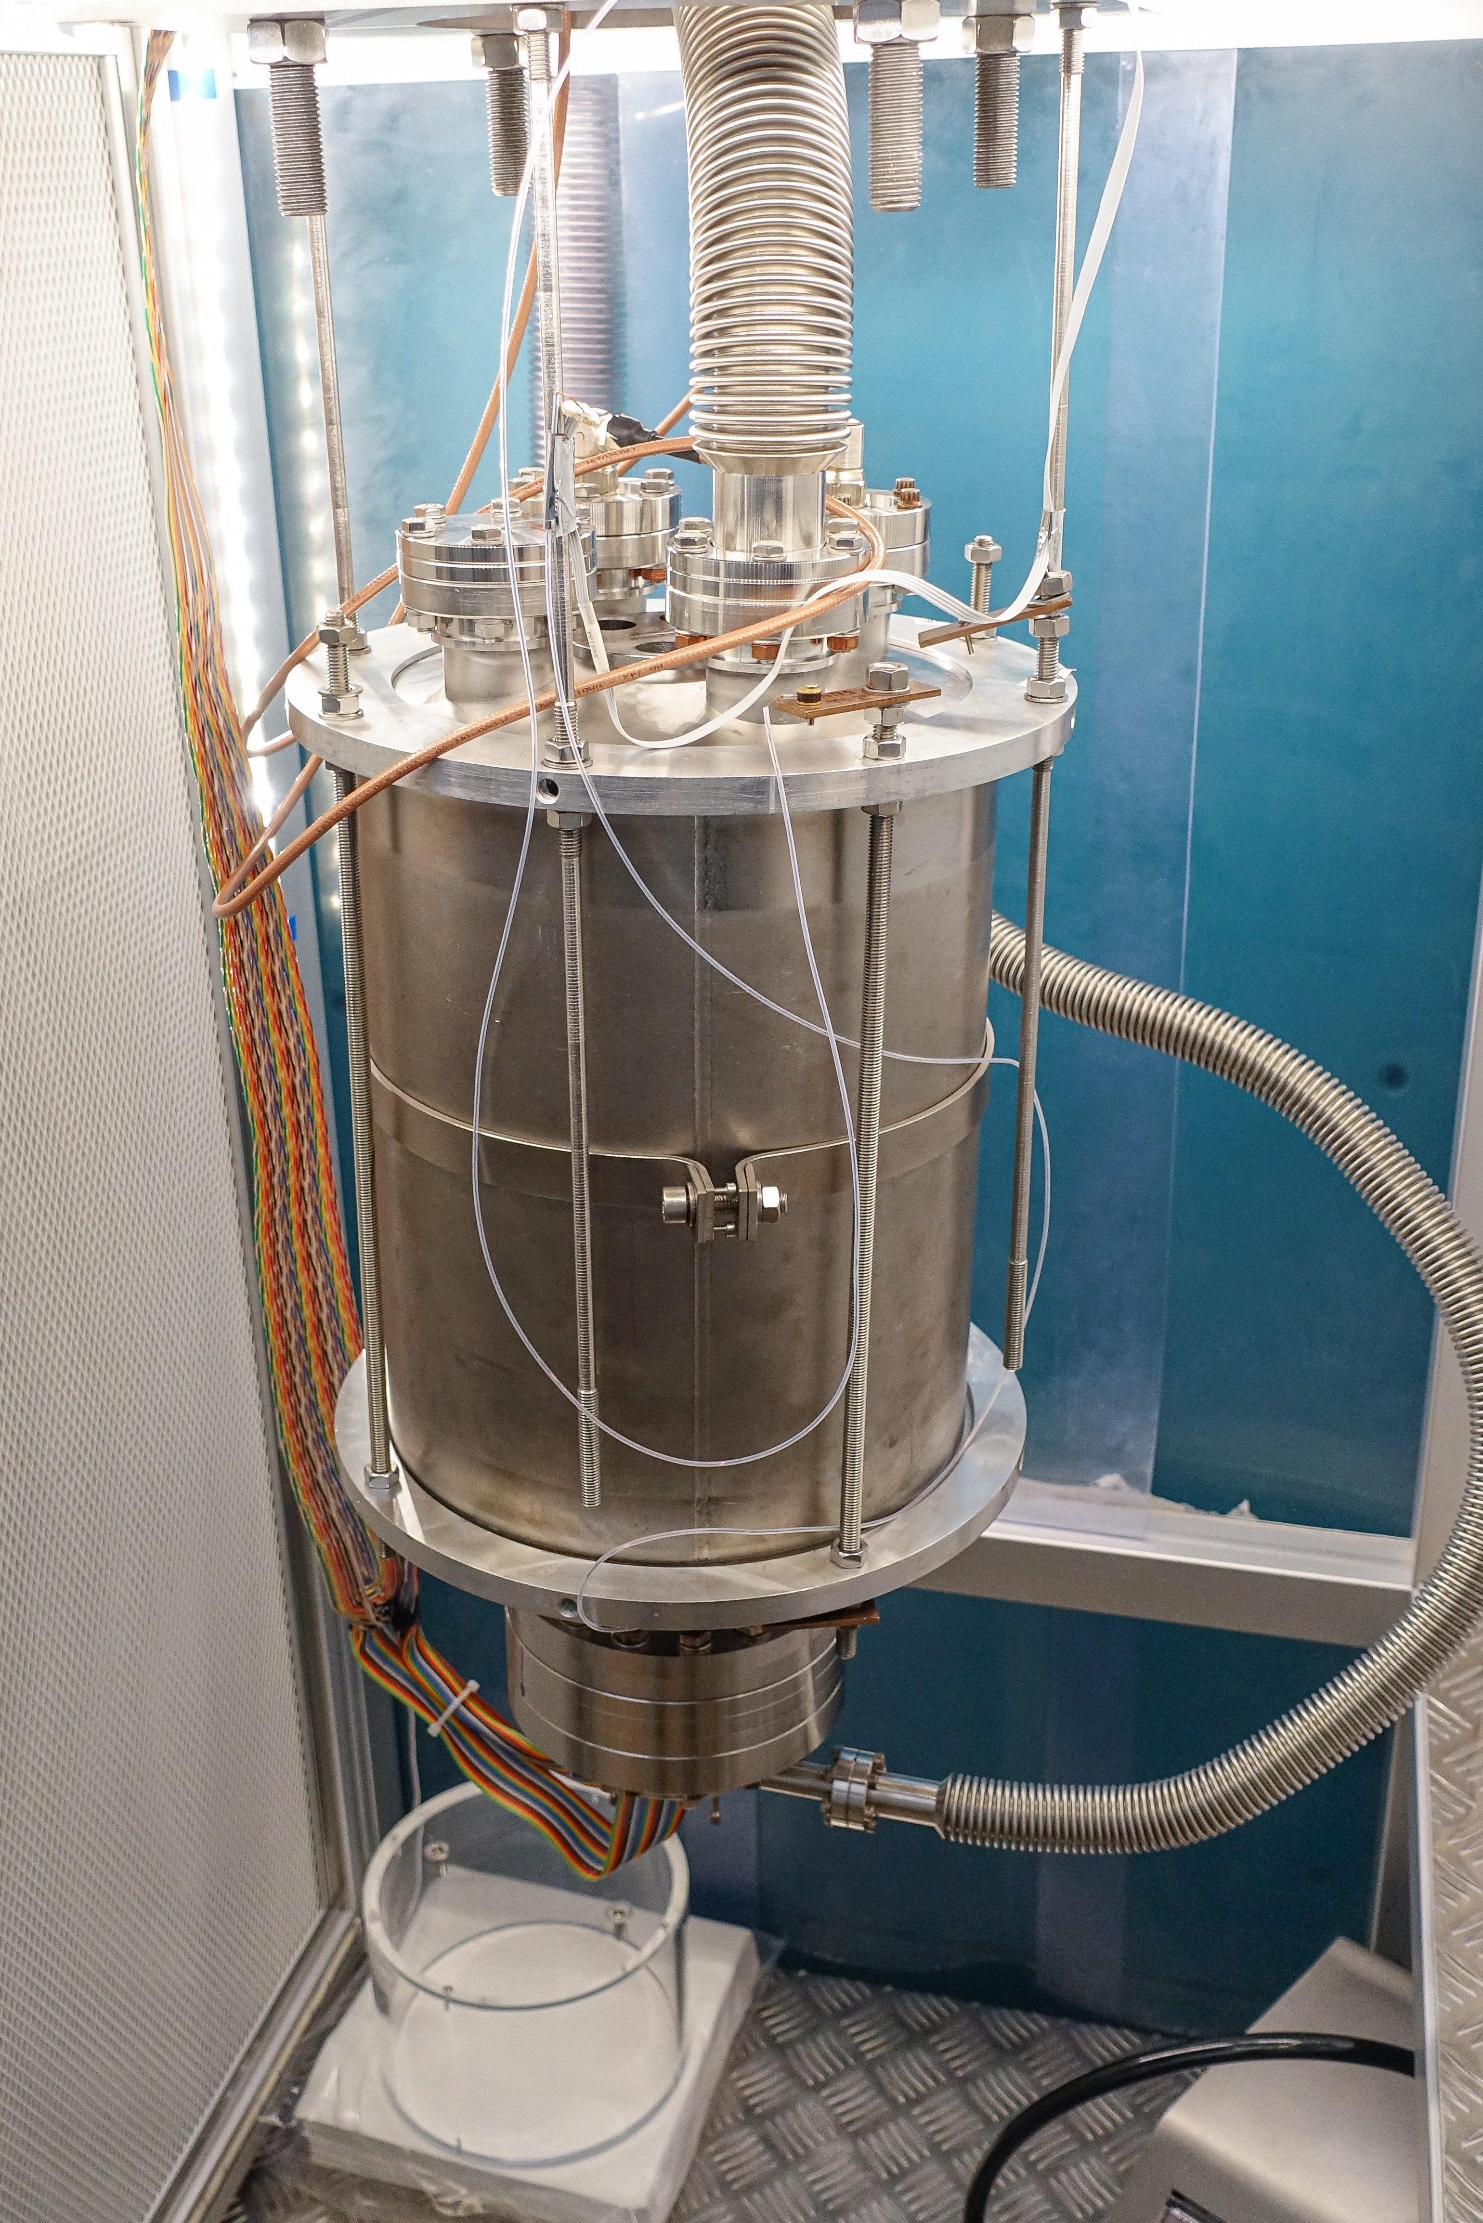
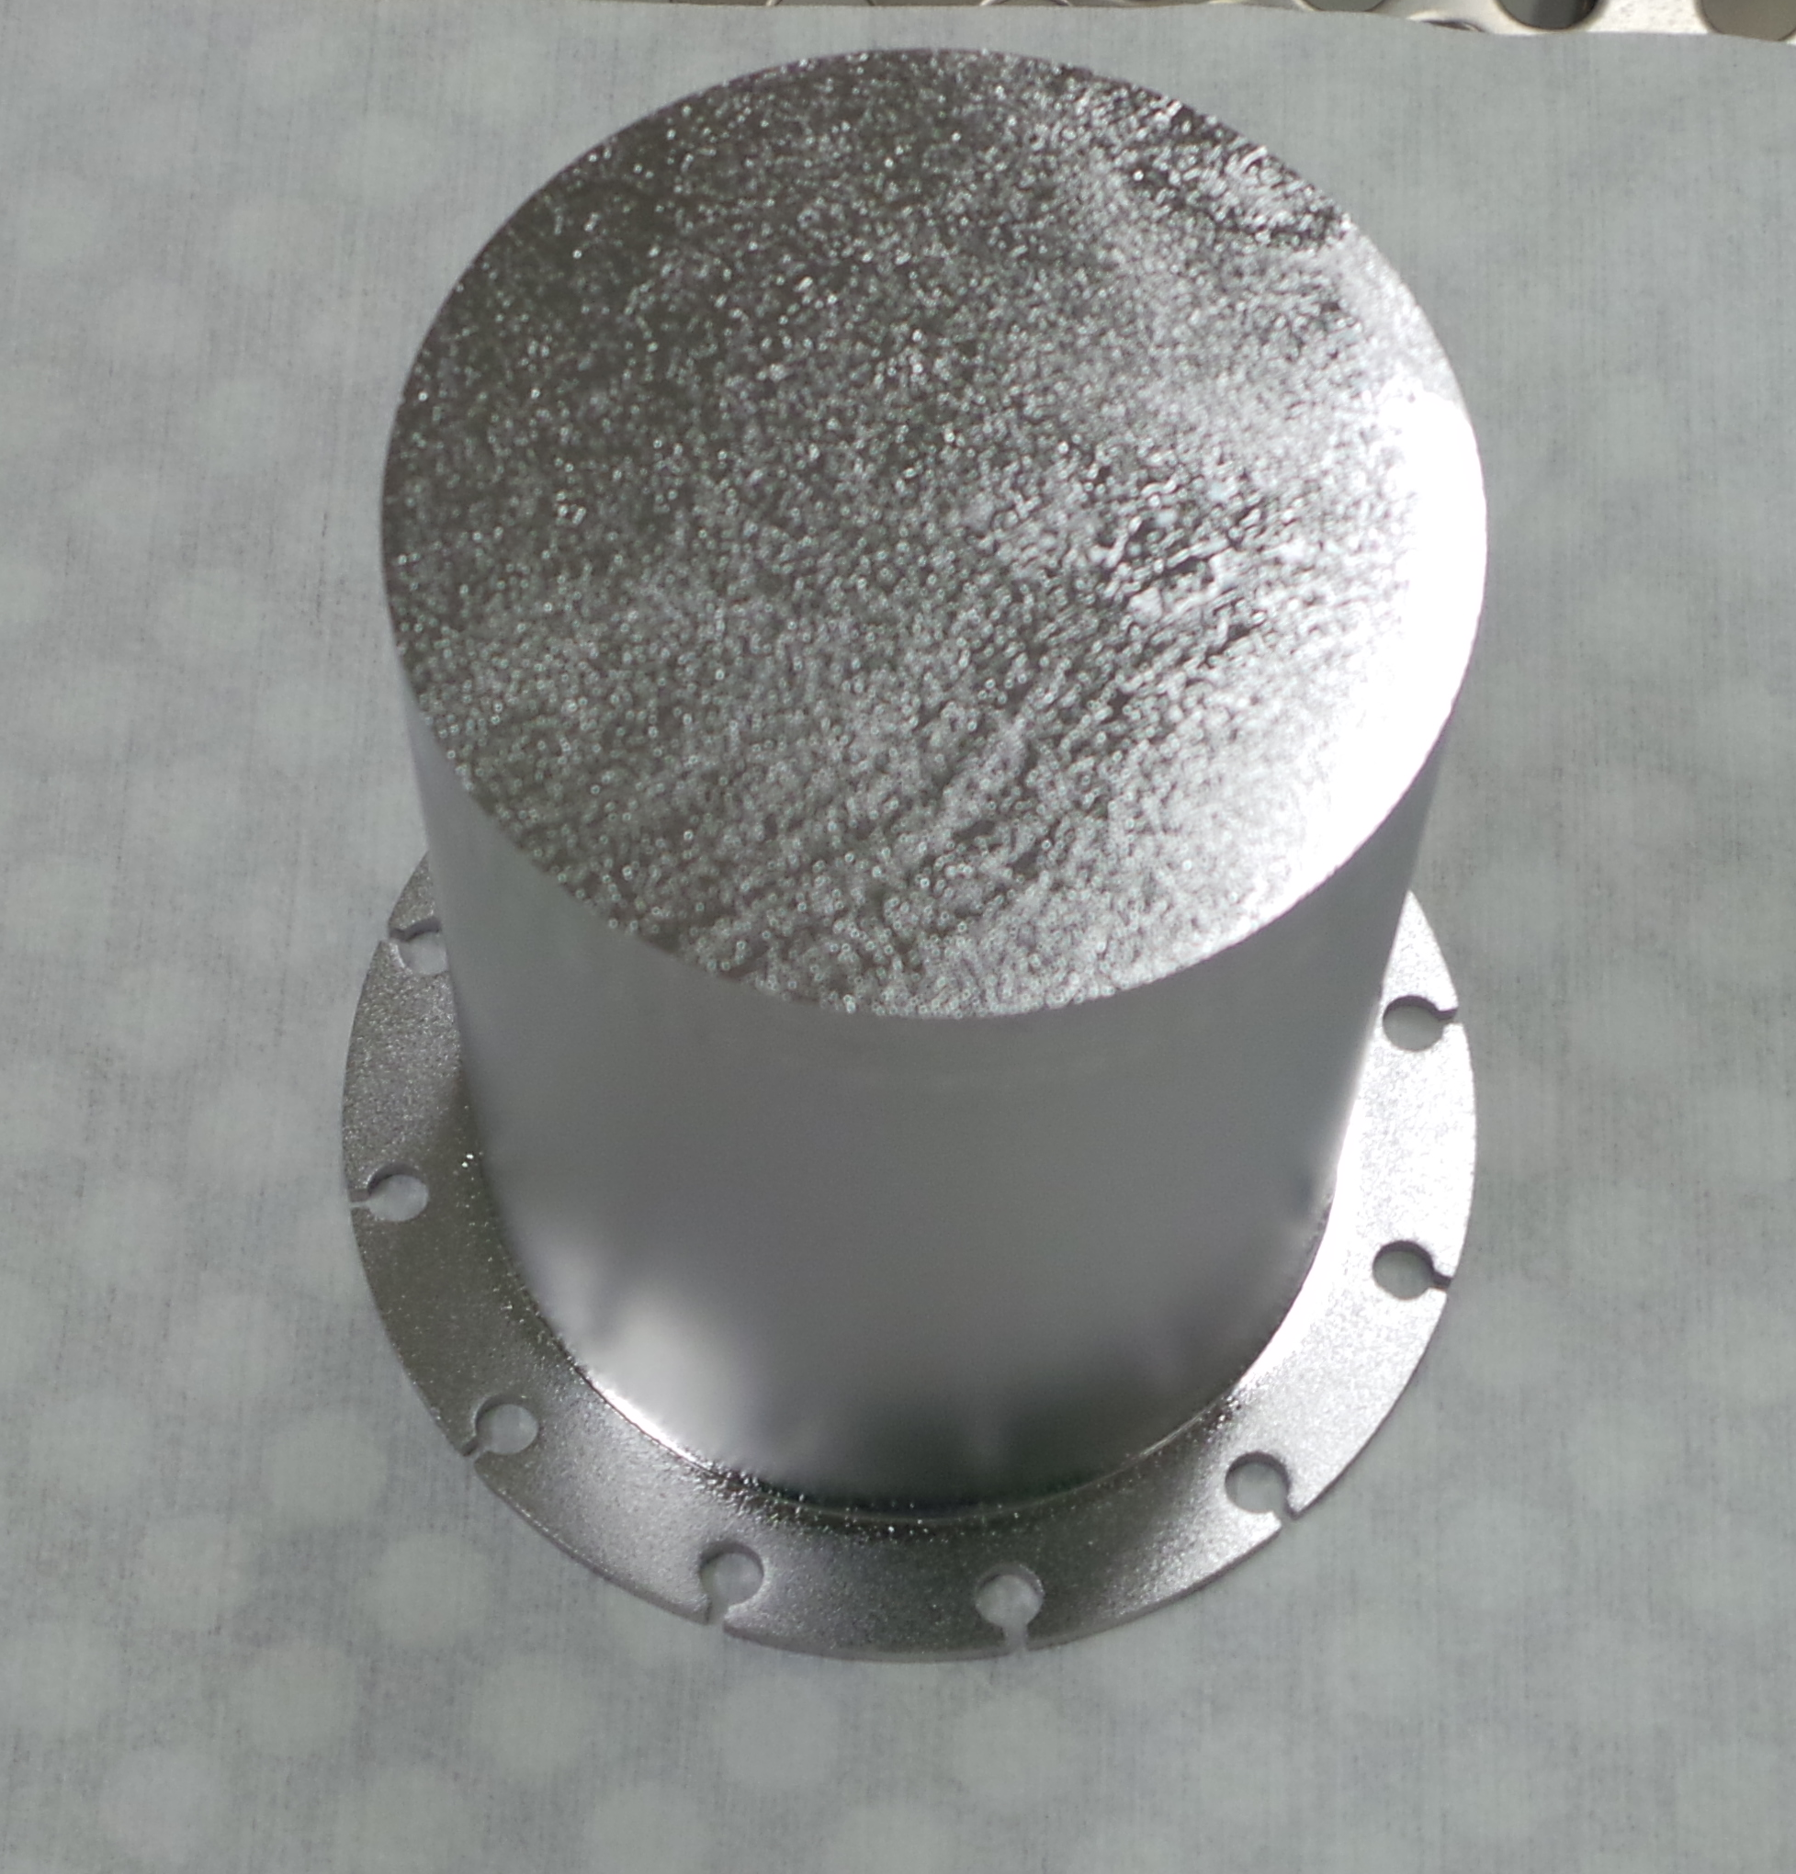
RaSTA: Next steps
All parts arrived at HZB
Manufacturing of flanges ongoing
RF baseline measurements (warm)
Nb coating of all components
→ First cold test with bulk Nb sample (crosscheck with QPR)

Slide 20
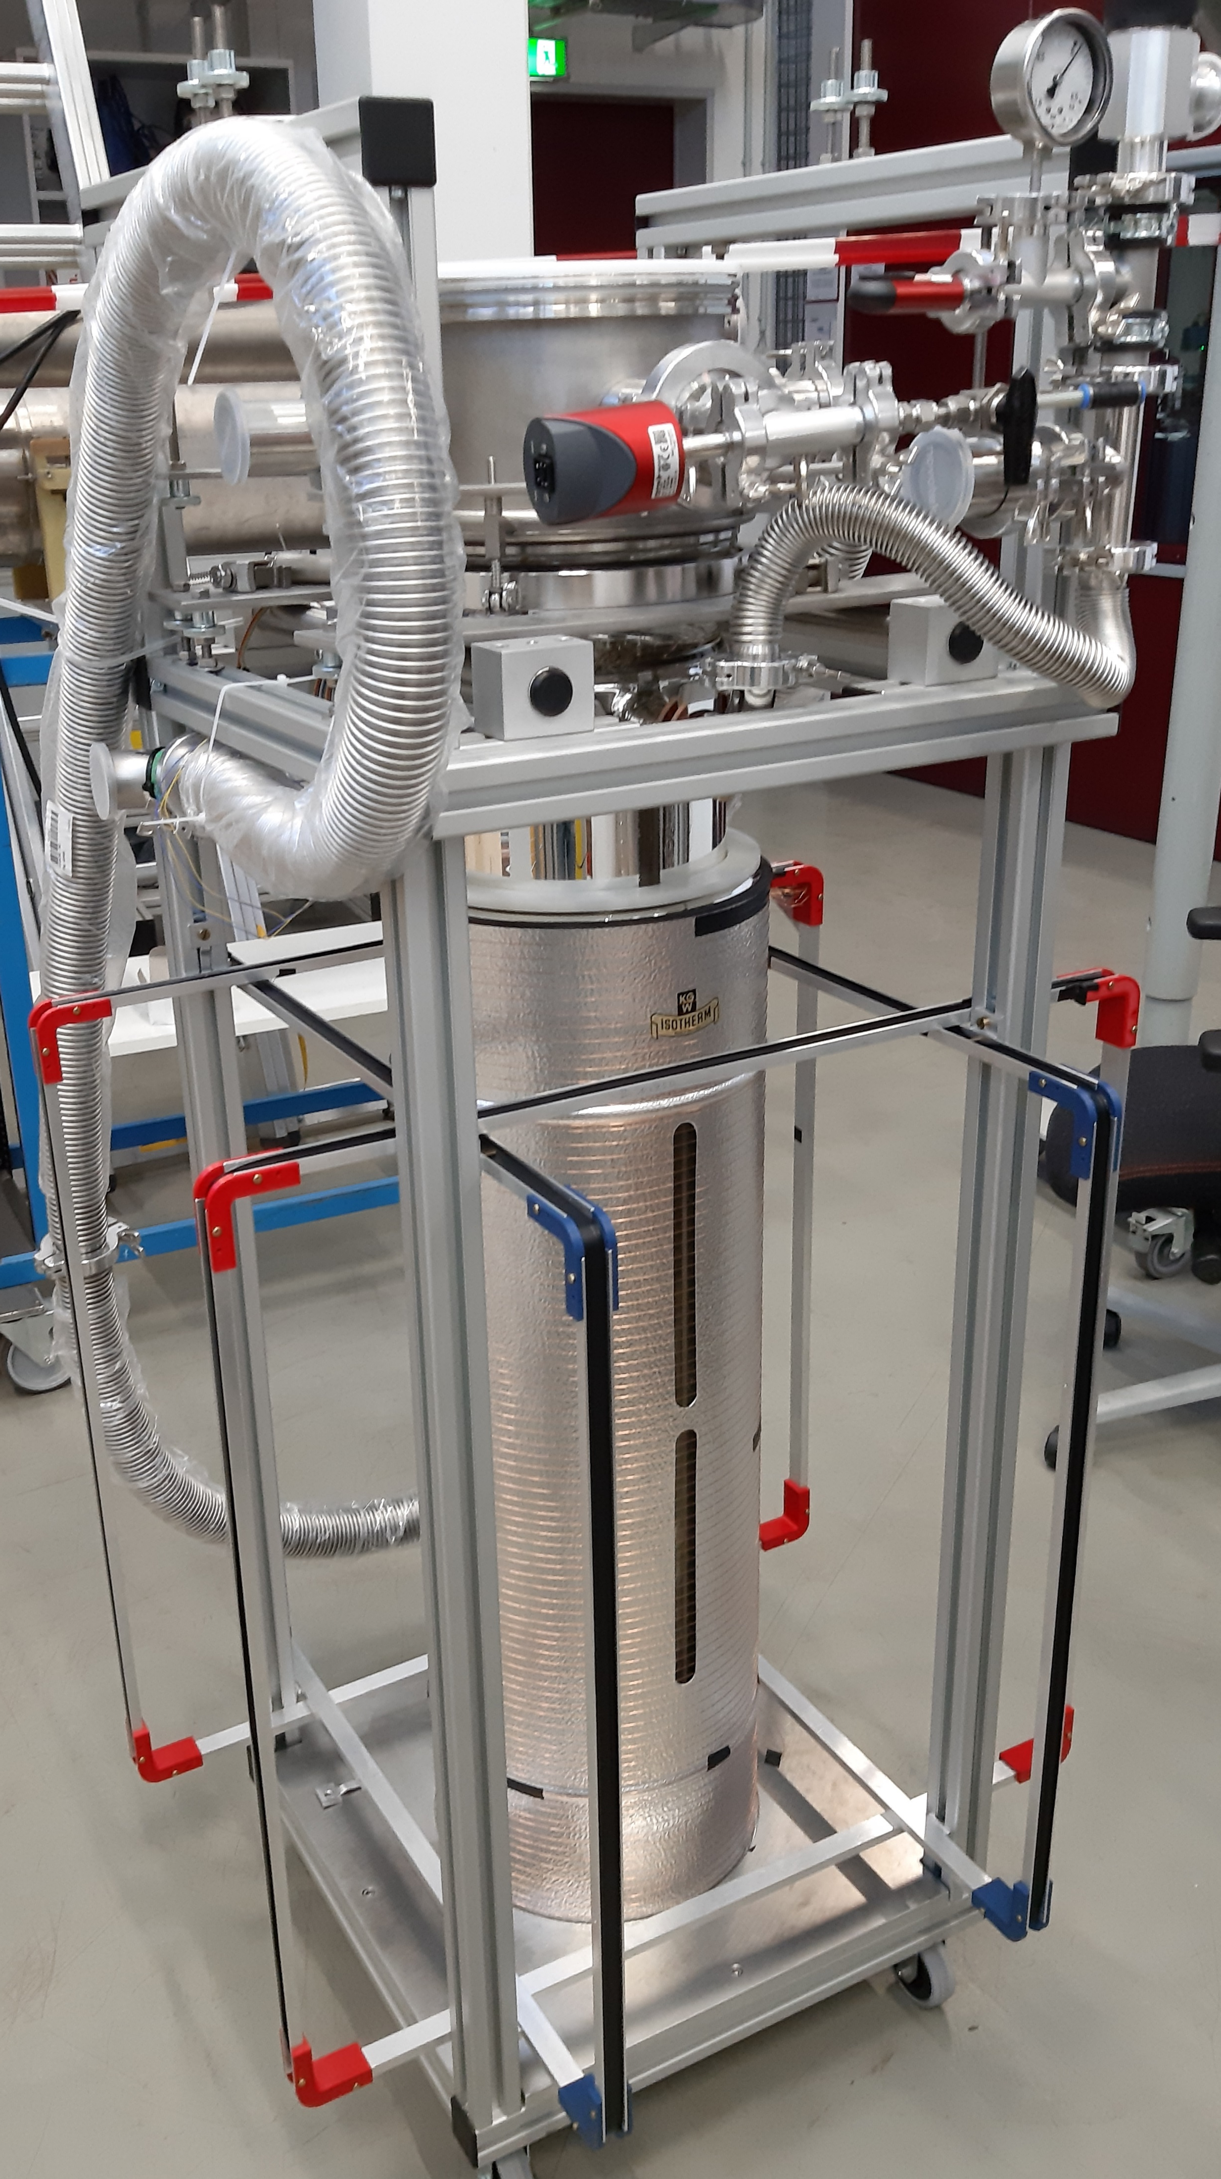
miniVTS: Cryogenic material studies
Glass cryostat, very flexible, easitly adapted
  No radiation protection → low power RF only
Fully manual operation
  LHe and/or N2 from dewars
  Turnaround time few hours
  Slow/fast cooldown/warmup, parking
No magnetic shield, active 3D-Helmholtz coils
Recent examples
  Cryogenic sensor tests (B.Sc.)
  GMR, carbon resistors
  Trapped flux in sc samples (Ph.D)
  B- and T-mapping
→ non-RF R&D on samples

Slide 21
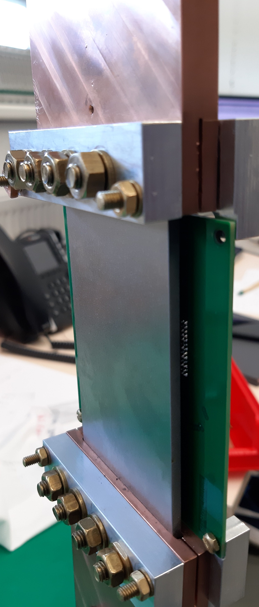



miniVTS – trapped flux in samples
[F. Kramer, TUPOTK006, IPAC’22]
$$\frac{dT}{dx}$$
Cu
Sample:
100 x 60 x 3 mm³
8 Cernox sensors for T-mapping
and active heater control
3 heaters
(top, bottom, LHe)
PCB with
5x3x3
AMR sensors
Nb
$$\frac{dT}{dx}$$
Cu
1 data point = 1 T_{C} cycle
→ ~100 cycles/day
→ Ongoing work: Nb thin film samples
$$\frac{dT}{dt}$$

Slide 22
Summary and Outlook
QPR is ready for measuring low R_{res}
  Nb-coated flange is new standard
  Demountable design for interchangeability
RaSTA is under construction
  Commissioning starts in few months
  Test of QPR-shape samples
miniVTS magnetometry is running
  Characterization of coated samples just started
2 Ph.D positions open soon
  NOVALIS project for SIS structures
  QPR measurements
  B- and T-mapping

Slide 23
TTC working group „Thin Films“ or „Non-bulk Nb as RF surface“
Online meetings, one topic per meeting
Open discussions, exchange of knowledge, ideas, problems, …
Chairs
  Marc Wenskat , Sebastian Keckert
Indico webpage: https://indico.cern.ch/category/6583/
Mailing list: ttc-wg-thinfilms@listserv.dfn.de
  To subscribe send „Subscribe ttc-wg-thinfilms NAME“ to sympa@listserv.dfn.de
Next meeting not yet scheduled
→ possibility to continue discussions of this workshop
Thank you for your attention !

Slide 25
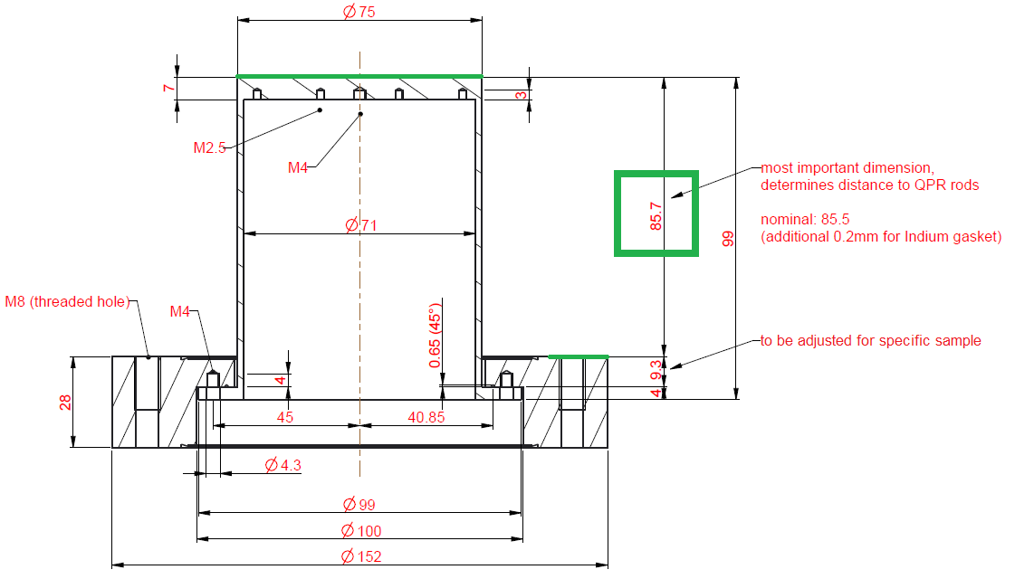
QPR sample interface definition
RF sample surface
‚naked‘ (dismountable) sample or
assembly with DN100CF flange (double sided)
Final height: 85.5 mm
Attention:
CERN QPR differs by 3.5 mm in height !

