Slide 1



Nb₃Sn coating of a 2.6 GHz Nb SRF cavity using a Cylindrical Magnetron Sputtering System
Sharifuzzaman Shakel, Nizam Sayeed, Hani E. Elsayed-Ali (Old Dominion University)
Grigory V. Eremeev (Fermilab)
Anne-Marie Valente-Feliciano, Uttar Pudasaini (JLab)
Frank Batten College of
Engineering & Technology
Old Dominion University

Slide 2
Outline
Design, Commissioning and Initial operation of Cylindrical Magnetron Sputtering System
Optimizing conditions for Nb₃Sn fabrication using Multilayer Sequential Sputtering Method
Properties Nb₃Sn films developed on flat Nb and Sapphire substrates
Nb₃Sn coating inside of a 2.6 GHz Nb SRF cavity : Analyzing coated cavity performance
Optimizing cavity coating conditions
Frank Batten College of
Engineering & Technology
Old Dominion University

Slide 3
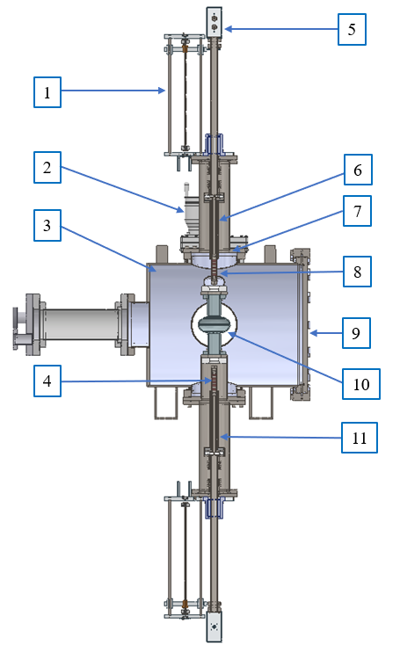
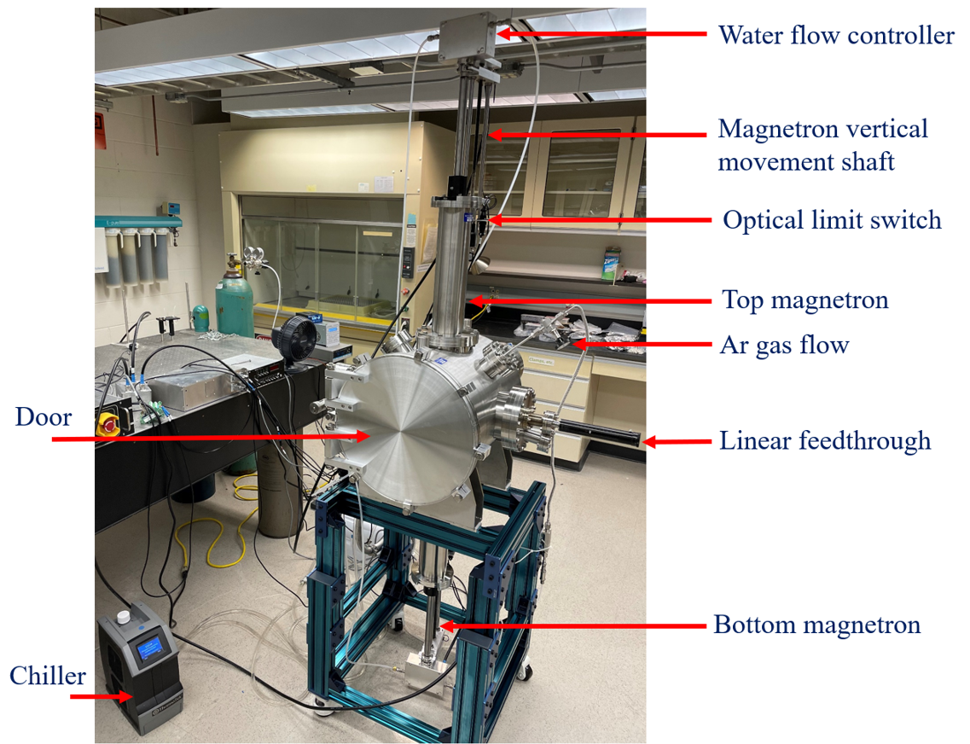
Design of Cylindrical Magnetron Sputtering System
Magnetron movement controller shaft
Gate valve
Vacuum chamber
Cylindrical magnets
Water flow controller
Top magnetron
8’’ ConFlat (CF) port
Tube target
Chamber door
2.6 GHz Nb SRF cavity
Bottom magnetron
Cross section sketch of Cylindrical Magnetron Sputtering System
09/20/2022 | Shakel

Slide 4
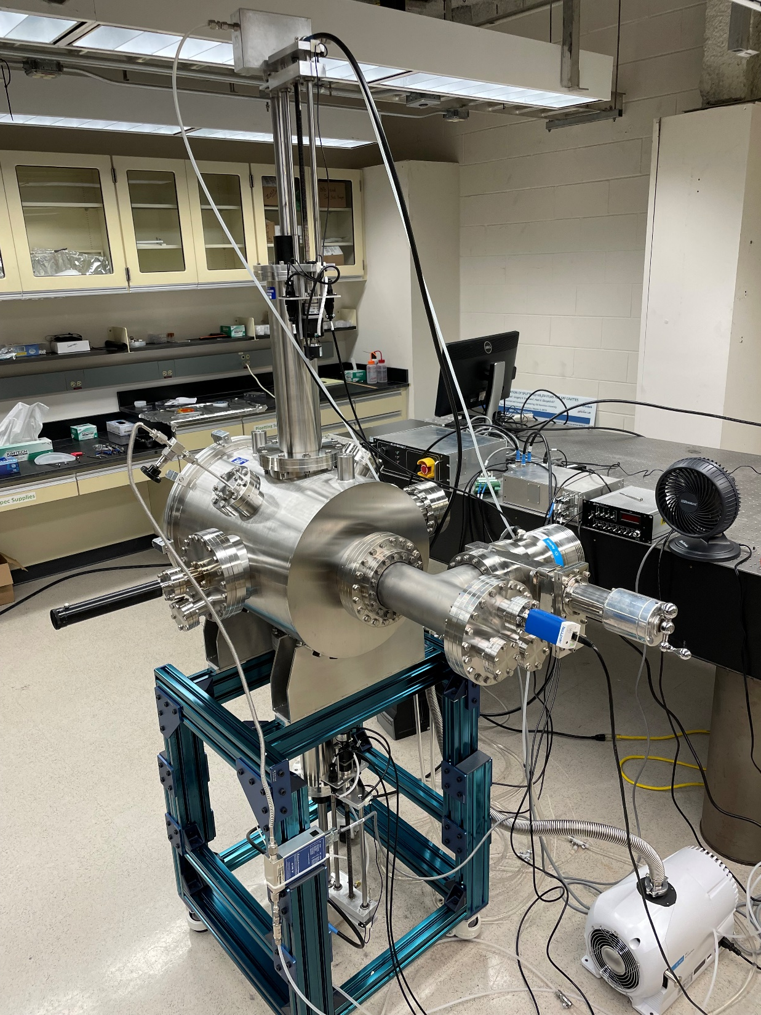
Features of Cylindrical Magnetron Sputtering System
Motor controller
Cooling water flow rate: 0.9 L/min
Maximum travel distance by each magnetron: ~280 mm
Maximum magnetron travel speed: 1.3 mm/s
Baseline pressure: 4 x 10⁻⁸ Torr
Typical deposition pressure: 3-10 mTorr
Ar gas flow: 50 SCCM
Available DC power in: 1 kW
Communication controller
Gas flow controller
Turbo pump
Gate valve
Pressure gauge
4
09/20/2022 | Shakel

Slide 5
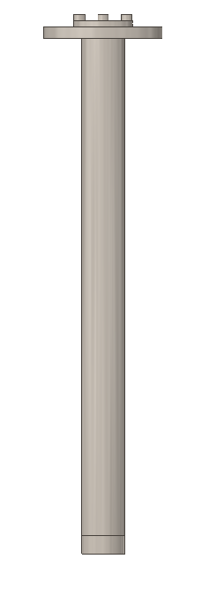
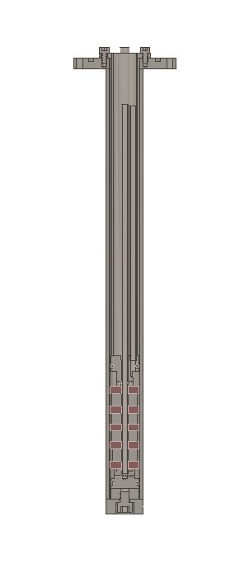
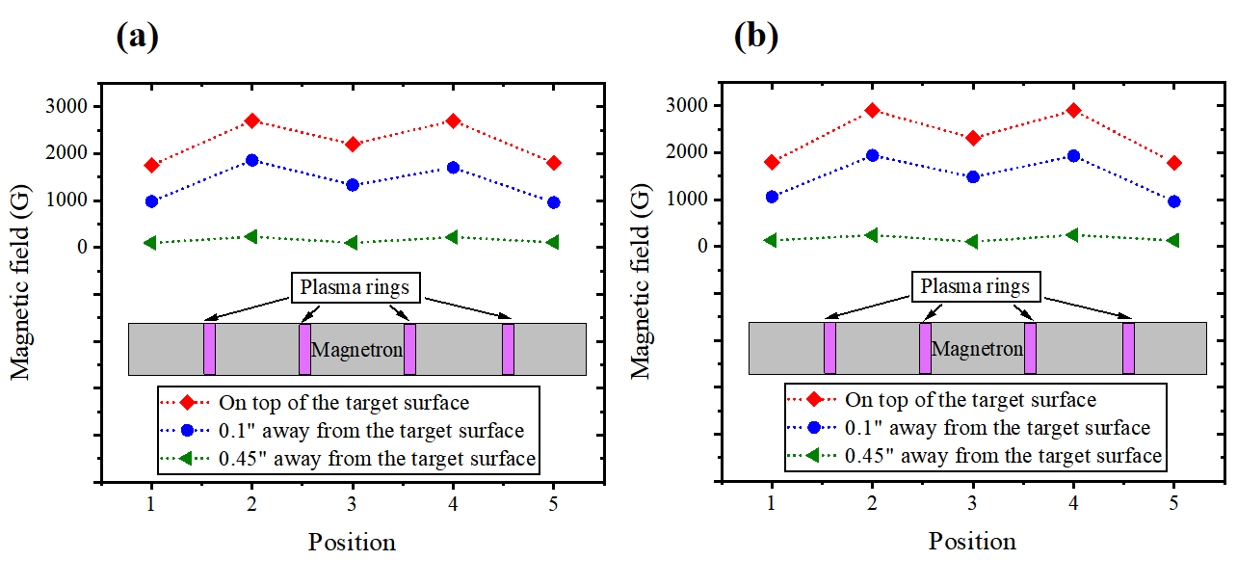
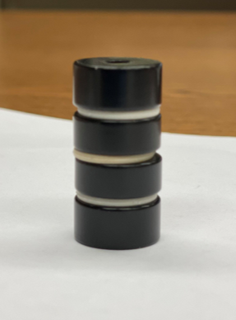
Magnetic Field Distribution
Top magnetron
Bottom magnetron
Spacer
Magnetic field distribution vs Distance
Magnet
Neodymium magnets
(N55 grade)
Cylindrical magnetron
5
09/20/2022 | Shakel

Slide 6
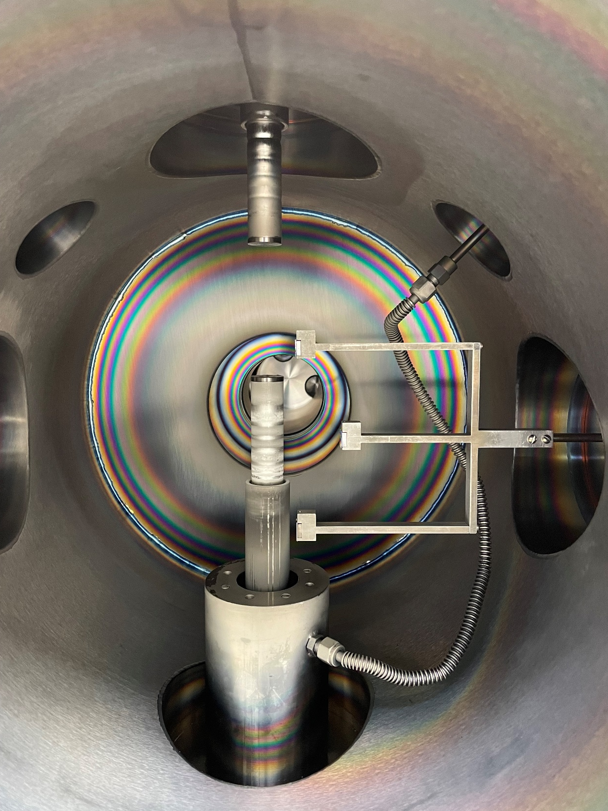
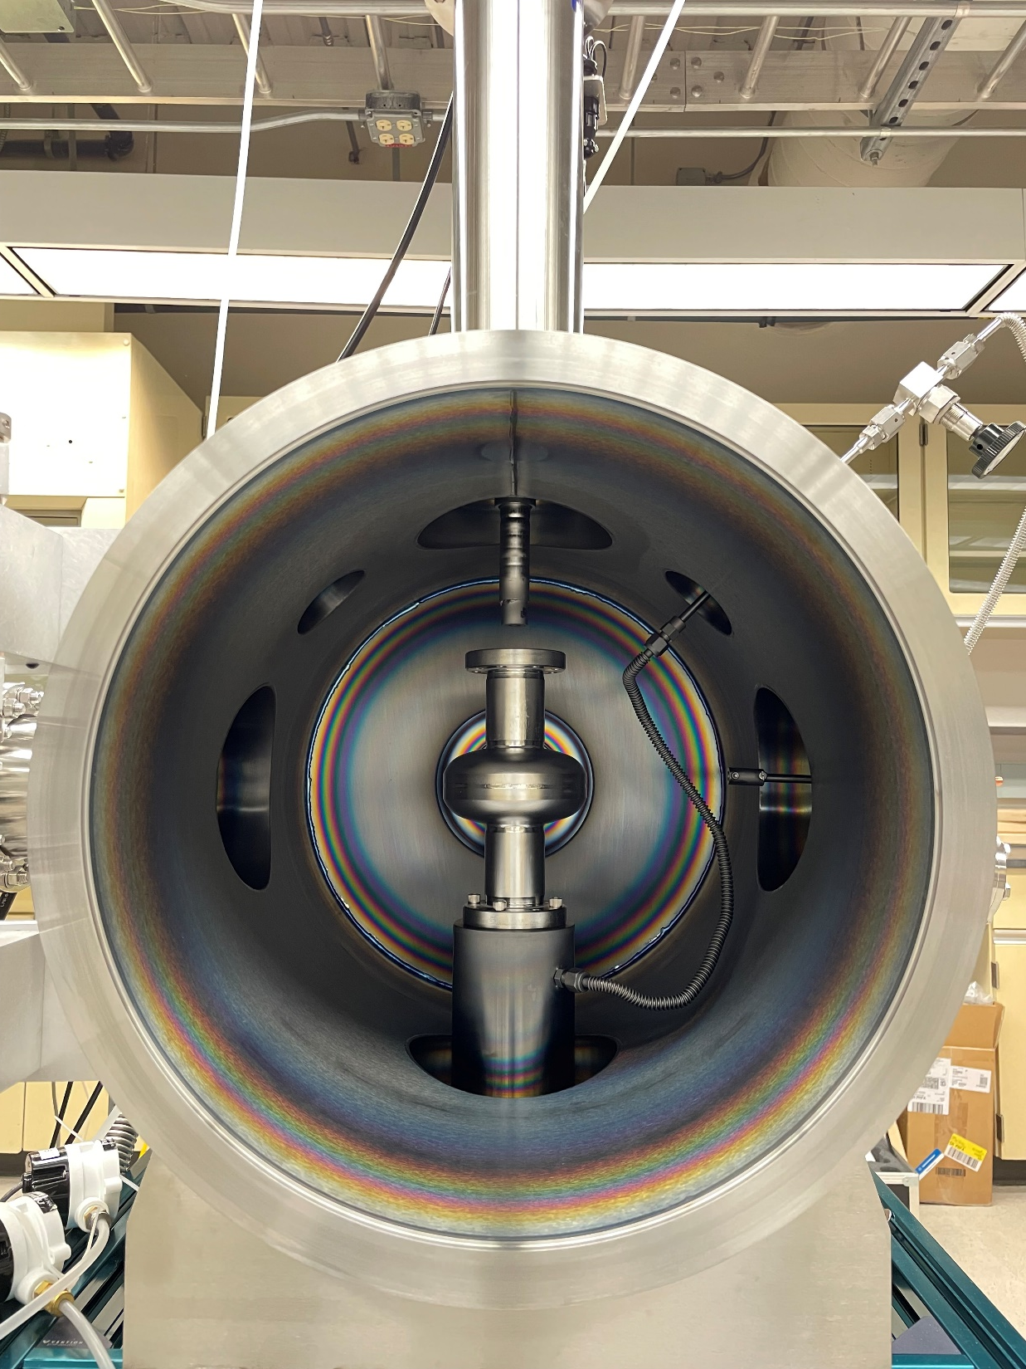
Nb tube
target
Top beam tube
Equator
Sn tube
target
Bottom beam tube
2.6 GHz Nb SRF cavity placed on
the chamber
Mocking the beam tubes and equator positions of the cavity with Nb substrates
6
09/20/2022 | Shakel

Slide 7
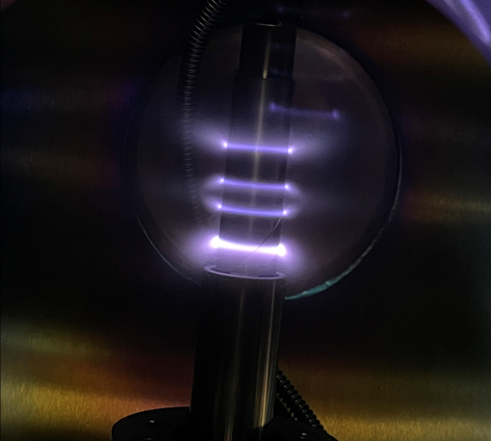
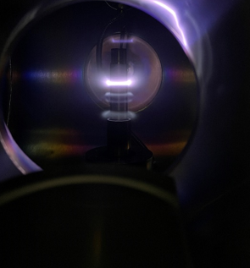
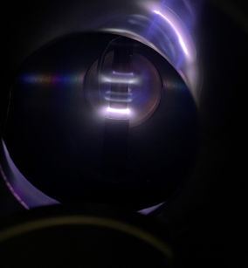
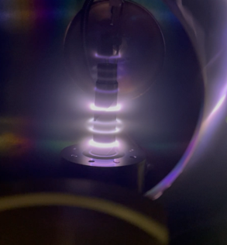
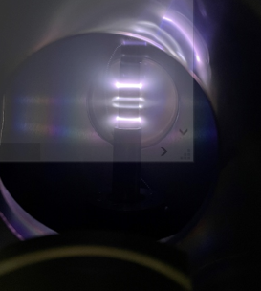
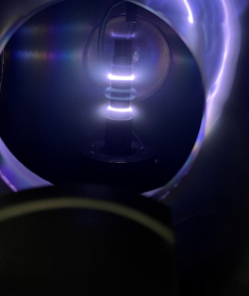
Power Calibration for Nb deposition
Different DC power used for discharging
50 SCCM Ar gas flow and 10 mTorr pressure used
2 W
8 W
12 W
(a)
(b)
(c)
Minimum 18 W DC power (or higher) needs to be applied for ~8/10 minutes to get symmetric plasma formation
Once symmetric plasma formation appears, it sustains even power is reduced.
18 W
15 W
12 W
(d)
(e)
(f)
7
09/20/2022 | Shakel

Slide 8
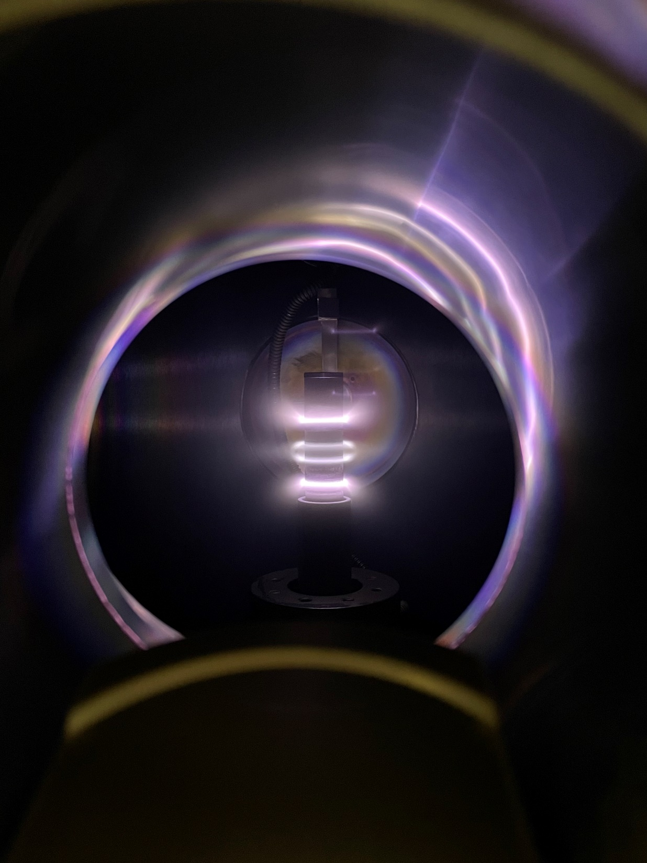
Power Calibration for Sn deposition
Stable and Symmetric plasma formation at 8 W DC power (21 mA)
Calibrated the power to prevent Sn target from melting
09/20/2022 | Shakel

Slide 9
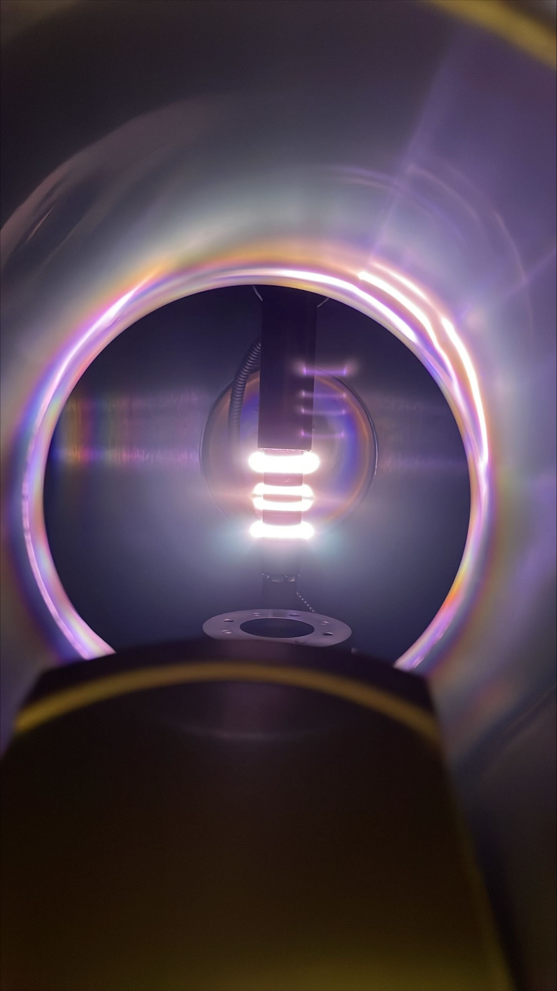
Nb layer deposition
Nb tube target discharged
0.9’’ OD x 0.8’’ ID x 4.5’’, 99.99% pure
DC power used : 30 W
Current: 101— 106 mA
Nb target completes
2 passes across the cavity length, moving speed 1 mm/s
~50 nm thick coating on equator position
Nb deposition using top magnetron
10 mTorr Ar pressure, 50 sccm flow
09/20/2022 | Shakel

Slide 10
Sn layer deposition
Sn tube target is discharged
0.9’’ OD x 0.8’’ ID x 4.5’’, 99.99% pure
DC power used : 8 W
Current: 22 — 23 mA
Sn target travels one time across cavity length. Moving speed 0.75 mm/s
Sn deposition using bottom magnetron
10 mTorr Ar pressure, 50 sccm flow
~25 nm thick Sn deposited on equator position
09/20/2022 | Shakel

Slide 11
Nb₃Sn fabrication by Multilayer Sequential Sputtering method
 | Top beam tube | Equator | Bottom beam tube
Nb | 36 nm | 50 nm | 33 nm
Sn | 19 nm | 25 nm | 18.5 nm
Ratio | 1.89 | 2 | 1.78
50 nm Nb
25 nm Sn
50 nm Nb
25 nm Sn
Nb and Sn each layer thickness
(16 layers of each)
50 nm Nb
25 nm Sn
200 nm Nb
Top Beam tube | Equator | Bottom beam tube
880 nm | 1200 nm | 824 nm
Nb substrate
Total Film Thickness
09/20/2022 | Shakel

Slide 12
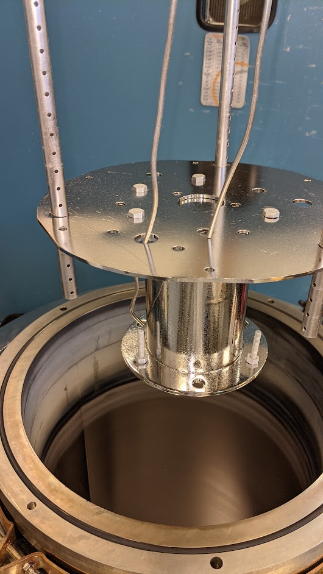
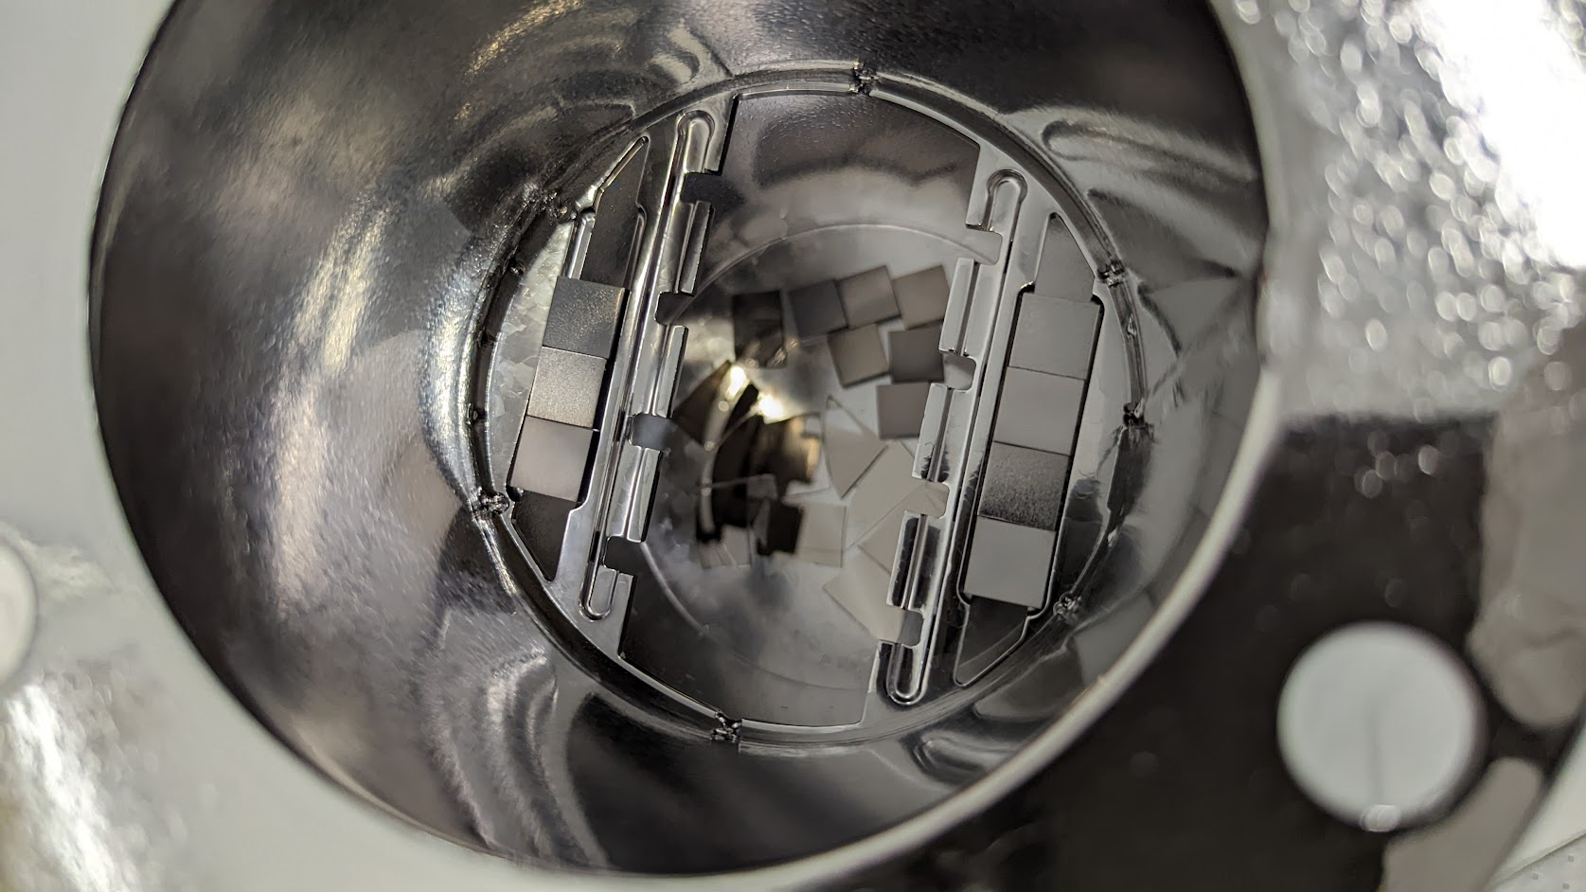
Annealing of the Nb₃Sn samples
Films are annealed at 950⁰ C for 3 hours in separate furnace
Temperature was ramped at 6⁰ C/min to reach the annealing temperature from the room temperature.
12
09/20/2022 | Shakel

Slide 13
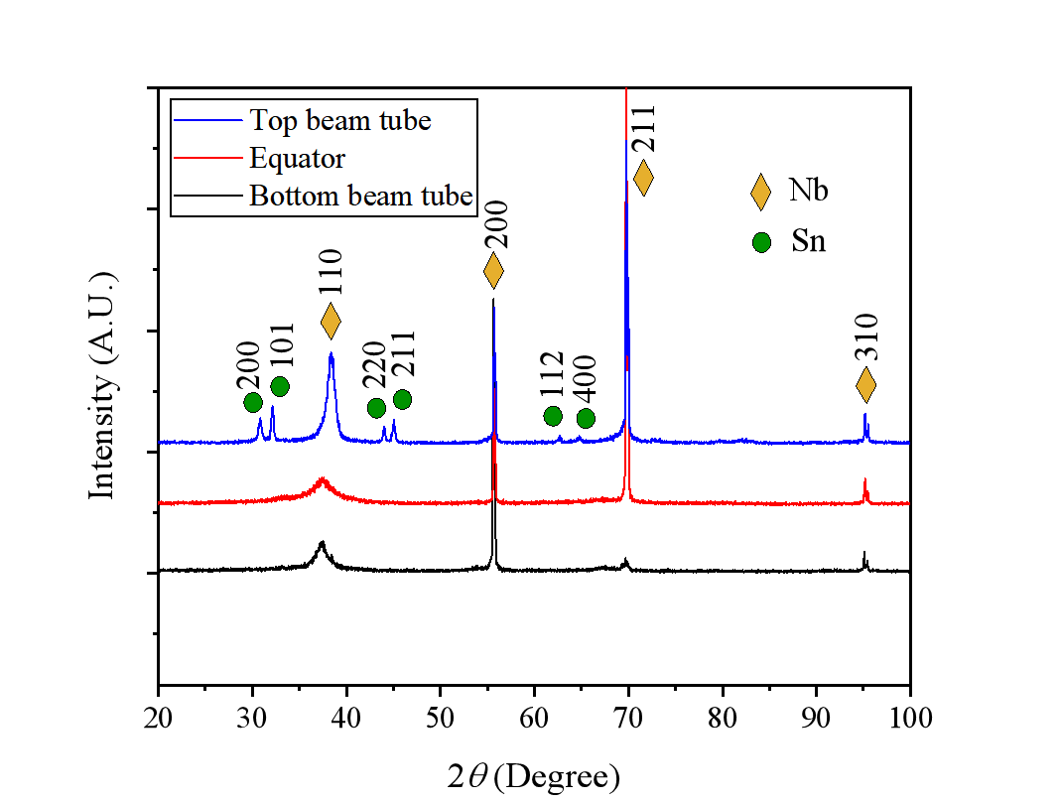
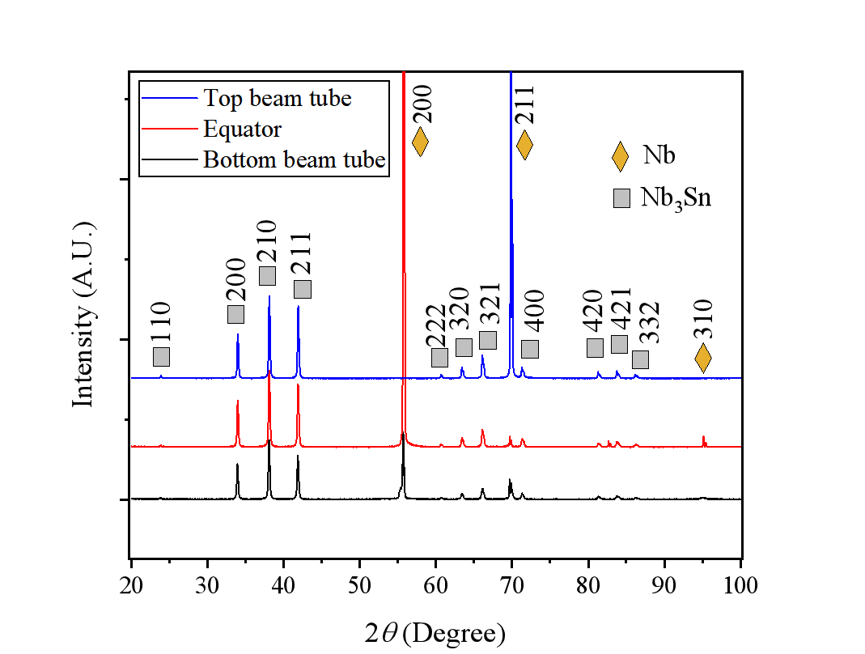
Structural Characterization
(a) as-deposited films
(b) annealed films
Formation of single phase Nb₃Sn after annealing is confirmed comparing the X-ray diffraction patterns of the (a) as-deposited and (b) annealed films
09/20/2022 | Shakel

Slide 14
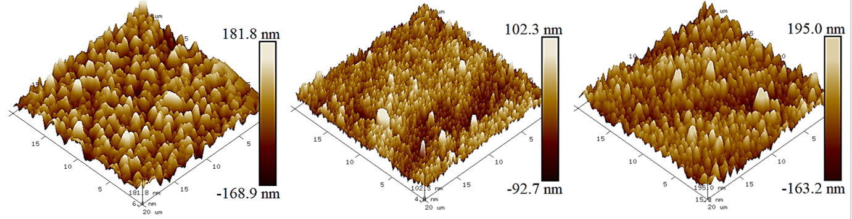
Composition of Sn in the (a) as-deposited films (b) annealed films
Position | Sn (atm %) As-deposited films | Sn (atm %) Annealed films
Top beam tube | 33 | 22
Equator | 32 | 19
Bottom beam tube | 25 | 19
Position | RMS roughness as-deposited (nm) | RMS roughness annealed (nm)
Top beam | 68 | 50
Equator | 26 | 28
Bottom beam | 43 | 50
09/20/2022 | Shakel

Slide 15
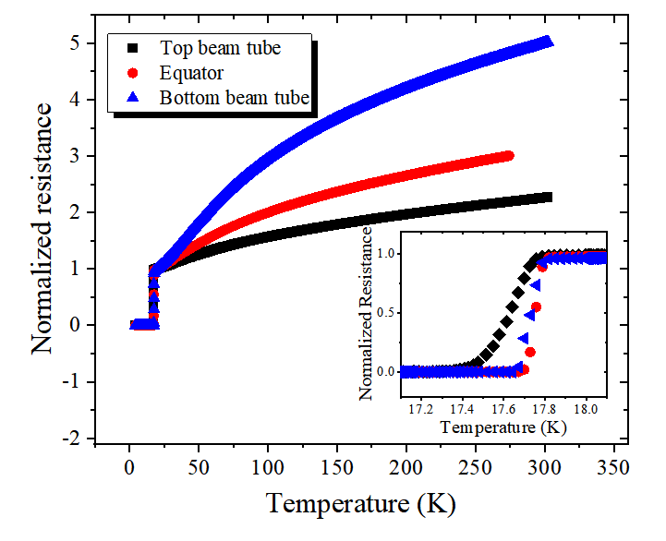
Superconducting Properties
Sample position | T_{c} (K) | ΔT_{c} (K) | RRR
Top beam tube | 17.61 | 0.24 | 2.26
Equator | 17.76 | 0.06 | 3.00*
Bottom beam tube | 17.73 | 0.1 | 5.01
Superconducting critical temperature (T_{c}) for Nb₃Sn
on sapphire
09/20/2022 | Shakel

Slide 16
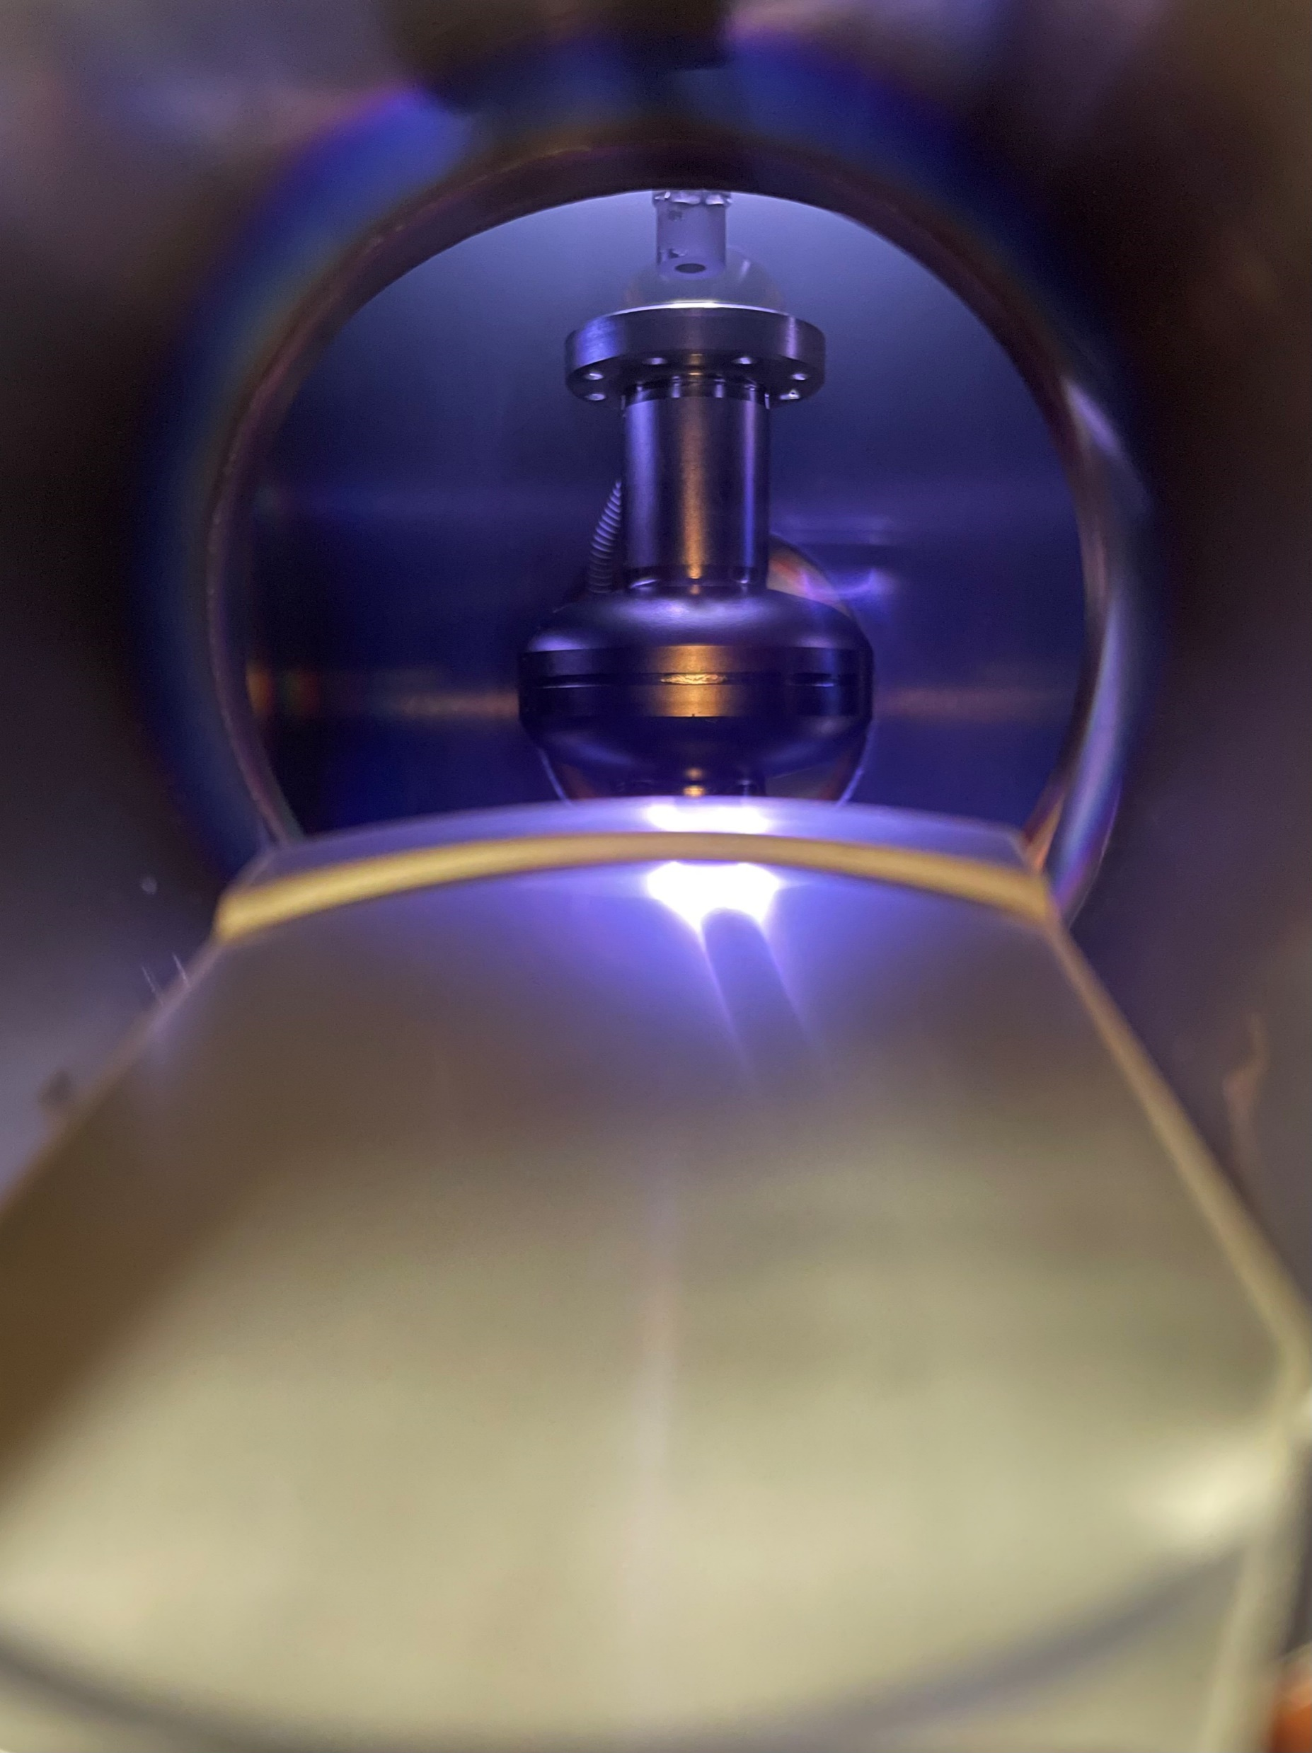
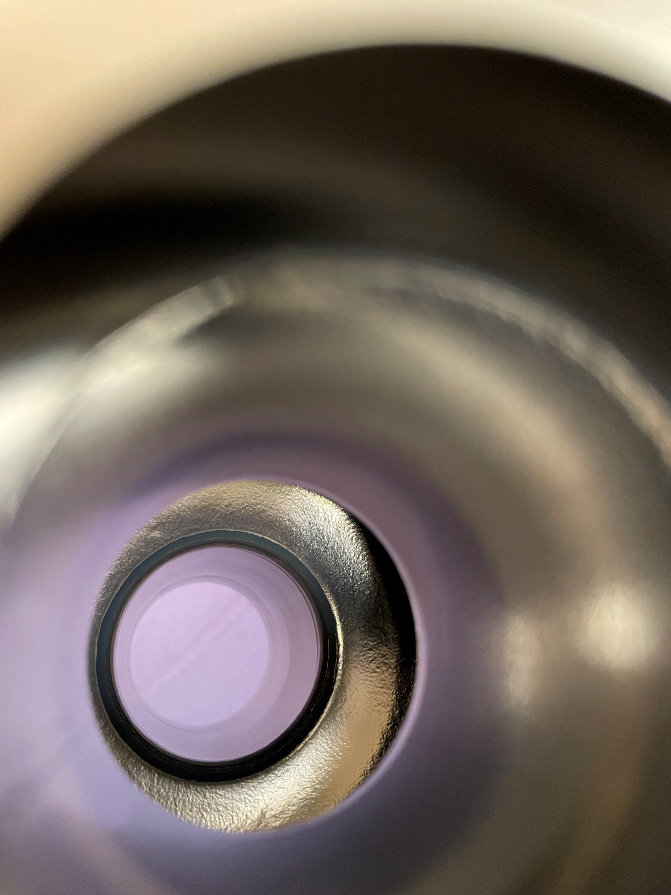
Cavity Coating
SRF cavity
Uniform deposition
No color gradient
No pilling-off film
No patchy regions
Cavity coating with multilayers of Nb and Sn
Ar gas line
09/20/2022 | Shakel

Slide 17
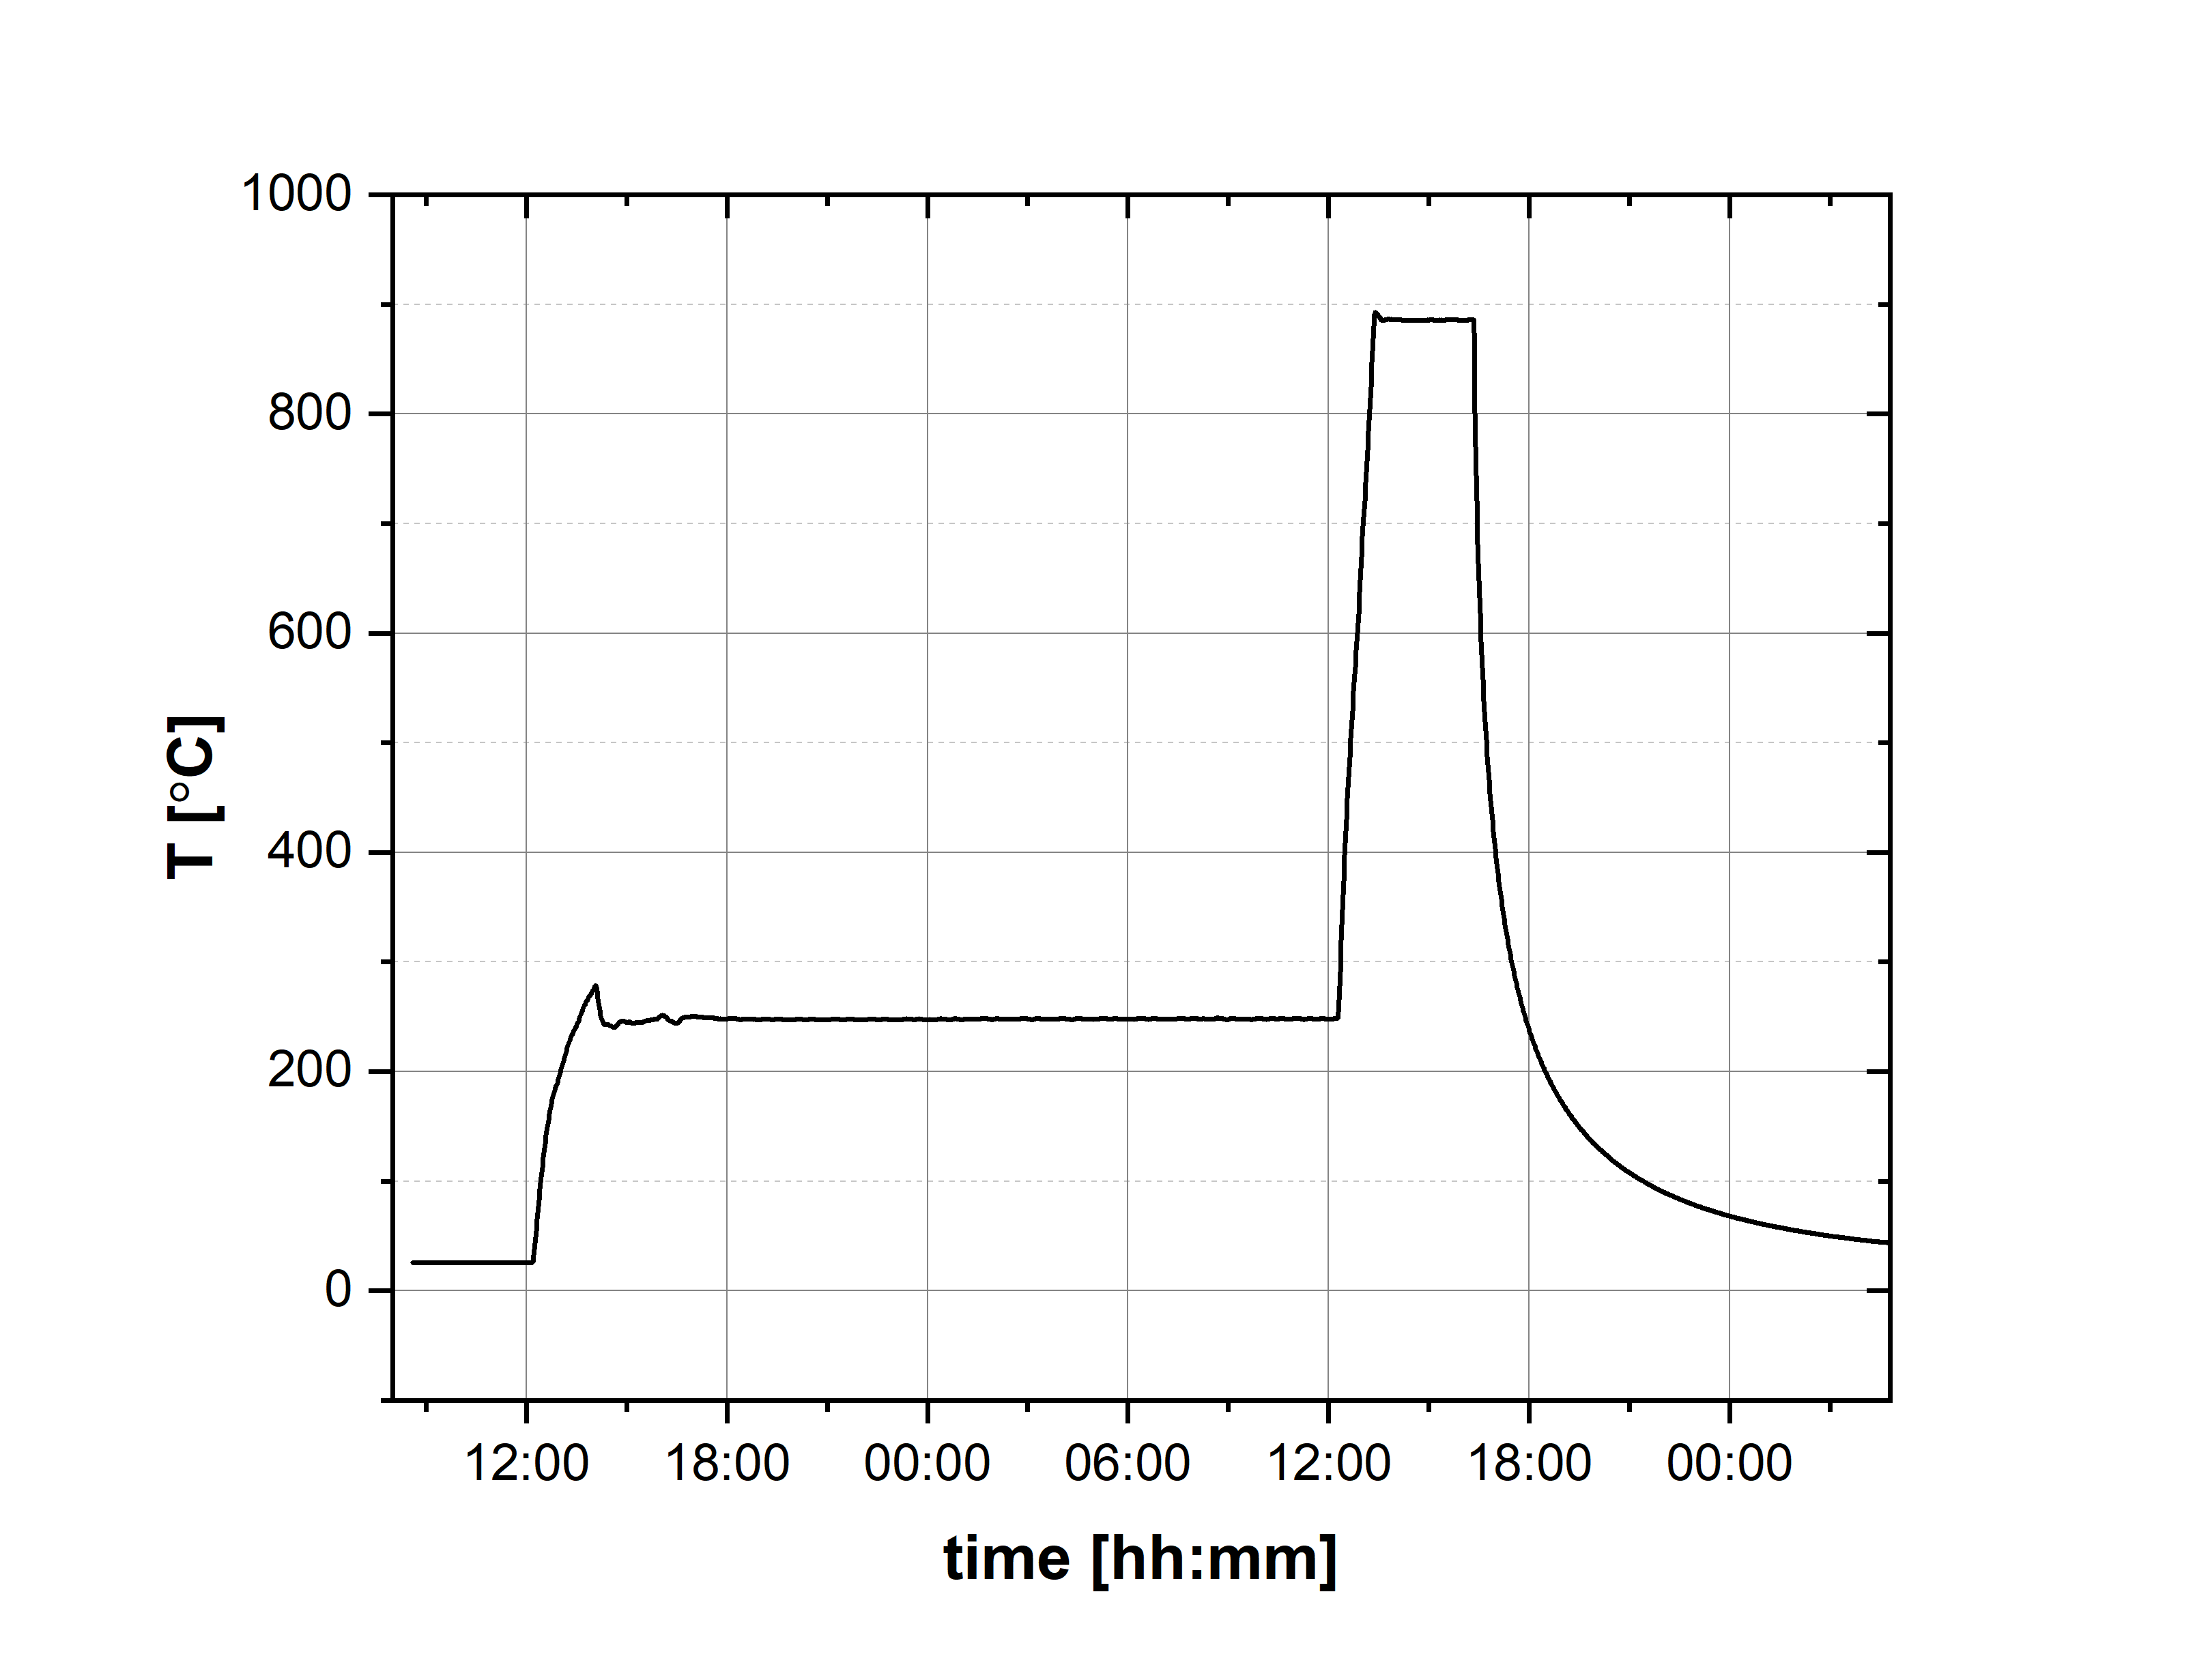
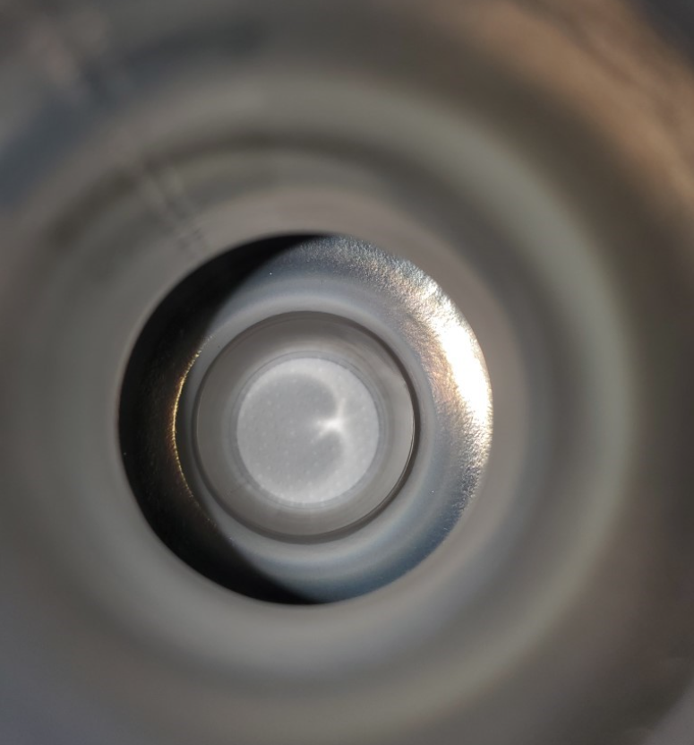
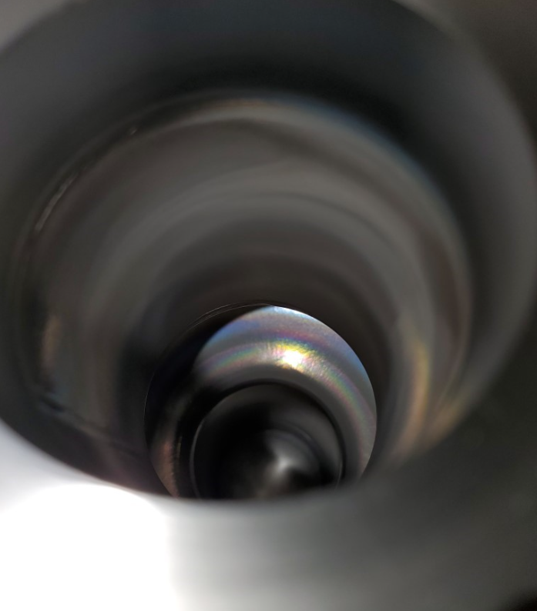
Annealing of coated cavity
Temperature profile of furnace used for annealing of the coated cavity
(950⁰C for 3 hours)
Post annealing cavity pictures
Coated cavity annealed and performance test done in FermiLab
09/20/2022 | Shakel

Slide 18
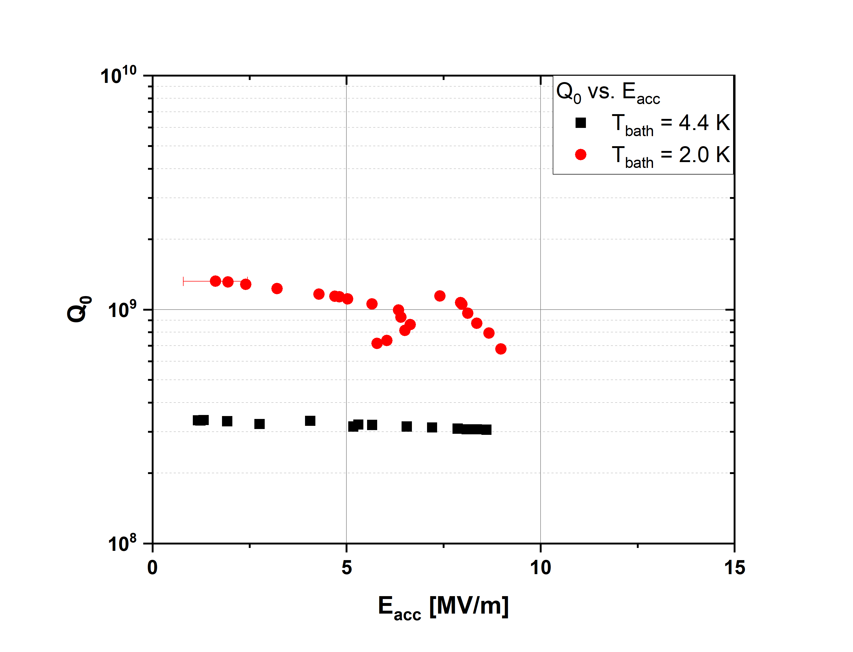
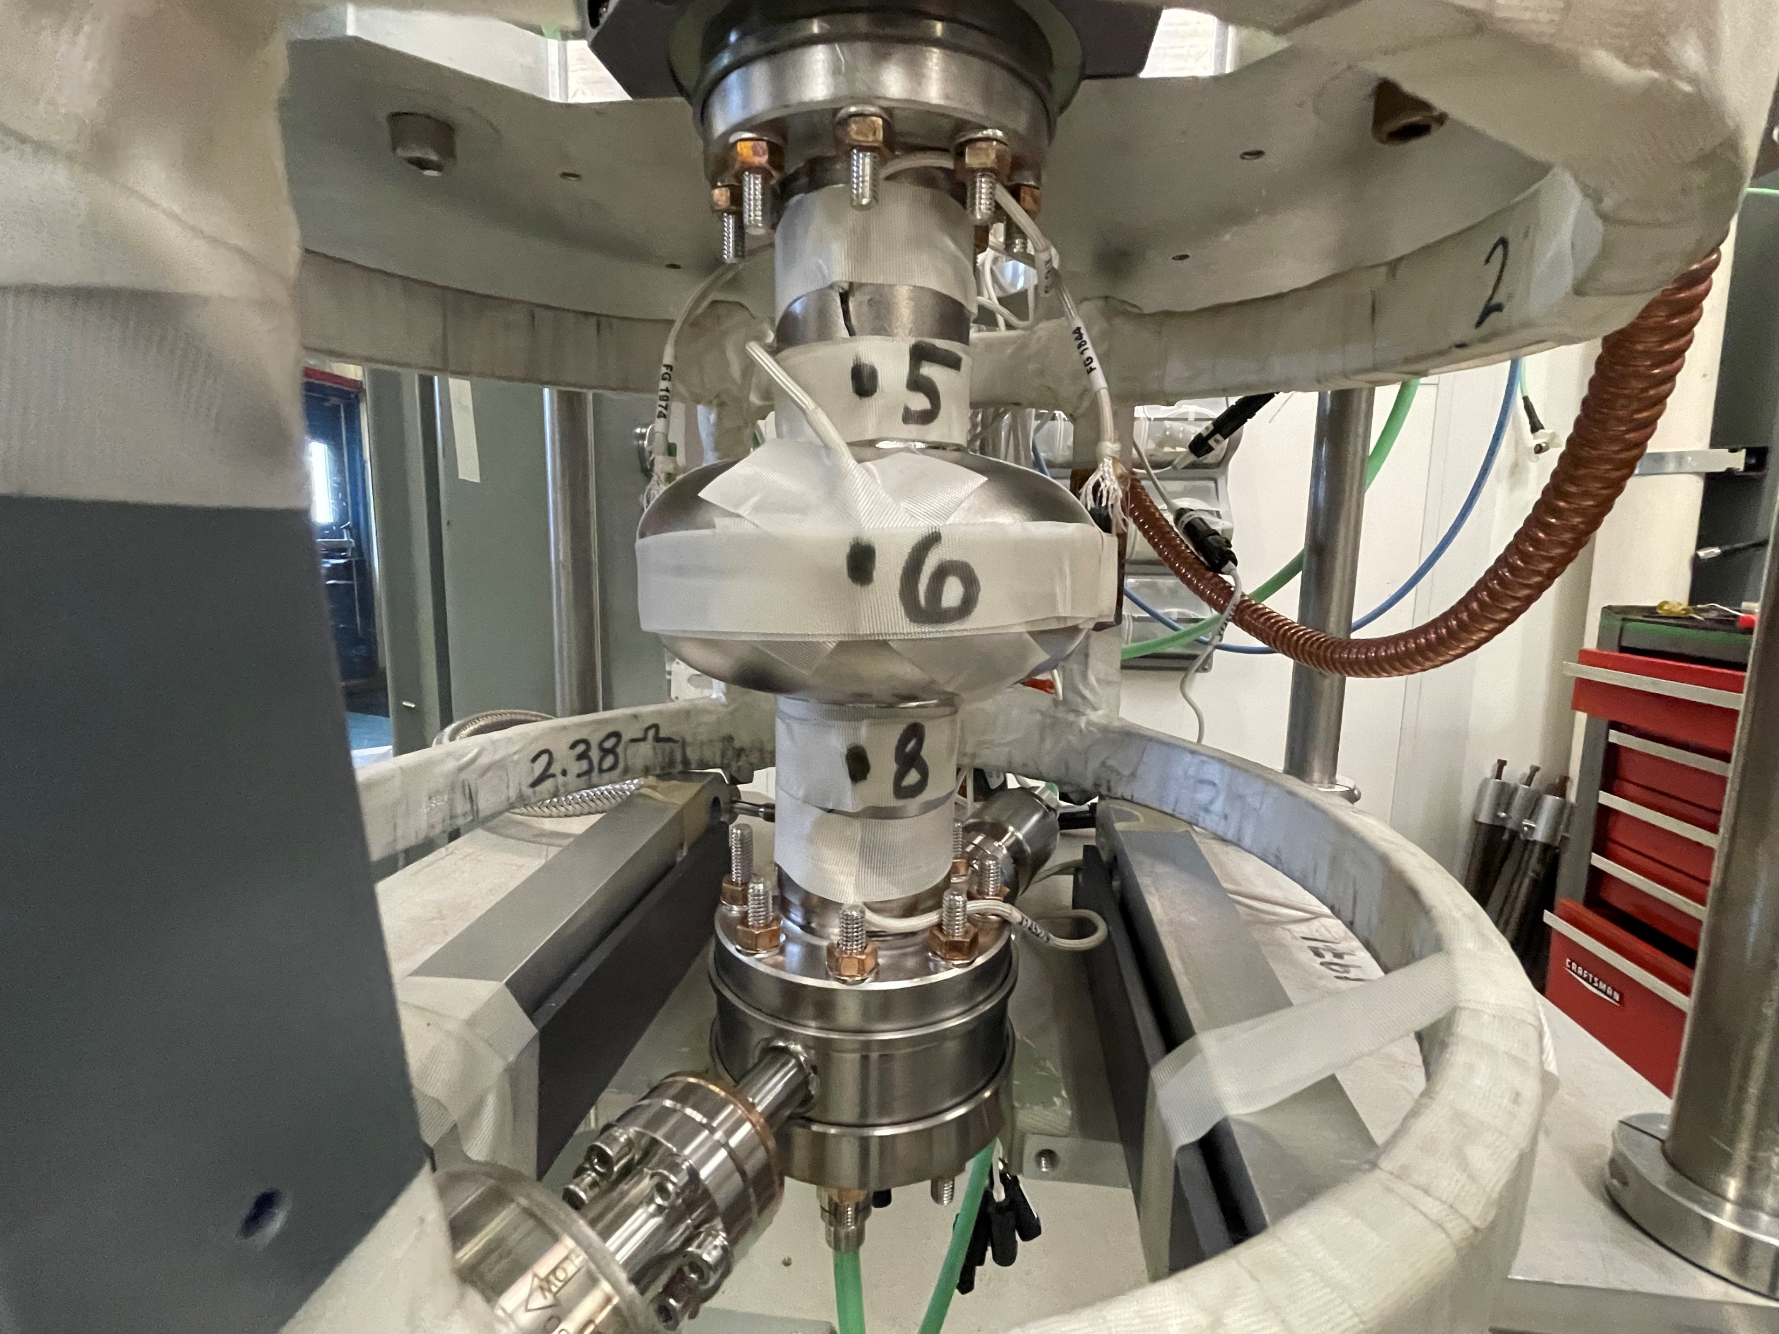
Nb₃Sn coated cavity performance
Nb Q₀ ~ 7 x 10⁹
@ T_{bath} = 2.0 K
Nb Q₀ ~ 1 x 10⁸
@ T_{bath} = 4.0 K
Results
(Q₀) of 3.2 x 10⁸ at E_{acc} = 5 MV/m at T_{bath} = 4.4 K
(Q₀) of 1.1 x 10⁹ at E_{acc} = 5 MV/m at T_{bath} = 2.0 K
Cold test set up for cryogenic RF testing of the cavity in
Vertical test stand
09/20/2022 | Shakel

Slide 19
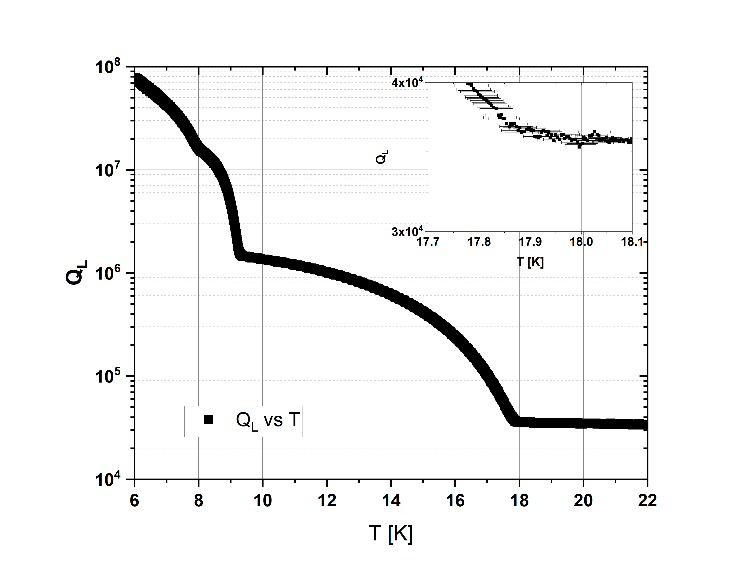
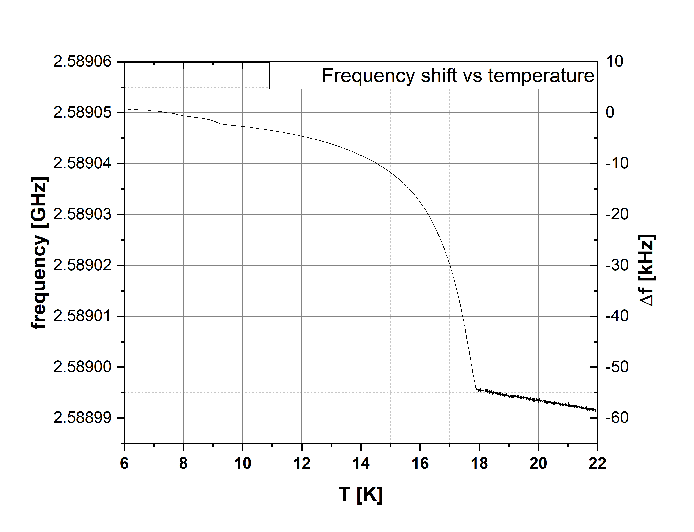
Nb₃Sn coated cavity performance
Frequency shift vs Temperature
Loaded Quality Factor (Q_{L}) vs Temperature (T)
The transition temperature of Nb₃Sn layer is observed at ~ 17.9 K
09/20/2022 | Shakel

Slide 20
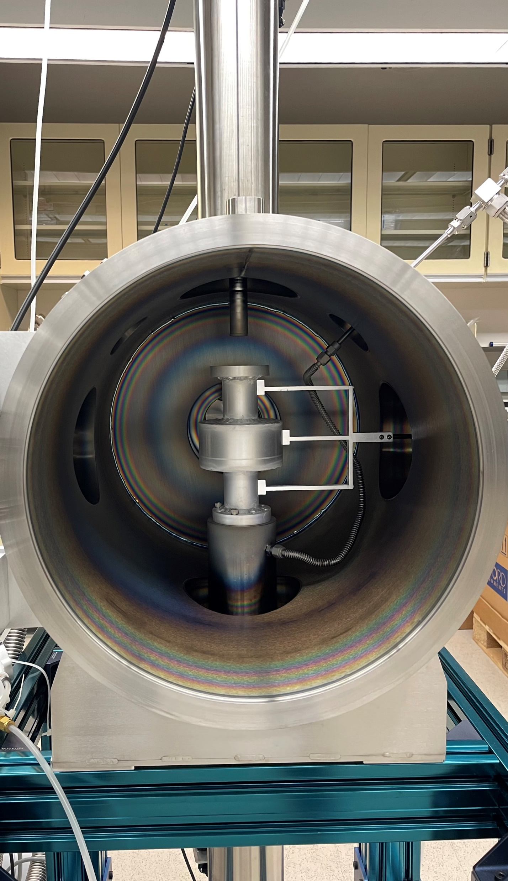
Optimizing the cavity coating conditions
Installing a mock-up cavity
Replicating the similar plasma geometry/density, magnetron current value to that of actual 2.6 GHz SRF cavity.
More accurate film thickness and film surface analysis will be possible compared to deposition in flat samples.
Experiment in progress for uniform thick Nb₃Sn deposition across the entire length of the cavity using multilayer sequential sputtering method
09/20/2022 | Shakel

Slide 21
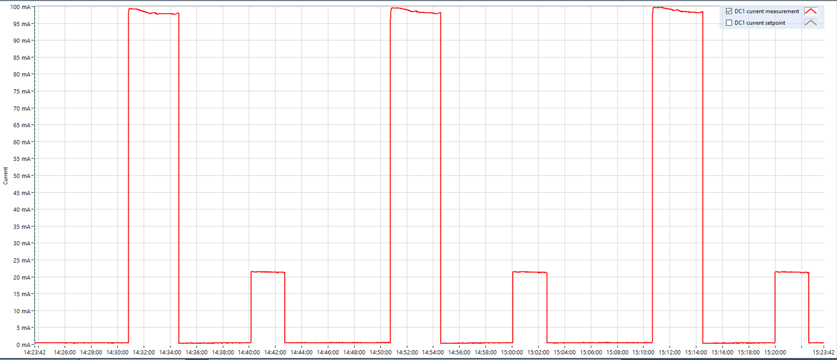
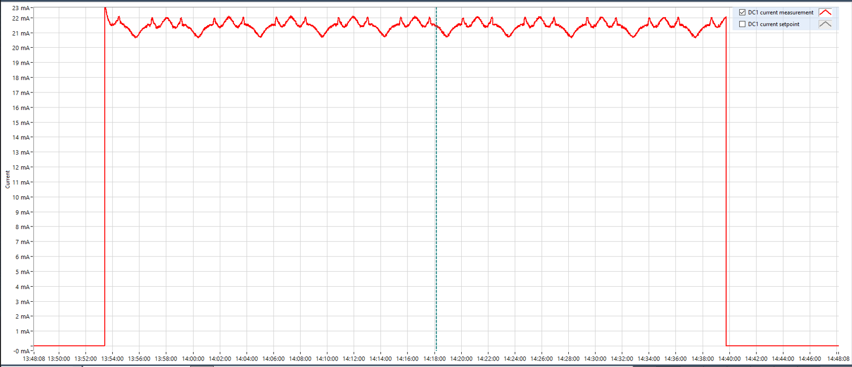
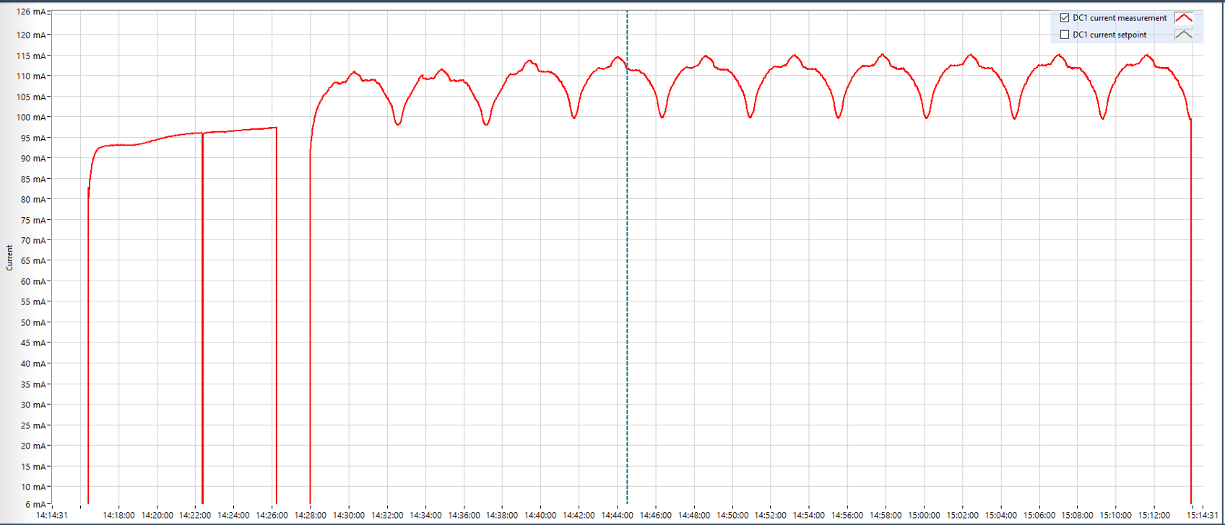
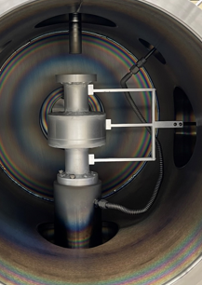
Challenges
Pressure/Current changes due to cavity
Discharging without cavity, magnetron current for Nb and Sn deposition are steady across the deposition range
Discharging inside cavity, magnetron current fluctuates due to the changes in pressure while the magnetron’s moving inside the cavity
Position of gas inlet into the cavity needs to be reconsidered
Current profile of magnetrons discharging without cavity installed
Pressure
gradient
Sn discharge
Inside cavity
~6% fluctuation in current
Nb discharge
Inside cavity
~15% fluctuation in current
09/20/2022 | Shakel

Slide 22
Summary
Designed and commissioned a cylindrical magnetron sputtering system
Used multilayer sequential sputtering to coat Nb₃Sn into 2.6 GHz Nb SRF cavity
Film T_{c} 17.61 – 17.76 K obtained
In cryogenic RF testing the quality factor (Q₀) of 3.2x10⁸ at E_{acc} = 5 MV/m at T_{bath} = 4.4 K and Q₀ of 1.1x10⁹ at E_{acc} = 5 MV/m at T_{bath} = 4.4 K.
The transition temperature of Nb₃Sn layer is measured at about 17.9 K.
Optimization of multilayer sequential sputtering method.
09/20/2022 | Shakel

Slide 23
Future Plans
Optimizing multilayer coating conditions using mock-up cavity – resolving pressure/current gradient, uniform coating covering entire length of the cavity
Cavity performance improvement using multilayer sequential sputtering of Nb₃Sn
Optimizing plasma formation and deposition conditions for Co-sputtering of Nb and Sn Cavity coating by Co-sputtering technique
Acknowledgement
This work support was provided by the U.S. Department of Energy, Office of High Energy Physics, Contact No. DE-SC0022284.
09/20/2022 | Shakel

Slide 24
Thank You!

