Slide 1
Validation Of The JLab Physics In GEANT4 Using Meson Pion Photo-Production Data
Sokhna Bineta Lo Amar^{(1, 2)}
Oumar Ka⁽¹⁾
Paul Gueye⁽²⁾
Annual Jefferson Lab Users Organization (JLUO) Meeting
June 13-15, 2022
⁽¹⁾ : Université Cheikh Anta Diop (UCAD), Dakar (Senegal)
⁽²⁾ : Facility for Rare Isotope Beams (FRIB)

Slide 2
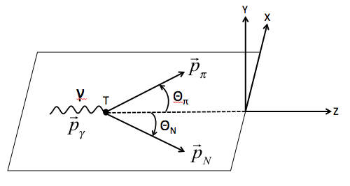
Introduction
CLAS, detector allowing to probe deeply the nucleons with high statistics
GEANT4, GEometry ANd Tracking 4
Tool dedicated for simulation between particle and matter and for data analysis
Applications, high energy, nuclear energy, space and materials sciences to medical physics
Goal
Validate GEANT4 physics using JLab data in the GeV range
Pion photo-production: good alternative to probe matter
Electromagnetic and Hadronic interactions combined
Resonances identified
CLAS, CEBAF Large Acceptance Spectrometer
Experiences performed with the CLAS detector, located in the hall B of JLab

Slide 3
Outline
GEANT4
Cross-sections and Comparison
Results
Conclusion & Perspectives

Slide 4
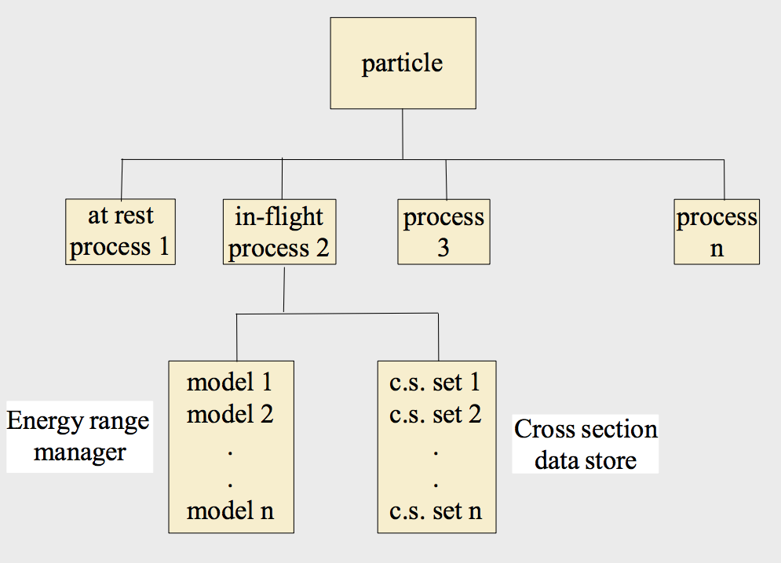
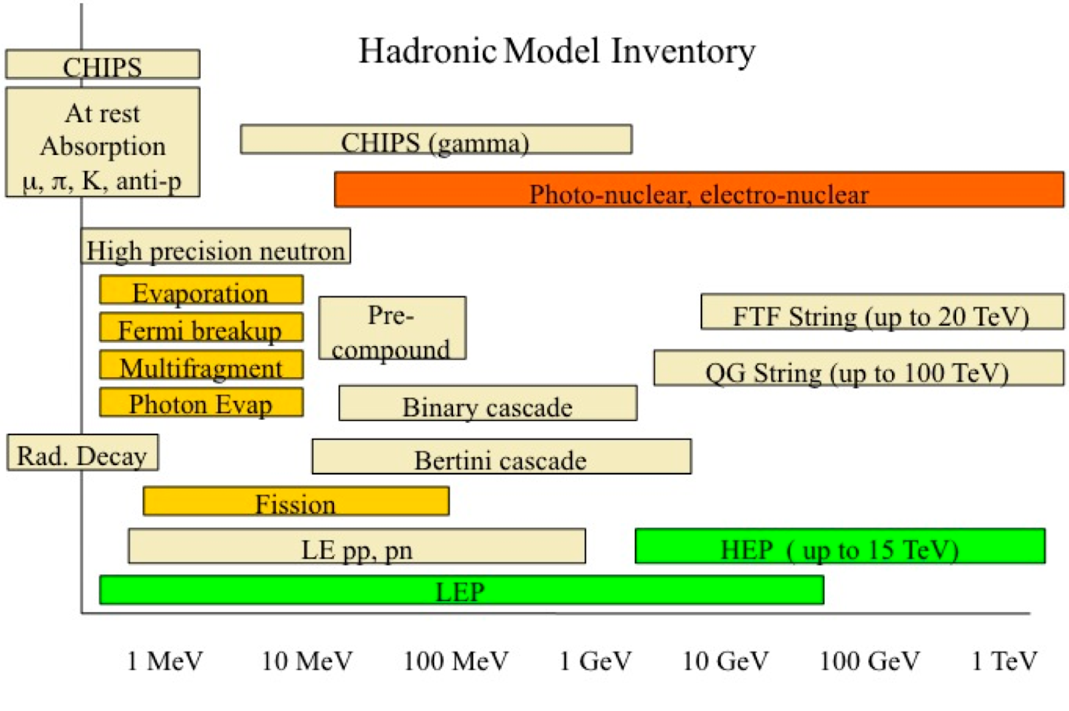
GEANT4 Physics implementation and Photo-production reaction
Interactions in GEANT4 as a physics processes
Tens of categories of hadronic models (GEANT4 9.6.p02 version)
Two distinct packages: EM and Hadronic physics

Slide 5
GEANT4 Physics implementation and Photo-production reaction
Models | Incident particles | Incident energies | Applications
String models: Quark-Gluon-String (QGS) Fritiof (FTF) | p, n, K, π. | >~20 GeV >~5 GeV | Radioprotection and high energy
Cascade models: Bertini (BERT) Binary Invariant Cascade (BIC) | p, n, π, K, Λ, Σ⁺, Σ⁻ L, Ω⁻, Ξ⁻, Ξ⁰, γ p, n, γ p, n, π⁺, π⁻ | <~10 GeV | Intermediate energies
Chiral Invariant Phase Space (CHIPS) | μ, π, K, anti-p, anti-baryon, γ | ~1 MeV → ~10 GeV | Intermediate to high energies
Pre-compound model (P or PRECO) | p, n | < 20 MeV | Low energy nucleon-nuclei interaction Nuclear de-excitation
High Precision Neutron (HP) | Neutrons | 0→170 MeV | Detail neutron transport Radioprotection
Models in function of incidents particles, energy range, applications
Tens of models but users interesting in a restricted number, regularly tested and validated by GEANT4
Only two, potentially suitable for photo-production reactions in the: BERT and CHIPS

Slide 6
Cross-sections and Comparison Generalities
Cross-sections
GEANT4, interactions between particle and matter quantified by exclusive/inclusive cross-sections
Cross-sections data tabulated for each hadronic model
Comparison: PDG and GEANT4 (BERT &CHIPS)
PDG: Particle data Group, large database including diverse compilations
Comparison: GEANT4 and SAID + experimental data of JLab
SAID: Scattering Analysis Dial-in
(Phenomenological model based on word-wide experimental data and maintained by GWU)
Missing data from CLAS below 600 MeV

Slide 7
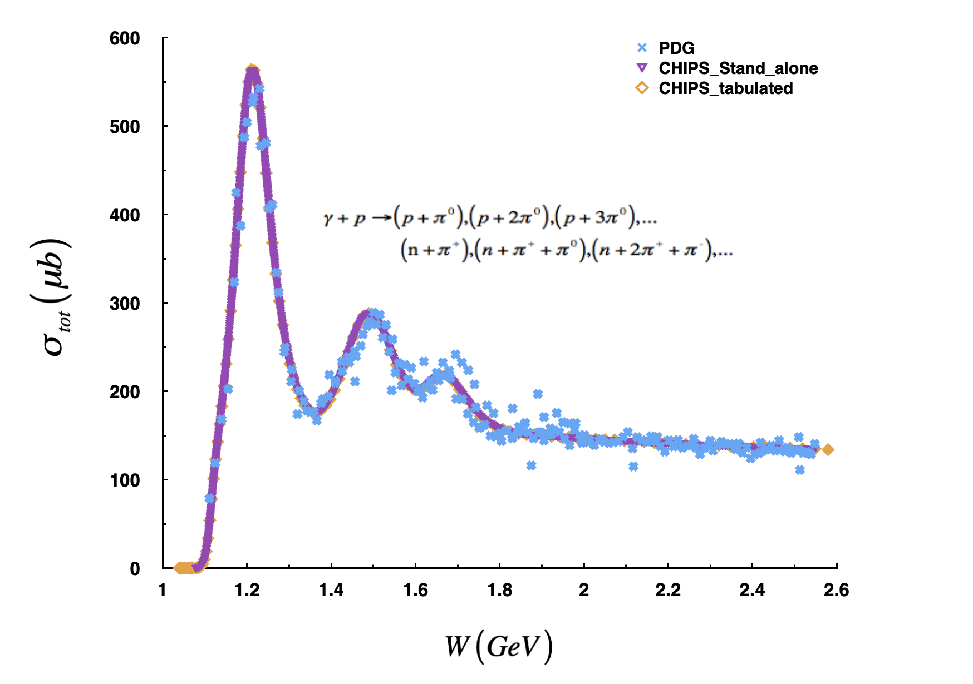
Cross-sections and Comparison GEANT4 (CHIPS) vs PDG
CHIPS_Stand-alone allow to verify the tabulated data
Superimpose perfectly
CHIPS_tabulated
fits correctly with PDG data

Slide 8
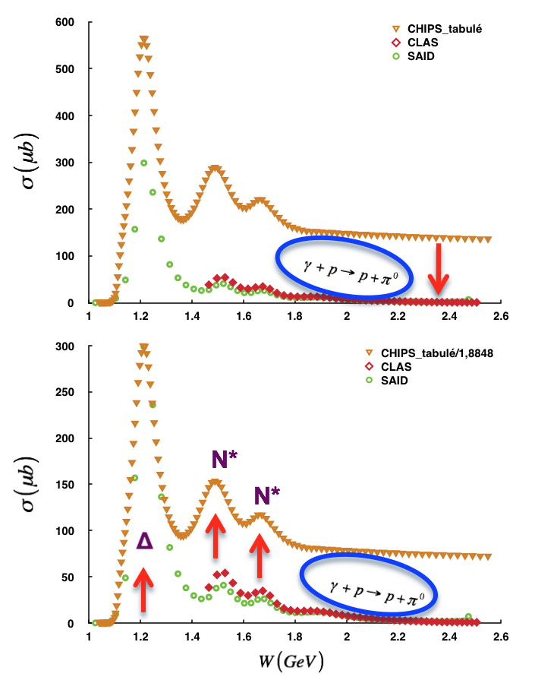
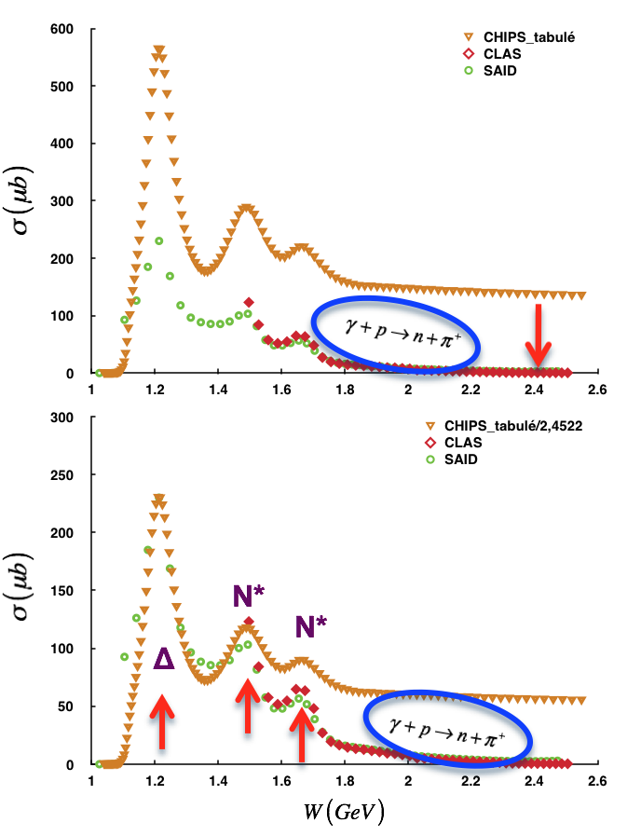
Cross-sections and Comparison GEANT4 (CHIPS) vs CLAS/SAID
GEANT4_CHIPS
Reproduce experimental resonances(∆ resonance of CHIPS normalized to SAID)

Slide 9
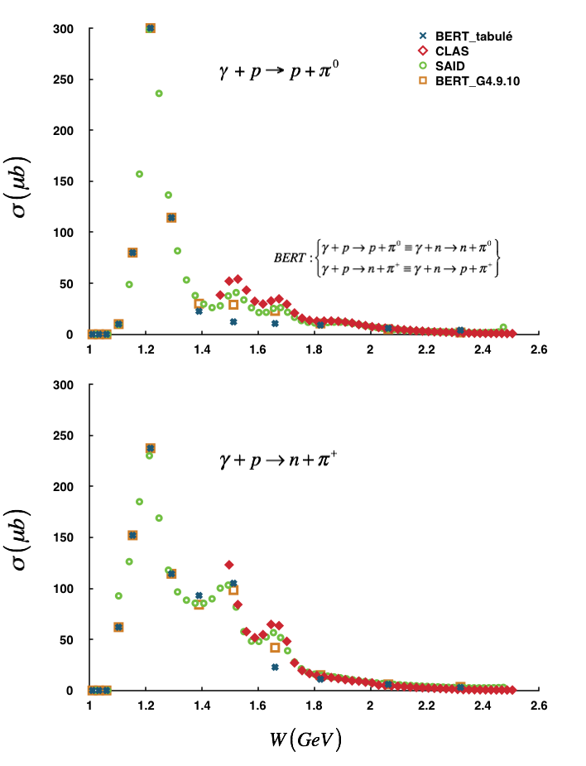
Cross-sections and Comparison GEANT4 (BERT) vs CLAS/SAID
GEANT4_BERT
Correctly describe the ∆ resonance of SAID for the π⁰ and π⁺ channels
Few data observed around the 1st resonance while the 2nd and the 3rd resonances are missing
Revised in version 10: Slightly improved but more needed

Slide 10
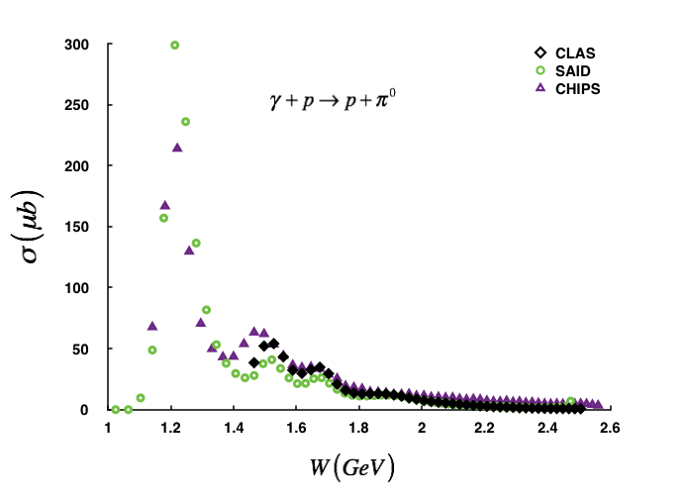
Results Total cross-sections
CHIPS_pπ⁰
Resonances reasonably reproduced
Cross-sections underestimated around the ∆ resonance but quasi-superimpose CLAS data
Slight shift of the second peak noticed: contribution of very close multiple resonances such as N*(1440), N*(1520), N*(1535).

Slide 11
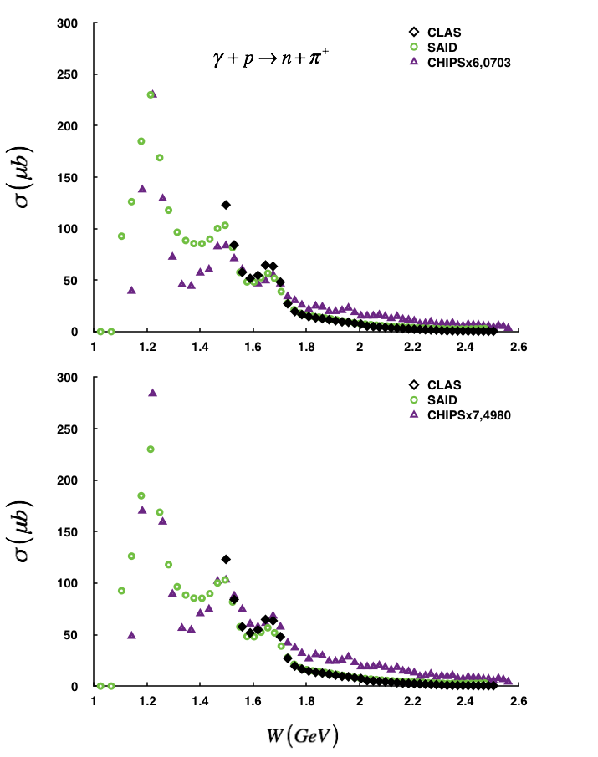
Results Total cross-sections
CHIPS_nπ⁺ :
Data normalized to the 1st and 2nd resonances of SAID to better show the correct description of the physics behind the experimental data by the model
The gap observed around the 2nd resonance is absent here

Slide 12
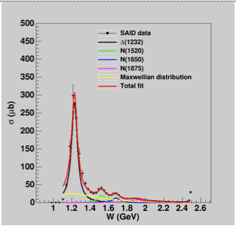
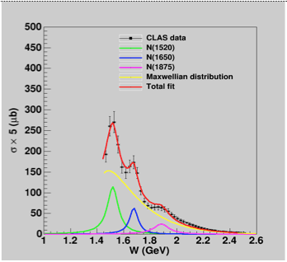
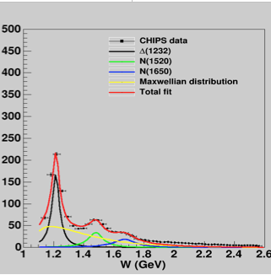
Results BW fits
Relativistic BW fits of π⁰ cross-sections from CLAS data, the phenomenological model SAID and the simulated data of CHIPS

Slide 13
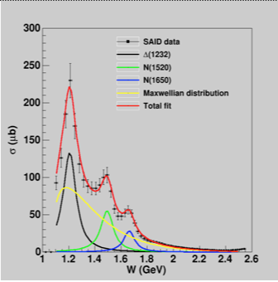
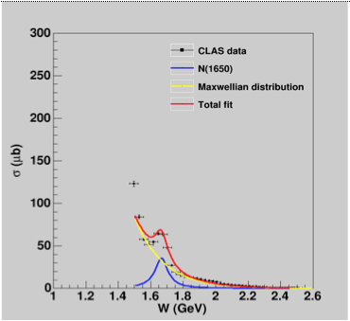
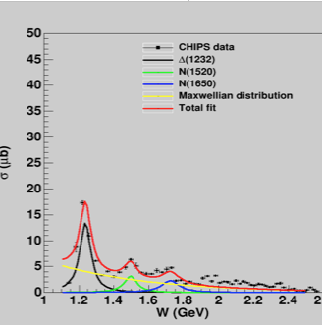
Results BW fits
Relativistic BW fits of π⁺ cross-sections from CLAS data, the phenomenological model SAID and the simulated data of CHIPS

Slide 14
Results BW parameters fits comparison
Nπ⁰ | Parameters | 1st Peak ∆ (1232) | 2nd Peak N*(1440) - N*(1520) | 3rd Peak N*(1650) – N*(1720)
CLAS | σ₀ (μb) | - | 3.542 ± 0.566 | 1.523 ± 0.434
 | M (GeV) | - | 1.519 ± 0.008 | 1.676 ± 0.012
 | Γ (GeV) | - | 0.099 ± 0.021 | 0.068 ± 0.025
SAID | σ₀ (μb) | 33.083 ± 4.243 | 2.941 ± 0.546 | 1.935 ± 0.755
 | M (GeV) | 1.228 ± 0.005 | 1.525 ± 0.008 | 1.679 ± 0.016
 | Γ (GeV) | 0.074 ± 0.020 | 0.092 ± 0.022 | 0.094 ± 0.041
CHIPS_simu | σ₀ (μb) | 49.497 ± 11.213 | 7.765 ± 1.160 | 3.750 ± 0.756
 | M (GeV) | 1.213 ± 0.008 | 1.480 ± 0.006 | 1.662 ± 0.016
 | Γ (GeV) | 0.084 ± 0.023 | 0.080 ± 0.014 | 0.082 ± 0.01
Nπ⁺ | Parameters | 1st Peak ∆ (1232) | 2nd Peak N*(1440) - N*(1520) | 3rd Peak N*(1650) – N*(1720)
CLAS | σ₀ (μb) | - | - | 5.442 5± 4.324
 | M (GeV) | - | - | 1.666 ± 0.019
 | Γ (GeV) | - | - | 0.097 ± 0.083
SAID | σ₀ (μb) | 24.817 ± 2.498 | 10.026 ± 2.755 | 4.574 ± 0.825
 | M (GeV) | 1.208 ± 0.007 | 1.494 ± 0.019 | 1.664 ± 0.010
 | Γ (GeV) | 0.119 ± 0.002 | 0.115 ± 0.035 | 0.102 ± 0.023
CHIPS_simu | σ₀ (μb) | 1.602 ± 0.113 | 0.429 ± 0.091 | 0.430 ± 0.043
 | M (GeV) | 1.237 ± 0.005 | 1.496 ± 0.009 | 1.724 ± 0.006
 | Γ (GeV) | 0.076 ± 0.007 | 0.087 ± 0.020 | 0.120 ± 0.016

Slide 15
Results BW parameters fits comparison
pπ⁰
SAID-CHIPS : the agreement between masses (widths) are less than 1.22% (13.51%) for ∆; 2.88% (27.17%) for the 2nd peak and 0.48% (89,36%) for the 3rd peak, respectively.
nπ⁺
SAID-CHIPS : the agreement the effective masses (widths) are within 2.4% (36.16%) for the (1232), 0.13% (32.18%) for the 2nd peak and 3.61% (17.65%) for the 3rd peak, respectively.
$$M_{Peak}=\frac{\sum_{i=1}^{N=3}{ω_{i}M_{i}}}{\sum_{i=1}^{N=3}{ω_{i}}}$$
$$Γ_{Peak}=2M_{Peak}\sqrt{\frac{1}{N−1}\sum_{i}^{N}{{\left(\frac{Γ_{i}/2}{M_{i}}\right)}^{2}}}$$
$$ω_{i}=\frac{Γ_{i}/2}{M_{i}}$$

Slide 16
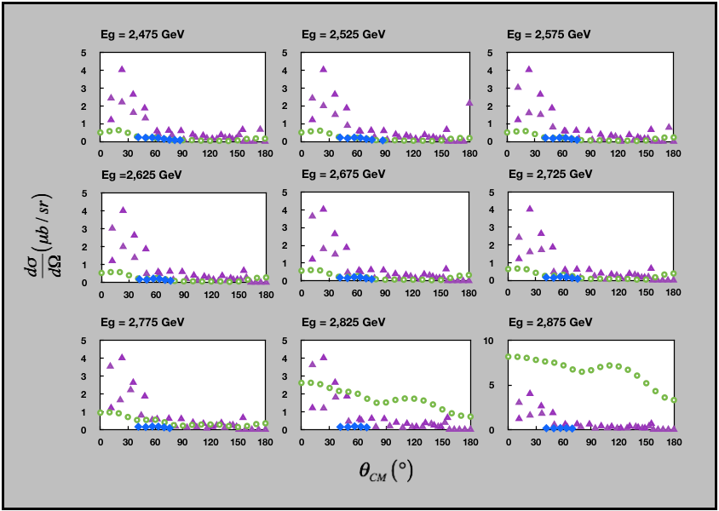
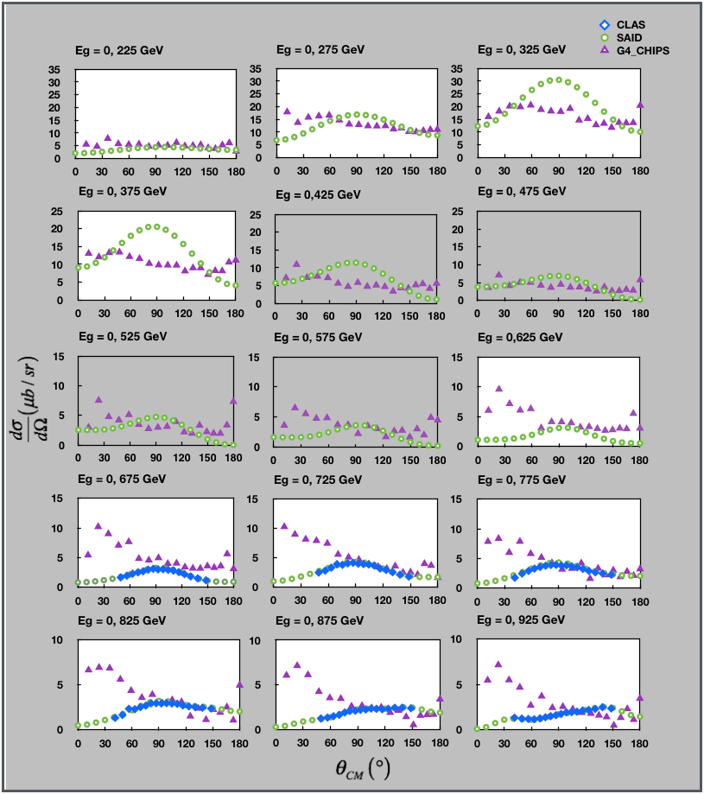
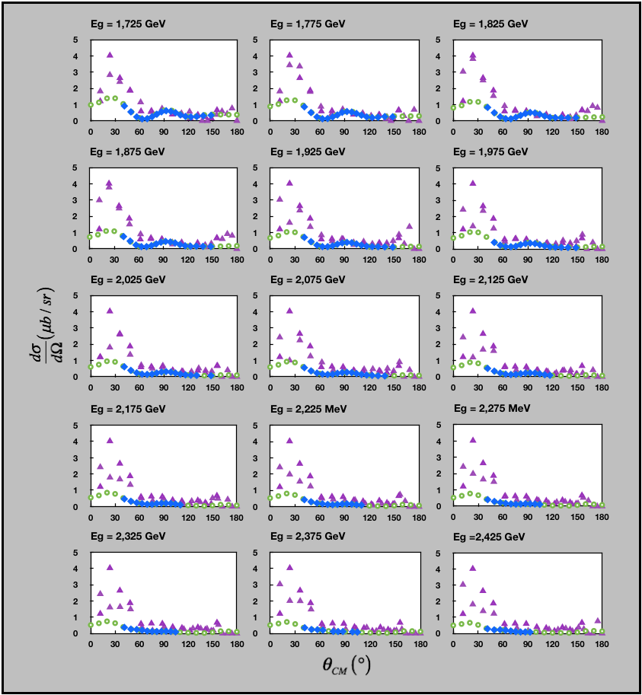
Results Angular distribution
Some examples of angular distribution of γ + p → p + π⁰ channel
Angular distributions between CHIPS and CLAS/SAID are very different
No agreement between CLAS and SAID from 2.775 GeV

Slide 17
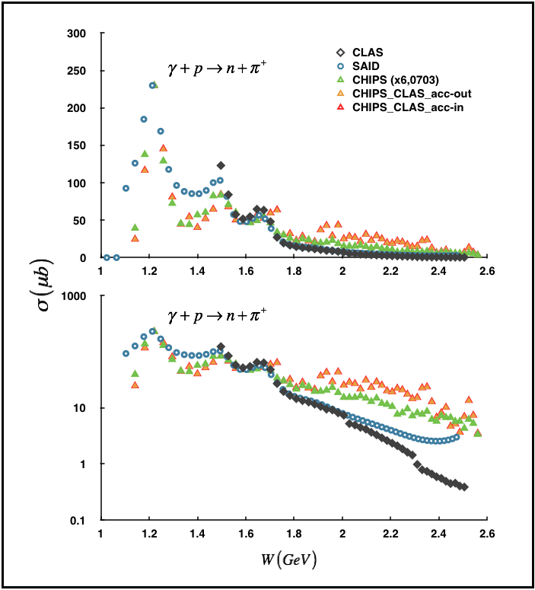
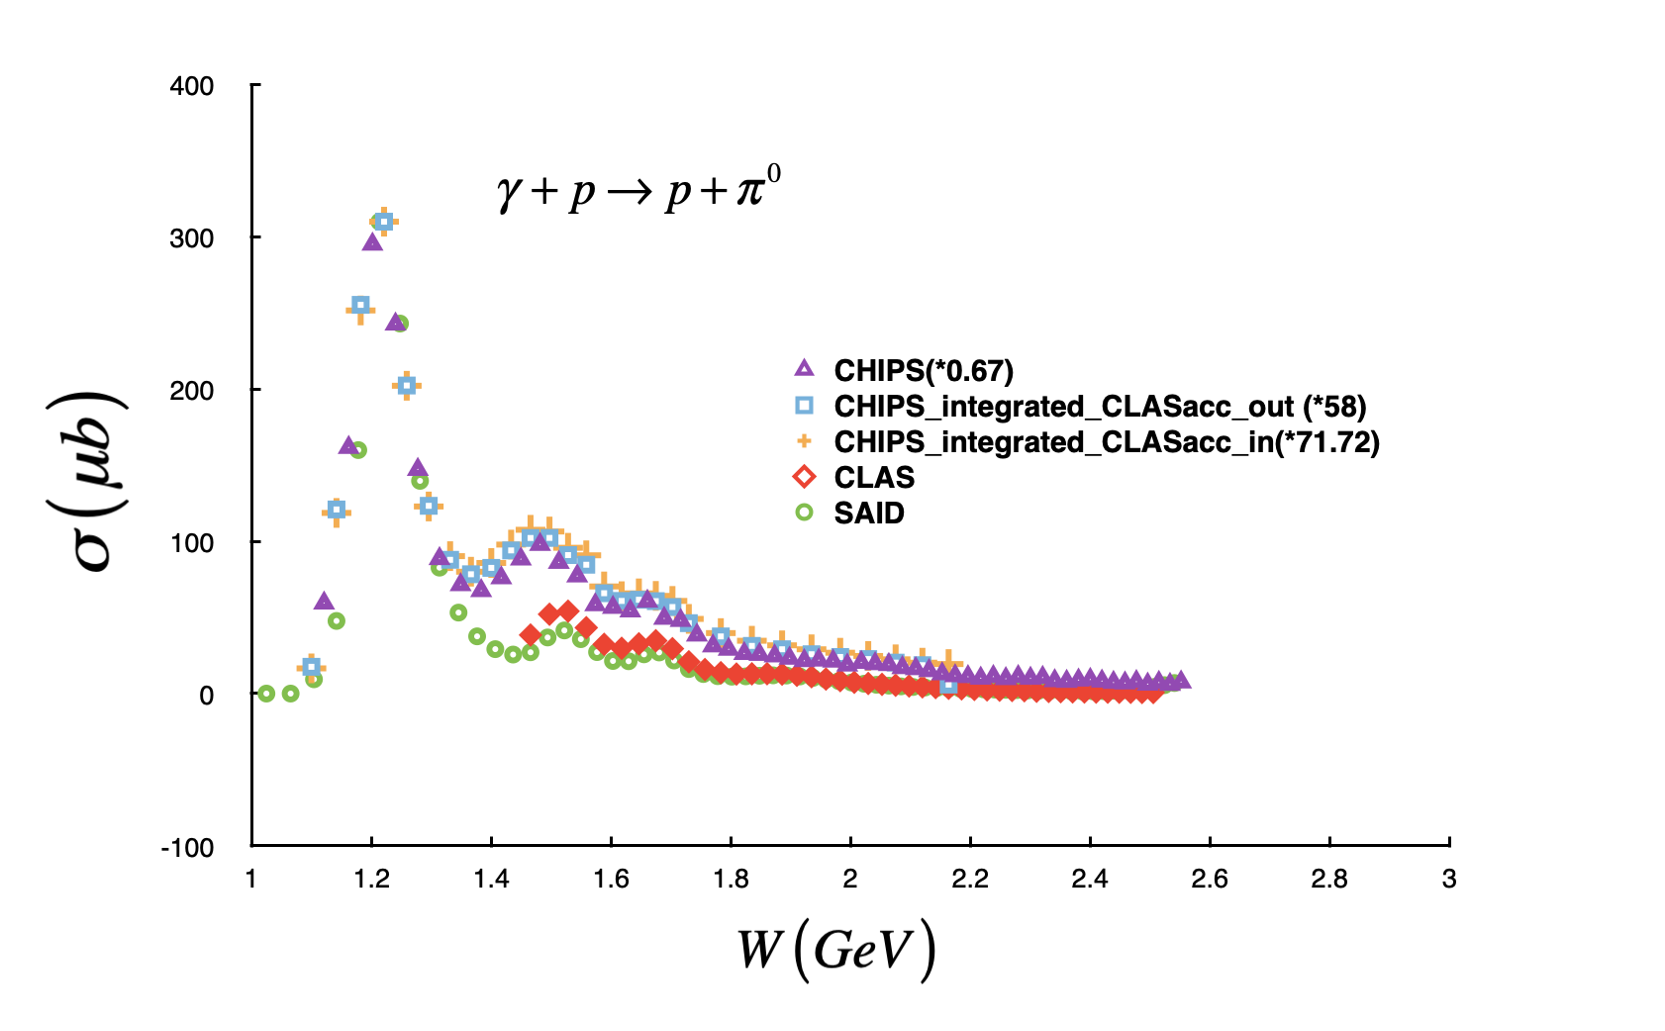
Results Cross-sections integrated
Differential cross-sections of GEANT4 integrated on all the scattering angle (0 - 180º) or according the CLAS acceptance (8 – 140º) overlap perfectly the total cross-sections data

Slide 18
Summary
Study the validity of JLab physics in GEANT4 for the pion photo-production reactions off proton
CHIPS (Chiral Invariant Phase Space)
BERT (BERTini Cascade).
Verification of tabulated photo-production cross-sections through the Stand-alone code.
Comparison of tabulated data with experimental data (CLAS/SAID) and PDG
Simulation of the exclusive pion production reactions via an incident photon beam, using the CHIPS model.
Perspectives
Calculate the individual contribution of resonances under the 2nd and 3rd peak
Improved performance of CHIPS for describing differential cross sections.
Study of mesons other than the pions: eta is in progress
References
https://doi.org/10.1140/epja/s10050-021-00640-3
https://link.springer.com/article/10.1140/epja/i2019-12732-4
E-mail: amarsokh@msu.msu.edu

Slide 19
Thank you so much!

