Slide 1

Ce+BAF : Positron Beams at Jefferson Lab
Matt Poelker, Joe Grames

Slide 2
We’ve talked about this before, where do things stand today?
Physics side
  Positron physics workshops at JLab in 1999, 2009 and 2017
  Recent EPJA issue dedicated to e+ physics at Jefferson Lab
  Today, two conditionally approved PAC proposals exist
Accelerator side
  PEPPo experiment
  Supportive JLAAC recommendations
  Positron LDRD
  In general, widespread enthusiasm for e+ production using low, medium and high energy e- beams
Gun group has been busy : CEBAF injector upgrade for MOLLER and UITF for HDIce testing
2023 looks to be a great year to finally build a positron source, start with 8 MeV electron beam, learn from it
In parallel, identify all positron users to help define our long term goals

Slide 3
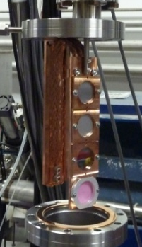

Polarized Electrons for Polarized Positrons (PEPPo) @ CEBAF
PEPPo (Polarized Electrons for Polarized Positrons) => demonstrate feasibility of using bremsstrahlung radiation of MeV energy Polarized Electrons for production of Polarized Positrons.
J. Grames, E. Voutier et al., JLab Experiment E12-11-105 (2011)
W (1mm)
<10 W beam
8 MeV, 1μA, 85% polarization
PEPPo possible due to support from SLAC E166, DESY, Princeton, Cornell, International Linear Collider Project and the Jefferson Science Associates

Slide 4

Polarized Positron Production
(PEPPo Collaboration) D. Abbott et al. , Phys. Rev. Lett. 116 (2016) 214801
PEPPo demonstrated efficient polarization transfer of 8.2 MeV/c polarized electrons to positrons, expanding polarized positron production using MeV electron beam energies.
electron beam polarization
85.2 ± 0.6 ± 0.7 %
Whenever producing e⁺ from e⁻, polarization is coming for free, if initial electrons are polarized.

Slide 5
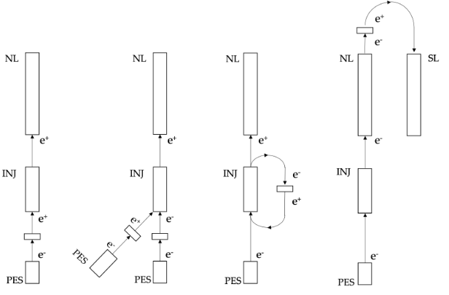
PEPPo approach is a new approach
”Conventional” unpolarized bremsstrahlung positron sources have been built and operated successfully
SLAC – Stanford Linear Accelerator Center (US)
HERA – Hadron Electron Ring Accelerator (Germany)
BELLE/KEK – National Laboratory for High Energy Physics (Japan)
CESR – Cornell Electron Storage Ring (US)
VEPP – Budker Institute of Nuclear Physics (Russia)
BEPCII – Beijing Electron Positron Collider (China)
PEPPo builds upon this
e+ polarization / intensity configurable
cw (all prior machines are pulsed)
we know how to make polarized e- beam
what e- beam energy to implement at CEBAF?
Today’s 12 GeV e- energies
1090 MeV
123 MeV
7 MeV

Slide 6

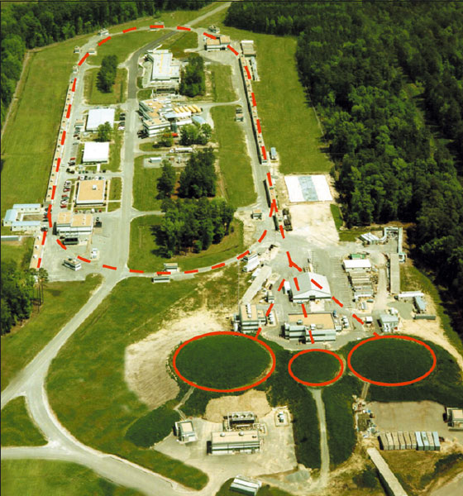

PEPPo – Polarization and Intensity Trade Off
The Yield (e+/e-) depends on the beam power Beam Energy x Beam Current
Polarization transfer is universal whether the electron beam is 10 MeV, 100 MeV, 1 GeV, etc…
D
High Pol
Low Yield
1090 MeV
_{Yield scales with Beam Power}
123 MeV
High Yield
Low Pol
7 MeV
IP² ~ E(max)/2
C
B
A
0
_{e+ energy}
E_{(max)}=7, 123, 1090 MeV

Slide 7
No matter the e-beam energy, the e+ source looks like….
A positron injector model was designed to explore feasibility
  Target, magnet and collimation define transverse emittance
  Dipoles separate e-/e+ and define momentum spread
  Chicane compresses bunch length

Slide 8
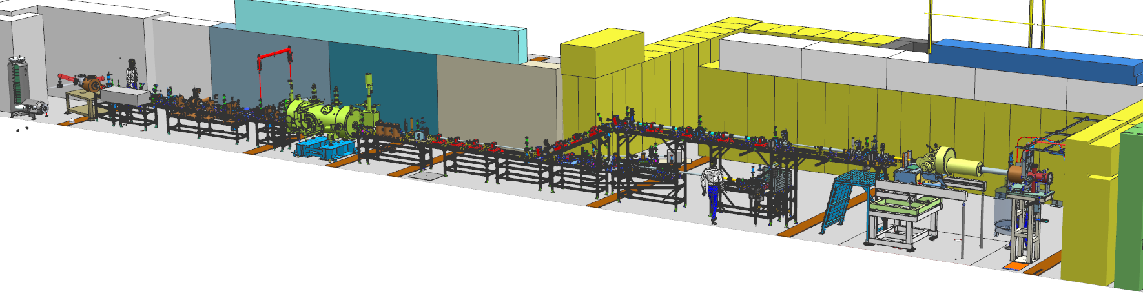
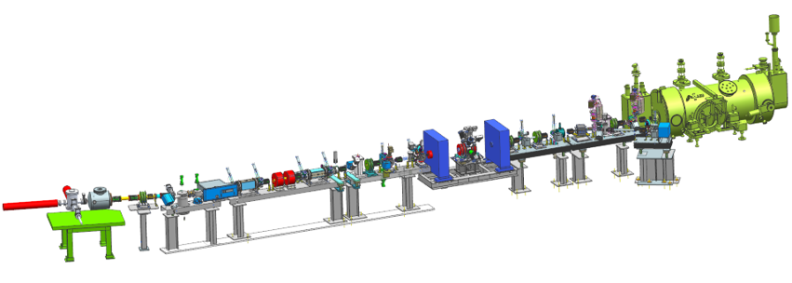
For past 5 years, we’ve been building injectors
Upgraded Injector Test Facility
CEBAF Injector Upgrade

Slide 9

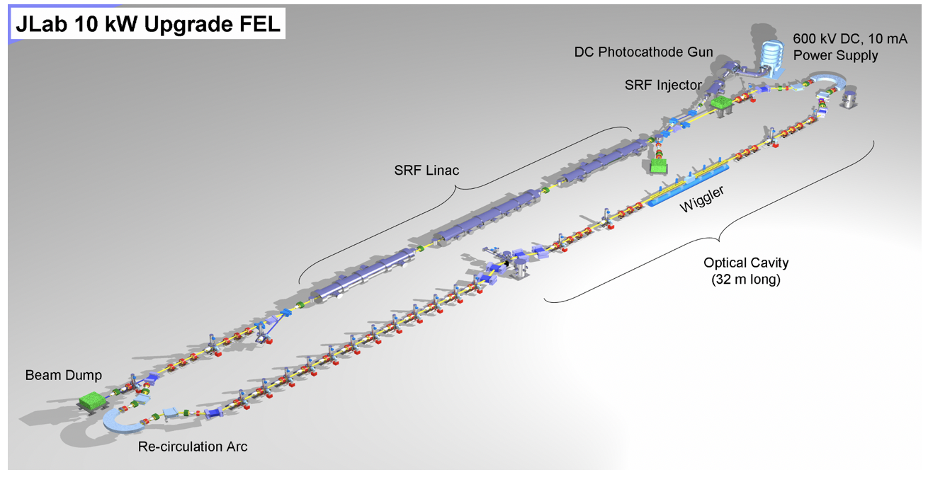
With CEBAF and HDIce obligations behind us, time to build e+ source

Slide 10
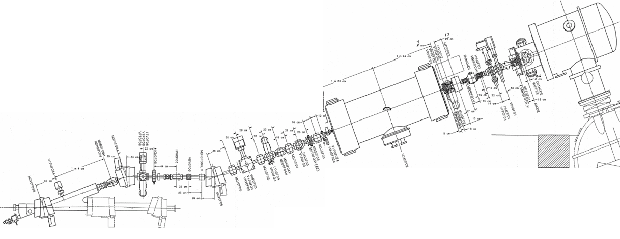
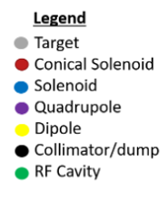
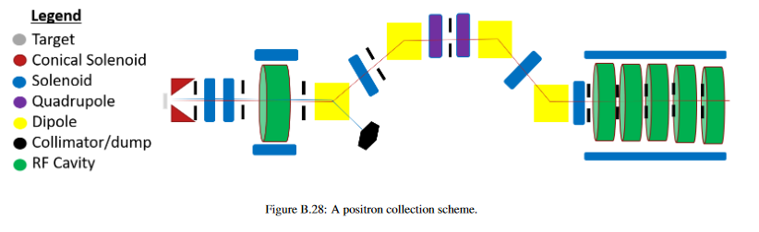
Producing polarized e+ at LERF
LERF gun still holds world records, but it is vent/bake style
LERF ¼ CM has a helium leak, not compatible with polarized e- source
Install new load locked gun and CEBAF ¼ CM
e+
e-
Polarized positron source conceptual layout

Slide 11
Polarized Electron – Positron Injector
Injector we propose to build and learn from, is compact
It could coexist with other LERF activities (e.g. cryomodule commissioning)
e+
~ 15 m

Slide 12
Goal – over the next 5 years, at the LERF
Build a positron injector
  350 kV gun polarized electron beam with 1000 C lifetime at 1mA
  e- beam through ¼ CM, 8 MeV electron beam
  Optics model of the positron source including especially the positron distribution downstream of target and capture/bunching sections
  e- and e+ beamline layout
  Positron target that can take >10 kW
  Solenoid magnet, >0.5 T, positron spatial capture
  RF cavity, positron temporal capture
  e+ diagnostic beamline
>100 nA unpolarized or >10 nA polarized positron beams

Slide 13
LERF is well suited – 8 MeV to cut our teeth, higher energy when needed
Or send e-beam through a full module (probably what’s needed)
Linac Compression e+ MeV Gun
Just 8 MeV
Radiation Shielding
Cryogenics
RF/Magnet controls
Safety Systems
Expandability

Slide 14
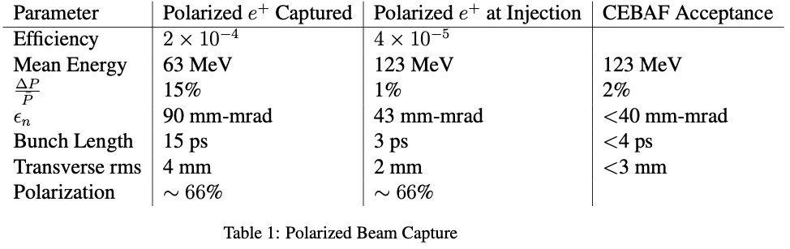
Being realistic… : 123 MeV polarized e- driven PEPPo Injector
Jefferson Lab Users are asking for e+ beams with polarization >60% and current >100 nA
Collimation defines normalized emittance
Dipoles separate particle species
Dispersion selects final dp/p
Bunching achieve with R56 chirper/chicane
>5 x 10⁻⁵
>60%
A GaAs source source providing 1 mA for a week = 600 Coulombs (5x CEBAF)
We would like to have a charge lifetime >1000 C

Slide 15
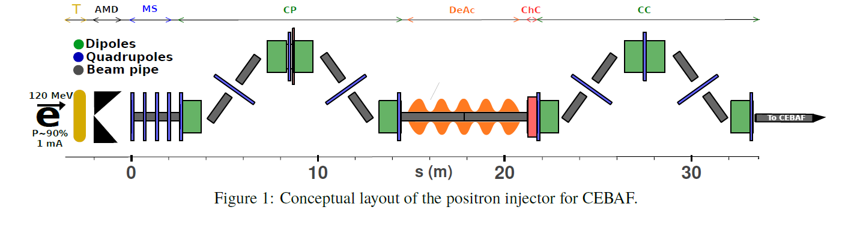
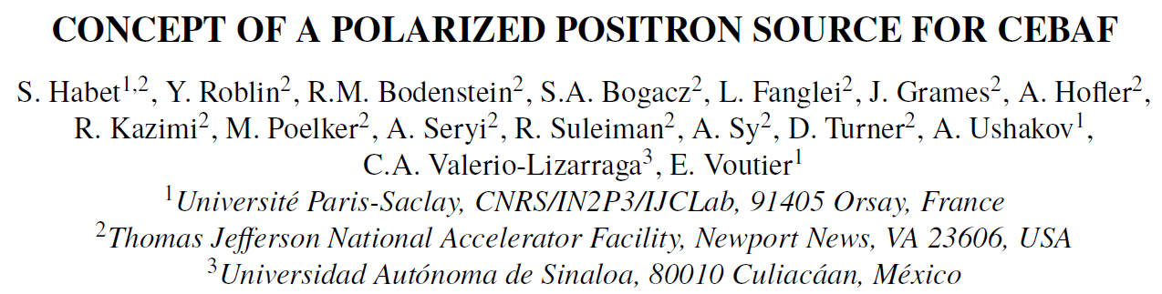
An evolving design…today’s latest
  Sami Habet, IJCLab-Orsay
T: tungsten target, source of positrons
AMD: adiabatic matching device, grab as many positrons as possible
MS: matching section, four quads to manage transverse profile
CP: magnetic chicane, sets momentum bite
DeAc: decelerating/accelerating section reduces momentum dispersion
ChC: chirping cavity correlates momentum dispersion with time-of-flight
CC: second chicane compresses positron bunch

Slide 16
Technical and engineering goals
Risks, realities, complications….
  1 mA polarized e- beam with >1 kC lifetime (have 200 C @ 0.2 mA now)
  Target that can survive >10 kW e-beam
  >0.5 T dc solenoid in high x-ray environment
Note, with 8 MeV electron beam, we won’t be activating anything
But at the LERF, conversion with higher energy electron beam is a real possibility, that’s how we get to higher positron current

Slide 17
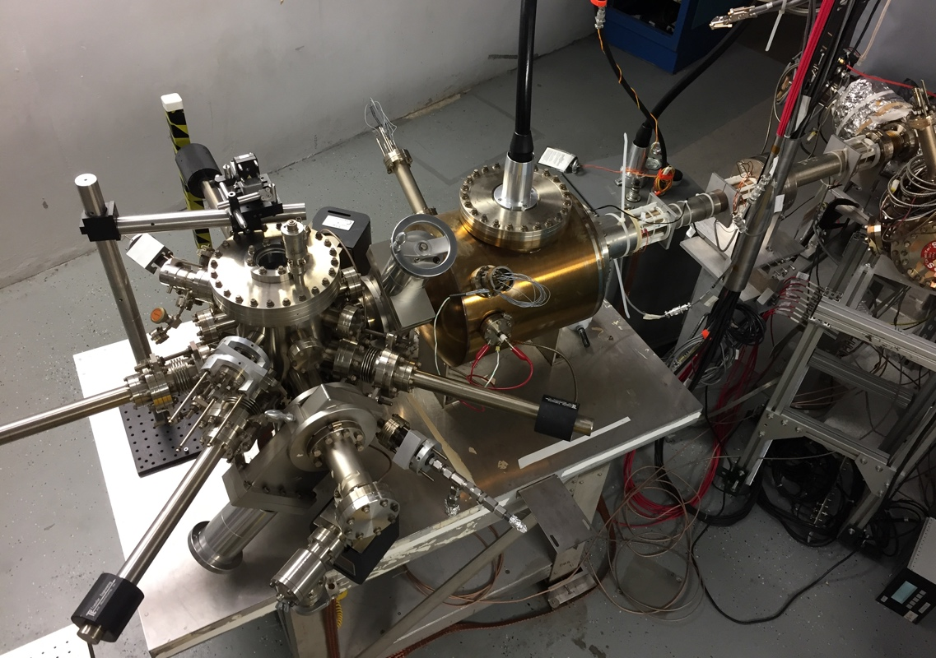
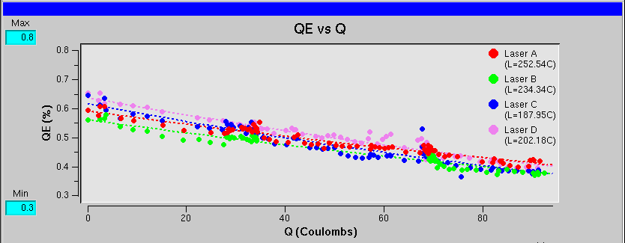
CEBAF polarized electron source
Gun2 Photocathode (Fall 2016 – Spring 2017)
  Lifetime ~200 C (σ_{4D} ~ 1mm) with intensity @ 200 μA
Preparation
Chamber
Activation Laser
HV Chamber
QE = QE₀ e ^{-(Q/Lifetime)}
GaAs
Storage
Loading
Chamber
P. Adderley et al., Phys. Rev. Accel. Beams 13, 010101 (2010)

Slide 18
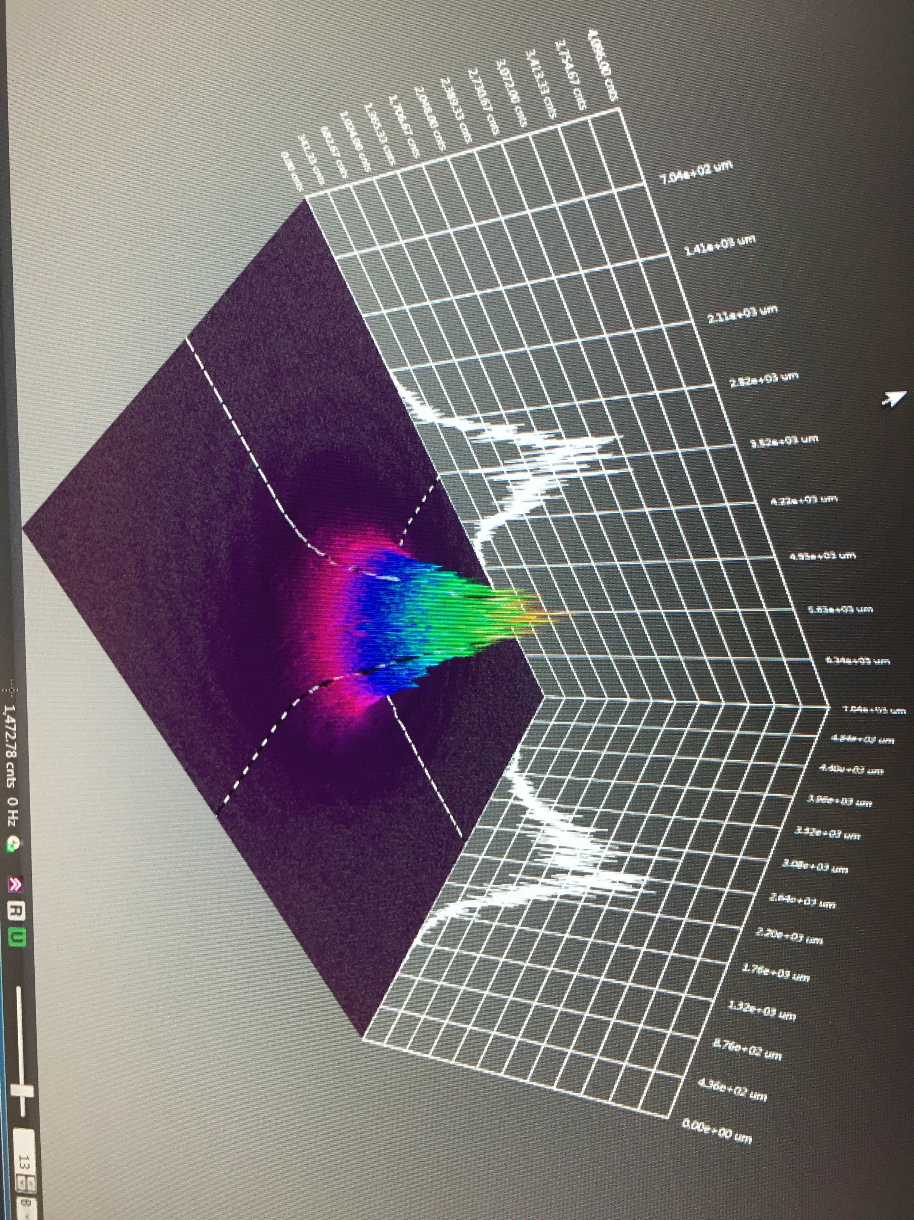

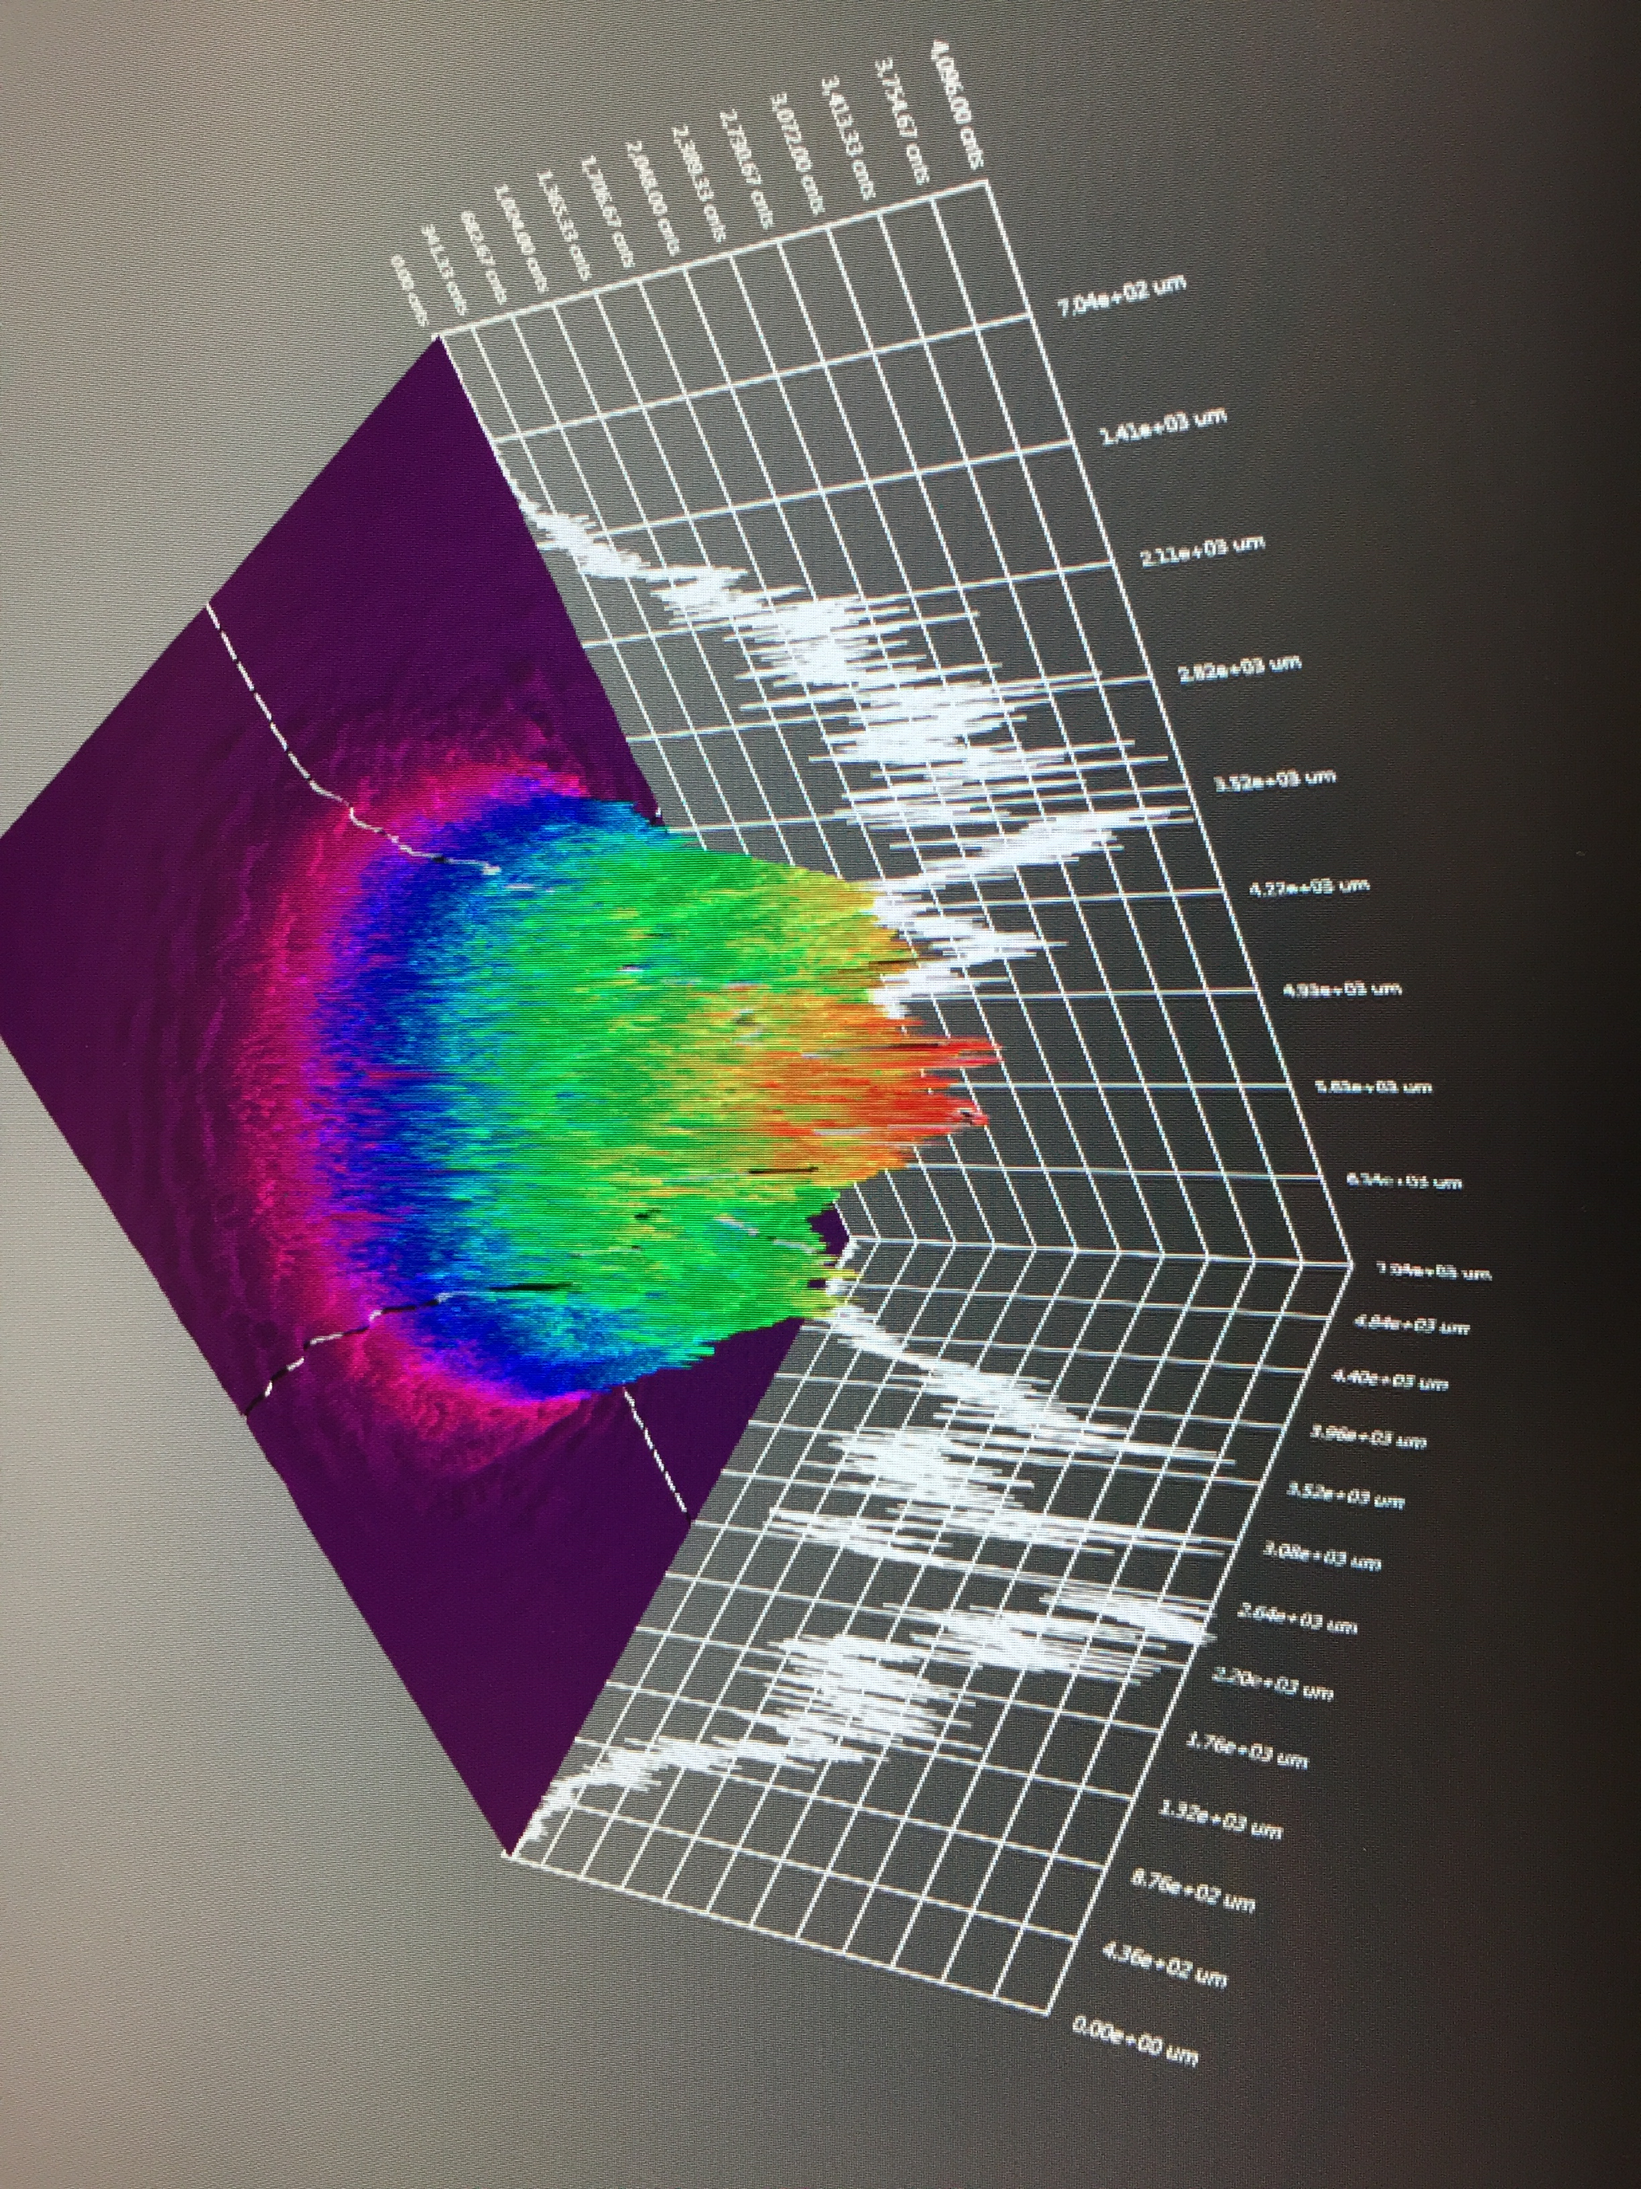
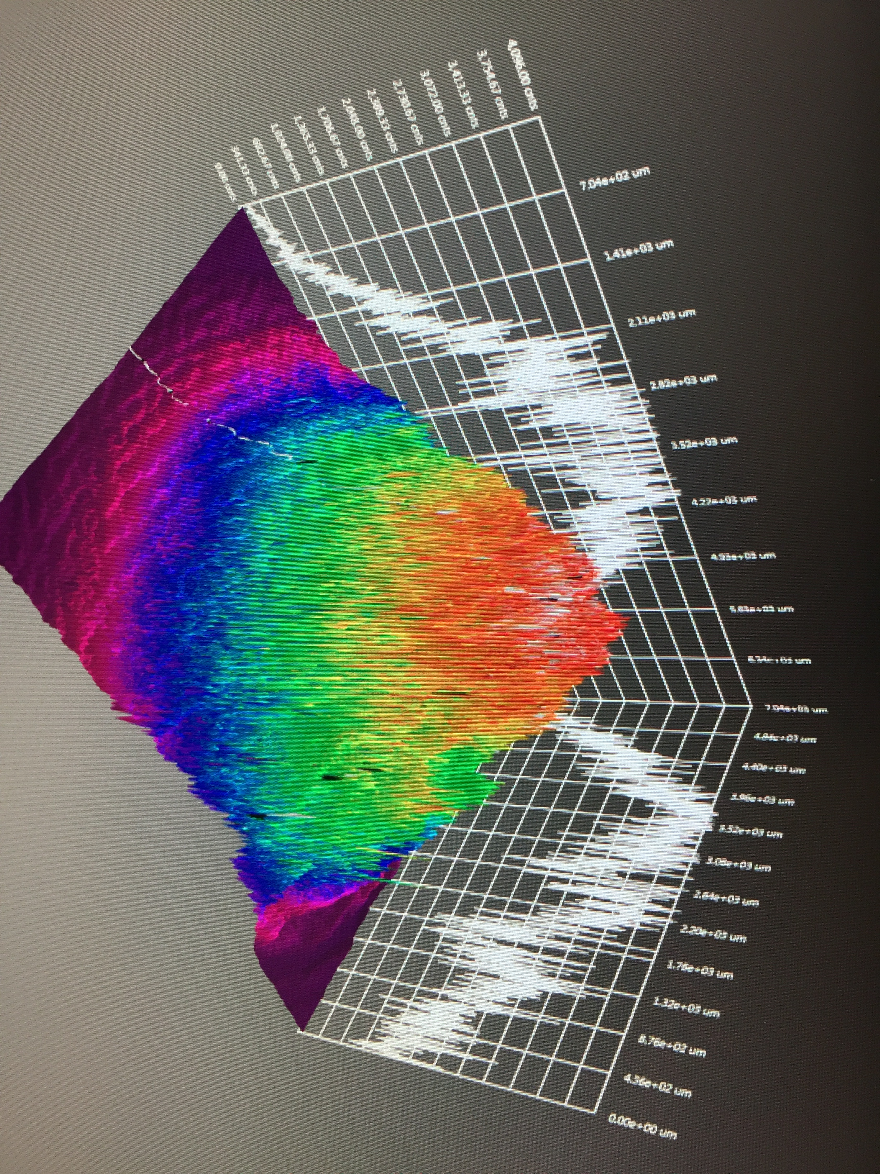
Operating >1 mA for weeks
  By increasing laser size we set our new lifetime record for mA operation (>400 C)
  Eventually size became “too big” for CEBAF gun
  Designing a new photogun to “straighten the curve”
J. Grames, P. Adderley, J. Hansknecht, R. Kazimi, M. Poelker, D. Moser, M. Stutzman, S. Zhang, “Milliampere beam studies using high polarization photocathodes at the CEBAF Photoinjector” Polarized Sources, Targets and Polarimeters Workshop, Dajeon South Korea (2017)
Days
Trend we want to realize

Slide 19
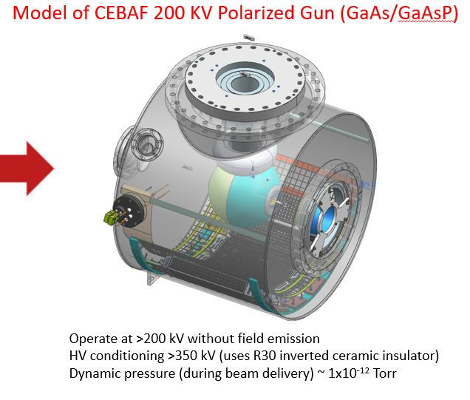
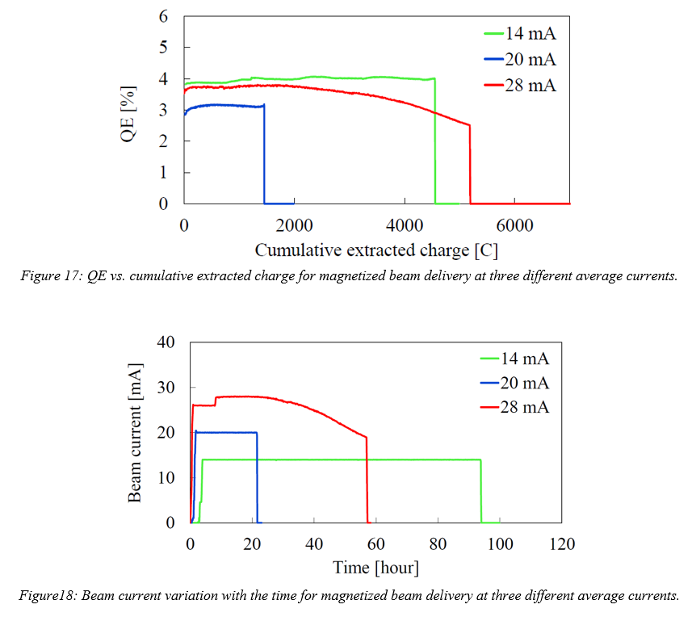
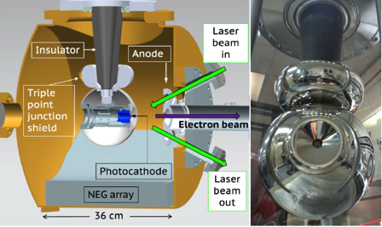
Building a polarized electron source for >1 mA operation
  Applying the experience and lessons learned from the 300 kV unpolarized photogun to build a 200 kV UHV polarized electron source for high polarization photocathodes
300 kV Magnetized Beam Electron Source (Cs_{x}K_{y}Sb)
C. Hernandez-Garcia et al., Phys. Rev. Accel. Beams 22, 113401 (2019)
R30 inverted geometry ceramic insulator
Conditioned to 350 kV
Demonstrated 4.5 mA CW 300 kV, and 28 mA at 100 kV

Slide 20
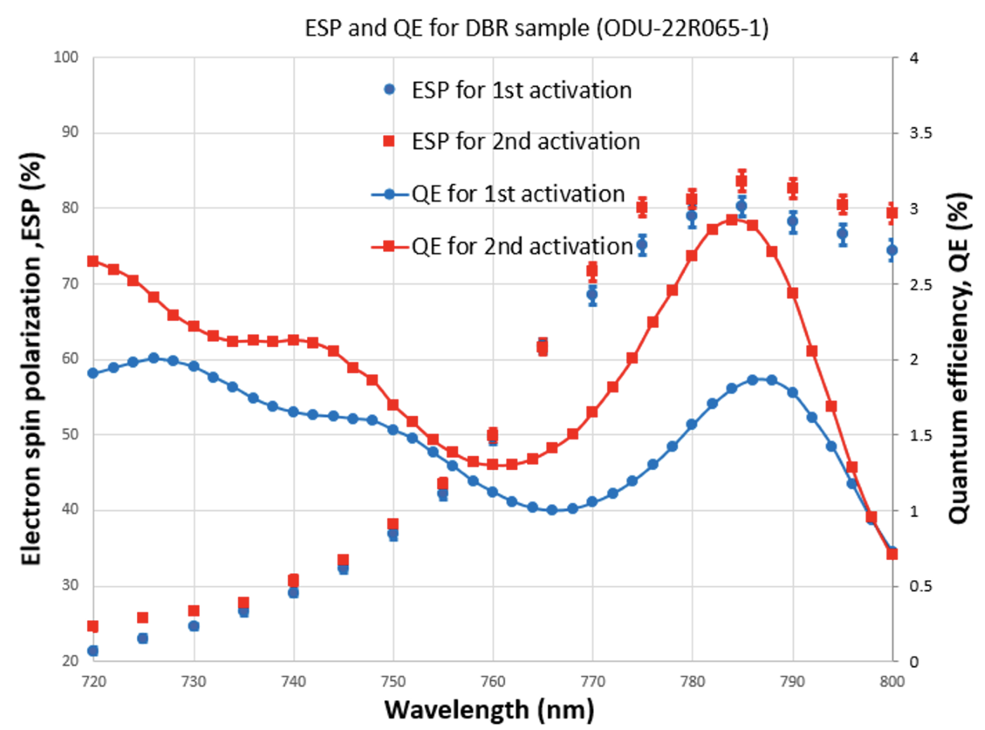
ODU, Ben Belfore’s third photocathode, SSL with DBR
Scarcity of high polarization photocathodes
Successful collaboration between ODU, JLab and BNL, high polarization photocathodes grown via MOCVD
Now we have photocathode material to use for the positron program!
  Pol ~ 83%
  QE ~ 3%
  λ_{peak} ~ 785 nm
Work of Ben Belfore, Wei Liu

Slide 21
Target that can survive >10 kW (100 kW) of beam power
Work of A. Ushakov, IJCLab
Preliminary studies for 120 MeV x 1 milliamp solid rotating target
Beam energy: electron beam with energy of 120 MeV
Beam current: 1 mA (continuous wave, RF frequency of 1497 MHz)
Beam size on target: beam has a Gaussian distribution with RMS size >150 μm. The biggest beam spot size is limited by aperture size of focusing magnet downstream the target
Target material: pure Tungsten
Target thickness: 4 mm
Average power deposited in target: 17 kW
Concept of target cooling: rotating tungsten rim is mounted on water cooled copper disk (could even be fixed target lower power for initial 8 MeV tests)

Slide 22
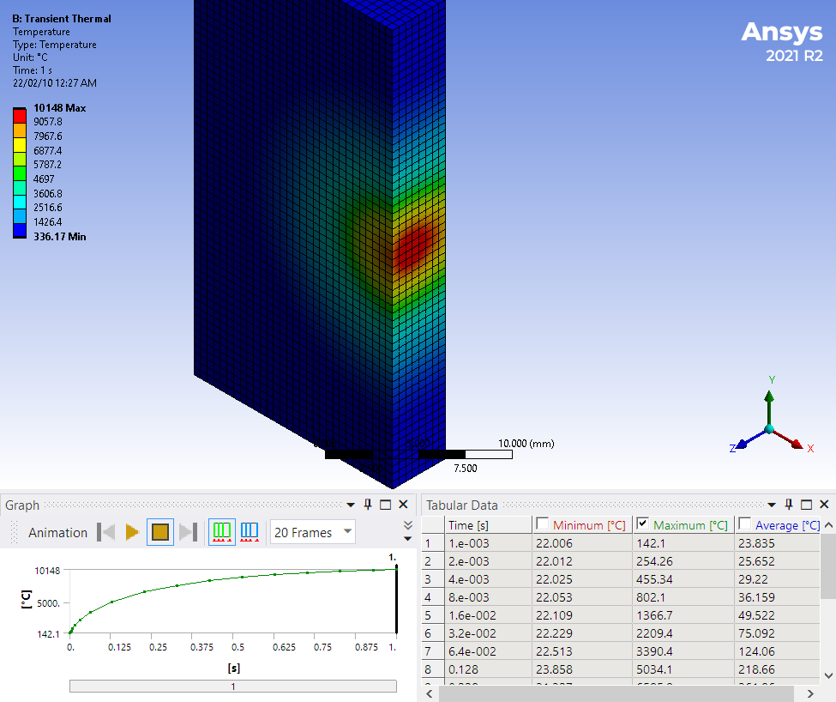
Managing 100 kW of beam power
Work of A. Ushakov, IJCLab
Temperature of Stationary Target
after 1 s
1 mA @ 120 MeV cw electron beam with 1.5 mm RMS size melts the stationary 4 mm thick tungsten target in 64 ms

Slide 23
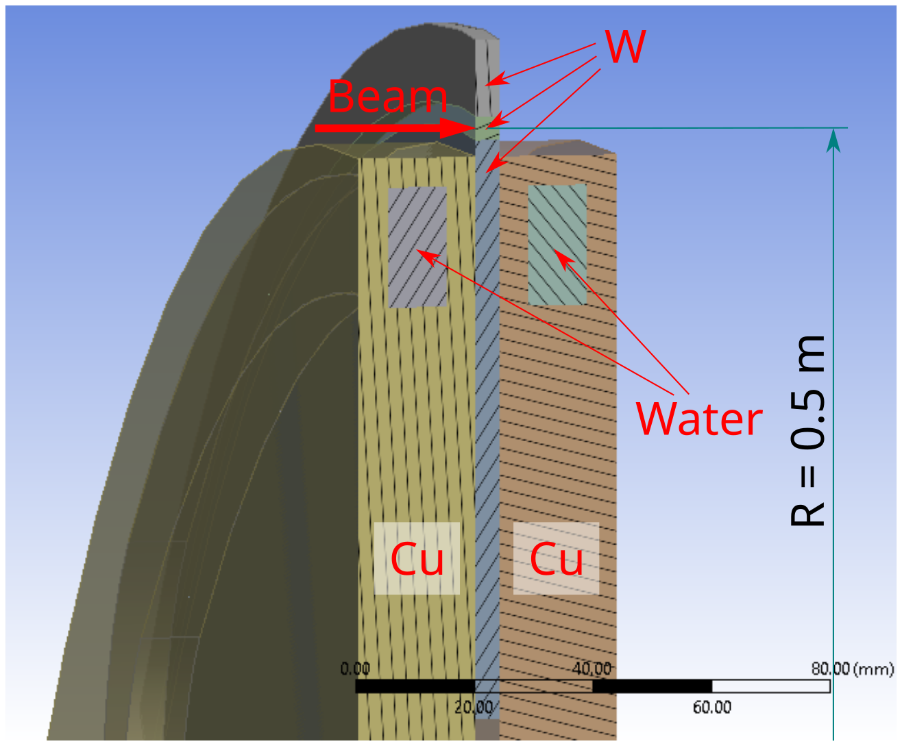
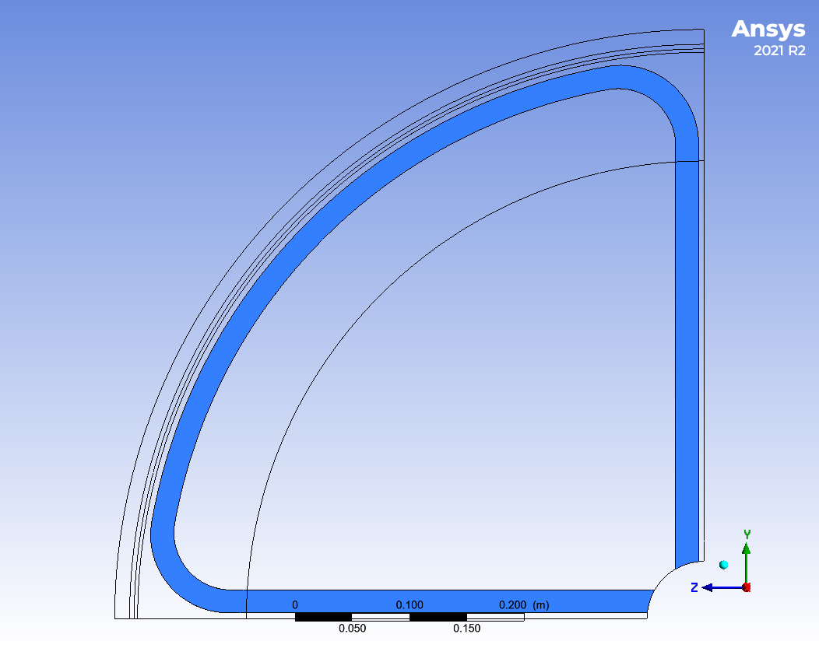
Water cooled rotating tungsten target
Work of A. Ushakov, IJCLab
W Rim Cooled from One Side by Copper Disk with 10mm x 20mm Cross Section of Water Channel and 2 m/s Flow (ANSYS Fluent)
Beam Passing through the Target at Radius of 0.5 m

Slide 24
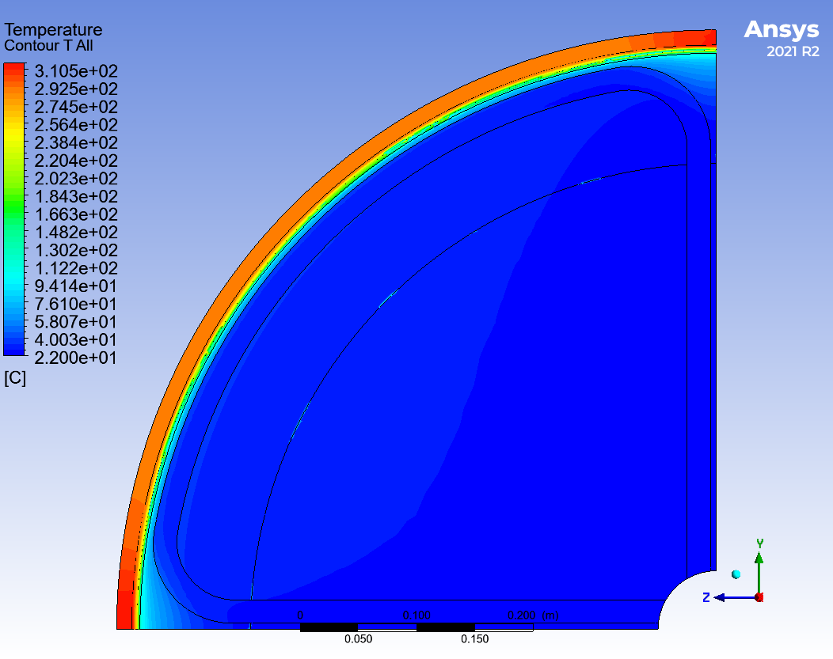
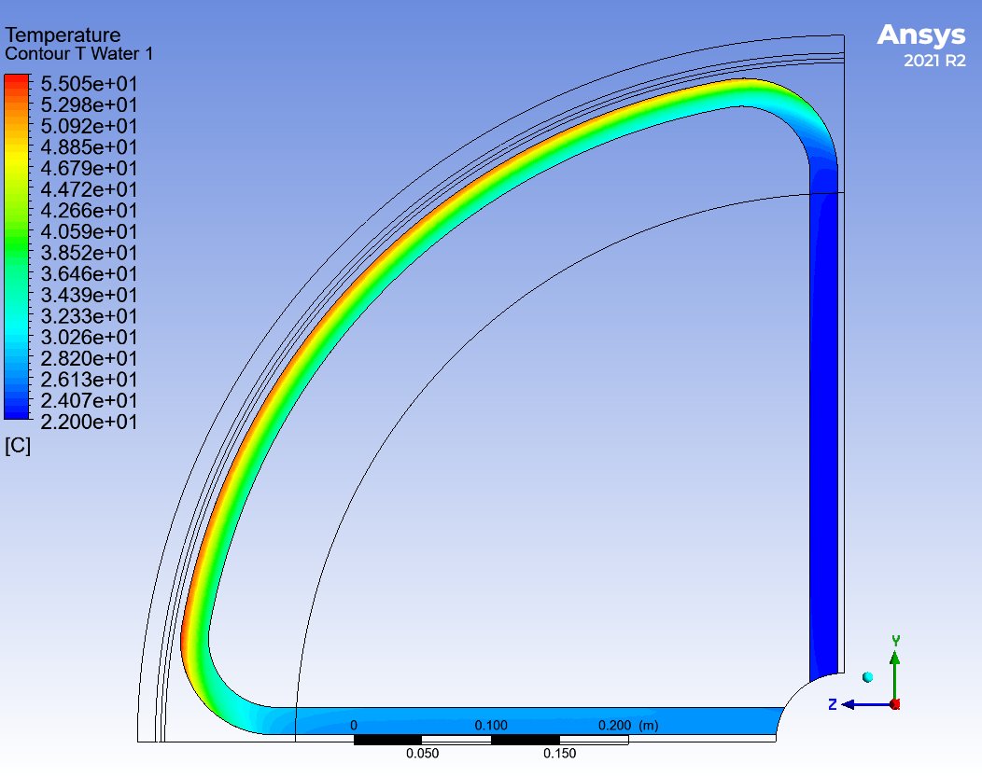
Exploring “DC” thermal load
Work of A. Ushakov, IJCLab
Average Temperature of Tungsten and Copper (left) and Temperature of Water (right)
T_{max} = 310 °C
T_{max} = 55 °C
24

Slide 25
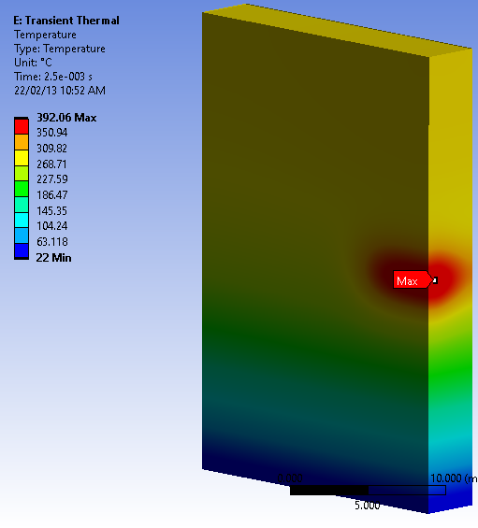
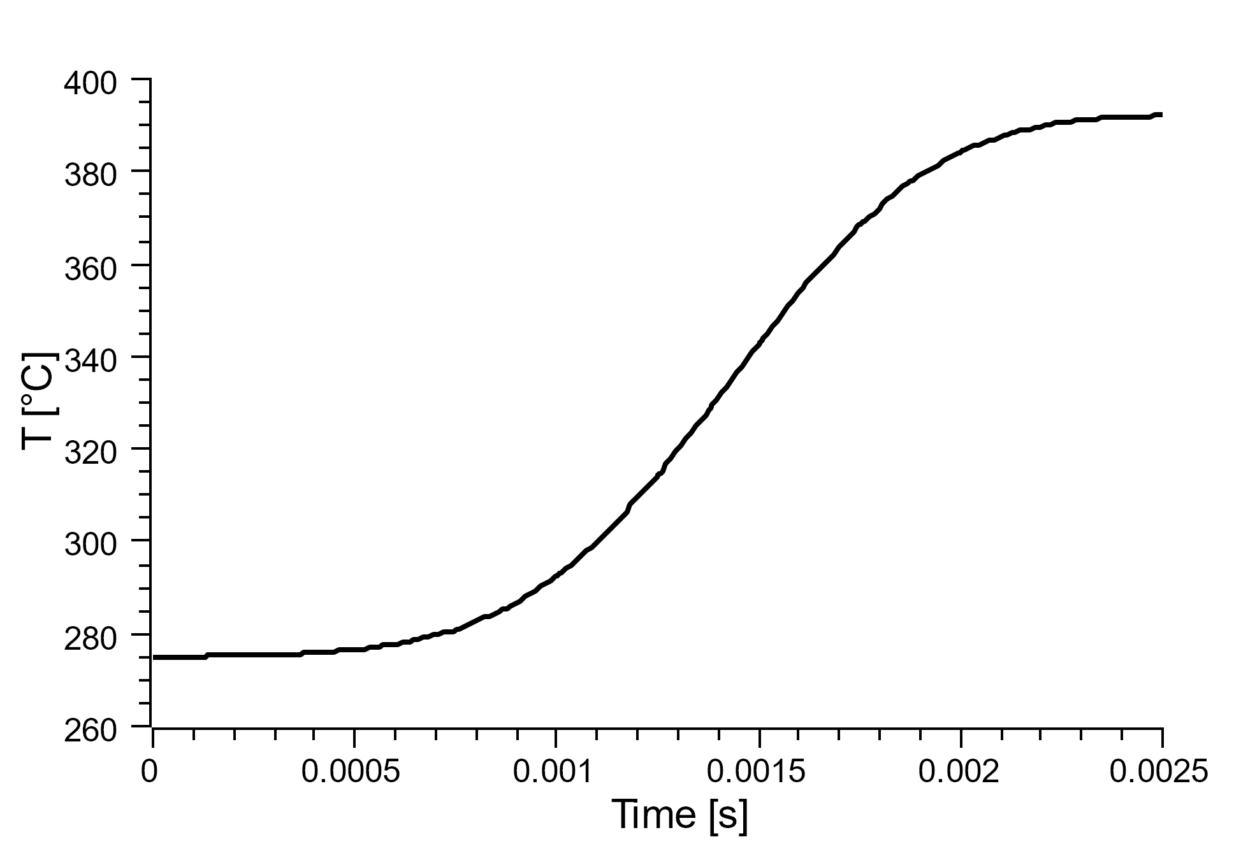
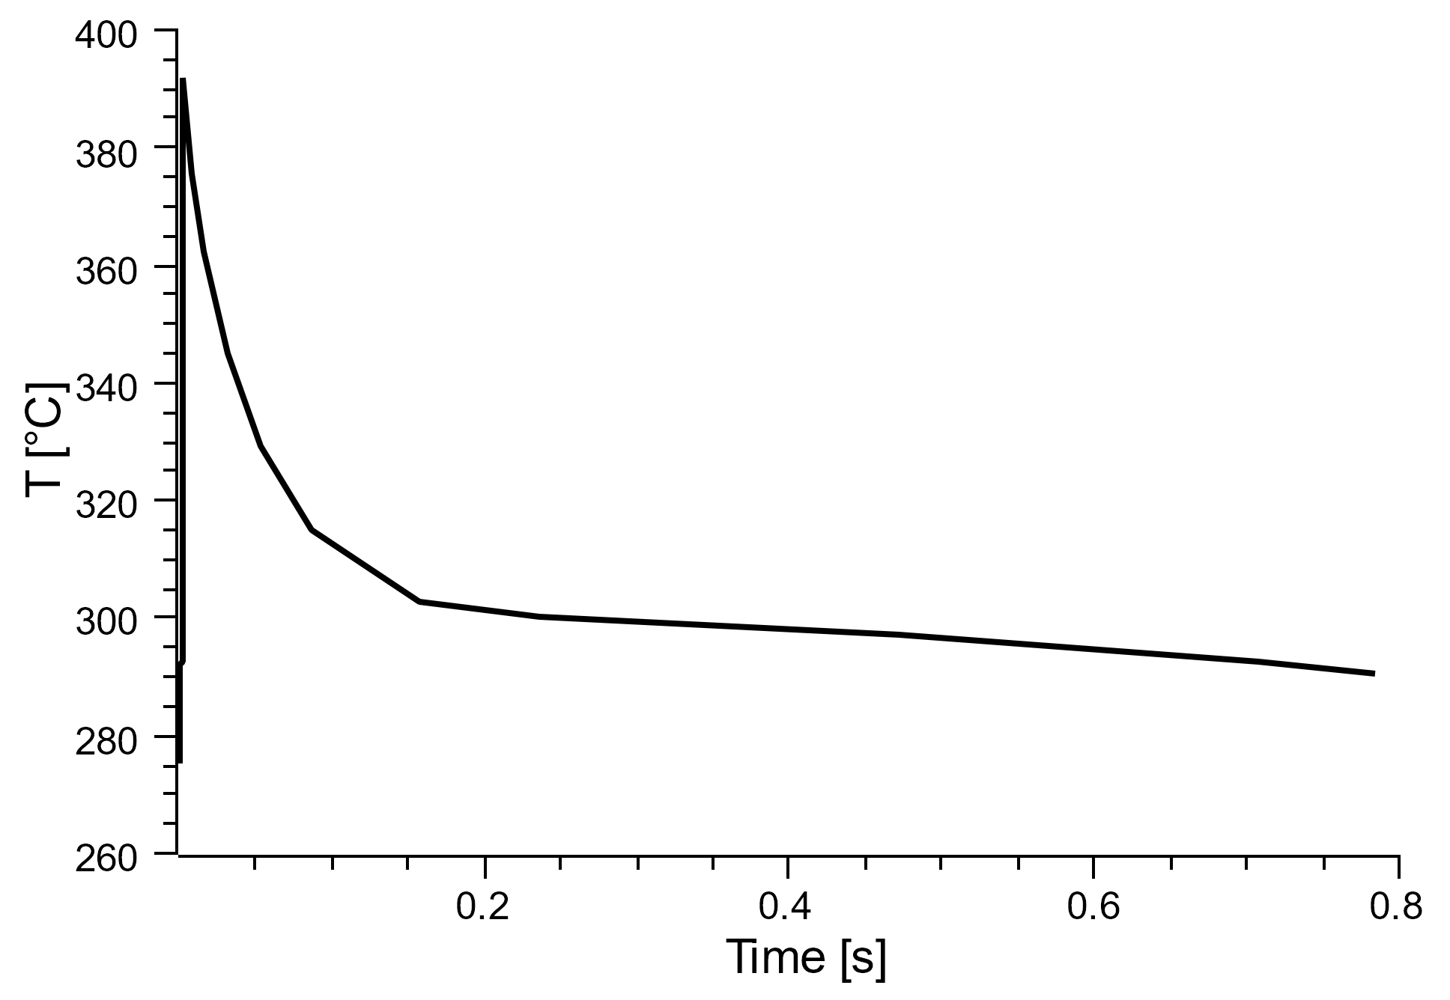
Thermal cycling for a spinning target
Probe of Temperature T vs Time at Selected Point on Target moving with 4 m/s
(R = 50 cm)
Work of A. Ushakov, IJCLab
Snapshot of T after 2.5 ms
Temperature vs time t for 0 < t < 2.5 ms
(1.5 mm RMS beam size)
One Thermal Cycle
(3.14 m / 4 m/s = 0.785 s)
ΔT_{max} ≈ 118 °C
Temperature rise during one full rotation of JLab positron target on top of average T

Slide 26
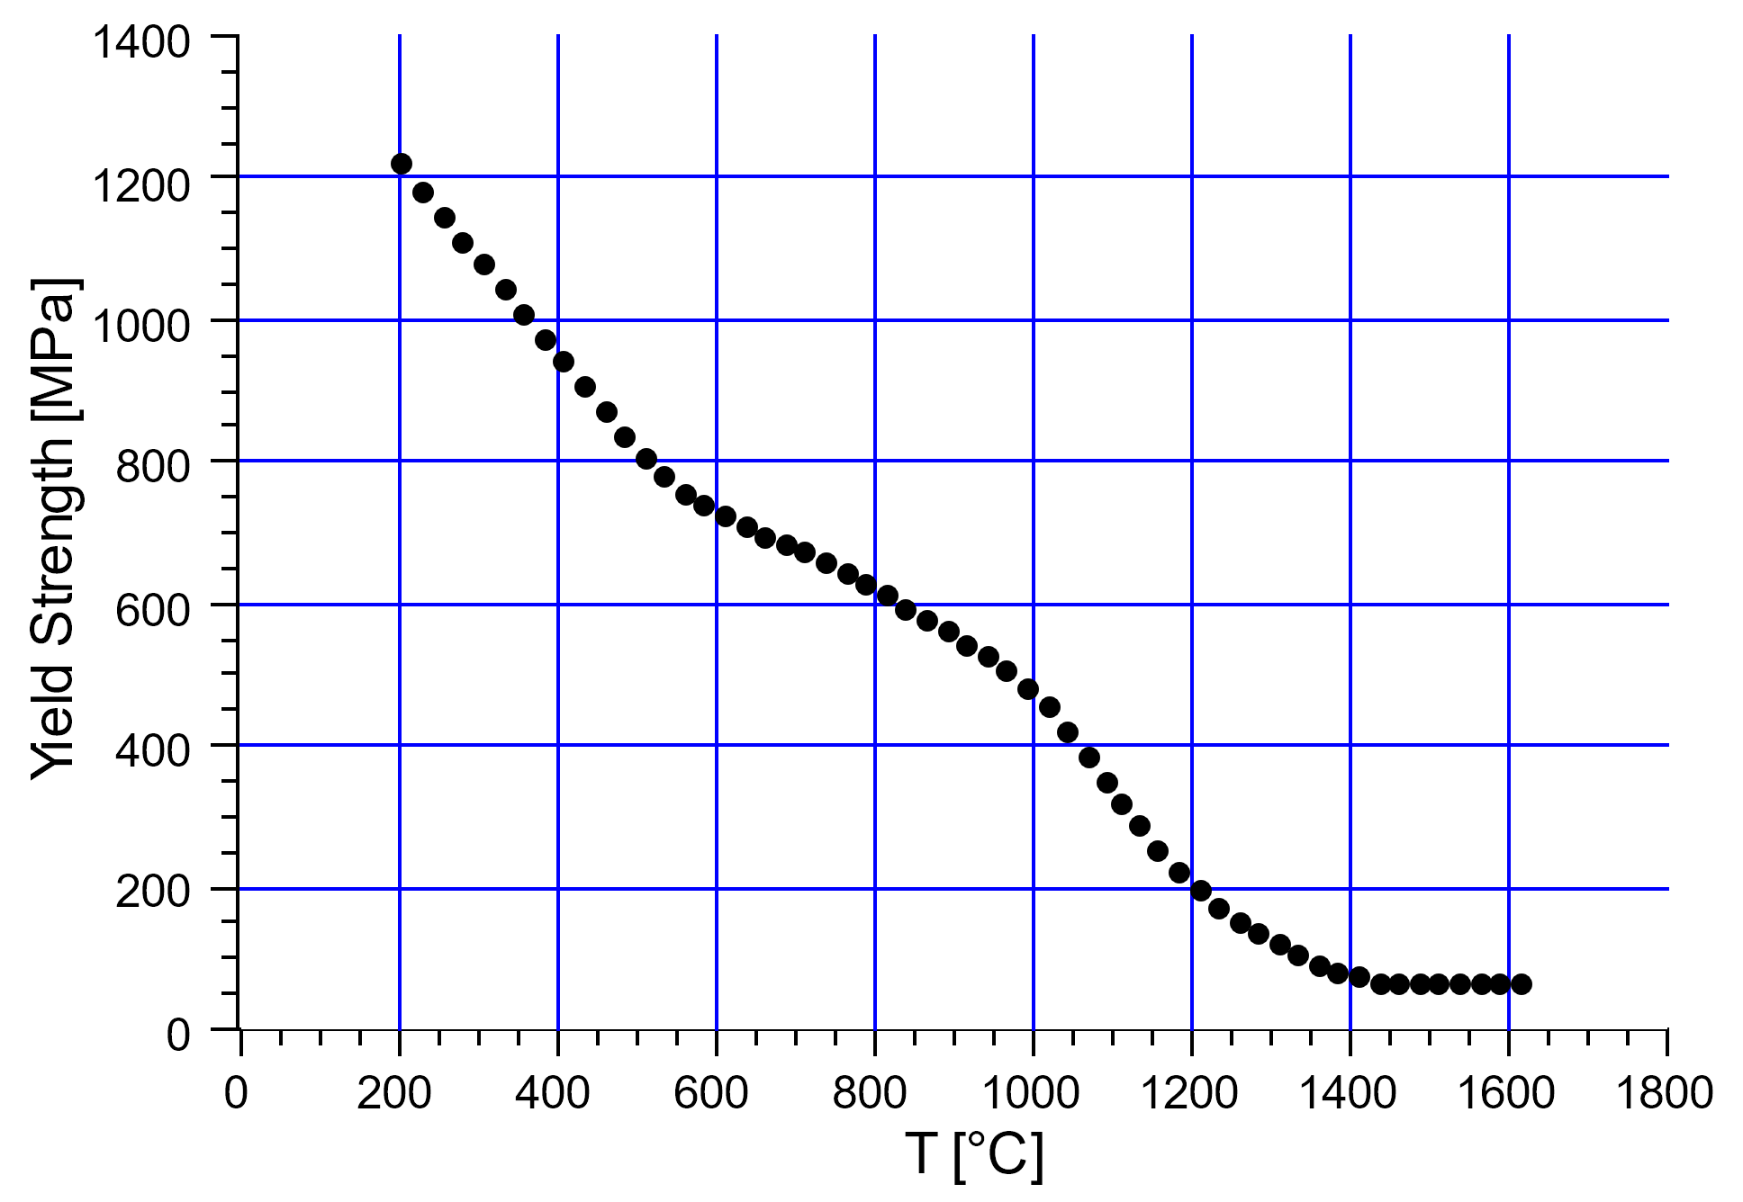
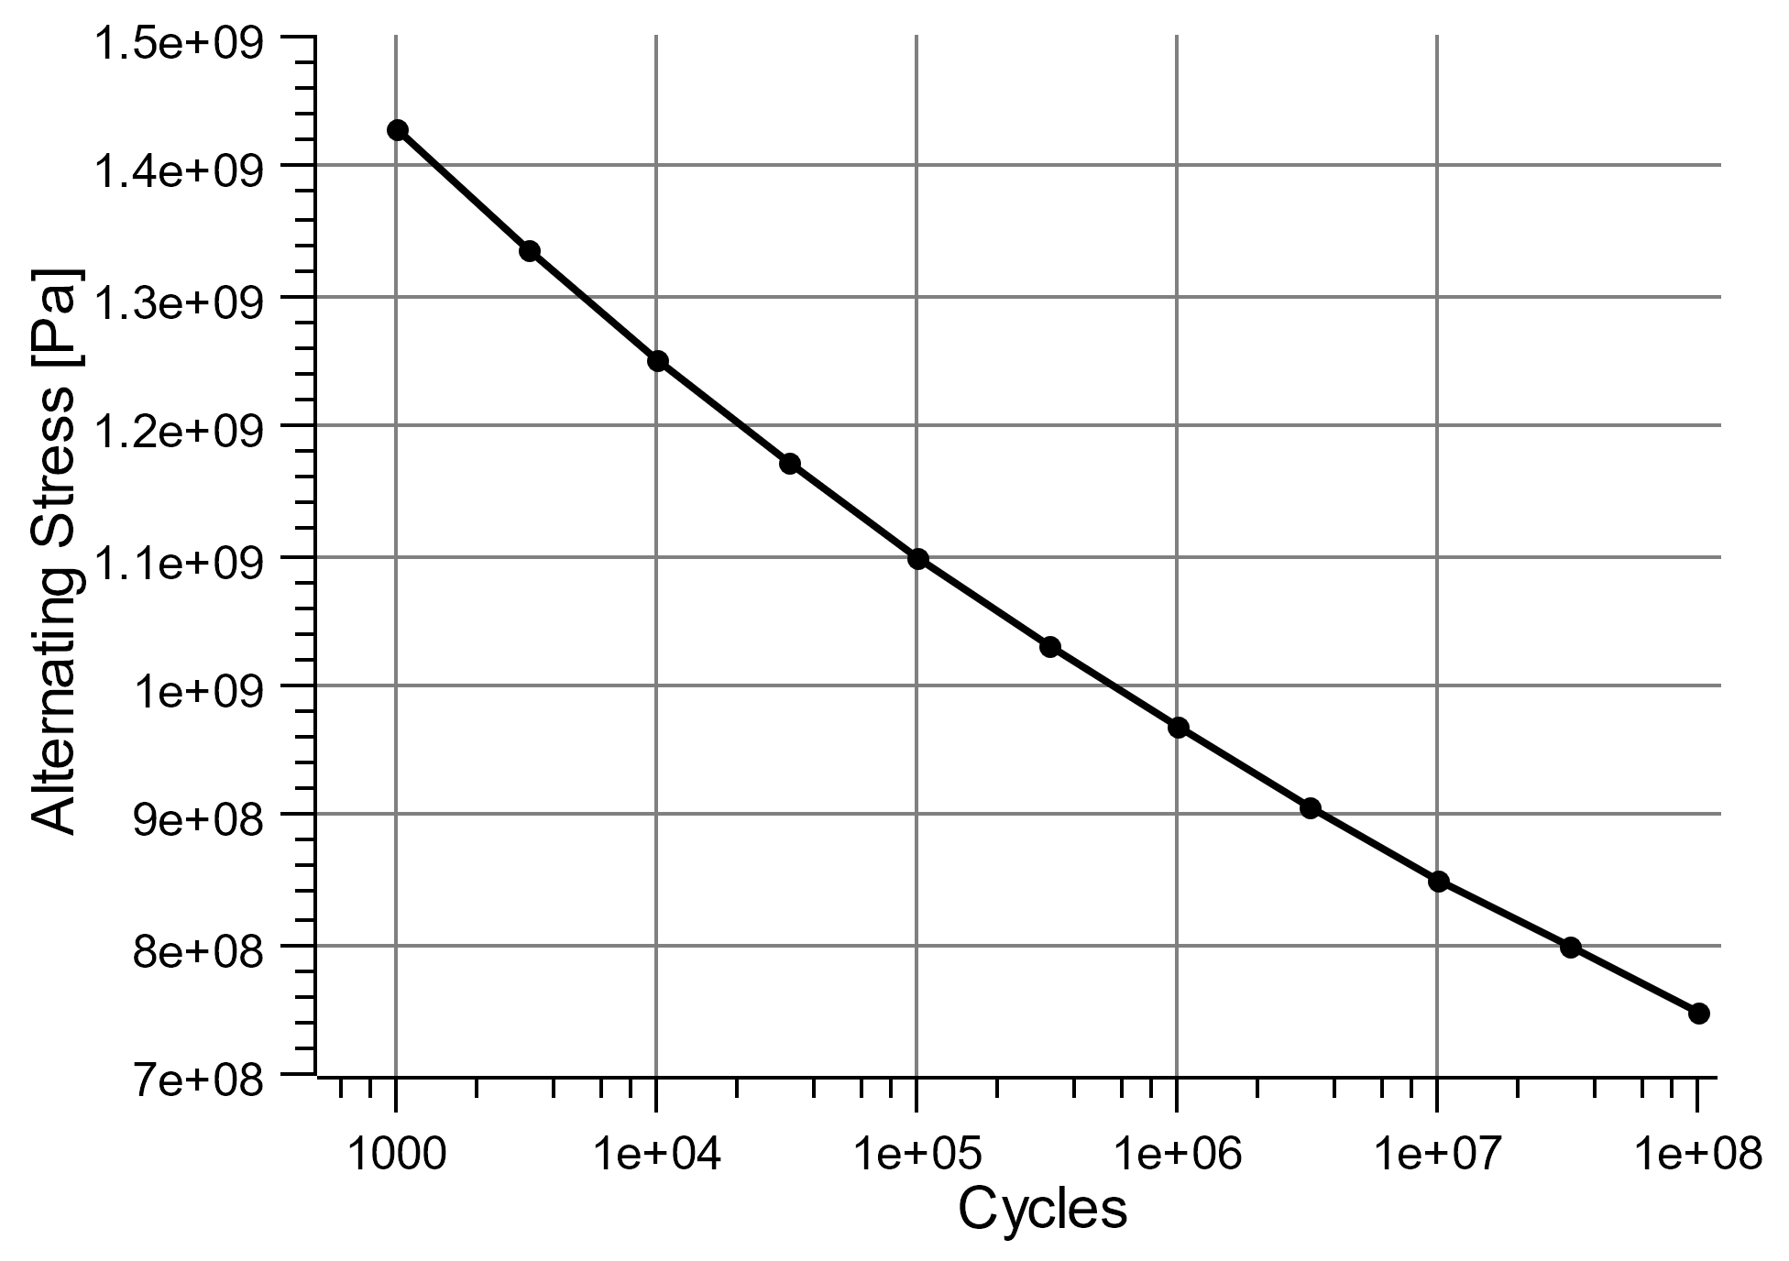
Operating 100 kW target for 1 year
Work of A. Ushakov, IJCLab
Average Thermal Stress (Equivalent von-Mises Stress, left) and
Yield Strength of Tungsten vs Temperature (right) for Two Cooling Channels
Thermal
Stress
Tungsten produced
by Plansee
Thermal
Cycling
For 5000 h of source operation and 0.875 s cycles: 2.3E+7 of thermal cycles limit the tolerable alternating stress.

Slide 27
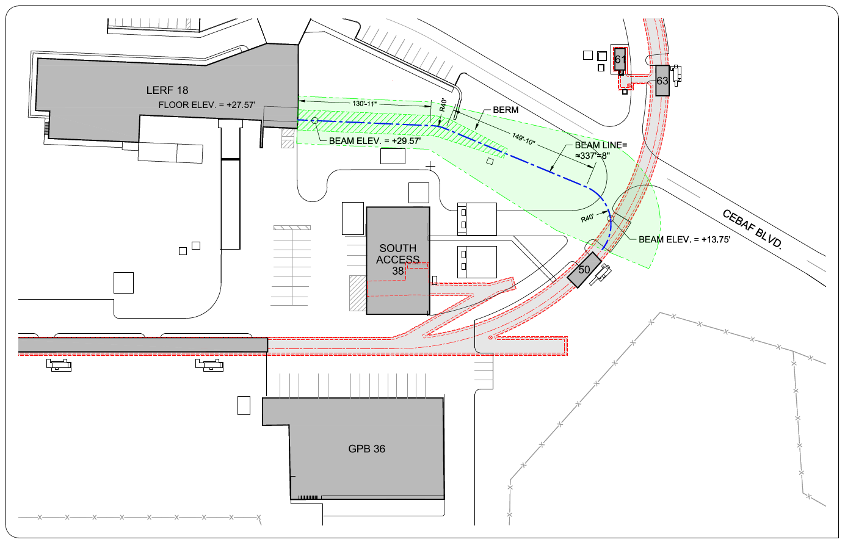
Work of Joel Dobeck

Slide 28
Positron R&D extends further…
Positron R&D goes beyond the gun group….CASA, ENG, INJ, SRF
Not covered today … but opportunities for future talks:
Reversing polarity of CEBAF magnets
Transport of e+ to 12 GeV
High energy spin rotators
High power GaInSn liquid metal target (proposed by Xelera)
Integration to CEBAF injector
Good news, our positron R&D is NOT in conflict with 20+ GeV CEBAF
What we learn at LERF is broadly applicable to CEBAF (cw beams, polarization from electrons)
Meshes nicely with future-of-JLab options (variants for 100 MeV, 650 MeV, etc.)

Slide 29
Conclusions
Finish the CEBAF injector upgrade, this frees up labor
After installing the new booster at CEBAF, we move existing CEBAF ¼ CM to the LERF, or get the existing LERF ¼ CM fixed
Install a 350 kV load locked gun at LERF, making 8 MeV polarized electron beam 1 mA
Design and build a 10 kW prototype target, 0.5 Tesla magnet and the e-/e+ beam lines
In five years we make >100 nA positron beams, this means with good beam quality, suitable for acceleration

Slide 30
Acknowledgments
Many have contributed to our positron R&D
Alex Bogacz, JLab
Alicia Hofler, JLab
Amy Sy, JLab
Andriy Ushakov, IJCLab-Orsay
Carlos Hernandez-Garcia, JLab
Cristhian Valerio, Univ. of Sinoloa
Dennis Turner, JLab
  Eric Voutier, IJCLab-Orsay
  Fanglei Lin, ORNL
  Jay Benesch, JLab
  Karl Smolenski, Xelera
  Larry Cardman, JLab
  Reza Kazimi, JLab
  Ryan Bodenstein
  Ryan Richards, Univ. of Virginia
  Sami Habet, IJCLab-Orsay
  Stephen Brooks, BNL
  Joe Grames, JLab
  Val Kolstrum, Xelera
  Yuhong Zhang, JLab
  Yves Roblin, JLab
Joe and Eric continue to fan and feed and push things along

Slide 31
Backup Slides

Slide 32
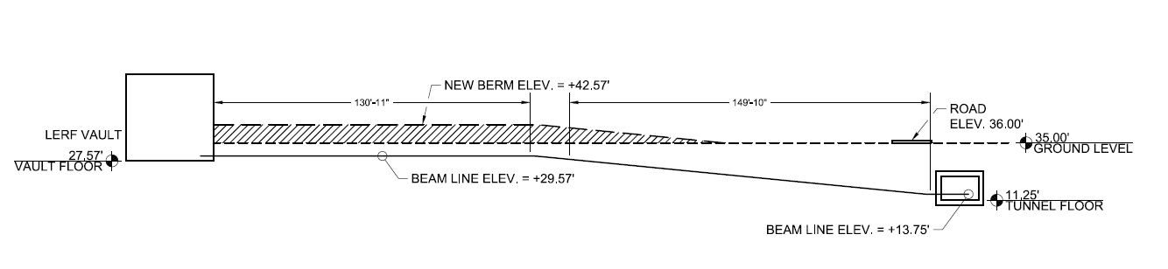
Work of Joel Dobeck

Slide 33


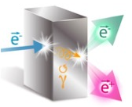
Exploit electron spin polarization to produce polarized positrons
Polarized Bremsstrahlung
Polarized Pair Creation
P_{circ}(γ) / P_{z} (e⁻)
P_{z} (e⁺) / P_{circ} (γ)
Longitudinal spin polarization passes from incident electrons to outgoing pair-produced positrons in the electromagnetic shower, when incident on a target, e.g. high-Z material useful.
E_{γ} / T_{e-}
T_{e+} / (E_{γ} – 2m_{e+})
E.A. Kuraev, Y.M. Bystritskiy, M. Shatnev, E.Tomasi-Gustafsson, PRC 81 (2010) 055208

Slide 34

12 GeV CEBAF : Polarized Electron or Polarized Positron Beams
Capability | Electrons | Positrons
Hall Multiplicity | 4 | 4
Max Energy | 12 GeV | 12 GeV
Beam Frequencies | 249/499 MHz – cw | 249/499 Mhz – cw
Unpolarized intensity | >200 uA | >1 uA
Polarized intensity | >200 uA | >50 nA
Polarization | > 85% | > 60%
Fast/Slow Helicity Reversal | Yes | Yes
2020 JLAAC Recommendations
  “R6: Augment the scientific case with a plan to translate the R&D into a realistic facility.”
  “R7: Include radiation protection considerations into the evaluation of the electron beam energy choice.”

Slide 35
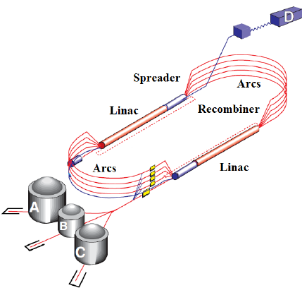
CEBAF 12 GeV : Transverse Emittance* and Energy Spread†
Large e+ initial dp/p and emittance damped adiabatically unitl SR in upper arcs
Whereas e- parameters grow, e+ parameters improve to 10-12 GeV (sim to e-)
Values are provided at the end of each segment. For positron this is up to pass 5 extraction, for electrons it goes all the way to hall D.
* Emittances are geometric
† Quantities are rms

Slide 36
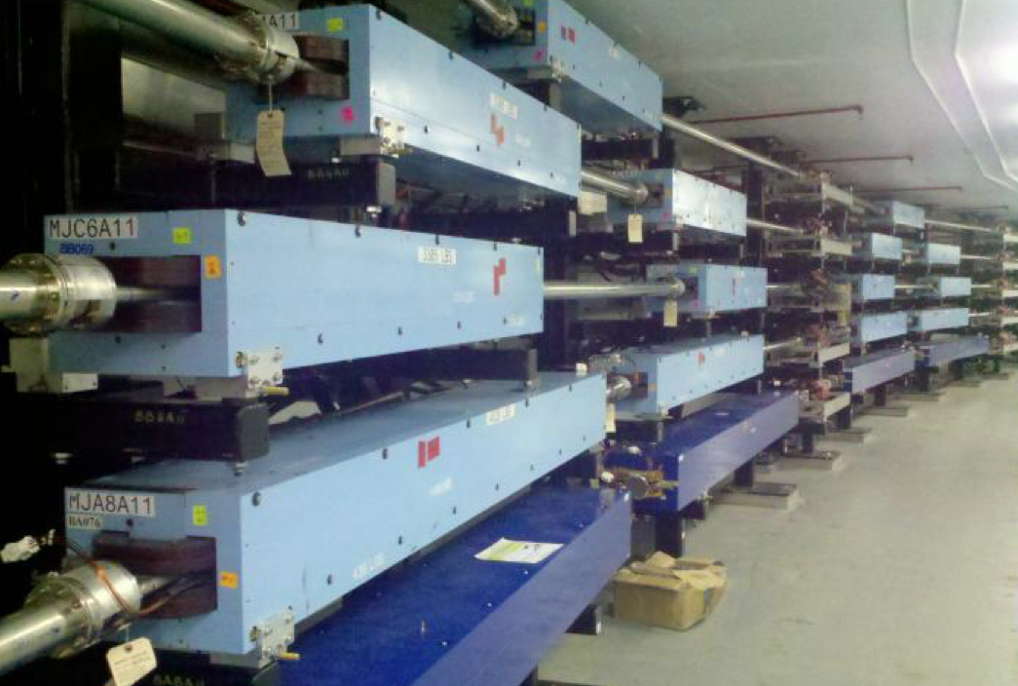
CEBAF 12 GeV : Magnetic Transport System
Reversing polarity of 2100 CEBAF magnets – S. Philips (DC Power)
>1900 (correctors & quads) already bipolar operation
39 (recirculation/transport dipoles) will require engineered solution
  21 recirculation & dog-leg
  12 extraction units
  6 end-station transport/dump
$1M – Remote PS switches, shunt modules, firmware, PSS integration
Hall D is only permanent magnet – would have to be rotated
Magnetic Field Integrity – M. Tiefenback (Magnet Integrator)
Unipolar dipoles would need to be deliberately tested
  demonstrate field restores after polarity inversion
  quantify possible systematic effects
Soft iron steel are expected to perform well under polarity reversal
Two decades of operation suggest remnant fields <20 G tolerable
  Sudden power supply trips introduce uncontrolled flux
  Modifications to power supplies or field maps

Slide 37


Improving charge lifetime of polarized electron source
Photocathode QE starts high ~1%, but deteriorates via ionized gas bombardment
Distributing ion damage over large area reduces rate of deterioration
Ionized residual gas bombards the photocathode, lowers quantum efficiency, limits charge lifetime.
Charge lifetime increased by four when doubling the laser spot size from 0.5 mm to 1.0 mm (fwhm)

Slide 38
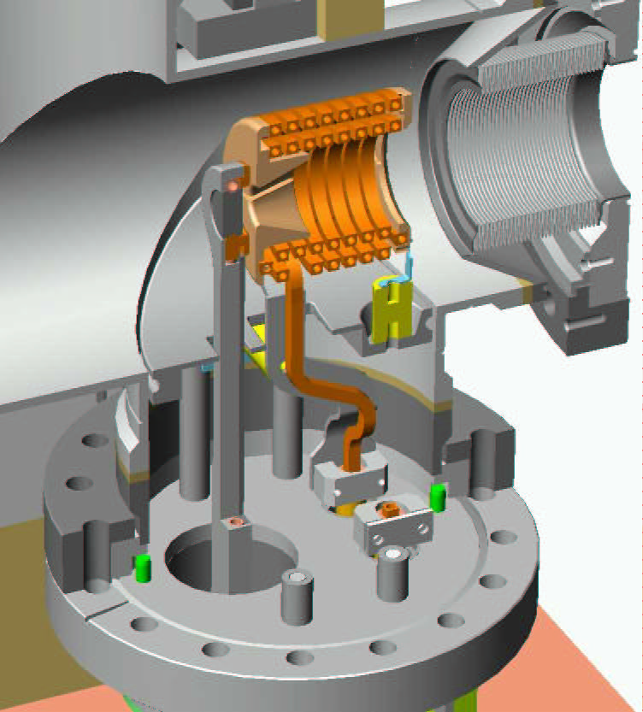
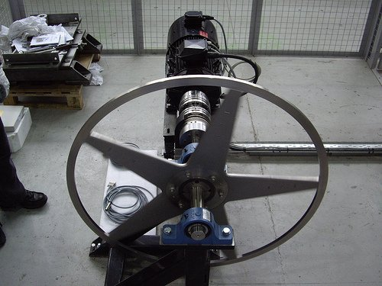
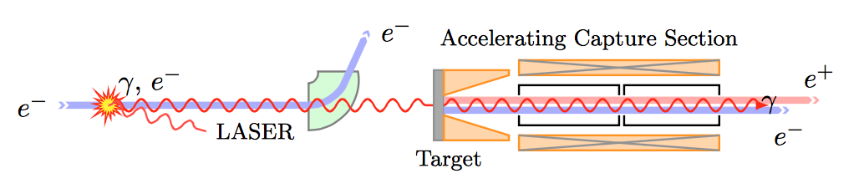
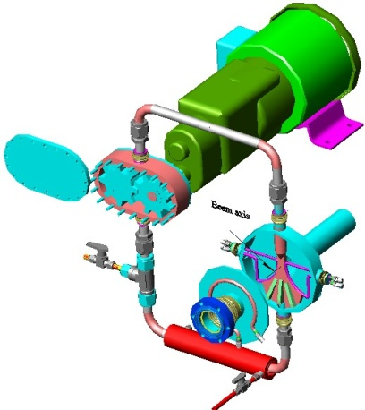
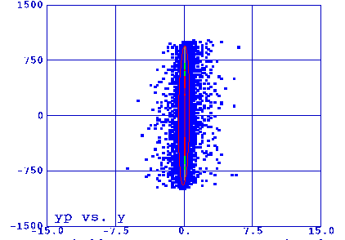
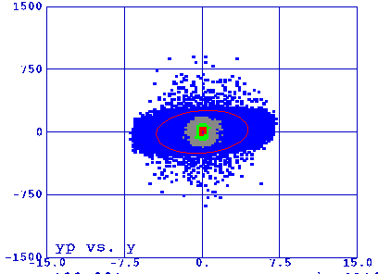
e+ collection technology for ~8 MeV, and then 100 MeV…
DC collection magnet (high rad, 0.5 -> 1.5 Tesla)
Large acceptance collection cavity
Managing magnetized e+ beams
J. Barley, V. Medjidzade, A. Mikhailichenko
“New Positron Source for CESR”
W Target
Flux concentrator
angle

