Slide 1
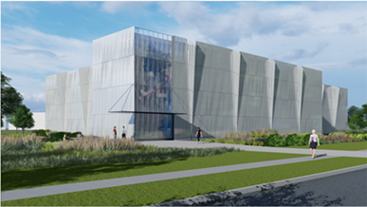
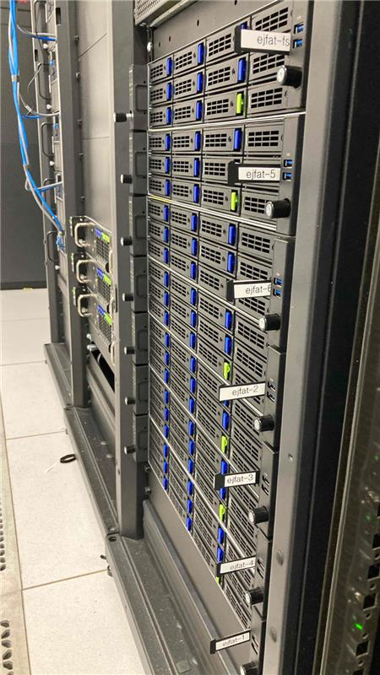

Data Science: HPDF
Amber Boehnlein
June 15, 2022

Slide 2
Outline
Scientific Computing at Jefferson Lab
The National Context: Integrated Research Infrastructure
High Performance Data Facility

Slide 3
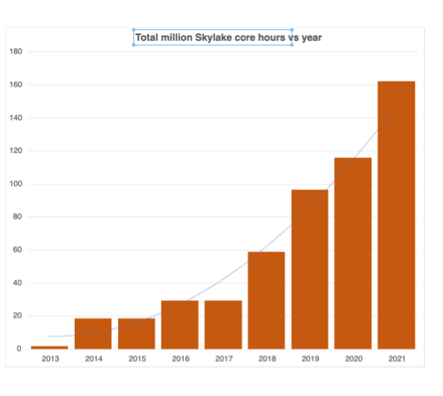
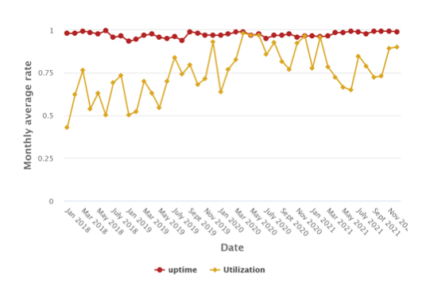
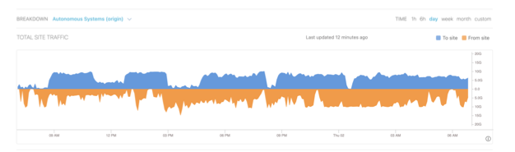
Scientific Computing at Jefferson Lab
In 2017, we adopted design
criteria to support the 12 GeV
experimental program
  Facilitate reduced time to science
    Improve the service delivery of
    the onsite resources
    Embrace a distributed computing
    model via OSG
  Integrate (in preference to creating)
    This creates a standard environment
    aligned with the LHC community
  In 2018, we articulated a
  ‘Grand Challenge’

Slide 4
Grand Challenge in Readout and Analysis for Femtoscale Science
See the buzzwords!!!
Streaming
Calibration/ML
Distributed Computing
Heterogeneous
Statistical Methods
Credit: Rolf Ent

Slide 5
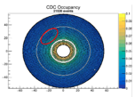
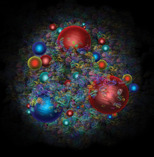
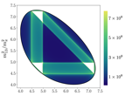
Nuclear Physics Discovery Paradigm
Elucidating the structure and dynamics of the proton requires new systems:
  Experiment: Redraw the boundaries between online and offline
    12 GeV and EIC
  LQCD as a data source
    Advances in algorithms and computational power
  Global Analysis—integrate across all relevant data sources
    Legacy and 12GeV and EIC
Monitoring
Experiment
Streaming
Readout
Simulation
Calibration
LQCD gauge config.
Reconstruction
Physics amplitudes
Analysis
QCD theory
Spatial and momentum Distributions
Visualization
and global analysis

Slide 6


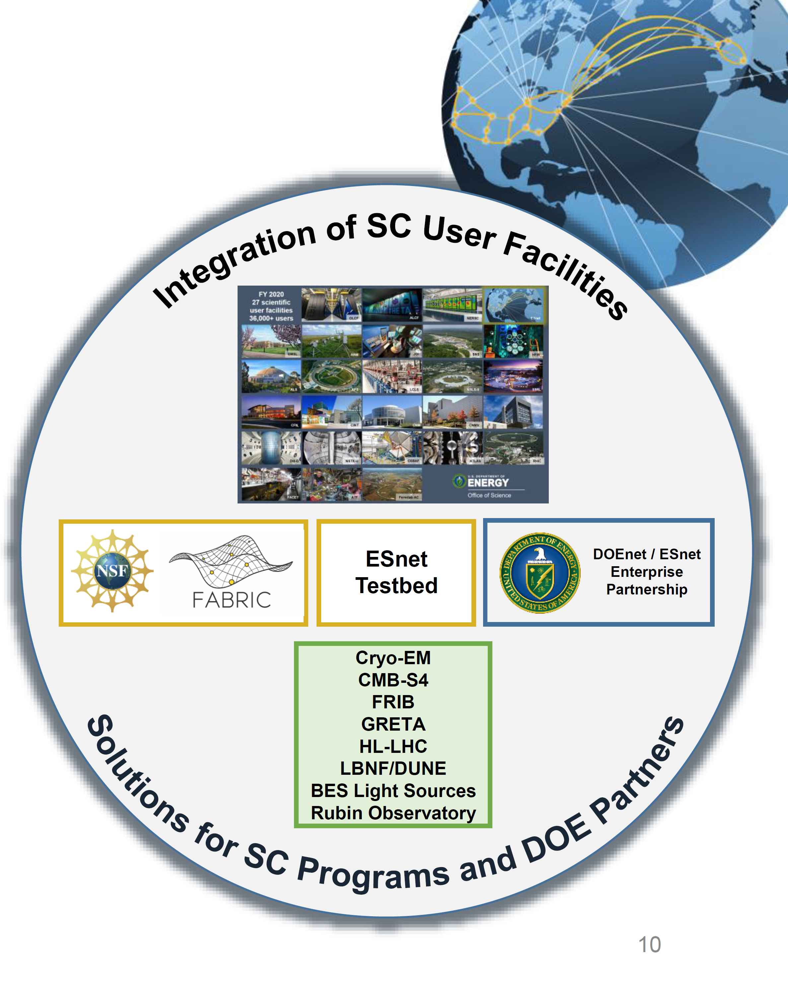
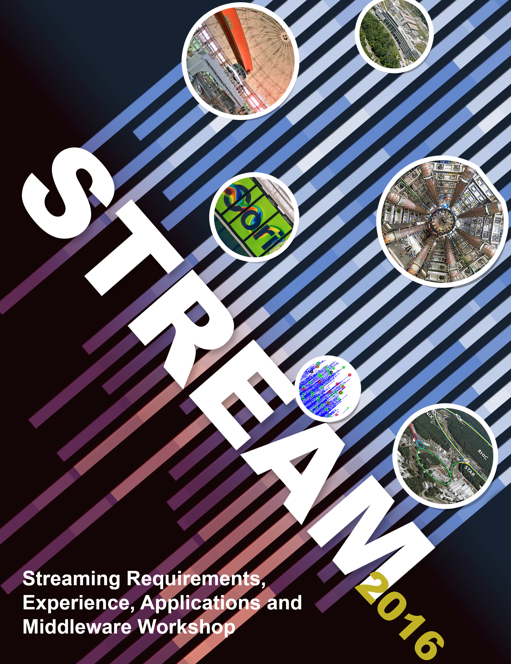
National Context
Most scientific communities have a similar discovery paradigm
  Details differ; implementations differ
The large facilities have historically focused on computationally intensive workloads
  Not well tuned for experimental workloads
DOE User Facilities generate a lot of experimental, observational, and computational data
  Tends to be ‘managed’ in-house for the benefit of a scientific community
DOE User Facilities also have data gaps
  Self-Driving Facilities require significant instrumentation and Operational Technology
Adoption of FAIR data principles is essential
  Findable, Accessible, Interoperable, Reproducible
Community studies have articulated the need for a data-centered high performance computing facility

Slide 7
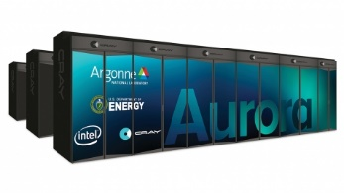
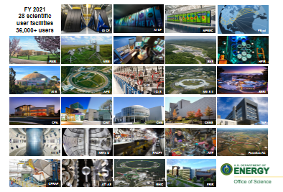
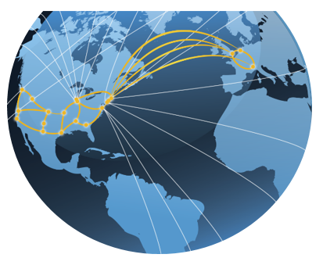

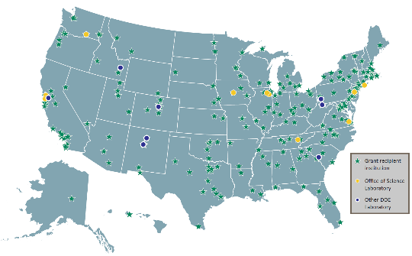
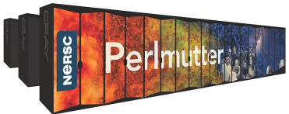
Our vision: A DOE integrated research ecosystem that transforms science via seamless interoperability
ALCF
Computational and Data Infrastructure,
tied together by ESnet and data services
Experimental and Observational
User Facilities
ESnet
OLCF
Researchers
Simulation & modeling
AI Tools
Digital Twins
Sensors
at the edge
wireless
testbeds
Data Repositories
PuRE Data Assets
Exascale Computing
Extreme-scale Data Tools
High Performance Data Facility
Laboratory
Compute Assets
NERSC
Credit: Ben Brown, ASCR

Slide 8

Realizing the vision
Integrated Research Infrastructure
(IRI)
  There is a DOE activity in program to
  develop the architectural blueprint for the software (ABA)
  Full utilization of modern programmable networking technology
  Hardware resources designed for data workloads: High Performance Data Facility

Slide 9
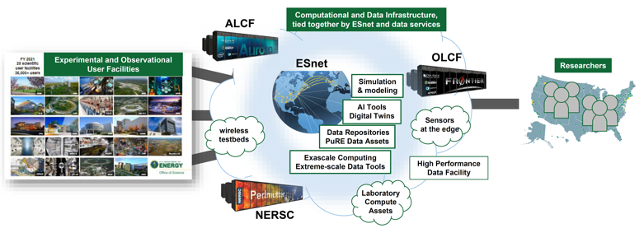
HPDF will integrate data, theory, and experiment
Scientific community recognizes the need for a data-focused high performance computing facility
Focused on unique opportunities for data-intensive applications and real-time computing to support significant growth in DOE-SC user facility data
Designed to meet the data management, long term storage, and data mining needs of researchers
HPDF integrates with edge computing at remote sites to provide real-time access to architecturally-diverse computing and storage resources
Complements existing HPC capabilities in DOE

Slide 10
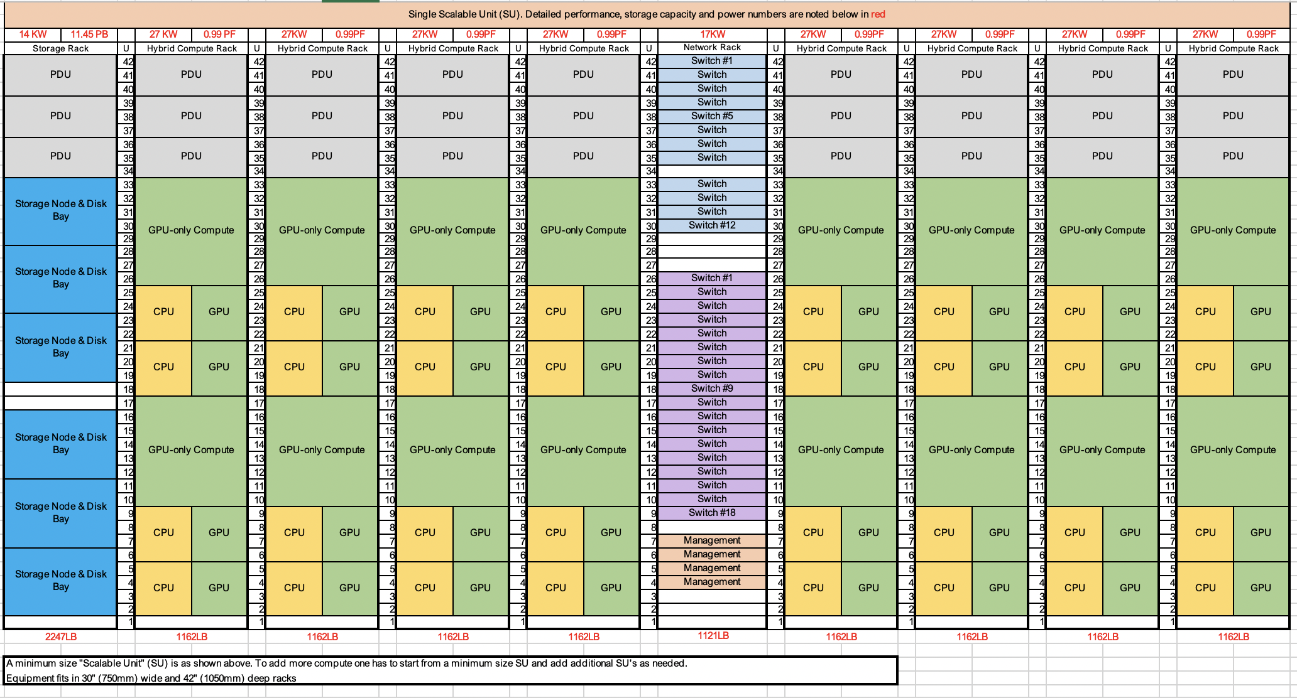
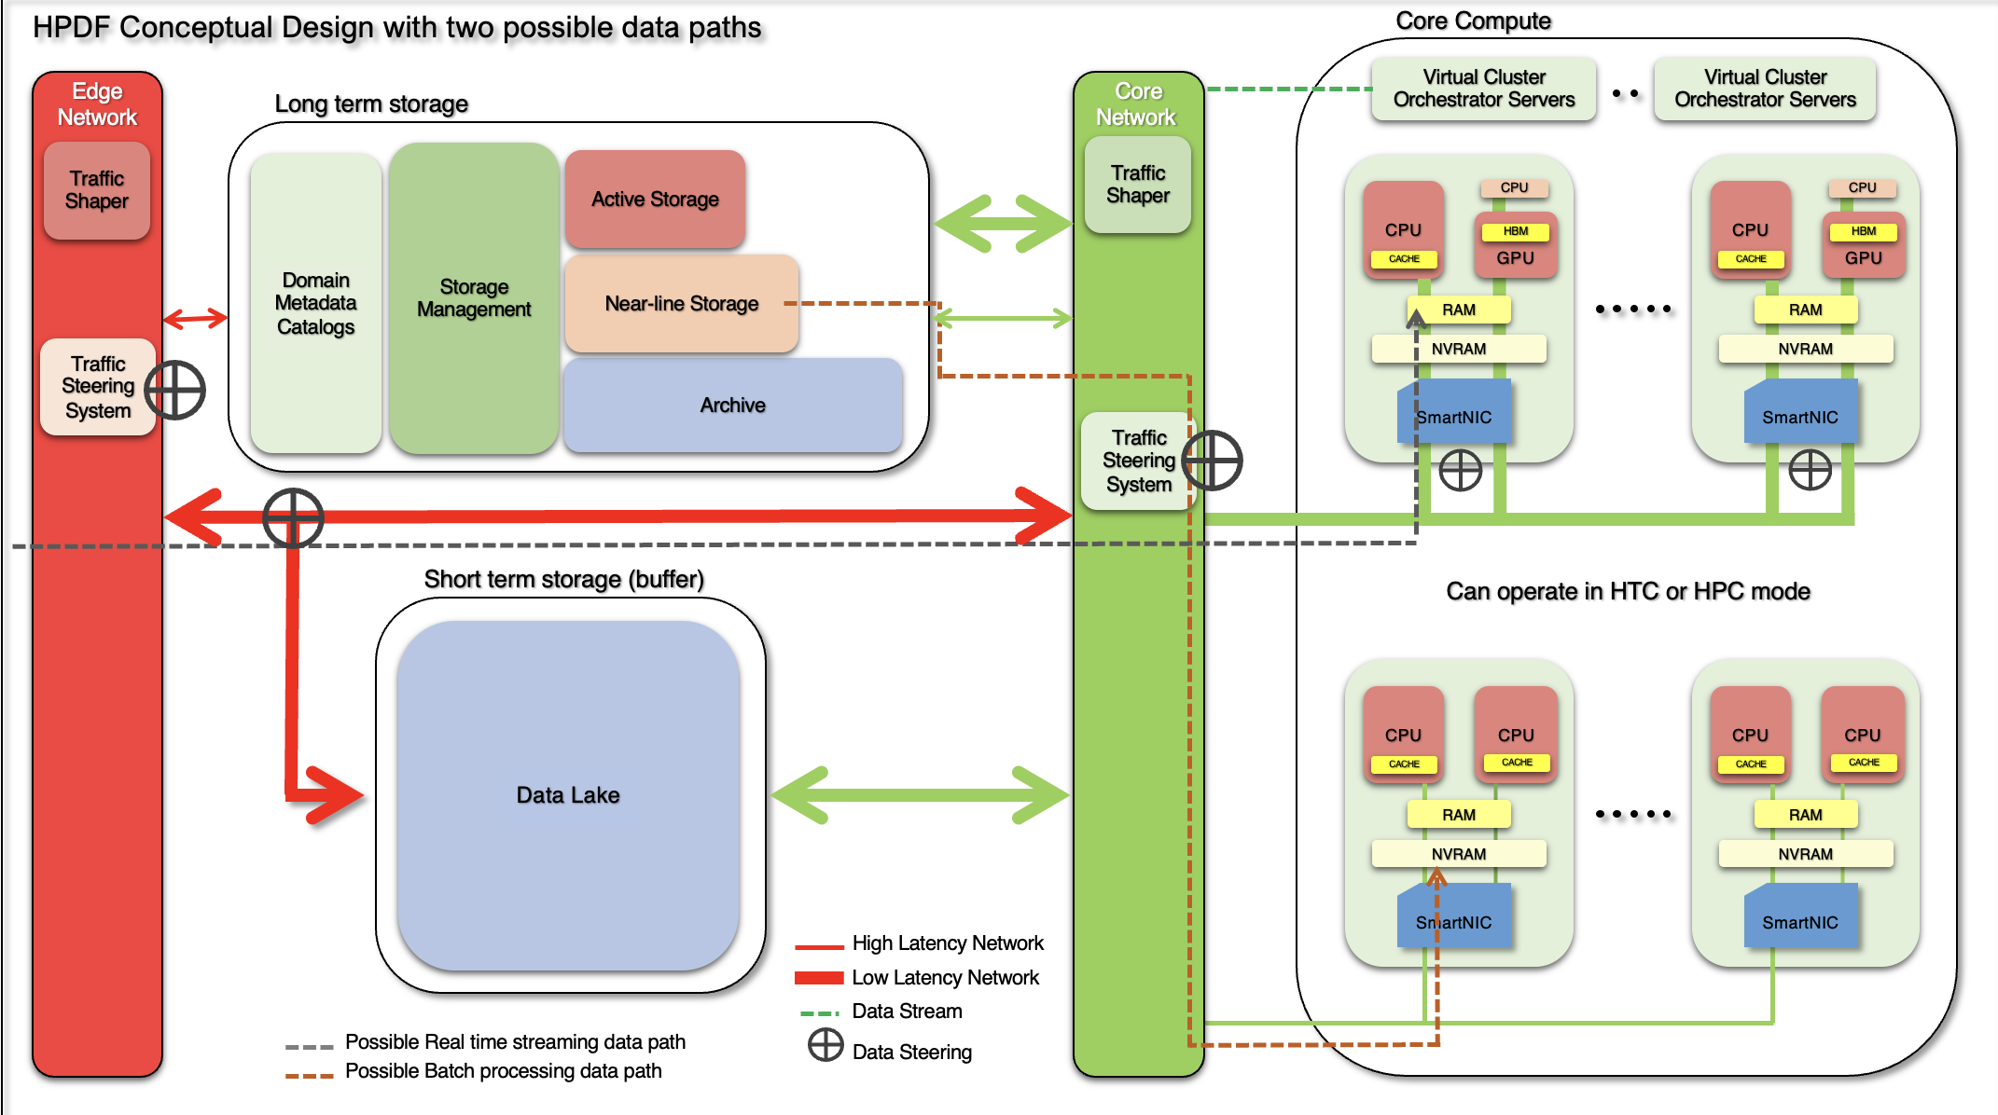
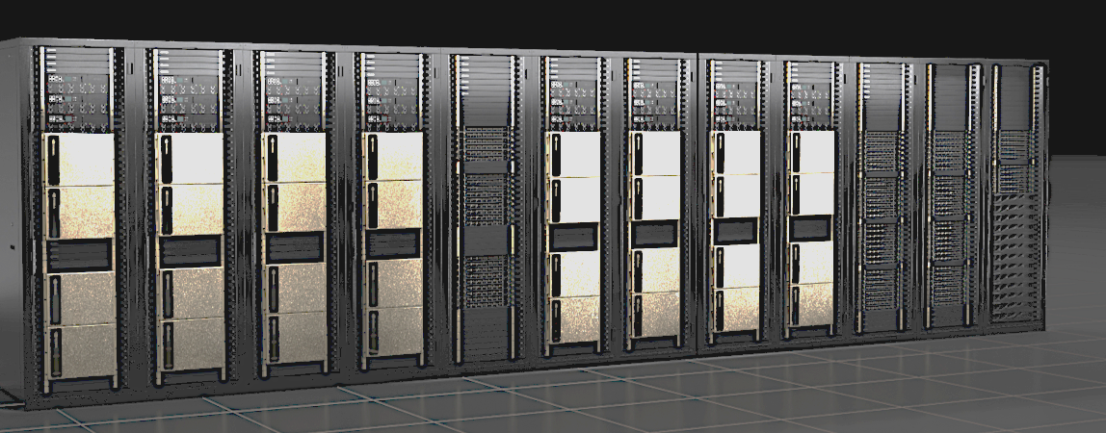
HPDF Machine Concept
Modular design based on rows of racks with net switches in center rack, “Scalable unit”.
All GPUs and CPUs on high bandwidth network – can build a cluster on any scale.
Block diagram -> rack layout-> picture.

Slide 11
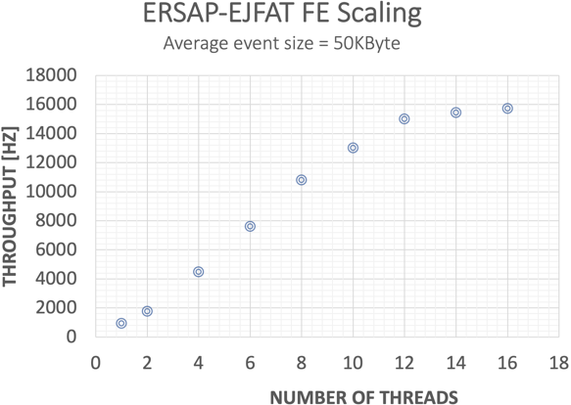
Intelligent Networking is foundational
ASCR funding enables EJFAT (ESnet JLab FPGA Accelerated Transport) R&D with Esnet
Purpose: Increase science rate by providing a high-rate data path into a data center with dynamic workload balancing using AI/ML.
Status: Core technology is operational, rate testing underway.
Pursuing further partnerships to develop and demonstrate data transfer and processing
ERSAP = Environment for Real-time Streaming, Acquisition and Processing
CLAS12 raw data passed through ESnet Firmware → Processed with CLAS12 software → demonstrates how EJFAT can be used to transport raw data streams to a remote processing center
Notes:
The is from a test where data from a CLAS12 raw data file is passed through the ESnet firmware to receivers that process the data with the CLAS12 software. The plot shows the event processing rate as a function of threads in the receiving end. This is a functionality test demonstrating how EJFAT can be used to transport raw data streams to a processing center on a remote host.
It is worth re-emphasizing here that this test is not stressing the network bandwidth. The scaling (and plateau) in the plot is purely a function of the back-end processing and not demonstrating any limitations of the EJFAT system itself. It is significant because the network packet headers are being rewritten in real time by the EJFAT firmware and thus, redirected towards a compute resource.

Slide 12
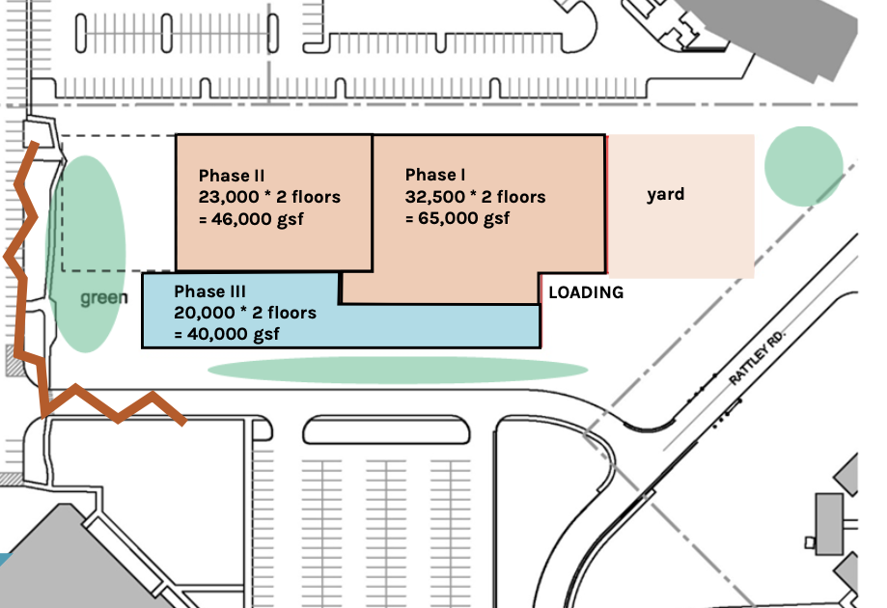
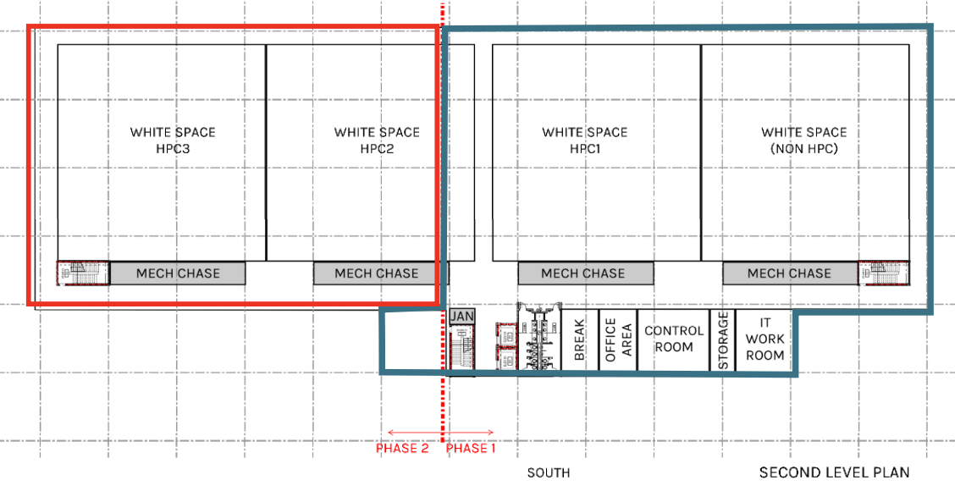
HPDF@home: the Jefferson Lab Data Center Building
Custom designed 2-story building that supports HPDF computing goals
Expandable for future needs
Strong support from the Commonwealth of Virginia:
  Providing $3M in design funds (FY23)
  Commonwealth of Virginia intended commitment of ~$40M to build shell (FY24+)
Phase-I Design Concept

Slide 13
EIC & HPDF
EIC Butterfly Computing Model Is an IRI Model
The HPDF is cutting edge computing
as a service
  Tools will be applied for EIC and 12 GeV.
The HPDF will be the driver for
requirements of network connectivity
and bandwidth
Developments like EJFAT, and AI/ML
monitoring of data centers, can be
applied to data acquisition and
computing for the 12 GeV program
and inform decisions for the EIC computing model

Slide 14

Summary
Building from our Jefferson Lab expertise in Scientific Computing
  We continue to pursue our ‘Grand Challenge’
  Inform the national conversation through the IRI ABA
  Work towards HPDF sited on the Jefferson Lab Campus
  Come full circle with IRI and HPDF methodologies benefiting the 12 GeV program and EIC
Questions?

