Slide 1
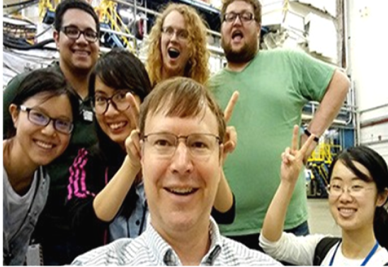
JLUO Annual Meeting DEI Update
Our Journey
Diverse Workforce
Our Accomplishments
Future Plans
Continued Challenges
Aurora Realin
DEI Program Manager

Slide 2
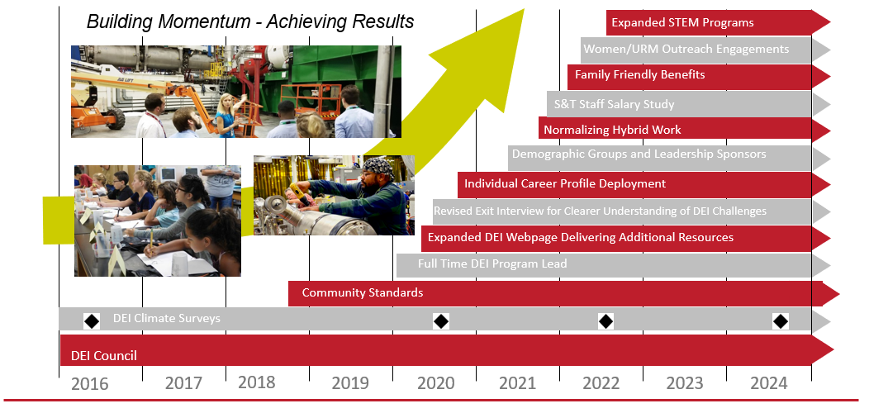
Attracting And Retaining A More Diverse Workforce

Slide 3
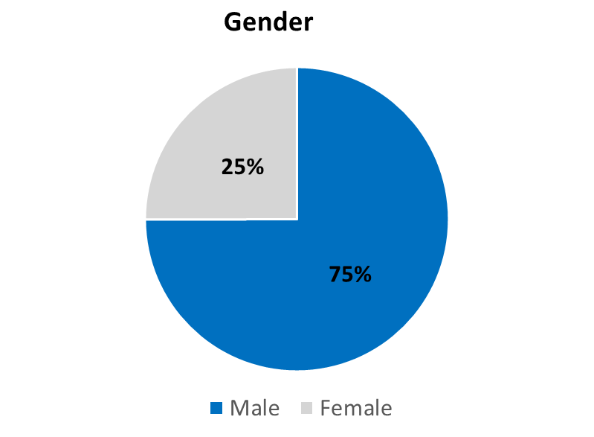
Our Growing Diverse Workforce and Lab Community
25 joint faculty appointments
20 postdoc researchers
16 undergrad students
1559 visiting scientists
800 employees 1692 Users 37 countries

Slide 4
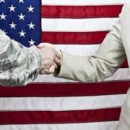
DEI Council & Demographic Focus Groups Key Accomplishments
Ongoing engagement with senior leadership, staff and Users through Demographic Focus Group meetings
Developed routine promotion of DEI resources, events, and information in a centralized location.
Published real-time and relevant content through the DEI Corner (biweekly edition of the Weekly Brief) to increase awareness and conversation.
Updated DEI website with real-time resources
Hosted DEI virtual sessions celebrating key heritage months
Established Veteran Mentoring Program
Reintroduced Safe Zone/LGBTQ+ Educational Sessions and Overcoming Barriers to Communication

Slide 5
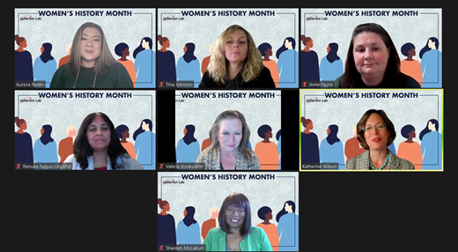
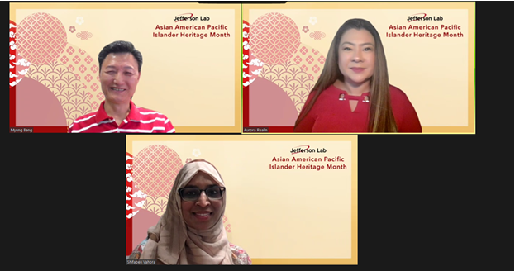
Staff and User Events
May 18th & June 7th
Optima EAP Mental Health Awareness Virtual Event
June 16th Get Connected
Onsite Event

Slide 6
DEI Lab-Wide Accomplishments
Advance DEI in recruitment process
Rebranded Career Page
Diverse Hiring Panel Representation
Targeted outreach efforts
Increased percentage of Veterans in the workforce (~12%)
Talent Management
Career Development Planning through Individual Career Profile tool (ICP)
Revised Standards Of Conduct to include fresh content on DEI and Ethics
Introduced Research Misconduct Policy and Research Integrity Knowledge document for annual review
Implemented Remote Work Policy
Designed to optimize employee flexibility while meeting mission needs
Introduced “Remote Work at Jefferson Lab” eLearning for staff
Facilitator course available: “Leading a Hybrid Team at Jefferson Lab”
Expansion of benefits portfolio to include Paid Parental Leave
Supports efforts to achieve a more inclusive workforce and retention of staff, particularly females

Slide 7
Current State – FY22 YTD (5.16.22)
ALL STAFF (GENDER)
% Female Representation
We have made gradual gains in female and minority representation in the Operations and Senior Leadership.
We remain stagnant on our representation for women and minorities in STEM.
ALL STAFF (MINORITY)
% Minority Representation

Slide 8
Future Lab-Wide Strategies
Migrate to a new Applicant Tracking System
Rebranded Career Page to improve navigation, candidate experience and accessibility
Expansion of outreach plan, specifically with HBCUs & MSIs
Introduce specific core competencies with a focus on DEI for line management
Upskilling line management
Leverage Individual Career Profiles to identify career pathing opportunities & address retention
Launch Inclusion Survey early 2023 (staff & Users)
Assess progress and identify new opportunities

