Slide 1
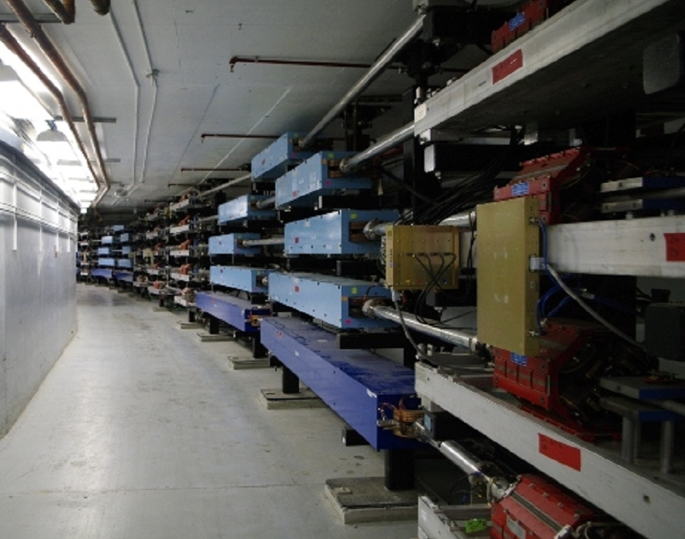
CEBAF Operations Overview
Camille M Ginsburg
Director of Accelerator Operations
JLUO Meeting 13 June 2022

Slide 2
Overview
Operations: Progress and plans for physics runs and shutdowns
Upgrades: Energy reach and improvements to reliability and reproducibility, as well as planning for future experiments

Slide 3
CEBAF operational priorities
Reach 12 GeV (5.5 pass) in normal operation
Prepare for higher total current, not to exceed 1.1 MW
  Expect to see 1.1 MW in October; Documentation due end FY22
Improve component performance
  Install better cryomodules, reduce particulates in warm sections, monitor field emission induced radiation to understand impact of improvements
  Ensure high-power RF meets future needs
Minimize trip rates to <15/hour, partially tied to field emission
  Maximize energy margin to minimize RF trips
Reduce beam losses through improved tuning and diagnostics
Make shutdown and problem recovery faster and more reproducible through work processes, procedures, and planning
Prepare for future experiments
Notes:
Something to address beam losses?

Slide 4
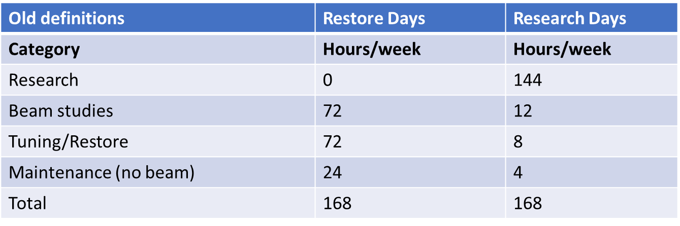
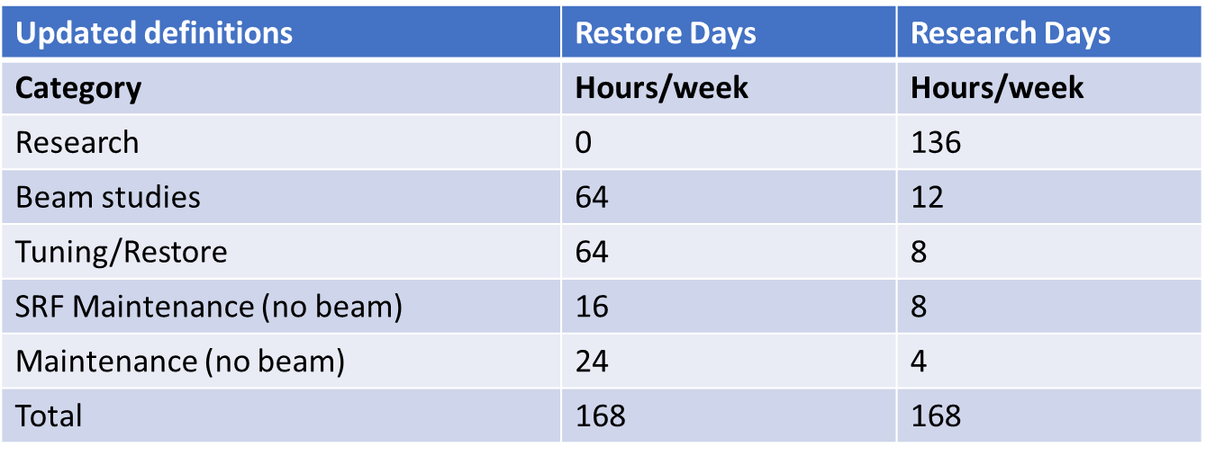
Revised operating assumptions starting FY21
Additional beam-off time is required for SRF maintenance, both during restoration
after a shutdown and during research weeks

Slide 5
CEBAF Status: FY21/22 Physics Run
FY21: mostly spent in long shutdown, start mid-August 2021
  Achieved 775.9 delivered operating hours out of 780 planned hours and 1104 scheduled hours, corresponding to a delivery of 99% of planned, and a reliability of 70.3%
  DOE requirement is 80% reliability
FY22: ran from start of FY into February, with short holiday break
  For FY22 to-Feb achieved 2092 delivered operating hours and had 592 unscheduled failure hours; reliability 79.8%
Startups have been smooth even after long down, with reliability soon >80%
  Efforts by DC power et al. on magnet reproducibility
  Efforts by all groups in preventive maintenance and “hot checkout”
  Updated ops procedures and tools
  Injector improvements
  …
Notes:
Add more detail about smooth startup

Slide 6
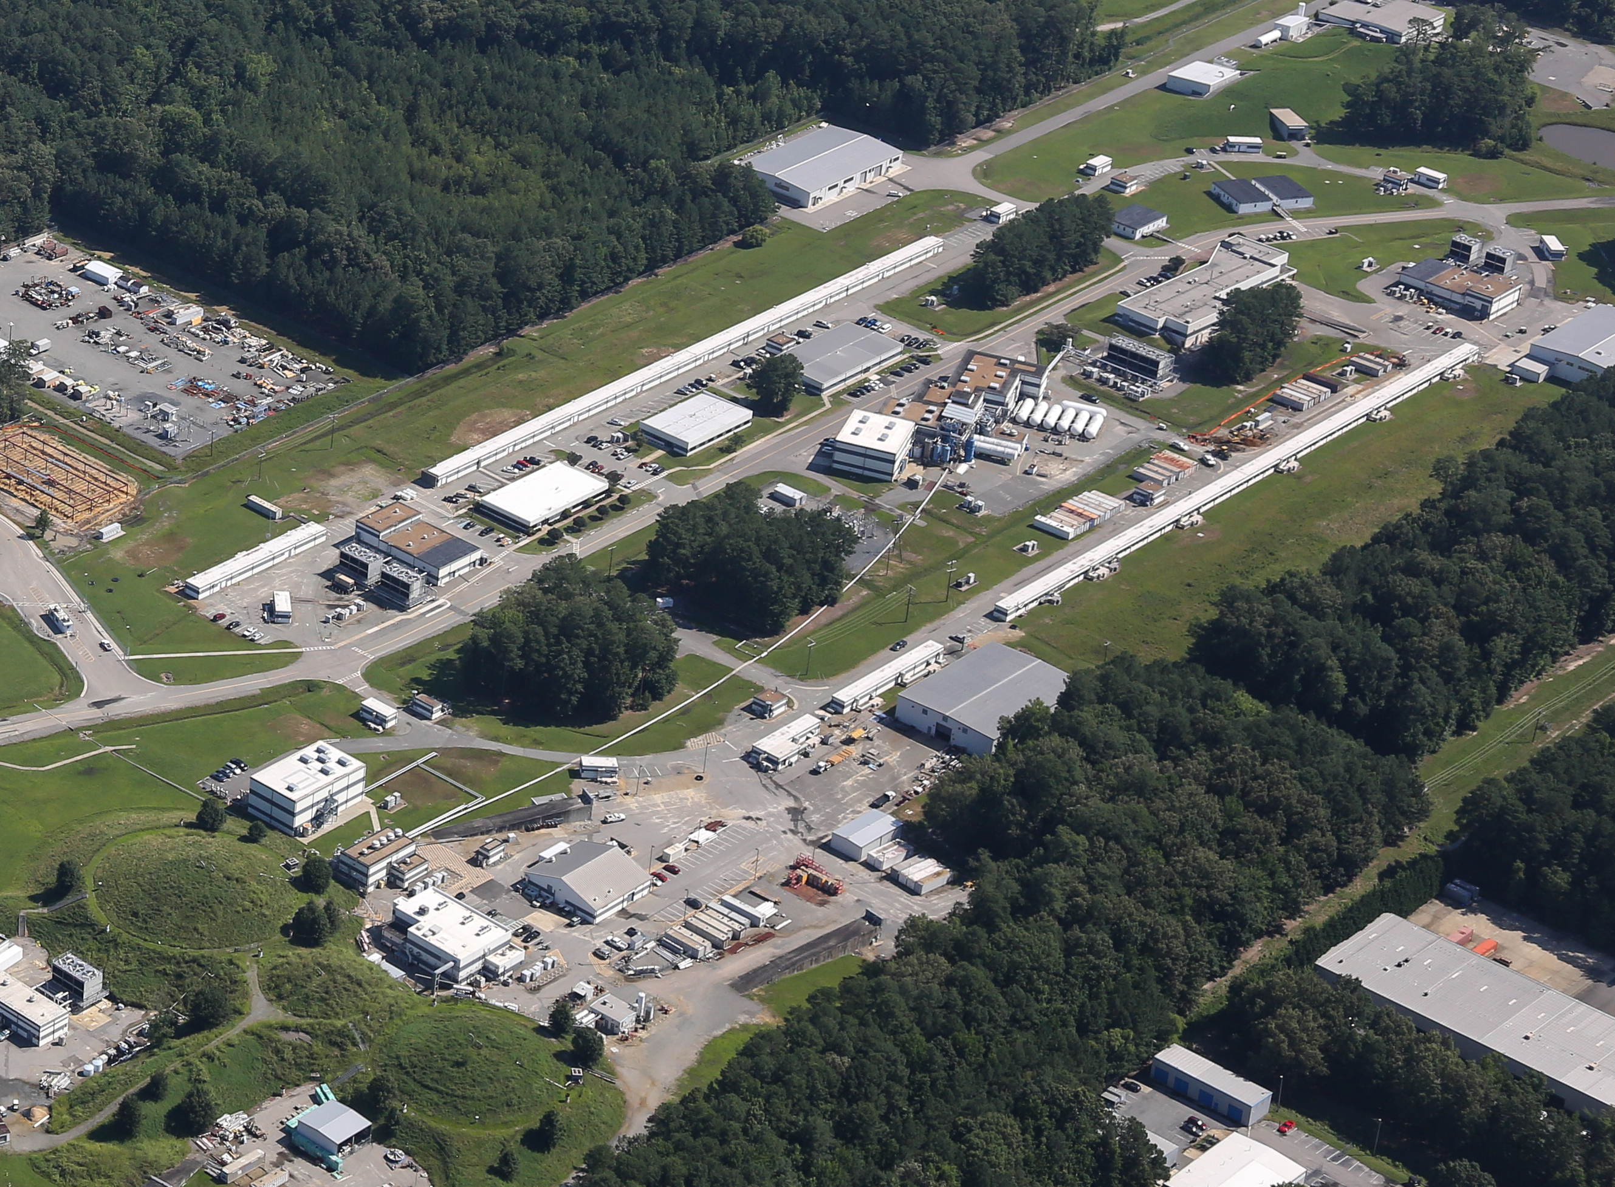
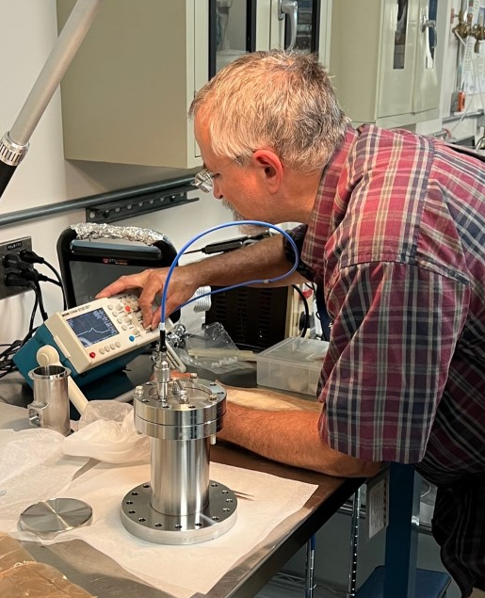
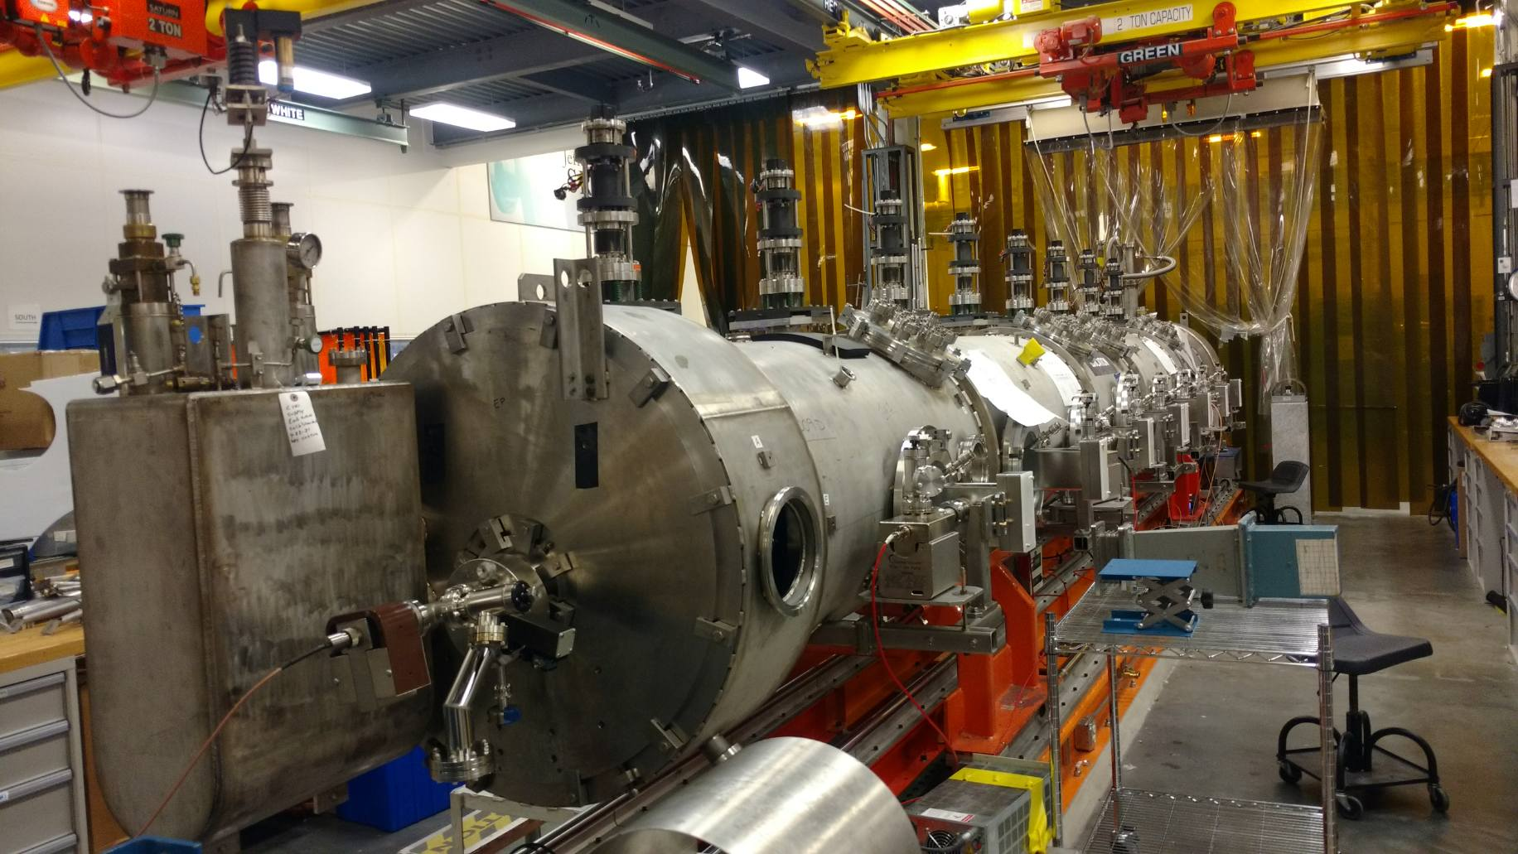
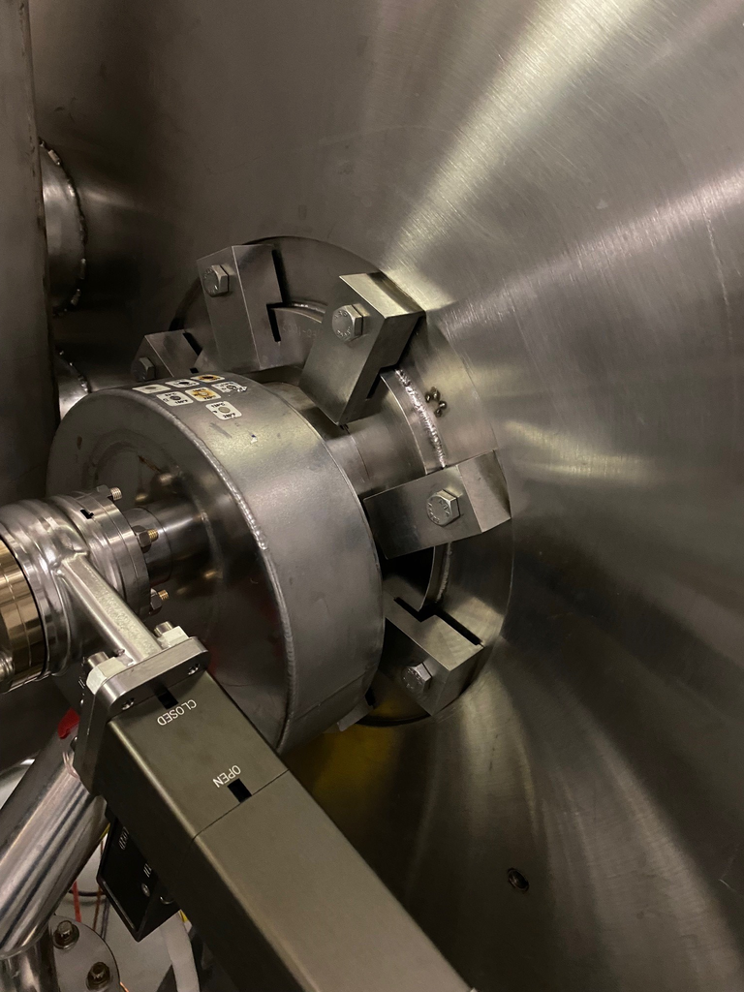
FY22 operations: 17 weeks in the books; SAD Complete; Run restarted June 8
CEBAF FY22 SAD
Girders surrounding the replaced cryomodules refurbished
Significant upgrades, improvements and maintenance tasks completed across the CEBAF accelerator, experimental halls, facilities and site.
C75-02 cryomodule installed w/ RF system upgrade
Failed RF feedthrough replaced
Injector vacuum restored
C50-01R cryomodule installed
CHL2 carbon adsorber bed installed
C100-9R cryomodule installed
Rolling power outages to test/repair breakers
C100 insulating vac leak welded
Hall A detector reconfiguration

Slide 7
FY22 schedule
33 weeks of operations (3 recovery + 30 physics)
Three linac energies (910, 980, 1047 MeV/linac)
  First two have been successful
  The transition 910 to 980 MeV/linac was very smooth thanks to good preparation
  Transition to 1047 MeV/linac required SAD work, still
3 month shutdown + 1 month of prep for physics restart
Restarted June 8 with Hall D; Hall B and Hall C also restarted
  Hall A will restart in about 2 months
  Currently a lingering issue in the injector causing BLM trips

Slide 8
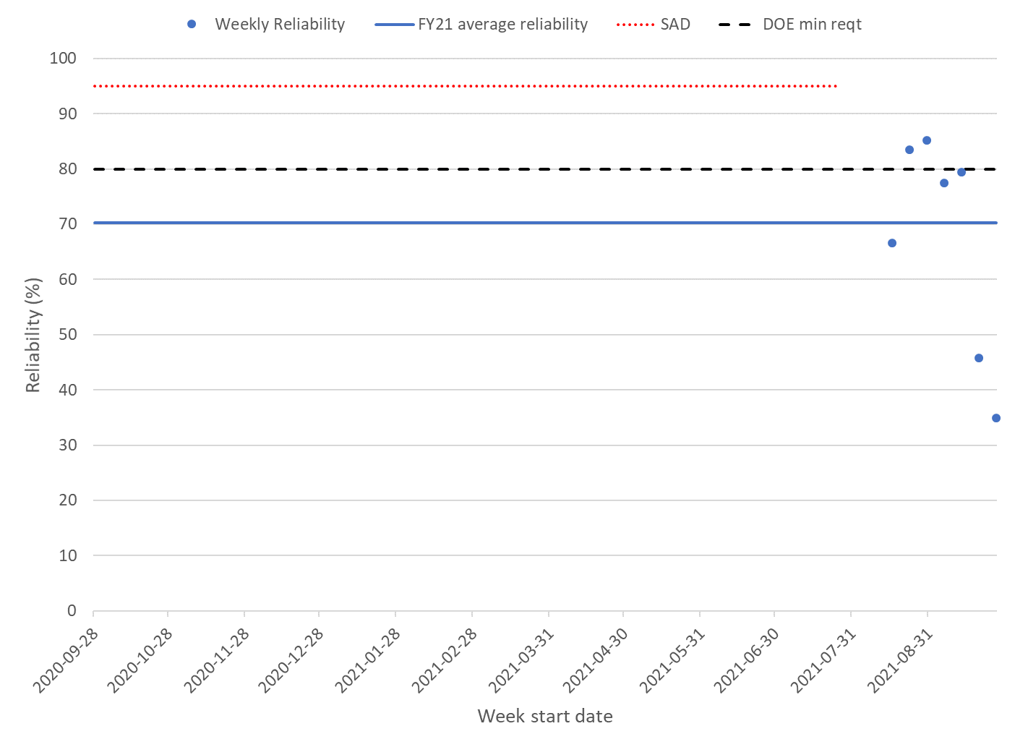
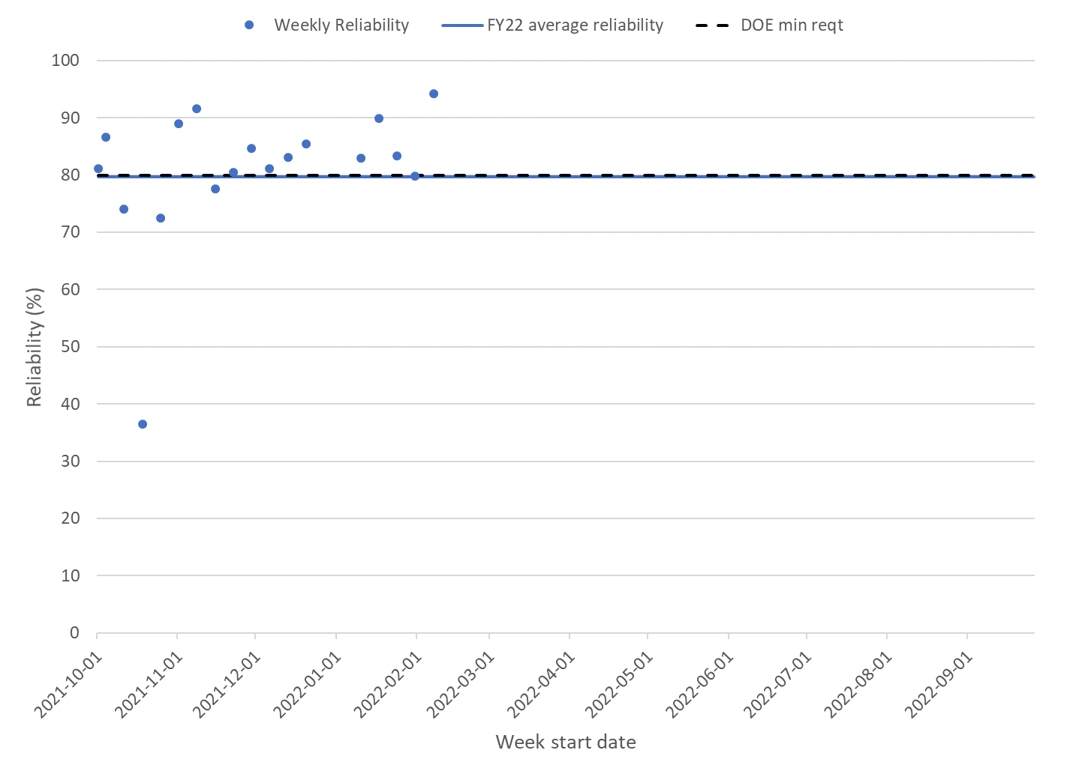
CEBAF Reliability (performance measure reported to DOE)
FY21 reliability: 70% (short run after long shutdown)
FY22 reliability through May 2022: 80%
Reliability = delivered hours / (delivered+unscheduled failure hours)
FY21 weekly reliability
FY22 weekly reliability

Slide 9
FY23 SAD
SAD Oversight Committee is working already with Shawn Frierson (Operability Lead) and SME’s to define work scope at a high level
Expect 3 month shutdown – very short
Phase 2 Injector Upgrade
3 linac cryomodules plus one booster cryomodule won’t fit
  Will submit proposed decision to delay C75-03 (including RF upgrade) to FY24 SAD to Andrei for approval
South Linac PSS Upgrade
  To be delayed; only upgrade Hall D and Tagger and work on other smaller incremental PSS upgrades
Hall A Crane and experiment change-out
…Under development

Slide 10
CEBAF Performance Plan
Reach 12 GeV in 5.5 passes with good reliability & polarization
  Reliability: critical spares, obsolescence etc.
  Energy Reach: new/refurbished cryomodules
Oct 2020 plan to DOE has been followed quite well
Two new roles established: Gradient performance & Beam reproducibility leads
  Raise visibility of these areas, improve coordination and focus on reliability
  Both roles were delayed, though activity started/continued
New task force on SRF materials & UHV procedures est. July 2020
  Contributed already to north linac refurbishment in FY20-21 SAD
  Document of best practices achieved

Slide 11
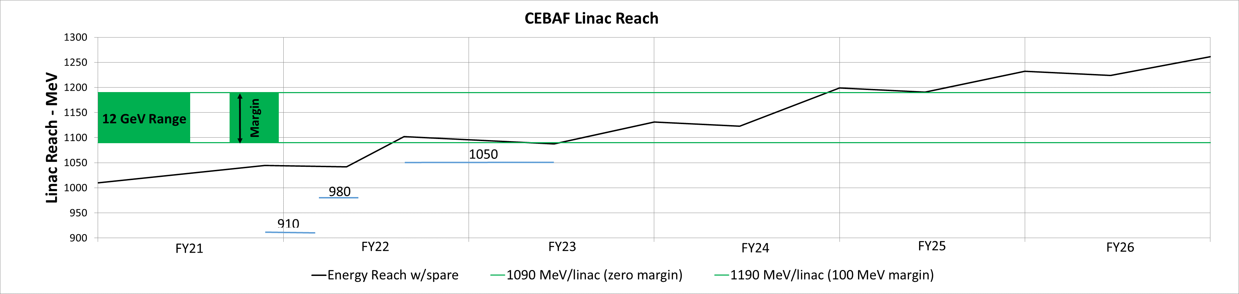
CPP Energy Reach Plan & Achievements
FY21: Two refurbished cryomodules installed: P1 and C75-01 for net gain of 77 MeV in NL
FY21 & ongoing: New NDX detectors allow tuning of gradient to keep radiation low for net gain ~19 MeV (NL) and 18 MeV (SL)
FY21 & ongoing: New beamline vacuum installation procedures may have reduced degradation due to NL thermal cycle ~10 MeV
FY22: 3 refurbished cryomodules installed: C75-02 & C50-01R (NL) guess 80 MeV gain, C100 (SL) guess 20 MeV gain
FY22 run continuation: 1047 MeV per linac with good polarization for Halls A & B
We are here
Exact details of which cryomodules go where will change

Slide 12
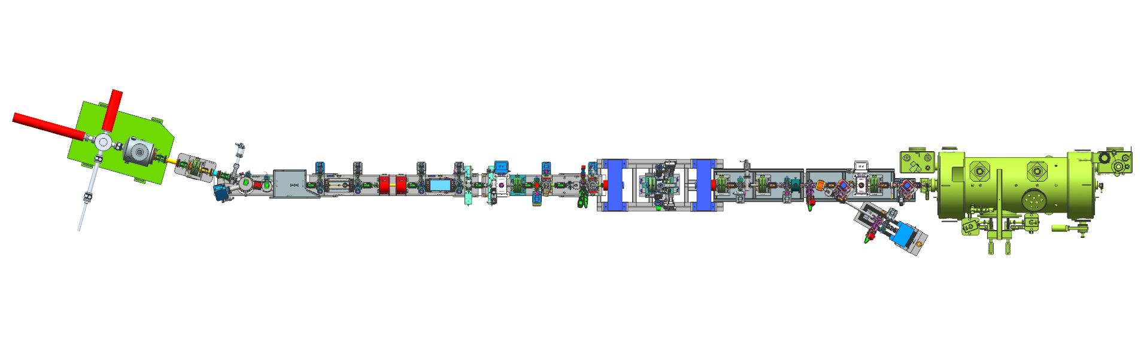
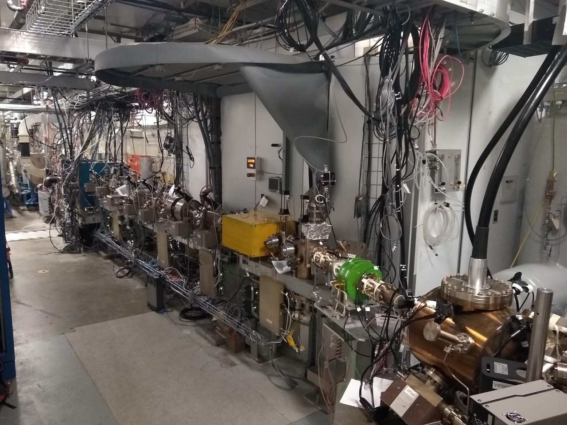
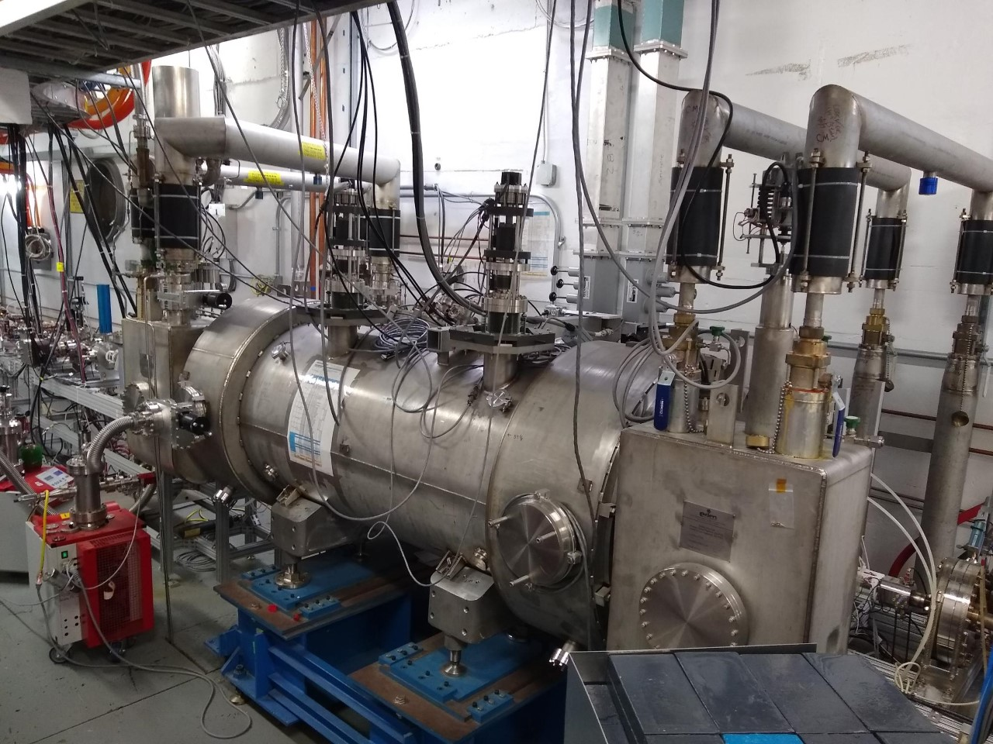
AIP Project – CEBAF Injector Upgrade
Phase 1 (Installed Sep 2020 – May 2021)
  200 keV Gun and Wien Filter Upgrade
  Improves Parity Quality Beam Transmission
  Commissioning May-Jul 2021
Phase 2 (Planned Mar 2023 – Jun 2023)
  SRF Booster (2 & 7 cell booster to 10 MeV)
  Improves Parity Quality Beam Optics
  SRF Booster commissioned at UITF 2020-2022
200 keV beam line @ CEBAF
SRF Booster @ UITF

Slide 13
Non CPP upgrades
Updated Troubleshooting Guide for operators in progress
  May reduce beam tuning time
  Improve decision making, e.g., more guidance on when to call for assistance
  Good progress on updates for injector, for example
New rad-hard neutron detectors installed around the C100’s and a couple other key locations for continual field emission monitoring
ML/AI initiatives
High-power RF plan: keep CM’s powered for 30 years
Injector and beamline upgrades for MOLLER et al.

Slide 14
Conclusions
Successful physics runs
Safe and effective shutdowns
Good progress on CEBAF performance improvements
  Energy reach
  Reproducibility
  Reliability
Upgrades planned to address long-term issues
Many thanks for the kind and collaborative efforts of the experimental Run Coordinators!

Slide 15
Please volunteer to be a Program Deputy
email Paul Vasilauskis
vasilaus@jlab.org
2-week commitment
Important contribution to CEBAF operation
Valuable experience

