Slide 1
Careers Paths
Thanks to Midhat Farooq and Crystal Bailey at the APS for providing many of these slides.

Slide 2
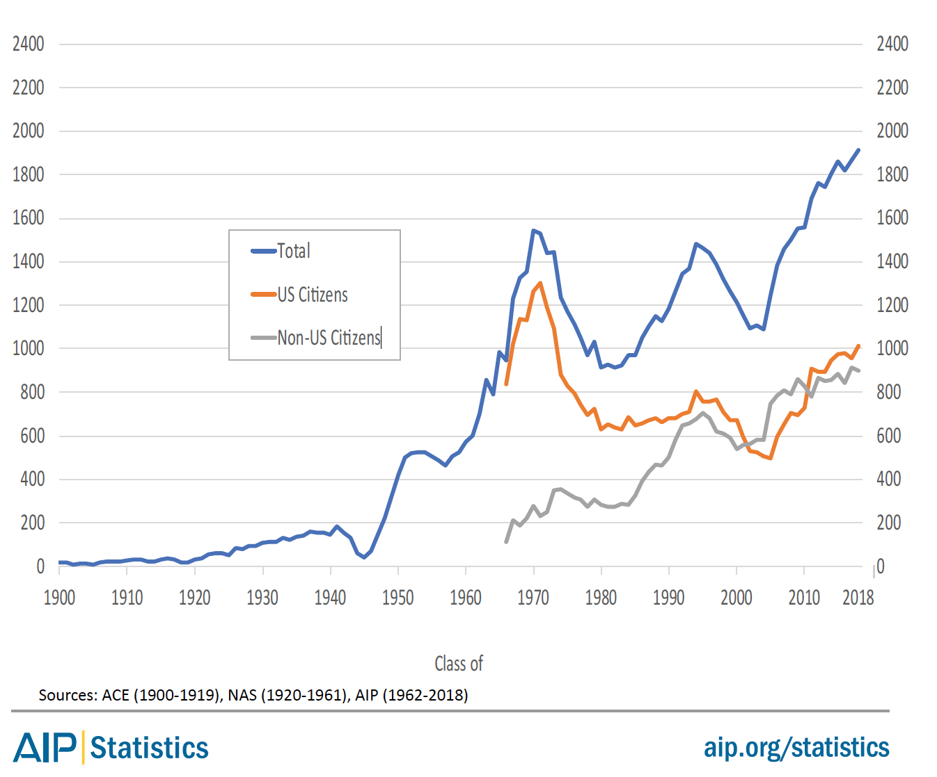
How many PhDs are there?
The number of Physics PhDs granted in the U.S. has almost doubled over the last two decades.
Number of US Physics PhDs
~1600 physics PhDs go into the U.S. job market every year
Class of

Slide 3
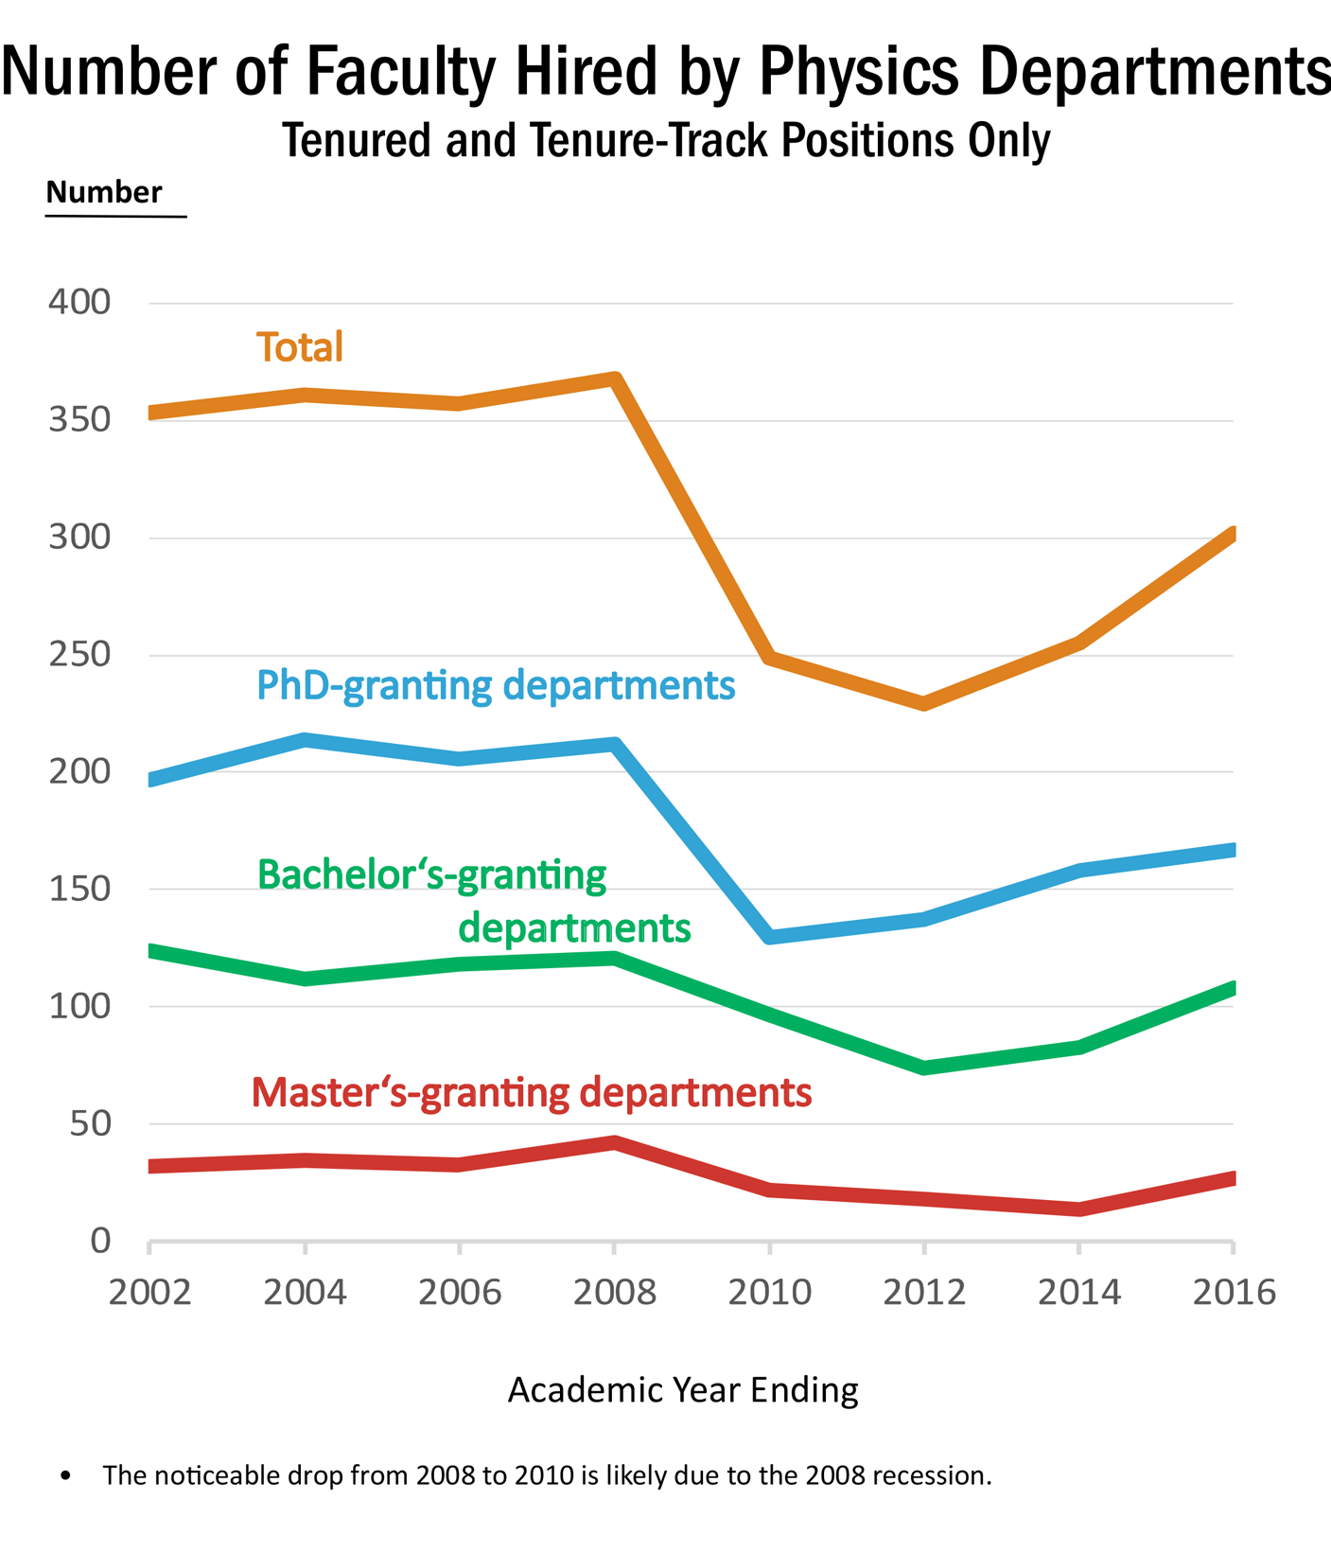
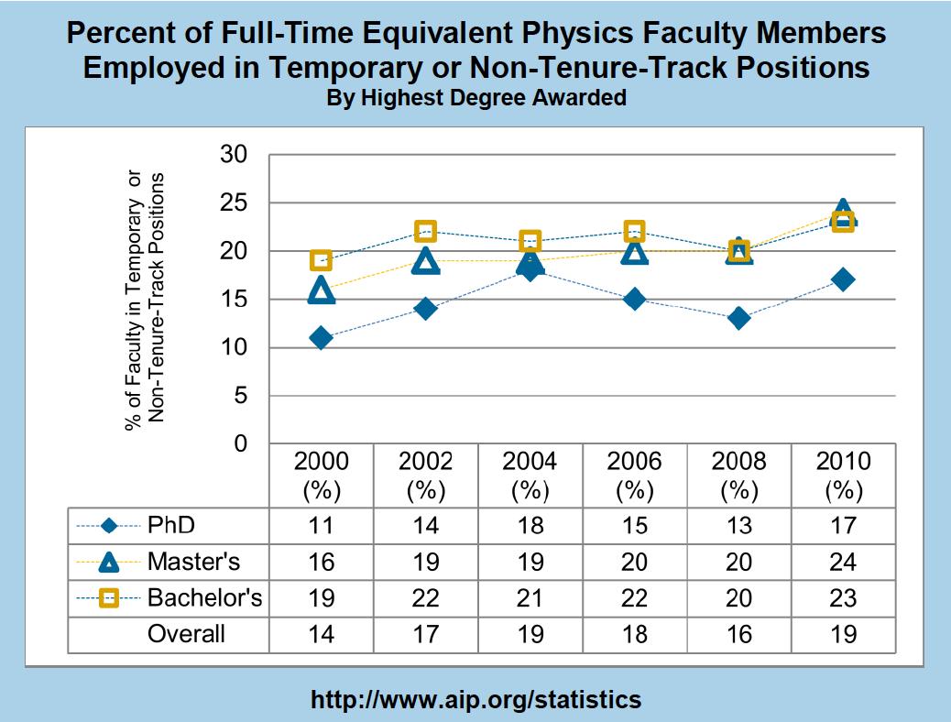
Academic sector demand
About ~300 new hires (2016 data)
But ~1600 PhDs looking for jobs every year
Typically, ~19% of faculty positions were temporary or non-tenure-track.
Slide from Crystal Bailey (bailey@aps.org)

Slide 4
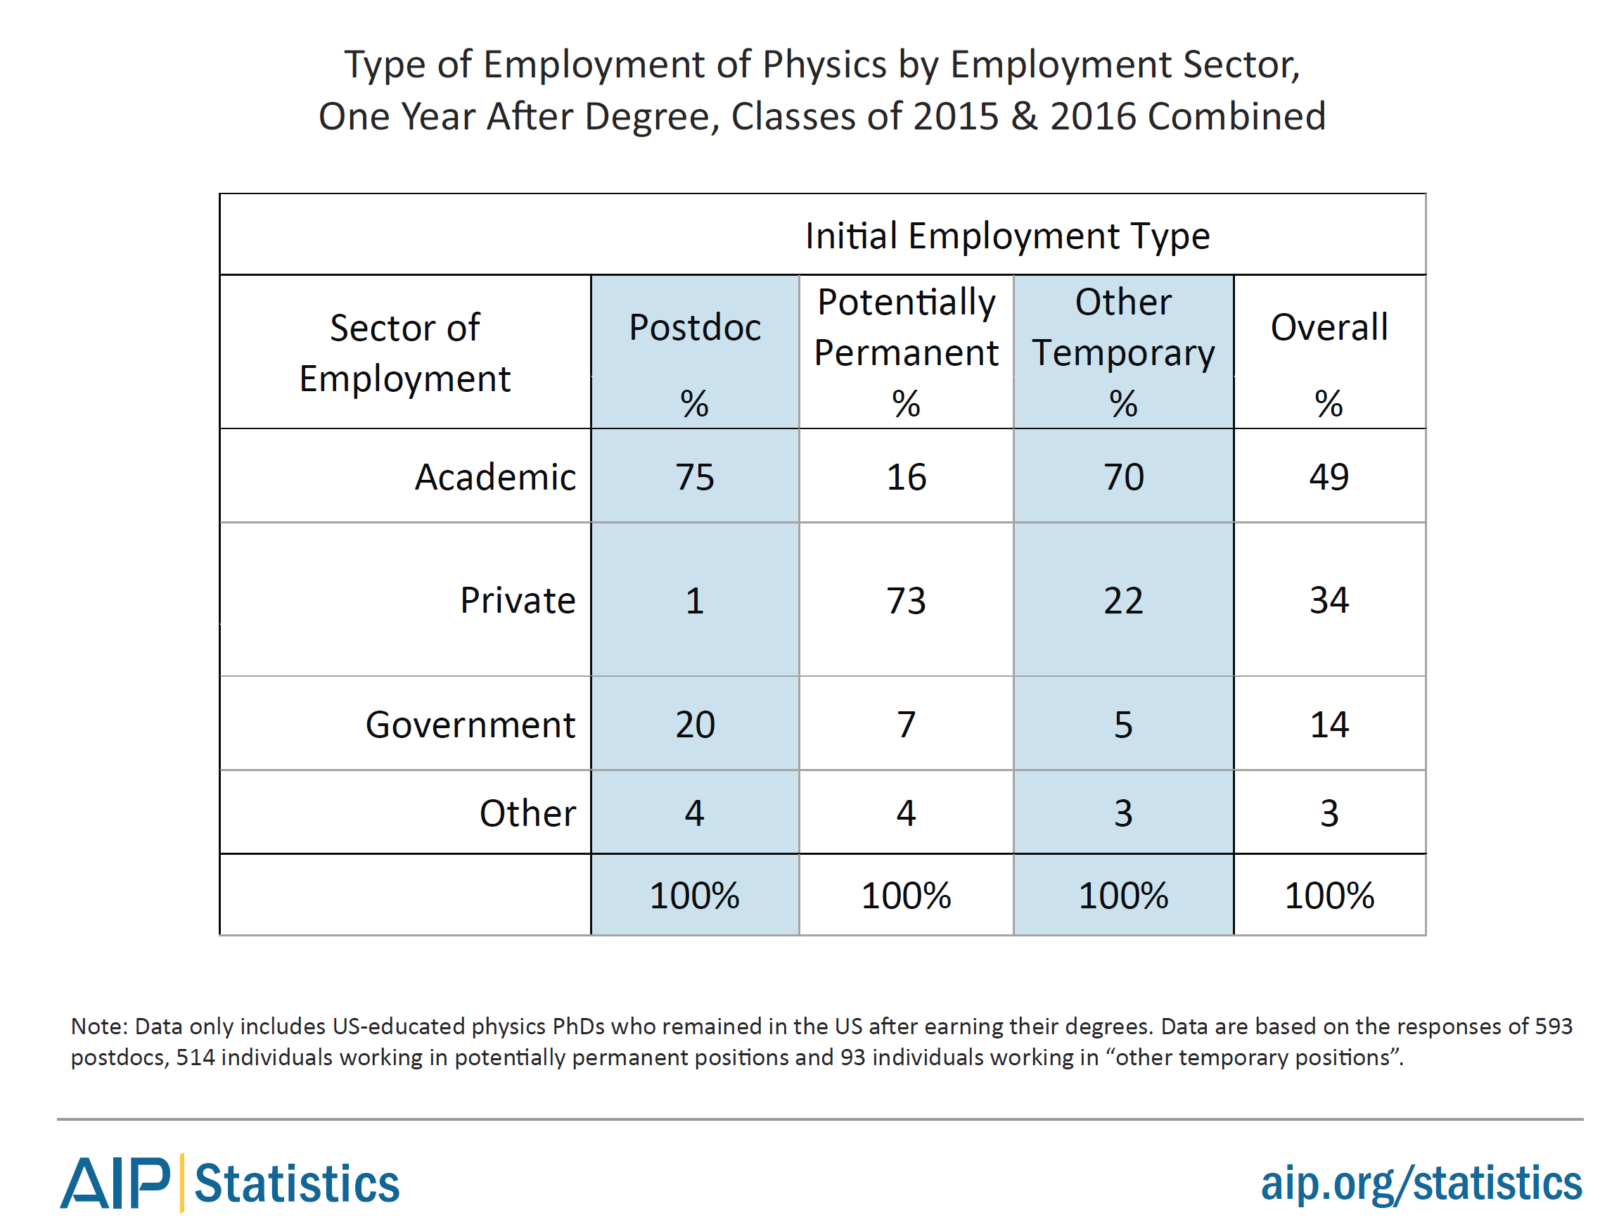
What are they doing (PhDs)?
2015-2016 graduates: 1 year after PhD
About half of physics PhDs are initially employed in the academic sector.
However, ~73% of the potentially permanent jobs are in the private sector.

Slide 5
Who employs physics PhD’s?

Slide 6
What are they (PhD and MS) doing?
Source: AIP Statistical Research Center Report Common Careers of Physics PhDs in the Private Sector, June 2015
RESEARCH!

Slide 7
Bottom line: the largest initial employment sector for physics graduates is the private sector.

Slide 8
How much do physics PhDs earn?

Slide 9
United States CV vs. Resume
https://www.aps.org/careers/guidebook/resume.cfm
In the United States job market, CVs are:
comprehensive - they include most professional relevant details of your life
general - they do not specifically emphasize a particular area of experience or expertise
lengthy - a CV can be several pages long
Resumes in the United States are:
limited - they describe a limited subset of your expertise
focused - they include skills and experiences that are relevant to a specific job description
short - ideally a resume is one page long
Goal of both of these documents is to get you an interview!

Slide 10
Read The Job Carefully and Customize
There is no one perfect CV or Resume.
Ideally you customize to highlight your skills that match what the job is looking for.
(i.e. it is a JLab job looking for a DAQ expert, you want that information up-front and easy to find and hidden on page 10 of your 20 page CV)
Again, CV and Resume are typically part of the documents that get you an interview. Letters are also important.

Slide 11
Who Gets A Job Offer Strongly Depends On Who Applies and What Skills Employer Is Looking For Please do not beat yourself up when you don’t get a particular job! I know this is easy to say and harder in practice; but better to keep trying, looking, and improving then to focus on things that are out of your control.

Slide 12
Summary
Many physics degree holders entering job market every year
Majority find careers in private sector
I know many of your wish to stay in academia and please reach for you goal.
BUT, keep your eyes open for other opportunities as academic jobs are limited while public sector job are more available and pay better.
Just because it is public sector, doesn’t mean you cannot find a research position!
https://www.aps.org/careers/

