Slide 1
New Measurements of the EMC Effect at 12 GeV
Cameron Cotton
Frontiers and Careers Workshop
MIT Laboratory for Nuclear Science
August 6th, 2022
This work is supported by U.S. Department of Energy under Award numbers DE-SC0014434 and DE-SC0014664

Slide 2
Outline
Physics Background
E12-10-008 Physics Goals
Phase I Results
E12-10-008 Targets & Kinematics
2

Slide 3
Outline
Physics Background
E12-10-008 Physics Goals
Phase I Results
E12-10-008 Targets & Kinematics
3

Slide 4
Background: Discovery of the EMC Effect
Prediction (PRE-1983)
Experiment
$$F_{2}^{A}=ZF_{2}^{p}+NF_{2}^{n}$$
J. Aubert et al., Phys. Lett. B123, 275 (1983)

Slide 5
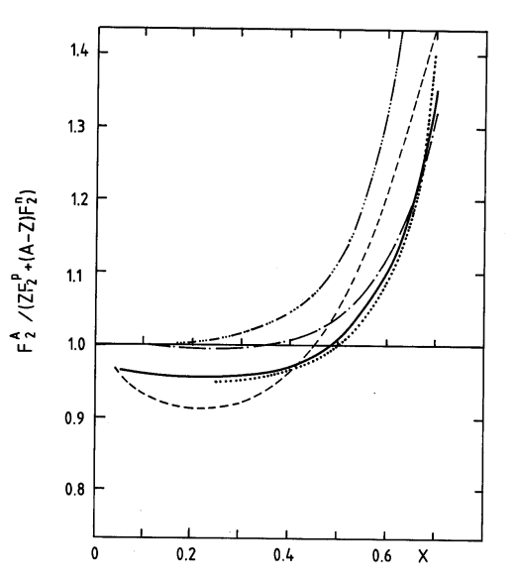
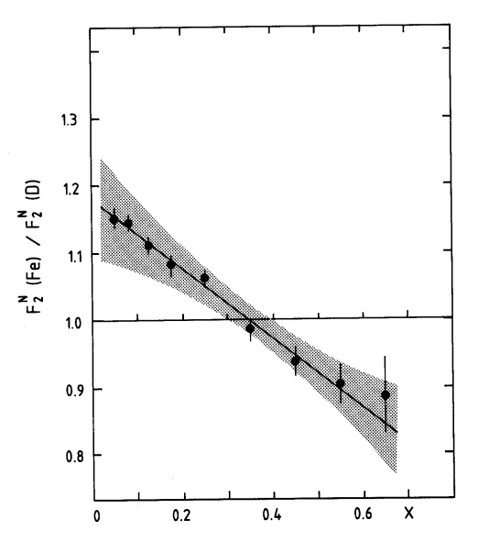
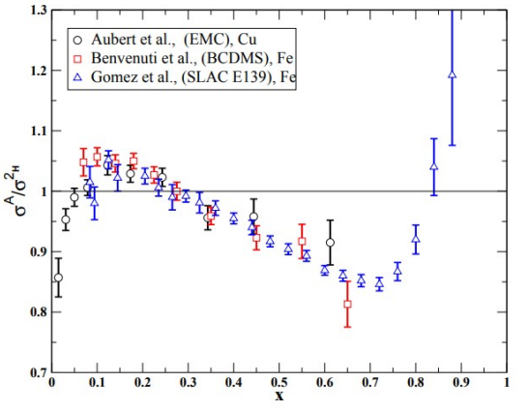
Background: Discovery of the EMC Effect
Prediction (PRE-1983)
Experiment
$$\frac{F_{2}^{A}}{ZF_{2}^{p}+NF_{2}^{n}} =1$$
A$ssume R≡\frac{σ_{L}}{σ_{T}} is A Independent$
$$\frac{σ_{A}}{Zσ_{p}+Nσ_{n}} =1$$
Quark distributions are modified in nuclei?!
Increase due to Fermi Motion
J. Aubert et al., Phys. Lett. B123, 275 (1983)

Slide 6
Background: The EMC Effect
The EMC Effect remains one of the biggest unsolved mysteries in nuclear physics.
1000s of papers have been written about the EMC Effect in the last 40 years - still no consensus.
Some Open Questions:
Is the nucleon structure modified in nuclei?
Proton in Hydrogen ≠ Proton in Iron?
Is there a connection to SRCs?

Slide 7
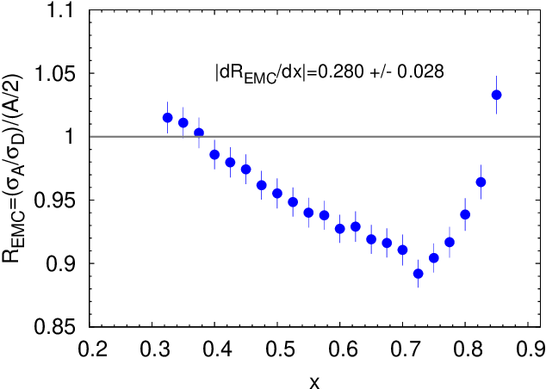
Background: Quantifying the EMC Effect
The “size” of the EMC Effect in a given nucleus is determined from the slope in the range: $0.35<x<0.7$
J. Arrington et al., arXiv:1206.6343 [nucl-ex], (2022)

Slide 8
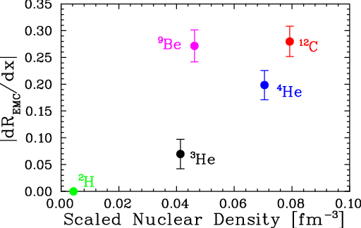
Background: Quantifying the EMC Effect
The “size” of the EMC Effect in a given nucleus is determined from the slope in the range: $0.35<x<0.7$
A density-dependent fit does an alright job for larger nuclei, but totally fails for light (A<12) nuclei.
What is driving the EMC Effect?
J. Arrington et al., arXiv:1206.6343 [nucl-ex], (2022)

Slide 9
Outline
Physics Background
E12-10-008 Physics Goals
Phase I Results
E12-10-008 Targets & Kinematics
9

Slide 10
Physics Goals: EMC Effect in 3He
3He/D ratio requires a large isoscalar correction to extract the EMC Effect.
Strong model dependency of the isoscalar correction is avoided by measuring 3He/(D+p) instead.
The proton introduces a problem at low Q² -it has no Fermi Motion to smooth resonances – can’t get clean 3He/(D+p) slope at low Q².
Using higher energy beam, we reach higher Q² and resonance structure pushed out to x>0.8, allowing for comparison with 3He/D data out to larger x to validate isoscalar correction model.

Slide 11
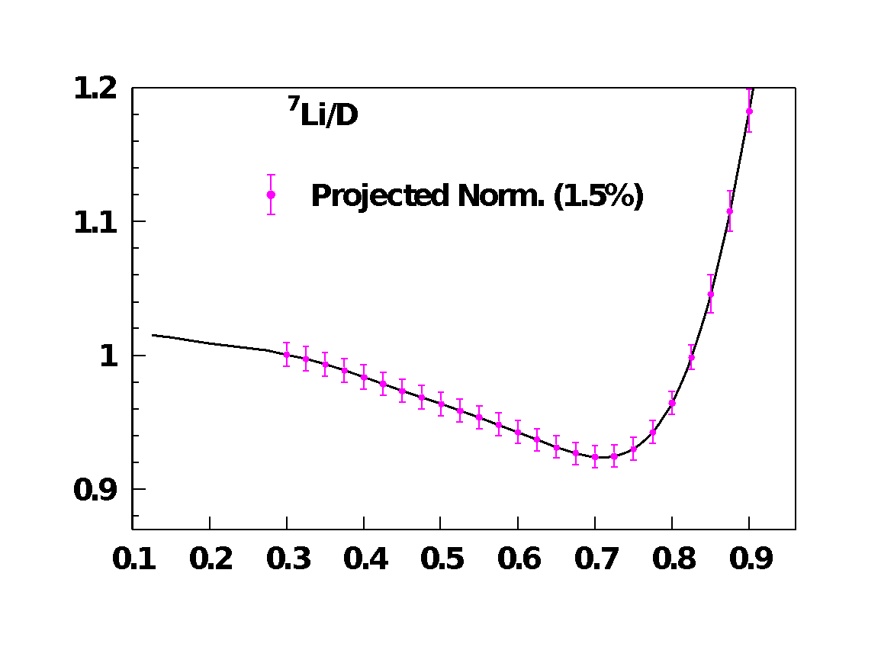
Physics Goals: EMC Effect in Light Nuclei
E12-10-008 will be the first experiment to measure the EMC Effect in several light nuclei including 6Li and 7Li.
Light nuclei are amenable to comparison with theorists’ calculations that can exact nuclear wave functions.

Slide 12
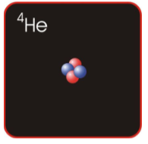
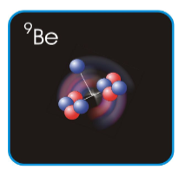
Physics Goals: EMC Effect in Light Nuclei
E12-10-008 will be the first experiment to measure the EMC Effect in several light nuclei including 6Li and 7Li.
Light nuclei are amenable to comparison with theorists’ calculations that can exact nuclear wave functions.
Light nuclei provide a great environment to study nuclear structure and clustering within the nucleus.

Slide 13
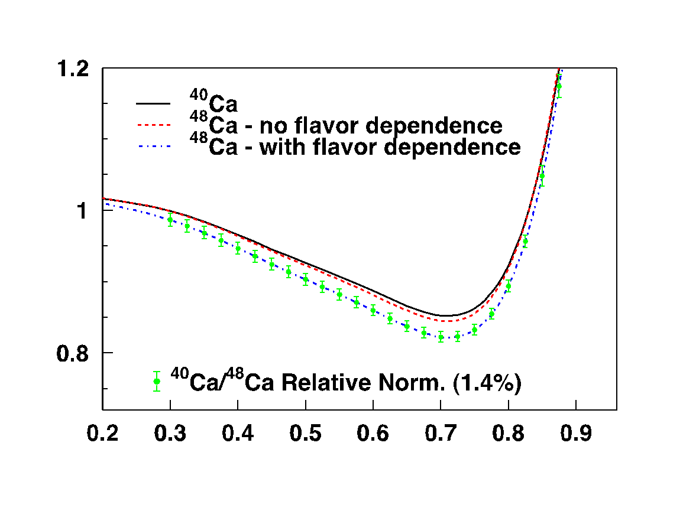
Physics Goals: Flavor Dependence of EMC Effect
We will study possible flavor dependence of the EMC Effect through measurements of 40Ca and 48Ca.
The flavor-dependent CBT Model predicts a ~3% difference between 40Ca and 48Ca at x=0.6.
On the other hand, we would expect a difference of <1% if there is no flavor dependence.

Slide 14
Physics Goals: EMC-SRC Correlation
There is a strong correlation between the size of the EMC Effect and SRCs.
With data from our experiment and the x>1 experiment that will run in parallel, we will add many new nuclei to investigate this connection.
J. Arrington et al., arXiv:1206.6343 [nucl-ex], (2022)

Slide 15
Outline
Physics Background
E12-10-008 Physics Goals
Phase I Results
E12-10-008 Targets & Kinematics
15

Slide 16
Upcoming Run: Targets
Coverage of large range of target masses, densities, and n/p values
Many new light targets (cluster structure)

Slide 17
Upcoming Run: Kinematics
Kinematic coverage for both EMC and x>1 (SRC) experiments.
EMC and x>1 will run in parallel in the hall, utilizing both the SHMS and HMS detectors.
Coverage of a large range of Q2 to verify we are in scaling regime
Total 23 PAC days for Phase I and II
Phase I completed in 2018 (2 days)

Slide 18
Outline
Physics Background
E12-10-008 Physics Goals
Phase I Results
E12-10-008 Targets & Kinematics
18

Slide 19
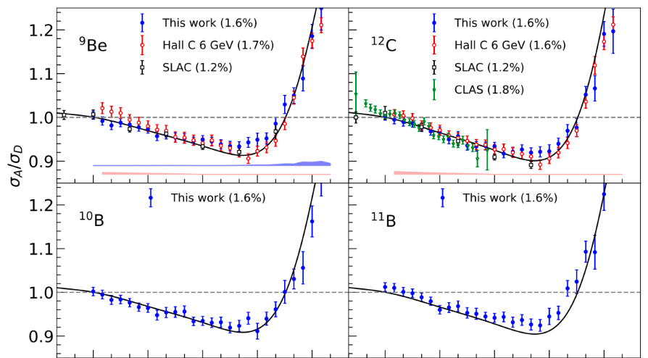
Results: Canonical EMC Plots
Phase I – Collected data for several light nuclei
Data showing characteristic EMC Effect shape!
A. Karki et al., arXiv:2207.03850 [nucl-ex], (2022)

Slide 20
Results: EMC Slope v. Density
A. Karki et al., arXiv:2207.03850 [nucl-ex], (2022)

Slide 21
Summary
After 39 years and 1000s of papers, we still don’t know the cause of the EMC Effect.

Slide 22
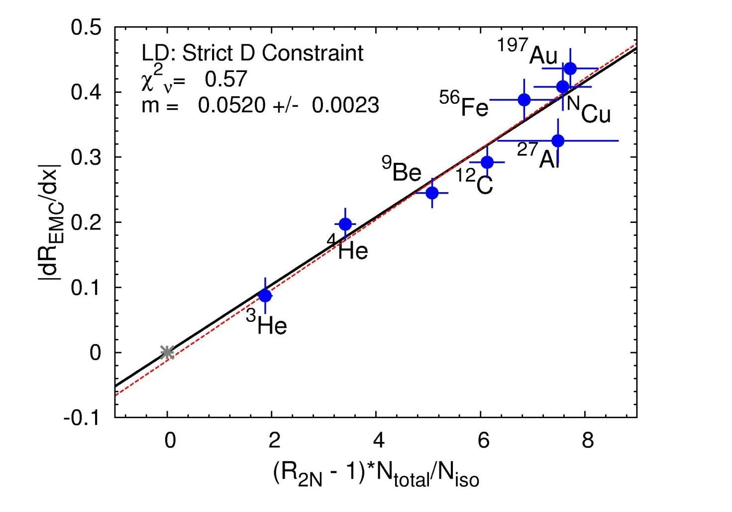
Summary
After 39 years and 1000s of papers, we still don’t know the cause of the EMC Effect.
E12-10-008 will add EMC data for several new nuclei:
Light nuclei provide insight to nuclear clustering and are more amenable to comparison with theoretical calculations
40Ca and 48Ca will allow us to study possible flavor dependence of the EMC Effect, as predicted in several models
More nuclei for EMC-SRC comparison
J. Arrington et al., arXiv:1206.6343 [nucl-ex], (2022)

Slide 23
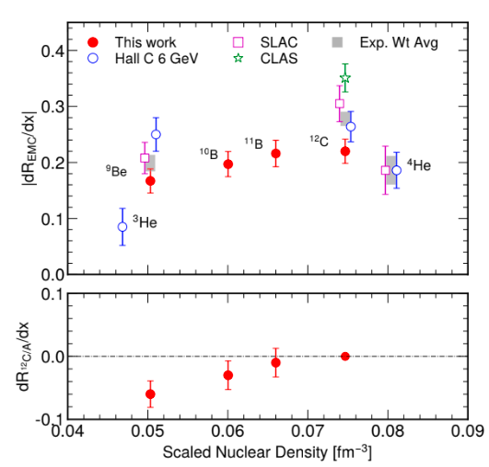
Summary
After 39 years and 1000s of papers, we still don’t know the cause of the EMC Effect.
E12-10-008 will add EMC data for several new nuclei:
Light nuclei provide insight to nuclear clustering and are more amenable to comparison with theoretical calculations
40Ca and 48Ca will allow us to study possible flavor dependence of the EMC Effect, as predicted in several models
More nuclei for EMC-SRC comparison
Analysis of Phase I (2018) data looks promising – plots show characteristic shape of the EMC Effect. Corresponding SRC data under analysis.
A. Karki et al., arXiv:2207.03850 [nucl-ex], (2022)

Slide 24
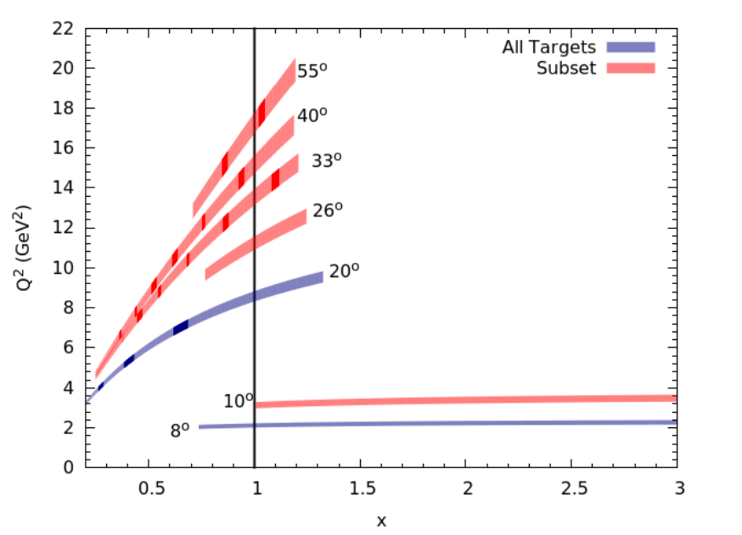
Summary
After 39 years and 1000s of papers, we still don’t know the cause of the EMC Effect.
E12-10-008 will add EMC data for several new nuclei
Light nuclei provide insight to nuclear clustering and are more amenable to comparison with theoretical calculations
40Ca and 48Ca will allow us to study possible flavor dependence of the EMC Effect, as predicted in several models
More nuclei for EMC-SRC comparison
Analysis of Phase I (2018) data looks promising – plots show characteristic shape of the EMC Effect. Corresponding SRC data under analysis.
Phase II will run this Fall!

Slide 25
Collaboration
Spokespeople:
John Arrington (LBL), Aji Daniel, Donal Day (UVa), Nadia Fomin (UTK), Dave Gaskell (JLab)
Postdocs:
Burcu Duran (UTK), Tyler Hauge (LBL)
Graduate Students:
Cameron Cotton (UVa), Abishek Karki (MSU), Casey Morean (UTK)

Slide 26
Questions?

Slide 28
Backup Slides

Slide 29
Physics Goals: n/p ratio
We will be able to extract the n/p ratio in nuclei by comparing cross sections of adjacent nuclei.
This may provide insight into nuclear modeling that is required to extract n/p cross sections from D/p.

Slide 30
Fermi Smearing

