Slide 1
Along with some statistics on physics Careers Paths
Careers at National Labs
Douglas W. Higinbotham
5 August 2022

Slide 2
Careers Paths
Thanks to Midhat Farooq and Crystal Bailey at the APS for providing the statistics slides.

Slide 3
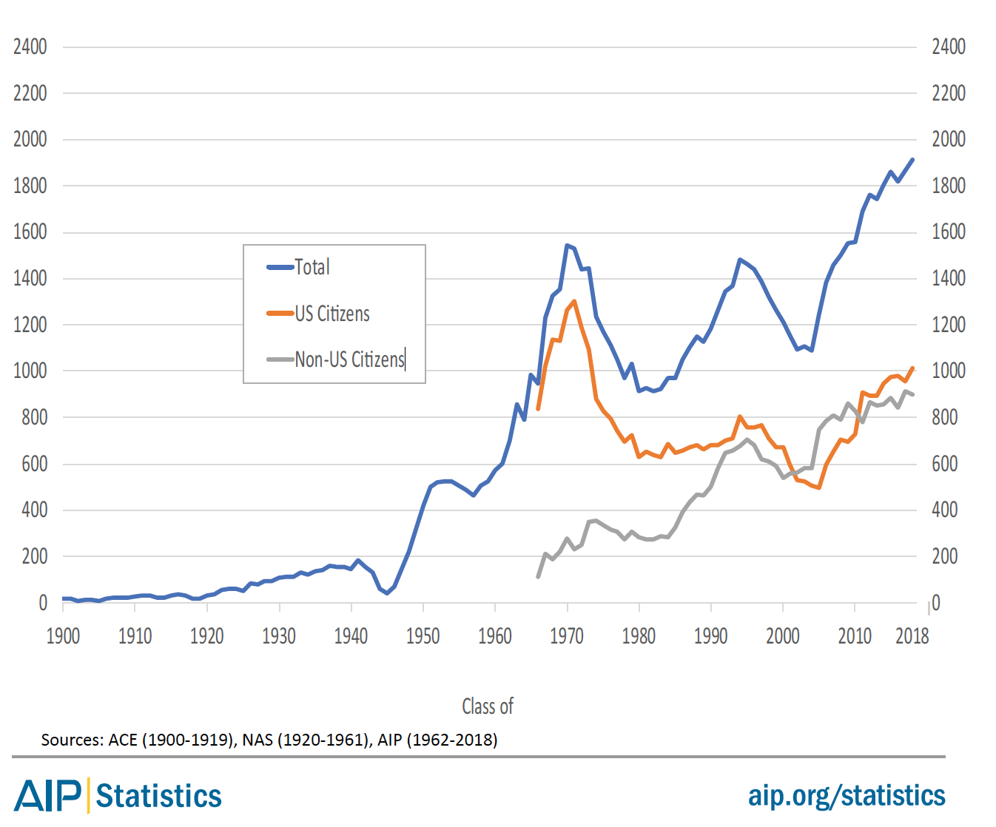
How many PhDs are there?
The number of Physics PhDs granted in the U.S. has almost doubled over the last two decades.
Number of US Physics PhDs
~1600 physics PhDs go into the U.S. job market every year
Class of

Slide 4
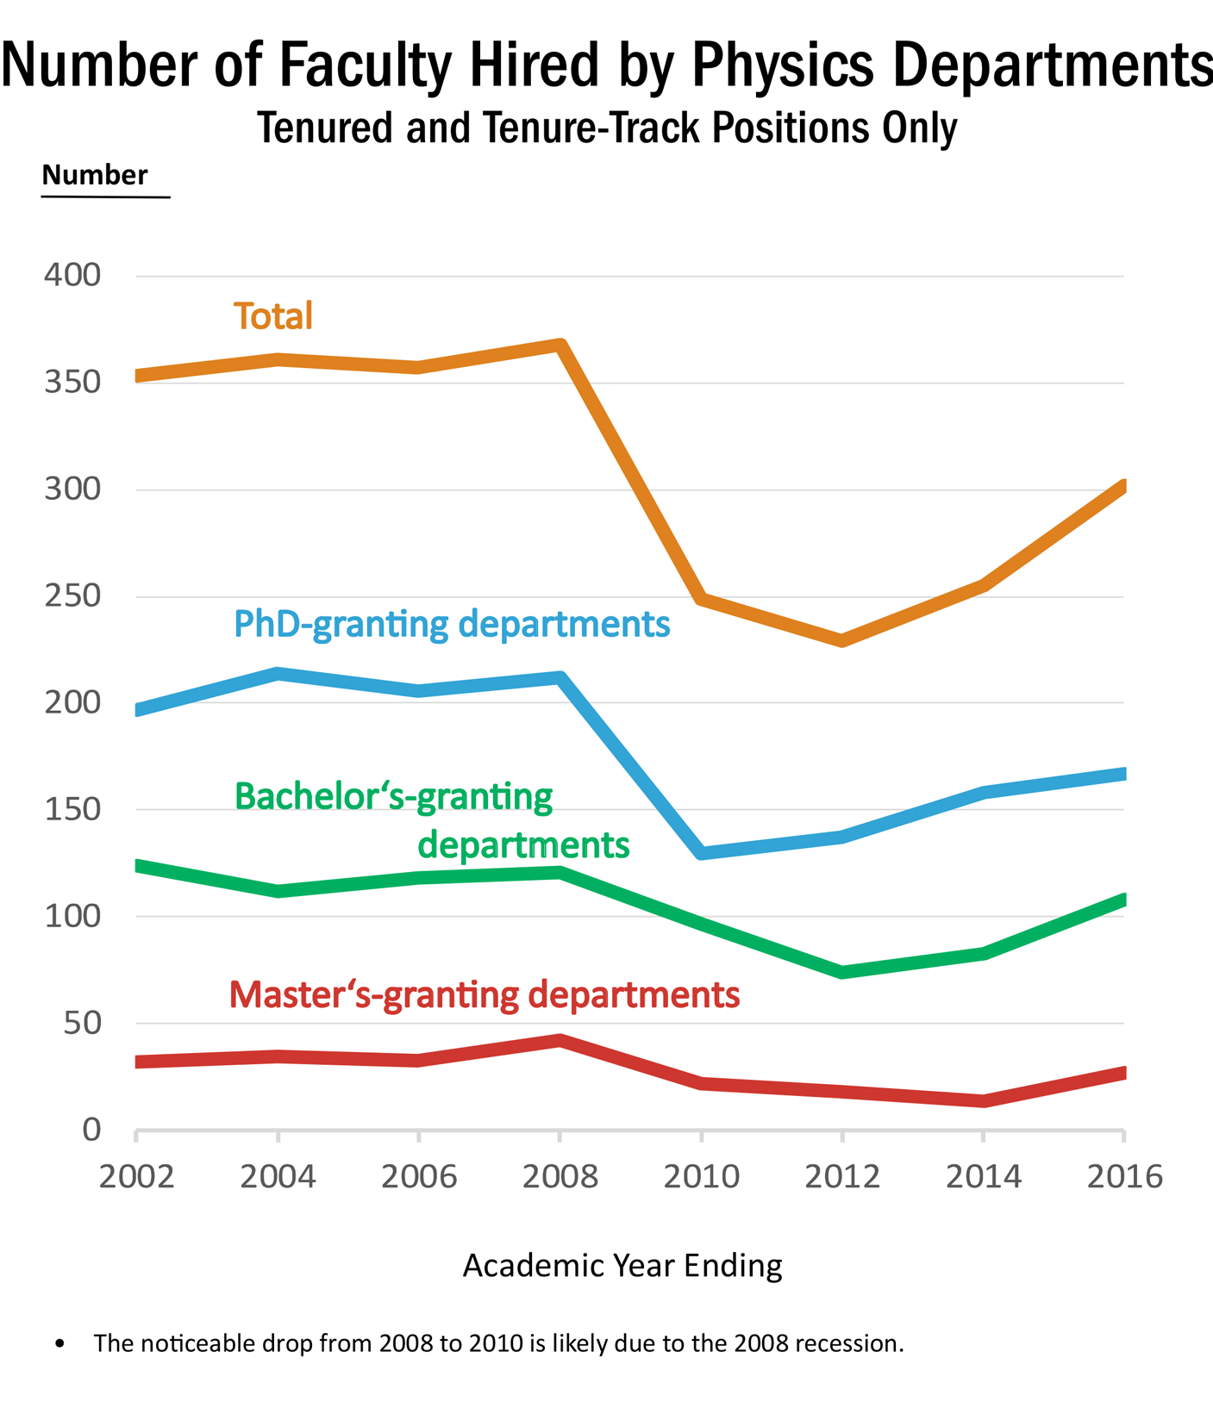
About ~300 new hires per year (2016 data), but ~1600 PhDs looking for jobs every year
Slide from Crystal Bailey (bailey@aps.org)

Slide 5
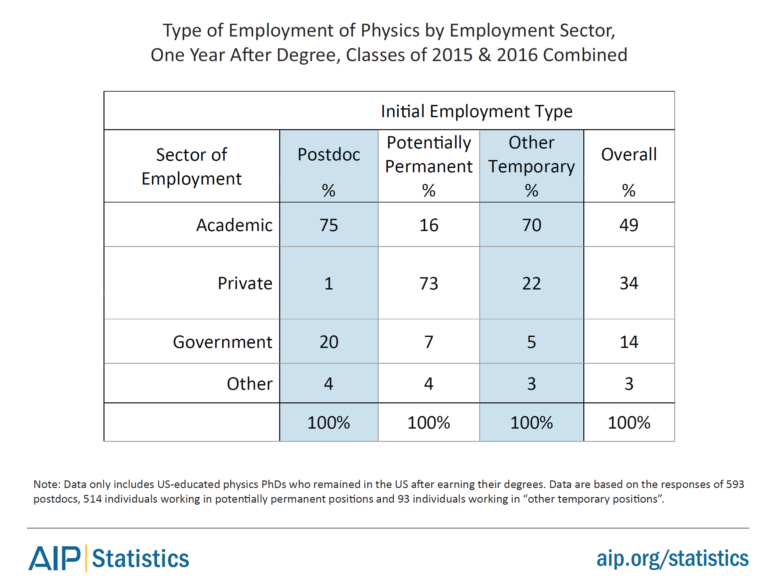
What are they doing (PhDs)?
2015-2016 graduates: 1 year after PhD
About half of physics PhDs are initially employed in the academic sector.
However, ~73% of the potentially permanent jobs are in the private sector.

Slide 6
What are they (PhD and MS) doing?
Source: AIP Statistical Research Center Report Common Careers of Physics PhDs in the Private Sector, June 2015
RESEARCH!

Slide 7
Bottom line: the largest initial employment sector for physics graduates is the private sector.

Slide 8
How much do physics PhDs earn (2015/16)?

Slide 9
My Career Path:
1988-1992: Undergraduate @ W&M
1992-1999: Graduate Research @ UVA
Passed my qualifying exam before picking a group
Stationed at NIKHEF in Amsterdam, the Netherlands
I discovered I am a lab rat!
Took an extra year as a “pre-doc” helping

Slide 10
Presented my Ph.D. research here.
This room in the summer of 1999
Having taken a long time getting my PhD didn’t hurt me as I made good use of the time at NIKHEF and when I interviewed I was already preforming at the level of a postdoc.
I got three MIT postdoc offers from one talk because all three groups were looking for a postdoc that could independently lead research and supervising students.

Slide 11
My next steps
MIT Postdoc stationed at Jefferson Lab 1999-2001
2001 Hired by Jefferson Lab
Staff Science I, II, III and now Senior Scientist
Helped run MANY experiments
Helped with MANY proposals
Helped with MANY papers
I always try to put put students first
e.g. Subedi et al. ( Science paper ) has the 3 Ph.D. students first
Now lead the Jefferson Lab scheduling team (i.e. you can ask why your experiment was scheduled )
Also direct the Jefferson Lab EIC Center (students)

Slide 12
Highlights of National Lab Jobs
Get to do research without having to write grants
Often get to work with amazing students and postdocs (depends a bit on the details of the job )
My wife is in the JLab injector group and that is more a behind the scenes hardware job, she never did a postdoc!
My jobs at JLab have all been very closely tied to our users.
Reasonable pay (not as good as industry but often better than university)
No tenure, but layoffs are rare (but do happen).

Slide 13
Example job posting https://careers.peopleclick.com/careerscp/client_jeffersonlab/external/en-us/gateway.do?functionName=viewFromLink&jobPostId=2686&localeCode=en-us
Hall A/C Postdoctoral Fellow
Posting Date: 07/28/2022 Salary Range: $59,500 - $89,300 (PD) Work Location Type: Flexible On-site (working more than 60% on-site)
Hall C (one of the experimental halls at Jefferson Lab) has successfully finished a large number of experiments with the new Super High Momentum Spectrometer (SHMS) and High Momentum Spectrometer (HMS) and we are looking for a Postdoctoral Fellow that will take an active role in this program. Come and join our team!

Slide 14
From the job posting, it states that in this role you will:
Run experiments to study the pion form factor, L–T separated pion electroproduction, short range correlations, the EMC effect and nuclear PDFs in a range of nuclei using the standard SHMS and HMS setup
Run experiments with the the Neutral Particle Spectrometer (NPS) to measure DVCS, p⁰ SIDIS and wide angle Compton data
Measure in medium modifications by tagging the recoiling proton in a Large Acceptance Detector (LAD),and measure R in SIDIS and using the Compact Photon Source (CPS) with a transversely polarized hydrogen target to study the wide angle Compton reaction. (i.e. build detectors)
Work alongside users and staff scientists to take part in the running and analysis of the ongoing experiments
Interact with the Jefferson Lab user community in the development of new experimental equipment and proposals
Provide support for the operation of the SHMS and HMS detectors and other Hall equipment
Present experimental results at meetings and conferences

Slide 15
Jefferson Lab Benefits DOE reviews these and keeps them more or less inline with the other labs.
Medical, Dental, and Vision Care Plans
Flexible Spending Accounts
Paid Time-off and Leave Programs (NEW Paid Parental, vacation, holidays, and sick leave). [ also has flex time ]
401(k) Plan – 9% Lab Contribution; 100% vested
Flexible Work Arrangements (Remote & Alternate Work Schedules available)
Tuition Assistance, Training and Professional Development Programs
JLab also adds on their job posting:
Live near the waterways of the Chesapeake Bay region with access to nearby beaches, mountains, and all major metropolitan centers on the East Coast

