Slide 1
Academic Career in the US
Bill Briscoe
Frontiers and Careers in Nuclear and Hadronic Physics
August 5, 2022

Slide 2
In my day
In the days of mandatory retirement
In the days when the Manhattan Project crew was retiring or dying off (poor health habits)
In my fourth year of grad school at CUA
Zero applications sent out
Four invitations for interviews
Two postdoc offers
One research faculty offer at twice the salary
In my fourth year as research faculty at UCLA
Zero applications sent out
Two invitations for tenure track interviews
Two offers (Stanford – GWU)
Been at GWU for 40+ years

Slide 3
More recently - Axel Schmidt‘s experience (with his permission)
2016–2017: 3 applications
3 direct rejections
Make your postdoc count! High-impact results Rapid timeline
Publications in major journals
2017–2018: 11 applications
10 direct rejections
1 shortlist → rejection
2018–2019: 5 applications
3 direct rejections
2 shortlists → offers
Fun, exciting, but highly speculative research is a poor strategy.

Slide 4
Today there are not nearly enough faculty openings.
0.5
0.4
0.3
N/N₀
New PhDs Openings
0.2
0.1
0
0
5
10
Time (years)
15
20

Slide 5
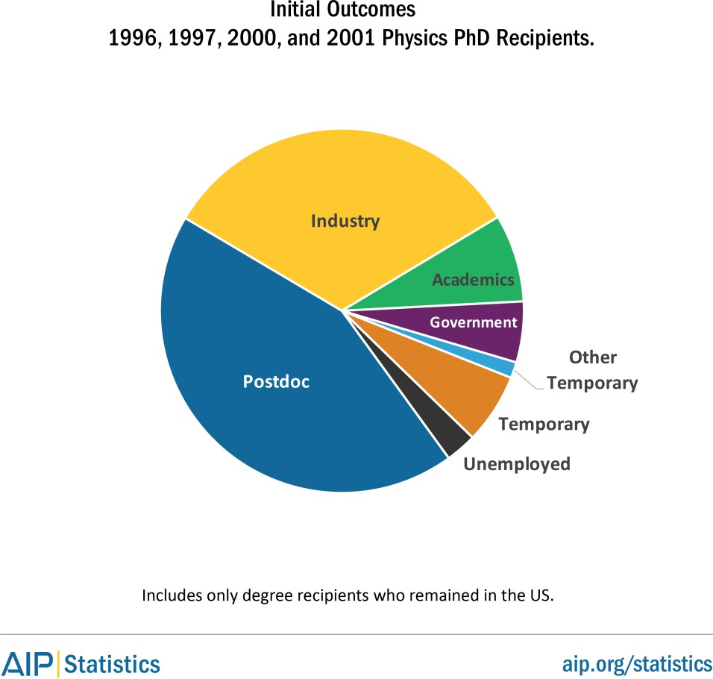
Where people go after their PhD

Slide 6
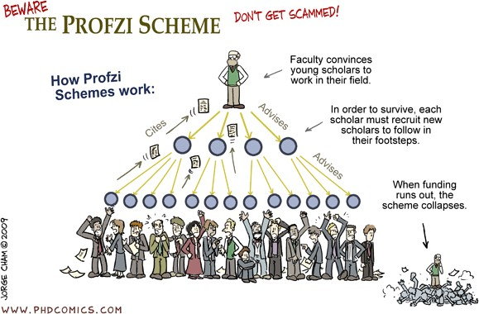
Today Academic physics is like a Ponzi scheme. (from Axel Schmidt)
1500 new physics PhDs / year, faculty turnover is < 300/year
https://www.aip.org/statistics

Slide 7
Think strategically about your academic career. (according to Axel Schmidt)
Bad reason to take a postdoc:
“I know I don’t want to go into academia, but this postdoc is available.”
Good reasons to take a postdoc:
“I know I want to become a professor.”
“I’m not sure yet if I definitely want to become a professor, but I need some more research experience to decide.”
During your postdoc time:
Prioritize high-impact, short-time line results. Apply early, apply often.
Know how long you’d be willing to stay a postdoc.

Slide 8
If you want to be a professor nowadays, remember two things!
Absence does not make the heart grow fonder
Familiarity does not breed contempt

Slide 9
What does this mean?
You need to be visible whether you are a grad students or a postdoc.
You need to be on the author list of papers, proposals and reports, not just acknowledged.
You need to make presentations at conferences, meetings, workshops, and collaboration events.
Take the minutes at you group meetings.
You need your professors talking you up.
You need to be in every picture

Slide 10
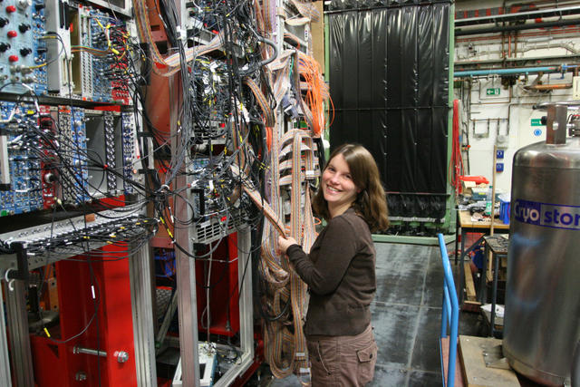
And it helps to be doing physics in the picture

Slide 11
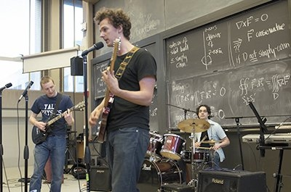
But it could also be physics related - SPS

Slide 12
How do I do this?
Open your mouth and speak up within you own research group and any collaborations to which you belong.
Make comments and suggestions on all drafts being passed around.
Submit abstracts to meetings and make sure you are the one presenting your work.
Ask questions.
Be aggressive but not annoying!

Slide 13
How do expand beyond my own group and collaborations
Do service work at the university or lab that is helpful to others.
Write data acquisition and analysis software
Join committees
Volunteer to organize the next Frontiers and Careers Workshop.
Get involved!
Be a mentor to other students!

Slide 14
Advice from Axel Schmidt
Work on your web presence
Get a LinkedIn profile and post
Update your github profile and showcase your coolest projects
Prepare your resume
A very concise 1-page document presenting your competencies Purpose is to get you an interview
Decide where to aim
Only you know what kind of work makes you happy Research your options
Talk to people
Build your network Ask questions, learn!

Slide 15
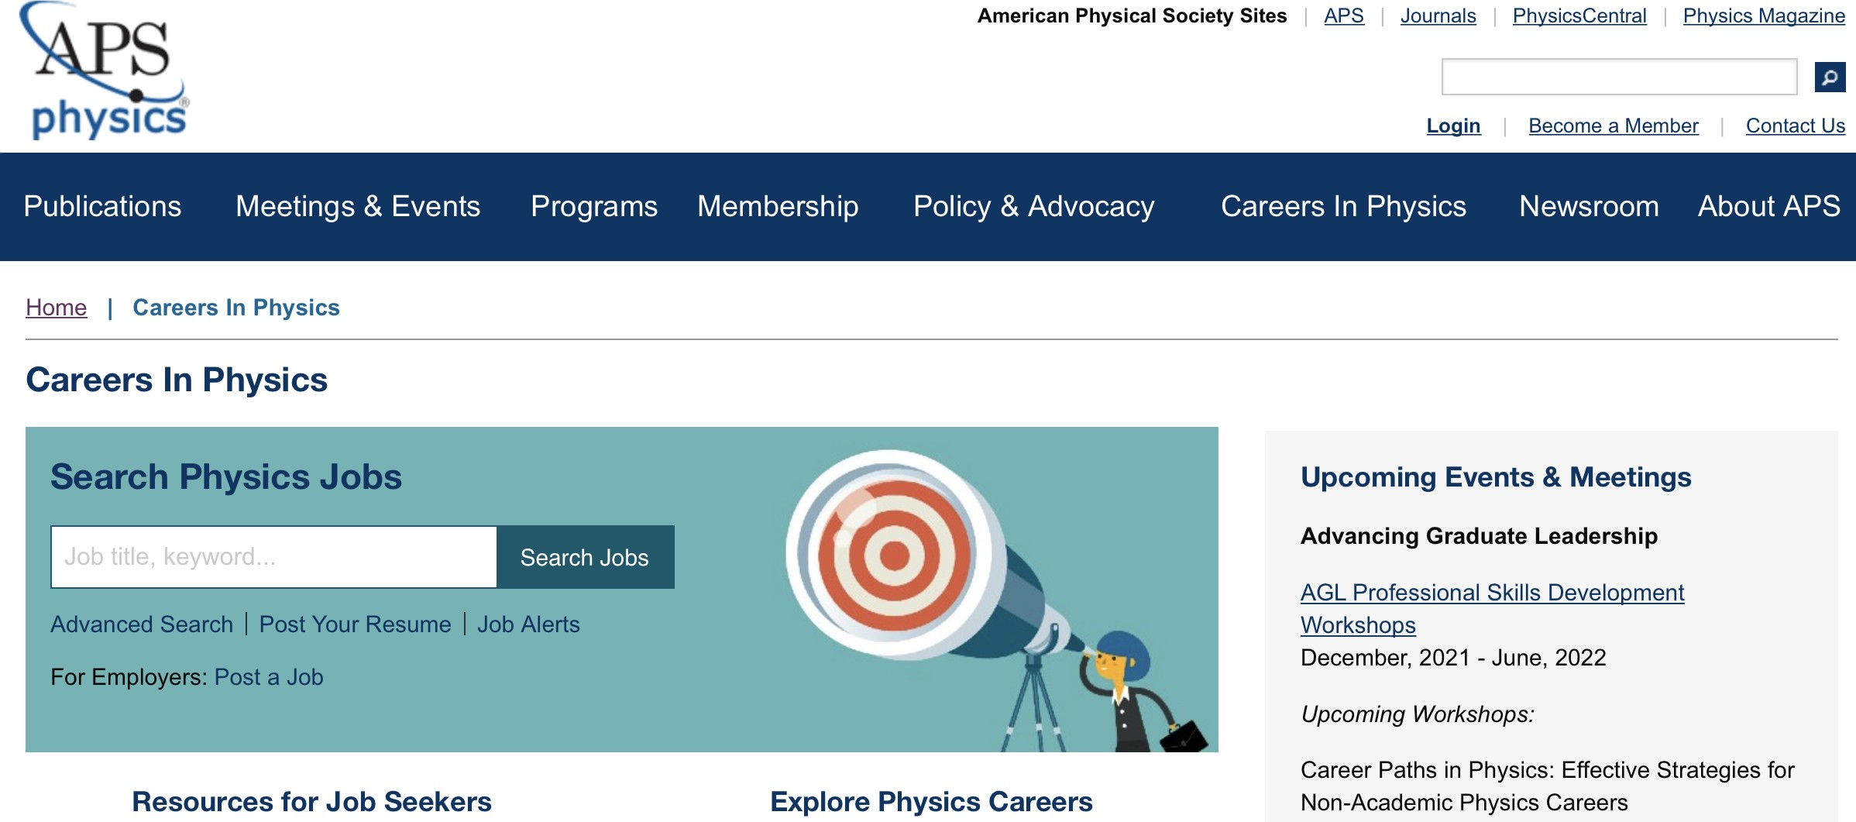
Where to start?
www.aps.org/careers
Job board
Advice on how to apply Webinars, resources

Slide 16
Faculty Application
Everyone asks for:
Cover letter
≈ 3+ letters of recommendation
CV + Publication list or link to online listing
Research statement
Teaching statement – undergraduate!
You might additionally be asked for:
Service statement
Diversity statement
Proposal for a new course – undergraduate!

Slide 17
What happens after you apply?
You should get an acknowledgement, if not email or call – your application may have gone to the wrong place. Some/most universities now require that your application go through their human resources office, not directly to the search committee.
Three usual responses:
Thanks, but no thanks
Thanks, we will let you know
Thanks, can we set up a Zoom meeting – this is usually an indication that you are on the short list
Zoom meeting are usually with the search committee and usually probe for details in a friendly and professional manner.
At this point you wait…..

Slide 18
Now what happens?
The search committee at this point goes back to the whole department and the dean’s office to present who they think are the best candidates. This usually gets into the realm of politics and budgetary concerns.
The department suggest to the dean that they want to bring in X candidates to interview and the dean usually suggests Z = X – Y.
If you are lucky, the search committee chair will invite you for an on-campus interview.
You now need to start asking for details as to what the interview involves – get as much information as possible – good to have a spy/contact!

Slide 19
How do I prepare for the interview?
Find out with whom you will be meeting – faculty and deans
You will be meeting with faculty from your area of expertise.
You will be meeting with faculty outside your area of expertise.
The dean with whom you speak may or may not be a scientist/mathematician.
Go on the university web site and learn about the people with whom you may speak – it impresses people if you seem to know something about them and their interests.
Remember, you are also interviewing them!

Slide 20
How do I prepare for the interview?
You need to prepare a seminar or colloquium.
You may also be asked to prepare a sample lesson.
Not everyone in the audience will be a physicist or even a scientist, mathematician or engineer.
Keep it simple and do not use specialized jargon.
To be safe, you should have a pdf version of your presentation ready – just in case you have to upload to their local system.

Slide 21
Things to watch out for during interview
Dress professionally – Act professionally
Have your elevator talk ready – this is very useful if you are meeting with students and postdocs.
Read the room and act accordingly.
Some people might not offer a hand to shake, but if the hand goes out don’t leave them hanging.
Even if you know people well in the group, no hugs etc.
Do not get drawn into any local politics.
Follow APS meeting guidelines and you will keep out of trouble.
If they take you to dinner, do not go out of bounds on food or drink.

Slide 22
What do you do after the interview?
Prepare for your next interview.
You will usually be told an estimate of the timeline they are under.
Don’t call them, they will call you.
Just keep on doing your thing.
Exception – if you are given an offer from another university, you can start calling other places to find out where they are, especially if you would prefer them over the first offer.
Once you have one offer, you are in charge!

Slide 23
What if they make you an offer?
Negotiate, negotiate, negotiate
Starting salary – you will be offered a 9-month salary – it may be lower than your current 12-month postdoc salary.
Startup considerations.
Summer salary for first year or so.
Teaching load – reduced during first year(s).
Student and/or postdoc support
Laptop, PC or workstation.
Travel money
Experimentalists usually get equipment money.
Check out employee benefit packages!

Slide 24
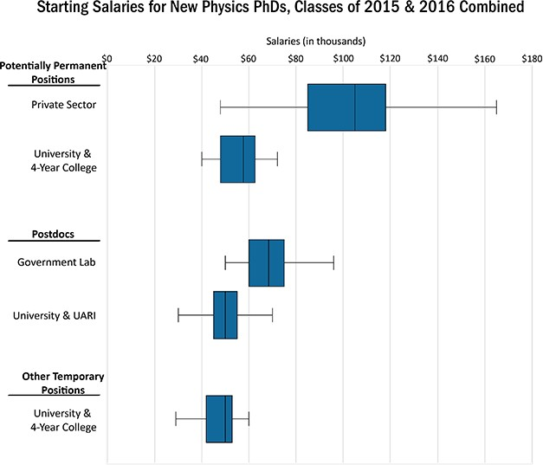
Starting salaries

Slide 25
When do I take the offer
Once you accept the offer negotiations stop!
Seek advice from:
Your current supervisor
Your PhD advisor
Your contacts at the university
Contact other places at which you interviewed and tell then you need their decision asap; if they really want you, they will respond quickly or urge you to give them more time to react.
People talk, the rumor mill is active – they probably know already.
Do not accept too quickly, but do not string people along.

Slide 26
After I accept
Tell your current supervisor – give proper notice.
Finish up your work and try to get things ready for publication – analysis reports, drafts etc – do not leave people hanging with incomplete work.
Your will be told the formalities of the hiring process – these differ, but there be loads of paperwork and training.
Prepare for move – you did ask about moving expenses, did you think of that?
You are one of the lucky ones and now all you must worry about is getting tenure!
That is another talk!

