Slide 1
Modern Hadron Spectroscopy in the Snowmass 2021 Exercise
Summary of Topical Group RF07 (Rare Processes and Precision Measurements Frontier)
Richard Lebed, Arizona State University
Hadron Spectroscopy with a CEBAF Energy Upgrade
Jefferson Lab, 16 June 2022

Slide 2
For decades, hadronic spectroscopy was the core of high-energy physics
1947: Discovery of $π^{±}$, $K^{±}$, $K^{0}$
1950 $\sim$ 1965: The hadron zoo; strangeness; the Eightfold Way; the quark model; color charge
1974: Charmonium; evidence for asymptotic freedom & QCD
1977: Bottomonium; 3rd generation of quarks needed for $CP$ violation
1983: First full reconstruction of $B$ meson decays
1983: $W$& $Z$ bosons. Look for top quark! Look for Higgs! Look for BSM!!
1983– Hadron spectroscopy: Fill out the quark-model multiplets

Slide 3
And then, in 2003…
The Belle Collaboration at KEK found evidence for a narrow new particle at 3872 MeV
In the broad mass range of charmonium, but behaves very unlike a pure $c\overline{c}$ state
Almost certainly a hadron of valence quark content $c\overline{c}q\overline{q}$
S.K. Choi et al., Phys. Rev. Lett. 91 (2003) 262001
Reminder: The primary goal of Belle was the search for CP violation in the B system

Slide 4
Do we really understand hadrons?
Why was every hadron discovered in the quark model’s first 50 years a $q\overline{q}$ meson or $qqq$ baryon? Even Gell-Mann & Zweig saw other options:
$q\overline{q}q\overline{q}$, $q\overline{q}q\overline{q}q\overline{q}$, … (tetraquark, hexaquark, …)
$qqqq\overline{q}$, $qqqqqqq\overline{q}$, … (pentaquark, octoquark, …)
And with development of QCD and the discovery of gluons, other possibilities became available:
$gg$, $ggg$, … (glueball)
$q\overline{q}g$, $q\overline{q}gg$, … (hybrid meson)
Are diquarks in their attractive color channel important hadrons subunits?
Do molecules of hadrons (like deuterons) form?
It is quite humbling that after 60 (50) years of the quark model (QCD), we still do not have undisputed answers to these fundamental questions!

Slide 5
What the charmonium system should look like
$$χ_{c0}(2P)$$
Lines with labels: predicted (eigenstates of quark potential model) and observed experimentally

Slide 6
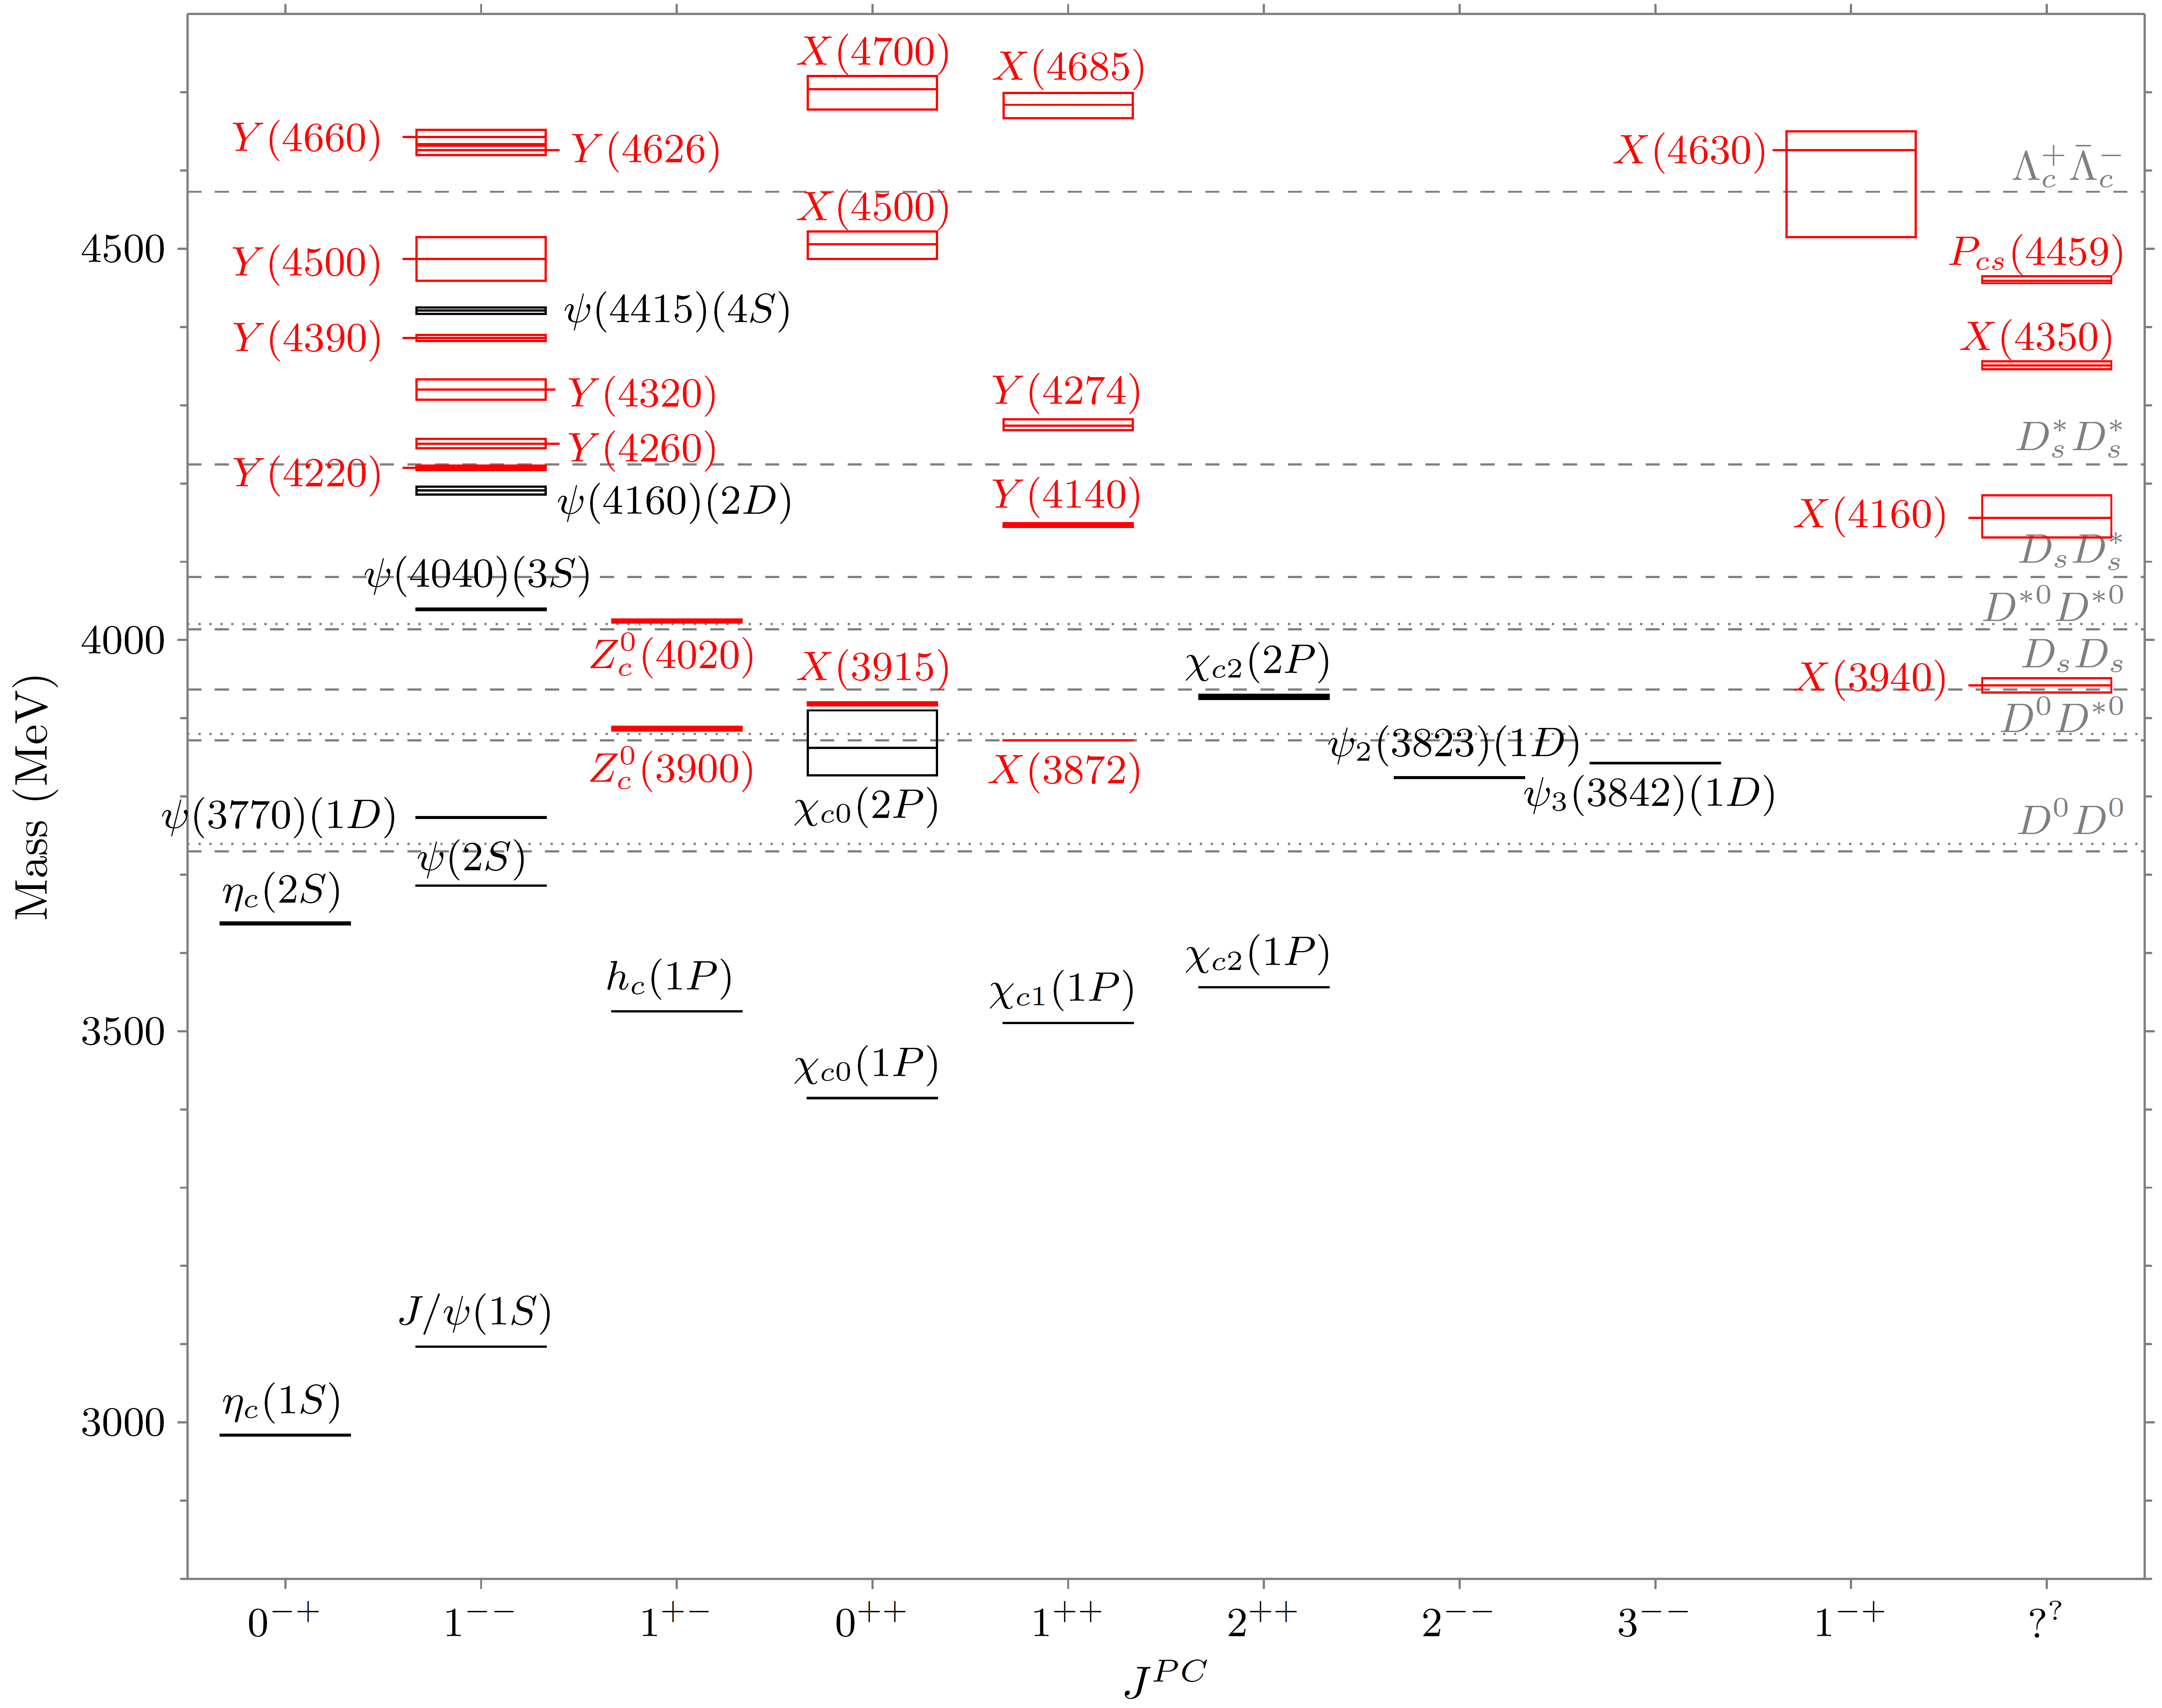
What the charmonium system really looks like
X(6900)
$XYZP$ states have hadronic transitions to narrow charmonium states with surprisingly large rates
Some are explicitly 4-quark effects, e.g., $Z_{c}^{+}(3900)→J/ψπ^{+}$

Slide 7
Heavy-quark exotics census: June, 2022
54 observed exotics, both tetraquarks and pentaquarks
44 in the charmonium sector (including open-strange)
5 in the (much less explored) bottomonium sector
2 with a single c quark (and an s, a u, and a d)
1 with a single b quark (and an s, a u, and a d)
1 with all $c$ and $\overline{c}$ quarks
1 with two c quarks
A naïve count estimates well over 100 more exotics are waiting to be discovered
Lesson 1: The currently running experiments need researchers to carry out processing and analysis of large amounts of data

Slide 8
Not all exotic candidates have heavy quarks
$π_{1}\left(1600\right)$ (discovered 1998) is believed to be a hybrid meson because its $J^{PC}=1^{−+}$ is not accessible to $q\overline{q}$ states
$f_{0}\left(1710\right)$ is believed to have a sizeable glueball component because the quark model predicts one fewer $0^{++}$ states than are seen, and of them $f_{0}\left(1710\right)$ shows up most prominently in $J/ψ$ decays (a glue-rich environment)
$φ(2170)$ has a peculiar decay pattern and may be an $s\overline{s}g$ hybrid or the $s\overline{s}q\overline{q}$ tetraquark analogue to the $c\overline{c}q\overline{q}$ state $Y(4230)$
Lesson 2: Exotics studies require high- and low-energy intercommunity dialogue

Slide 9
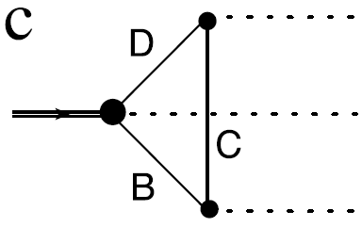
Their internal structure is not yet resolved
u
Mesons depicted here, but each model has a
baryonic analogue
c̄
c
_
u
hadrocharmonium
$$π^{+}$$
$$D^{\left(∗\right)+}$$
$$Y$$
$$π^{−}$$
$$D^{(∗)0}$$
$${\overline{D}}^{\left(∗\right)−}$$
$$J/ψ$$
Image adapted from Godfrey & Olsen, Ann. Rev. Nucl. Part. Sci. 58 (2008) 51
threshold/rescattering/cusp effect
Lesson 3: No single model accommodates all the new states— Even mixtures between several types could occur All possibilities should be pursued, with an eye toward their unique experimental signatures

Slide 10
What kind of “state” is it?
Not every “bump” in the data is a Breit-Wigner resonance, i.e., corresponding to a pole in one particular region of the complex scattering amplitude
Distinguishing “resonances” from “virtual states” and “bound states”, not to mention (supposedly) simple “threshold rescattering effects”, requires:
Careful determination of amplitude dependence on energy across the resonant region to measure the lineshape in different decay modes
Algorithms to model amplitudes in such a way as to obey bedrock quantum-field theory principles like unitarity
Lesson 4: Modern hadron spectroscopy analysis will require collaborations featuring frequent interactions between experimentalists and theorists, and the collective work of multiple theory researchers

Slide 11
Why can’t lattice simply sort these states out?
Lattice QCD simulations have known, quantifiable uncertainties, and now predict many observables at the sub-percent level
But that’s true for states that are stable against strong decay— Almost none of the new states are in that category
There does now exist a technique (Lüscher formalism) for handling unstable states, but many practical complications remain (see below)
Nevertheless, lattice results can also provide strong constraints on matrix elements and values of amplitudes
Lesson 5: The lattice can be used in coordination with phenomenological modeling and with modeling of amplitudes

Slide 12
The major experiments
Currently ongoing (with future upgrades approved or proposed), hadron spectroscopy is among major goals
LHCb (CERN, E.U.) ✓
Belle II (KEK, Japan) ✓
BESIII (IHEP, China) ✓
GlueX (JLab, U.S.) ✓
Currently running, hadron spectroscopy is a minor focus
CMS (CERN, E.U.) ✓
ATLAS (CERN, E.U.)
Future facilities
Electron-Ion Collider [EIC] (approved: BNL, U.S.) ✓
Super Tau-Charm Facility (proposed: China) ✓
PANDA (planned: FAIR, Germany)
JLab24 (proposed, U.S.) ✓

Slide 13
Experimental Facilities
Present & Future

Slide 14
LHCb [https://cds.cern.ch/record/2806113]
The LHC experiment, using multi-TeV $pp$ collisions in two runs since 2010 (9 fb⁻¹): huge numbers of $b$- and $c$-containing hadrons (strong production cross section!) Very clean final-state signals when produced via subsequent weak decays
LHCb specializes in studies of $b$ and $c$ physics (forward-angle detection, RICH detectors for charged hadron identification, large dedicated trigger bandwidths, as opposed to high-$p_{T}$ experiments)
LHCb has discovered more hadrons (conventional & exotic) than any other facility in past decade:
Pentaquarks $P_{c}^{+}→J/ψ p$, all-charm tetraquark $X(6900)→J/ψ$ $J/ψ$, open-charm tetraquarks $X(2900)→D^{−}K^{+}$, double-charm tetraquark $T_{cc}^{+}$, double-charm baryon $Ξ_{cc}^{+}$, etc.
With Runs 3 & 4 in next decade, LHC will continue to produce more heavy quarks than any other facility LHCb detector upgrades (I ongoing, II next decade) designed to take advantage of instantaneous luminosity already achieved at LHC

Slide 15
CMS (& ATLAS) [2204.06667]
CMS & ATLAS detectors instead cover central-rapidity region & already run at full LHC luminosity Since high-$p_{T}$ detection prioritized, lots of heavy quarks escape
Trigger efficiencies kick in for higher-$p_{T}$ muons Best sensitivity to double-bottomonium final states $ΥΥ$ with $Υ→μ^{+}μ^{−}$, in search for $b\overline{b}b\overline{b}$ states (also in $Υμ^{+}μ^{−}$decays) Should also play role in verifying the LHCb claims for $J/{ψJ/ψ}$, etc.
No dedicated charged-hadron identification (can’t distinguish $π^{+}, K^{+}, p$) induces large backgrounds in many channels with ($J/{ψ→}μ^{+}μ^{−}$)+hadrons
But can identify strangeness in processes involving $K_{s}^{0}→π^{+}π^{−}$ and $Λ→pK^{−}$ (secondary vertex and mass identifies them) Hidden strangeness via $φ→K^{+}K^{−}$ (very narrow mass peak)
In such cases, CMS (& ATLAS) can provide complementary results to LHCb Examples: $X(4140)→$ $J/ψφ$, pentaquark searches in $B^{+}→J/{ψ p \overline{Λ}}$
Request for prioritization of collaborations to dedicate enough manpower and computing resources to these topics (dedicated triggers needed)

Slide 16
Belle II ($e^{+}e^{−}$near $b\overline{b}$ threshold) [https://www.slac.stanford.edu/~mpeskin/Snowmass2021/BelleIIPhysicsforSnowmass.pdf]
Data-taking at Belle II began in 2019; as successor to Belle, has long tradition of uncovering new exotic & conventional states in $c\overline{c}$ and $b\overline{b}$ : $X(3872)$, $Z_{c}^{+}(4430)$, $Z_{b}^{+}\left(10610\right)$, etc.
Belle II instantaneous luminosity so far only somewhat exceeds that of Belle, albeit using new, promising $e^{+}e^{−}$machine technology (nanobeams). Major upgrade of interaction point in 2026-27 to reach full design luminosity, about 2 orders of magnitude higher. Expect $40×$ more data than Belle I by 2031
Production cross sections are EM, so Belle II cannot compete with LHCb in channels with all charged particles or in simpler final states with neutrals ($γ$, $π^{0}$, $η, ω$), but in these cases should have enough sensitivity to verify some LHCb findings
Tuneable c.m. energy above $B\overline{B}$ threshold: unique access to high $b\overline{b}$, $b\overline{b}q\overline{q}$, $b\overline{b}g$
Other unique production processes: $γγ→c\overline{c}$ , exclusive double-charmonium production ($J/ψX_{c\overline{c}}$) give access to other narrow charmonium states
Request continued support to U.S. researchers in data analysis and detector upgrades to cope with increasing luminosity

Slide 17
BESIII ($e^{+}e^{−}$near $c\overline{c}$threshold) [2204.08943]
Premiere facility for precision $e^{+}e^{−}$ tau/charm physics (up to 5 GeV)
Unlike at $B$ factories, $c\overline{c}$, $c\overline{c}q\overline{q}$, $c\overline{c}g$ states are created directly with better efficiencies in a larger variety of final states. However, dedicated energy scans are needed to map out resonant lineshapes. At present, BESIII has the most precise method to study vector states ($ψ$ and $Y$) and narrow $Zc$ states, a number of them having been discovered by BESIII
Observations of transitions between exotic hadrons [e.g., $Y(4230)→γX(3872)$] seen nowhere else
Very large sample of $J/ψ$ (10¹⁰) a unique window to light-hadron spectroscopy (glueballs and hybrids)
Program to continue 5-10 more years with upgrade of energy to 5.6 GeV and of luminosity (3$×$)
Recommend support to U.S. researchers at this unique experiment

Slide 18
The Super Tau-Charm Facility [2203.07141]
Imagine BESIII with luminosity two orders of magnitude higher (${10}^{35}{cm}^{−2}s^{−1}$). Sites have been proposed in China and Russia Data taking in 2030s
Energy scans would completely map out $ψ,$ $Y$, narrow $Zc$ states (beyond any competition from $B$ factories)
Huge data sets of radiative & hadronic transitions between $c\overline{c}$ and exotic states would become available
Estimated $3×{10}^{12}J/ψ$ means great glue-rich sources for glueballs and light hybrids
Good potential to produce pentaquarks $P_{c}$, $P_{cs}$ and all-heavy ($c\overline{c}c\overline{c}$) tetraquarks
U.S. participation at this unique facility is desirable (natural transition to researchers trained at BESIII)

Slide 19
Photoproduction Experiments [2203.08390]
The only major U.S.-based hadron experiments for next decade
Photoproduction ($γ^{(∗)}p→Xp$ or $γ^{(∗)}A→XA$) offer clean probes to produce states $X$ without strong-interaction contamination
Can scan over both c.m. energy ($X$ mass) and $γ^{∗}$ virtuality ($X$spatial size)
GlueX (@Jlab), running since 2017: Original purpose is to search for light hybrids, e.g., $π_{1}\left(1600\right)$, but can also look for hidden-strangeness exotic candidates like $φ(2170)$ and $P_{c}$ pentaquarks in $γ^{∗}p→p$ $J/ψ$
Proposed upgrade of CEBAF facility to higher energy (24 GeV) would make observations of charmonium-like exotics more likely
EIC (Electron-Ion Collider @BNL) approved to begin construction in 2024, data-taking expected to begin in 2030 With c.m. energy 20-140 GeV, access to $XYZP$ states likely (at lower EM rates)
Domestic opportunity for U.S.-based research groups interested in hadron spectroscopy

Slide 20
PANDA
PANDA (antiProton ANnihilation at DArmstadt): A proposed experiment at FAIR (Facility for Antiproton and Ion Research) in Germany
FAIR to be commissioned in 2025
Annihilation of $\overline{p}$ on $p$ in fixed targets (${10}^{31}{cm}^{−2}s^{−1}$ in Phase One) Much higher cross sections than $e^{+}e^{−}$
Very clean: Make just one mesonic resonance $X$ in formation, $\overline{p}p→X$, lots of $J^{PC}$ accessible
High-resolution scans across resonances to obtain detailed lineshapes

Slide 21
Theoretical Approaches

Slide 22
Phenomenological modeling [2203.16583]
The internal structure of heavy-quark exotics is not yet resolved, so multiple approaches must continue to be developed
Heavy-quark ($m_{Q}≫Λ_{QCD}$) hadrons ―especially multiquark exotics― admit features not available for light-quark ones:
Usually fewer decay modes (hence narrower); anomalous decay modes (e.g., $X(3872)→J/ψρ$); small $KE$ for $m_{Q}$, hence heavy-quarks nucleate quark clusters (Hadronic molecules? Diquark compounds?)
Large $m_{Q}$ allows for scale separation from lighter d.o.f.: effective field theory, Born-Oppenheimer approximation

Slide 23
Phenomenological modeling [2203.16583]
Many candidates lie near di-hadron thresholds [e.g., $X(3872)$ to $D^{0}{\overline{D}}^{∗0}$] Hadron molecules? Threshold effects? Configuration mixing?
Do $b$ and $c$ systems have analogous states? Do they form full isospin and SU(3)-flavor multiplets?
No single picture simultaneously explains all exotic candidates Multiple perspectives needed to develop comprehensive understanding
Recommendation: Funding for development of U.S. multi-institution consortium to pursue coordinated approach to this hadron spectroscopy

Slide 24
Amplitude analysis [2203.08308]
A “bottom-up” theory approach; no model assumed Use only core features of quantum field theory: unitarity, analyticity of scattering amplitudes, crossing symmetry
“Model” amplitudes by using only functions obeying these constraints
This is a big, intricate job! JPAC (Joint Physics Analysis Center) is a collaboration of theorists & experimentalists (JLab, COMPASS, …) carrying out these complicated calculations
Examples: $f_{0}\left(1710\right)$ likely dominated by glueball component; $π_{1}\left(1400\right)$ hybrid candidate seems to be artifact of true $π_{1}\left(1600\right)$ state
Recommendation: Continued support for collaborations such as JPAC

Slide 25
Lattice QCD simulations [2203.03230; talk by Sasa Prelovsek]
Very good results for light, conventional hadrons; for conventional quarkonium below open-flavor thresholds; for decay constants; etc.
Can study $m_{q}$ dependence of observables
…Even with lower values of $m_{π}$ and unquenching
Technique (Lüscher formalism) for unstable particles w/ 2-body decays
Improvements underway/future goals (given sufficient computing resources, researcher support)
Decays to particles with nonzero spin
Decays with more than one two-body final state (coupled-channel)
3-body decays
Isospin breaking, electroweak transitions, …

Slide 26
Recommendations from RF07
No big new experiments called for in the U.S.! All facilities are operating now, approved in U.S., or proposed by other countries
Human capital: need continued and enhanced support & training of personnel for dedicated data analyses
Support for research that crosses the traditional particle/nuclear physics divide
Support for analysis & triggering resources at experiments not originally focused on hadronic physics (e.g., CMS, ATLAS)
Support for detector equipment enhancements relevant to hadron spectroscopy (e.g., LHCb)

Slide 27
Recommendations from RF07
Continued & expanded support for researchers at Belle II and BESIII: a big U.S. physics footprint for a small U.S. investment; training can be carried over to future Super Tau-Charm Facility
U.S. facilities: support & training for junior researchers at GlueX, many of whom will then staff the upcoming EIC or possible JLab24
Support for U.S. cross experiment/theory initiatives such as JPAC to carry out intricate multi-level amplitude analyses
Support for U.S. multi-institution theory initiatives, including lattice, to broaden researchers’ perspectives and generate new collaborations

Slide 28
Backup Slides

Slide 29
Do we really understand hadrons?
Why was every hadron discovered in the quark model’s first 50 years a $q\overline{q}$ meson or $qqq$ baryon? Even Gell-Mann & Zweig saw other options:
$q\overline{q}q\overline{q}$, $q\overline{q}q\overline{q}q\overline{q}$, … (tetraquark, hexaquark, …)
$qqqq\overline{q}$, $qqqqqqq\overline{q}$, … (pentaquark, octoquark, …)
And with development of QCD and the discovery of gluons, other possibilities became available:
$gg$, $ggg$, … (glueball)
$q\overline{q}g$, $q\overline{q}gg$, … (hybrid meson)
Are diquarks in their attractive color channel important hadrons subunits?
Do molecules of hadrons (like deuterons) composed of mesons form?
It is quite humbling that after 60 (50) years of the quark model (QCD), we still do not have undisputed answers to these fundamental questions!
Modern hadron spectroscopy aims at settling these issues
Consequences could be far-ranging:
Neutron star models
Contributions of hadronic effects in rare B decays (BSM)
Phenomenology of any strongly coupled theory

Slide 30
Hadron Spectroscopy White papers
RF7 LoIs/white papers, final structuring
Experiment
Theory
Future work at existing facilities
Approved or proposed facilities
Specific types of models
Lattice QCD
Analysis techniques
LHCb (An,Skwarnicki)
Tau-charm & J/$ψ$ factories (Mitchel)
Hadron molecules & thresholds
(Karliner)
Heavy-hadron specific (Prelovsek)
JPAC: Amplitude analysis (Szczepaniak)
Belle II (Fulsom)
Charm photoproduction factory (Pilloni)
Diquark models (Santopinto)
(our contact people for hadron spectroscopy part – many are our group subconveners)
BESIII (Mitchell)
The EIC (Electron-Ion Collider) (Stevens)
We have had 6 dedicated workshops over the last 2 years, in which we engage a broad community worldwide [attendance ~ O(10²) physicists]
See:
https://snowmass21.org/rare/hadron_spectroscopy
GlueX @ Jlab (Dobbs)
CMS (& ATLAS) (Pompili)

Slide 31
LHCb [https://cds.cern.ch/record/2806113]
The LHC experiment, using multi-TeV $pp$ collisions in two runs since 2010 (9 fb⁻¹), made huge numbers of $b$- and $c$-containing hadrons (strong production cross section!) Very clean final-state signals when produced via subsequent weak decays
LHCb specializes in studies of $b$ and $c$ physics (forward-angle detection, RICH detectors for charged hadron identification, large dedicated trigger bandwidths, as opposed to high-$p_{T}$ experiments) Runs at intentionally diluted instantaneous luminosity
With Runs 3 & 4 in next decade, LHC will continue to produce more heavy quarks than any other facility LHCb detector upgrades (I ongoing, II next decade) designed to take advantage of the instantaneous luminosity already achieved at LHC
LHCb has discovered more hadrons (conventional & exotic) than any other facility in past decade:
Pentaquarks $P_{c}^{+}→J/ψ p$, all-charm tetraquark $X(6900)→J/ψ$ $J/ψ$, open-charm tetraquarks $X(2900)→D^{−}K^{+}$, double-charm tetraquark $T_{cc}^{+}$, double-charm baryon $Ξ_{cc}^{+}$, etc. etc. etc.
Many heavy-quark configurations not reachable at other facilities than LHC ($b$-baryons, $bc$, $bb$, …) and important for sorting out different models of multiquark states

Slide 32
LHCb next 2 decades [https://cds.cern.ch/record/2806113]
LHCb Upgrade I (2020s): In commissioning phase as we speak Full software triggering with 40 MHz readout (beam-collision frequency) of all subdetectors. Instantaneous luminosity used is ~$10×$ better Request continued participation of U.S. groups in data taking and analysis
LHCb Upgrade II (2030s): Tech Design Report released. More granular and radiation-hard detector, use timing in subdetectors as 4th dimension in event reconstruction, improved EM calorimeter to fight pile-up that deteriorates detection of neutrals, tracking chambers in the magnet for low-$p$ tracks etc. Another factor of ~10 improvement in luminosity Request for U.S. involvement in R&D, later detector funds

Slide 33
Belle II ($e^{+}e^{−}$near $b\overline{b}$ threshold) [https://www.slac.stanford.edu/~mpeskin/Snowmass2021/BelleIIPhysicsforSnowmass.pdf]
Data-taking at Belle II began in 2019; as successor to Belle, this $e^{+}e^{−}$ experiment has long tradition of uncovering new exotic & conventional states in $c\overline{c}$ and $b\overline{b}$ systems: $X(3872)$, $Z_{c}^{+}(4430)$, $Z_{b}^{+}\left(10610\right)$, etc.
Belle II has reached instantaneous luminosity so far only somewhat exceeding that of Belle, albeit using new, promising $e^{+}e^{−}$machine technology (nanobeams). Major upgrade of interaction point in 2026-27 to reach full design luminosity, about 2 orders of magnitude higher. Expect $40×$ more data than Belle I by 2031
Because production cross sections are EM, Belle II cannot compete with LHCb in channels with all charged particles or in simpler final states with neutrals ($γ$, $π^{0}$, $η, ω$) However, in these cases it should have enough sensitivity to verify some claims made by LHCb
Belle II can edge LHCb in sensitivity in more difficult channels with neutrals (soft $γ$or $π^{0}$, multiple neutrals)
Tuneable c.m. energy above $B\overline{B}$ threshold gives unique access to high-mass $b\overline{b}$, $b\overline{b}q\overline{q}$, $b\overline{b}g$ states (important for hadron spectroscopy!)
Other unique production processes: $γγ→c\overline{c}$ , exclusive double-charmonium production ($J/ψX_{c\overline{c}}$) give access to other narrow charmonium states
Belle II at full luminosity will be competitive with BESIII on charmonium-like exotics ($Y$,$Zc$states) thanks to initial-state radiation [ISR] ($e^{+}e^{−}→γc\overline{c}$)
Request continued support to U.S. researchers in data analysis and detector upgrades to cope with increasing luminosity
Farther future (2030s): Proposal for running with polarized beams and modestly improved luminosity

Slide 34
Unique experimental capabilities
LHCb: matchless numbers for $b$-hadron decays ($b$-baryons is a unique gateway) reconstructed in charged final states, and in simple channels with neutrals. Exotics in charmonium-like, open-charm, double-charmed and double-charmonium-like configurations already observed Largest impact on hadron spectroscopy in the past decade and best prospects for new discoveries (reaching $b$-quark exotics?) and improved studies on known states for the next two decades However, some important hadron configurations seen elsewhere have not been detected at LHC
CMS/ATLAS can play an important role in special channels, in particular for $b\overline{b}b\overline{b}$ spectroscopy.
Belle II has unique access to$b\overline{b}$-like states, $Y_{b}$ and $Z_{b}$. ISR production of $Y_{c}$and narrow $Z_{c}$ states becomes competitive with BESIII at full luminosity. Unique access to $c\overline{c}$-like states in $γγ$ collisions and via double-charmonium production, which is difficult to observe elsewhere
BESIII has best access to $c\overline{c}$-like states ($Y_{c}$ and narrow $Z_{c}$), and sees transitions among exotic-hadron candidates. Large $J/ψ$ sample a gateway to light glueballs and hybrids
STCF would increase these capabilities dramatically
GlueX: dedicated photoproduction experiment to produce light hybrids, making first steps towards charmonium-like spectroscopy in unique production environment. Possible upgrade of CEBAF to make detection of such states more likely. Photoproduction at EIC is also likely to play a role Photoproduction rates are limited by EM cross-sections, but offers special handles to study hadron substructure (energy scans, spatial extent)

