Slide 1
24 GeV CEBAF FFA* Energy Upgrade
Feasibility study for FFA racetracks in the existing CEBAF tunnel to reach the top energy of 22-24 GeV
Alex Bogacz
J-FUTURE Workshop
Jefferson Lab / Messina University
*FFA (Fixed Field Alternating-Gradient)

Slide 2
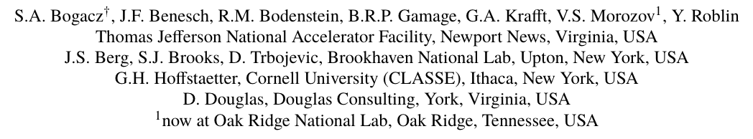




The FFA@CEBAF Collaboration
, Kirsten Deitrick

Slide 3

Overview
Adiabatic FFA Arc – -proven architecture
  Non-scaling FFA based on high-gradient permanent magnets
  Adiabatic control of betas and dispersion (gradual variation of cells)
Multi-pass linac optics
  Periodic triplet lattice for all passes
  650 MeV injector upgrade
Modified CEBAF switchyard with pathlength corrections
Current baseline: 650 MeV inj + 3-pass CEBAF + 2×FFA
Synchrotron radiation impact on beam quality, mitigations
Positron option
Summary, Outlook

Slide 4
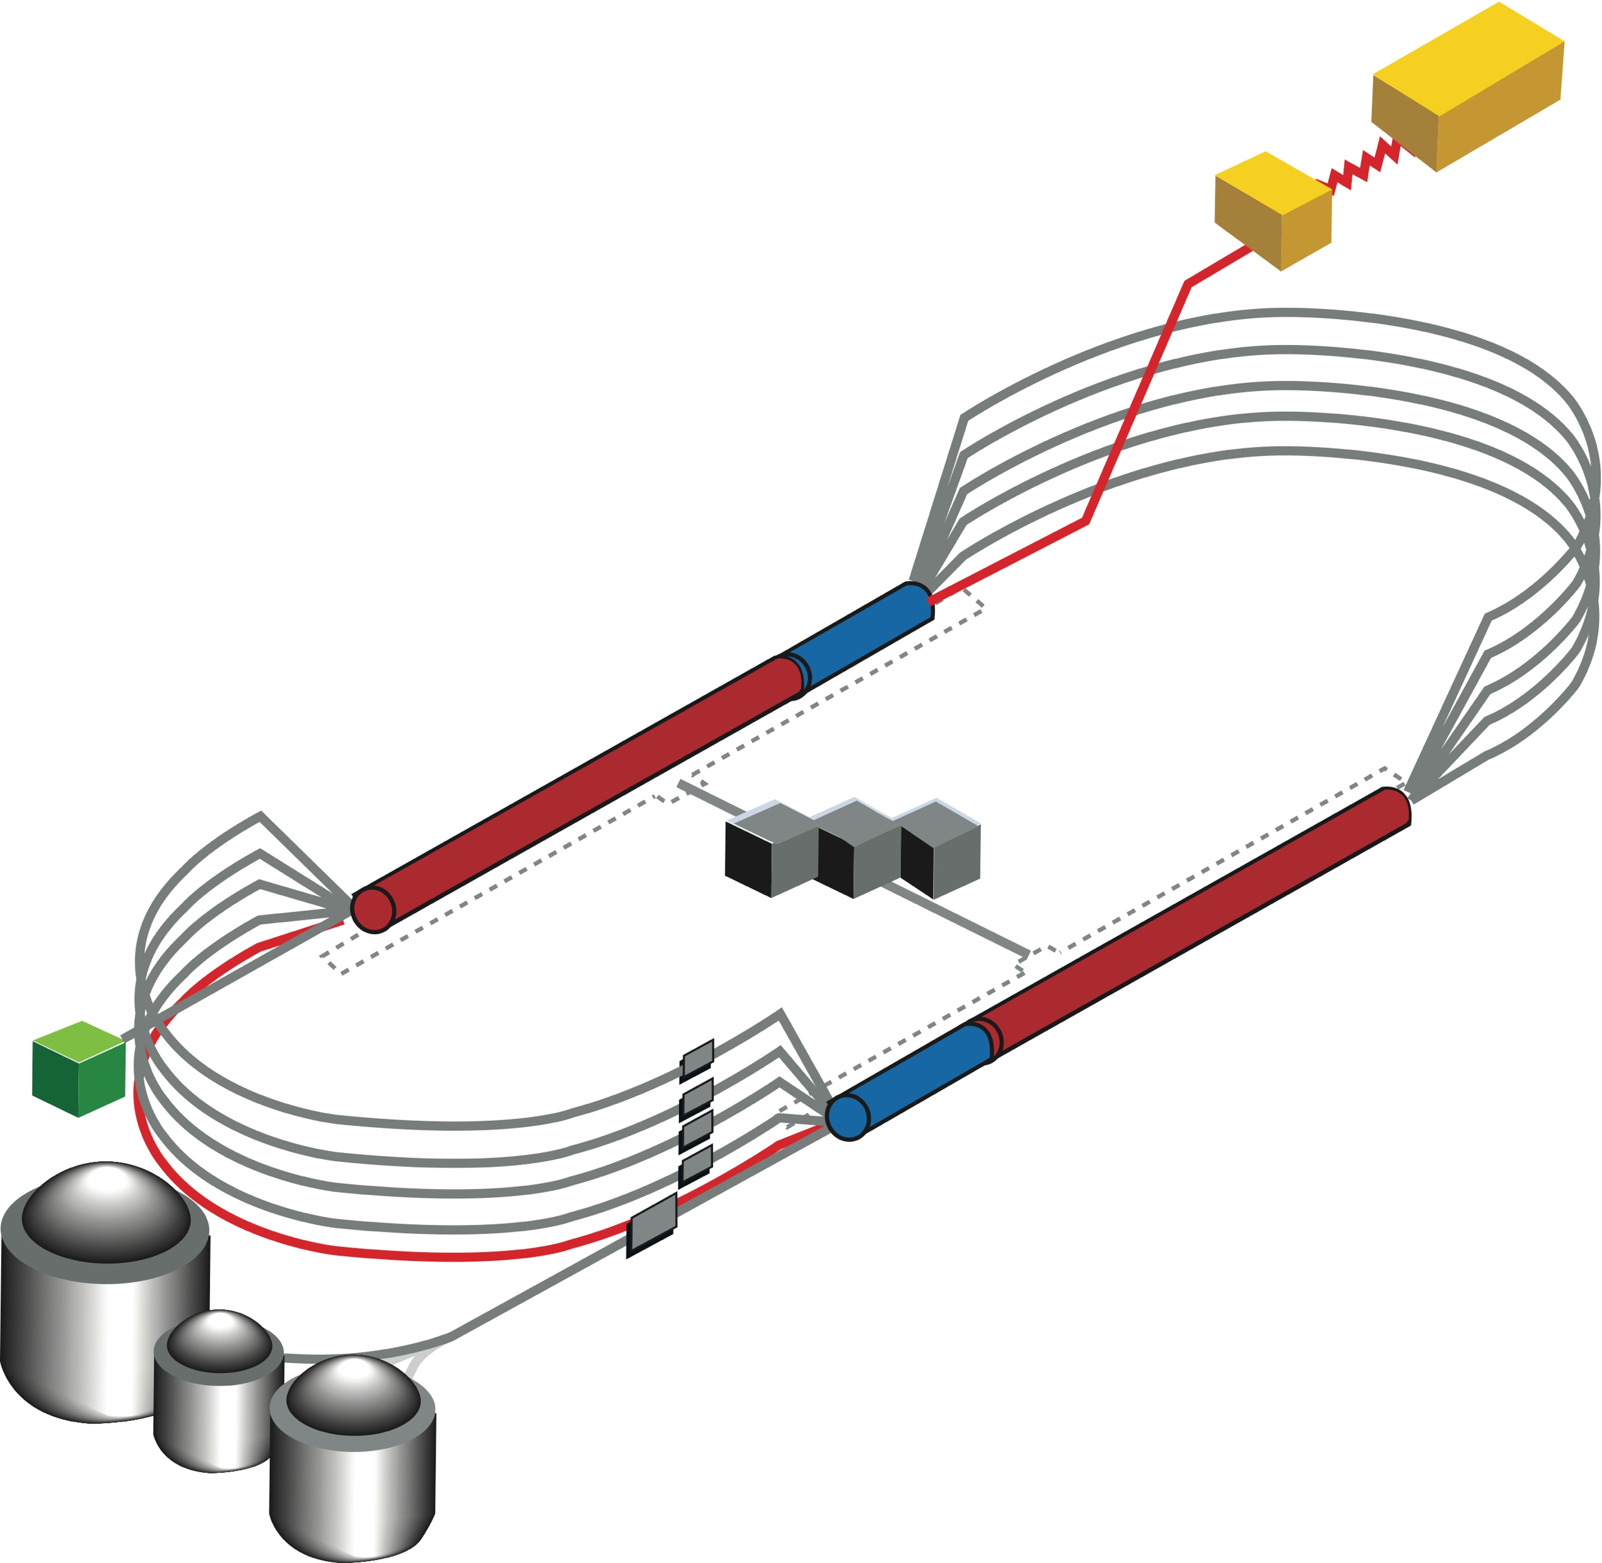
CEBAF FFA Upgrade – ‘Big Picture’
  Starting with 12 GeV CEBAF as a baseline
  NO new SRF (1.1 GeV per linac)
  Remove the highest two recirculation passes (Arc 7 & 9 and Arc 8 & A) and replace them with two pairs of FFA arcs including time-of-flight chicanes
  Recirculate 11 times to get to 22-24 GeV:
    3 passes with the current CEBAF (Arcs 1-6)
    8 passes through a pair non-scaling FFAs (4 + 4)
    -proven architecture
    Novel permanent magnet technology used for power and cost savings
FFA Arcs
TOF
TOF
TOF
TOF
FFA Arcs
Pass Arithmetic: 5 -1 + 4 -1 + 4 = 3 + 8 = 11

Slide 5
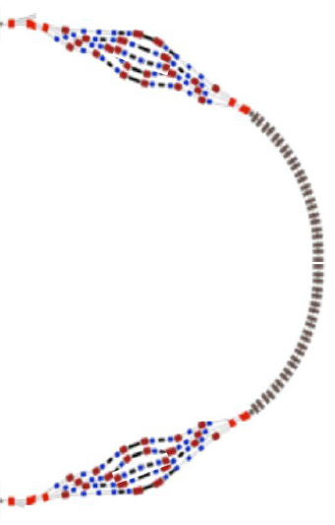
FFA CEBAF with -like Arcs

Slide 6
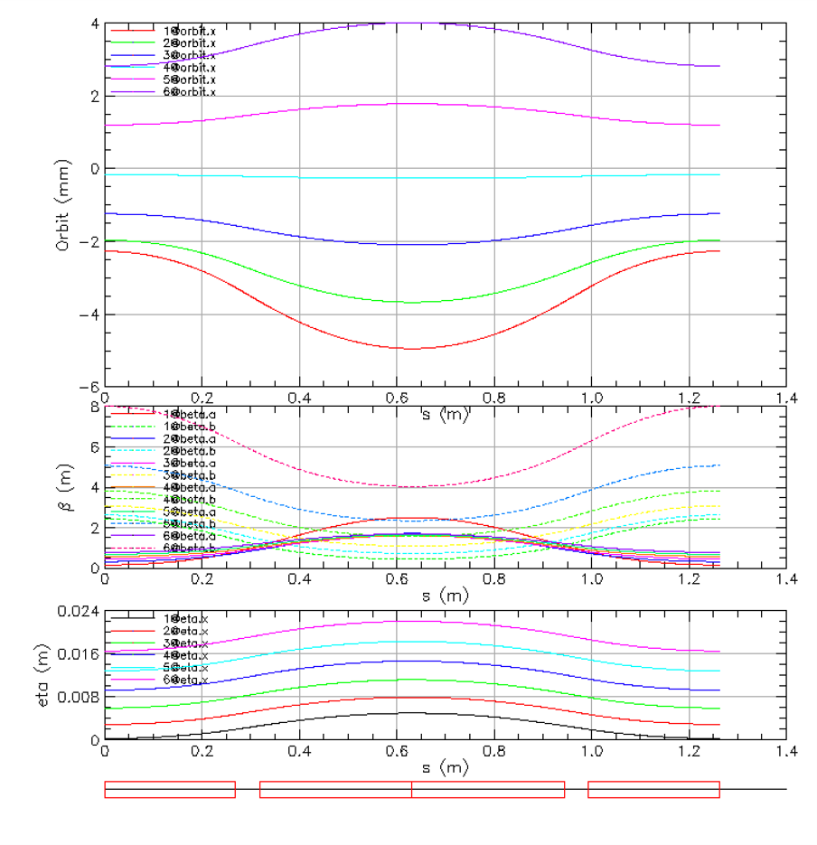
Compact FFA FODO Cell – How Does it Work?
Large momentum acceptance FFA cell, configured with combined function magnets capable of transporting multiple energy beams through the same string of permanent magnets (beams with energies spanning a factor of two)
BD
BF
BD
1 T
50 T/m
1 T
50 T/m
magnets: from 38cm² to 78cm²
BD
BF
BD

Slide 7
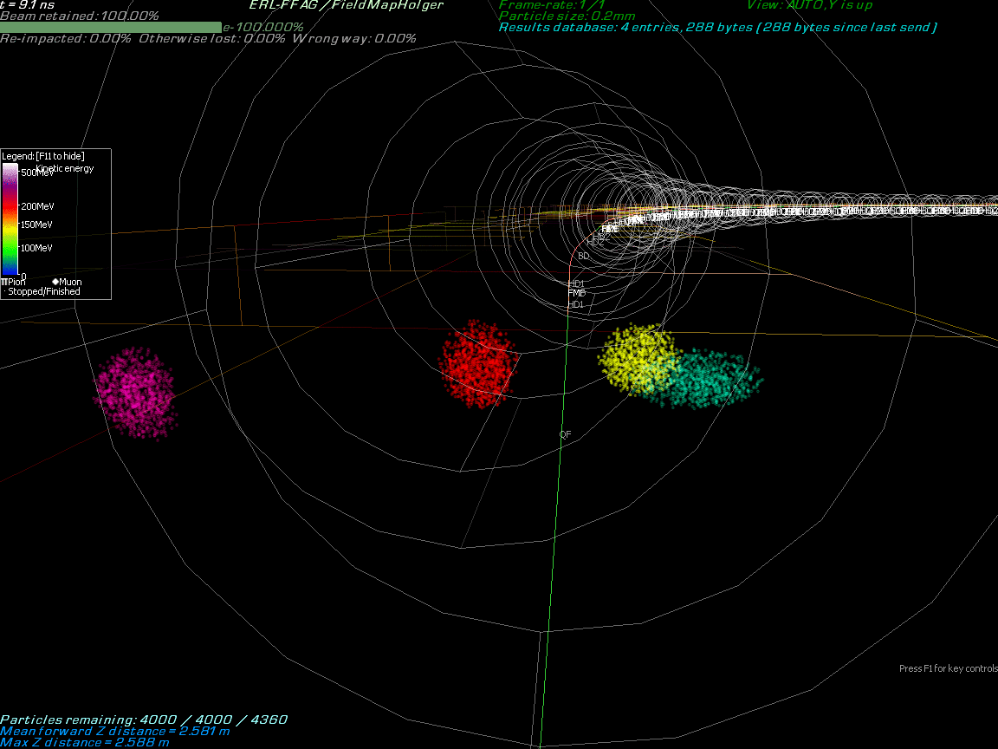
Multi-Bunch Dynamics in FFA Arc
Stephen Brooks
BNL

Slide 8
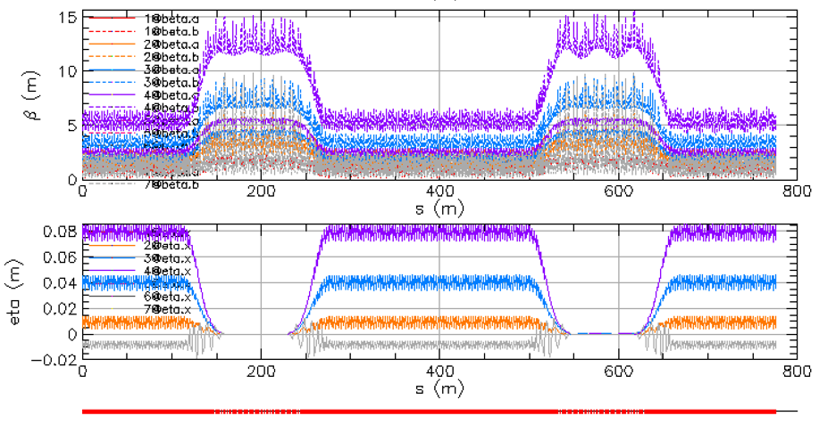
Adiabatic FFA Arc Architecture
Gradual variation of individual cell length and bend angle allows for beta functions to expanded adiabatically and the dispersion to vanish at arc ends. The larger beta functions are compatible with higher-beta optics in the linacs (30 − 90 meter betas). This simplifies switchyard and reduces its functionality to pathlength and momentum compaction adjustment.
Optical functions for the entire 10-22 GeV (6-pass) FFA racetrack

Slide 9
Two FFAs, 4+4 turns, Dipole Fields and Gradients
MAD-style Lattices
Parameter | 4+4 FFA1 | 4+4 FFA2 | Units
Emin | 8.3 | 16.8 | GeV
Emax | 14.6 | 23.7 | GeV
Eref | 11.55 | 18.5 | GeV
BF length | 2.96693 | 2.38270 | m
BF angle | -2.45793 | -1.62101 | degrees
BF dipole | -0.55706 | -0.73273 | T
BF quad | -14.865 | -32.808 | T/m
BD length | 0.72907 | 1.31331 | m
BD angle | -0.37050 | -1.20742 | degrees
BD dipole | -0.34171 | -0.99019 | T
BD quad | 46.697 | 43.393 | T/m

Slide 10
Injector Upgrade for FFA CEBAF
With the present 123 MeV injector, the difference in the first and final pass energies in the North Linac is too large (1:175) to effectively control the beam.
FFA Arcs
TOF
TOF
TOF
650 MeV
123 MeV
650 MeV recirculating injector will allow a manageable difference in energies (1:33)
TOF
FFA Arcs

Slide 11
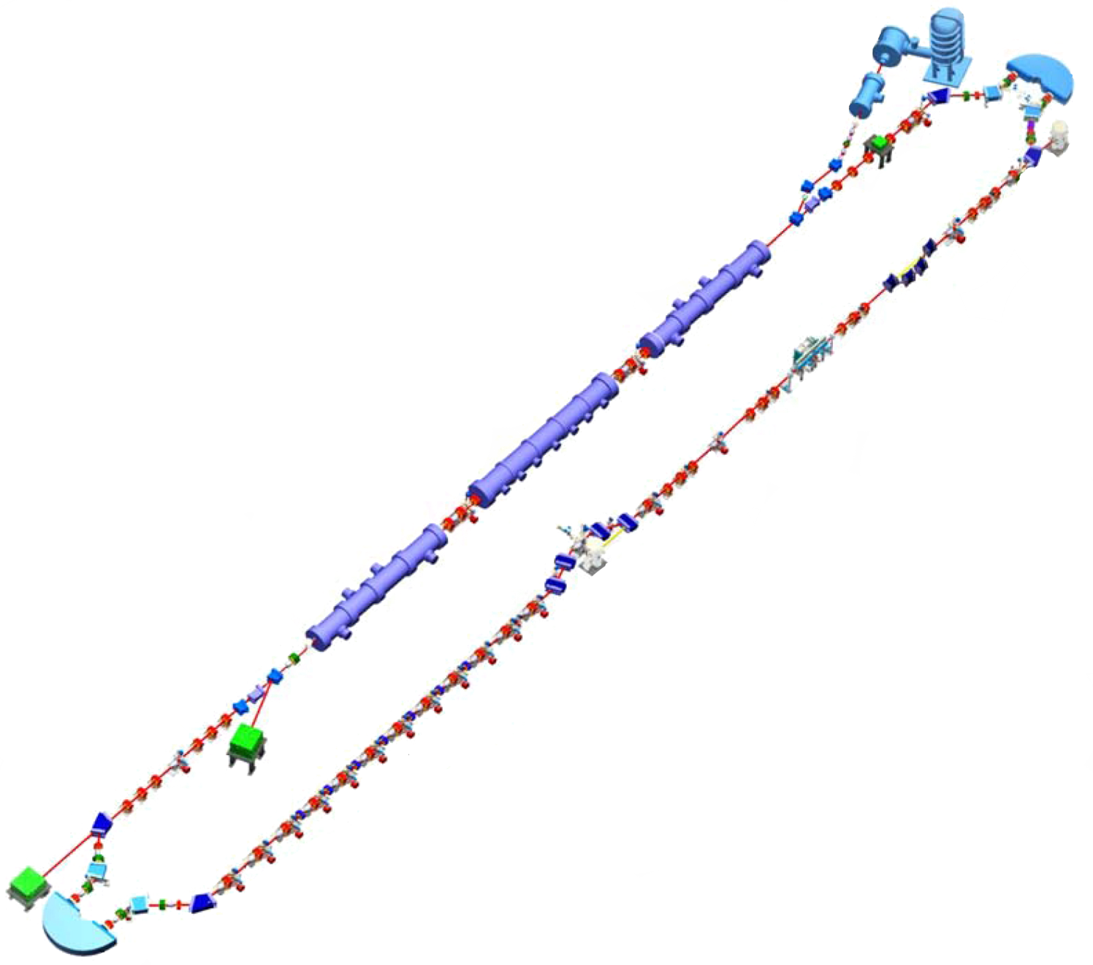

650 MeV Recirculating Injector
110 MeV Injector
110 + 2 × (3 × 90) MeV = 650 MeV
C-90
C-90
C-90
650 MeV to NL

Slide 12
Vertical Splitting with Positrons
110
650
380
Side view with vertical split and merge dipoles
Two stacked 380 MeV return loops
110 e⁺
380 e⁺
650 e⁺
650 e⁻
110 e⁻
380 e⁻

Slide 13
Positrons from 110 MeV Electrons
Target
Top view
Side view
110 e⁻
e⁺
110
650
Dipole switch
380
Target
110 e⁺
380 e⁺
650 e⁺
110 e⁻
650 e⁻
Dipole switch
380 e⁻

Slide 14
Positrons from 650 MeV Electrons
Top view
Side view
e⁺
650 e⁻
Target
110
650
Dipole switch
380
e⁺
650 e⁻
Target
110 e⁺
380 e⁺
650 e⁺
650 e⁻
Dipole switch
110 e⁻
380 e⁻

Slide 15
Multi-pass Linac Optics (11 passes)
Present FODO linac offers periodic optics only for the lowest energy pass with large beta beating for higher passes (beta ~1000 m), which is not compatible with small betas (~10 m) in the FFA arcs.
‘Twin Cell’ Triplet
30
650 MeV
pass-1
BETA [m]
G[kG/cm] = 2.35
G[kG/cm] = -2.40
Q = 0.39
Q = 0.39
0
0
BETA_X
BETA_Y
19.2
120
21.6 GeV
pass-11
BETA [m]
0
0
BETA_X
BETA_Y
19.2

Slide 16
Multi-pass Linac Optics (1:33 Energy Ratio)
650 MeV
30
pass-1
BETA_X&Y[m]
0
0
BETA_X
BETA_Y
241
2.83 GeV
30
pass-2
BETA_X&Y[m]
0
0
BETA_X
BETA_Y
241
21.6 GeV
90
pass-11
pass-10
BETA_X&Y[m]
0
0
BETA_X
BETA_Y
241

Slide 17
Energy Loss, Emittance Dilution (3-pass CEBAF)

Slide 18
Energy loss, Emittance Dilution (Two FFAs: 4 + 4 pass)

Slide 19
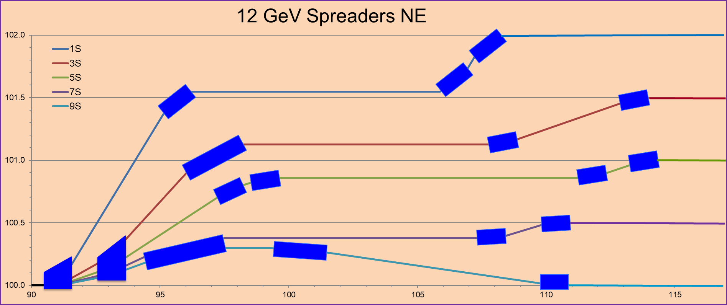
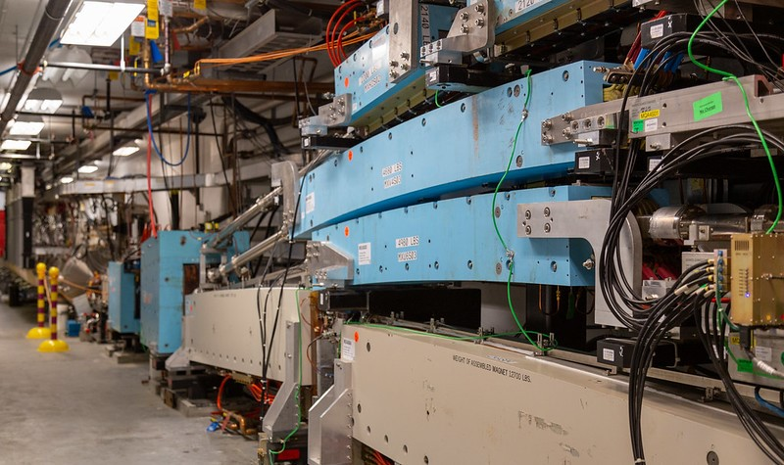
Switchyard Modifications for Two FFAs
5-pass CEBAF
3-pass CEBAF + 4-pass FFA I + 4-pass FFA II

Slide 20
Capability to transport/accelerate electrons and positrons through beamlines configured with permanent magnets
Positron Option for FFA@CEBAF?
NL
NL
e⁻
e⁺
SL
SL
NL
e⁻
e⁺
SL

Slide 21
‘Bisected’ Linacs RLA – Accommodating e⁻ and e⁺
NL
e⁻
e⁺
SL
‘Bisected’ linac optics
30
NL
BETA_X&Y[m]
0
0
BETA_X
BETA_Y
241
Quadrupole gradients scale up with momentum to maintain periodic structure for the first half of the linac and then the quadrupole strengths are mirror reflected in the second linac half

Slide 22
Summary
Present Baseline (1.1 GeV per linac):
  650 MeV Recirculating Injector (additional three C-90 cryomodules)
  Recirculate 3 passes with the current CEBAF
  Additional 8 (4 + 4) passes via two FFAs: 8.3 – 14.7 GeV and 16.8 – 23.7 GeV
Adiabatic FFA arcs configured with compact FODO cells
  Beta and dispersion matching to the linacs through cell-by-cell variation (length, bend)
  Open mid-plane permanent magnet design: B-field ≤ 1 T, Gradient ≤ 47 T/m
Multi-pass linac optics: Periodic triplet lattice for all passes
Synchrotron Radiation impact on beam quality
  Net transverse emittance dilution (normalized): 60 mm mrad
  Net natural energy spread: 2×10⁻³
  Net synchrotron radiated energy: 964 MeV
Physics topics that can only be explored with energy well above 12 GeV (Hall C)
  Interpretation of EIC exclusive and semi-inclusive programs, e.g. conventional Rosenbluth LT separations
  Double Deep Virtual Compton Scattering, Deeply Virtual Meson Production (scaling region)
  Parity Violation to constrain strange quarks, Tagged Deep Inelastic Scattering
at 23 GeV, β = 20 m → σ = 150 microns

Slide 23
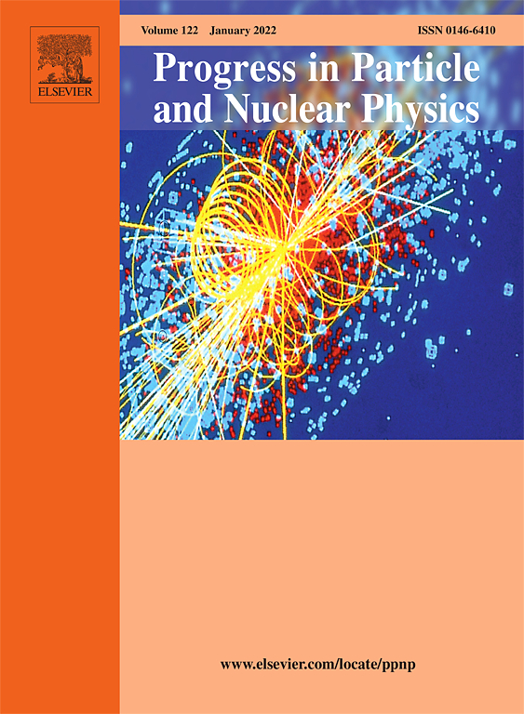
Outlook
‘White Paper’ on Future of CEBAF

Slide 24
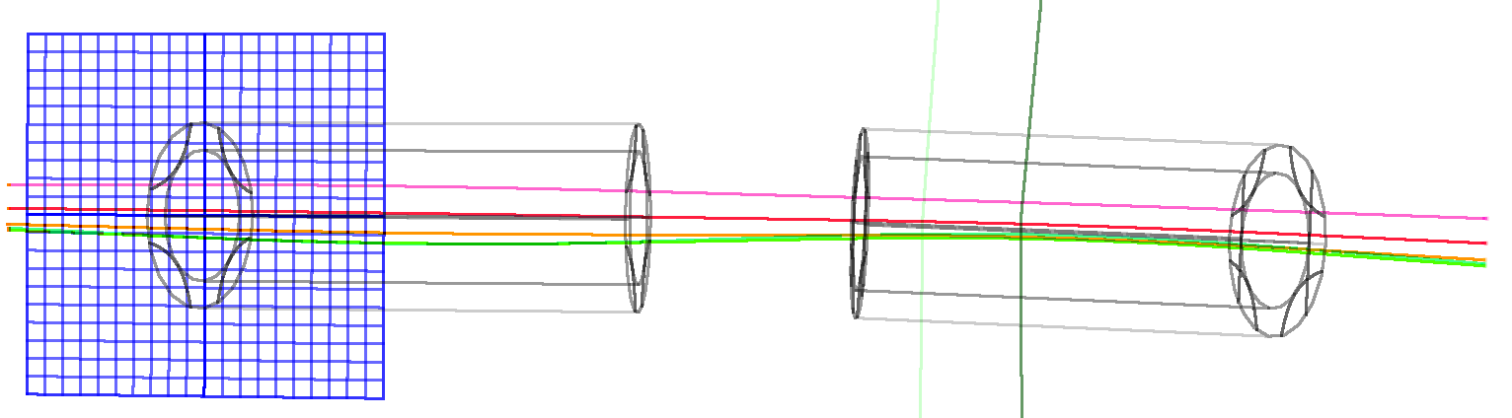

Thanks for your attention!

