Slide 1
Streaming Readout X
Front End Electronics: Insights on Cost and Schedule
Fernando Barbosa, JLab
EIC Project L3 CAM
WBS 6.10.08
18 May 2022

Slide 2
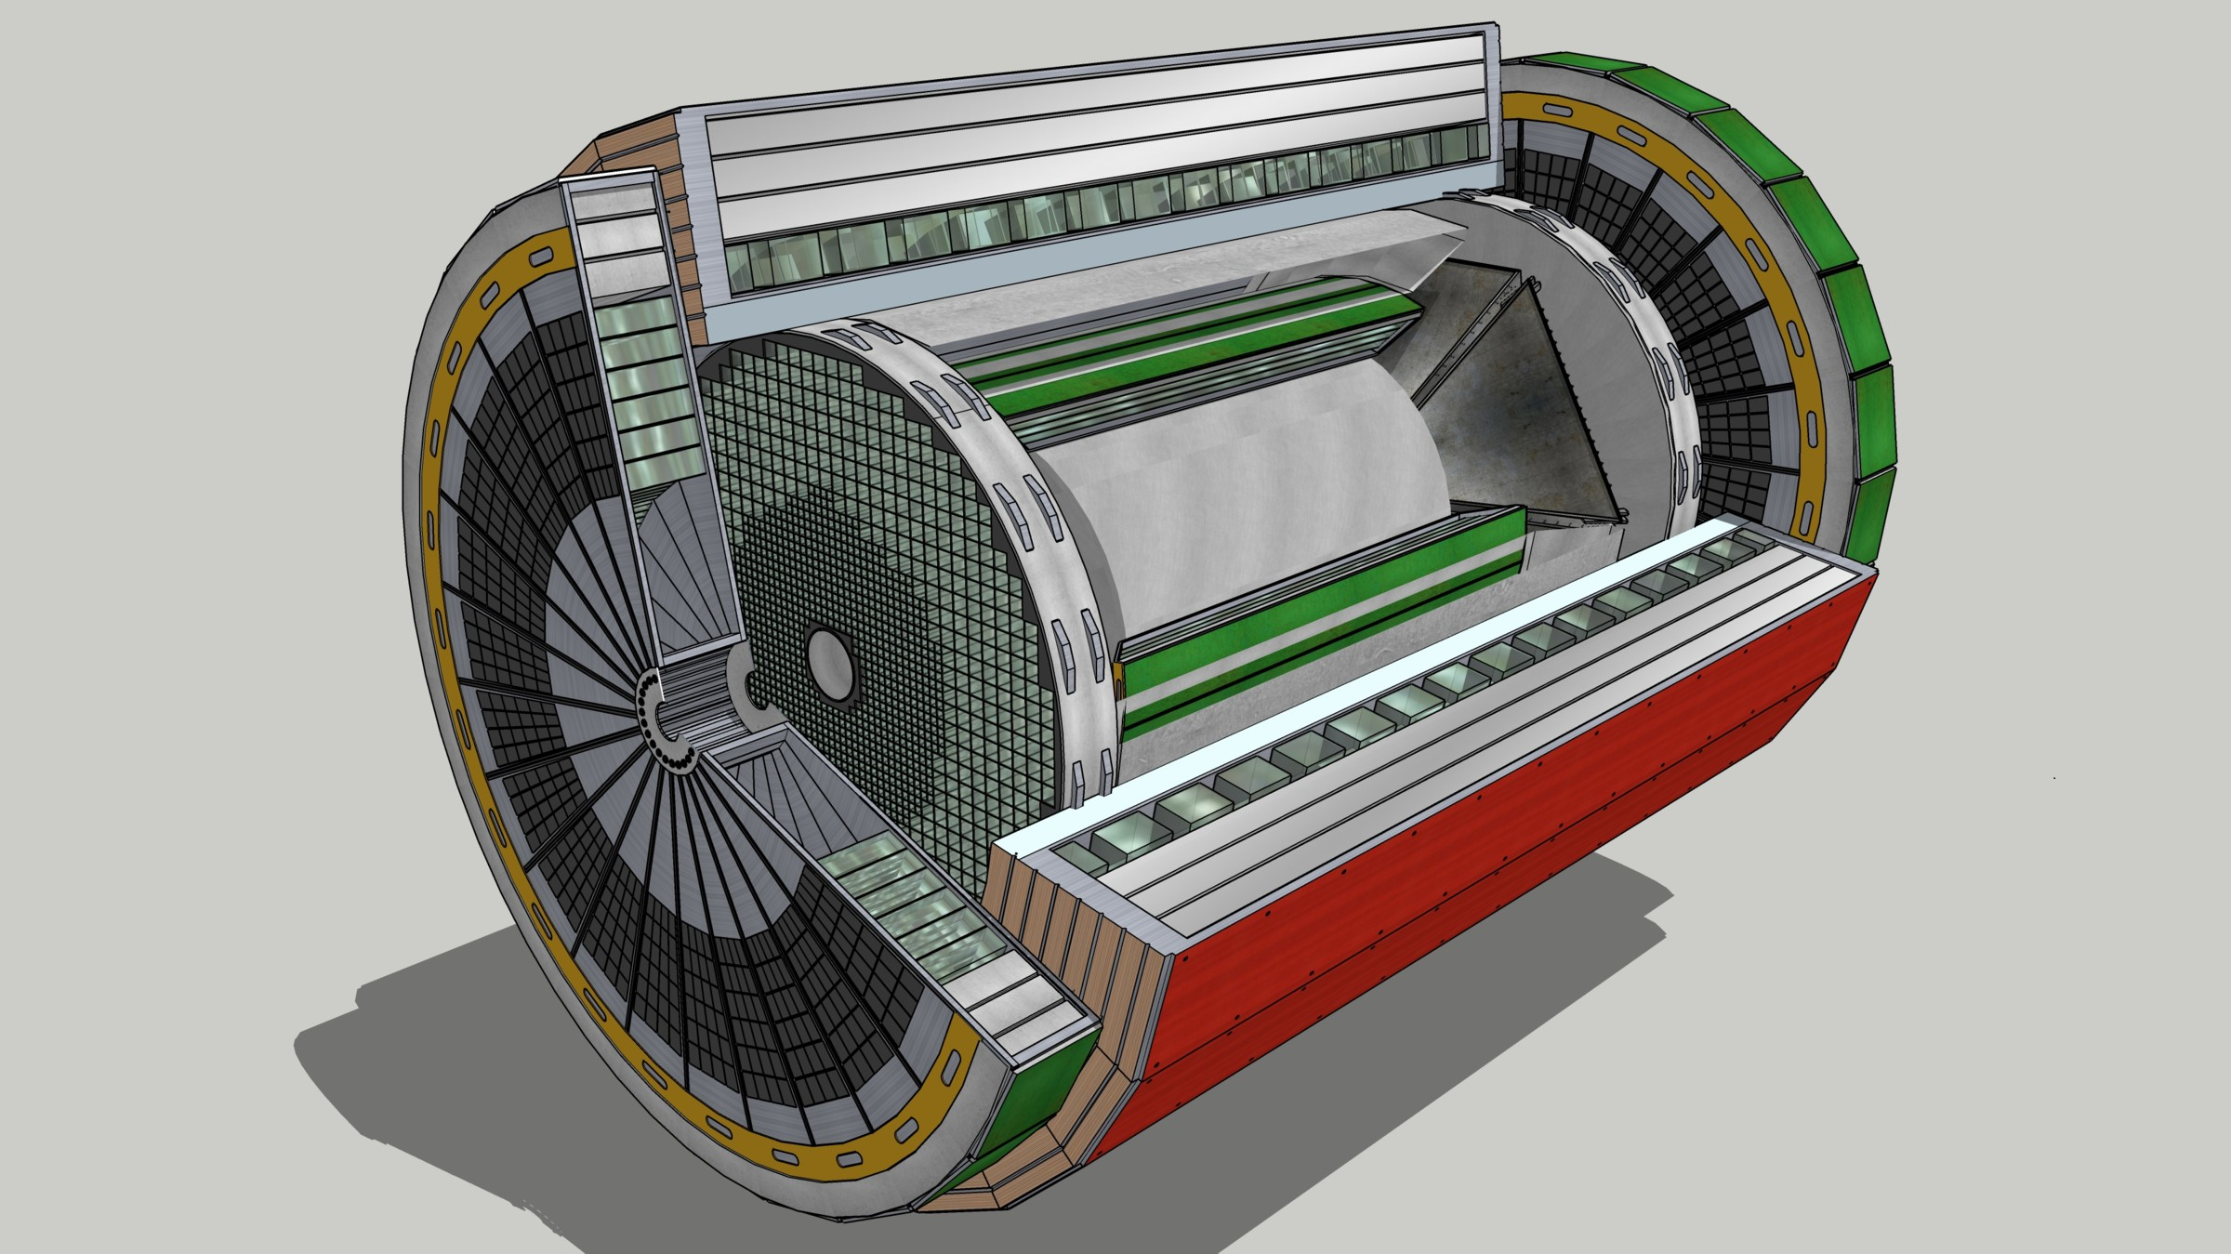
Streaming Readout Architecture
EIC Project Reference, YR, CD-1
Data
Configuration & Control
Power
Detector
FEB
(Front End Board)
FEP
(Front End Processor)
DAQ
(Data Acquisition)
Total
BW: O(100 Tbps)
BW: O(10 Tbps)
Global timing, busy & sync
Beam collision clock input
L ~ 100 m
fiber
ASIC
Goal: O(100 Gbps)
Fiber
Switch / Server / Link-Exchange:
Readout
Switch / Server: Processing
Switch / Server: Buffer
FEB
Storage
FPGA
Fiber
Monitoring
FEP
FEB
LVDS ~ 5m
Analog ~ 20m
Power Supply System
(HV, LV, Bias)
Cooling Systems
w/ Jin and Kai

Slide 3
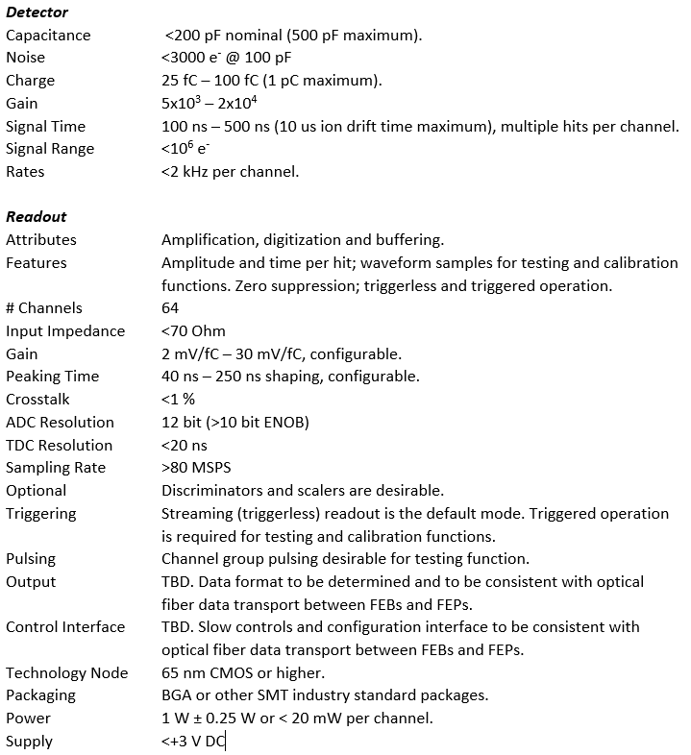
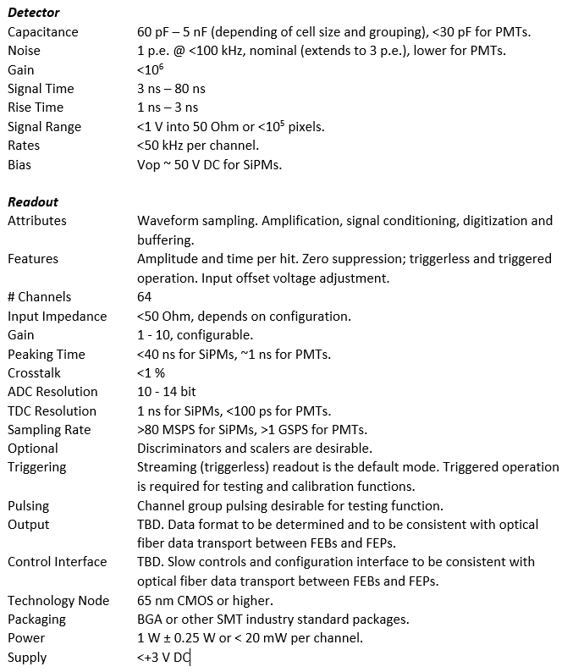
EIC Project Specifications Summary
Preliminary specifications for MPGD & Photonic Sensors (ASICs)

Slide 4
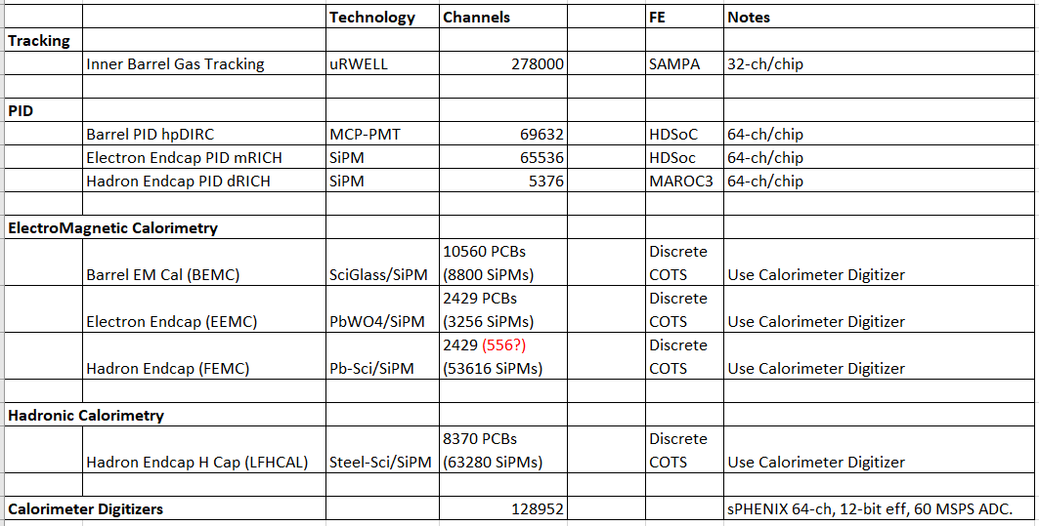
ECCE Proposal Summary WBS 6.10.08 w/ updates
Si, AC-LGAD FEE development (e.g., ALPIDE, ALTIROC) under eRD112, closely coupled to detector.

Slide 5
SAMPA – 32ch, 160 ns peaking, up to 20 MSPS, 130 nm CMOS.
- Does the 160 ns shaping satisfy the detector/physics requirements?
If Yes, FAB run needed <1 year.
If NO, upgraded design in 65 nm CMOS could yield a new SAMPA with ~40–50 ns
peaking – ~3.5 years of development.
HDSOC – 64ch, 1-3 GSPS, 250 nm CMOS - NALU, distributed by CAEN.
V2 Under development, should be available within ~1 year. NALU is receptive to
further refinements.
MAROC3A – 64ch, 350 nm SiGe, 102 usec, WeeRoc, distributed by CAEN.
Older technology but still available, new version with different package within
~2 years. Wilkinson ADC requires ~102 usec conversion (12-bit @ 40 MHz).
- Does the long conversion (<10 kHz/ch) satisfy the detector/physics rate
requirements?

Slide 6
A closer look at the calorimeters’ readout, from sPHENIX:
64 ch ADC Module
16ch/cable
X4
1 ch discrete COTS FE
128,952 channels
  8,060 cables (16 ch diff/cable).
  2,015 ADC modules (64 ch/ADC).
  168 crates (12 ADCs/crate).
It is very unlikely that we can fit 8,060 cables for the calorimeters’ readout.
Alternative?

Slide 7
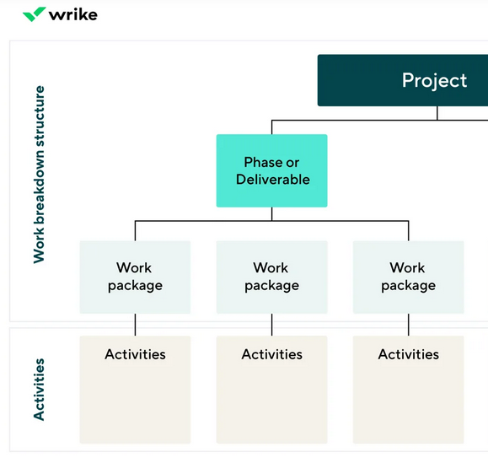
Project Management
DOE
Project
(BNL, Jlab)
Collaboration, WGs
Project (BNL, Jlab partnership) interfaces with DOE and ensures that the Physics goals are met and within the proposed cost and schedule structure.
WBS – Work-Breakdown Structure is a deliverable-oriented breakdown of a project into smaller activities:
- WBS 6.10.08 for Electronics
- WBS 6.10.09 for DAQ.

Slide 8
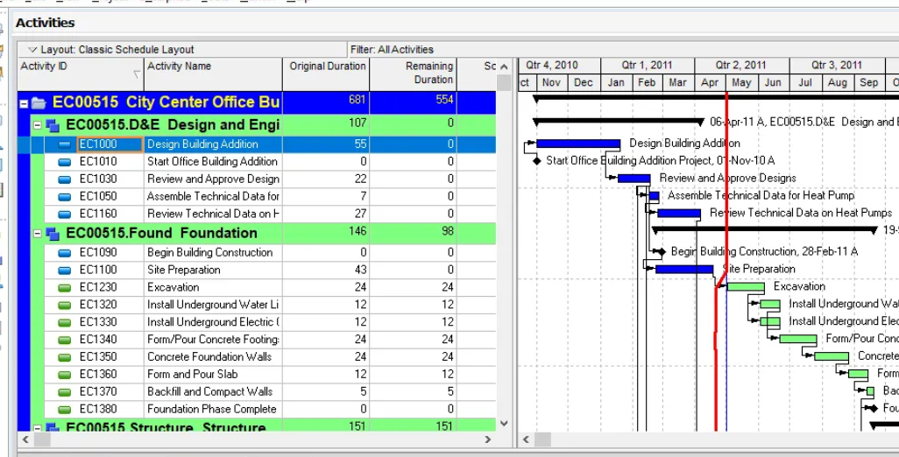
P6 – Oracle Primavera P6 – Project management software, which includes resource allocation, scheduling, risk analysis and control capabilities.
It is critically important that the WBS structure in P6 be an exact description of the development plan with:
  Detailed activities and linkages to other activities and WBSs
  Scheduling - Start, Duration, Finish
  Resources – Materials, Labor (scientist, engineer, tech,…)
Delays in activities are costly and will likely impact overall project schedule.
Activities/items not included in P6 may only be funded through a future project re-calibration.

Slide 9
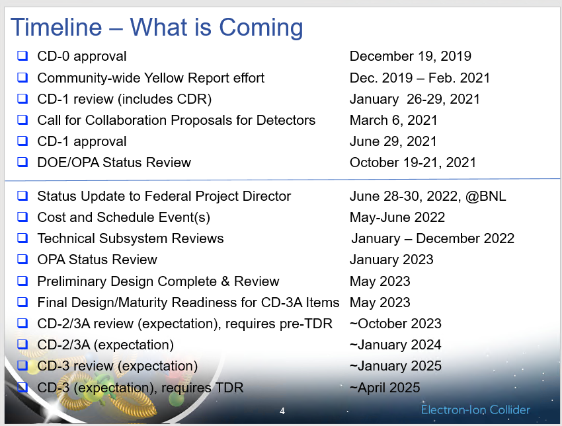
Timeline
Presently, all WBSs in P6 are being updated with information from the ECCE proposal and with additional revisions:
  Informs management of the overall impact on budgets from proposal.
From Elke,
Path to CD-2/3A
5/13/2022

Slide 10
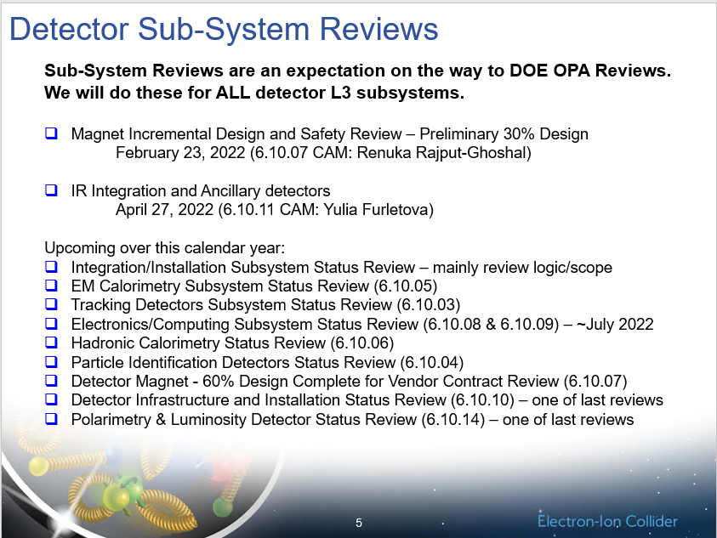
Electronics/Computing Subsystem Status review ~July 2022.
  Assess maturity of design and identify immediate needs.
  Design maturity at 50% by 3/31/2027 for CD-2/3A.
From Elke,
Path to CD-2/3A
5/13/2022

Slide 11
Planning
Project
(BNL, Jlab)
Sub-Detector WGs
Electronics/DAQ WG
We need:
  Overall system/block diagram
    to understand implementation approach and inform P6 activities listing.
  Assess/review/verify applicability and feasibility of proposed readout elements.
    (SAMPA, HDSOC, MAROC3A, 64-ch ADC, cables, …).
  Assess # channels (detector and readout) for each sub-detector and their partitioning or grouping, for example:
    #SiPM cells/units grouped - #readout chs - #readout channels per PCB.
    Distribution of HV, BIAS, LV channels, sensor aggregation.
  Identify Activity Groups – distribute tasks/responsibilities to groups/institutions, with technical representatives, which will perform and deliver the various required tasks and products.
  ~July 2022 - capture all major updates and initiate any needed R&D initiatives.
  ~May 2023 - finalize input into P6.

