Slide 1
Streaming Readout Development for CODA @ JLab
Streaming Readout X – May 17-19, 2022
Hybrid Meeting
David Abbott
Ben Raydo
FEDAQ Group
Jefferson Lab – Physics Division

Slide 2
Data Acquisition at JLab
At JLab we have 4 Experimental Halls, all running with different detectors - and physics priorities.
Of course all are having increased demands for the DAQ.
Experiments are increasingly reliant custom electronics to interface detectors and digitize signals.
ASICs and FPGAs are becoming the norm (and the future) for the front-end.
But older hardware is still relevant and useful (particularly for starving budgets)
Our goal is to support both the traditional Triggered model along with the Streaming model within one integrated DAQ framework.
Leverage existing hardware to implement streaming
Add support for new electronics
Try to make it as seamless and user friendly as possible

Slide 3
The CODA Data Acquisition Toolkit
The ROC is software responsible for collecting data from front-end hardware and sending it to the next stage.
AFECS
COOL
Database
GUI
ROC – Readout Controller
EMU – Event Management Unit
ET – Event Transport (Shared memory)
AFECS – Agent Framework Experiment
Control System
Platform
ROC
Trigger/Clock
TI
CPU
File
ROC
TI
EMU
(Event Builder)
ET
EMU
(Event Recorder)
CPU
File
ROC
TI
User
CPU

Slide 4
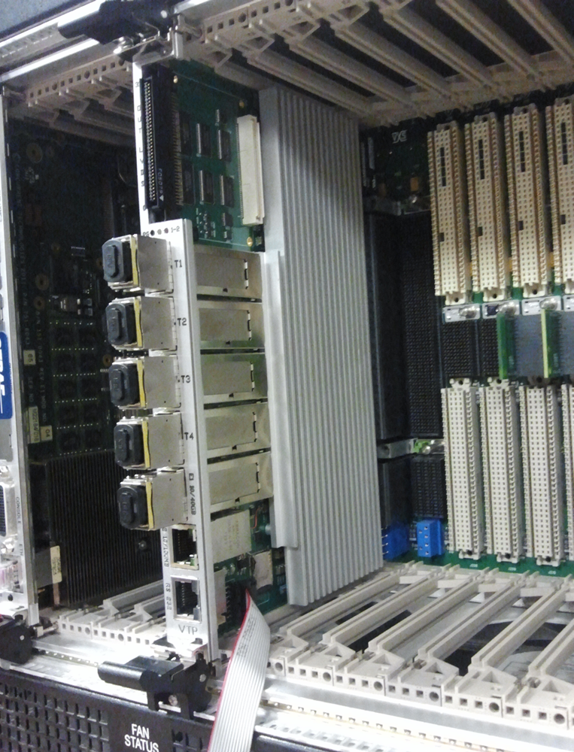
VXS Standard (VITA 41)
JLab standardized on this technology for the 12GeV Upgrade
- Originally used for the L1 trigger data path
Dual Star – switched serial backplane (along with original VME)
Up to 20Gb (4 lanes) from each Payload to the 2 Switch slots (A, B)
Up to 18 Payload slots are available
Easy distribution of Trigger, Sync and low jitter clock to all modules in the crate.
A B
VXS Trigger Processor (VTP)
Relieve the ROC of all of the “Readout” tasks and implement them in the FPGAs.
Triggered or Streaming readout from All payload modules in parallel
This requires the payload modules to have some intelligence/programmability and serial link capability (e.g. FPGA-based).
The Software ROC now is primarily responsible only for Configure, Control and Monitoring the VTP-Based DAQ.

Slide 5
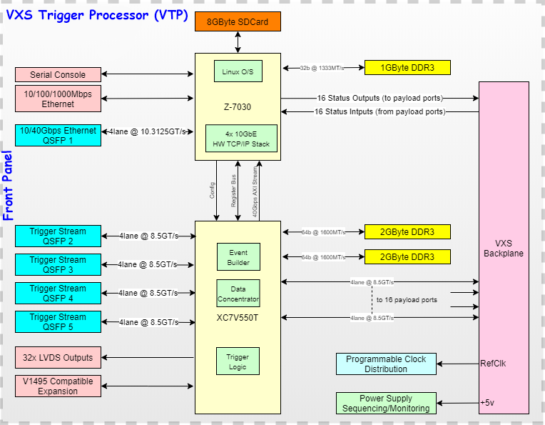
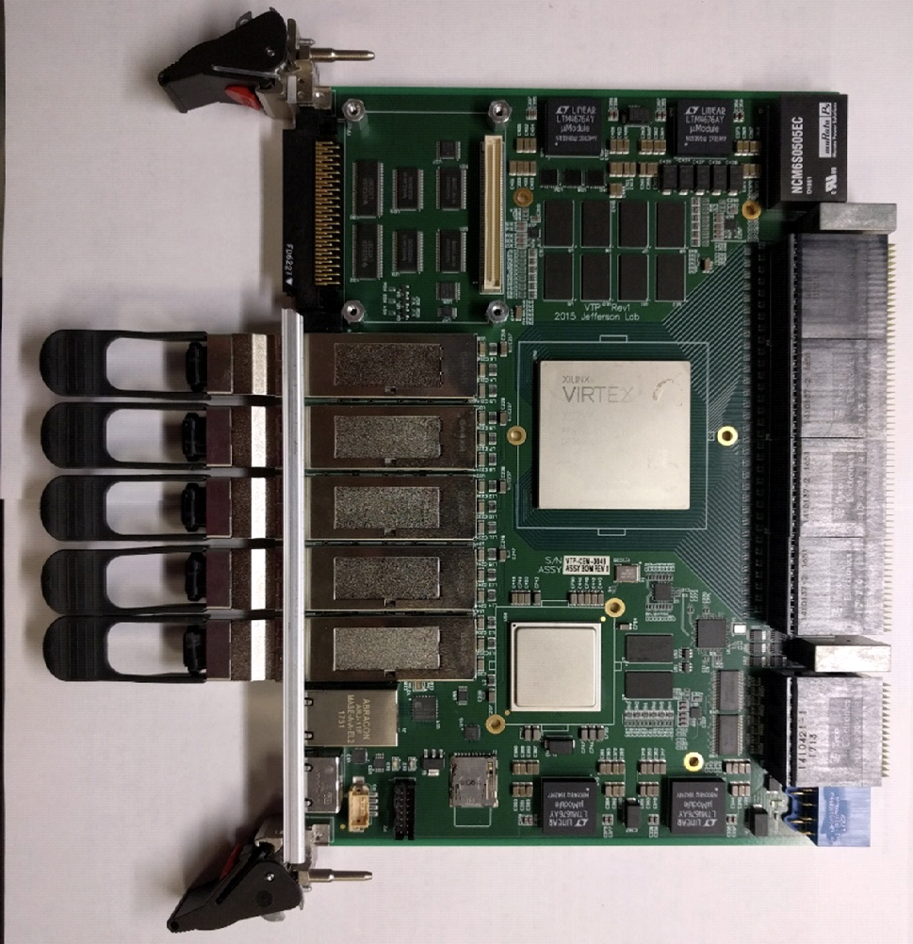
JLAB – VTP Board
Linux OS on the Zync-7030 SoC
(2-core ARM 7L , 1GB DDR3)
10/40Gbps Ethernet option
(runs the CODA ROC)
Xilinx Virtex 7 FPGA
Serial Lanes from both the VXS backplane and the Front panel
4GB DDR3 RAM
Four
10Gbps
Ethernet
16 Payload
Ports
64 total
serial lanes
FADC
FADC
FADC
FADC
16 total lanes
for external
serial links
FADC
FADC
V7
FADC
FADC
Z7

Slide 6
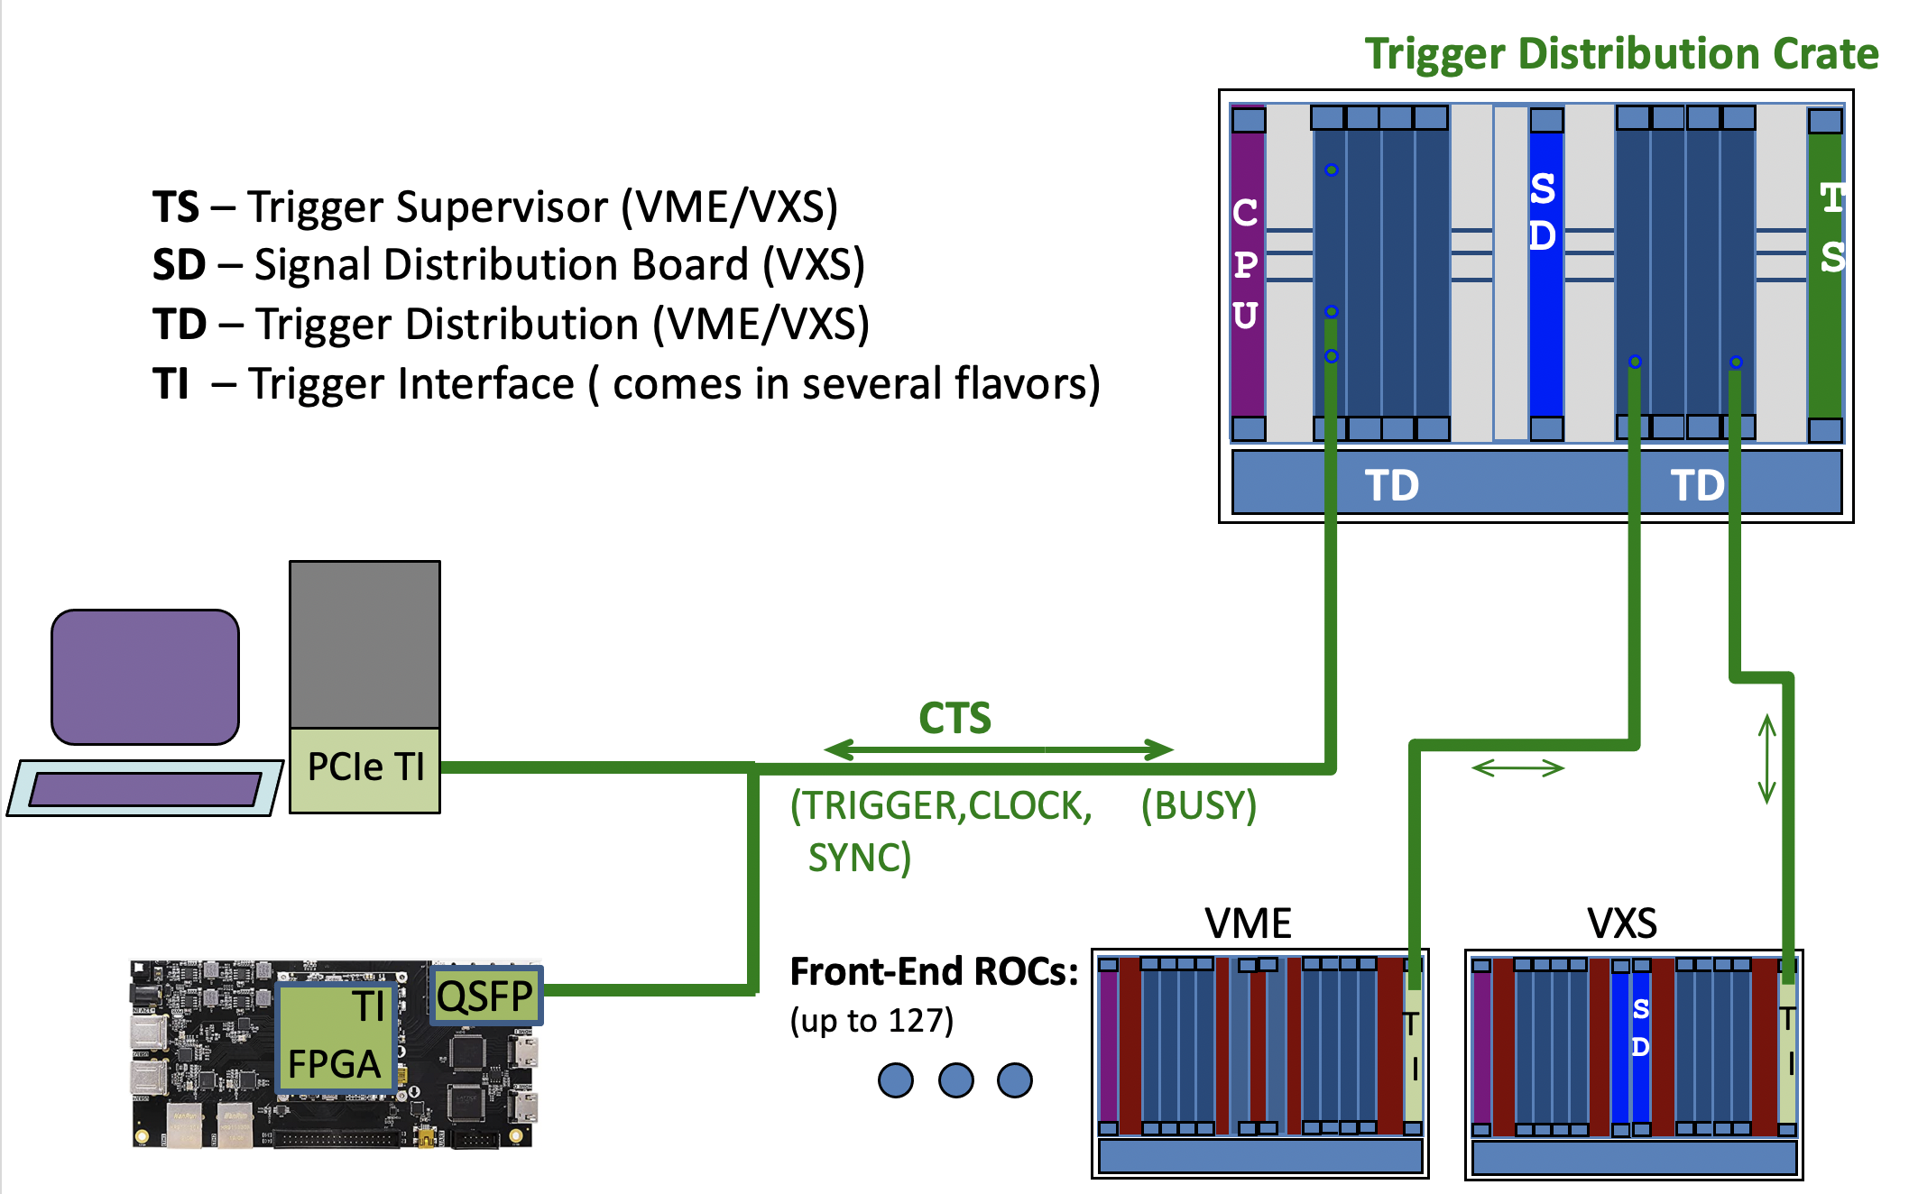
JLAB Clock and Trigger Distribution System
For large DAQ systems with many front-ends (ROCs)
The TI board can be used as a TS for small (up to 9) front-ends

Slide 7
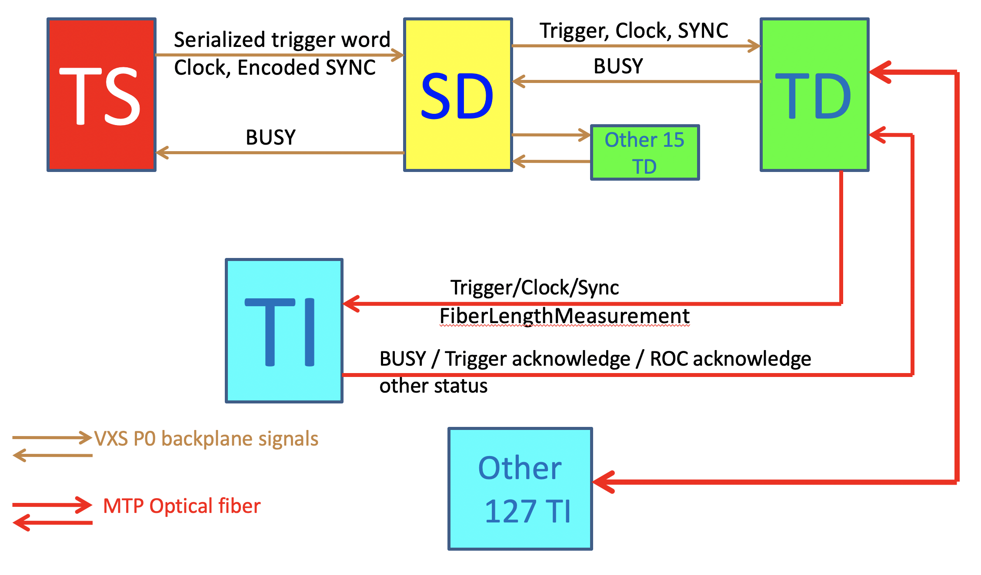
Timing System Components

Slide 8
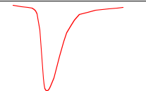
JLAB FADC – Streaming mode
A 250 MHz FADC generates a 12 bit sample every 4ns. That’s 3 Gb/s for one channel. 16 channels is 48 Gb/s.
Currently, we identify a threshold crossing (hit) and integrate charge over a ROI and send only a sum and timestamp for each hit.
Available bandwidth will allow for 1 hit every 32ns from all channels.
A data frame (Time Slice) for all available hits is generated in the VTP every 65µs
Readout Time Slice
(65 µs)
TS1
TS2
TS3
TS4
ROI
ROI
ROI
ROI
Chan 1
.
.
.
TH
TH
TH
TH
Fine
Time Stamp
0
N
ROI
ROI
ROI
Chan 16
TH
TH
TH
The next revision to the firmware will have an option for full ROI wave forms to be streamed, but this will allow possible dropped hits due to bandwidth limitations
The FADC can still simultaneously operate in triggered mode with an 8µs pipeline and 2µs readout window.

Slide 9
FADCs - Triggered vs Streaming
Triggered Mode
Streaming Mode
ROI
ROI
ROI
External
Trigger
(timestamp)
Time Slice
(Frame #
& timestamp)
ROI
ROI
ROI
TH
TH
TH
0
511 (Sample #)
TH
TH
TH
PTW (0-2µs)
PL (0-8µs)
0
Fine time stamp (4 ns)
N ( Max Sample #)
PL: Programmed Lookback
PTW: Time window
Data we get on a trigger:
- FADC waveform values for the ROI
- Threshold Sample # (hit time)
- Trigger absolute time stamp
1 Frame = N Clocks (up to 16bits, currently 65536 ns)
Data we get for a Frame:
- Pedestal subtracted sums over an ROI for every hit over threshold
- Threshold sample # fine time stamp for each hit
- Frame # and absolute time stamp for the frame
ROC Data Format
Length (words)
ROC Data Format
Length (words)
Tag
DT
M
Tag
DT
SS
Trigger Bank
Trigger #
timestamp
Stream Info Bank
Frame #
timestamp
Data Banks
Data Banks

Slide 10
Stream Aggregation – Data formats
Raw Stream Bank (RSB)
(Payload Port – e.g. FADC)
Aggregate Stream Records
1st Aggregation (ROC)
Subsequent Aggregations
RSB Header
Length (words)
ROC Header
Length (words)
ASB Header
Length (words)
Tag
DT
SS
Tag
DT
SS
Tag
DT
SS
TSS – Time Stamp Segment
(holds Frame number and time stamp for ROC aggregation point ).
TSS
A-TSS
Raw Stream
Data for one
Time slice
AIS
AIS – Aggregation Info Segment
(holds information on RSBs that are attached).
A-AIS
Tag: Payload port ID – Unique just to the FEE/Digitizer Module
Detector/Channel info
DT: Data Type – User/FEE specified
SS: Stream Status – Raw Bank, Did data get dropped? Clock info,
Error?
Note: It is important for the ”Front-End” Electronics/Digitizers to be
integrated with the timing distribution.
- Data Frames are defined by the system clock
- Local time stamps are synced with the system
- Can streams be started and stopped synchronously?
PP 1
ROC 1
PP 2
ROC 2
…
PP N
For subsequent aggregations the ROC Records are simply appended and a new A-TSS and A-AIS are created to hold Time Stamp/Slice info and total number of ROCs.
…
Tag: ROC ID – Unique to the whole system
DT: Data Type – Bank of Banks (0x10)
SS: Stream Status – ROC Stream info – how many
got created. Which streams included. Error?
ROC M

Slide 11
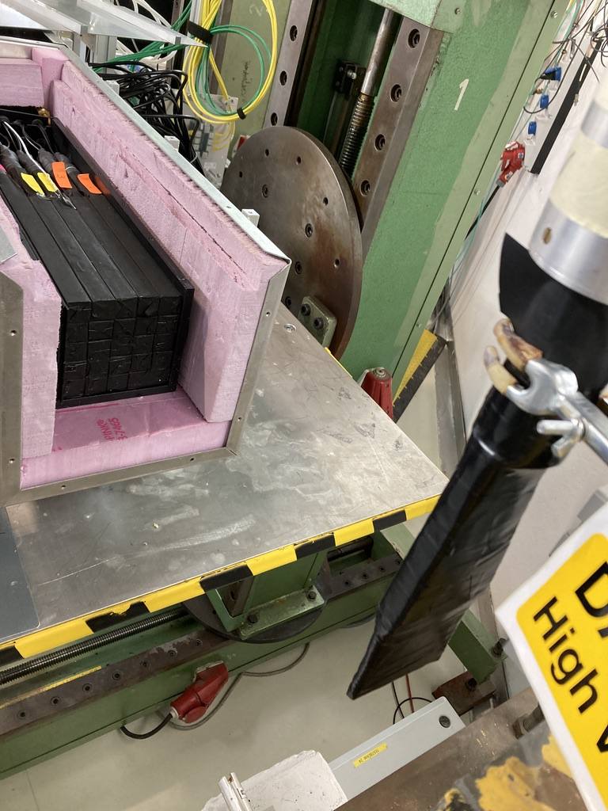
Beam Tests
Recent beam tests with a calorimeter prototype at DESY (Thanks to Doug Hasell for coordinating this opportunity)
5x5 PbWO4 Crystal Array (2 cm^2 face) with 2-5GeV electron test beam
Jlab 250Mhz FADC boards
Triggered data are waveforms read out over VME bus.
Stream data are integrated sums and times of all hits over a threshold in the calorimeter regardless of the trigger status.
phototubes
Trigger scintillator
e-

Slide 12
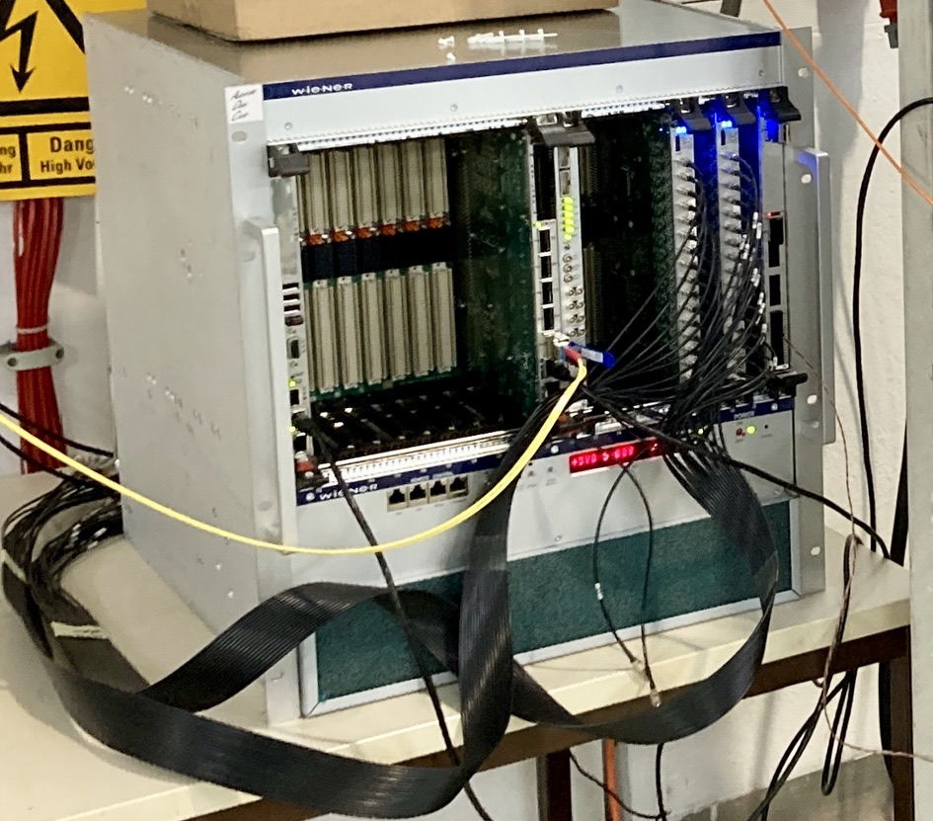
Simple Hybrid CODA System
DISC
e-
Two ROCs are defined for the DAQ System
VME_ROC
Runs on the CPU
Reads out Triggered data
VTP_ROC
Configures and manages the stream data
TI
SD
Trigger
CPU
VTP
VXS Crate
FADCs
EMU
(Stream
Aggregator)
File
10Gbps
EMU
(Event Builder)
File
1Gbps
PC/Server

Slide 13
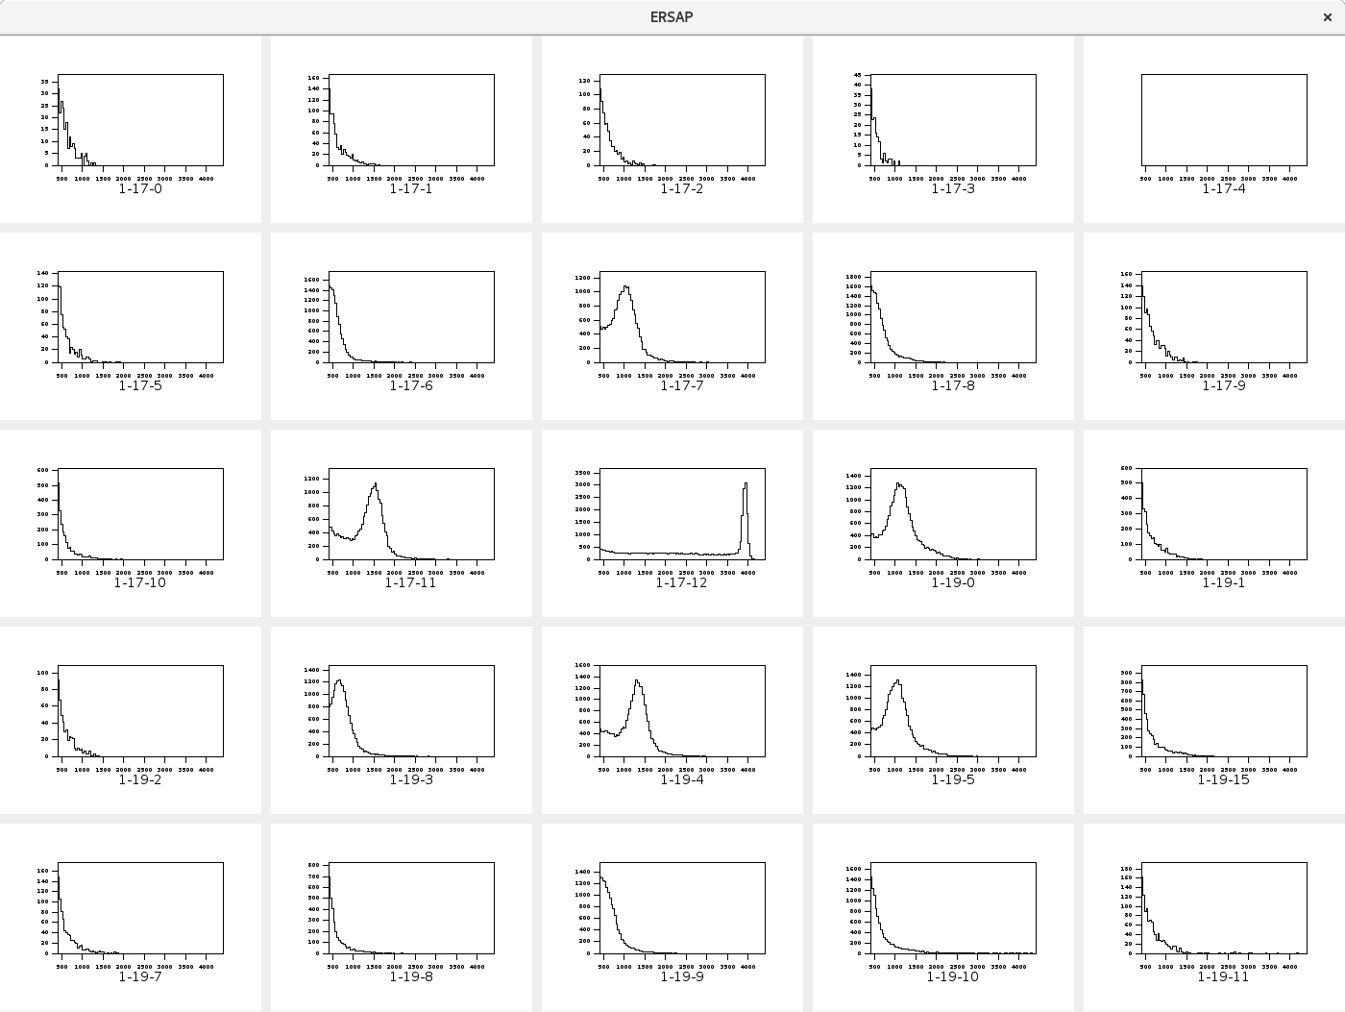
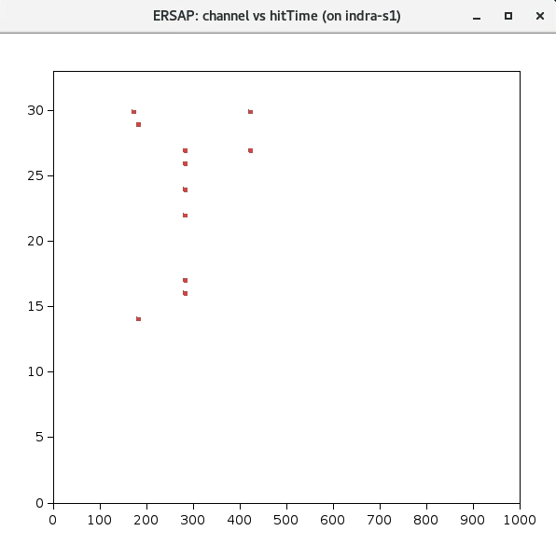
Beam Tests
Calorimeter spectra – Streaming Data
(Electron beam centered on the central crystal)
Time Slice Frame containing a Trigger
FADC Channel
Time

Slide 14
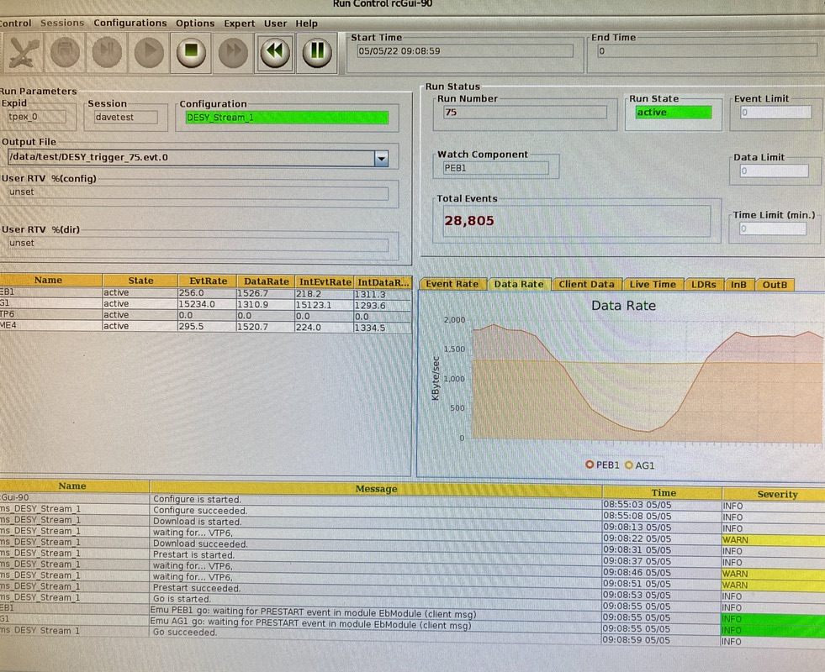
Beam Tests cont…
Rates were relatively low for these tests
The electron beam varied in current depending on if they were filling the PETRA synchrotron.
Note the respective data rates on Run Control.
Streaming frame and data rates are relatively constant (15.2kHz, ~1.3MB/s)
Triggered rates rise and fall as the electron beam comes and goes (reading out wave forms even in triggered mode generates a lot of data)

Slide 15
“Zero” Suppression
In the streaming environment we have to mange these the two extremes
Empty time frames
Too much data for available bandwidth
For the current Streaming ROC format there is a minimum 72 bytes/frame sent. So for 65µs frames that comes to ~1.1MB/s ”empty” data rate.
If there is no Payload data then they are not present. AIS entries establish they were empty.
EVIO Header (32 bytes) is just for transport to the Aggregator – then stripped.
Empty Frames for the Beam Tests)
TET (threshold over pedestal) | Empty Frames | Frames with Triggers
10 | 68.9% | 0.084%
50 | 97.0% | 0.64%
EVIO Header
Length (words)
Minimum 40 bytes for up to 2 payloads.
Total 68 bytes for 16 payloads
ROC ID
DT
SS
TSS
AIS
PP 1
…
PP N

Slide 16
Congestion Management
Too much data is handled both locally an globally
Globally “Sync” is used to start and stop all the streams at their source (FADCs)
A “Busy” generated by any ROC can feed back and inhibit all streams for all ROCs
Locally, PPs stream hits to a VTP DRAM buffer. The Frame Builders have a frame “fifo”
A Frame builder will only aggregate hits into a ROC frame if the fifo is not full. Otherwise the frame is dropped.
Built ROC frames at the Zync will always get sent (eventually).
Up to 4 independent network streams can be defined. Each PP maps to a specific output stream.
Limited Zync resources only provide 2 high performance TCP connections (or 4 UDP streams)
Note:
TCP Performance
~7-8 Gbps per link without frame drops
UDP performance (9000 MTU)
>9.5Gbps per link without frame drops
~50% CPU utilization for a single stream
(These tests were done with both VTP and a Server connected through a single switch)
DRAM
4 x Frame
Builder
Zync
PP 1
BUF 1
1
TCP/UDP
2
TCP/UDP
VXS
3
UDP
4
UDP
PP 16
BUF 16
VTP

Slide 17
Some general observations…
The design of our Clock/Trigger/Sync/Busy distribution system is critical to the flexibility and functionality of the CODA Hybrid DAQ.
The VXS platform works for JLAB, but is an impractical and/or financial overhead for small university groups. The same could be said for other solutions like the FELIX/DAM architecture for EIC.
It seems there is a need for an affordable COTs or alternative ”lightweight” solution which supports Streaming that can be made available to the community for development and test systems.
VXS/VTP
FELIX
DAM Board
“Smart” Switch
Form factor:
PCIe?
Stand Alone?
VME board?
The critical component to just about any system is a System on a Chip with enough resources to support at least a few Front End electronics serial link protocols and perform 1st stage hardware stream aggregation. And present the data to the next stage in a standardized way.
FEE
SoC
ROC
FEE
ethernet
Server
FEE
FPGA
PCIe
Server
FEE

Slide 18
Summary
We have successfully started integration of Streaming support within the CODA software framework and supported hardware.
The Hybrid DAQ system give us a lot of flexibility to support older hardware within a Triggered system as well as newer hardware that can conform to the the Streaming requirements.
UDP data transport from the VTP is proving to be reliable and the most efficient method for getting data to backend processing.
Upgrades to JLAB FADC firmware this Summer will allow for more streaming options including waveforms.
The ability to take both Triggered and Streaming data simultaneously should provide useful data for Online processing to better define efficient event identification algorithms as part of a high level trigger.
Integration of other ASIC-based front-end electronics within the CODA streaming environment still needs to be developed.

