Slide 1
Update on KaonLT Experiment
Richard Trotta on behalf of the KaonLT and PionLT collaboration

Slide 2
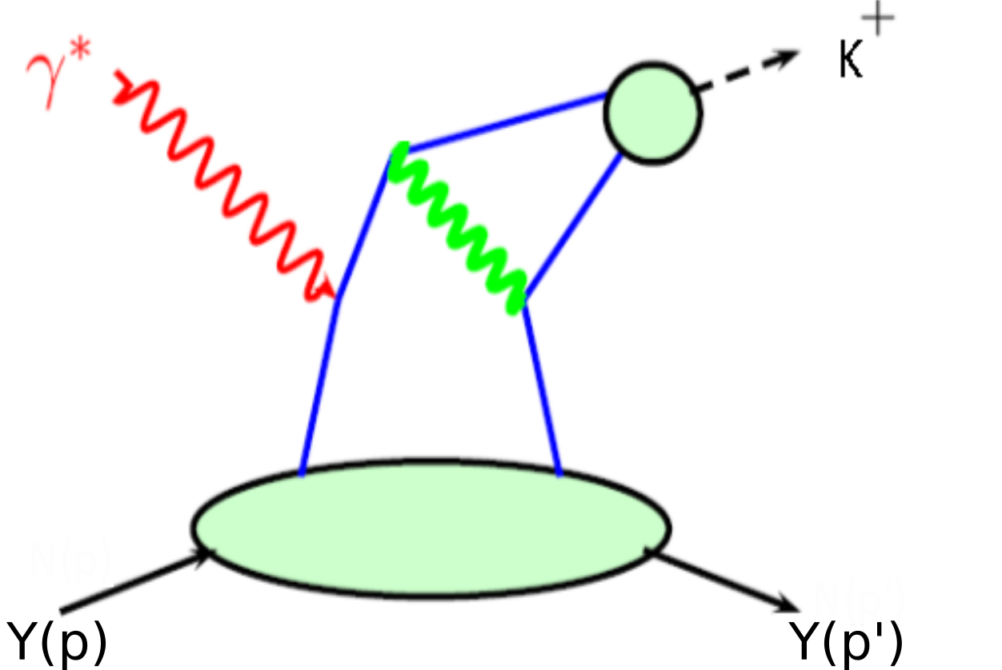
L-T separated K⁺ data for verifying reaction mechanism
Jlab 6 GeV K⁺ data demonstrated the technique of measuring the Q² dependence of L-T separated cross sections at fixed x/t to test QCD Factorization
Consistent with expected scaling of 𝜎_{L} to leading order Q⁻⁶ but with relatively large uncertainties
Separated cross sections over a large range in Q² are essential for:
Testing hard-soft factorization and understanding dynamical effects in both Q² and –t kinematics
Interpreting non-perturbative QCD contributions in experimentally accessible kinematics
M. Carmignotto et al., PhysRevC 97(2018)025204
t
Notes:
Shows that the technique works, just need more/better data

Slide 3
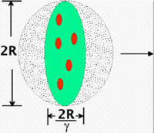
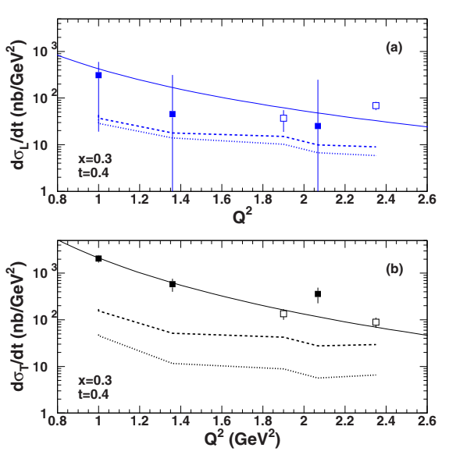
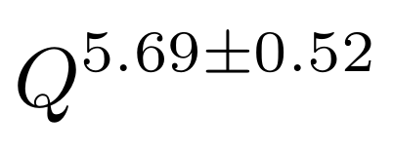
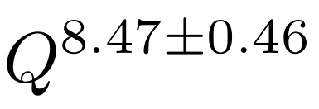
Hard-Soft Factorization
The K⁺ electroproduction cross section has a Q² dependence at fixed x and -t
Provides important insight into hard-soft factorization for systems including strangeness
Factorization of 𝜎_{L} scales to leading order Q⁻⁶
In that regime expect 𝜎_{T} to go as Q⁻⁸ and consequently 𝜎_{L}>>𝜎_{T}
Important because partons are “frozen” transversely in the reference frame of pQCD (i.e. infinite momentum frame)
M. Carmignotto et al., PhysRevC 97(2018)025204
Notes:
Calculations using the VR (dashed) and the VGL (dotted) models are also shown.

Slide 4
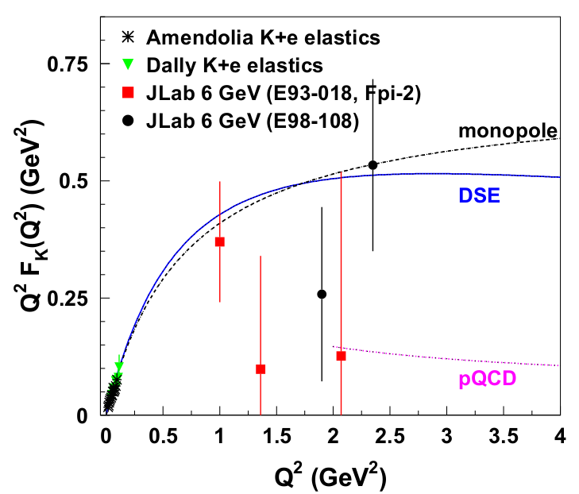
Meson Form Factors
Pion and kaon form factors are of special interest in hadron structure studies
Pion - lightest QCD quark system and crucial in understanding dynamic generation of mass
Kaon - next simplest system containing strangenes and also crucial in understanding dynamic generation of mass
Clearest case for studying transition from non-perturbative to perturbative regions
Jlab 6 GeV data showed FF differs from hard QCD calculation
Evaluated with asymptotic valence-quark Distribution Amplitude (DA), but large uncertainties
12 GeV FF extraction data require:
measurements over a range of -t, which allow for interpretation of kaon pole contribution
M. Carmignotto et al., PhysRevC 97(2018)025204
F. Gao et al., Phys. Rev. D 96 (2017) no. 3, 034024

Slide 5
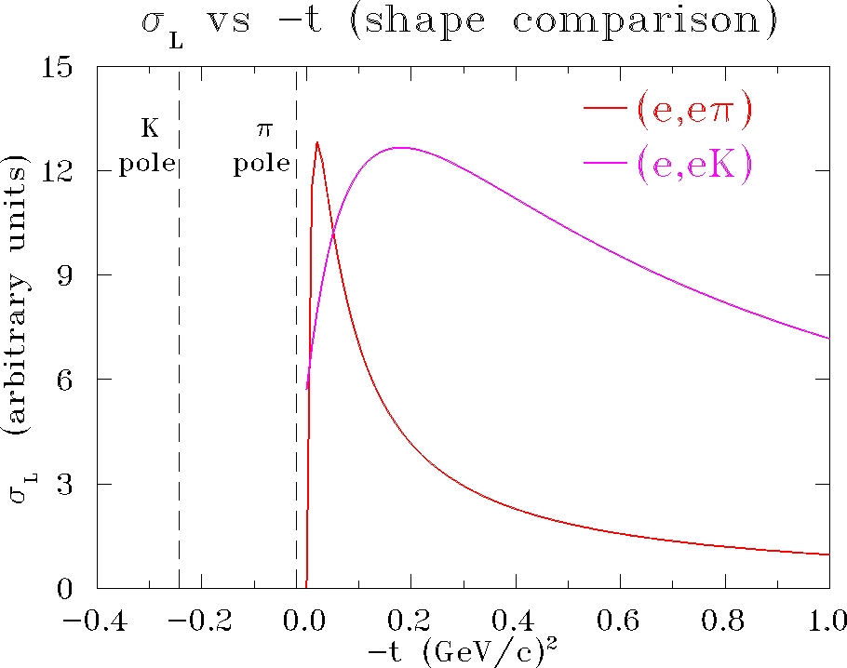
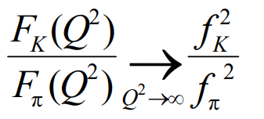
Comparing π⁺ and K⁺ Form Factor
Large -t pion data lies a similar distance from the pole as kaon data
The Born term model should be approximately valid for kaon form factor
The hard scattering limit in pQCD predicts a similar result
Requirements:
Full L/T separation of the cross section – isolation of σ_{L} (which requires σ_{L} >> σ_{T})
Selection of the pion pole process
Extraction of the form factor using a model
Validation of the technique - model dependent checks
Notes:
Pole = point to t-m in sigL equation

Slide 6
Comparing π⁺ and K⁺ Form Factor
Large -t pion data lies a similar distance from the pole as kaon data
The Born term model should be approximately valid for kaon form factor
The hard scattering limit in pQCD predicts a similar result
Requirements:
Full L/T separation of the cross section – isolation of σ_{L} (which requires σ_{L} >> σ_{T})
Selection of the pion pole process
Extraction of the form factor using a model
Validation of the technique - model dependent checks

Slide 7
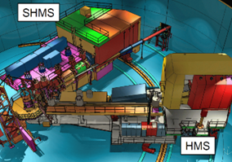
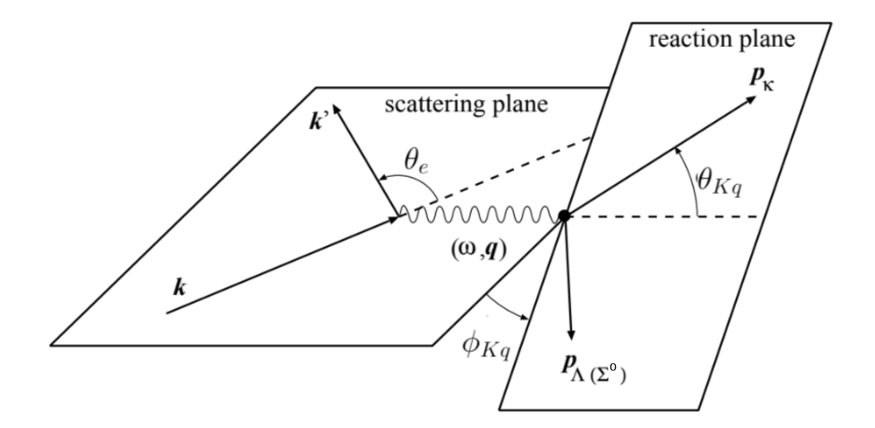
Review E12-09-011 (KaonLT) Goals
Q² dependence will allow studying the scaling behavior of the separated cross sections
First cross section data for Q² scaling tests (x=0.25, 0.4) with kaons
Highest Q² (Q²=5.5 GeV²) for L/T separated kaon electroproduction cross section
First separated kaon cross section measurement above W=2.2 GeV
p(e,e’K⁺)Λ,Σ⁰ t-dependence allows for detailed studies of the reaction mechanism
Contributes to understanding of the non-pole contributions, which should reduce the model dependence
Bonus: if warranted by data, extract the kaon form factor from Λ data

Slide 8
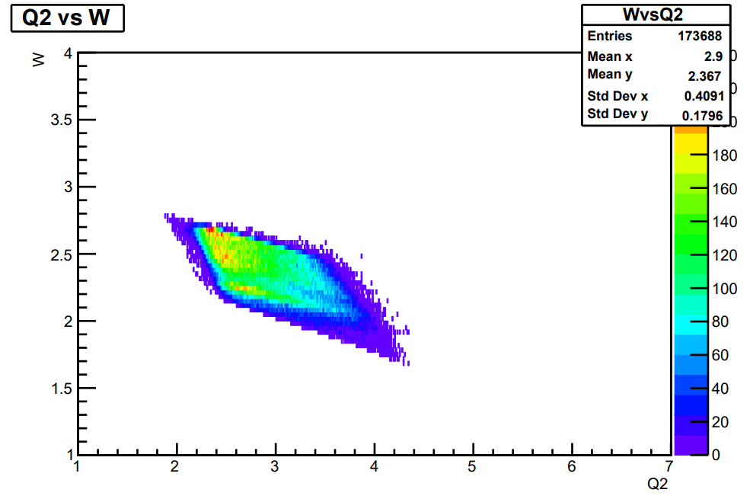
Kaon LT - Data Collected
The p(e, e′K⁺)Λ,Σ⁰ experiment ran in Hall C at Jefferson Lab over the fall 2018 and spring 2019.
E (GeV) | Q² (GeV²) | W (GeV) | x | ε_{high}/ε_{low} | Δε
10.6/8.2 | 5.5 | 3.02 | 0.40 | 0.53/0.18 | 0.35
10.6/8.2 | 4.4 | 2.74 | 0.40 | 0.72/0.48 | 0.24
10.6/6.2 | 3.0 | 2.32 | 0.40 | 0.88/0.57 | 0.31
10.6/8.2 | 3.0 | 3.14 | 0.25 | 0.67/0.39 | 0.28
10.6/6.2 | 2.115 | 2.95 | 0.21 | 0.79/0.25 | 0.54
4.9/3.8 | 0.5 | 2.40 | 0.09 | 0.70/0.45 | 0.25
E=10.6 GeV
Q²=3.0, W=2.32, x=0.40, ε_{high}=0.88
Notes:
Large delta_eps by design
Q2 and W value is where diamond is centered

Slide 9
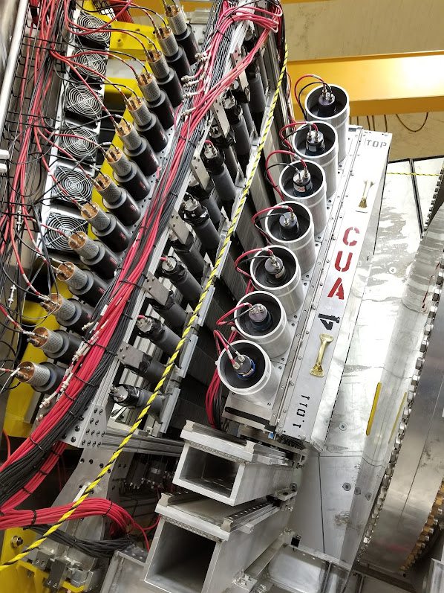
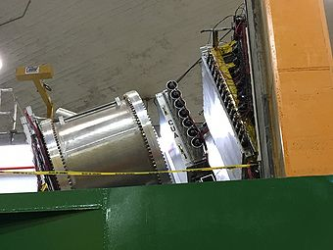
Experimental Details
Hall C: k_{e}=3.8, 4.9, 6.4, 8.5, 10.6 GeV
SHMS for kaon detection :
angles, 6 – 30 deg
momenta, 2.7 – 6.8 GeV/c
HMS for electron detection :
angles,10.7 – 31.7 deg
momenta, 0.86 – 5.1 GeV/c
Particle identification:
Dedicated Aerogel Cherenkov detector for kaon/proton separation
Four refractive indices to cover the dynamic range required by experiments
Heavy gas Cherenkov detector for kaon/pion separation
n | π_{thr} (GeV/c) | K_{thr} (GeV/c) | P_{thr} (GeV/c)
1.030 | 0.57 | 2.00 | 3.80
1.020 | 0.67 | 2.46 | 4.67
1.015 | 0.81 | 2.84 | 5.40
1.011 | 0.94 | 3.32 | 6.31

Slide 10
Analysis Phases
*PionLT experiment running (6 months)
Calibrations ✔
Calorimeter, aerogel, HG cer, HMS cer, DC, Quartz plan of hodo
Assure we are replaying to optimize our physics settings
[~2 months] Efficiencies and offsets*
Luminosity, elastics, Heeps, etc.
[3-4 months] First iteration of cross section
Extract the kaon electroproduction cross section
[~1 months] Fine tune
Fine tune values to minimize systematics
[~3+ months] Repeat previous two steps
Repeat until acceptable cross sections are reached
This will highlight any potential complications
[~1 month] Possible attempt at form factor extraction
The Rosenbluth separation technique** is used to isolate the longitudinal term and thus the form factor can be extracted
Current step
On-deck
**This is the first commissioning L-T separation for the HMS+SHMS setup

Slide 11
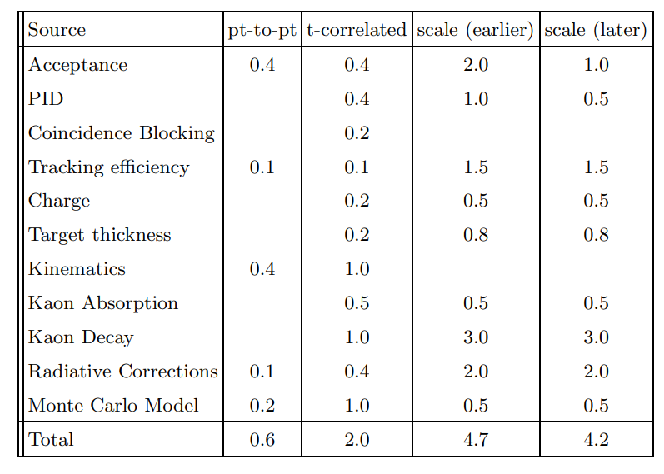
Efficiencies and offsets - considerations
This is perhaps the most important step in the entire analysis.
These studies are so critical because of a 1/Δε amplification and possibly small R=σ_{L}/σ_{T} in the systematic uncertainty of the σ_{L}
Careful analysis will allow the required precision cross section measurements for extracting form factors.
Two main tools: luminosity scans and elastic analysis
KaonLT Proposal, PAC 34
Notes:
The uncorrelated errors between the high and low eps settings are listed in the first and second column. The point-to-point uncertainties are amplified by 1/∆eps in the L-T separation. The t-correlated uncertainties are also amplified, while the scale uncertainties propagate directly into the separated cross sections

Slide 12
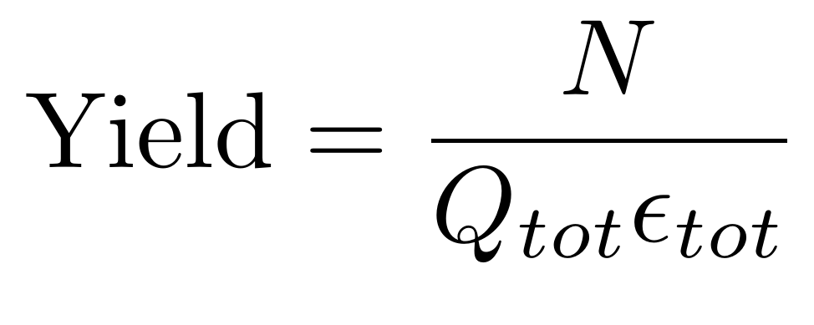
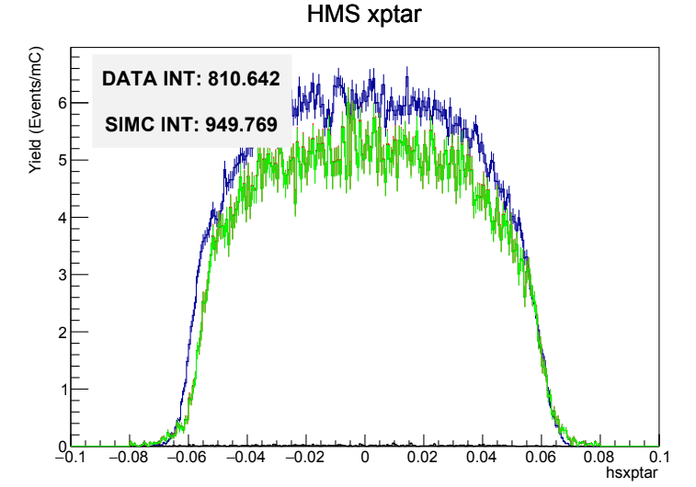
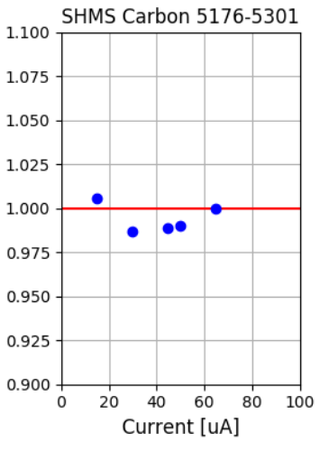
Efficiencies and offsets - experimental approach
For KaonLT the luminosity scans provide a means to understand the accuracy of the efficiencies.
Data are taken as a function of current/rate on a carbon target and efficiency corrected yields are analyzed.
Since the carbon density should not change with current/rate, any deviation of the yield from unity is indicative of an issue with the efficiencies that needs to be addressed.
The elastic scans provide information on spectrometer offsets in angle and momentum
Elastic data is taken at the same or similar kinematics to those for the production data and the normalized yields are compared to those calculated with SIMC
Any deviations from unity are indicative of discrepancies in the spectrometer angle, momentum, or the beam energy used in the analysis
For instance, elastic singles data is used to fit angle and momentum offsets then the elastic coincidence data examines the deviation of invariant reconstructed mass, missing energy, and missing momentum from their nominal values.
(Yield)/(Yield_{65uA})
Notes:
The elastic scans provide information on spectrometer offsets in angle and momentum after any corrections from the luminosity scans have been implemented
Together these need to be fully understood in order to minimize the overall systematic uncertainties

Slide 13
Extract the Kaon Electroproduction Cross Section
SIMC, including a model of the experimental setup, is used to simulate a variety of effects.
A model for the kaon electroproduction model is developed, including a 𝜒2 minimization to achieve the best agreement between data and SIMC.
This is achieved by iterating the model input cross section.
The experimental cross section can then be extracted as long as the model input cross section properly describes the dependence on all kinematic variables.
Example polynomial showing expected kinematic dependency
Notes:
Iteraration and fine tuning on these
t_c and Q_c are the bin center?

Slide 14
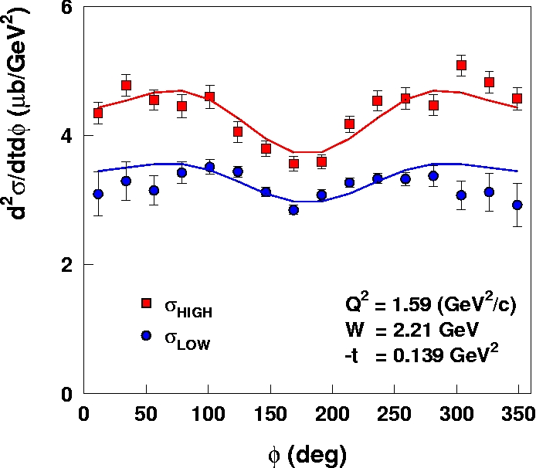
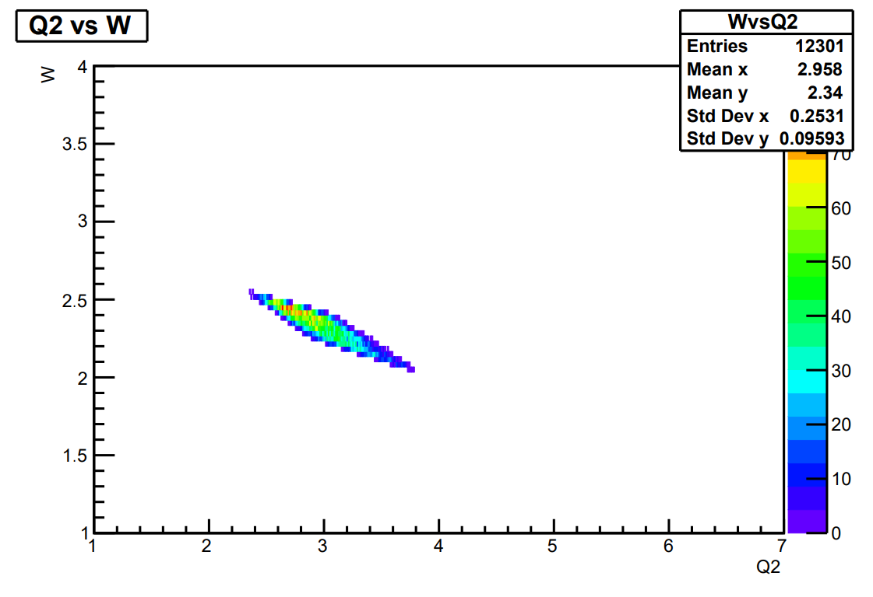
L/T Separation
σ_{L} is isolated using the Rosenbluth separation technique
Measure the cross section at two beam energies and fixed W, Q², -t
Phase space matching to constrain the kinematic region for the two differing beam energies
Extract cross section in -t and ϕ bins
This allows for the simultaneous extraction of the interference terms
E=10.6 GeV
ε_{high}
ε_{low}
T. Horn et al., PhysRevC 97(2006)192001
Notes:
sig1=sigLT, sig2=sigTT. 3 free, independent parameters.
The unseparated cross section can then be linearly fit thus obtaining the L and T cross sections as the slope and intercept respectively

Slide 15
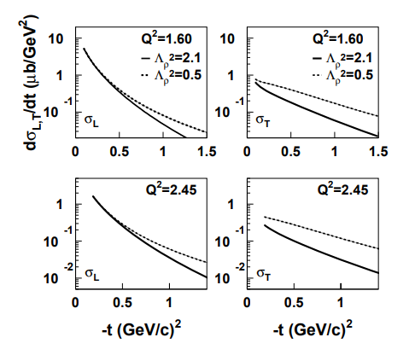
Form Factor Extraction
The product of the kaon form factor is related to σ_{L} through the probability of the virtual photon interacting with a kaon
If σ_{L} shows an exponential fall off with t this is a sign of the point-like behavior warranting the form factor extraction
The extraction of the kaon form factor is done by fitting the longitudinal cross section calculated by the VGL Regge model to the experimental data.
The model is evaluated for different values of Λ²_{K+}
T. Horn’s Thesis
M. Vanderhaeghen, M. Guidal, and J.-M. Laget, Phys. Rev. C 57, 1454
Notes:
Delta is the cutoff parameter of the Regge trajectory for the kaon which is an input to the model.
the best is taken by minimizing the difference between model σ_{L} and experimental.
Plot is an example of VGL Regge model for different lambda values (note: this is for the rho exchange)
*** IF ASKED: It would be good to at least include a plot of the K and K* trajectories, as both of these are expected to contribute substantially to (e,e'K+), unlike (e,e'pi+) which was dominated by just the pion trajectory.

Slide 16
Summary and Outlook
E12-09-011 ran Fall 2018, Spring 2019
Also have the PionLT data from Summer 2019, Fall 2021, and Winter 2022 available
See Jacob’s PionLT talk following this one!
Currently in the late stages of the second phase of analysis
Studies of efficiencies and offsets from luminosity and elastic analysis being worked on by Ali Usman, Vijay Kumar, and Richard Trotta
Next stage is to extract the kaon electroproduction cross section for both Λ,Σ⁰ channels
This is achieved by iterating the model input cross section.
The experimental cross section can then be extracted as long as the model input cross section properly describes the dependence on all kinematic variables.

Slide 17
Thanks to everyone in the KaonLT collaboration
Salina Ali, Ryan Ambrose, Darko Androic, Whitney Armstrong, Carlos Ayerbe Gayoso, Samip Basnet, Vladimir Berdnikov, Hem Bhatt, Deepak Bhetuwal, Debaditya Biswa, Peter Bosted, Ed Brash, Alexandre Camsonne, Jian-Ping Chen, Junhao Chen, Mingyu Chen, Michael Christy, Silviu Covrig, Wouter Deconinck, Markus Diefenthaler, Burcu Duran, Dipangkar Dutta, Mostafa Elaasar, Rolf Ent, Howard Fenker, Eric Fuchey, Dave Gaskell, David Hamilton, Ole Hansen, Florian Hauenstein, Nathan Heinrich, Tanja Horn, Garth Huber, Shuo Jia, Mark Jones, Sylvester Joosten, Muhammad Junaid, Md Latiful Kabir, Stephen Kay, Vijay Kumar, Nathaniel Lashley-Colthirst, Bill Li, Dave Mack, Simona Malace, Pete Markowitz, Mike McCaughan, Robert Michaels, Rachel Montgomery, Jacob Murphy, Gabriel Niculescu, Maria Niculescu, Zisis Papandreou, Sanghwa Park, Eric Pooser, Love Preet, Julie Roche, Greg Smith, Petr Stepanov, Holly Szumila-Vance, Vardan Tadevosyan, Aram Teymurazyan, Richard Trotta, Hakob Voskanyan, Carlos Yero, Ali Usman

Slide 18
Extra Slides

Slide 19
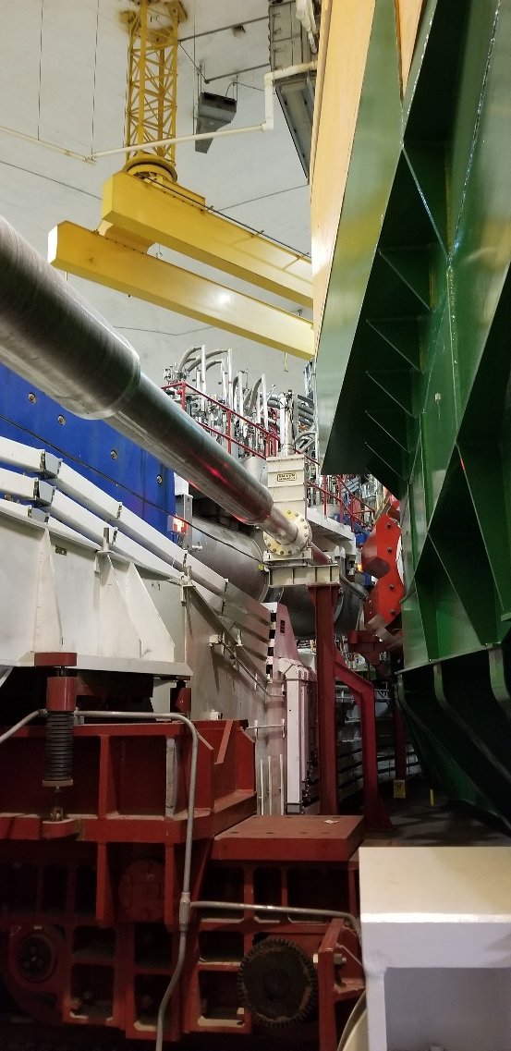
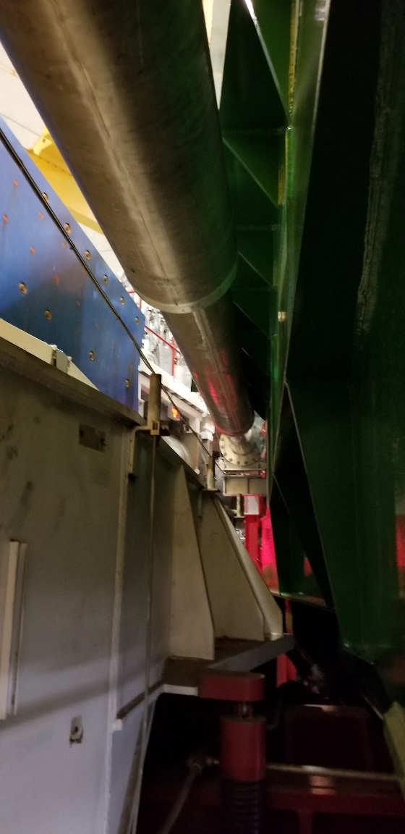
SHMS small angle operation
Some issues with opening and small angle settings at beginning of run
SHMS at 6.01°
HMS at 12.7°
[12/17/18]
SHMS
HMS
SHMS
HMS
Work of many people ...

Slide 20
L/T Separation
After validation of the Sullivan process, the longitudinal term allows one to access the physics.
The ɸ dependence is fit for all terms simultaneously then the L-T terms can be extracted from the known ε dependence where the longitudinal term is the slope and the transverse is the intercept at ε=0.
In order to minimize the systematic uncertainties, this will need to be done a few times as values are fine-tuned and the previous steps are further optimized.
Notes:
Spectrometer acceptance, kinematics, and efficiencies

