Slide 1
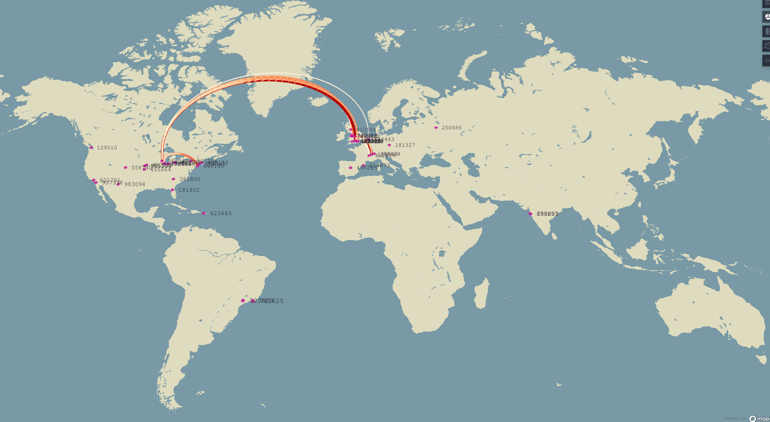
Building the DUNE International Computing Facility
Steven Timm
Fermilab
Software and Computing Roundtable, April 5 2022.
For the DUNE collaboration

Slide 2
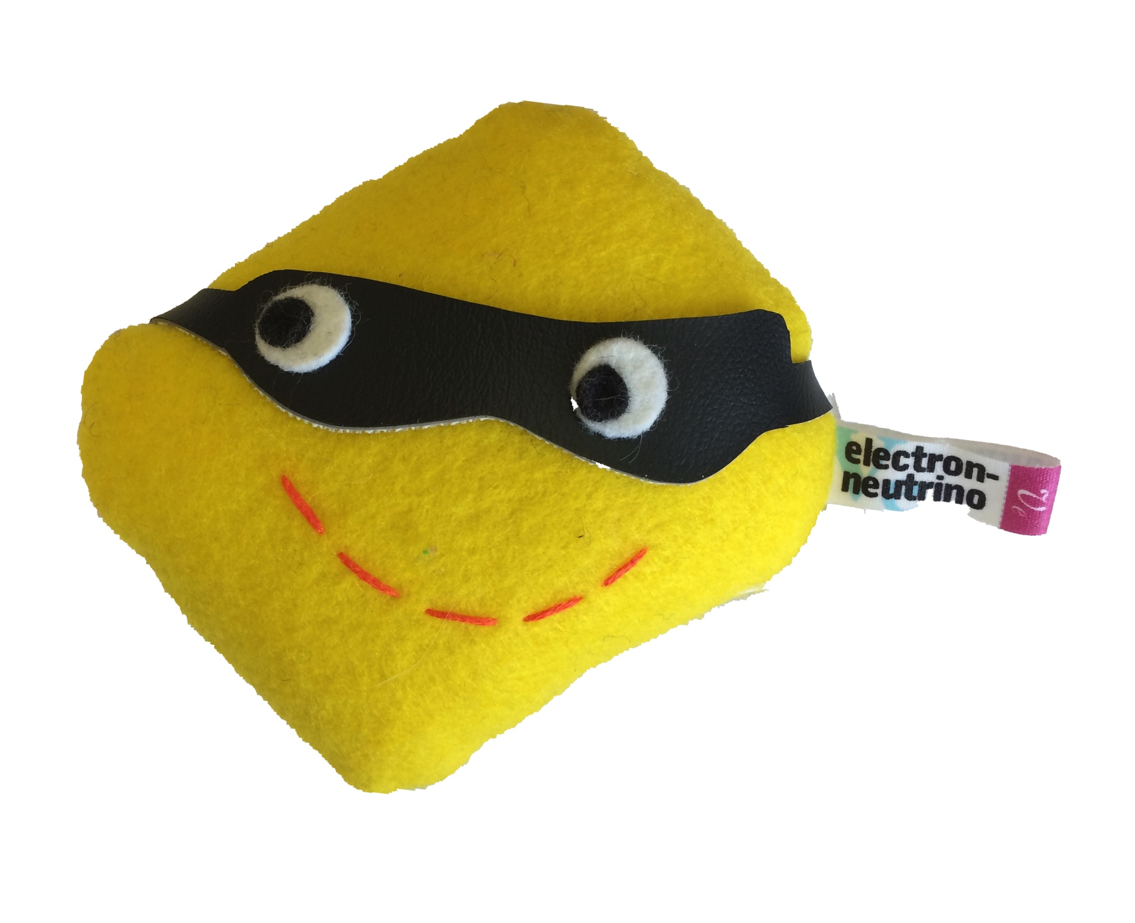

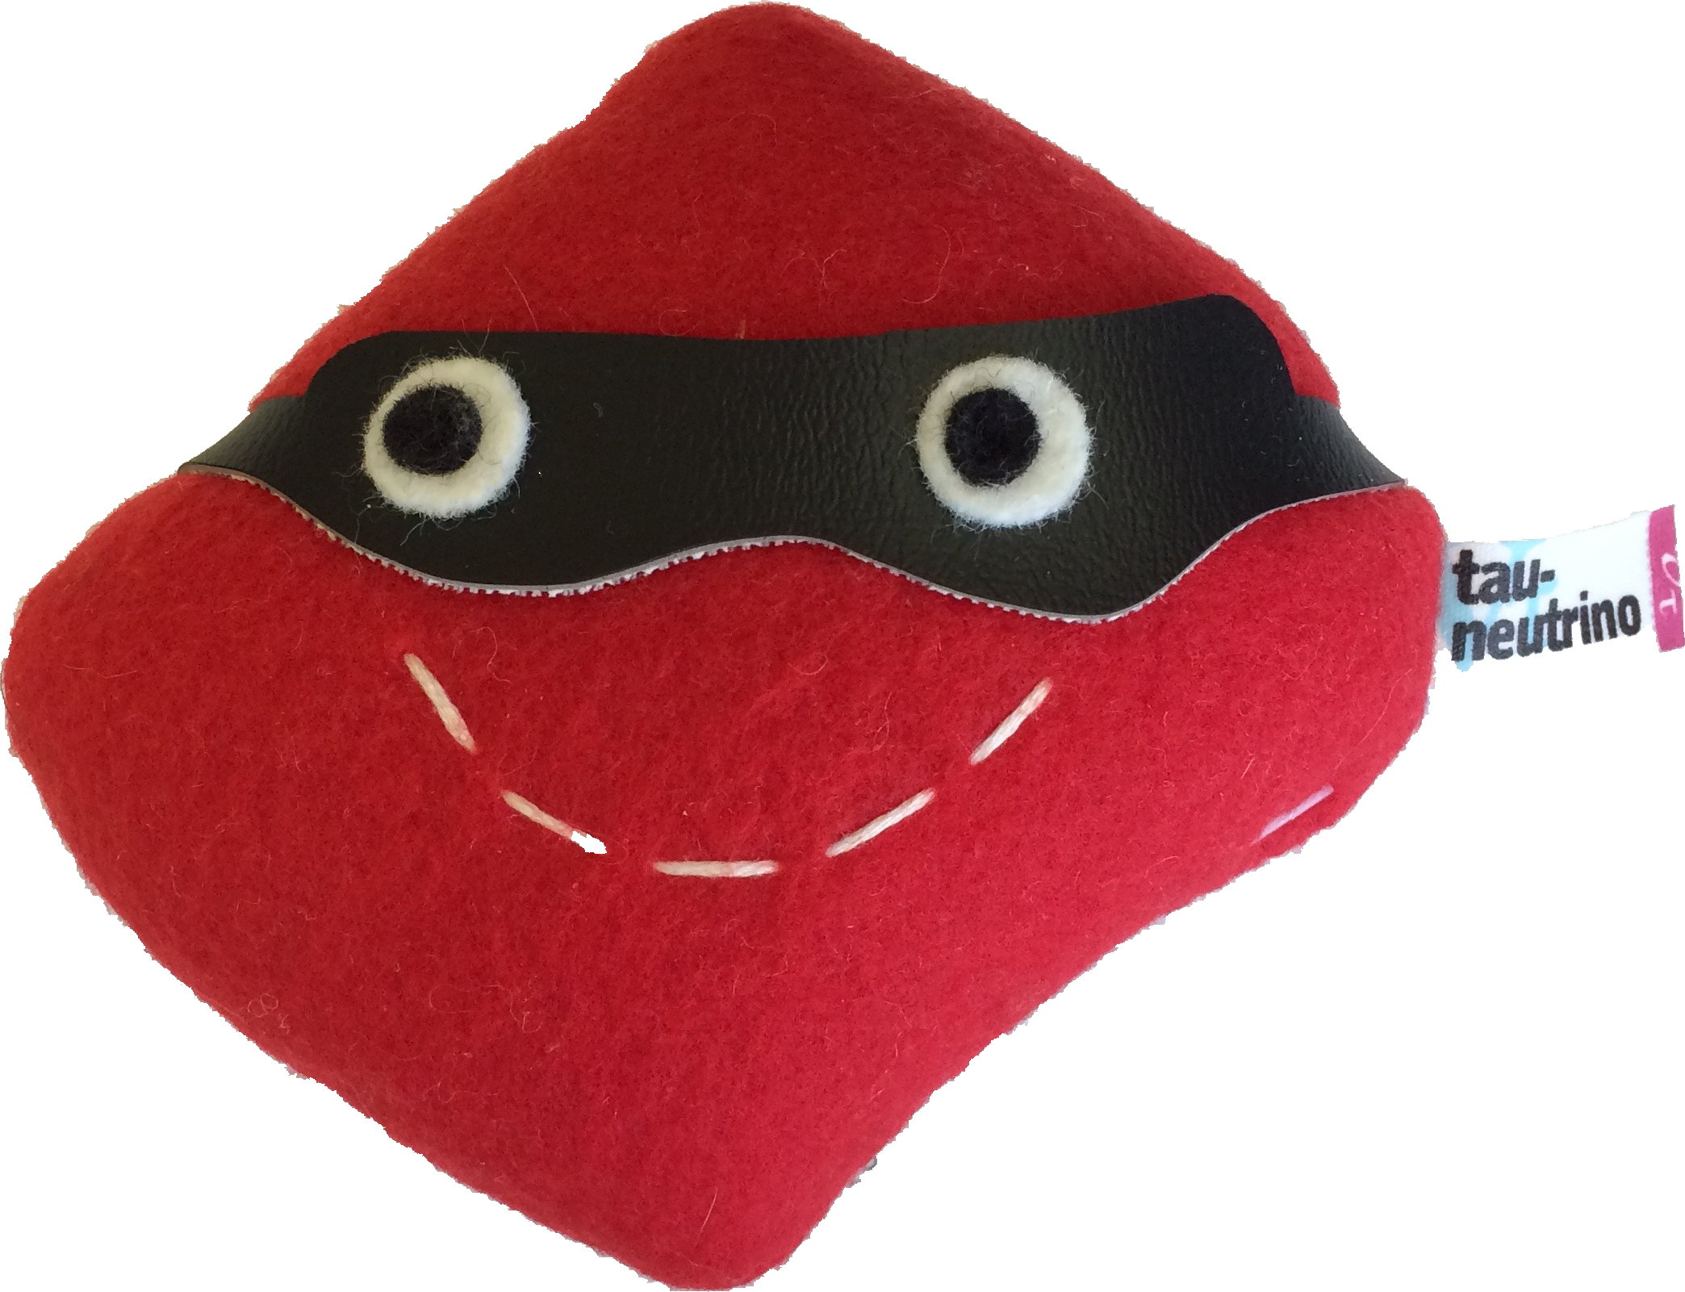
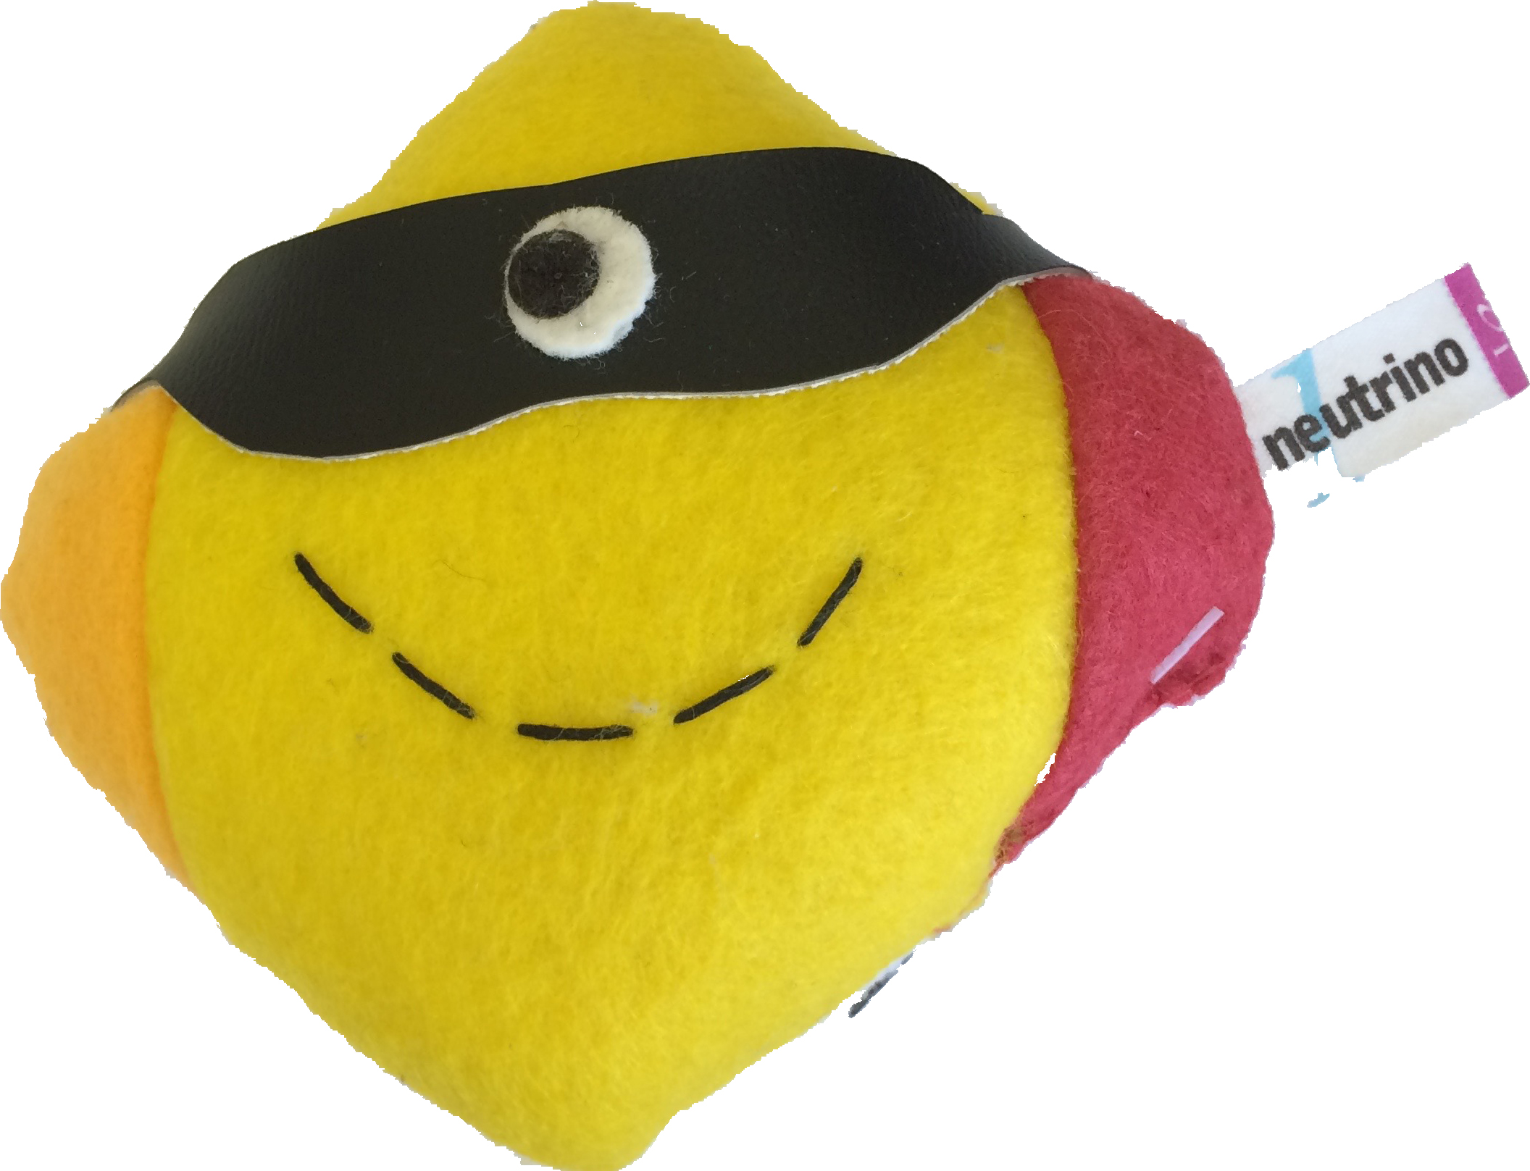
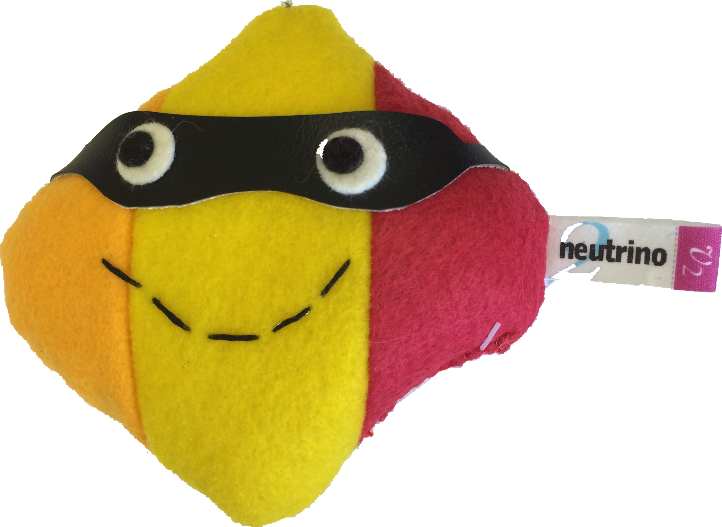
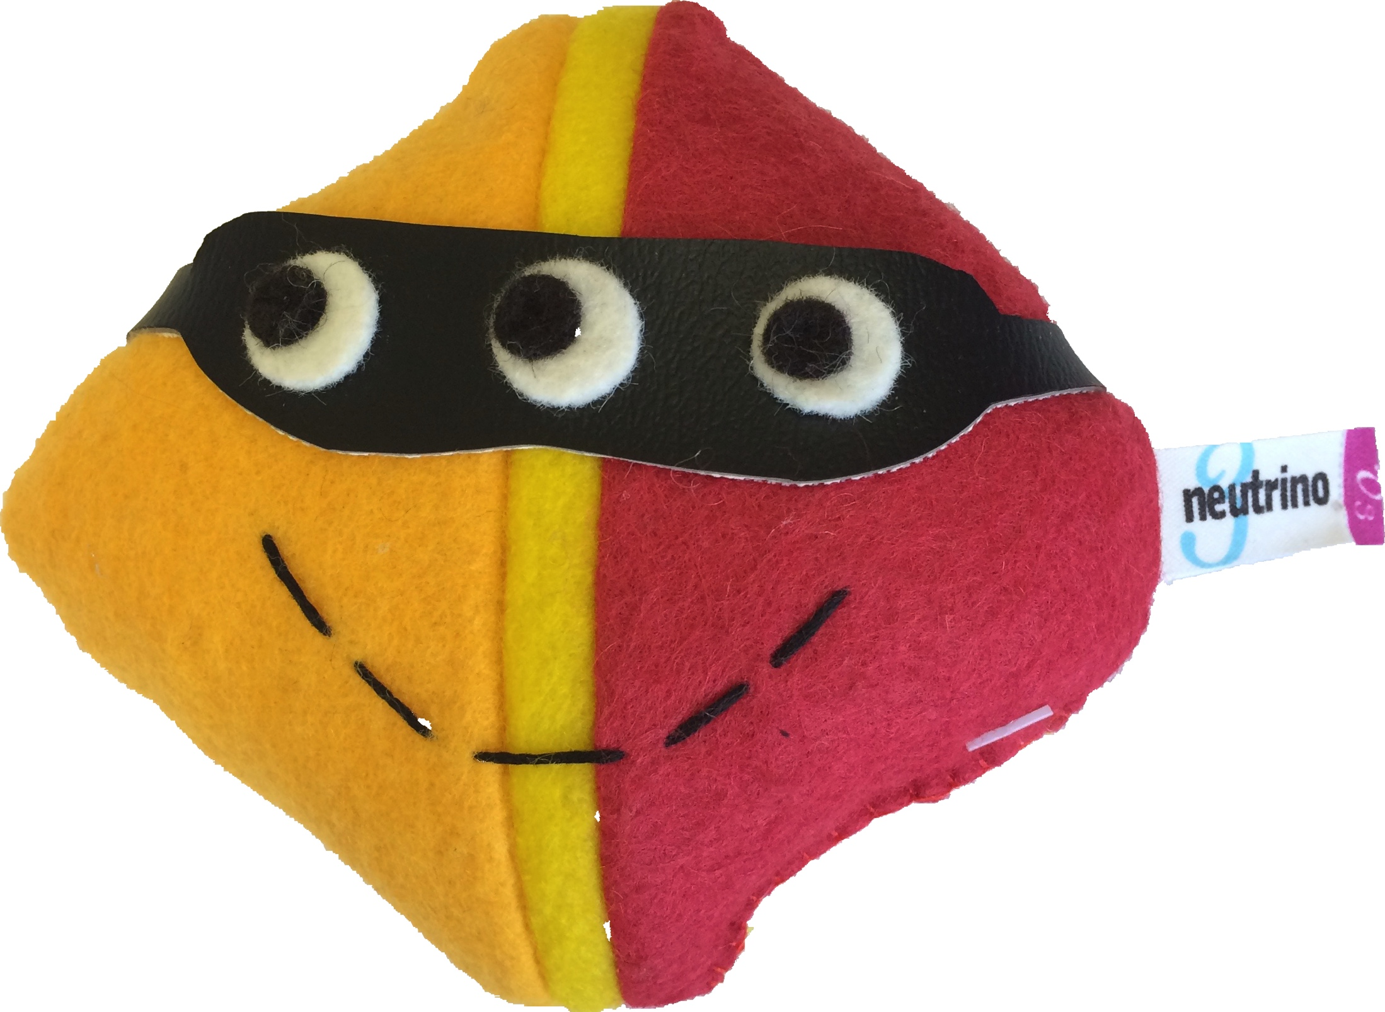
DUNE: Precision measurements of neutrino mixing
Intro to DUNE
Flavor Basis
(Interactions)
Outline:
Intro to DUNE
Data Formats
Reco & Analysis
Compute Infrastructure
Workflow and Data Mgmt
Conclusions
ν_{e}
ν_{μ}
ν_{τ}
Mass Basis
(Motion)
ν₁
ν₂
ν₃
2 different views of the same neutrinos
Particlezoo.net

Slide 3
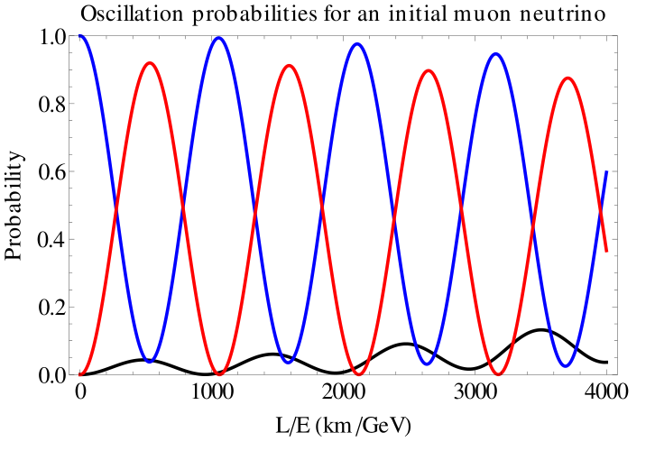
Neutrino Oscillations
Intro to DUNE
The quantum wavelength of a 2 GeV muon neutrino is ~ 10⁻¹⁶ m
But it is actually a superposition of the 3 mass types of neutrinos which have slightly different wavelengths – the beat wavelength between the types is about 2000 km.
Bottom line – propagation can change a muon type neutrino
into an electron type neutrino
ν_{μ}
ν_{e}
f

Slide 4
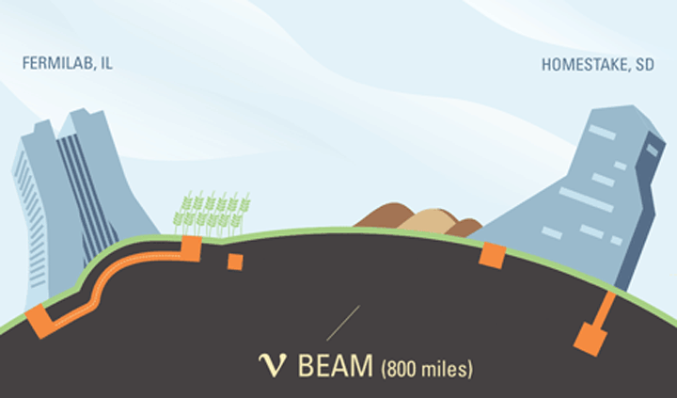
Put a huge LAr detector “DUNE” in the Homestake Gold Mine
Make a very powerful neutrino beam
Run for 10 yrs.
Intro to DUNE
Notes:
Do I want to add BSM or astrophysics …

Slide 5
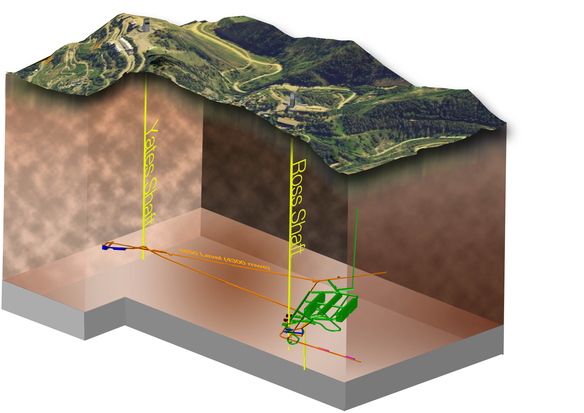
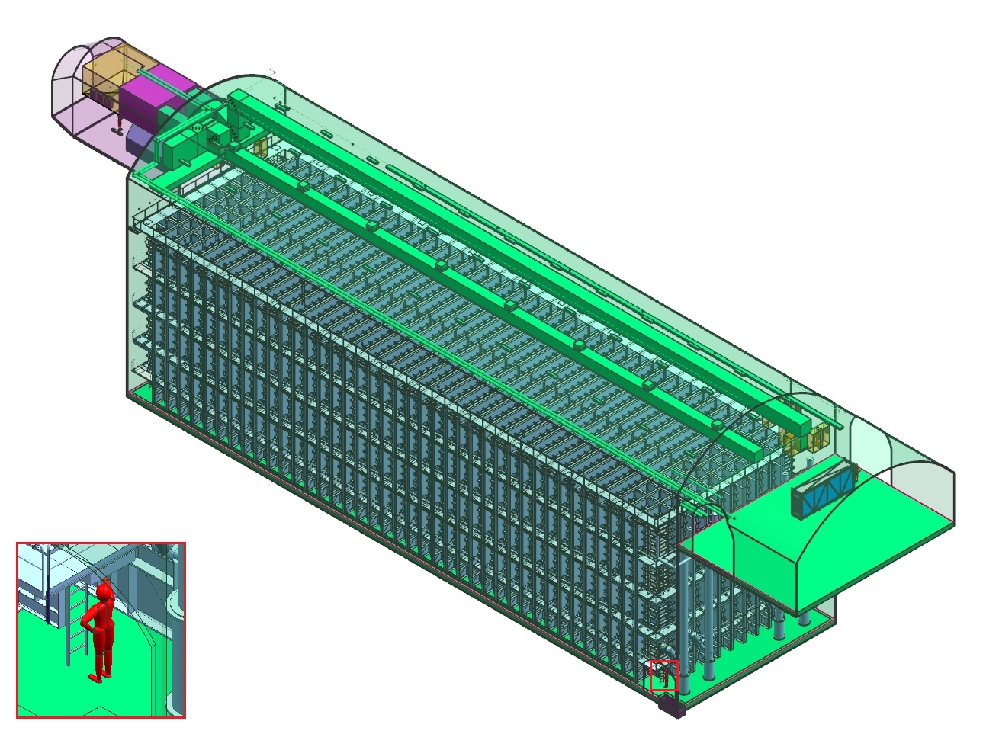
Far Detector
Intro to DUNE
40-kt (fiducial) liquid argon
time projection chambers
- Installed as four 10-kt modules
Caverns
now being excavated
One 10-kt single-phase FD module
Sanford Underground
Research Facility (SURF)
4850’ level at SURF
First module will be a
single phase LAr TPC
Notes:
Add a slide about what else you can do with a vat of argon

Slide 6

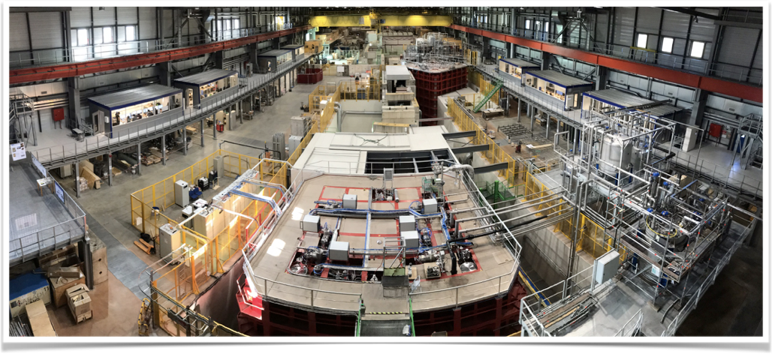
~1kt LAr-TPC’s at CERN
Intro to DUNE
Dual phase
Single phase

Slide 7
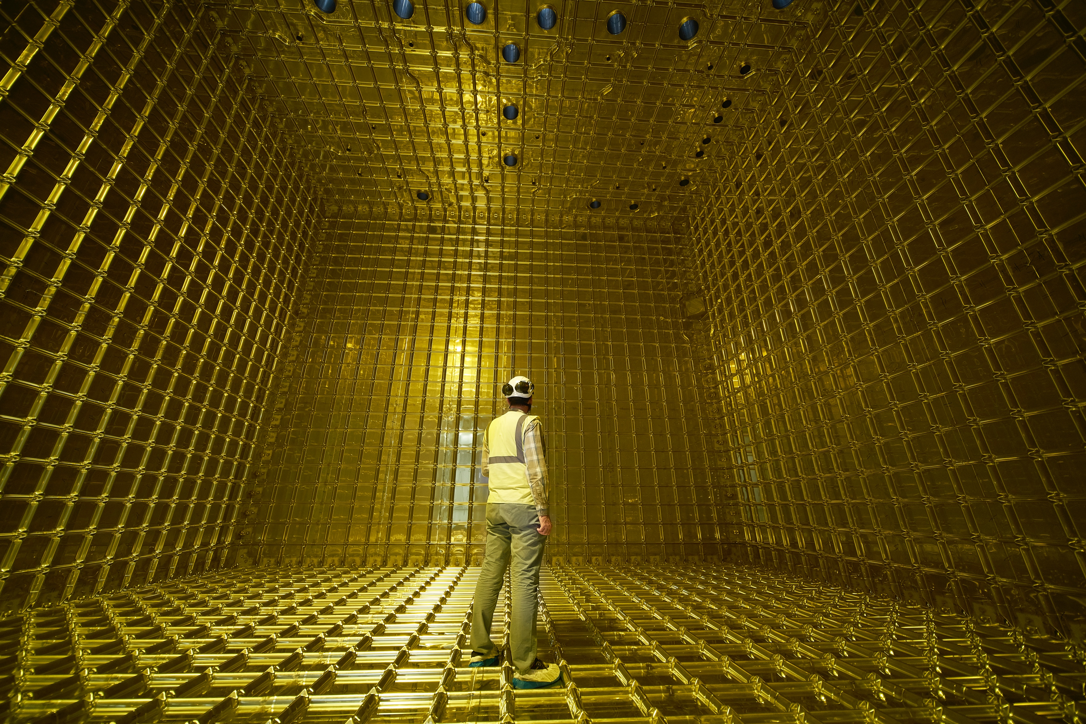
Build “small” prototypes @CERN
Intro to DUNE
ProtoDUNE I
6 APA’s out of 150
1 kt of 17 kt LAr

Slide 8
DUNE Computing—Now and Future
Intro to DUNE
Collaboration formed in 2015
~1400 collaborators, 5 continents
100 compute elements, 15 storage elements
5% scale prototypes at CERN taking beam (plus 1 starting at FNAL this year).
18 PB on tape already just from test beam and simulation(similar to CDF/D0)
Already some legacy software—analysis preservation already an issue
Making full computing plan now for an experiment that has long time to first science.
DUNE Experiment will still be running 20 years from now.. Maybe longer.
Past end of Unix epoch!
Past useful life of x86_64 architecture
Can’t assume Linux will survive that long
Can’t assume grid computing will survive that long.
Heterogeneous CPU/GPU/FPGA architecture is part of present and essential to future.
Will quantum computing be widely available by then?

Slide 9
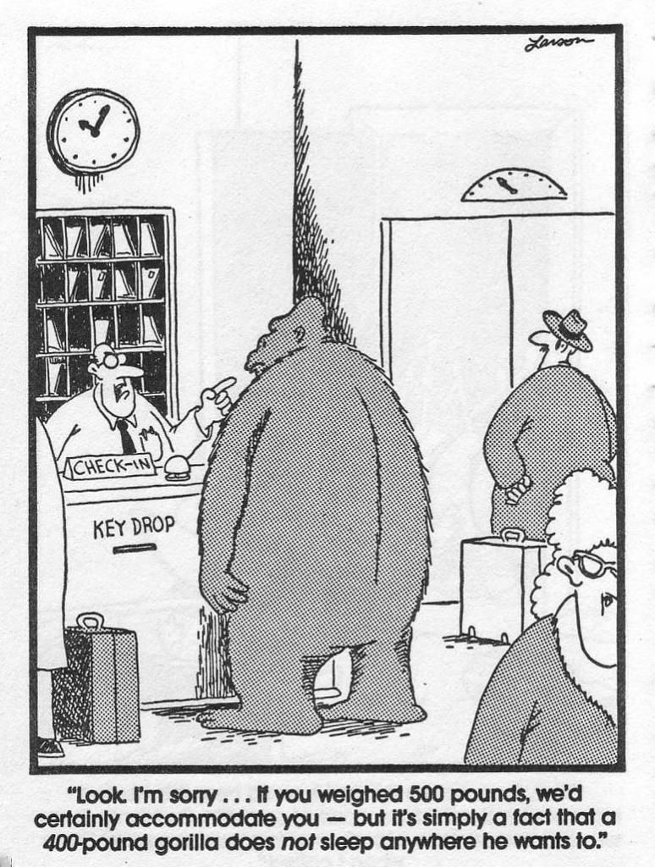

Similarities with LHC
Intro to DUNE
LHC Palace
Hotel
Use many of the same underlying software tools and packages
Have global collaboration with many different ideas on how to do things.
Participate (or observe) in activities like OSG, WLCG, HEP-CCE, IRIS-HEP, DOMA, FIM4R, Rucio
Full DUNE detector expected to be same data volume as LHC Run 3 experiments.
Have distributed computing and storage model

Slide 10
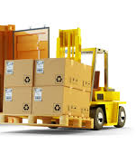
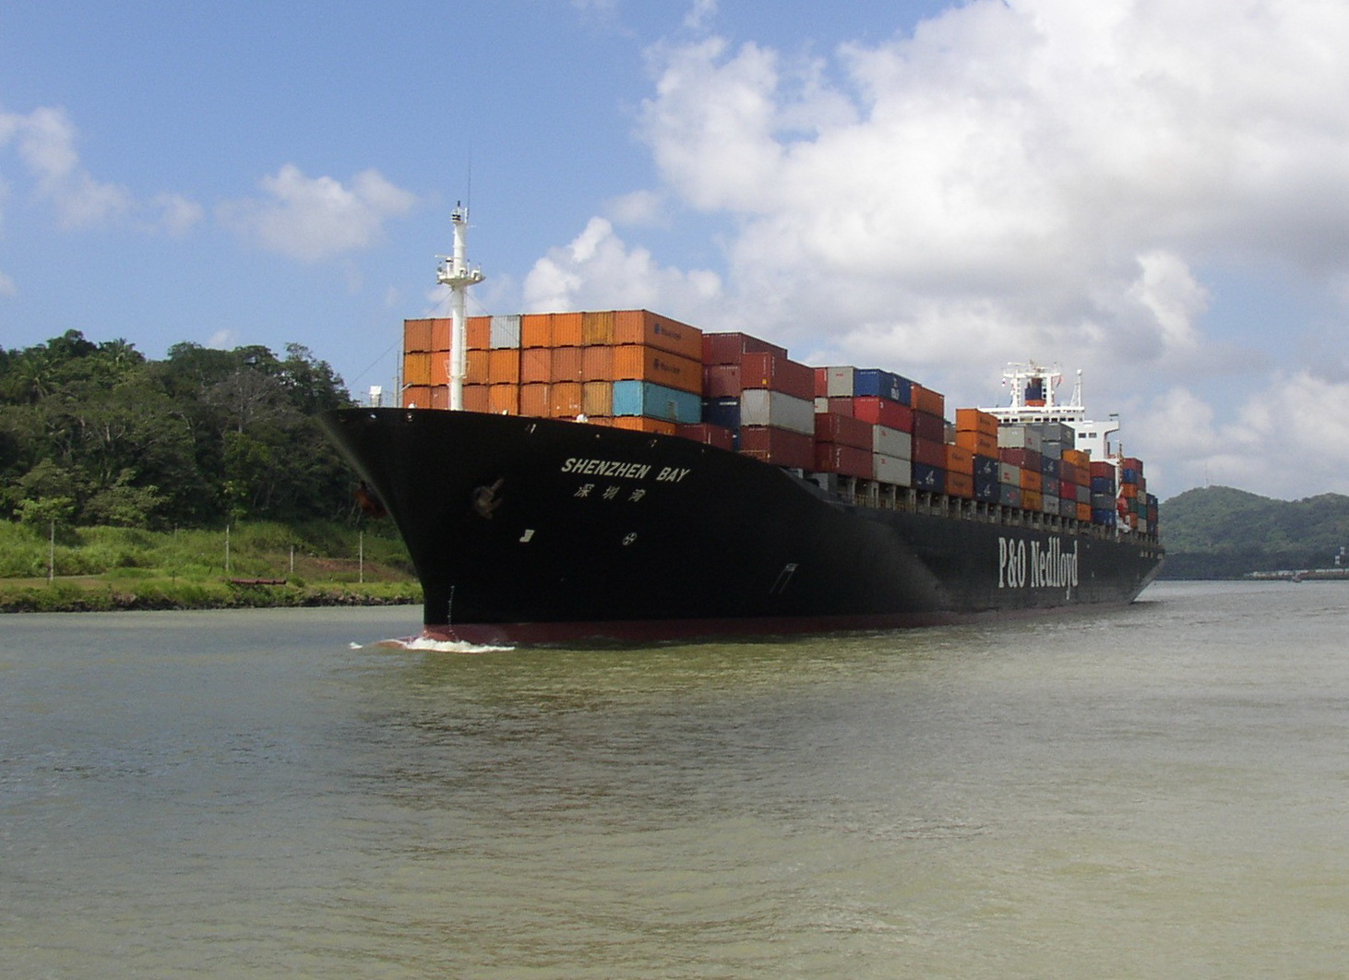
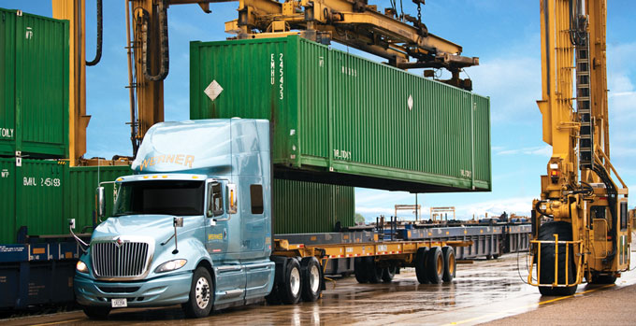
Scaling
Data Formats
2018: ProtoDUNE event
6 APA ~ 130 MB
At 25 Hz
Someday: Supernova
150x4x20,000 5 ms APA
~400 TB. 1 trigger per month.
Maybe 1 real SN in life of expt.
~2029: Beam/cosmic ray event
in 1 FD module -- 150 APA ~ 6GB at < 0.1 Hz

Slide 11
ProtoDUNE-SP Event sizes
Data Formats
protoDUNE raw events are each about 75 MB (compressed), at 10-25Hz
  Compare ~2 MB for ATLAS/CMS p-p
  And ~8 MB for ALICE Pb-Pb
6 APA’s mounted at sides of cryostat
~5 mm resolution over 7x7x7m

Slide 12
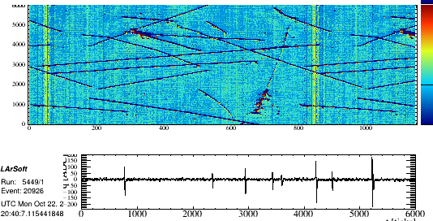
Signal processing for 1 APA
Reco & Analysis
Good use case for GPU
Time, 0.5 μsec
Wire #
Signal for 1 channel
Time, 0.5 μsec
JINST 13 (2018) no.07, P07006 arXiv:1802.08709
Notes:
Need to speed this up.

Slide 13
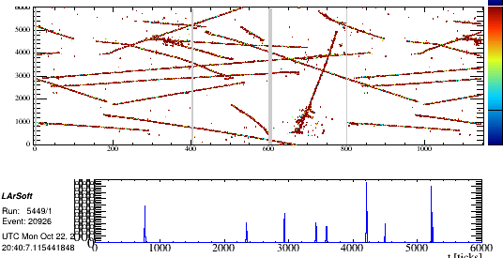
Signal processing for 1 APA
Reco & Analysis
2560x6000 12 bit ADC. Remove bad hits, coherent noise, deconvolute
Notes:
Need to speed this up.

Slide 14
Identification of particles in a beam event
Reco & Analysis
PANDORA
3D reconstruction
Then particle ID
Big neural network use case.
NEED A LOT
OF PROCESSING
POWER!
Pandora: Eur.Phys.J. C78 (2018) no.1, 82
Wirecell: J.Phys.Conf.Ser. 762 (2016) no.1, 012033

Slide 15
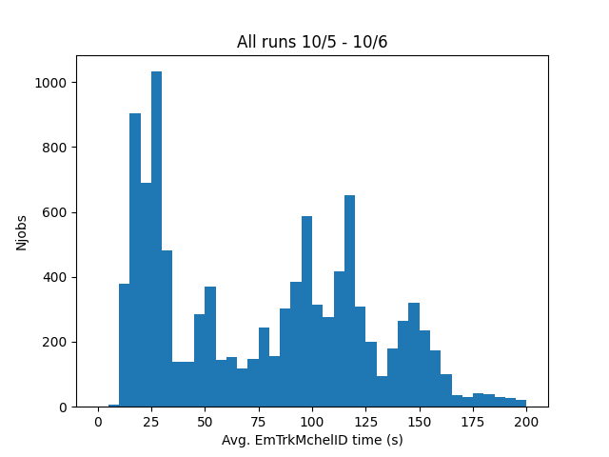
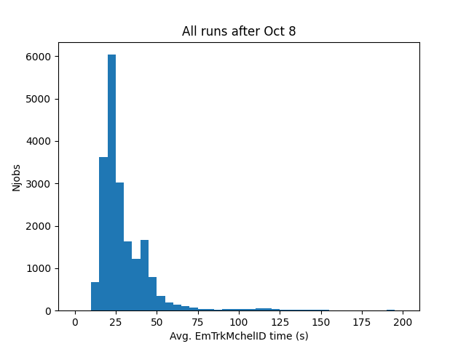
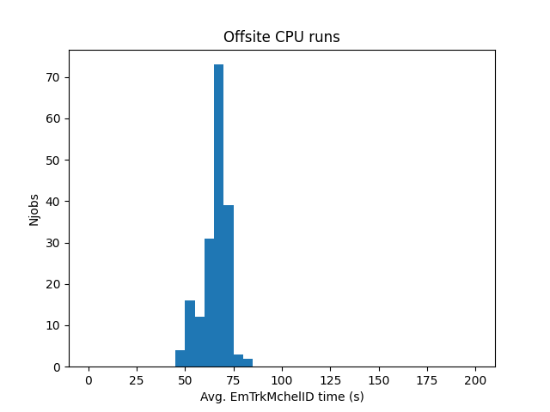
GPU as a Service on ProtoDUNE Data
Reco & Analysis
GPU runs during network saturation
Use GPU inference server to identify Michel electrons
  60K files to process, 100-150 events each
  Conventional compute at FermiGrid
  GPU inference server in Google Cloud (Iowa)
For a while saturated the 100Gbit site network link
Saw at least a factor of 2-3 speedup CPU-only runs in “real-world” conditions
GPU runs post network saturation
CPU-only runs outside FNAL

Slide 16
Software Management
Compute
Infrastructure
SPACK is gradually becoming the build/packaging method being used, replacing legacy Fermilab UPS/UPD
Learning how to read HDF5 format files now being output by the DAQ
  Great for writing fast, still learning how to do streaming reads.
Within past year have moved most of our experimental SW repos to GitHub
Implementing a pull request model with approvals.
Computing consortium responsible for software infrastructure but individual physics and detector groups are responsible for physics reconstruction algorithms.
Memory footprint always an issue.

Slide 17
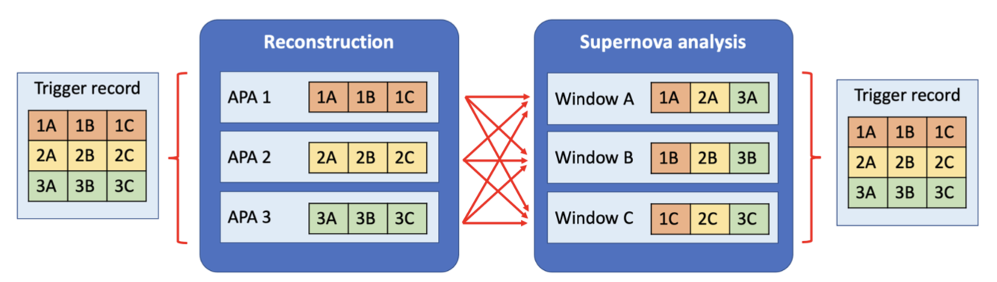
DUNE Unique Framework Requirements
Compute Infrastructure
Three APAs: (1, 2, 3)
A full module has 150
Three time windows: (A, B, C)
Time windows may overlap and may be of different duration

Slide 18
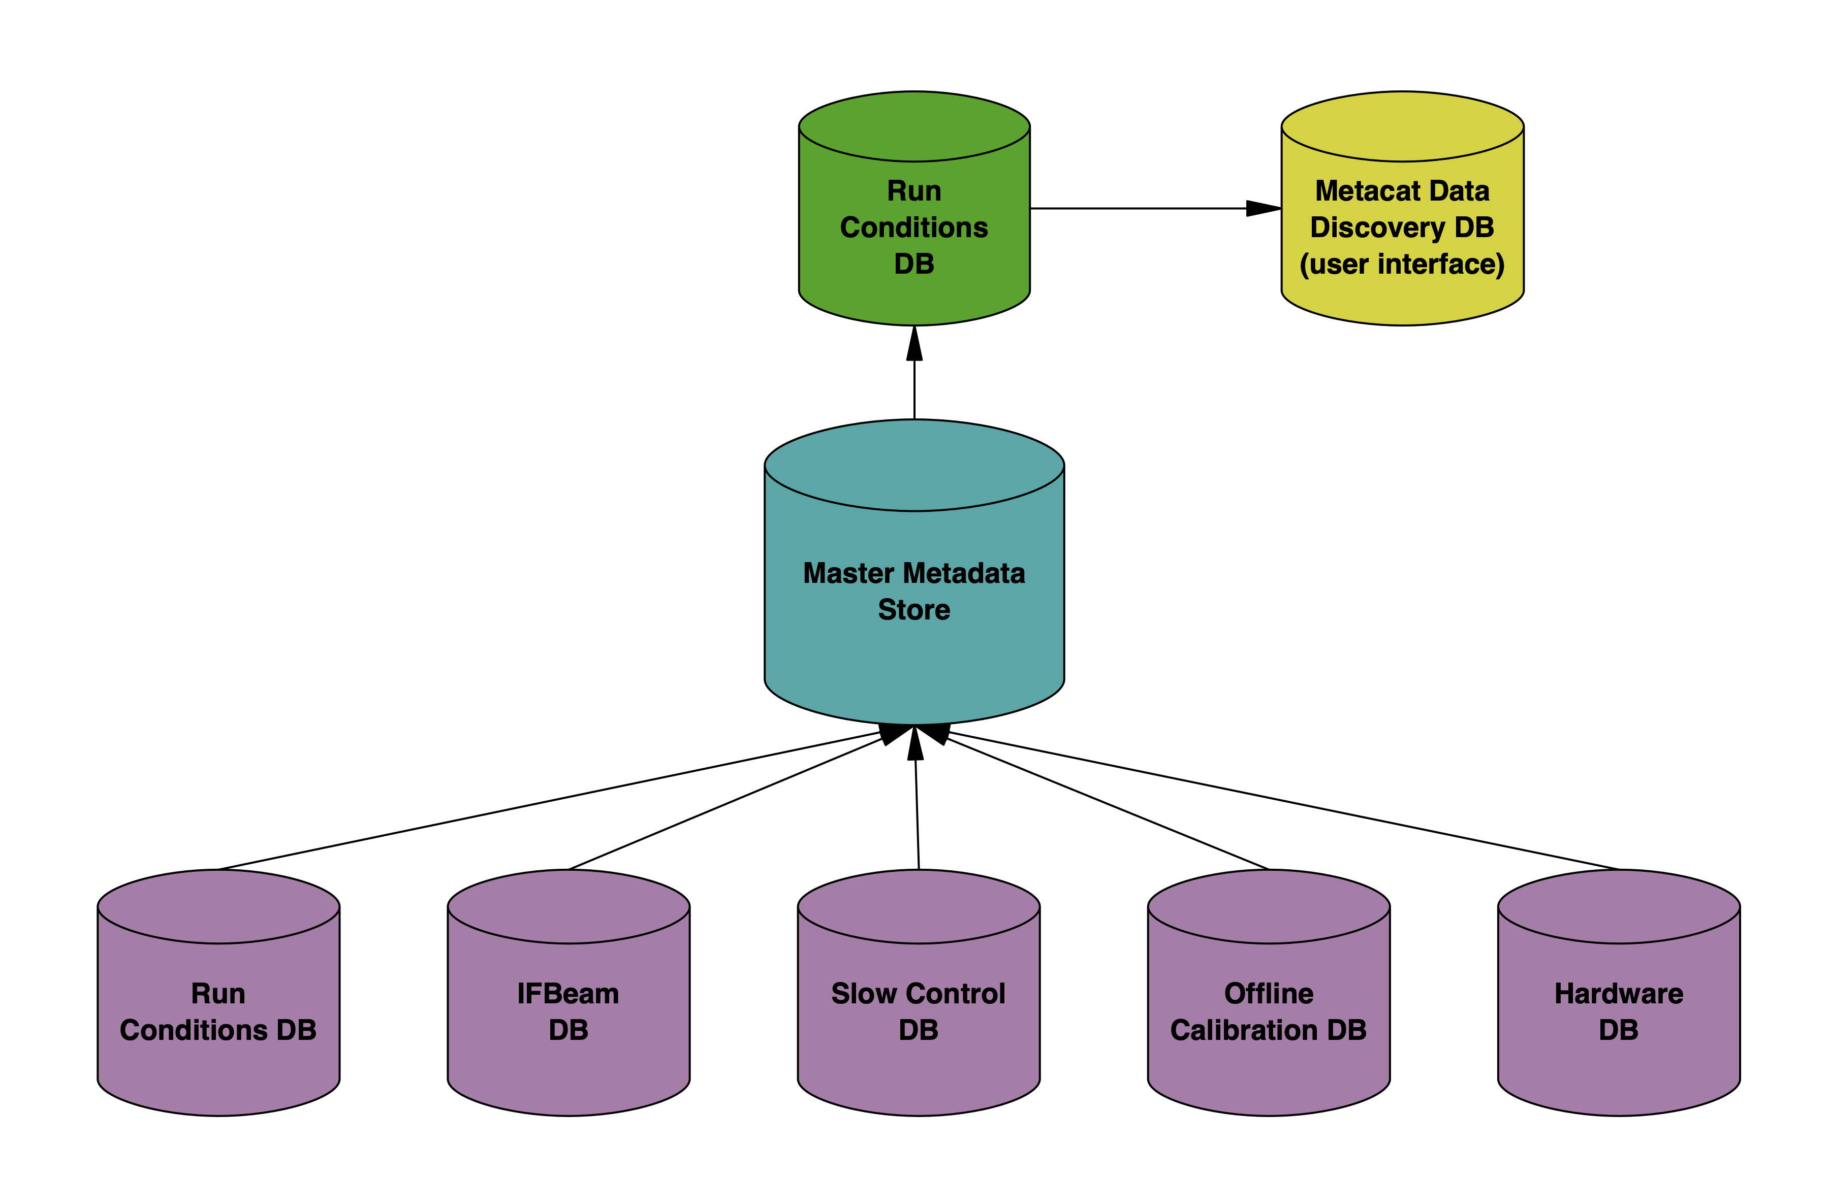
Database Systems Design
Compute Infrastructure
Several databases needed for DUNE
  Run configuration
  Slow Control
  Beam instrumentation
  Calibration
  Hardware
Centralized metadata store
  Unstructured – flexible
  Temporal and run-based metadata
  Filtered relational DB interface based on
  user needs
  Single-point access (all metadata) for
  offline use
  Direct access to individual databases for
  expert use only

Slide 19
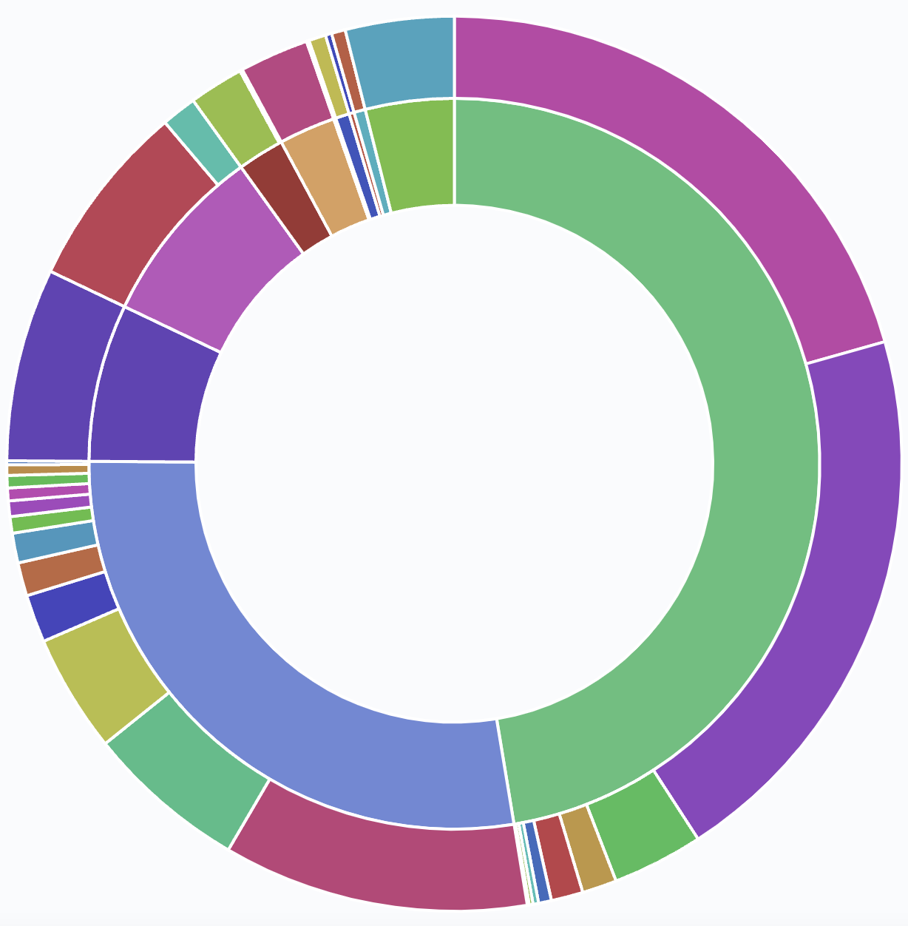
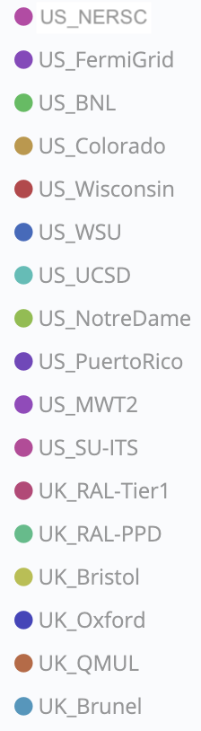
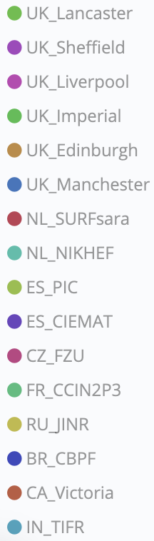
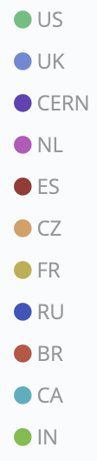
DUNE Global
Computing Resources
Compute Infrastructure
Accessing NERSC via Fermilab’s HEPCloud platform.
Goal to have no more than 25% of offline at FNAL.
O(10K) slots available

Slide 20
Workflow and
Data Management
Workflow System
Goal:
ULTRA-LATE BINDING
Have a system that can tell a job at RUN TIME
What’s the best workflow to work on
What currently-unprocessed file from that workflow is closest to fetch and work on.
Currently have a proof of concept which will be tested in data challenge this summer.
Workflow
Agents
MetaCat
Workflow
Dashboard
Users
Command
Service
RUCIO
Generic Job
Factory
Workflow
Database
Workflow
Allocator
DUNE
Central
Services
which request/stage?
which file?
Grid site
Request for information
Request for action
Generic
Job
Bootstrap
Script
Site
Disk
Remote
Disk
Request for data

Slide 21
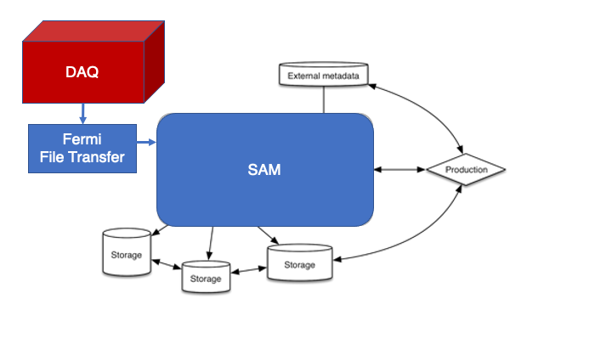
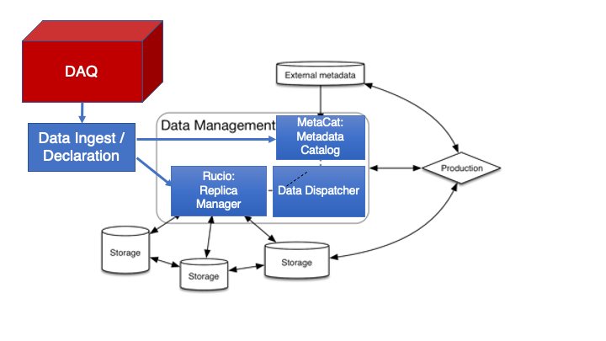
New Data Management System to replace SAM
Workflow and
Data Management
SAM=Sequential Access With Metadata
Developed for D0, used by most Fermilab experiments since then.
Unified system to locate data, keep track of metadata, and keep track of projects.
Need a replica management system that’s better equipped for a global distributed data system. Rucio
Also need a hierarchical metadata system for more flexibility. MetaCat
And need to preserve the project/URL delivery and staging features we have in SAM now. Data Dispatcher

Slide 22
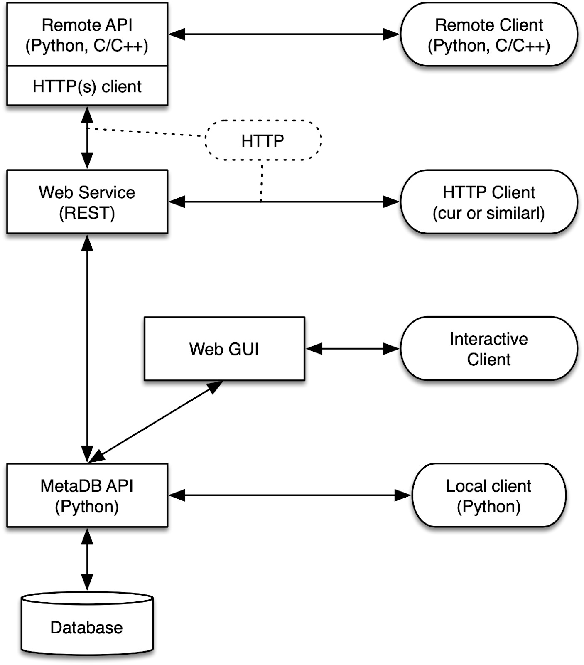
New Components: MetaCat
Workflow and
Data Management
New Metadata Catalog
Code base stable for more than a year, beginning integration testing at scale now.
Provides all current features of SAM metadata, plus
  Options for user-defined scopes
  Options for reserved fields
  Options for hierarchical metadata attached to a data set and not to each individual file.
  Option to query files based on MetaCat plus external conditions databases
  Schema that’s compatible with Rucio replica manager

Slide 23
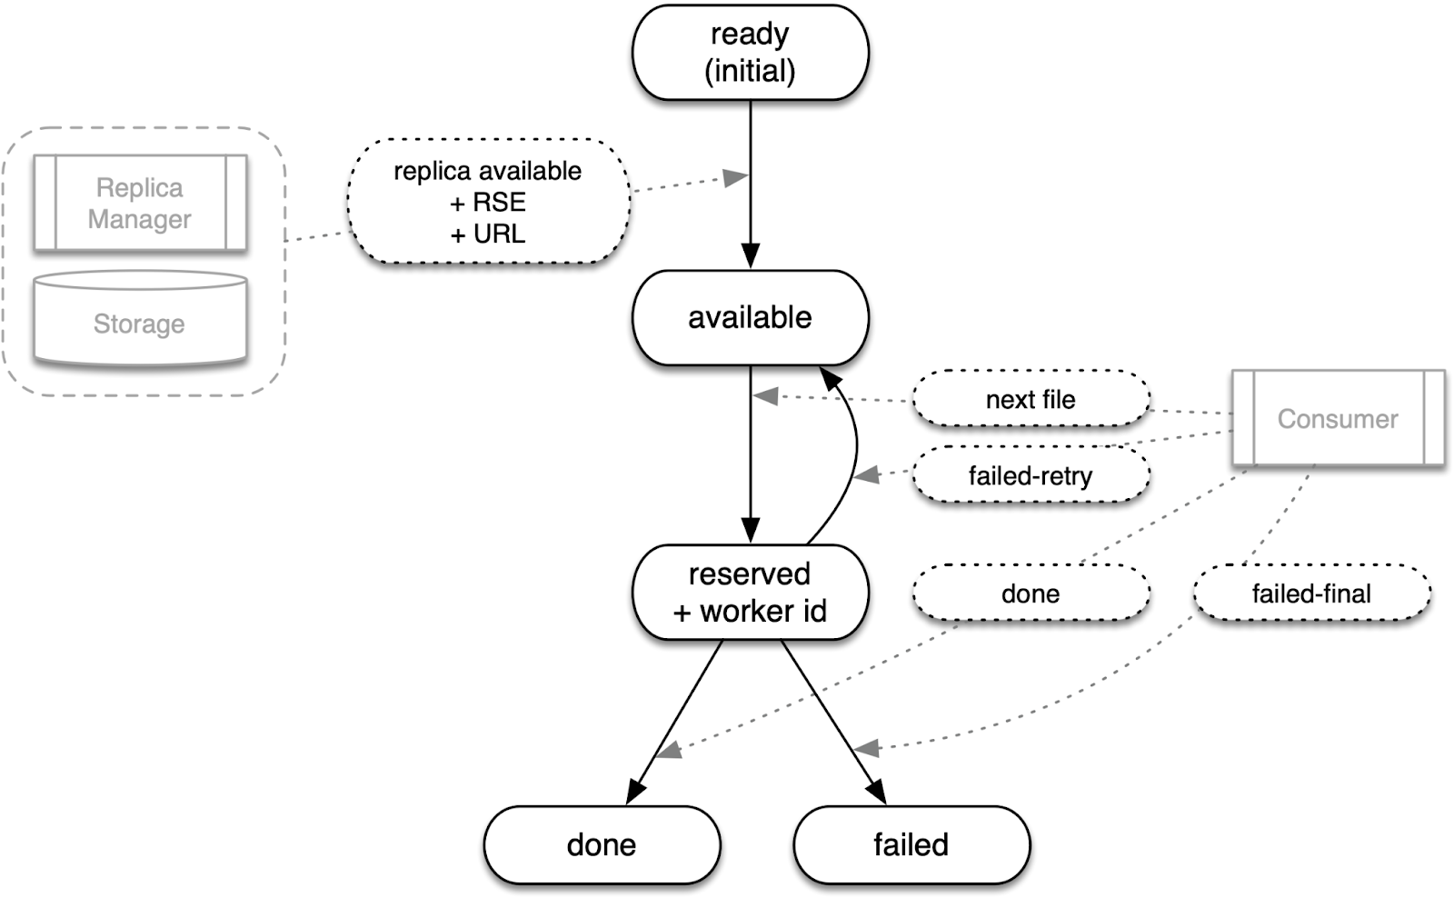
New Components: Data Dispatcher
Workflow and
Data Management
Data Dispatcher
  Currently in beta testing
Provides server to keep track of files in a project
  And when they are available for use
Client calls server to get next file to process,
  Server returns URL of next file which can be streamed or copied to the worker node.
Client notifies server when file is either complete or has failed

Slide 24
ProtoDUNE-II Data Pipeline Configuration
Workflow and
Data Management
Ingest
Daemon
FTS3
Declaration
Daemon
2
1
DAQ
Data
Store
CERN
EOS
CERN
CTA
Red arrows: Control FTS3
Green arrows: Declarations
Yellow arrows: 3rd party xfer
Blue arrows: Data path
Expected
Throughput
10Gbit/s
6
5
FNAL
dCache/
Enstore
Other Storage Elements
MetaCat
3
Rucio
4
FTS3

Slide 25
Challenges Beyond High-Throughput Computing
Workflow and
Data Management
Semi-infinite appetite for GPU and machine learning
  Several stages of DUNE software good fit for GPU but where do we get them from
  Highly constrained power budget underground and limited space to put computers on surface
High appetite for container/Jupyter based analysis
  Column-based store analysis very helpful to some DUNE analyzers already but how do you keep it reproducible/loggable/etc.
  Two container-based analysis facilities already available, one at FNAL, one in Canada organized by York U.
How to handle the extreme I/O intensive merges. (150:1!)
  Disk is getting bigger but not faster. Even SSD’s won’t deliver IOPS we need.
  Tape robots already a bottleneck
Heterogeneous platform execution and validation
  Field has gotten soft from 20 years of RedHat Linux and x86. Pax RedHat is over.
  Need ways to execute and validate the workflow on number of platforms.
Data and Execution Environment preservation—already have published papers.
How to make all this friendly to mobile environments

Slide 26
Summary
DUNE Computing has unique challenges to reconstruct, simulate, and analyze our detector
We have built a global computing consortium and are making good progress with addressing many of those problems
We are grateful not only to the members of our consortium but to many others from the various laboratories who have worked on solving those problems to date.
Also thanks to all those in the various scientific software communities on whose work we are building and on whose shoulders we stand.
Work supported by the Fermi National Accelerator Laboratory, managed and operated by Fermi Research Alliance, LLC under Contract No. DE-AC02-07CH11359 with the U.S. Department of Energy

