Slide 1
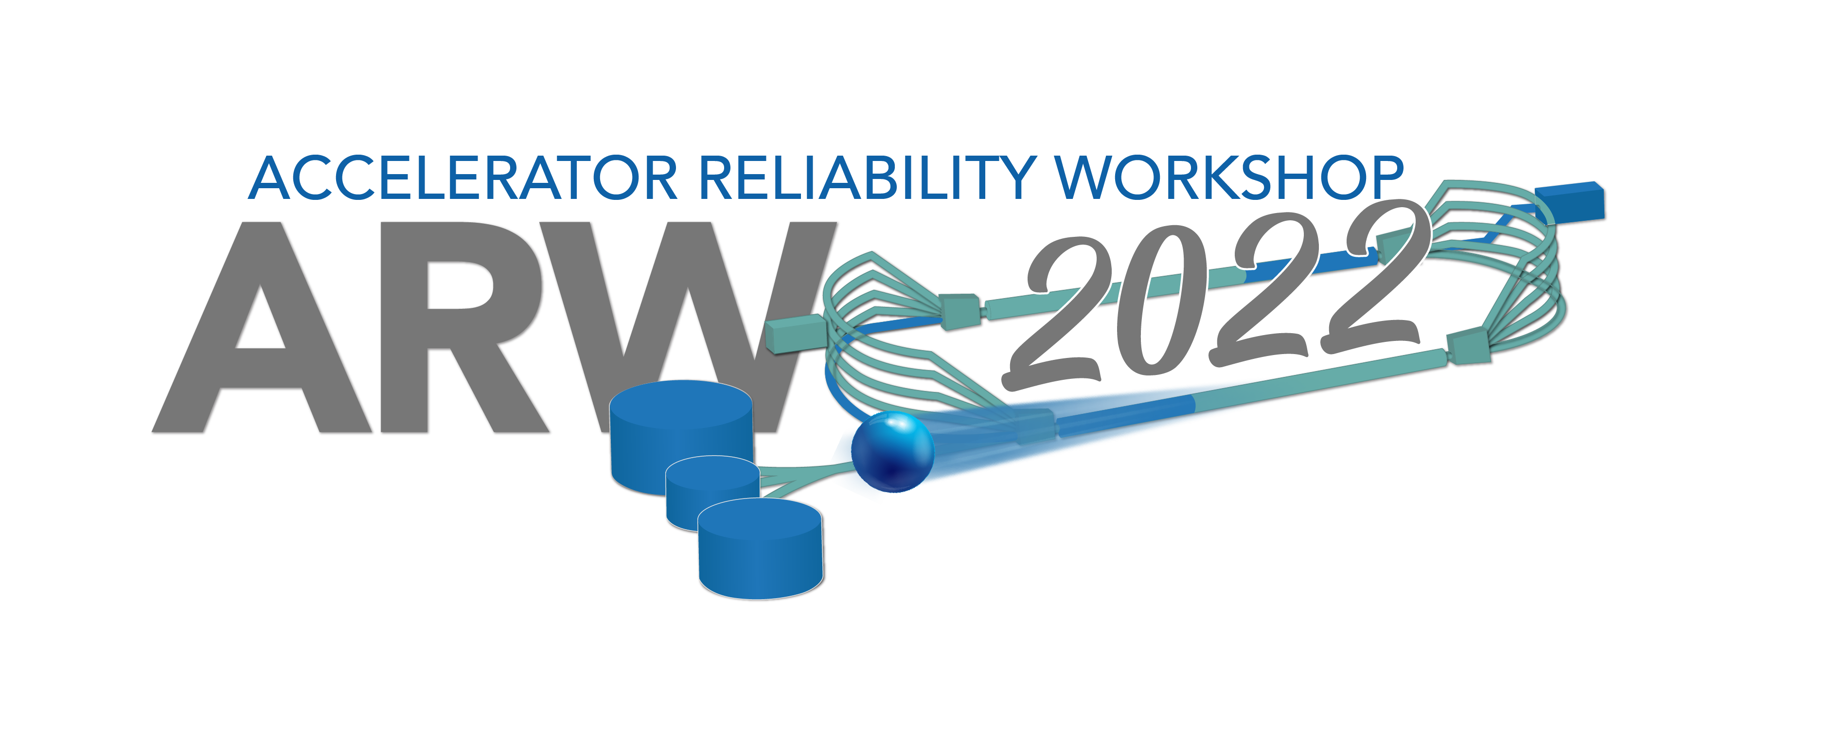
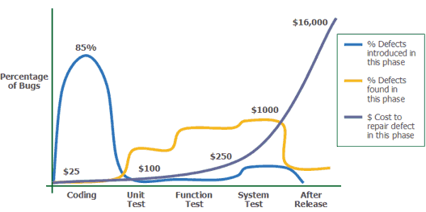
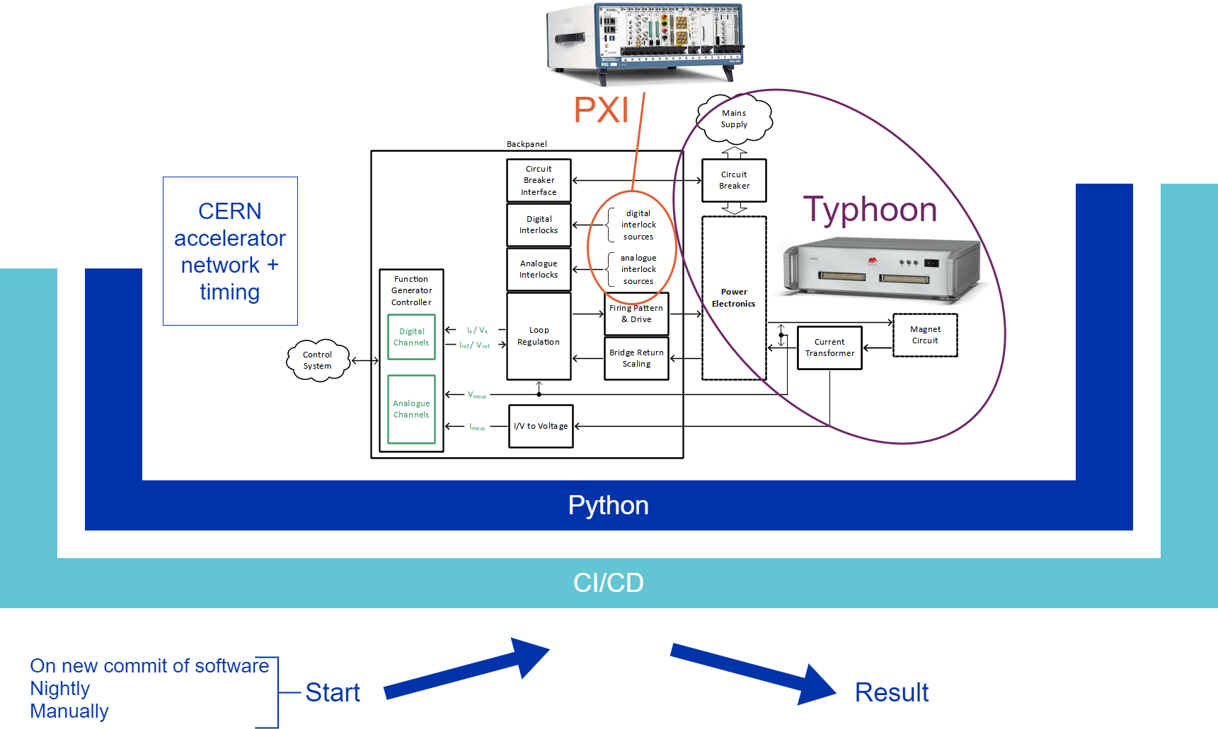
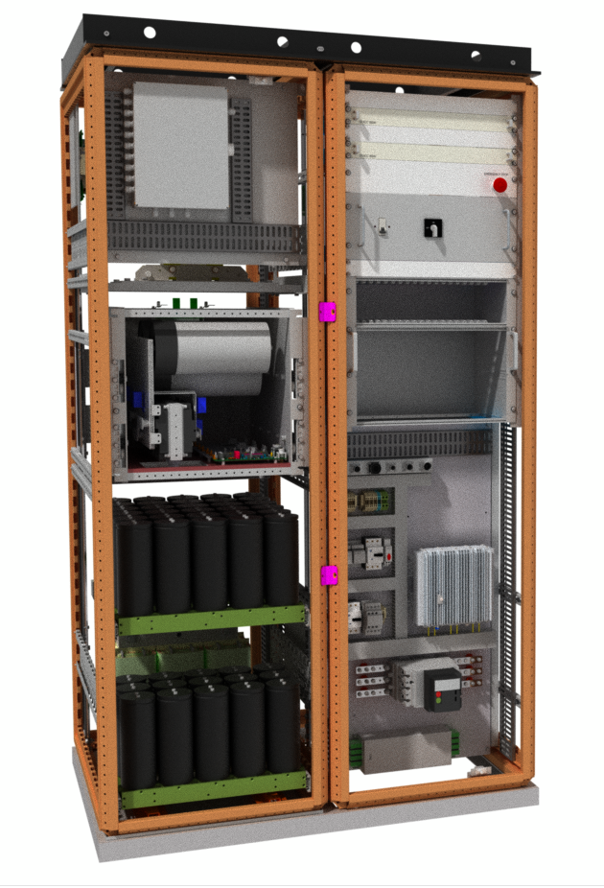
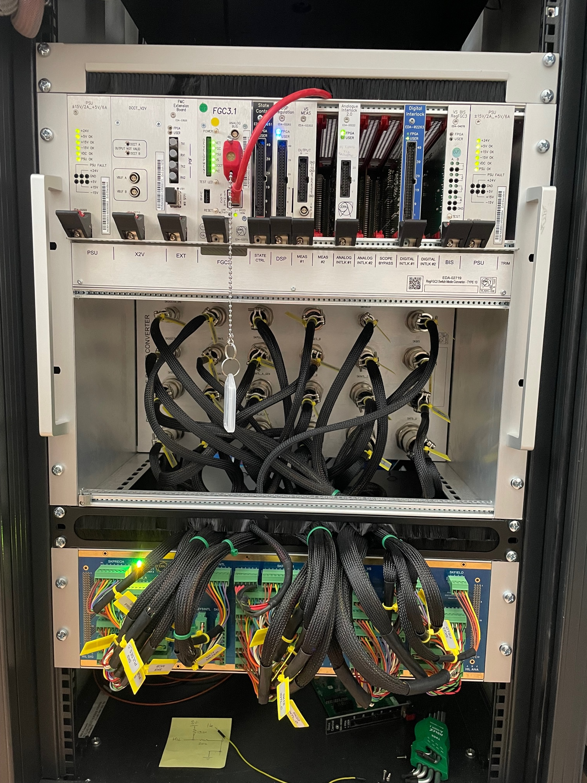
Real time emulation of power systems as a tool to improve Accelerator reliability
P. Haynes (peter.haynes@cern.ch), R. Grimmer, Z. Karagiannidou, D. Nisbet; CERN, Switzerland.
Introduction
Around 5000 power converters provide current to magnets in CERN’s accelerators, transfer lines and experimental areas. Converters range from 1W to 10MW; each is controlled by a dedicated converter controller which provides homogenous software interfaces to the accelerator control systems, and has diverse hardware and programmable logic implementations. A typical converter controller is composed of a Function Generator / Controller (FGC) with regulation extensions (RegFGC3)¹ matching the converter’s specific needs. This results in ~130 hardware combinations and ~100 programable logic configurations, all controlled by dedicated software classes. New software and programmable logic are frequently released, adding features, and improving performance; these require testing before being deployed to operational devices.
Testing presents a complex challenge: incompatibilities and regression can occur during the development of new software and programmable logic. To prevent deploying defective software or logic into the accelerator, it is necessary to test at a system level. A test fixture has been designed to emulate a range of power converters allowing system testing to be undertaken across a wide range of controls.
Software Testing Methodologies
Testing and Deployment Process
Software engineering has embraced test-driven development, unit testing, automated testing² and other tools to find defects earlier in the development cycle.
Using a defined, staged release process migrates risk away from the deployment and operation phases of a project and ensures higher reliability of the final product.
Our aim was to apply this methodology to hardware testing³. Typically system testing is realised in a laboratory which can be expensive and time consuming; by introducing an emulated testing stage in the development cycle we minimise the cost of testing. Automating and running this stage with every commit of software means that regressions can be found and resolved more quickly.
Applied Software Measurement, Capers Jones, 1996
Unit testing
Tests functions or IP blocks
Tested on a server
Validates function against specification
Cost, Space required,
Complexity
Simulation
Tests functions relating to one function - regulation
Tested in limited hardware
Validates current loop regulation performance
Emulated testing
Tests that functions work together - as a system
Tested with controller hardware
Validates controller at a system level
Laboratory testing
Tests that functions work together - as a system
Uses a physical converter
Validates specific, difficult to emulate functions
Test Framework
Emulating a power converter
PXI used to emulate non regulation signals such as safety interlocks
For greatest test coverage, an emulated system must accurately represent the target system. A Typhoon Hardware In the Loop (HIL) system is used for real-time emulation of the converter.
The Device Under Test (DUT) is connected to the CERN accelerator network, allowing timing and reference values to be sent to the controller as they are in the accelerator.
Models for thyristor converters, Modular Multi-level Converters and other voltage-controlled voltage sources have been developed in Typhoon to represent the converters used in the CERN accelerator complex.
Utilising existing CERN Python tools, a wrapper layer was created to interact with the Typhoon, the PXI and the converter controller. This layer conducts the testing with tests running in an order proportional to the risk i.e.
Failure of any test prevents future tests running to ensure that defects are not masked and are immediately addressed.
DUT
A continuous integration - continuous development (CI/CD) implementation is used to manage the running of the tests nightly, on demand or manually. The same system is used to package the Python test framework and to compile the real time models in virtual ‘Docker’ machines. The CI/CD also ensures that it is possible to trace and recreate the software elements of the test fixture.
The CI/CD service triggers the Dockers to build and compile. Once this is done, it notifies daemons on the PXIs to run the tests of the emulated converters. Where many tests require the same physical hardware, these are scheduled by the CI/CD service.
Initialisation
Safety Interlocks
Accelerator Interface
Regulation
Example of an Emulated CERN Power Converter
SIRIUS⁴ (shown left) is a widely used CERN developed converter, capable of delivering ±450V and ± 200A, and is an example of a converter which has been emulated.
Typhoon models are compiled into optimised mathematical models. During operation, the signal inputs and outputs of the HIL connect to variables in the mathematical model allowing the HIL to emulate power converters.
The developed models do not represent the converters exactly as this would complicate the
A bespoke interface unit (shown right bottom) was designed to adapt the electrical signals between the Typhoon HIL, the PXI and the converter controller (top of image). This conditions the signals so they match those present in a physical converter and they are within the range of the instruments input-output specifications.
models and require considerably more resource to develop. Differences between the physical converter and the models have been studied to ensure the simplified model remained valid.
Conclusions
Software engineering methodologies have been applied at a system level to continually test CERN power converter controllers. Having these test fixtures available and running tests nightly has been shown to detect defects sooner and reduces the reliance on expensive testing with physical converters.
Tools normally used for software development were used to accelerate the deployment of the test fixture and reduce its cost. Ensuring that the test fixture recreates the power converter and accelerator environment as closely as possible has led to high test coverage and has given the test results more qualitative value. As a result, there is now high confidence that deployments of code to the converter controllers will not regress their functionality resulting in accelerator down time.
Emulated testing could be applied to other systems in an accelerator complex, allowing them to benefit from increased reliability. Additionally having a defined, staged release process and testing methodology where software is tested at a unit level before being tested in an emulated environment and subsequently in a test lab environment, would also increase reliability.
Future Developments
Increase test coverage with models of more of CERNs families of power converters
Test the controller in each of the separate timing environments of the CERN accelerators
Develop an accessible-to-all method of starting tests on selected emulated converters
References
[1] M. Di Cosmo and B. Todd, The new modular control system for power converters at CERN, ICALEPCS (2015)
[2] O. Elazhary, C. Werner, Z.S. Li, D. Lowlind, N.A. Ernst and M. Storey, Uncovering the benefits and challenges of continuous integration practices, IEEE Trans. Software Eng. (2021) 7–8
[3] G. Cabrera and R. Grimmer and P. Haynes and D. Nisbet, A system test platform for the {CERN} power converter control electronics, IOP, JINST 17 C05009
[4] K. L. Haugen, K. Papastergiou, P. Asimakopoulos and D. Peftitsis, "On dimensioning the fundamental brick for a scalable DC-DC converter with energy recovery," 2021 23rd European Conference on Power Electronics and Applications (EPE'21 ECCE Europe), 2021, pp. P.1-P.10, doi: 10.23919/EPE21ECCEEurope50061.2021.9570676.

