Slide 1
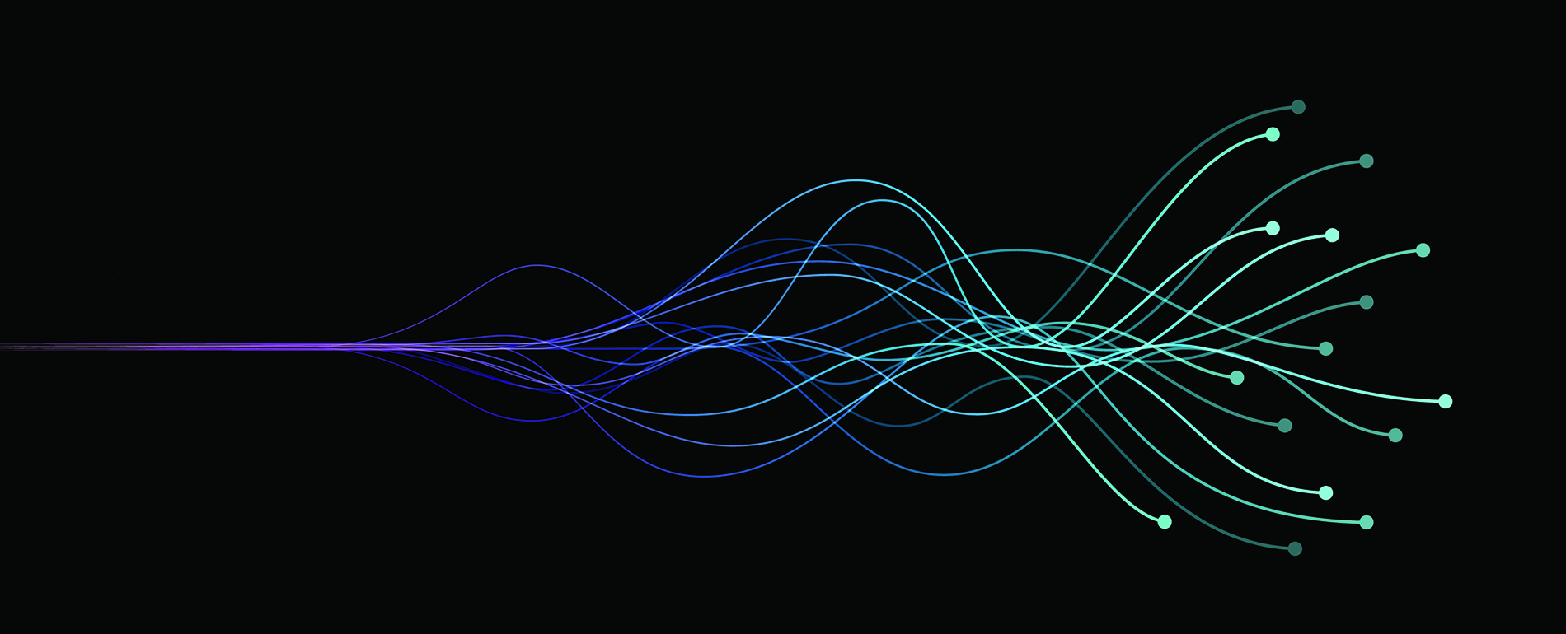
Toward More Efficient Accelerator Tuning with Deep Learning
Chris Tennant | Jefferson Lab

Slide 2
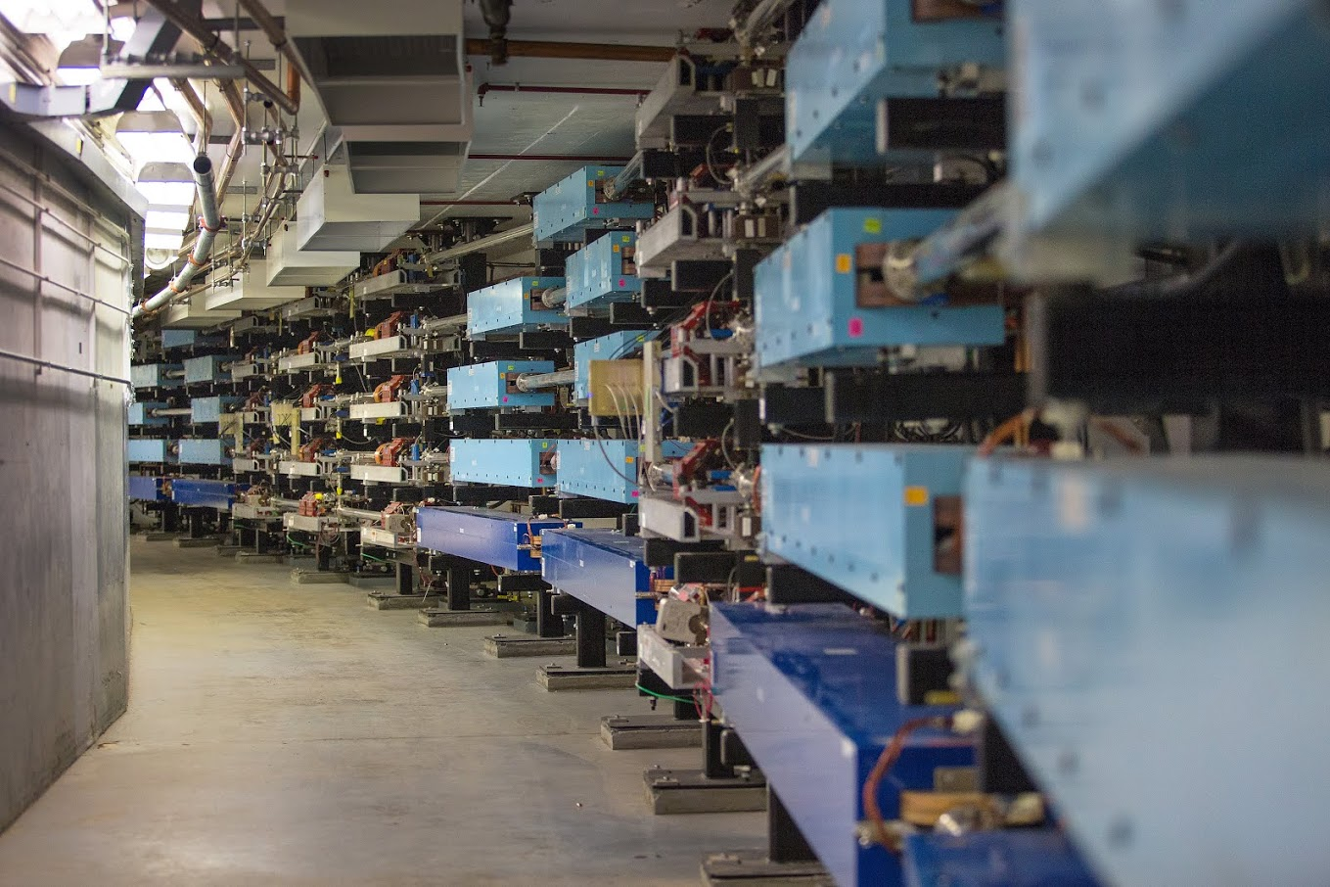
Outline
leverage deep learning on graph representations of a beamline in order to create a tool for improving the efficiency of beam tuning tasks
Introduction
graphs, whole-graph embeddings
Motivation
application for beam tuning
Method
representing a beamline as a graph
graph neural networks (GNNs)
Results
embeddings, beam test, monitoring stability
Future Work
Tennant

Slide 3
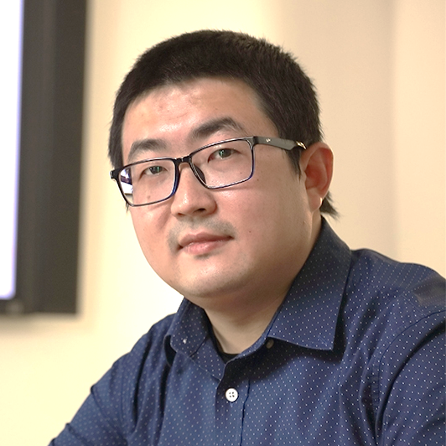
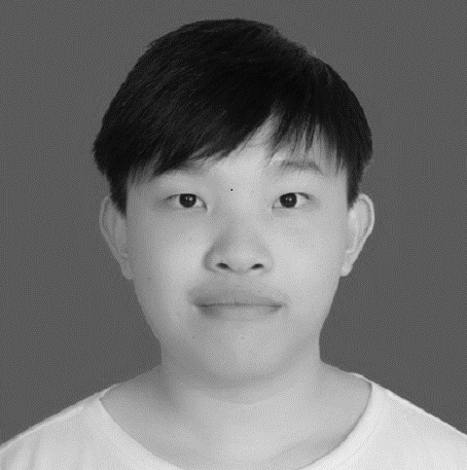
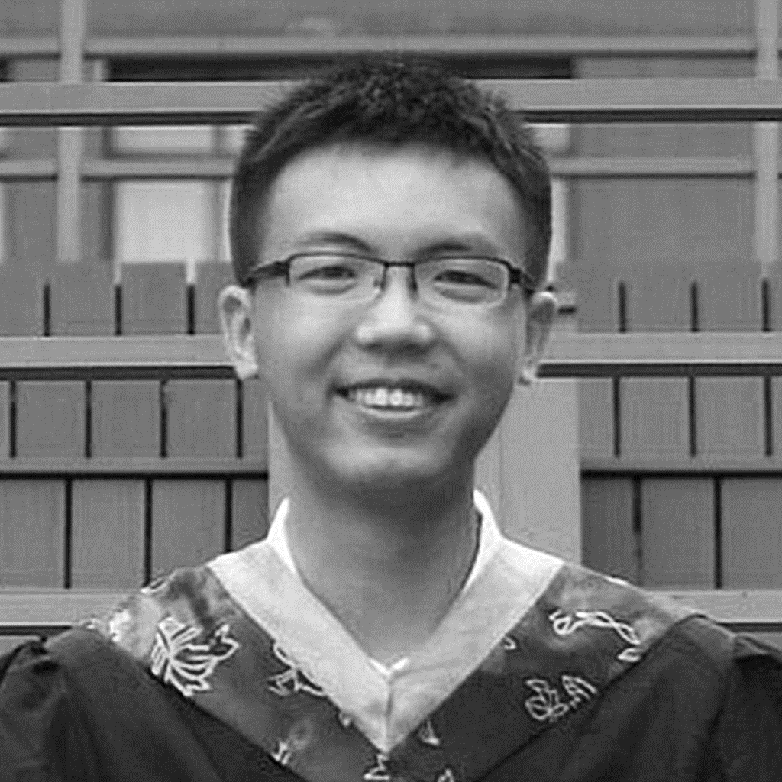
Acknowledgements
Theo Larrieu and Daniel Moser
Dr. Jundong Li Song Wang Zhiming Xu
Tennant

Slide 4
Introduction: What is a Graph?
graphs are a general language for describing and analyzing entities with relations/interactions
Tennant
(courtesy X. Bresson)

Slide 5
Introduction: Whole-Graph Embedding
represent the state of a beamline at a specific date and time as a graph
embed graph into 2- or 3-dimensions using a graph neural network (GNN)
a GNN provides a framework for defining a deep neural network on arbitrary graph data
Tennant

Slide 6
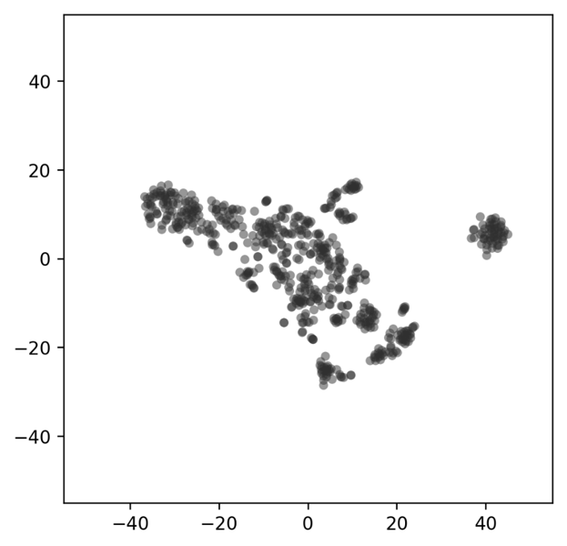
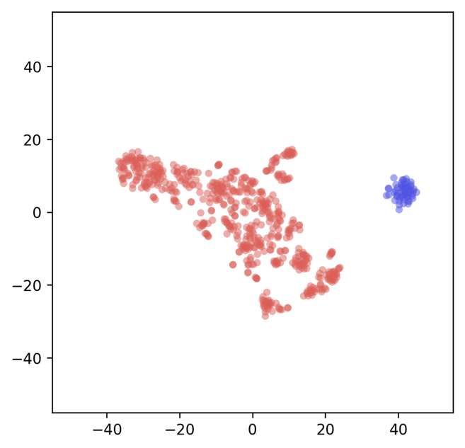
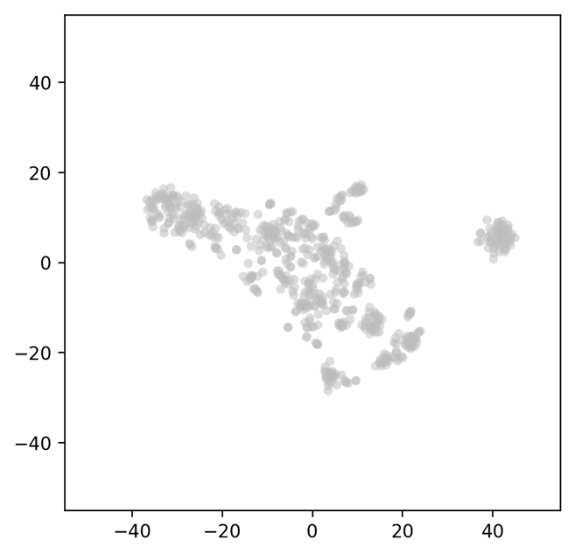
Motivation: Application for Beam Operations
visualize the underlying distribution/pattern of beamline states
use cluster analysis to identify regions of parameter space
make changes to machine and observe trajectory in latent space
good
5
6
4
7
bad
3
1
2
provides a data-driven framework with visual feedback to more quickly converge to known optimal beamline configurations
Tennant

Slide 7
Method: Beamline-to-Graph
1.25 m
2.15 m
1.15 m
0.90 m
1.15 m
quad A
cavity A
BPM A
quad B
quad C
BPM B
BEAMLINE
GRAPH
X position | -1.4685e+00
Y position | 1.0382e+00
A
A
strength | 2.612e+04
strength | 4.6428e+02
C
A
gradient | 7.0000e+00
phase | -1.5601e+02
B
B
= quadrupole magnet
= accelerating cavity
strength | -7.6428e+02
X position | 0.9543e+00
Y position | 1.0034e+00
= beam position monitor (BPM)
Tennant

Slide 8
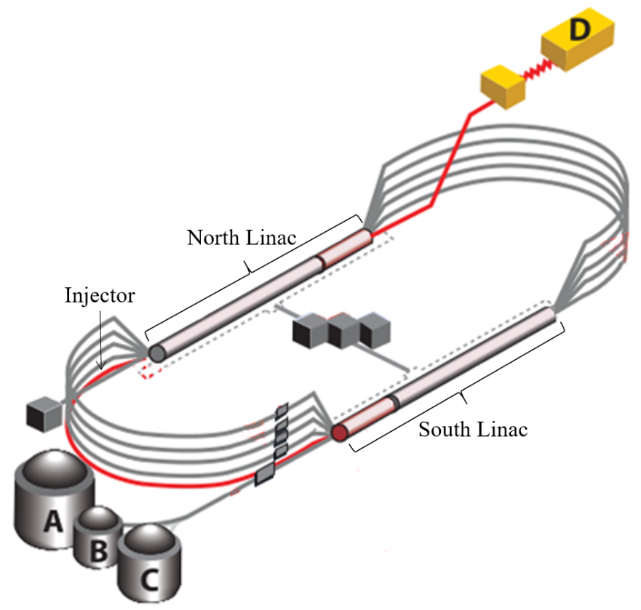
Method: Beamline-to-Graph
CEBAF is a CW recirculating linac utilizing 418 SRF cavities to accelerate electrons up to 12 GeV through 5-passes
consider a 95 m portion of the injector
software developed so that:
given a date and time stamp, a beamline is defined from the CEBAF Element Database (CED)
node features are populated by process variables (PVs) stored in the operational archiver
each graph: 11 node types, 206 nodes, 296 node features, and 409 edges
Dataset Name | Number of Graphs | Number of Edges | Labeled?
2021 | 2,129 | 2 | N
Good Setups | 354 | 2 | Y
Bad Setups | 354 | 2 | Y
January 2022 | 352 | 2 | N
info.dat
defines the node types
meta.dat
lists the number of each node type in the graph
node.dat
[node ID, node name, node type, node attributes]
link.dat
[start node ID, end node ID, edge type, edge weight]
Tennant

Slide 9
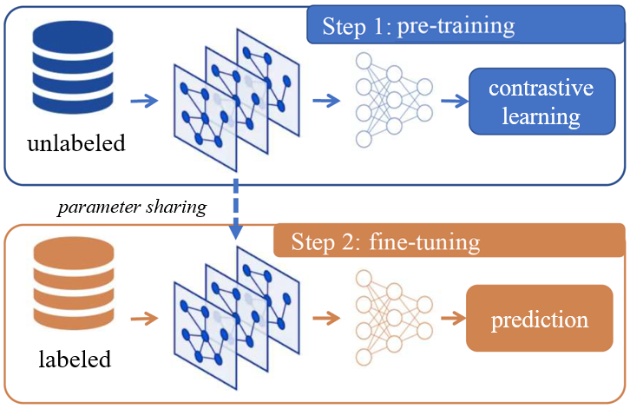
Method: GNN Model Training
pre-training the model on a large set of unlabeled data using a technique called self-supervised learning (SSL)
tries to learn as much as possible from the data alone
take advantage of years of operational data stored in the archiver without having to do the expensive task of hand labeling the data
a special class of loss function, known as contrastive loss, maximizes agreement between latent representations from similar graph pairs while minimizing agreement from unlike pairs
fine-tune the model on the downstream task of classifying good and bad setups using a smaller labeled dataset
a dimensionality reduction to visualize the results in 2D
this same basic workflow is being leveraged to produce state-of-the-art results in natural language processing and vision tasks
Tennant

Slide 10
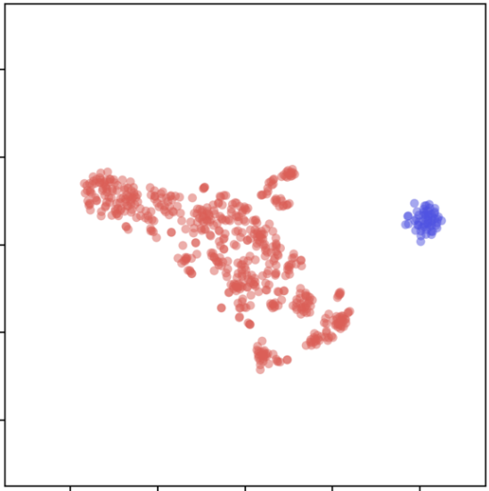
Applications
enable data exploration (identifying trends and patterns)
Represent accelerator beamline as a graph
Pre-train a GNN in a self-supervised way
Fine-tune the GNN on a smaller set of labeled data
Scheduled training to maintain performance over time
good
gain insight into relationships between beamline components (via GNN attention weights)
bad
identify good and bad regions of parameter space
On-line Tool: provides near real-time feedback on effect of tuning changes
Off-line Tool: more efficient means to optimize a beamline (does not require valuable and limited machine time)
Monitor Stability: plot the beamline configuration in latent space over time
Tennant

Slide 11
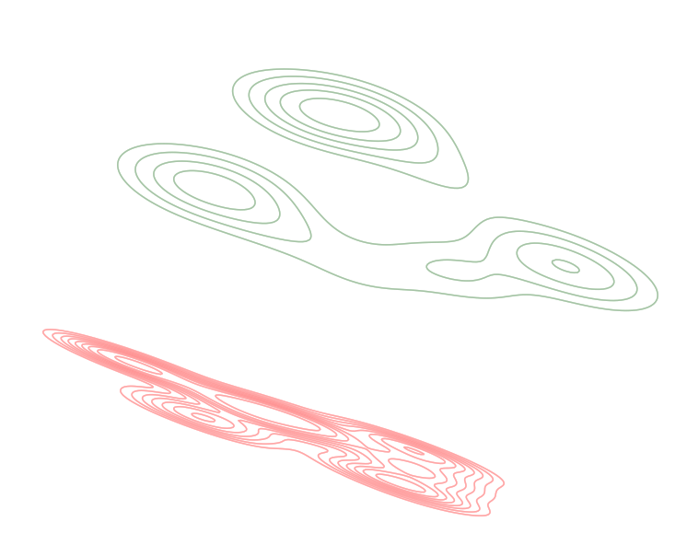
Results: Embeddings
a GNN encoder pre-trained on the 2,129 unlabeled graphs from 2021
model fine-tuned on the smaller set of labeled (354 good, 324 bad) graphs
good
bad
Tennant

Slide 12
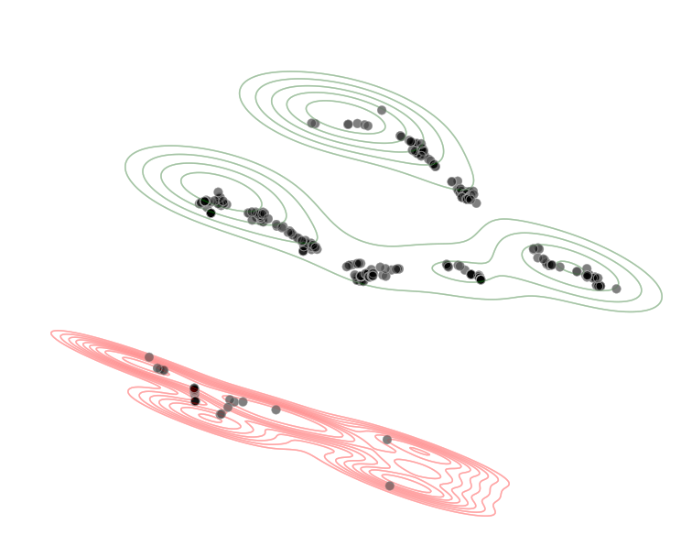
Results: Embeddings
a set of 352 unlabeled graphs representing operations in January 2022 were input to the model and their resulting latent representations plotted
good
bad
Jan. 2022
Tennant

Slide 13
Results: Exploring Model Performance
Setting | GNN (2-edges) | MLP (2-edges) | GNN (5-edges) | GNN (5-edges, directed)
Edge Removal | 0.9225 | 0.8612 | 0.9008 | 0.7798
Feature Removal | 0.9037 | 0.8483 | 0.6992 | 0.7302
Feature Shuffling | 0.9876 | 0.8417 | 0.7752 | 0.7307
No SSL | 0.8663 | 0.8512 | 0.8047 | 0.7380
a GNN outperforms an MLP
preserving structural information greatly enhances performance
too many edges causes performance to deteriorate
may be due to feature over-smoothing
directed edges degrade performance
by construction, edges end on reading nodes → information is not conveyed to other nodes
pre-training in a self-supervised way leads to a more accurate final model
especially when limited, labeled data is available
Tennant

Slide 14
Results: Proposed Beam Test
5
6
4
7
7
3
1
1
2
migrate from one injector setup to another in a methodical, incremental way
use graph embeddings to visualize trajectory through latent space (off-line)
start with a saved injector configuration from Feb. 8, 2022 and make 63 small, incremental changes (starting downstream and working upstream) to reach a configuration from Aug. 30, 2022
Tennant

Slide 15
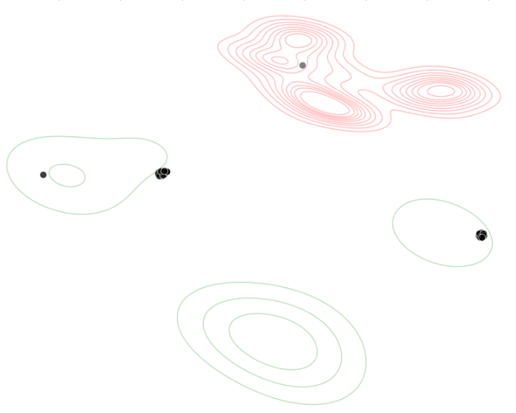
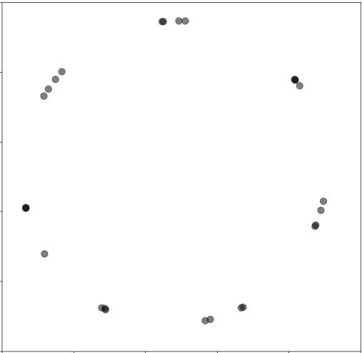
Results: Injector Configuration Change
All-Save
02-08-2022
All-Save
08-30-2022
Tennant

Slide 16
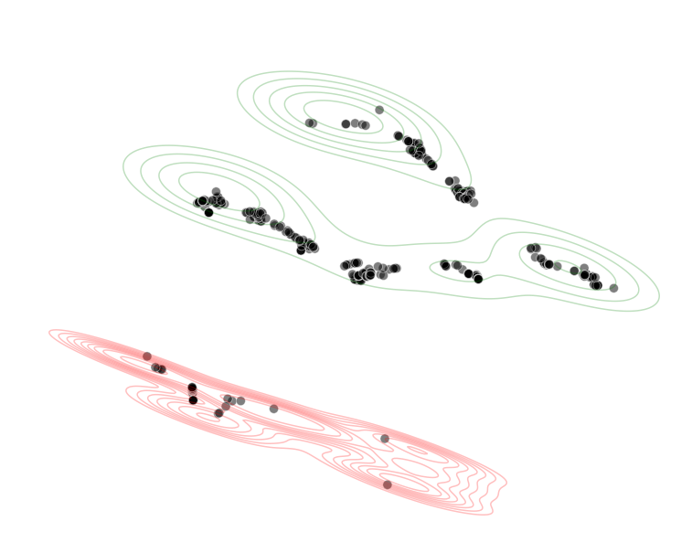
Results/Future Work: Addressing Reproducibility and Stability
embeddings provide a way to measure the reproducibility of the machine in a quantifiable way → use an appropriate distance metric in the latent space
embeddings provide a way to monitor system stability
it’s trivial to track one PV over time, but this work provides a means to track a 296-dimensional space over time
consider a tool where a user defines a bounding box of stable/good running → in the background, the beamline configuration is queried every minute, a graph generated, embedded in the latent space, and an alert is sent to operators anytime the system crosses the boundary
can think of it as a “global diagnostic”
Tennant

Slide 17
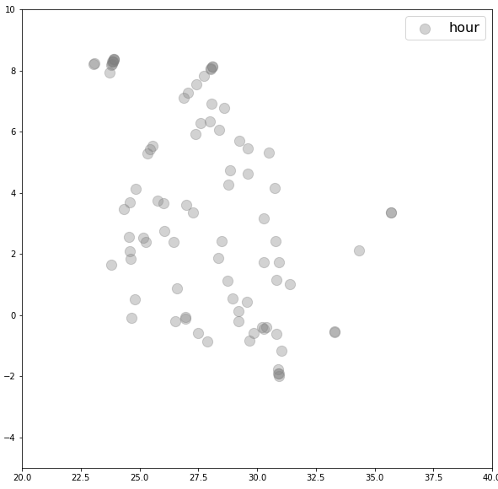
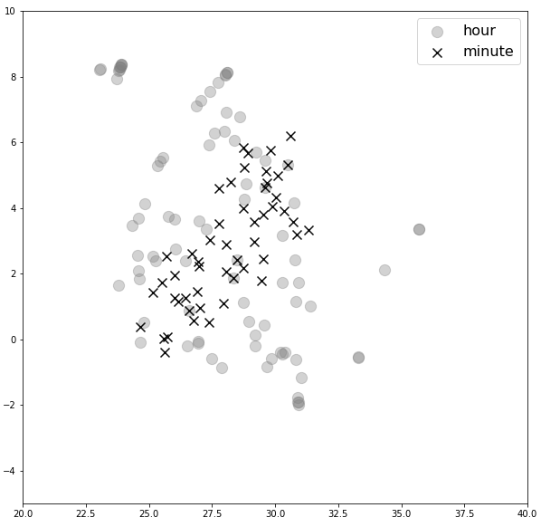
Results/Future Work: Monitoring Stability
identify a period of stable running and observe associated embeddings
current (μA)
16 hours
16 hours
50 minutes
machine trips
Tennant

Slide 18
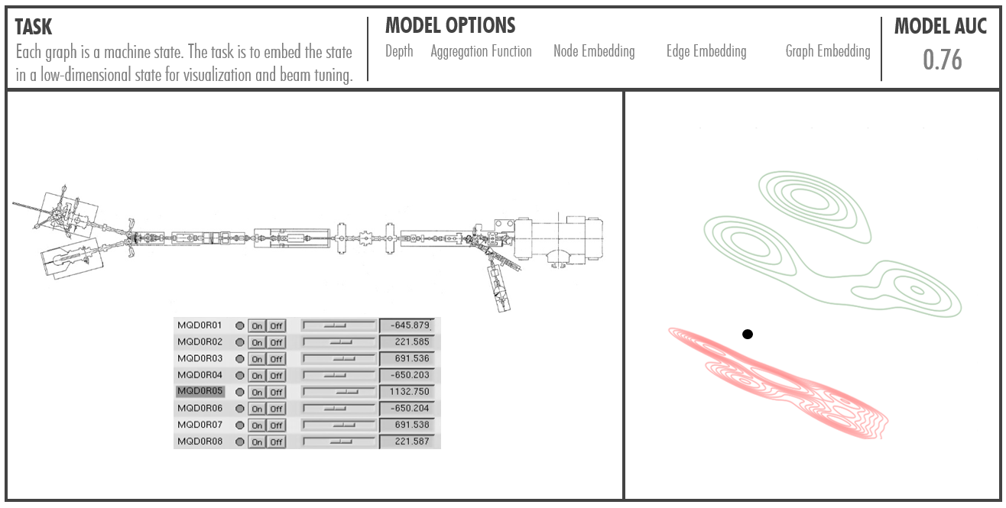
Future Work: Off-line Tuning
a user can change setting nodes (left panel) and the resulting beamline state is converted to a graph, embedded, and visualized (right panel)
represents a data-driven approach to converge on settings to place the machine state in an optimal region of parameter space
the optimization can be done by hand, using a conventional optimizer, or RL
input graphs must be modified and have reading nodes re-moved
Tennant

Slide 19
Summary
the objective is to leverage deep learning on graph representations of a beamline in order to create a tool for improving the efficiency of beam tuning tasks
encouraging results motivates continued study in this area
developed software to represent a beamline as a graph
developed software to train a GNN
embeddings show clear distinction between good and bad regions in latent space
results of beam test show demonstrated visualizing beamline changes as trajectories in latent space
shows utility for tracking system stability
potential for a powerful off-line tuning tool
provide interpretable explanations
this represents a general framework applicable to any arbitrary beamline
Tennant

Slide 20
Thank You.
tennant@jlab.org

