Slide 1
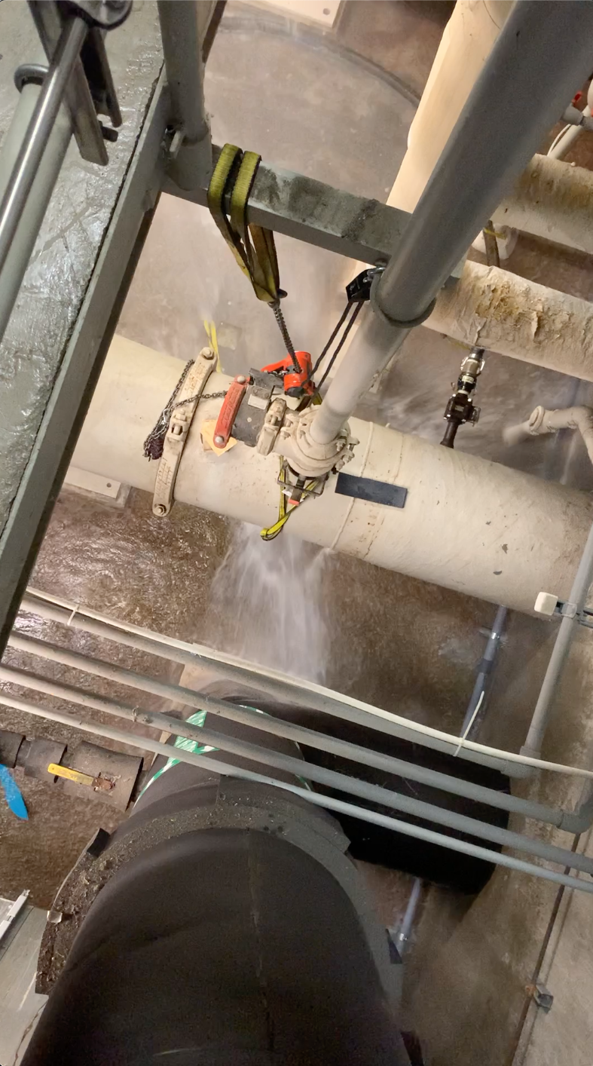
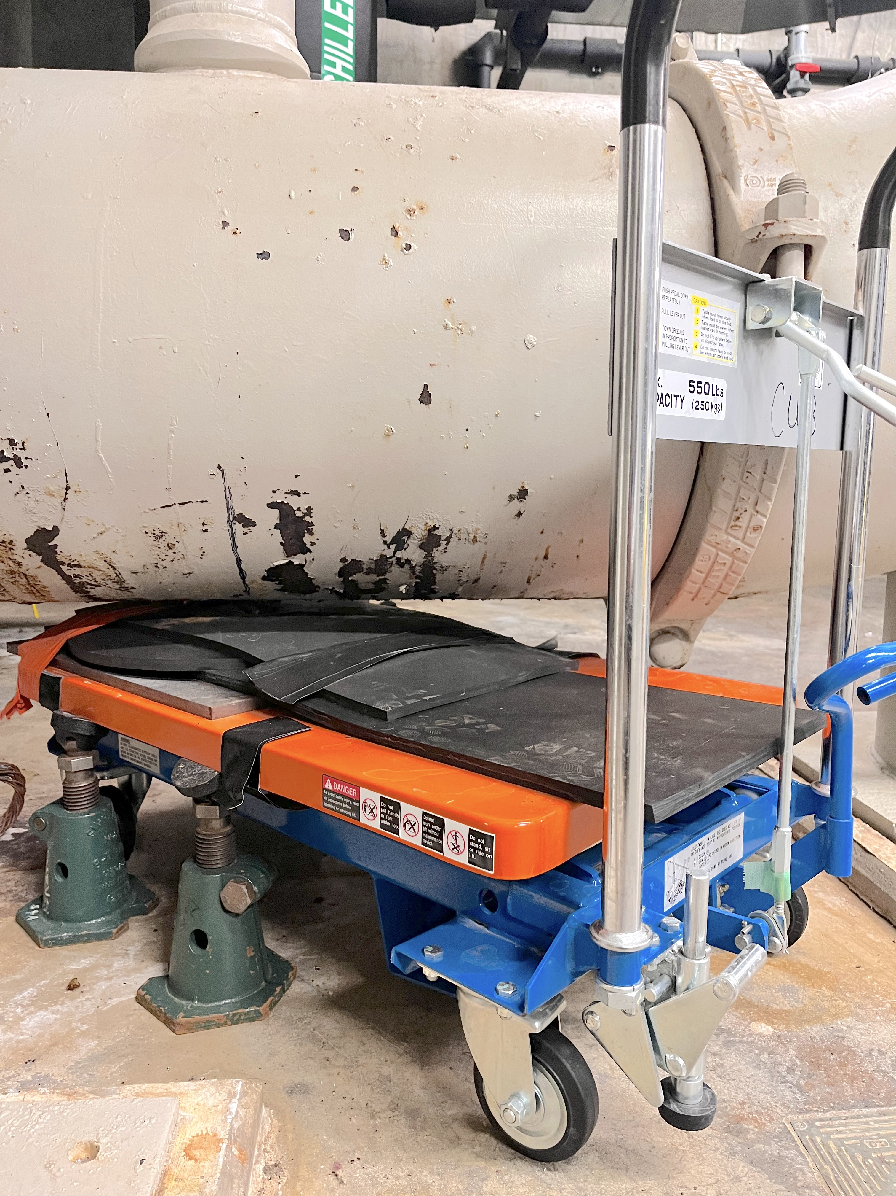
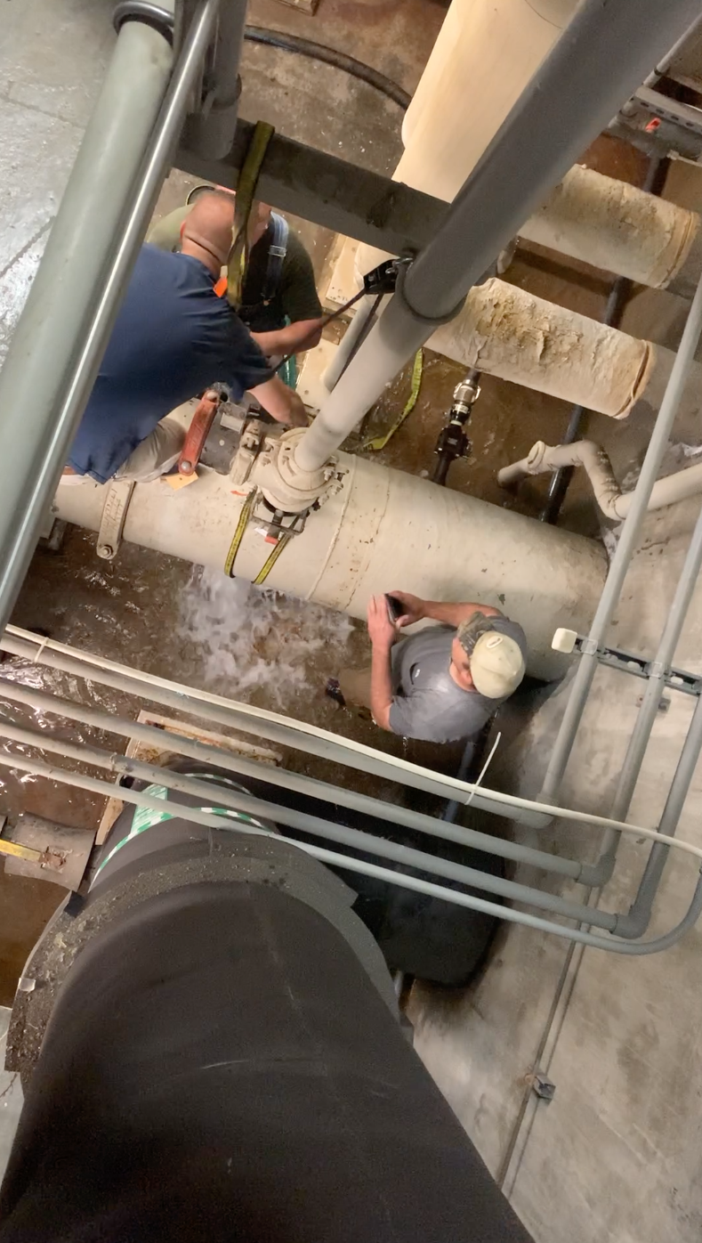
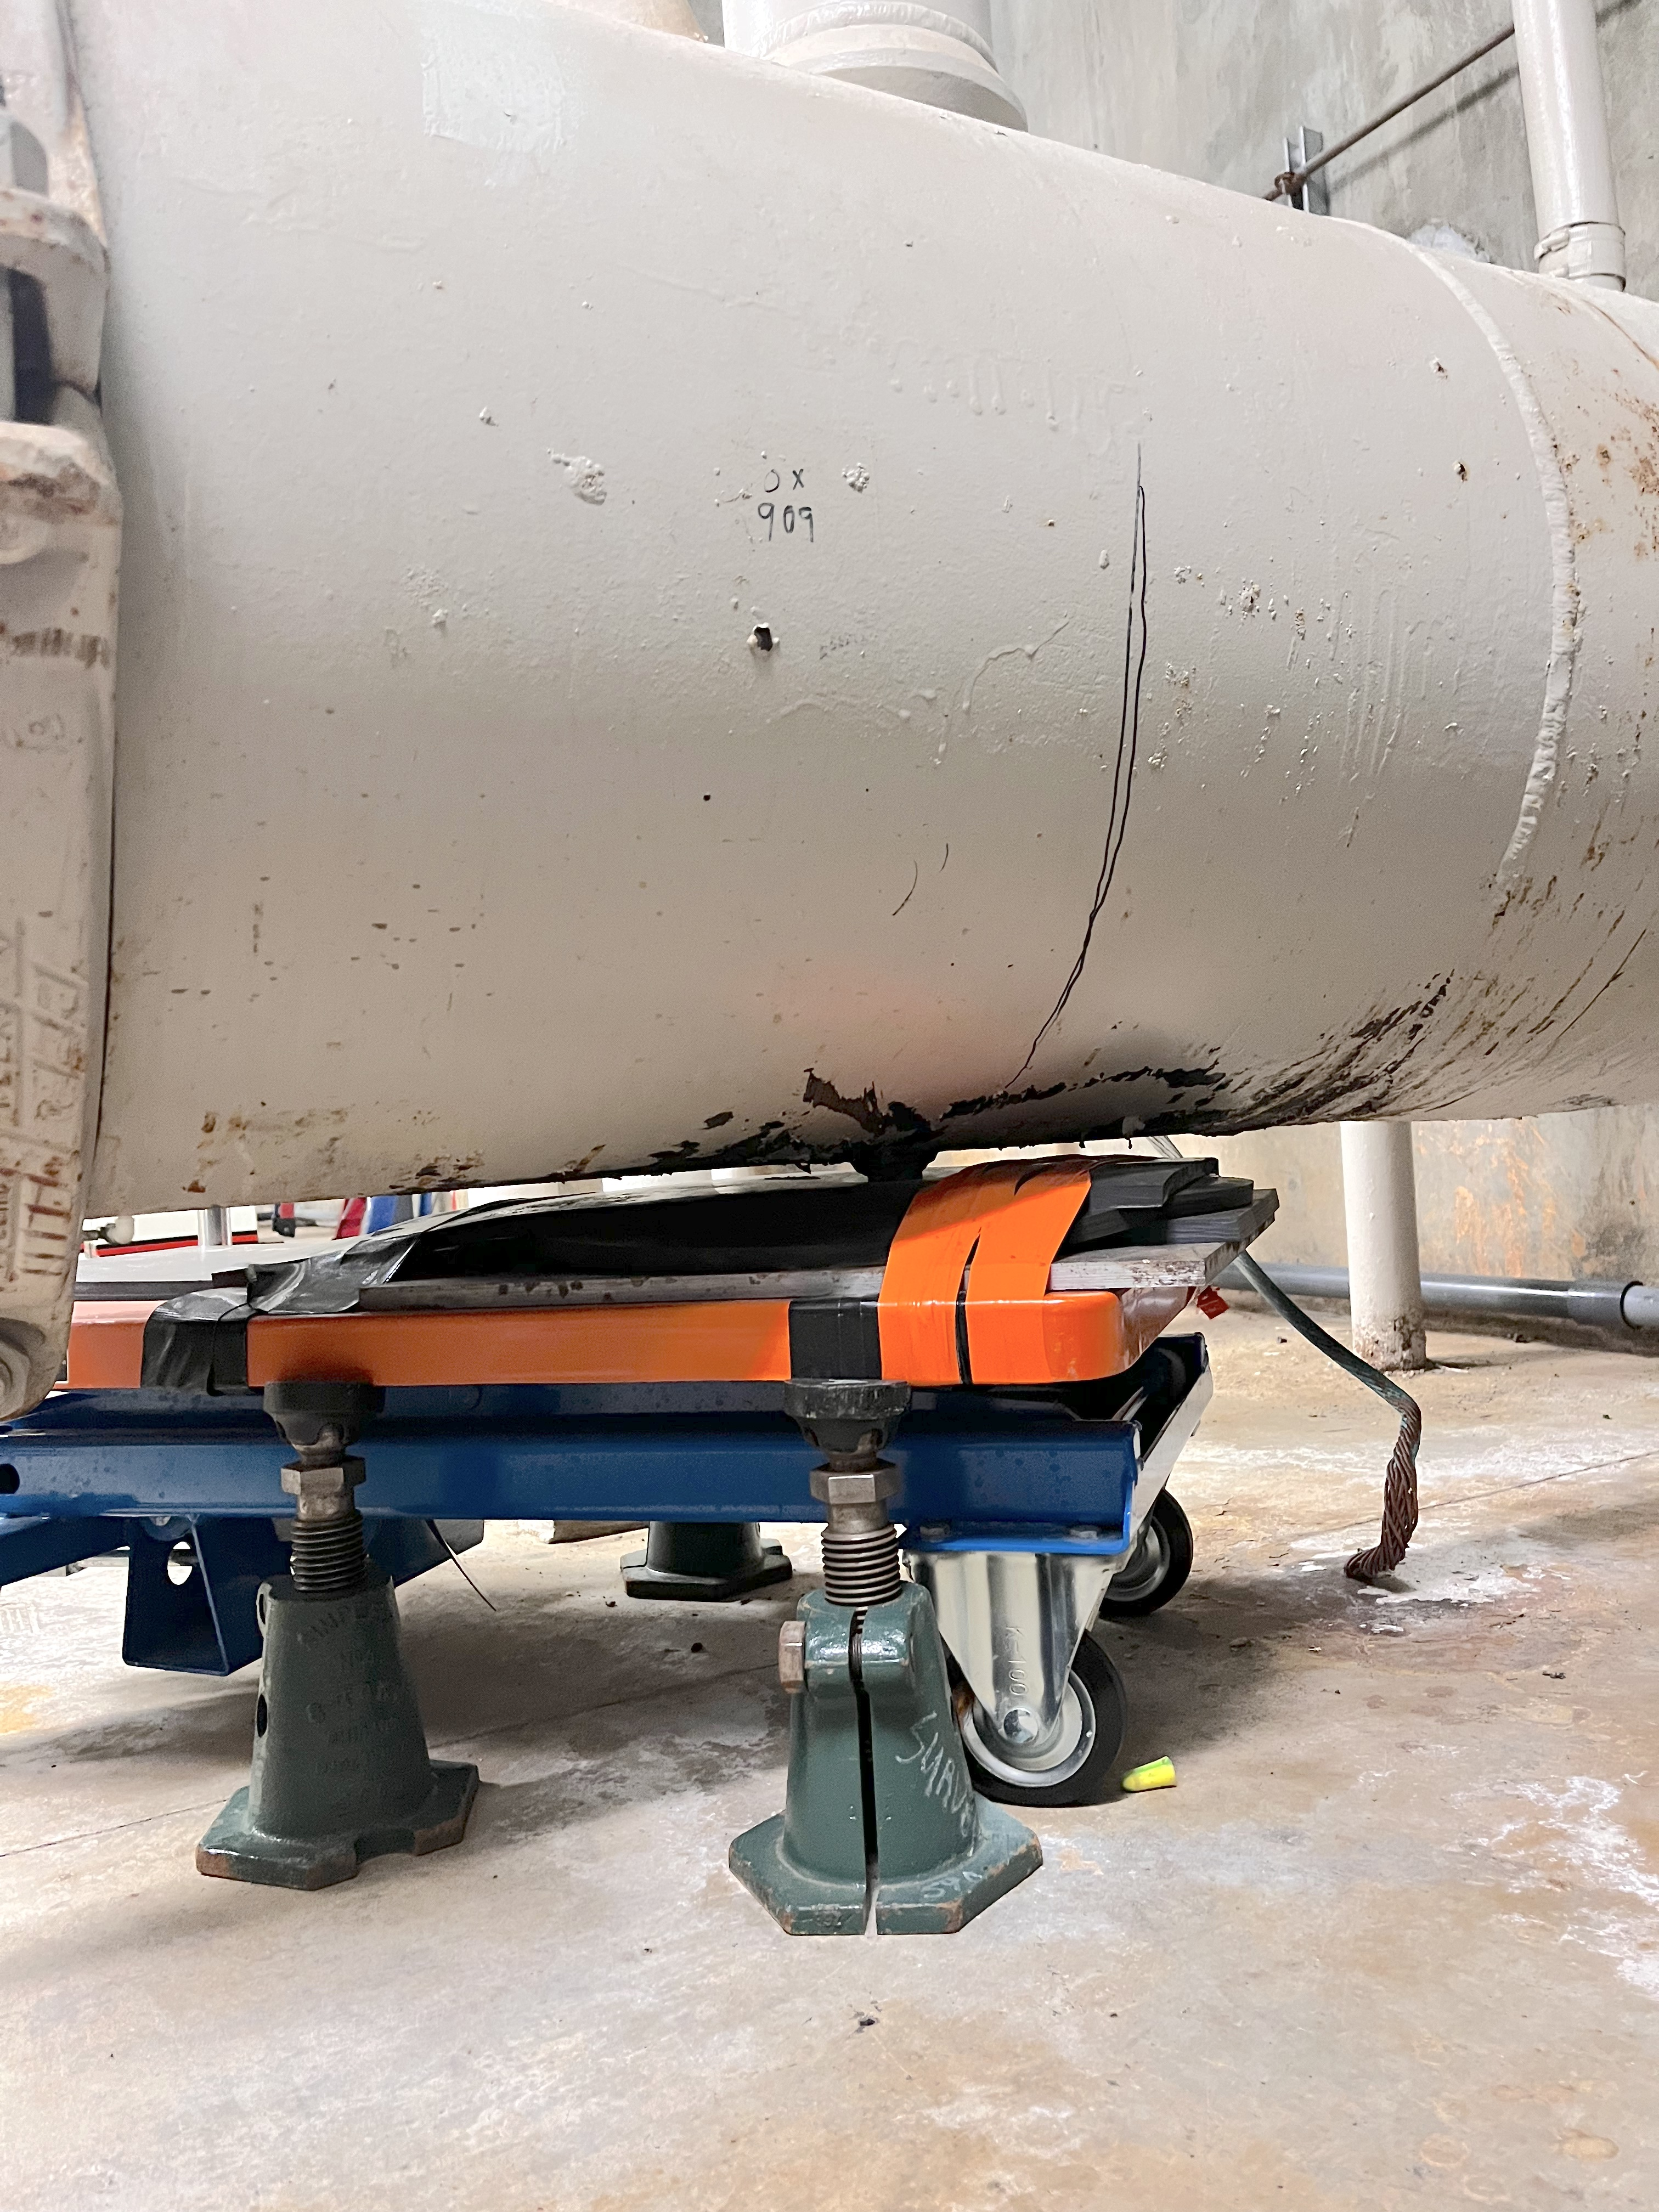
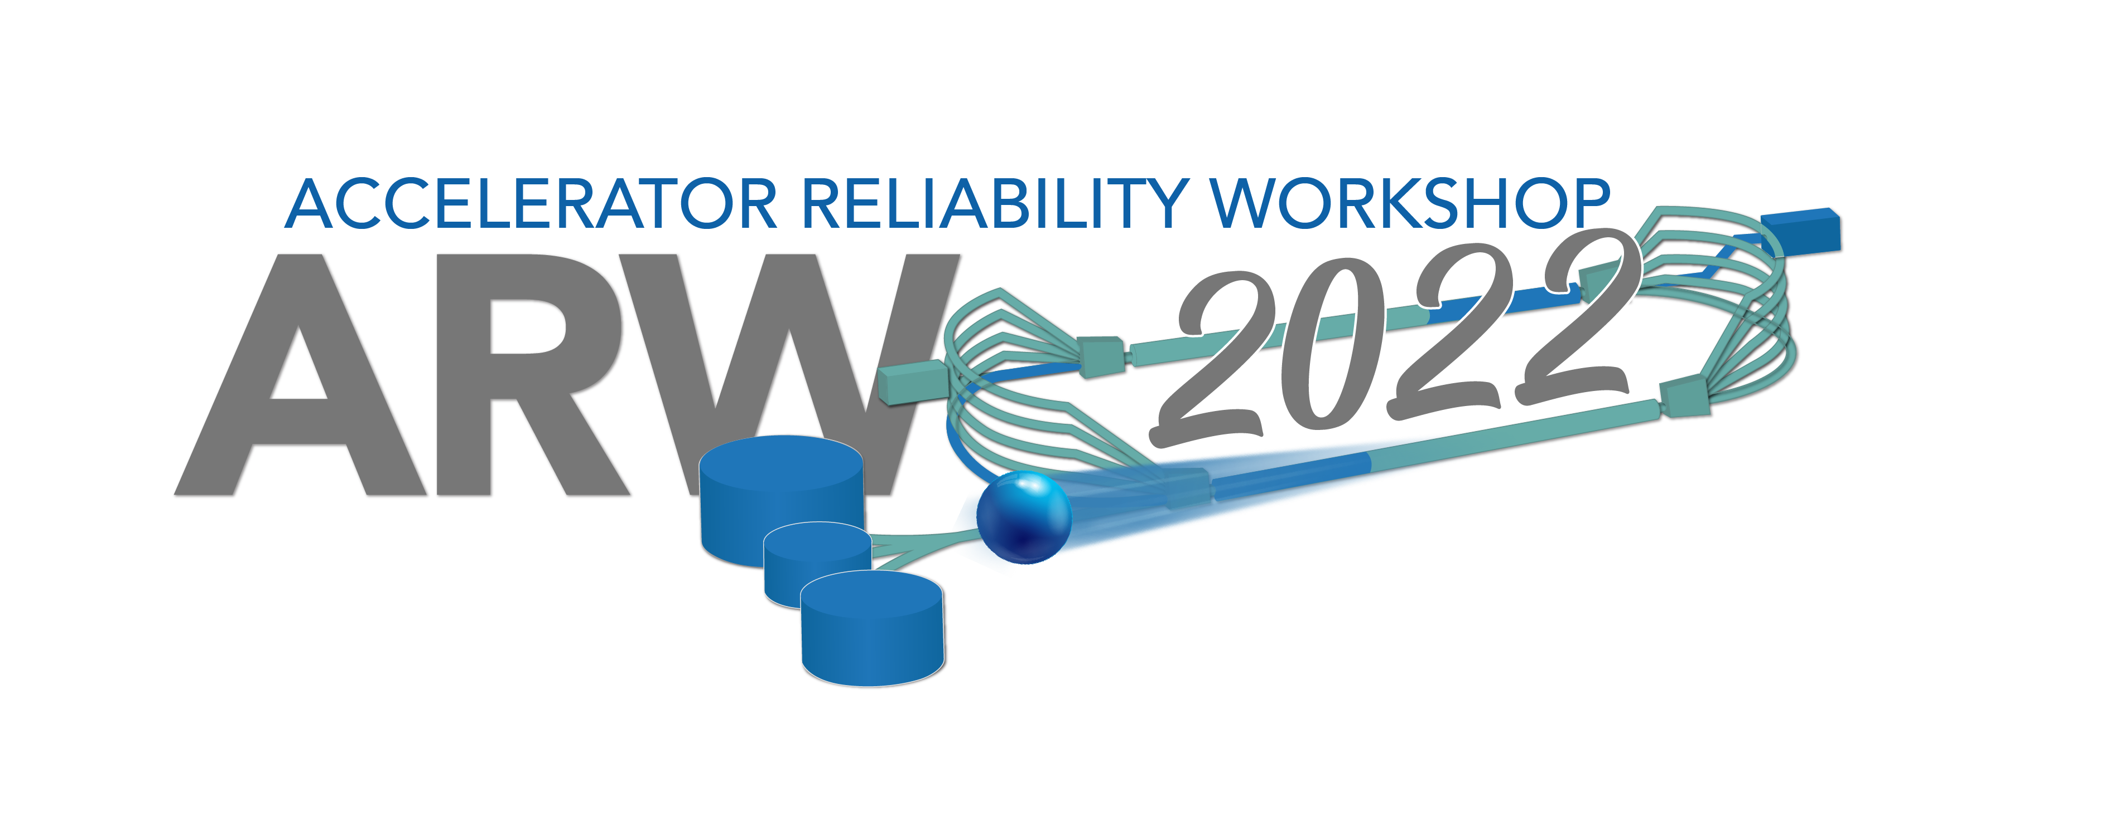
Temporary Repair of a Leak on the Main Cooling Water Supply at SNS
Geoffrey Milanovich
Oak Ridge National Laboratory
Summary
The main cooling water line (1 meter diameter) for technical equipment at the Spallation Neutron Source (SNS) had a fitting begin to fail, resulting in a several tens of gallons per minute leak. Mechanics prepared an ingenious temporary repair while management discussed the option of turning off the system, which would have resulted in several days of downtime. When the fitting finally failed completely a short time later, the mechanics were able to implement their scheme and stop the leak while the accelerator continued to run. The repair held without issue until permanent repairs were made during the next extended outage.
Leak Discovery
The leak developed from an unused fitting at the bottom of the line. It was pure luck that the leak location was easily accessible.
Leak Repair Jig
An ingenious solution using rubber mats and a lift table provided enough coverage and flexibility to stop the leak.
This screenshot shows water hitting the floor and ricocheting over 3 meters away. 10,000 gallons per minute flow through this line. The system was losing hundreds gallons of water per minute and quickly drained the water storage tank. A pipe directly above the leak prevented wrapping the pipe circumferentially.
Several mats were layered to provide complete coverage and flexibility. The fixed stands were added after the initial repair to prevent slippage if the hydraulic cart failed.
This screenshot shows initial attempts to repair the leak using a plug sized to the hole. The water was coming out with enough force to prevent the plug from fitting even while using a hydraulic jack for leverage.
This image from the other side of the pipe shows the size of the fitting that leaked. The ~2.5 cm fitting quickly drained the several hundred thousand gallon water tank for the site.
Acknowledgements: Mike Dayton
ORNL is managed by UT-Battelle, LLC for the U.S. Department of Energy under contract DE-AC05-00OR22725

