Slide 1
Track Finding in CLAS12 with a Machine Learning Approach using SNR
Audrey Lawton, David Heddle, CNU & JLab

Slide 2
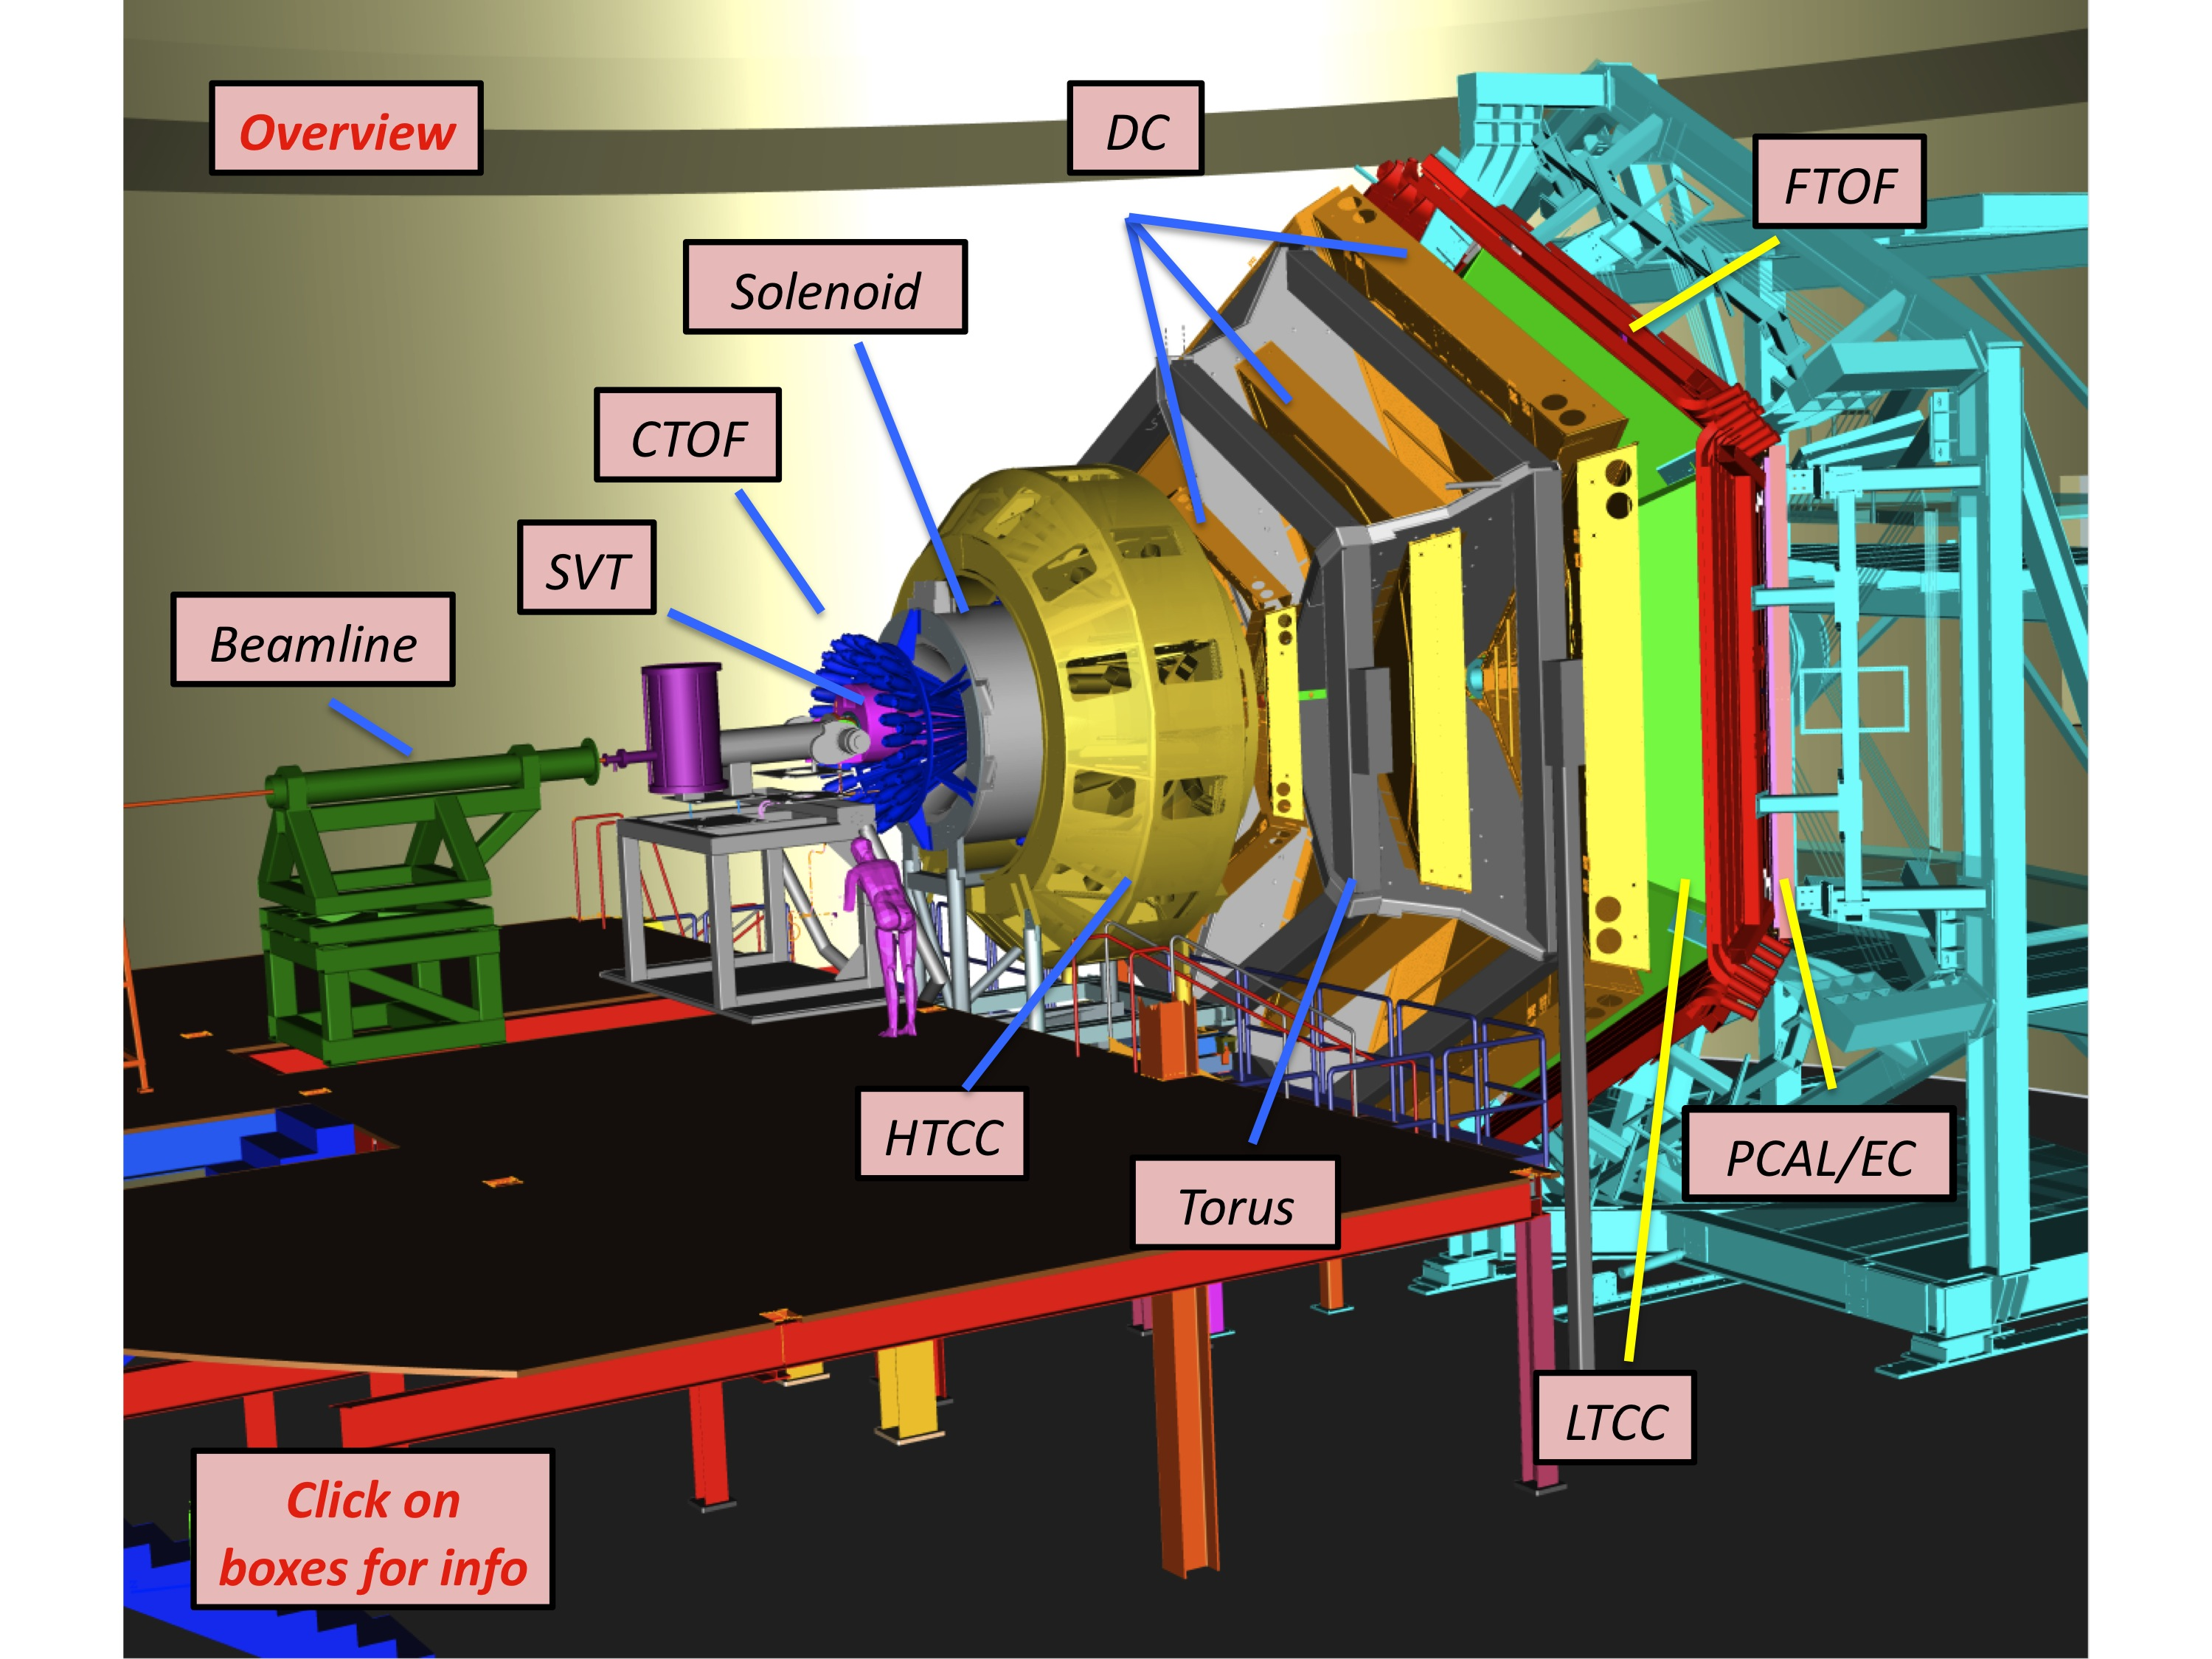
CLAS12

Slide 3
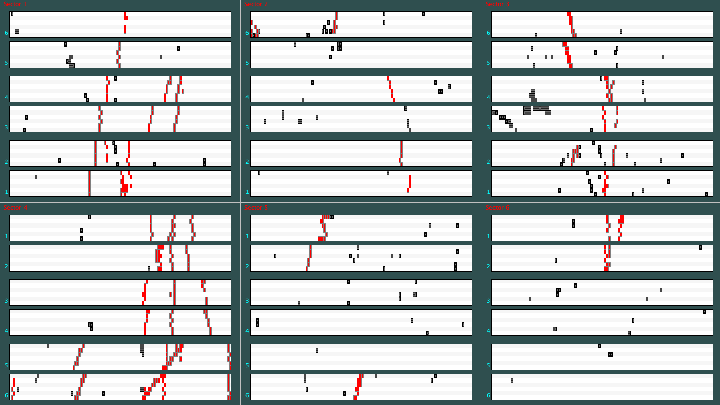
CLAS12 Drift Chambers
6 sectors surrounding beamline
6 superlayers in each sector
6 layers in each superlayer
112 wires in each layer
6*6*6*112 = 24,192 wires (cells)
Raw data contains hits (both “real” and noise)
Tracking software finds segments (from hits in a superlayer) and tracks from the segments.
A track is made up of six correlated segments
Superlayer (group of 6 layers)
Noise hits
Real hits
Segment (in a superlayer)

Slide 4
Track Finding
Goal: Convert raw “hits” into track parameters (charge, initial position, momentum, direction)
Steps:
Pattern Recognition (do I have tracks?)
Estimate track parameters based only on DC hits (Geometric fit)
Refine track parameters using detailed timing information
This work is not concerned with Step 3.
Tracking speed is crucial. CLAS takes ~Petabyte/month of raw data. The tracks must be reconstructed ~ as fast as the data are taken, otherwise the data pile up in the corner. This translates roughly to about 100 ms/event. This is stressing.

Slide 5
The Segment and Noise-Removal (SNR) Algorithm
Uses bitwise operations on big words. (Each DC layer is represented by 128-bit integers to handle 112 wires)
Effectively turns a single core into a parallel processor—this algorithm is very fast.
Programmable
Accommodates any number of missing layers (aka inefficiencies)
Set for different curvatures (momenta)
Within parameter coverage
Some false negatives (noise missing the Noise Rapture and left behind)
No false positives (good data identified as noise and mistakenly removed)

Slide 6
Result of SNR
SNR is presently used in CLAS track finding as step 0, where it removes noise to reduce combinatorics.
SNR has additional output: long (128bit) words (one for left leaning, one for right leaning) with bits set at wire numbers where it has found segment candidates. There is also a quality factor, the red oval indicates the most confidence.
This data is not used.
This work aims to use this discarded data as input for a ML based track finder.

Slide 7
SNR Dictionary: Use the free SNR segment data
SNR → 6 Big Words with bits set at the sites of segments.
Method: use this as a key into a dictionary.
Take the 6 Big Words and combine them into one Über Word, written as a number in Base 36*. That is the dictionary key.
Take simulated track parameters (q, x, y, z, p, θ, φ) and hash that into a Base 36 number. That is the dictionary value.
Example SNR segment key: 16yi773t2bk$0|2dx0ee7m4n4$0|o5wqjqw3k$0|61h6mxq0w$0|4atpfk$0|jcpog$0
Example (hashed) Track value: -1$0$0$0$2s$1k9$0
Key encodes what SNR knows about the all segments in a sector
Value encodes charge, vertex, momentum, direction—the track information
* Radix 36 is convenient for creating short info-rich strings because it uses all 10 digits and all 26 characters of the Latin alphabet. It gets used a lot for encoding, e.g., in the shortening of URLs.

Slide 8
So…
An event is ready for track reconstruction
Run the SNR Analysis (already happens to remove noise)
Use the resulting segment data to create a key
Use the key in the dictionary to retrieve the value
Decode the value to get track parameters
If this works, you get a very fast estimate of the track parameters (roughly μsecs vs. the current method which takes 10’s of milliseconds)

Slide 9
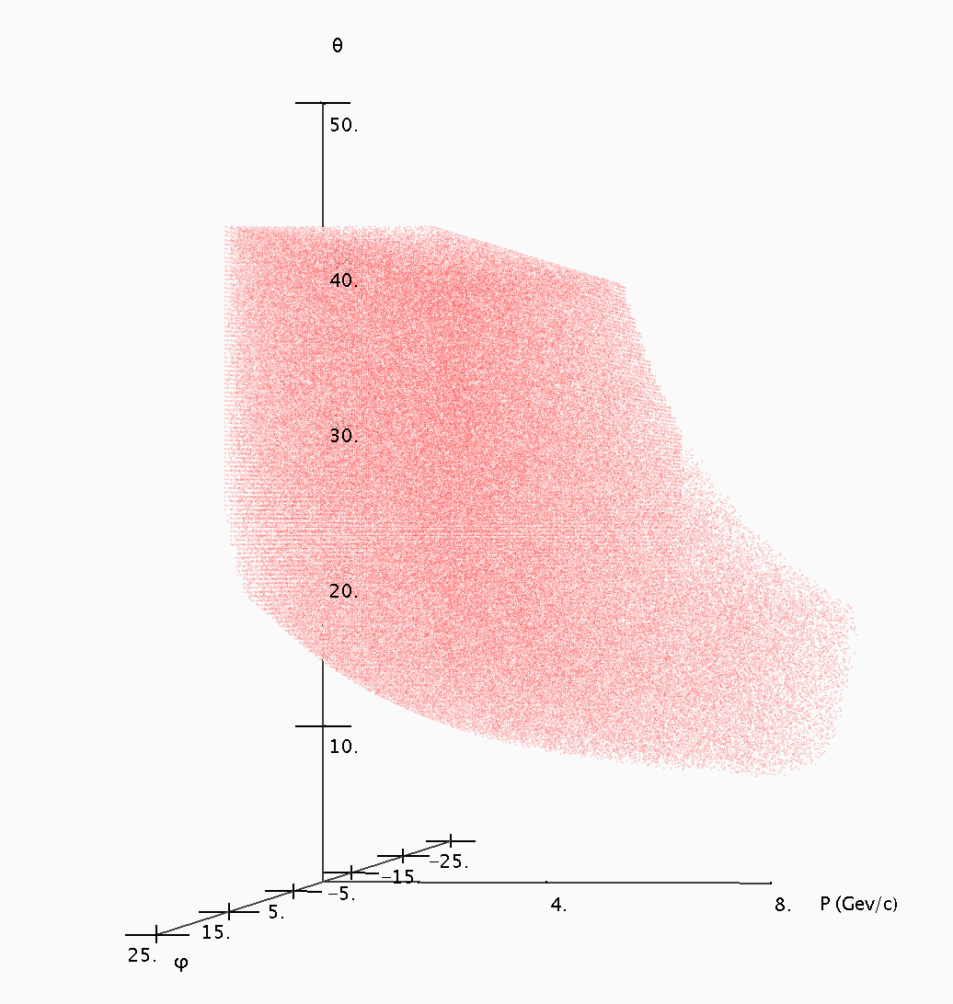
Dictionary Entries (Isomorphic to detector acceptance)
Each red dot represents a simulated track that made it through all six superlayers.

Slide 10
Why Is “nearest” expensive
Dictionary is a hash table
Nearby keys do not correspond to nearby values
The “nearest” algorithm is brute force and slow:
Go through every key in the dictionary, convert Base36 back to Big Word, and find the one with the highest number of bits in common with the missing key.

Slide 11
SRN Conclusion
The dictionary approach has great potential. (It gives better than acceptable resolutions)
It uses “free” information (the SNR segments that we already compute—but currently discard.)
The dictionary (~30 MB) is small enough to easily fit in memory.
But…the “slow missing key” problem must be solved.

Slide 12
Machine Learning Approach
Goal: Create a machine learning algorithm with two approaches, each using the SNR data as inputs to ML:
The ML outputs are the track parameters directly (dictionary is not used), or (alternative ML approach)
If the key is not found, the ML output is the nearest key in the dictionary (Use ML for the missing key problem)

Slide 13
Dataset and Data collection process
This is step of the machine learning process we are currently working on
We are using perfect GEANT4 (GEMC) simulated data to create our dataset
The information we are using in this iteration of the machine learning process includes:
SNR key
Initial position, direction and momentum
(Clean) drift chamber hits
We plan to use the keys from the SNR Algorithm as the input and the track parameters as our output (The 1st ML approach)

Slide 14
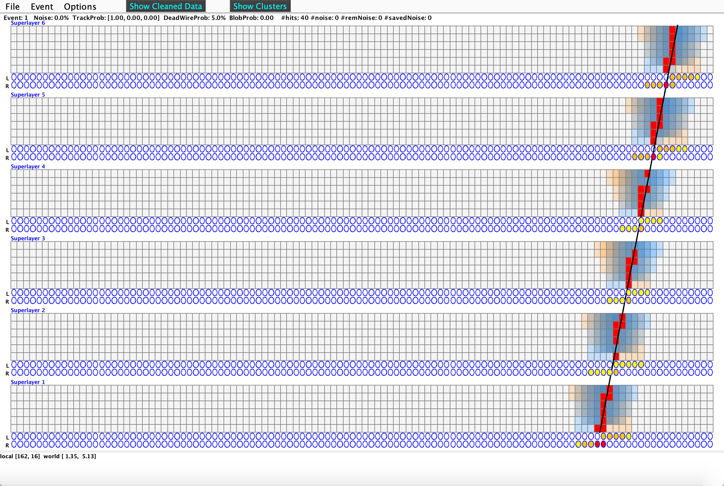
Regression
Using a regression machine learning model, to generate a function matching the track fit as shown in clean data
Regression is normally used to predict a dependent variable value based on a given independent variable

Slide 15
Regression
The plan is to use the weights of the function generated to estimate the initial position and angle in this simplified version of the problem before tackling more complex scenarios

Slide 16
Conclusion
We are working a simplified (clean) version of the problem and will expand when we determine the proper approach.
We will also explore a solution to “slow missing key” problem (the 2nd approach) to determine a first estimate of track parameters to replace computationally expensive traditional methods.
This work was supported
by the Center for Nuclear Femtography

