Slide 1



Near-Threshold Production of Heavy Quarkonium
Yuxun Guo
University of Maryland
Oct. 12, 2021
Based on 2103.11506 with
Xiangdong Ji and Yizhuang Liu.

Slide 2
Outline
Introduction
Gravitational form factors (GFF)
QCD interaction of a color dipole
Photoproduction of J/ψ
Conclusions and outlook

Slide 3
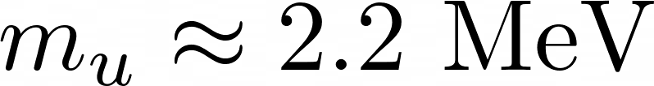
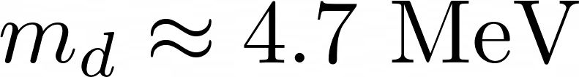
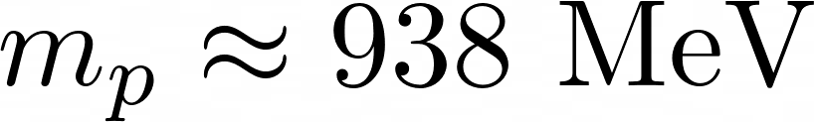
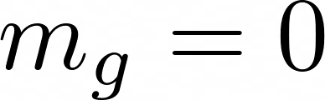
Introduction to proton mass
-mass without mass
Most of the proton mass comes from dynamical energy!

Slide 4
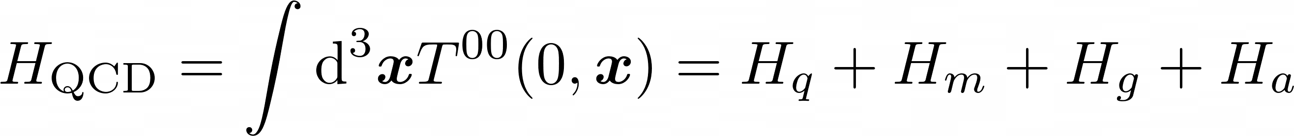
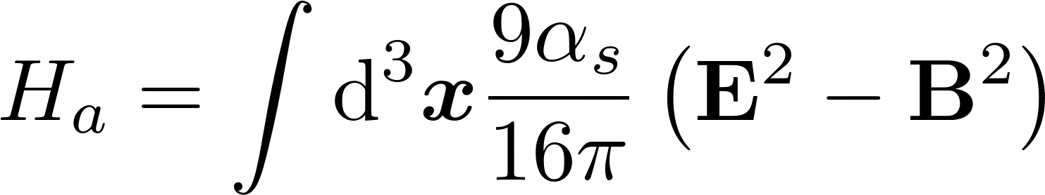
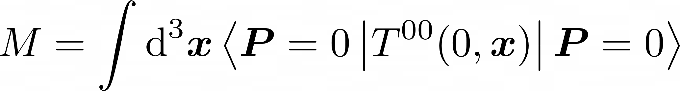
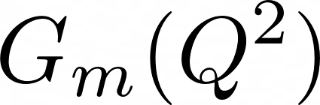
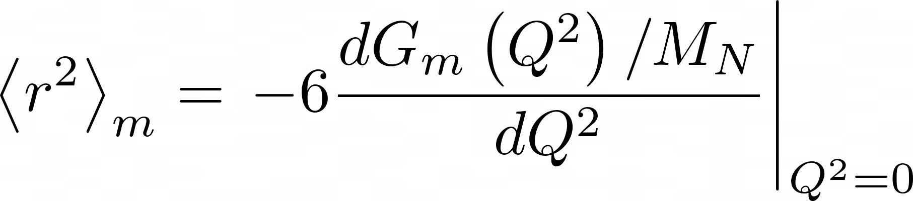
Two important points
X. Ji (1995),
X. Ji, Y. Liu and A. Schafer (2021)
Quantum anomalous energy (QAE)
Mass radius
Quark energy
Quark mass
Gluon energy
QAE
D. Kharzeev (2021), X. Ji (2021)
mass
mass form factors
(Breit frame)
mass radius

Slide 5
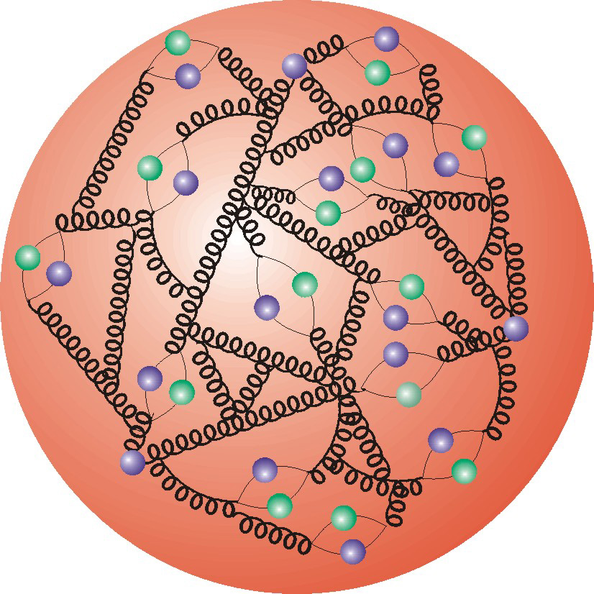
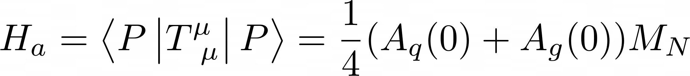
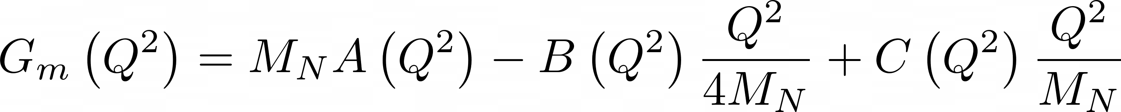
Gravitational form factors
Matrix element of EMT can be written into gravitation form factors.
X. Ji (1996)
Importance to mass structure
QAE
Mass form factors

Slide 6
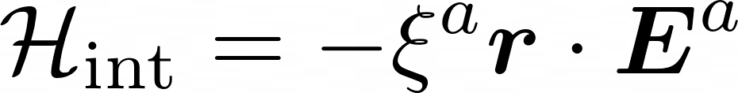
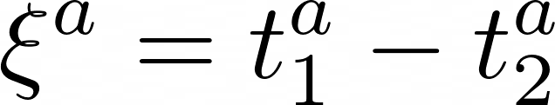
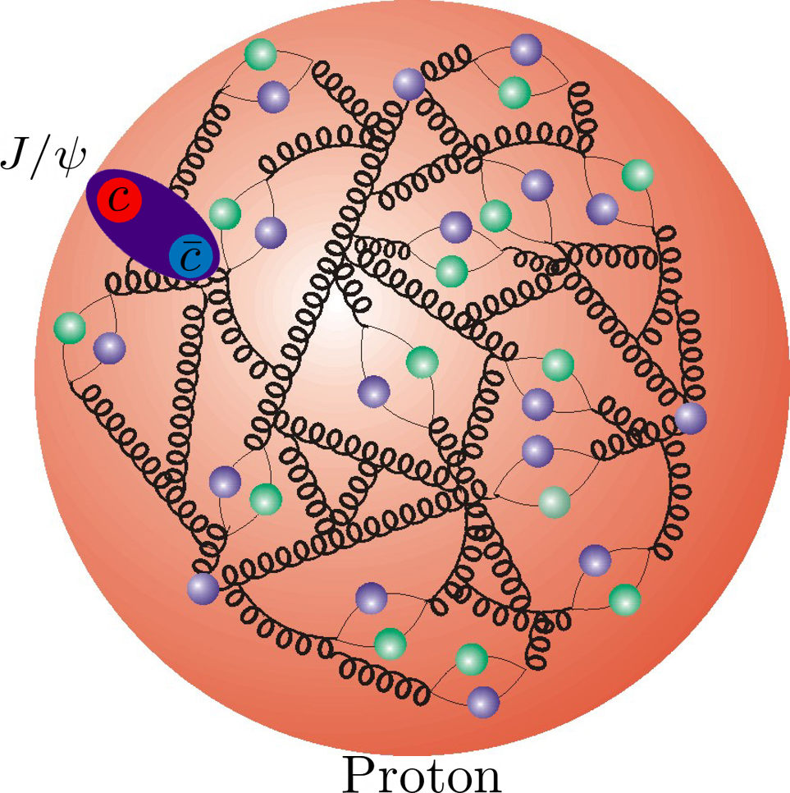
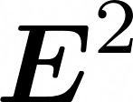
Color dipole as a probe
D. Kharzeev (1996),
M.B. Voloshin (1979)
with
Quadratic Stark effect in QCD – measures the color electric field
The quarkonium needs to be small;
The relative motion in the quarkonium is slow;
Perturbatively calculable;
Heavy quarkonium is needed!

Slide 7
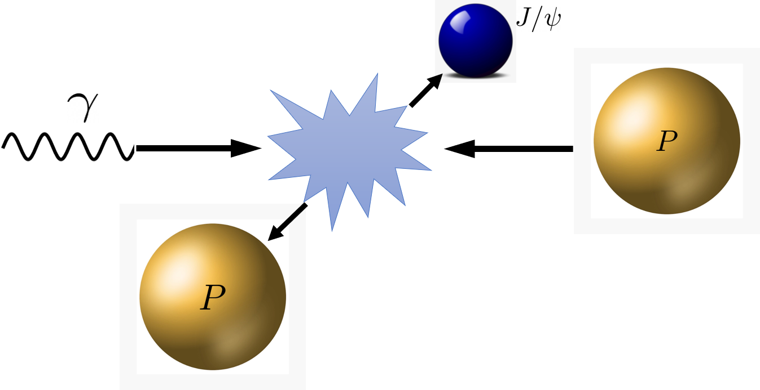
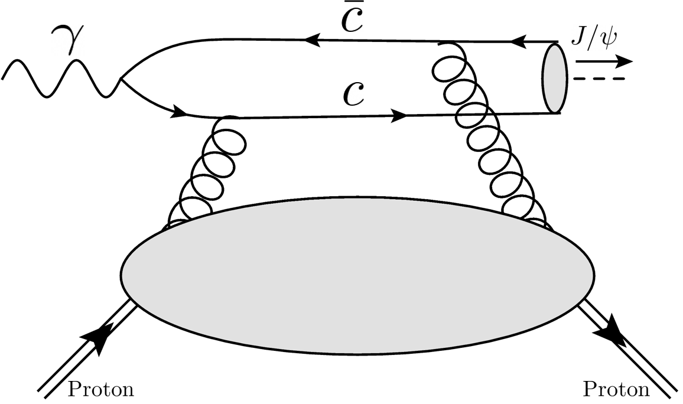
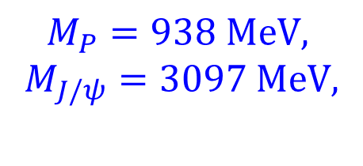

Heavy quarkonium production
Near threshold, J/ψ slowly goes through the proton and measures the distribution inside.
$$M_{P}=938 MeV,$$
$$M_{J/ψ}=3097 MeV,$$
$$W_{th}=4.035 GeV$$
$$E_{th}^{γ}= 8.210 GeV$$

Slide 8
Previous works
Vector dominance model
Dispersive analysis
Holographic QCD
pQCD analysis at large momentum transfer
D. Kharzeev (1996),
D. Kharzeev et. al. (1999),
O. Gryniuk and M. Vanderhaeghen (2016)
O. Gryniuk et. al. (2020)
Y. Hatta and D.-L. Yang (2018)
Y. Hatta, A. Rajan and D.-L. Yang (2019)
K. A. Mamo and I. Zahed (2020,2021)
P. Sun, X.-B. Tong and F. Yuan (2021)

Slide 9
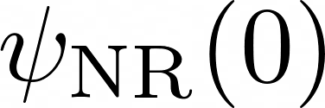
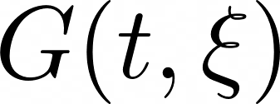
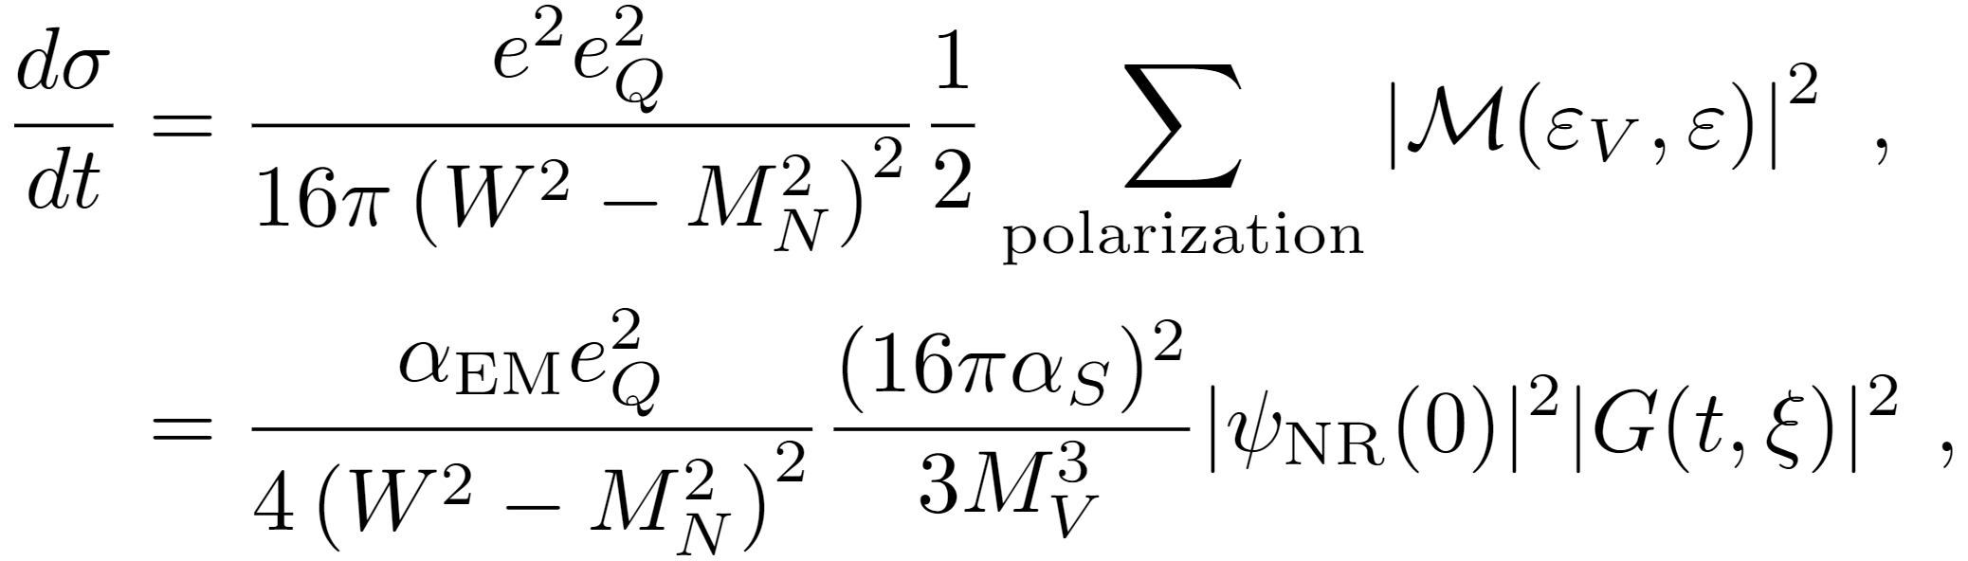
QCD factorization
YG, X. Ji and Y. Liu (2021)
The cross section can be analyzed using QCD factorization in the heavy quark limit near the threshold.
NRQCD
R. Van Royen et. al. (1967)
B. Gittelman et. al. (1975)
G. T. Bodwin et. al. (2006)

Slide 10
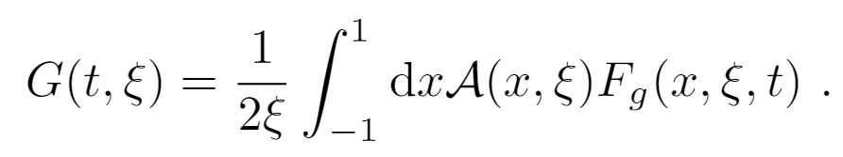
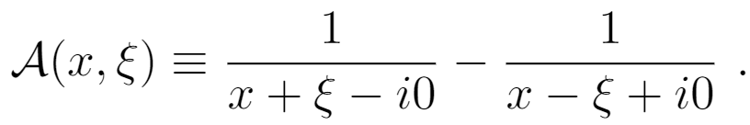
Hadronic matrix element
:Hadronic matrix element
Hard Kernel:
Gluon GPD:
Consistent with leading twist result in deeply virtual meson production.
J. Koempel et. al. (2011)

Slide 11
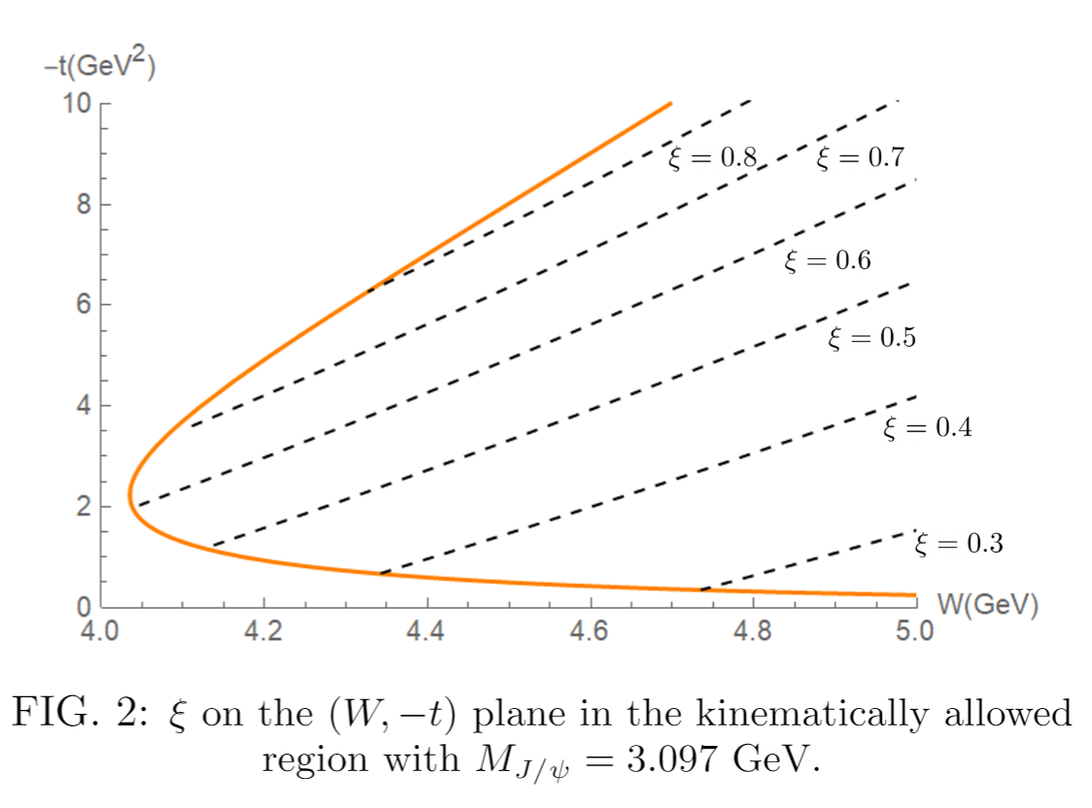
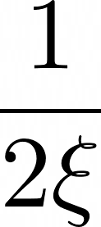
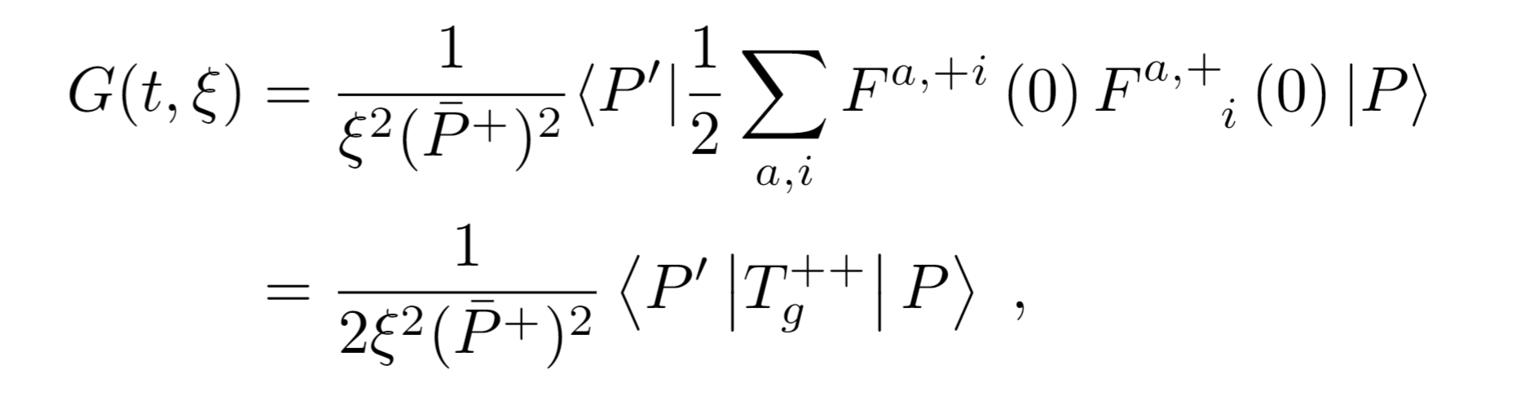

Kinematics near threshold
t and $ξ$ are large near threshold.
Taking the leading moment of x,
Measurement of the gravitational form factors.

Slide 12
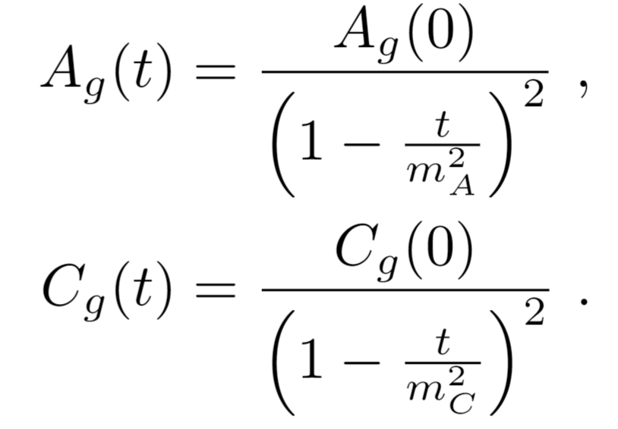
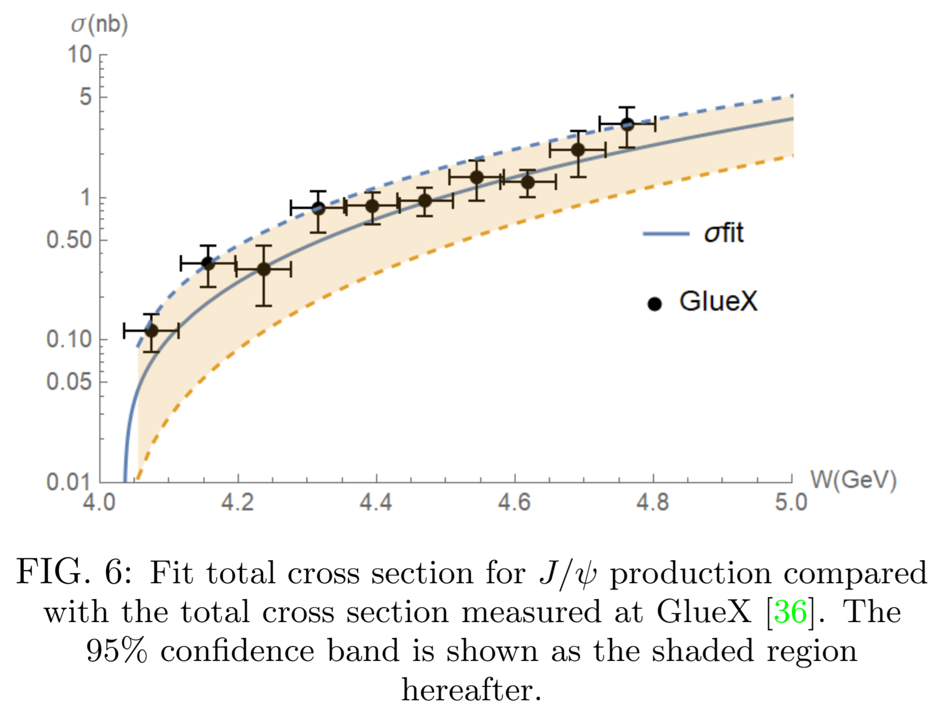
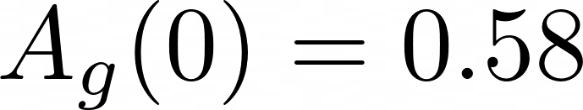
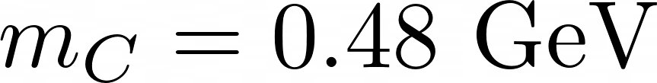
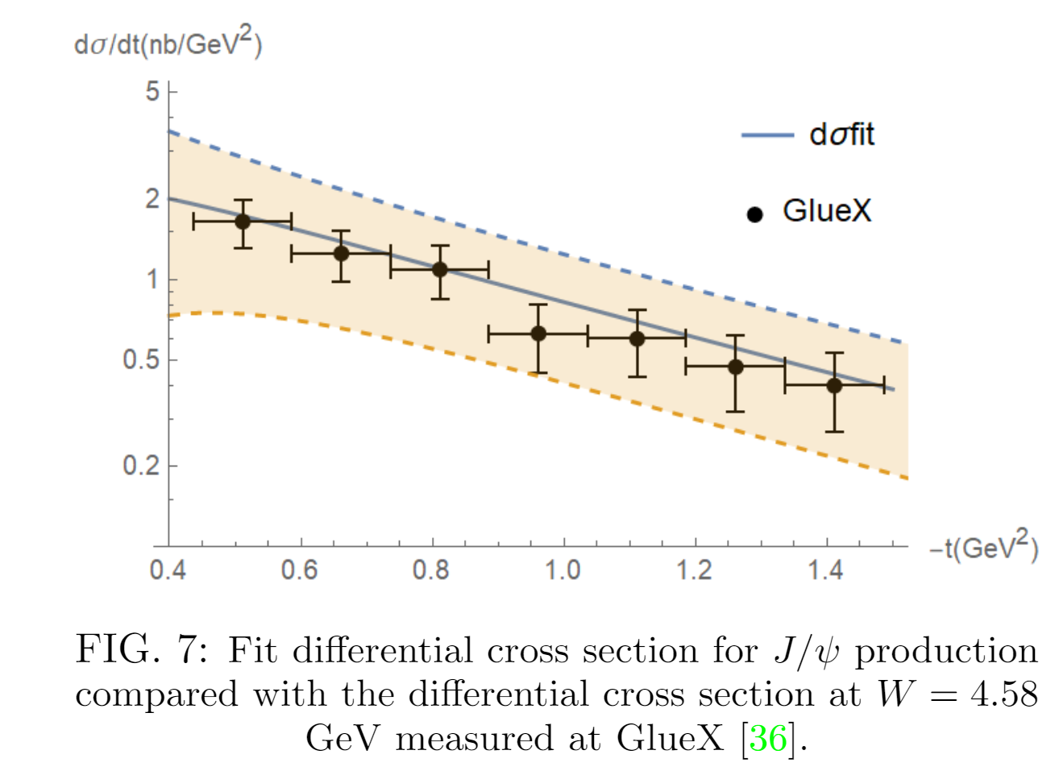
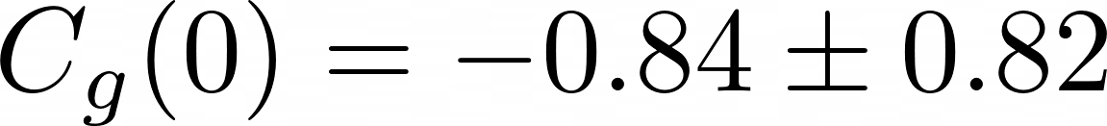
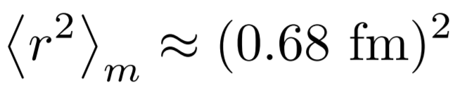
Fitting gravitational form factors
Fixed from lattice
Fit

Slide 13

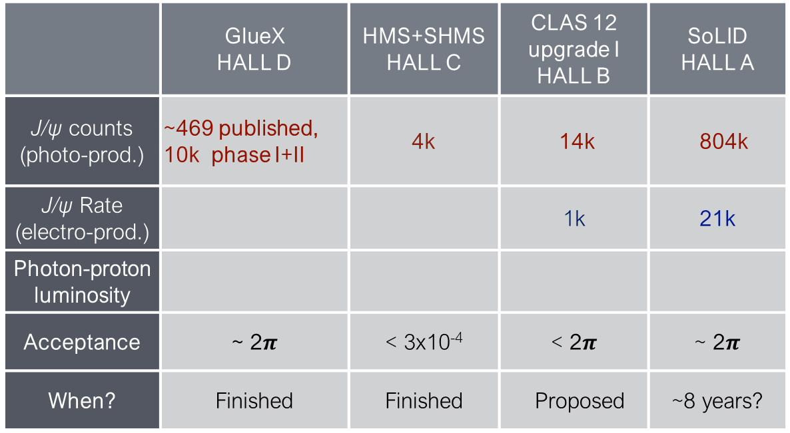
More J/ψ data at JLab
Z.-E. Meziani
 | GlueX HALL D | HMS+SHMS HALL C | CLAS 12 upgrade I HALL B | SoLID HALL A
J/ψ counts (photo-prod.) | ~469 published, 10k phase I+II | 4k | 14k | 804k
J/ψ Rate (electro-prod.) |  |  | 1k | 21k
Photon-proton luminosity
Acceptance | ~ 2$π$ | < 3x10⁻⁴ | < 2$π$ | ~ 2$π$
When? | Finished | Finished | Proposed | ~8 years?
More data at JLab will allow much more precise measurements of gravitational form factors.
Besides, we also look forward to the production at future EIC.

Slide 14
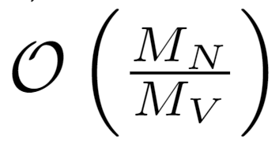
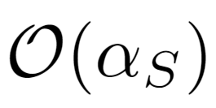
Conclusions
Factorization formula to the leading order in the heavy quark limit.
Measurements of the gluonic gravitational form factors
Outlook
Higher order correction in and
Higher twist effects including three-gluon exchange
Factorization theorem to higher/all order

Slide 15
Thanks!
This work was partially supported by the Center for Nuclear Femtography (CNF),
administrated by the Southeastern Universities Research Association under an
appropriation from the Commonwealth of Virginia and a CNF graduate fellowship
CY 2021 Yuxun Guo.
15

